Slide 1
Brookhaven National Laboratory
Single Event Effect (SEE) Facilities
Kevin Brown
June 11, 2026

Slide 2
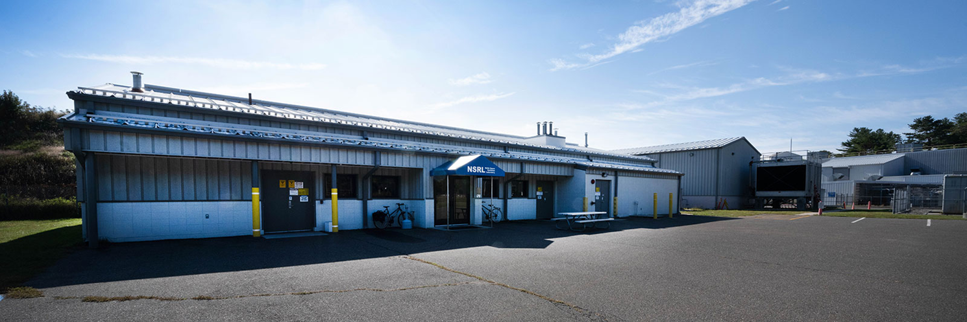
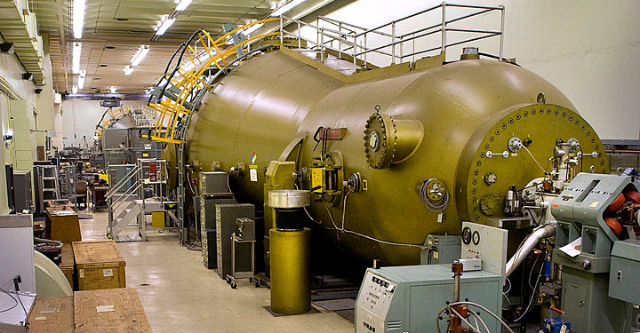
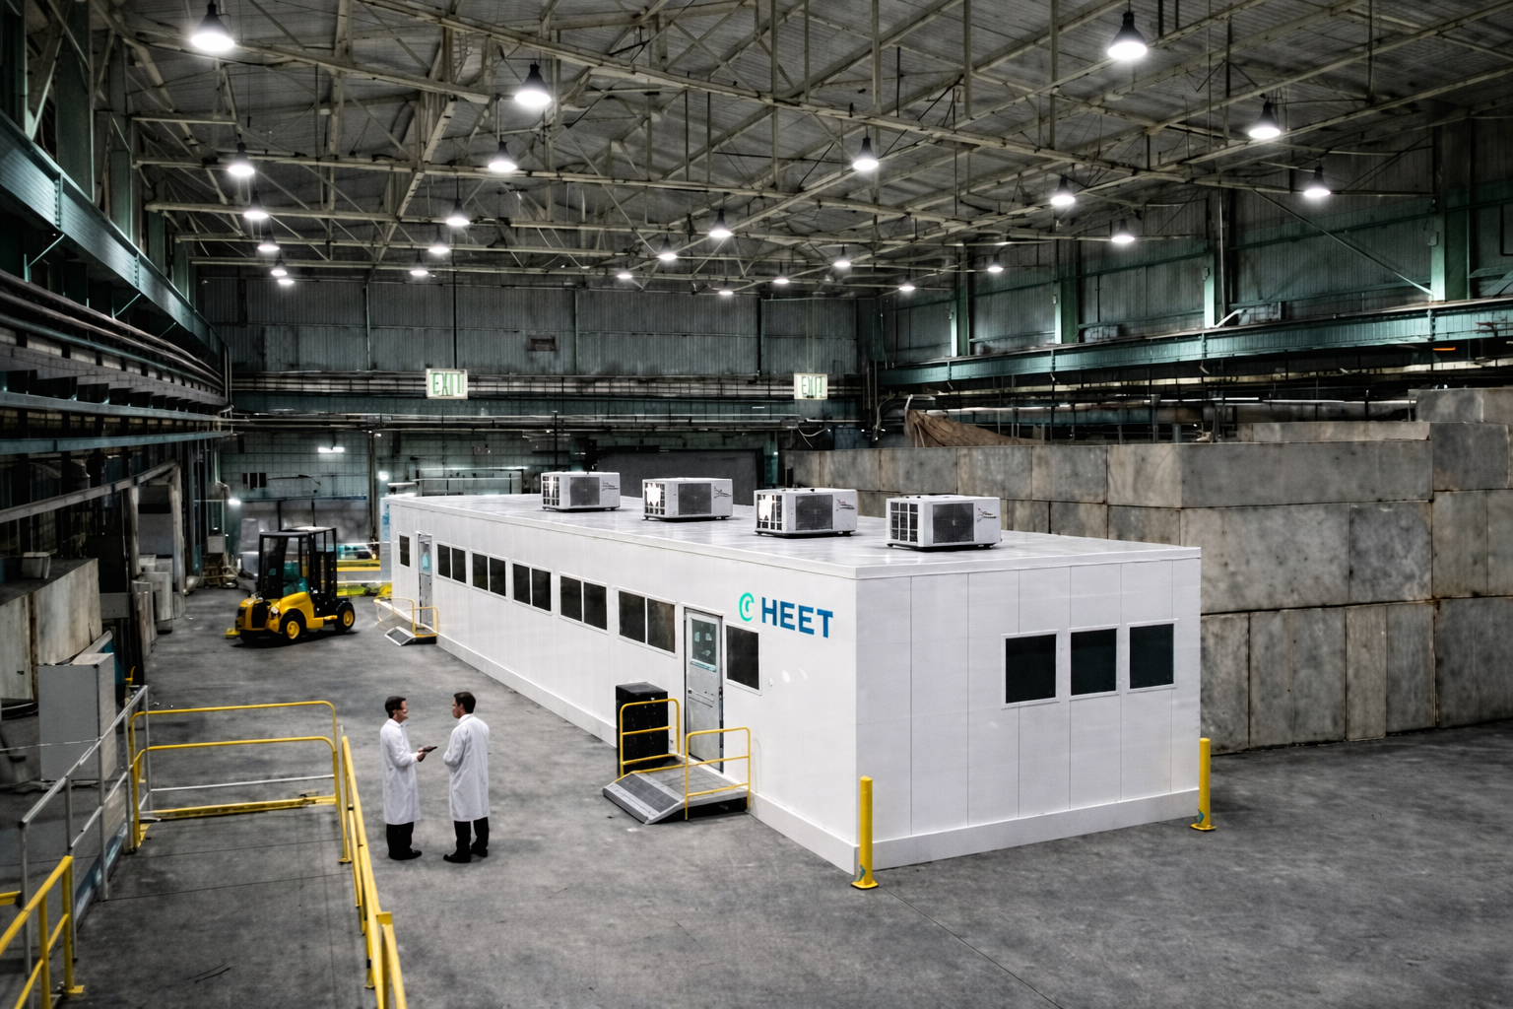
Space Effects Testing at BNL (p and ions)
Brookhaven National Laboratory (BNL) leverages its unique accelerator complex and expertise to deliver some of the world’s most advanced high-energy testing facilities, capable of simulating the effects of extreme environments such as deep space.
The NASA Space Radiation Laboratory (NSRL) provides beams of all ions from protons to uranium, ranging in energy from 50 MeV to 1500 MeV.
Tandem van de Graaff supports lower-energy testing needs for single event upset and equipment calibrations.
Future High Energy Effects Test (HEET) facility would significantly increase beam hours and provide energies up to 2500 MeV/n.

Slide 3
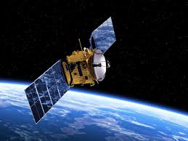
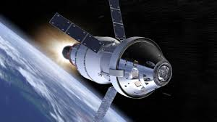
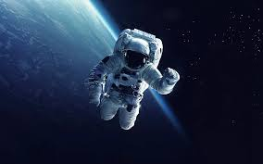
Applications of BNL SEE Testing
Radiobiology for human space exploration and medical research
  Understand effects of cosmic radiation on human biology, including cancer and central nervous system health risks
  Primary focus of NASA testing; supports NASA Human Research Program, Artemis missions, and future missions to Mars or beyond
  National Cancer Institute also testing new cancer therapies
Microelectronics testing for commercial and national security applications
  Over 1800 hours of electronics beamtime anticipated in 2026
  Supports satellite reliability and radiation-hardened electronics for large aerospace entities (Blue Origin, SpaceX, Boeing) and startups
  Missile Defense Agency and defense primes (Lockheed Martin, Northrop Grumman) testing for defense and intelligence missions
Shielding for space equipment
  Test spacecraft and spacesuit shielding materials

Slide 4
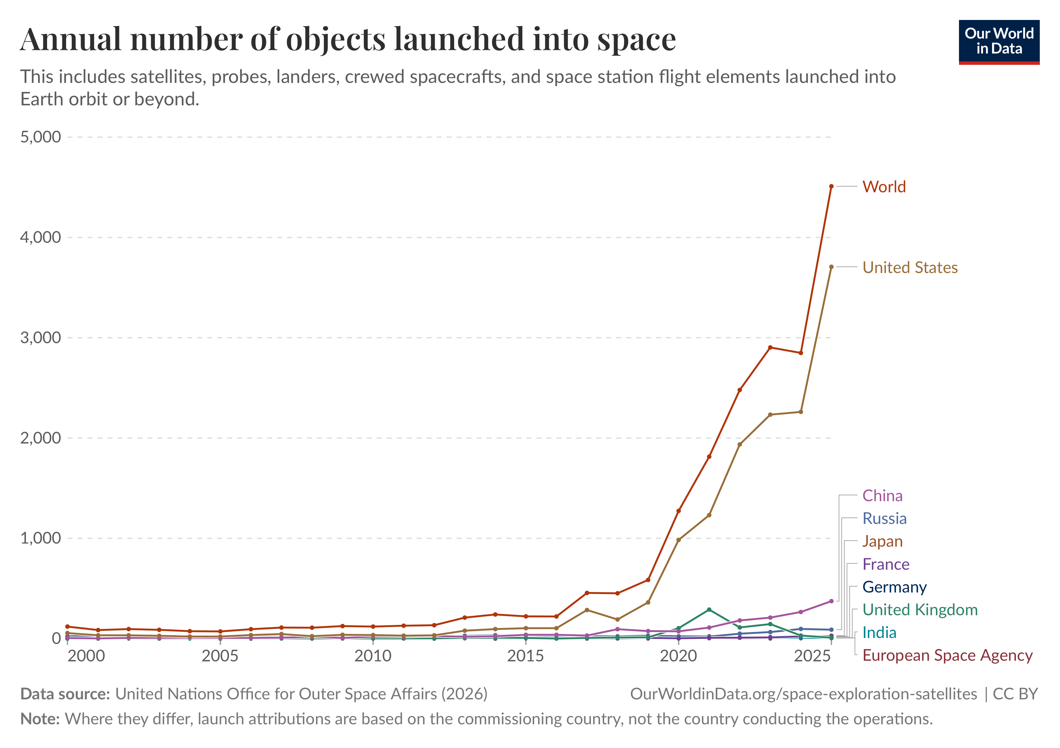
Supply & Demand for SEE Testing
Drivers of Demand
Proliferation of satellites, with higher complexity and COTS electronics; projections of 3-5x growth in number of satellites by 2040, each with many radiation-sensitive electronics components
Greater move toward deep space exploration
Growing interest in data centers in space
Space as a defense and national security frontier
Publication of Testing at the Speed of Light (2018)
SHREC Report (2019)
Capacity Shortfall
Heavy ion capacity remains a key bottleneck; unofficial analysis from third-party contractor projects total heavy ion beam demand to reach 15k hours by 2030 and 23k by 2040, with ~9k hours (range of 6-12k) expected to be demand for high energy.
Current heavy ion facilities (BNL, LBNL, TAMU, MSU) expected to provide ~15k hours by 2030 but gap of ~8k hours predicted by 2040.
  NSRL is currently only high-energy facility, with >2000 hours annually.

Slide 5
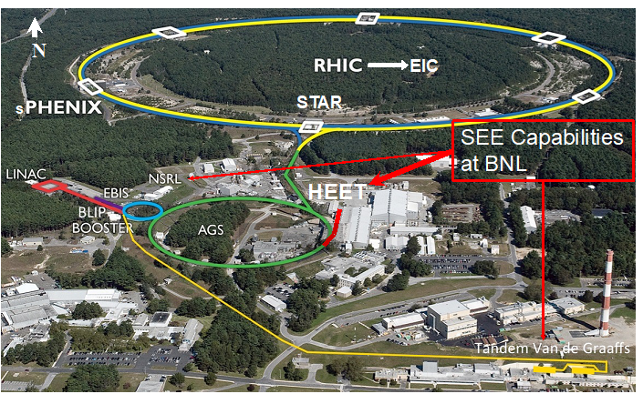
BNL’s Accelerator Complex
The Electron Beam Ion Source (EBIS) provides a large variety of ions on demand. The Laser Ion Source (in EBIS) quickly provides many elements.
The Linear Accelerator (LINAC) provides protons. The Tandem accelerators act as backup and third source for ions and protons, and are themselves user facilities.
NSRL receives beam directly off the Booster.
Proposed HEET would have one or two beamline(s) off the Alternating Gradient Synchrotron (AGS); operational in ~3 years once funding is secured.
BNL’s Relativistic Heavy Ion Collider was decommissioned in early 2026 to make way for the future Electron-Ion Collider.

Slide 6
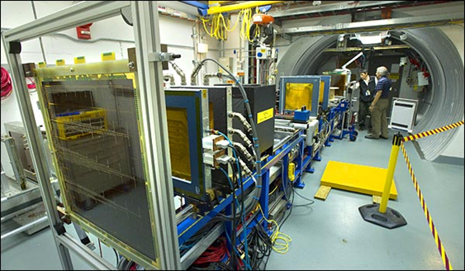
NASA Space Radiation Laboratory
Founded in 2003 as a joint NASA-DOE facility, NSRL is currently the only facility that can mimic deep space through high-energy heavy ion beams.
  NASA underwrites the facility; BNL staff operate and maintain facility.
  NASA books portion of beam hours annually in 3 blocks; remaining hours are available for other researchers.
  Though established for radiobiology studies, more and more users are studying the effects of space radiation on electronic devices and systems.
NSRL key features:
Beams of all ions from protons to uranium and energies up to 1500 MeV
High energy beams can penetrate electronics cases; no need to de-lid parts
Flexible beam profile allowing simultaneous test of multiple devices or functional tests of complete systems
Large and highly stable beam

Slide 7
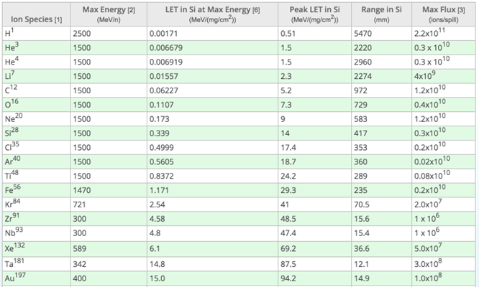
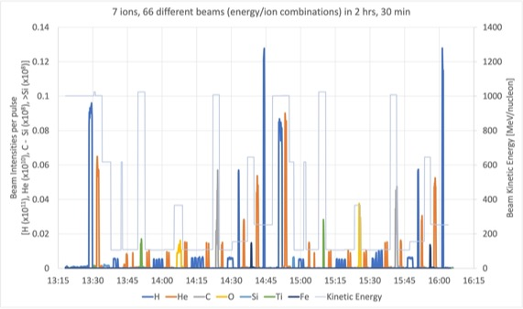
NSRL Beams
Ion Species and Energies
NSRL Beam Features
Digital beam imager provides real-time information about beam intensity and shape.
“Physics beam” is often a round Gaussian pencil beam, with FWHM of ~1 cm for a 1-GeV proton beam.
Beam spots are somewhat larger for lower energy beams.
Collimation down to ~1mm is also possible.
Typical beam profiles are the square 20×20 cm² profile and can be extended to 60×60-cm² profile.
Beam uniformity is typically ±3% across the target field.
Beam is delivered for 400 ms for every 4-6 seconds.
>30 different beams/hour

Slide 8
NSRL Planned Upgrades
Quadrupole Compensation to improve beam ripple
  AC quadrupole inserted into the accelerator lattice can be modulated on frequencies seen in the measured spill.
  Sources of the harmonics are from multiphase power supplies that have inherent ripple at harmonics of the AC line frequency.
  By measuring the ripple harmonics and then feedforwarding corrections to the air core quadrupole, the spill harmonics can be removed.
Machine learning for accelerator operations to improve beam quality and operational efficiency, such as for:
  Automated beam tuning
  Operational Digital Twin
  Data-driven model calibration
  Fast adaptive control
Digital Twins, e.g.:
  For booster extraction bump control to enabled faster, model-guided extraction tuning with improved orbit control and full-ring virtual orbit diagnostics
  For beam transport tuning, to support model-based beam tuning for reproducible uniform beam delivery
Beam optimizer with badger interface

Slide 9
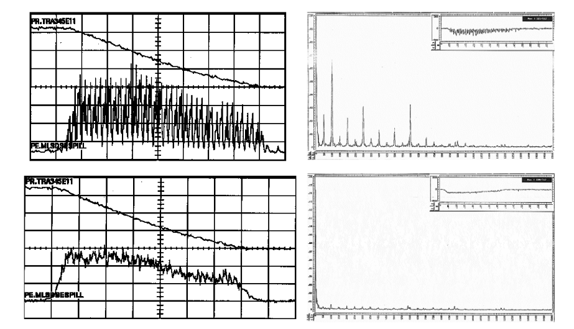
Quadrupole Compensation
Experiments done at CERN (1980s)
A horizontal focusing quadrupole inserted into the accelerator lattice can be modulated on frequencies seen in the measured spill.
The sources of the harmonics are from multiphase power supplies that have inherent ripple at harmonics of the AC line frequency.
By measuring the ripple harmonics and then feedforwarding corrections to the air core quadrupole, the spill harmonics can be removed.
Air core quad feed forward

Slide 10
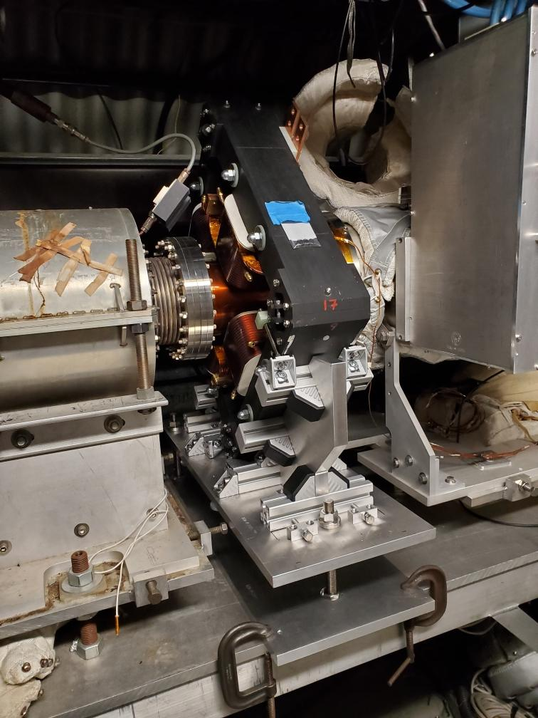
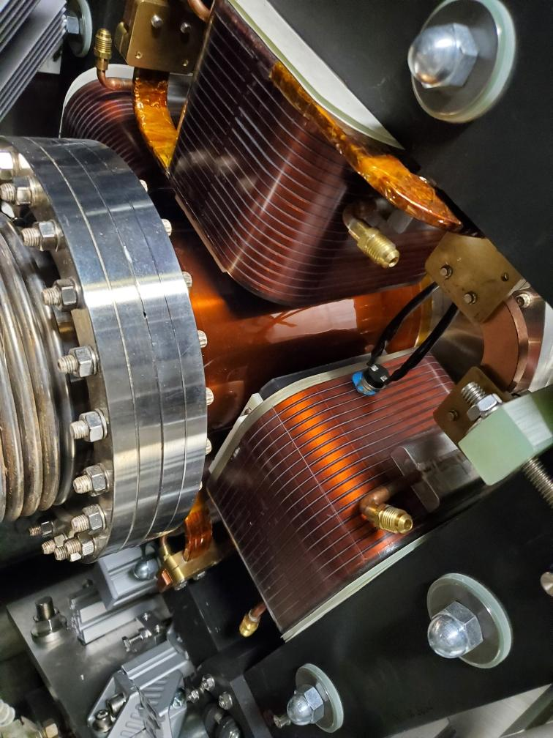
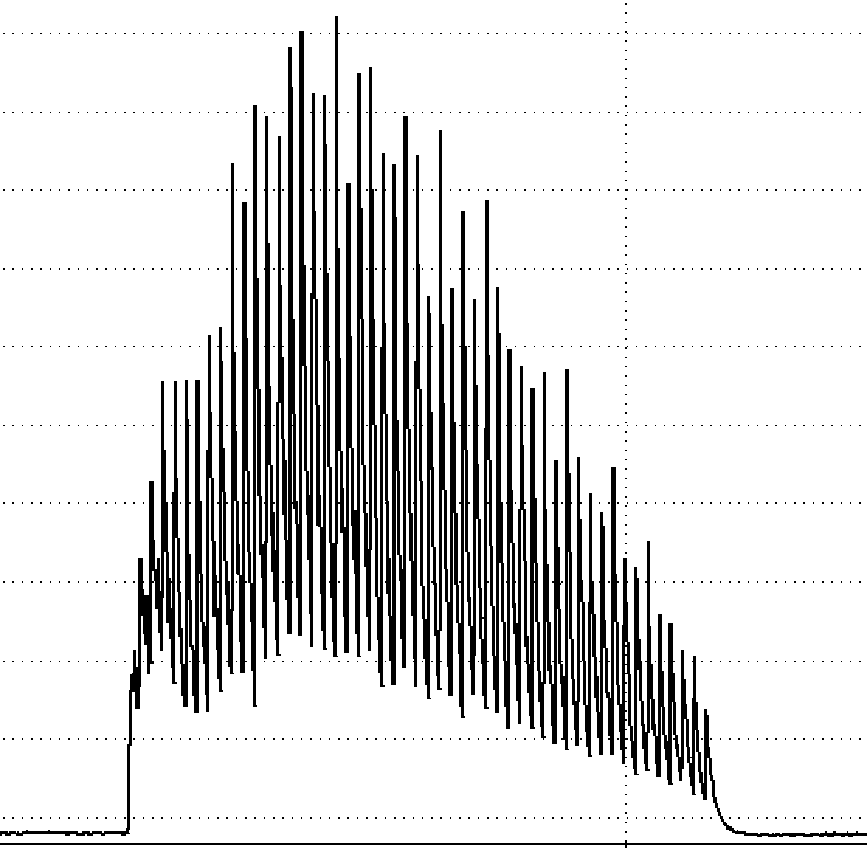
AC Quadrupole in Booster
Spill is used as figure of merit. Not for direct feedback or feedforward.
Correction does not use beam signal.
AC Quad
Ref. Quad
AC Quad PS
Tuned Filter with adjustable phase & gain

Slide 11
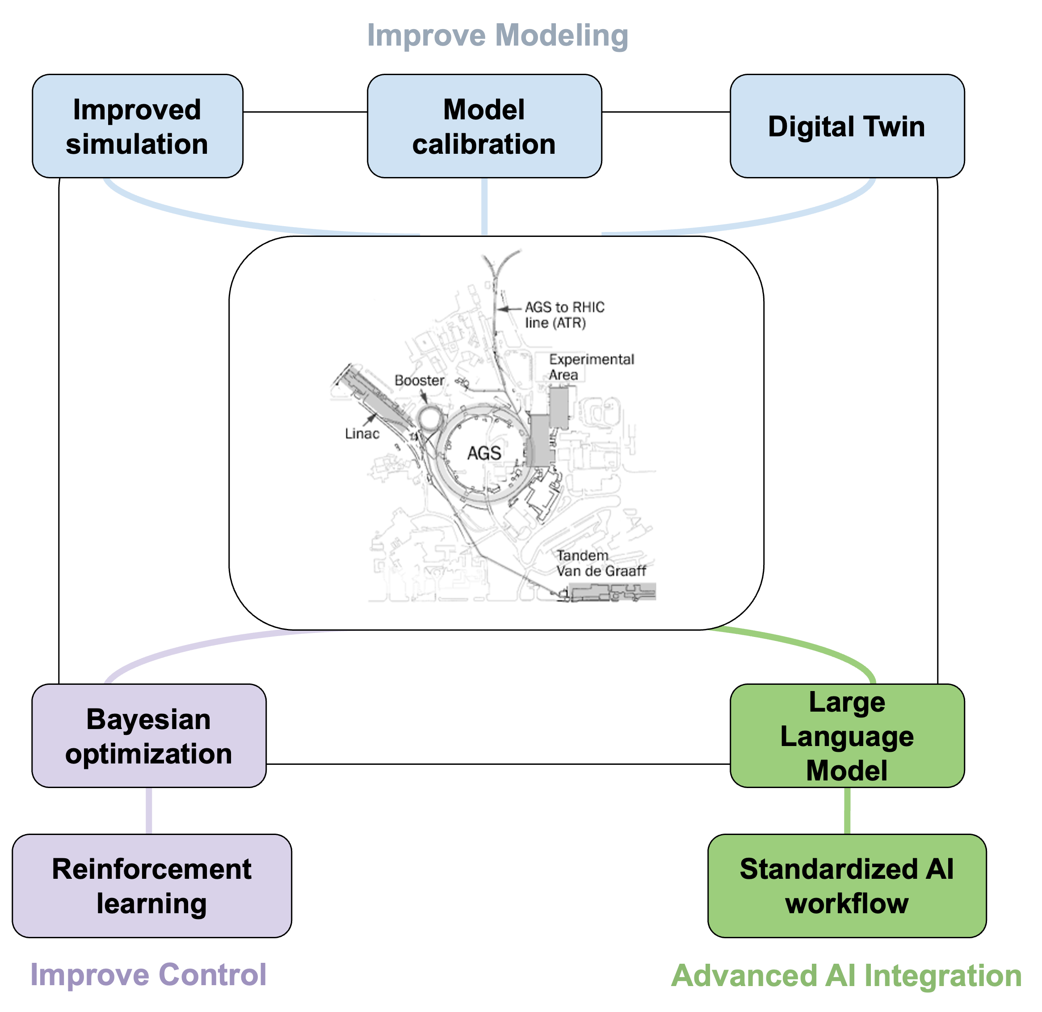
Machine Learning for Accelerator Operations
Goal: Improve beam quality and operational efficiency.
Key Applications
Automated beam tuning
Operational Digital Twin
Data-driven model calibration
Fast adaptive control

Slide 12
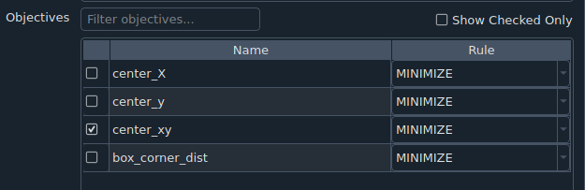
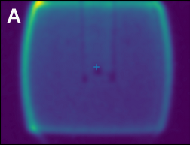
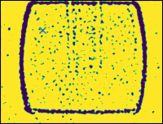
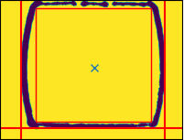
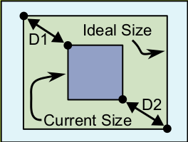
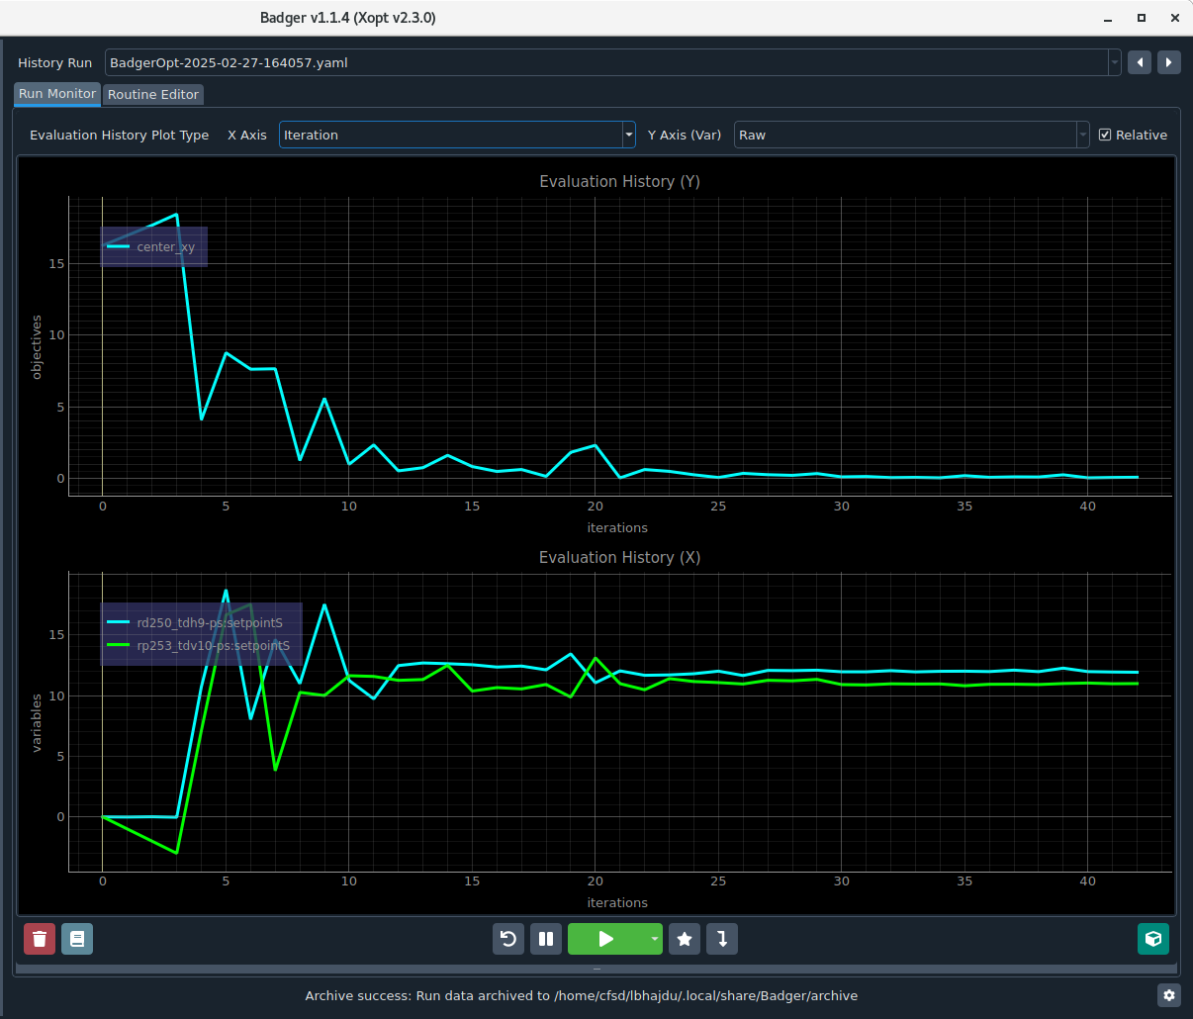
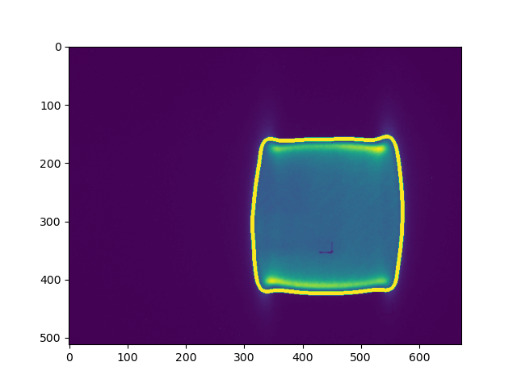
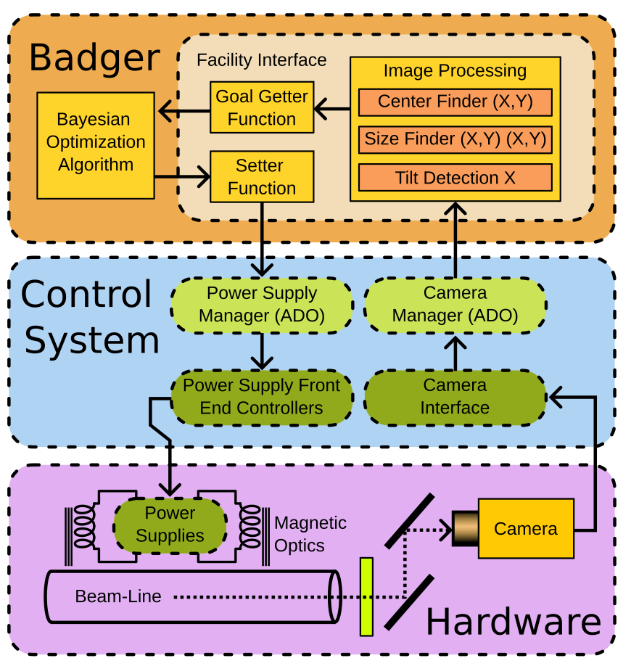
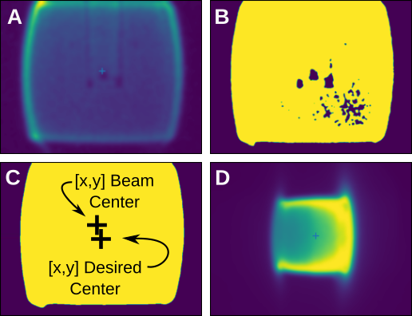
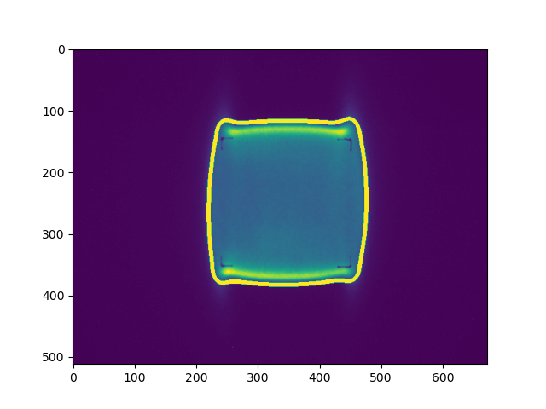
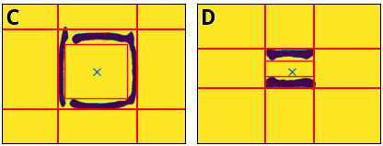
NASA Space Radiation Laboratory BO Beam Optimizer with Badger Interface
Beam Sizing Algorithm
Early live NSRL beam optimization studies with Badger interface for beams of different rigidities:
Centering
Sizing
Title
Focus shifting to digital-twins offering:
Offline tuning
Less convergence failures
System Architecture
Initial
Tuned

Slide 13
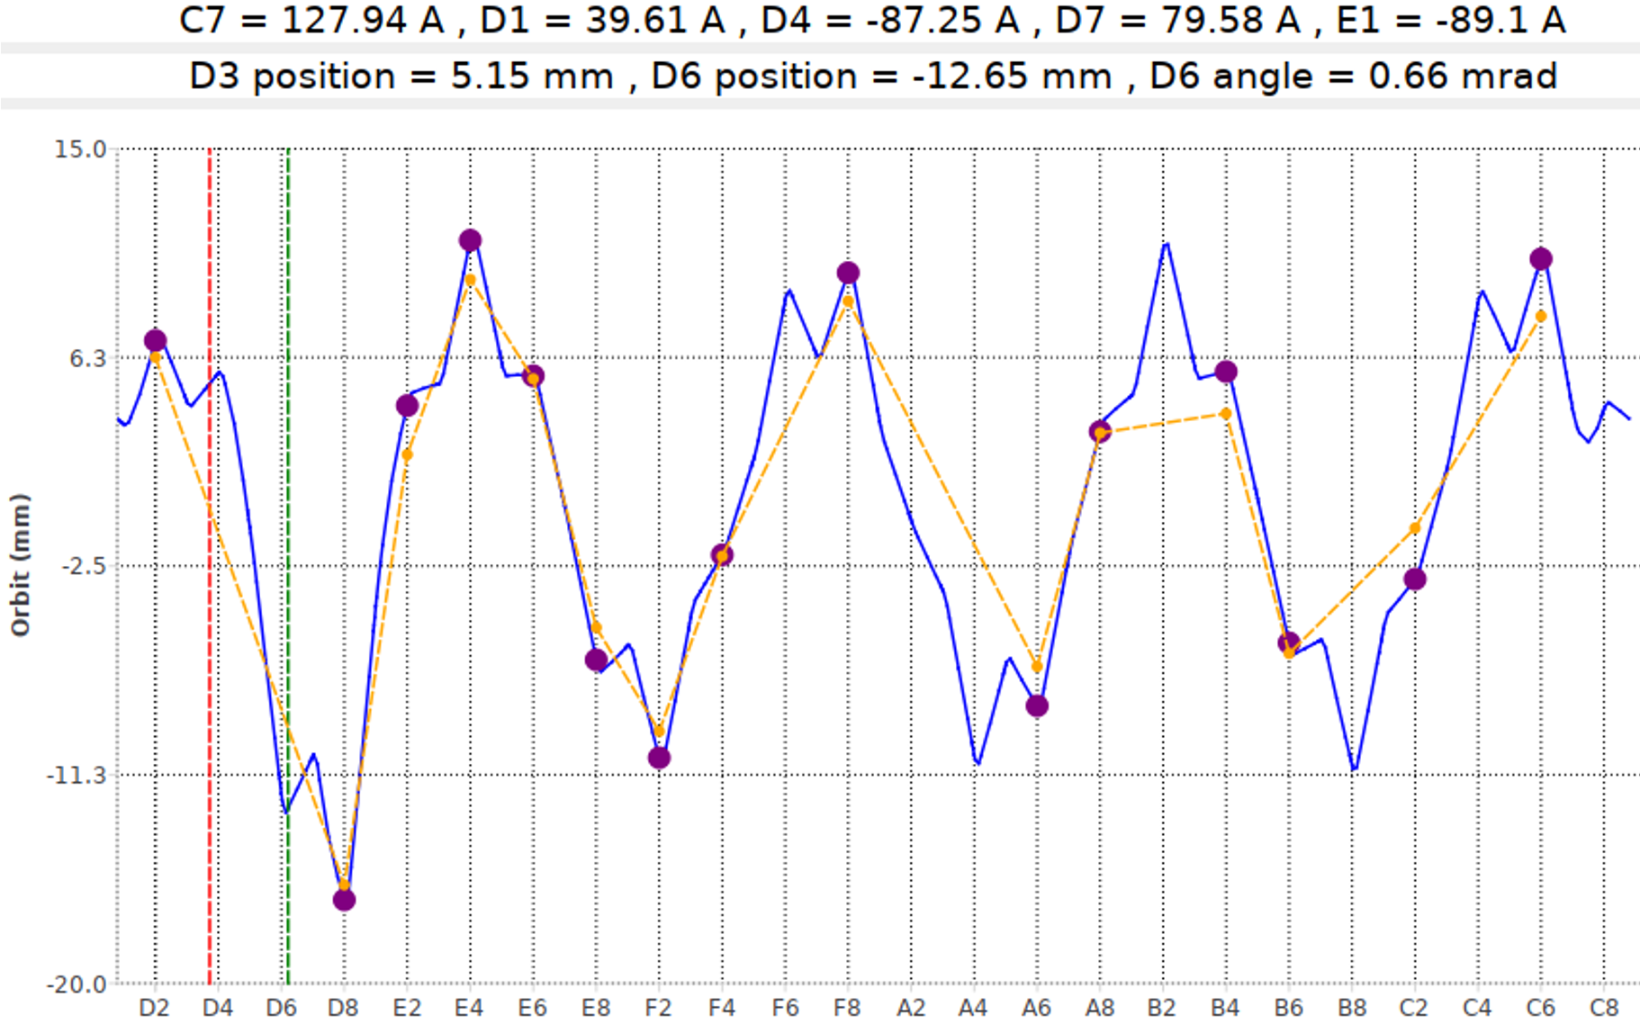
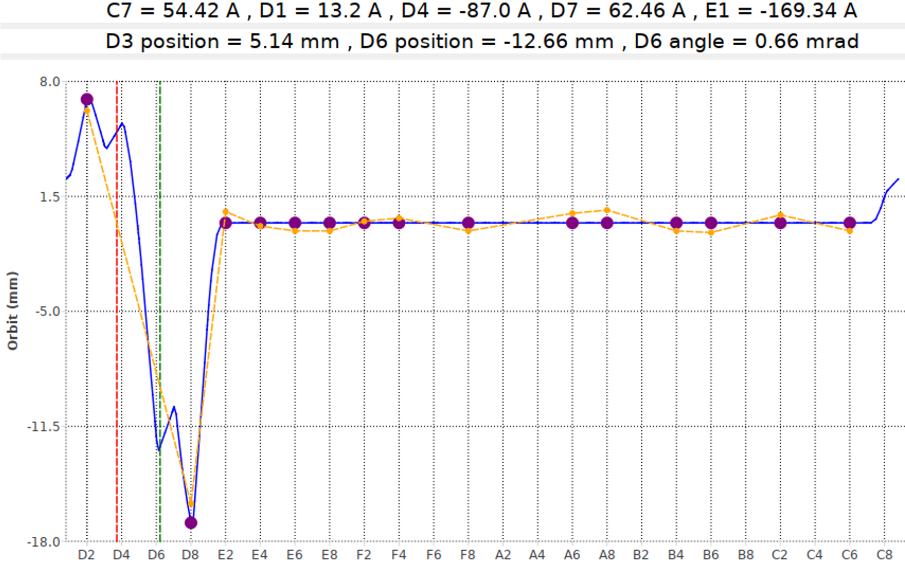
Digital Twin for Booster Extraction Bump Control
Goal: Minimize residual closed-orbit distortion while maintaining proper extraction conditions at the D3 and D6 septa.
Outcome: Enabled faster, model-guided extraction tuning with improved orbit control and full-ring virtual orbit diagnostics.
Bump with residual
Model-corrected Bump

Slide 14
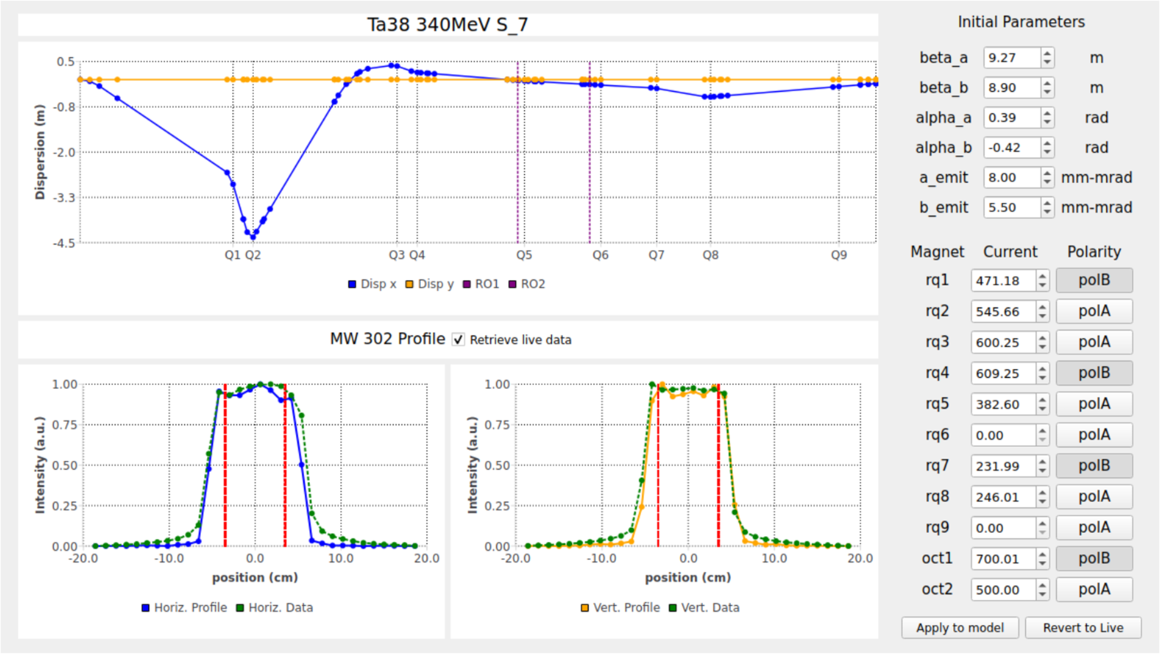
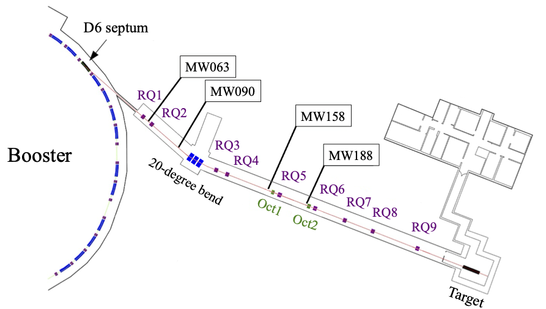
Digital Twin for NSRL Beam Transport Tuning
Goal: Provide real-time virtual diagnostics and model-based tuning for achromatic transport and uniform beam delivery.
Outcome: Enables model-based beam tuning, supports reproducible uniform beam delivery.

Slide 15
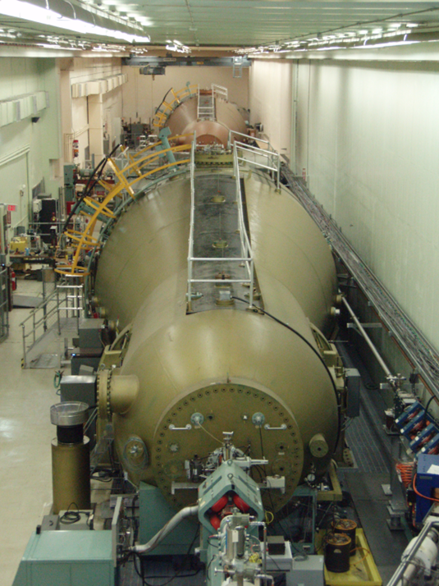
Tandem van de Graaff
Consists of two 15-megavolt electrostatic accelerators capable of delivering continuous or high-intensity pulsed ion beams in a wide range of ion species at various energies.
Ideal for early testing and screening of electronics for sensitivity to radiation and for equipment calibration.
Tandem key features:
Can provide ion beams for more than 50 ion species at a wide range of energies and intensities
Capabilities range from 29 MeV protons to 385 MeV uranium
Allows for testing large number of parts efficiently—up to hundreds if needed
Flexibility in moving through test campaigns
Best for characterizing devices and comparing options early in testing campaigns

Slide 16
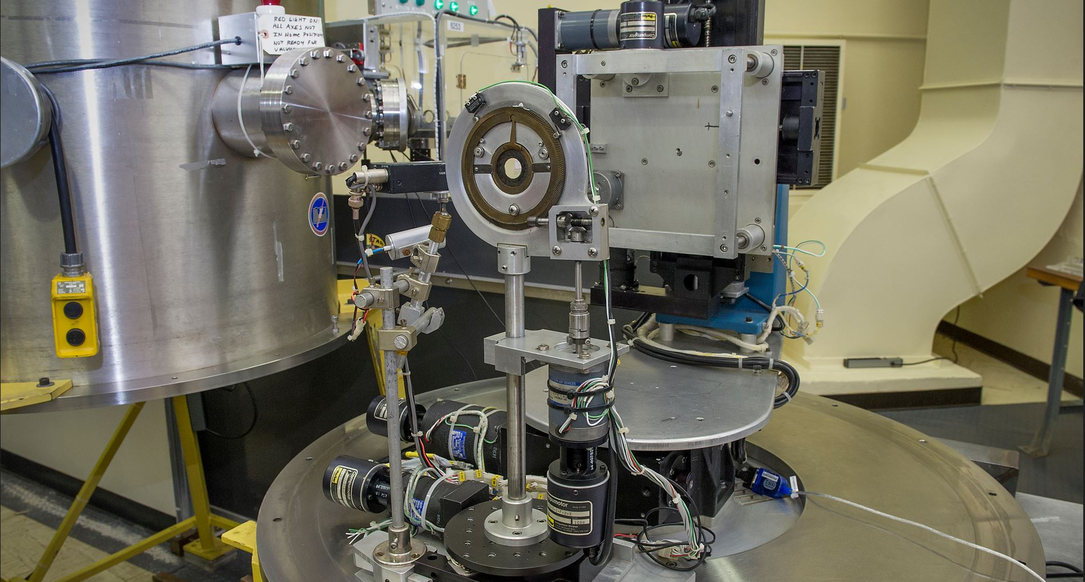
SEU Facility and Tandem Upgrades
SEU facility offers:
Testing in vacuum
Variable aperture 2 – 30 mm
Laser alignment of parts
X, Y, Z, Tilt mounting stage
Mount plate 25 cm x 25 cm
Working area 15 cm x 25 cm
Variety of electrical feedthroughs
Tandem upgrades:
SEU End Station Controls & Vacuum​
Whatman Line Modernization​ (produce microfilters for industry)
Beamline Upgrades​ (modernize controls)
Fiber Optic System (Internal Accelerator)​ - eliminate Lucite rods
Other infrastructure projects (Gas transfer, water, motor controls, etc.)
AI/ML autotuning program with digital twin development

Slide 17
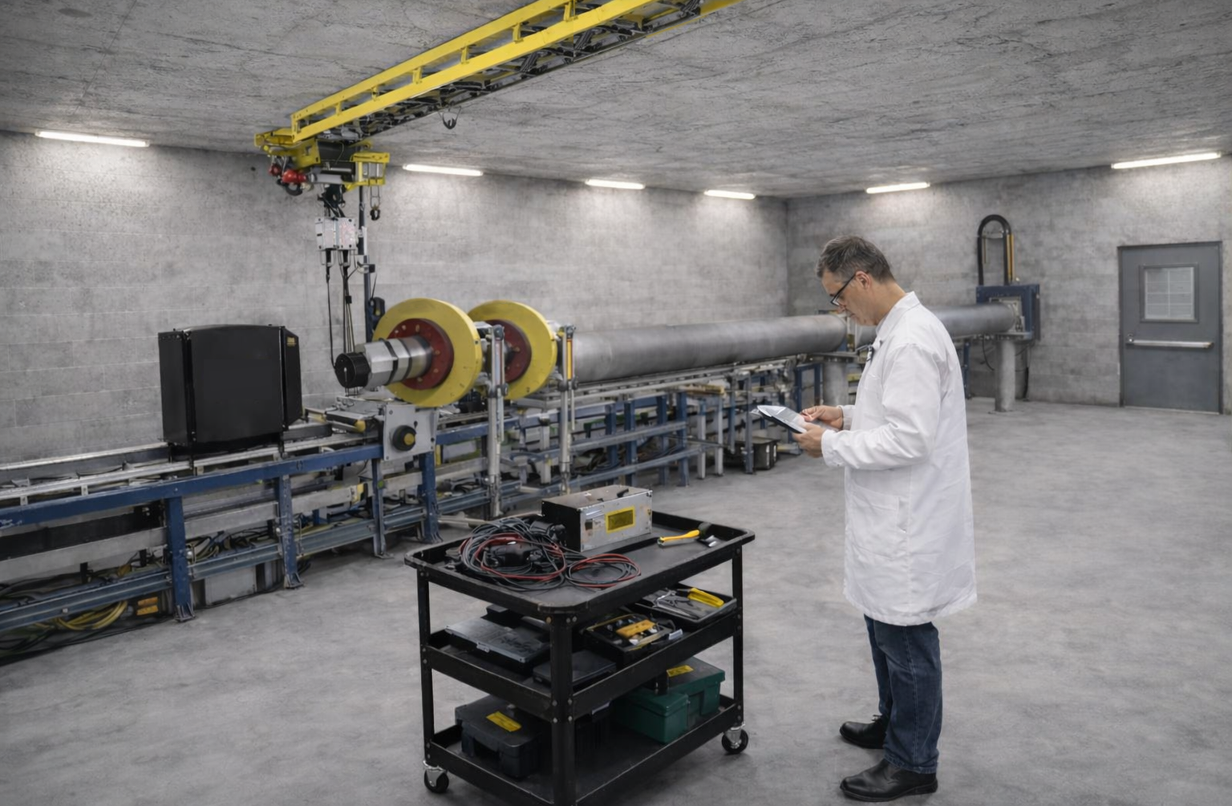
High Energy Effects Test Facility
Designed to be a dedicated SEE testing facility, HEET would significantly increase testing capacity at BNL and primarily serve electronics testing needs.
Though currently unfunded, BNL has delivered feasibility report and conversations are ongoing with DoW for potential funding of facility construction.
HEET key features:
Greater than 4000 hours/year of testing capacity
High energy reach up to 2500 MeV​
Ability to simulate galactic cosmic radiation (GCR) and solar particle events (SPE) spectra​
Protons and full range of ion beams​​, and ion cocktail beams
Potential for two target rooms to increase testing efficiency
INTERIOR OF THE FUTURE TARGET ROOM
(Architectural rendering, not a photo)

Slide 18
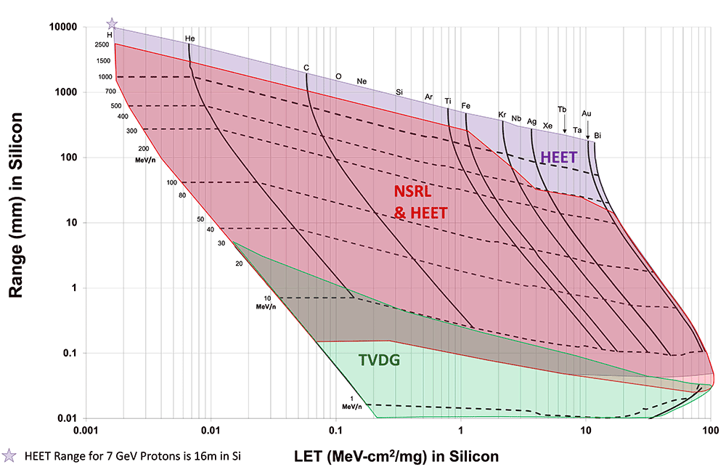
HEET Beam Features
Wide range of beam energies with high energy reach​ (40 MeV/n to 2500 MeV/n, <100 - 200 MeV/n with degrader)​
High duty cycle and high duty factor beam flux​
Continuous beams with energy control in the beamline​
3D Uniform beams with spatial dimensions as large as 20x20 cm²​
High LET with deep range probes​

Slide 19
SEE Future Directions at BNL
With increasing global demand for radiation-hardened electronics, BNL seeks to expand testing capacity at both HEET and NSRL operations in the coming years.
BNL may leverage strategic partnerships and new business models to fill available beam hours (third-party testing aggregators and/or well-funded commercial entities).
Facilities remain committed to prioritizing vital government missions in space exploration and national security.
Lab-to-lab collaboration is welcomed to advance the accelerator science behind SEE testing and to identify joint funding opportunities.

Slide 20

SEE Testing Program at BNL
BNL has launched a Space and Electronics Radiation Effects Program to bring all relevant lab capabilities under one umbrella for streamlined management and access to information.
For more information, please contact relevant POCs:
Claire Applegarth
Program Manager
capplegar@bnl.gov
631-344-3010
Michael Sivertz
Principal Investigator at NSRL
sivertz@bnl.gov
631-344-6102
Dannie Steski
Head of Tandem Facility
steski@bnl.gov
631-344-7851
Kevin Brown
Point of Contact, HEET
kbrownk@bnl.gov
631-344-4409

Slide 21
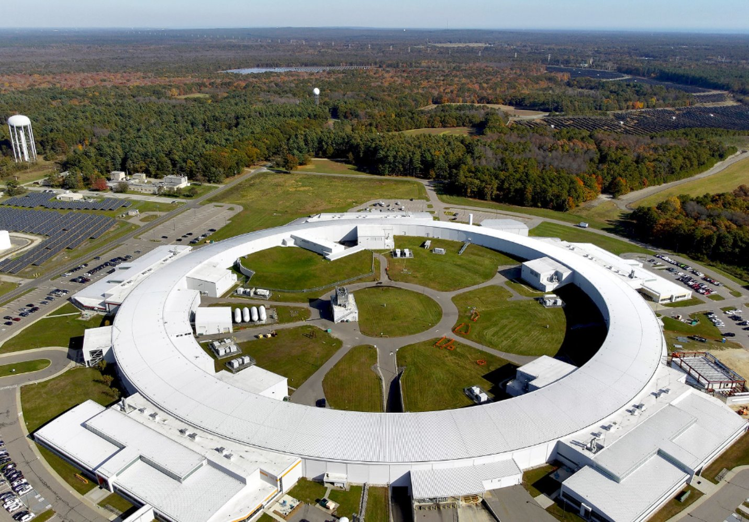
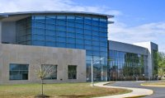
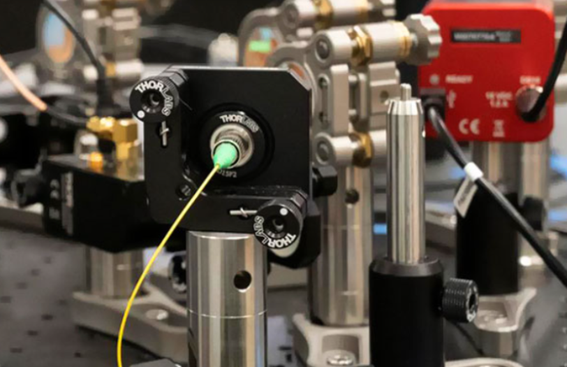
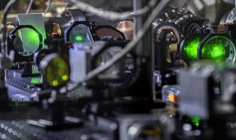
Unique BNL Facilities
The Center for Functional Nanomaterials (CFN) is a user facility providing state-of-the-art capabilities for the fabrication and study of nanoscale materials.
National Synchrotron Light Source II is a state-of-the-state 3 GeV electron storage ring offering researchers world-leading spectral brightness.
Instrumentation Lab creates customized solutions to instrumentation challenges, from detectors probing for fundamental particles to quantum networks.
Accelerator Test Facility is a user facility advancing next-generation particle accelerator technologies.

Slide 22
Thank you!

Slide 23
Back-up

Slide 24
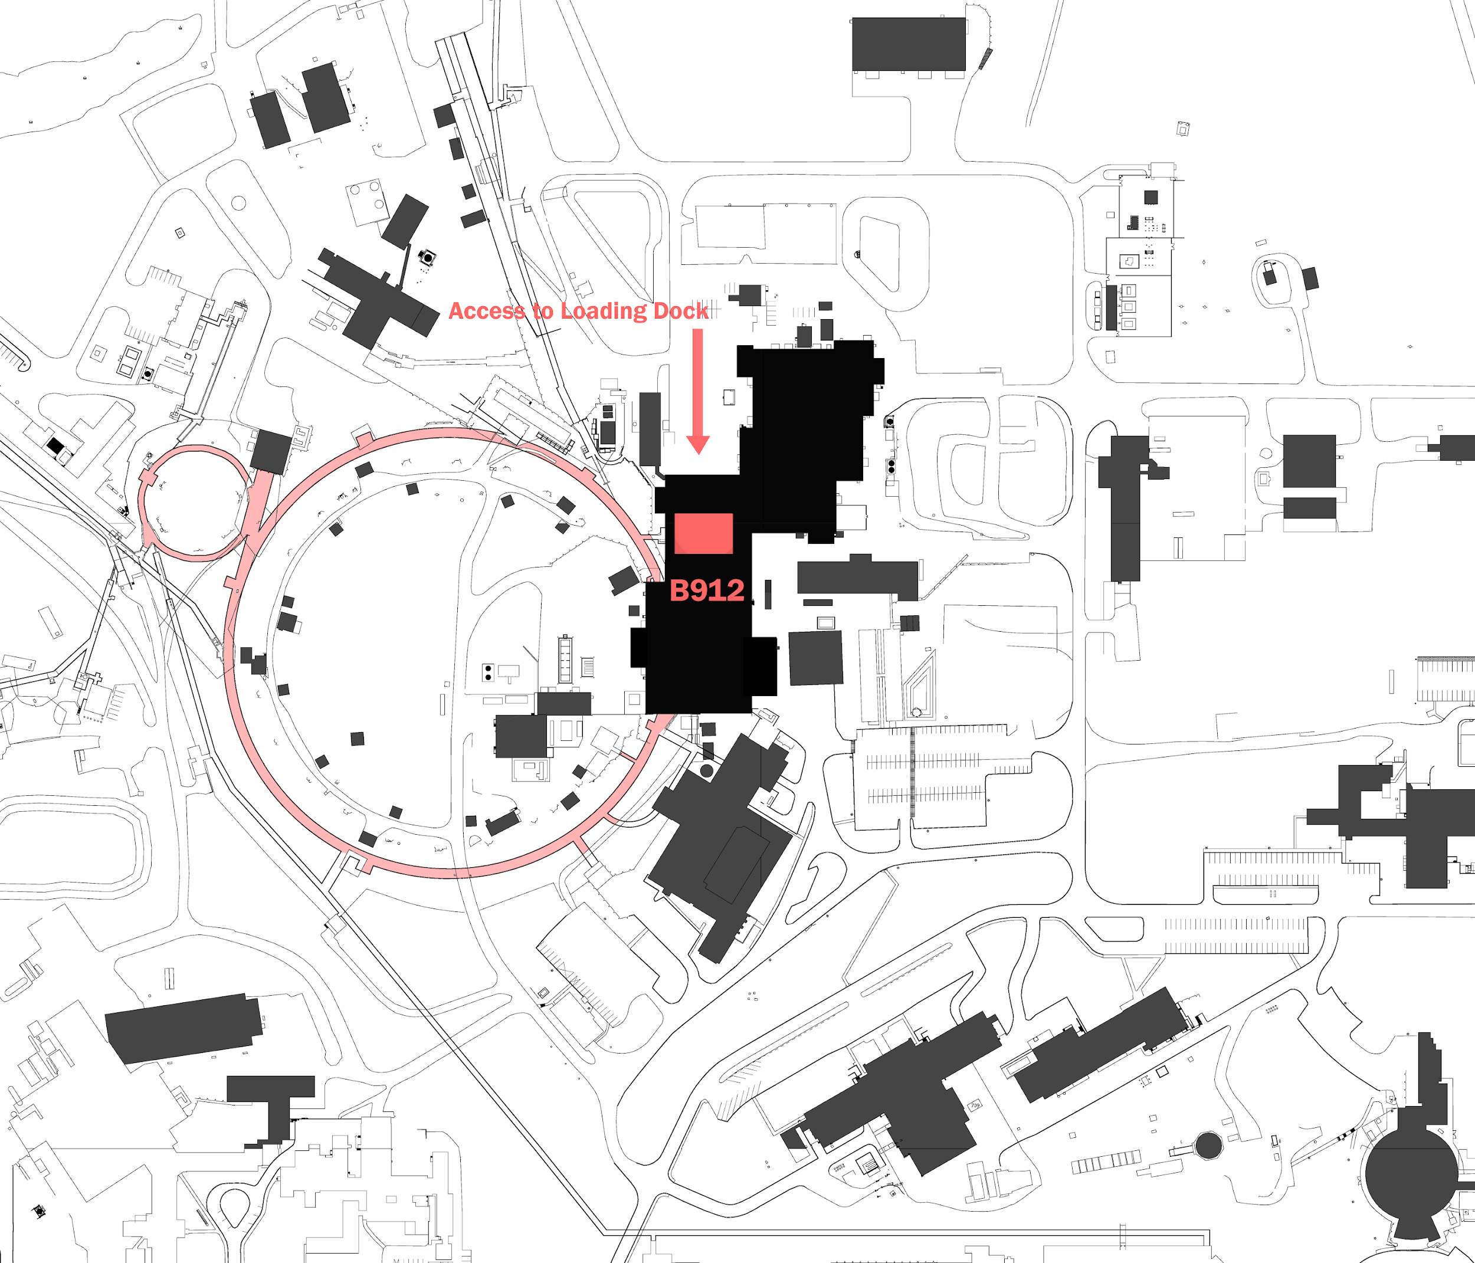
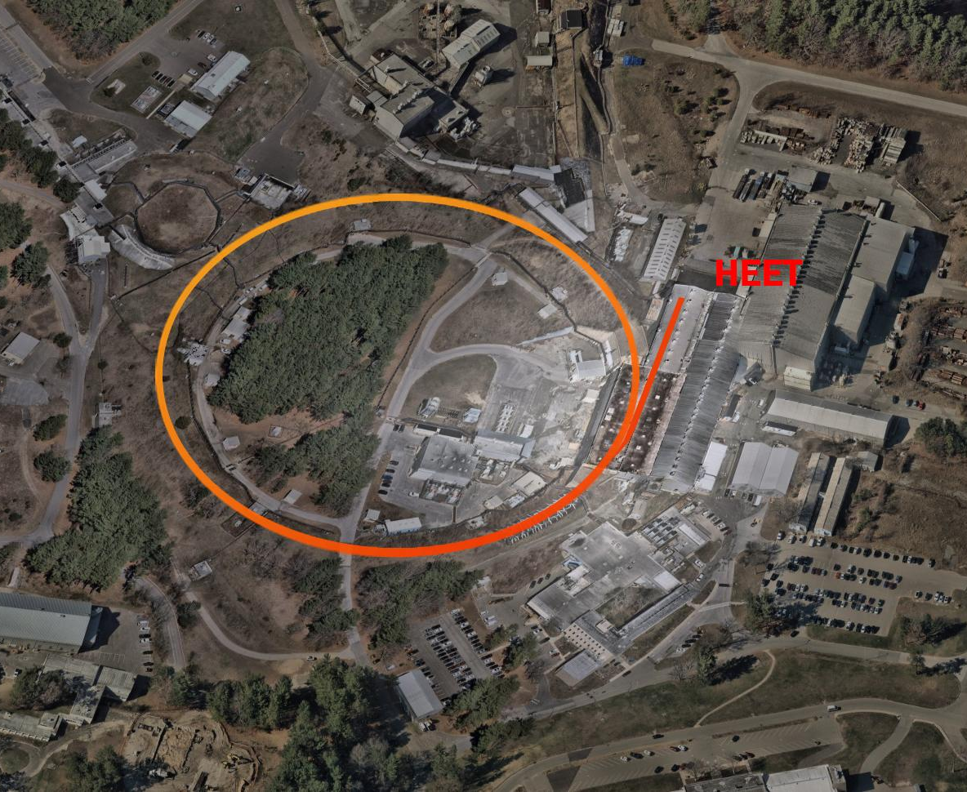
Proposed Site for HEET Project
AGS

Slide 25
Section of AGS Ring
HEET-2
Phase 3
HEET-1
Phase 1 & 2

Slide 26
Section of AGS Ring
HEET-2
Phase 3
HEET-1
Phase 1 & 2

Slide 27
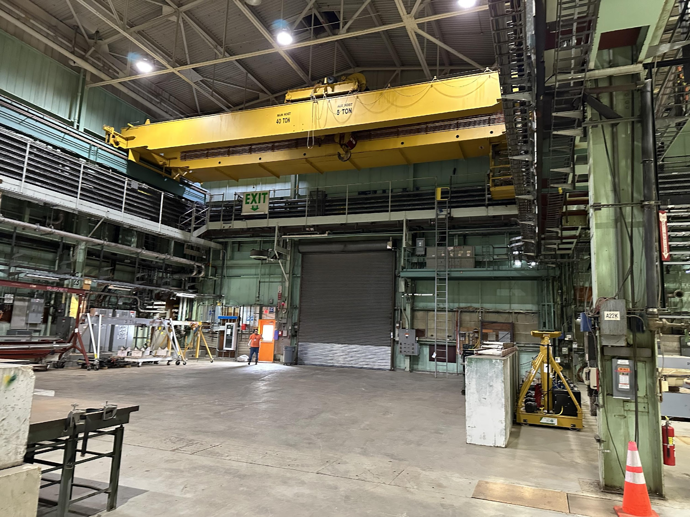
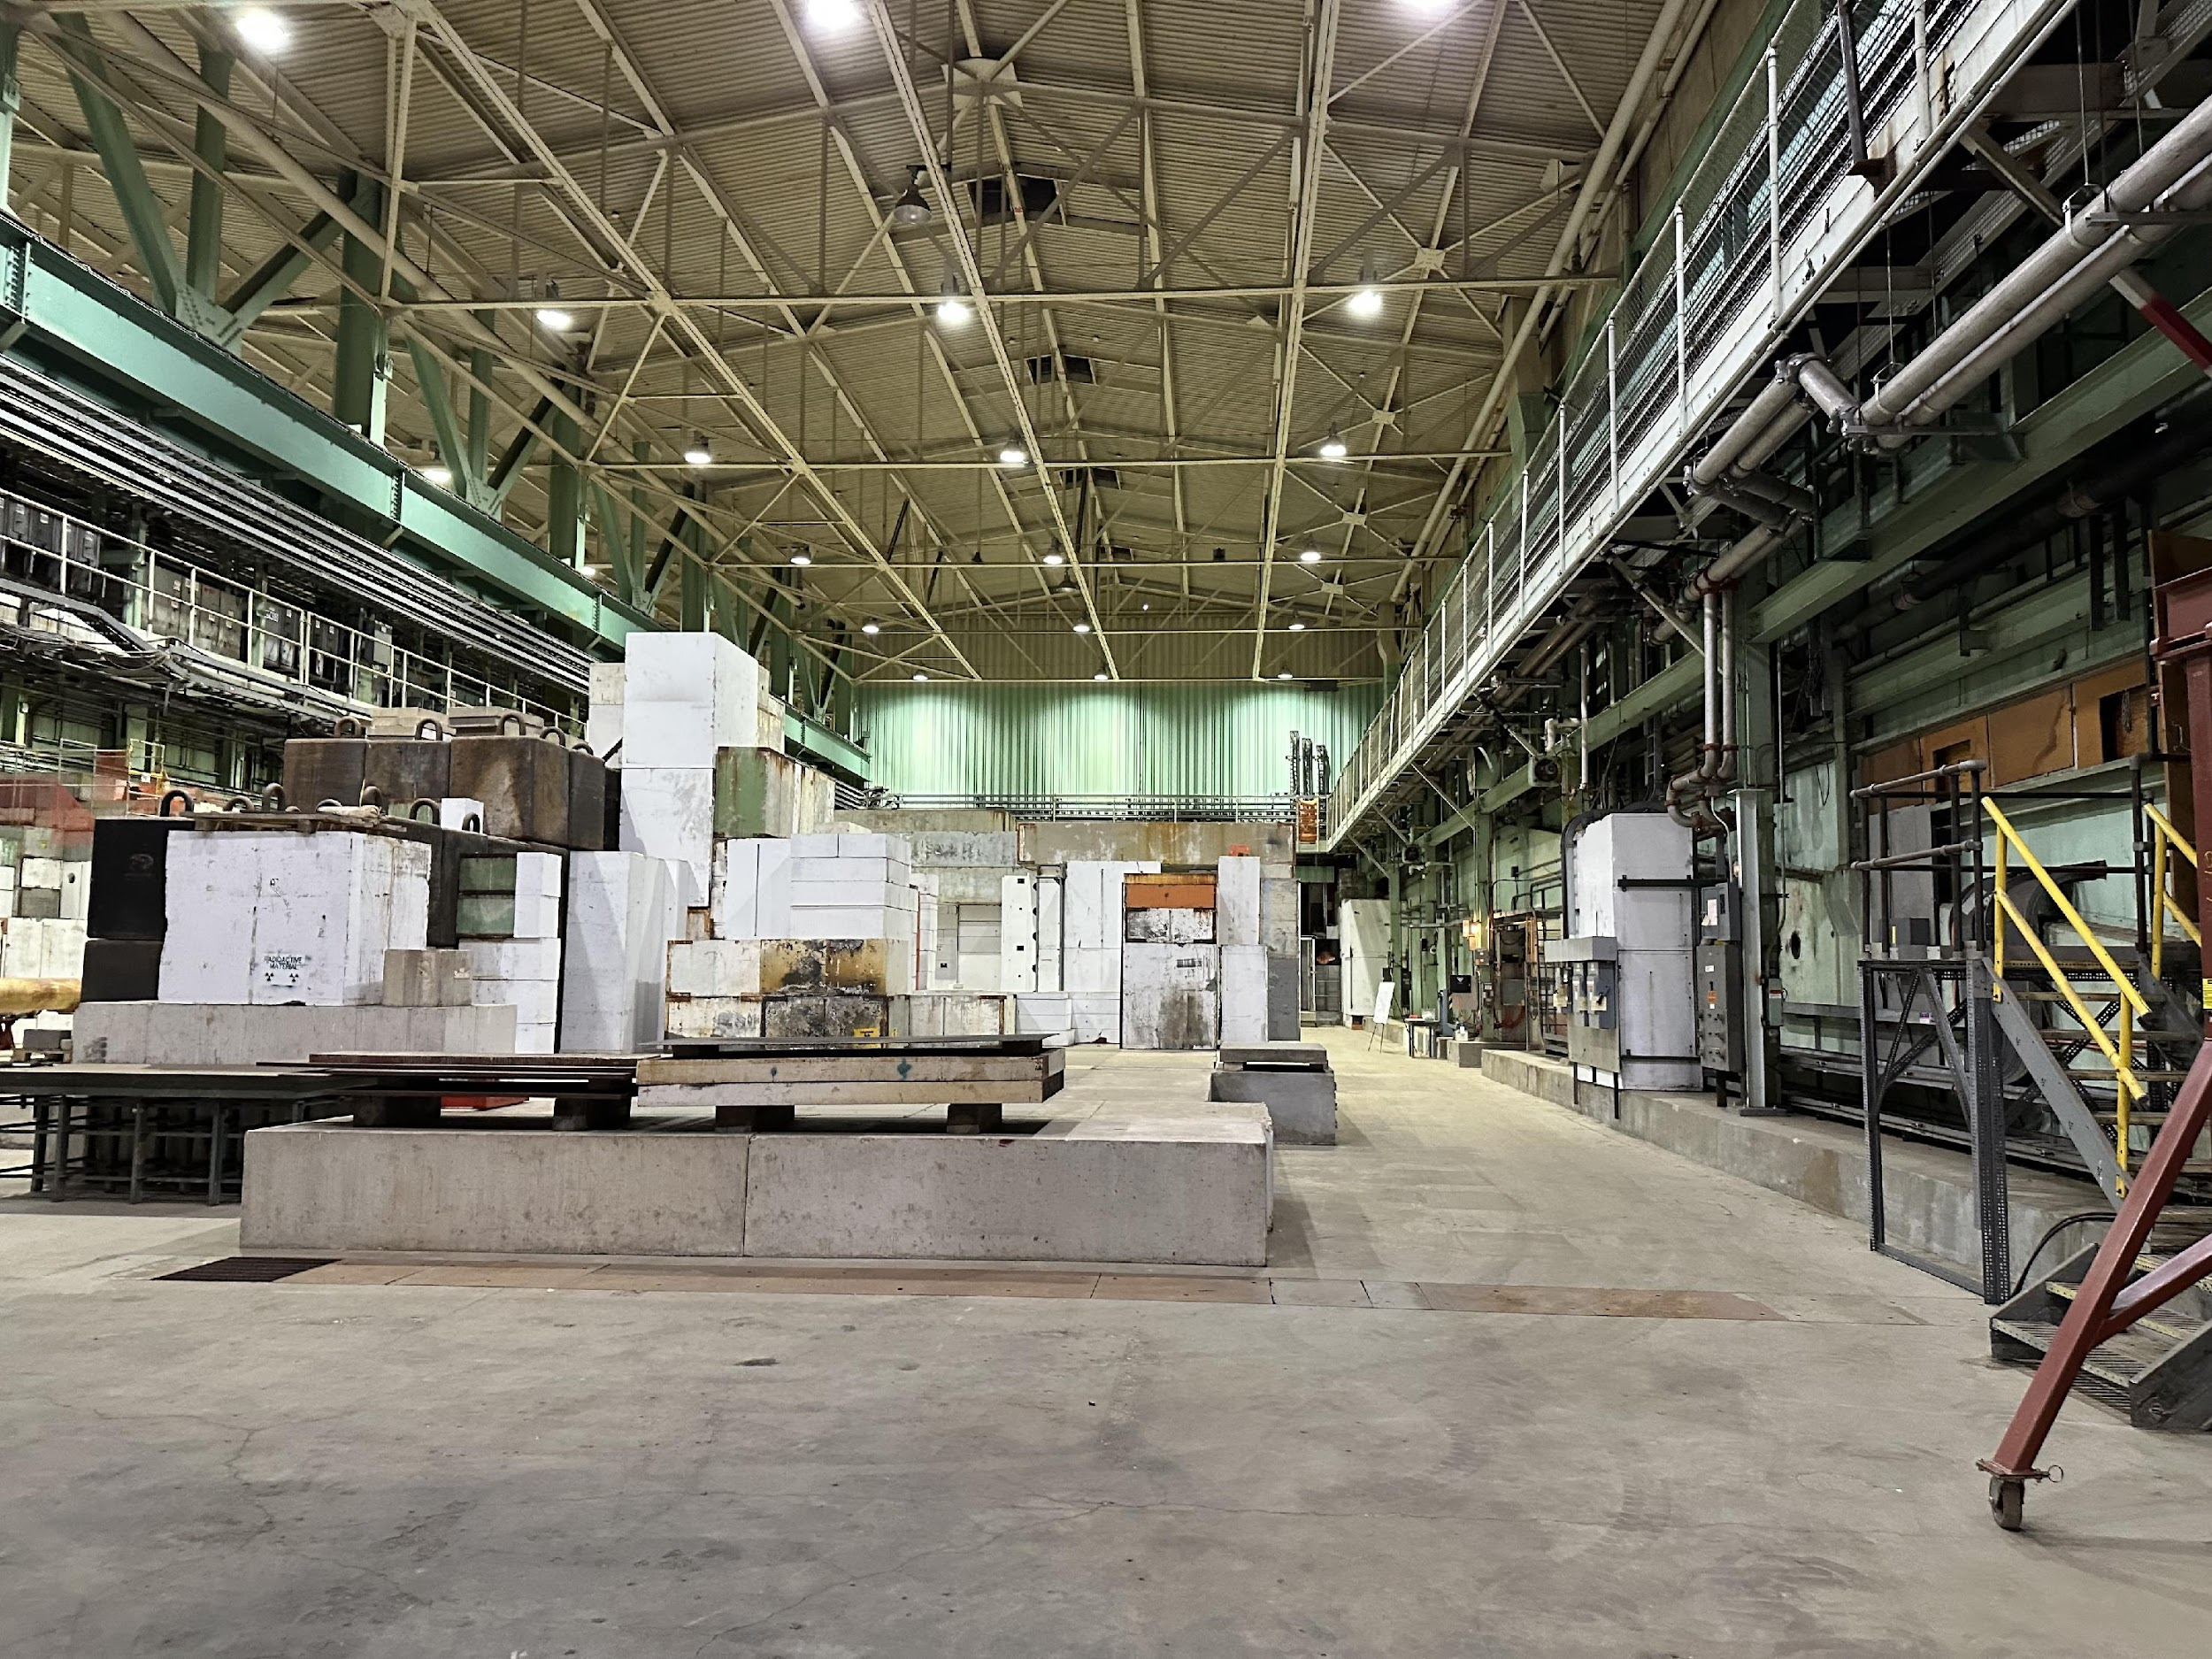

Slide 28
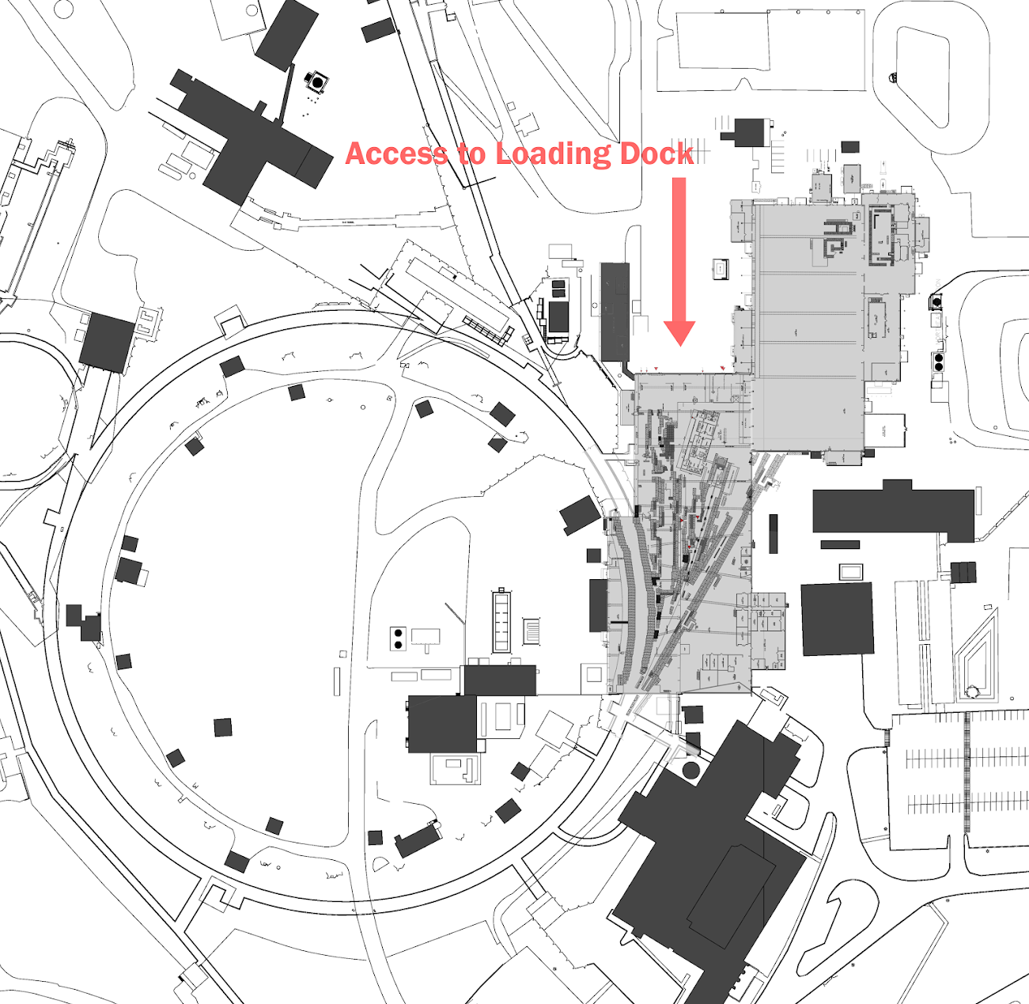
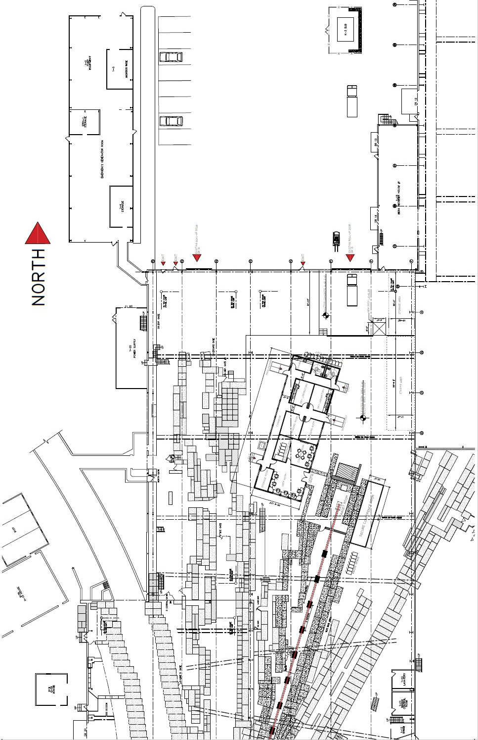
Large Scale Site Plan B912

Slide 29
Proposed HEET Building Elevation

Slide 30
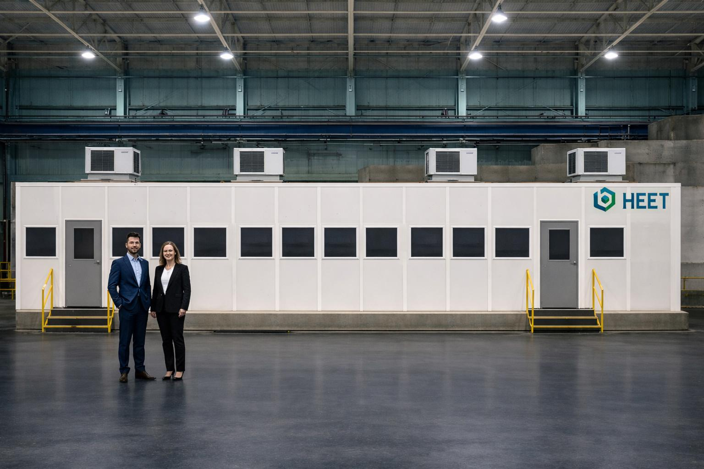
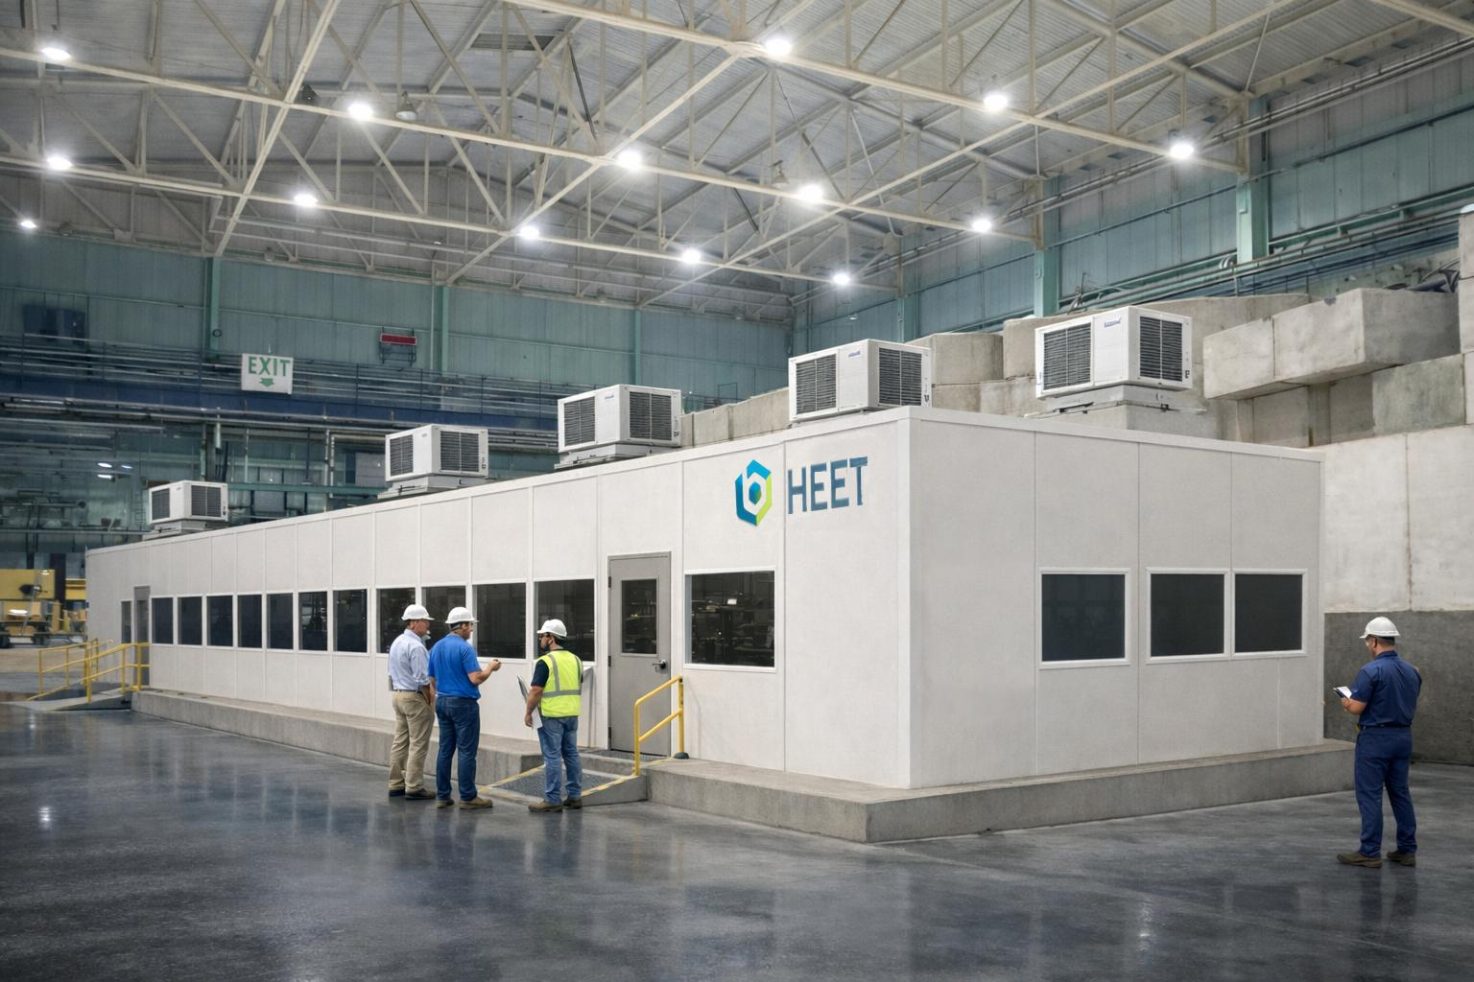
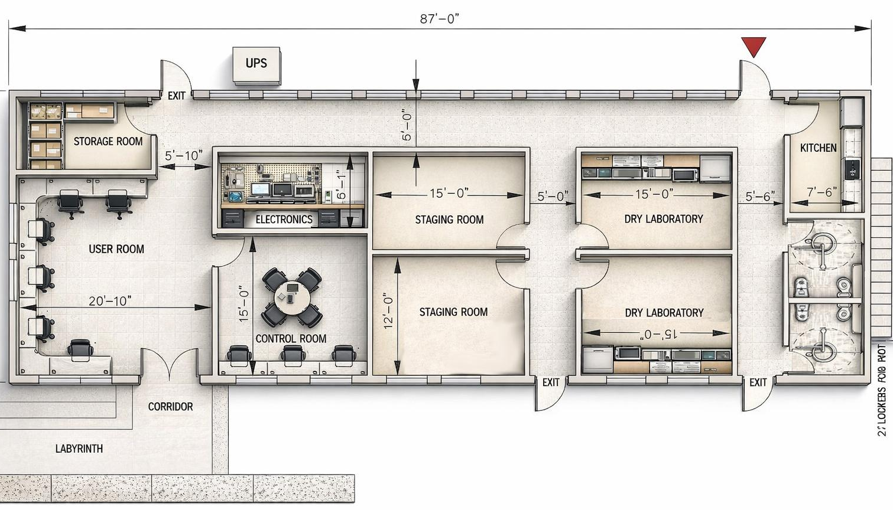
Proposed HEET Building Elevations
Rendered HEET’s Floor Plan

