Slide 1
Introduction:
Fusion Landscape and Requirements
June 11, 2026
Arnold Lumsdaine
Fusion and Fission Energy and Science Directorate, Oak Ridge National Lab
Notes:
Image - 2021-P09584: Aerial overview of the Spallation Neutron Source, SNS, and the future location for the SNS Second Target Station, September 30, 2021. This image has been reviewed by an ORNL Releasing Official and is approved for public release, September 26, 2022.

Slide 2
Multiple technology facilities are needed to qualify materials and components for use in fusion power plants
Material Plasma Exposure eXperiment (MPEX) – Plasma Material Interaction for neutron damaged materials (under construction)
Blanket Component Test Facility (BCTF) – Testing of blanket components in nuclear and non-nuclear environments
Fuel Cycle Test Facility (FCTF) – Handling of sufficient amounts of tritium and allow for full scale processing rates that are orders of magnitude higher than state of the art
Fusion Prototypic Neutron Source (FPNS) – Exploring whether materials retain adequate properties and integrity for damage levels greater than 20–50 displacements per atom (dpa) in a fusion neutron environment
Volumetric Neutron Source (VNS) – Examine components at scale for performance in the fusion nuclear environment
Notes:
Too expensive to build facilities;

Slide 3
Why don’t these facilities already exist?
Many of these facilities are under construction internationally (UNITY-1 & 2, CHIMERA, LIBERTI, H3AT, IFMIF-DONES, etc.)
The facilities are expensive, and many require the development of first-time use critical technologies. All require challenging integration of complex systems.
The development of a Fusion Pilot Plant (FPP) without verification of materials and components that can survive the integrated fusion environment carries significant risk.
This verification and qualification will be needed well beyond the development of an FPP.
It is too expensive and takes too long to develop these facilities. It is too risky and costly to not develop these facilities.
?

Slide 4
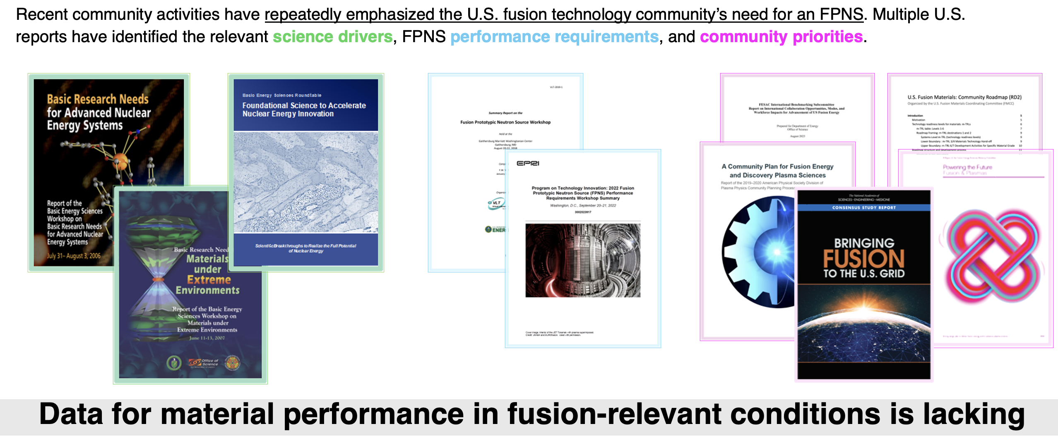
We have no way to test materials and components in a neutron environment that represents the harsh conditions of a fusion power plant

Slide 5
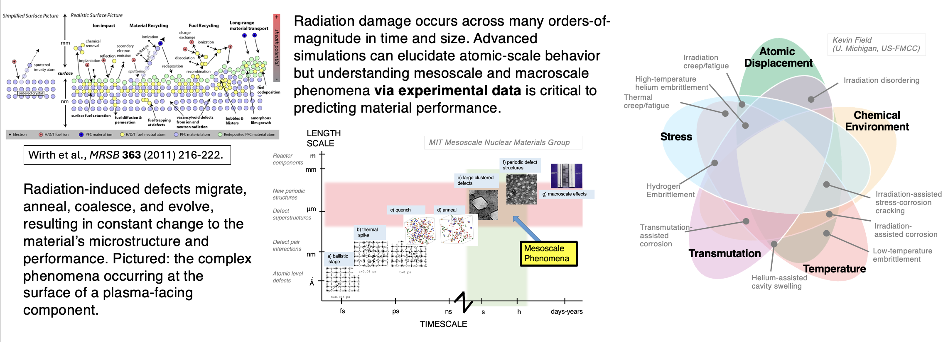
The evolution of PFC armor and structural materials (and thus property changes) in extreme radiation environments is highly complex, dynamic and difficult to predict

Slide 6
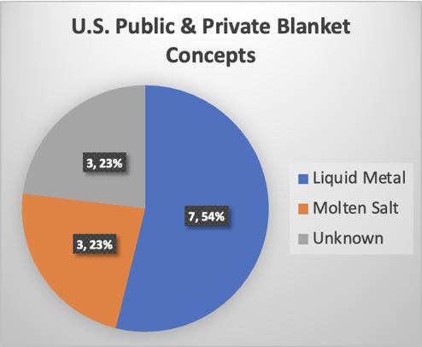
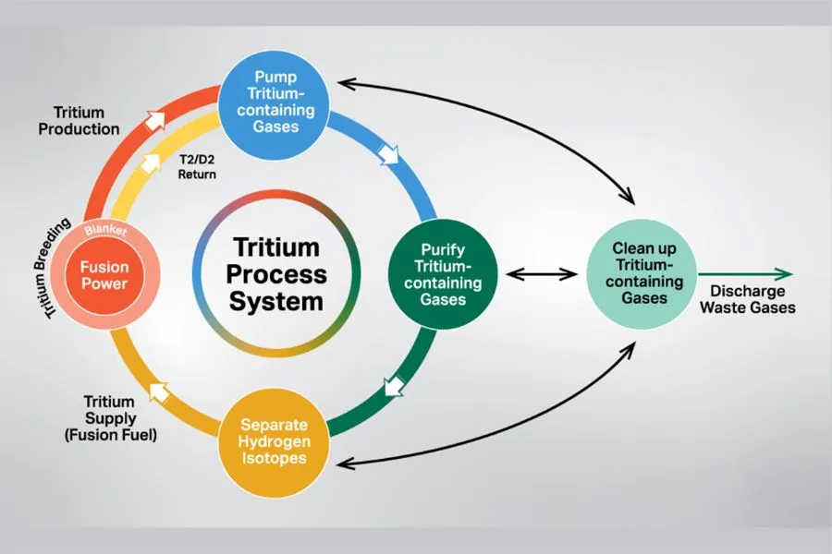
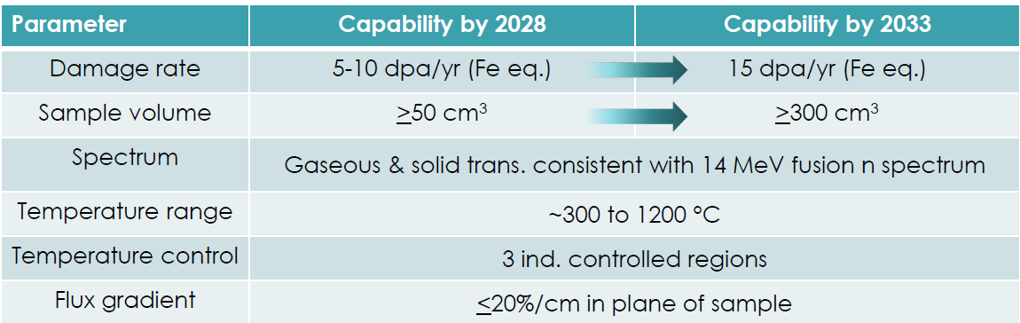
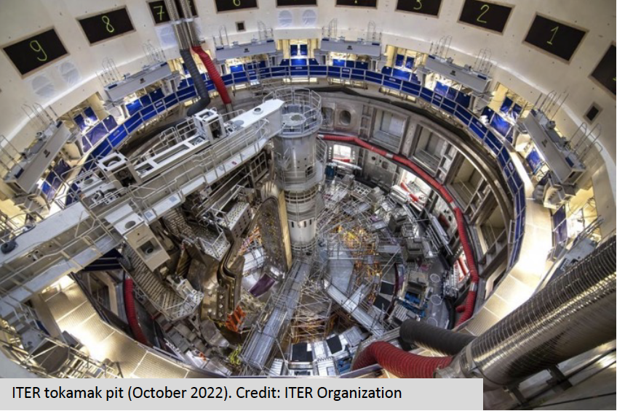
US Consensus on Facilities that Best Serve Fusion
A strong consensus was developed in the Subcommittee that four facilities ‘Best Serve Fusion’ (in alphabetical order): Blanket Component Test Facility (BCTF), Fuel Cycle Test Facility (FCTF), Fusion Prototypic Neutron Source, and ITER.
Each of these facilities support multiple pathways to fusion energy, including ITER which has/will provide knowledge transfer about fusion technology & engineering experience at reactor scale, including system integration, precision engineering and quality control
The other eight facilities were all deemed ‘important’. Many of these facilities were associated with single-concept fusion confinement approaches
These facilities are highly important and well-deserving of FES support
The readiness for construction varied significantly between all facilities

Slide 7
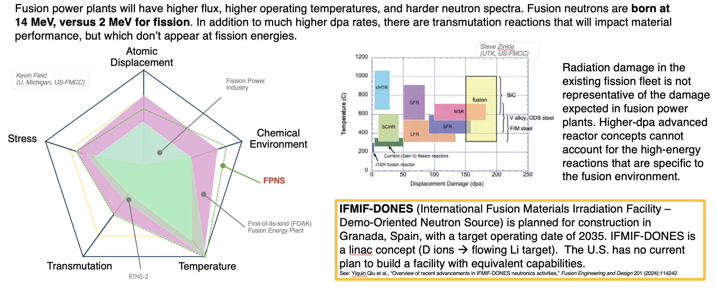
Evaluation of options for an FPNS: fusion neutron spectrum considerably harder than fission – introduces substantial gaseous and solid transmutant elements in structural materials closes to fusion engine

Slide 8
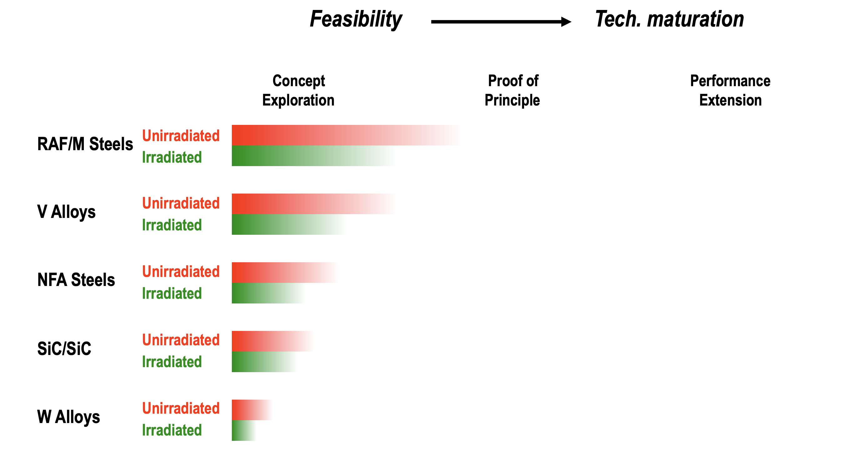
Fusion materials current readiness

Slide 9
Multiple facilities are needed to develop fusion materials and technologies and de-risk reactor development
Fusion Prototypic Neutron Source (FPNS)
Purpose: establish the materials science knowledge base to understand materials degradation in a D-T fusion environment and code qualify materials.
High flux, small sample, high dpa
Capabilities (from 2023 RFI):
15 dpa/cy damage (Fe equivalent)
Gaseous and solid transmutant generation rates consistent with 14 MeV fusion neutron
300 cm³ sample volume
Flux gradient ≤20%/cm in the plane of the sample
Volumetric Neutron Source (VNS)
Purpose: produce a high volume and high flux of D-T neutrons to test and qualify nuclear components.
High flux, large sample, moderate dpa
Capabilities (from 2025 EU VNS):
1-2 dpa/cy damage (Fe equivalent)
Neutron wall load >0.5 MW/m²
1x10¹⁴ n/cm²-s on wall
Tokamak with 200 MW power consumption
52 MW heating & current drive, 29 MW fusion power
Tritium breeding necessary for ops
Integrated Blanket Test Facility
Purpose: validate fusion tritium breeding blanket concepts at representative scale including coupled effects.
Requires VNS in order to examine coupled affects and produce meaningful quantities of tritium.
Fuel Cycle Test Facility
Fuel Cycle Test Facility
Purpose: validate tritium extraction, processing, handling, monitoring, and materials interactions.
Co-locating with Integrated Blanket Test Facility will allow for processing of tritium bred in prototypic fashion.
Notes:
Change to EU VNS

Slide 10
The Special Competitiveness Studies Project (SCSP) recommends substantial investment in fusion
“Fusion Forward: Powering America’s Future” was released in October 2025.
The SCSP report recommends that the U.S. “make a One-Time Investment of $10 Billion to Enable and Accelerate U.S. Fusion Commercialization.”
  “The DOE fusion program’s mission and budget should evolve into one that accelerates fusion R&D and industry-led demonstration activities.”
  “Building on existing FES funding levels, $10 billion in new funding should go towards a multi-pronged approach of . . . [b]uilding commercialization-relevant R&D facilities to close scientific and technological gaps in key fusion components and systems needed to enable the National Fusion Goal and then build reliable power plants thereafter.”
Notes:
Too expensive to build facilities;

Slide 11

The U.S. DOE Fusion Science & Technology Roadmap proposes developments to close key fusion gaps
“The U.S. will:
  Build key infrastructure to address critical fusion materials and technology (FM&T) gaps;
  Innovate and advance the science and engineering of fusion; and
  Grow the U.S. fusion ecosystem through domestic and international public-private partnerships, fostering new regional consortia, building research FS&T infrastructure and supply chains and fusion manufacturing networks.”
https://www.energy.gov/fusion-energy
Notes:
Too expensive to build facilities;

Slide 12
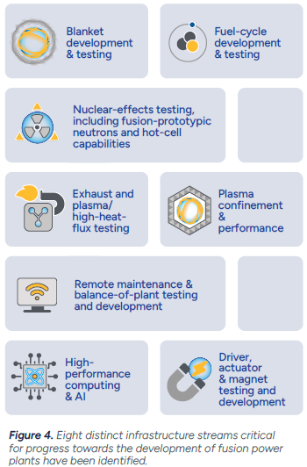
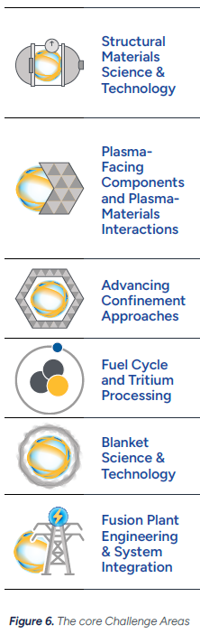
The U.S. Fusion Roadmap identifies 6 core challenge areas and 8 infrastructure streams to close technology gaps
Notes:
Too expensive to build facilities;

Slide 13
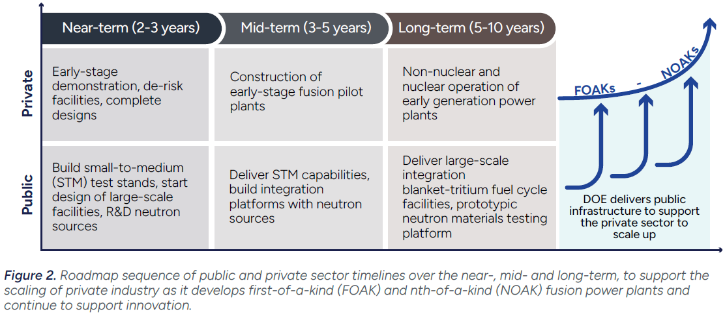
The U.S. Fusion Roadmap proposes an aggressive approach to public and private sector facility development
Notes:
Too expensive to build facilities;

Slide 14
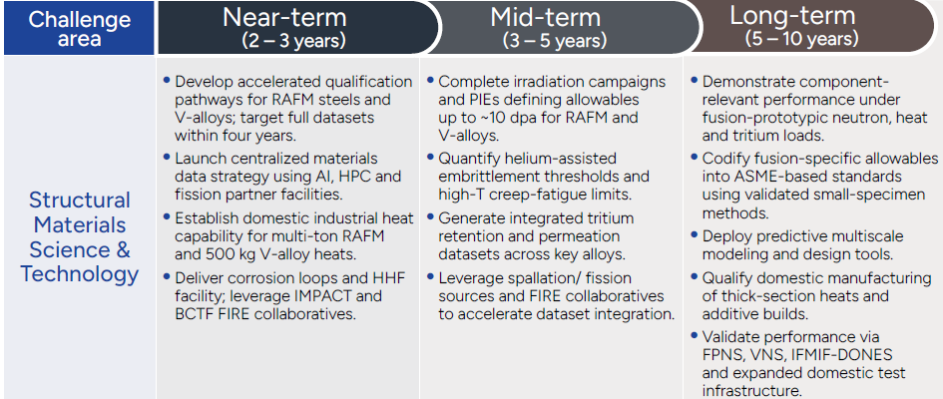
Roadmap calls for a VNS in 5-10 years

Slide 15
U.S. Fiscal Year 2026 budget
The Department is encouraged to pursue modalities, including public-private partnerships, to deliver small and medium-scale experimental capabilities, and address specific science and technology gaps through the development of . . . a blanket testing experiment, a nuclear high-heat flux experiment, and an experiment that develops prototypes for low-cost neutron sources.
The Department is also encouraged to utilize research funding to start design and develop cost estimates for a large-scale Fusion Prototypical Neutron Source facility and an integrated blanket-fuel cycle test facility consistent with recent FESAC reports.
The agreement provides up to $12,500,000 to fund the Emergent Confinement Concepts program to explore the next generation of fusion concepts that could lead to a volumetric neutron source identified in the FESAC Long Range Plan.
Emphasis added
Notes:
Too expensive to build facilities;

Slide 16
Muon catalyzed DT neutron source
A DT neutron source producing >10¹⁶ n/s could be built at the Spallation Neutron Source site in ~5 years (given appropriate authorization and funding)
  The SNS accelerator complex has considerable flexibility.
  PPU enables 2.8MW power and flexible operations between targets stations
  SNS can support additional targets with beam power up to 800kW without jeopardizing the core mission of neutron scattering
The advantages of a muon catalyzed DT neutron source:
  A magnetic / inertial confinement reactor is not necessary – muon catalyzed fusion does not require thermonuclear temperatures
  The proposed facility does not require building an accelerator – SNS excess power is adequate
  The science has been validated – a private company collaborator is innovating and optimizing the concept by actively conducting enabling R&D
  The target could be focused for VNS or FPNS applications
  A muon beam will have benefits across several DOE programs

Slide 17
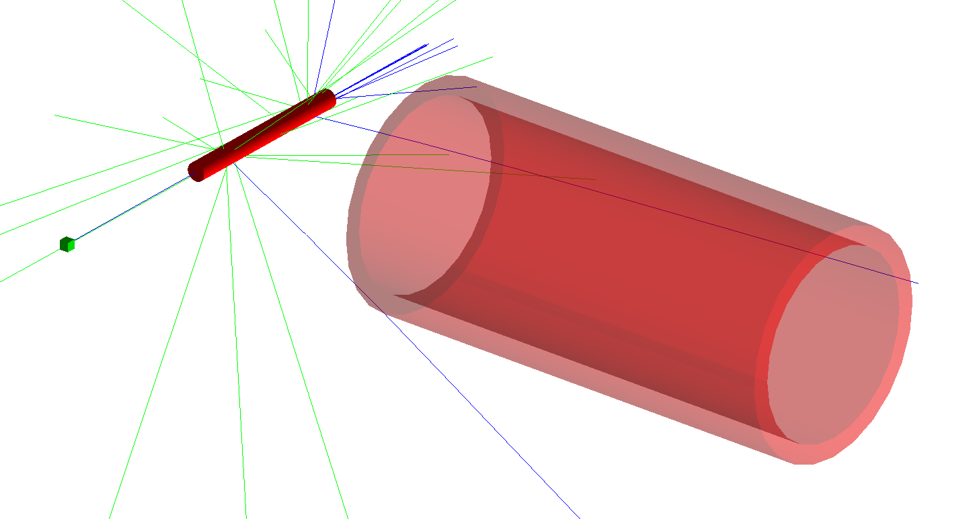
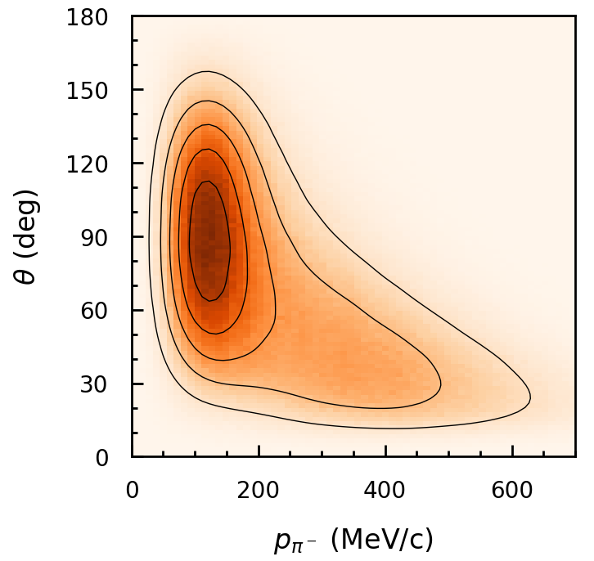
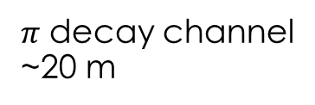





$\text{A} μCF \text{DT} \text{neutron} \text{source} \text{require} \text{multiple} \text{targets}$
High-energy proton beam hits a target generating $π^{−}$
$π^{−}$ are captured and decay into $μ^{−}$
$μ^{−}$ are cooled and sent to a fusion target
GEANT simulation in progress
$π^{−}$ angular and momentum distribution
Another APPLICATION (i.e. fundamental physics)
14.1 MeV
neutrons
$$π→μ$$
Capture Solenoid
Muon ionization cooling
Fusion target
$μ$ Target
$$π$$
Proton
Beam
$π$ decay channel
~20 m
Notes:
Only the loss in the proton beam diverts to the muons

Slide 18
Acknowledgement – ORNL / Acceleron MuCF team
Fusion and Fission Energy Science Directorate
  Troy Carter
  Trey Gebhart
  Arnie Lumsdaine
  Mickey Wade
Computing & Computational Sciences Directorate
  Thomas Evans
  Stefano Tognini
Neutron Sciences Directorate
  Sarah Cousineau
  Sang-Ho Kim
  Vasiliy Morozov
  Fulvia Pilat
Physical Sciences Directorate
  Marcel Demarteau
Acceleron
  Ara Knaian
Acknowledgements to Brian Wirth (UTK) for slides 4-8 regarding FESAC facilities recommendations
Notes:
Add reference to Acceleron poster

Slide 19
Q&A

Slide 20
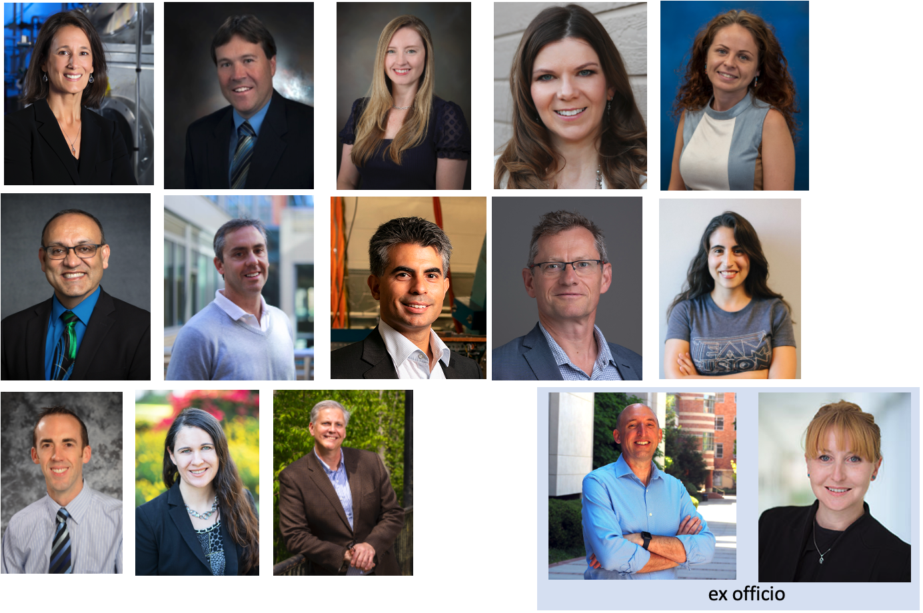
FESAC Facilities Construction Projects Sub-Committee Members
US DOE Office of Science requested input on prioritization of facility needs in December 2023
Prof. Brian Wirth, U. of Tennessee - Knoxville (Chair)
Prof. Carlos Paz-Soldan, Columbia University (Vice-Chair)
Dr. Felicie Albert, Lawrence Livermore National Laboratory
Mr. David Babineau, Savannah River National Laboratory
Dr. Kate Bell, Sandia National Laboratories
Dr. Cami Collins, Oak Ridge National Laboratory
Prof. Evdokiya Kostadinova, Auburn University
Dr. Rajesh Maingi, Princeton Plasma Physics Laboratory
Prof. Jaime Marian, U. of California - Los Angeles
Dr. Thomas Sunn Pedersen, Type One Energy
Dr. Erica Salazar, Commonwealth Fusion Systems
Dr. Chase Taylor, Idaho National Laboratory
Dr. Kathreen Thome, General Atomics
Prof. Troy Carter, U. of California - Los Angeles (ex-officio)
Prof. Anne White, Massachusetts Institute of Technology (ex-officio)
Notes:
BRIAN
Also acknowledge our designated federal official, Dr. Jean-Paul Allain the Associate Director of DOE FES
Thank you to Sam Barish and Sandy Newton, and the staff of the DOE FES for hosting our in-person Subcommittee meeting at Germantown headquarters

Slide 21

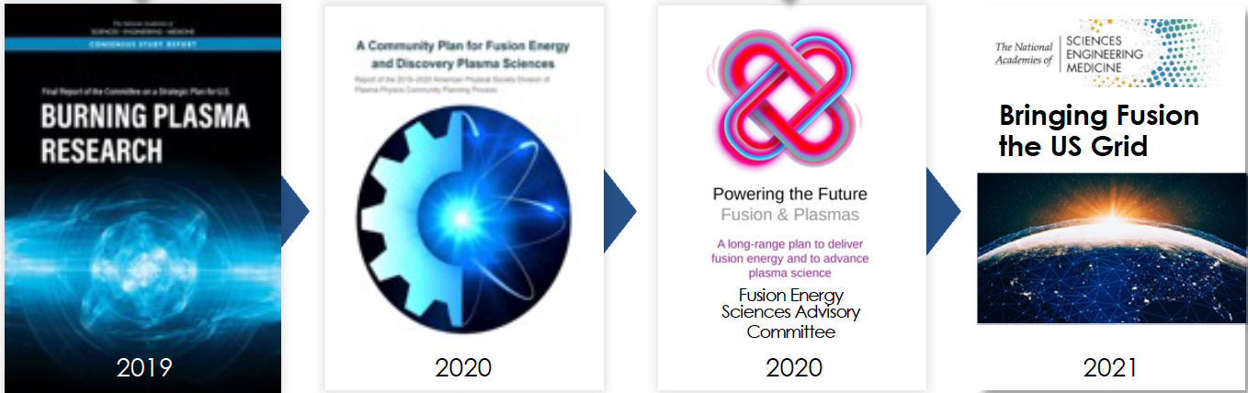
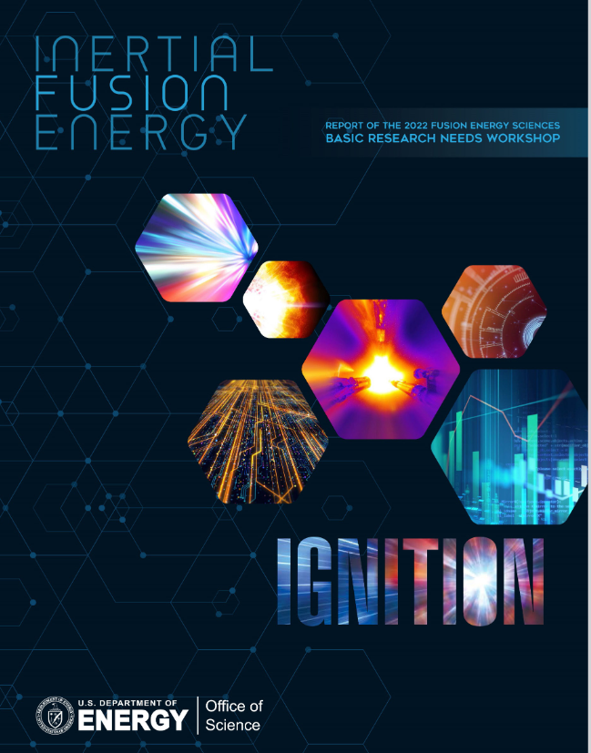
Prior reports & recent events informed discussions
2022 Whitehouse event to launch ‘Bold Decadal Vision’ and milestone-based public-private partnerships
2022 & 2023 demonstrations of fusion scientific gain from IFE in the US & 69 MJ fusion heating over 6 seconds in the UK
Notes:
One webinar per facility was held and advertised to the community
One or two per week from Mid-February 2024 to early April 2024.
Speakers selected based on white paper submissions
Included a “community overview” with consensus elements whenever feasible
Q&A done in the open, community Q&A also included
Essential element of our process as a sub-committee
https://sites.google.com/view/fesac-fcp/home

Slide 22
Fusion Prototypic Neutron Source (FPNS)
• The need for an irradiation source to test and qualify materials has been recognized since the 1970s.
• Many facilities have been proposed, but in the U.S., only RTNS (I & II) were built and operated at < 0.1 dpa between 1979 and 1987
• IFMIF is being designed and technology prototyped by the Japan/EU (IFMIF EVEDA)
- IFMIF cost estimated at >$1.25B
- DONES (essentially half-IFMIF) currently being pursued, estimated at ~$700M
• Multiple FESAC & community reports (e.g., RENEW, Gaps and Priorities, etc.) have promoted material testing in a prototypic fusion neutron spectrum
- More recently, the US APS-DPP Community Planning Process reiterated that FPNS is needed and assigned a high(est) priority ranking among needed new start facilities
- In summer/fall 2022, EPRI hosted a 2-part workshop series to further discuss requirements for an FPNS and build consensus on timeline, with the emergence of private fusion companies

Slide 23
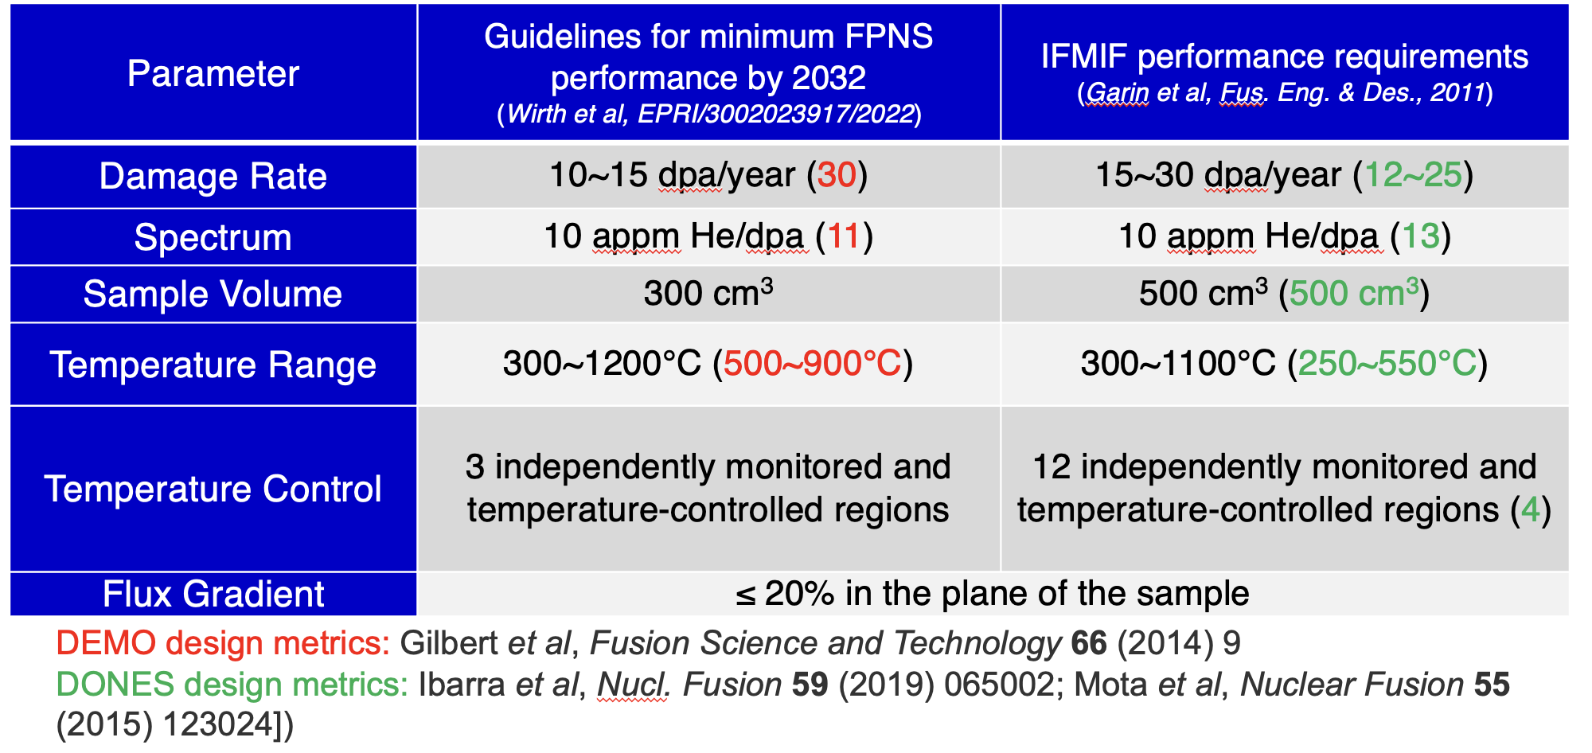
Operational performance requirements of FPNS relative to IFMIF (Fe equivalent)

Slide 24
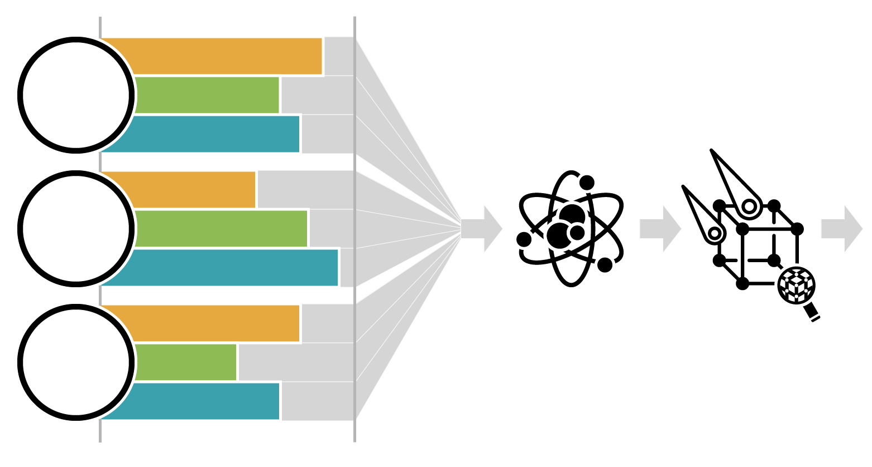
Broad community evaluation of concepts submitted to RFI on FPNS has been completed
Fusion Prototypic Neutron Source Concept Maturation
Fusion Materials Testing and Qualification
Concept A
Simulates
fusion
conditions
Concept B
Fusion Energy
Concept C
Concept A
Meets performance requirements
Concept B
Concept C
Concept A
Technology
is mature
Concept B
13 university, private industry, and national lab participants are working with every concept proposer to understand the merits.
Final report completed and submitted to DOE in April 2025
Concept C
Less
More
16 concepts submitted
(13 other concepts not pictured)
Notes:
Participants:
ORNL, LANL, PNNL, BNL, General Atomics, UTK, MIT, Stony Brook, UCLA, Univ of Wisconsin, PPPL, JLab, CATF
Institutions engaged:
Astral Systems, Focused Energy, IFMIF-DONES, LANL, LBNL, LLNL, MIT, NIFS, ORNL, PPPL, Realta Fusion, Shine Technologies, SLAC, UC-Berkley/LBNL, USNRL

Slide 25
FPNS RRA organizational structure
SSC
Oversight Team
Phil Ferguson
Arnie Lumsdaine
Brian Wirth
James White
Fusion Conditions (FCC)
Jaime Marian
Performance Requirements (PRC)
Eric Pitcher
Systems Studies (SSC)
Sara Ferry
Brian Grierson
Maturity Evaluation
Sehila Gonzalez
Arnie Lumsdaine
Rajesh Maingi
Jacob Schwartz
Jackson Williams
Particle Acceleration
Stuart Henderson
Christian Baumgarten
John Galambos
Cameron Geddes
Peter Ostroumov
Yutai Katoh
Ethan Peterson
Lance Snead
Wahyu Setyawan
Jason Trelewicz
Brian Wirth
Ying Yang
Weicheng Zhong
Tim Bohm
Granz Gallmeier
Evaluate technical maturity of proposed FPNS concept
FPNS
Risk Reduction Activity
Assess the prototypicality of neutron spectra relative to fusion device spectra
Computational/neutronic assessment of concept’s ability to meet RFI requirements
(e.g., dpa rate)
PRC
FCC
In addition to the complete report, each subcommittee wrote a report with significantly more detailed information.
Notes:
Highly experienced and well respected leaders in field. Estimate over 400 years of technical experience represented
PRC – technical standpoint (fluence, volume)
SSC – two sub-committees
Maturity – TRL (consideration of risk to reach performance parameters)
Particle accelerations – linac vs. cyclotron, different ion sources, low E acceleration
Integrated rather than linear approach

Slide 26
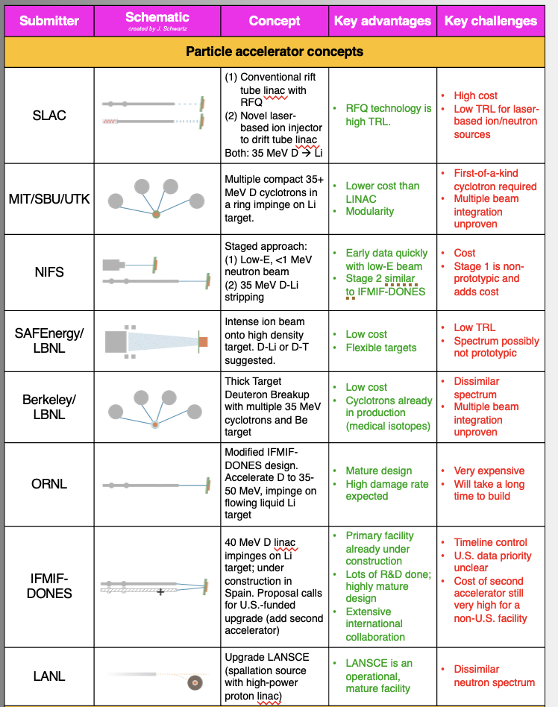
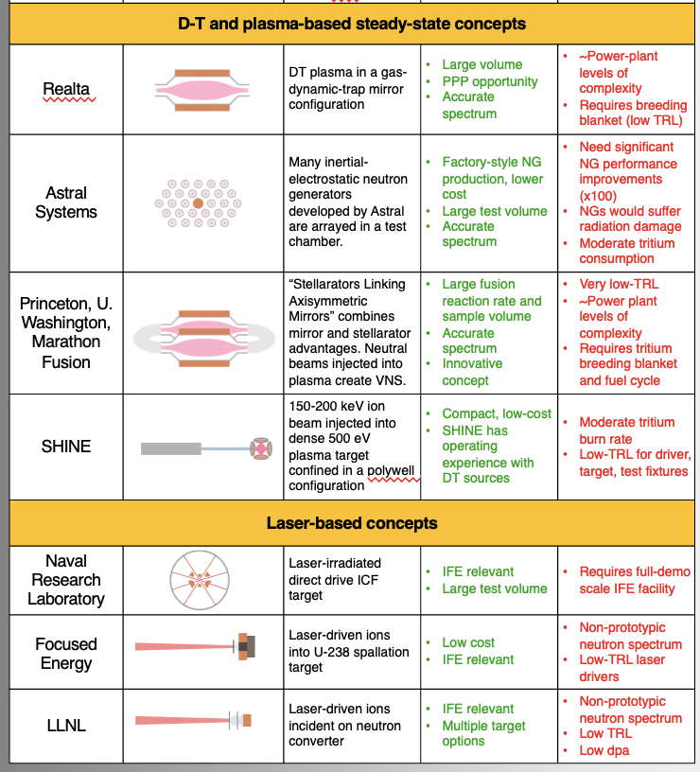
U.S. FPNS Concepts
Notes:
I might be inclined to crop out the submitter column

Slide 27
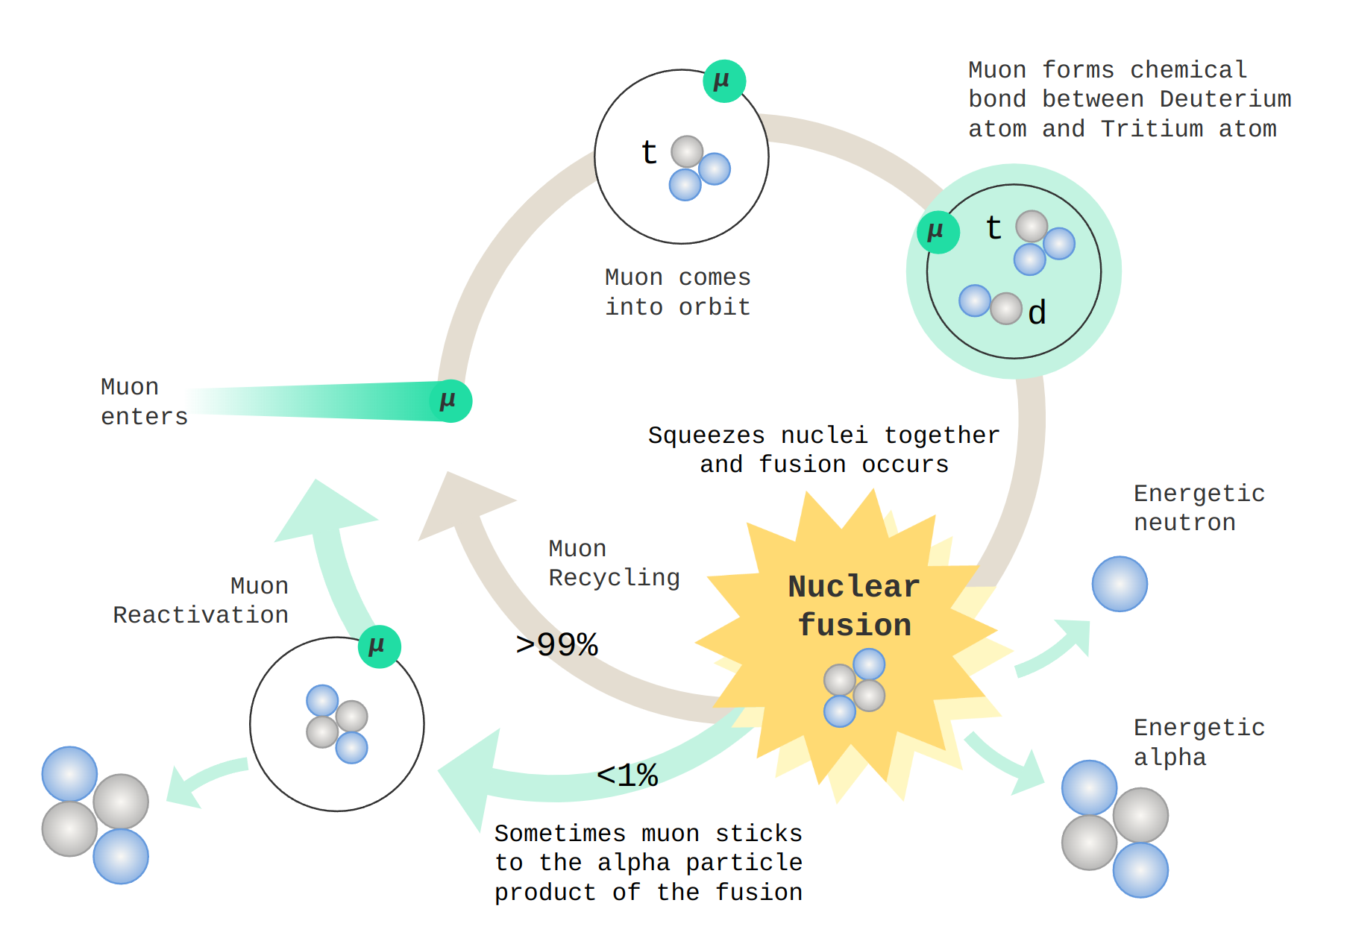
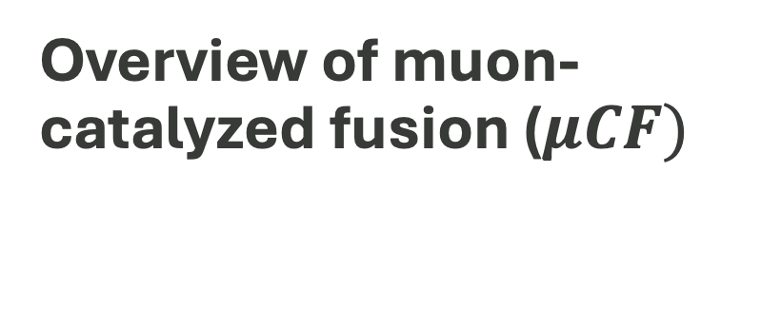
Overview of muon-catalyzed fusion ($μCF)$
No inertial/magnetic confined plasma needed
Discovered in 1956 by Alvarez (Phys. Rev. 105, 1957)
Muonic atom capture: smaller Bohr radius of muonic deuterium/tritium due to the muon mass (~207×m_{e})
(dd)_{µ} , (dt)_{µ} , (tt)_{µ} muonic molecules: Large wavefunction overlap due to small Bohr radius → Increased probability for fusion
Fusion event releases Muon ~99% of the time, enabling the cycle to repeat (catalysis)
A single muon can generate from 150 to 300 fusions before decaying
Figure courtesy of Acceleron
Notes:
Add credit

Slide 28

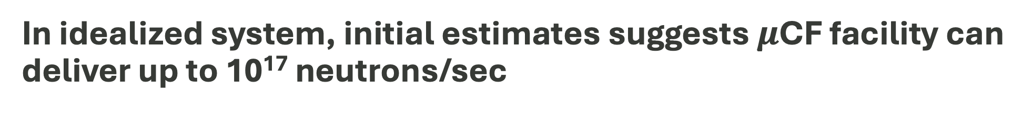
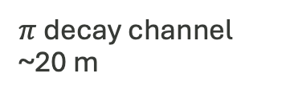


In idealized system, initial estimates suggests $μ$CF facility can deliver up to 10¹⁷ neutrons/sec
 | Beam Power (kW) | Beam Energy / muon (GeV) | uCF cycles | D-T Fusion Neutron Rate (s⁻¹)
Low-End Estimate | 100 | 10 | 100 | 6x10¹⁵
High-End Estimate | 300 | 3 | 300 | 2x10¹⁷
14.1 MeV
neutrons
$$π→μ$$
Capture Solenoid
Muon ionization cooling
Fusion target
$μ$ Target
$$π$$
Proton
Beam
$π$ decay channel
~20 m

Slide 29
$μCF$ facility can approximate VNS neutron flux levels
EU VNS neutron flux levels
IB-FCTF neutron flux requirement
Fusion rate (n/s) | Fusion Power (MW) | r (cm) | L (cm) | Area (m²) | n/cm²-s | Neutron Wall Load (MW/m²)
 |  |  |  |  | ~1x10¹⁴ | <0.5
 | 0.25 |  |  | 0.5 |  | 0.5
3x10¹⁶ | 0.07 | 10 | 20 | 0.13 | 2.3x10¹³ | 0.5
2x10¹⁷ | 0.46 | 10 | 20 | 0.13 | 1.5x10¹⁴ | 3.3
2x10¹⁷ | 0.46 | 25 | 30 | 0.47 | 2.5x10¹³ | 0.54
Inner surface of blanket
Source
r
L
Optimal setup

Slide 30
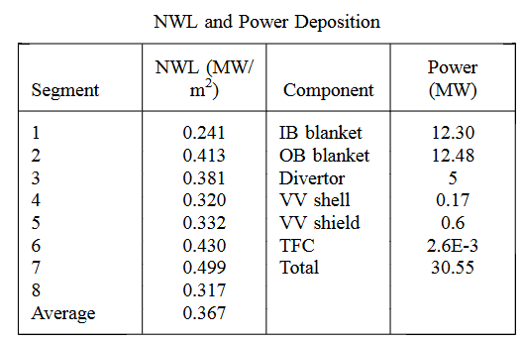
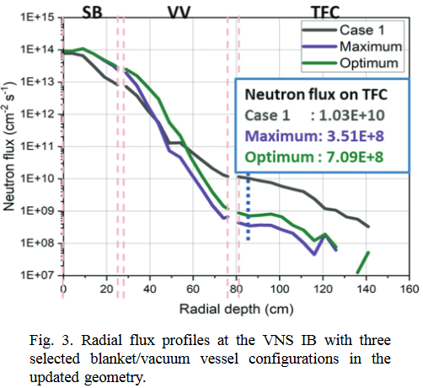
From EU Volumetric Neutron Source Design
D. Leichtle, et al, (2025) Preconceptual Neutronics and Shielding Studies of a Beam-Driven Tokamak Volumetric Neutron Source, Fusion Science and Technology, DOI: 10.1080/15361055.2025.2503680

Slide 31
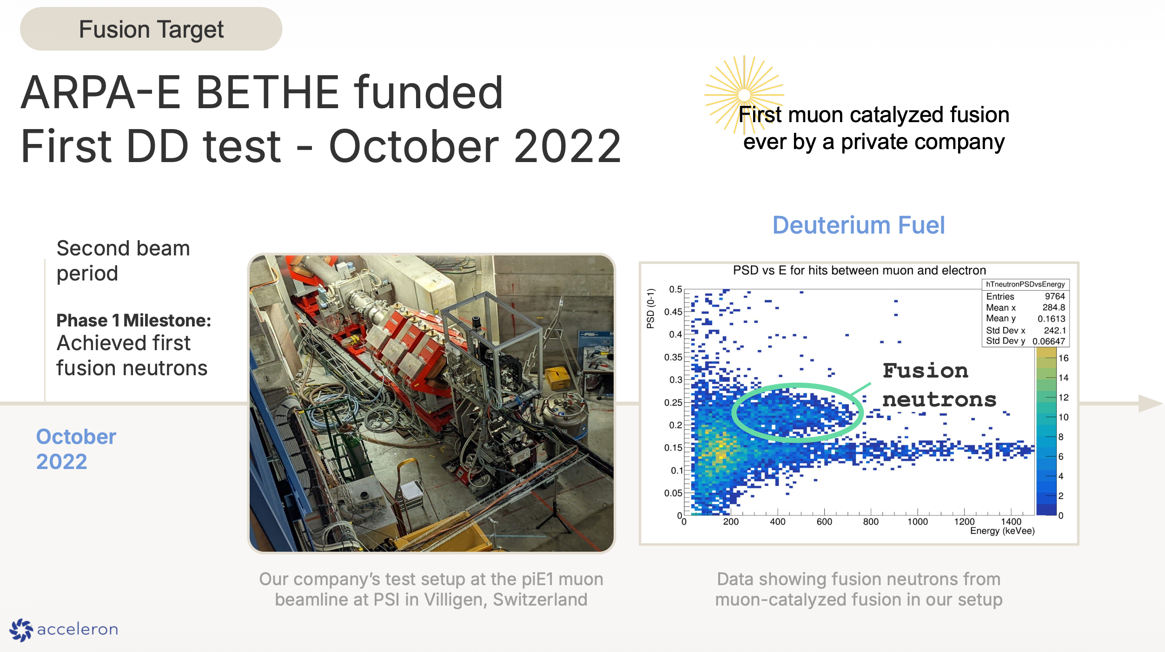
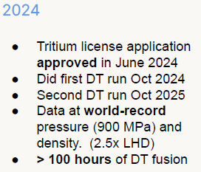
Acceleron Fusion has measured $μCF$ neutrons

Slide 32
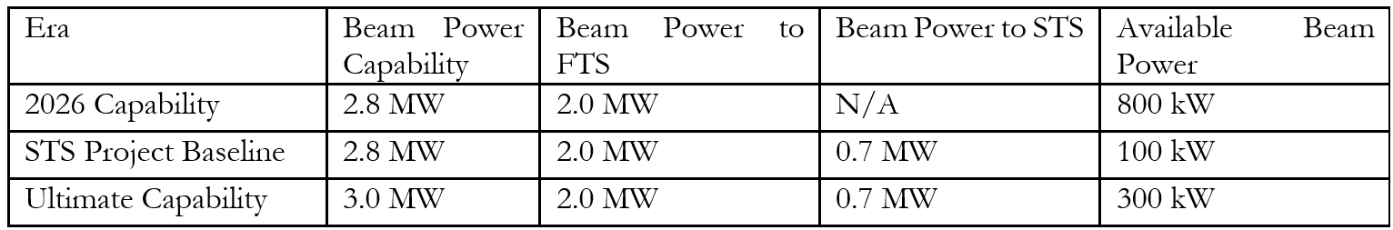
ORNL Spallation Neutron Source has excess beam power – both prior to and subsequent to Second Target Station operations
The SNS facility, originally designed for 1.4 MW, is now operating at 2 MW (milestone achieved on April 23, 2026)
  The accelerator is expected to ramp up to a full beam power of 2.8–3 MW within a few years.
  Since the First Target Station (FTS) has a power limit of 2 MW, an additional 0.8–1 MW of beam power will be available until the Second Target Station (STS) becomes operational in the mid-to-late 2030s.
  After STS completion, 100–300 kW will remain accessible.
This surplus beam power can support a diverse portfolio of applications alongside the primary neutron scattering mission.

Slide 33
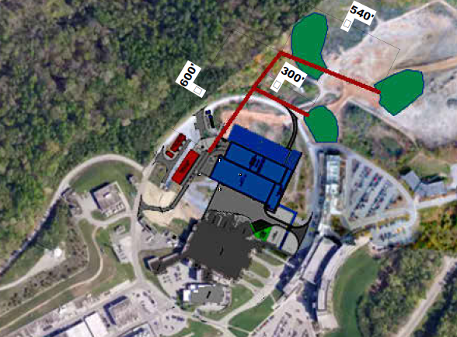
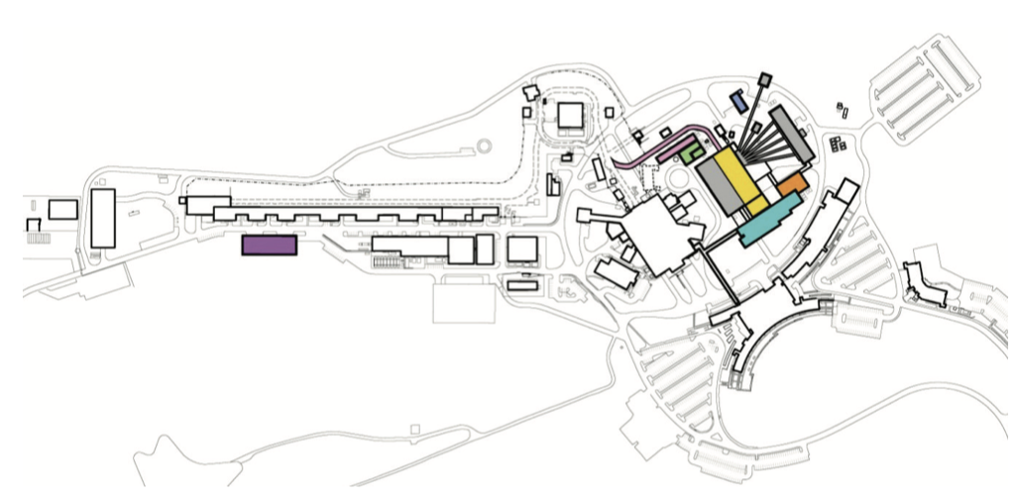
Potential Locations for a $μ$CF-based VNS
Proposed approach would extract a fraction of the SNS proton beam prior to the Second Target Station into a new beamline
Proton beam can then be directed to selected VNS location
100-300 kW even after STS
operations begins
Accumulator Ring
SNS Site Layout
1
Second Target
Station
Potential
VNS sites
First Target
Station
SNS Linac

Slide 34
Next Steps
Target(s) simulation and pre-conceptual design
  Preliminary modeling and simulation of the DT target to determine the muon beam profile necessary to achieve the expected neutron flux output.
  Estimate of the required design of the proton target and beamline components (magnetic lenses, decay pipe, and possibly a muon cooling system) to achieve the desired muon beam profile.
Facility design and scoping
  Estimate of beamline design and integration with existing facility.
  Estimate of neutron shielding requirements: cost, material, and weight.
Validation planning
  Muon beam development at a current accelerator facility.

Slide 35
Technical issues to address
Trade-off between rate and spectral purity to design target diameter and wall thickness
Mechanical design for frequent replacement of wall materials
Design and validation of the cooling system
  Both the muon production target and the μCF cell will produce significant heat fluxes (tens to hundreds of kW) and need to be cooled
  Cooling technology needs to be developed, tested, and then fielded on the accelerator
Design of the muon production target, striking the right balance between size, cost, efficiency, and beam purity for this application
Design of the pion-to-muon conversion and muon beam cooling line
Design of the fusion cell and target chamber
Facility and site planning for 10 to 100 gram quantities of tritium at ORNL
Design for integration with the SNS accelerator.

Slide 36
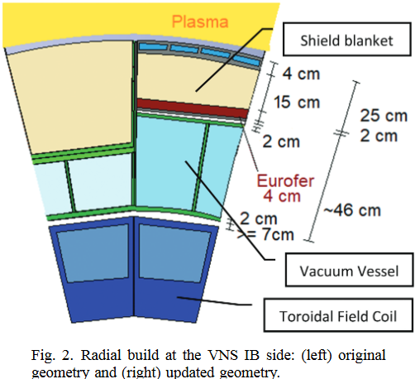
From EU Volumetric Neutron Source Design
D. Leichtle, et al, (2025) Preconceptual Neutronics and Shielding Studies of a Beam-Driven Tokamak Volumetric Neutron Source, Fusion Science and Technology, DOI: 10.1080/15361055.2025.2503680

Slide 37
Key risks for a muon-catalyzed DT fusion source at SNS
Risk Title | Risk Statement | Mitigation in Phase I
Fusion Target cooling | The target will experience a substantial heat load and must be thermally controlled to maintain the fusion yield. | Design and analysis
Shielding | Shielding configurations could be substantial and time consuming to get the necessary approvals. | Design, analysis and discussion with approval authorities
Pion Production Target cooling | The full proton beam power will be dumped into the pion production target, which needs to be removed. | Design and analysis
Muon focusing | After the pions decayed into muons, the muons need to be strongly focused onto the small DT target for highest yield. | Design and analysis, possible verification
Tritium | We must successfully make the regulatory and safety case for handling 10-100 g of tritium; the equipment must pass safety review. | Discussion with safety and regulatory authorities (present in DOE)
First wall lifetime | The lifetime of the target cells in the planned neutron field can be bounded but is not known; the system must be designed for easy/frequent replacement of the target cell. | Design and analysis
DOE multi-program challenges | Multiple programs within the Office of Science must identify complementary goals to work together for the life of the project (construction and operations). | Discussion with relevant authorities, development of agreements

Slide 38
DT neutron source performance
Inner surface of blanket
Source
r
White paper gives range of 6x10¹⁵ n/s to 2x10¹⁷ n/s
  Uses spare beam power from SNS accelerator
  Range of muon production efficiency
  Assumption of fusions per muon
Consider a nominal rate of 3x10¹⁶ n/s
  300 kW beam power
  10 GeV of total beam energy input per muon
  150 fusions/muon
  Isotropic linear source is 1cm x 10cm (diameter x length)
Neutron loads calculated on next slide
L
Optimal setup
Test blanket module
Sources
TBM-like setup

