Slide 1
Muon Ionization Cooling
A path toward high-intensity muon sources and muon colliders
June 10, 2026
Katsuya Yonehara
The New Science and Applications at SNS Workshop

Slide 2
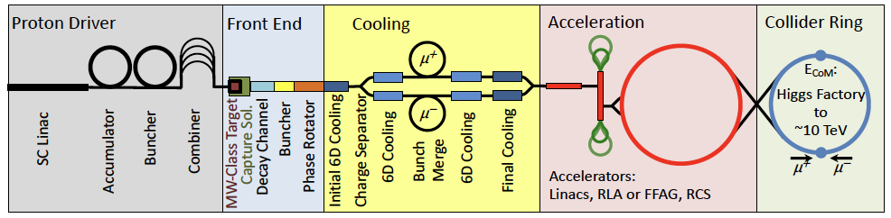
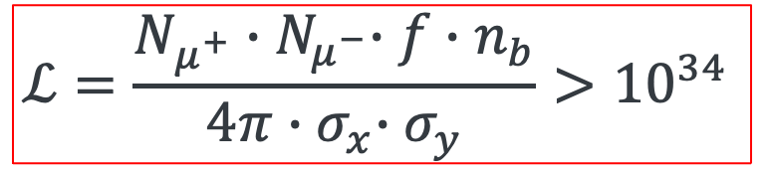
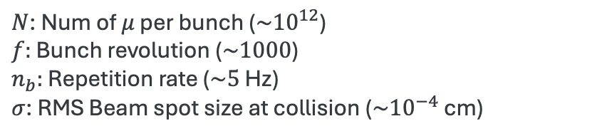
Overview of Muon Collider
Proton beam-based muon collider mainly separates five segments
Accelerator complex performance is determined by luminosity
$$ℒ=\frac{N_{μ^{+}}{∙N}_{μ^{−}}∙f∙n_{b}}{4π{∙σ}_{x}∙σ_{y}}>{10}^{34}$$
$N$: Num of $μ$ per bunch ($\sim {10}^{12}$)
$f:$ Bunch revolution ($\sim 1000$)
$n_{b}:$ Repetition rate ($\sim 5$ Hz)
$σ$: RMS Beam spot size at collision ($\sim {10}^{−4}$ cm)
cm⁻² s⁻¹

Slide 3
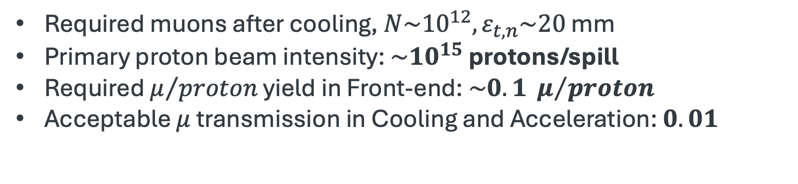
Muon production and cooling requirements
Front End and Cooling are the primary collider performance drivers
Proton beam-based muon collider
Required muons after cooling, $N\sim {10}^{12}, ε_{t,n}\sim 20$ mm
Primary proton beam intensity: $\sim {10}^{15}$ protons/spill
Required $μ/{proton}$ yield in Front-end: $\sim 0.1 μ/{proton}$
Acceptable $μ$ transmission in Cooling and Acceleration: $0.01$

Slide 4
Key Challenges toward a Muon Collider
Blue: Topics discussed in this presentation
Physics & conceptual challenges
  High-intensity muon source with rapid 6-dimensional (6D) cooling
  Multi-MW target systems and collective beam-plasma effects
  Deliverable physics
Accelerator technological challenges
  High field magnets up to 40-50 Tesla
  High gradient RF cavities
  Beam diagnostic and instrumentation
  Rapid cycling accelerator systems/High gradient muon accelerator
  Beam-Induced Background (BIB) mitigation

Slide 5
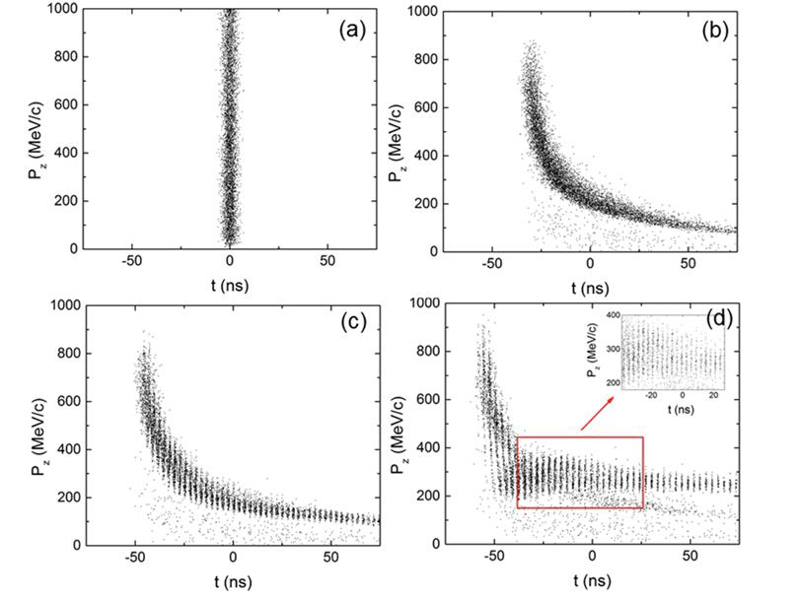
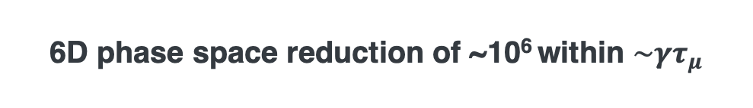
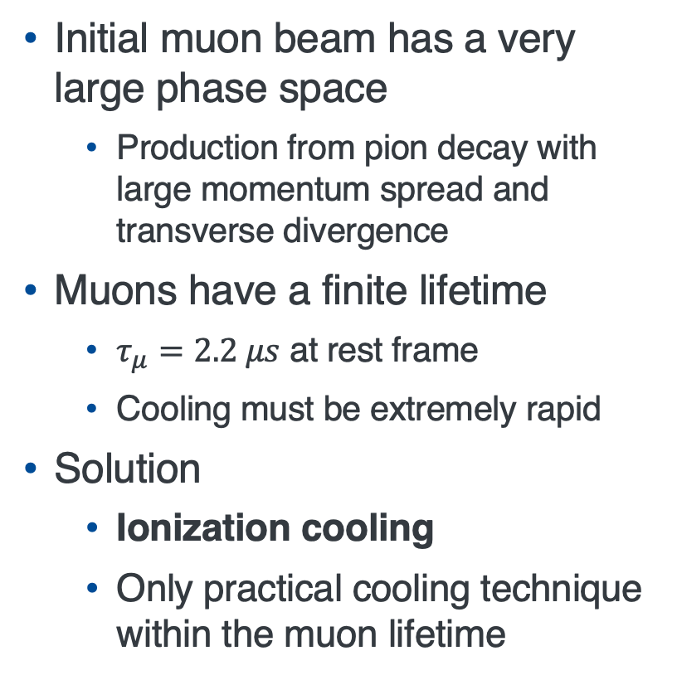
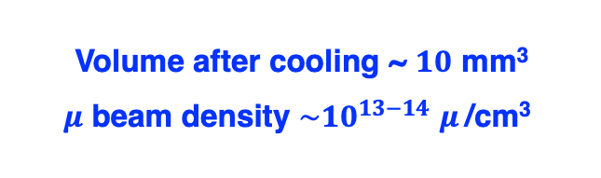
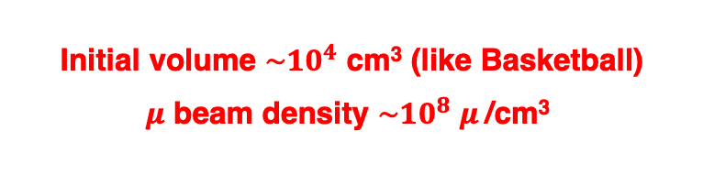
Challenge: Producing an Intense Muon Beam
Front-End beam manipulation
Capture pions and muons in a high-field solenoid
60-m drift section develops energy-time correlation
RF buncher forms 21 bunches
Phase-rotator aligns bunch energies
μ/proton conversion ~10 % achieved
Initial muon beam has a very large phase space
  Production from pion decay with large momentum spread and transverse divergence
Muons have a finite lifetime
  $τ_{μ}=2.2 μs$ at rest frame
  Cooling must be extremely rapid
Solution
  Ionization cooling
  Only practical cooling technique within the muon lifetime
Muon phase space cooling
Initial volume $\sim {10}^{4}$ cm³ (like Basketball)
$μ$ beam density $\sim {10}^{8}$ $μ$/cm³
Volume after cooling ~ $10$ mm³
$μ$ beam density $\sim {10}^{13−14}$ $μ$/cm³
6D phase space reduction of ~10⁶ within $\sim γτ_{μ}$

Slide 6
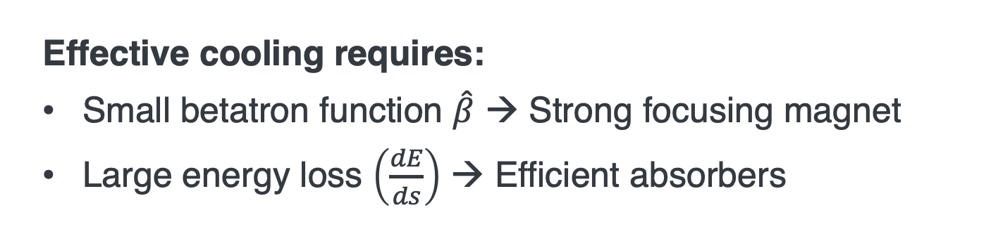
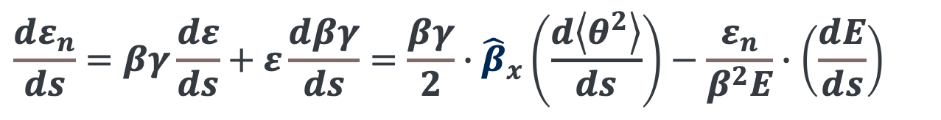
Principle of Ionization Cooling
Ionization cooling reduces beam emittance through energy loss in an absorber, introducing a non-Hamiltonian dissipative process
Betatron function
Stopping Power
$$\frac{dε_{n}}{ds}=βγ\frac{dε}{ds}+ε\frac{dβγ}{ds}=\frac{βγ}{2}∙{\hat{β}}_{x}\left(\frac{d\left\langle θ^{2}\right\rangle }{ds}\right)−\frac{ε_{n}}{β^{2}E}∙\left(\frac{dE}{ds}\right)$$
Heating term
Multiple scattering
Cooling term
Ionization energy loss
Effective cooling requires:
Small betatron function $\hat{β}$ → Strong focusing magnet
Large energy loss $\left(\frac{dE}{ds}\right)$ → Efficient absorbers

Slide 7
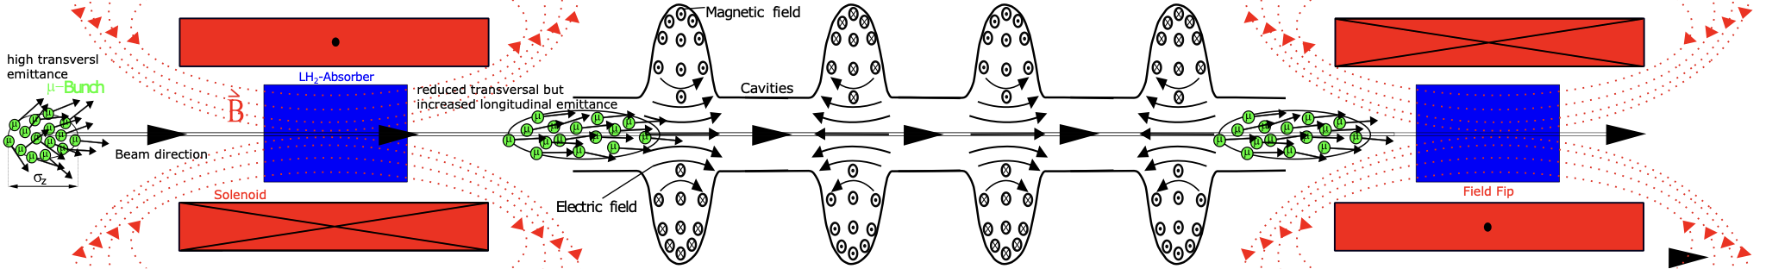
Concept of ionization cooling
High gradient RF
High-gradient RF effectively restores lost energy in the absorber
Maintain beam momentum
High gradient RF enables compact systems
As a result, cavities are immersed in strong magnetic fields
Absorber in strong magnet
Ionization energy loss in absorber
Low beta function enhances cooling
Strong focusing overcomes multiple scattering
Progressive emittance reduction in series of cooling stages
Continue until target emittance is reached

Slide 8
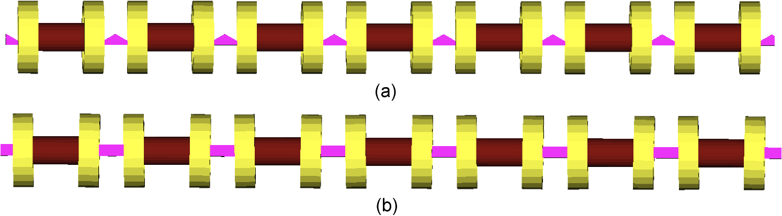
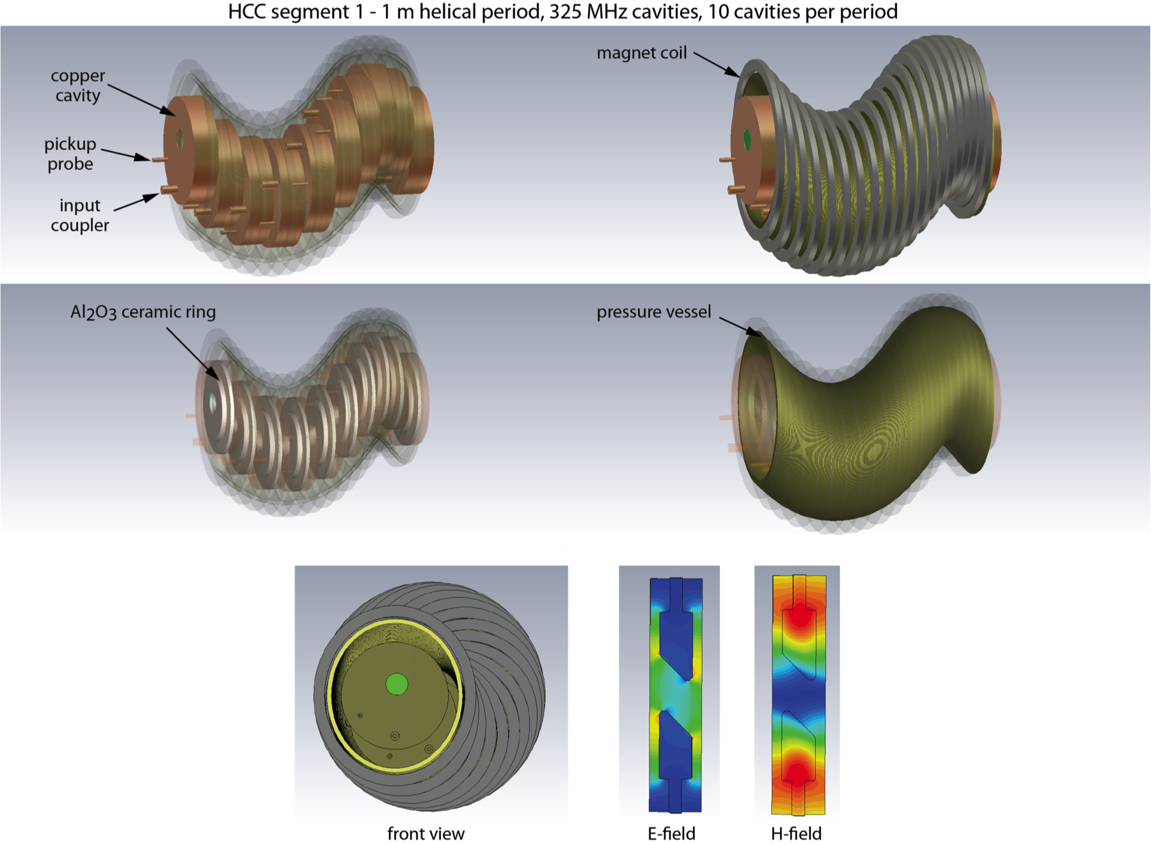
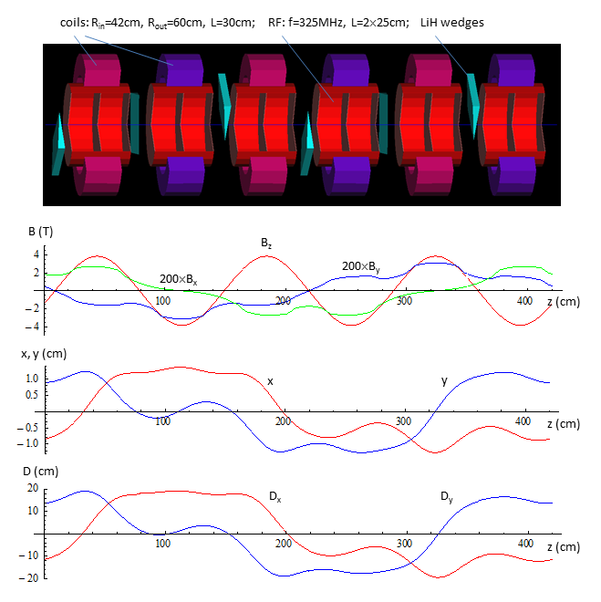
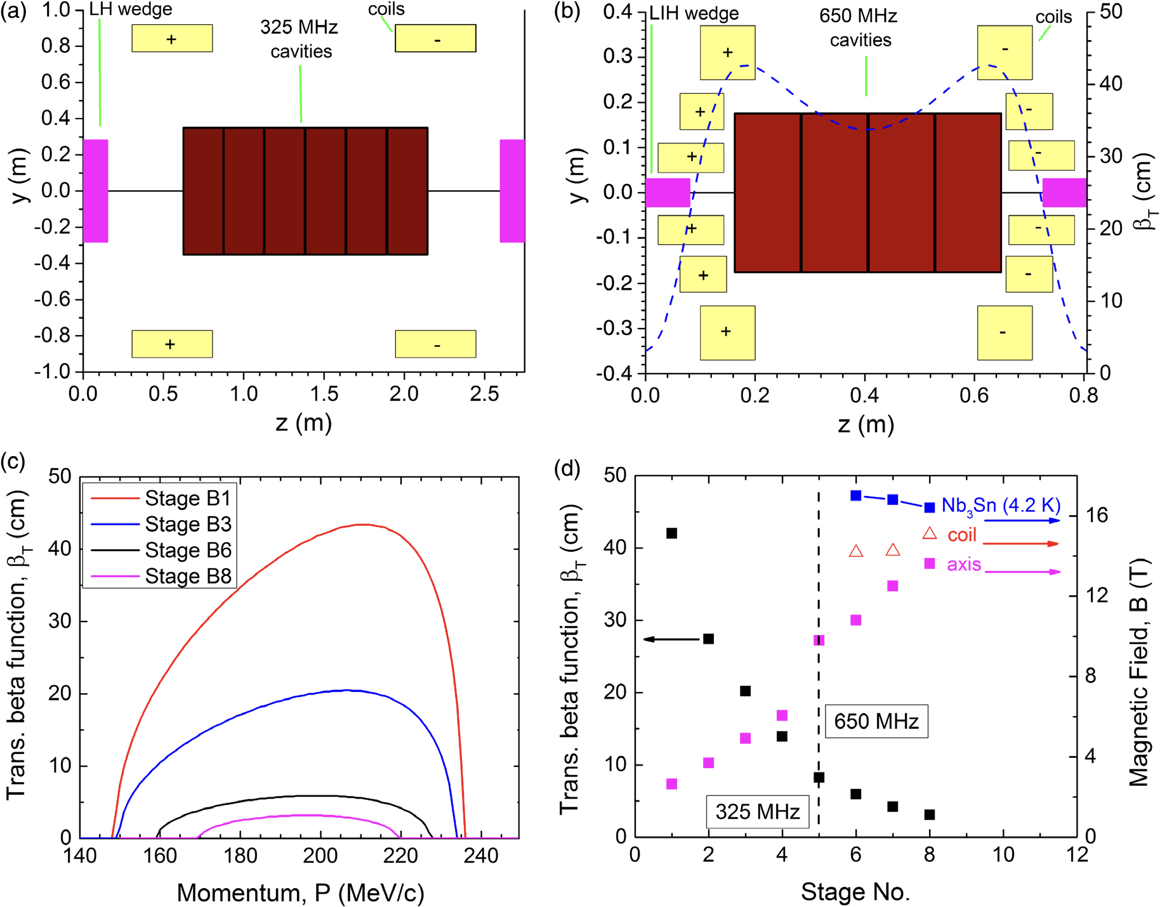
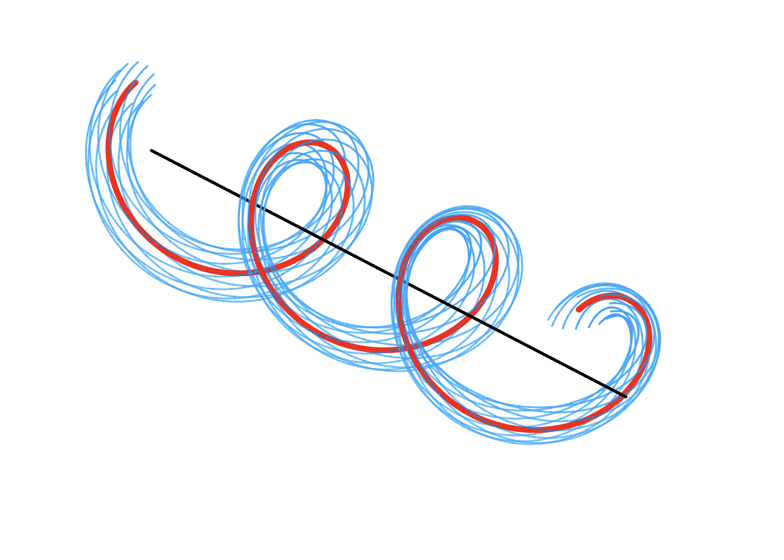

Ionization Cooling Channel Designs
Despite different lattice designs, all concepts require strong magnetic focusing and high-gradient RF systems
Rectilinear Channel (baseline)
3-16 Tesla solenoid on axis
20-30 MV/m RF
Helical FOFO Channel (initial cooling)
4 Tesla solenoid on axis
25 MV/m RF
Simultaneously cooling both $μ^{+}$ and $μ^{−}$
Helical Channel (alternate)
5-12 Tesla solenoid on axis
20 MV/m RF

Slide 9
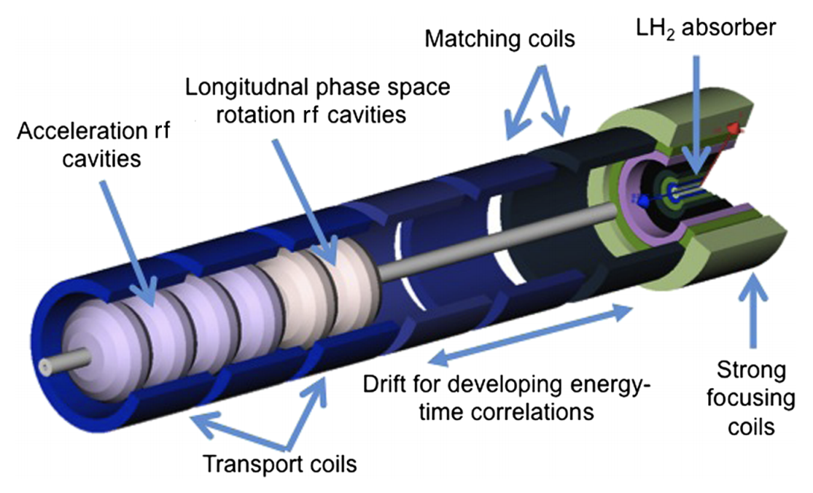
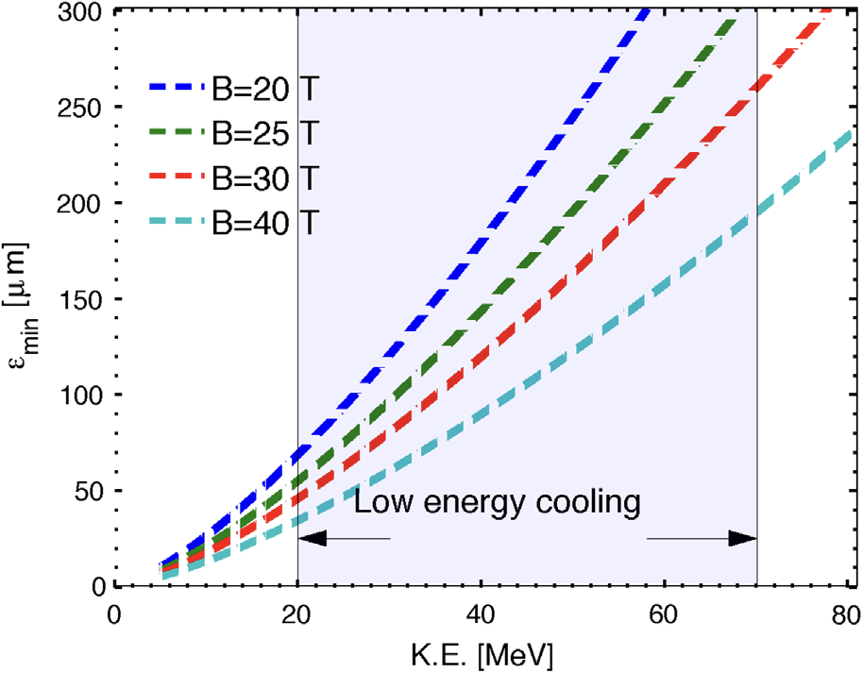
Final Cooling with Ultra-High Magnetic Fields
Operate at low muon kinetic energy (20-70 MeV)
Use ultra-high-field solenoids (40-50 T)
Reach the collider target emittance of 20-25 μm
Recent IMCC studies have significantly improved performance

Slide 10
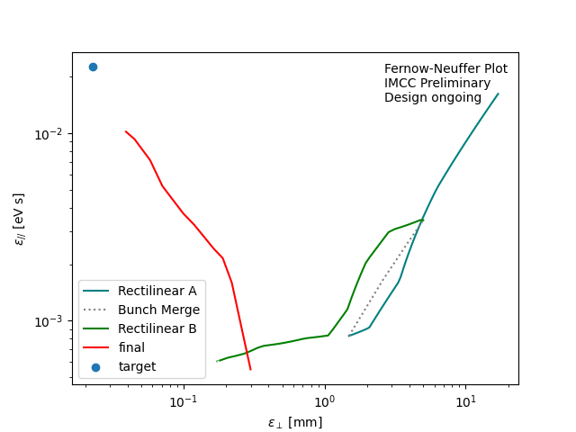
Simulated Cooling Performance (IMCC)
Collider target region
(20 μm, 20 eVs)
Start point (20 mm, 15 eVs)
This is after the Front-End channel
Bunch merge (21 bunches → 1 bunch)
Increase emittance while increasing bunch intensity

Slide 11
Recent development of key cooling components
Muon Cooling R&D is strongly aligned with ongoing developments in high-power targets, HTS magnets, RF systems, and beam instrumentation at intense proton facilities

Slide 12

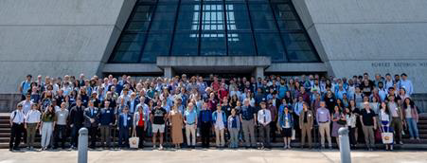
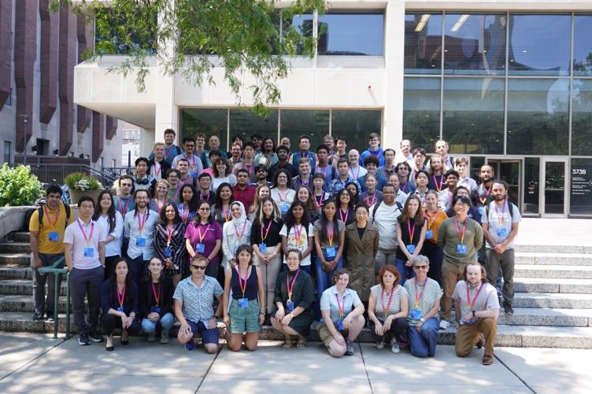
The US Muon Collider Collaboration (USMCC)
Coordinating the US R&D effort toward a future muon collider
Current activities
Develop a technically credible path toward a muon collider
Define R&D priorities for the next decade
Design a muon collider demonstrator
Coordinate U.S. participation in international efforts
Train the next generation of accelerator scientists
USMCC accelerator school
in 2025

Slide 13
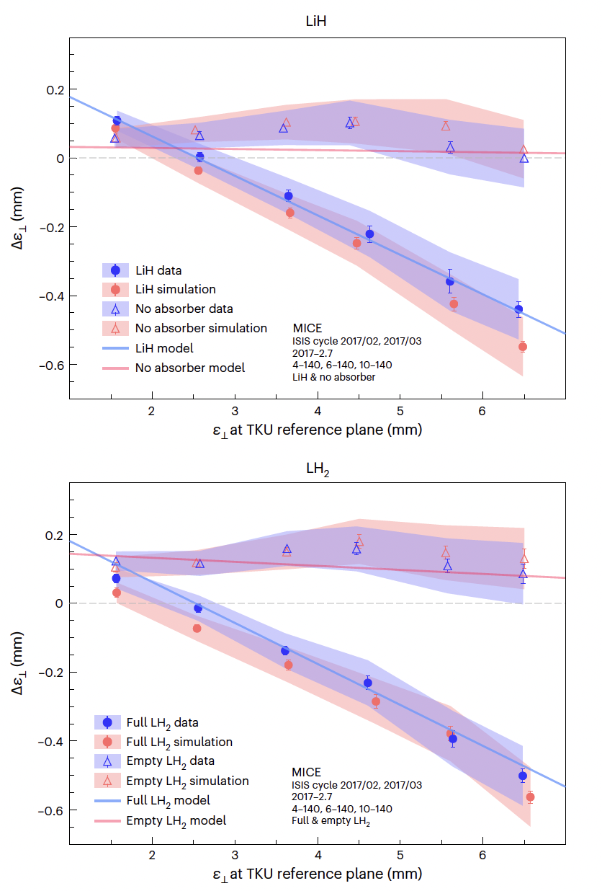
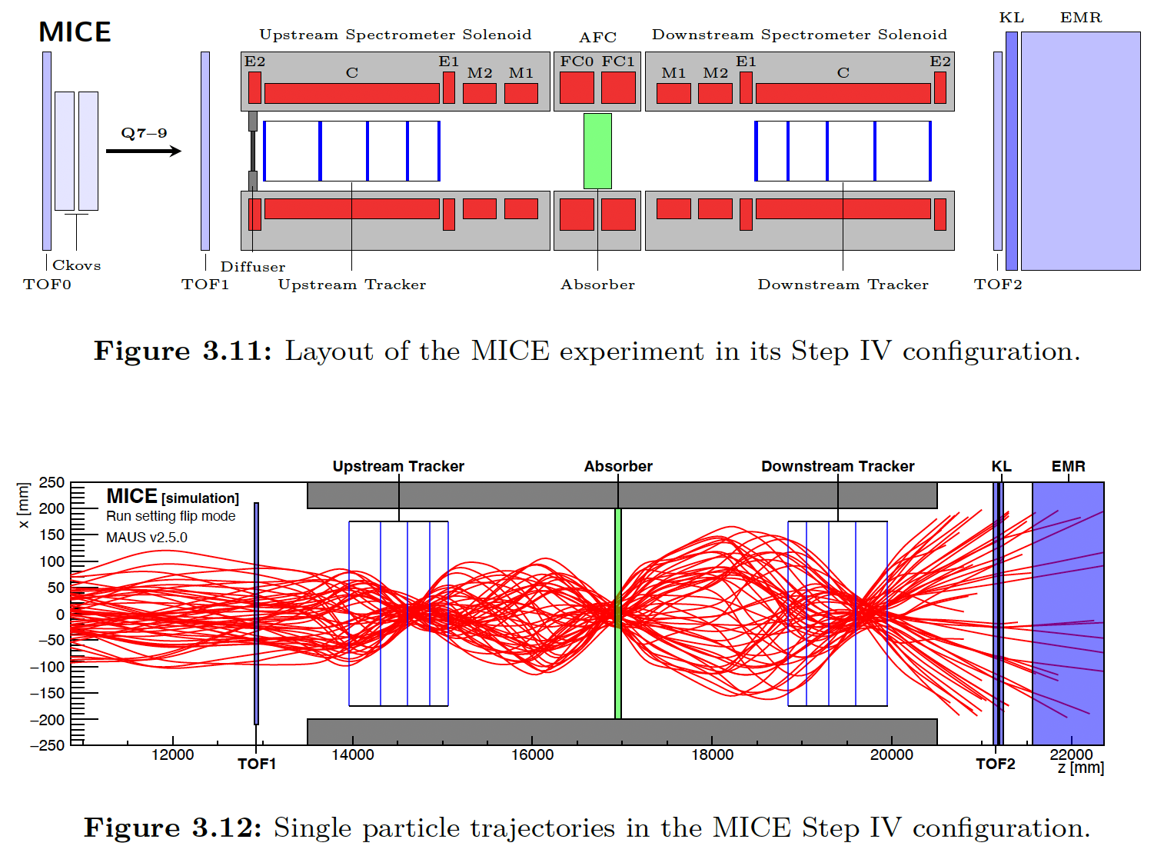
Muon Ionization Cooling Experiment (MICE)
First experimental demonstration of ionization cooling
Validated simulation models of energy loss (energy straggling) and multiple scattering
Measured emittance evolution using single-particle tracking

Slide 14
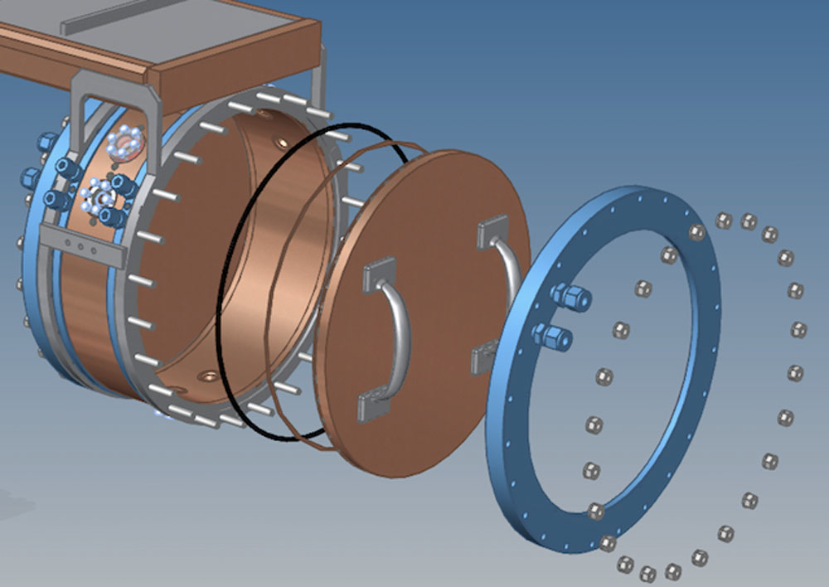
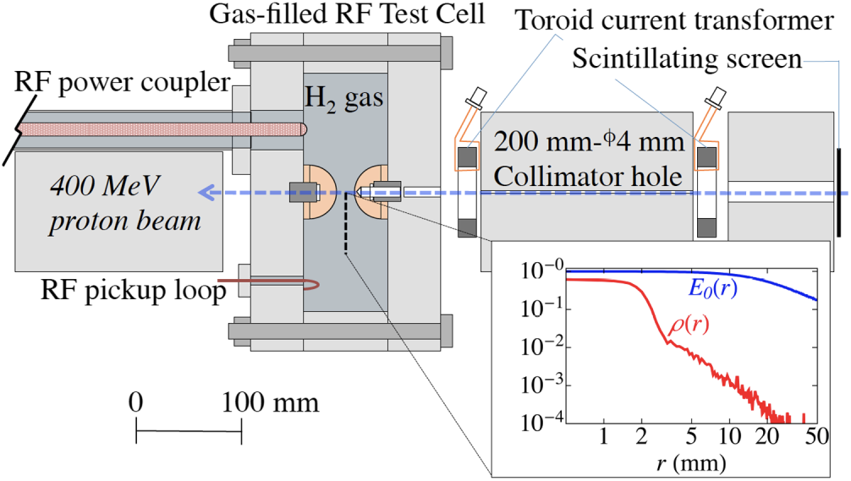
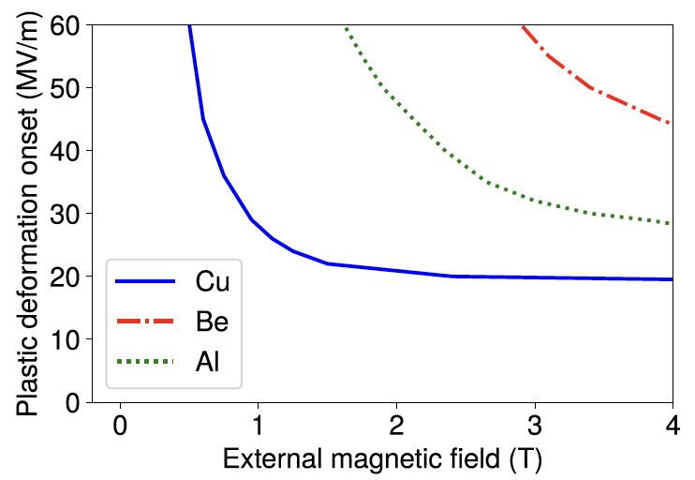
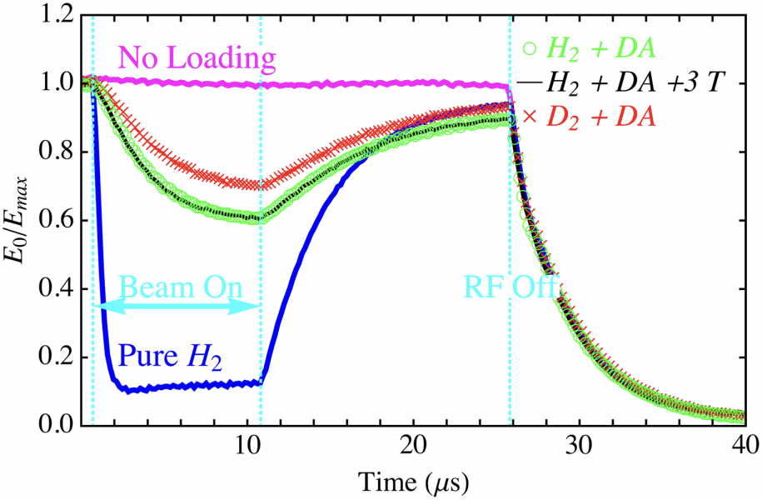
High Gradient RF in strong solenoidal fields
Operating high-gradient RF cavities in strong magnetic fields was a long-standing challenge
Magnetic fields focus dark currents onto cavity surfaces, enhancing electric breakdown (BD)
Beryllium window cavity significantly reduced BD probability
Observed RF envelope
High-pressure H2 gas cavities suppress BD
Plasma loading effects were also characterized

Slide 15
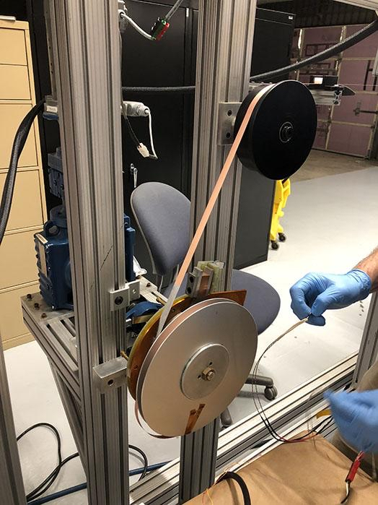
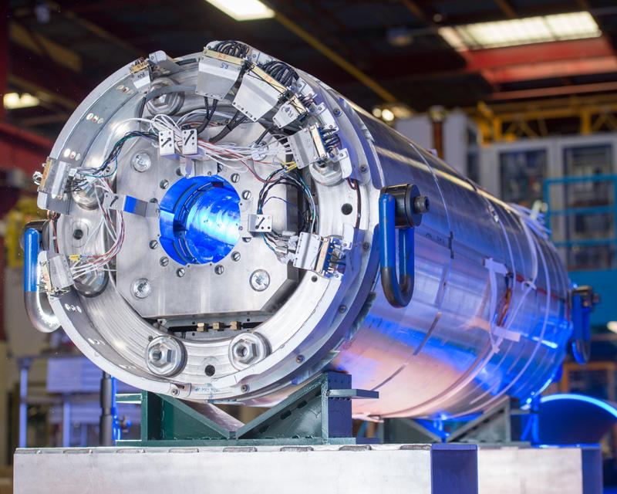
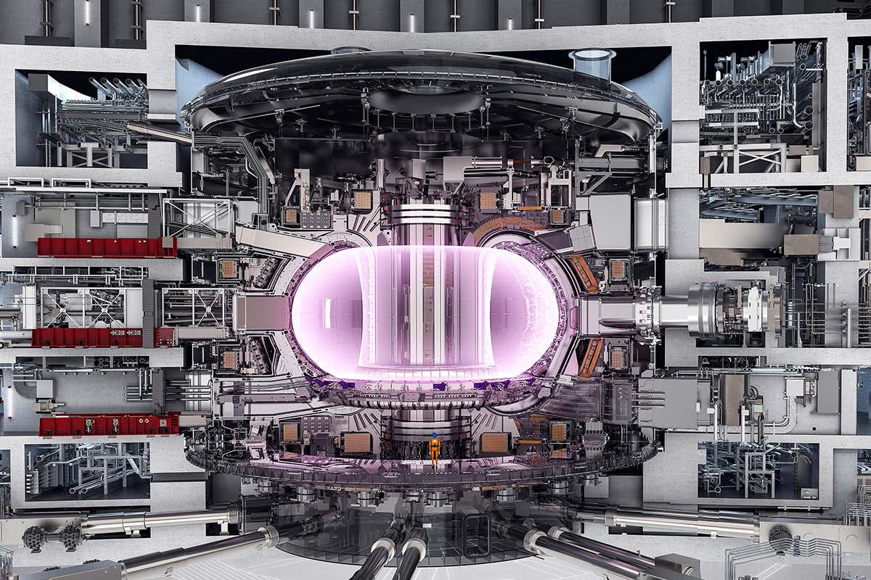
High-field magnet technology for Muon Collider
HTS magnet
Bi-2212: Promising accelerator-magnet conductor
REBCO: FCC and Fusion programs
Hybrid Nb3Sn + HTS concepts under development
HL LHC Quad
Nb3Sn
150 mm aperture
Peak field on conductor 11.4-11.6 Tesla
ITER central solenoid
13 Tesla
18 m height and 4.3 m diameter
Demonstrates large-scale high-field magnet technology
Toroidal field
Magnetic field in the TF winding 12 Tesla
Magnetic field at the plasma center: 5.3 Tesla

Slide 16
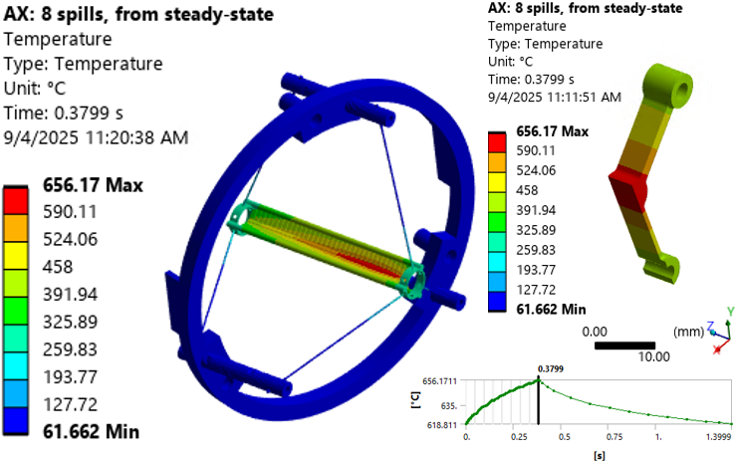
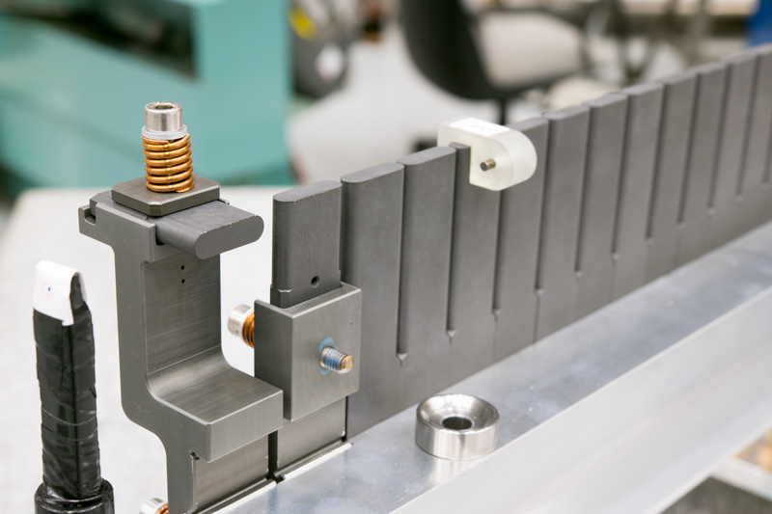
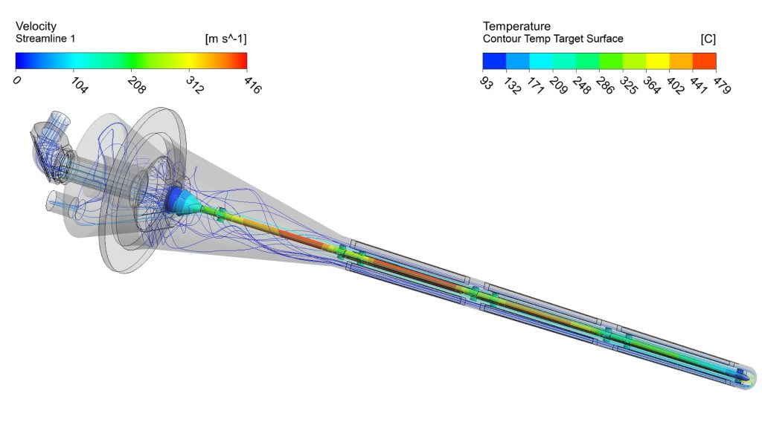
High power target systems for intense muon sources
NuMI target
1.2-m long Graphite fin target
Operates above 1 MW beam power
Segmented fins mitigate thermal stress
Mu2e Target
Tungsten WL10 or Inconel718
220 mm long
Operate inside a 5-Tesla solenoidal magnet
Radiation cooled
Up to 8 kW beam power
LBNF target
1.5-m long Graphite (4 segments)
Designed for 1.2 MW beam power operation
Helium cooling system
Upgrade to 2.4 MW

Slide 17
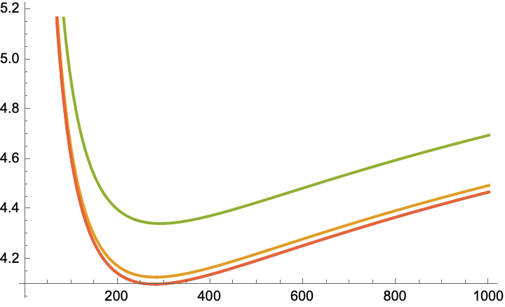

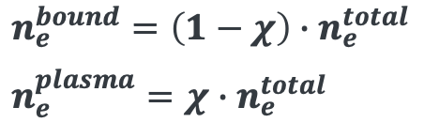

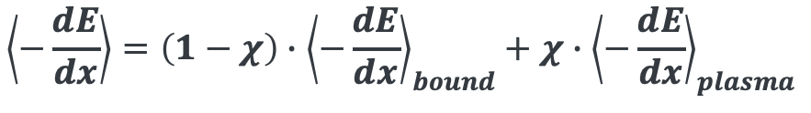

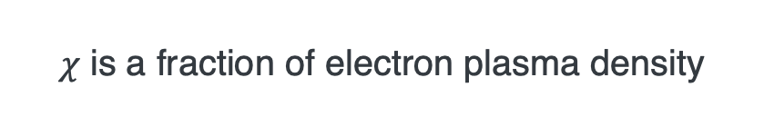
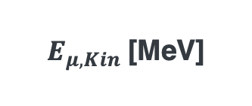
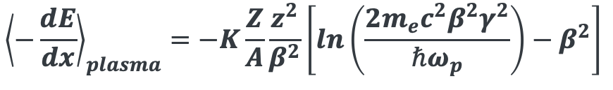
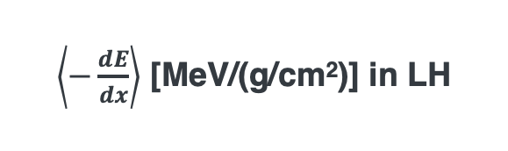
Potential Beam-Plasma Modification of Stopping Power
Beam induced plasma with High-density muon and primary proton beams in matter potentially modifying the stopping power
Experimentally validate
S. N. Chen, Nature 8:14586
$χ$ is a fraction of electron plasma density
$\left\langle −\frac{dE}{dx}\right\rangle$ [MeV/(g/cm²)] in LH
$$n_{e}^{bound}=\left(1−χ\right)∙n_{e}^{total}$$
$$n_{e}^{plasma}=χ∙n_{e}^{total}$$
Modified stopping power formula
$$\left\langle −\frac{dE}{dx}\right\rangle =\left(1−χ\right)∙{\left\langle −\frac{dE}{dx}\right\rangle }_{bound}+χ∙{\left\langle −\frac{dE}{dx}\right\rangle }_{plasma}$$
$$χ=0.1$$
$${\left\langle −\frac{dE}{dx}\right\rangle }_{plasma}=−K\frac{Z}{A}\frac{z^{2}}{β^{2}}\left[ln\left(\frac{2m_{e}c^{2}β^{2}γ^{2}}{ℏω_{p}}\right)−β^{2}\right]$$
$$χ=0.01$$
$χ=1$e-7
$E_{μ, Kin}$[MeV]
Enhanced stopping power could potentially improve cooling performance
This effect is not included in present cooling-channel designs and represents a possible future R&D direction

Slide 18
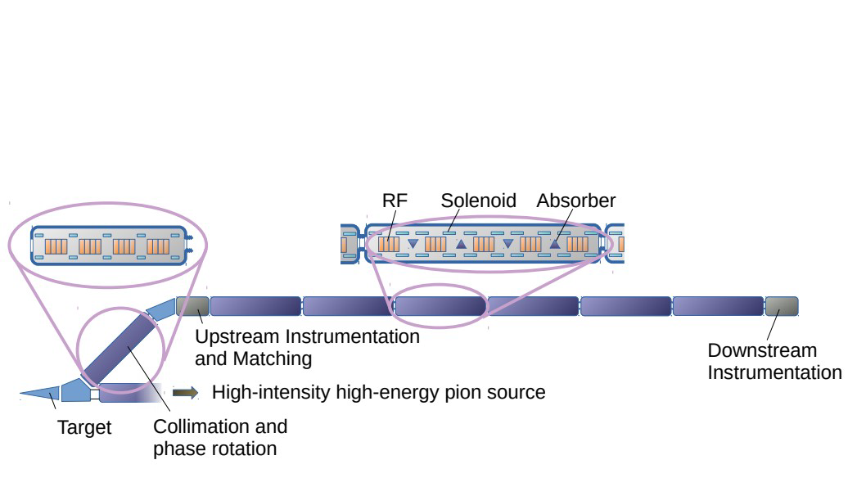
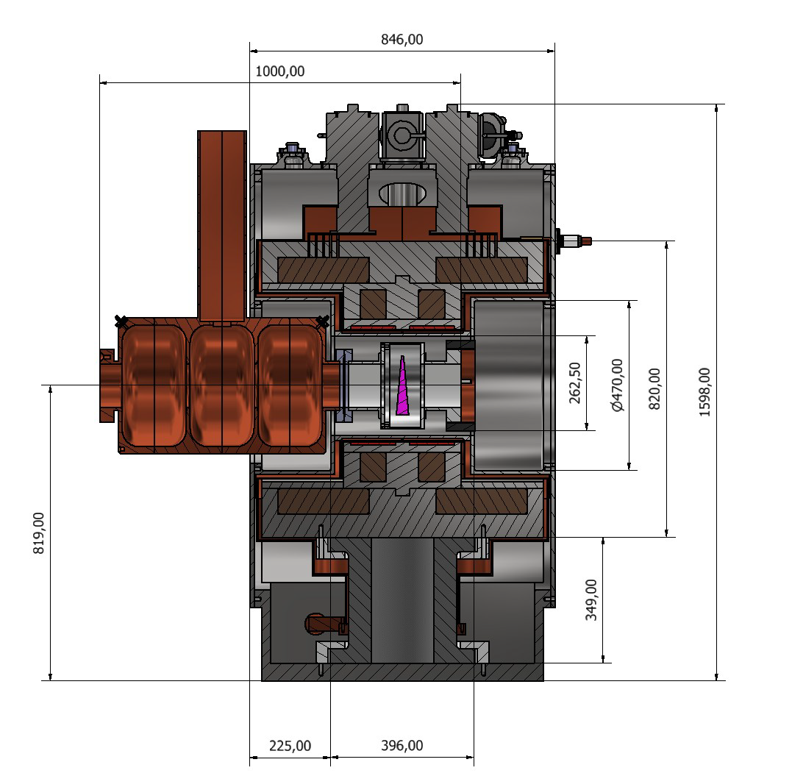
Next Step Beyond MICE: An Integrated Cooling Demonstrator
IMCC design demo channel
Several important issues remain unsolved from MICE
Demonstrate longitudinal cooling and emittance exchange
  Demonstrate full function cooling channel
Beam operation and optics matching
  Beam instrumentation, feedback, and optics matching control
Intensity effect
  How closely can the demonstrator reproduce collider-relevant beam conditions?

Slide 19
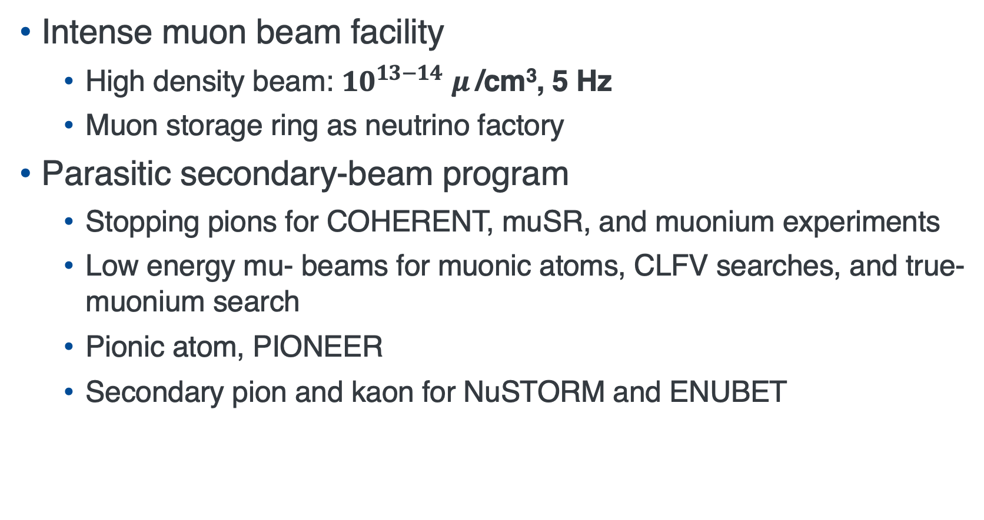
Physics Opportunities Enabled by an Intense Muon Source
Intense muon beam facility
  High density beam: ${10}^{13−14}$ $μ$/cm³, 5 Hz
  Muon storage ring as neutrino factory
Parasitic secondary-beam program
  Stopping pions for COHERENT, muSR, and muonium experiments
  Low energy mu- beams for muonic atoms, CLFV searches, and true-muonium search
  Pionic atom, PIONEER
  Secondary pion and kaon for NuSTORM and ENUBET

Slide 20
Future Directions and Opportunities
Sustain critical muon collider R&D activities
  Operate effectively within constrained funding environments
  Collaborate with IMCC
  Train the next generation of accelerator scientists
Synergistic R&D
  Strengthen collaboration with present HEP high-power target programs
  Leverage developments in beam diagnostics from HL-LHC & LBNF/DUNE
Explore next-generation muon source concepts
  Ultracold muon source concepts demonstrated at J-PARC

Slide 21
Summary
Ionization cooling is a viable path toward a muon collider
  MICE experimentally demonstrated the cooling principle
  Cooling-channel designs achieve collider-scale emittance in simulations
Key technologies are rapidly advancing
  High-gradient RF operation in strong magnetic fields has been demonstrated
  High-field HTS magnets are being developed
  High-power target systems provide a strong foundation for future muon sources
A cooling demonstrator is the next critical milestone
  Validate an integrated cooling channel
  Benchmark simulations and operational concepts
  Enable future intense muon facilities and a muon collider
Train the next generation of accelerator scientists
  USMCC will host accelerator school in summer 2026, please contact the USMCC organizing committee for details

Slide 23
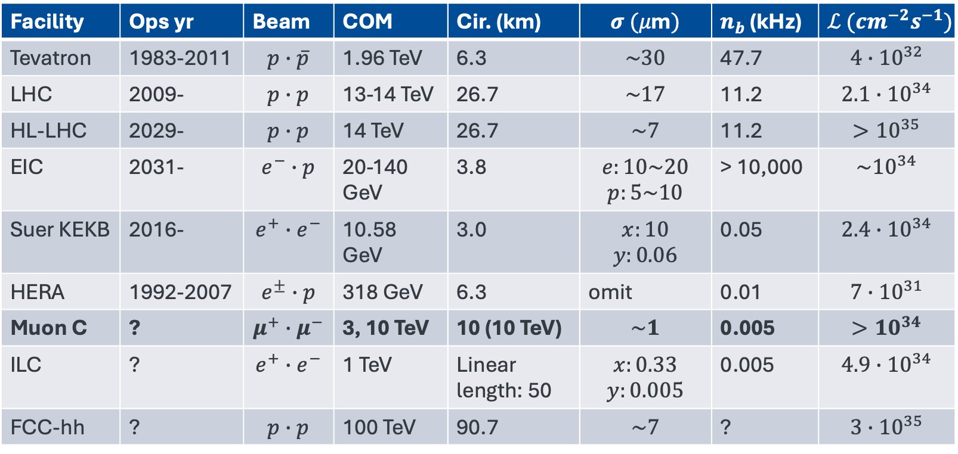
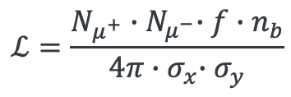
Collider Luminosities
$$ℒ=\frac{N_{μ^{+}}{∙N}_{μ^{−}}∙f∙n_{b}}{4π{∙σ}_{x}∙σ_{y}}$$
At the present time
Facility | Ops yr | Beam | COM | Cir. (km) | $$σ (μ\text{m})$$ | $n_{b}$ (kHz) | $$ℒ ({cm}^{−2}s^{−1})$$
Tevatron | 1983-2011 | $$p∙\overline{p}$$ | 1.96 TeV | 6.3 | $$\sim 30$$ | 47.7 | $${4∙10}^{32}$$
LHC | 2009- | $$p∙p$$ | 13-14 TeV | 26.7 | $$\sim 17$$ | 11.2 | $$2.1∙{10}^{34}$$
HL-LHC | 2029- | $$p∙p$$ | 14 TeV | 26.7 | $$\sim 7$$ | 11.2 | $${>10}^{35}$$
EIC | 2031- | $$e^{−}∙p$$ | 20-140 GeV | 3.8 | $$e:10\sim 20$$ $$p:5\sim 10$$ | > 10,000 | $${\sim 10}^{34}$$
Suer KEKB | 2016- | $$e^{+}∙e^{−}$$ | 10.58 GeV | 3.0 | $$x:10$$ $$y:0.06$$ | 0.05 | $${2.4∙10}^{34}$$
HERA | 1992-2007 | $$e^{±}∙p$$ | 318 GeV | 6.3 | omit | 0.01 | $${7∙10}^{31}$$
Muon C | ? | $$μ^{+}∙μ^{−}$$ | 3, 10 TeV | 10 (10 TeV) | $$\sim 1$$ | 0.005 | $${>10}^{34}$$
ILC | ? | $$e^{+}∙e^{−}$$ | 1 TeV | Linear length: 50 | $$x:0.33$$ $$y:0.005$$ | 0.005 | $$4.9∙{10}^{34}$$
FCC-hh | ? | $$p∙p$$ | 100 TeV | 90.7 | $$\sim 7$$ | ? | $$3∙{10}^{35}$$

