Slide 1
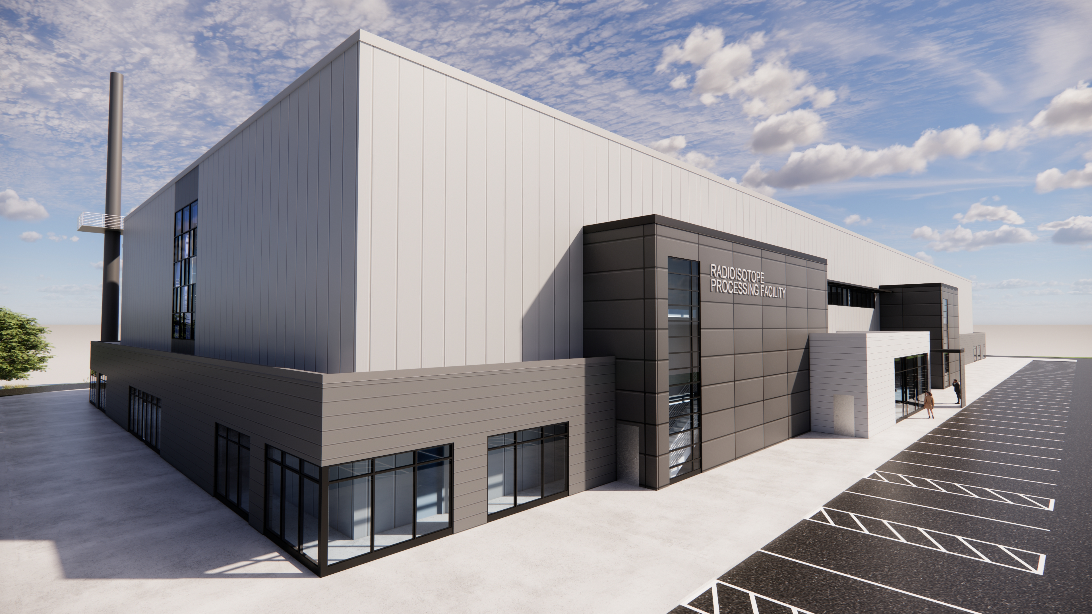
Radioisotope Processing Facility
Oak Ridge National Laboratory
Bryan Leber
RPF Project Director
Controlled by: UT-Battelle
CUI Category(ies): PROPIN
Distribution/Limited Dissemination Control: none
POC: Bryan Leber, (832) 312-9716
Notes:
Accessing Title Slide Options
The standard ORNL presentation template includes five branded title slide layouts:
Title | Standard. The preferred layout for lab-wide and general presentations. Features a default aerial photograph of the lab.
Title | Custom Image. Allows replacement of the default background with a custom full-slide image (16:9 or 4:3 landscape format).
Title | Custom Portrait Image. Supports inclusion of a custom 4:3 portrait image positioned next to the introductory text.
Title | Custom Landscape Image. Supports inclusion of a custom 16:9 landscape image positioned next to the introductory text.
Title | Text Only. Offers additional space for longer titles and multiple presenters.
Additional Lab-approved title slides specific to directorates and user facilities are available in PowerPoint under the following folders: Custom Title Slides and User Facility Templates, located in Presentation Templates.
Custom Title Slide Guidelines
Image Rights. Any custom images, graphics, or photography must be owned by ORNL or used with documented permission from the original creator or source.
Appropriate Image Use. Select images that work well with the layout. Ensure the focal point of the image is not obscured by the title text and white overlay box.
Relevance and Impact. Visuals are a key element of effective communication. Whenever possible, use imagery that enhances the message of your presentation and reflects ORNL’s mission and values.
Quality and Clarity. Use high-resolution images for clarity on large screens. Avoid overly complex or dark images that may conflict with the title text.
Text-Only Option. If no appropriate or approved imagery is available, or if imagery is not permitted for the subject matter, the Title | Text Only layout provides a clean, professional alternative.
Learn more about ORNL presentations
https://ornl.sharepoint.com/sites/Branding/SitePages/Presentations.aspx

Slide 2






Radioisotope Processing Facility Overview Agenda
Value and benefit
to our nation
Partnership & Collaboration
What is the Radioisotope Processing Facility (RPF)?
Where will RPF be built?
Project Timeline
Design and Construction approach IAW DOE 413.3b & NQA-1

Slide 3
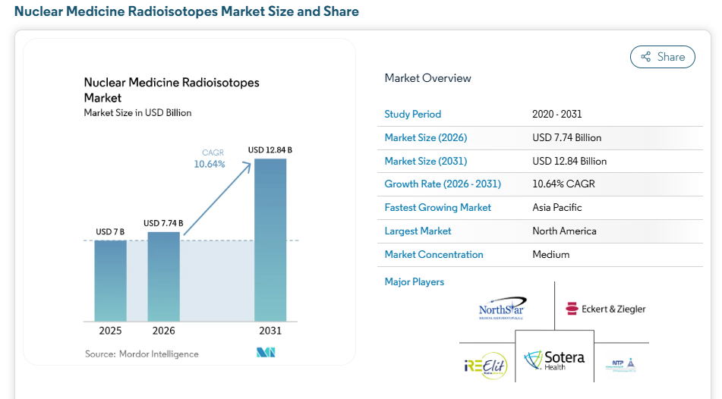
Market size for medical radioisotopes expected to double in the next five years
Mordor Intelligence Report:
Global Nuclear Medicine Radioisotope Market

Slide 4
The need for a processing capability free from foreign dependency has been an identified gap for approximately a decade
Nuclear Science Advisory Committee Isotope (NSAC-I) subcommittee, Meeting Isotope Needs and Capturing Opportunities for the Future: The 2015 Long Range Plan For the DOE-NP Isotope Program,
July 2015
2019: Biennial science and technology review of the Oak Ridge National Laboratory (ORNL) Radioisotope Portfolio
2020: ORNL Assessment of Short-Term Strategies for Increased Radioisotope Production
“Many very important isotopes for which the U.S. is dependent on foreign supply”
“a domestic capability to produce (will) act as a hedge against possible disruption”
“… complete assessment of potential short-term solutions to add processing capabilities within the DOE Isotope Program”
“If the DOE Isotope Program requires [priority foreign produced] isotopes to be produced at ORNL, ORNL would need a new radiochemical processing facility.”

Slide 5

RPF Supports our Nation’s Isotope Vision
“To establish the United States as the world’s undisputed leader in isotope science and production, ensuring a secure, resilient, and innovative domestic supply of critical isotopes essential for national prosperity, health, and security.”
– DOE IRP

Slide 6
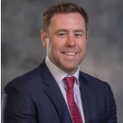
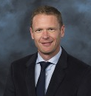

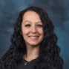
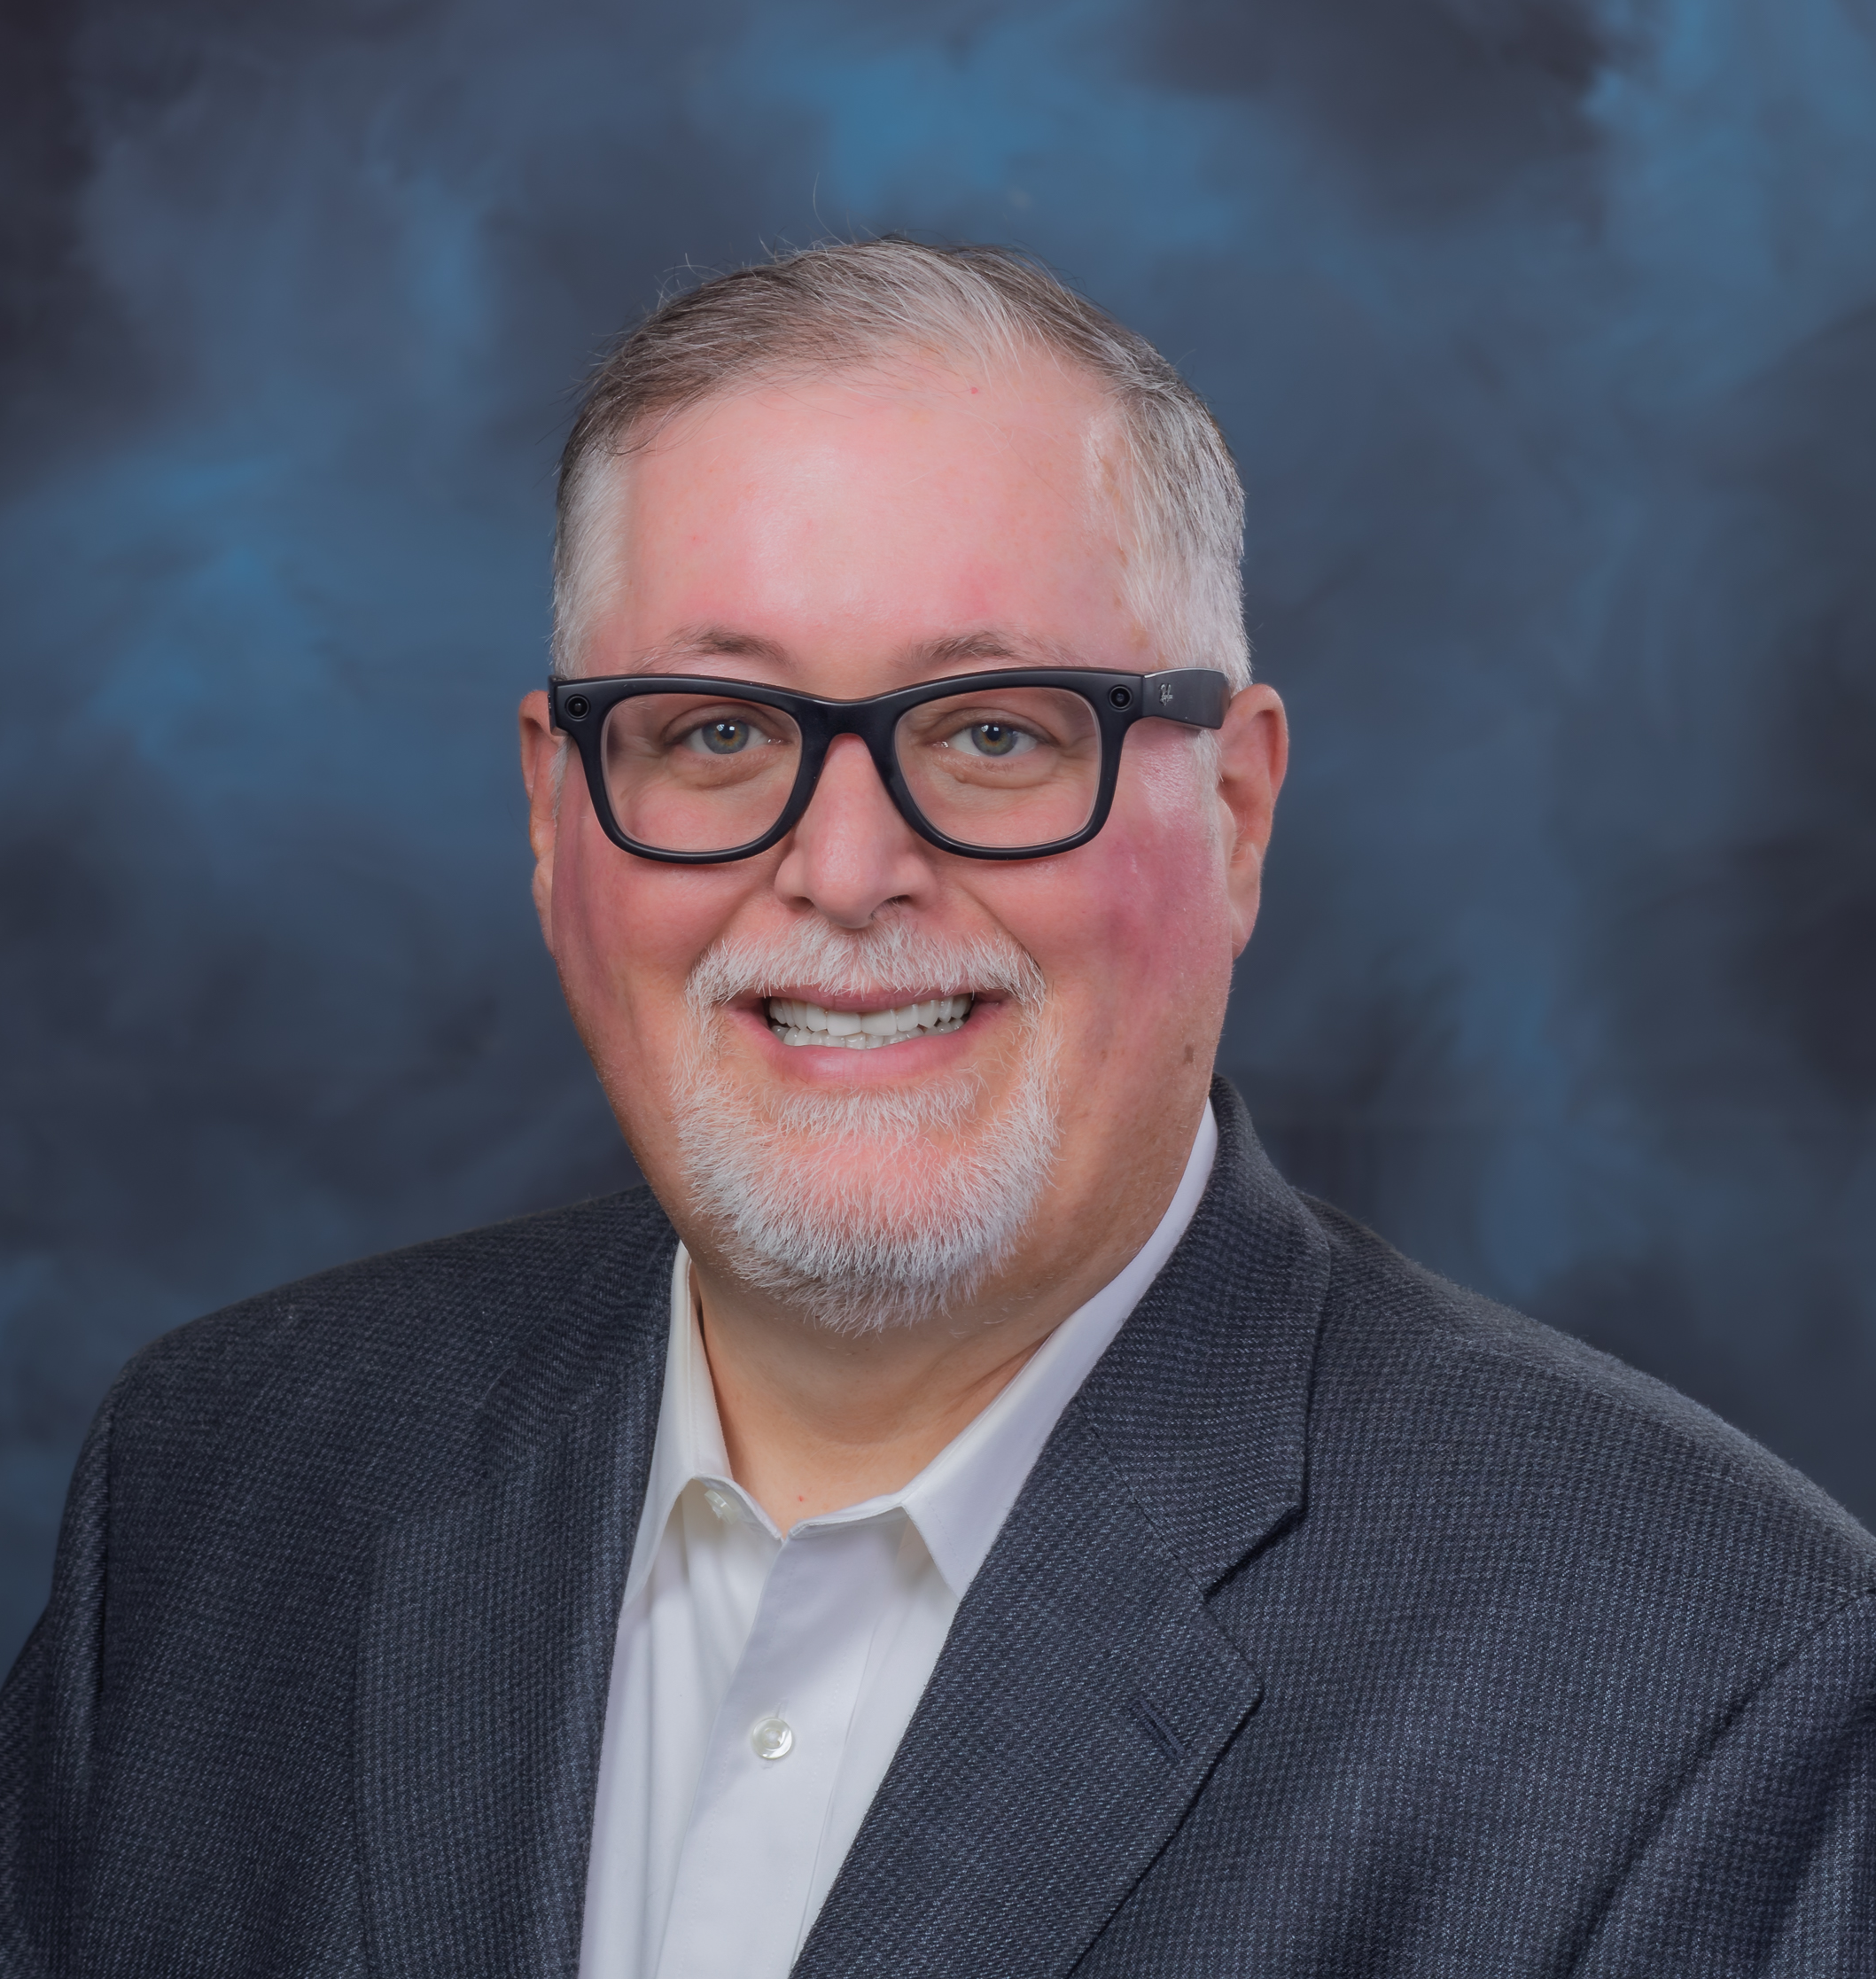
RPF Contractor Integrated Project Team Organization Chart
Program Manager
v
v
Roy Copping
ISED Radioisotope
Program Manager (RSTD)
Bryan Leber
RPF Project Director
Peter Rosenblad
RPF Project Manager
Quality Assurance
Jaclyn Hall
RPF Administrative Assistant
v
Chris Stafford
Quality Assurance Team Lead (QAD)
Project Team (Matrixed Staff)
v
v
v
Will Kirkland
Design Authority/Systems Engineer Lead (RSTD)
Dave Phelps
Project Controls Lead
(PMO)
Mario Naranjo
Modular Hot Cell Design Lead
(RSTD)
v
v
v
v
v
Jennifer Stanford-Durham
Project Controls
(PMO)
Randy Pickens
Facilities Lead
(LMD)
Randy Fair
ES&H/Regulatory Lead
(NIPO)
Dave Clark
NNFD Technical/
Operations Advisor (NNFD)
Michael Russell
Quality Representative
(QAD)
v
v
v
v
v
Jacob Cornell
Engineering Systems Technician (RSTD)
Natasha Blair
Safety Basis Lead
(NFSD)
Chris Lowe
Safety Basis Lead
(NFSD)
Phil Meehan
Facilities Site Prep Representative (LMD)
Rachel Botes
Procurement Representative
(Contracts)

Slide 7
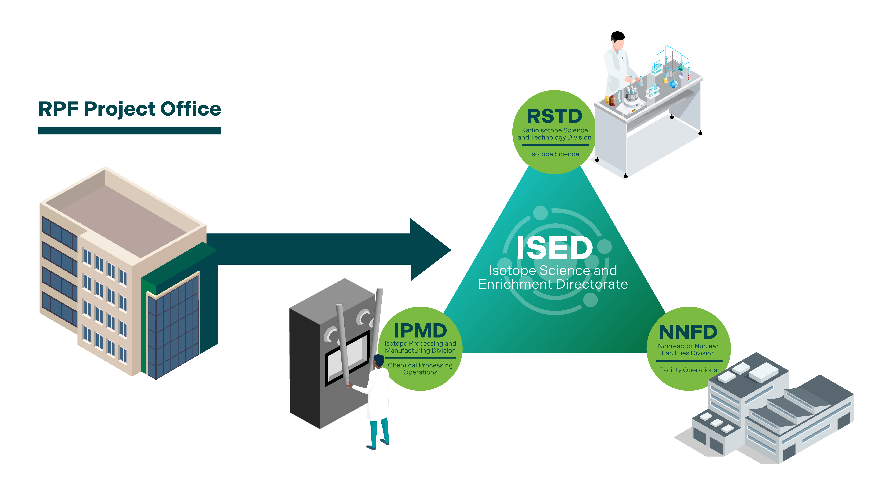
RPF ORNL Project Stakeholders
Integration and Alignment are critical to unleash the full capability of our mission critical facility

Slide 8
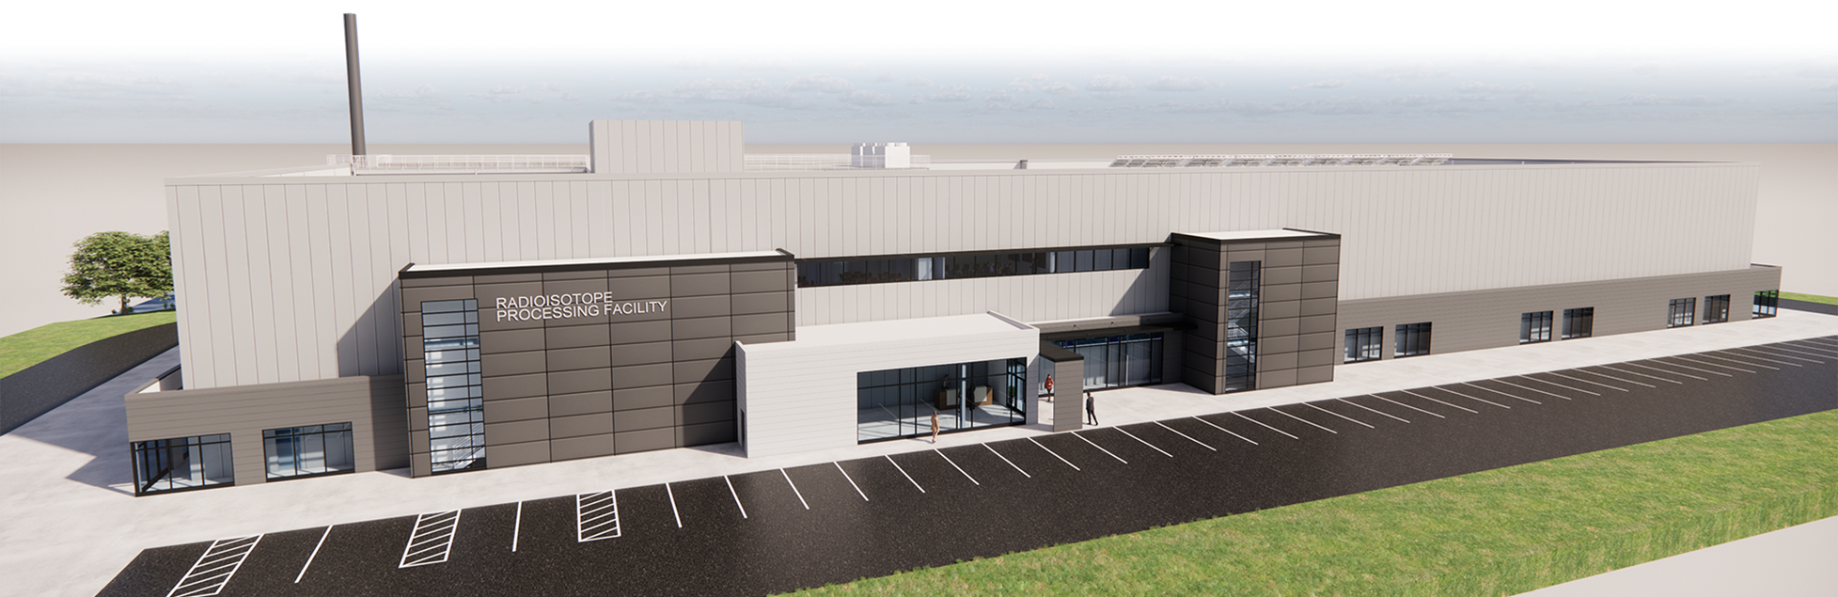
RPF Overview
Provides U.S. radioisotope independence from foreign supply
Modernizes radioisotope production and mitigates risk from legacy nuclear facilities
Isotope (proof of concept) R&D inside RPF will empower private American industry isotope partners

Slide 9
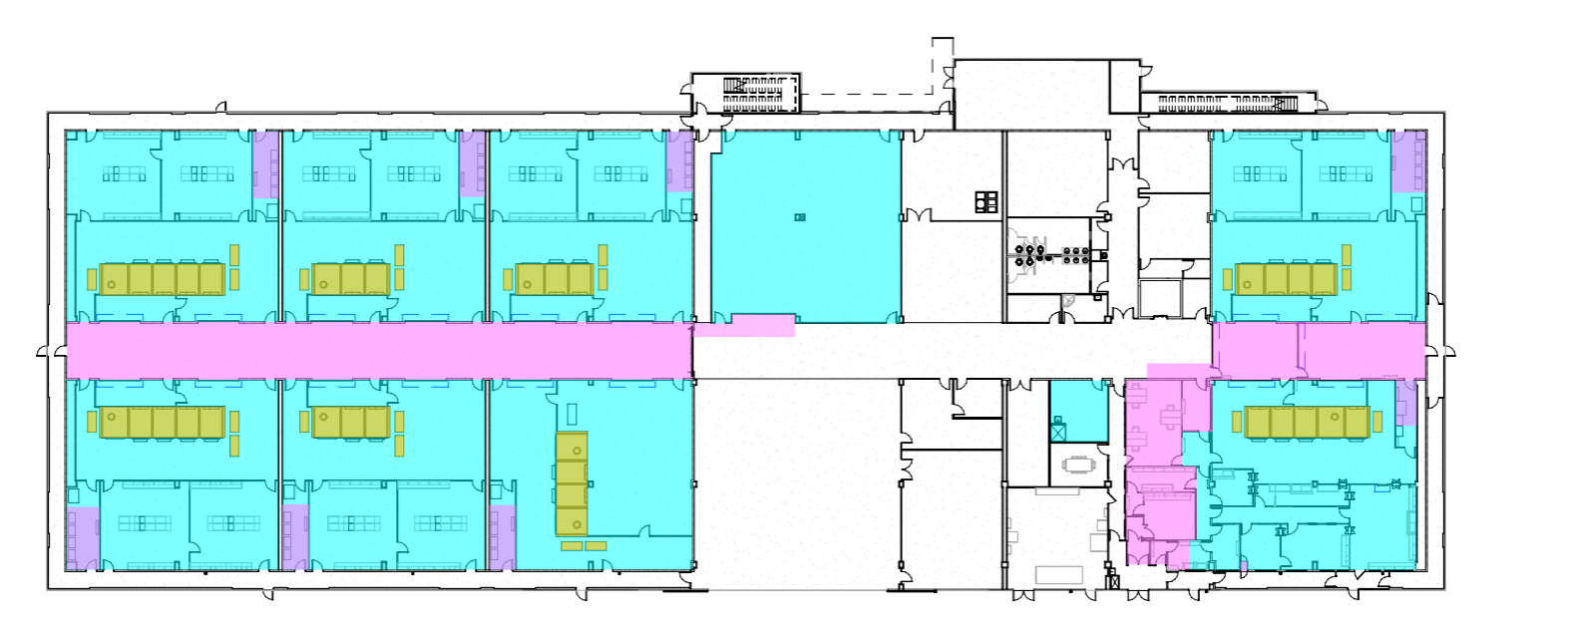
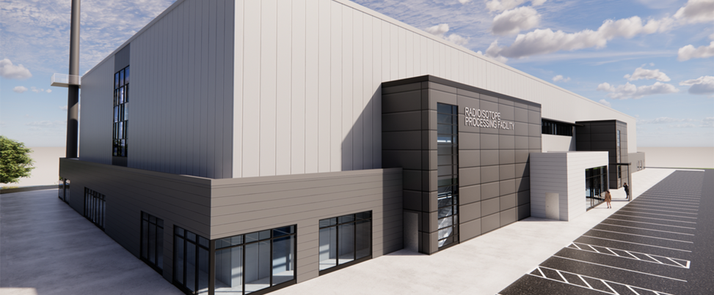
RPF Overview
Hazard CAT2 Facility (DOE STD-1027)
Dynamic, flexible, & scalable
A facility that strengthens our nation’s dominance in critical radioisotope processing

Slide 10
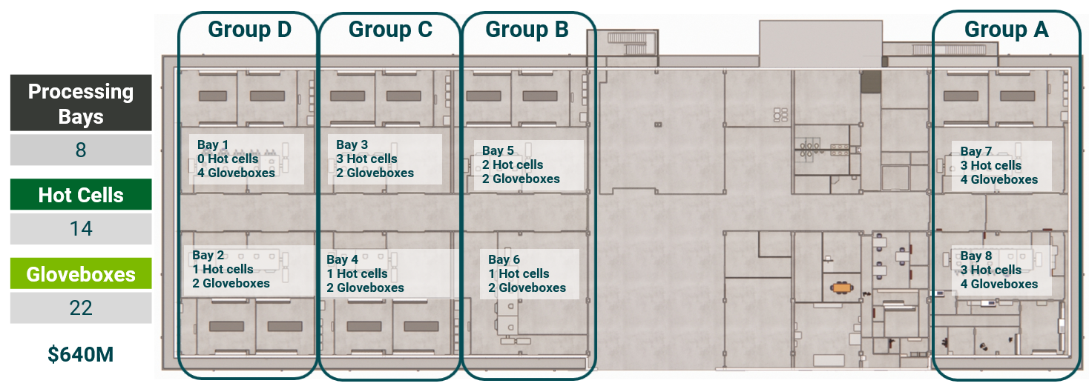
RPF Overview
The 14 MHCs and 22 gloveboxes included in the base scope will:
  Provide a transloading capability for HFIR targets
  Provide a stable and reliable source of radioisotopes for medical, national security, energy, industrial, and research applications
  All 8 bays will be built out and ready for MHCs as part of the project
  The ultimate capability of RPF will include 32 MHCs and 48 gloveboxes

Slide 11
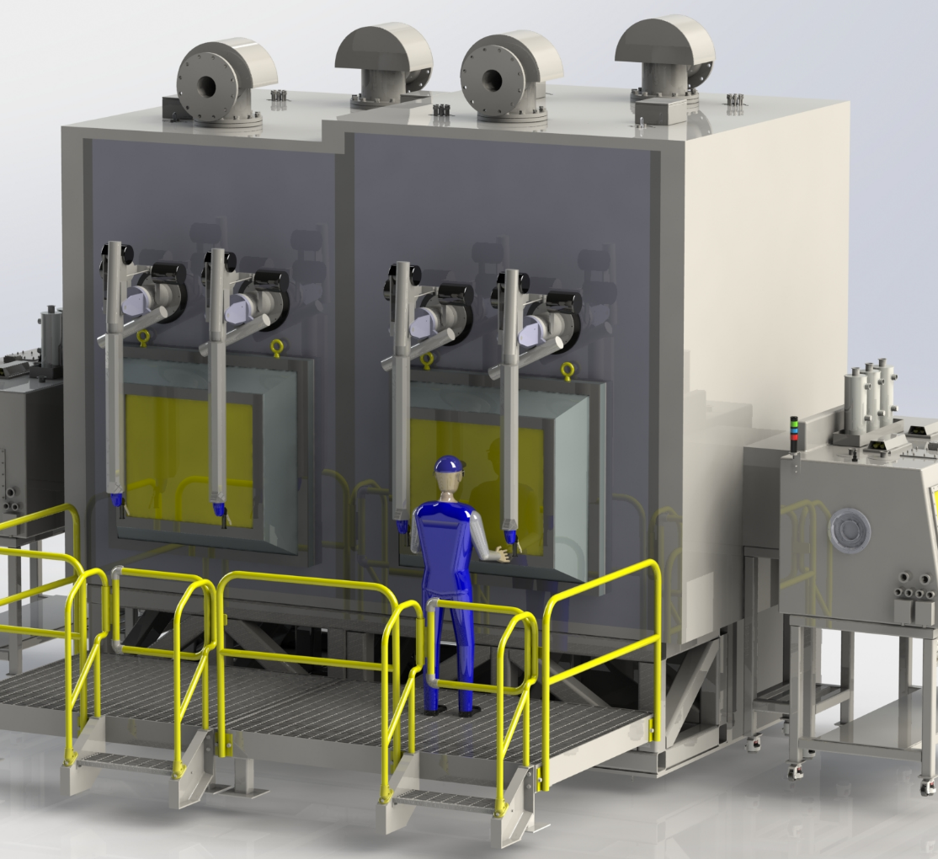
RPF’s flexibility is derived from the modular hot cell concept
Modular hot cells (MHC) are a different approach to nuclear facilities
MHC's can be customized to hazards for a particular isotope line, reducing cost and space
More efficient radioisotope processing
MHC's can also be changed or added in future campaigns and assembled on site

Slide 12
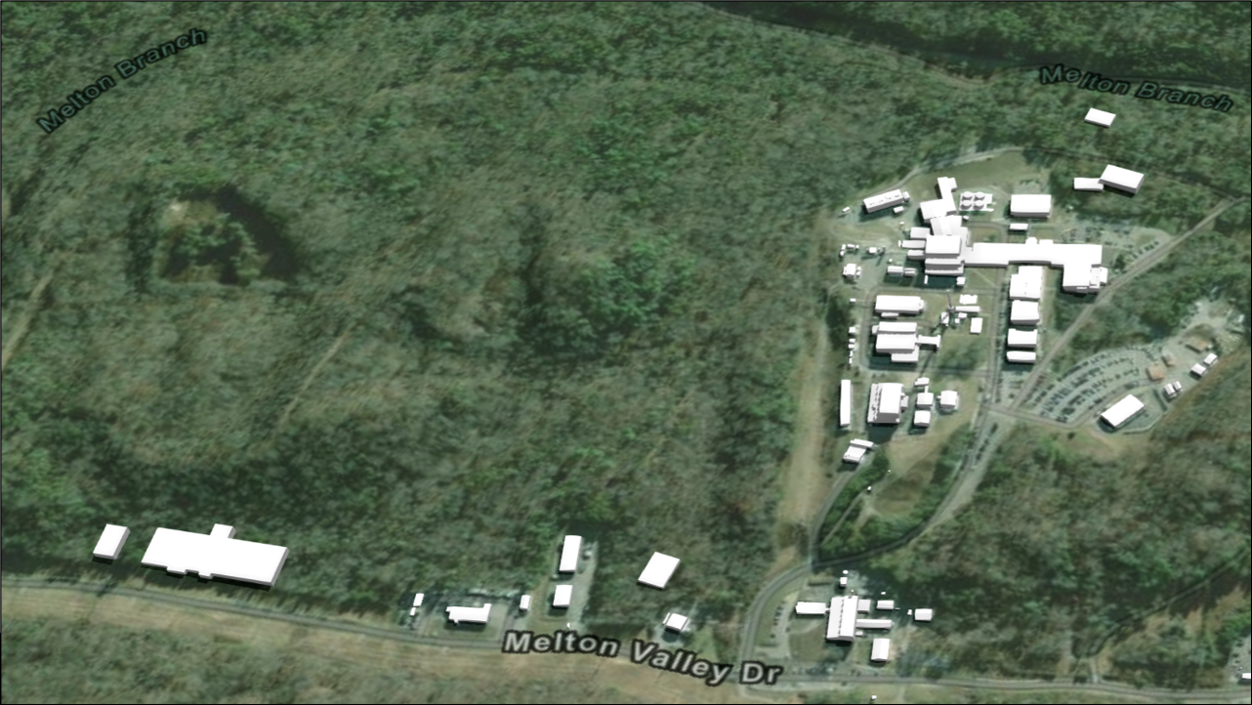
RPF Project Site
The Radioisotope Processing Facility is 0.6 miles from the High Flux Isotope Reactor.
High Flux Isotope Reactor (HFIR)
Radioisotope Processing Facility (RPF)

Slide 13
Detailed Project Timeline
CD-4
Approve Start of Operations
(DOE ORR)
(Early Finish)
Award Facility Construction Contract
Final Documented Safety Analysis Approval
Facility Prelim & MHC Final Design Review
Preliminary PDSA Approval
Contractor
ORR
Complete
CD-4
Approve Start of Operations
(DOE ORR)
(Late Finish)
CD-2/3 Performance Baseline and Construction Approval
(Early Finish)
CD-1
Alternative Selection / Cost Range Approval
Final Design Review
Facility In-The-Dry
Management
Self
Assessment
Complete
Construction Complete
Q2
FY26
Q2
FY27
Q2
FY28
Q3
FY28
Q1
FY29
Q4
FY29
Q3
FY30
Q4
FY31
Q4
FY33
Q4
FY34
Q2
FY35
Q4
FY35
Q1
FY36
Q2
FY36
Q2
FY39
CD-3A Site Preparation and MHC Fab-Install LLP Approval
CD-3A MHC Fab-Install
Complete
Ready to Award CD-3A MHC Fab-Install S/C

Slide 14
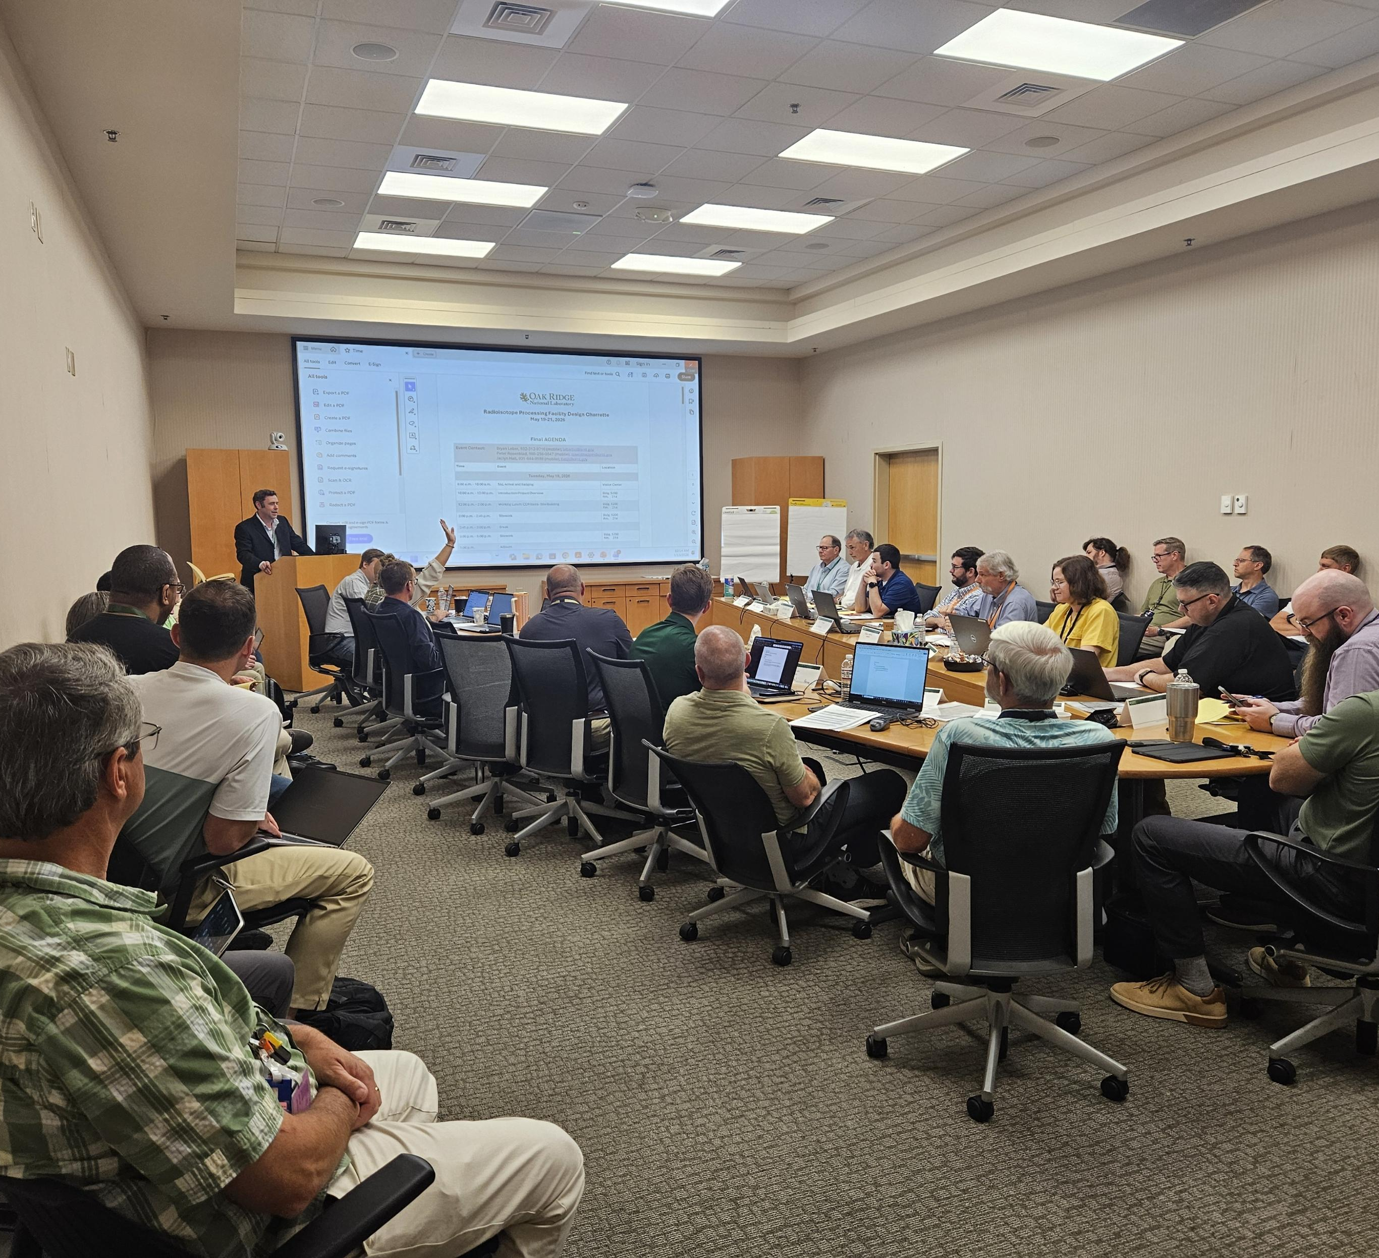
RPF Design Charette May 19th-21st
The meeting emphasized a few key themes:
Stakeholder engagement and alignment
ASME NQA-1 Facility
Facility constructability
MHC fabricability
Designing with the “end in mind” to support operational readiness

Slide 15
What are your Questions/Comments?

