Slide 1
Fundamental Symmetries Experiments with Ultracold Neutrons at Los Alamos
LA-UR-26-24655
Steven Clayton, LANL
ORNL Workshop: New Science and Applications at the SNS, June 10-12, 2026, Oak Ridge, TN

Slide 2
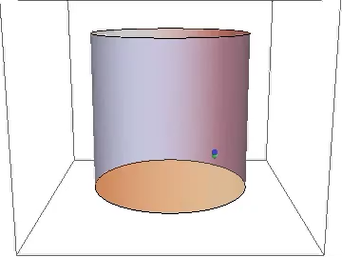


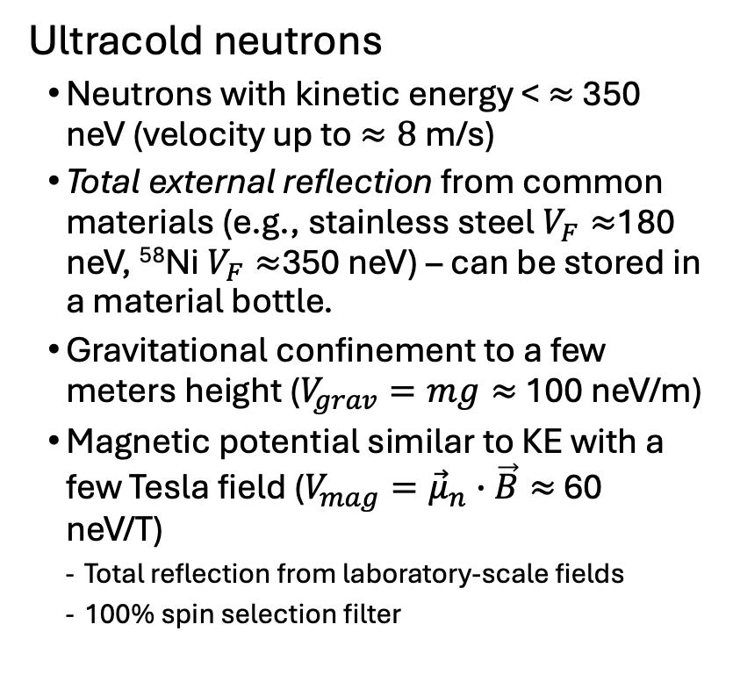

Experiments on neutron properties typically use cold or ultracold neutrons
Ultracold neutrons
  Neutrons with kinetic energy < $≈$350 neV (velocity up to $≈8$ m/s)
  Total external reflection from common materials (e.g., stainless steel $V_{F}≈$180 neV, ⁵⁸Ni$V_{F}≈$350 neV) – can be stored in a material bottle.
  Gravitational confinement to a few meters height ($V_{grav}=mg≈$ 100 neV/m)
  Magnetic potential similar to KE with a few Tesla field ($V_{mag}={\vec{μ}}_{n}∙\vec{B}≈$ 60 neV/T)
    Total reflection from laboratory-scale fields
    100% spin selection filter
$$E$$
$$V_{mag}$$
Trajectory of UCN “Low-field seeker” spin state
$$x$$
Notes:
Advantage of UCN: confinement, long observation times possible.
Disadvantage: not nearly so many as cold n beams.

Slide 3
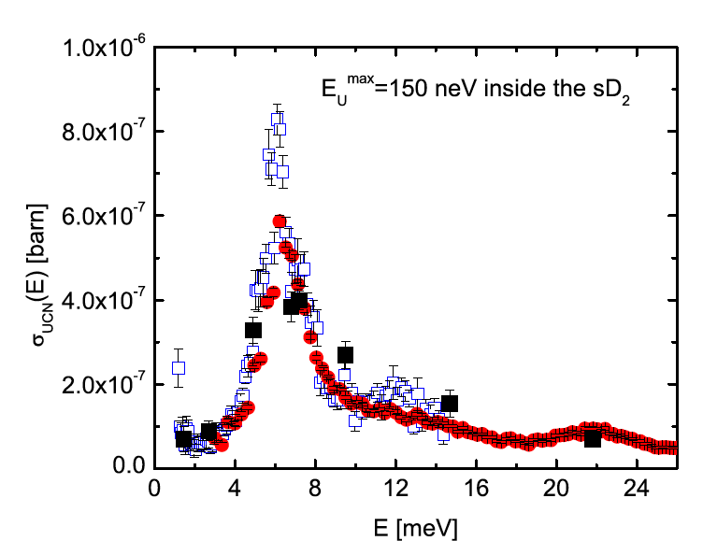

LANL UCN Source
Spallation neutrons from W target
K.E. ~ 2 MeV
Thermal neutrons in Be and graphite moderator
K.E. ~ 25 meV
Frei et al (2010)
Cold neutrons in polyethylene cold moderator
K.E. ~ 6 meV
Ultracold neutrons in SD2 converter
K.E. ~ 100 neV
P_{UCN} = $ρ$_{SD}∫$Φ$_{CN}(E)σ_{UCN}(E)dE

Slide 4
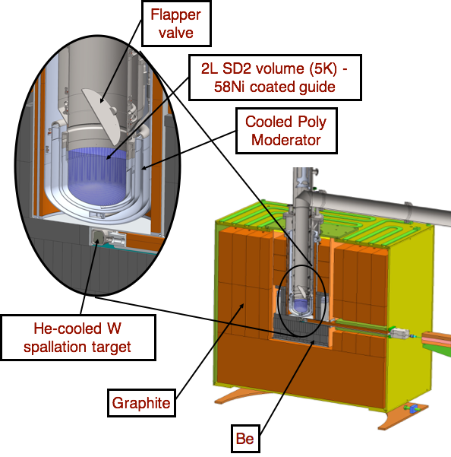
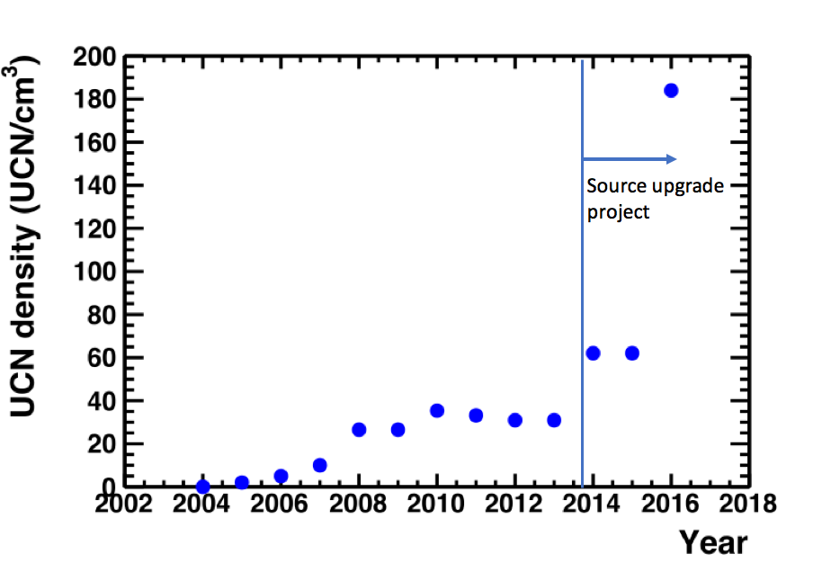
LANL UCN Source
T. M. Ito et al., Phys. Rev. C 97, 012501(R) – 29 January 2018

Slide 5
LANL UCN Experimental Hall
UCN Source
UCNτ+
UCNProBe
nEDM
UCNA+
Notes:
Two types of fundamental UCN symmetry experiments at LANL: neutron beta decay measurements, and neutron electric dipole moment search.

Slide 6
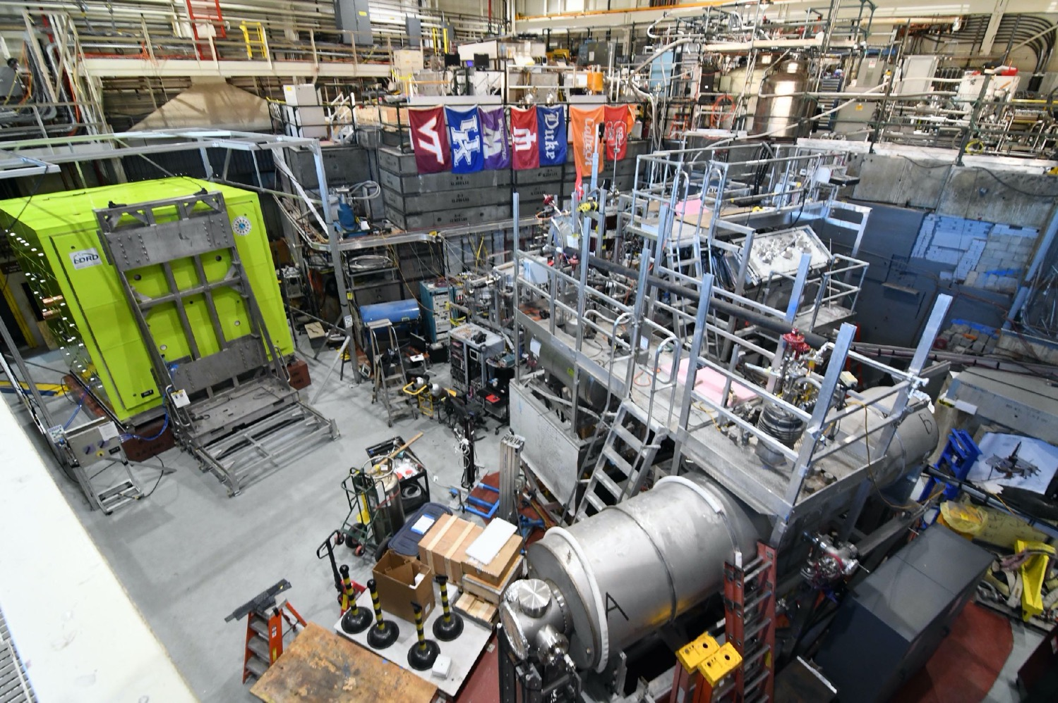
LANL UCN Experimental Area (2022)
UCN source
LANL nEDM experiment
UCNτ/UCNτ+ experiment
UCNA/UCNB/UCNA+ experiment

Slide 7
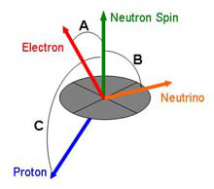
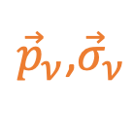


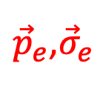

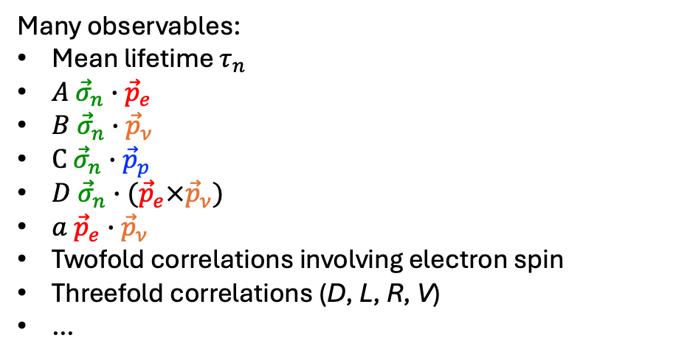
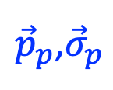
Neutron β decay observables
$n→p+e+{\overline{ν}}_{e}$, β endpoint energy 782 keV
Many observables:
Mean lifetime $τ_{n}$
$A {\vec{σ}}_{n}∙{\vec{p}}_{e}$
$B {\vec{σ}}_{n}∙{\vec{p}}_{ν}$
$C {\vec{σ}}_{n}∙{\vec{p}}_{p}$
$D {\vec{σ}}_{n}∙({\vec{p}}_{e}×{\vec{p}}_{ν})$
$a {\vec{p}}_{e}∙{\vec{p}}_{ν}$
Twofold correlations involving electron spin
Threefold correlations (D, L, R, V)
…
LANL Experiments
$${\vec{σ}}_{n}$$
UCNτ/UCNτ+, UCNProBe
${\vec{p}}_{e}$,${\vec{σ}}_{e}$
UCNA/UCNA+
(UCNB)
${\vec{p}}_{ν}$,${\vec{σ}}_{ν}$
${\vec{p}}_{p}$,${\vec{σ}}_{p}$
Differential decay rate:
$$\frac{dW}{dE_{e}dΩ_{e}dΩ_{ν}}=G(E_{e})\left(1+a\frac{{\vec{p}}_{e}∙{\vec{p}}_{ν}}{E_{e}E_{ν}}+b\frac{m_{e}}{E_{e}}+\left\langle {\vec{σ}}_{n}\right\rangle ∙\left(A\frac{{\vec{p}}_{e}}{E_{e}}+B\frac{{\vec{p}}_{ν}}{E_{ν}}+D\frac{{\vec{p}}_{e}×{\vec{p}}_{ν}}{E_{e}E_{ν}}\right)\right)$$
…also ${\vec{σ}}_{e}$ combinations
Notes:
Starting with the basics on neutron beta decay: A free neutron decays into a proton, electron, and electron anti-neutrino, in an average of 15 minutes.
There are a number of possible observables considering the initial and final particles’ momenta and spin, something like 20 observables that one can imagine. A good discussion on this is in Dubbers and Schmidt cited here.
The observables include the total rate of the process, in other words the inverse lifetime, and correlations between the outgoing particles.
For example, the beta asymmetry ”big A” is the amount of preference for the electron to be emitted in the direction of the initial particle spin.
”Little a” is the correlation between electron and anti-neutrino directions; though in practice the electron and proton momenta measured and neutrino direction inferred.
It’s summarized in this differential decay rate shown here.

Slide 8
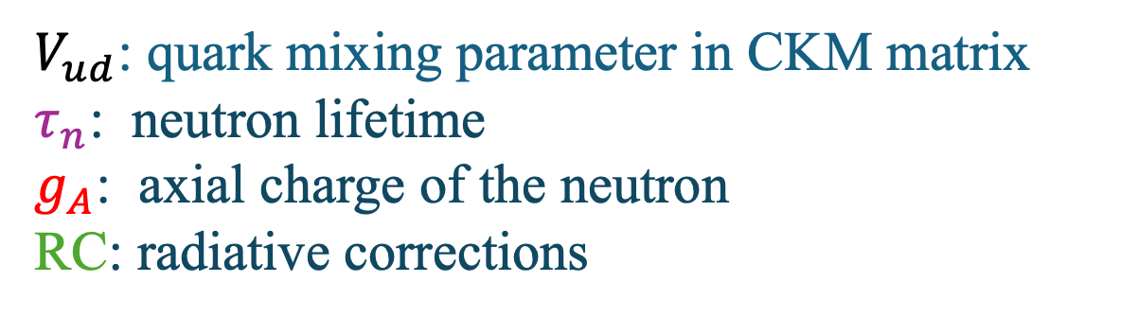
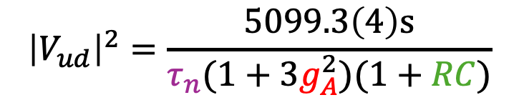

Neutron β decay in the standard model
=1 by CVC
$≈−1$
$$ℳ_{q}=\frac{G_{F}}{\sqrt{2}}V_{ud}\left[p(γ_{μ}\left(g_{V}+g_{A}γ_{5}\right)+\frac{κ_{p}−κ_{n}}{2M}σ_{μν}q^{ν})n\right]\left[eγ^{μ}\left(1−γ_{5}\right)ν_{e}\right]$$
Weak magnetism: determined from electromagnetic properties (anomalous magnetic moments)
Other terms are forbidden in the SM or can be neglected at low energies.
$${\left|V_{ud}\right|}^{2}=\frac{5099.3\left(4\right)\text{s}}{τ_{n}(1+3g_{A}^{2})(1+RC)}$$
→ Neutron decay master formula:
$V_{ud}$: quark mixing parameter in CKM matrix
$τ_{n}$: neutron lifetime
$g_{A}$: axial charge of the neutron
RC: radiative corrections
Notes:
When we move to the nucleon level, towards comparison with experiments, then the effects of the quarks being bound up in the nucleons by the strong force must be taken into account.
That is done by introducing form factors gV and gA and a induced term.
The vector term is protected from being modified by the strong interaction by conserved vector current, and similarly the weak magnetism term is related to electromagnetic properties.
The axial charge can be modified by QCD effects, but there is a near symmetry that sets is value to approximately -1.
Other form factors that could be introduced turn out to be zero or can be neglected at low energy.
In the end, essentially a single parameter, gA or lambda which is gA/gV, accounts for nucleon QCD structure.
RC ~ 4% is known precisely through theory calculations.
And the only other free parameter is Vud.

Slide 9
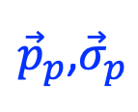
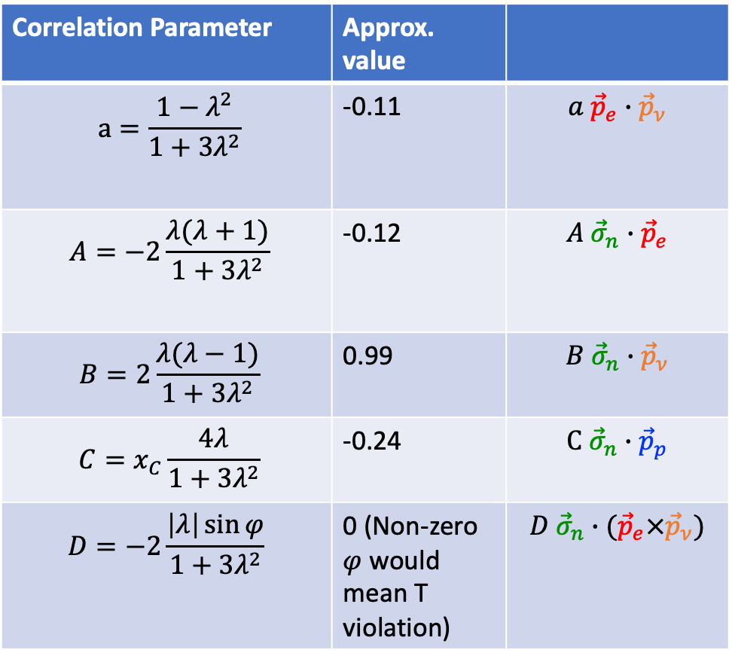
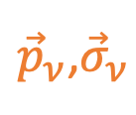
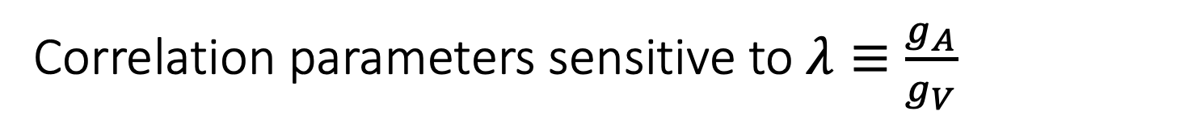


Correlation parameters sensitive to $λ≡\frac{g_{A}}{g_{V}}$
Correlation Parameter | Approx. value
$$a=\frac{1−λ^{2}}{1+3λ^{2}}$$ | -0.11 | $$a {\vec{p}}_{e}∙{\vec{p}}_{ν}$$
$$A=−2\frac{λ(λ+1)}{1+3λ^{2}}$$ | -0.12 | $$A {\vec{σ}}_{n}∙{\vec{p}}_{e}$$
$$B=2\frac{λ(λ−1)}{1+3λ^{2}}$$ | 0.99 | $$B {\vec{σ}}_{n}∙{\vec{p}}_{ν}$$
$$C=x_{C}\frac{4λ}{1+3λ^{2}}$$ | -0.24 | $$C {\vec{σ}}_{n}∙{\vec{p}}_{p}$$
$$D=−2\frac{\left|λ\right|\sin{φ}}{1+3λ^{2}}$$ | 0 (Non-zero $φ$ would mean T violation) | $$D {\vec{σ}}_{n}∙({\vec{p}}_{e}×{\vec{p}}_{ν})$$
$${\vec{σ}}_{n}$$
${\vec{p}}_{e}$,${\vec{σ}}_{e}$
${\vec{p}}_{ν}$,${\vec{σ}}_{ν}$
${\vec{p}}_{p}$,${\vec{σ}}_{p}$

Slide 10
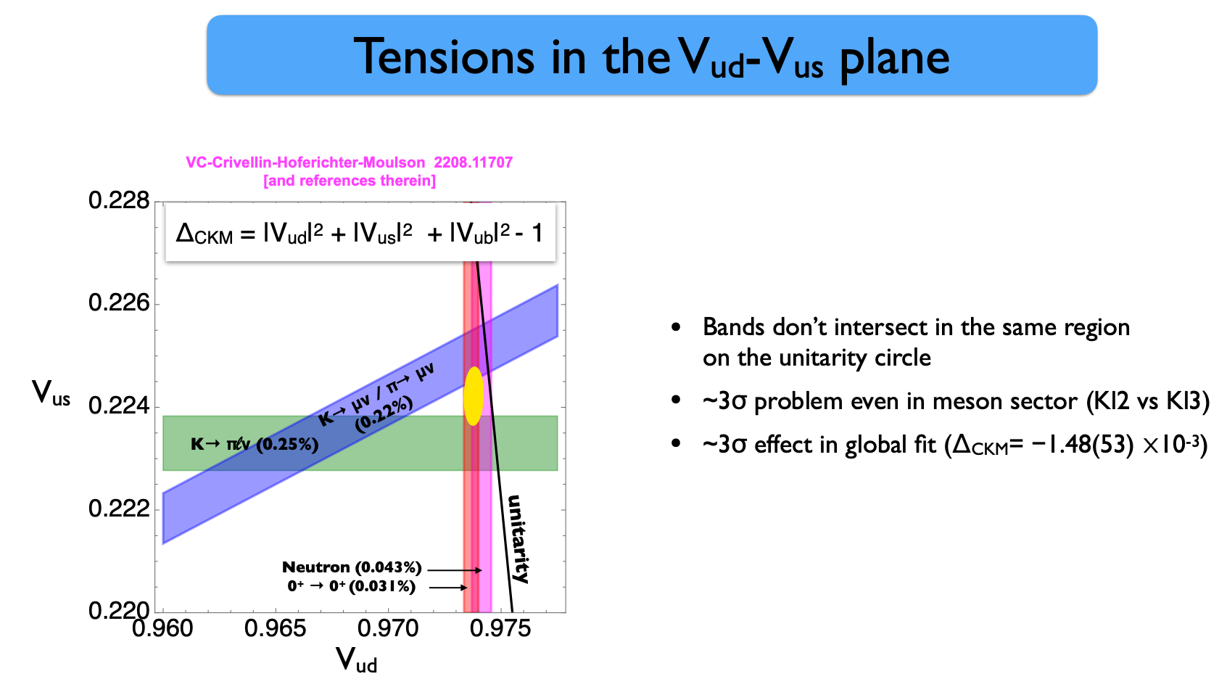
“Cabibbo Anomaly”
Slide from V. Cirigliano talk at January 2026 INT workshop, “Testing the Standard Model in Charged-Weak Decays”

Slide 11
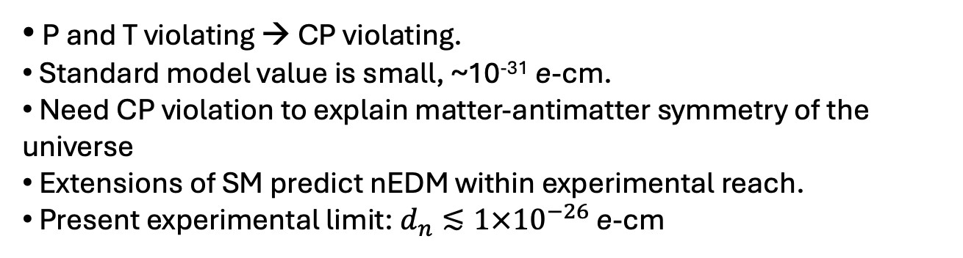
Neutron electric dipole moment (nEDM)
-
P
+
+
-
T
+
-
P and T violating → CP violating.
Standard model value is small, ~10⁻³¹ e-cm.
Need CP violation to explain matter-antimatter symmetry of the universe
Extensions of SM predict nEDM within experimental reach.
Present experimental limit: $d_{n}≲1×{10}^{−26}$ e-cm

Slide 12
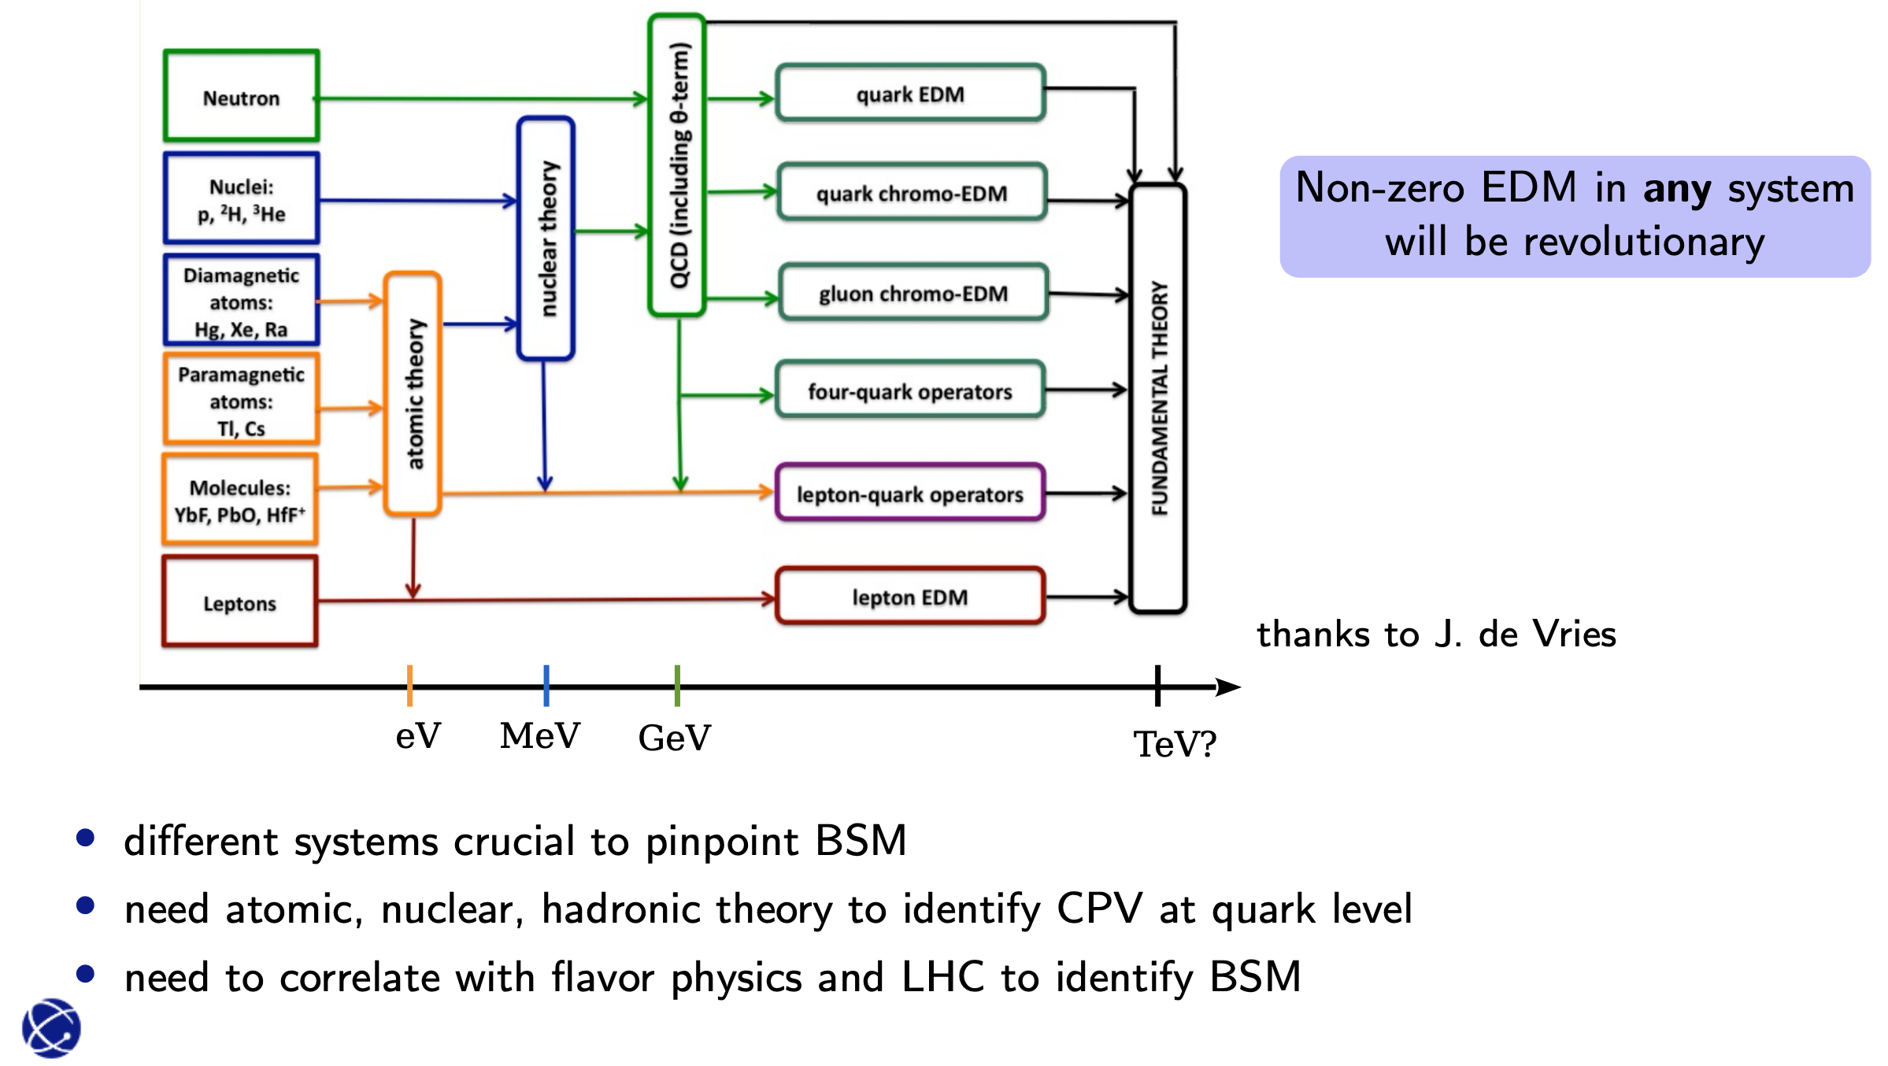
EDMs and BSM physics
Slide from E. Mereghetti, LANL

Slide 13
Where we (nEDM) stand
Lightly edited slide from T. Chupp, nEDM2023 Workshop Wrapup, 9 November 2023

Slide 14
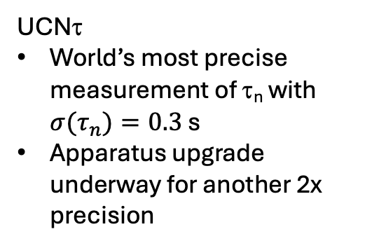
LANL UCN Experimental Hall
UCNτ
World’s most precise measurement of τ_{n} with ${σ(τ}_{n})=0.3$ s
Apparatus upgrade underway for another 2x precision
UCN Source
UCNτ+
UCNProBe
nEDM
UCNA+

Slide 15
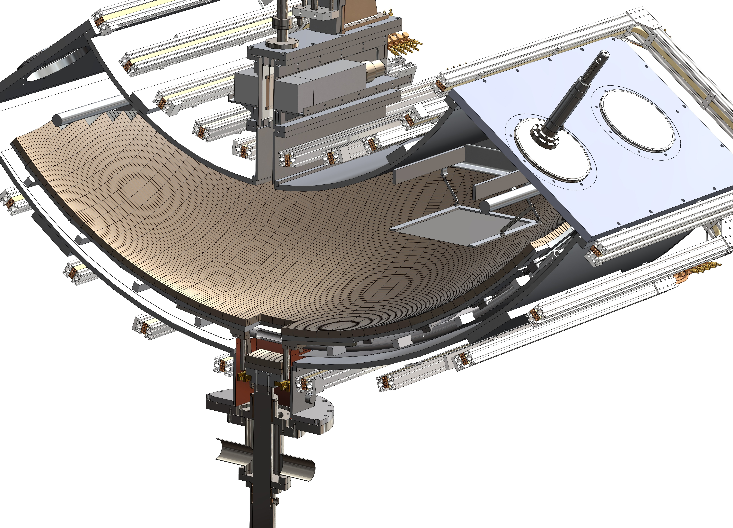

UCNτ experiment traps ultracold neutrons via magnetic and gravitational forces, avoiding big systematic corrections.
UCN trap with very low intrinsic losses
  Magneto-gravitational trap
  Superposed holding field to eliminate B-field zeros (no depolarization losses)
  Fast removal of quasi-bound UCNs possible through trap asymmetry and field ripple
High statistics are achievable
  Large volume
  In situ UCN detector
    High overall efficiency
    Also: Less sensitive to phase-space evolution than draining
Based on original concept: P.L. Walstrom, J.D. Bowman, S.I. Penttila, C. Morris, A. Saunders, NIMA 599 (2009) 82-92
Physics results:
Phys. Rev. C 111, 045501 (2025)
Phys. Rev. Lett. 127, 162501 (2021)
Science 06 May 2018, 10.1126/science.aan8895
Notes:
Wall loss eliminated by design: no size and/or energy extrapolation is necessary.

Slide 16
UCNτ Summary
2017: Improved removal of quasi-trapped UCN (“Giant Cleaner”)
2018: Improved normalization of initial UCN population by adding upstream buffer volume.
2019: Special run of “Fill and Dump” mode, in which UCN are drained through the trapdoor into a detector
2020: Improved normalization by adding detector to count UCN in upstream buffer volume at end of fill.
2021: Improved ¹⁰B/ZnS screens (better efficiency)
2022: Segmented dagger detector (smaller rate-dependent effects).
PRL (2021)
Science (2018)
PRC (2022)
(Fill&Dump Study)
New results included in 2025 PRC
Year data were taken
Notes:
“Current” is the combined 2020-22 result (2025 Phys. Rev. C)
“Global” is the combined 2017-18 and 2020-22. The 2018 Science paper (2016 data) had different enough conditions that we did not include it in this Global result.
UCNτ is essentially statistics limited
A 0.4-s result takes 2-3 years
The Roundhouse buffer volume added in 2018 is important for normalization, but it reduces the loaded population significantly
Our knowledge of some systematics also depends on statistics.
The leading systematic, UCN identification / clustering uncertainties, could be addressed by improved main detector (described later in this talk).
Data-driven studies of systematics at the next level may require several full-precision data sets.

Slide 17
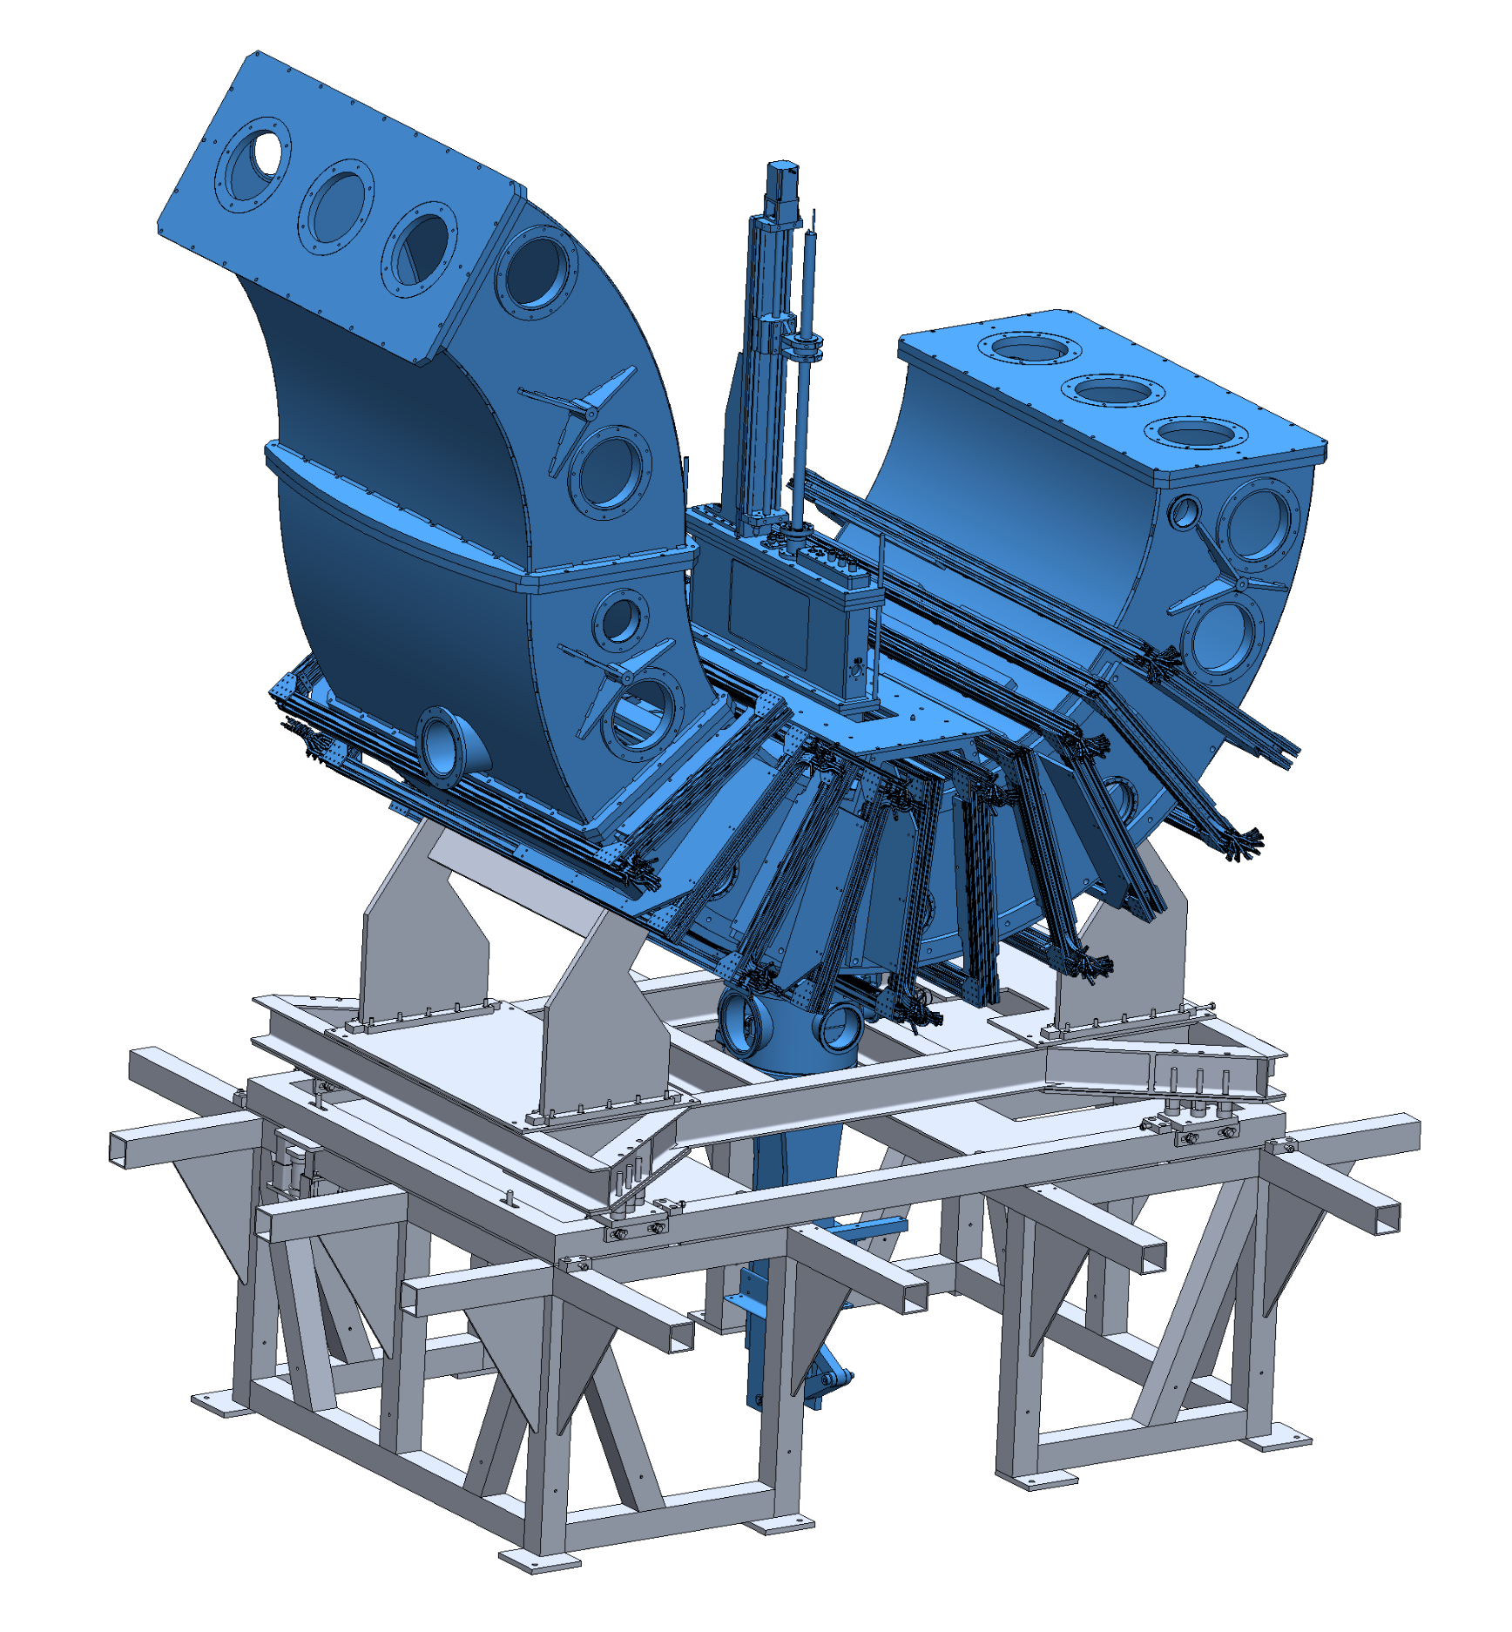
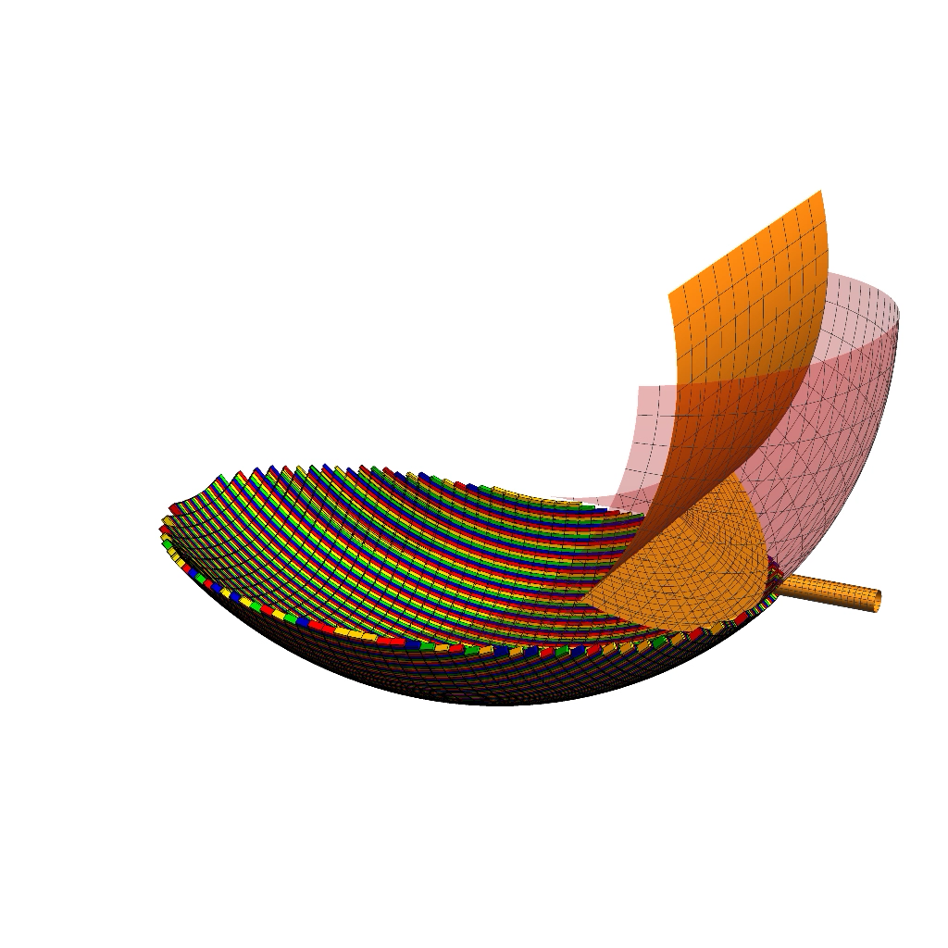
Upgrade to UCNτ apparatus for better UCN loading efficiency
Elevator concept for efficient transport into the trap
Elevator (material volume) is filled with UCN in its raised position.
Then the elevator sweeps all the way through the trap and stays on the other side, leaving adiabatically-transported UCN in the trap.
Prototype was demonstrated in 2025 showing successful UCN loading; improvements underway.
Vacuum vessel is extended to fit the elevator (and cleaner).
Notes:
[Left image is a video]

Slide 18
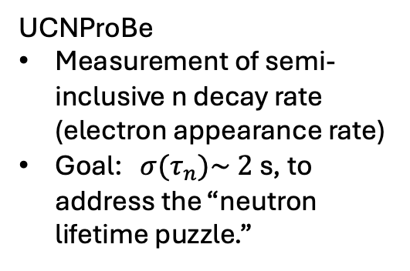
LANL UCN Experimental Hall
UCNProBe
Measurement of semi-inclusive n decay rate (electron appearance rate)
Goal: ${σ(τ}_{n})\sim 2$ s, to address the “neutron lifetime puzzle.”
UCN Source
UCNτ+
UCNProBe
nEDM
UCNA+

Slide 19
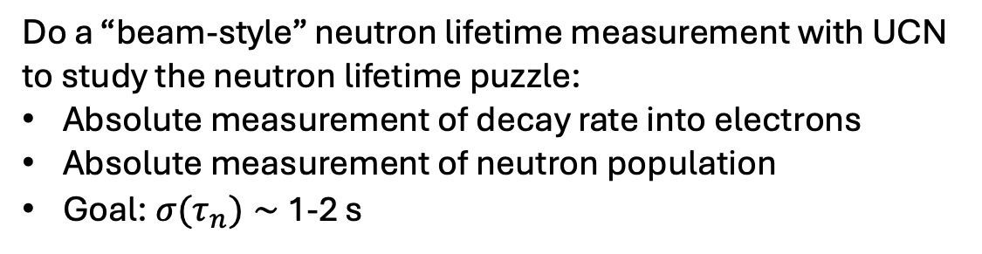
UCNProBe
Do a “beam-style” neutron lifetime measurement with UCN to study the neutron lifetime puzzle:
Absolute measurement of decay rate into electrons
Absolute measurement of neutron population
Goal: ${σ(τ}_{n})∼$ 1-2 s

Slide 20
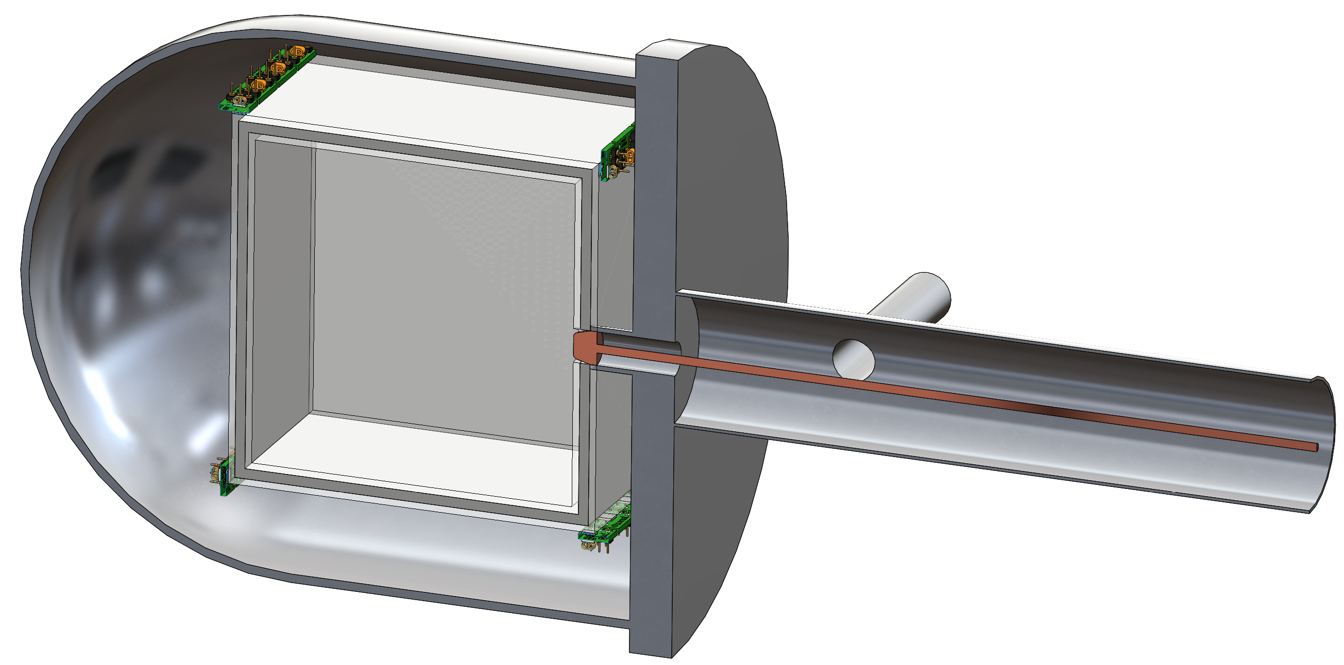

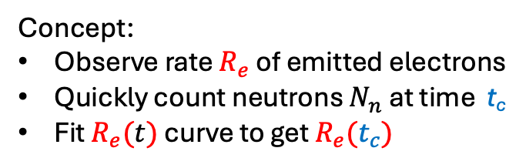

Ultra-Cold Neutron Experiment for Proton Branching Ratio in Neutron Beta Decay (UCNProBe)
UCN storage box comprised of scintillator plates (dPS)
Concept:
Observe rate $R_{e}$ of emitted electrons
Quickly count neutrons $N_{n}$ at time t_{c}
Fit $R_{e}(t)$ curve to get $R_{e}(t_{c})$
$$R_{e}(t_{c})= τ_{n}^{−1}N_{n}(t_{c})$$
R_{e}(t)
$$t_{c}$$
time
Requires absolute measurements similar to the beam experiment:
  Number of neutrons in the trap
  Number of decay products
  Needs precision ~0.1% for each quantity
Z. Tang (LANL) DOE Early Career project
Notes:
New idea in early R&D stage at LANL. PI: Zhaowen Tang.
Measure $τ_{β}$ using UCNs
if $τ_{β}$ =${ τ}_{n}$(from Bottle), then unaccounted systematic error in beam method
$τ_{β}$ >${ τ}_{n},$ then possible new physics
Requires absolute measurements of two quantities
Number of neutrons in the trap
Number of neutrons that decayed (measurement of charged particles)
Decay product detection
Electron (Using deuterated polystyrene (dPS) as a UCN trap and detector)
Neutron detection
UCN capture on ³He gas
Goal of present effort:
Demonstrate our ability to measure the charged particle and
UCN density detector efficiency to ~0.1% (~1 second error on ${ τ}_{n}$)
Preliminary measurement of ${ τ}_{n}$ at ~1% level

Slide 21
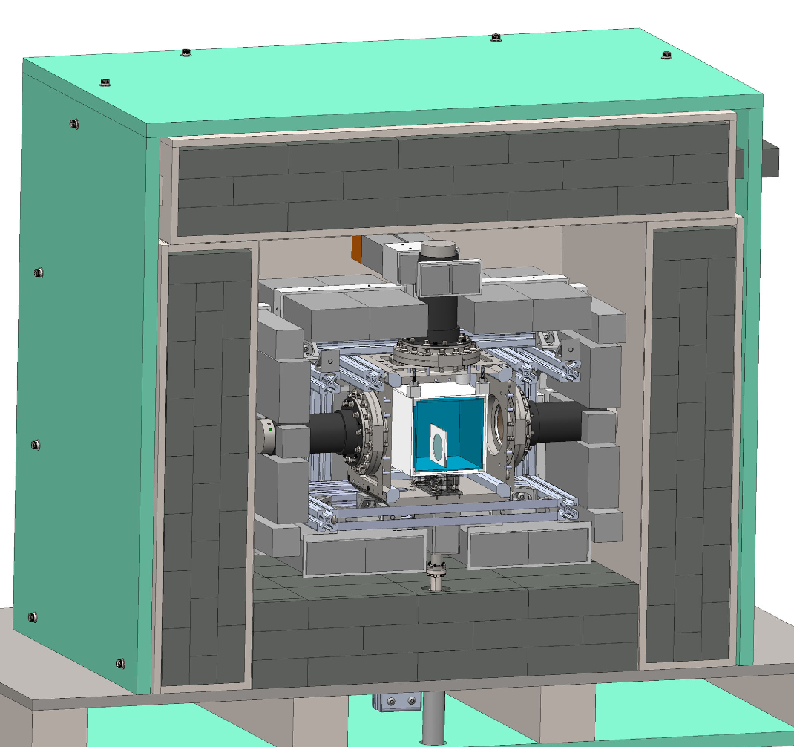
Martin Krivos, LANL
UCNProbe Design
Borated Polyethylene – 1-2”
Lead shielding – 6”
Active veto (NaI) –
  16 crystals
  57% solid angle coverage
UCN Storage Box

Slide 22
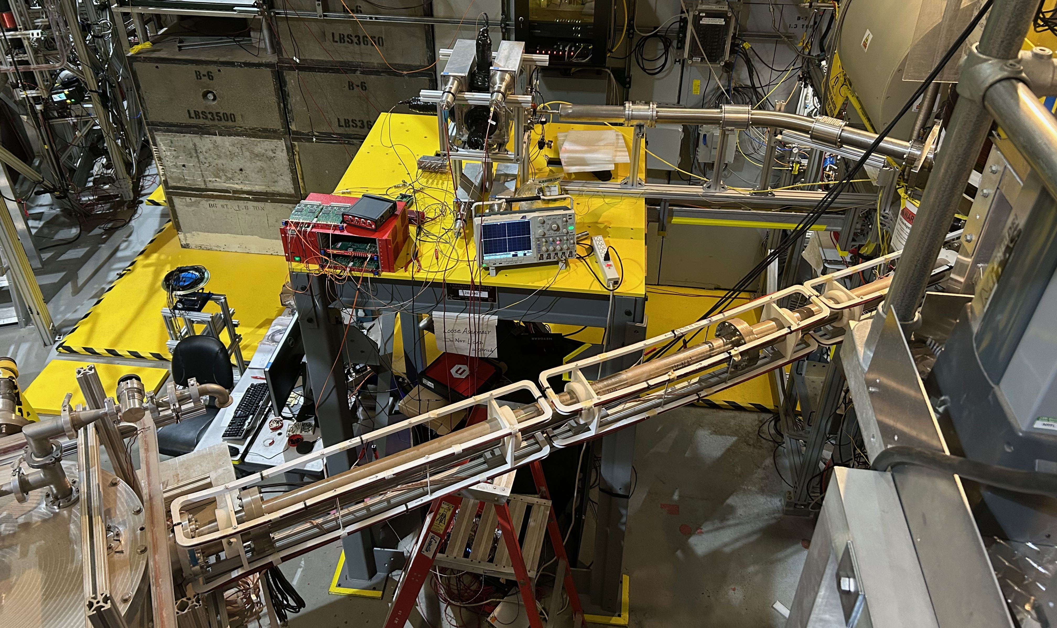
Test of UCNProBe neutron detector with UCN
First test with UCN (Late CY2025; data analysis underway).
All major components are expected this year (2026).
UCNProBe Feed Guide
UCNA+ Feed Guide

Slide 23


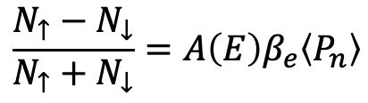




LANL UCN Experimental Hall
UCNA
Beta-asymmetry A measurement
Completed in 2012 with ${σ(A}_{0})/A0∼0.6$%
Upgrade underway with goal ${σ(A}_{0})/A0∼0.2$%
UCN Source
$$\frac{N_{↑}−N_{↓}}{N_{↑}+N_{↓}}=A\left(E\right)β_{e}〈P_{n}〉$$
$$N_{↓}$$
$$N_{↑}$$
$B_{0}$ ~ 1 T
$${\vec{p}}_{e}$$
UCNτ+
$${\vec{σ}}_{n}$$
UCNProBe
nEDM
UCNA+

Slide 24
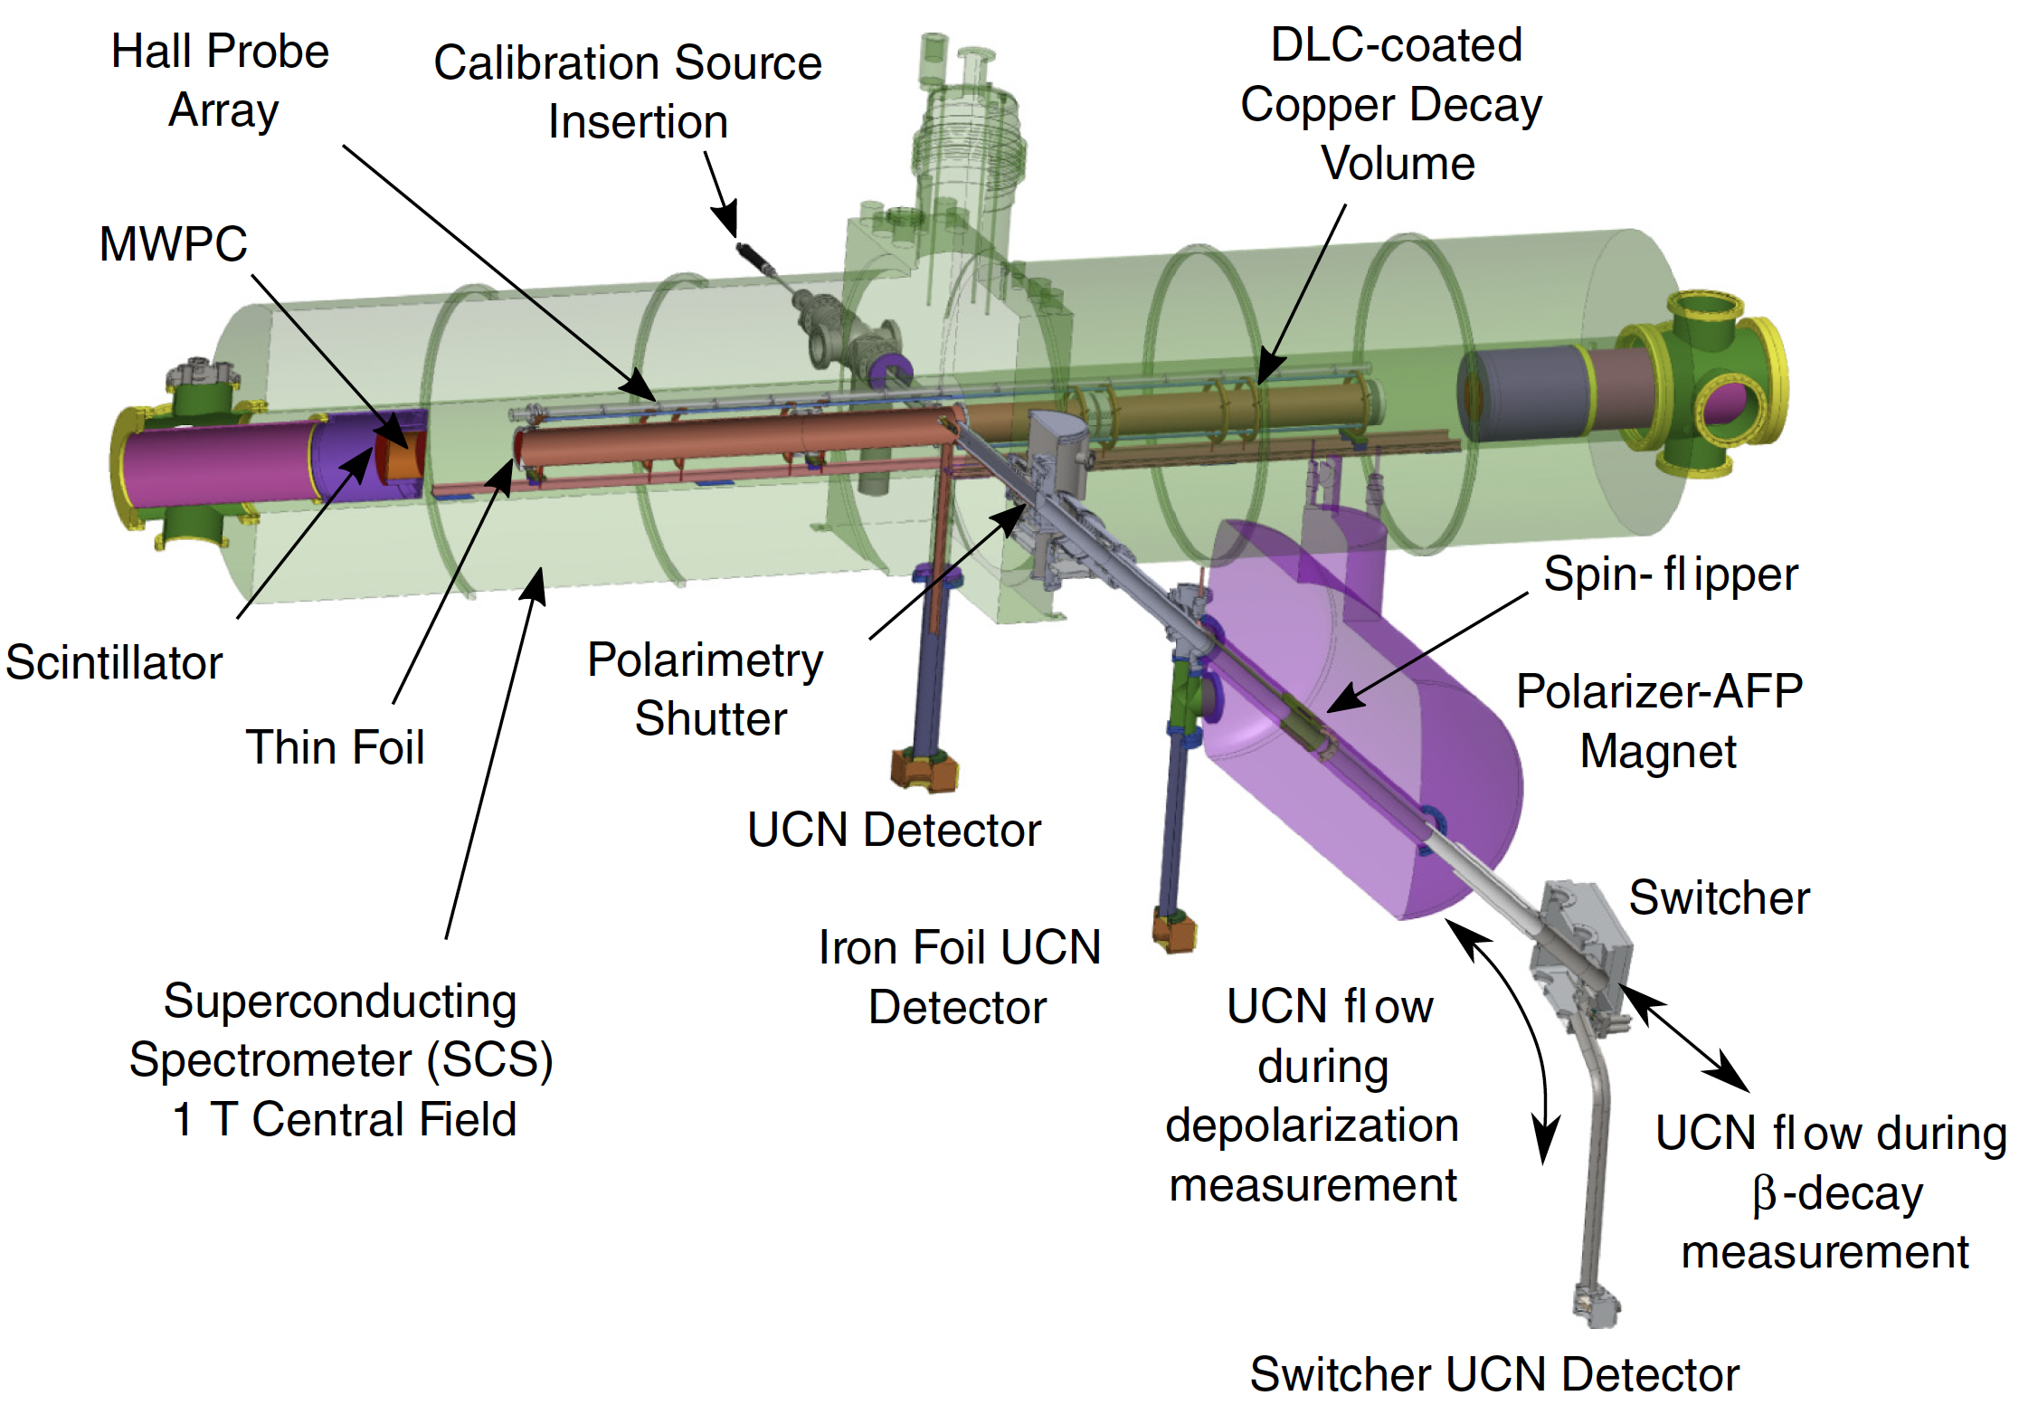
UCNA Diagram
Notes:
Turning to the neutron beta decay experiments now, and thinking in terms of the Standard Model which again gives us this relationship between the parameters, we want to determine Vud from neutron decay and then check unitarity of the first row of the CKM matrix.
We need correlation measurements that are sensitive to gA: that’s big-A, little-a, or B.
At the moment, the most precise gA comes from big-A measurements. I’ll quickly show two of these experiments which are currently the most precise measurements, both of big-A.
The A measurement (that is beta asymmetry) is shown schematically here. We want to compare the numbers of electrons emitted along and opposite to the neutron spin direction.
We also need the neutron lifetime, that is the total rate of beta decay, generally measured either with a cold neutron beam method or ultracold neutrons bottles, though there have been other clever ideas to measure this.

Slide 25
UCNA+: Upgrade detectors and improve detector calibration
Goal: Reduce systematics and take advantage of higher UCN density.
e
UCNA
PMTs
Light guides
Plastic scintillator
MWPC windows
e
UCNA+
Plastic scintillators
Edge readout with SiPM arrays
No light guide → better uniformity
Array of SiPMs enables position reconstruction → no need for MWPC for fiducial cut
Add second scintillator in sandwich configuration → muon veto and continuous background measurement
Also: add source scanner for automated, frequent detector calibration.
Major components of the upgrade are largely complete (source scanner is a prototype); beta detector tests underway.

Slide 26

LANL UCN Experimental Hall
UCN Source
UCNτ+
UCNProBe
LANL nEDM
Electric dipole moment measurement using Ramsey’s separated oscillatory fields technique
Goal sensitivity of ~3$×{10}^{−27} e•cm$
nEDM
UCNA+

Slide 27
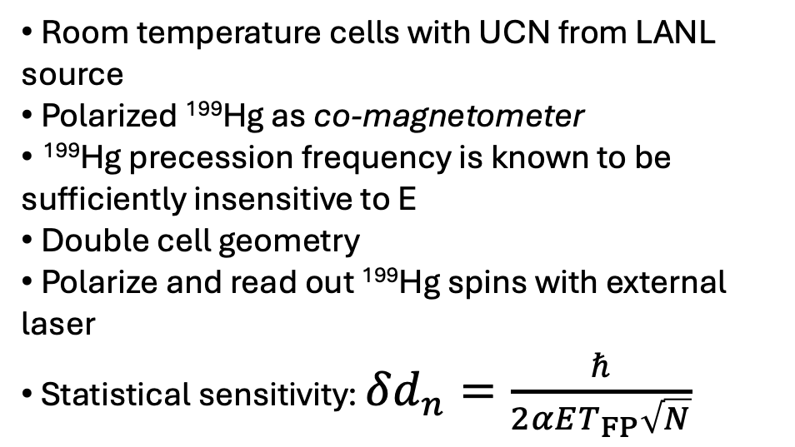
nEDM@LANL measurement
ν_{n} = (2μ_{n}B₀ + 2ed_{n}E)/h
Room temperature cells with UCN from LANL source
Polarized ¹⁹⁹Hg as co-magnetometer
¹⁹⁹Hg precession frequency is known to be sufficiently insensitive to E
Double cell geometry
Polarize and read out ¹⁹⁹Hg spins with external laser
Statistical sensitivity: $δd_{n}=\frac{ℏ}{2αET_{FP}\sqrt{N}}$
n
E
B₀
¹⁹⁹Hg
ν₃ = 2μ₃B₀ /h
ν_{n} = (2μ_{n}B₀ − 2ed_{n}E)/h
n
E
B₀
¹⁹⁹Hg
E
ν₃ = 2μ₃B₀ /h
E
B₀

Slide 28
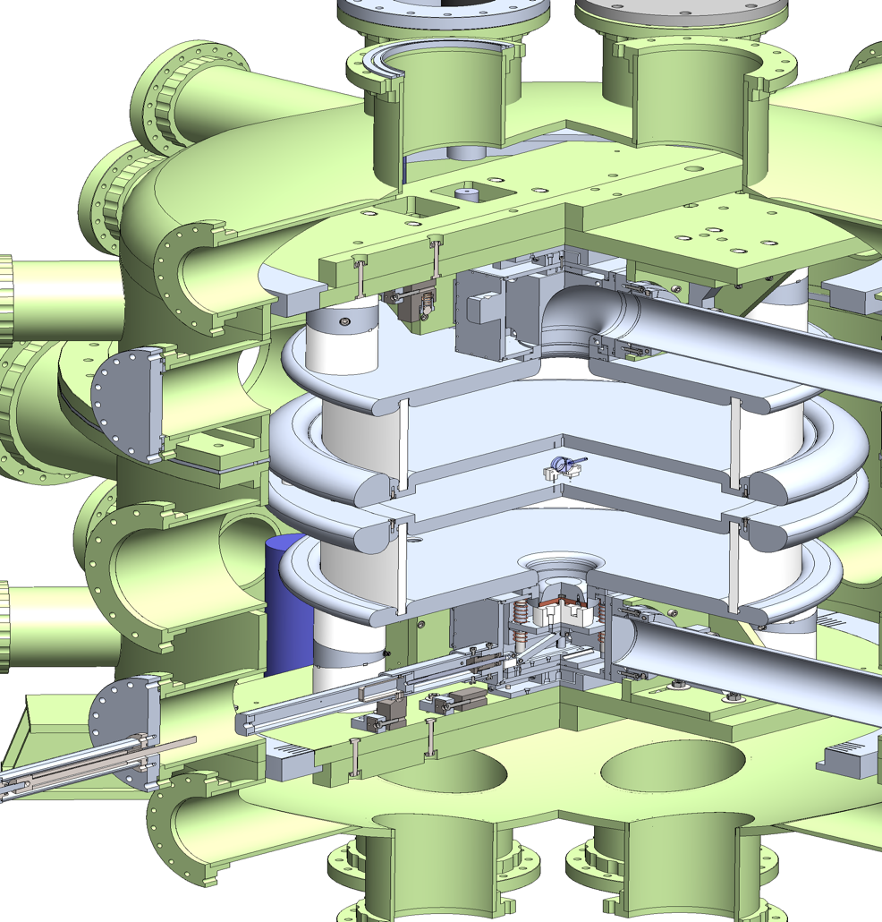
LANL nEDM Central Apparatus
^{Features:}
Non-magnetic vacuum vessel (LANL)
¹⁹⁹Hg co-magnetometer polarization cell, readout optics,(existing) laser system. (Yale/IU/UW)
External UCN spin analyzer (IU)
B0 coils (UKy)
4+ layer magnetically shielded room (IU, LANL)
External magnetometers (UMich, IU)
200 kV direct feed (LANL)
UCN valve (LANL)

Slide 29
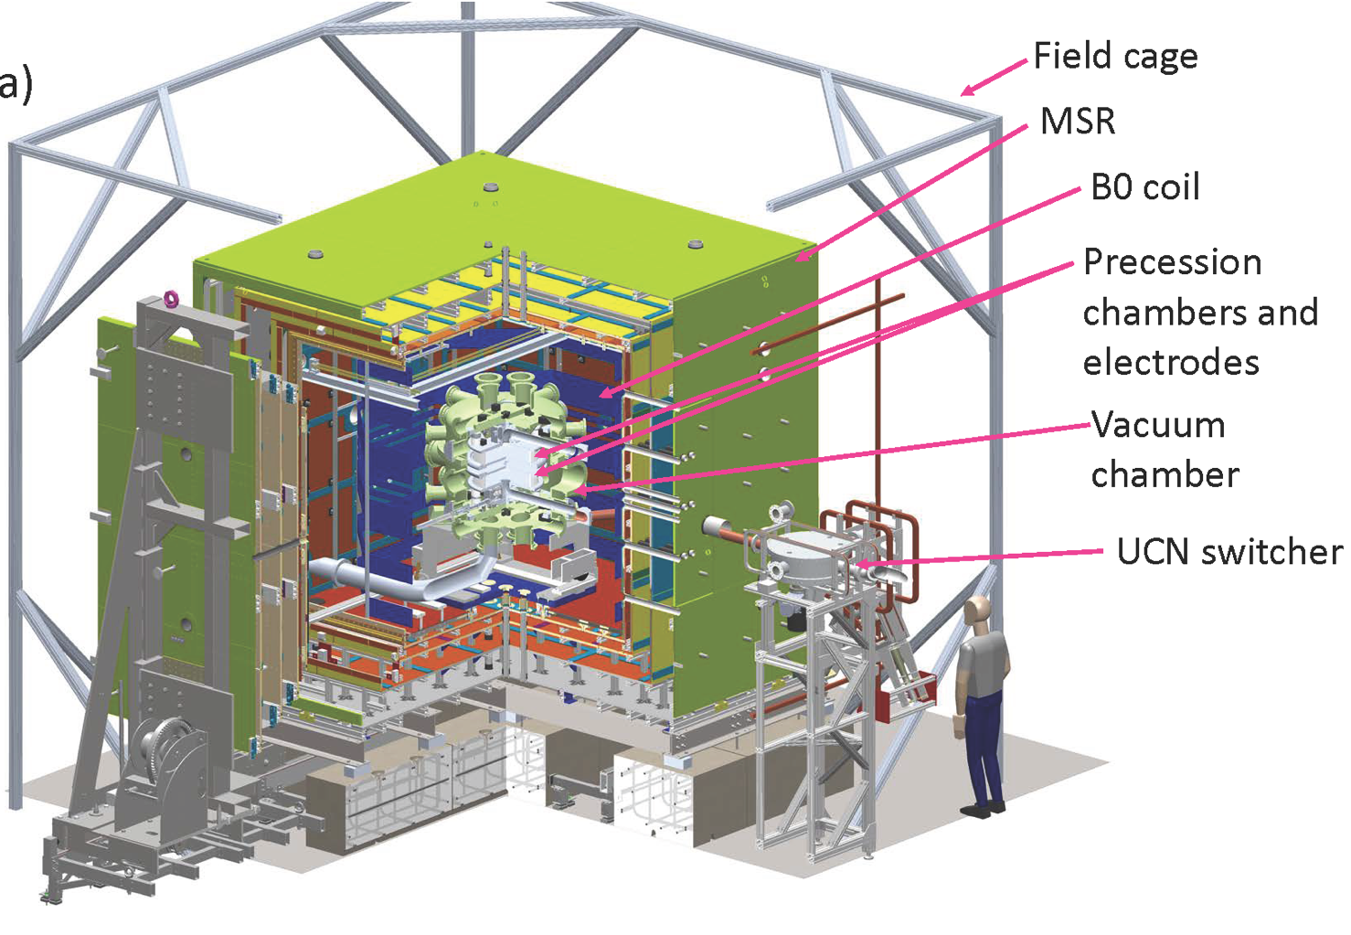
LANL nEDM

Slide 30
How would these experiments benefit from a more intense UCN source?
Reduces statistical uncertainty, which presently dominates the overall uncertainty in these experiments.
Enables data-driven systematics at full measurement precision
  Detailed studies of phase-space evolution in UCNτ
  Backscattering studies in UCNA
  Different B₀, holding period, etc. in nEDM
Enables stringent state selection (e.g., initial state cuts)
  E.g., check for systematics expected to scale with UCN energy
Enables smaller apparatuses, which can give better control of systematics
  E.g., smaller nEDM measurement cells
    Less sensitivity to B-field gradients
    Reduced gravitational effect (height of UCN ensemble center-of-mass versus that of comagnetometer)

Slide 31
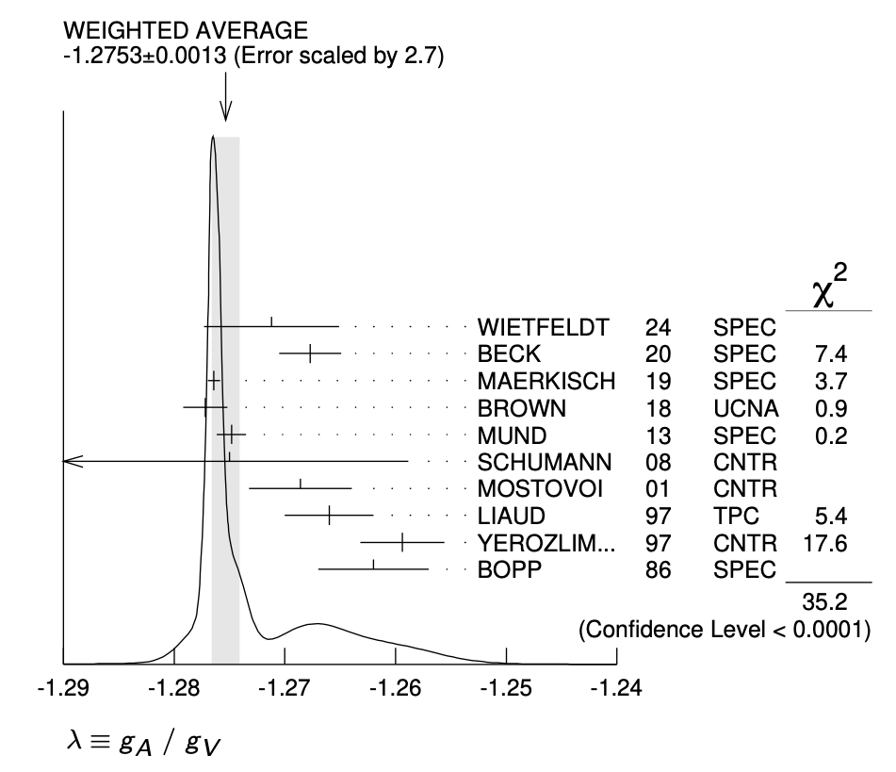
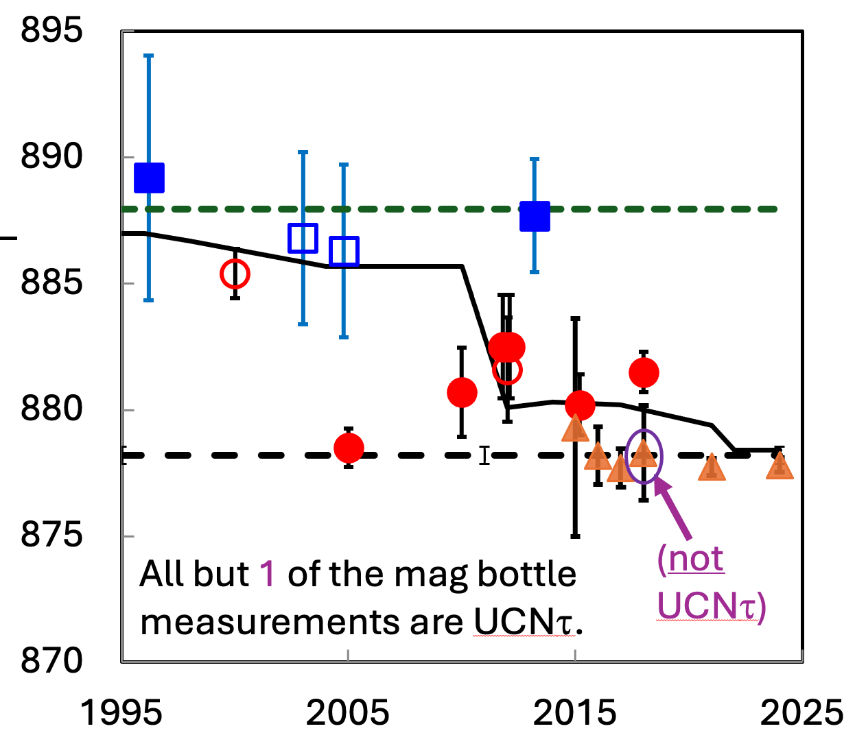
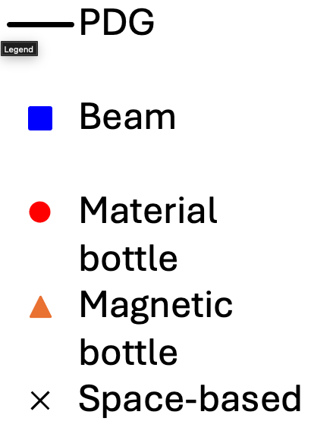
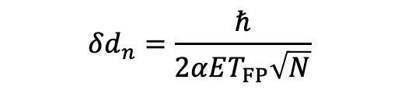
Which measurements are particularly needed?
PDG 2026
Pin down g_{A}
  Some tensions in the world data.
  Need complementary measurements in case of hidden systematics (or new physics!)
  Assuming agreement in upcoming physics results, still room for more improvement to match theory uncertainty in CKM unitarity test
Address neutron lifetime puzzle
  May depend on outcome of BL2…
  UCNProBe is a difficult experiment for similar reasons as the BL experiments.
Need a new idea to push nEDM sensitivity below a few 10⁻²⁷ e-cm
  Without a cryogenic nEDM experiment, no present efforts are realistically targeting sub 10⁻²⁷ e-cm sensitivity.
  Need a combination of long observation time, really high electric field, and lots of neutrons.
  Need to address systematics at this level.
$$δd_{n}=\frac{ℏ}{2αET_{FP}\sqrt{N}}$$

Slide 32
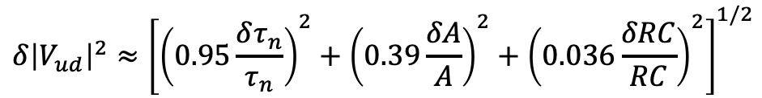

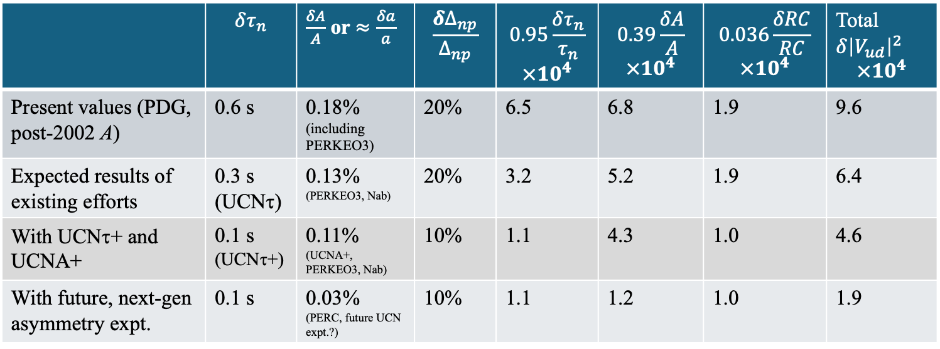
CKM test using V_{ud} from neutron decay
[Snapshot from a few years ago]
$$Δ_{CKM}≡{\left|V_{ud}\right|}^{2}+{\left|V_{us}\right|}^{2}+{\left|V_{ub}\right|}^{2}−1$$
$$δ{\left|V_{ud}\right|}^{2}≈{\left[{\left(0.95\frac{δτ_{n}}{τ_{n}}\right)}^{2}+{\left(0.39\frac{δA}{A}\right)}^{2}+{\left(0.036\frac{δRC}{RC}\right)}^{2}\right]}^{1/2}$$
 | $$δτ_{n}$$ | $\frac{δA}{A}$ or $≈\frac{δa}{a}$ | $$\frac{{δ∆}_{np}}{∆_{np}}$$ | $$0.95\frac{δτ_{n}}{τ_{n}}$$ $$×{10}^{4}$$ | $$0.39\frac{δA}{A}$$ $$×{10}^{4}$$ | $$0.036\frac{δRC}{RC}$$ $$×{10}^{4}$$ | Total$δ{\left|V_{ud}\right|}^{2}$ $$×{10}^{4}$$
Present values (PDG, post-2002 A) | 0.6 s | 0.18% (including PERKEO3) | 20% | 6.5 | 6.8 | 1.9 | 9.6
Expected results of existing efforts | 0.3 s (UCNτ) | 0.13% (PERKEO3, Nab) | 20% | 3.2 | 5.2 | 1.9 | 6.4
With UCNτ+ and UCNA+ | 0.1 s (UCNτ+) | 0.11% (UCNA+, PERKEO3, Nab) | 10% | 1.1 | 4.3 | 1.0 | 4.6
With future, next-gen asymmetry expt. | 0.1 s | 0.03% (PERC, future UCN expt.?) | 10% | 1.1 | 1.2 | 1.0 | 1.9
Compare to nuclear decay $δ{\left|V_{ud}\right|}^{2}≈5×{10}^{−4}$
Major assumption behind this table: that the results of these experiments are consistent (i.e., no need to inflate combined error).

Slide 33
Extra slides

Slide 34
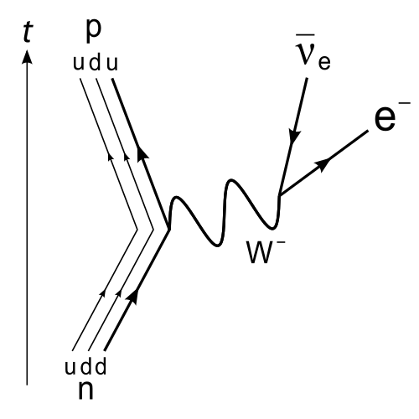


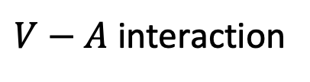


Neutron β decay at the quark level
$n→p+e+{\overline{ν}}_{e}$, β endpoint energy 782 keV
$$ν_{μ}$$
Muon decay
$$μ^{−}$$
$q^{2}≪m_{W}$: 4-fermion interaction
$V−A$ interaction
Quark level: $ℳ_{q}=\frac{G_{F}}{\sqrt{2}}V_{ud}\left[uγ_{μ}\left(1−γ_{5}\right)d\right]\left[eγ^{μ}\left(1−γ_{5}\right)ν_{e}\right]$
Notes:
In the standard model the decay proceeds through the weak interaction. At the quark level it looks a lot like muon decay, in fact with the same coupling constant.
At the momentum transfers relevant here, much less than the W mass, the matrix element reduces to a 4-fermion current-current interaction with the W mass absorbed into this constant, G_Fermi.
The currents are left-handed in the standard weak interaction, equal parts vector and axial-vector.
To get G_Fermi, we can measure the rate of muon decay, and that is how it is determined very precisely to less than one part-per-million precision.

Slide 35
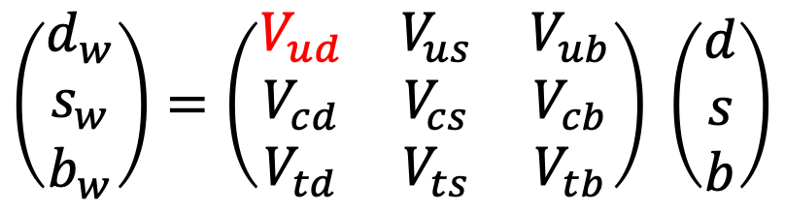
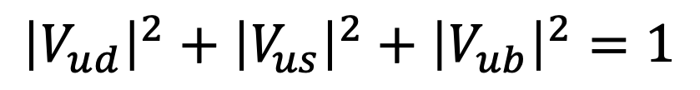
CKM Matrix
Quark level: $ℳ_{q}=\frac{G_{F}}{\sqrt{2}}V_{ud}\left[uγ_{μ}\left(1−γ_{5}\right)d\right]\left[eγ^{μ}\left(1−γ_{5}\right)ν_{e}\right]$
$$\left(\begin{matrix}d_{w} \\ s_{w} \\ b_{w}\end{matrix}\right)=\left(\begin{matrix}V_{ud} & V_{us} & V_{ub} \\ V_{cd} & V_{cs} & V_{cb} \\ V_{td} & V_{ts} & V_{tb}\end{matrix}\right) \left(\begin{matrix}d \\ s \\ b\end{matrix}\right)$$
Weak states
CKM mixing matrix
Mass eigenstates
Unitarity:
$${\left|V_{ud}\right|}^{2}+{\left|V_{us}\right|}^{2}+{\left|V_{ub}\right|}^{2}=1$$
Notes:
Different than muon decay however, we have to account for the fact that the quark states which participate in the weak interaction are not the same as the mass states.
That is parameterized by the CKM matrix, which must be unitary. Here we’re interested in the up-down term Vud that enters into neutron and nuclear beta decay.

Slide 36
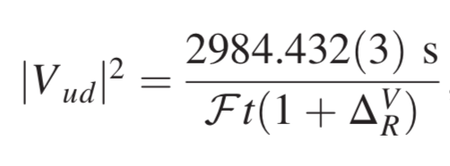
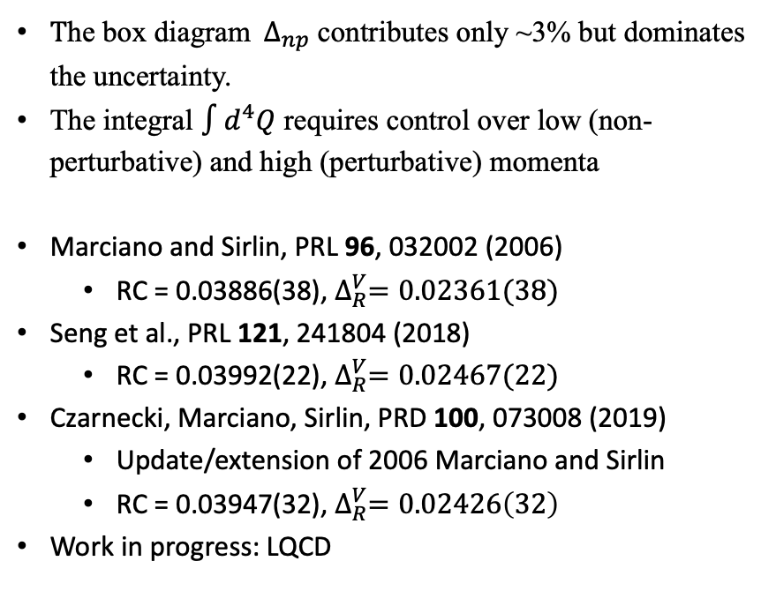

Beta decay radiative corrections
Neutron decay:
Superallowed nuclear decay:
$${\left|V_{ud}\right|}^{2}=\frac{5099.3\left(4\right)\text{s}}{τ_{n}(1+3g_{A}^{2})(1+RC)}$$
${\text{T}\text{he} \text{box} \text{diagram} Δ}_{np}$ contributes only ~3% but dominates the uncertainty.
The integral $∫d^{4}Q$ requires control over low (non-perturbative) and high (perturbative) momenta
Marciano and Sirlin, PRL 96, 032002 (2006)
  RC = 0.03886(38), $∆_{R}^{V}=0.02361(38)$
Seng et al., PRL 121, 241804 (2018)
  RC = 0.03992(22), $∆_{R}^{V}=0.02467(22)$
Czarnecki, Marciano, Sirlin, PRD 100, 073008 (2019)
  Update/extension of 2006 Marciano and Sirlin
  RC = 0.03947(32), $∆_{R}^{V}=0.02426\left(32\right)$
Work in progress: LQCD
RC for n decay
Notes:
An accurate and precise value for the electroweak radiative correction is required, and this requires calculation
Both neutron and nuclear beta decay do depend include a so-called universal radiative corrections for beta decay.
Most of the corrections can be calculated precisely, but there is a contribution shown by the diagram that dominates the uncertainty.
The difficulty is due to the need to integrate over all momenta, requiring control over the non-perturbative and perturbative regimes as well as the intermediate momenta.
I won’t read off the numbers here, but this is an active topic for computation and I’ve plotted the last few values for the neutron decay RC (the value for superallowed decay differs by a constant offset).
The more recent values seem to be accepted now.
2006 Marciano and Sirlin
Phenomonological (short distance: pQCD, long distance: dipole form factors, intermediate: interpolation)
2018 Seng et al.
Express hadronic gamma-W box diagram as a dispersion relation to relate to data on nu and nubar scattering
2019 CMS
[For neutron decay] “where ¯g(Em) represents long-distance loop corrections as well as bremsstrahlung effects averaged over the neutron beta decay electron spectrum and Em=1.292581 MeV is the end point electron energy specific to neutron decay. We find its updated value is slightly shifted to
α2π¯g(Em)=0.015035…
That contribution to the neutron decay RCs in Eq. (17) is specific to the neutron spectrum and is not maintained for other beta decays, although the function g(E) used to derive it is universal to all beta decays.
It, along with the 3ln(mZ/mp) term in Eq. (10), is independent of strong interaction effects [46]. The rest of that RC expression represents axial current induced effects that are dependent on strong interactions. They provide the main focus for this paper."

Slide 37

UCN sources around the world
Mainz* (Germany)
SD2, reactor
NCSU (USA)
SD2, reactor
PSI (Switzerland)
SD2, spallation
TUM (Germany)
SD2, reactor
ILL* (France)
Turbine, reactor
LHe, reactor
PNPI (Russia)
LHe, reactor
TRIUMF (Canada)
LHe, spallation
J-Parc (Japan)
SD2, spallation
LANL*(USA)
SD2, spallation
RCNP (Japan)
LHe, spallation
(moved to TRIUMF)
Operating sources (*Multi-experiment facilities)
Sources under construction

Slide 38



The in-situ Neutron Detector
Z. Wang et al., NIMA 798, 30 (2015).
⁷Li
⁴He
⁷Li+⁴He
n + ¹⁰B → ⁷Li + α
Light Output
Vacuum compatible: low outgassing
Realtime neutron counting (scintillation light)
(Relatively) fast neutron counting: detection time is 8-10 s
High neutron efficiency: each trapped neutron can have multiple interactions until absorbed.

Slide 39

View of the Halbach array and lowered UCN detector
UCN Detector
(¹⁰B/ZnS:Ag)
¹⁰B/ZnS:Ag Strips Taped to the Array for a Test

Slide 40


Polarized UCN density in a dummy nEDM cell
Vanadium foil
Cell
(20 liters)
Polarizing magnet (6 T)
Polarized UCN density (E < 170 neV) at t=0
13.6(6) UCN/cc from the fill and dump measurement (was 2.5 UCN/cc before the source upgrade )
39(7) UCN/cc from vanadium foil activation measurement
The difference can be attributed to loss in the switcher (~0.5) and the finite detection efficiency (~0.7).
To UCN source
Switcher
Cell valve
UCN detector

Slide 41
Estimated statistical sensitivity of LANL nEDM
Parameters | Values
E(kV/cm) | 12.0
N(per cell) | 39,100
T_{free} (s) | 180
T_{duty} (s) | 300
α | 0.8
σ/day/cell (10⁻²⁶ e-cm) | 5.7
σ/day (10⁻²⁶ e-cm) (for double cell) | 4.0
σ/year (10⁻²⁷ e-cm) (for double cell) | 2.1
90% C.L./year (10⁻²⁷ e-cm) (for double cell) | 3.4
This estimate is based on the following:
50 cm diameter cell
The estimate for E, Tfree, Tduty, and α is based on what has been achieved by other experiments.
The estimate for N is based on the actual detected number of UCN from our fill and dump measurement at a holding time of 180 s.
* “year” = 365 live days. In practice, it will take 5 calendar years to achieve this with 50% data taking efficiency and nominal LANSCE accelerator operation schedule

Slide 42


UCNA+ source calibration scanner
Prototype was fabricated and assembled.

Slide 43




UCNA+ detector
$$γ$$
Double layer Scintillator
256 edge coupled SiPM (Sensl C-Series)
  2xEljen EJ-200 scintillator
  2xCAEN DT5550w 128 SiPM readout/bias system (Citiroc)
Position and Energy read out with same detector
e-
Detectors are fully assembled
Tests with calibration sources in vacuum and with applied magnetic field are planned for early 2026.
Detector built by Prof. R. Pattie,Jr and undergraduate students

Slide 44



UCNτ/UCNτ+ Collaboration
Los Alamos National Laboratory: M. Blatnik, S. M. Clayton (co-spokesperson), C. Cude-Woods, S. A. Currie, M. A. Hoffbauer, T. M. Ito, S. Lin, M. Makela, C. L. Morris, S. Seestrom, C. O’Shaughnessy, M. Singh, I. Smythe, Z. Tang, F. W. Uhrich, P. L. Walstrom, Z. Wang
North Carolina State University: J. H. Choi, B. Chrysler, R. Musedinovic, N. Washecheck, A. R. Young
Oak Ridge National Laboratory: L. J. Broussard, F. Gonzalez, J. Ramsey, A. Saunders
Tennessee Technological University: C. Alfaro, A. Grice, A. T. Holley (co-spokesperson)
University of Illinois Urbana-Champaign: A. Clarke, W. Fox, C.-Y. Huang, C.-Y. Liu, A. Paghadal, L. Reeves, E. Thorsland, A. Wehe, K. Young
Argonne National Laboratory: N. B. Callahan
California Institute of Technology: A. Croley, B. Filippone, K. P. Hickerson, R. Zhu
DePauw University: A. Komives
East Tennessee State University: R. W. Pattie, Jr.
Indiana University/CEEM: L. Blokland, D. J. Salvat, W. M. Snow
Institut Laue-Langevin: P. Geltenbort
Joint Institute for Nuclear Research: E. I. Sharapov

Slide 45







UCNA+ R&D Collaboration
East Tennessee State University:
  T. Cox, J. Fry, A. Greathouse, K. Hawkins, R.E. McDonald IV, N. Meredith, R. W. Pattie JR
Indiana University/CEEM:
  M. Dawid, W. Fox, M. Luxnat, D.J. Salvat, J. Vanderwerp, G. Visser,
Los Alamos National Lab:
  M. C. Anderson, S. Clayton, , C. Cude-Woods, D. Fernandez, R. Gupta, T.M. Ito, S. Lin, M. Makela, C. Morris, C. O’Shaughnessy, E. Renner, Z. Tang, Z. Wang
North Carolina State University:
  J.H. Choi, B. Chrysler, K. Murer, R. Musedinovic, N. Washecheck, A.R. Young
Oak Ridge National Laboratory:
  F. Gonzalez, A. Saunders
Tennessee Technical University:
  A.T. Holley, L. Chapman, C. Hasting, E. Upton, C. Shepherd
University of Kentucky:
  R. Gupta, B. Plaster
University of Illinois- Urbana Champaign
  C.Y. Liu
Work supported by LANL LDRD program; the U.S. Department of Energy, Office of Science, Office of Nuclear Physics under Awards No. DE-FG02-ER41042, No. DE-AC52-06NA25396, No. DE-AC05-00OR2272 and No. 89233218CNA000001 under proposal LANLEEDM; NSF Grants No. 1614545, No. 1914133, No. 1506459, No. 1553861, No. 1812340, No. 1714461, No. 1913789, No. 2209511, No 2515036.
Student researchers in bold.

Slide 46




LANL nEDM Collaboration
LANL=Los Alamos National Laboratory
UK=University of Kentucky
UM=University of Michigan
UIUC=University of Illinois
IUB=Indiana University
YU=Yale University
UW=University of Washington
ETSU=East Tennessee State University
R&D Funding:

