Slide 1


Overview of Accelerator Driven Systems
Stuart Henderson
June 11, 2026

Slide 2
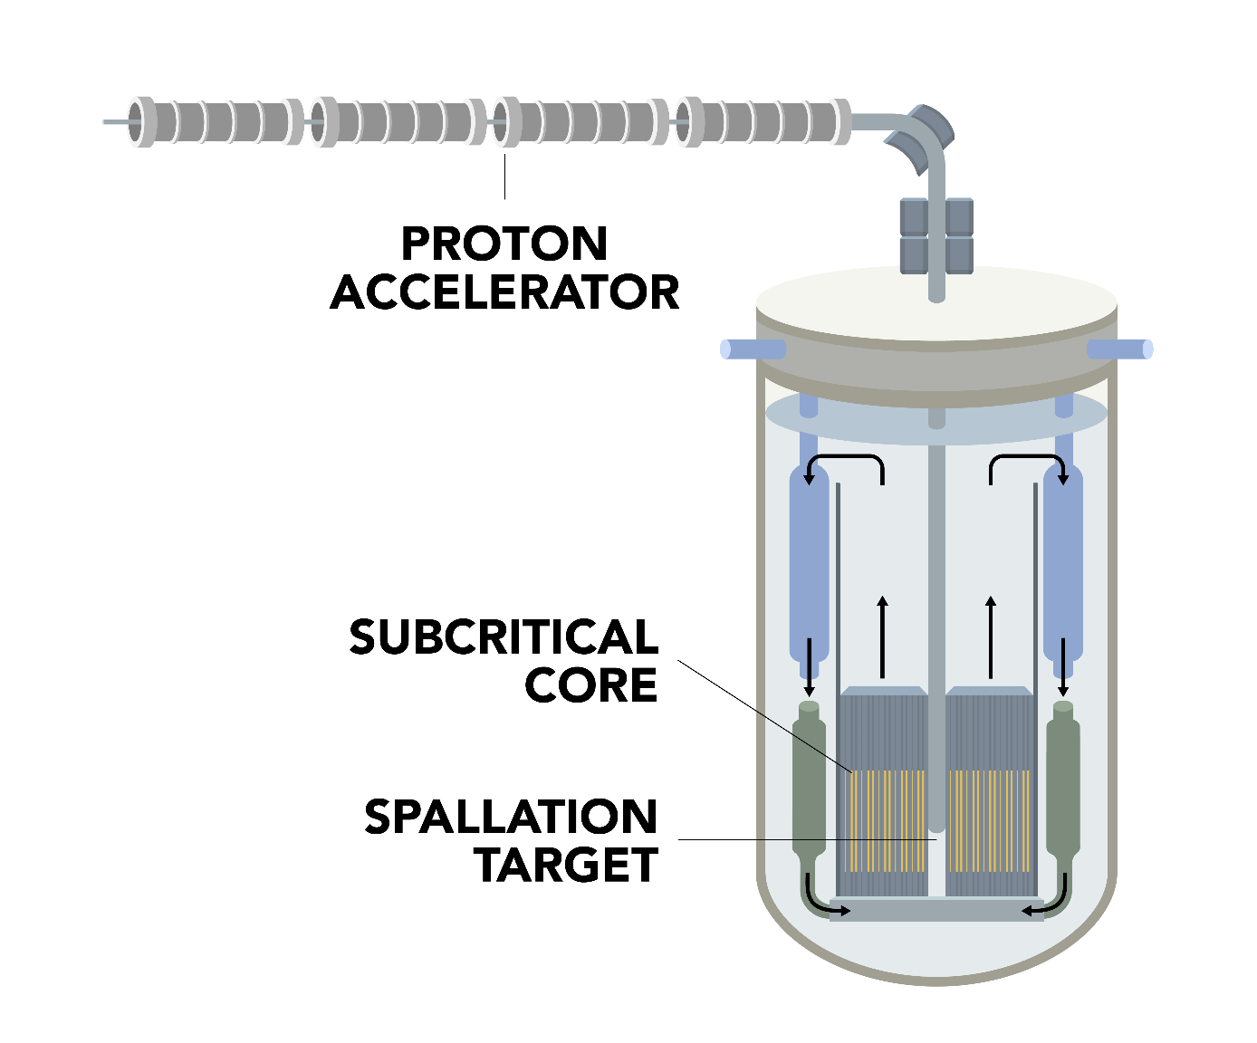
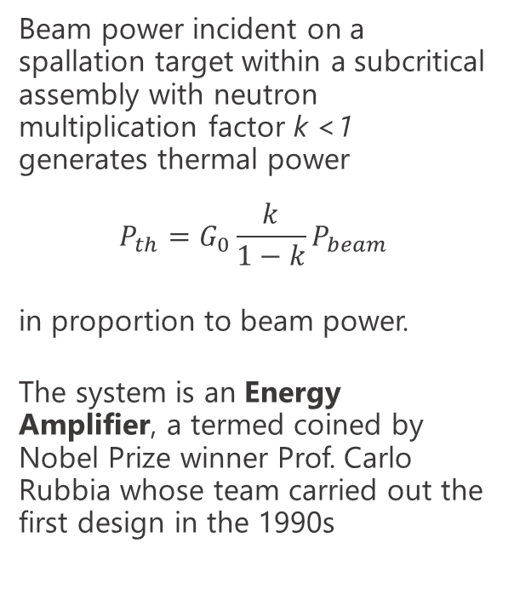
Accelerator-Driven Subcritical Systems Concept
Proton accelerator provides an external, controllable source of neutrons (via spallation) sustaining fission in subcritical assembly
Lead-cooled Subcritical Assembly maintains a safe minimum margin of subcriticality in all conditions
Subcritical core can utilize a wide range of fuels, therefore can serve multiple missions including energy production and transmutation of problematic isotopes in spent nuclear fuel
With neutron multiplication factor k < 1, the system generates thermal power in proportion to beam power – an Energy Amplifier

Slide 3
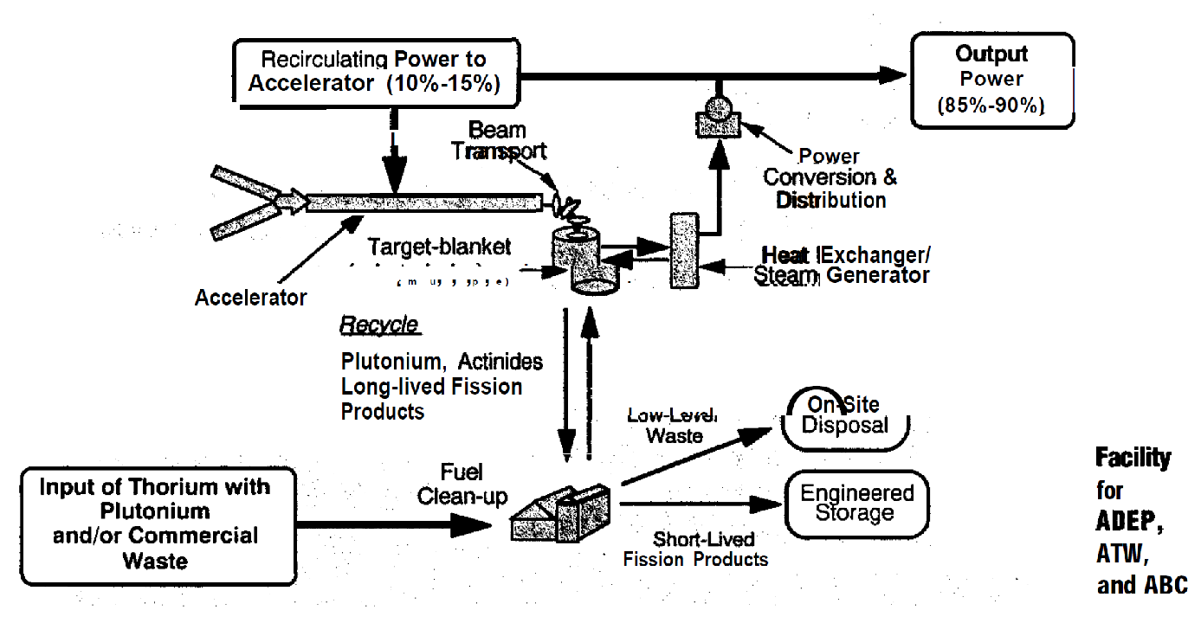
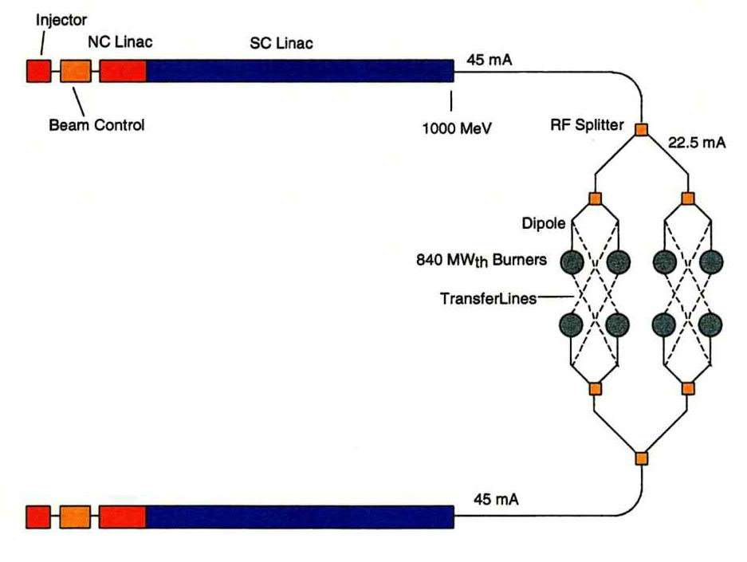
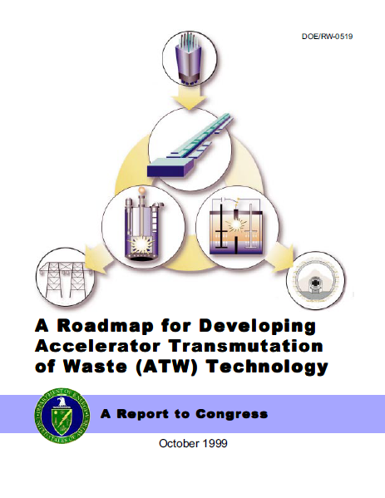
Accelerator Transmutation of Waste at Los Alamos National Laboratory (1992-2000)
LANL developed R&D program focused on transmutation of nuclear waste.
  Collaboration with several DOE national laboratories (Oak Ridge, Brookhaven and Sandia) and industrial partners (Grumman, Bechtel, Westinghouse, B&W and Kaman)
Related programs explored accelerator production of tritium, establishing linac performance and reliability requirements directly applicable to the Energy Amplifier.
Key technologies developed: high power SRF linac design, subcritical target blanket physics, beam control systems, and power conversion architecture.

Slide 4
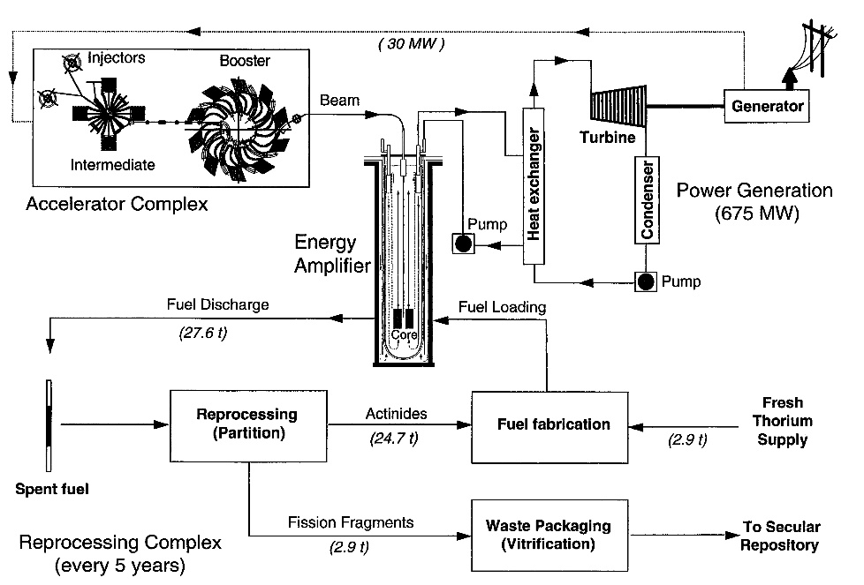
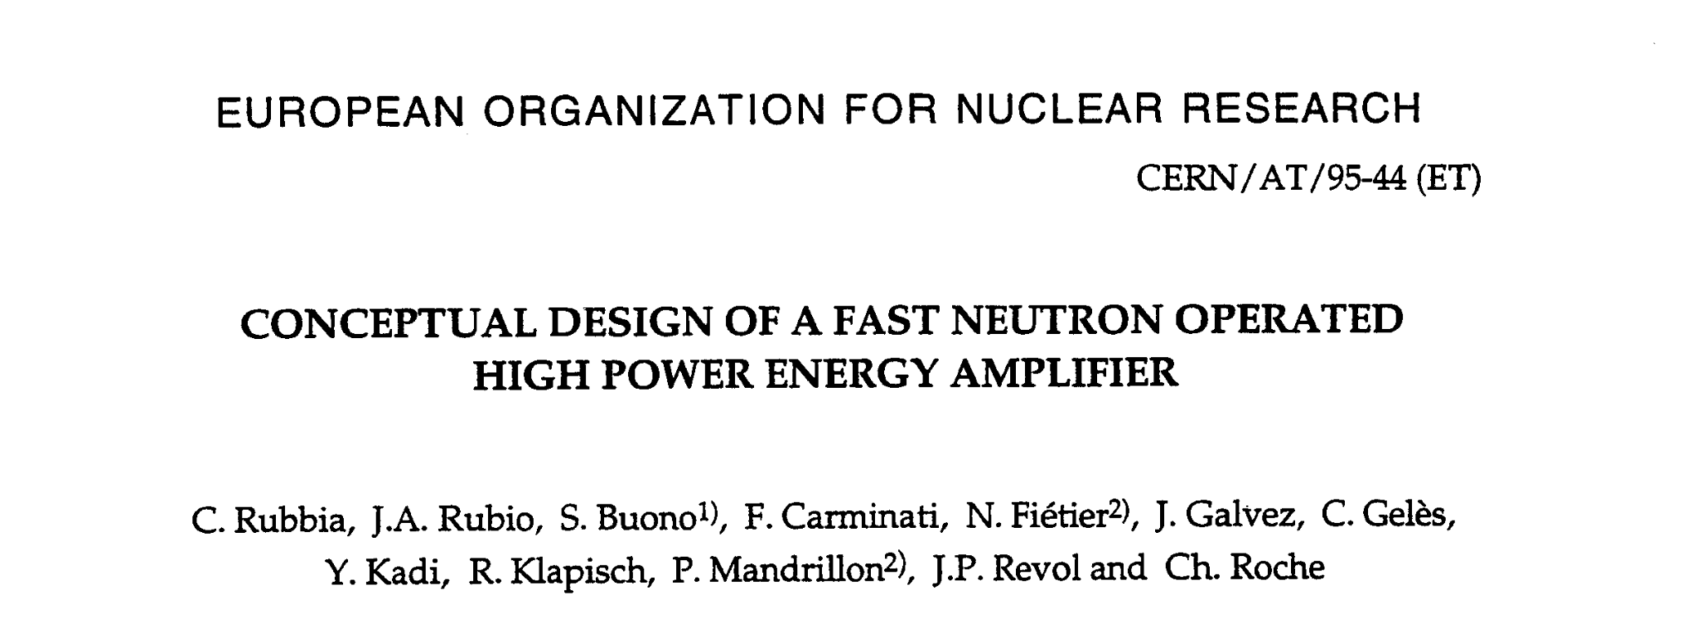
Carlo Rubbia’s Thorium Energy Amplifier (1993)
CERN Nobel prize winner Carlo Rubbia proposed and developed the Thorium Energy Amplifier, an Accelerator Driven Subcritical System to burn Thorium fuel for power production

Slide 5
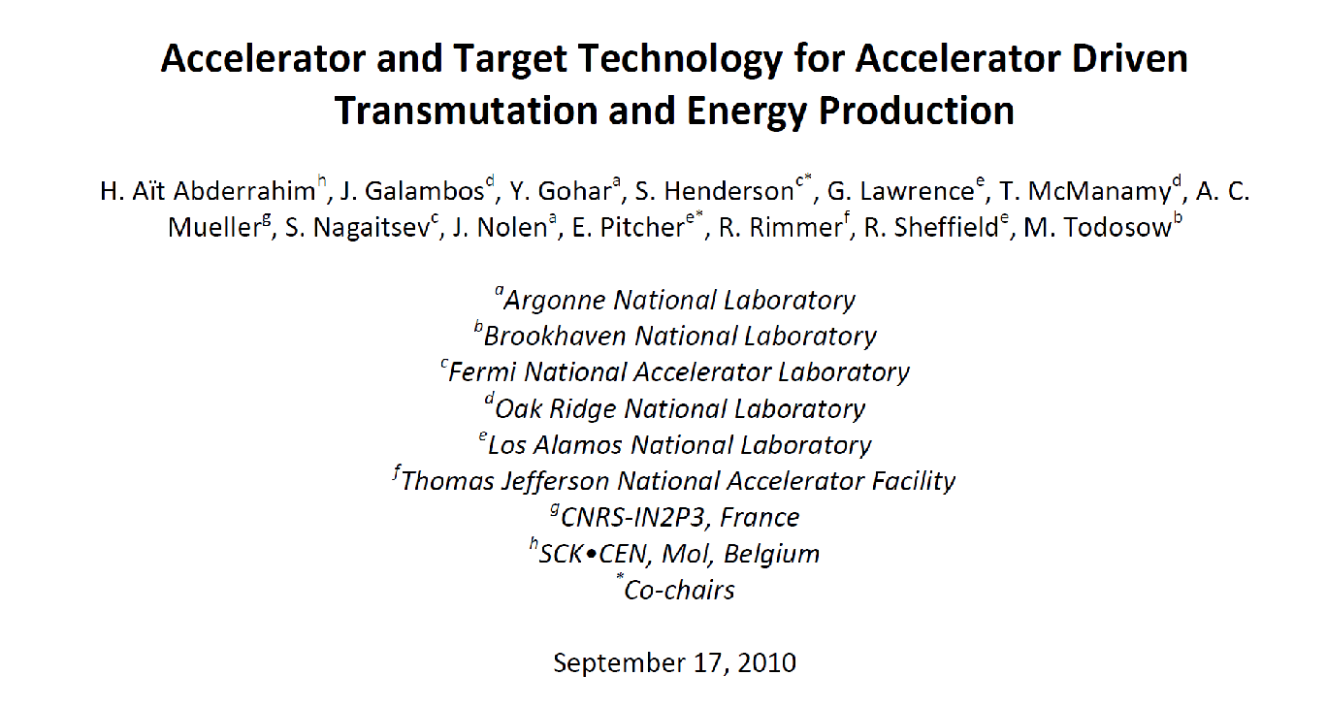
DOE Assessment of Accelerator And Target Technology (2010)
DOE commissioned a technology assessment, co-chaired by S. Henderson and E. Pitcher with a group of international scientists.
Report positively assessed the technology and its readiness, was briefed to DOE Energy Secretary S. Chu, and gained traction in the U.S.
Fukushima accident happened 7 months later and appetite for advanced nuclear systems withered

Slide 6
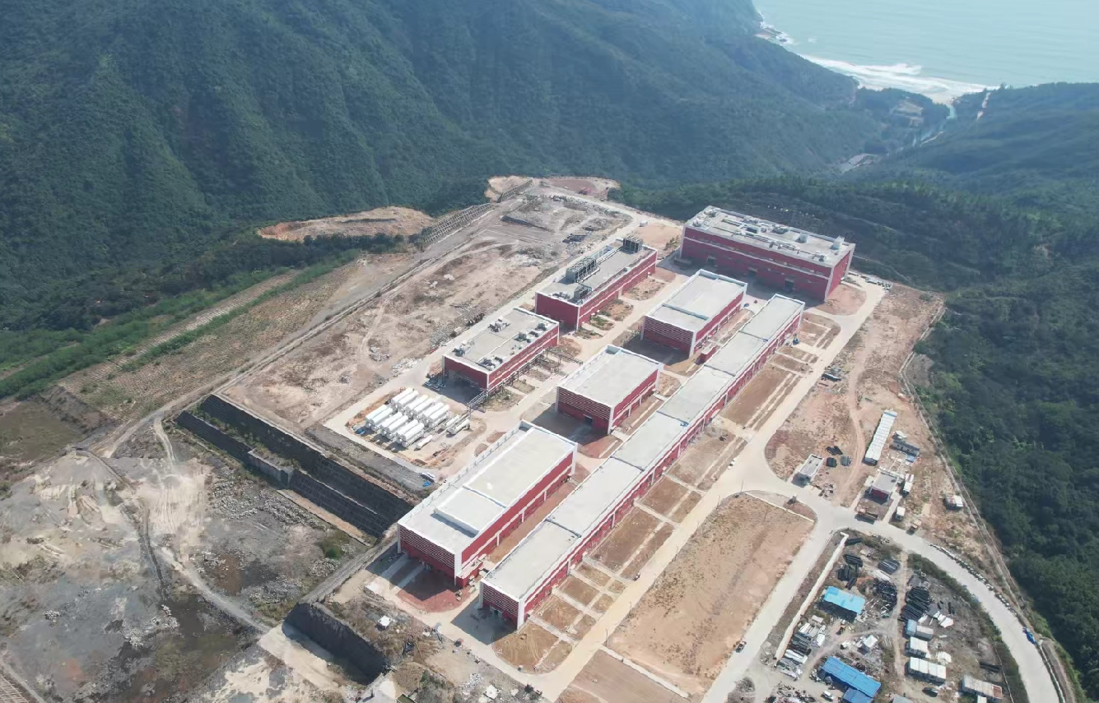
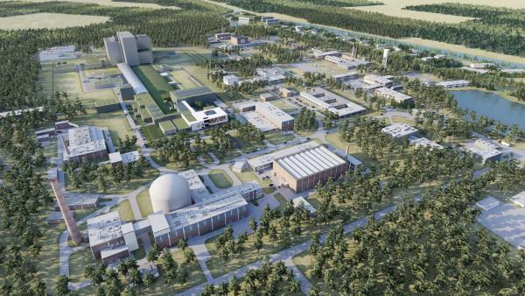
Significant ADS activities are underway in China and Europe
China ADS Initiative (CiADS) site in Huizhou; partnership of Chinese Academy of Science, China National Nuclear Corporation, China General Nuclear Power Group
Europe: MYRRHA. Belgian Center for Nuclear Research (SCK-CEN) in Mol.; replaces BR-2 research reactor with an ADS driving 50-100 MW subcritical core

Slide 7
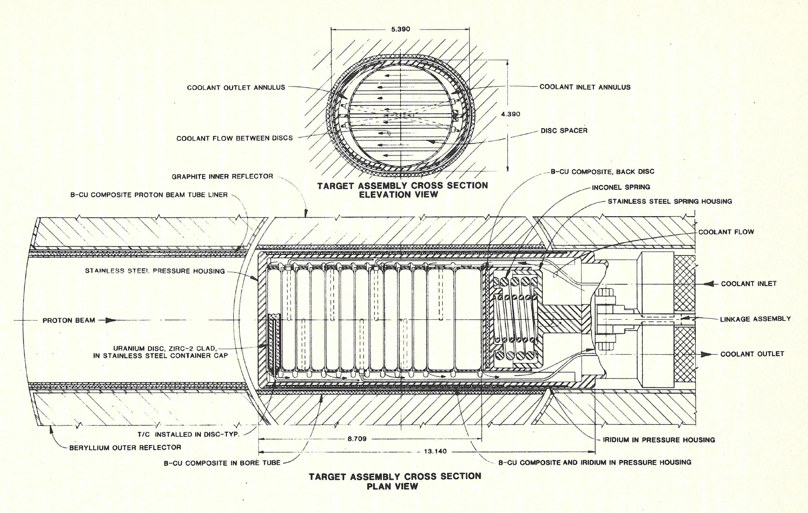
Coupling of accelerators to reactors and fissile material has been investigated and demonstrated since the 1980s
The Intense Pulsed Neutron Source (a neutron spallation source) at Argonne National Laboratory operated an accelerator-driven enriched uranium subcritical target assembly from 1988-1991 for the purpose of generating neutrons for scientific research
The subcritical target assembly had the following features:
77%
Enriched Uranium
k-eff = 0.8
Subcriticality Level
500 MeV, 14 uA
Proton beam, 7kW beam power
49 kW
Fission power generated with 7kW proton beam, energy gain of 7
Demonstrated a factor of 7 energy amplification from accelerator induced fission.

Slide 8
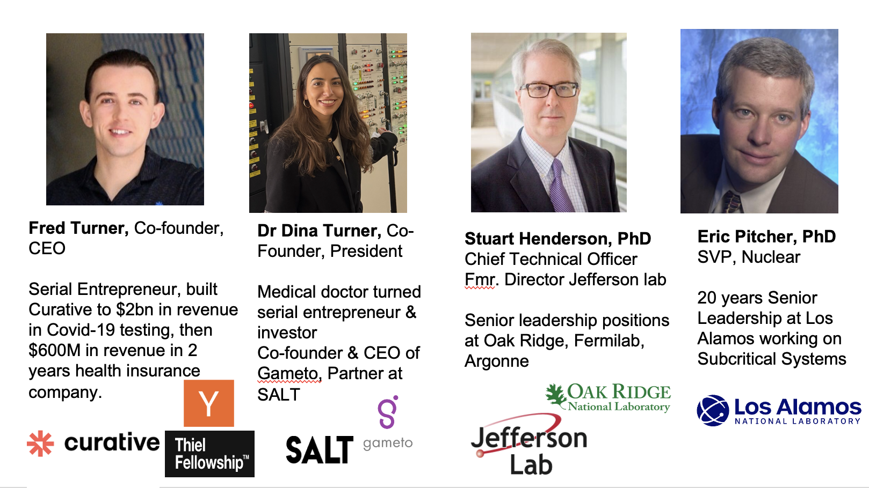






Subcritical Systems Inc. Is Commercializing Energy Amplifier Technology
Based in Austin, Texas, bringing the Energy Amplifier concept to the marketplace for electrical power generation
Leadership Team Is comprised of entrepreneurs & investors who have built multi-billion dollar companies and scientists with deep experience in the technology
Steve Jurvetson, Managing Director Future Ventures - Investor
Founding investor in SpaceX, Tesla, and Commonwealth Fusion Systems

Slide 9
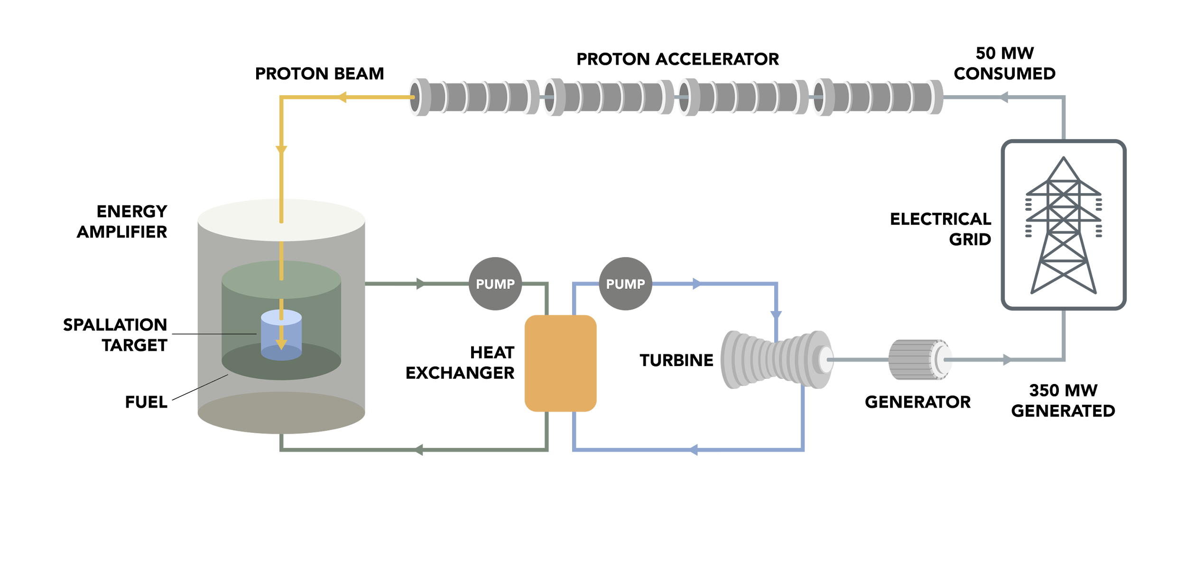
Subcritical Systems Energy Amplifier Plant-Level Characteristics
Gross thermal power | 935 MW
Gross Primary electric power | 350 MW
Thermodynamic efficiency | 37.5%
Core system multiplication, keff, max | 0.97
Coolant/target | Pb
Proton beam energy | 1500 MeV
Proton current maximum | 13.5 mA
Beam power maximum | 20 MW
Primary coolant outlet temp. | 540 °C
Subcritical Rankine cycle with superheated steam

Slide 10
Features and Benefits of the Energy Amplifier for Fission Power
Unmatched Safety
Part 70 Regulatory Path
Technology is In-hand
Fuel Cycle Flexibility
Subcritical by Design: Remains subcritical in all normal and off-normal conditions
Externally Driven Fission: Particle accelerator allows for a rapid on-off switch
Passive Safety: Features are incorporated throughout
Not a critical reactor, therefore regulated under Part 70 SNM license
Enables rapid deployment with cost effective construction and competitive cost of electricity
Part 70 applies a risk-informed, performance-based QA program (Subpart H) scoped only to items relied on for safety (IROFS)
Does not require separate construction license
Uses existing technology and capitalizes on developments in the national labs
Fast spectrum system offers advantages in fuel utilization, long fuel life-reduced refuleing, high operating temperature and low pressure
Favorable safety physics and compatibility with passive heat remove systems
The combined features of a fast neutron spectrum and subcriticality by design offer significant potential to capitalize on the future evolution of the fuel cycle
Offers long-term prospect for transmutation of spent nuclear fuel
Stuart Henderson - Subcritical Systems, Inc.

Slide 11
The Energy Amplifier is not regulated like a critical reactor.
NRC confirmed vastly simpler licensing pathway (Part 70)
The NRC staff has completed its review of the white paper and is basing its response on the following key assumptions:
• The integrated ADS will be designed and operated as subcritical, so it does not meet the definition in 10 CFR 50.2 for a nuclear reactor because the ADS system is not “designed or used to sustain nuclear fission in a self-supporting chain reaction.”
• The integrated ADS will be designed and operated for the sole purpose of generating electrical power; however, so it does not meet the current definitions in 10 CFR 50.22 for either a utilization facility or a production facility.
• The particle accelerator portion of the ADS meets the 10 CFR 30.4 definition….
Given these key assumptions presented in the white paper, 10 CFR Part 30 and Part 70 appear to be a viable licensing pathway.
Subcritical Systems Docket Number 07007043

Slide 12
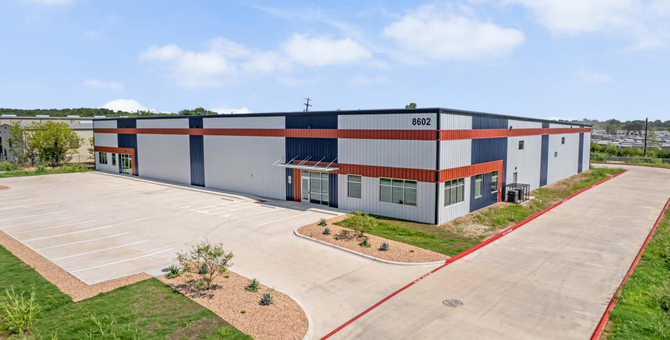
Subcritical Systems is developing the capabilities to construct multiple units, with resulting economies of scale
Technical approach:
Utilize proven technology in use worldwide: accelerator design is based on SNS
Capitalize on completed and ongoing R&D for further cost reduction and minimization of performance risk
Utilize standardized modular components and systems manufactured on assembly lines
Develop in-house production capability for critical components to manage supply-chain risk
Capitalize on fuel flexibility, evolving as the supply chain evolves
Subcritical Systems Headquarters, Austin TX

Slide 13
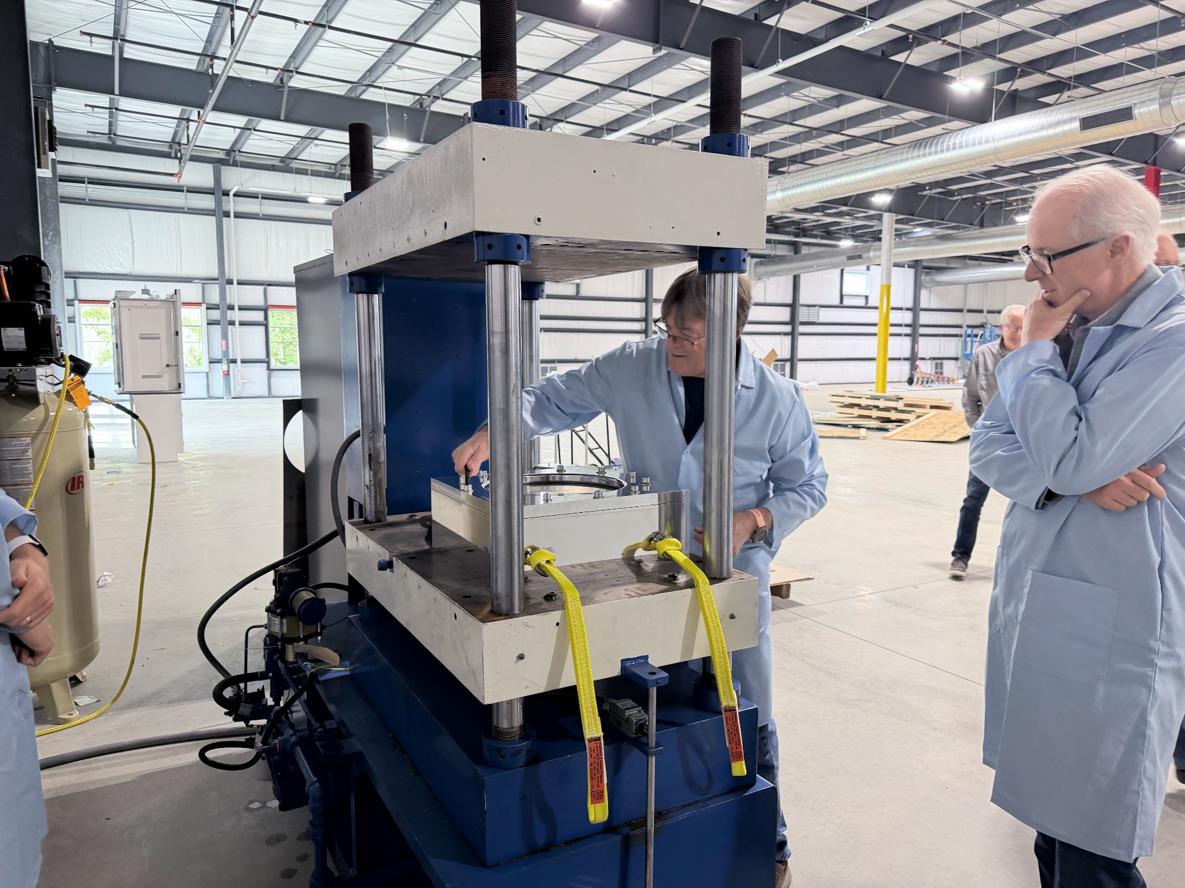
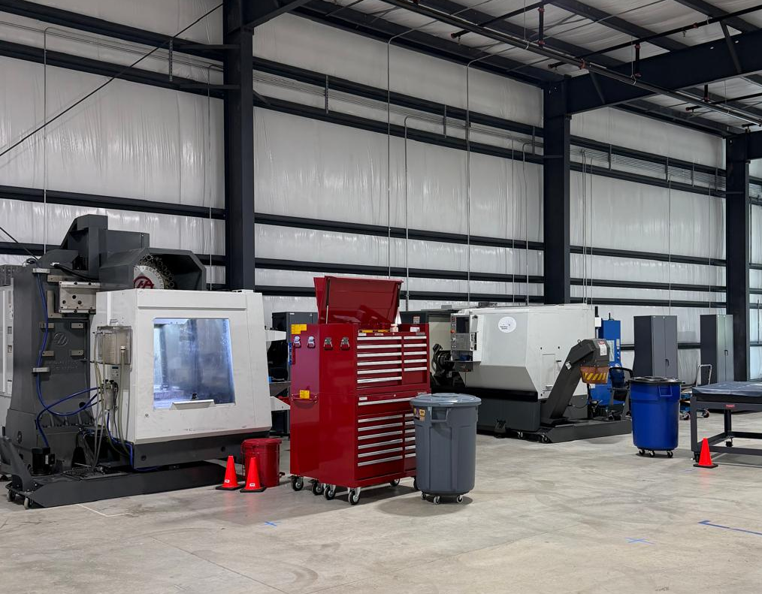
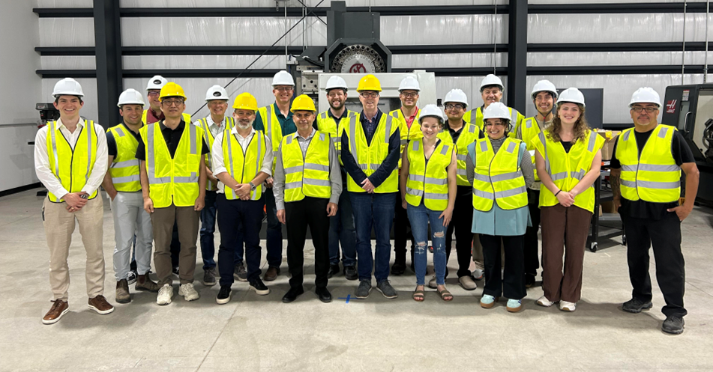
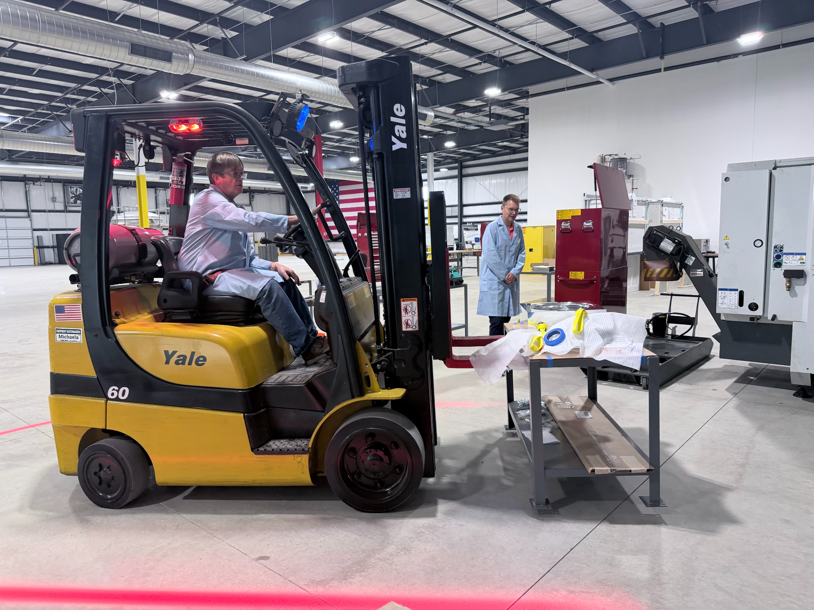
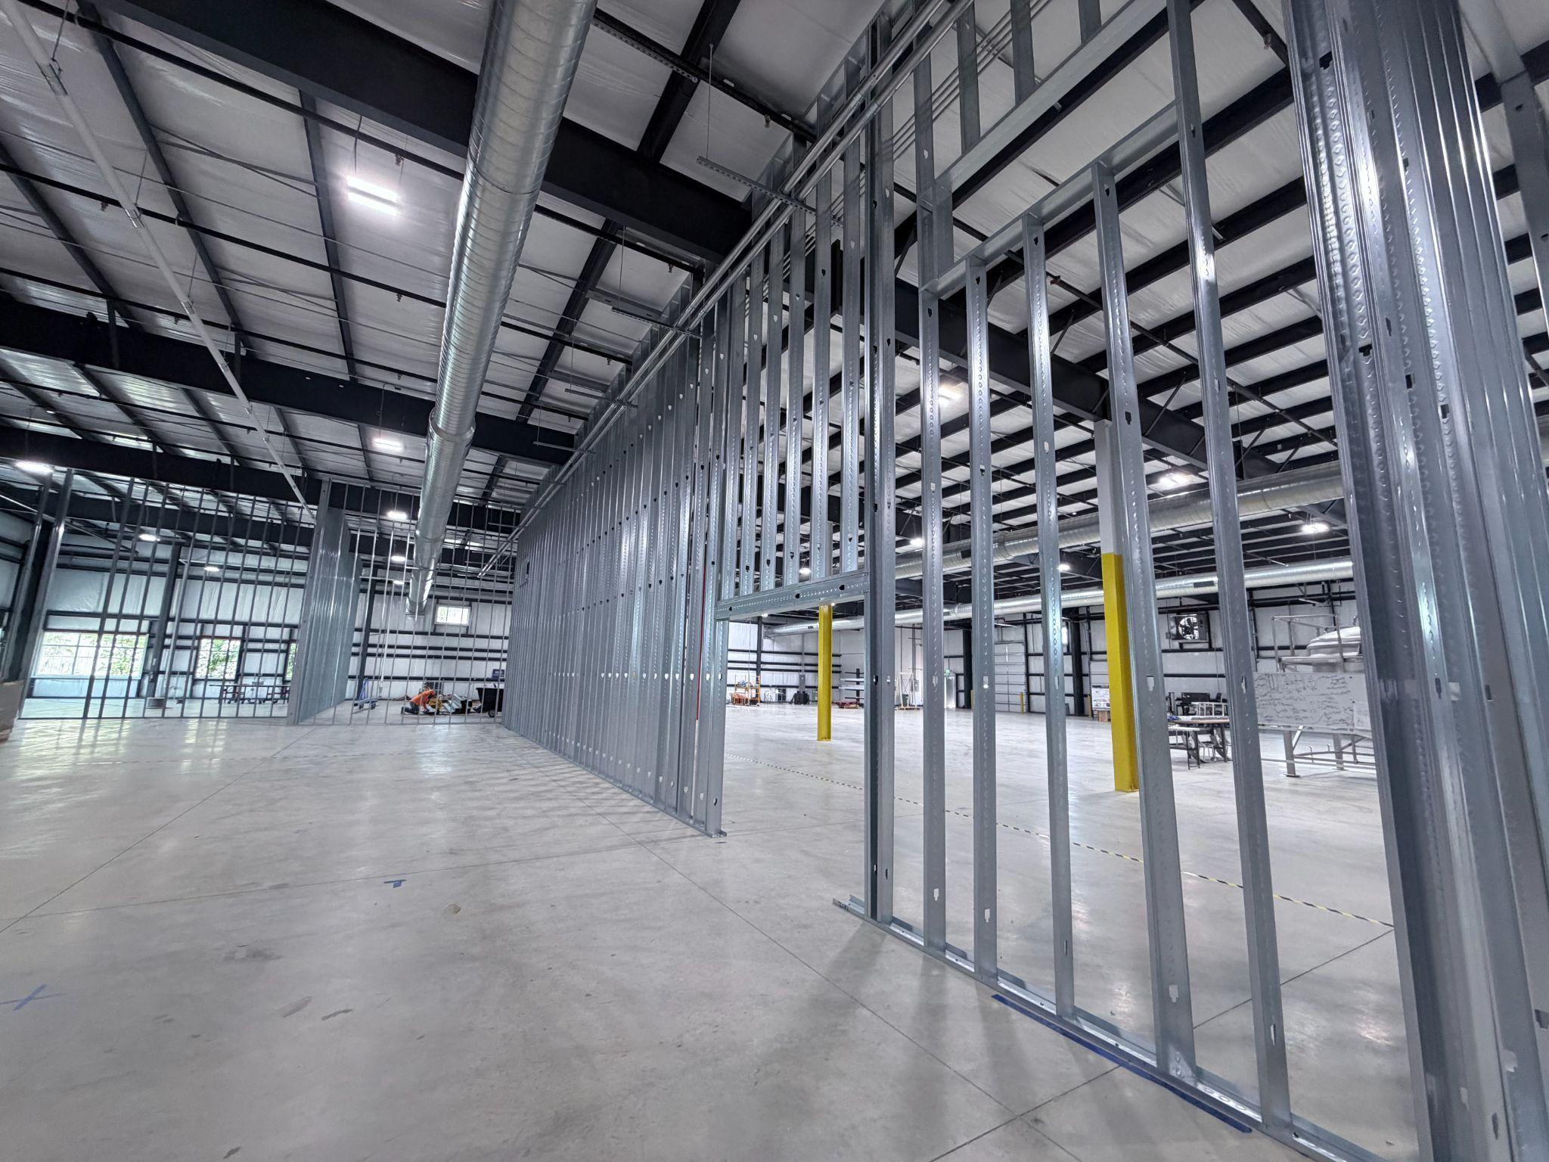
Vertical integration of key accelerator components in our manufacturing facility in Austin, TX
Goal is end-to-end fabrication of cryomodules, including SRF cavities and couplers
Stuart Henderson - Subcritical Systems, Inc.

Slide 14
Subcritical System’s Interest in a 3rd SNS Target Station
Materials Irradiation
Deeper burnup in a fast-spectrum system ultimately limited by e.g. fuel cladding material – need access to very high dpa rates
Neutron multiplying assembly PoP and demonstration tests
Prototyping
Validation of codes and reduction in uncertainties
keff measurement techniques and validation
Note: Requires capability of handing/irradiating fissile material
Transmutation
Access to fast neutron spectrum for transmutation research
Technical Component testing/verification
Proton beam window design verification (normal and off-normal function)
Isotope Production R&D
Access to high power beam for prototyping high-power irradiation approaches

Slide 15

Contact Information
Subcritical Systems Inc.
8602 Lava Hill Rd. Austin, TX 78744
www.subcritical.com
Commercial Inquiries:
Stuart Henderson PhD, I CTO I stuart@subcritical.com
Dr. Dina Turner I Co-founder, President I dina@subcritical.com
Fred Turner I Co-founder, CEO I fred@subcritical.com
Proudly Built in America. Power America.

Slide 16
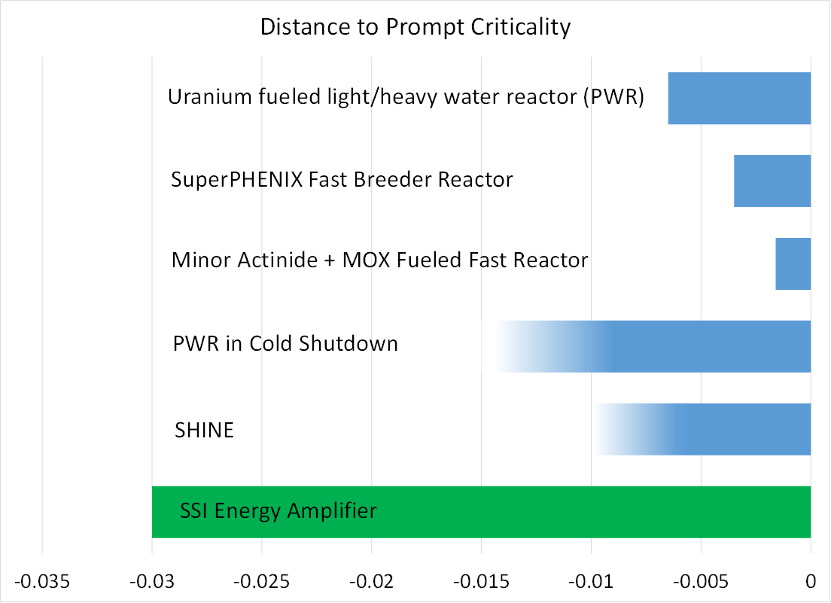
The Energy Amplifier with k_{eff} < 0.97 is deeply subcritical, with no mechanism for reactivity insertion
At k_{eff} = 0.97 the SSI subcritical core degree of subcriticality is 300% greater than that accepted by the NRC as sufficient for “cold standby” of 3-GW scale commercial reactors (Westinghouse PWR)
During operation and credible events, there is no plausible means to insert reactivity into the system other than reducing subcritical core temperature
With a 𝛽_{eff} = 0.00687, at k_{eff} = 0.97 the SSI core is 4.4$ subcritical

Slide 17
Summary of Accelerator-Subcritical Core Coupling Experiments and Facilities
Experiment / Facility | Location | Timeframe | Accelerator | Neutron Source
Kharkiv Inst. Phys. & Tech. | Ukraine | 2019-2022 | 100 MeV electron; 100 kW | photonuclear in W/U
Kyoto Univ. Res. Reactor Inst. | Japan | 2009-present | 100 MeV proton | spallation; W, Pb-Bi
GUINEVERE, SCK-CEN | Belgium | 2009-2014 | 250 keV Deuterium | D-T, 14 MeV neutrons
RACE, Idaho State & UT-Austin | U.S. | 2003-2006 | 30 MeV electron | photonuclear in W/U
YALINA | Belarus | 1997-2008 | Deuterium | D-D, D-T, 2.5, 14 MeV neutrons
MUSE | France | 1995-2004 | Deuterium 200 keV | D-D, D-T, 2.5, 14 MeV neutrons
Argonne Intense Pulsed Neutron Source | U.S. | 1988-1991 | 500 MeV proton; 7 kW | 77% enriched Uranium assembly; keff ~0.8

Slide 18
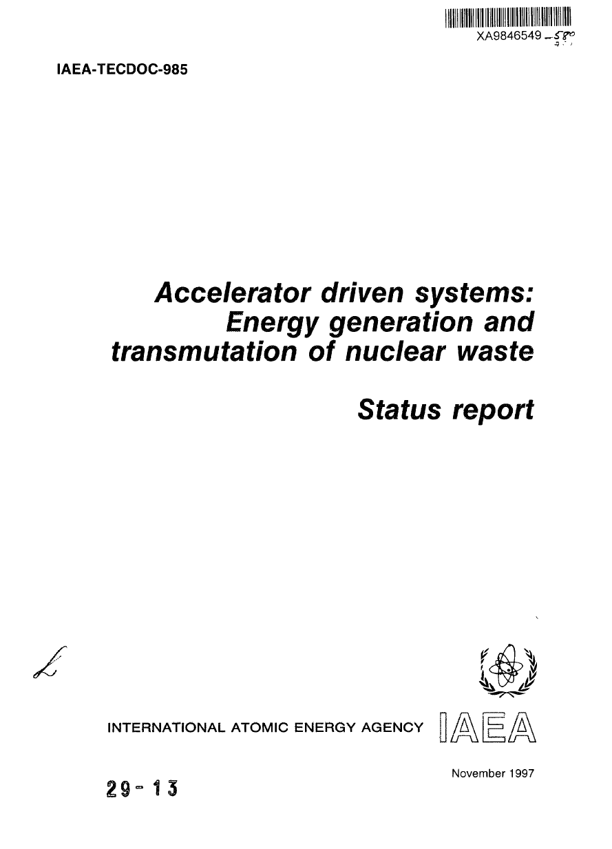
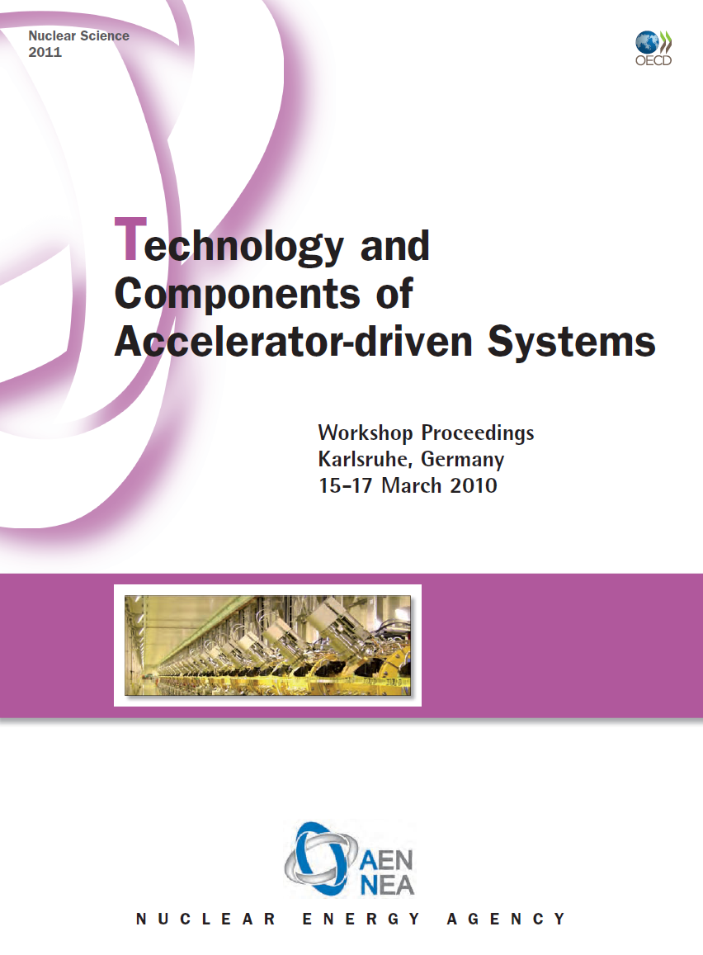
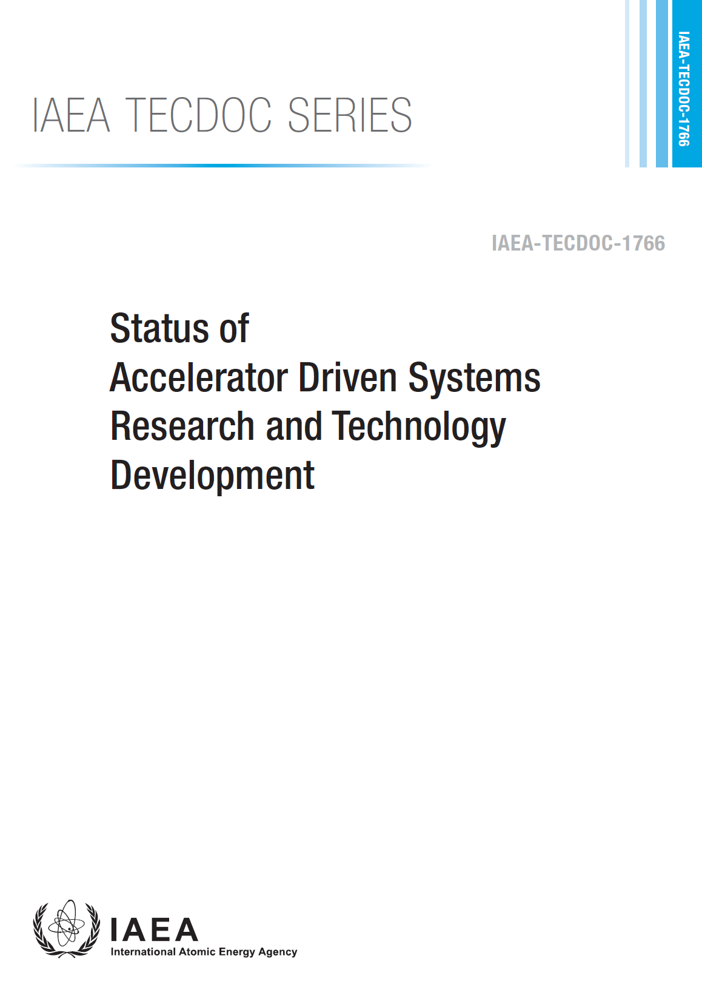
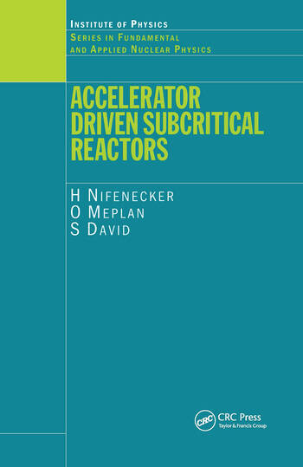
The concept of Accelerator Driven Systems is not new and has been thoroughly studied worldwide over four decades
Two concepts were thoroughly developed in the 1990s
CERN Nobel prize winner Carlo Rubbia’s Thorium Energy Amplifier (1995)
Los Alamos National Laboratory’s Accelerator Driven Transmutation Technologies program (1994)
Accelerator and Target Technology for Accelerator Driven
Transmutation and Energy Production
S. Henderson, E. Pitcher, Co-Chairs
DOI:https://doi.org/10.2172/1847382
18

