Slide 1
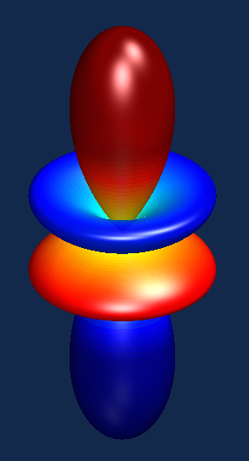
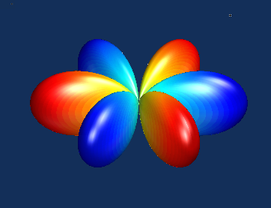


Cooperative use of muons and neutrons to sleuth ‘hidden’ order in f-electron magnets
Gregory J. MacDougall
University of Illinois at Urbana-Champaign

Slide 2
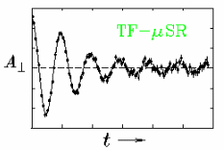
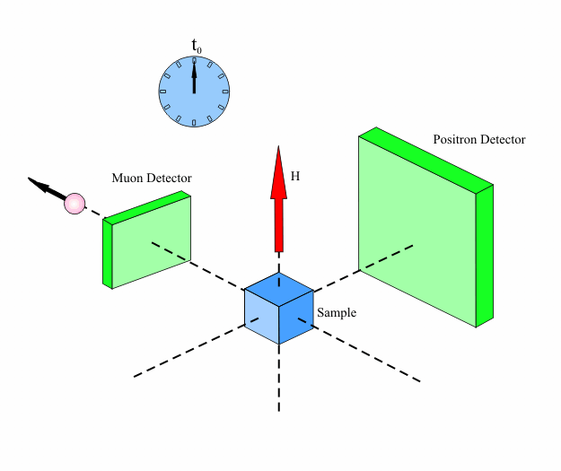
Muon spin rotation/relaxation (μSR)
Muon precession reflects the magnet field environment inside materials
Frequency Mean field
Amplitude Volume fraction
Relaxation Second moment
/Fluctuations

Slide 3
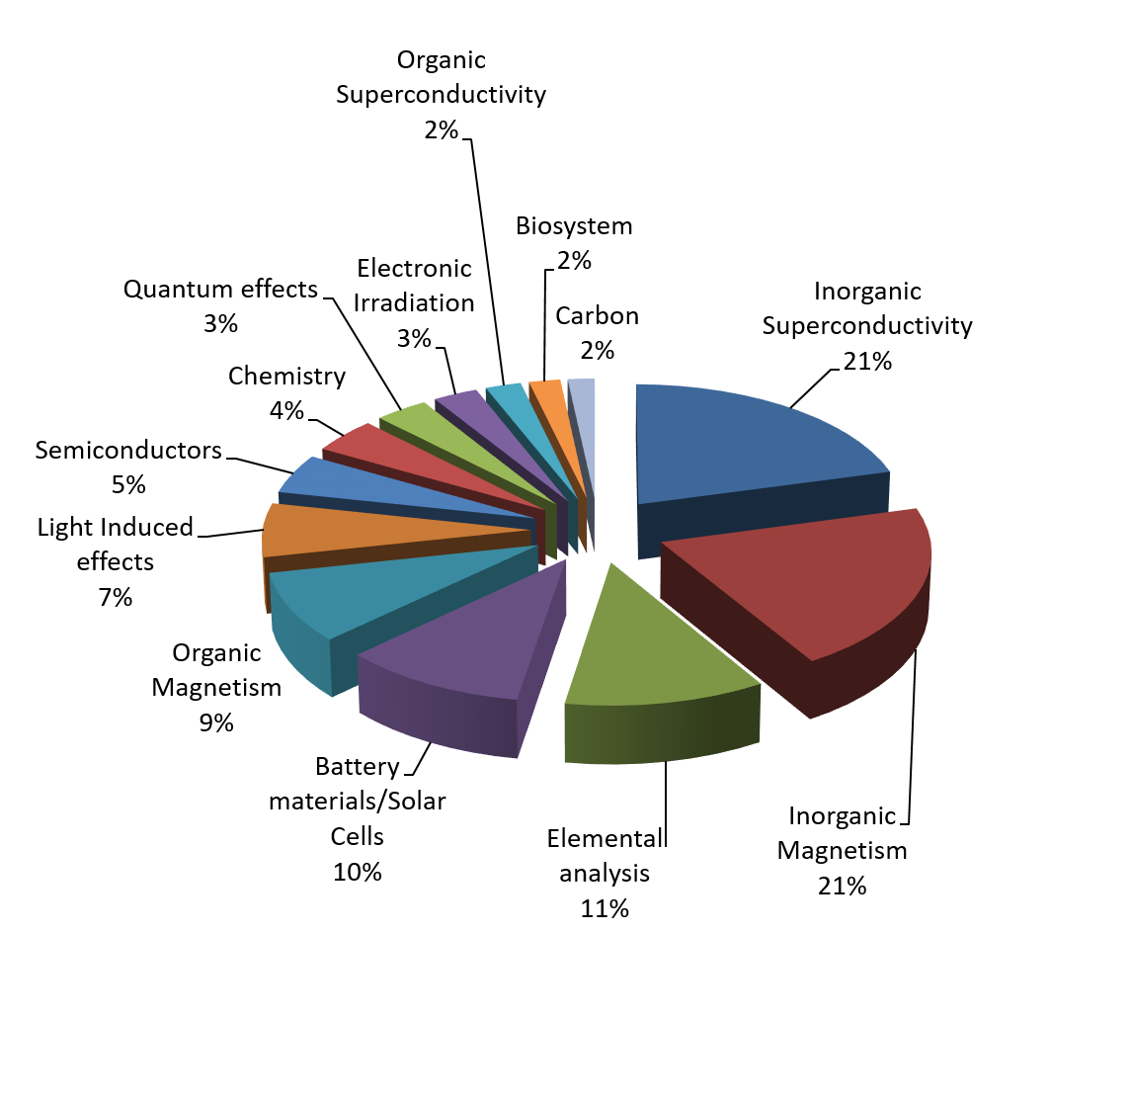
Who uses μSR?
Variants of μSR are making meaningful contributions to the areas of:
  Magnetism
  Superconductivity
  Molecular systems
  Quantum diffusion
  Hydrogen storage
  Battery materials
  Semiconductors
  Radical chemistry
  Thin films and heterostructures
User base of ISIS facility,
courtesy of A. Hillier

Slide 4
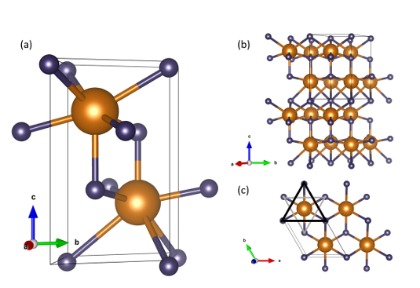
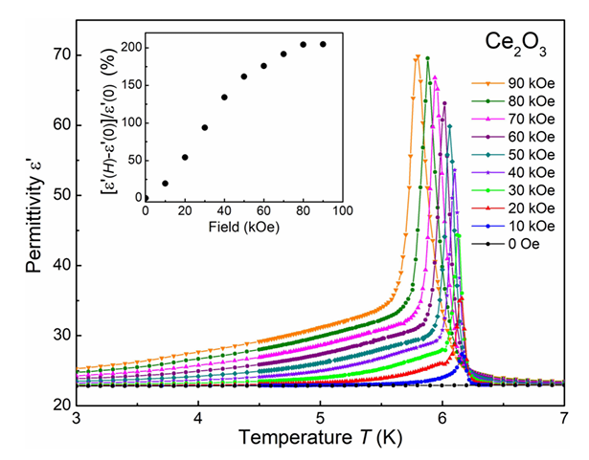
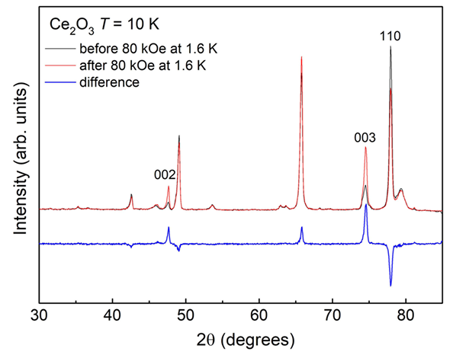
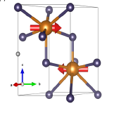
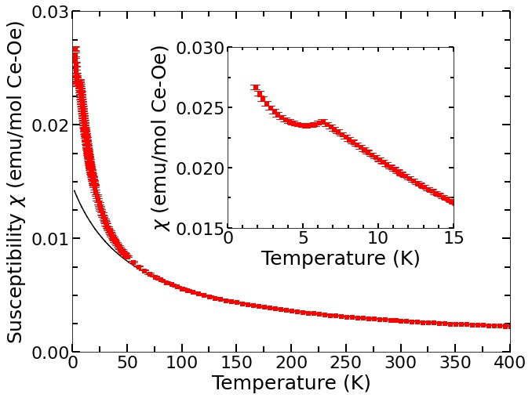
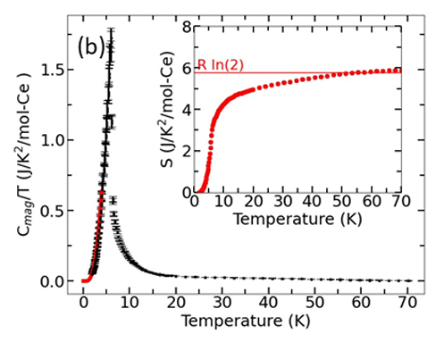
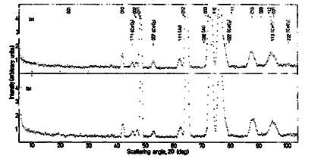
The peculiar case of Ce₂O₃
H || c
T. Kolodiazhnyi et al., PRB 98, 054423 (2018)
m_{eff} = 2.17 μ_{B}
Θ = 27.7 K
But no magnetic
Bragg peaks!
(m_{order} < 0.3 μ_{B})
A. Cote et al., arXiv 2303.11878 (2023)
H. Pinto et al., Phys. Lett. 88A, 81 (1982)

Slide 5
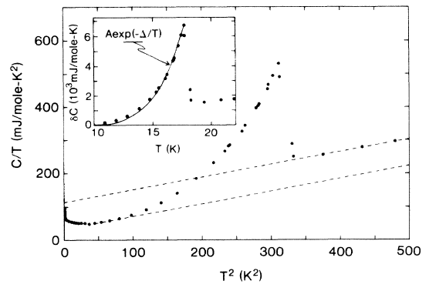
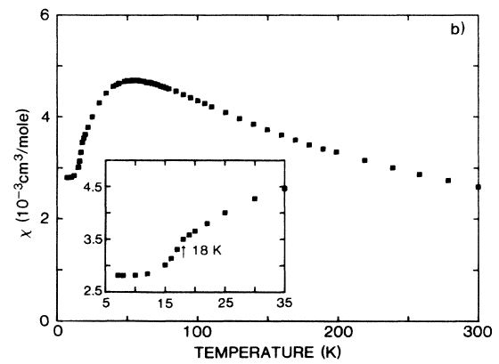
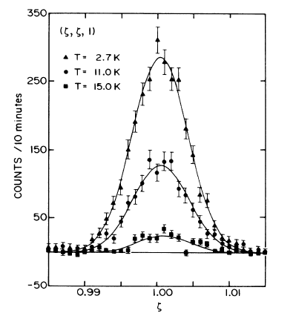
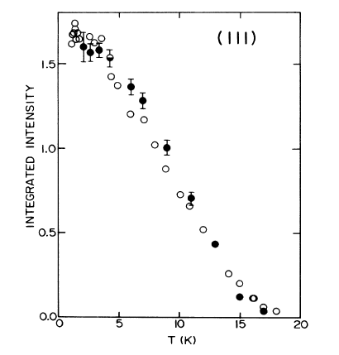
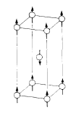
“Hidden order” problems
URu₂Si₂
Large jump in C_{p}
(not itinerant)
Magnetic transition
M.B. Maple et al., PRL 56, 185 (1986)
Order is hidden!!
(from neutrons)
m = 0.037 μ_{B}
Small moment
(must be itinerant)
T.E. Mason et al., PRL 65, 3190 (1990)

Slide 6
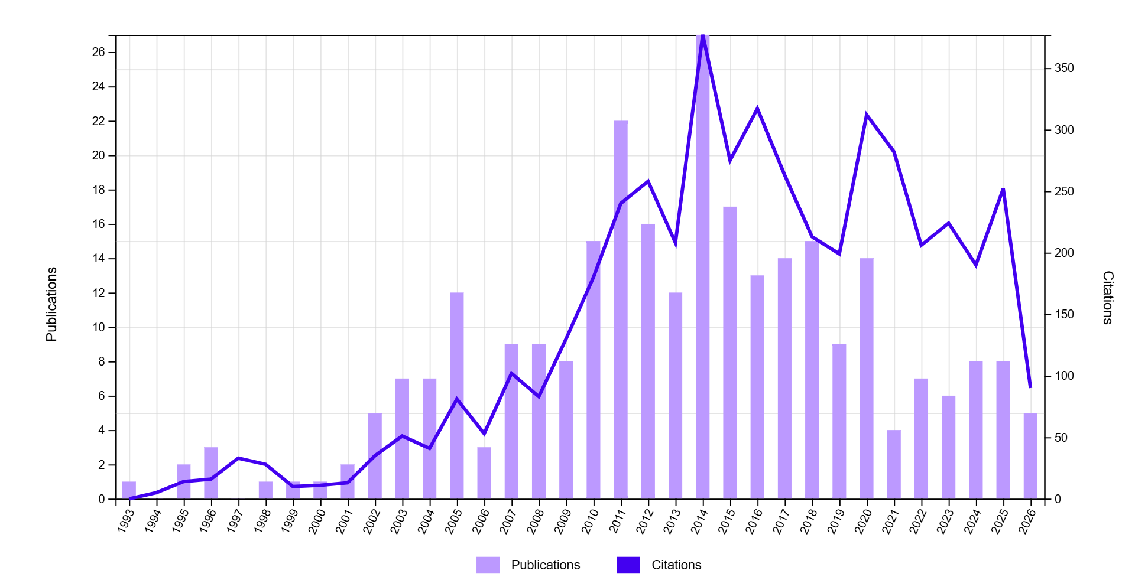
“Hidden order” problems
URu₂Si₂
Publications explicitly using the words “hidden order” in abstract
M.B. Maple et al., PRL 56, 185 (1986)
m = 0.037 μ_{B}
Materials of interest include heavy fermion metals, quantum spin systems, 2d materials, photonic crystals, and unconventional superconductors of many types. Compounds skew heavily to large-Z elements.
Progress has required the synergistic use of multiple probes on the same samples.
T.E. Mason et al., PRL 65, 3190 (1990)

Slide 7
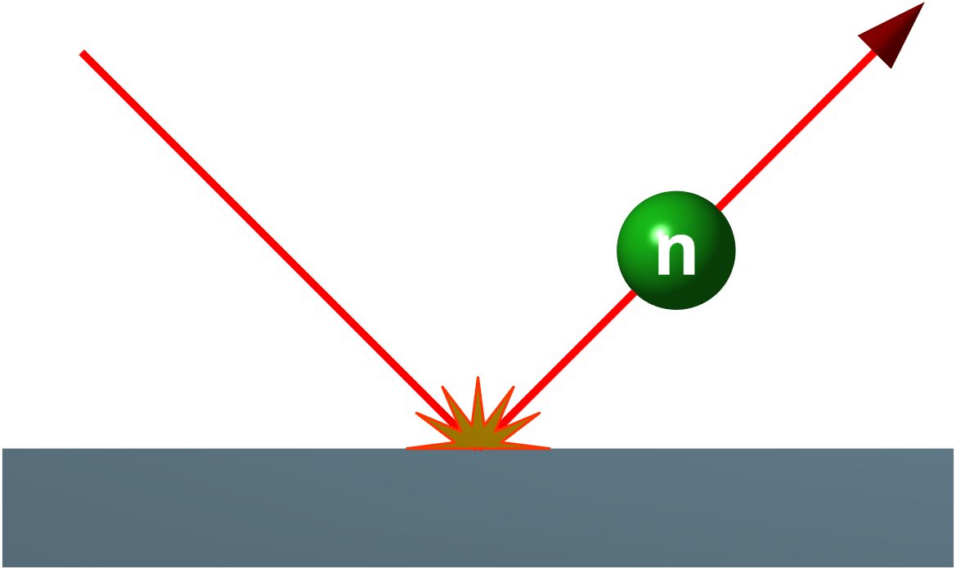
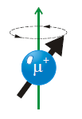
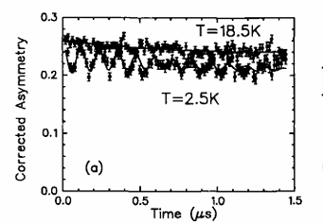
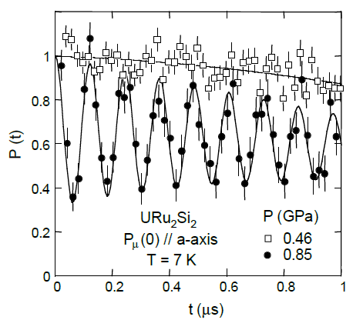
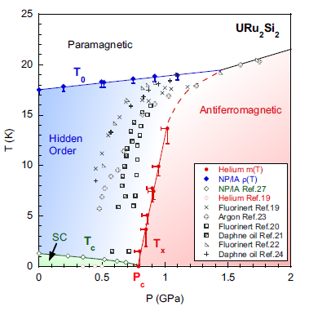
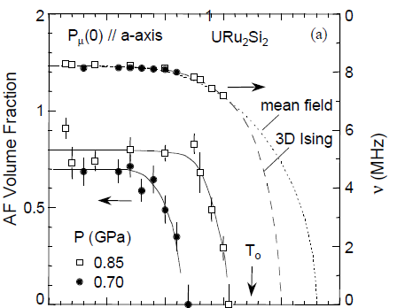

μSR example: Phase separation in URu₂Si₂
G.M. Luke et al., Hyperfine Int. 85, 397-409 (1994)
M.B. Maple et al., PRL 56, 185 (1986)
m = 0.037 μ_{B}
H. Amitsuka et al., Physica B 326, 418-421 (2003)
N.P. Butch et al., PRB 82, 060408(R) (2010)
T.E. Mason et al., PRL 65, 3190 (1990)
AF order is a competing phase, enhanced by pressure

Slide 8
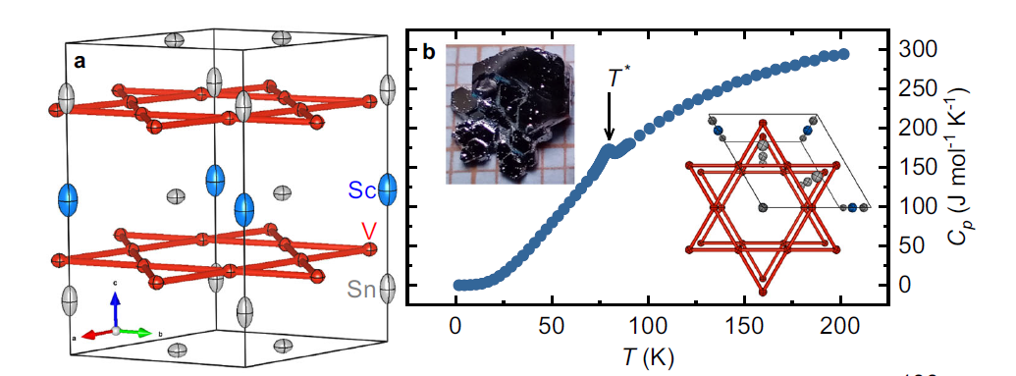
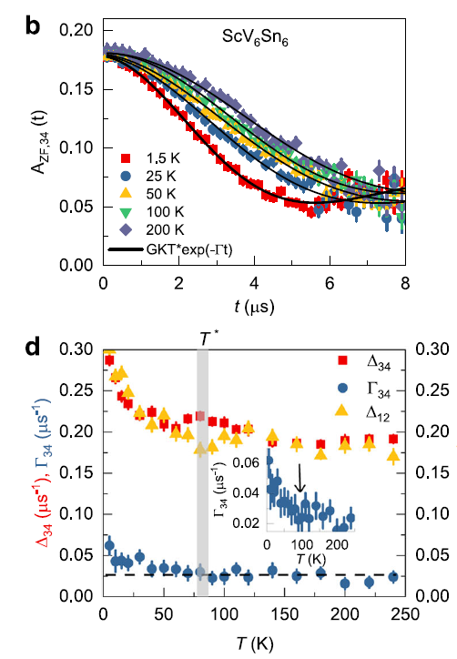
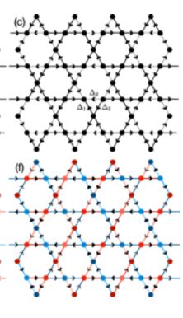
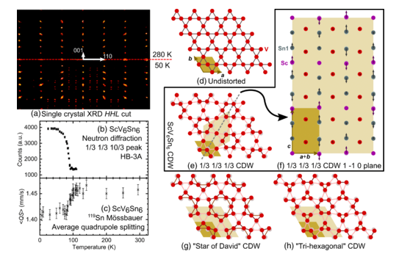
μSR example: small moment order in ScV₆Sn₆
~1G
Z. Guguchia et al., Nature Communications 14: 7796 (2023).
F. Grandi et al., PRB 107, 155131 (2023)
H.W. Suriya Arachchige et al., PRL 129 216402 (2022).
Time reversal symmetry breaking field consistent with predicted loop current order!

Slide 9
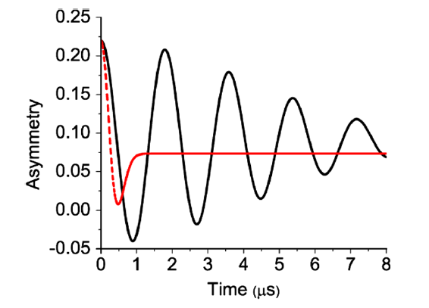
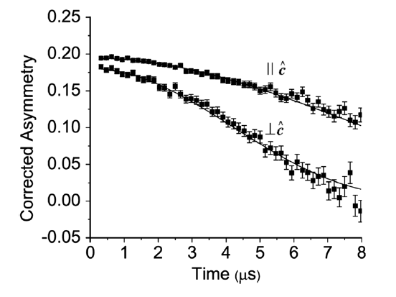
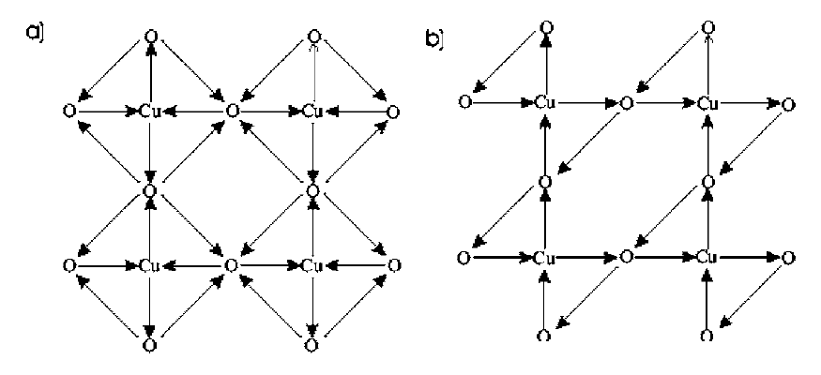
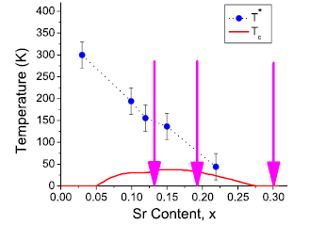
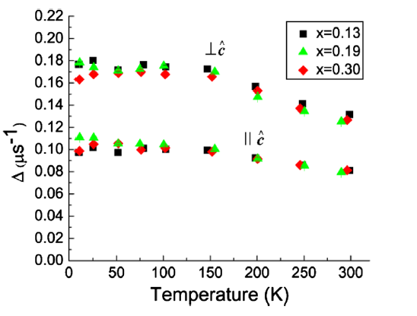
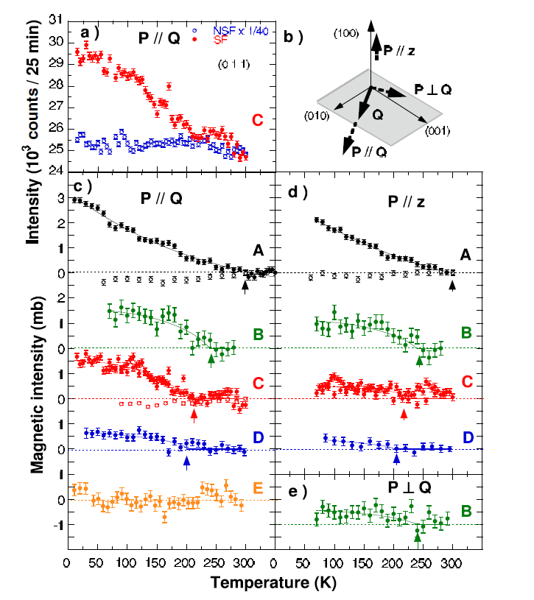
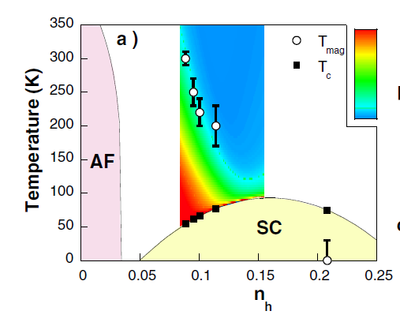
μSR example: small moment order in the cuprates
H_{predicted} = 40G
La_{2-x}Sr_{x}CuO₄
C.M. Varma, PRB 73, 155113 (2006)
YBa₂Cu3O_{7-δ}
m = 0.1 μ_{B}
H_{max} = 0.2G
G.J. MacDougall et al., PRL 101, 017001 (2008)
B. Fauqué et al., PRL 96, 197001 (2006)
Loop current order must be dynamic (ν > 400MHz) if it is present !

Slide 10
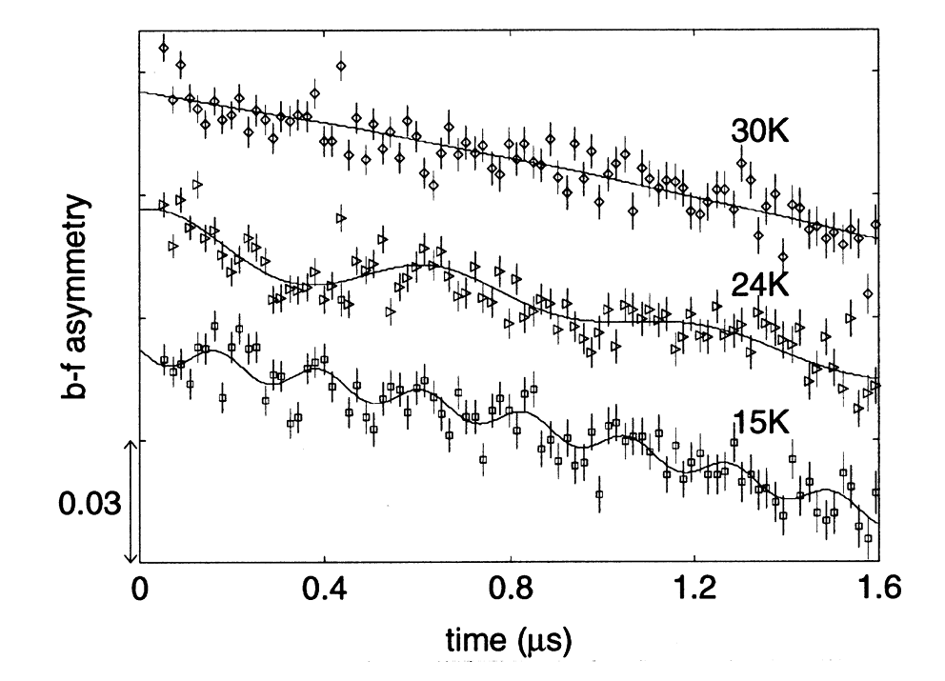
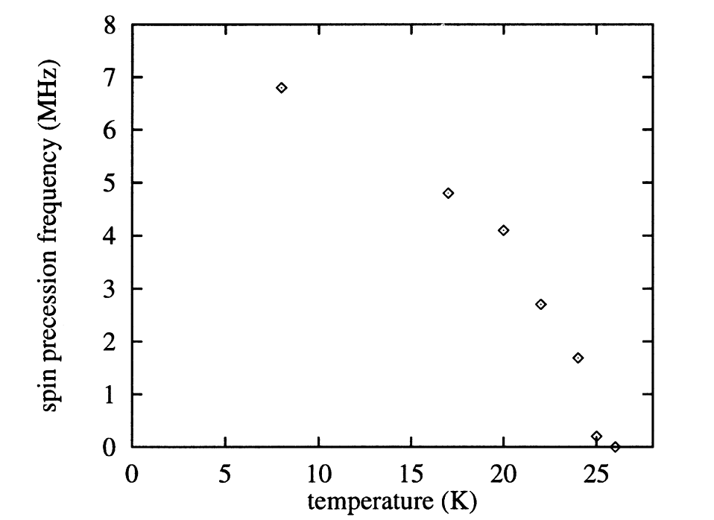
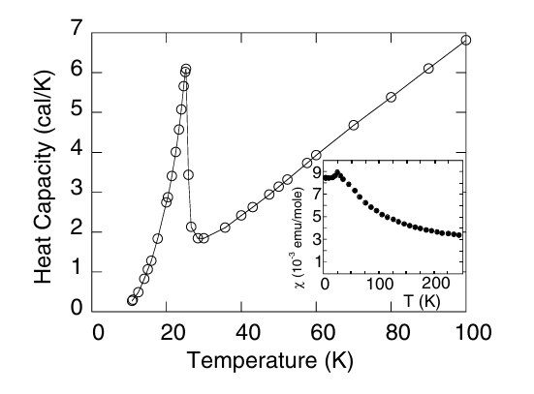
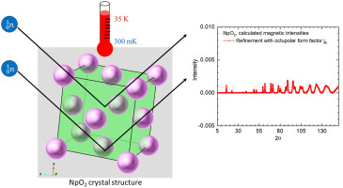
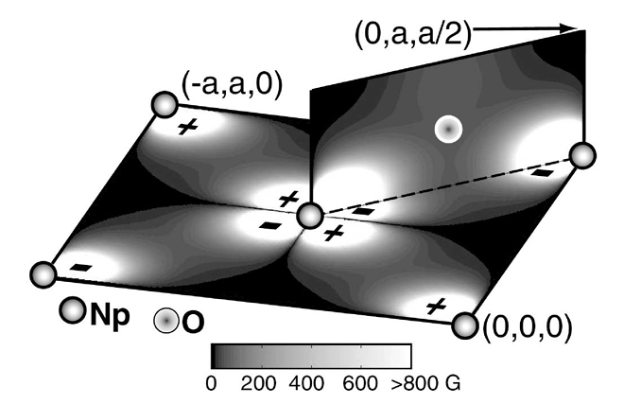
μSR example: Multipole order in NpO₂
m = 0.1 μ_{B}
W. Kopmann et al., J. Alloys and Compounds 271-273, 463-466 (1998)
D.W.. Osborne and E.F. Westrum,
J Chem. Phys. 21, 1884 (1953)
Consistent with
ordering of octupoles!
M.D. Frontzek et al., J. Solid State hem. 321, 123875 (2023)
Neutron scattering limit m_{dipole} < 0.01 μ_{B}
P. Santini and G. Amoretti, PRL 85, 2188 (2000)

Slide 11
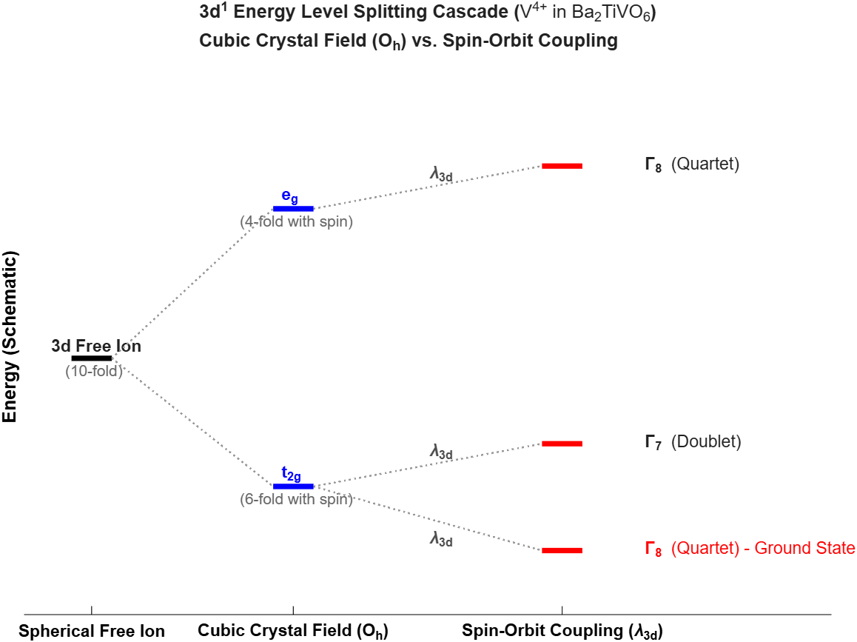
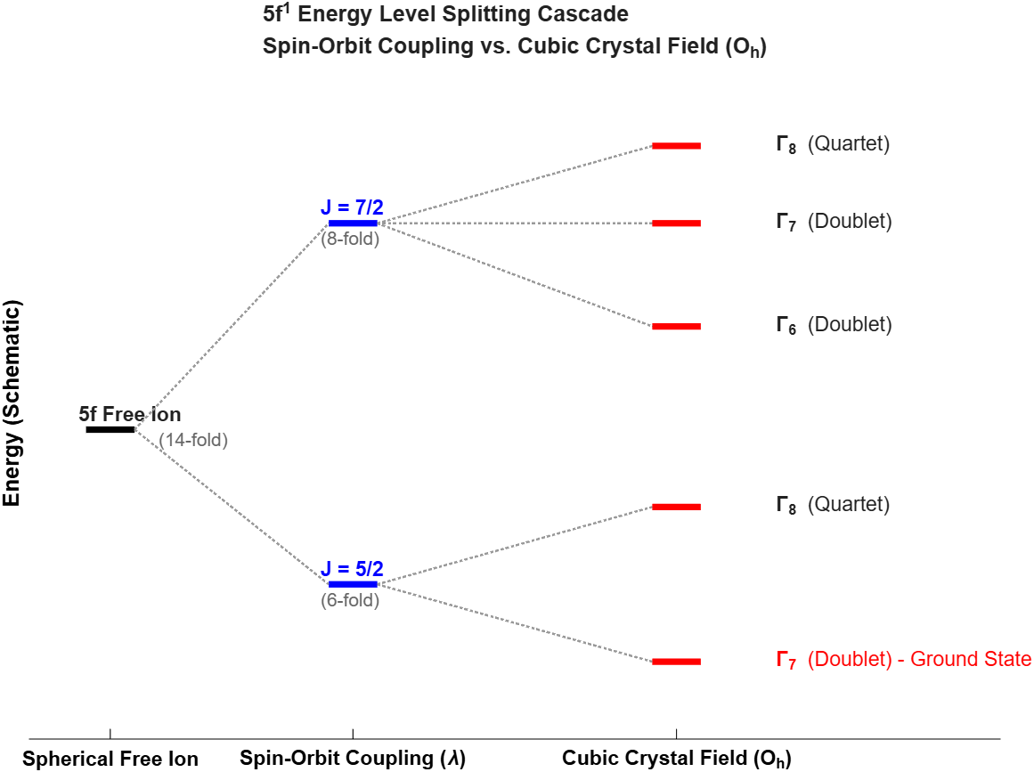
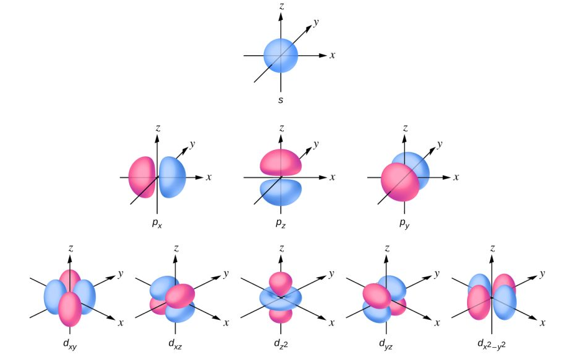
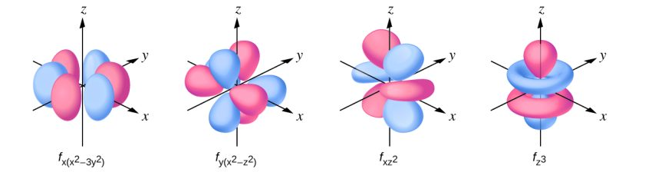
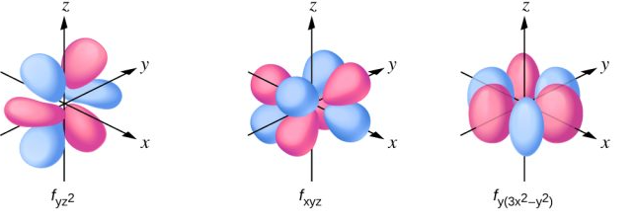
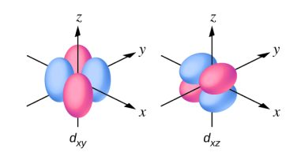
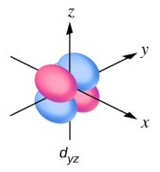
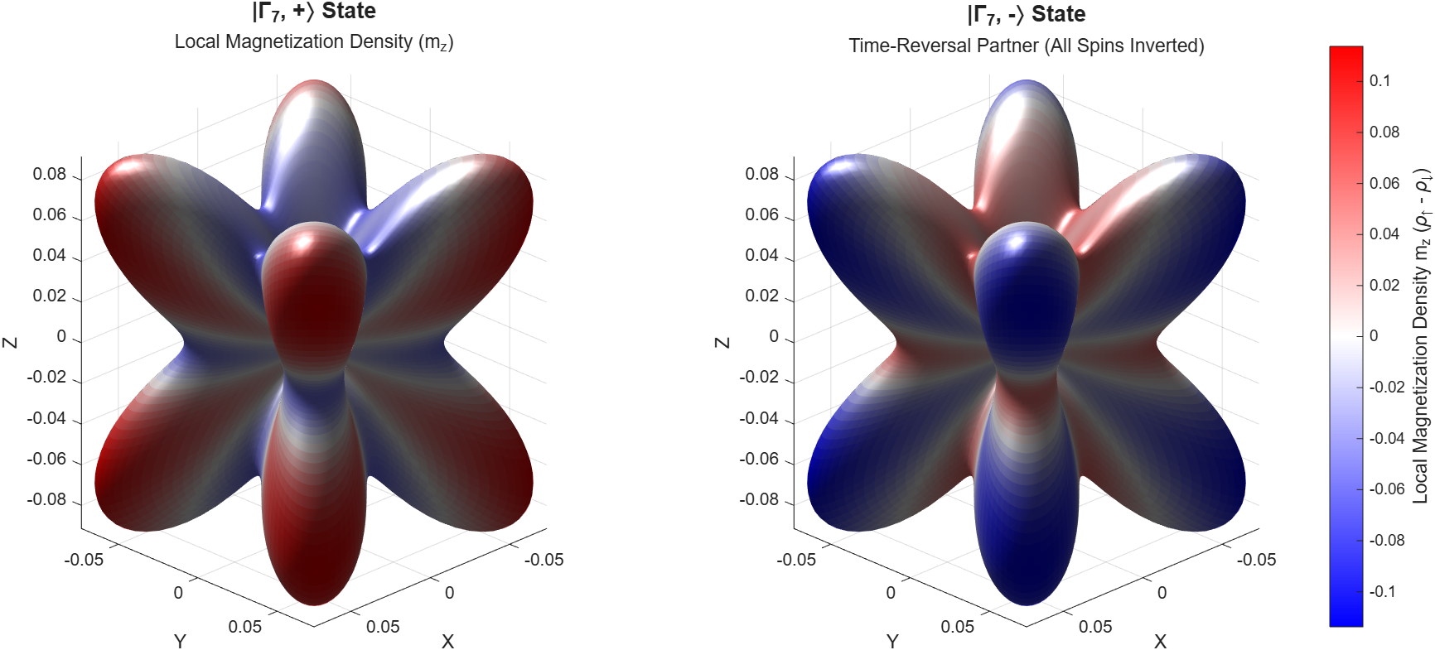
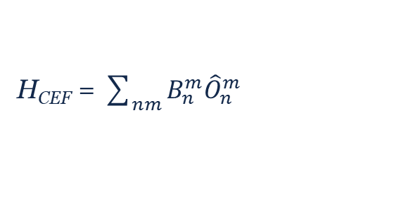
Reminder: origin of multipoles
Single ion Hamiltonian
3d materials
H_{CEF} ~1000 – 5000 meV
H_{SO} ~ 6 – 125 meV
4f materials
H_{CEF} ~ 10 – 100 meV
H_{SO} ~ 100 – 500 meV
H = H_{Coulomb} + H_{CEF} + H_{SO}
H_{CEF} = $\sum_{nm}{B_{n}^{m}{\hat{O}}_{n}^{m}}$
H_{SO} = λ L▪S
L = 0
L = 1
L = 2
L = 3
https://ecampusontario.pressbooks.pub/enhancedchemistry/
and ↓ equivalents

Slide 12
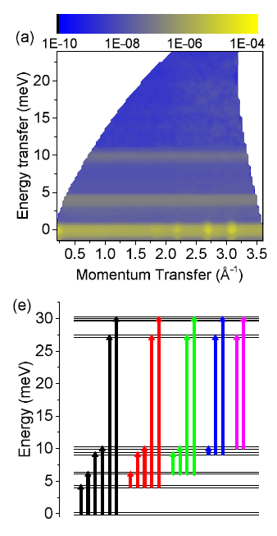









Crystal field example: MgEr₂Se₄
95%
axial
5%
transverse
and
D. Rieg-i-Plessis e al., PRB 89, 134438 (2019)

Slide 13





Sleuthing hidden order in Ce₂O₃
Step 1: Neutron powder diffraction
Results
Confirm (twice) that there is no magnetic Bragg peaks below T* = 6.5 K
Place upper limits on any ordered moment that could exist and not be detected:
BT-1
T = 2 K
POWGEN
T = 2 K
m < 0.3 μ_{B}
m < 0.026 μ_{B}
G. Sala et al., PRMaterials 2, 114407 (2018)
Also confirm that there are no observable structural distortions at T* !
A. Cote et al., arXiv:2303.11878

Slide 14






Sleuthing hidden order in Ce₂O₃
Step 2: μSR
Results
ZF-μSR spectra reveal an emergent TRSB field below T* of f = 14 MHz → 1 kG at the muon site.
LAMPF
Rapid of LF-μSR indicates ordered state is static on the μs timescale.
Muon stopping sites were calculated using the MuFinder software suite and ordered moment sizes were extracted from the TRSB field, assuming purely dipolar spins.
1kG
m = 2.45-2.65 μ_{B}
m = 0.4 μ_{B}
(c.f. m_{ND} < 0.3 μ_{B} )
(c.f. m_{ND} < 0.026 μ_{B})
A. Cote et al., arXiv:2303.11878

Slide 15






Sleuthing hidden order in Ce₂O₃
Step 3: Inelastic neutron scattering
Results
TOF neutron spectrometry with multiple E_{i} revealed two CEF excitations, which were fit to extract $B_{n}^{m}$ parameters for Ce³⁺.
Merlin
E_{i}=160meV
T=10K
E_{i}=12 meV
T=2K
Associated wavefunctions provide complete information about the multipolar matrix elements of the effective spin system:
Multipole | Channel | Operator | Moment
Dipole | axial | g|| | 0.24
 | transverse | g⊥ | 2.26
Quadrupole | axial | $${\hat{O}}_{2}^{0}$$ | -5.85
 | transverse | $${\hat{O}}_{2}^{2}$$ | 1.96
Octupole | axial | $${\hat{O}}_{3}^{0}$$ | 1.31
 | transverse | $${\hat{O}}_{3}^{3}$$ | 4.84
rigid
A dispersive collective excitation was also observed at T=2K consistent with dipoles
A. Cote et al., arXiv:2303.11878
Dormant multipolar degrees of freedom

Slide 16


Sleuthing hidden order in Ce₂O₃
Step 3: Inelastic neutron scattering

Slide 17


Sleuthing hidden order in Ce₂O₃
Step 4: Get to sleuthing
Neutron spectroscopy → Magnetic moments have significant dipole, quadrupole and octupole contributions. What is ordering?
No structural distortion → the primary OP is not quadrupolar order
TRSB field seen with μSR → large moment from odd-rank tensor (dipoles, octupoles,..)
Neutron diffraction → ordered dipole moment is small
E_{i}=12 meV
T=2K
Emergent magnon → excitations are dipole-like
Octupoles can explain everything. Two possibilities:
  Ordering of axial octupoles
    Sympathetic order of weak (g|| = 0.24) axial dipoles
    Excitations tap much larger (g⊥ = 2.26) transverse dipoles, hybridized with octupoles
    Axial quadrupole is rigid and leaves lattice unaffected
  Ordering of transverse octupoles
    Coherent superpositions of Kramers states forces the dipole moment to zero
    Large in-plane dipole still accessible dynamically, leading to dipole like excitations
    Secondary coupling to transverse quadrupoles ($ψ2Q)$, completely explain the anomaly in the dielectric constant through critical fluctuations of the octupolar order parameter.

Slide 18

Final thoughts: why care about multipoles?
Energy scales in rare-earth (4f) and actinide (5f) materials are dominated by spin-orbit coupling, → all electron orbits are magnetic and all magnetic moments have significant multipolar character.
Rare-earth elements dominate (~70%) the magnetic materials market (~$35-60 billion), which is growing at a CAGR of ~8%.
And contribute prominently to emerging fields like spintronics ($1.7-3 billion) and quantum information ($1.5-3.5 billion), each projected to grow at rates as high as 35% CAGR.
https://www.stanfordmagnets.com/a-comprehensive-overview-of-rare-earth-magnets.html
  Several avenues are being explored that make use of multipolar degrees-of-freedom:
  e.g. -densely packed, non-volatile memory with ultrafast (THz) switching capability
  - precision magnetoelectrical sensors controllable with compact electric fields
      -isolated quantum information (qubit) storage
  - multipolar-mediated superconductors with topologically protected edge states
Multipoles are hard to and understanding requires synergistic investigation with multiple techniques
→ There is a clear and immediate benefit from co-locating neutron and muon sources

Slide 19

SEEMS: a next generation muon source
Review of Scientific Instruments 94, 033908 (2023)

