Slide 1

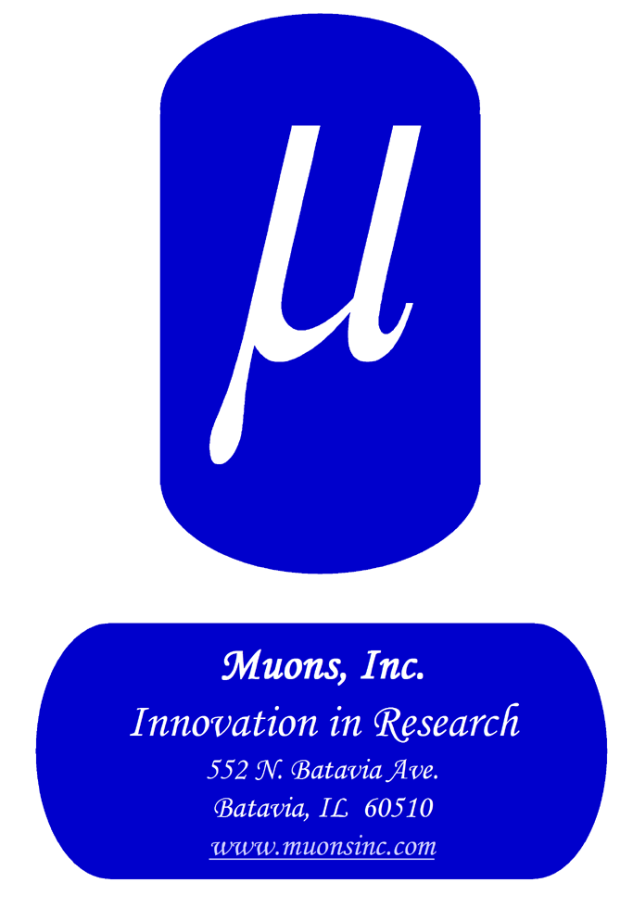
Muons, Inc.
MuSTAR Nuclear Power Plant Platform
for continuous improvement
(Muons Inc. Subcritical Technology Advanced Reactor)
Rolland Johnson, Ph.D., President Muons, Inc.
Rol@muonsinc.com

Slide 2

Muons, Inc. History, Status, Opportunities
Founded by Rolland Johnson and other former national lab employees in 2002
  now ~15 Senior Physicists and Engineers
  Built on $34M government + $6M self investments
Working with national labs and universities under DOE Contracts and SBIR/STTR grants
  ANL, BNL, FNAL, INL, JLab, LANL, LBNL, ORNL, PNNL, SLAC, and SRNL
  U of Chicago, Cornell, FSU, GWU, IIT, NCSU, NIU, and ODU
To help the DOE achieve its scientific goals, e.g.
  Supported 18 postdocs & 7 Ph.D. students
  Muon Colliders - renewed interest in our inventions made 20 years ago
Commercialization/manufacturing
  Magnetrons – Muons’ prototype 1497 MHz tube under test at JLab to relace CEBAF klystrons
  Ion Sources - Fusion Devices for Radiopharmaceuticals
    $2M Contract with Italy now being commissioned in Brasimone

Slide 3
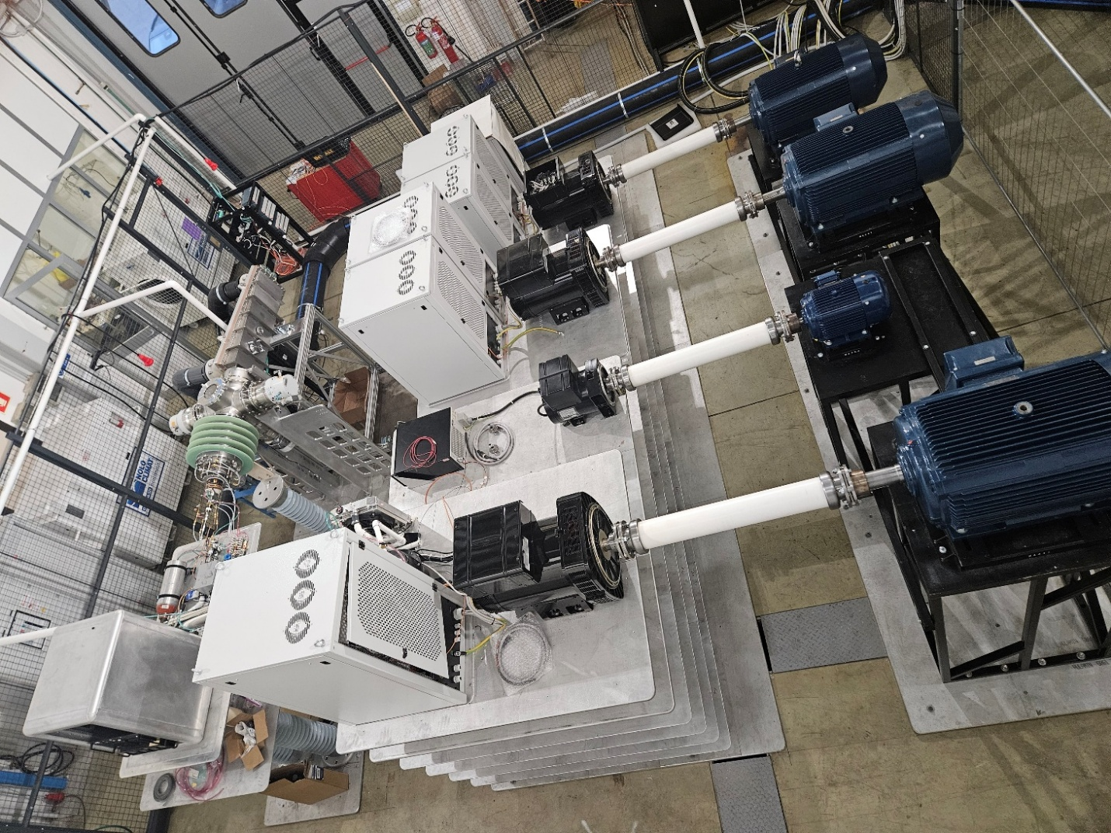
Muons, Inc.
MUONS’ 300 kV, 900 mA positive ion source.
Installed in Brasimone, Italy.
Now being commissioned with protons to complete 1.7M Euro contract with ENEA, (Italian DOE).
Will be used to accelerate D and T ions onto a titanium coated rotating target
Will produce 2.6 x 10^14 fusion neutrons per second
Part of the Sorgentina-rf Project to make Mo-99 from Mo-100.

Slide 4
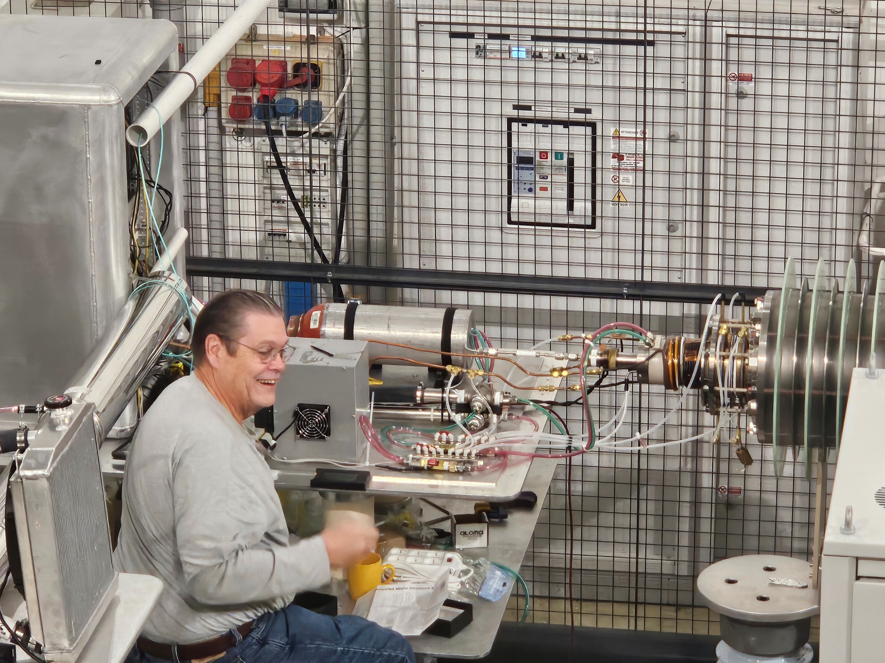
Muons, Inc.
Idea came from Muons-ORNL/SNS SBIR grant – Stockli & Dudnikov
Syd Murray with H2 Bottle, Plasma ion source, Accelerating grids, and electrodes
Between Florence and Bologna at 1000 meters in a never-fueled nuclear reactor site

Slide 5
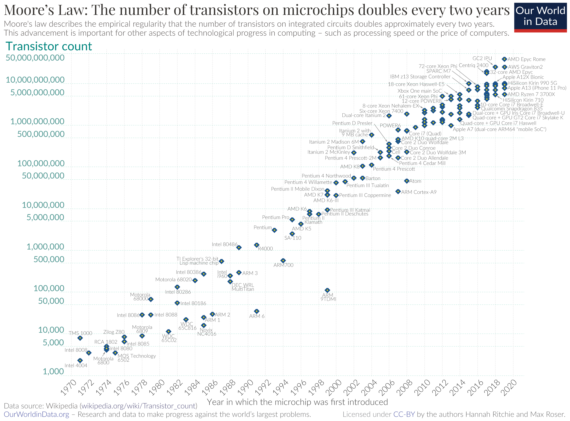
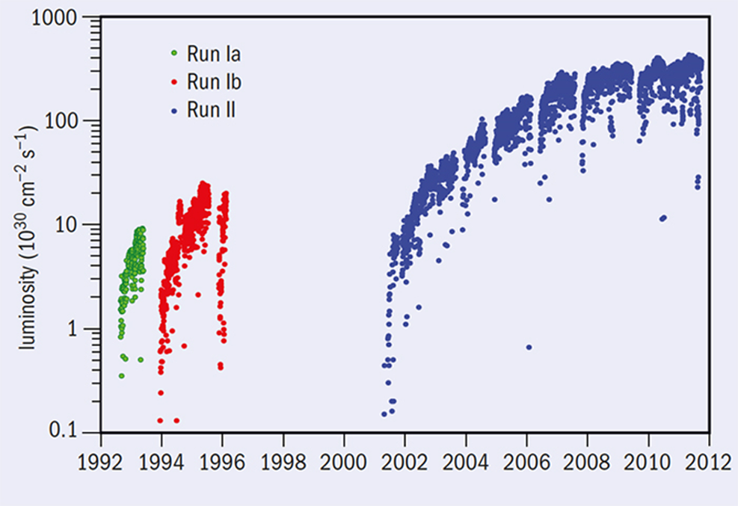
Why are Nuclear Reactors not like other Technologies that continuously improve on a semi log scale?
TEVATRON performance over 20 years, showing 350 times (35,000%) improvement in Luminosity
Moore’s Law now approaching 60 years of human ingenuity
The results were amazing, but in successful companies, such stories are normal for those that can follow Deming’s principle to “Improve Constantly and Forever…”

Slide 6
Nuclear Improvements Frozen by Regulations
The Nuclear Energy Industry is hobbled by Regulatory Demands to prevent:
Criticality Accidents (like Chernobyl)
Accidental Release of Radioactive Isotopes (like Chernobyl, 3-Mile Island, Fukushima)
These challenges can be overcome with an ACCELEATOR-DRIVEN SUBCRITICAL DESIGN and MOLTEN SALT FUEL with continuous removal of volatile radioactive isotopes.
CFR10: a nuclear reactor is defined as "any apparatus or device in which a nuclear chain reaction can be sustained and controlled in a self-supporting or neutron multiplying medium, and which is designed or used to produce heat, power, or any other form of radiation."
CFR10 Part 50, Appendix A: nuclear power plants must limit the release of radioactive materials into the environment following an accident. The limit for the release of iodine-131 is 5 curies per day. The limit for the release of cesium-137 is 15 curies per day.

Slide 7
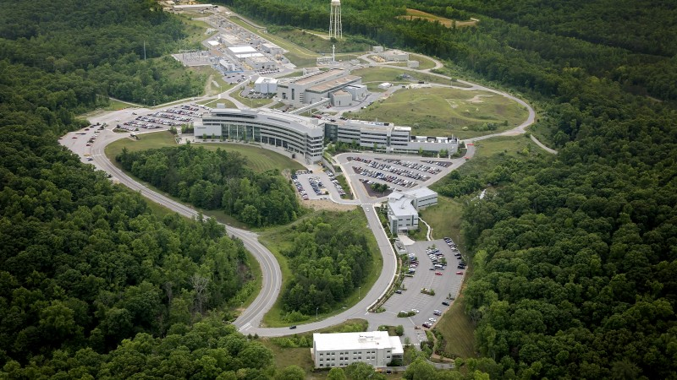
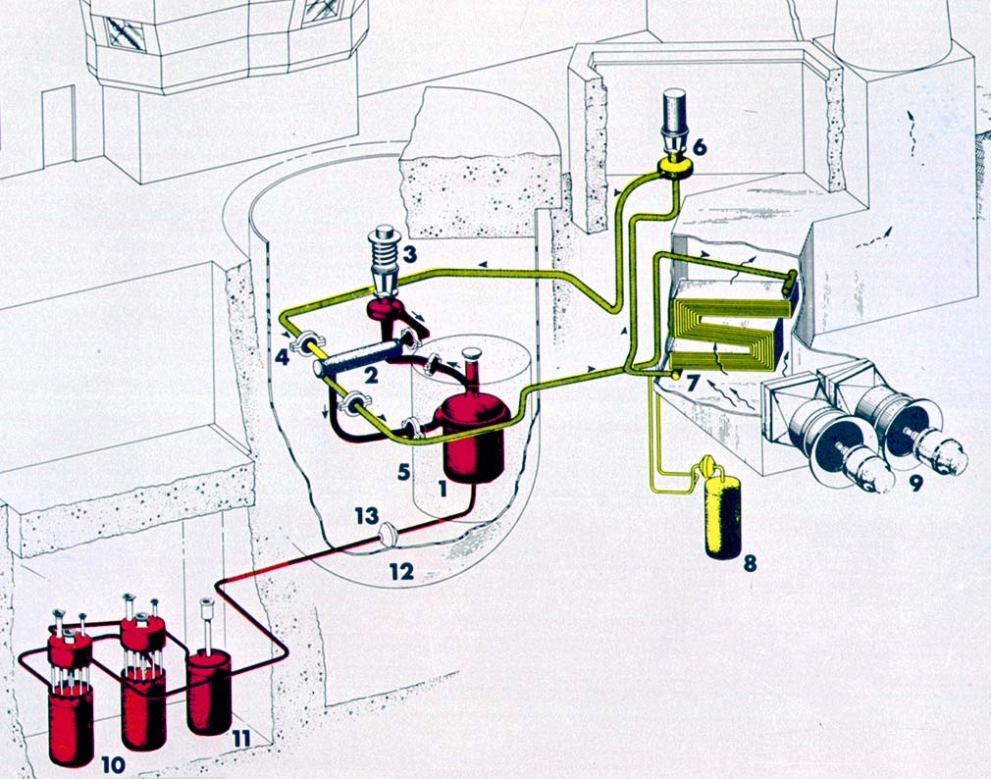
Overcoming challenges using proven US National Lab Innovations
Our Solution to overcoming the two constraints come from one new and one old development at Oak Ridge National Laboratory. The Superconducting Linac (operated from 2010 to now) of the Spallation Neutron Source (SNS) which has the power to drive multiple subcritical Small Modular Reactors
ORNL SNS (2010-…) ORNL MSRE (1965-1970) Diagram
The Molten Salt Reactor Experiment (MSRE) (operated from 1965 to 1970) which demonstrated how we can continuously remove volatile fission products from an operating reactor.

Slide 8
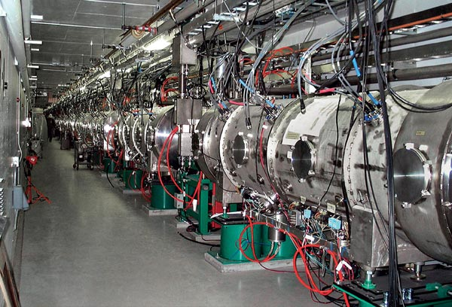
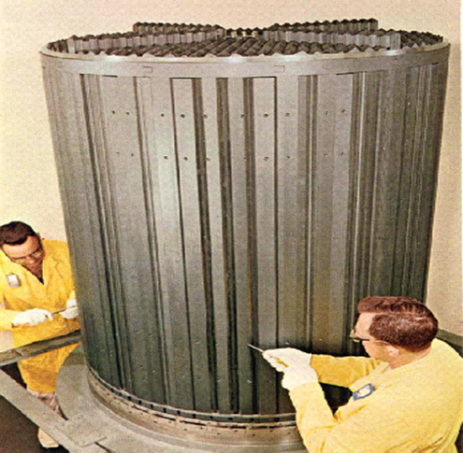
Overcoming challenges using proven US National Lab Innovations
FIG 1: Conceptual building blocks of the Mu*STAR NPP. (Left) The ORNL SNS Linac tunnel showing the cryomodules that hold the 805 MHz superconducting cavities, (Right) The MSRE graphite moderator. The Mu*STAR SMR graphite moderator is larger by a factor of 4 in linear dimensions or 64 by volume, increasing the output power from 8 to 500 MWt = 220 MWe

Slide 9
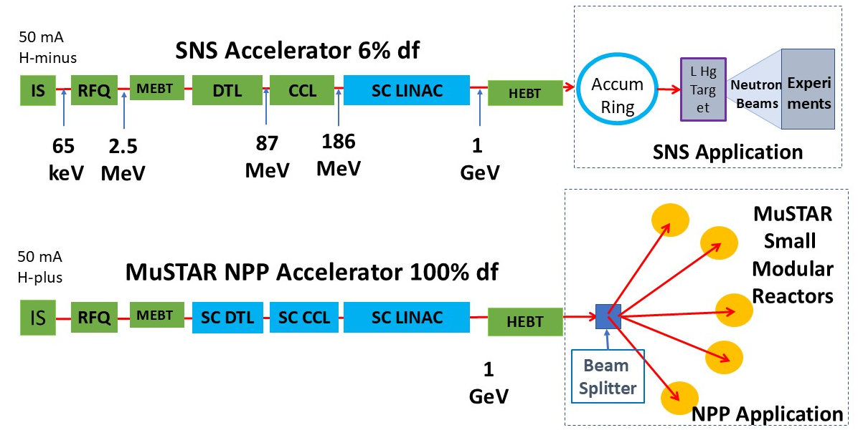
Comparison of the 6% duty factor operation of the ORNL SNS Linac that feeds a storage ring with the 100% duty factor Accelerator Driven Subcritical Nuclear Power Plant that is the subject of this proposal. The Mu*STAR NPP will require upgrading the DTL and CCL to be superconducting, replacing klystrons with less expensive and more efficient magnetrons, and developing the lossless beam splitter with SC RF cavities.

Slide 10
Muons, Inc.
Conceptual picture of underground Mu*STAR SMR with beamline, MS Heat Storage tank, and Hot Cell.

Slide 11
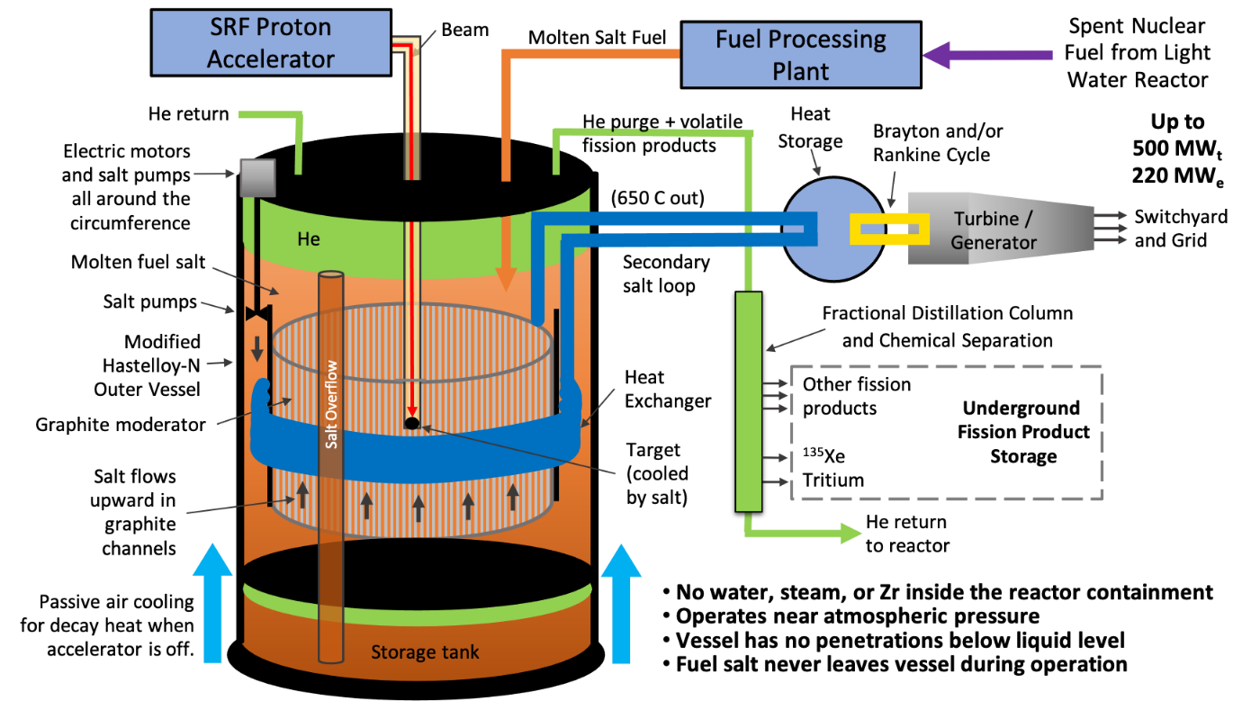
Conceptual picture of underground Mu*STAR SMR with beamline, MS Storage tank, and Hot Cell.

Slide 12
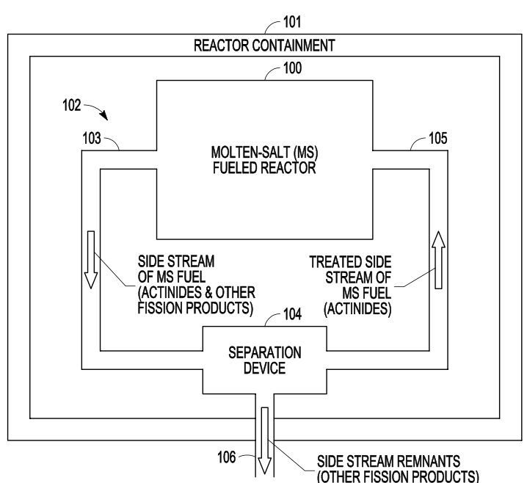
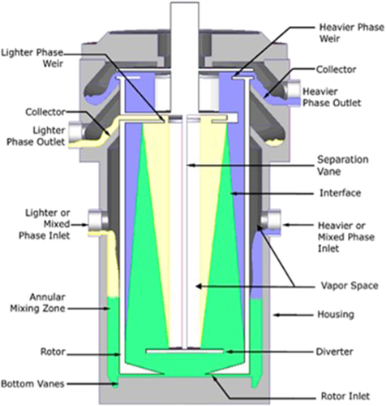
FIG 5: In-containment devices like vortex separators and centrifugal contactors will remove lighter fission products while leaving heavier actinides in the fuel to be transmuted for energy and to reduce the lifetime of remnants. Laser Induced Breakdown Spectroscopy (LIBS) before and after the separation device will be used to monitor the isotopic content of the core and will be the means to provide material accountancy for safeguards and proliferation protection.

Slide 13
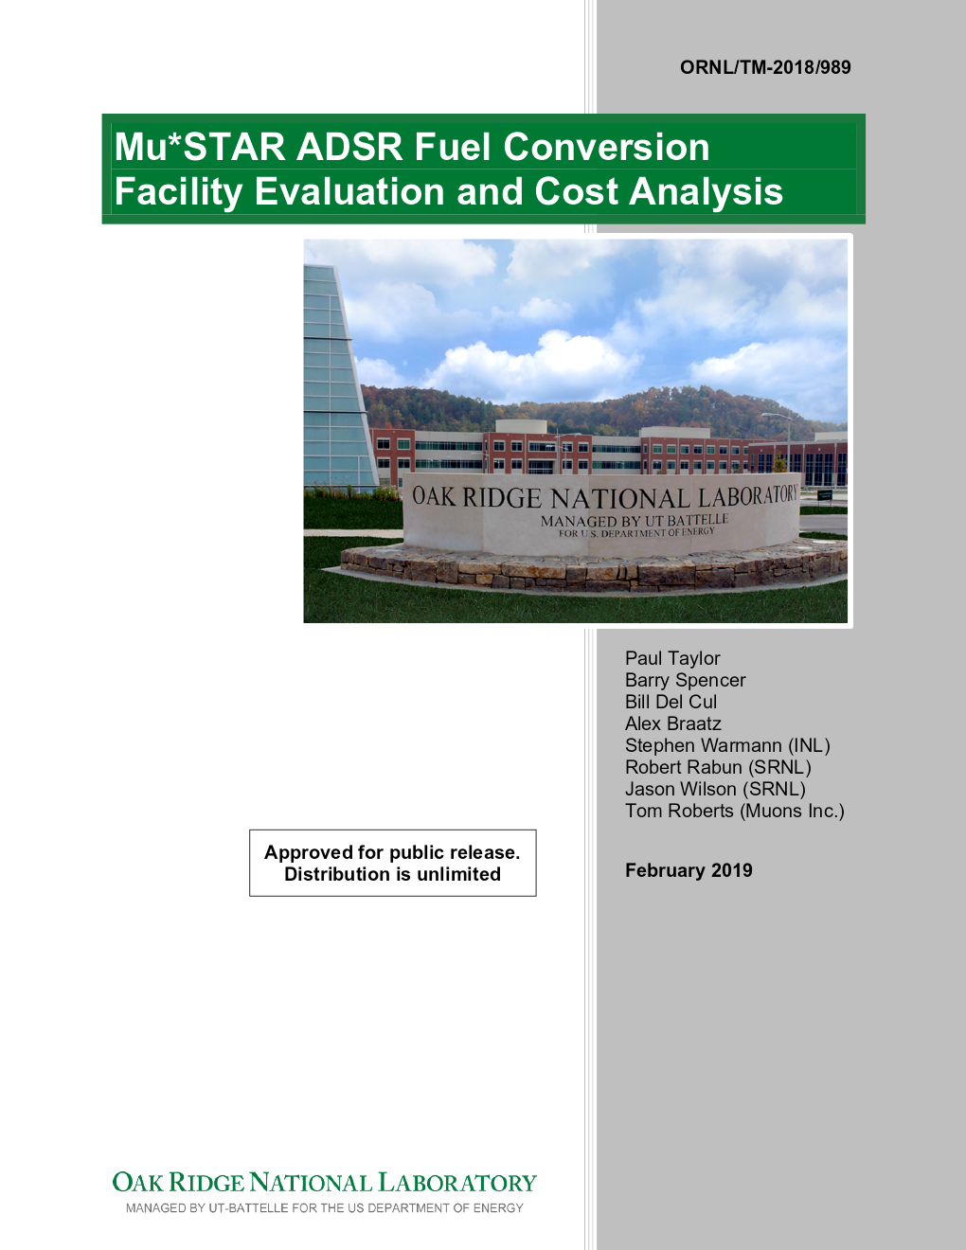
<- This GAIN Voucher Grant showed that conversion of UNF from oxides to fluorides can close the fuel cycle using a ADS.

Slide 14
Mu*STAR Nuclear Power Plants
Essential Features
Mu*STAR Concept based on ORNL Molten Salt Reactor Experiment (MSRE)
  with an internal Molten Fuel Salt-cooled uranium or tungsten spallation target
  The same fuel salts, graphite moderator, thermal spectrum as used by the MSRE
ORNL SNS 1 GeV Linac is the basis for the >50 MW proton accelerator design
  Use of MS fuel eliminates requirement on beam interruptions
  Solid fuels have thermal shock and destructive fatigue from beam trips
On-site conversion of UNF oxide rods to MS fluoride fuel without reprocessing
  described in MUONS’ GAIN Voucher Grant ORNL/TM-2018/989
  found to be affordable and straightforward
  but with large regulatory uncertainties in the cost of the hot cell
  Over 65 potential US sites with onsite UNF storage for a Mu*STAR NPP
Essential feature of MS fueled Cores is fuel access during operation (in confinement)
  Volatile radioactive isotopes can be removed from core (low source term)
  Vortex contactors/separators keep actinides in the fuel to be consumed
  Neutron Poisons removed to allow deeper burns of the UNF
  Technical challenge is to make separation devices that last in harsh environments

Slide 15
Mu*STAR Nuclear Power Plants
Essential Features (continued)
NRC obstacles lower because of subcritical operation and insignificant source term
  Subcriticality and radiotoxic inventory will be continuously monitored
Intermediate MS heat storage covers maintenance and repair periods
  Provides passive decay heat removal for Loss of Power Accidents
  The high operating temperature is well suited for supercritical CO2 turbines
One Linac serves several Mu*STAR SMRs (e.g. 10 * 220 MWe = 2.2 GWe NPP)
  Transverse-kicking cavities distribute RF beam bunch by bunch to SMRs
Mu*STAR NPP approach allows true economy of scale to apply to SMRs
  Add accelerator modules and factory built SMRs to get higher NPP power
  Electricity sales start with the first module, grow with added Next-of-a-Kind SMRs

Slide 16
Muons, Inc. Nuclear Power Plant Platform is well matched to AI development
  New DOE Genesis DE-FOA-0003612 encourages using AI to speed up development and licensing of ARs
  “Co-Intelligent Design, Licensing, Deployment of MuSTAR NPP Platform”
    Muons, Enercon (Basken), Jlab (Rimmer) & VT (Zhang) + (Budnitz, Galambos, Huff, Vogelaar) proposal
    Based on Ethan Mollick’s Co-Intelligence Paradigm (Human + AI)
    Platform’s large number of variables and applications is well suited for AI
    Laser Induced Breakdown Spectroscopy of circulating MS fuel is new for AI
  We will establish parameters for a proton beamline facility to develop ADS technology using the MuSTAR NPP Platform and AI
  The goal is to have NE technology develop at a rate that needs a semilog scale like most other modern technologies!

Slide 17
Bibliography
https://world-nuclear.org/information-library/nuclear-power-reactors/other/molten-salt-reactors
This proposal draws on the co-intelligence framework articulated by Mollick, which demonstrates that when humans and AI collaborate as co-intelligent partners, the result is not merely faster execution of existing tasks but qualitatively new forms of creativity and innovation.
Ethan Mollick, Co-Intelligence: Living and Working with AI, Portfolio/Penguin, 2024. Audible Books.

