Slide 1
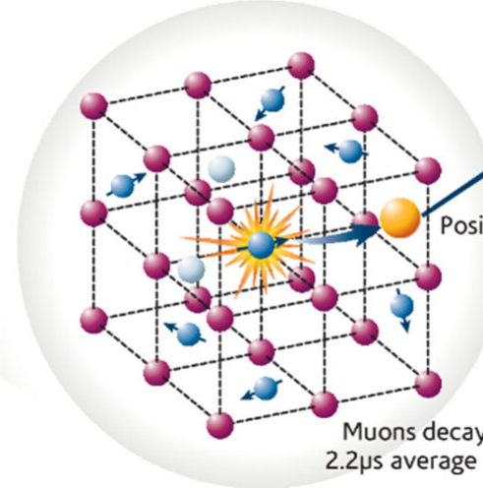
Muon spectroscopy initiative in the US
Despina Louca, University of Virginia

Slide 2
Design for a muon spectroscopy facility at the Spallation Neutron Source
The goal of the project is to build a world class facility with combined Single Event Effects (SEE) and Muon Spectroscopy (μSR) capabilities at the Spallation Neutron Source (SNS) - SEEMS

Slide 3
Overview
We planned for a technical design of the next generation muon facility
We held a workshop to demonstrate interest and make the case for a domestic capability
We submitted a pre-proposal to NSF that did not get funded. The facility did not show much interest in the past.
Projected calculations put the muon flux at about 1000 times any existing facility that would allow faster throughput, time-resolved experiments, detection of smaller moments and slower fluctuations.
μSR is a real space probe of materials that has made seminal contributions to the study of magnetism, superconductivity, semiconductors, quantum diffusion, chemical kinetics, and thin film heterostructures.
Co-located with the neutron scattering program at SNS, the proposed μSR facility would be a valuable addition to the US research capabilities and could naturally be incorporated into the existing user program.

Slide 4
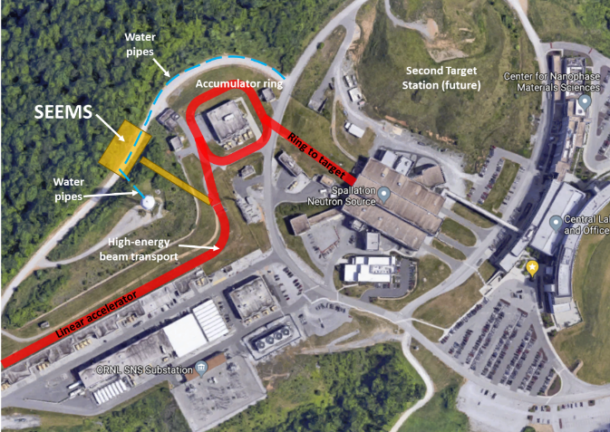
The proposed location of the SEEMS facility (orange) at the SNS relative to the accelerator beam (red) and other existing and planned infrastructure.
Using a laser stripping technique, it is most reasonable to place the SEEMS facility in between the SNS linac and the accumulator ring.

Slide 5

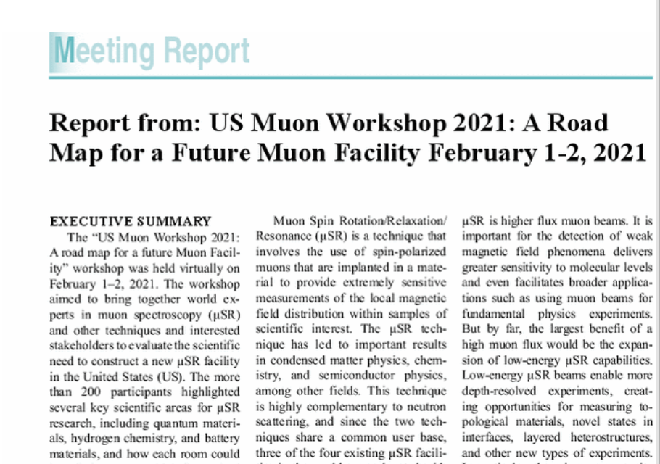
Quote
NSF and DOE supported workshop

Slide 6
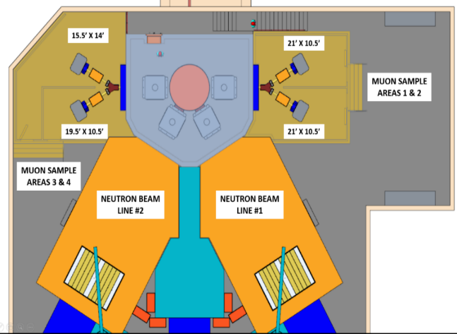
Beamlines
End stations receiving high-energy neutron beams for SEE testing .
For µSR, the high flux of the proposed facility would support conventional, surface muon beamlines, as well as more specialized decay muon beamlines and low-energy muon beamlines
Surface muon beamlines are built to be short (relative to neutron beamlines) to minimize any spatial broadening of the muon pulse and to minimize decay of the muons in flight
The high flux means that multiple µSR beamlines can originate from the same beam port around the target

Slide 7
