Slide 1


Developing muon-catalyzed fusion as an abundant new source of energy

Slide 2



Introduction
Fusion is a safe, abundant, clean source of energy
Fusion of the deuterium in a stream of tap water could power a city.

Slide 3
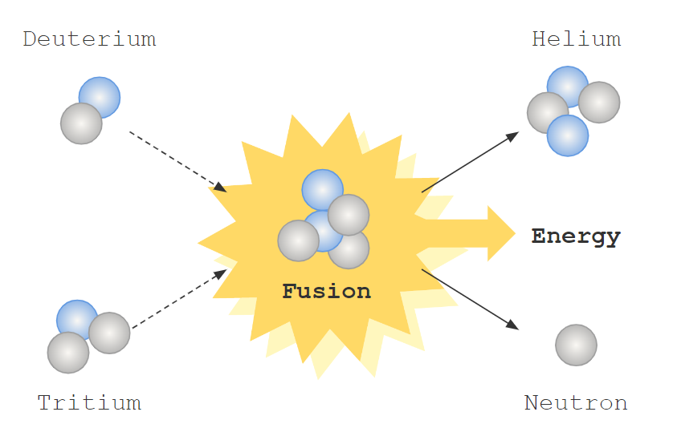
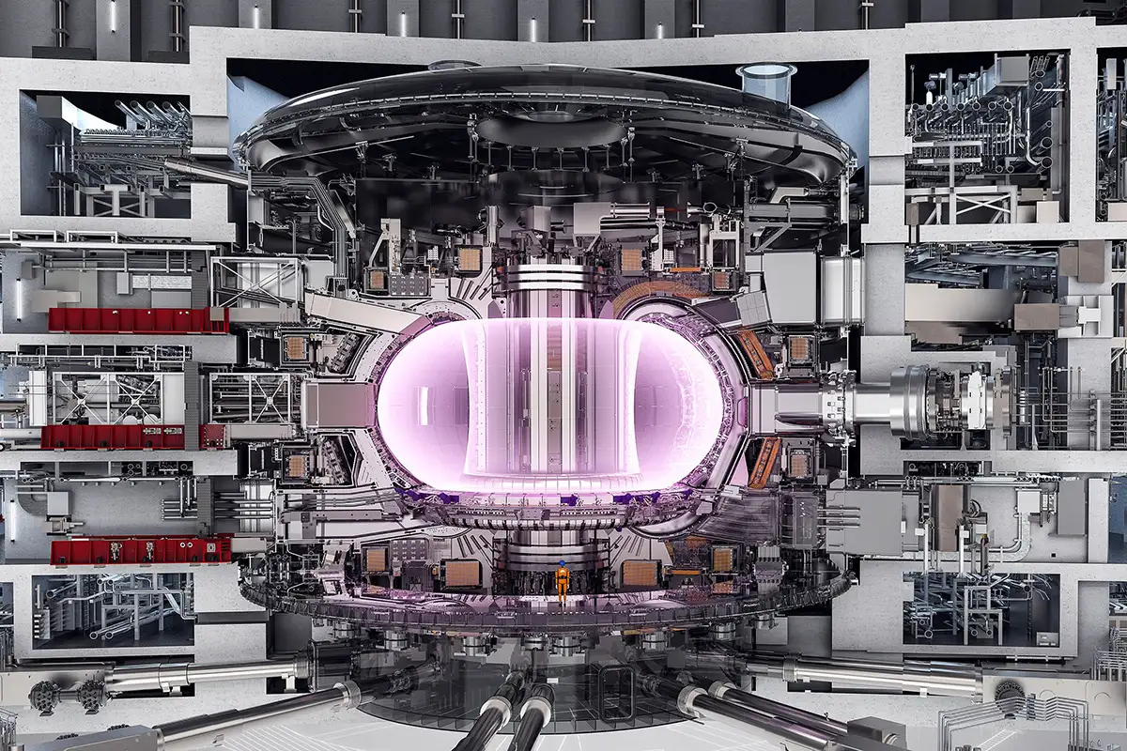
Introduction
Plasma fusion requires stable 100,000,000 ⁰C plasma
The deuterium-tritium fusion reaction has the highest cross section.
A cutaway view of the ITER tokamak, scheduled to burn DT in 2039.

Slide 4

Introduction
Muons can catalyze
nuclear fusion reactions
at lower temperature
µ
Muon forms chemical bond between Deuterium atom and Tritium atom
t
µ
t
Muon comes into orbit
d
Negatively-charged muon enters
µ
Squeezes nuclei together and fusion occurs
Energetic neutron
Muon Recycling
Muon Reactivation
Nuclear fusion
µ
99%
Energetic alpha
1%
Sometimes muon sticks to the alpha particle product of the fusion

Slide 5

Sticking was seen as the key issue
NC or LTS accelerator
Klystron drivers
Rankine (steam) cycle balance of plant
Fusion Cell
Muons
Small amount of energy
Proton Beam
Many muons lost
Sticking-imposed limit of 300 fusions/muon
10 GeV/muon
5000
fusions/muon
* 20 MeV
40% efficient
Accelerator and muon production target
1 muon
Fusion cell and
breeding blanket
100 GeV
Balance of Plant
10 GeV
40 GeV
30 GeV
25% recirculating power
110 MW
Industrial
Process Heat
Acceleron Fusion Confidential
Electricity
200 MW
100 MW
Electricity to the Grid

Slide 6
Energy balance
Brayton (helium) cycle balance of plant
NbSn SC Accelerator
Magnetron Drivers
Muons
Fusion Cell
New Approach
Large amount of energy
Ion Beam
Muons collected by fields inside target
Sticking-imposed limit of 300 fusions/muon
4
GeV/muon
300
34
64%
efficient
fusions/muon
* MeV
Accelerator and muon production target
1 muon
Fusion cell and
breeding blanket
10.2 GeV
Balance of Plant
3.6 GeV
4 GeV
8.8 GeV
3.1 GeV heat recycling
0.5 sec heat
5 GeV
45%
recirculating power
Acceleron Fusion Confidential

Slide 7
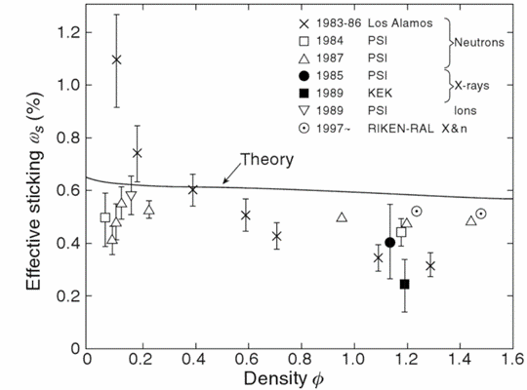
Background
Sticking may decrease with density
Both experiment and theory predict that sticking decreases with density.
Data from four experimental groups is shown.
At high density, the measured sticking is uniformly lower (better) than predicted by theory
Density is stated as a fraction of liquid hydrogen atomic number density.
100
H. Rafelski theory
Sticking limit on the number of fusions per muon
170
200
250
330
500
1000
Ref: K. Nagamine, 2008

Slide 8
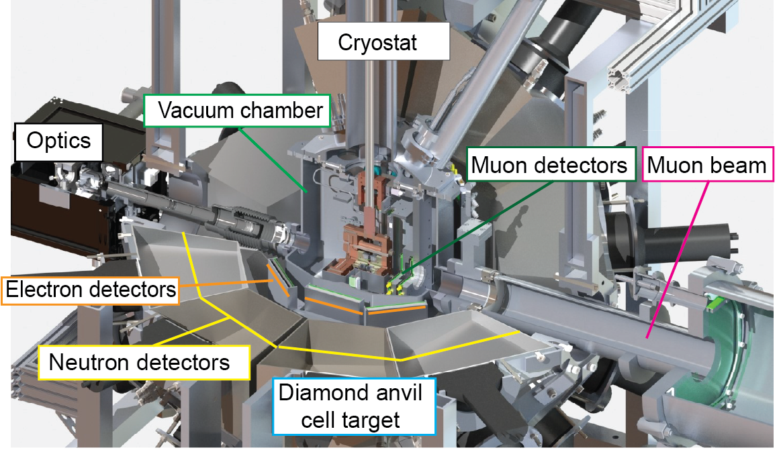
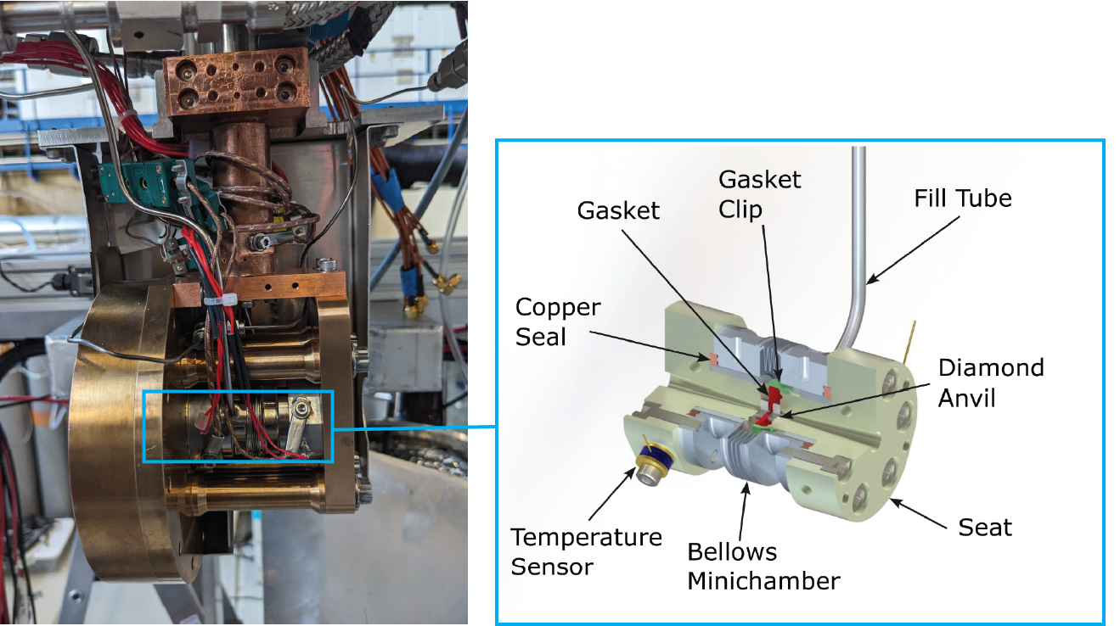
Diamond Anvil Cell
DAC compresses DT mixture to extreme pressures (densities up to 2.2 LHD)
DAC paper submitted for publication and available on arXiv!

Slide 9
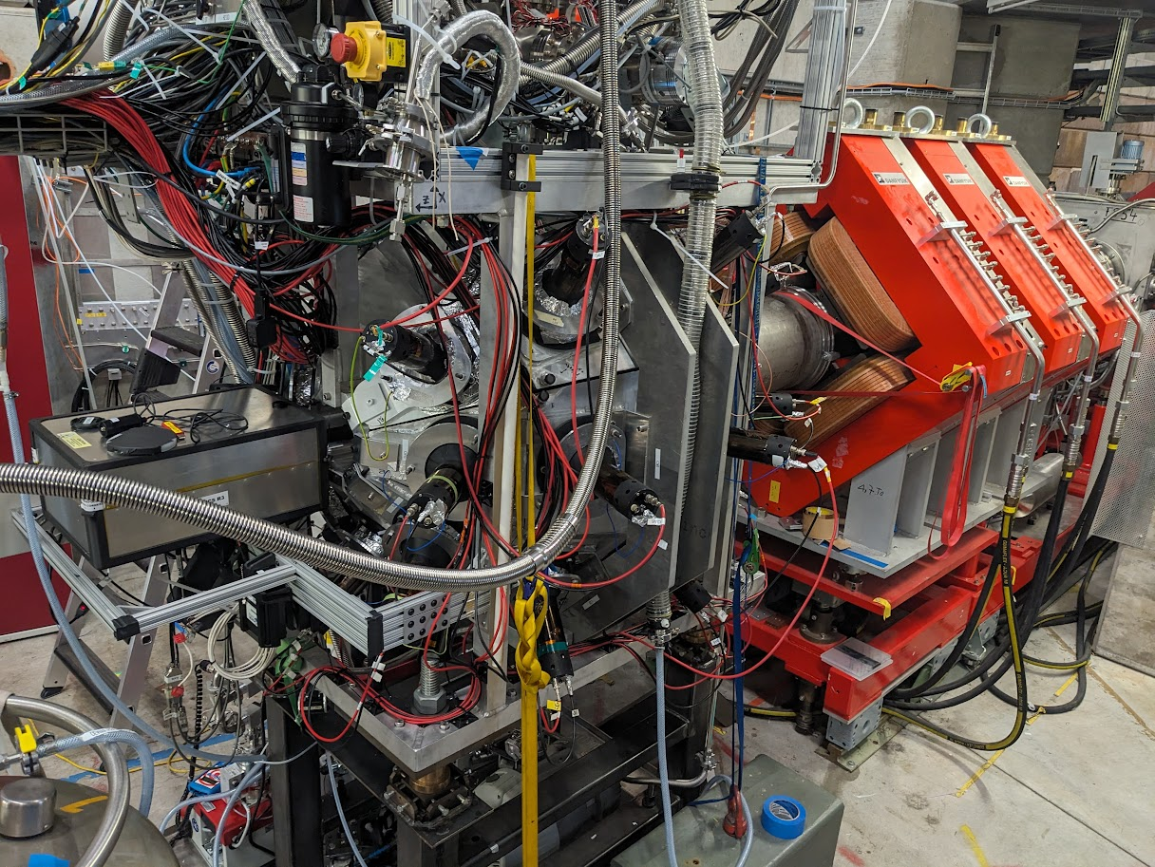

Slide 10
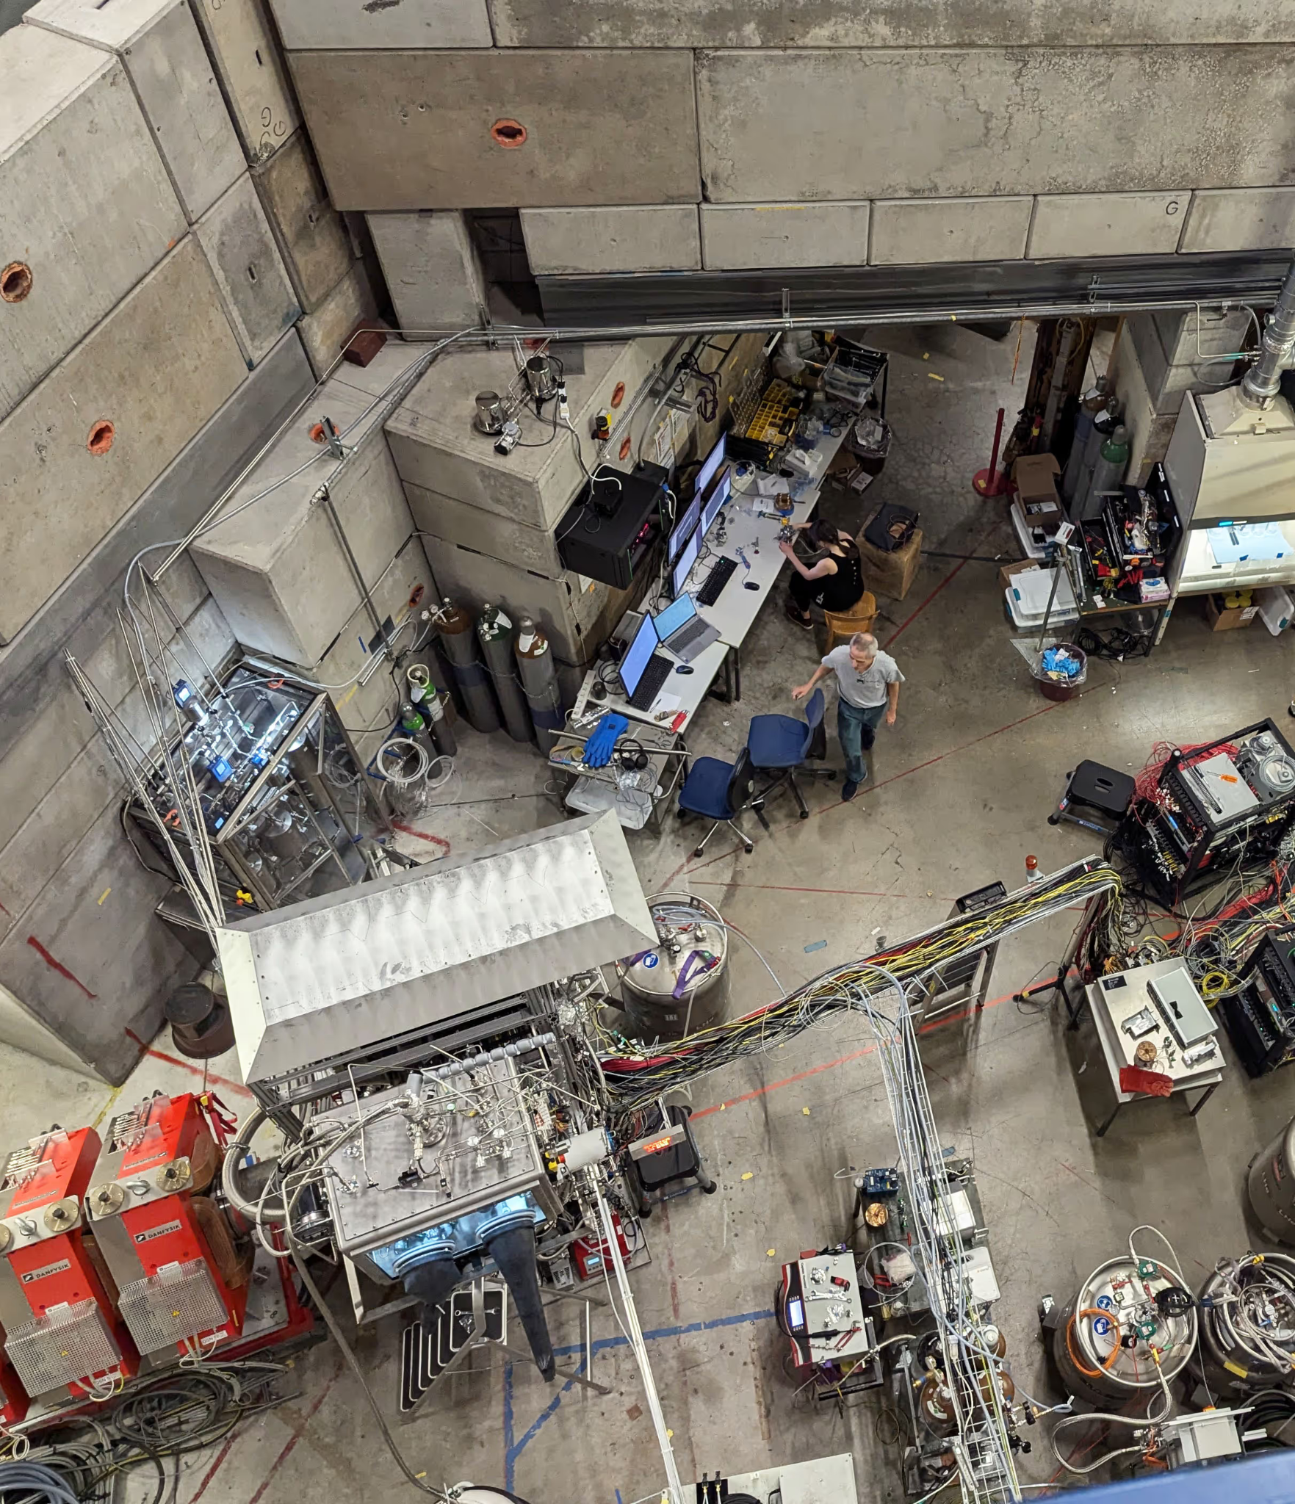

Slide 11
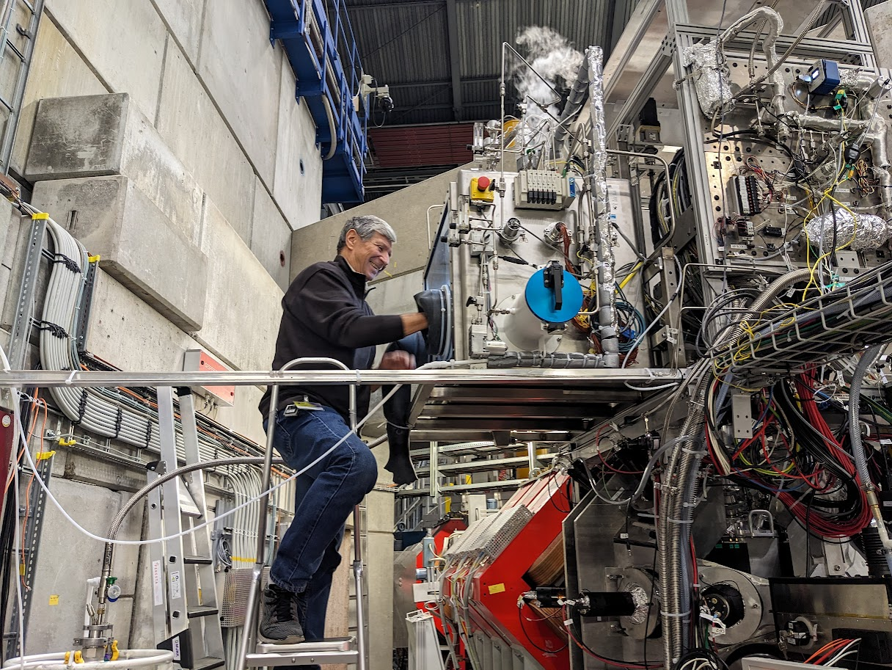
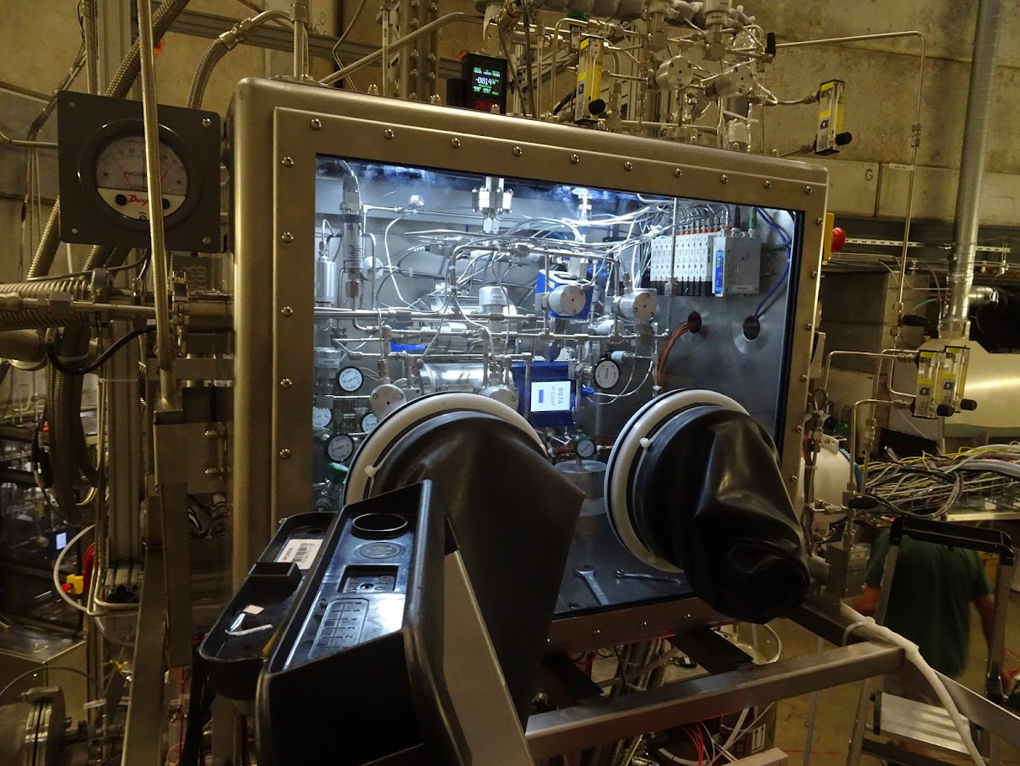
Loading Tritium into the U-beds

Slide 12
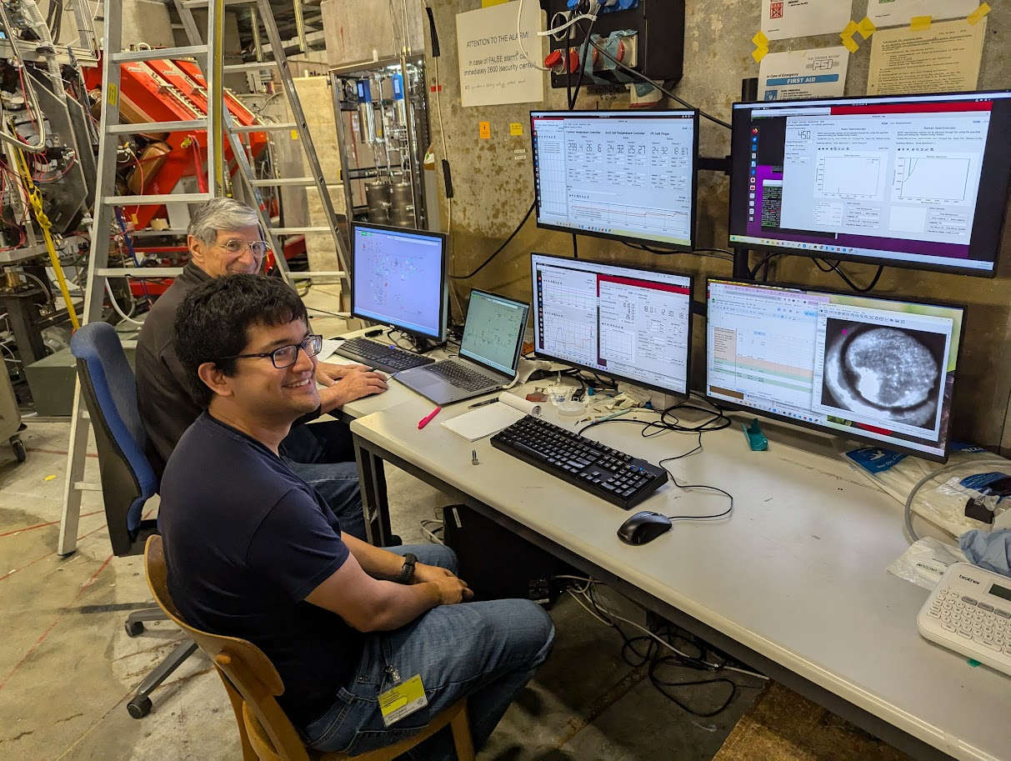
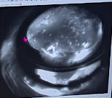
Loading the Cell with Liquid DT
DT gas handling system paper in review and soon to be available on arXiv!

Slide 13
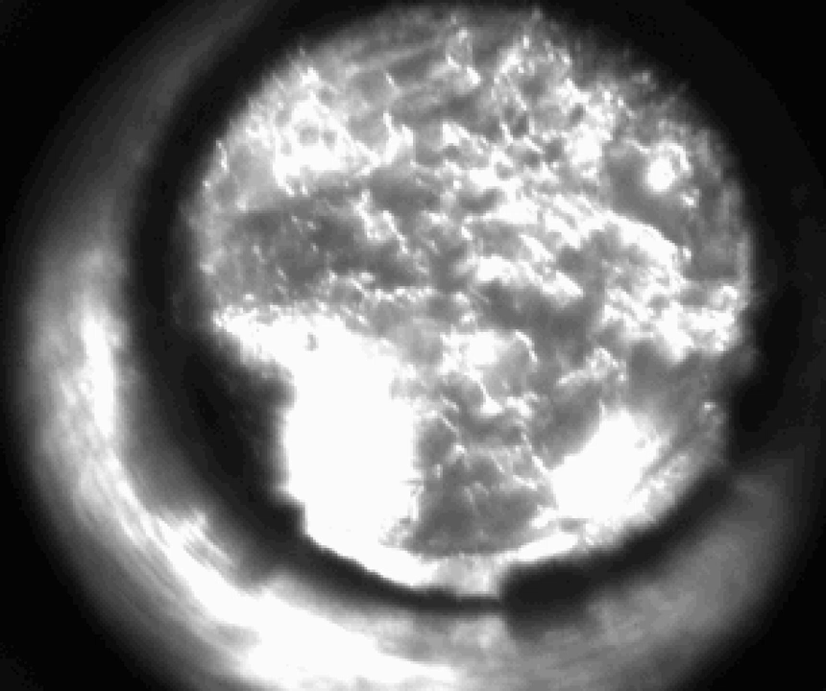
Compression of the Liquid DT to a Solid

Slide 14
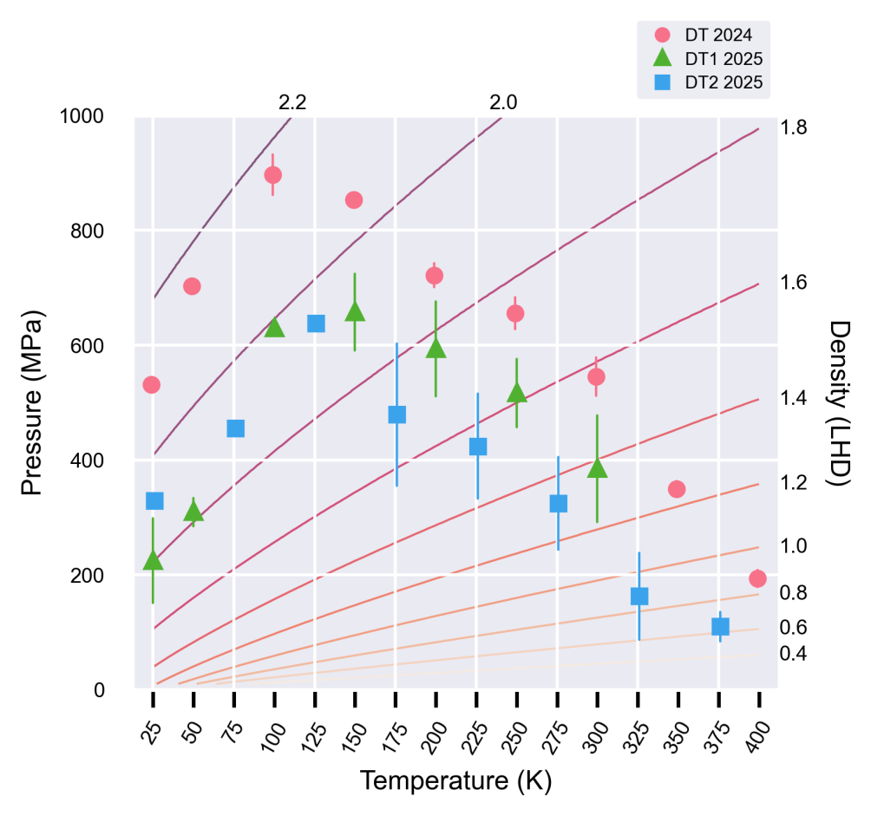
2024/2025 Beam Campaigns
MuFusE achieved first tritium-operation in our diamond anvil cell in October 2024
  World-record static DT pressure of 990 MPa: ~3 times higher than previous highest
  First μCF data collected at densities φ > 1.45 LHD
For 2025, significant engineering work to increase DAC volume, upgrade detectors and optics, and improve DAQ to handle fusion neutron pileup during DT operations
Data collected from 5 hydrogen compressions during 2025 beam period:
  3 DD + 2 DT cell compressions

Slide 15
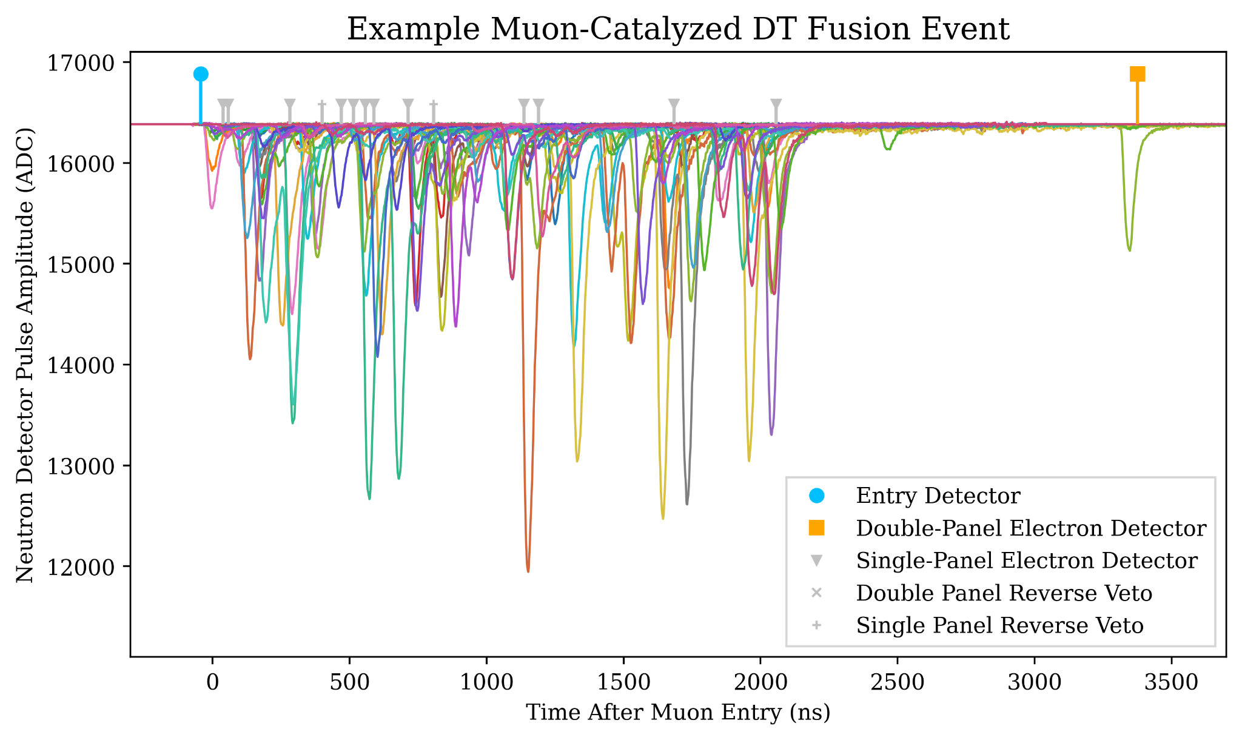
MuFusE Detector Systems
A muon entering the diamond anvil-cell is registered by the entry detector, triggering neutron detector waveform acquisition
Muon decay electrons induce two-panel hits on the electron detector system
Fusion catalysis ends with presumed sticking event
Neutron detectors record fusion activity

Slide 16
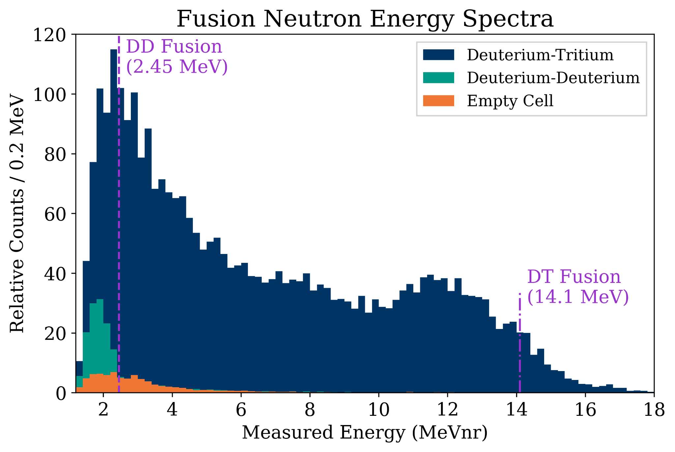
Fusion Observation!
We observe both DD & DT μCF neutrons from our diamond anvil cell!
Events selected using pulse-shape discrimination.
DT events undercounted here due to pileup - accounted in full kinetics analysis workflow.

Slide 17
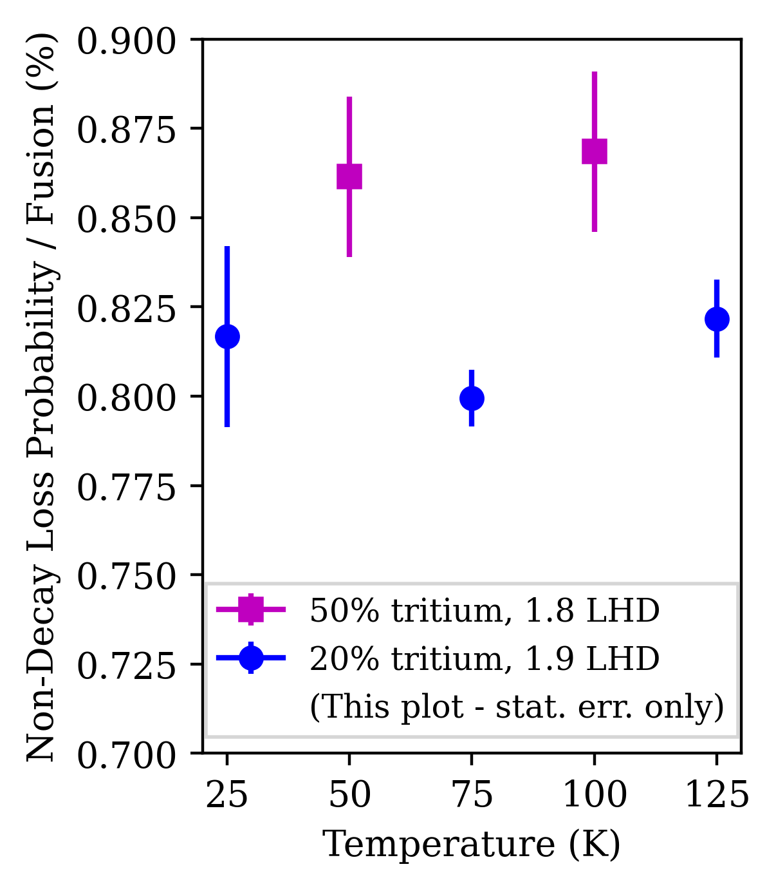
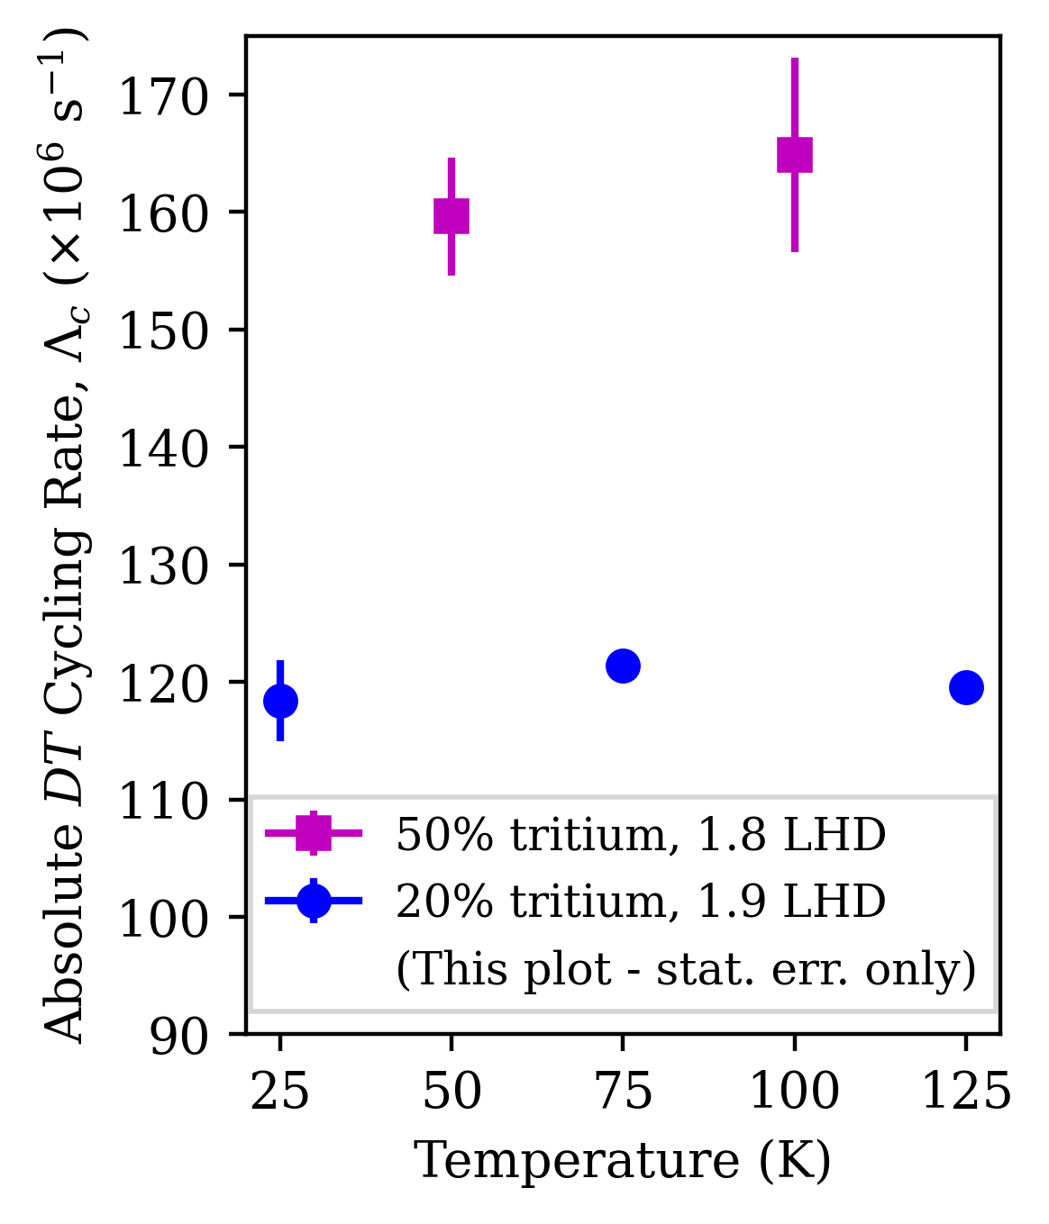
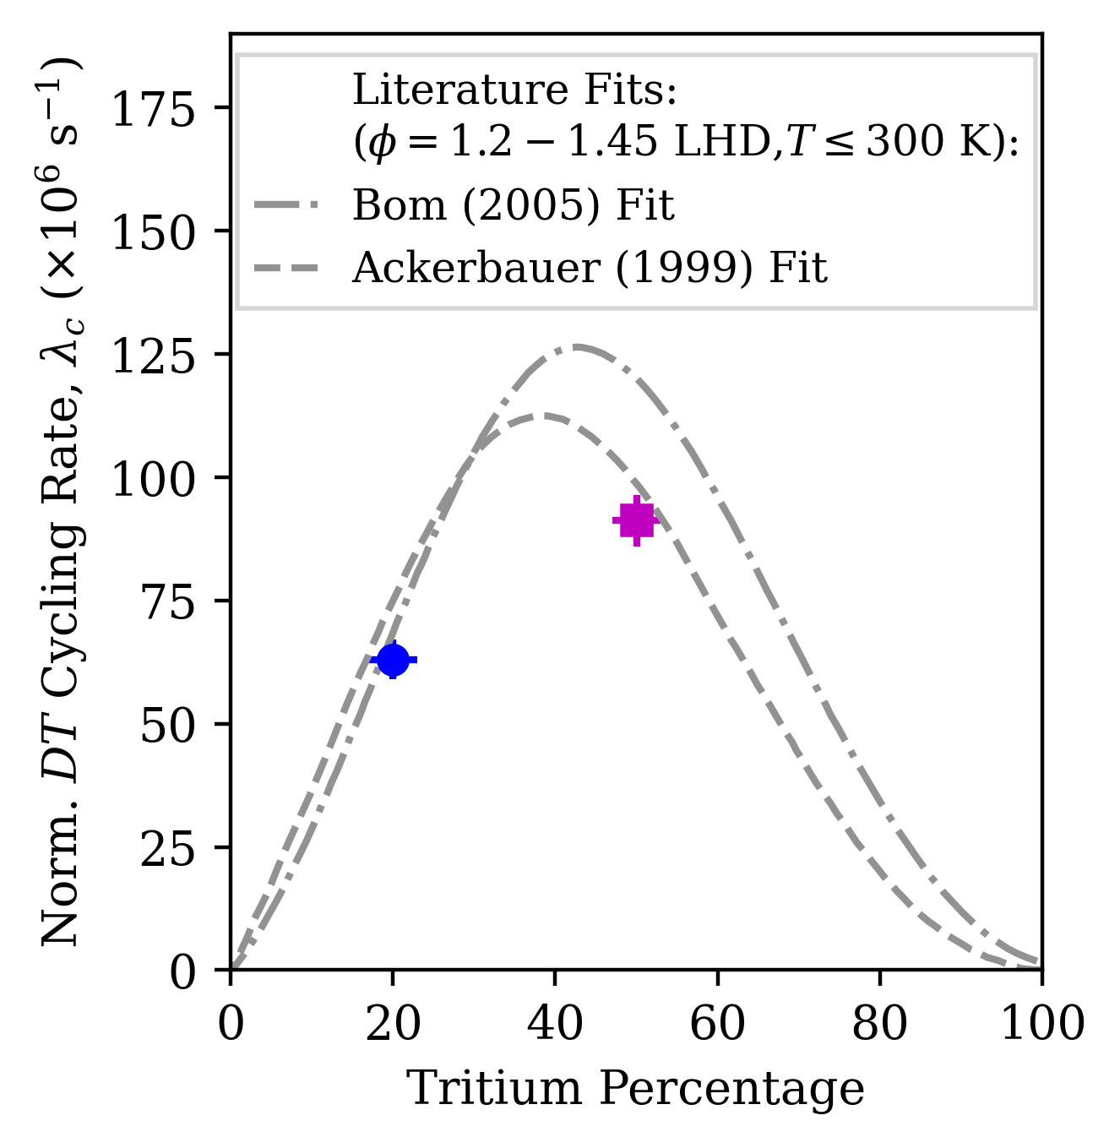
MuFusE 2025 - DT Results (T<150K)
MuFusE Preliminary
MuFusE Preliminary
MuFusE Preliminary
Total cycling rates & non-decay loss probabilities determined from loss timescale of fusion events together with total detected energy yields.
50% tritium compression exhibits fastest absolute cycling rate observed in an equilibrated isotopologue mixture. In progress: analysis of sub-process kinetics, higher temperature runs, and loss sources.

Slide 18
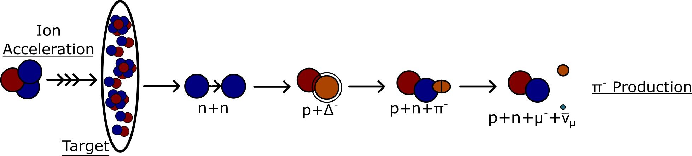
Pion and Muon Production
▶ A high-energy ion beam strikes the production target, initiating a hadronic cascade.
▶ Negative pions are produced primarily through ∆-resonance excitation in nucleon-nucleon collisions.

Slide 19
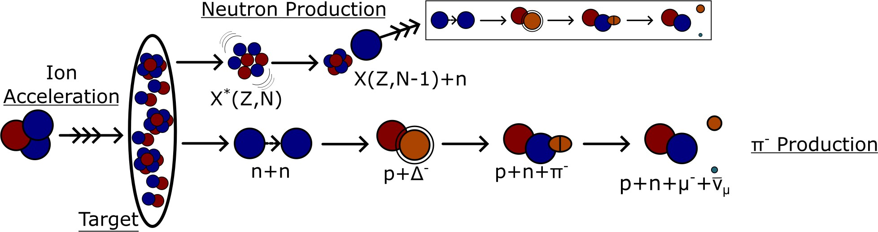
Pion and Muon Production
▶ A high-energy ion beam strikes the production target, initiating a hadronic cascade.
▶ Negative pions are produced primarily through ∆-resonance excitation in nucleon-nucleon collisions.
▶ High-energy spallation neutrons propagate through the target and contribute a secondary pion-production channel.

Slide 20
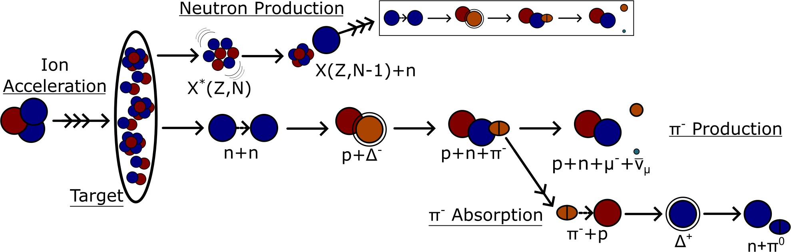
Pion and Muon Production
▶ A high-energy ion beam strikes the production target, initiating a hadronic cascade.
▶ Negative pions are produced primarily through ∆-resonance excitation in nucleon-nucleon collisions.
▶ High-energy spallation neutrons propagate through the target and contribute a secondary pion-production channel.
▶ Pion loss via ∆-resonance absorption sets an effective upper limit on target thickness.

Slide 21
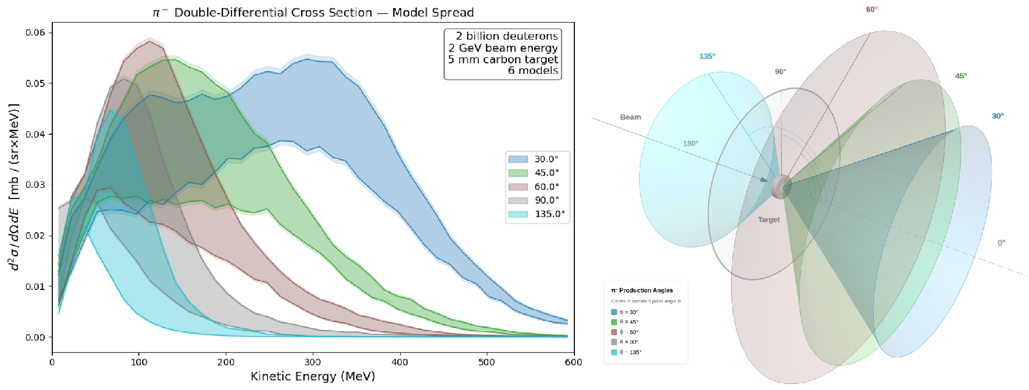
Pion Production: Model Uncertainties
▶ d ² σ/d Ω dE quantifies π⁻ yield as a function of production energy and angle.
▶ It directly constrains pion production rates, absorption, and the forward trajectories that seed secondary production.
▶ Across BIC, INCL++, and Bertini models with and without high-precision neutrons, predicted yields vary by up to a factor of 2.
▶ Direct measurement is essential to constrain model predictions and reliably optimize the muon source.

Slide 22
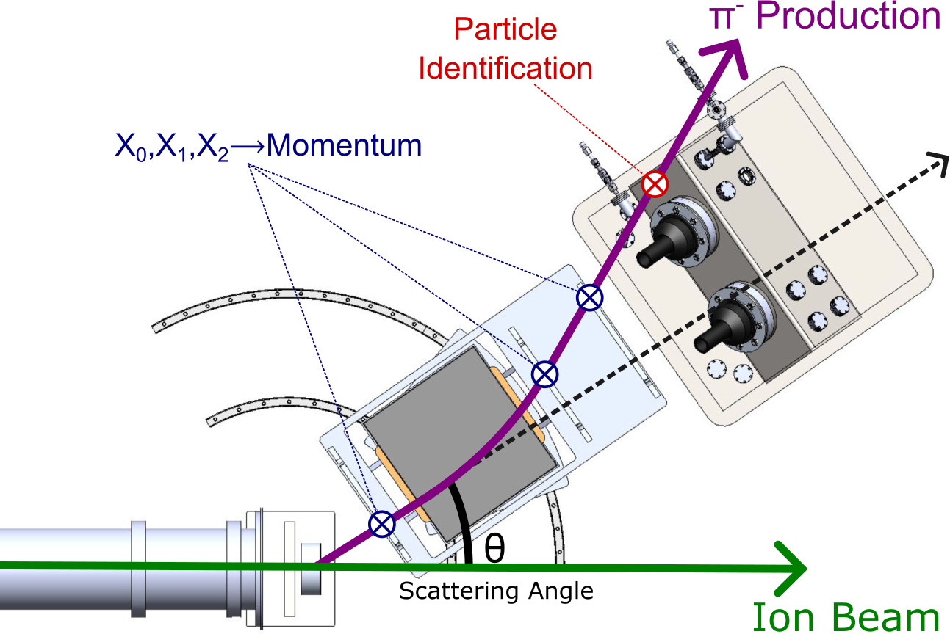
Experimental Overview
Beam and Production Target
^{▶ 2} H and ⁴ He beams at ∼1 GeV/u
▶ Novel target materials
▶ Variable-width target
Momentum Resolution & Coverage
▶ Trajectory-tracking detectors
▶ Dipole bending magnet
Angular Resolution & Coverage
▶ Narrow collimator
▶ Rotating detector array
Negative Pion Identification
▶ Magnet charge filtering
▶ Cherenkov electron veto

Slide 23
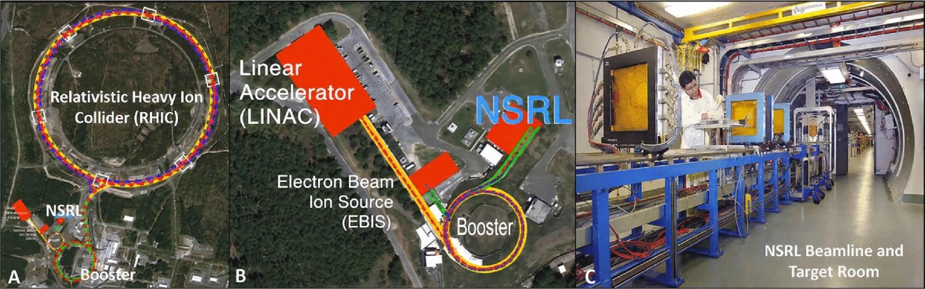
Beamline and Facility
NASA Space Radiation Laboratory at Brookhaven National Laboratory
▶ A) BNL’s Booster provides ions of all species to RHIC and NSRL
▶ B) Deuterons are supplied by the Tandem Van de Graaff accelerator
▶ C) The NSRL beam is supplied to target room with experimental support facilities

Slide 24
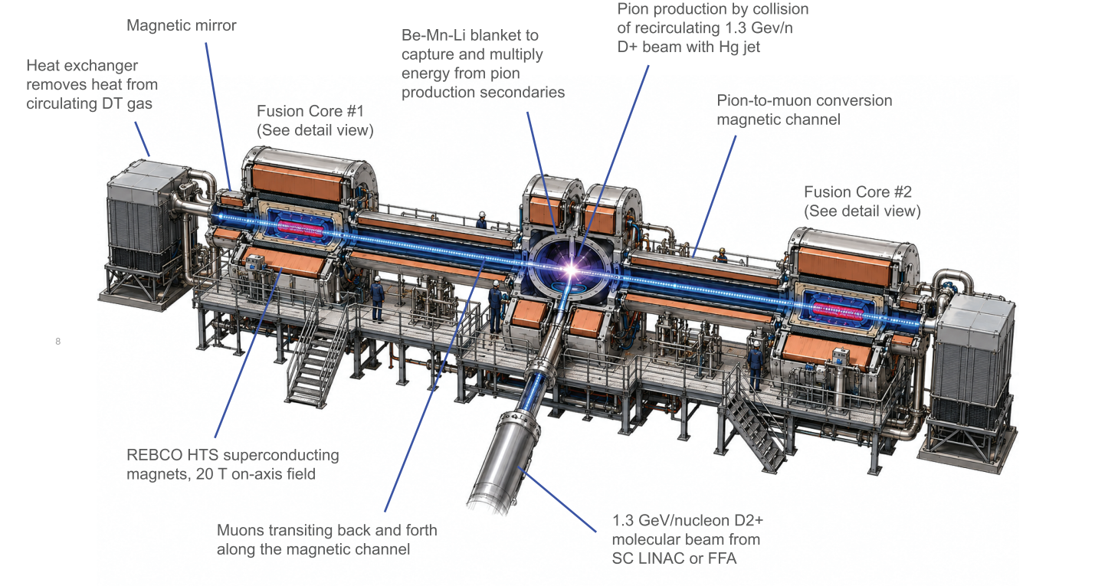
Conceptual Fusion Power Plant Design

Slide 25
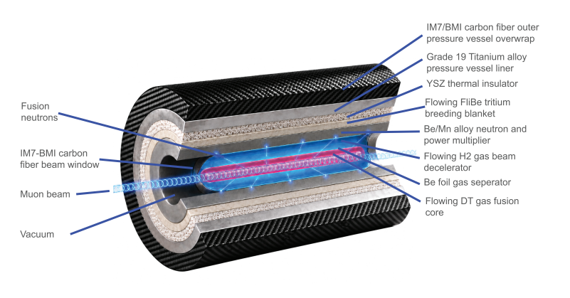
Conceptual Fusion Power Plant: Fusion Core

Slide 26
Technological Applications
Muon-catalyzed fusion is the most efficient process known for the accelerator-driven production of fast neutrons. Applications include:
  Production of electricity
  Neutron source for fusion materials testing
  Industrial production of tritium
  Industrial production of medical isotopes
  Recycling of used nuclear fuel

