Slide 1
Introduction: Radioisotope Production at ORNL
6/10/2026
ORNL Perspective and Trends
Chris Bryan
Radioisotope Science and Technology Division

Slide 2
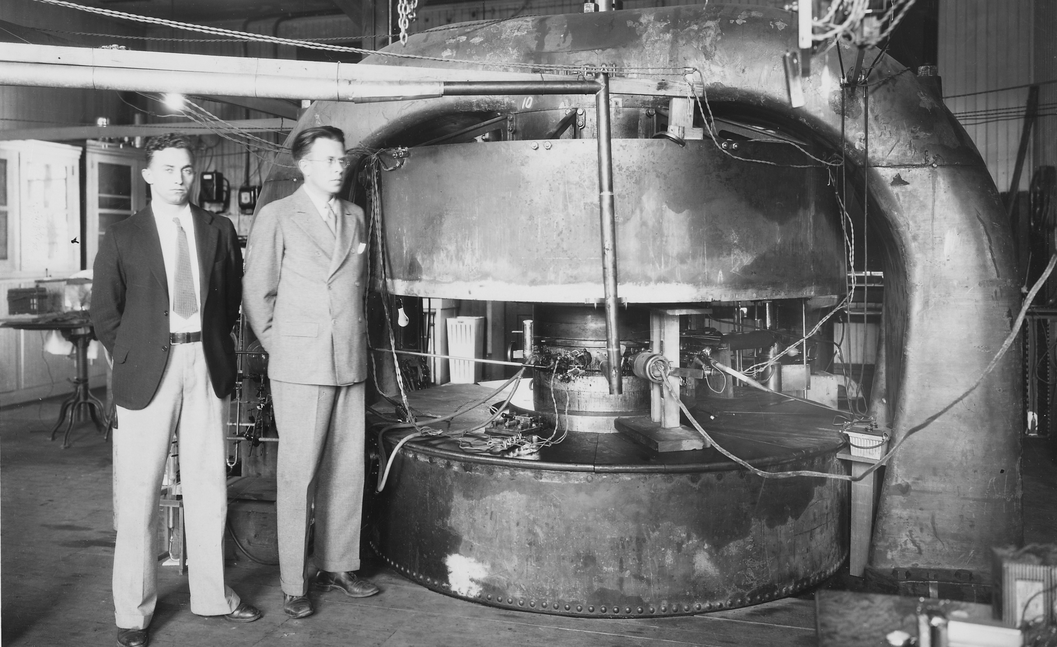
The first radioisotopes were produced using cyclotron accelerators thanks to Earnest O. Lawrence in the 1930s

Slide 3

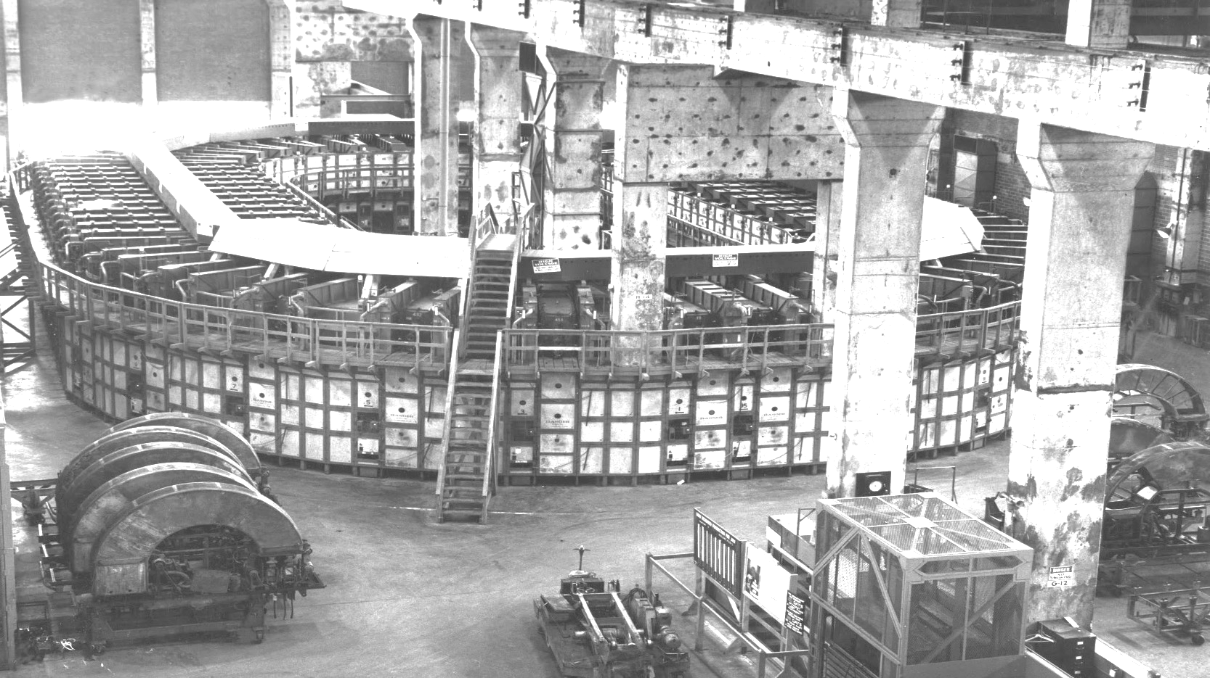
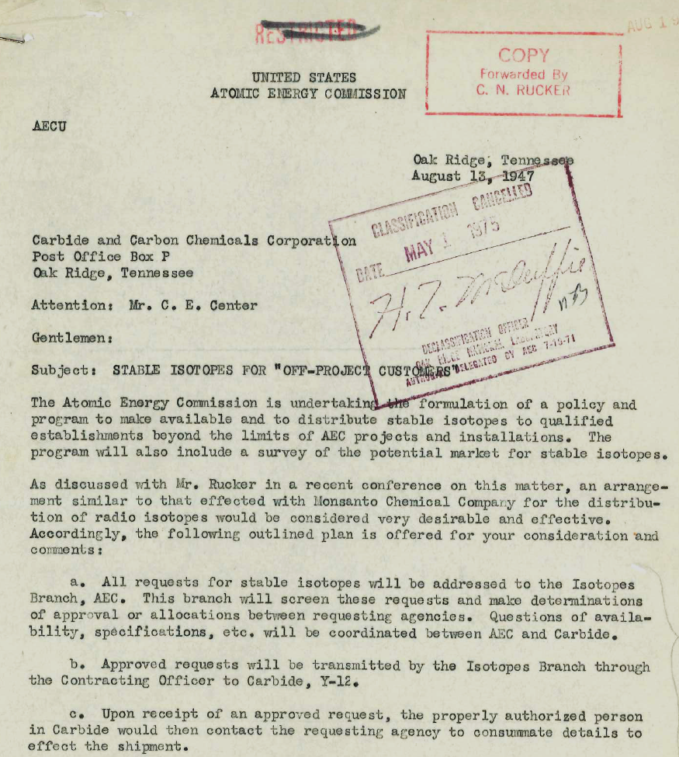
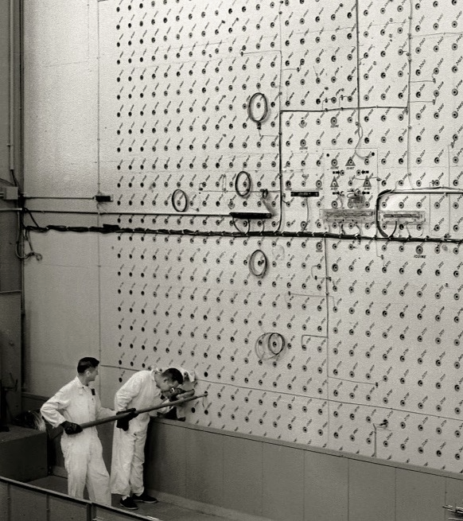
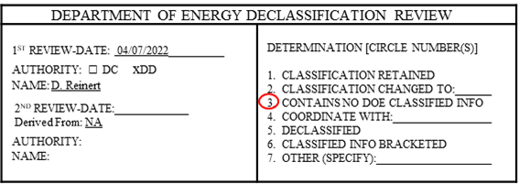
Reactor-based Isotope production, enrichment and distribution began at Oak Ridge in 1946
Notes:
By the 1960’s ORNL was shipping 100’000 shipments. Today we focus on Isotopes not available in the private sector.

Slide 4
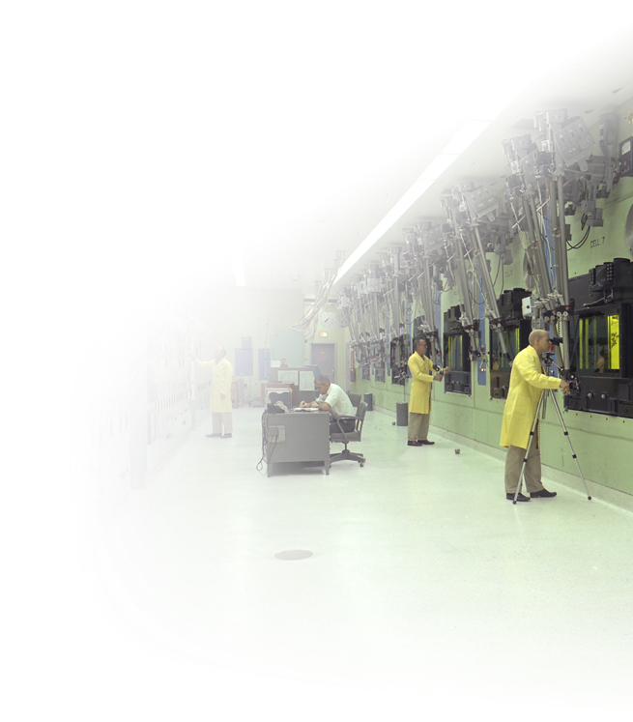

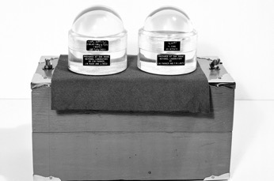
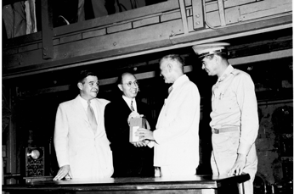
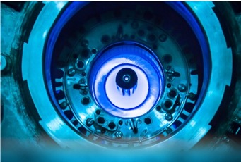
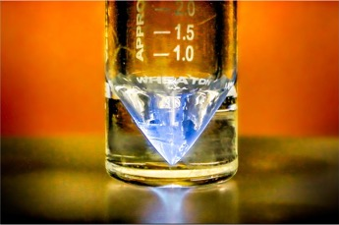

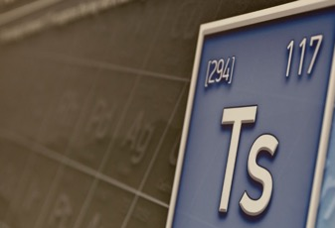
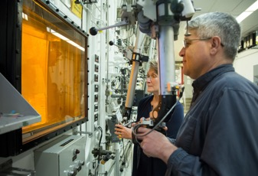
From its inception, ORNL has produced and supplied isotopes
1945
1946
1965
1966
1943 ORNL’s Graphite Reactor goes critical
1997
2015
2016
2018

Slide 5

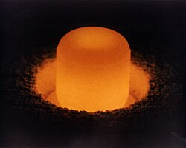
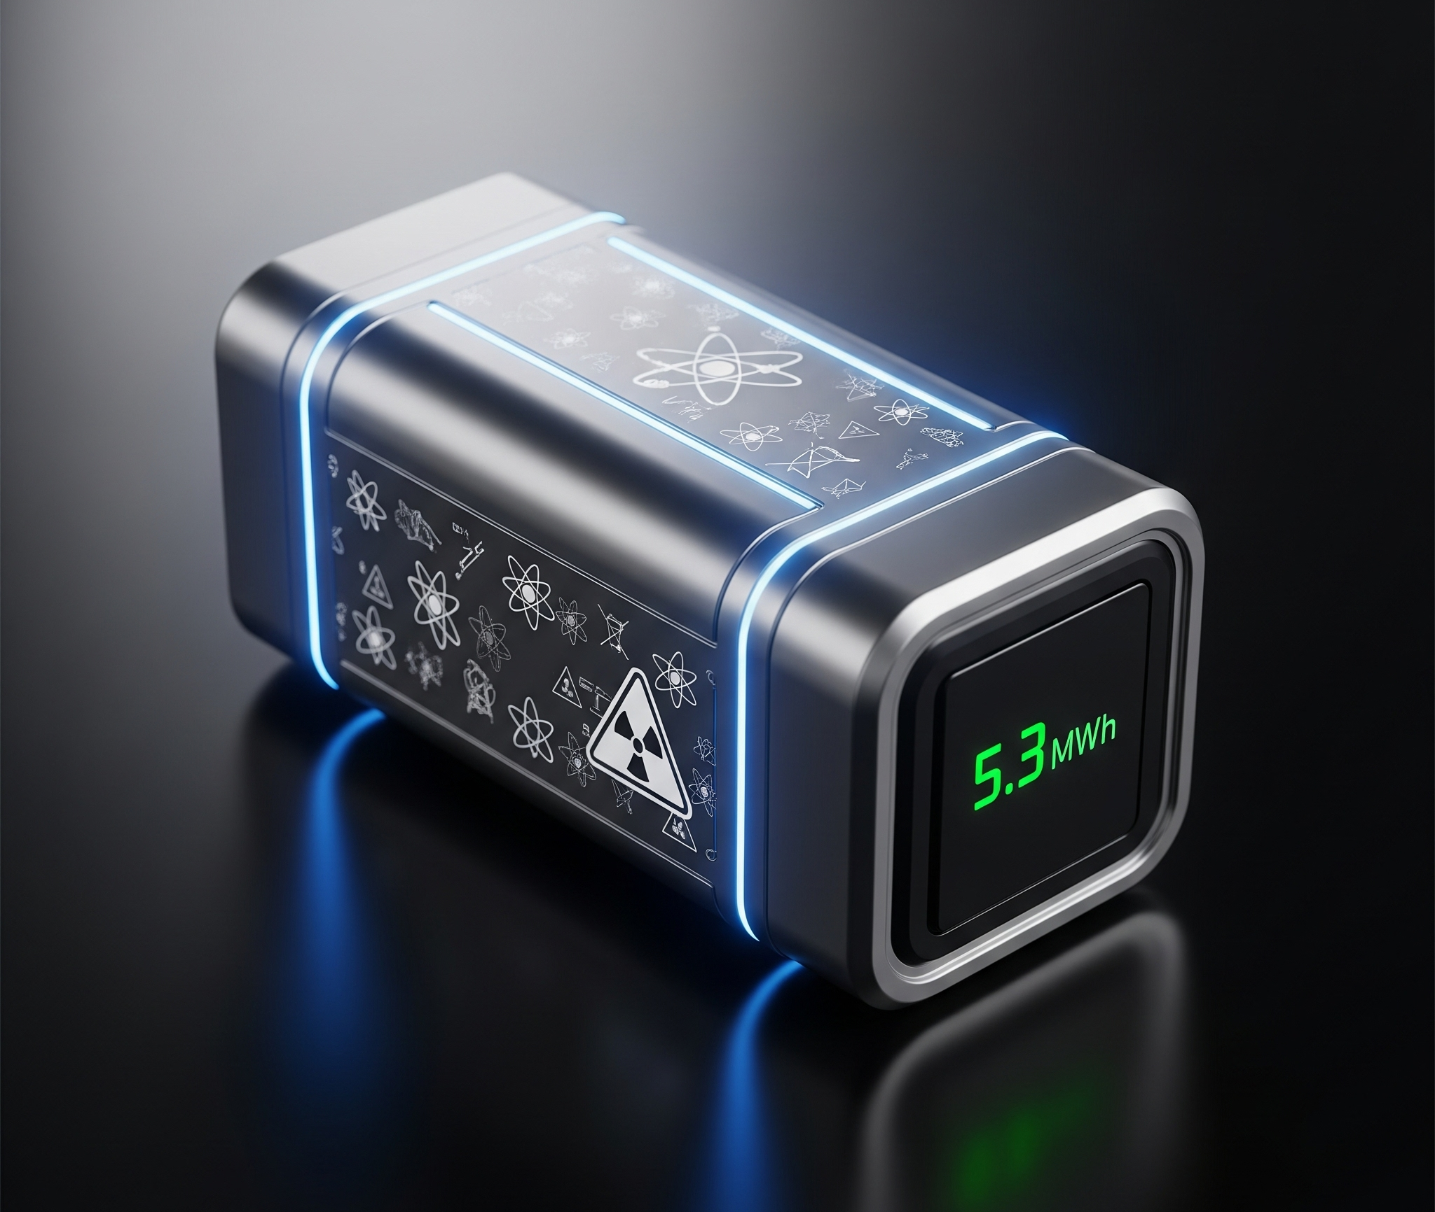
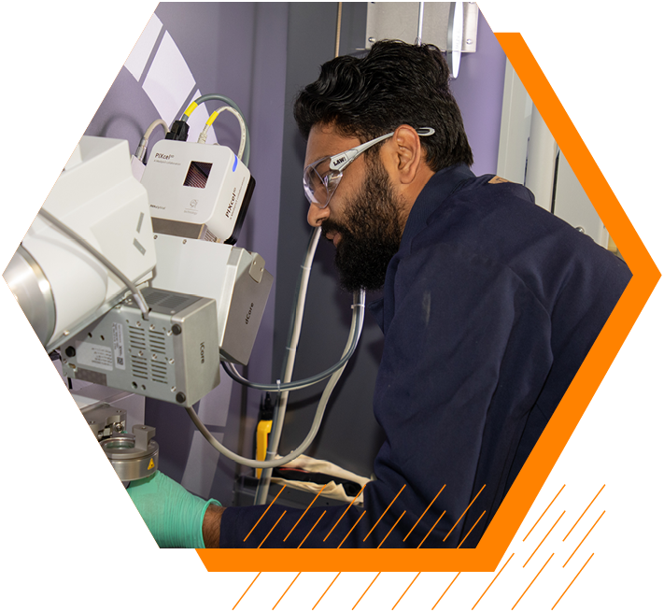
ORNL’s Radioisotope portfolio supports multiple programmatic and initiative areas
DOE Radioisotope Program
Plutonium-238 Supply Program
(DOE-NE)
ORNL Nuclear Battery Initiative
ORNL ARM Initiative
Notes:
Accelerating Radiotherapeutics through Advanced Molecular Constructs

Slide 6
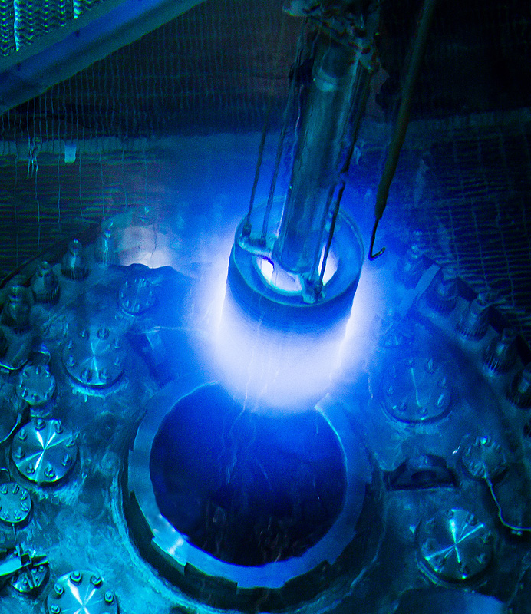
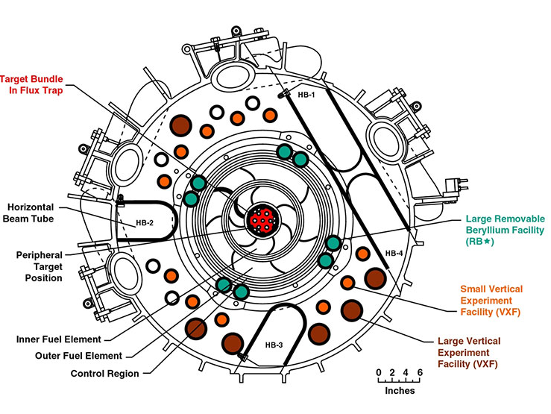
The High Flux Isotope Reactor (HFIR) drives much of ORNL’s radioisotope portfolio
Highest domestic steady state neutron flux environment
Multi-purpose machine
  Neutron scattering
  Radioisotope production
  Materials irradiation testing
  Nuclear forensics
  Fundamental physics (antineutrinos)

Slide 7
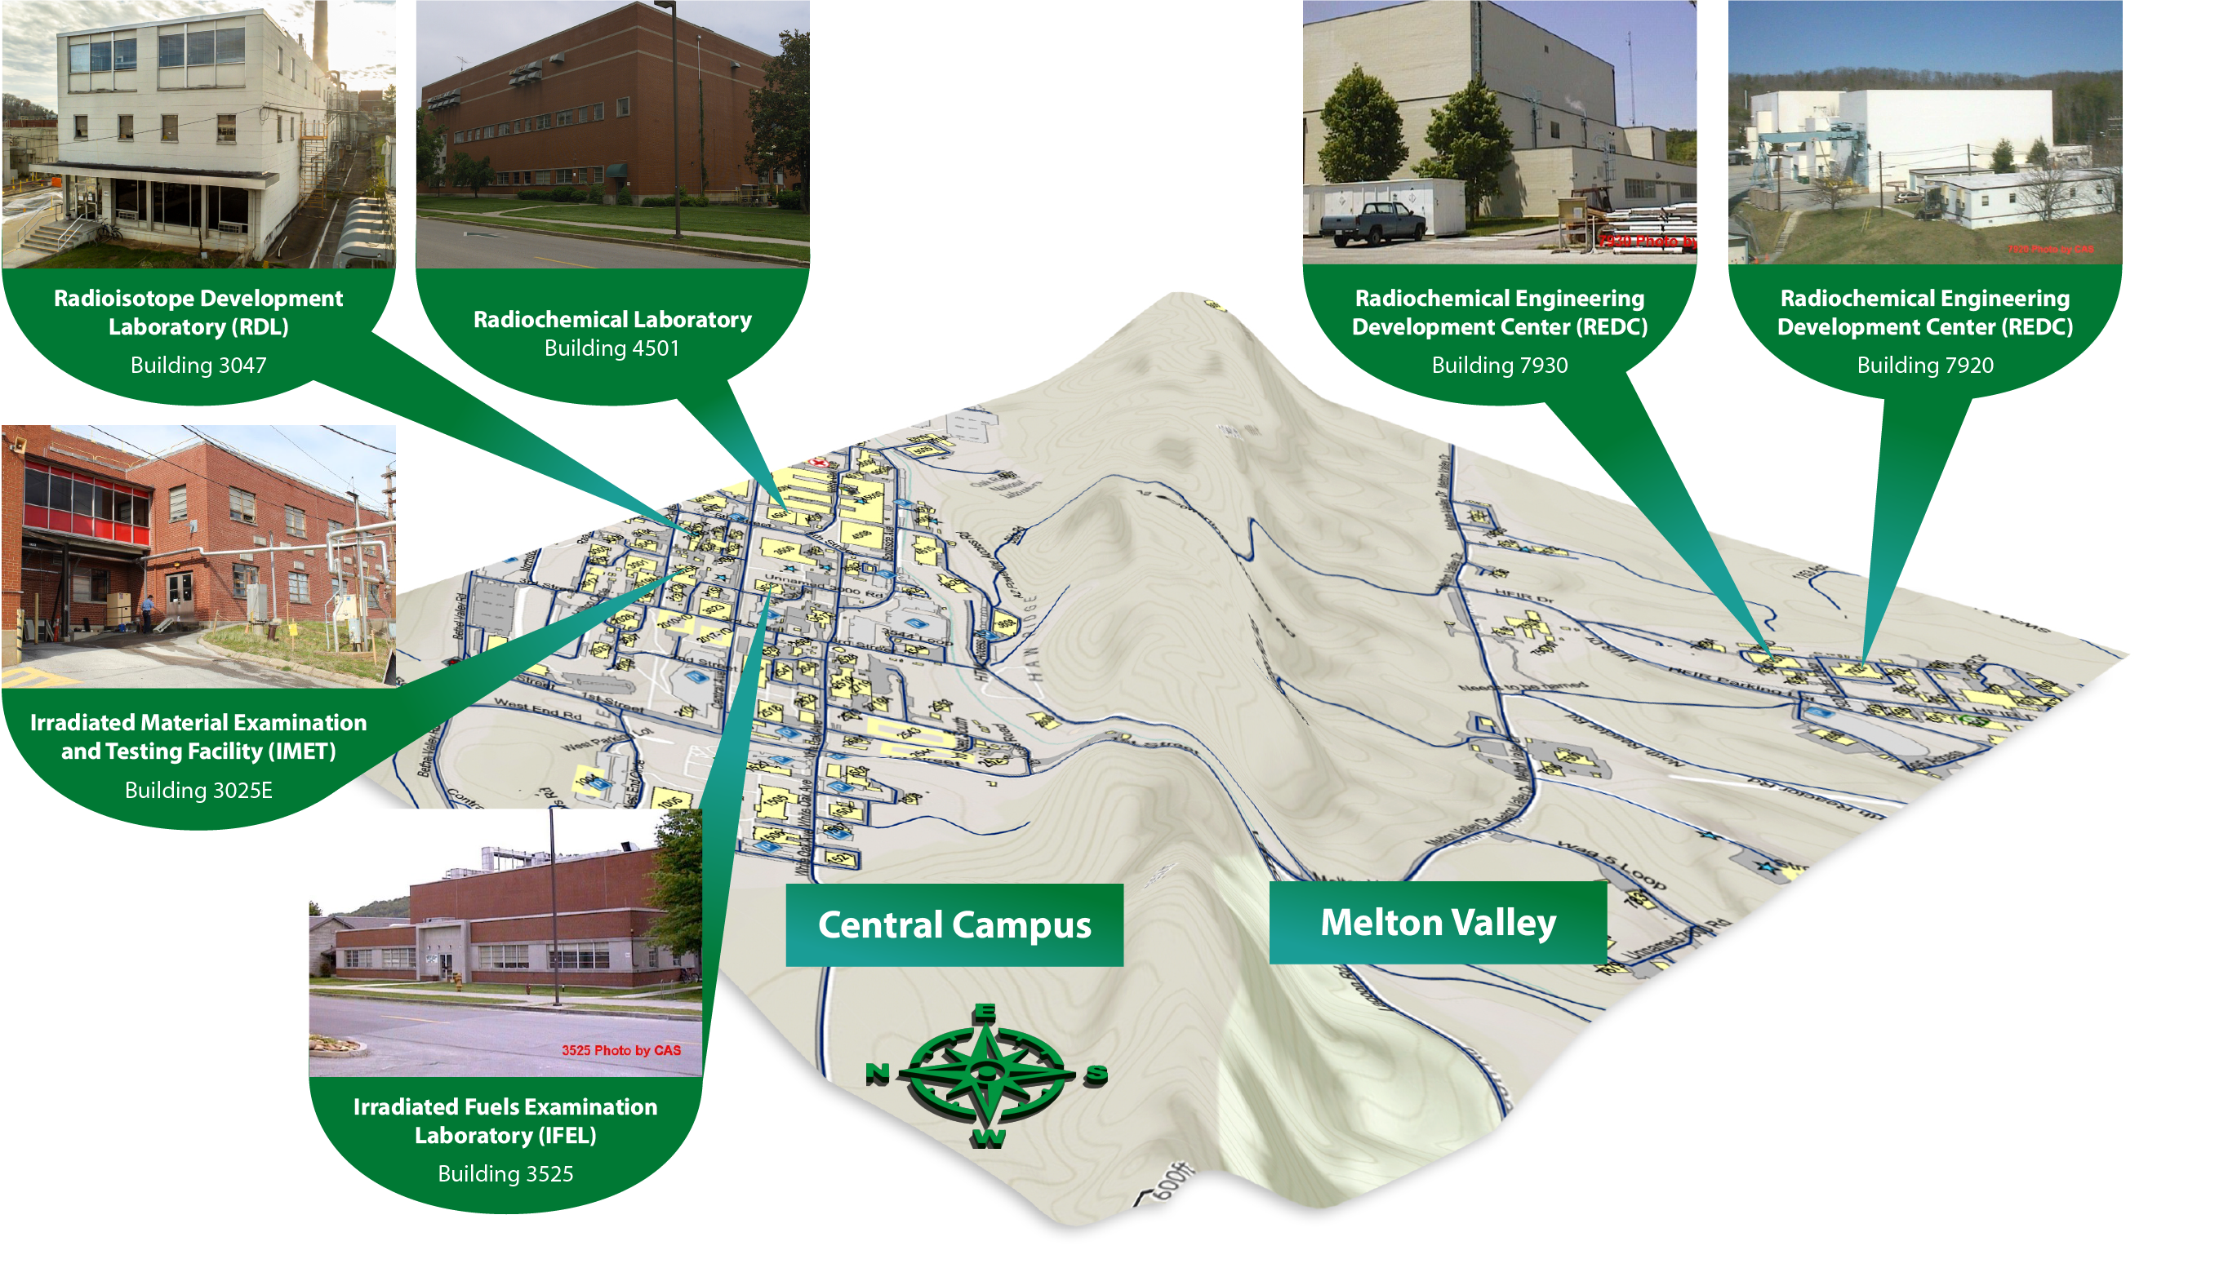
Multiple processing facilities support radioisotope processing
R&D and production in five operational nuclear and radiological hot cell facilities at ORNL
Notes:
Mike’s slide
Lee may clarify meaning of Cat 2 verses Cat 3

Slide 8
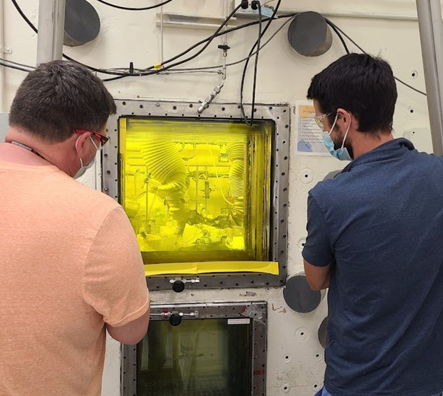
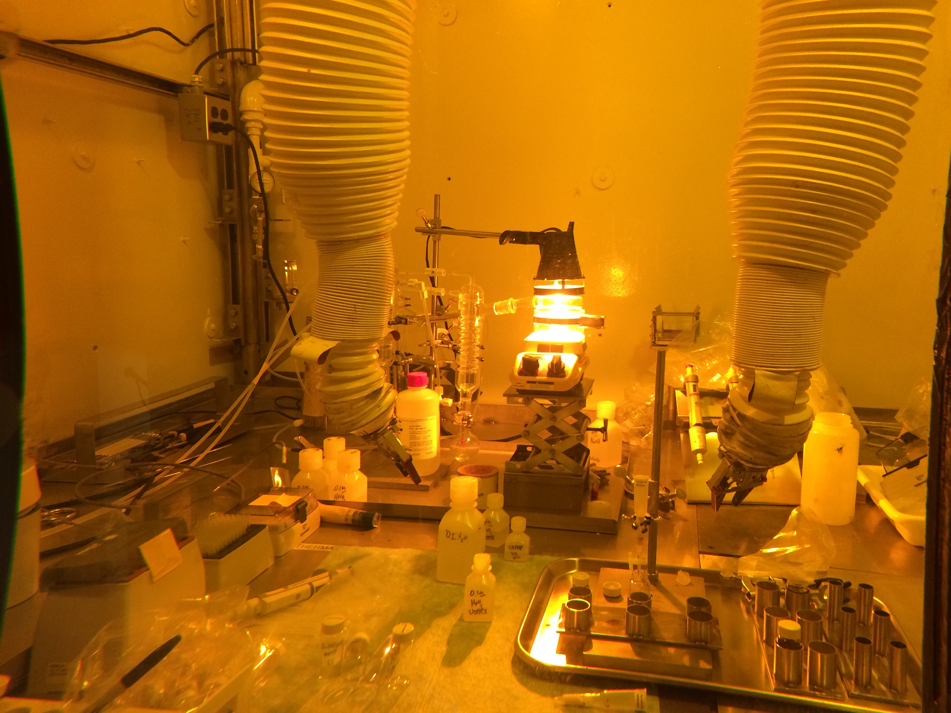
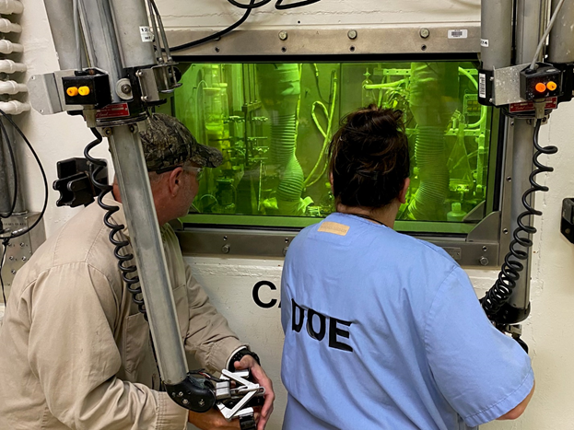
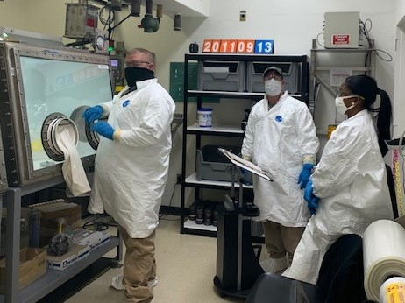
Facilities, research and production staff are key to ORNL’s radioisotope processing capabilities

Slide 9
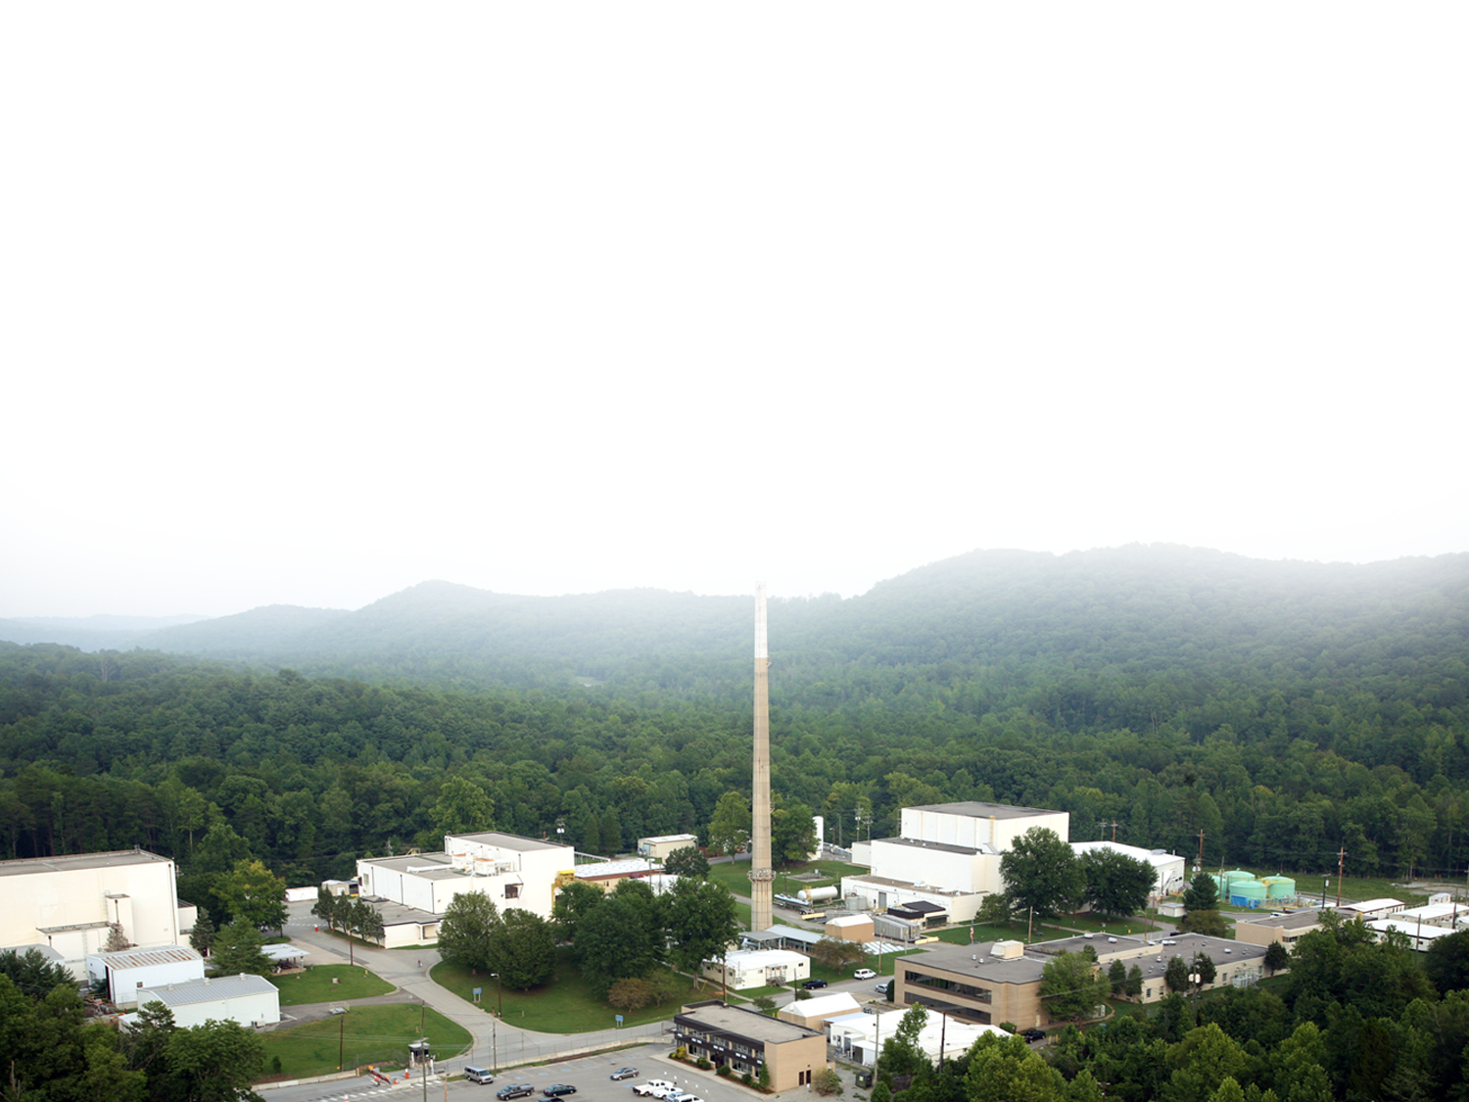
Radioisotopes produced at Oak Ridge
²²⁵Ac (Decay)
²²⁷Ac
¹³³Ba
²⁵²Cf
²⁴⁹Bk
²⁵⁴Es
²⁵⁷Fm
^{166m}Ho
⁶³Ni
¹⁴⁷Pm(fission)
²²⁶Ra
⁷⁵Se (Ind/MURR)
¹⁹²Ir
^{117m}Sn
⁸⁹Sr
²²⁸Th
²²³Ra/²²⁷Th
²²⁴Ra/²¹²Pb
¹⁸⁸W/¹⁸⁸Re
ORNL also dispenses high-purity ^{238,239,240,242,244}Pu, ²³⁷Np, ²⁴³Am, ⁹⁹Tc, ²⁰⁹Po, ^{233,234,235,238}U, ²²⁹Th, and ^{244,248}Cm from inventory
(²³⁸Pu for NE-3/NASA)
Production of these radioisotopes is made possible because of the
High Flux Isotope Reactor and/or hot cell processing capabilities at ORNL

Slide 10
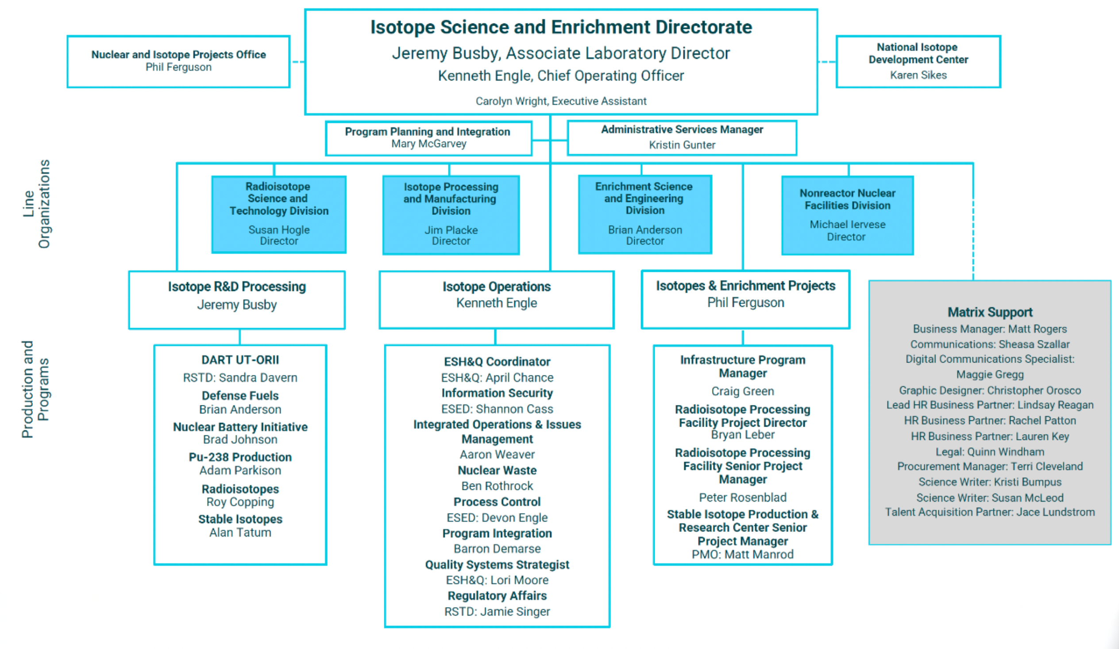

Slide 11
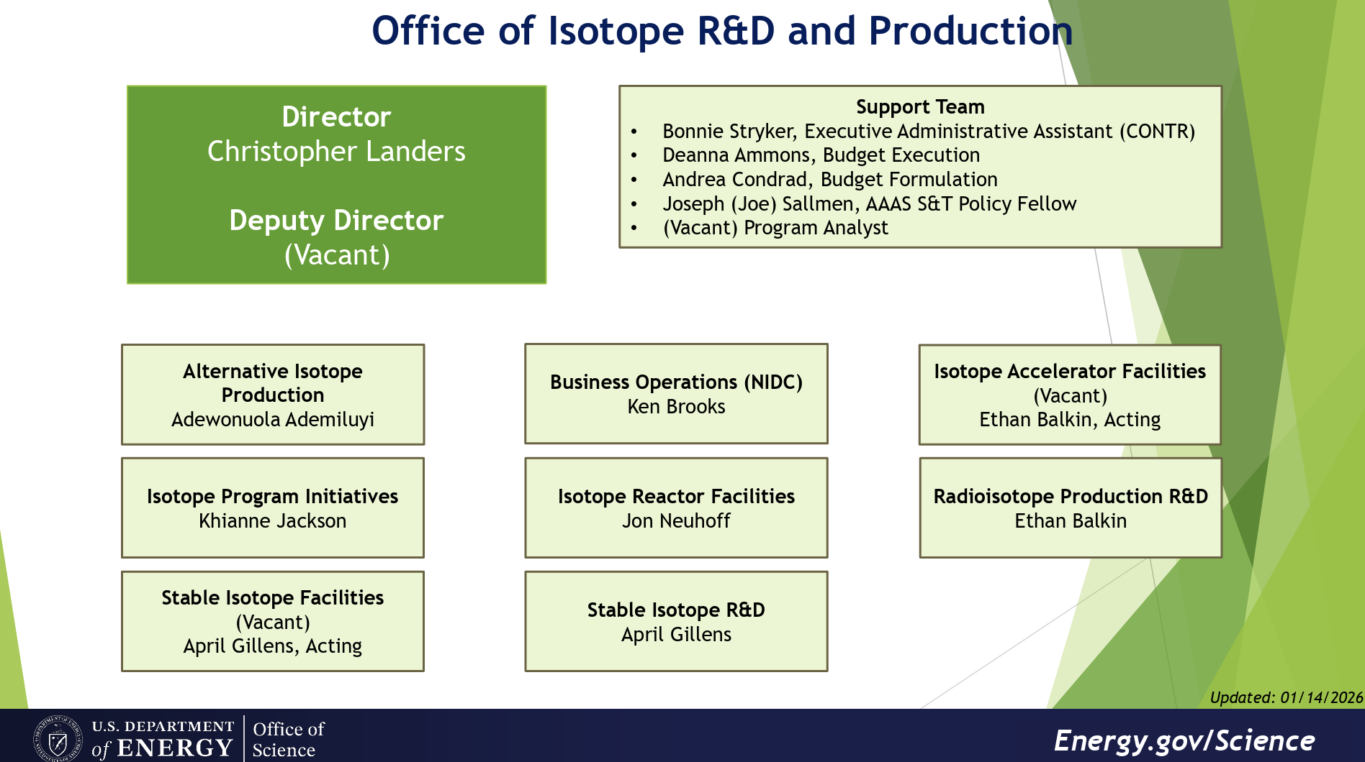

Slide 12
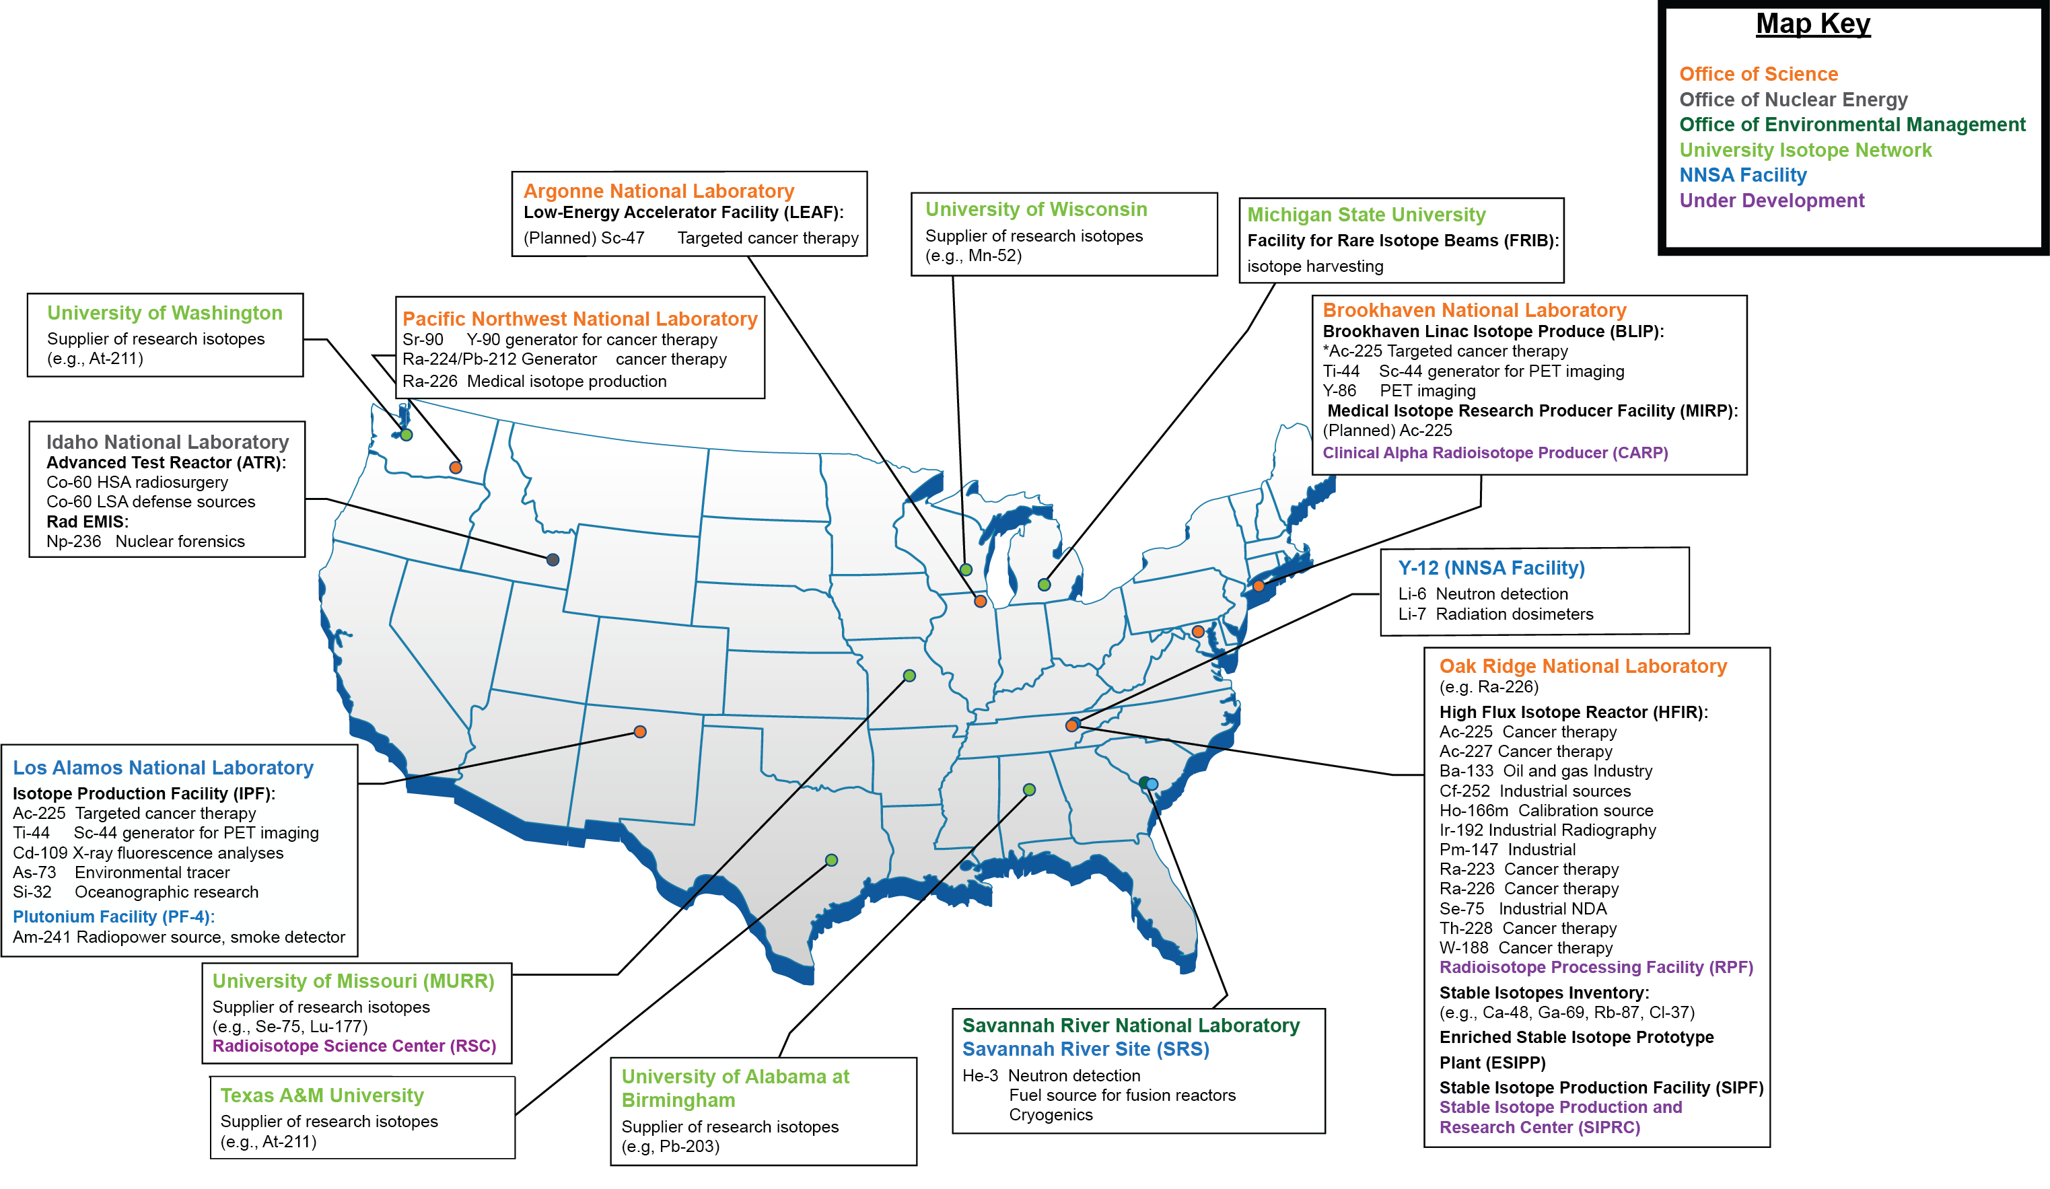
Oak Ridge supports DOE-IRP, The Office of Isotope R&D and Production
, Gd-153,Fe-59)
Notes:
Very large growth in ORNL Isotope Program scope since xfer from NE to SC-NP
core R&D funding established
development of enrichment/facility construction (ESIPP, SIPF, SIPRC)
Ac-227 project
RPF

Slide 13
ORNL radioisotopes support medical and industrial applications
 | Isotope | Half Life | Application
MEDICAL APPLICATIONS | Actinium-225 (Th-229 derived) | 9.9 days | Targeted Alpha Therapy (TAT)
 | Carbon-14 | 5370 a | Medicinal Chemistry
 | Actinium-227 | 21.7 years | Ra-223 (t_{1/2}=11.4 days) and Th-227 (t_{1/2}=18.6 days) for prostate cancer palliation and treatment
 | Thorium-228 | 1.9 years | For Pb-212 (t_{1/2}=10.6 hours), TAT applications
 | Radium-224 | 3.6 days | Pb-212 (t_{1/2}=10.6 hours) for Targeted Alpha Therapy
 | Strontium-89 | 50.6 days | Palliative bone cancer treatment
 | Tungsten-188 | 69 days | For Re-188 (t_{1/2}=17 hours) Cancer therapy
 | Tin-117m | 13.6 days | Palliative bone cancer treatment
INDUSTRIAL APPLICATIONS | Ba-133 | 10.5 years | Oil and Gas Industry. Gamma radiation source for flow meters
 | Cf-252 | 2.65 a | Neutron sources for reactor start-up/radiography
 | Ir-192 | 74 d | Industrial gamma radiography, nuclear medicine
 | Se-75 | 120 d | Industrial gamma radiography
 | Ho-166m | 1200 a | Radiation standard
 | Ni-63 | 100 a | Explosive trace detectors and chemical detection
 | Pm-147 | 2.62 a | Non-contact/thin film measurement instruments

Slide 14
Targeted Radioisotope Therapies
Isotope | Type | Half-life | Details | Uses
Lutetium-177 | Beta emitter | 6.65–6.7 days | Key in PRRT; used in PSMA therapies; trials | PRRT, PSMA therapies
Actinium-225 | Alpha emitter | 9.92 days | High-potency alpha emitter; expanded supply at ORNL | Prostate, neuroendocrine cancers
Radium-223 | Alpha emitter | 11.4 days | FDA-approved for bone metastasis; core alpha therapy isotope | Bone metastasis treatment
Astatine-211 | Alpha emitter | 7.2 hours | Ideal half-life for TAT; trials for thyroid cancer, glioblastoma, prostate cancer | TAT for various solid tumors
Copper-67 | Beta/gamma emitter | 61.8 hours (2.57 days) | Strong theranostic potential; commercial-scale production starting 2026 | Theranostic applications
Terbium-161 | Beta emitter | 6.89 days | Explored as next-gen theranostic isotope; auger electrons + imaging gammas | Emerging theranostics
Lead-212 | Beta emitter (parent of alpha daughters) | 10.62 hours | Ideal for TAT; evaluated in early-phase PSMA and NET trials | Targeted alpha therapy
Bismuth-213 | Alpha emitter | 45.6 minutes | Produced from 225Ac generators; promising short-lived alpha emitter | Rapid-delivery alpha therapies

Slide 15
Nuclear Batteries
Advanced Radio Thermoelectric Generators (RTGs)
Betavoltaic Systems
Solid State Source
Micronuclear Hybrids (Alpha)
Betavoltaic Systems
Isotope | Half-life | Average Beta Energy | Power Density / Output
Tritium (3H) | 12.3 years | ~5.7 keV (max 18.6 keV) | low-µW/g scale
Nickel-63 (63Ni) | ~100 years | ~17.4 keV avg | nW/cm² to µW/cm³; ~10 µW/cm³
Promethium-147 (147Pm) | 2.62 years | ~62 keV avg (max 224 keV) | ~15 µW/cm²; ~340 mW/g (Pm2O3)
Carbon-14 (14C) | 5700 years | ~49 keV avg (max 156.5 keV) | ~15 J/day (prototype small cell)
Radio Thermoelectric Generators
Isotope | Half-Life | Power Density | Radiation Type & Shielding
Sr-90 | 28.9 years | 0.92 W/g (0.445–0.46 W/g in ceramic) | Beta; bremsstrahlung shielding required
Cm-244 | 18.1 years | ~3 W/g (27 W/cm³ volume) | Alpha + neutron + gamma; heavy shielding
Tm-170 | 128.6 days | 11.6–13.6 W/g | Beta + 84 keV gamma + X-rays; moderate shielding
Am-241 | 432.2 years | 0.115 W/g | Alpha + gamma
Pu-238 | 87.7 years | 0.54 W/g | Alpha + gamma
Not all of these radioisotopes are/can be made at ORNL

Slide 16
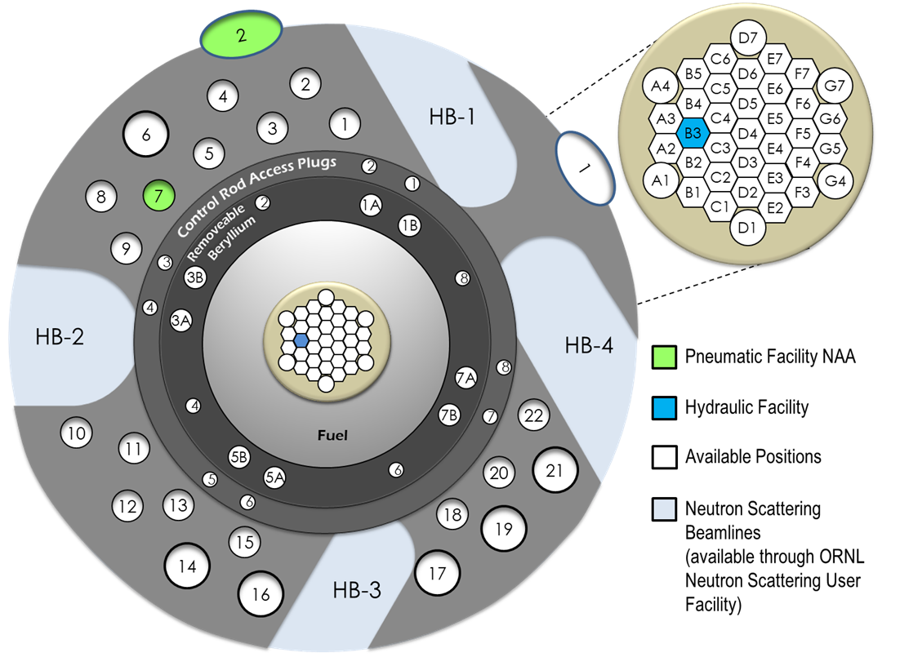
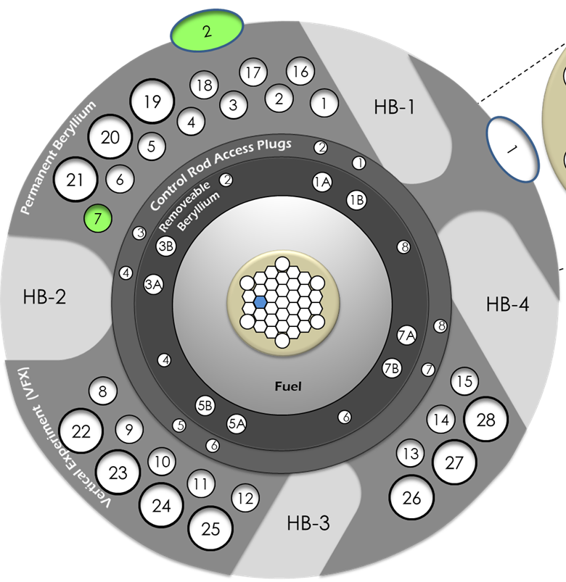
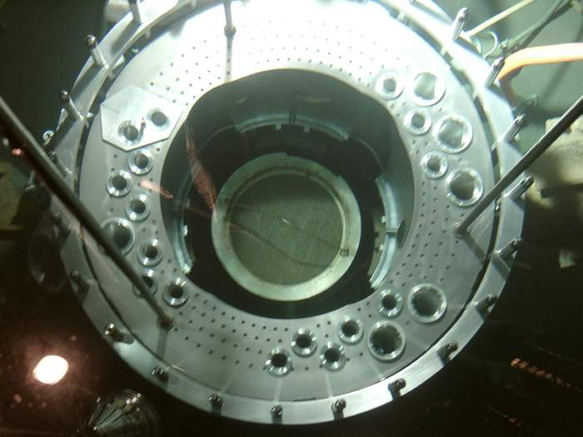
HFIR Beryllium Reflector Replacement Project (HBRR) significantly increases irradiation capacity
18- to 24-month outage planned for 2029
  Increases irradiation channels from
  22 to 28
  Nearly doubles usable target volume
  Enables 63% increase in ²³⁸Pu production

Slide 17
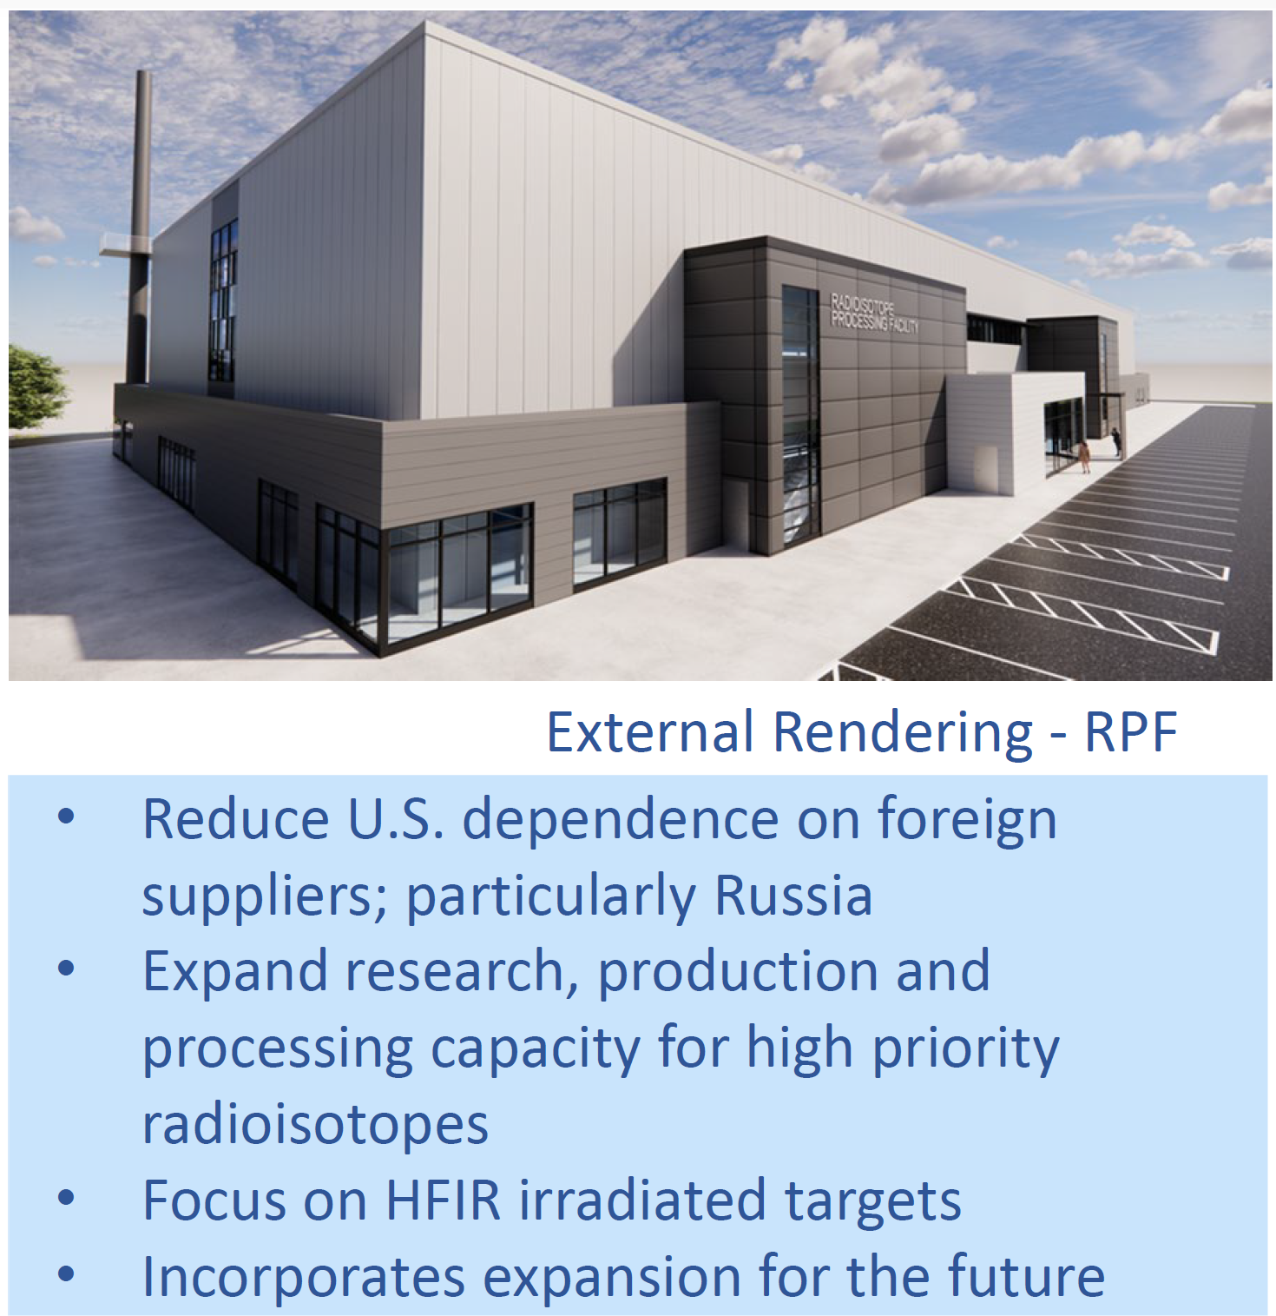
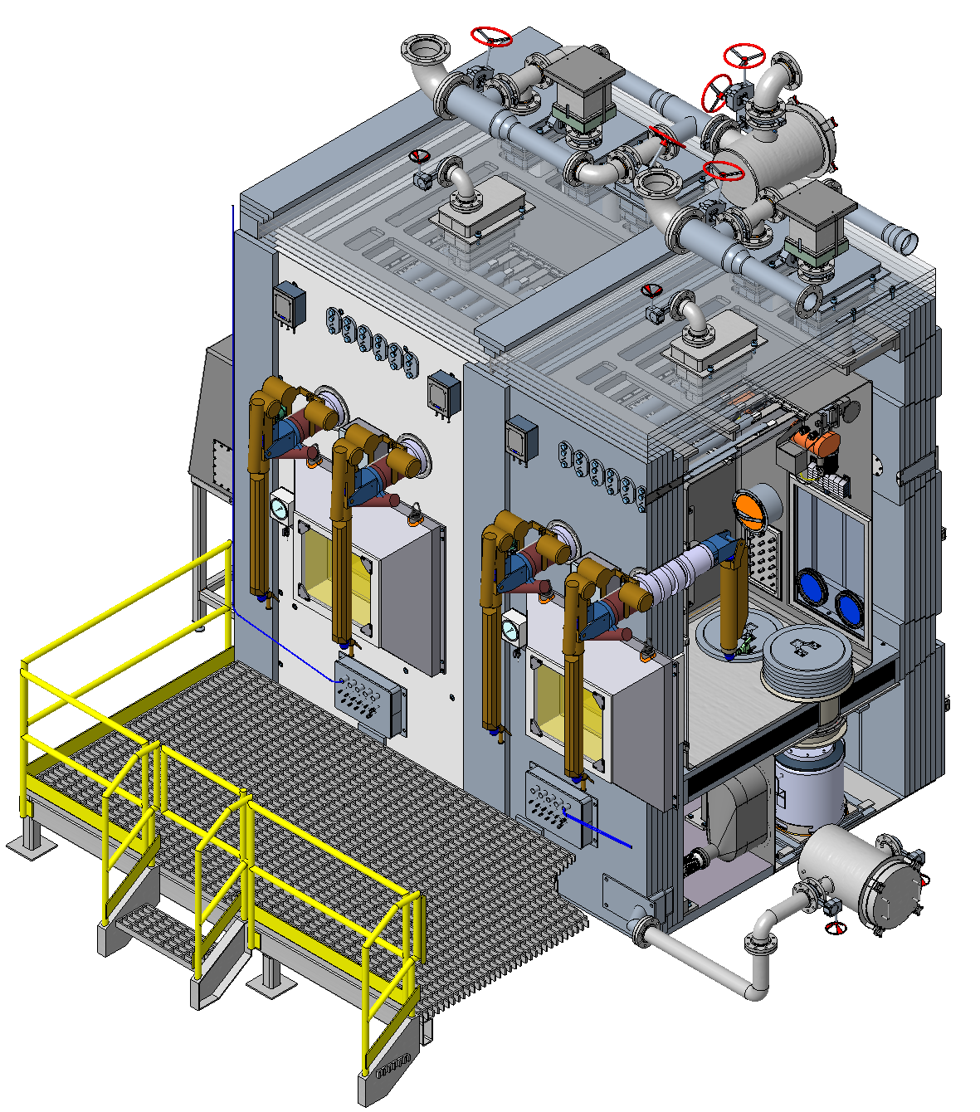
Infrastructure Improvements at ORNL will lead to improved capacity, capabilities and flexibility
Radioisotope Processing Facility (RPF)
Modular Hot Cells (MHC)
RPF is a funded project that enables new radioisotope production plus expanded hot cell and glovebox capacity for R&D
ORNL is developing a new standardized MHC to meet near- and long-term needs of the US DOE Office of Isotope R&D and Production (IRP)
Notes:
The increased radioisotope demand has driven the need for additional hot-cell and glovebox capacity at ORNL, resulting in the Radioisotope Processing Facility project, which aims to construct a new space with modular/flexible bays that can be adapted to address changing isotope priorities and needs. Estimate completion around 2030.

Slide 18
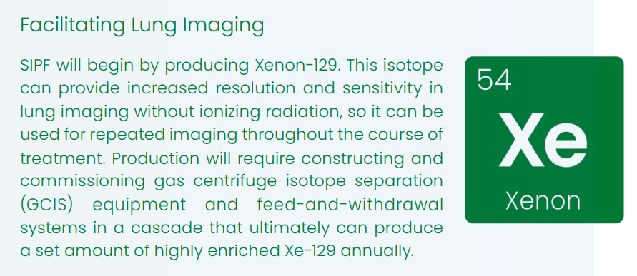
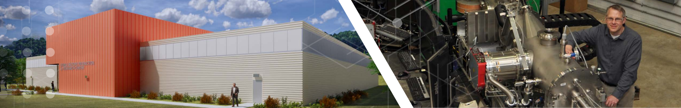
Stable Isotope Production and Research Center (SIPRC)
Consolidates enrichment platforms (electromagnetic isotope separation + gas centrifuge)
  Supports simultaneous enrichment campaigns
  Provides feedstock for high-value HFIR-produced isotopes
  Enables research and future capacity expansion
Example isotope
Notes:
Inspired by legacy Oak Ridge enrichment capabilities, Stable isotopes will be produced in a new facility called the SIPRC.

Slide 19
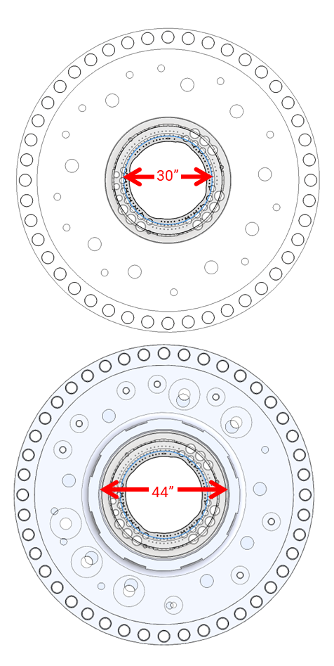
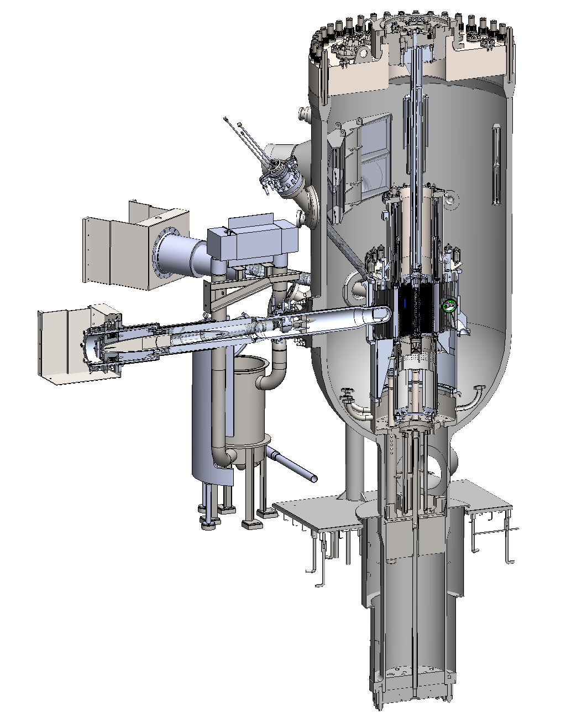
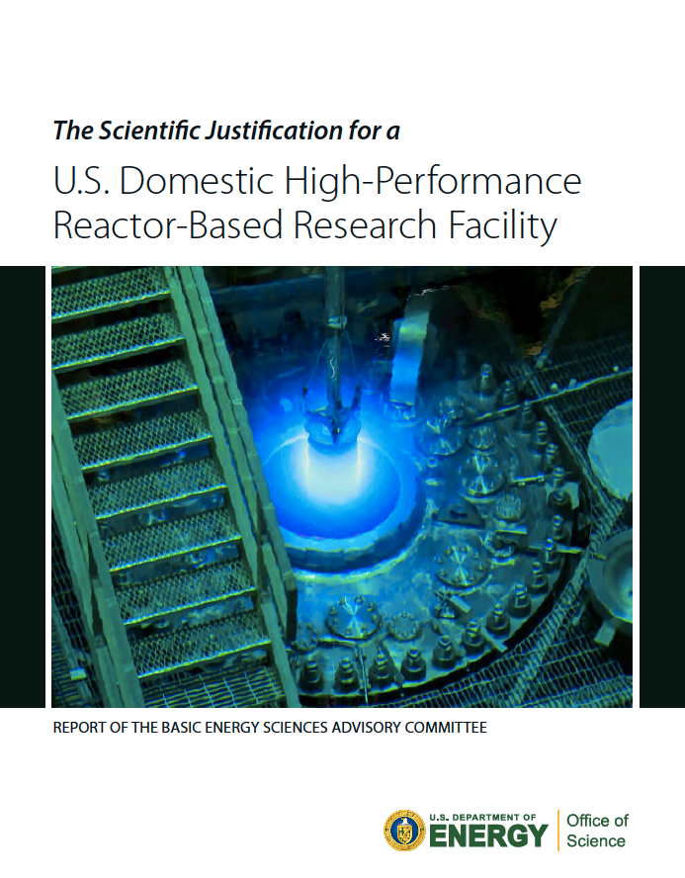
HFIR pressure vessel replacement will extend life beyond the year 2100
Vessel material will be more radiation-resistant (i.e., stainless steel) and adhere to current standards
HFIR vessel and systems will be capable of operating at up to100 MW
Beam tube vessel penetrations will enable future beamline changes, including tube size and/or direction (within limits)
Vessel head design will be improved to allow future online insertion/removal systems for improved isotope production and maintenance
Current Head
Future Head
Vessel and associated systems that will be replaced

Slide 20
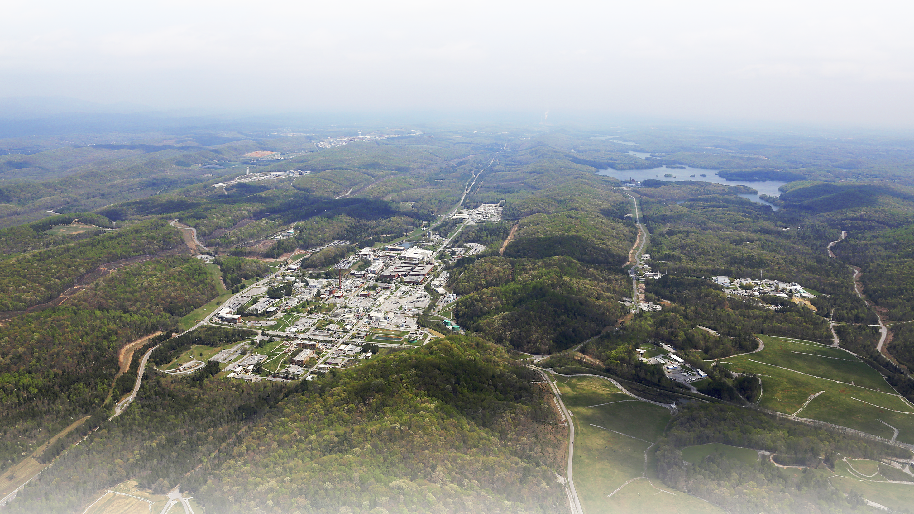
Questions?

