Slide 1

Neutron Scattering Society of America
An Introduction to Single Event Effects (SEE)
&
A National Perspective on Neutron Sources and Capabilities
Adrian Brügger, Ph.D.
President, NSSA

Slide 2
Neutron Scattering Society of America
Mission Statement
Identify and bring together the neutron scattering community of North America
Identify the needs of the neutron scattering user community, including future requirements for instrumentation and sources and to represent these needs to the neutron facilities and funding agencies
To stimulate, promote, and broaden the use of neutron scattering in science and technology

Slide 3
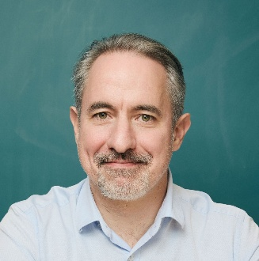




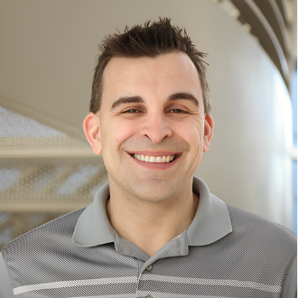

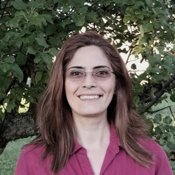
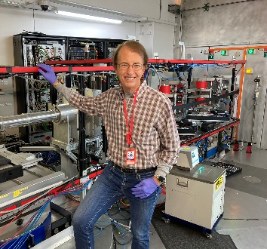
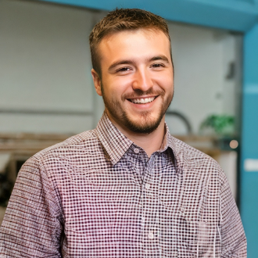
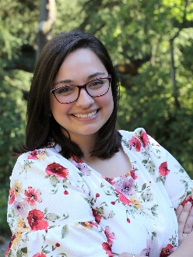

NSSA Executive Committee – About Us
Vice President
Financial Secretary
Membership Secretary
Comms Secretary
President
Secretary
Adrian Brügger
Columbia University
Volker Urban
ORNL
Amy Xu
Louisiana State University
William Ratcliff
NIST
Clarina dela Cruz
ORNL
Adam Aczel
ORNL
Postdoc Member
Student Member
Members-at-Large
Zahra Yamani
CNL
Hubert King
NIST
Drew Marquardt
University of Windsor
Caitlyn Wolf
NIST
Mark Robertson
University of Southern Mississippi

Slide 4
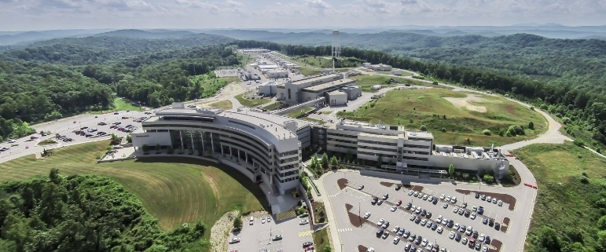
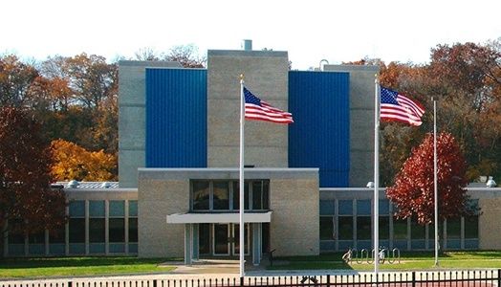


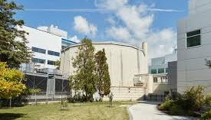
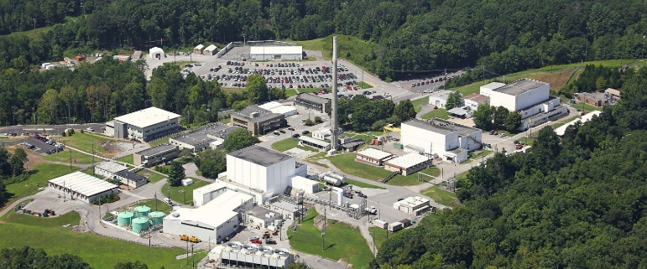


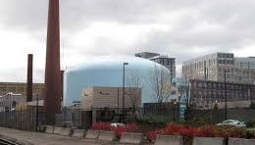


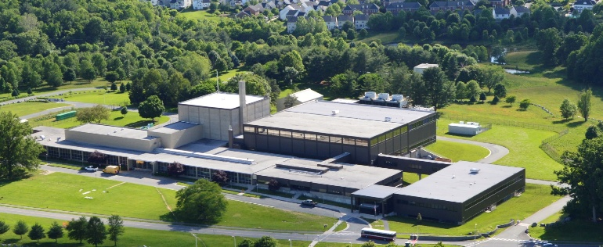
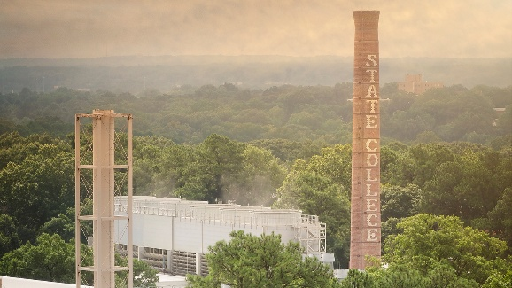


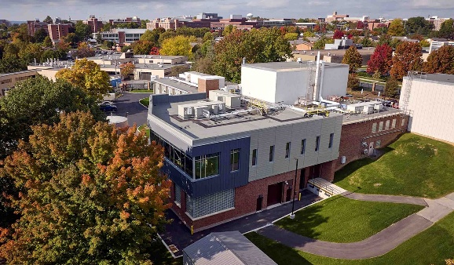
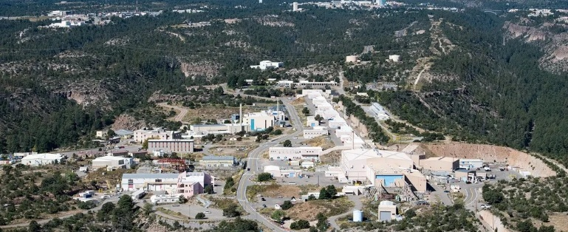


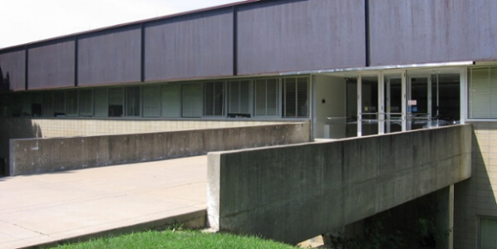

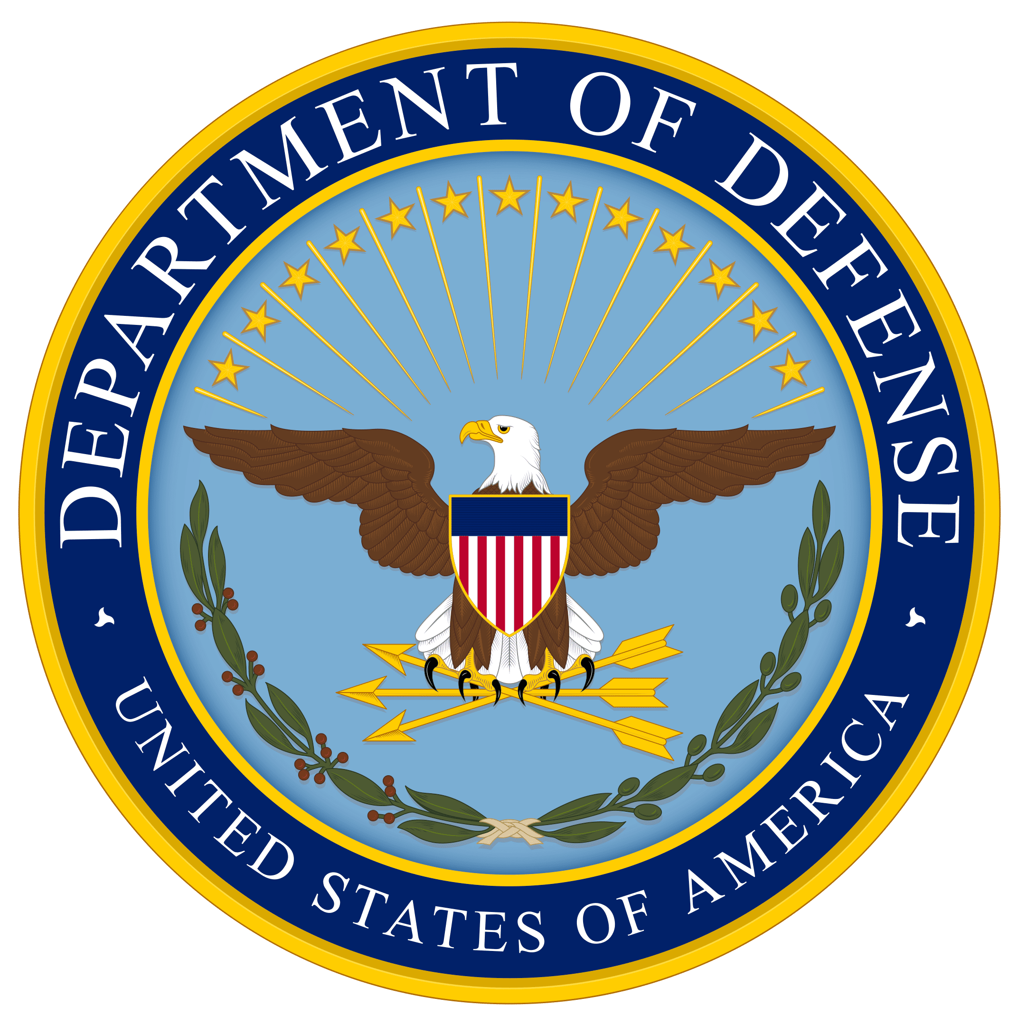
Neutron Sources in North America
ORNL Spallation Neutron Source (SNS)
Oak Ridge, TN
Missouri University Research Reactor (MURR)
Columbia, MO
McMaster University Nuclear Reactor
Hamilton, ON, CA
ORNL High Flux Isotope Reactor (HFIR)
Oak Ridge, TN
MIT Nuclear Reactor Laboratory (MITR)
Cambridge, MA
Federal Facilities
University Facilities
NIST Center for Neutron Research (NCNR)
Gaithersburg, MD
NC State University Nuclear Reactor Program (PULSTAR)
Raleigh, NC
Penn State University Breazeale Reactor
State College, PA
LANL Los Alamos Neutron Science Center
Los Alamos, NM
Indiana University
Low Energy Neutron Source
Bloomington, IN

Slide 5
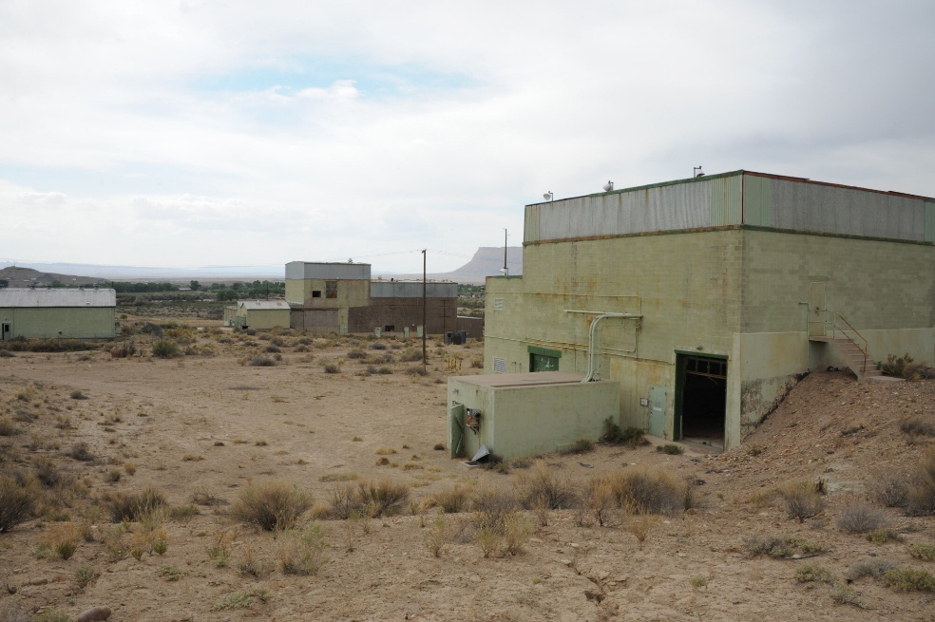
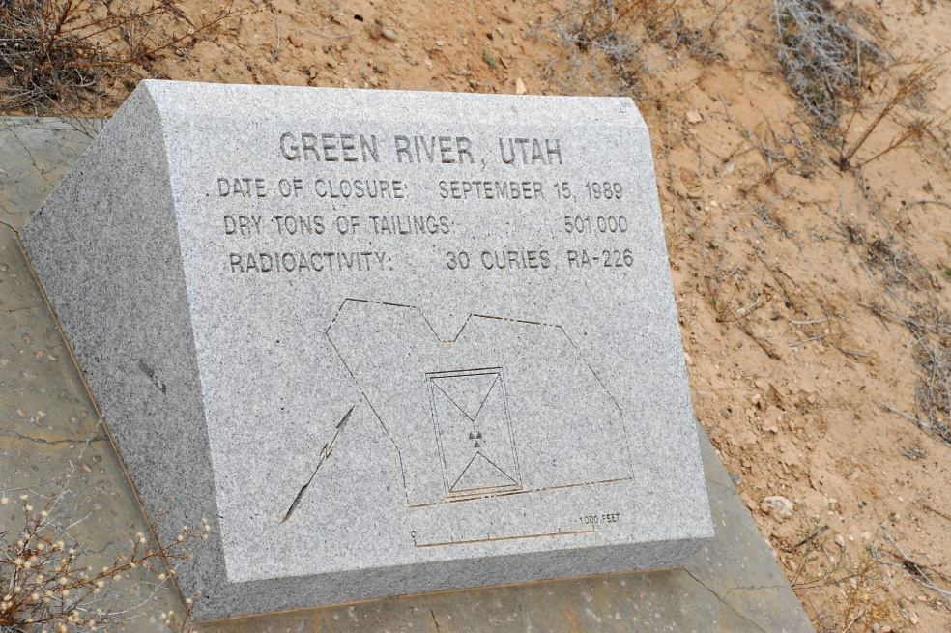
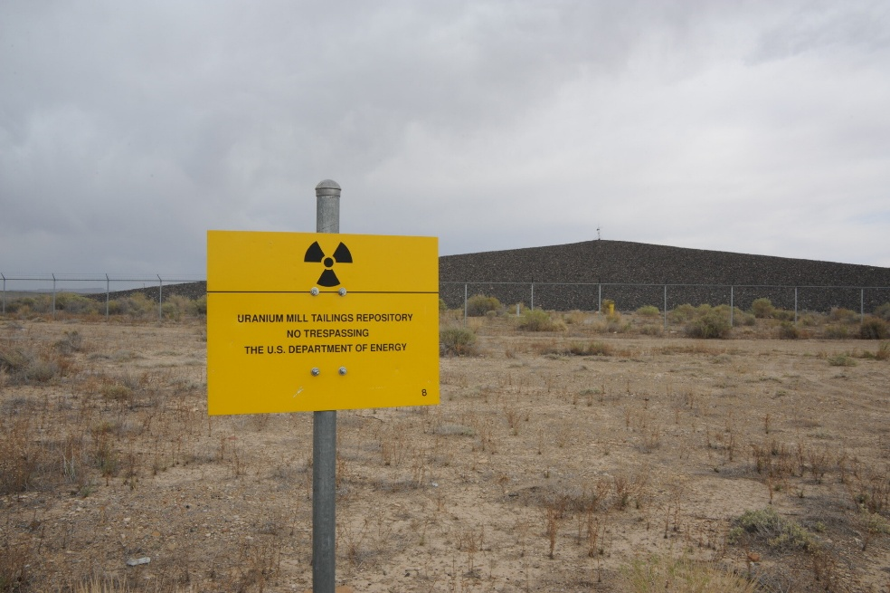
Single Event Effects/Upsets
In 1978 Intel discovered that DRAM (Dynamic Random Access Memory) chips were experiencing spontaneous random bit flips.
Chips produced from Si sand from a new mine in Utah
Sand sourced downstream Green River Uranium Mill (Union Carbide)
Ceramic coating contained traces of U and Th, processed into the chip casings
U and Th emit α particles, which pass through the silicon die on the DRAM, ionizing the material and creating an electron hole pair → bit flip
Critical in semiconductor industry in various failure-critical fields: aerospace, defense, communication, etc.

Slide 6
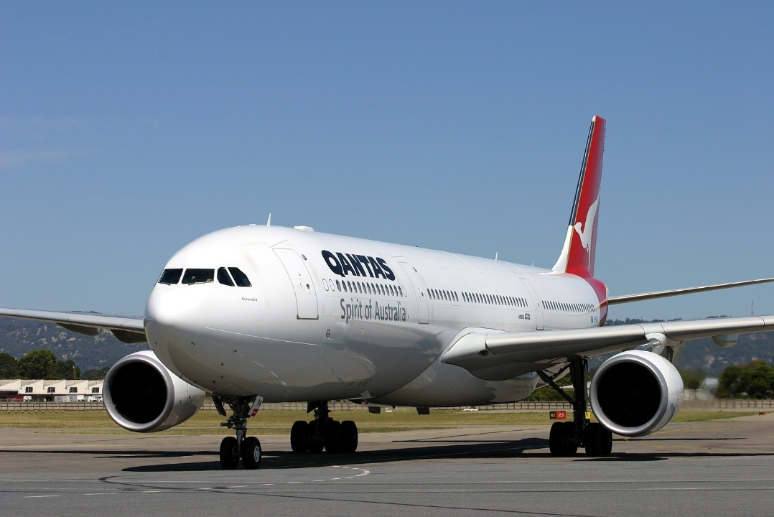
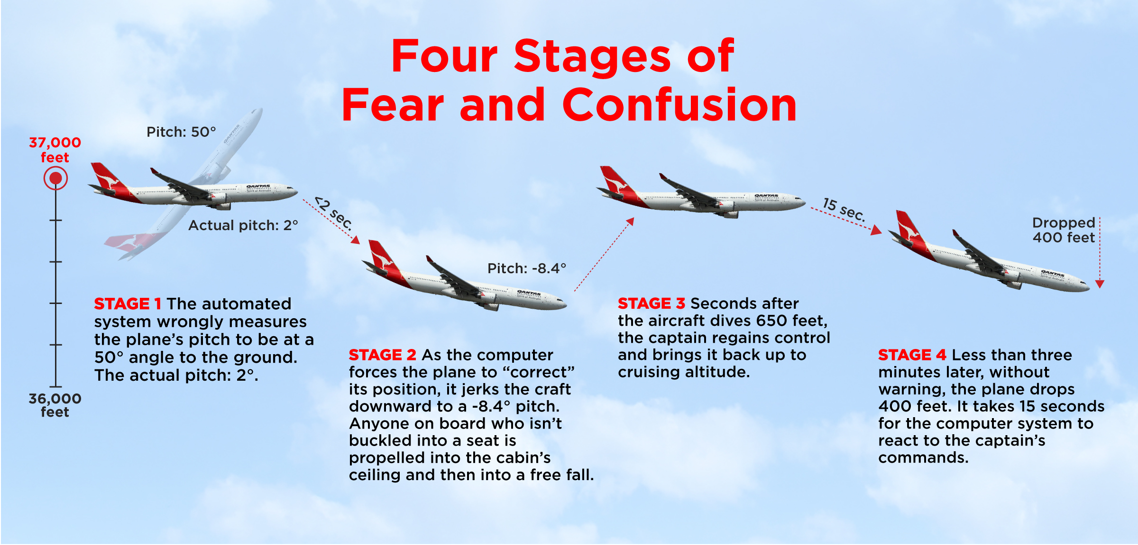
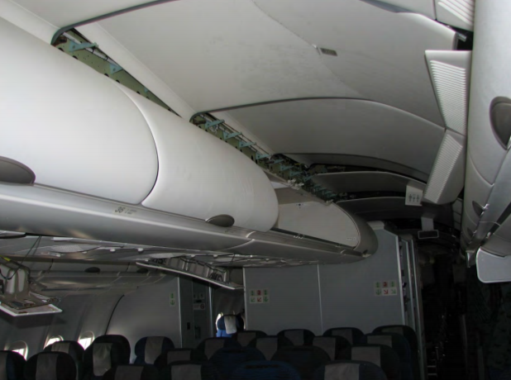
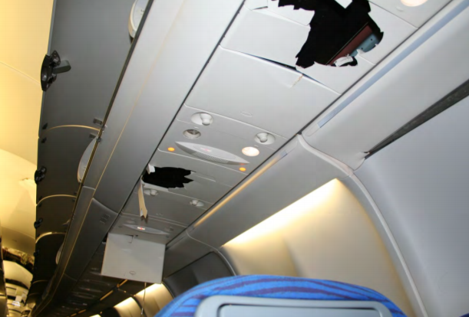
Case Study: Qantas Flight QF72
Qantas A330 from Singapore Changi Airport to Perth Airport, 7 October 2008
  Pair of uncommanded pitch-down maneuvers caused severed injuries to several passengers of -0.8 g, 8.4° pitch down
  Simultaneous “stall” and “overspeed” warnings, loss of altitude
  Declared “Mayday” and made emergency landing in Exmouth, Western Australia
  14 people airlifted to Perth for emergency treatment
Air Data Inertial Reference Unit (ADIRU) provided erroneous data spikes in angle-of-attack (AOA) data.
Australian Transport Safety Bureau (ATSB) investigated possible causes in simulator. SEU was only reasonable explanation: "Single event effects have been suspected of generating some of the soft errors that occur in a wide range of different aircraft systems”
EASA issued Emergency Airworthiness Directive for Northrop Grumman ADIRU’s improper handling of faulty flight data
Notes:
In the usual case, when all three AOA values were valid and consistent, the average value of AOA 1 and AOA 2 was used by the FCPCs for their computations. If either AOA 1 or AOA 2 significantly deviated from the other two values, the FCPCs used a memorised value for 1.2 seconds. The FCPC algorithm was very effective, but it could not correctly manage a scenario where multiple spikes occurred in either AOA 1 or AOA 2 that were 1.2 seconds apart—that is, if the 1.2-second period of use of the memorised value happened to end while another spike was happening.

Slide 7
Case Study: Airbus A320 Grounding
November 2025, JetBlue A320 from CAN to EWR: autopilot performed uncommanded pitch-down maneuver, resulting in injuries and diversion
EASA and FAA issued emergency airworthiness directive to ground all A318, A319, A320, and A321 models for a flight computer software rollback → 6000 aircraft grounded
Problem quickly identified as Single Event Effect caused by cosmic radiation
  Failure occurred in Elevator Aileron Computer (ELAC) system
  Previous software update inadvertently remove SEE protections from code package
Grounding brought SEE into spotlight – recognized by broad public as a hazard

Slide 8
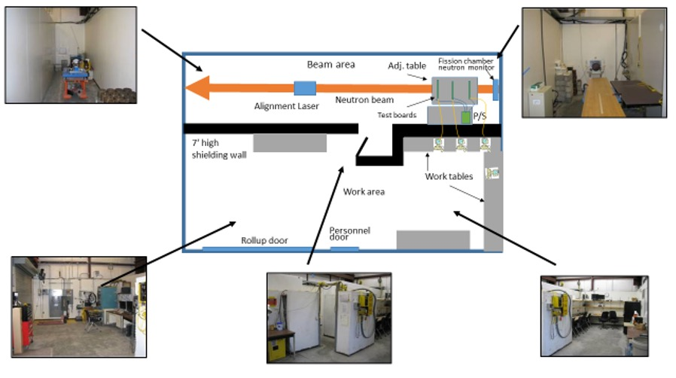
Solution: SEE/SEU Certification Testing
Neutron Single Event Effects Testing at LANSCE (Steve Wender P-27, Jeff George ISR-1)

Slide 9
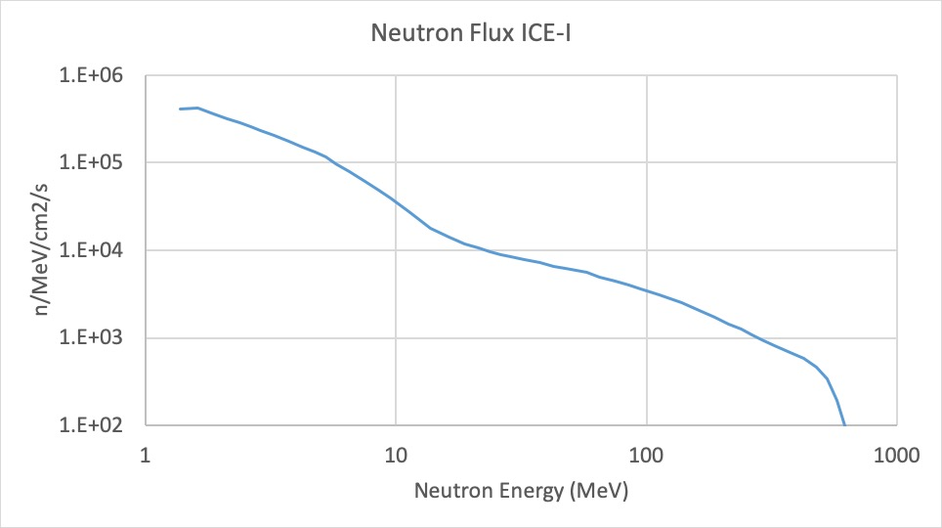
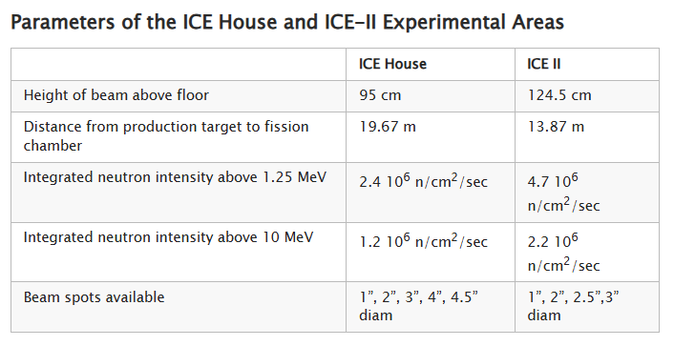
Challenge #1: Testing Capacity
ICE House, 30-L commissioned in 2004
ICE-II, 30-R commissioned in 2012
Terrestrial neutron spectrum caused by cosmic radiation
Critical for chip, aerospace, defense industry but limited capacity
Pay to play/Proprietary
Export-controlled
Only US SEE facility
Neutron Single Event Effects Testing at LANSCE (Steve Wender P-27, Jeff George ISR-1)

Slide 10
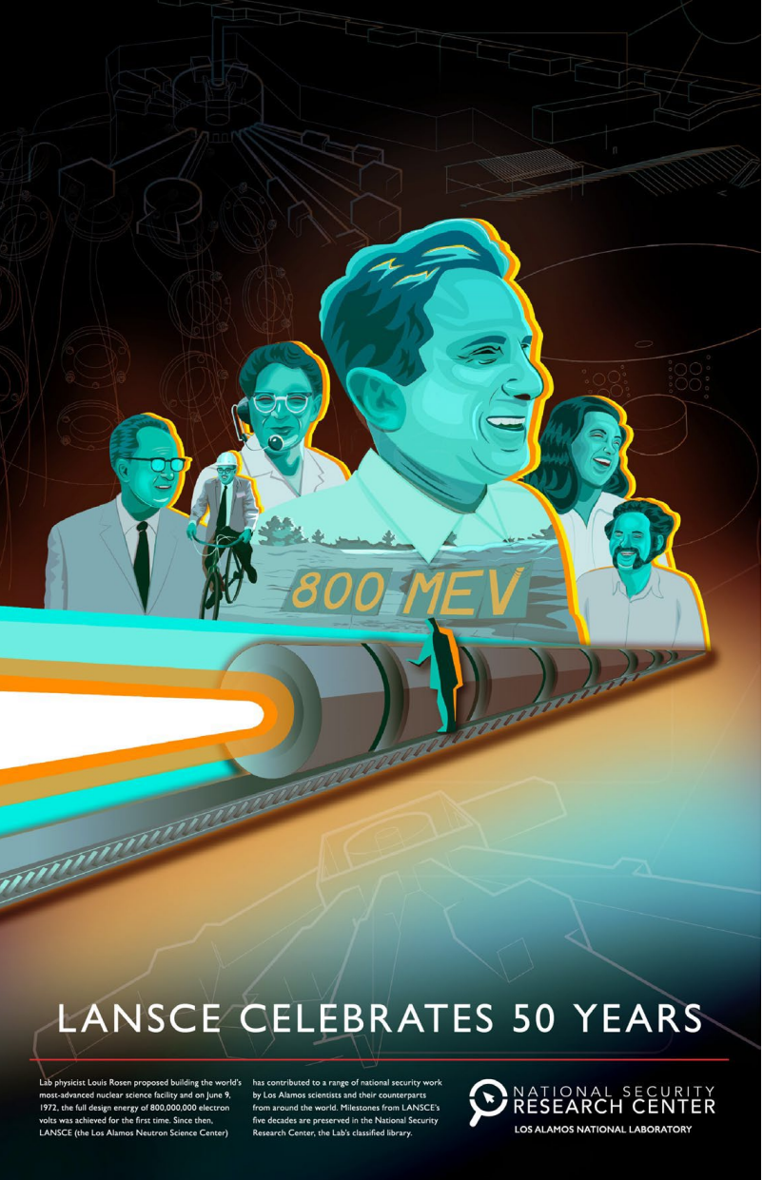

Challenge #2: Strategic Resiliency
LANSCE is an excellent resource, but single point-of-failure is problematic when considering neutron testing capability a strategic time-critical asset
  LANSCE Modernization Project (LAMP) is a critical upgrade required to ensure LANSCE readiness and reliability
  End-of-life component failures – accelerator delivered first beam in 1972
  Original Cockcroft-Walton generators and Drift Tube LINAC remain
  CD0 Achieved in 2024, CD1 imminent, dark period in 2029-2031
Outages are expected during the upgrade → must build strategic backups for critical needs
Export control of SEE work disallows work to be performed outside the USA (ISIS ChipIr)
LANSCE Modernization: A Proposal to Update an Essential Department of Energy (DOE) Facility (J. Tapia)

Slide 11
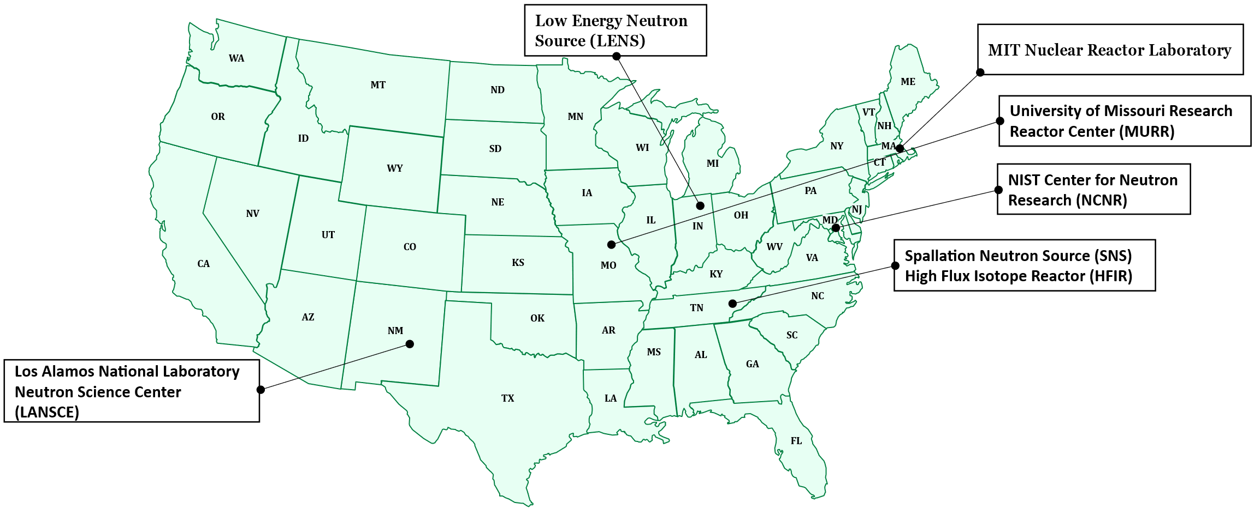
Opportunity: US Facility Portfolio
Penn State Breazeale Reactor
NCSU Nuclear Reactor Program
LANSCE outage for LAMP 2029-2031
SNS just successfully completed Proton Power Upgrade
HFIR outage for Cold Source Replacement 2028 and HBRR 2029-2031
NIST NCNR back up to 20MW after 5 year outage 2021-2026

Slide 12
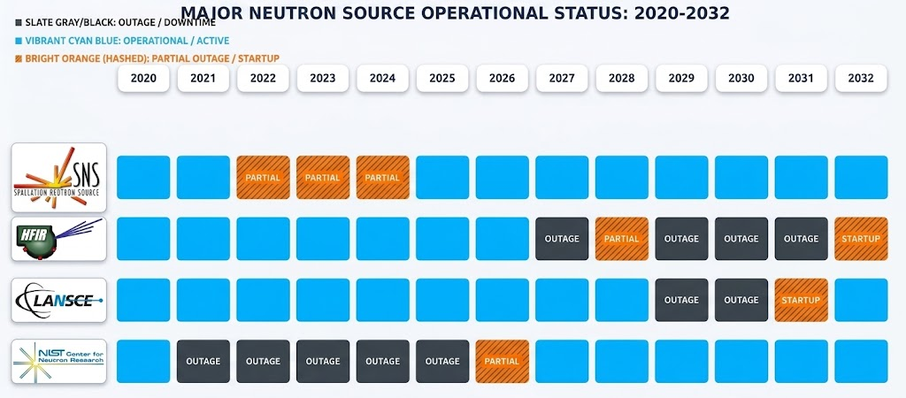
US Facility Portfolio: Resiliency
Penn State Breazeale Reactor
NCSU Nuclear Reactor Program
LANSCE outage for LAMP 2029-2031
SNS just successfully completed Proton Power Upgrade
HFIR outage for Cold Source Replacement 2028 and HBRR 2029-2031
NIST NCNR back up to 20MW after 5 year outage 2021-2026

Slide 13
SEE @ ORNL SNS
Proposed in 2015 by Bernie Riemer, Franz Gallmeier, and Laura Dominik
Second national facility critical to bridge future outages
Opportunity for ORNL SNS to broaden portfolio for mission-critical aerospace applications
When do we need this? By the time LANSCE goes dark for LAMP!!!
Single Event Effects Test Facility at Oak Ridge National Laboratory (B. Riemer, F. Gallmeier, L. Dominik)

Slide 14

Neutron Community Letter

Slide 15
Motivation of Letter
Provide a voice for all neutron scatterers in the Americas, transcending sponsor structures and neutron sources → Lobby
Current Challenges:
  Defunding of NSF, NIH, etc.
  Neutron shortage due to outages and general low production capacity
  Fractured neutron source landscape, siloed along funding agencies
    Department of Energy (DOE) Basic Energy Sciences (BES)
    Department of Energy (DOE) National Nuclear Security Administration (NNSA)
    Department of Commerce (NIST)
    NSF & Industry Support of Specific Instruments
This meeting is a fantastic step in the right direction to find capability/capacity overlap between agencies
Goal: collaborate across facilities and build resilient network

Slide 16

Thank you

