Slide 1
Radioisotope Production at SNS (RIPS)
Justin Griswold – Radioisotope Science and Technology Division
June 11th, 2026
New Science and Applications at the SNS Workshop

Slide 2
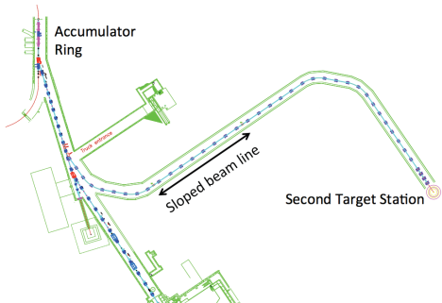
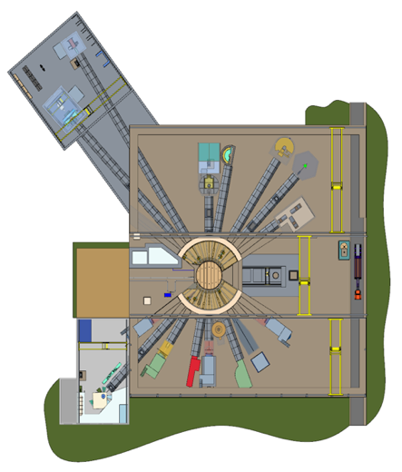
Proton Power Upgrade provides opportunity for excess beam power to produce radioisotopes
Potential Radioisotope Production Station
Year | Power | Power Capability (predicted) | Approx. Power Margin | Maximum Beam Energy
2023 | 1.55 MW | 1.55 MW | 105 kW | 1.1 GeV
Today | 2.0 MW | 2.8 MW | 800 kW | 1.3 GeV
2035 (post STS) | 2.7 MW | 3.0 MW | 300 kW | 1.3 GeV
Second Target Station
First Target Station
FTS: 2.0 MW
at 40 pps (50 kJ/pulse)
STS: 0.7 MW
at 15 pps (46.7 kJ/pulse)
RIPS: 0.25 MW
at 5 pps (50 kJ/pulse)

Slide 3
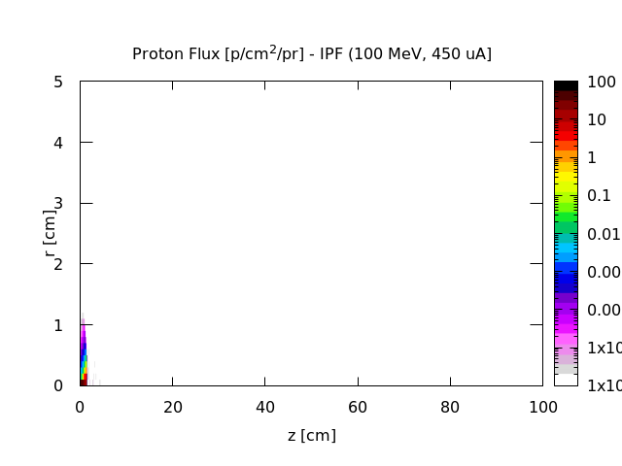
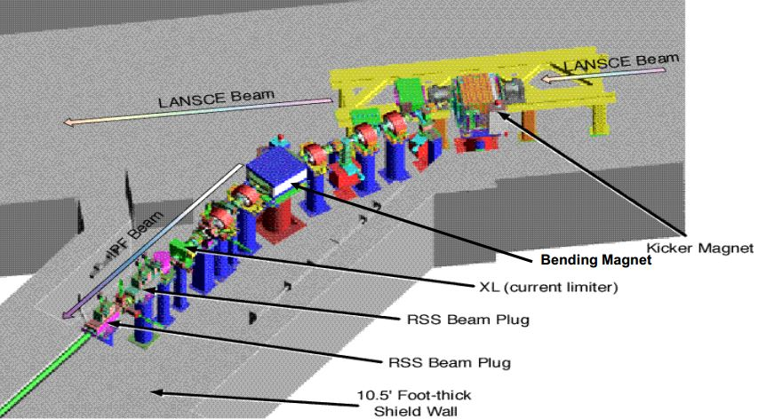
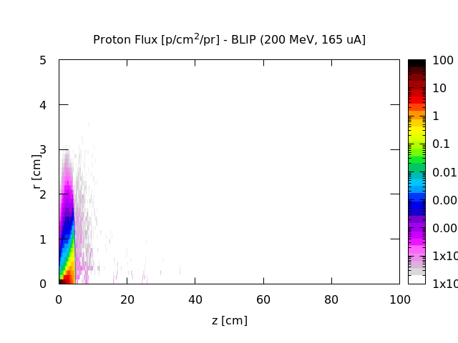
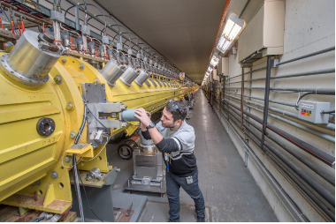
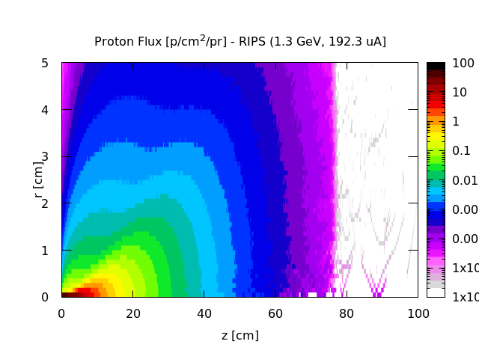
Potential Beam Parameters – Radioisotope Production Target Station (RIPS)
  IPF at LANL: 100 MeV protons (~275 µA)
Proton kinetic energy: 1.3 GeV
Beam energy per pulse: 50 kJ/pulse
Pulse length: 700 ns
Repetition rate: 5 Hz
Proton stopping range to 30 MeV in Th:
  RIPS (1.3 GeV): 78 cm
  BLIP (200 MeV): 4.8 cm
  IPF (100 MeV): 1.5 cm
  BLIP at BNL: 66-200 MeV protons (~150 µA)
  RIPS: 1.3 GeV protons (192 µA)

Slide 4
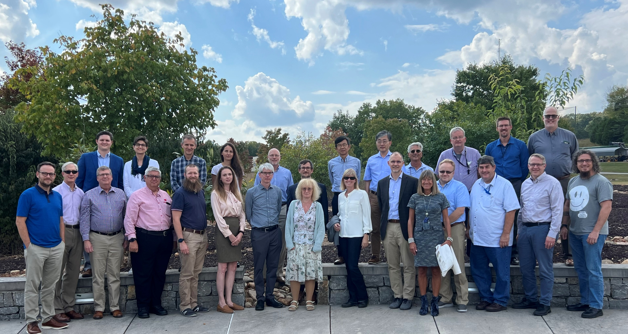
Radioisotope Production at SNS (RIPS) Workshop Hosted at ORNL in September 2023
Subject matter experts in high-energy accelerator radioisotope production and isotope separation techniques from five countries, four DOE national labs, and the DOE Office of Isotope R&D and Production attended the workshop
Accelerator physicists from BNL, LANL, LBNL, TRIUMF, CERN, PSI, and ILL presented
Key takeaways were importance of target design/survivability, safety considerations, and complexity of ISOL

Slide 5
LDRD project initiated in FY24 to investigate the viability production of novel radioisotopes at the Spallation Neutron Source.
Identify isotopes of interest through the modeling and simulation of prospective irradiation parameters and target compositions
Provide a design concept for an experimental/demonstration facility
Develop a target design concept that can receive high energy beam pulses from the SNS accelerator
Identify enhanced isotope separation methods for SNS produced radionuclides

Slide 6











Diverse team with experts in accelerator physics, isotope production, and separations.
ISED
NSCD
Sarah Cousineau
Sang-ho Kim
Fulvia Pilat
Justin Griswold
Ethan Asano
Jonah Duran
STS
PSD
Dave Rotsch
Adam Stevenson
Dan Stracener
Yongjoong Lee
Charlie Rasco

Slide 7
Specific Aim #1:
Identify isotopes of interest through the modeling and simulation of prospective irradiation parameters and target compositions

Slide 8
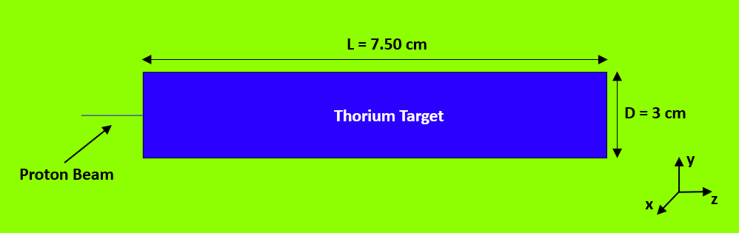
Radioisotope Yield Calculations
Identified Critical Radionuclides
Identified Potential Targets
Beam Parameters and Codes
Finalized list of seven radionuclides based on need, physical properties (i.e. half-life), and production at other facilities
Targeted alpha therapy cancer treatment radioisotopes ²²⁵Ac (t_{1/2} = 9.92 days), ²²⁵Ra (decay parent of ²²⁵Ac, t_{1/2} = 14.8 days), and ²³⁰Pa (t_{1/2} = 17.4 days)
Beta emitters used for cancer therapy and SPECT imaging ¹¹¹Ag (t_{1/2} = 7.42 days), ¹⁰⁶Ru (t_{1/2} = 371.8 days), ¹⁵⁵Tb (t_{1/2} = 5.35 days), and ¹⁶¹Tb (t_{1/2} = 6.96 days)
Thorium
Uranium
Tungsten
Tantalum
1.3 GeV Proton Beam
100 MeV energy deposition (target length varied)
200 μA beam current
Varied irradiation time from 3 to 14 days
Various physics models were used within each code:
FLUKA
PHITS
MCNP (coupled with PHITS-DCHAIN for activation/decay)
GEANT4 (coupled with PHITS-DCHAIN for activation/decay)
Simple thick thorium target model used for simulations (~620 g)

Slide 9
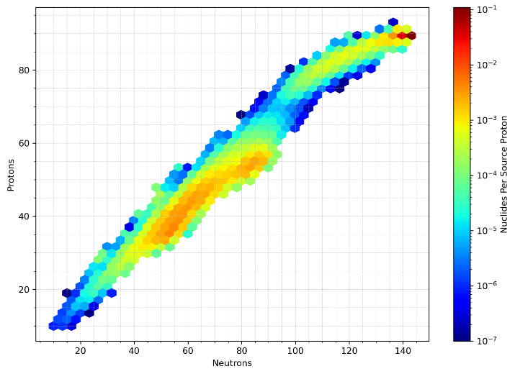
Simulations revealed diverse inventory of radionuclides that could be produced in significant quantities through proton irradiation of a thorium target

Slide 10
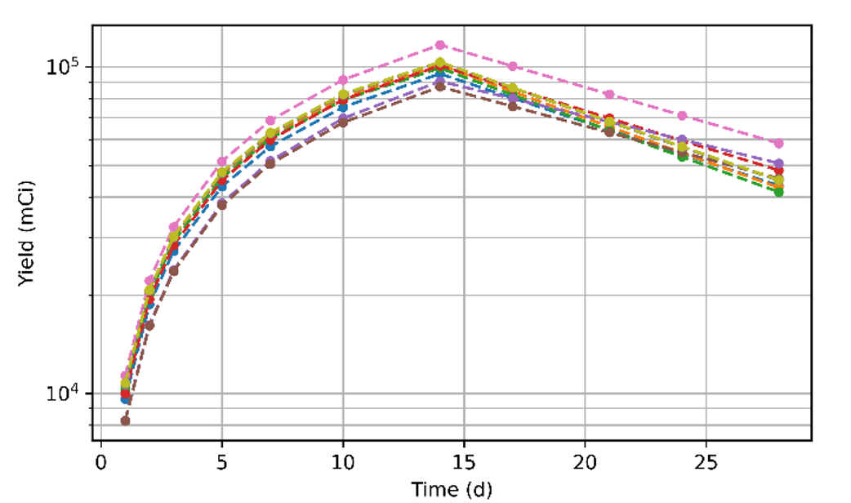
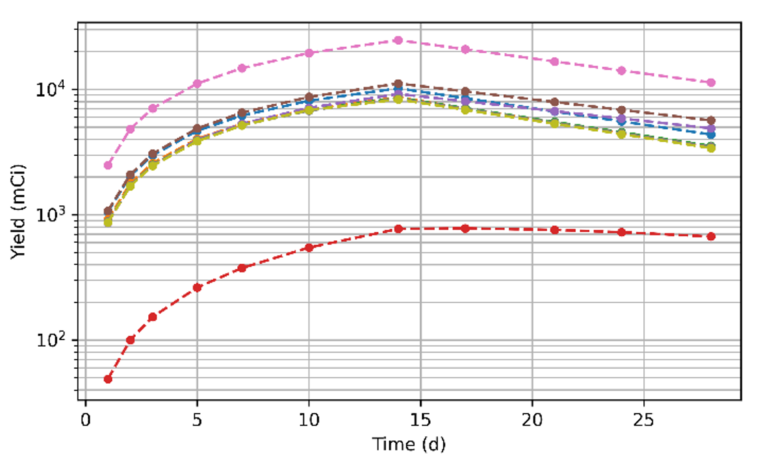
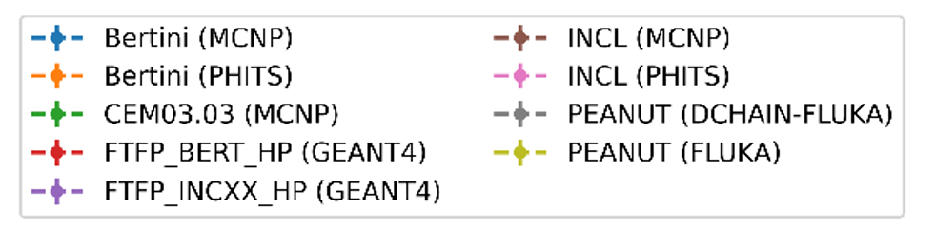
Sample Radioisotope Yield Calculations (²²⁵Ac, t_{1/2} = 9.92 days)
Thick Thorium Target Irradiation
Thick Uranium Target Irradiation
Significant variation observed between models
Thorium yields consistently outperformed all other targets for benchmark isotopes

Slide 11
Significant Quantities of Various Medical Radionuclides Produced
(Assumes 14-day irradiation of 620 g Th target)
Isotope | Half-life (d) | Activity (Ci) | Application
¹⁰⁶Ru | 371.8 | 3.3–8.3 | β therapy
¹¹¹Ag | 7.45 | 99–293 | SPECT
¹⁵⁵Tb | 5.32 | 2.1–34 | SPECT
¹⁶¹Tb | 6.89 | 0.07–2.0 | β therapy
²²⁵Ac | 9.92 | 87–117 | α therapy
²²⁵Ra | 14.9 | 8.8–38 | α therapy
²²⁷Ac | 21.8 (y) | 0.2–0.4 | α therapy
²³⁰Pa | 17.4 | 3.6–28 | α therapy
Thick thorium (620 g, 7.5 cm thick) target degrades beam by ~100 MeV
The diversity of radionuclides produced at 1.3 GeV allows for flexibility as isotope demands shift
Significant science and engineering challenges remain for target design, target cooling, shielding, transportation, and post irradiation processing

Slide 12
Specific Aim #2:
Develop design concept for an experimental/demonstration facility.

Slide 13
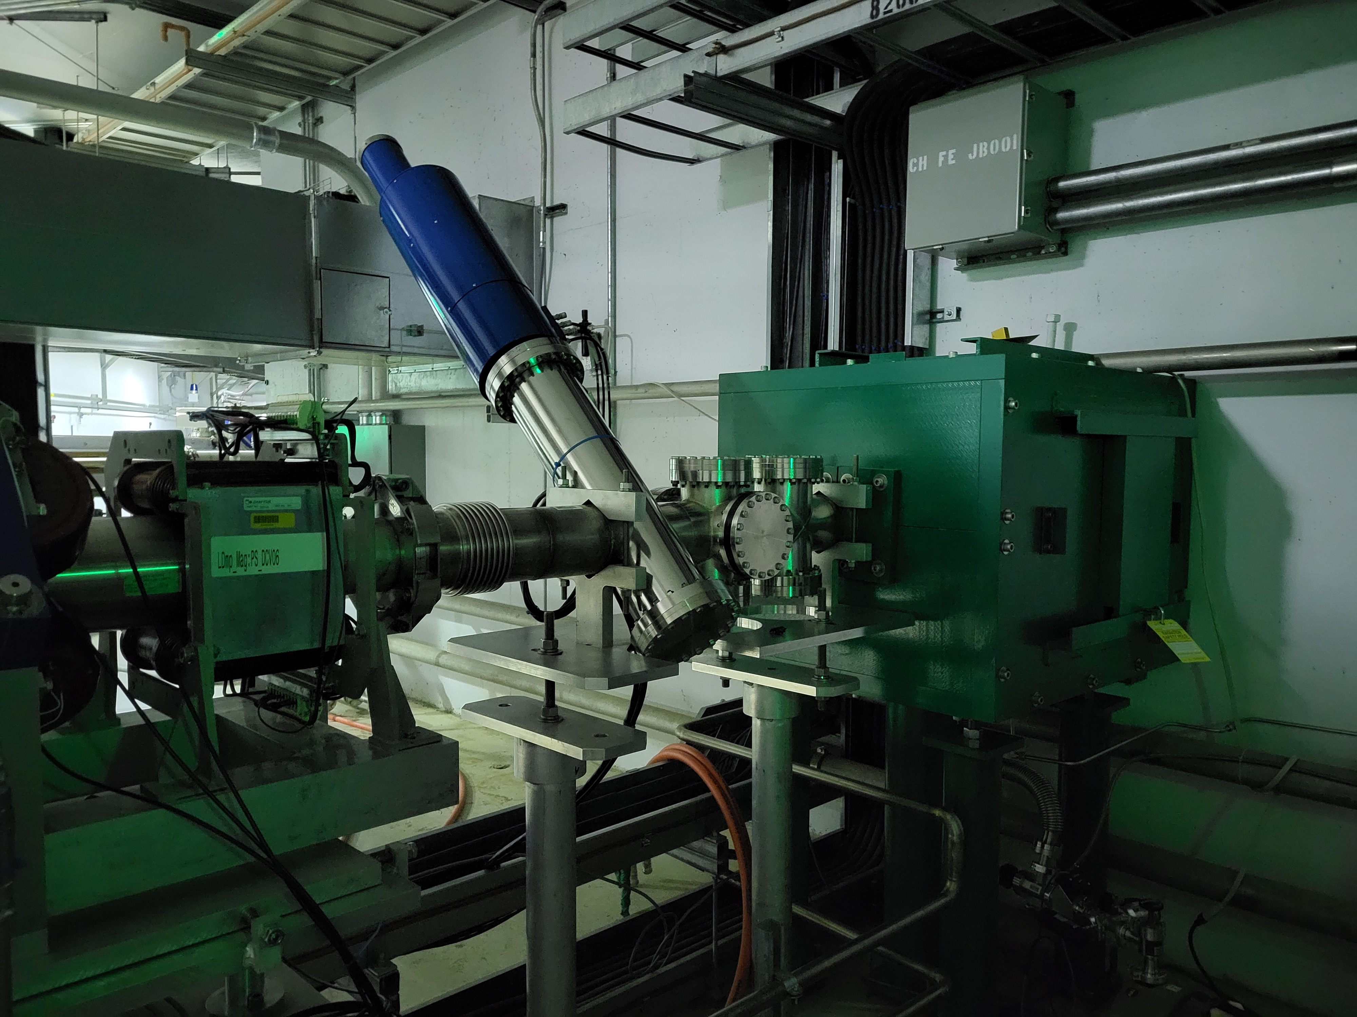
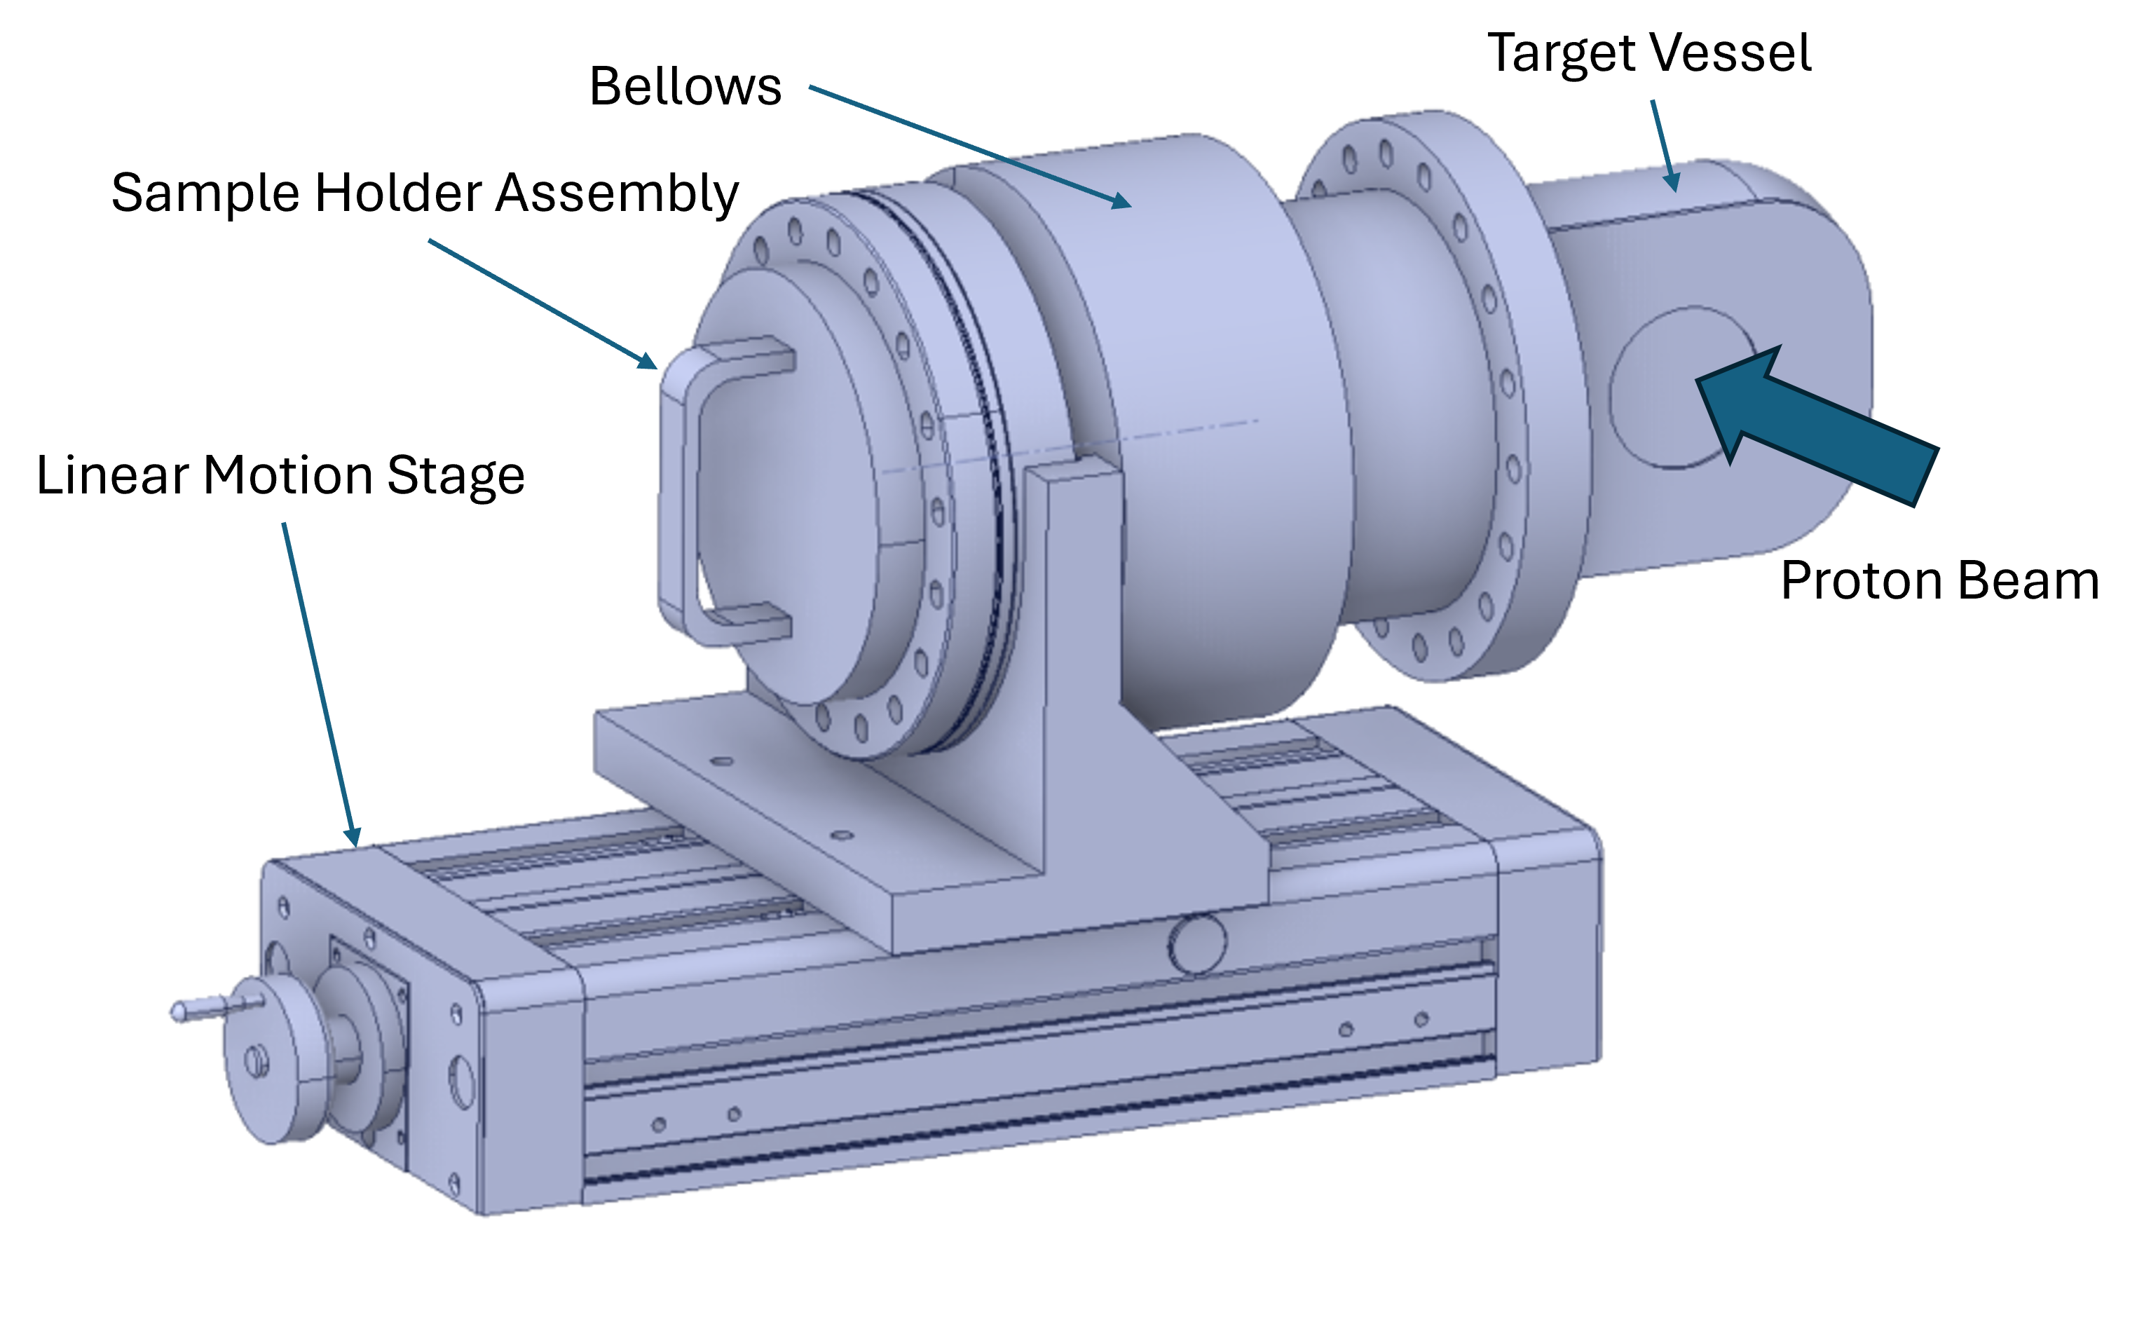
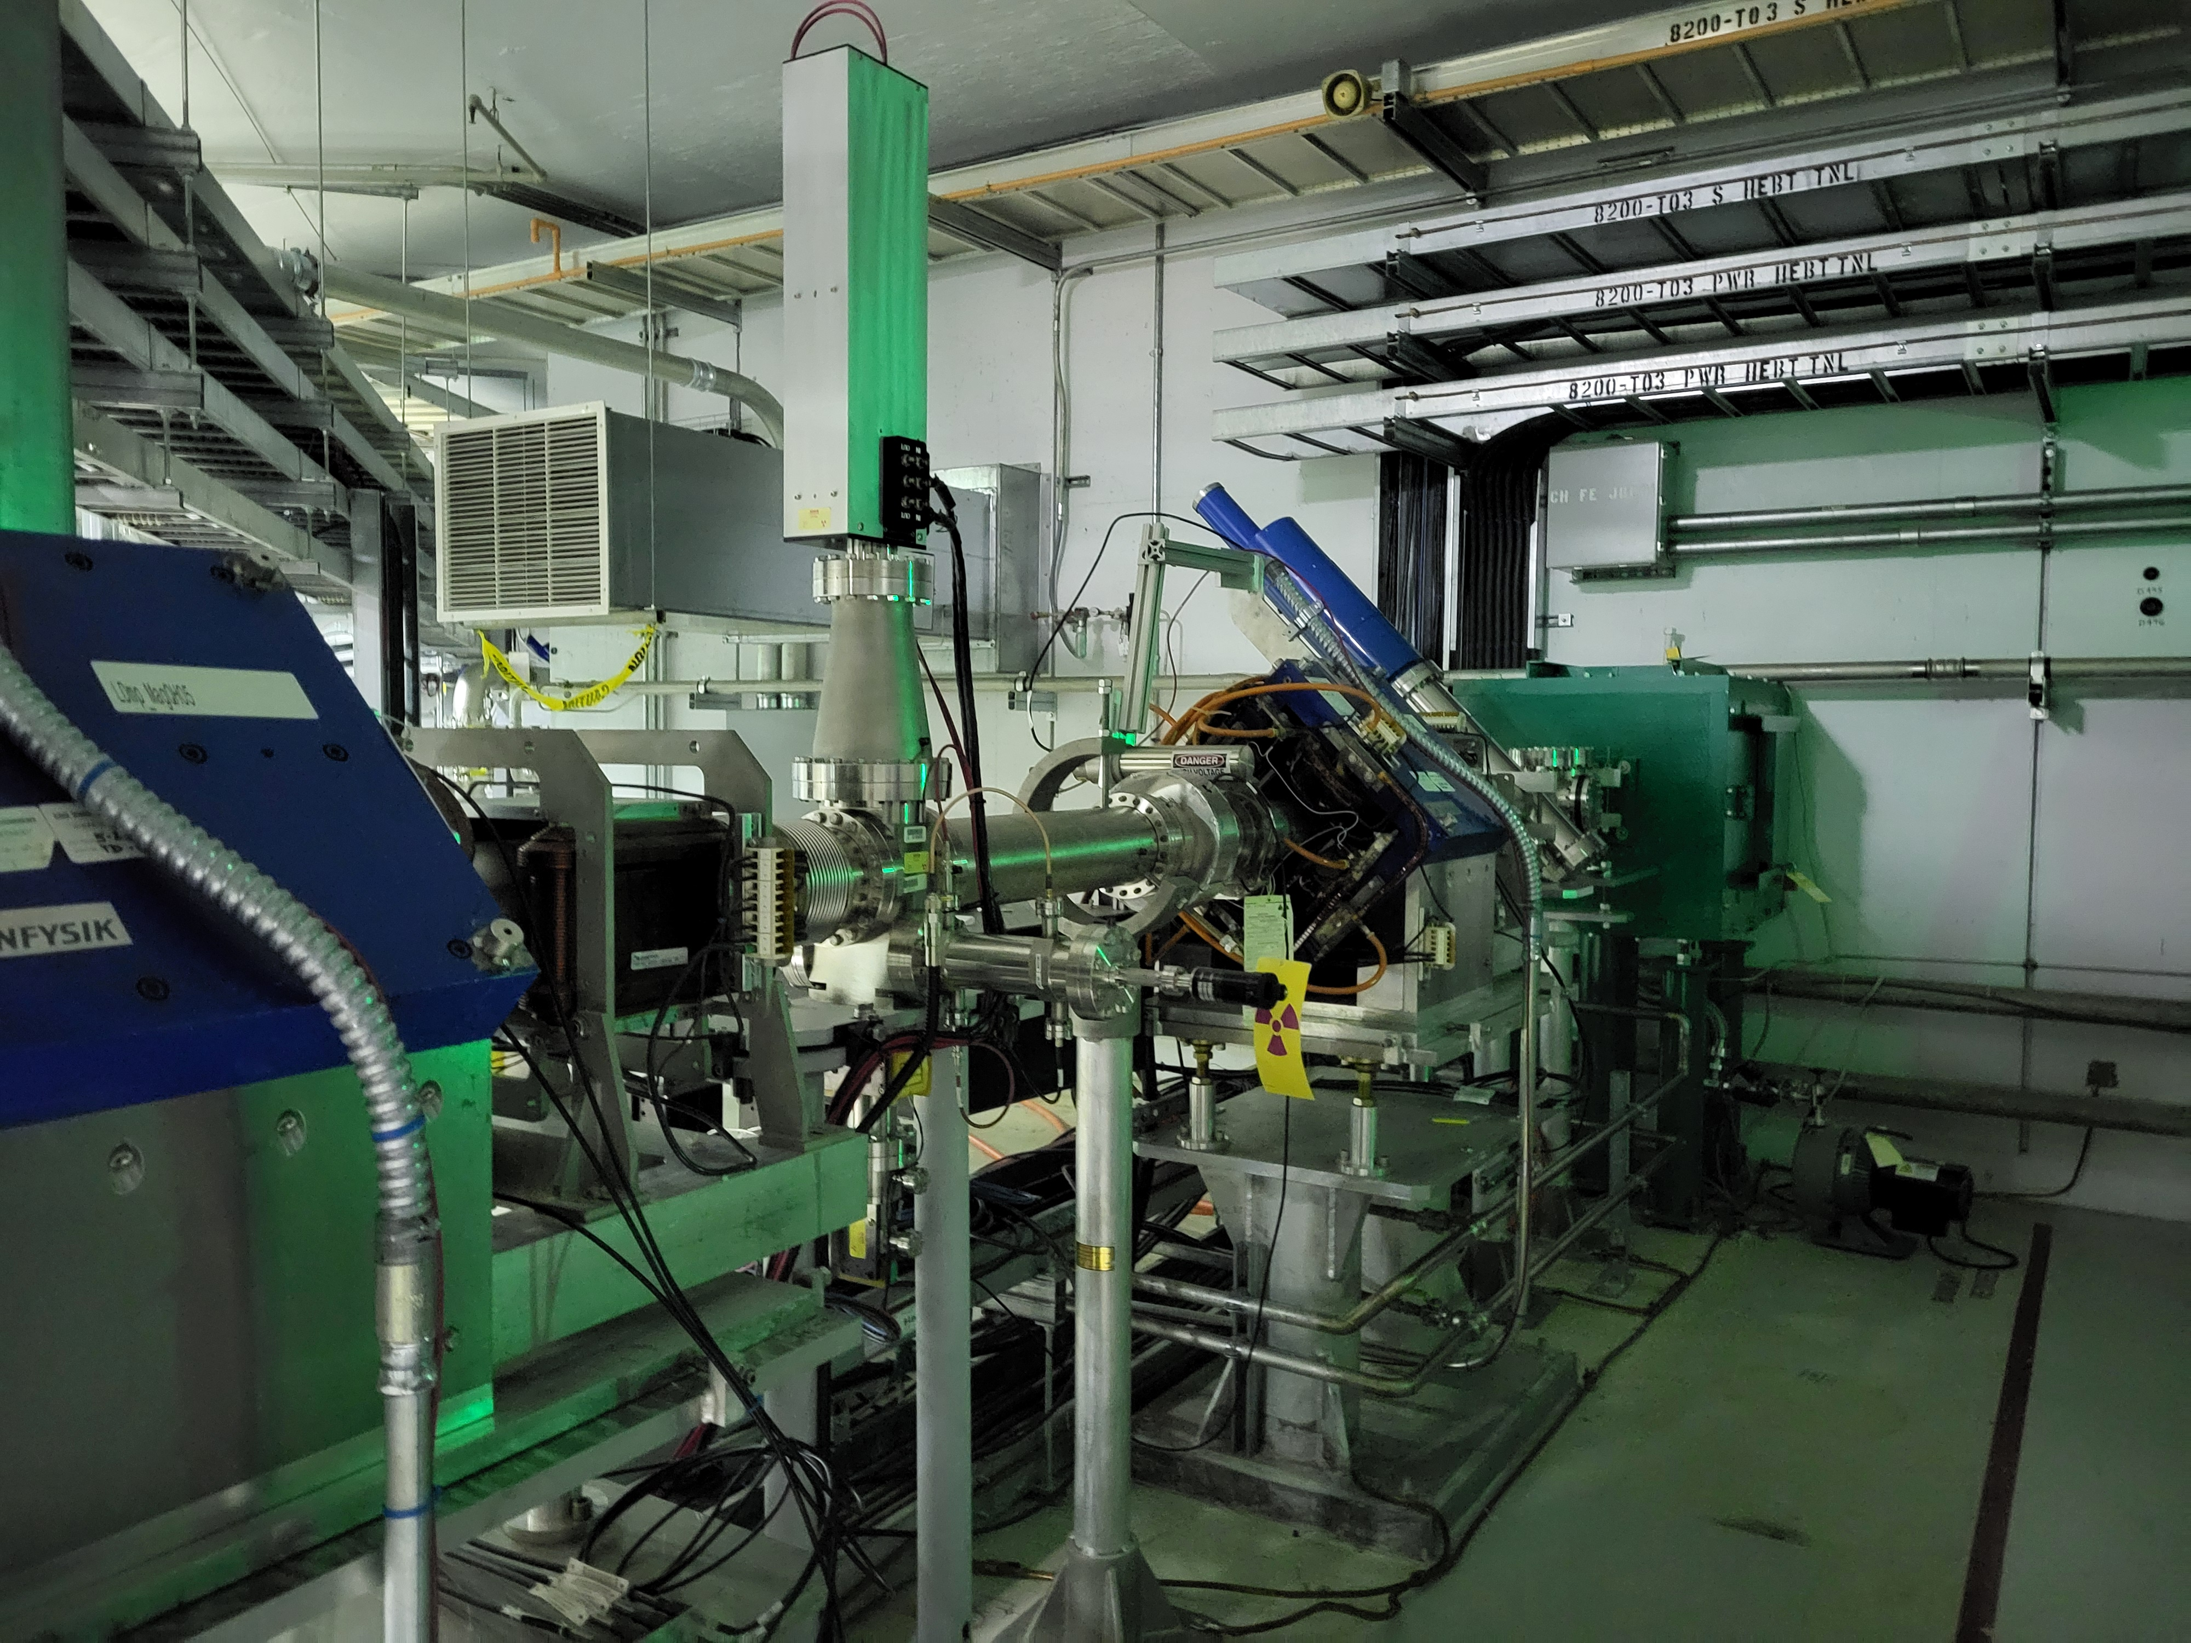
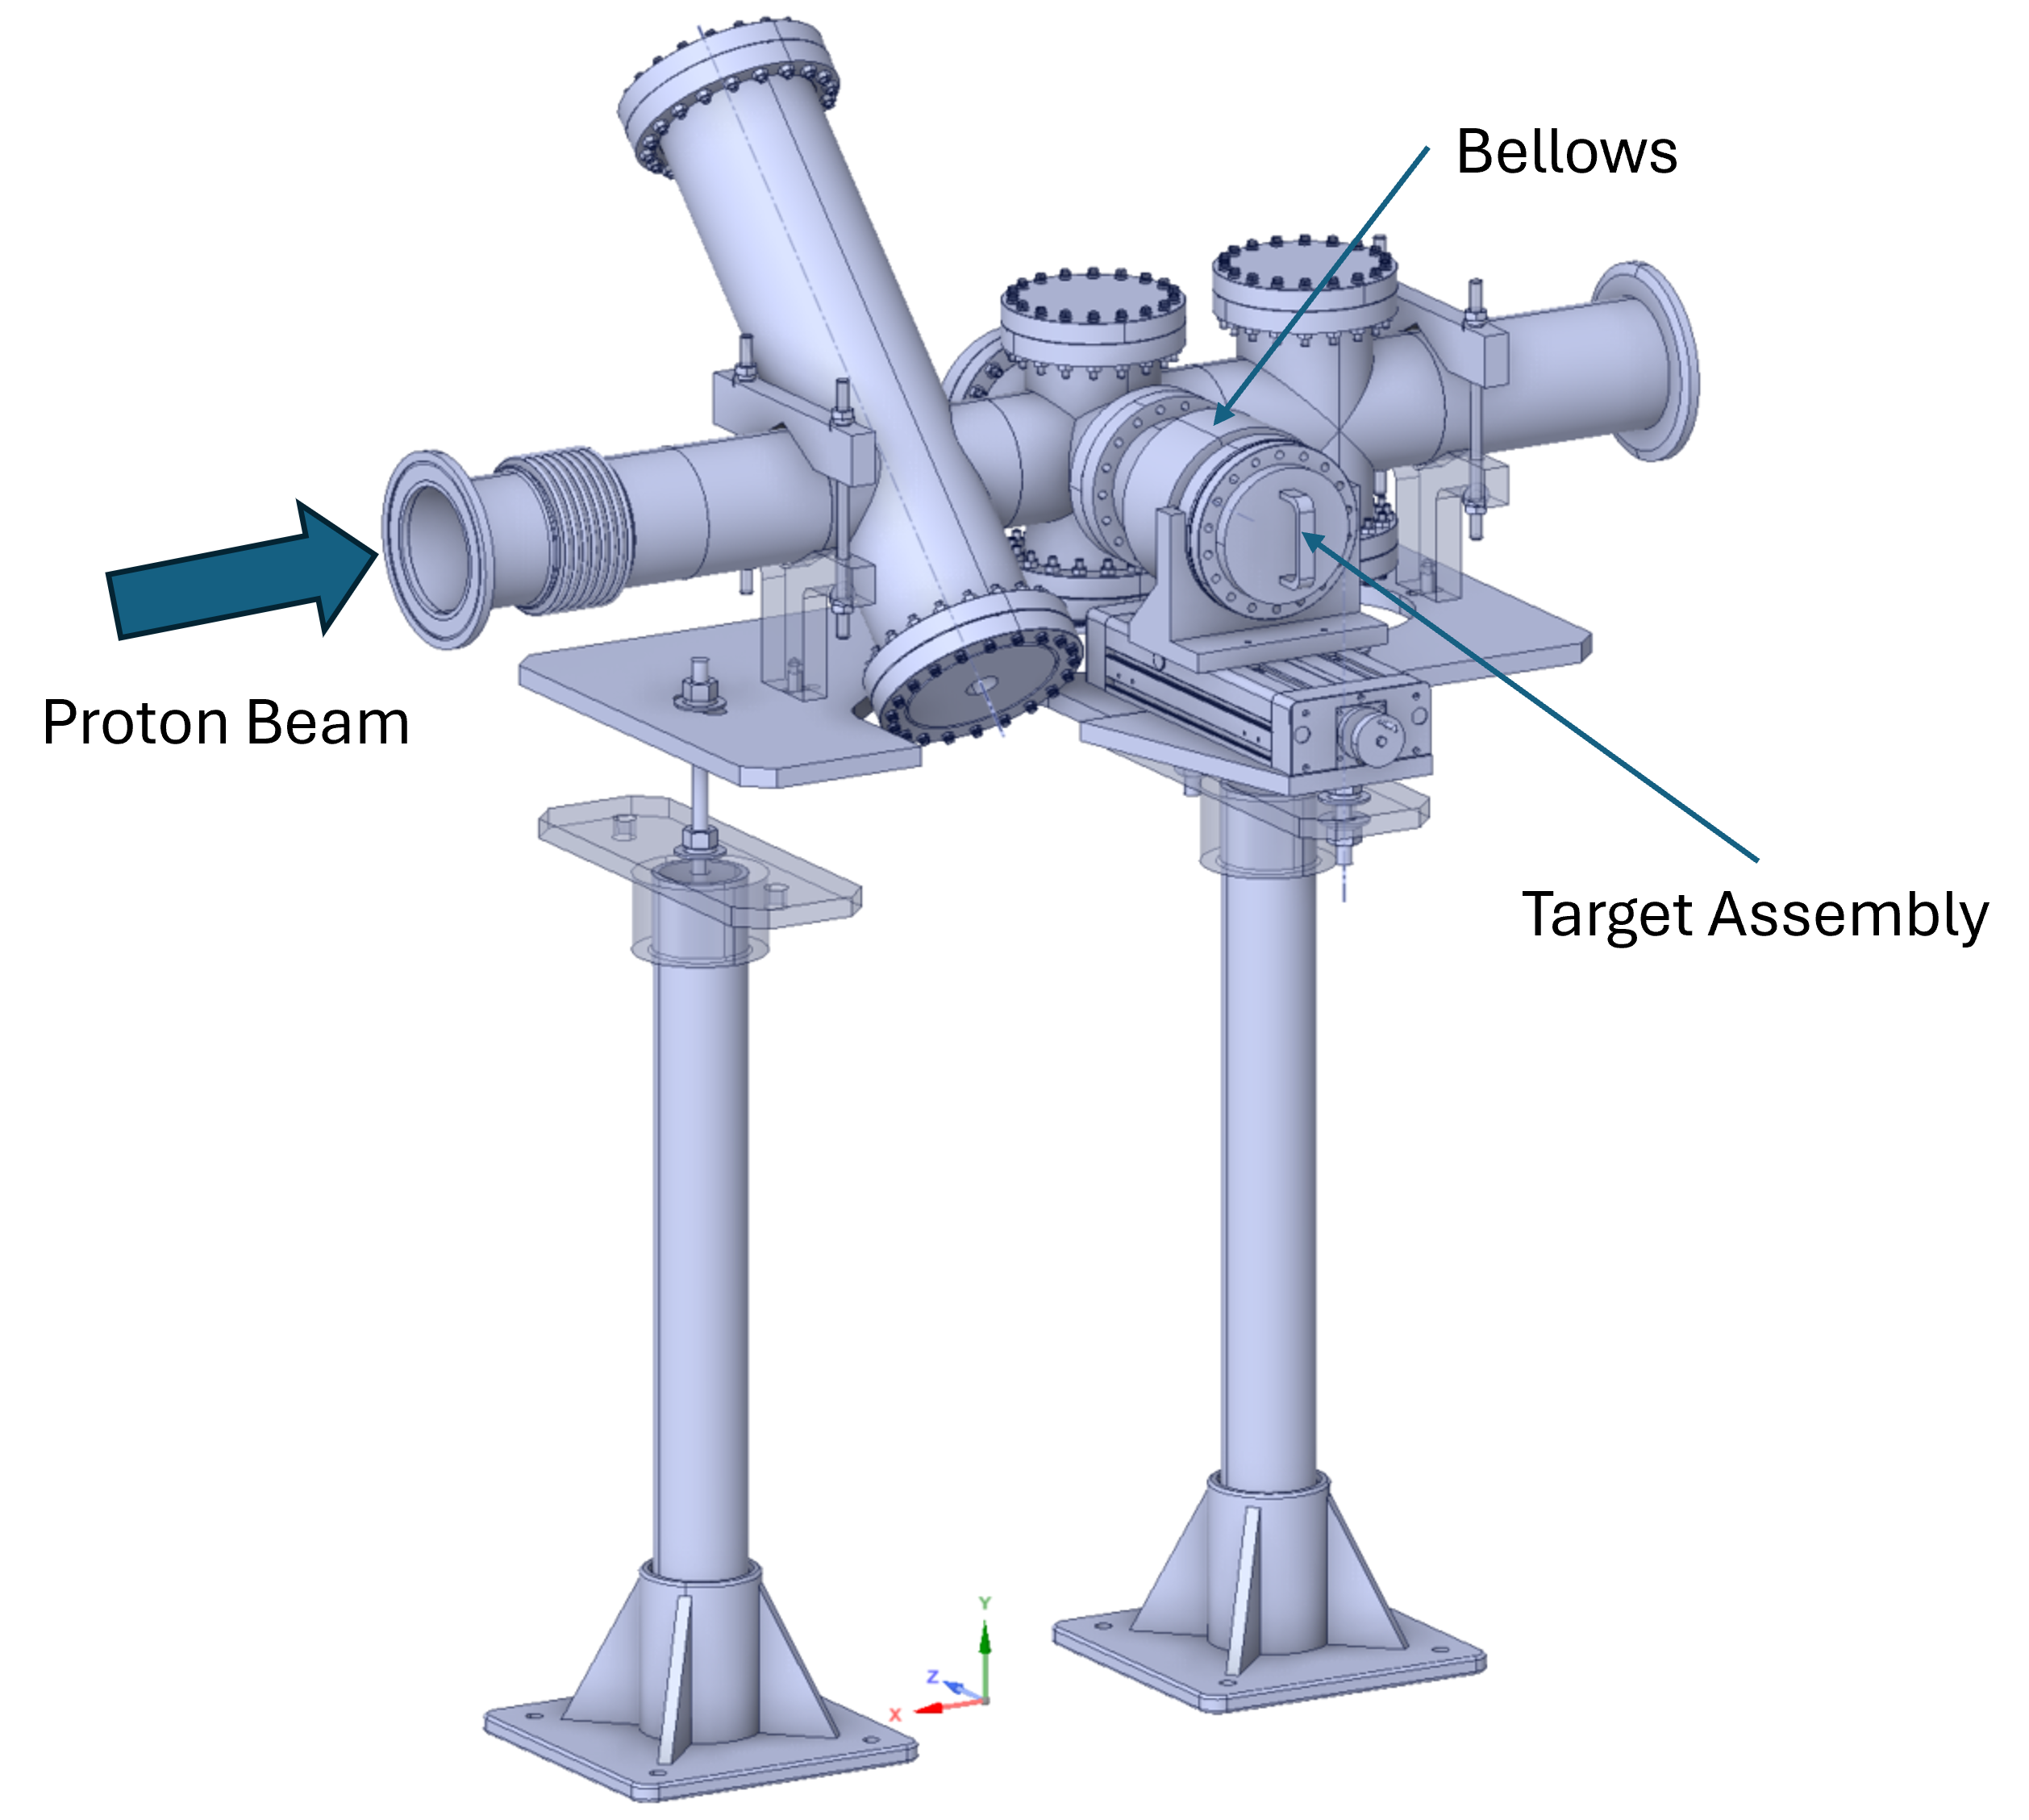
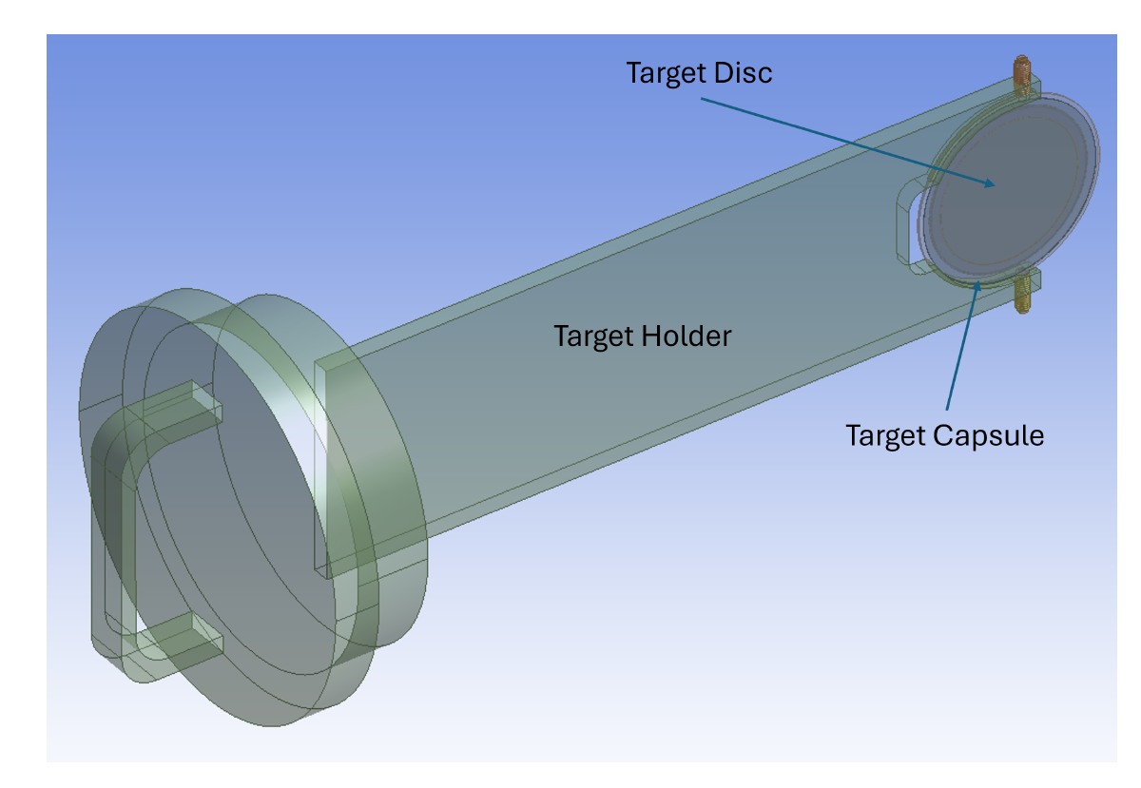
Experimental Test Station Concept
Concept test station at SNS linac dump area has been developed.
Protons are routinely routed to the linac beam dump, and energy can be varied from 800-1300 MeV.
Maximum power for beam studies is 7 kW.
Designed for easy access to irradiated targets.
Recent images of the Linac beam dump

Slide 14
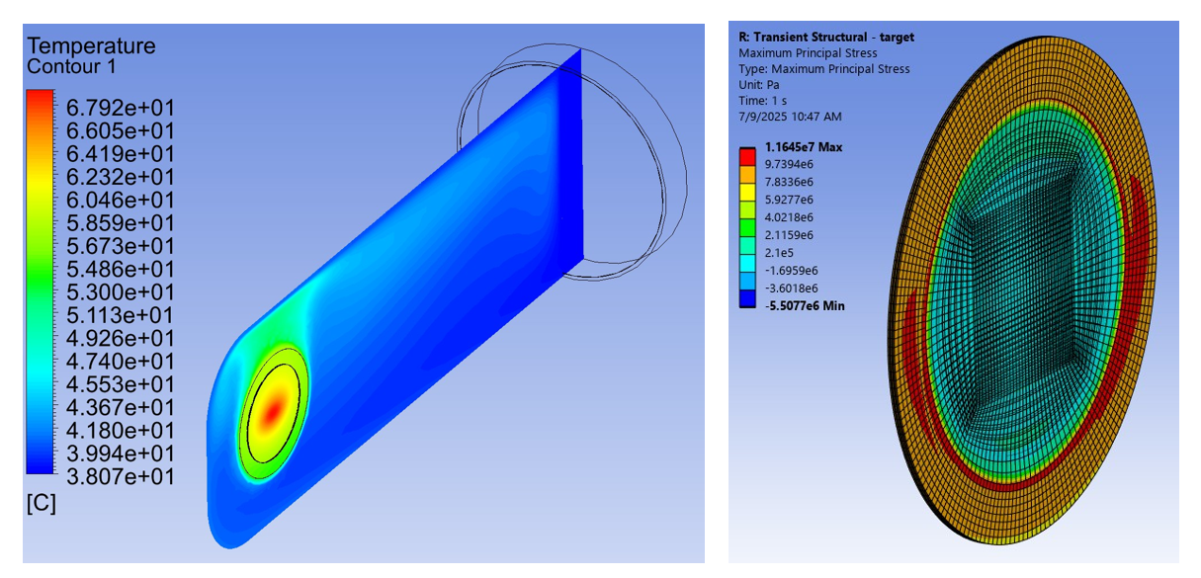
Experimental Test Station Concept
A simulated test irradiation was performed to model target survivability and radiation dose
Irradiation parameters:
  0.25 mm thorium target disc
  SS316 target capsule
  1kW
  1.3 GeV
  48 hours
Temperature and transient structural analysis were performed using ANSYS
Temperature analysis served as input to structural analysis and confirmed temperatures well below melting
Structural analysis showed that tensile and yield stresses were less than ASME thermal stress limits

Slide 15
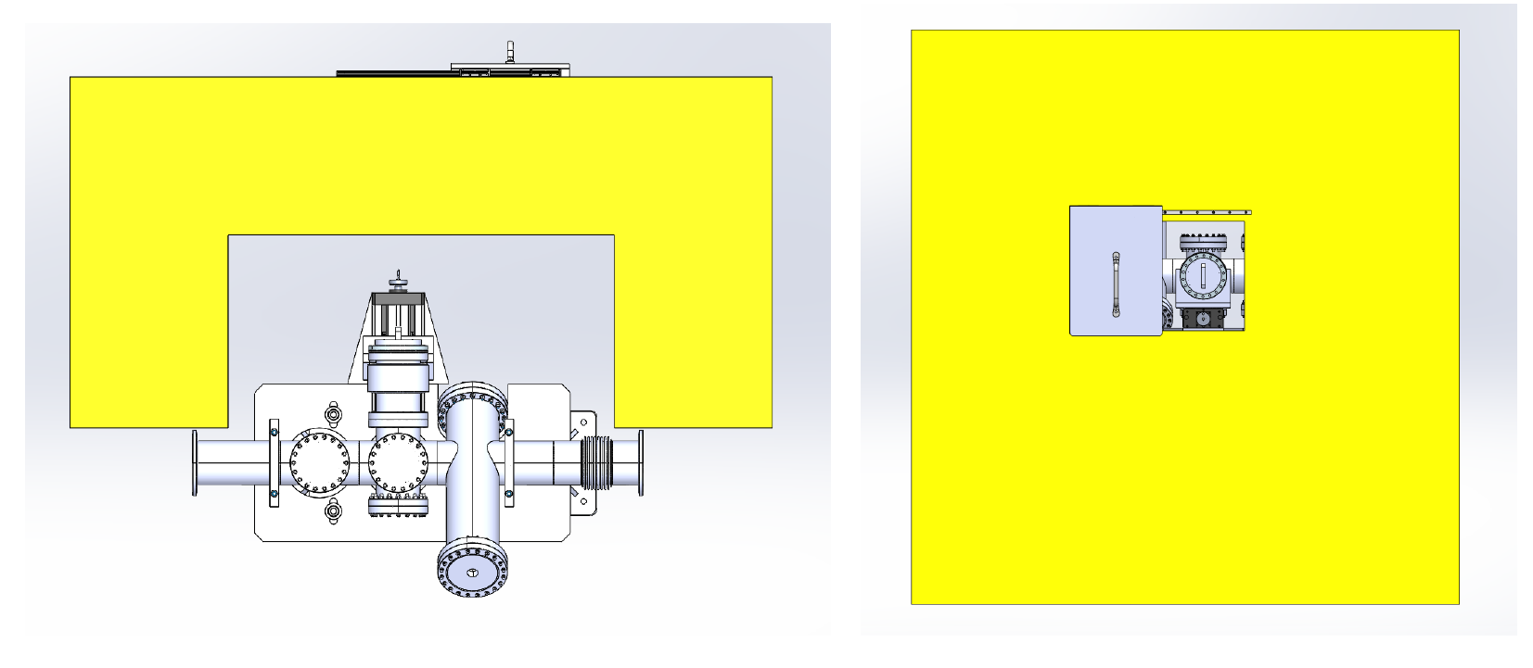
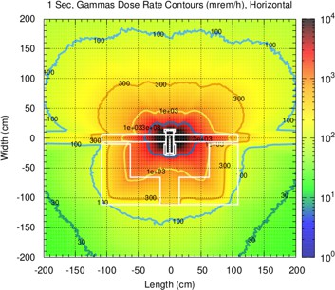
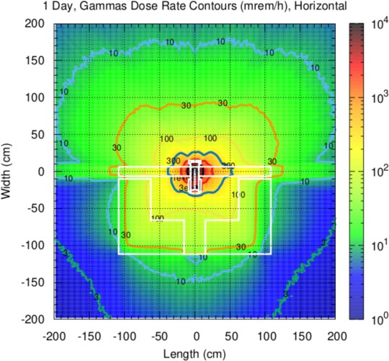
Experimental Test Stand Concept
MCNP6.2/CINDER2008 were used to calculate activation yields and dose rates.
After 24 hours of decay, the calculated dose from the activated target is less than the administrative limit of 100 mR/hr at 30 cm distance.
Top view (left) and side view (right) of the irradiation port surrounded by portable concrete shielding (yellow).
Top view of the decay dose (left) at EOB and (right) after 24 h of decay time

Slide 16
Specific Aim #3:
Develop a target design concept that can receive high energy beam pulses from the SNS accelerator.

Slide 17
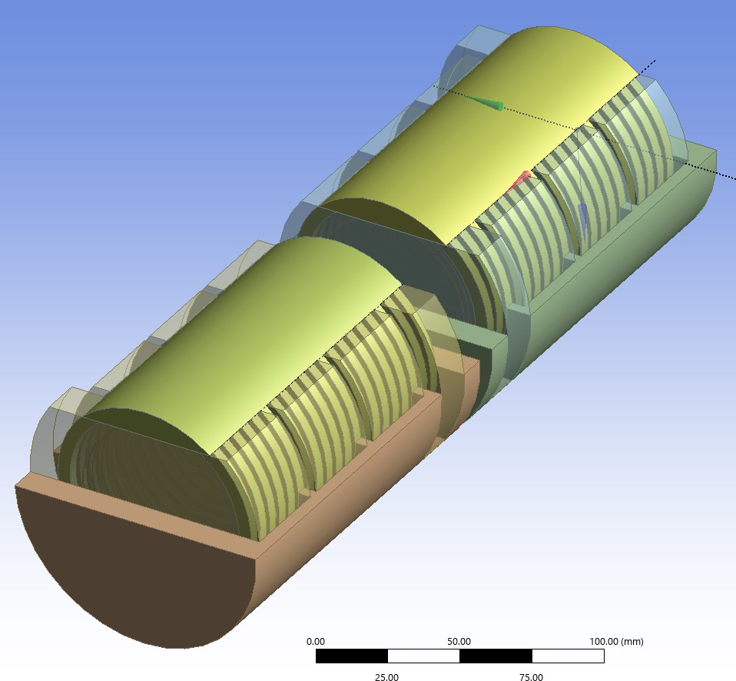
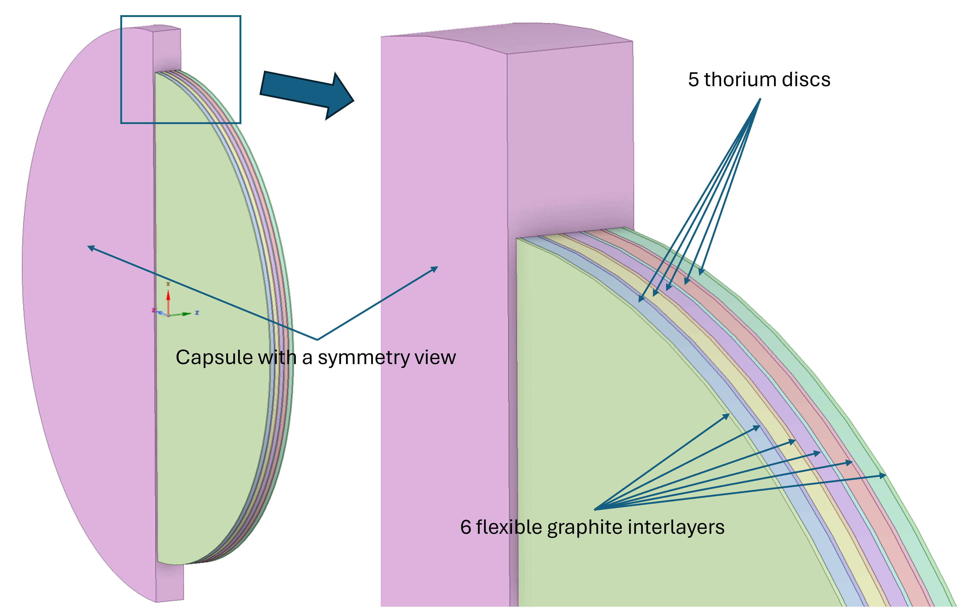
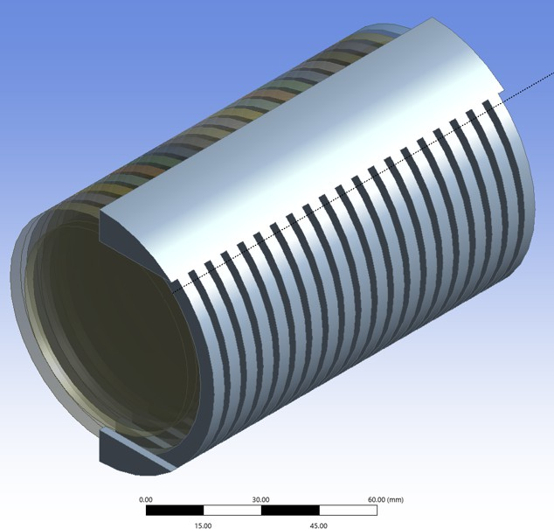
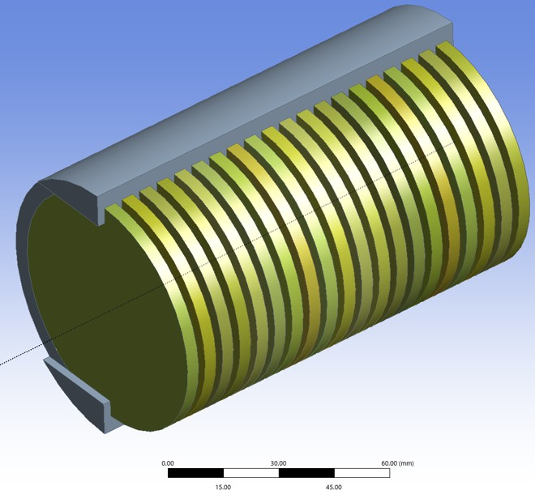
Production Target Concept
Includes modular, two-cassette system with efficient cooling channels.
Each cassette can hold up to 20 capsules (200 thorium discs total).
Five thin thorium discs (0.5 mm) encapsulated with graphite shock absorbers within 316L austenitic stainless-steel capsule.

Slide 18
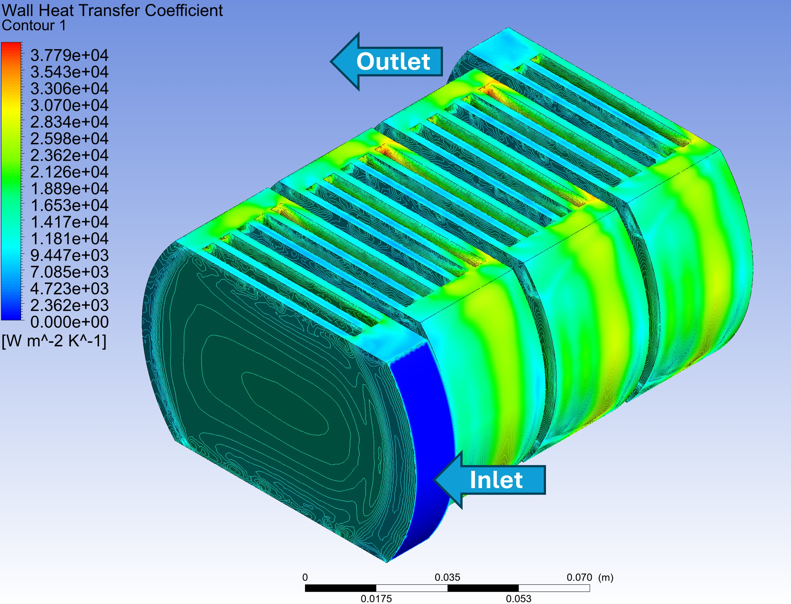
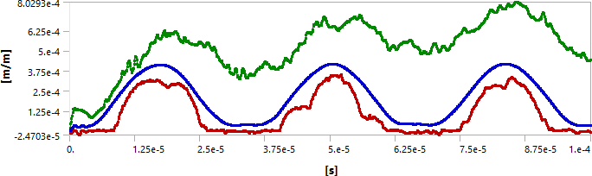
Production Target Concept
A super-gaussian (flat-top) beam profile is assumed with 700 ns pulse length, 250 kW beam power, and 1.3 GeV beam energy
Maximum energy deposition for a thorium disc was calculated with FLUKA to be 33.1 MeV/cm
Finite element simulations with ANSYS were performed to analyze steady-state/transient thermal and structural analysis.
Concluded that this thorium target design should withstand a 14-day irradiation
Initial concept of water manifold for coolant flow. Assumed mass flow rate of 1 kg/s.
The strain response of the target capsule to a single beam pulse. Shown are the maximum, average, and minimum values of the principle elastic strain.

Slide 19
Specific Aim #4:
Identify enhanced isotope separation methods for SNS produced radionuclides.

Slide 20
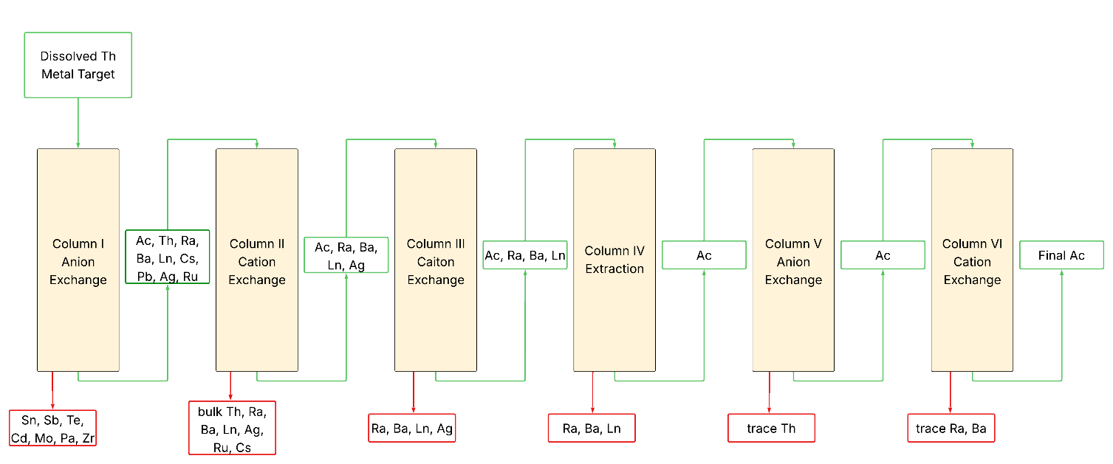
Isotope Separation Methodology
Chemical separation methods developed for activated thorium targets have been developed in other studies, such as the Tri-Lab Production of ²²⁵Ac with BNL and LANL.
Current ORNL facilities such as the Radiochemical Engineering Development Center, or future facilities like the Radioisotope Processing Facility could be used for isotope processing.
Advancements in offline radioactive electromagnetic isotope separation are needed to ensure high specific activity medical radioisotopes.
Six-column separation process employed for Ac-225 recovery from thorium metal in Accelerator-produced Ac-225 project

Slide 21
Closing Remarks and Next Steps to Making RIPS a Reality
Can utilize reliable surplus of SNS beam power for large-scale radioisotope production without new accelerator construction.
Models predict significant quantities of medical radionuclides can be produced using 1.3 GeV protons on a thorium target.
Diverse portfolio of nuclides enables rapid adaptation to changing market needs.
Further development of experimental test stand concept is essential to validating theoretical production yields and providing radiotracers for additional chemical separations development.
Enhanced radioactive mass separations could unlock ability to produce carrier-free radionuclides.
Potential Radioisotope Production Station
Second Target Station
First Target Station

Slide 22
Acknowledgements
RIPS TEAM
NSCD
ISED
Research sponsored by the Laboratory Directed Research and Development Program of Oak Ridge National Laboratory, managed by UT-Battelle, LLC, for the U. S. Department of Energy.
Sarah Cousineau
Sang-ho Kim
Fulvia Pilat
Justin Griswold
Ethan Asano
Jonah Duran
STS
PSD
Thanks to:
S. Thomas
A. Woody
R. Palmer
I. Popova
D. Willis
R. Hoerres
P. Kankanamalage
Dave Rotsch
Adam Stevenson
Dan Stracener
Yongjoong Lee
Charlie Rasco

Slide 23
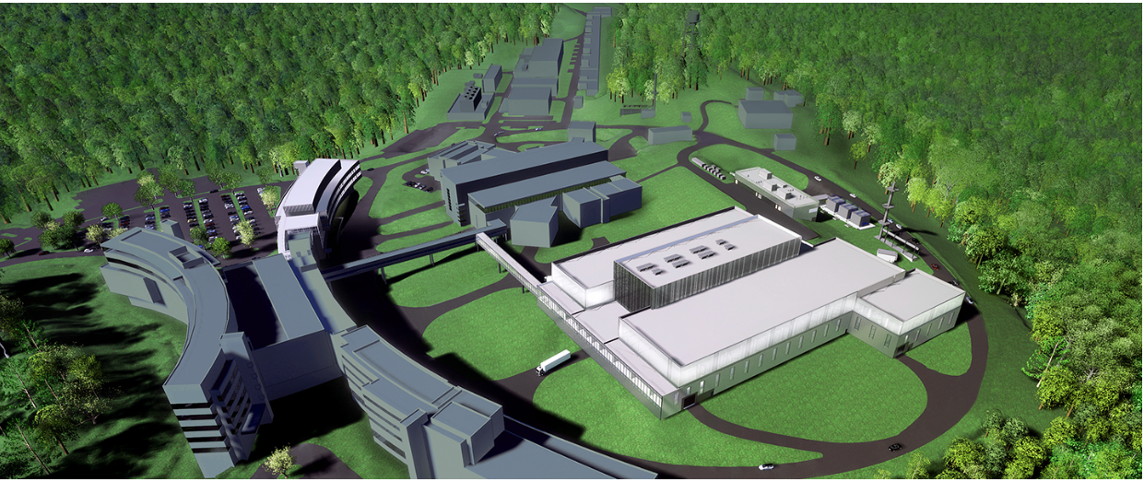
Thank You!

Slide 24
Extra Slides

Slide 25
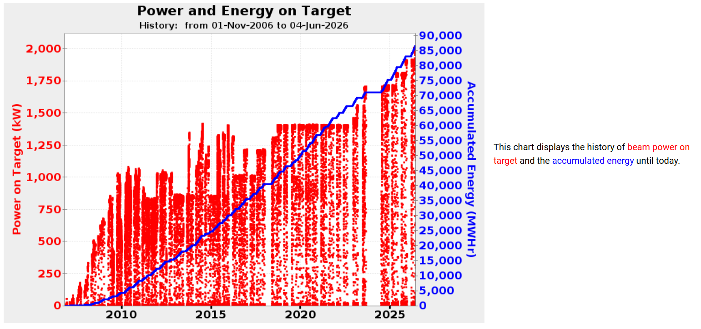
Beam Power to First Target Station Recently Increased to 2.0 MW

Slide 26
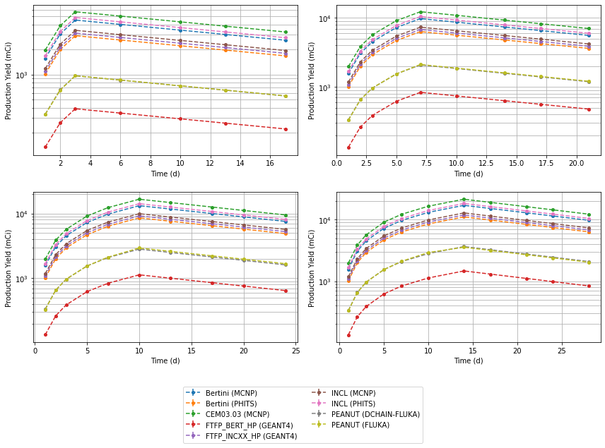
Yields (mCi) for ²³⁰Pa (t_{1/2} = 17.4 days) after 3-, 7-, 10-, and 14-day irradiations of thick thorium target
Peak production is ~10-20 Ci at 14 days

Slide 27
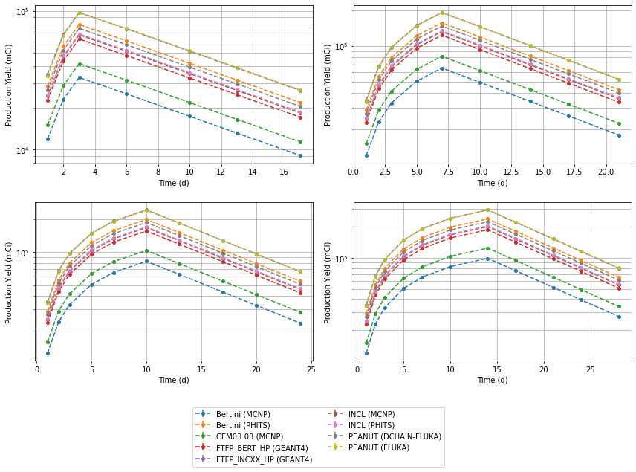
Yields (mCi) for ¹¹¹Ag (t_{1/2} = 7.45 days) after 3-, 7-, 10-, and 14-day irradiations of thick thorium target
Peak production is ~100-300 Ci at 14 days

Slide 28
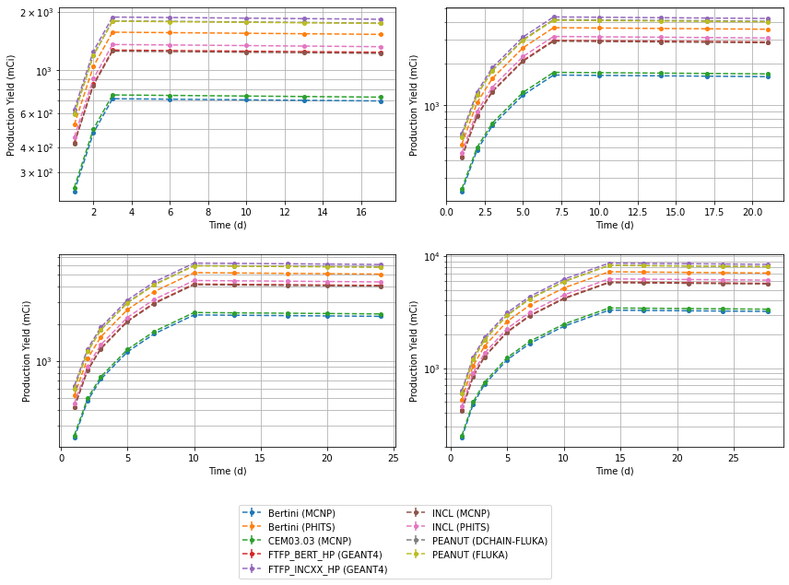
Yields (mCi) for ¹⁰⁶Ru (t_{1/2} = 373.59 days) (t_{1/2} = 17.4 days) after 3-, 7-, 10-, and 14-day irradiations of thick thorium target
Peak production is ~30-90 Ci at 14 days

Slide 29
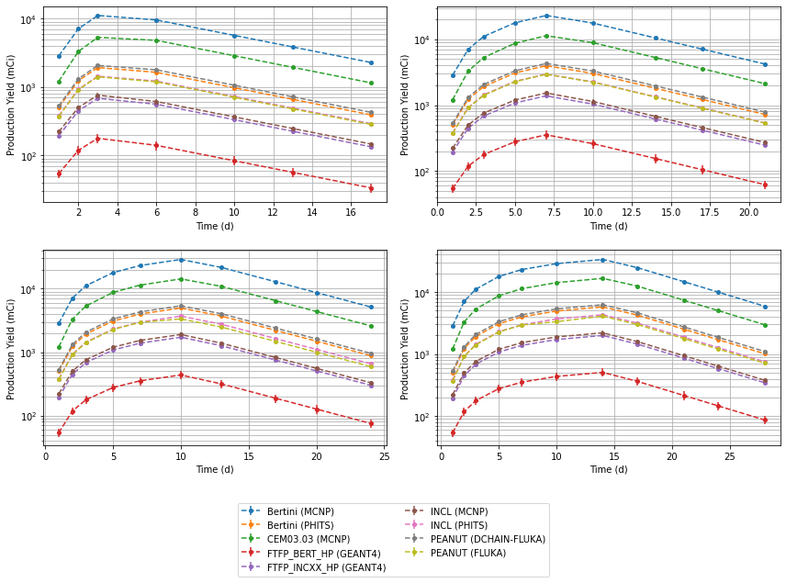
Yields (mCi) for ¹⁵⁵Tb (t_{1/2} = 5.32 days) after 3-, 7-, 10-, and 14-day irradiations of thick thorium target
Peak production is ~0.5-30 Ci at 14 days

Slide 30
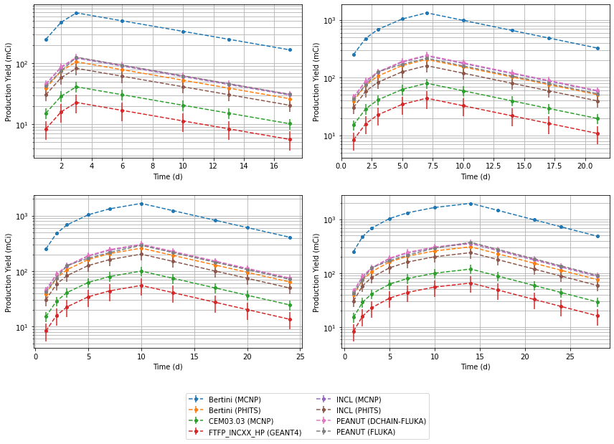
Yields (mCi) for ¹⁶¹Tb (t_{1/2} = 6.906 days) after 3-, 7-, 10-, and 14-day irradiations of thick thorium target
Peak production is ~0.05-2 Ci at 14 days

Slide 31
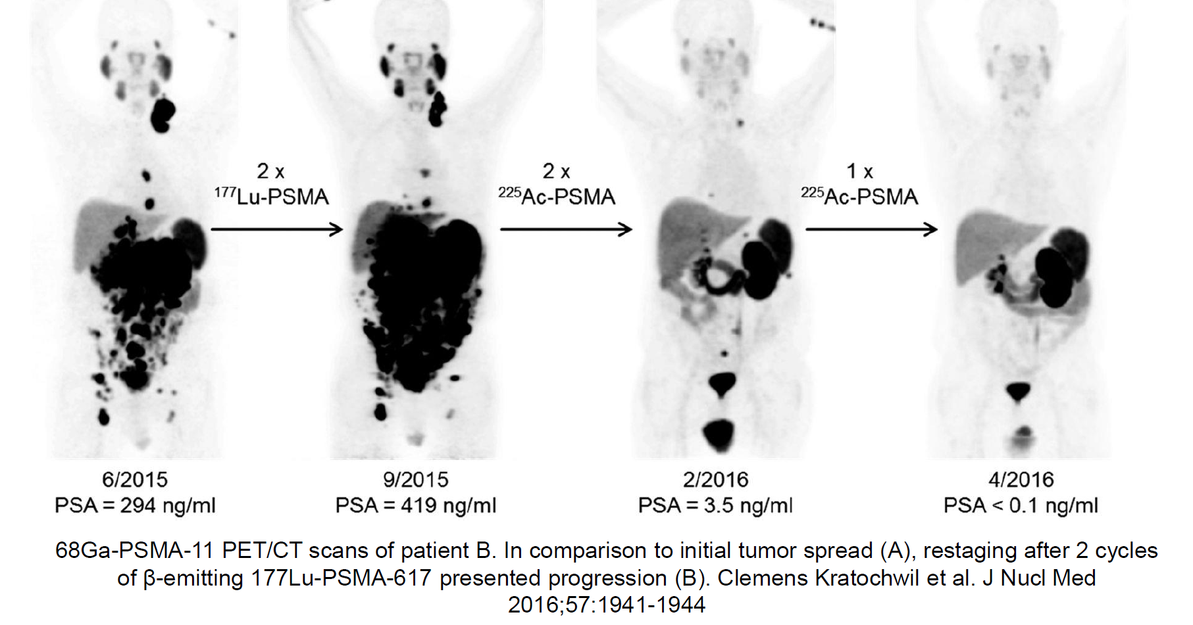
Study Case: Ac-225/Ra-225
Promising preclinical and clinical results for targeted alpha therapy with Ac-225
  Estimated annual global demand: 670 Ci (2.5 TBq) for 2 million patient doses per year
  Current global supply: 1.7 Ci (63 GBq)
    Main source: Ac-225 from fissile U-233 via Th-229: 1.1 Ci (41 GBq)

Slide 32
Beam Parameters – Radioisotopes Prod. Target Station (RIPS)
Proton kinetic energy: 1.3 GeV
Beam energy per pulse: 50 kJ/pulse
Pulse length: 700 ns
Repetition rate: 5 Hz
  FTS: 40 Hz (2.00 MW)
  STS: 15 Hz (0.75 MW)
  RIPS: 5 Hz (0.25 MW)
Time averaged beam current: 192.3 uA
  BLIP/BNL: 165 uA@200 MeV
  IPF/LANL: 450 uA@100 MeV
Proton stopping range to 30 MeV in Th:
  RIPS (1.3 GeV): 78 cm
  BLIP (200 MeV): 4.8 cm
  IPF (100 MeV): 1.5 cm
RIPS offers huge potential for mass production of Ac-225/Ra-225:
Theoretical Yields at E.o.B: 10 Days Beamtime
 | Ac-225 @ E.o.B | Ra-225 @ E.o.B
RIPS/ORNL | 15.9 TBq | 1.66 TBq
BLIP/BNL | 0.85 TBq | 0.03 TBq
IPF/LANL | 0.16 TBq | 1.78 GBq

Slide 33
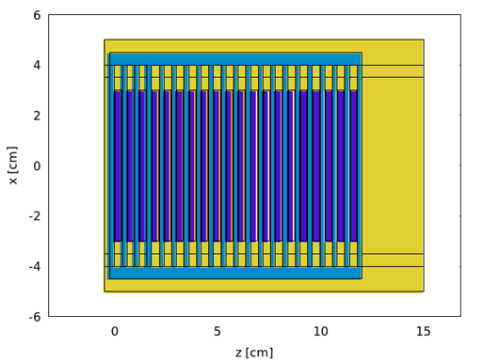
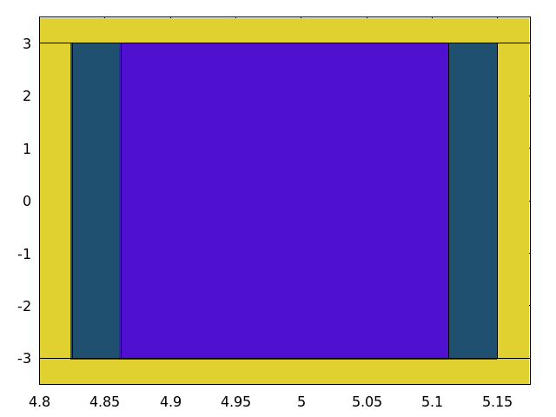
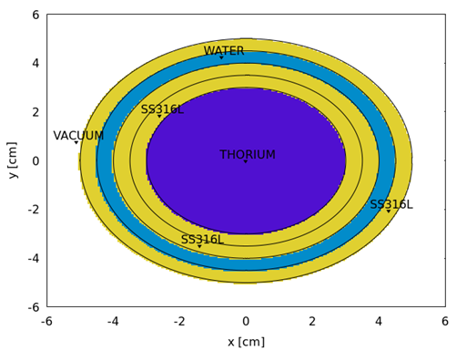
Target Model – Isotopes Yield Estimates
Capsule Rim
Close up view of target capsule cross section
Target Material: Thorium
Th-disc dimension: Φ 60 mm x t 2.5 mm (82.8 g)
Target Layout:
  Th-disc is contained in SS316L capsule
  Flexible graphite sheets are placed between the Th-disc and capsule window
  Radioisotopes production unit consists of 20 capsules containing Th-discs
  Water coolant channel with 2.25 mm width between the target capsules
  Radioisotopes production unit and coolant are housed in a pressure vessel made of SS316L
Capsule Window:
T = 0.25 mm
Flexible Graphite Sheet:
T = 0.127 mm (5 mil)
Target:
T=2.5 mm

Slide 34
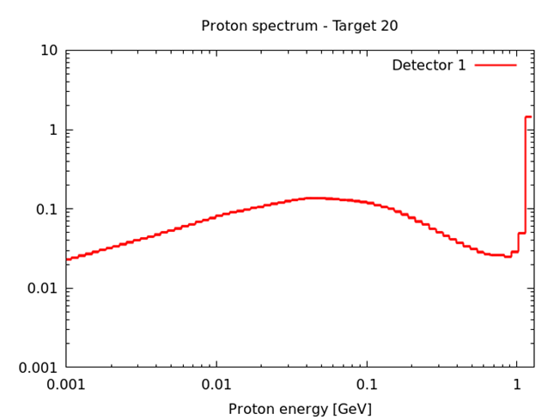
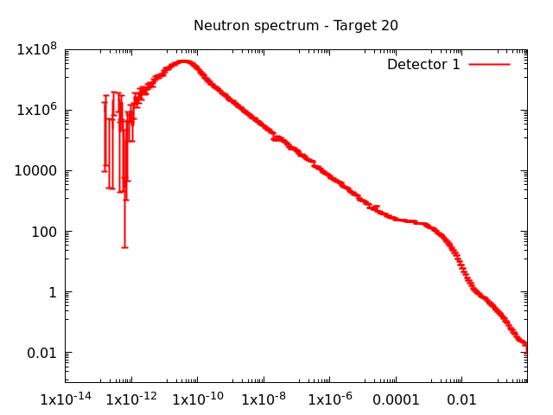
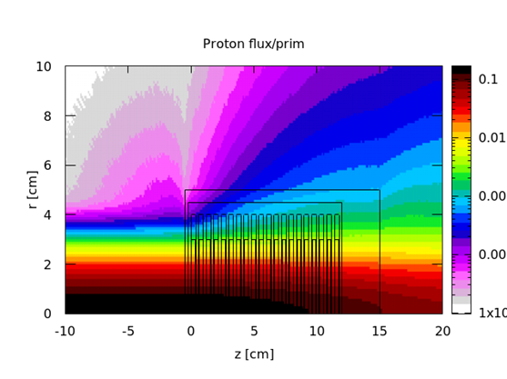
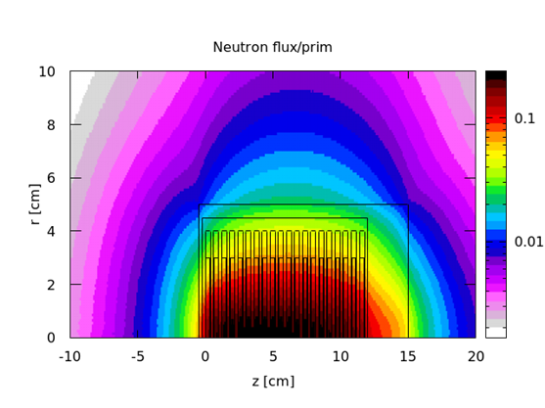
Ac-225/Ra-225 Activities: 10 days Beamtime
Isotopes | E.o.B | 1 week decay
Ac-225 | 2.01 TBq | 1.32 TBq
Ra-225 | 0.26 TBq | 0.19 TBq

Slide 35
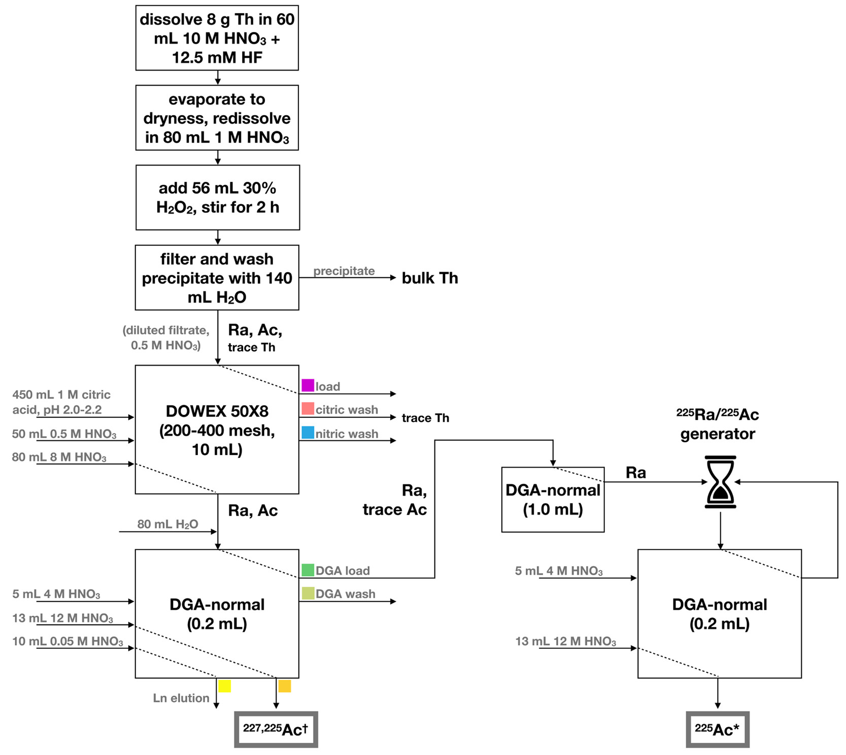
Ac-225/Ra-225 Activities: Effective
Ac-225/Ra-225 Yield Efficiency:
  Chemical separation yields:
    Ac-225/Ac-227: 44%
    Ra-225: 98%
  Resonant laser ionization and mass separation
    Collection efficiency: 10%
Ac-225/Ra-225 Yields per 10 day run cycle: 0.11 TBq
  Ac-225: 53 GBq (4% of activity at 1 week decay)
  Ra-225: 184 GBq (98% of activity at 1 w. decay)
    60 GBq of Ac-225 of can be isolated after a 7-day operational cycle of the generator
About 23 times 10-day long annual run cycles would meet the global demand of 2.5 TBq to treat 2 million patients
  More energy budget with 1.3 GeV beam could be explored by installing more downstream target capsules to improve the Ac-225 yields
  Breakthrough in R&D in Ac-225 separation will improve the yields
Johnson, J.D et al.,
Sci Rep 13, 1347 (2023)
Y.M. Palenzuela et al., Front. Med.
Vol. 8-2021
A.K.H. Robertson et al.,
Inorganic Chemistry 2020 59 (17)
12156-12165

Slide 36
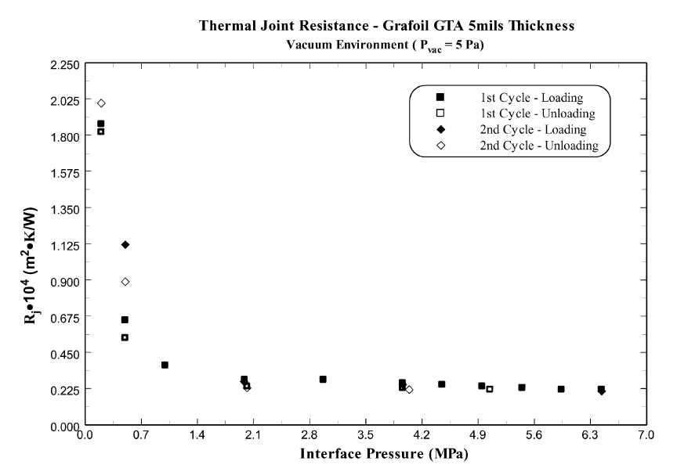
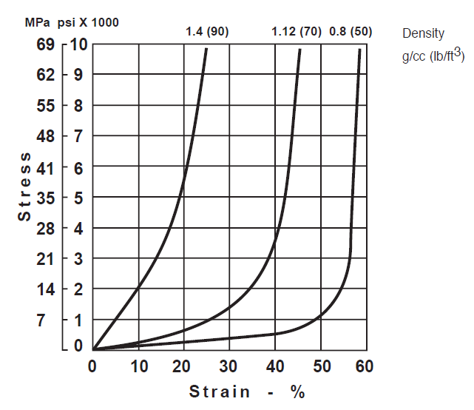
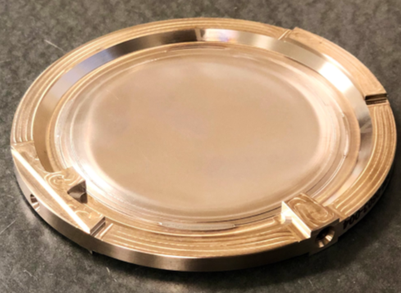
Flexible Graphite: Heat Conductor and Shock Absorber
If capsules are EB welded in vacuum:
  Water coolant pressure could form thermal contacts between target discs and capsule with thermal contact conductance of 5000 W/m2/K
If capsules are laser beam welded in sub atmospheric helium pressure:
  Estimated thermal contact conductance > 10000 W/m2/K
Flexible graphite is a soft material commonly applied as gasket material
  Low density: Consumes less energy budget
  Low stiffness and expandability upon compression: Shock absorber
  Higher thermal conductivity than any gaseous medium: Efficient heat removal
IPF target capsule at TRIUMF

Slide 37
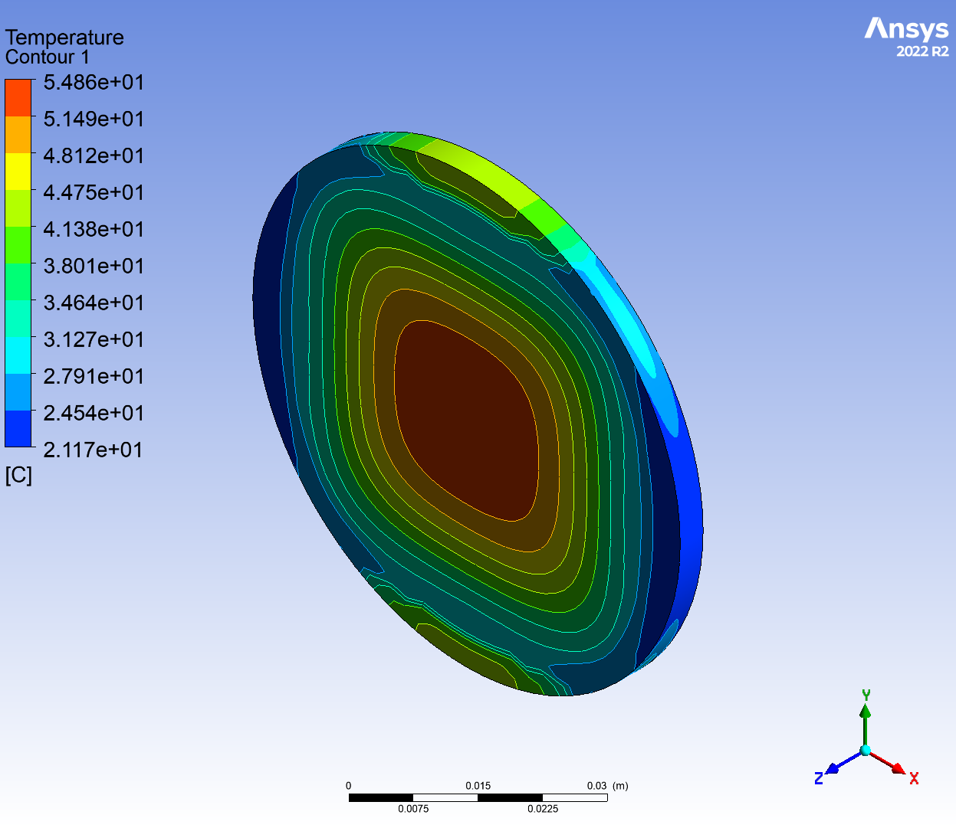
Temperature
Wall Heat Transfer Coefficient:
  Channel gap x height: 2.25 mm x 60 mm
    Following LANSCE target design, the gap width could be reduced to 1.5 mm for efficient use of energy budget
  Channel water speed: 3 m/s
  Dittus-Boelter relation: 14243.3 W/m2/K
Beam energy deposition in dE/dz [MeV/cm]
  Capsule: 24.2 MeV/cm
  Flexible graphite: 4.71 MeV/cm
  Target disc: 33.1 MeV/cm
Maximum Steady Temperature:
  Capsule:
    Bulk: 63 C
    Water contacts: 55 C < boiling point
  Flexible graphite: 185 C
  Target disc: 191 C
Temperature increase per pulse:
  Capsule: 12.5 C
  Flexible graphite: 13.7 C
  Target disc: 53.5 C

Slide 38
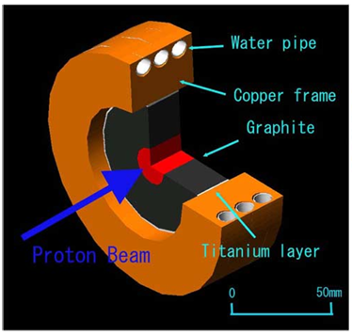

Some Thoughts …
Muon Target at J-PARC
With a 250 kW class RIPS target as presented, only about 0.1 GeV of 1.3 GeV energy budget is used meaning about 1.2 GeV of energy budget is still available
  Room for more target capsules in the downstream region of the presented target concept
    Increased production of medical isotopes with higher activities than presented
  Use 1.2 GeV remaining energy budget and fast neutrons for nuclear materials study
    Serving for high power targetry and fusion R&D where system lifetime is constrained by unknown post-irradiation material properties
  Muon target station in the upstream region of the RIPS target
    Muon beamline will supplement the existing neutron beamlines at ORNL for advancement of materials sciences (3.2 MeV/cm energy loss in graphite)
  Fast neutrons from the target could be guided to electronics irradiation station
    Existing electronics irradiation station does not the demand from the industry. The flux available from the RIPS target will largely exceed that of the ChipIr facility at ISIS, UK which uses a 32-kW solid tungsten spallation target as neutron source
ChipIr at TS2/ISIS

Slide 39


Temperature
Heat transfer models used:
  Conductive heat transfer
  Convective heat transfer
    Buoyancy flow model in air
  Radiative heat transfer: P1 model
Maximum temperatures:
  Thorium disc/capsule: 129 C
  Vessel: 103 C

Slide 40


Stress
Peak maximum principal stresses in structural components:
  Capsule: 11.5 Mpa << YS; UTS
  Vessel: 71 MPa < 1/2*YS; 1/3*UTS
    Strain hardened aluminum – Al5052-H38
      YS: 248 Mpa
      UTS: 276 Mpa
    Bottom wall thickness could be increased to reduce stress from the 1 bar air towards the accelerator vacuum

Slide 41


Beam Parameters Used for Study
  Target shall be cooled only passively by conductive, convective, and radiative heat transfer
  The dose from the target after a week decay time after end of bombardment shall not exceed 10 mrem/hr at 30 cm from the port
Beam parameters:
  Beam energy: 0.8-1.3 GeV
  Pulse length: 1.0 ms with 1 – 60 Hz rep. rate
  Beam size: $σ_{x}=$ 8 mm; $σ_{y}=$ 3 mm
    Switching off last two quads for beam expansion
  Proton current: 4.8e12 p/s (0.77 uA)
  Beam power: 1.0 kW
  Beamtime: 20 hours
Potential target location

Slide 42


Pilot Target Model
Target module consists of four components
  Target capsule made of SS316L
    Design follows the concept presented for SpA 2
  Target disc made of thorium
    Disc thickness: 0.25 mm (8 g)
  2 x flexible graphite sheets: 0.127 mm thick
  Retractable vessel made of Al5052
    Docked to the target port with bellow with a required stroke needed to free beam passage when not in use
      No need to break the accelerator vacuum for target handlings
    Houses the target capsule in atmospheric air environment separated from the accelerator vacuum
    Al5052 was chosen to reduce post radiation decay dose

Slide 43


Target Model – Isotopes Yield Estimates for Test Irradiation
Dose from the target reduces to a manageable level (10 mrem/h@30 cm) after 5 days cooling
Isotopes yields:
  Ac-225 (t_{1/2} = 9.92d): 66.8 μ Ci (2.5 MBq) at E.o.B
  Ra-225 (t_{1/2} = 14.8d): 9.4 μCi (0.35 MBq) at E.o.B
Isotopes | Activity [uCi] | Error [%]
Th-227 | 22.41 | 3.4
Ac-227 | 0.10 | 2.0
Ac-225 | 66.76 | 2.1
Ra-225 | 9.38 | 4.2
Ra-223 | 20.59 | 3.7
Dose (mR/hr)

Slide 44

Experimental Target Station
Demonstration of a miniature scale full cycle process from target manufacturing through 1.3 GeV irradiation, remote handling to isotopes separation
Manufacturing of target capsule with laser beam welding in sub atmospheric pressure helium
  Demonstration of manufacturability of the 250-kW target with in-beam thermal and mechanical characterizations
Simulation of target capsule handling and target disc extraction
Validation of isotopes yields:
  Post irradiation measurement of Ac-225/Ra-225 activities using gamma and alpha spectroscopy
  Chemical separation of Ac-225/Ac-227 and Ra-225 from irradiated Th-target
  Separation of Ac-225 from Ac-225/Ac-227 compound using resonant laser ionization and off-line mass separation

Slide 45


Initial Production Target Model Design Concept and Survivability
Th-disc dimension: Φ 60 mm x t 0.5 mm (16.6 g)
  Thin target to avoid beam pulse induced coherent longitudinal stress wave interference and to facilitate chemical separation of the isotopes by increasing surface to volume ratio
Target Layout:
  5 Th-discs are contained in SS316L capsule
  Other facilities use Inconel 718: Higher strength, but potential Nb-94 waste disposal issue (>0.2 Ci/m3) with 250 kW beam power
  Flexible graphite sheets are placed between the Th-discs and capsule window
    Efficient conductive heat transfer to water
    Short pulse beam induced shock absorber
    Reduced abrasive fretting of target capsule
  Steady-state temperature analysis:
  Capsule: 63 C (55 C at face)
    Bulk: 63 C
  Flexible graphite: 185 C
  Target disc: 191 C

Slide 46


Steady Stress
Water pressure: 2 bar following BLIP
Peak maximum principal stress:
  Shell: 163 Mpa (less than 235 Mpa (YS) and 560 Mpa (UTS) of SS316L)
    Maximum stress caused by bending at the capsule window-rim interface due to water pressure => room for further optimization
Peak maximum principal stress:
  Target: 2.2 MPa (less than 144 Mpa (YS) and 219 Mpa (UTS) of Th)
  Flexible graphite: 210 kPa (compression)

Slide 47


Dynamic Transient Structural Analysis – Capsule
Maximum principal strain variance:
  Number of beam pulses at 5 Hz for 10 days: 4.32e6
  Δε = 0.053% < fatigue limit

Slide 48


Dynamic Transient Structural Analysis – Target Disc
Maximum principal stress amplitude:
  Coherent interference of longitudinal stress waves in the thickness direction is smoothened
  Longitudinal waves in the radial direction contributes most to the dynamic stress
  Δσ = 27 MPa = 0.188*YS; 0.123*UTS
Fatigue life estimate:
  No data on fatigue strength of thorium
  Rule of thumb estimate:
    Good chance that the maximum stress amplitude is below fatigue limit as Δσ << UTS/2
Maximum dynamic stress peak in flexible graphite sheets is below 1 Mpa and maximum strain variance is below 0.2%
  Little concern about fatigue failure of flexible graphite

Slide 49


Dynamic Transient Structural Analysis – Thick Target Disc
Maximum principal stress amplitude in 2.5 mm thick thorium target disc:
  Coherent interference of longitudinal stress waves in the thickness direction is visible
  Δσ = 1.03*UTS; Δσ = 0.68*UTS => Most probably fail under 4.32e6 fatigue cycles

Slide 50

Mass Distribution in p+²³⁸U Reaction at Various Energies
50 MeV
Data generated and provided by Dr. A. Gottberg for RIPS Workshop, September 2023

Slide 51

Mass Distribution in p+²³⁸U Reaction at Various Energies
500 MeV
Data generated and provided by Dr. A. Gottberg for RIPS Workshop, September 2023

Slide 52

Mass Distribution in p+²³⁸U Reaction at Various Energies
1000 MeV
500 MeV
Data generated and provided by Dr. A. Gottberg for RIPS Workshop, September 2023

Slide 53

Mass Distribution in p+²³⁸U Reaction at Various Energies
1400 MeV
500 MeV
1000 MeV
Data generated and provided by Dr. A. Gottberg for RIPS Workshop, September 2023

