Slide 1
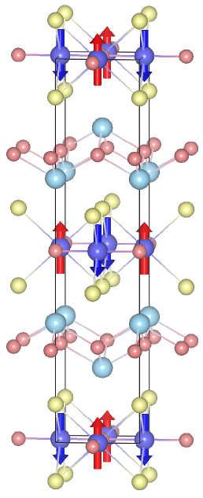
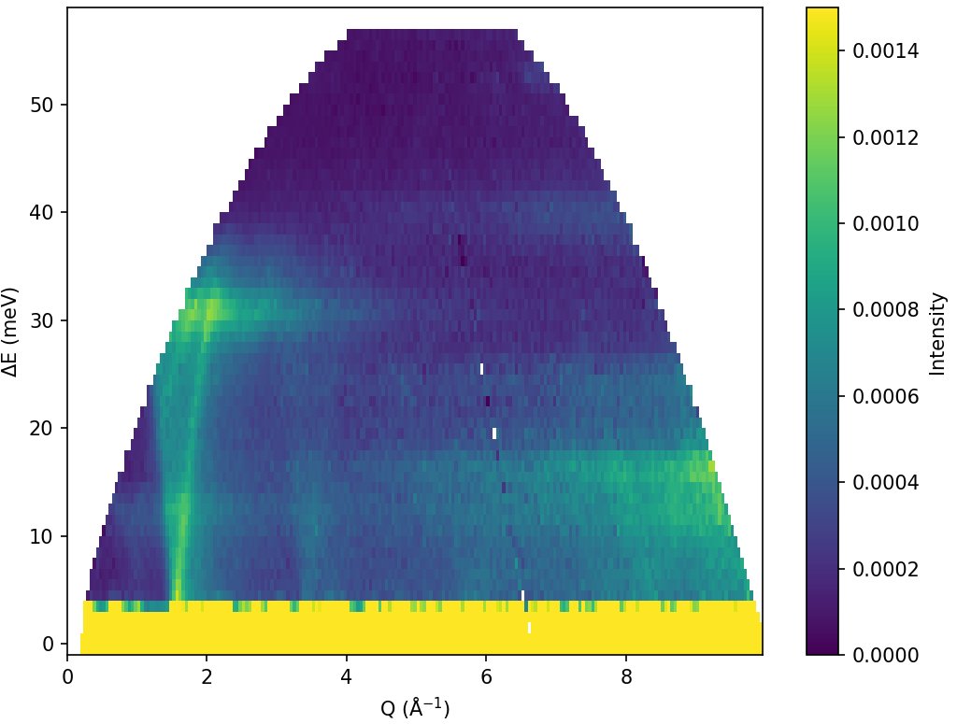
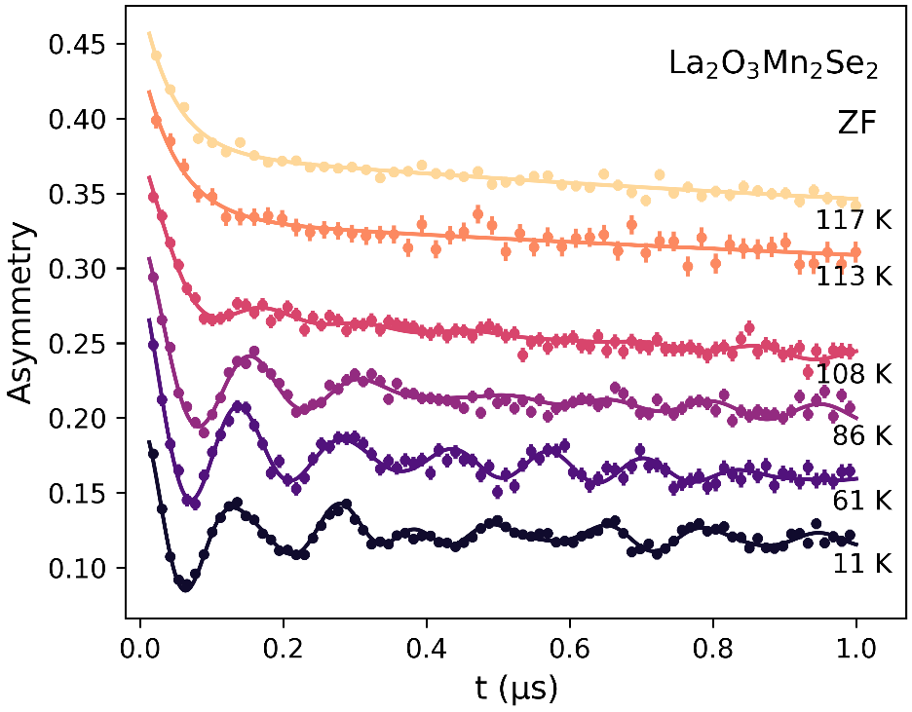
Two is Greater Than One (and Other Obvious Facts):
Learning More about Quantum Materials by Combining Muon Spin Spectroscopy and Neutron Scattering
Wei et al., Phys. Rev. Mater. 9, 024402 (2025)
Singh et al., under review at Nature Materials
Frandsen et al., Phys. Rev. Mater. 4, 074405 (2020)
Wang et al., under review at Science Advances
Ben Frandsen, Brigham Young University
New Science and Applications at the SNS, 11 June 2026

Slide 2
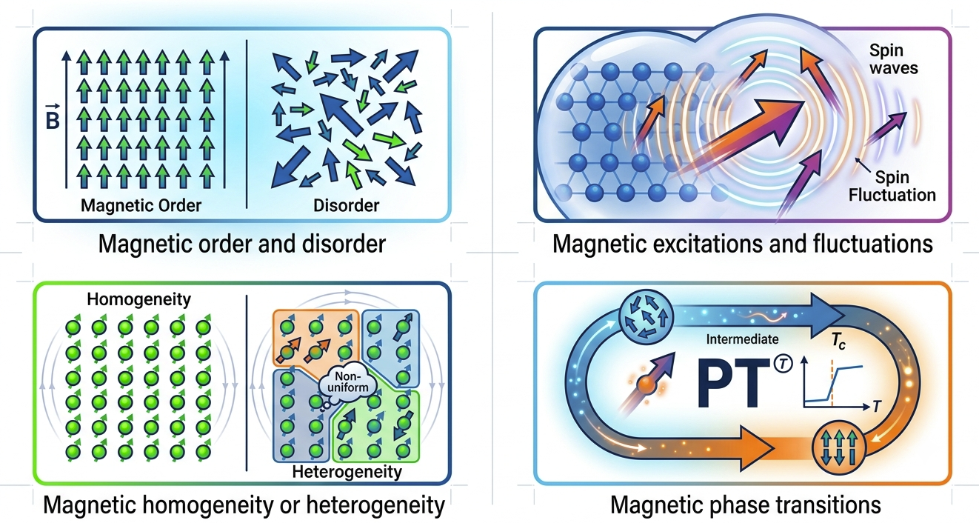
Neutron scattering and μSR: Essential and complementary tools in the quantum materials pipeline

Slide 3
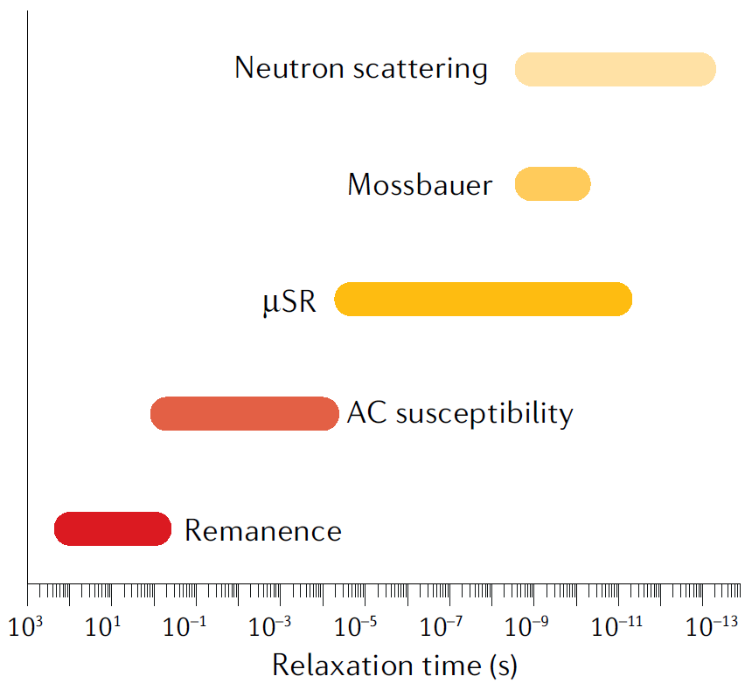
Muons and neutrons as complementary probes
Neutron Scattering | Muon spin spectroscopy
Reciprocal space, frequency domain | Real space, time domain
Excellent probe of long-range order, coherent excitations | Probes local magnetic field (sensitive to short-range order)
Sensitive to higher-energy, faster-timescale fluctuations | Sensitive to lower-energy, longer-timescale fluctuations
Typically requires moderate magnetic moment sizes (significant fraction of μ_{B}) | Can detect tiny magnetic moments
Volume-integrated probe | Volume-sensitive probe
Hillier et al., Nature Reviews Methods Primers, 2, 4 (2022)

Slide 4
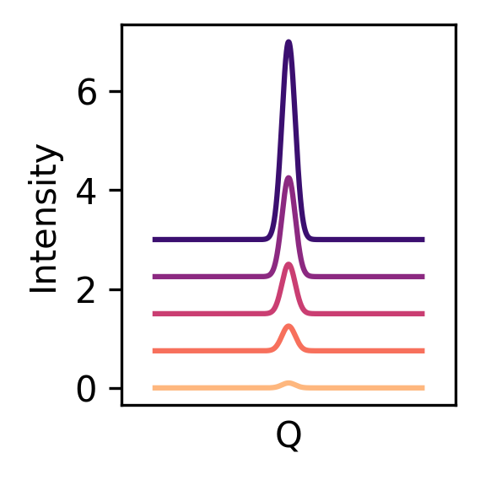
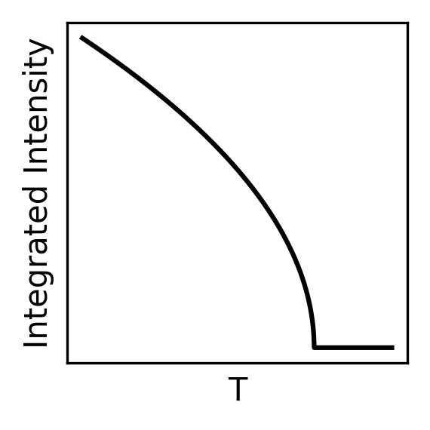
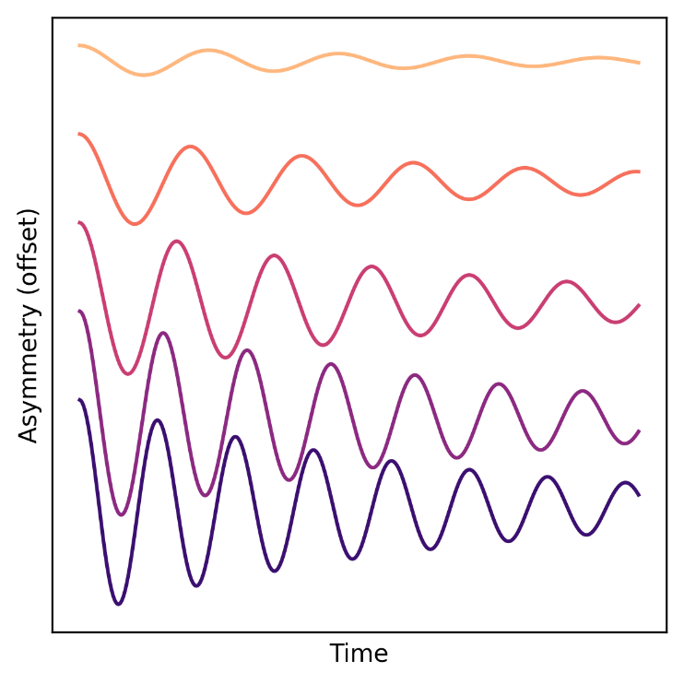

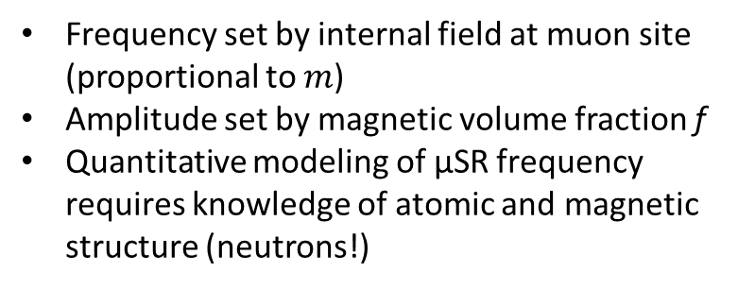
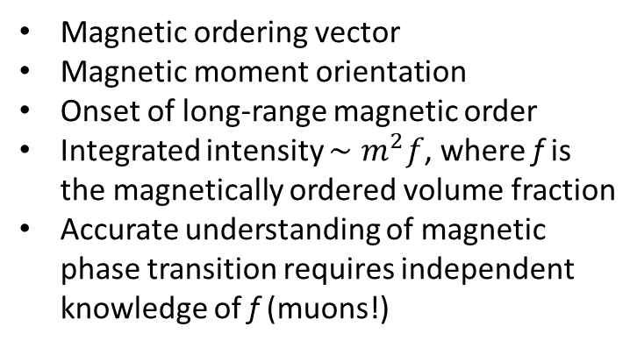
Example: Magnetic Bragg Peaks and ZF-μSR Oscillations
Neutron Diffraction
Zero-field μSR
Magnetic ordering vector
Magnetic moment orientation
Onset of long-range magnetic order
Integrated intensity $∼m^{2}f$, where f is the magnetically ordered volume fraction
Accurate understanding of magnetic phase transition requires independent knowledge of f (muons!)
Frequency set by internal field at muon site (proportional to $m$)
Amplitude set by magnetic volume fraction f
Quantitative modeling of μSR frequency requires knowledge of atomic and magnetic structure (neutrons!)

Slide 5

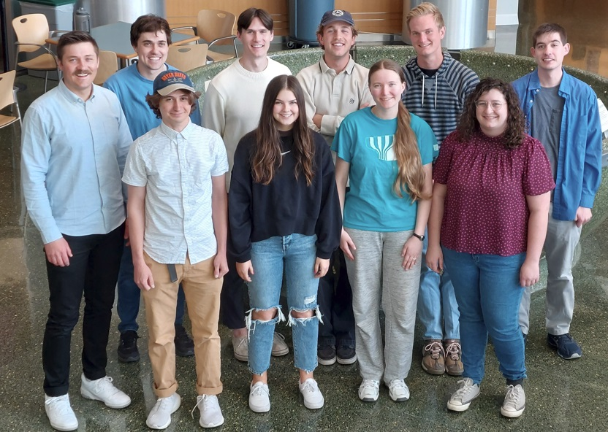


First Use Case: Altermagnetic La₂O₃Mn₂Se₂
BYU team: Sabrina Hatt, Camille Shaw, Emma Zappala, Jacob Osmun
NOMAD, ARCS
Funding: US Department of Energy
DE-SC0021134
Samples: Huiwen Ji, Chao-Chun Wei (U. Utah)
Facility scientists: Gerald Morris (TRIUMF), Garrett Granroth (ORNL)
Broader collaboration on La₂O₃Mn₂Se₂ and HEOs: Ken Burch, Benedetta Flebus, Raphael Hermann

Slide 6
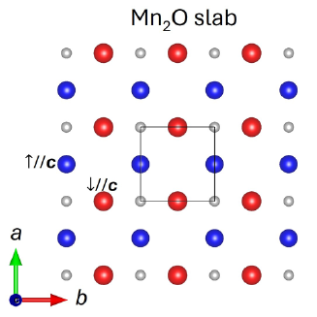
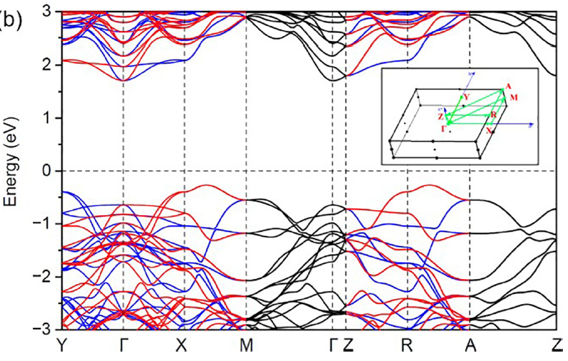
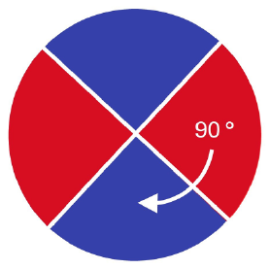
La₂O₃Mn₂Se₂: A simple toy model for altermagnetism
Up-spin and down-spin sublattices connected by rotation, not inversion or translation
AFM memory, ultrafast low-power switching, spin current
“Lieb” lattice
Spin-split bands even without spin-orbit coupling (“non-relativistic spin splitting”)
“d-wave” pattern of spin splitting
Wei et al., Phys. Rev. Mater. 9, 024402 (2025)

Slide 7
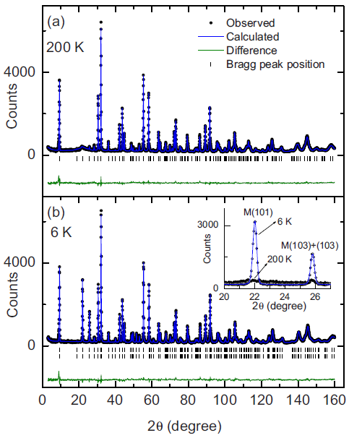
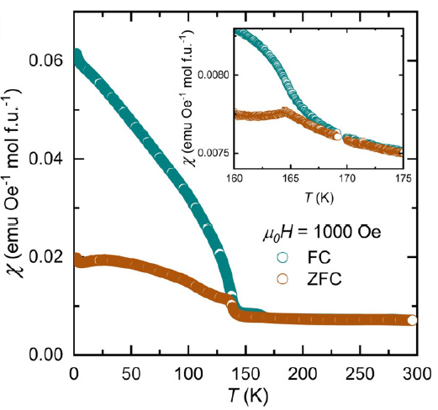
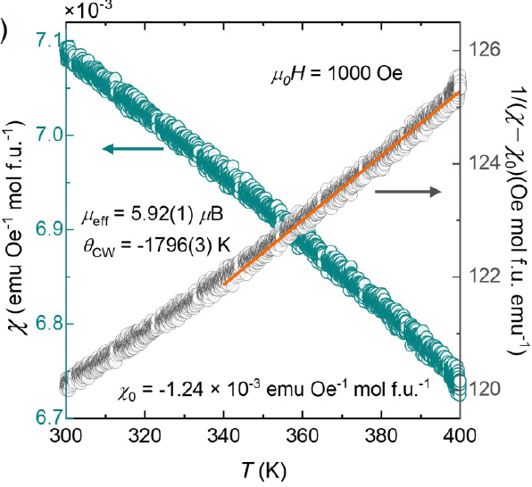
Magnetometry and neutron diffraction data
T_{N} ≈ 165 K
Curie-Weiss temp: −1796 K
(strong interactions!)
Ni et al., Phys. Rev. B 82, 214419 (2010)
Wei et al., Phys. Rev. Mater. 9, 024402 (2025)

Slide 8
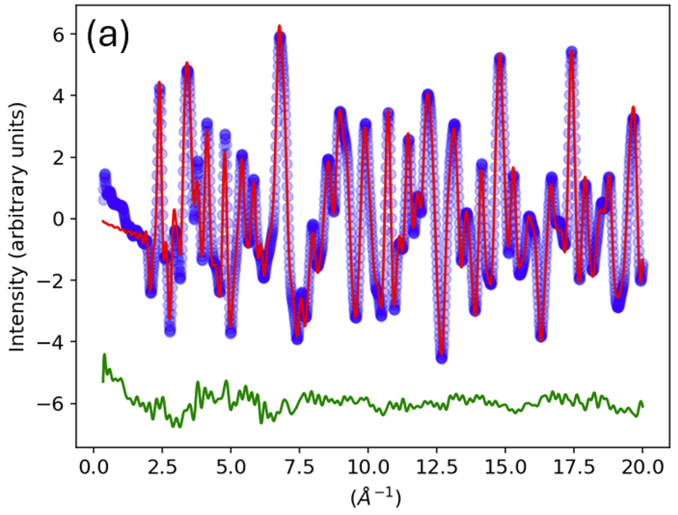
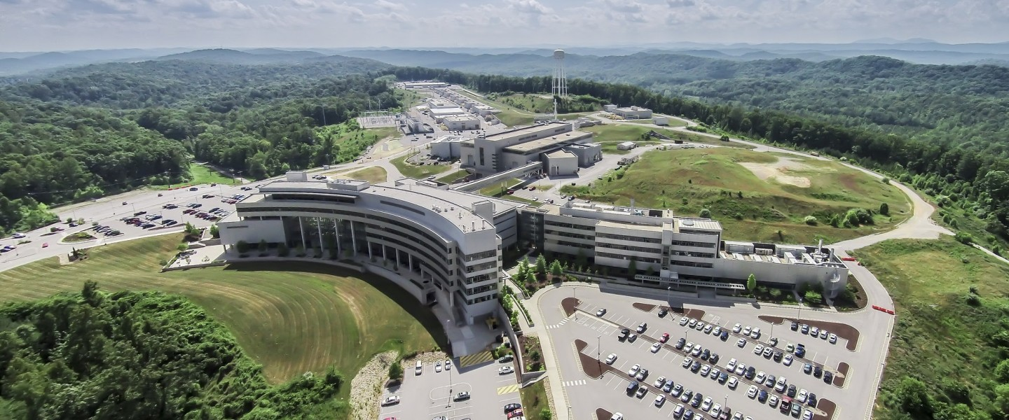
Neutron PDF data
Experiments at SNS/NOMAD
100 K, 200 K, 300 K, 400 K (T_{N} = 166 K)
Objective: Characterize any short-range magnetic order present in the system
100 K
Observed
Calc. (structure only)
PDF (Å⁻²)
r (Å)
Broad, systematic modulations in the fit residual are clear evidence for strong magnetic PDF signal
Wei et al., Phys. Rev. Mater. 9, 024402 (2025)

Slide 9
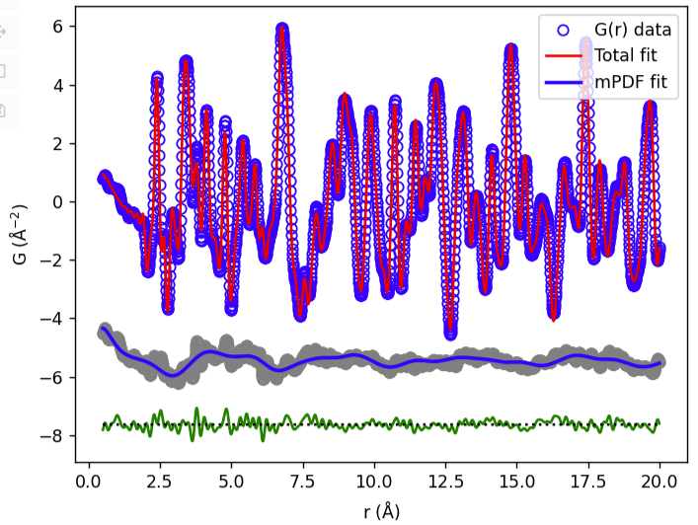
Magnetic PDF fits: 100 K
100 K
Good overall fit
Confirmed G-type AFM structure with spins oriented along c axis
Fit is significantly improved by also including 2D short-range AFM order within each plane
Isolated mPDF component
 | Ordered moment | Spin direction | Correlation length
3D long-range | ~3 μ_{B} | Along c | Infinite (LRO)
2D short-range | ~2 μ_{B} | Possibly canted up to 30° from c | ~13 Å (~3 lattice spacings)
Wei et al., Phys. Rev. Mater. 9, 024402 (2025)

Slide 10
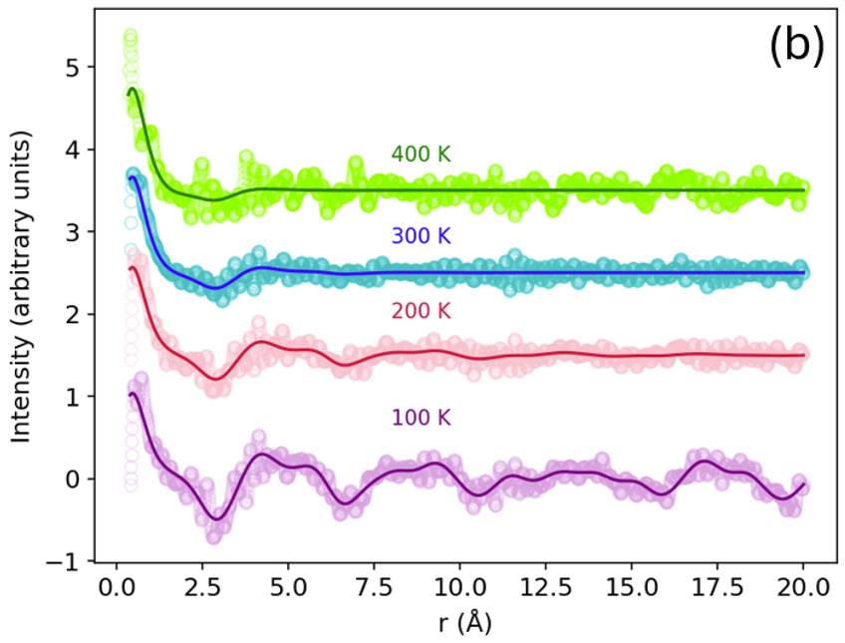




Magnetic PDF fits: Temperature dependence
Clear mPDF signal persists to at least 400 K—robust short-range magnetic order
Overall AFM-type structure is preserved within the layers
No inter-layer correlations above T_{N}
Correlation length and locally ordered moment decrease with increasing temperature
$$m_{SRO}∼1.2μ_{B}, { ξ}_{SRO}\sim 1.4 Å$$
$$m_{SRO}∼1.5μ_{B}, { ξ}_{SRO}\sim 2.5 Å$$
mPDF (Å⁻²)
$$m_{SRO}∼1.8μ_{B}, { ξ}_{SRO}\sim 7.1 Å$$
$$m_{LRO}∼3μ_{B}, { m}_{SRO}∼2μ_{B}, { ξ}_{SRO}\sim 13 Å$$
Wei et al., Phys. Rev. Mater. 9, 024402 (2025)

Slide 11
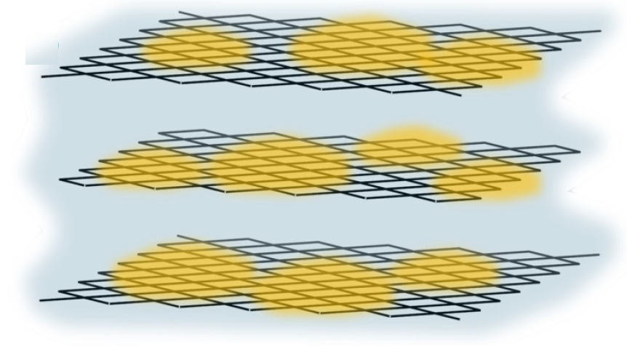
Magnetic PDF fits: Temperature dependence
Emerging picture: Puddles of intra-layer short-range order coexisting with long-range order down to 100 K and persisting into the paramagnetic phase up to quite high temperature.
$$m_{SRO}∼1.2μ_{B}, { ξ}_{SRO}\sim 1.4 Å$$
$$m_{SRO}∼1.5μ_{B}, { ξ}_{SRO}\sim 2.5 Å$$
mPDF (Å⁻²)
$$m_{SRO}∼1.8μ_{B}, { ξ}_{SRO}\sim 7.1 Å$$
$$m_{LRO}∼3μ_{B}, { m}_{SRO}∼2μ_{B}, { ξ}_{SRO}\sim 13 Å$$
Wei et al., Phys. Rev. Mater. 9, 024402 (2025)

Slide 12
Digging deeper with muon spin relaxation
Magnetic PDF shows widespread magnetic short-range order
  Static or dynamic? (Our energy-integrated neutron measurements yield only the instantaneous spin correlations)
  Everywhere throughout the sample or localized into spatially segregated regions?
Muon spin relaxation (μSR) is the perfect tool to answer these questions!
Why does this matter? Possibility of altermagnetic behavior even above the long-range ordering temperature!

Slide 13
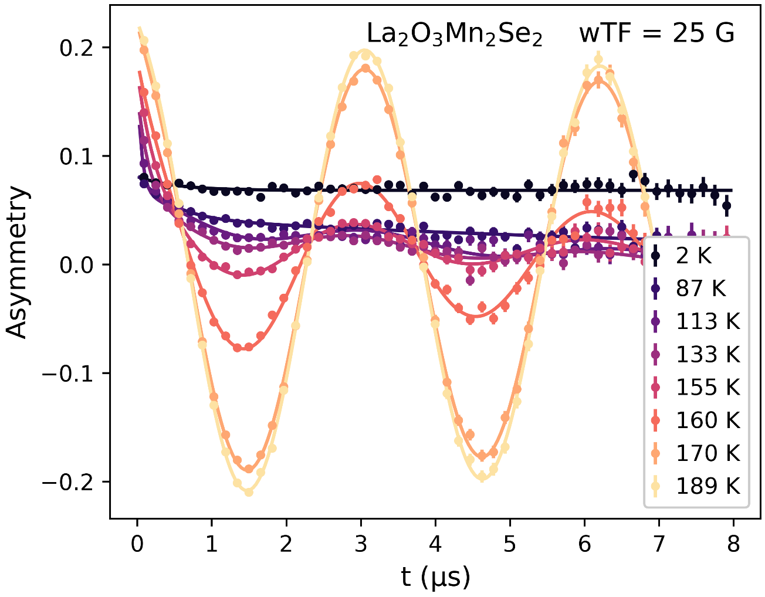
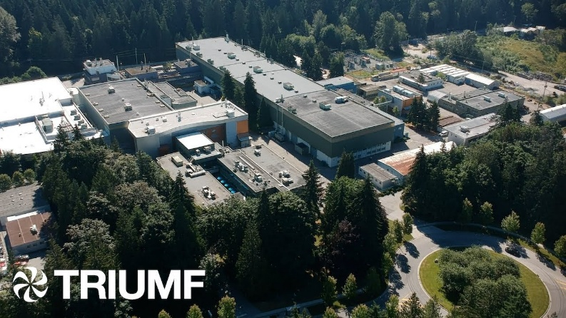
Static magnetic volume fraction
Applying a weak magnetic field transverse to the initial muon spin direction allows straightforward measurement of static magnetic volume fraction.
Oscillating amplitude proportional to sample volume lacking any static magnetism

Slide 14

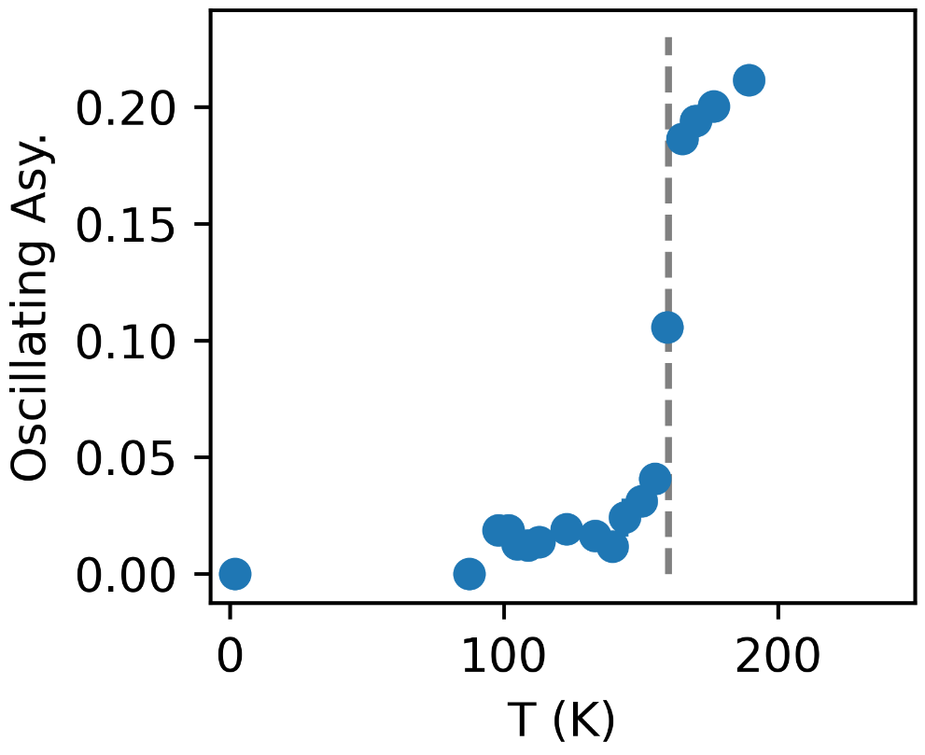
Static magnetic volume fraction
Applying a weak magnetic field transverse to the initial muon spin direction allows straightforward measurement of static magnetic volume fraction.
Growth of quasi-static SRO throughout sample volume
Partial volume fraction excluded from static LRO
Relates nicely to 2D SRO detected by magnetic PDF

Slide 15
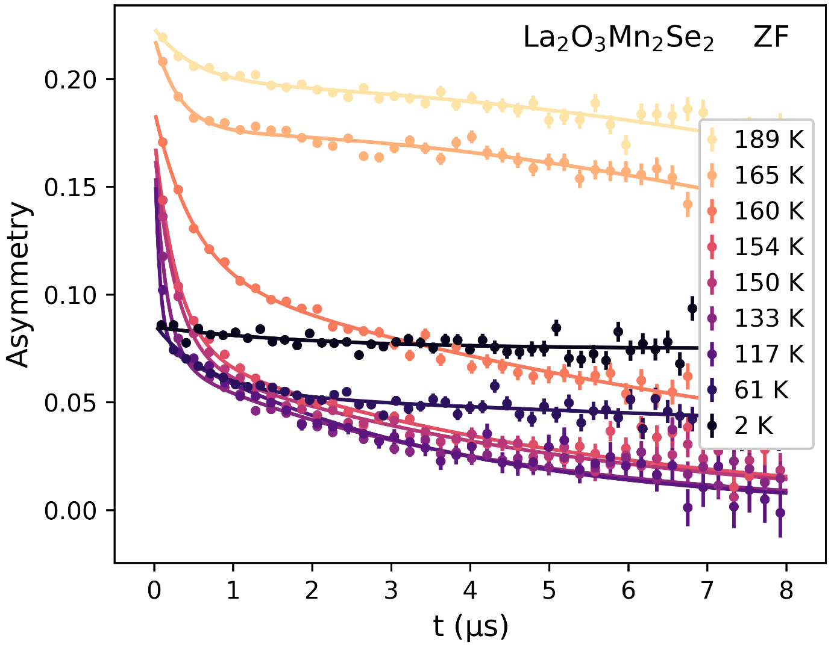
Internal field from static magnetic order
Measurements made in zero applied field probe the intrinsic magnetic field distribution in the sample.
Development of large, static internal field causes rapid muon depolarization

Slide 16
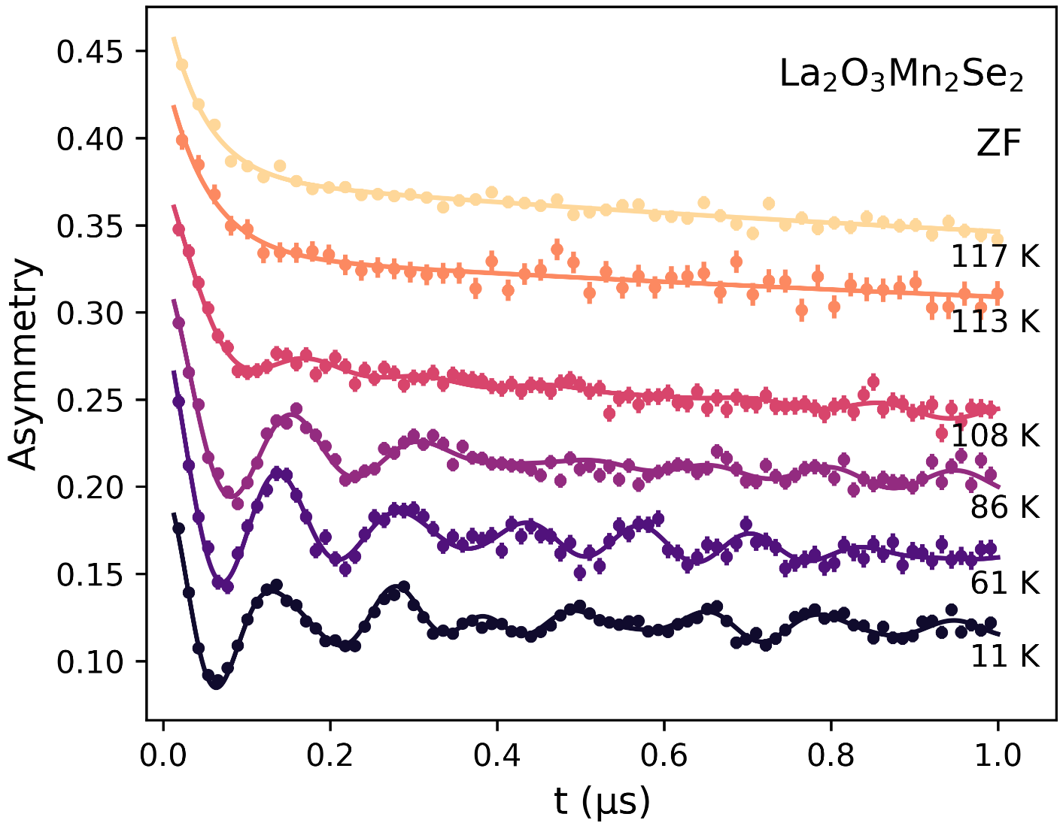

Internal field from static magnetic order
Coherent oscillations imply narrow distribution of field magnitudes at the muon stopping sites, i.e. a highly uniform magnetic state.
Loss of oscillations above ~110 K!

Slide 17
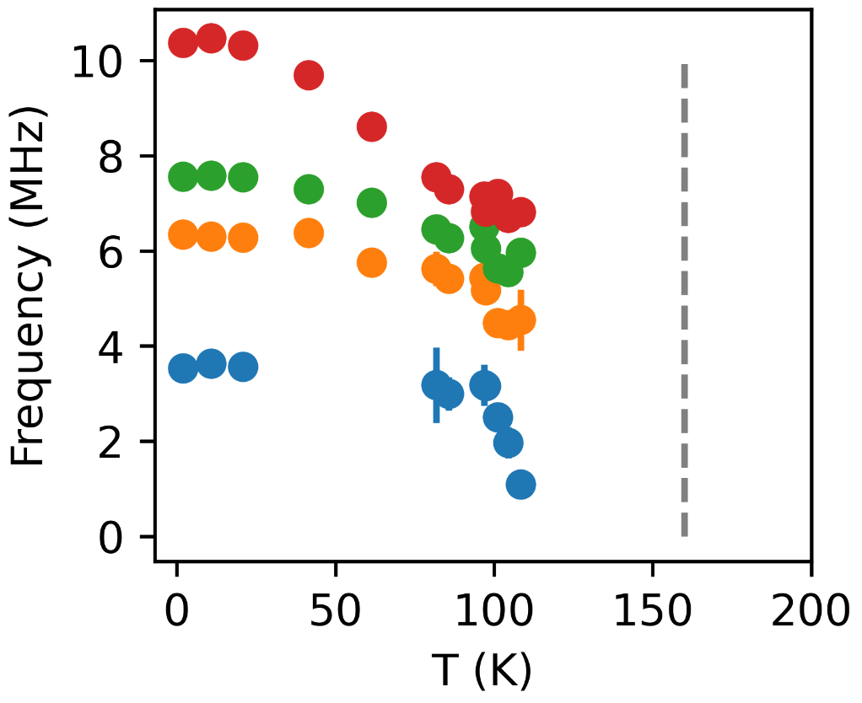
Internal field from static magnetic order
Coherent oscillations imply narrow distribution of field magnitudes at the muon stopping sites, i.e. a highly uniform magnetic state, below 110 K.
Loss of oscillations above ~110 K!
Hidden transition around 110 K!

Slide 18













Putting it all together
Fluctuating, inhomogeneous puddles of intra-planar SRO with AFM character and distribution of fluctuation times (quasi-static to very rapid)
Temperature
166 K
G-type LRO locks in through majority sample volume, volumetrically coexisting with strongly fluctuating 2D SRO
110 K
Static order(s) in full sample volume with gapped magnon mode
?
Wei et al., Phys. Rev. Mater. 9, 024402 (2025)
Singh et al., under review at Nature Materials

Slide 19
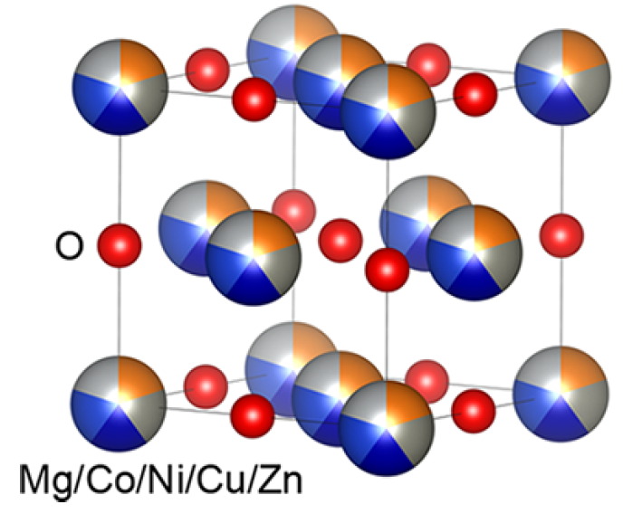
Second Use Case: Antiferromagnetism in HEOs
High-entropy oxides: 5 or more cation species mixed approximately uniformly across equivalent crystallographic sites
Excellent mechanical, optical, electric, and thermodynamic properties
Vast material parameter space, exceptional tunability
Intriguing interplay between local and average order and disorder
Magnetism has recently come into focus—how does magnetism behave in environments with such extreme disorder?
Zhang et al., Chem. Mater. 31, 3705 (2019)

Slide 20
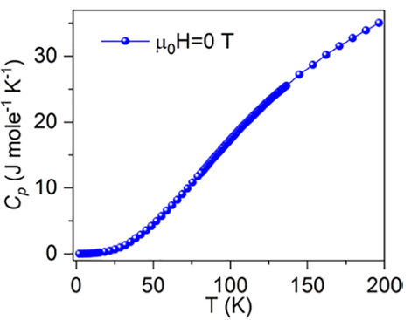
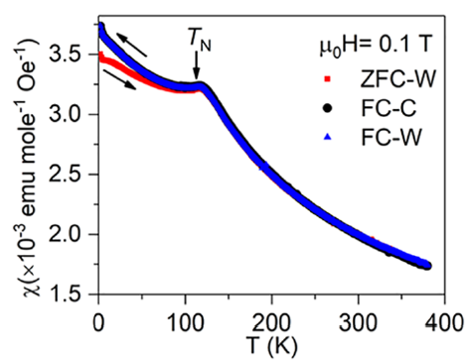
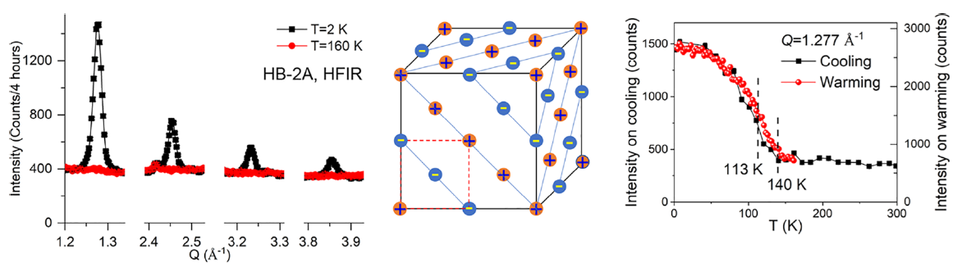
Some magnetic puzzles in MgO-HEO
No magnetic order??
Magnetic order below 113 K??
Magnetic order below 140 K??
Zhang et al., Chem. Mater. 31, 3705 (2019)

Slide 21
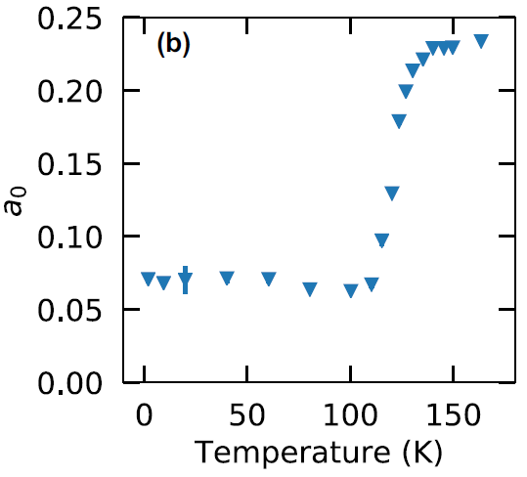
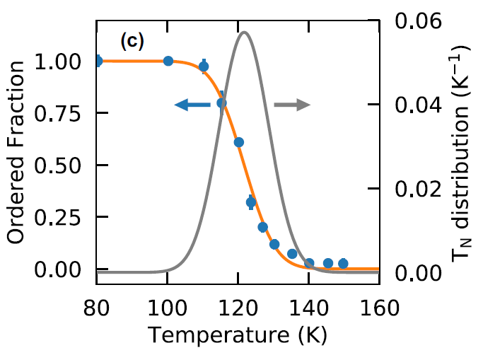
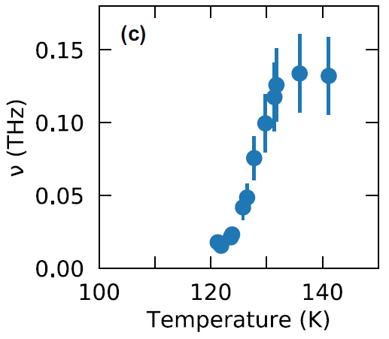
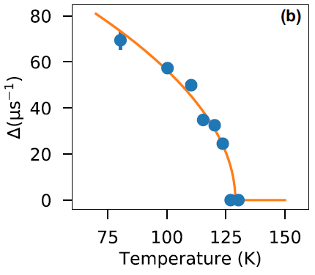
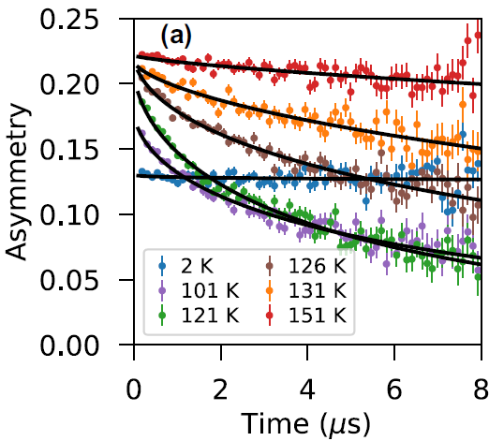
Answers from μSR
Gaussian distribution of Neel temperatures throughout the sample volume, centered on 121 K with FWHM of 17 K
Fully reconciles neutron, magnetometry, and heat capacity data
Character of the transition is nearly continuous
Insights into fundamental physics of magnetic phase transitions in extreme disorder
Frandsen et al., Phys. Rev. Mater. 4, 074405 (2020)

Slide 22
Summary and Conclusion
Neutron scattering and muon spin spectroscopy are ideal complements for studying quantum materials
Combined neutron and muon data provides much more complete picture of magnetic states and transitions
Altermagnetic La₂O₃Mn₂Se₂:
  Heterogeneous coexistence of quasi-static 2D short-range order and 3D long-range order in wide temperature range
  Hidden transition at 113 K
MgO-HEO
  Homogeneous magnetic ground state through full sample volume
  Broad, volume-wise transition over extended temperature range
  Critical spin dynamics in vicinity of transition
Wei et al., Phys. Rev. Mater. 9, 024402 (2025)
Singh et al., under review at Nature Materials
Frandsen et al., Phys. Rev. Mater. 4, 074405 (2020)
Wang et al., under review at Science Advances

