Slide 1
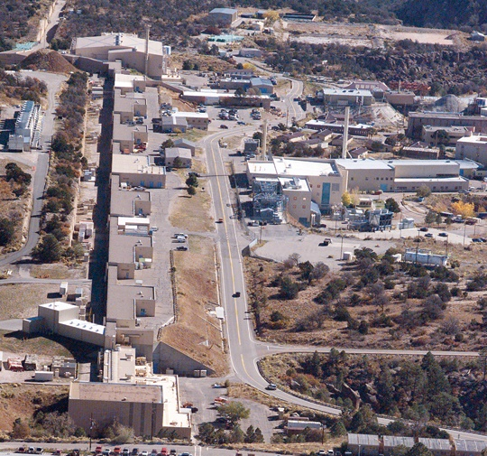
LANSCE is a 800-MeV linear accelerator sending two beams (H⁺ and H⁻) simultaneously to six areas
Isotope Production Facility (IPF)
Medical and other isotopes for the isotope program
Short-lived isotopes for defense programs, non-/counterproliferation, and criticality safety
Proton Radiography (pRad Facility)
Dynamic radiography for defense programs and counterproliferation
Ultra-Cold Neutron Facility (UCN)
Unique probe for nuclear physics, possible future defense program uses
Lujan Neutron Scattering Center (Lujan Center)
Neutron scattering and imaging for defense programs and nuclear energy
Nuclear physics for defense programs
Weapons Neutron Research Facility (WNR)
Nuclear physics for defense programs, counterproliferation, and criticality safety
Electronics testing for industry and global security
Area A
Future experimental possibilities
UCN
Lujan Center
Area A
pRad
WNR
Accelerator
IPF
NNSA work
Other work
Operations began in 1972 as the Los Alamos Meson Physics Facility (LAMPF) for a twenty-year basic nuclear physics program
In the 1990s, the facility was renamed the Los Alamos Neutron Science Center and repurposed as a user facility for stockpile stewardship
  100-800 MeV proton energies
  six target stations (three neutron spallation targets)
  sixteen beam lines
Notes:
Because of its flexibility, LANSCE has several user end stations that it supports:
IPF, Isotope Production Facility. Protons are peeled off at 100 MeV.
pRad and UCN are fed by protons from the main beam at 800 MeV.
H minus goes left to feed the Lujan Center and WNR.
Describe IPF
Describe pRad
Describe UCN
Describe Lujan
Describe WNR
Area A was the main experimental area when this machine first came online. Since then, those experiments have been decommissioned and beam is not currently provided to Area A. It is being cleaned out in anticipation of future use.

Slide 2
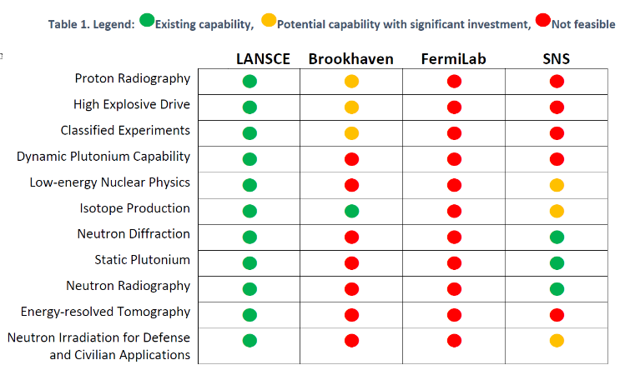
LANSCE accelerator has unique world-leading capabilities
CW
pRad
UCN
H⁺
IPF
100 MeV
DTL
Beam Structure
CCL
201
805
H⁺
H⁻
To Area A
8.3 – 16.7 ms
800 MeV
1mA
H⁻
Intensity
CW
PSR
Time
Lujan Center
…
WNR
290 ns
625 µs
Notes:
Only accelerator that accelerates both H+/H-
Different pulse structures for different end stations
Here we show the accelerator schematically to show how things are interconnected:
We have both H minus and H plus ion sources. These feed particles into the two Cockcroft Walton DC accelerators, who accelerator the two beams to 750 keV.
The injector beams are merged with some magnetic optics before being injected into the DTL.
After the DTL, we have another transition region before the CCL, after which particles are accelerated to their final energy of 800 MeV.
Various beamlines direct beam to the different user end stations.
We also outline the pulse structure, but maybe don’t need to go into details unless asked.
LANSCE has a complicated pulse structure:
Beam consists of a series of beam bursts, or macro pulses, each one lasting 625 microseconds.
Within each macro pulse is a finer structure of pulses, or micro pulses, each lasting about 290 ns, 360 ns period.
The macro pulse pattern can be repeated at a rate of up to 120 Hz. This results in an average current of about 1 mA at full beam power.
Most pulses consist of both H minus and H plus ions interleaved within the macro pulse.
Once they reach full energy, the differently charged ions are bent in different directions toward their ultimate end station.
Every sixth pulse consists of only H minus. These are destined for the PSR, and eventual the Lujan spallation neutron source.
Note that this is a nominal pulse structure. The accelerator can be configured to provide many other variations on this theme for specific purposes, but this could result in some disruption to the main user end stations.

Slide 3
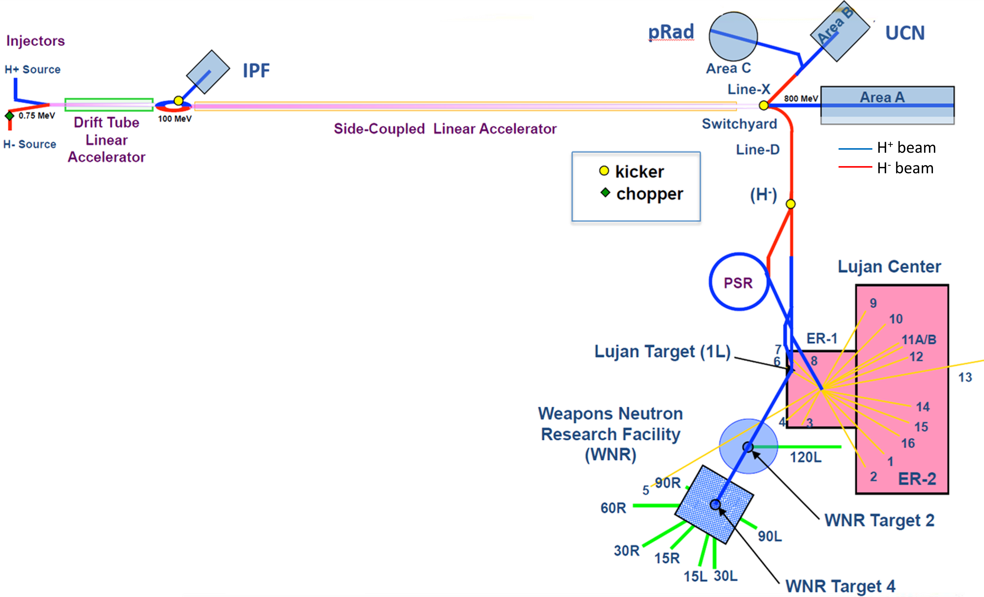
LANSCE Beam Delivery
To Proton Radiography
12-mA macropulse current
Up to 625-μs macropulse duration
96-ns beam “frames” w/ variable spacing
“On-Demand” macropulses
To Isotope Production
250-μA average current
100-MeV H⁺ beam
100 pulses / sec
To Ultracold Neutron
10-μA average current
625-μs macropulse duration
9 – 11 macropulses @ 20 Hz
every 5 seconds
Concurrent operation – beam delivered to all user stations
at effectively the same time.
To Lujan Center target
100-μA average current
20-Hz repetition rate
To WNR Target 4
4-μA average current
1.8-μs pulse spacing
625-μs macropulse
100 pulses / sec
Notes:
Order based on average rep rate of the linac provided to that user station.

Slide 4
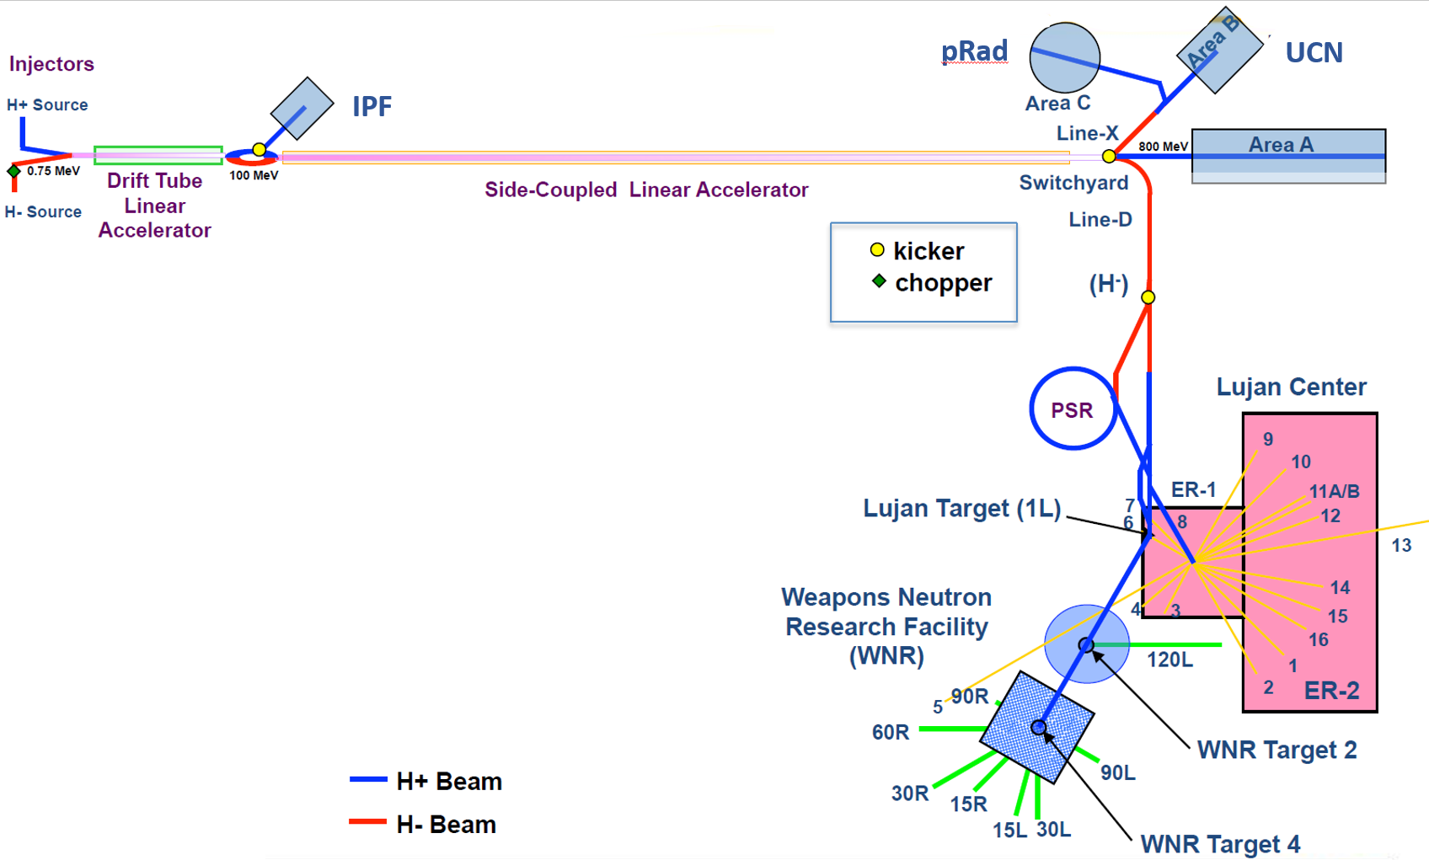
LANSCE Accelerator Modernization Project Scope
H+ beam
H- beam
LANSCE Front-End
(Scope of LAMP)
LANSCE has delivered high intensity proton beams since 1972
Many of the front-end components are original to the facility and are experiencing significant end of life issues
The purpose of LAMP is to address key critical vulnerabilities in the system that require a large major system project to fix

Slide 5
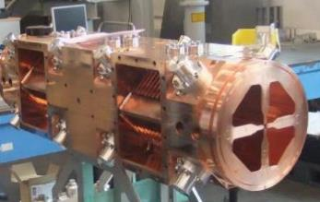
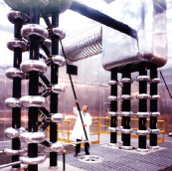
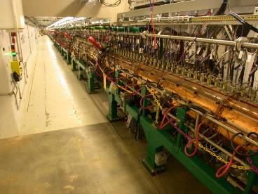
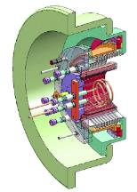
The project mandate is to keep the present machine capabilities with a modernized and more reliable front end
e.g. Radio Frequency Quadrupole (RFQ) 100 keV → 3 MeV
H+
Existing Cockcroft-Waltons
35 keV → 750 keV
2 x (10 m x 15 m x 10 m)
e.g. Modern drift tube linac
(SNS @ ORNL)
e.g. SNS H⁻ ion source
High reliability and uptime High beam current
~ 250 mm Φ
H-
Notes:
2x species RFQ
Choppers
2X species MEBT

