Slide 1
Neutron Scattering Sample Environments
Presented at the
“The Neutron Lifecycle” Lecture Series
Gary W. Lynn
Group Leader for Sample Environment
June 30, 2016

Slide 2
What is Sample Environment?
Sample Environment is an integral part of the neutron scattering experiment where neutrons are used as an investigative probe
Neutron Properties:
  Neutrons have no electric charge: can penetrate into materials to be scattered by the nucleus
  Neutrons have a magnetic moment and therefore are sensitive to the magnetic field of the atoms
  Neutrons have an intrinsic energy that makes them sensitive to inter-atomic vibrations
  Scattering and absorption cross-sections depend on the isotope: isotope labelling and contrast variation take advantage of the scattering differences between Hydrogen and Deuterium

Slide 3
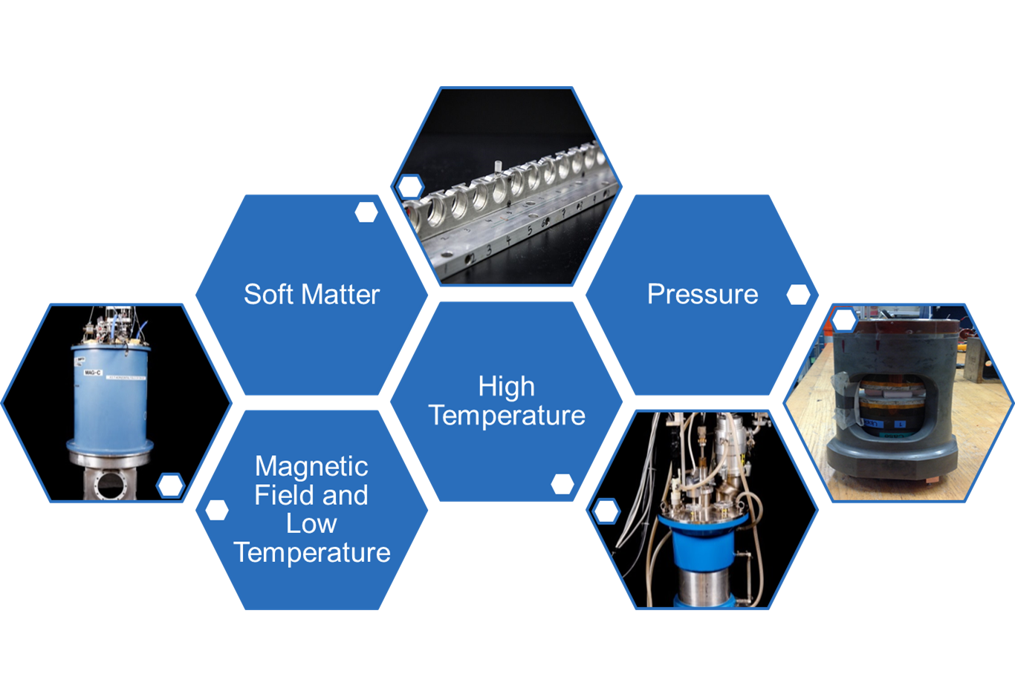
What is Sample Environment?
Sample Environment equipment is used to precisely and accurately control experimental parameters such as temperature, pressure and magnetic fields

Slide 4
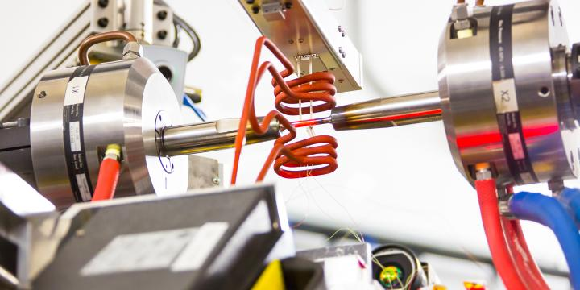

Neutrons Reveal Structure of Nickel-Based Superalloys Under High Temperature and Stress
VULCAN instrument
Nickel-based superalloys used in gas turbines
Work by Yan Gao and Shenyan Huang of GE Global Research
Combines microstructure measurements with mechanical testing
http://neutrons.ornl.gov/news/superalloys-under-high-temperature-and-high-stress
Ke An

Slide 5
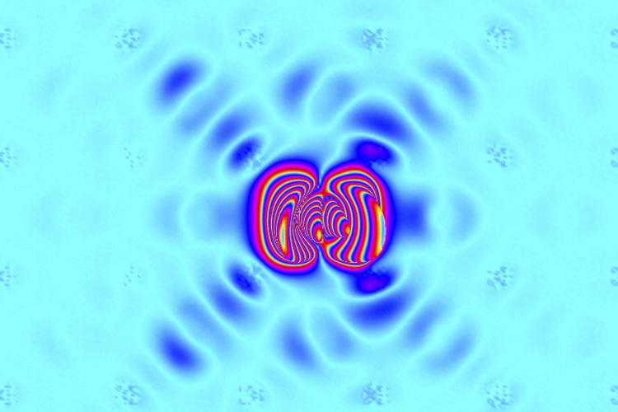




Neutrons Probe Atomic Vibrations in Tin Selenide
CNCS, CTAX and TAX instruments
Explains the low thermal conductivity of tin selenide
Efficient thermoelectric material (convert thermal gradients to electricity)
Used in space batteries
http://neutrons.ornl.gov/node/6667
Olivier Delaire
Tao Hong
Georg Ehlers
Songxue Chi

Slide 6
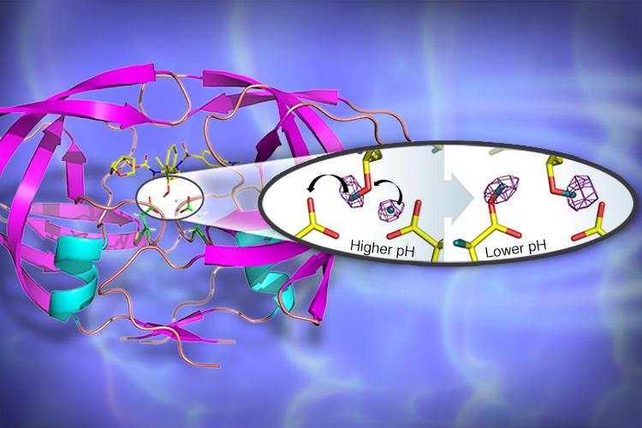
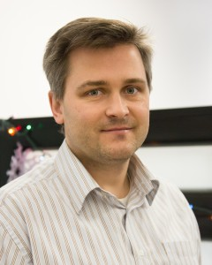

Neutrons Reveal Structure of the Enzyme HIV-1 Protease
IMAGINE instrument
HIV-1 Protease is a key drug target for HIV and AIDS therapies
Deuterium labeling used to focus in on hydrogen-bonding sites related to drug binding
http://neutrons.ornl.gov/node/13745
Andrey Kovalevsky
Kevin Weiss

Slide 7
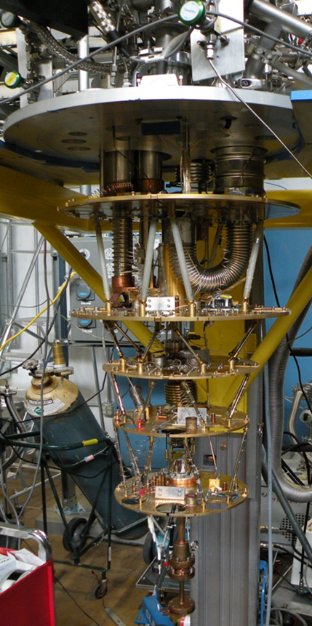
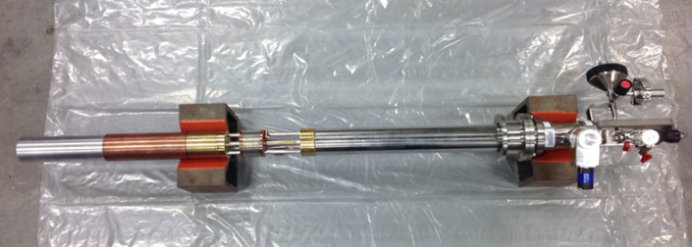
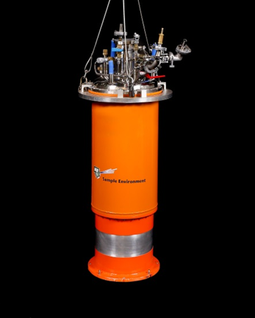
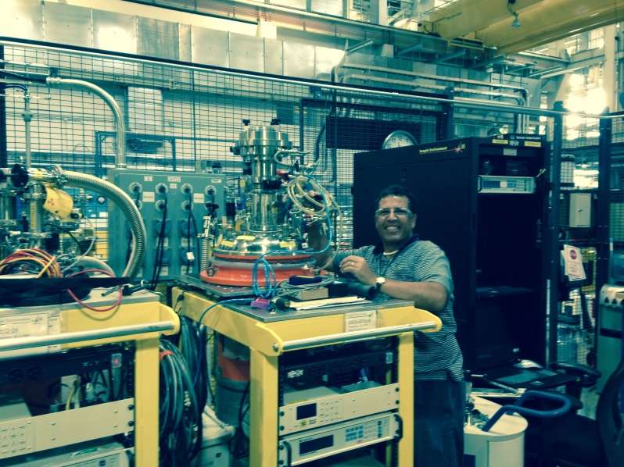
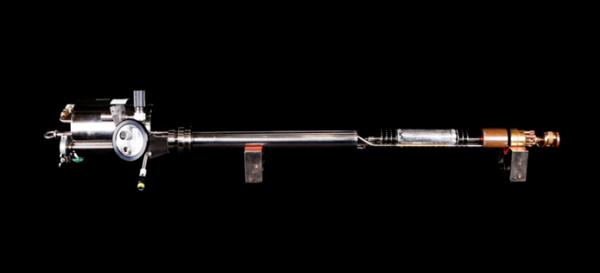
Low Temperature
Low Temperature Equipment:
Closed cycle refrigerators 4 K - 300 K
Liquid Helium Cryostats 1.5 K - 300 K
3He inserts 0.3 K - 300 K
Dilution refrigeration inserts 0.03 K - 300 K

Slide 8
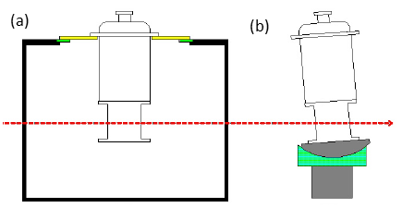
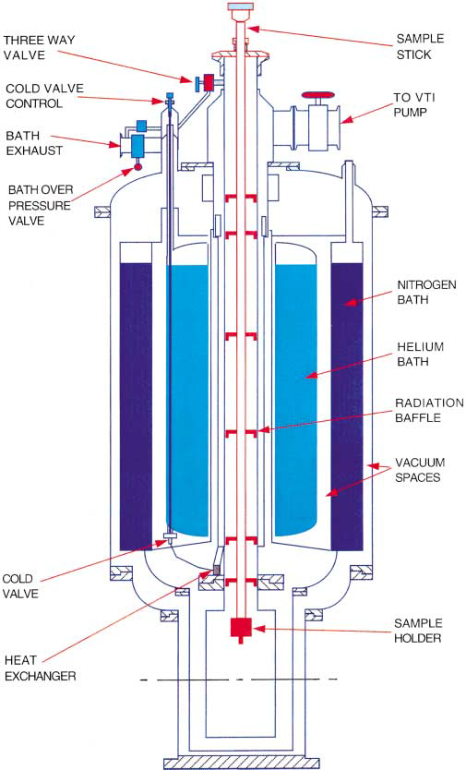
Low Temperature
Liquid Helium Cryostats
Temperature range 1.5 K - 300 K
Sample exposed to 10 mbar helium exchange gas inside IVC
Liquid helium exhausts through a heat exchanger integral to IVC
Exhausting cold helium gas flows around and cools IVC
Flange mount or tail mount
Flange diameter defines maximum diameter allowed (700 mm typical)
Outer Vacuum Chamber (tails) diameter 350 mm
Distance from stick flange to beam center 950 mm
Sample space diameter 43 mm

Slide 9
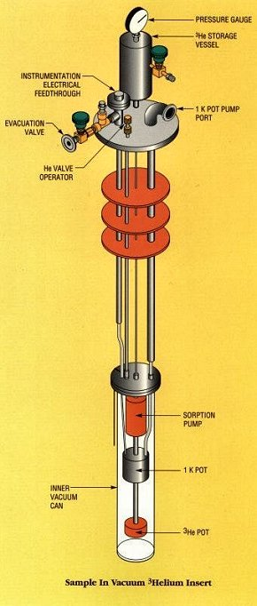
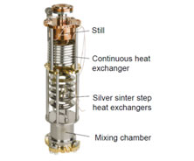
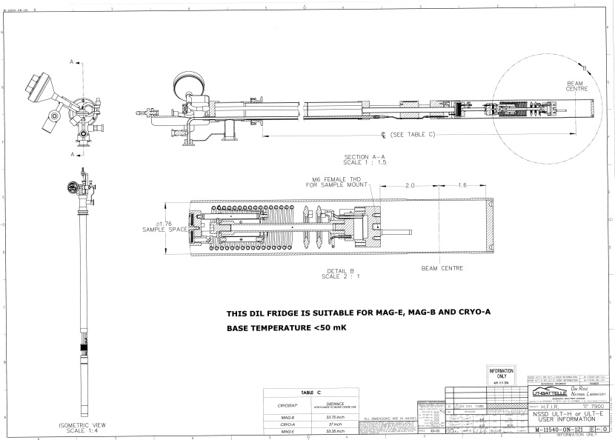
Low Temperature
3He Insert
Temperature range 0.3 K - 80 K (up to 300 K with VTI)
Achieve a base temperature less than 0.3 K for more than 40 hours
Maintain a base temperature less than 0.35 K for more than 6 hours with a 50 µW heat load
Temperature stability of ± 0.003 K below 1.2 K
Dilution Refrigeration Insert
Temperature range 0.03 K - 1.5 K (up to 300 K with VTI)
Cooling power at least 40 µW at 0.1 K

Slide 10
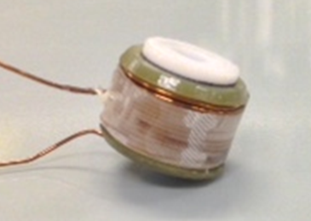
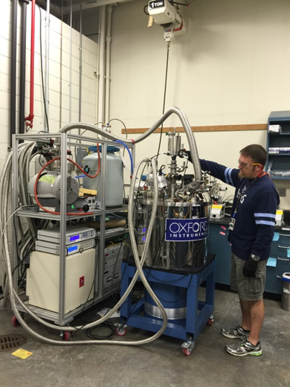
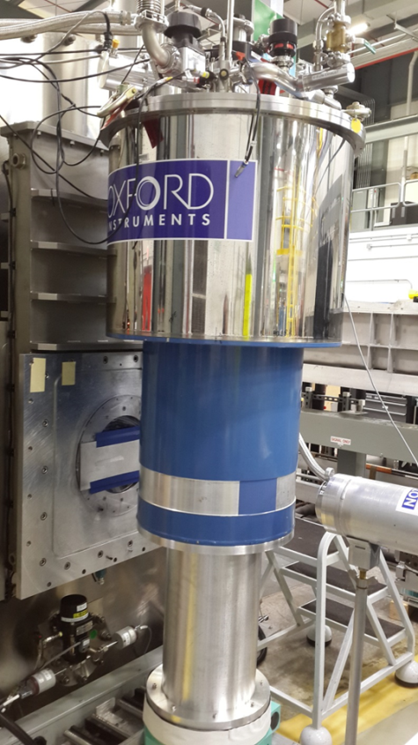
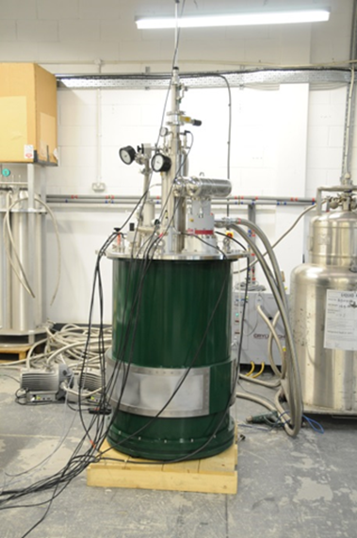
Magnets
Magnetic Field Equipment:
0.5-3 T electromagnet: specialized for Reflectometry or SANS
11 T superconducting cryomagnet, horizontal field
5-11 T superconducting cryomagnet, vertical field, symmetric or asymmetric
30 T pulsed magnet

Slide 11
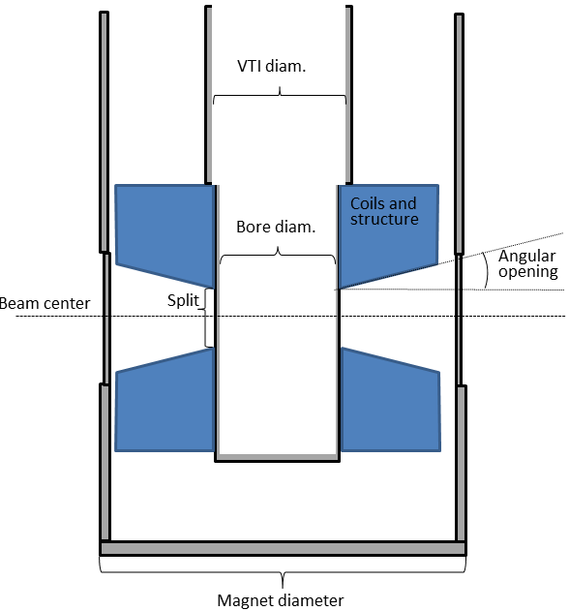
Magnets
Overall Physical Dimensions and Weight
Flange mount or tail mount
Flange diameter defines maximum diameter allowed (700 mm typical)
Define flange: bolt holes, vacuum boundary, etc.
Tail mount: distance from beam center to bottom of tail
Maximum overall height (2200 mm typical)
  Crane access: below the hook to mounting surface
  Movement around the facility: through doors, etc.
Total weight (including cryogens 450-680 kg) not to exceed crane capacity

Slide 12
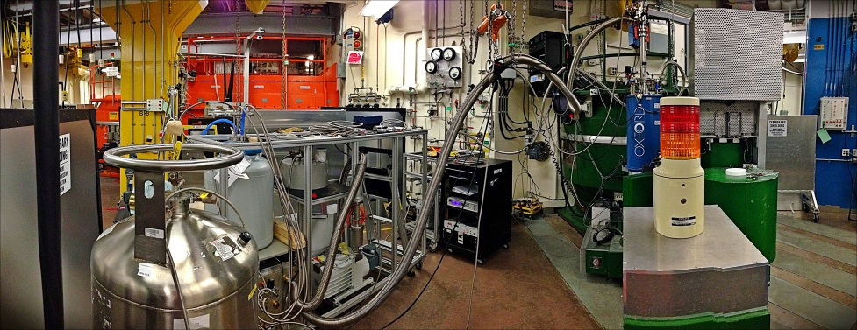
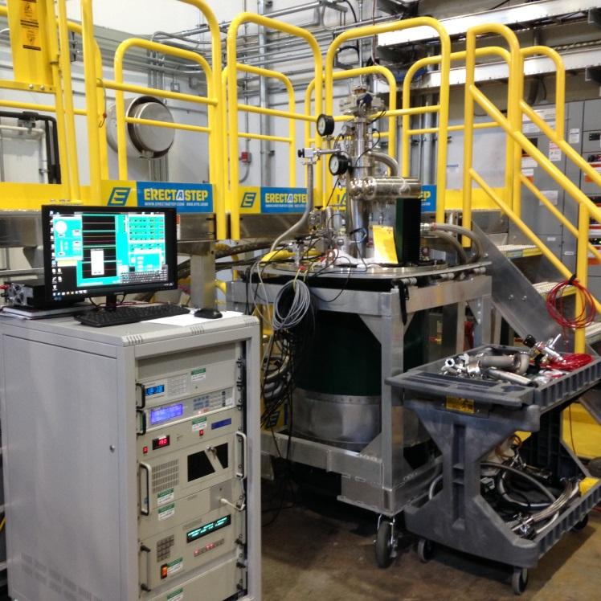
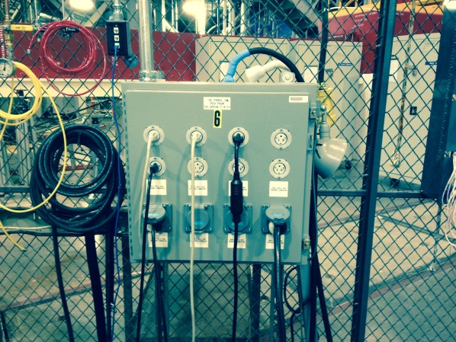
Magnets
Real Estate and Utilities
Ancillary equipment such as power supply, Helium re-condensing equipment, vacuum pumps, etc. can take up several square meters of space around the instrument
Routing of vacuum lines, power and signal cables can be a little tricky
Electrical power (U.S.):
  60 Hz at 110 V and 20 A for instrumentation
  60 Hz at 208 V and 30 A for power supply
  60 Hz at 480 V and 30 A for cold head compressor
Chilled water

Slide 13
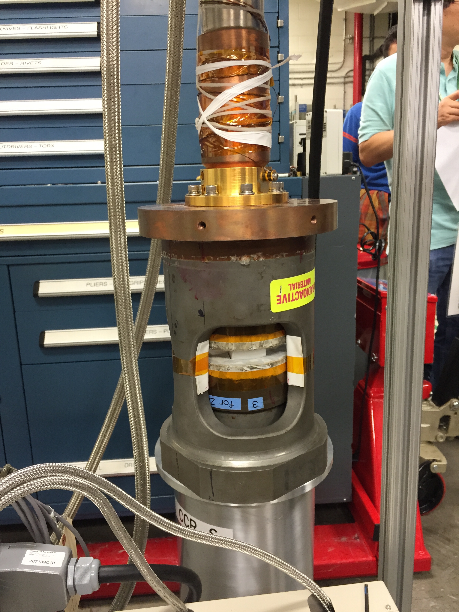
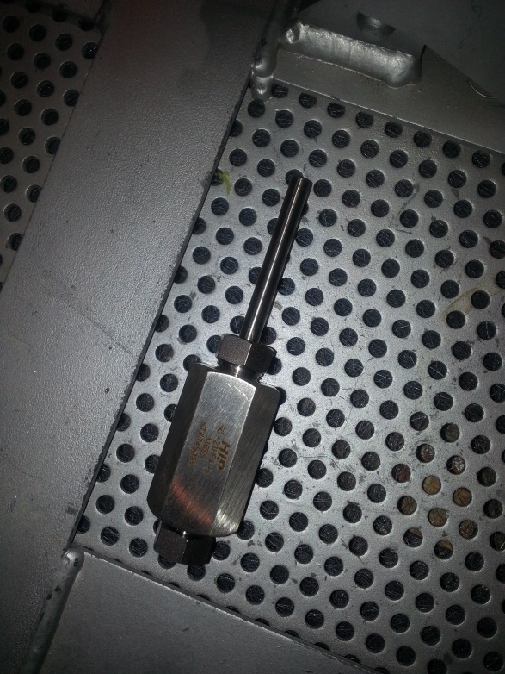
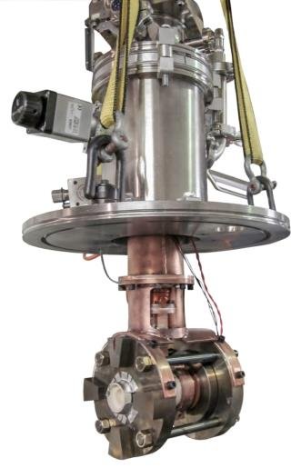
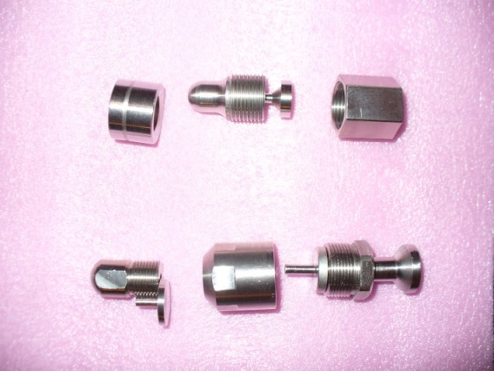
Pressure
Pressure Equipment:
400 - 1300 bar V and TiZr cells for diffraction
6 kbar and 1.5 - 300 K Helium gas cells
4 GPa and 3.5 K Palm Cubic Anvil
1 - 3 GPa and 0.3 - 1.5 K Clamp cells for inelastic
10 - 40 GPa and 15 - 300 K Diamond Anvil Cells for diffraction

Slide 14
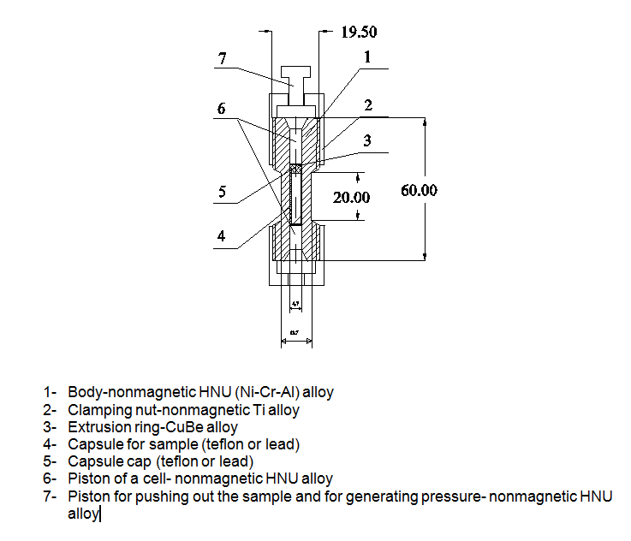
Pressure
Clamp Cell Design for Inelastic Scattering
500 mm³ sample volume for inelastic scattering
Fit in bore of magnet
Non-magnetic material
High thermal conductivity material to cool below 4 K
Cell components have similar coefficients of thermal expansion
Disadvantages: Peaks from the Material
Choices of Material for High Pressure Cells:
  NiCrAl yield strength 2 GPa
  CuBe yield strength 1.2 GPa
  CuTi yield strength 1.2 GPa
  Maraging Steel yield strength 0.8 GPa
  TiZr yield strength 0.7 GPa

Slide 15
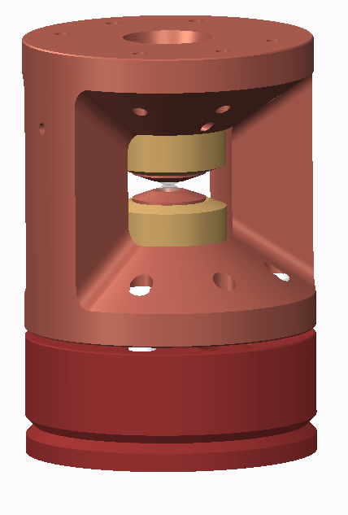
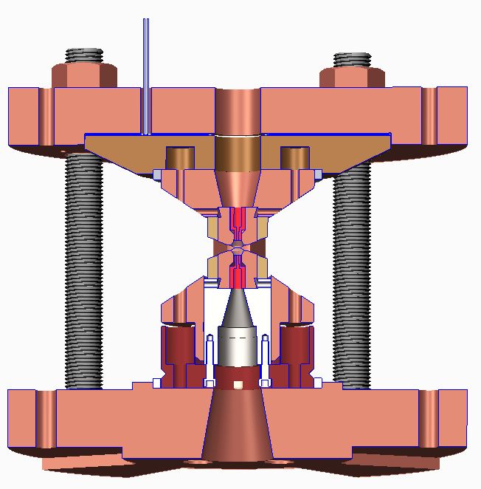
Pressure
Diamond Anvil Cell
Max recorded Pressure for Neutrons: 94GPa.
DAC can be made of Steel with Diamond anvils. For low temperatures, CuBe is used.
Sample volume is limiting, on the order of 0.7mm in diameter and .16mm in gasket thickness
Beamline Background reduction and collimation is of utmost importance for diamond anvil cell measurements.
7.5 cm
50 mm
15 cm
75 mm

Slide 16
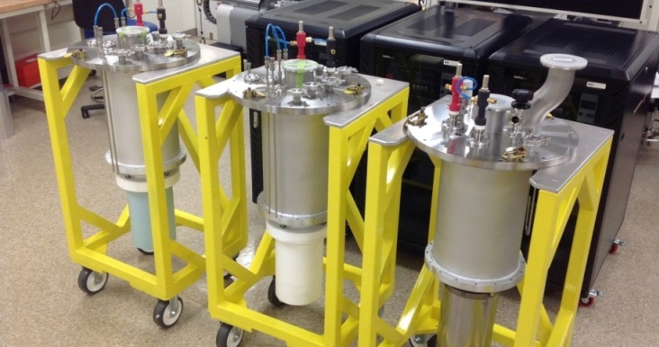
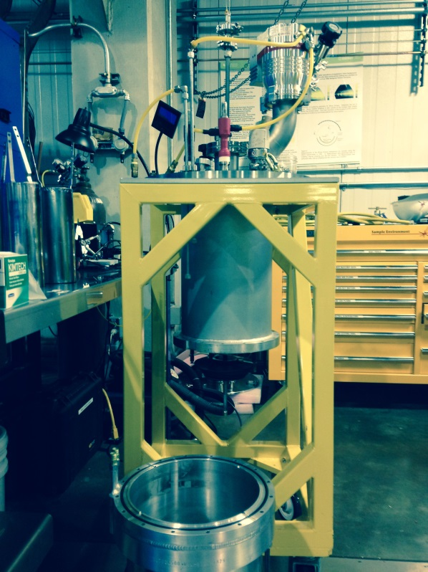
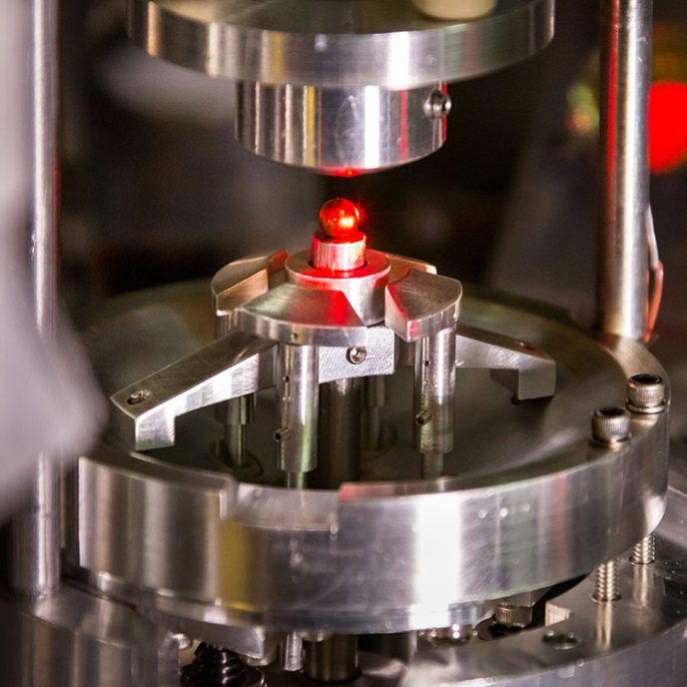
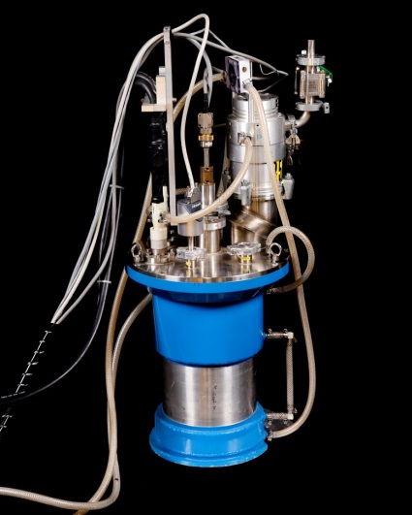
High Temperature
High Temperature Equipment:
1200 °C Vanadium ILL
1600 °C Niobium ILL
1200 °C or 1600 °C MICAS2
1500 °C Controlled Atmosphere
500 - 2000 °C Electrostatic Levitator

Slide 17
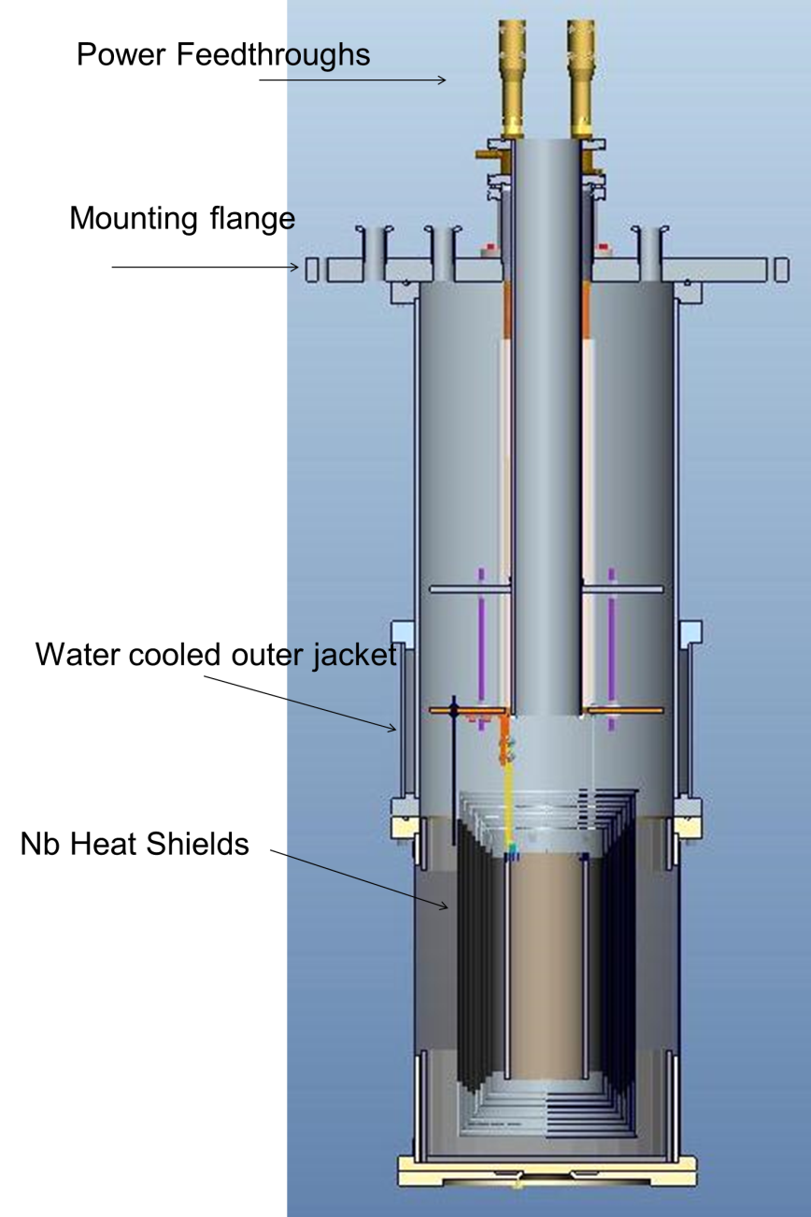
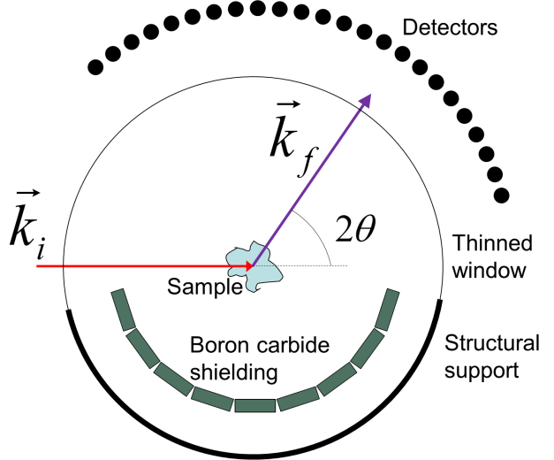
High Temperature
Radiative Heating Furnace
Customize Outer Vacuum Chamber for detector coverage
Minimize background using a thin (0.05 mm) Niobium window instead of Aluminum on Outer Vacuum Chamber
Use of Boron Carbide to prevent multiple scattering

Slide 18
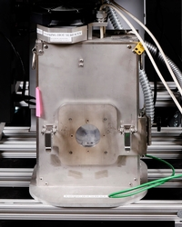
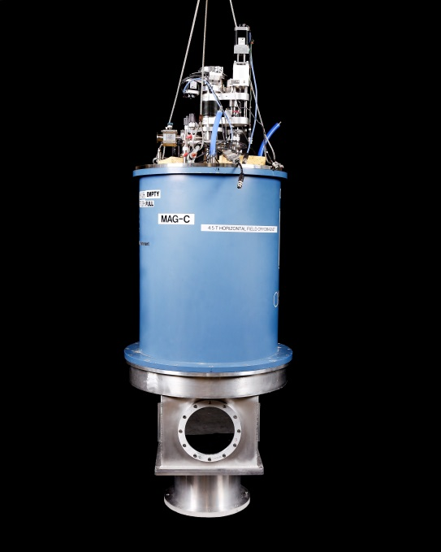
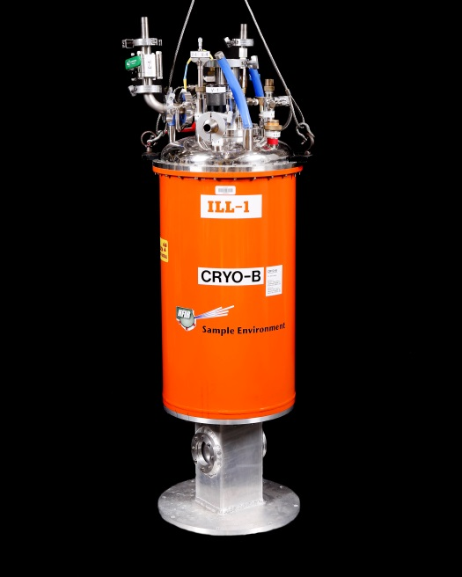
Soft Matter and Biological Materials
SANS Equipment:
30 °C - 800 °C tube furnace with quartz windows
4.5 T superconducting cryomagnet, horizontal field, silicon windows
Liquid Helium Cryostat 1.5 K - 300 K with sapphire windows, 200 bar pressure cell

Slide 19
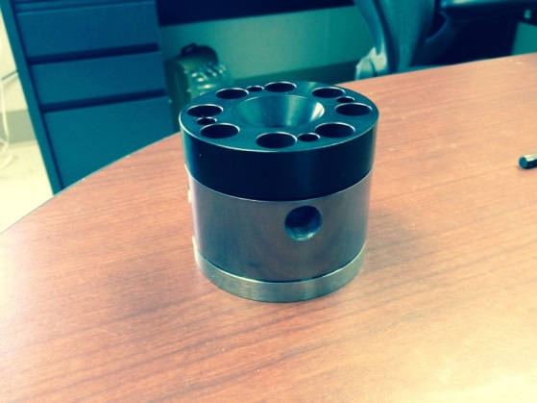
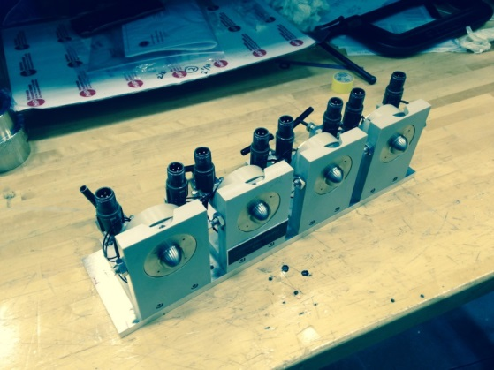
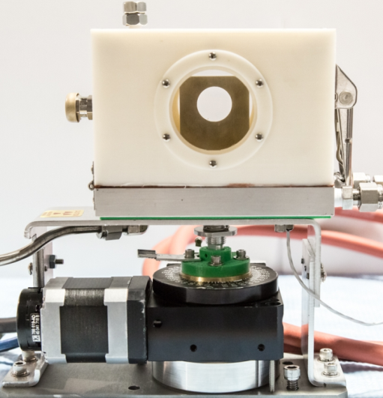
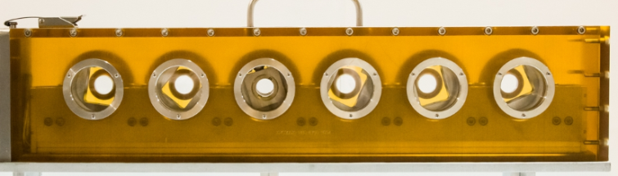
Soft Matter and Biological Materials
SANS Equipment:
1 kbar pressure cell, Tantalum lined
1 kbar 4-position pressure cells
Sample tumbler
Relative humidity controlled cell

Slide 20
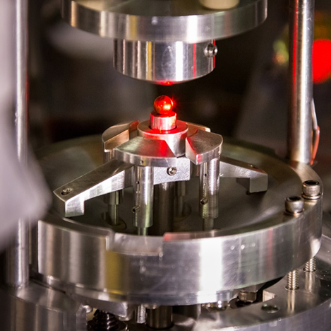
The Ability to Control Experimental Parameters Comes with a Cost
Avoid background issues: minimize amount of material in the incident and detected neutron beam paths
There are always trade-offs and compromises: the best material to achieve high pressures or temperatures may not be the most neutron friendly

