Slide 1
Management Overview and Responses to 2016 Recommendations
Presented to the SNS Accelerator Advisory Committee
Kevin Jones
Division Director RAD
March 8, 2017

Slide 2
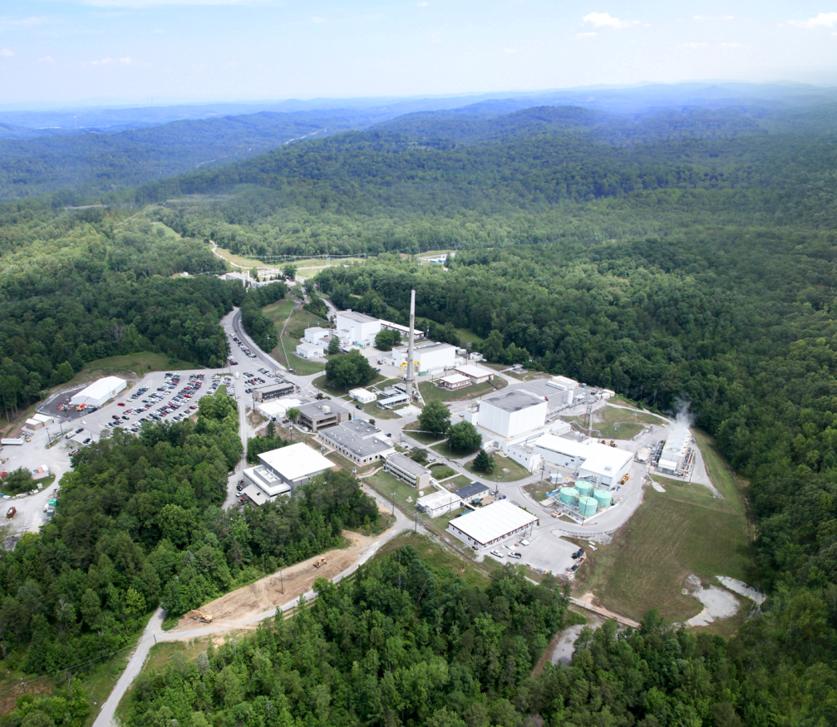
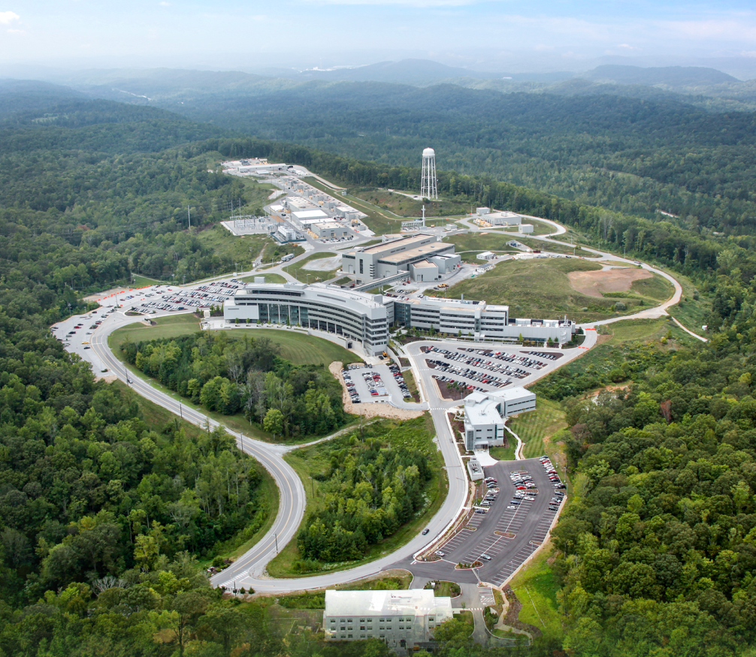
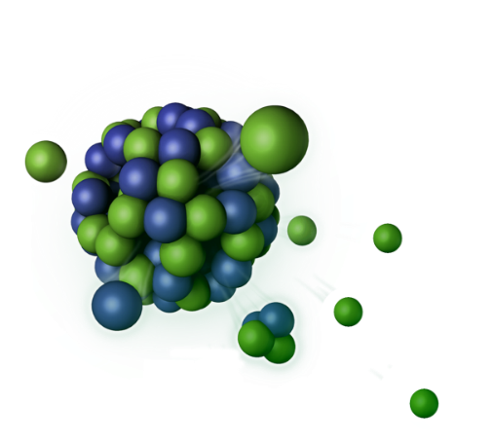
The Neutron Sciences Directorate (NScD) at Oak Ridge National Laboratory (ORNL) operates two advanced neutron scattering user facilities
Spallation Neutron Source (SNS) World’s most powerful beams of pulsed thermal neutrons with limited dynamic range
High Flux Isotope Reactor (HFIR) Intense steady-state neutron flux/high-brightness cold neutron source
Notes:
2

Slide 3
Our neutron scattering user facilities exceeded FY16 DOE performance objectives
HFIR: Operating at 85 MW
Operated | 12 beam lines
Completed | 51 years of operation Rebuilding of cooling towers and control rod drives Construction of new safety plates Fuel supply/inventory stabilization Additional missions of isotope production and materials irradiation and activation
SNS: Operating at 1.0 – 1.2 MW
Operated | 19 beam lines 2 targets
Completed | 10 years of operation Activities to increase beam power operating margin Activities that will lead to improved and increased neutron production in 2017
HFIR | Goal | Actual
Unique users | 340 | 450
Operating hours | 3,700 | 4,076.7
SNS | Goal | Actual
Unique users | 780 | 893
Operating hours | 5,000 | 5,832

Slide 4
The NScD represents about 16% of ORNL’s business
Associate Laboratory Director Paul Langan
Alan Tennant, Chief Scientist
Jeanine Evans, Executive Secretary
Joint Institute for Neutron Sciences
Alan Tennant
Second Target Station Project Office
John Galambos
Scientific and Program Services Office
Crystal Schrof
Directorate Operations
Hans Vogel
Quantum Condensed Matter
Stephen Nagler
Biology and Soft Matter
Wim Bras
Chemical and Engineering Materials
Richard Ibberson
Neutron Data Analysis and Visualization
Thomas Proffen
Research Reactors
Tim Powers
Instrument and Source
Don Abercrombie
Research Accelerator
Kevin Jones
Matrix Support
Bonnie Hébert, HR Manager Lorie Hickey, Business Manager
The AAC looks at the work of the Research Accelerator (RAD) and Instrument and Source (ISD) Divisions and advises the Associate Laboratory Director

Slide 5
The Neutron Sciences mission at SNS is supported by three Field Work Proposals
Sponsor
B&R Code Boundary
DOE/SC/BES
FWP
HFIR OPS FWP
FY16 - $63.4M
ENG FWP
FY16 – $28M
STS FWP
FY16 - $10M
SCIENCE FWP
FY16 - $67M
SNS OPS FWP
FY16 - $91M
AIP Funds ($2M/yr)
Flow of funding to Organizations
SCIENCE FWP funds Instrument Support, Data Acquisition, etc. in ISD, RRD and RAD
Organizations
RRD
ISD
BSMD
CEMD
QCMD
NDAVD
SPSO
DOO
RAD
Flow of work at Facilities
Facilities
HFIR
SNS

Slide 6
Accelerator science and technology underpins the ORNL objective of advancing the science and impact of neutrons
Jones’ version of the vision for Neutron Sciences Directorate (NScD):
“The ORNL neutron scattering user facilities use state-of-the-art sources, instruments, technology, and computing to produce cutting edge discovery and applied science that enhance the nation’s technical competitiveness. ORNL operates these large-scale user facilities on behalf of the Department of Energy (DOE) Office of Basic Energy Sciences (BES) to conduct work of importance to DOE and the nation.”
Key elements of the Laboratory Plan that enable ORNL and NScD to achieve this vision are:
Continuously engage the scientific community to sustain state-of-the-art capabilities at the BES neutron facilities
Further integrate neutron science with laboratory programs in computation, synthesis, materials science, and biology
Sustain and improve neutron production at SNS and HFIR
Optimize existing neutron scattering instrumentation and develop related innovative capabilities and technologies
Undertake a project to design, build, and commission a second target station (STS) supported by a proton power upgrade (PPU) that doubles the beam power to 2.8 MW
Nurture a climate of scientific, technical, and operational innovation to enable successful pursuit of these objectives

Slide 7
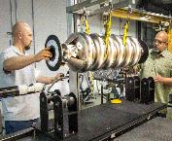
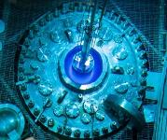
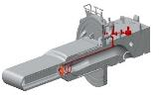
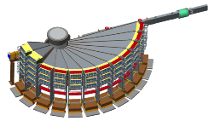
The Neutron Sciences Directorate has for FY16 and FY17 focused on five key organizational goals
Routine and reliable operation of SNS accelerator at 1.4 MW
2 or fewer SNS mercury target changes per year
7 cycles per year at HFIR
>400 scientific publications from our beam lines per year
$10M per year available for rolling investments in neutron scattering capabilities
POWGEN upgrade
Limited by target capability and RFQ transmission – delay in spare IRP delivery means delay in 1.4 MW capability with margin to late FY18
Limited by understanding of target capability – strategic decision in early FY17 to move to 3 targets per year
Achieved
Achieved
Achieved – execution of projects limited by resources so significant funding carryover
The Research Accelerator Division (RAD) owns the problem of routine and reliable operation of the accelerator at 1.4 MW, the Instrument and Source Division (ISD) owns the engineering and manufacturing challenge of delivering a 1.4 MW capable target and related infrastructure

Slide 8
The Research Accelerator Division (RAD) is the principal steward organization for operation and improvement of the SNS, spanning a diverse customer base
The division recognizes the following obligations related to this stewardship role:
We serve the users, our scientists, and the broader neutron scattering community
We sustain the performance of the world’s most powerful pulsed neutron source
We are efficient and cost-effective in the expenditure of the resources provided to us
We continuously improve our capabilities and performance
We develop our staff
Our mission is aligned with the Laboratory Plan and Agenda:
Develop and apply innovative technology, physics, operational and management tools to drive the highest reliability ≥1 MW-class pulsed neutron source with routine operation at or near 1.4 MW
For every user, deliver a complete and usable data set that meets or exceeds experiment objectives
Conduct a vigorous scientific and technical program of innovation for accelerators, neutron sources (specifically for targets and related systems) and instruments to support the Neutrons 2025 vision
Provide strong technical support to obtain CD-1 for the Proton Power Upgrade (PPU) project and to develop CD-1 for the Second Target Station (STS) project
Provide integrated resources that enable the success of the SNS enterprise

Slide 9
The Research Accelerator Division is organized around technical functions
Research Accelerator Division
Kevin Jones, Director
Accelerator Operations
Glen Johns
Accelerator Physics, Beam Instrumentation and Ion Source
Sarah Cousineau
Control Systems
Karen White
Electrical and RF Systems
Mark Champion
Instrument Data Acquisition and Controls
Steven Hartman
Mechanical Systems and Operations
Mike Baumgartner
Superconducting Linac Systems
Sang-Ho Kim

Slide 10
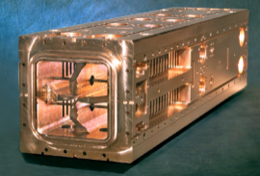
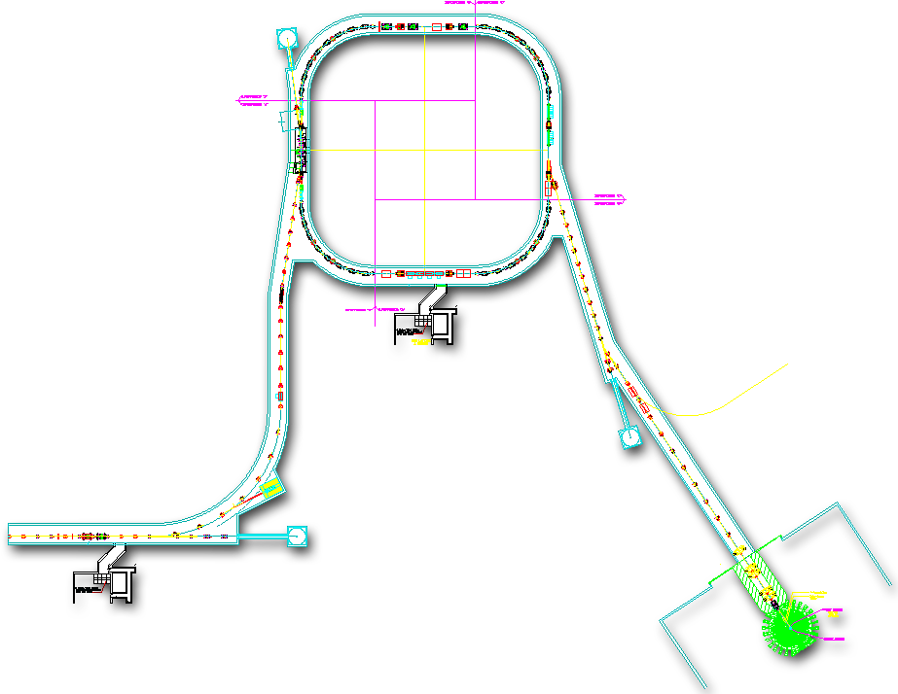
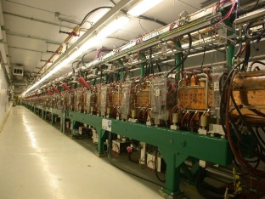
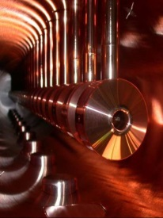
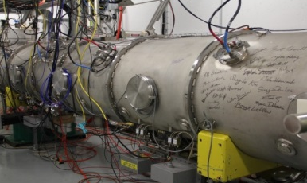
The SNS is a ~1 GeV pulsed linac and accumulator ring capable of delivering ~23.3 kJ proton pulses at 60 Hz
Accumulator Ring: Compress ~1 msec pulse to 700 nsec
Power (and base neutron flux) is the product of:
Beam Energy
Peak Current
Chopping Fraction
Duty Factor (Repetition Rate * Pulse Length)
Collimators
Injection
Extraction
RF
~700 nsec
RTBT
2.5 MeV
186 MeV
~972 MeV
HEBT
Front-End
Warm Linac
Superconducting LINAC
Liquid Hg Target
LEBT chopper system makes gaps between minipulses
(25%)
Each mini-pulse contains RF micropulses
945 ns
75%
Current
Current
~35mA
peak
~1 ms macropulse
1 ms macropulse
1ms
The front end produces a 60 Hz, ~1 ms long chopped H- beam
1 ms

Slide 11
The SNS is capable of sustained operation at power levels up to 1.4 MW but overall reliability has been affected by target performance

Slide 12
In the past year SNS has made considerable progress, but has also had to address a number of challenges
For the first time in any fiscal year, SNS delivered more than 5,000 MW-Hrs of beam to target
We delivered the second-highest number of hours for users (missed by 30 hours) in the history of the facility
We set a record for the brevity of a target change outage after the unplanned end-of-life event for Target 13
The Beam Test Facility (formerly the Integrated Test Stand Facility) is authorized and operational, the new RFQ is fully commissioned, and an active physics program is underway
We successfully demonstrated highly efficient laser-assisted H- ion stripping for 10μs
We established new records for ion source longevity and output
We initiated construction of the spare medium-beta cryomodule
We have undertaken a disciplined program of learning about targets by developing and implementing a constant operating power strategy augmented by improved post-irradiation examination techniques
We have implemented a three-outage per year operating rhythm, incorporating three targets per year to advance learning
We have established, implemented and refined a process for project prioritization, and have substantially improved outage planning and execution
We have made a substantial investment in improving work control at SNS
We have successfully managed and partially mitigated water leaks in the target systems core vessel
We are moving through the CD-1 process for the Proton Power Upgrade

Slide 13
The 2016 AAC report provided 30 recommendations that spanned a broad scope of activities
Actions to address each recommendation were developed
In some instances several actions were required to address a recommendation
In some instances, a single action could address more than one recommendation
Some actions had more than one sub-activity
A total of 24 distinct actions were identified
An owner was identified for each action
All information pertaining to actions was entered into the ORNL Assessment and Commitment Tracking System (ACTS)
All but one of the action items have been closed
The open activities pertain to ongoing target-related work with anticipated closure dates in January 2018
Topics presented to you during this meeting will address disposition of action items as appropriate

Slide 14
A detailed summary of the actions in response to your recommendations is available on the web site
Only one of the 30 recommendations has an action that remains open – design of the gas injection system for the target

Slide 15
Summary
SNS and RAD have had a very productive year since your last visit
Your recommendations stimulated considerable activity and resulted in substantial progress
We will complete all work necessary for operation at 1.4 MW with margin by April 2018
We have established a sound plan for the path to 1.4 MW operation by September 2018
We have established a 10-year look-ahead schedule that accommodates the PPU performance plan and ties work on achieving routine, reliable operation at 1.4 MW to the PPU schedule
Our staff make it all happen – they are what make us successful

