Slide 1
Overview of Proton Power Upgrade (PPU) and Second Target Station (STS) Projects
Presented to the
SNS Accelerator Advisory Committee
John Galambos
PPU Project Director
March 8, 2017

Slide 2
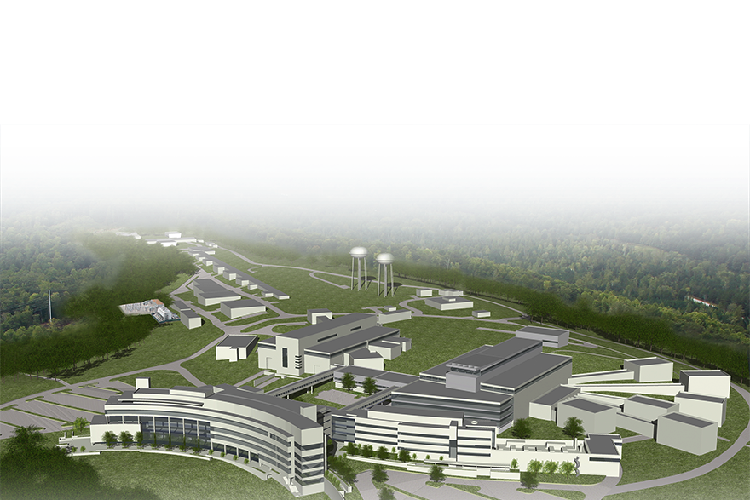
SNS-PPU to SNS-STS
SNS-PPU upgrades
the existing accelerator structure
  Increases neutron flux
  to existing beam lines
  Provides a platform
  for SNS-STS
SNS-STS constructs
a second target station with an initial suite
of 8 beam lines
CD-0
for SNS-PPU
and SNS-STS
are the same

Slide 3
PPU impact on first target station science
Big bang for the buck:
~ 10% of the SNS TPC: doubles the accelerator capability
FTS instruments were designed to operate at 2 MW of proton beam power on target
  Adequate choppers, shielding and detectors
  Higher data rates need evaluation on NOMAD and VISION
Higher neutron flux is useful
  Higher capacity means more experiments, more publications, science impact
    E.g. “mail-in” programs
    More complete parametric studies
  Increased opportunity for method and technology development
  Higher emphasis on rapid sample environment changes
  Grows the user community and enables more programmatic studies
    All instruments are over-subscribed

Slide 4
PPU high level parameters
PPU delivers 2.8 MW capable accelerator
Prior to STS, accelerator will run at 2 MW to FTS
 | Current SNS 1.4 MW | Full accelerator upgrade capability | FTS 60 Hz operation
Proton beam power capability (MW) | 1.4 | 2.8 | 2.0
Beam energy (GeV) | 0.97 | 1.3 | 1.3
RFQ output peak beam current (mA) | 33 | 46 | 46
Average linac chopping fraction (%) | 22 | 18 | 41
Average macropulse beam current (mA) | 25 | 38 | 27
Energy per pulse (kJ) | 23 | 47 | 33
Pulse repetition rate (Hz) | 60 | 60 | 60
Macro-pulse length (ms) | 1 | 1 | 1
33% energy increase
50% current increase
No change

Slide 5
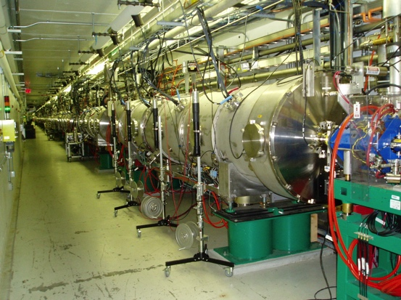
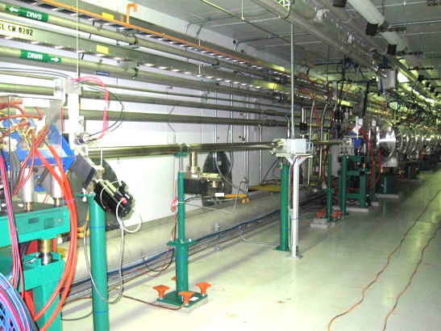
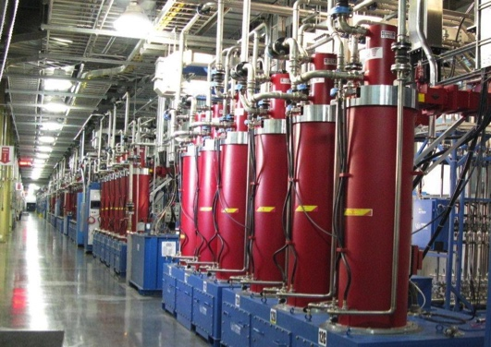
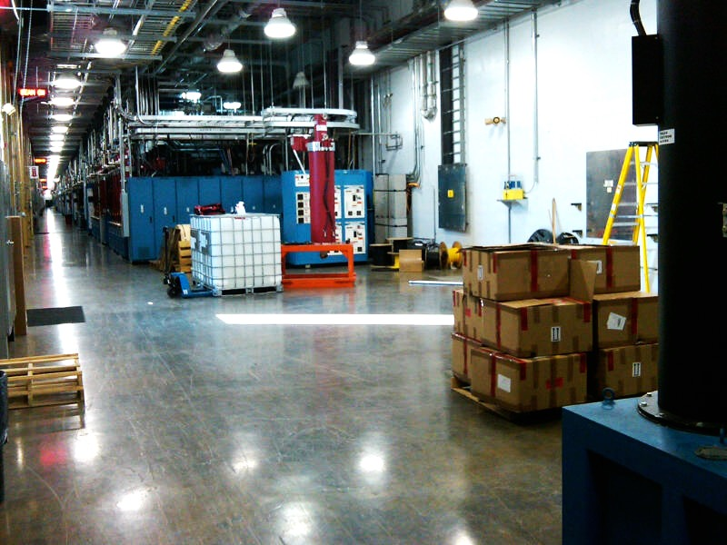
Accelerator built with upgrade provisions
Tunnel: Fill 7 empty drift sections with cryomodules (space available for 9)
Collimators
Extraction
Front-End
LINAC
Upgrade
Ring + transport lines: 96% magnets are 1.3 GeV ready
Klystron gallery: empty area for new SRF

Slide 6
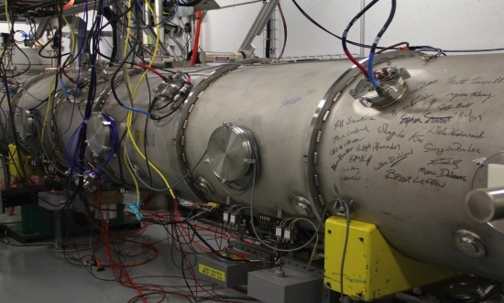
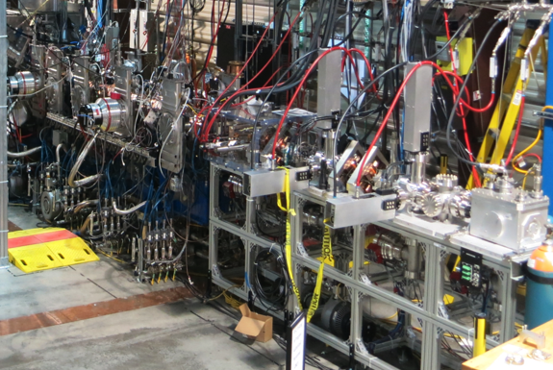
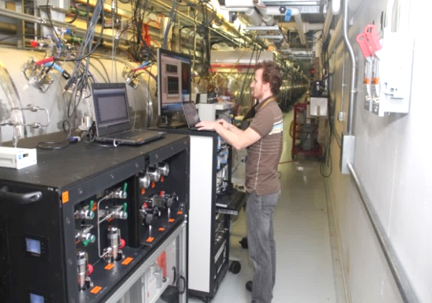
Operational improvements ensure technical basis
Ion source test stand:
demonstrated PPU required current
Ring damper system:
operational, insurance against instabilities
Spare SRF cryomodule: operational since 2012 with PPU gradient
Spare RFQ: tested and
provides required PPU transmission
In situ plasma processing: demonstrated cavity gradient improvement
Spare RFQ :
Improved transmission

Slide 7
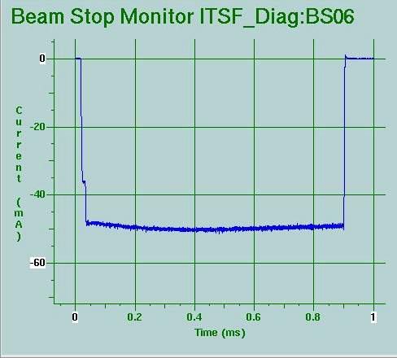
PPU: Front-end capability demonstrated
Ion source output
RFQ output
  Operation production source has demonstrated required output
  Measured beam transmitted through new RFQ meets STS requirement
STS Requirement
STS Requirement
Notes:
STS – new facility

Slide 8
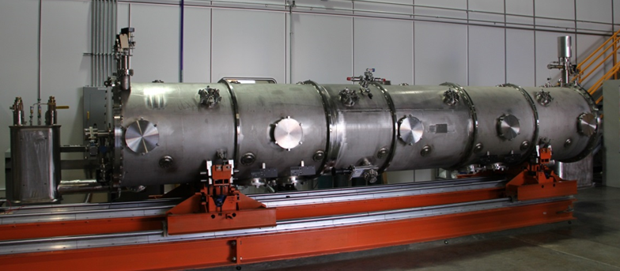
SCL systems scope
Increase beam energy from 1.0 GeV to 1.3 GeV
Procure, fabricate, test, install, and commission seven new high beta cryomodules
  Bids solicited from JLab, FNAL and FRIB
Prototype = spare cryomodule in production since 2012 with PPU gradient

Slide 9
RF systems scope
Additional SCL RF systems to support 7 new cryomodules
  3 modulators, 28 klystrons
Upgrade some existing RF infrastructure
  Using beam based measurements to refine plan
Klystron Gallery
New pump room

Slide 10
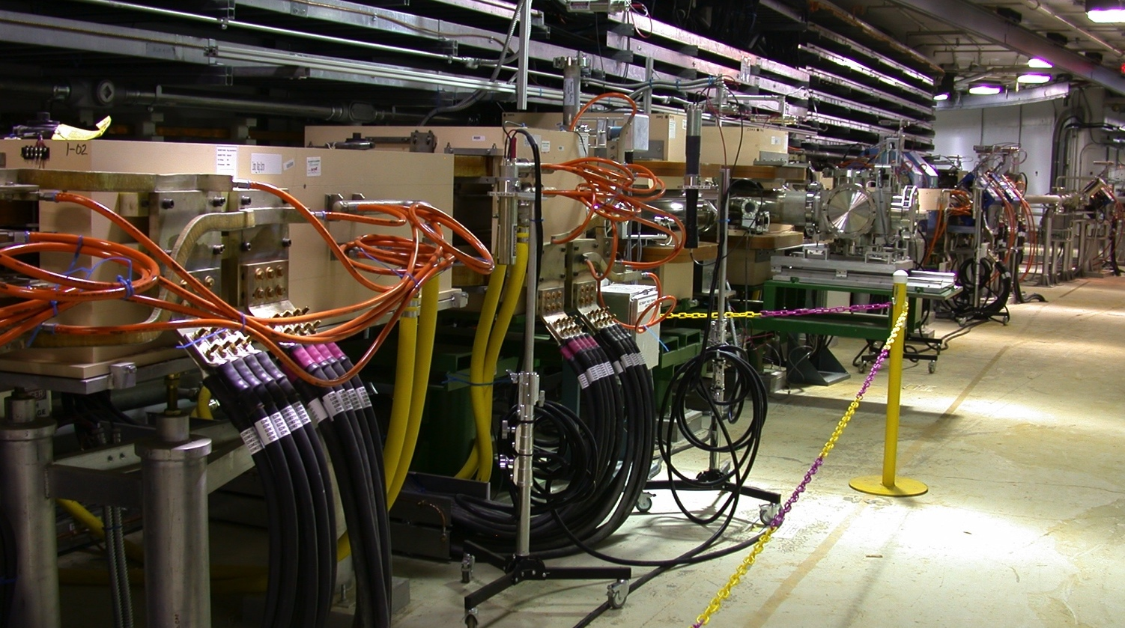
Ring systems scope
Ring injection area
Injection and extraction ring upgrades
  Injection area is the primary scope – bids from FNAL,BNL for magnets
Utilities, accelerator physics, injection dump

Slide 11
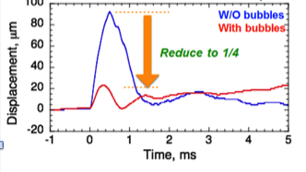
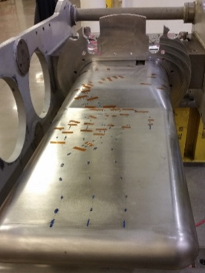
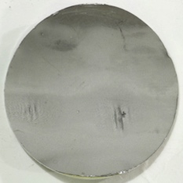
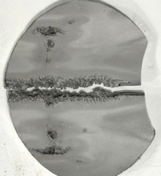
FTS scope: Builds on current FTS target activities
Jet flow
Std.
J-PARC data
Flow reduces cavitation
Gas injection reduces strain
Operations input to design evolution
Instrumentation provides confidence
2016
2017
2018
2019
2020
2021
2022
2023
2024
FTS reliability improvements
Hg flow
Initial gas injection
Structural & fabrication
PPU
Hg target
CD-3
PPU target fabrication start
High flow He injection
PPU complete
1.4 MW reliable operations
2 MW target structure
Evaluate systems for 2 MW, 1.3 GeV operation
High gas rate He injection development
PPU Scope:
Notes:
2017 – 2018 targets will inform PPU target design (current target management plan draft)
Low flow gas injection (GI3), jet-flow and thickened outer beam window … we will assess pressure wave (strain measurements) and cavitation mitigation (PIE)
Beyond 2018:
Last 1.4 MW target that can influence PPU target design must be taken out of service in early 2019, i.e., the 1st “Blue” target (flow improvement at sides of outer window)
Needs time for PIE, analysis and interpretation, concept development to CD-2 level
Perhaps one more target beyond current target management plan could be operated
Strain measurements; time for informative PIE is questionable under current operating plan (2/y)
After CD-2b, must allow time for final design & analysis, target fabrication, installation and commissioning
“Chinstrap” target potential features for 2018-19 operation
Swirl bubblers and / or modest increase in gas flow: smaller bubbles in greater volume fraction
Further flow modifications for cavitation mitigation
Incorporate improve pulse simulation techniques if available

Slide 12
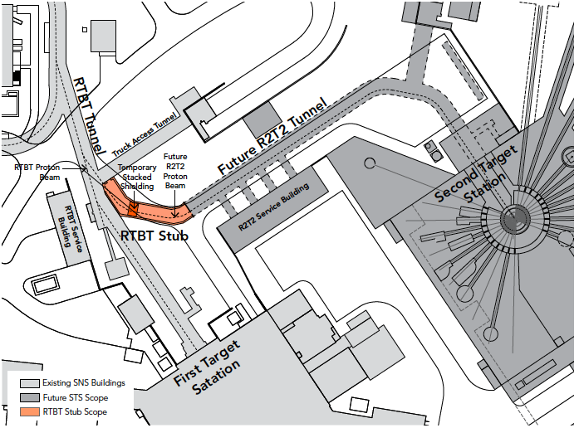
Conventional facilities scope
“RTBT Stub”
Build a tunnel stub to facilitate future STS tie in
  New “simpler” approach recently adopted
Klystron gallery build-out, new pump room

Slide 13
Major project risks
SCL: partner lab - costs, schedule
RF: RF power margin
FTS: target reliability
Schedule: long outage impacted by operations issue

Slide 14
CD-1 document preparation
Status
✔ Signed / complete
Drafted
  Acquisition Strategy - ✔
    Alternative selection
  Preliminary Project Execution Plan - ✔
    Key Performance Parameters
  CDR - ✔
  Assumptions / NScD MOU - ✔
  Risk Management Plan - ✔
  PHAR - ✔
  Parameter List - ✔
  QA (use SNS plan) - ✔
  Security Vulnerability - ✔
  NEPA agreement - ✔
  Project Management Plan - ✔
    Staffing, procurement, configuration management

Slide 15
PPU Key Performance Parameters: negotiated with BES
Key Performance Parameter | Thresholds (Performance Deliverable) | Objectives
Beam Power | 1.7 MW | 2.0 MW
Beam energy | 1.25 GeV | 1.3 GeV
Stored beam intensity in ring | 1.60x10¹⁴ protons¹ | 2.24x10¹⁴ protons²
Number of additional installed cryomodules | 6 | 7
¹ Corresponds to 2.0 MW @ 1.3 GeV and 60 Hz
² Corresponds to 2.8 MW @ 1.3 GeV and 60 Hz

Slide 16
PPU cost and summary schedule
TPC point cost: $212M
  Range is included , roughly + $20M
  Contingency is 35% (being scrubbed)

Slide 17
PPU planning
Long Term
CD-1
CD-2
CD-4
2016
2017
2018
2019
2020
2021
2022
2023
2024
2025
2026
Short Term
Ring, SRF reviews
RF, CF reviews
Target review
Director’s review
PM
ICR
OPA
IPR
CD-1
Oct
Nov
Dec
Jan
Feb
March
April
May
June
July
Aug
Fall 2016 system reviews
  Technical focus
Dec. 2016 – present
  Focus on cost, schedule, project agenda

Slide 18
February Director’s Review
Technical scope and basis of cost estimate is generally sound
Cost contingency and risk analysis need development
PPU needs independent mission need (from STS)
  Present CD-0 is with STS (2009)
  Consider removing STS specific scope

Slide 19
STS status
Firming up technical design basis
High level parameter choice to be finalized in a review April 19-21
  Response to 2016 BESAC panel report
    Frequency: 10-20 Hz
    Long pulse short pulse
Target technical approaches
  Rotating target
  No hot cell

Slide 20
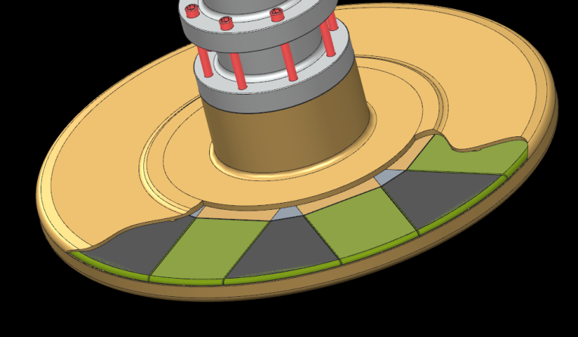
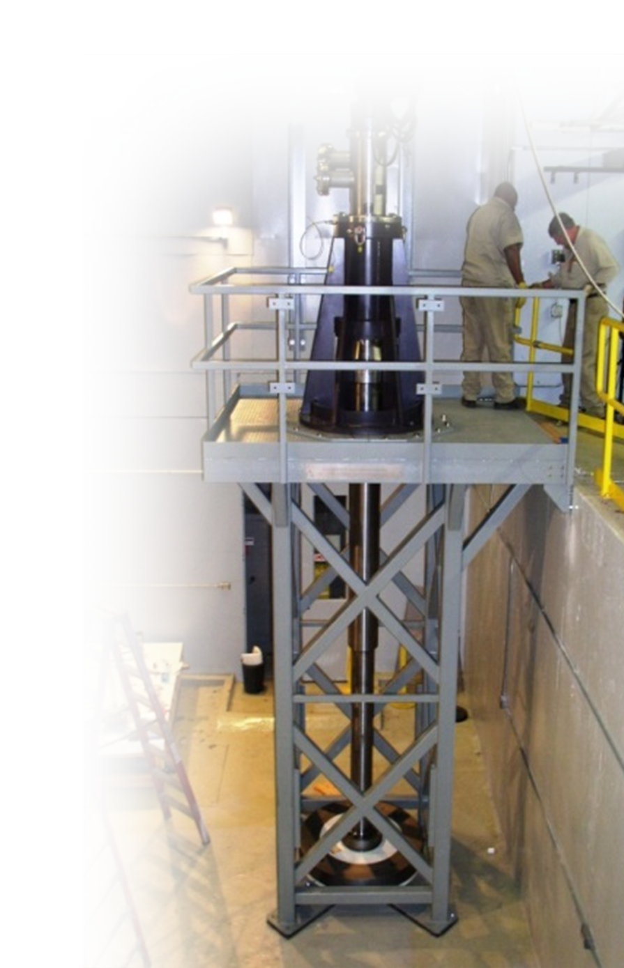
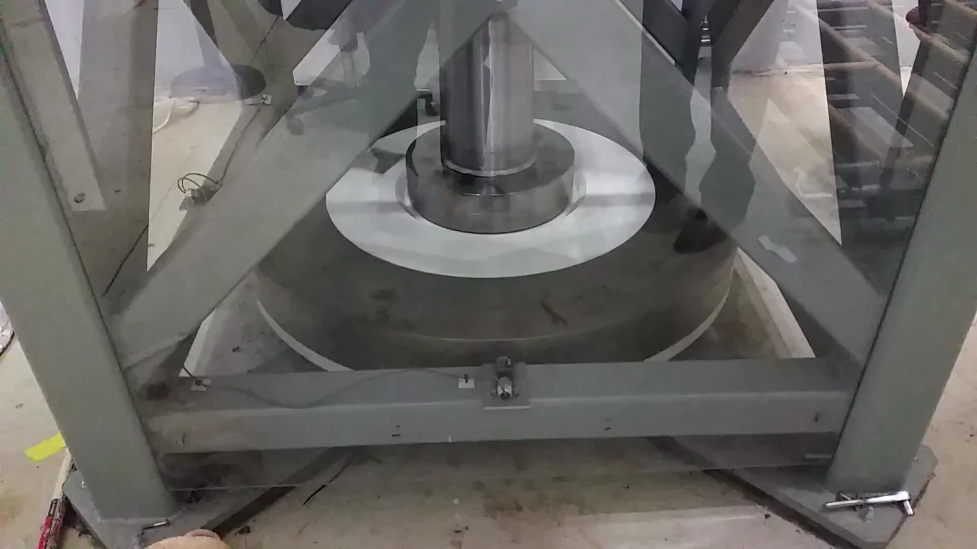
Rotating target: potential operating advantages but needs manufacturing validation
STS: rotating target test stand with a full-scale proof-of-principle mockup
[6000+ hr test]
25 cm deep x 5 cm high Ta clad W blocks (16 ea)
Target fabrication program underway to address possible issues related to large target segments

Slide 21
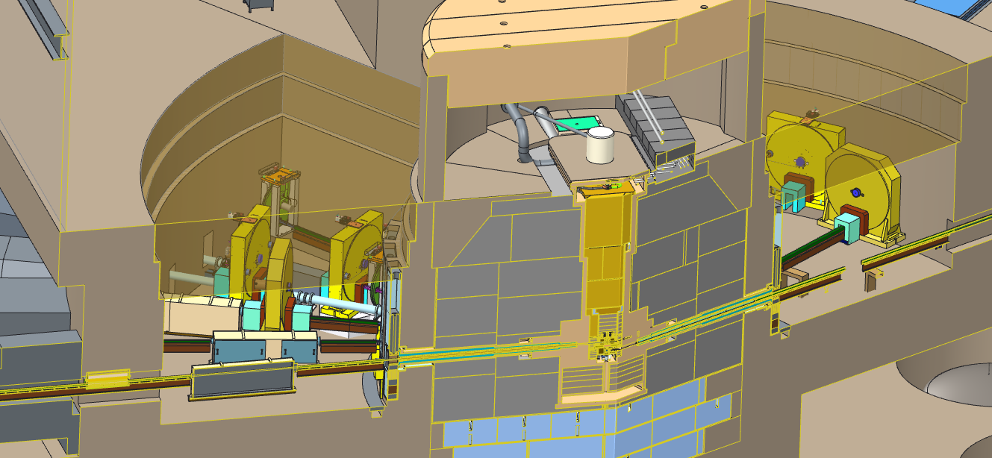
Target hall bunkers: Instrument line maintenance approach
Bunkers extend from a neutron beam distance of ~5.5 meter to 11.5 meter
The open space is required to accommodate relatively large and complex neutron beam line components
Guide Alignment Mechanism
Maintenance Shutter
T_{o} Chopper
Moderator
Section view through beam lines 6 and 20

Slide 22
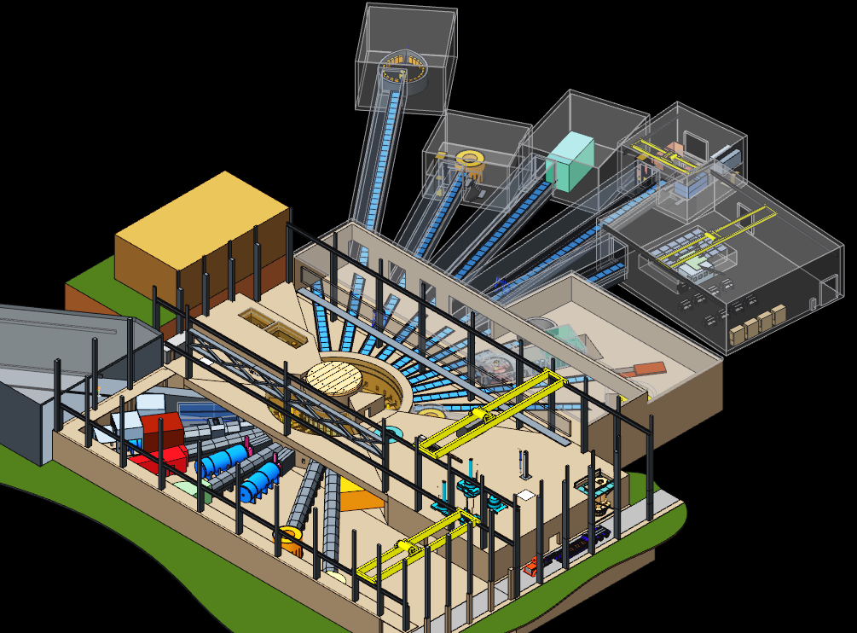
Beamline layout
Short beamlines one side, long beamlines on the other
“No hot cell” opens up space for other purposes

Slide 23
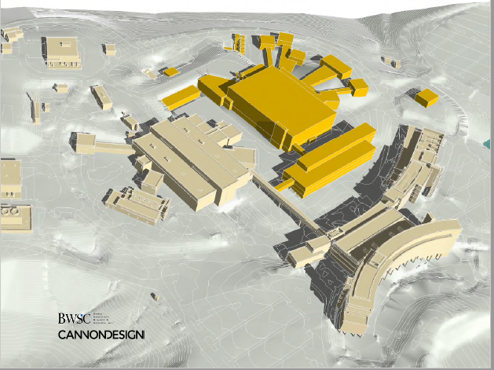
STS conventional facilities
From 30,000 ft, STS looks like another FTS – with long beam-lines
Some scope reduction: Gross sq. ft: 380,000 (TDR) to ~290,000 (now)

Slide 24
STS conventional facilities
Elevation: STS and FTS same elevation
  Sloped proton beam-line is complicated
Instrument layout: short / long segregation
Instrument elevation: tunnel, above, trench
Space needs requirements: initial scrub

Slide 25
High level schedule
PPU
CD-1
CD-2
CD-4
STS
CD-1
CD-2
CD-4
2016
2017
2018
2019
2020
2021
2022
2023
2024
2025
2026
Notional – funding dependent

Slide 26
Summary
PPU efforts are in full swing
  Preparing for CD-1 in FY2017
  Solid technical basis
  Schedule, cost, supporting documents in progress
STS technical concept is being refined
  Decision on repetition rate soon
  Target system designs are maturing
  Aiming for well defined requirements for conventional facilities

