Slide 1
Overview of Target Status
Presented to the
SNS Accelerator Advisory Committee
Mark Wendel
Group Leader
Source Development and Engineering
March 8, 2017

Slide 2
Operated targets since Feb ‘16
Target 13 leaked - ran to 2600 MW-hr
    Was the second target to run for a long time near 1.4 MW
    Formed a leak due to cavitation damage similar to T12 leak
Target 14 completed its run
    1.0 MW for 2700 MW-hr
Target 15 completed its run
    1.2 MW for 1700 MW-hr
    Removed for concern about potential damage based on T14 post-irradiation examination (PIE)
Target 16 life has just begun
    2nd jet-flow target operated at SNS
    1.0 MW power level will be used

Slide 3
22 SNS target units have been or are being made
16 targets have been operated
  7 have leaked mercury
  Current operational target is a jet-flow
2 targets are available as spares
  One original style without improvements
  One improved jet-flow style
4 targets are being fabricated with cavitation damage erosion reinforcement
  Two improved original style
  Two improved jet-flow
2 more new targets will be ordered this year with a new design

Slide 4
SNS has operated over 35 GW-hr using 16 target modules since starting operation in 2006
Demonstrated that we have a reliable 1.1 MW target for 2 targets per year
Demonstrated operation twice at >1.3 MW for one month
7 mercury vessels have developed leaks in operation because of structural stress or cavitation damage
  Last structural stress failure occurred in 2014 (design problem addressed)
  Cavitation damage is now routinely quantified by post-irradiation examination
Established phenomenological methods exist to extend target lifetimes
  Changes in mercury flow path to reduce cavitation damage
  Optimization of the structure to resist cyclic loads
  Mixing inert gas into the flowing mercury to reduce structural loading and cavitation damage
Improvements to the design are inevitable, given time to incorporate these solutions
 | Total MW-Hrs | Target 8 | Target 9 | Target 10 | Target 11 | Target 12 | Target 13 | Target 14 | Target 15
1.1-1.2 MW | 2193 | 319 | 367 | 296 | 69 | 563 | 356 | 0 | 223
1.2-1.3 MW | 2899 | 42 | 1066 | 0 | 60 | 356 | 306 | 0 | 1069
1.3-1.4 MW | 2115 | 32 | 453 | 0 | 0 | 788 | 842 | 0 | 0
>1.4 MW | 183 | 0 | 32 | 0 | 0 | 0 | 150 | 0 | 0
Hours of operation on target within the indicated power range

Slide 5
Progress in targets
Substantial work on new designs (Winder, breakout)
Improved analytical capability (Kaminskas, breakout)
Improved Post-Irradiation Examination (PIE) (McClintock, breakout)
Gas injection (Riemer, breakout)
Improved manufacturing process (Rosenblad, breakout)
Target management plan implemented

Slide 6
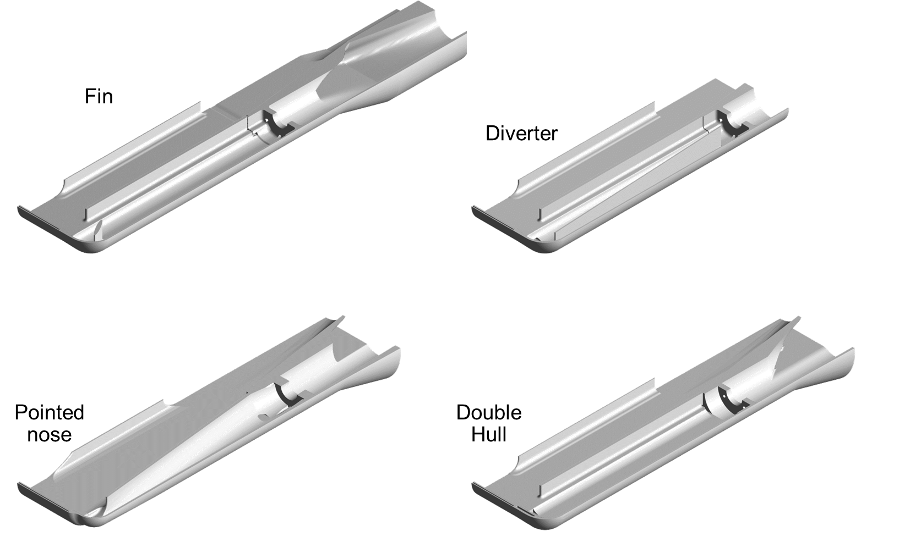
Progress: Target design
A new “Blue” target design has been developed and will be ordered soon
Several design iterations were completed with a sped up analysis process
More detailed information will be provided by Drew Winder in the target breakout session

Slide 7
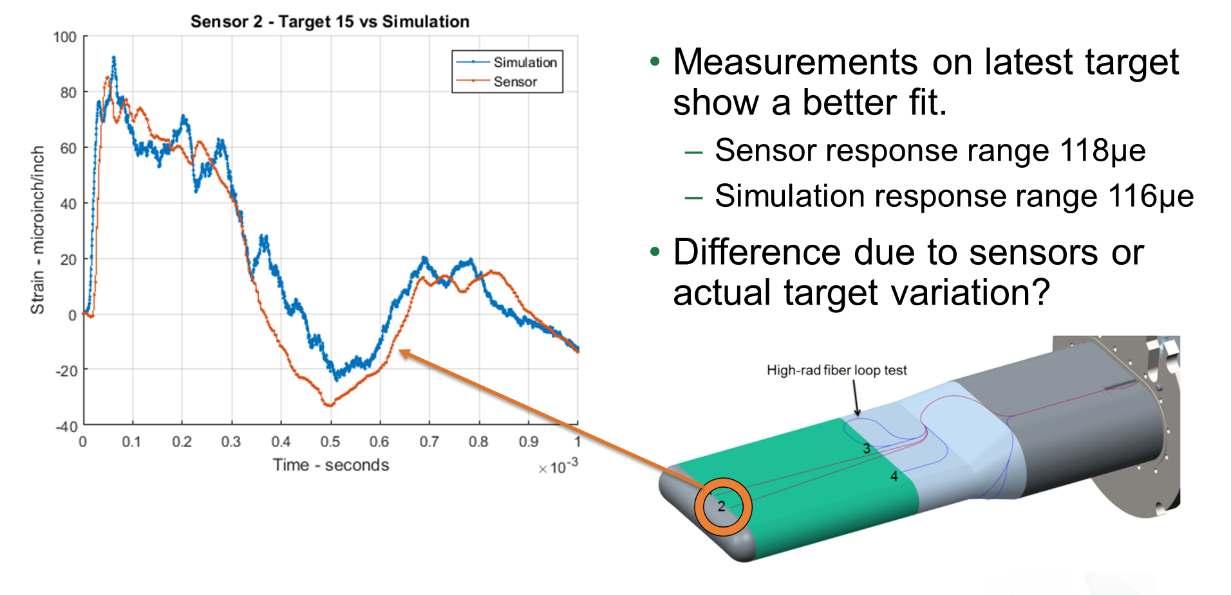
Progress: Target analysis
Comparisons with strain data
Tetrahedral (automatic) meshing
Steps toward design optimization
More detailed information will be provided by Saulius Kaminskas and Drew Winder in the target breakout session

Slide 8
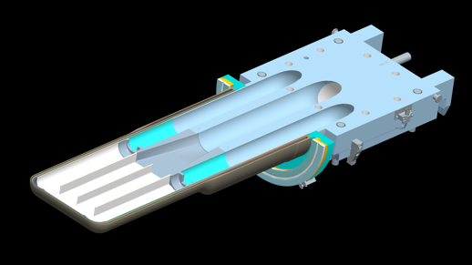
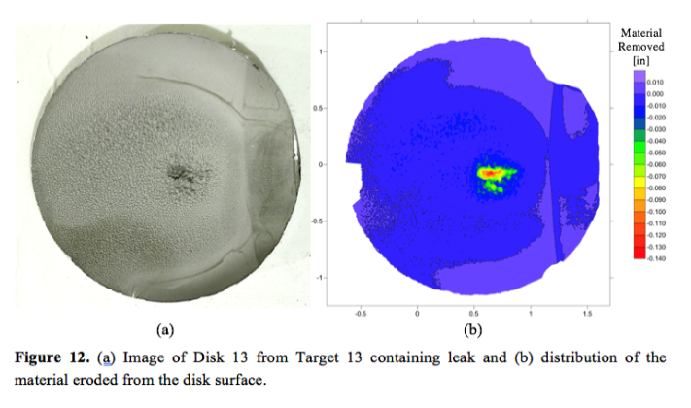
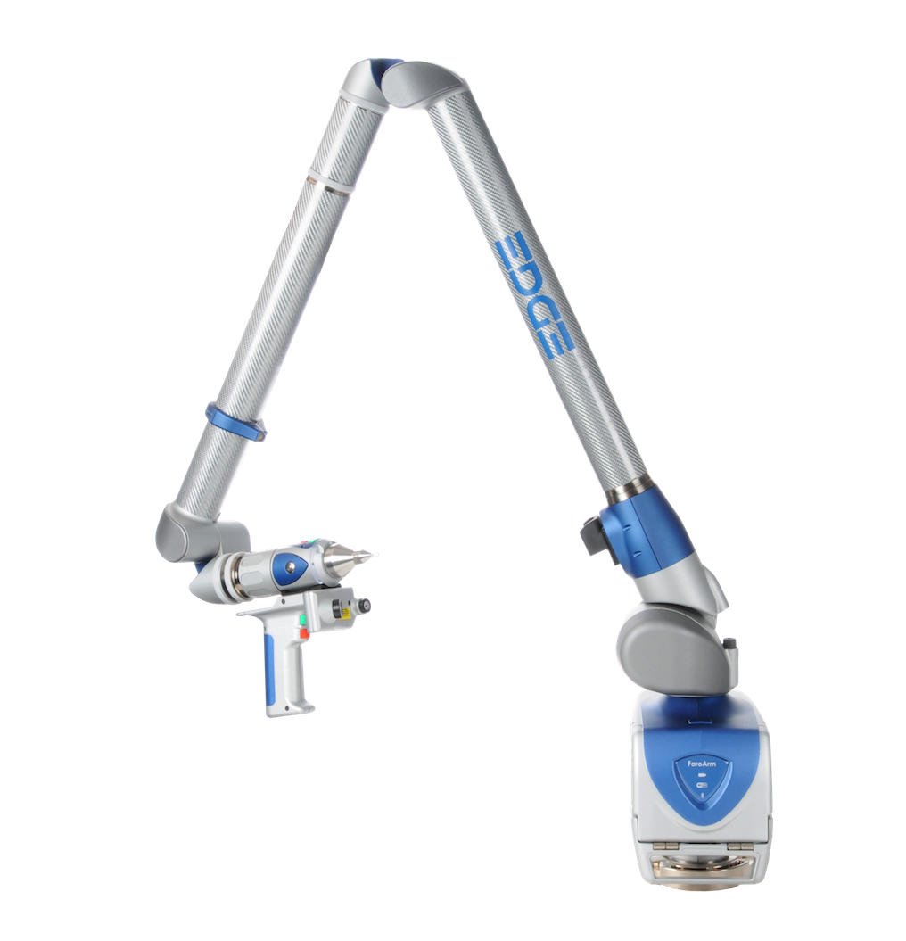
Progress: Post-irradiation examination
Laser scanning technique developed to measure depth of erosion
Leak location in T10 examined with microscopy/SEM
Target 10 crack
Target 12 and 13 Leak Location
More detailed information will be provided by David McClintock in the target breakout session

Slide 9
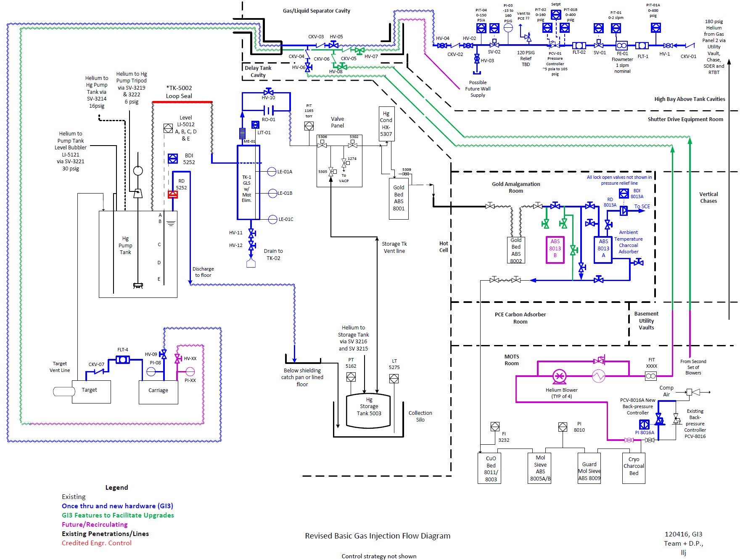
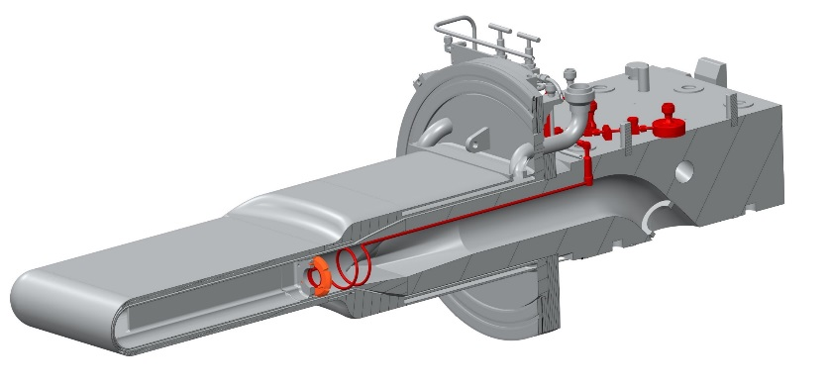
Progress: Gas injection initial implementation (GI3)
Performance parameters are identified
Critical facility safety issues have been addressed
Mercury off-gas delay bed has been added
Some gas supply hardware installed outside of service bay
Goal is to be ready in October 2017
System flow diagram for GI3
Targets are already equipped
More detailed information will be provided by Riemer in the target breakout session

Slide 10
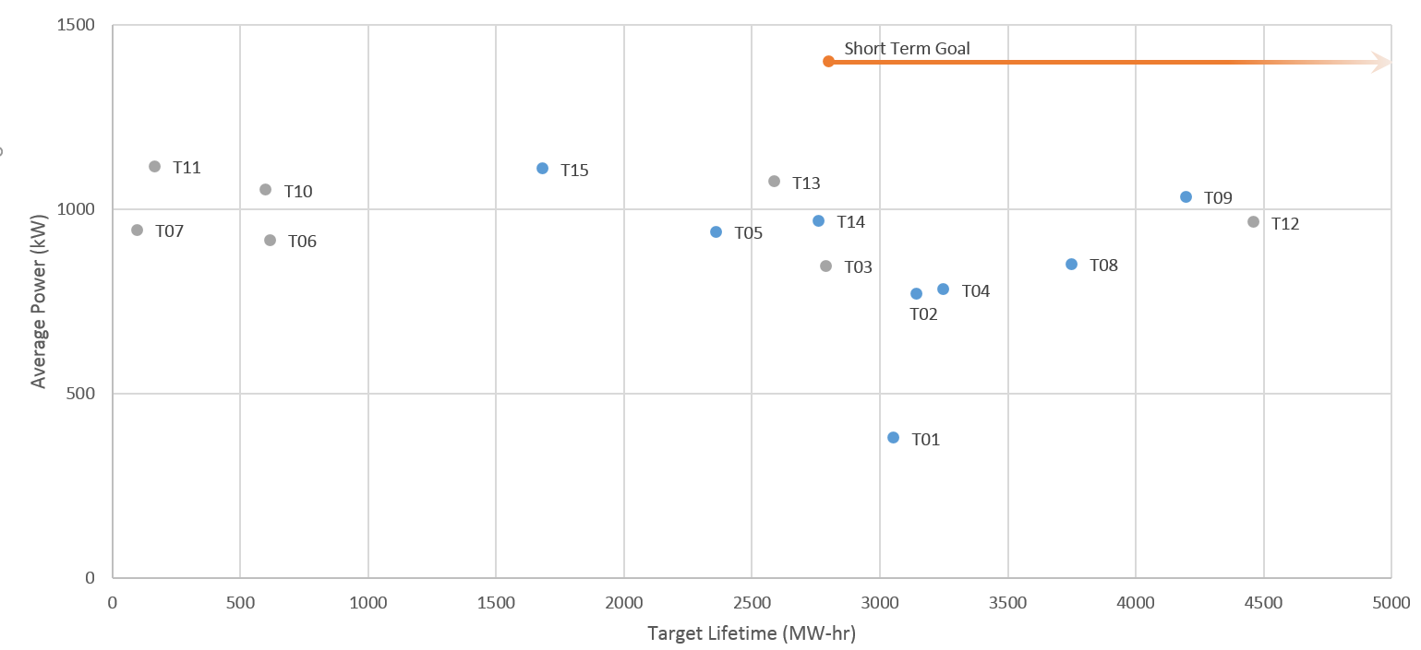
The short term goal is now to operate targets at 1.4 MW for ~1700 hours
(The change to a trimester operating schedule has opened the possibility to change targets more frequently)

Slide 11
The ongoing goal is to meet operational expectations while improving target performance
Improve…
  Develop the knowledge base for target design and operations
  Implement changes based on current state-of-the-art
  Push toward higher beam power
…while making neutrons
  Avoid unexpected target-related outages
  Maintain sufficient target inventory while controlling costs
  Ensure consistency with the planned operating schedule

Slide 12
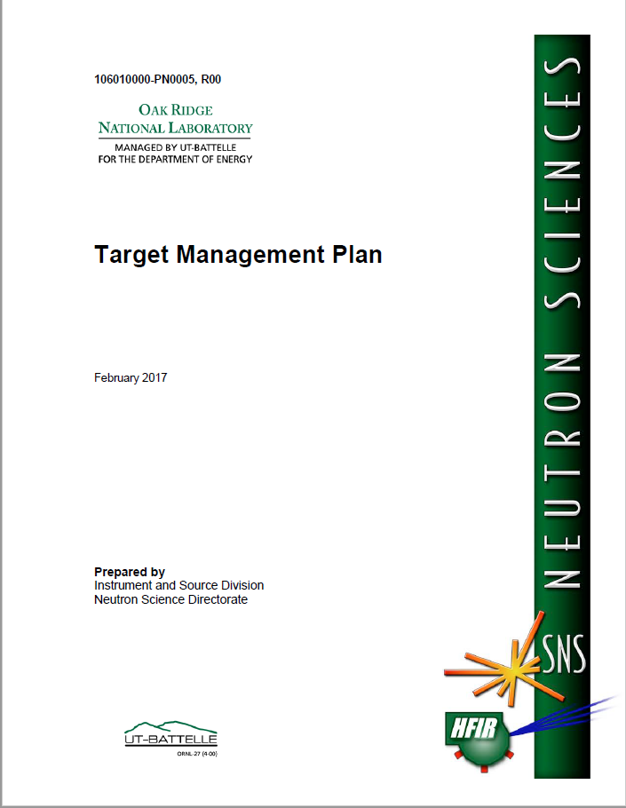
A plan now exists to steadily climb to higher beam power levels
Systematic learning is essential to improve target design
  Operating targets at constant power levels
  Post-irradiation examination of targets
  Dynamic in situ strain measurements that inform engineering analysis
Design change opportunities are infrequent
  Full cycle time for a design/fab iteration is up to 2 years
  Design releases need to be coordinated with anticipated discovery
Key elements for success of PPU have been identified

Slide 13
Starting point: Knowledge base
SNS operational experience
In-service target strain data from T13, T14, and T15
Improved manufacturing and quality assurance techniques
Research studies at LANL collaboration with J-PARC since ~ CY2000
J-PARC operational experience (many aspects including gas injection)
Information gained from cold Target Test Facility (TTF) R&D

Slide 14
Starting point: State of the art
Operational experience for Targets 1-15 indicates that the main challenges to target reliability are:
  Fatigue failures
    Seem to be managed
  Cavitation damage
    So far, only gradual leaks outside of the beam-deposition zone
The jet-flow style mercury vessel is preferred
  Proven cavitation damage mitigation
  As mechanically robust as the original flow target after modifications
Gas injection can be beneficial to prolong target lifetimes
  Injected bubbles
  Gas layers along the wall
Systematic plan will advance this state of the art

Slide 15
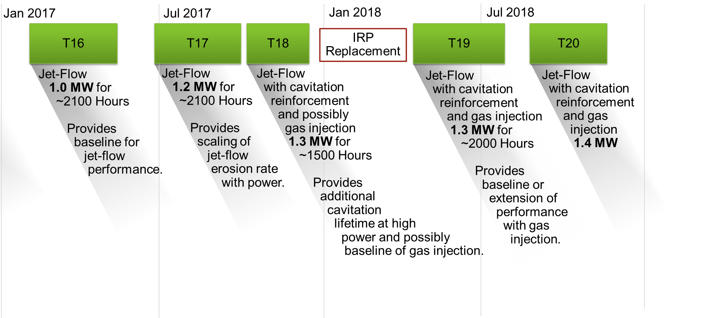
Target management plan advances jet-flow target operation with incremental design improvements
Each target planned will provide key information to support improved of target performance and life prediction
  Gas injection
  Strain measurements
  Operation of new target design features
Jul 2019
T21
Blue Target
First target with flow mitigation on front corners

Slide 16
Summary
Since last February, significant progress in target technology has been made for target design and development including
  Understanding of current CDE limits
  PIE and in situ measurements
  Design methods and improvements
  Gas injection initial implementation progress
A systematic approach has been taken to understand and improve target performance
The target management plan has been assembled to manage risk of user program interruption while successfully handling increasing beam powers

