Slide 1
Overview of Inner Reflector Plug (IRP) Issues
Presented to the
SNS Accelerator Advisory Committee
Kevin Jones/Don Abercrombie
Division Directors RAD/ISD
March 8, 2017

Slide 2
Outline
What are the Core Vessel components?
Core Vessel water leaks
  Status and resolution of the first (small) leak (Proton Beam Window)
  Status and path forward for the second (larger) leak (Core Vessel Loop 3)
Spare Inner Reflector Plug (IRP) fabrication

Slide 3
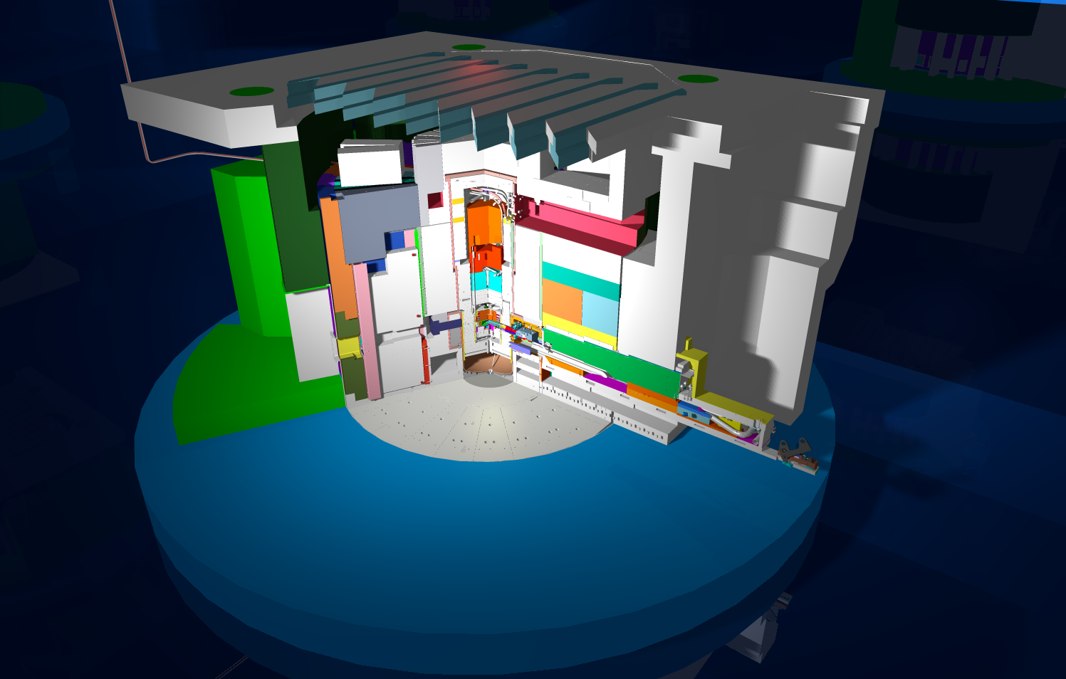
The core vessel contains the inner and outer reflector plugs, neutron moderators, core vessel inserts, and interfaces with the target and proton beam window seals
T-Block Roof Shields
Shutter Drive Equipment Room
Service Bay
Outer Reflector Plug
Neutron Beam Line
Inner Reflector Plug
Target and Carriage Assembly
Core Vessel

Slide 4
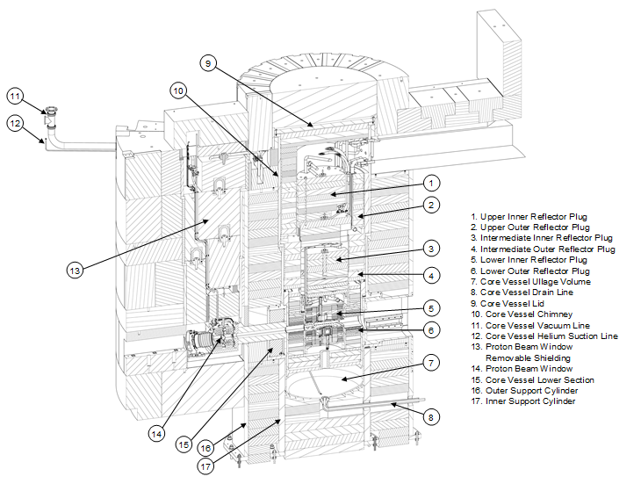
The core vessel contains a significant amount of equipment

Slide 5
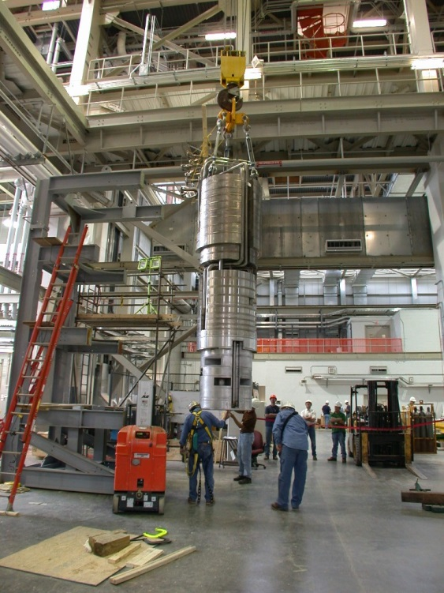
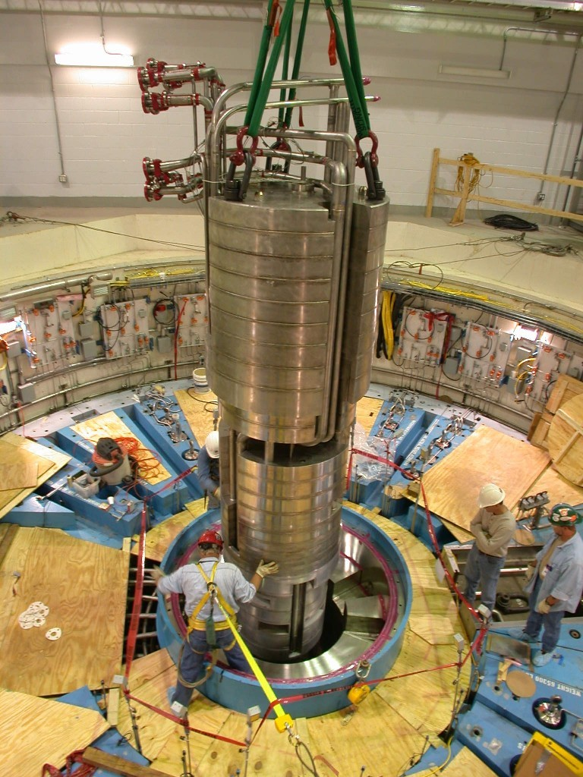
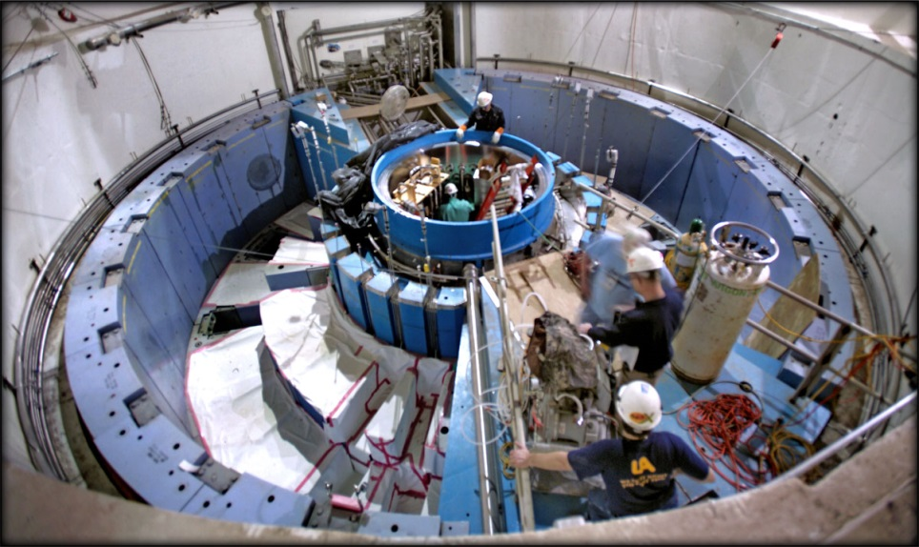
The Inner Reflector Plug (IRP) is a large, complex and essential limited-life component of the neutron source

Slide 6
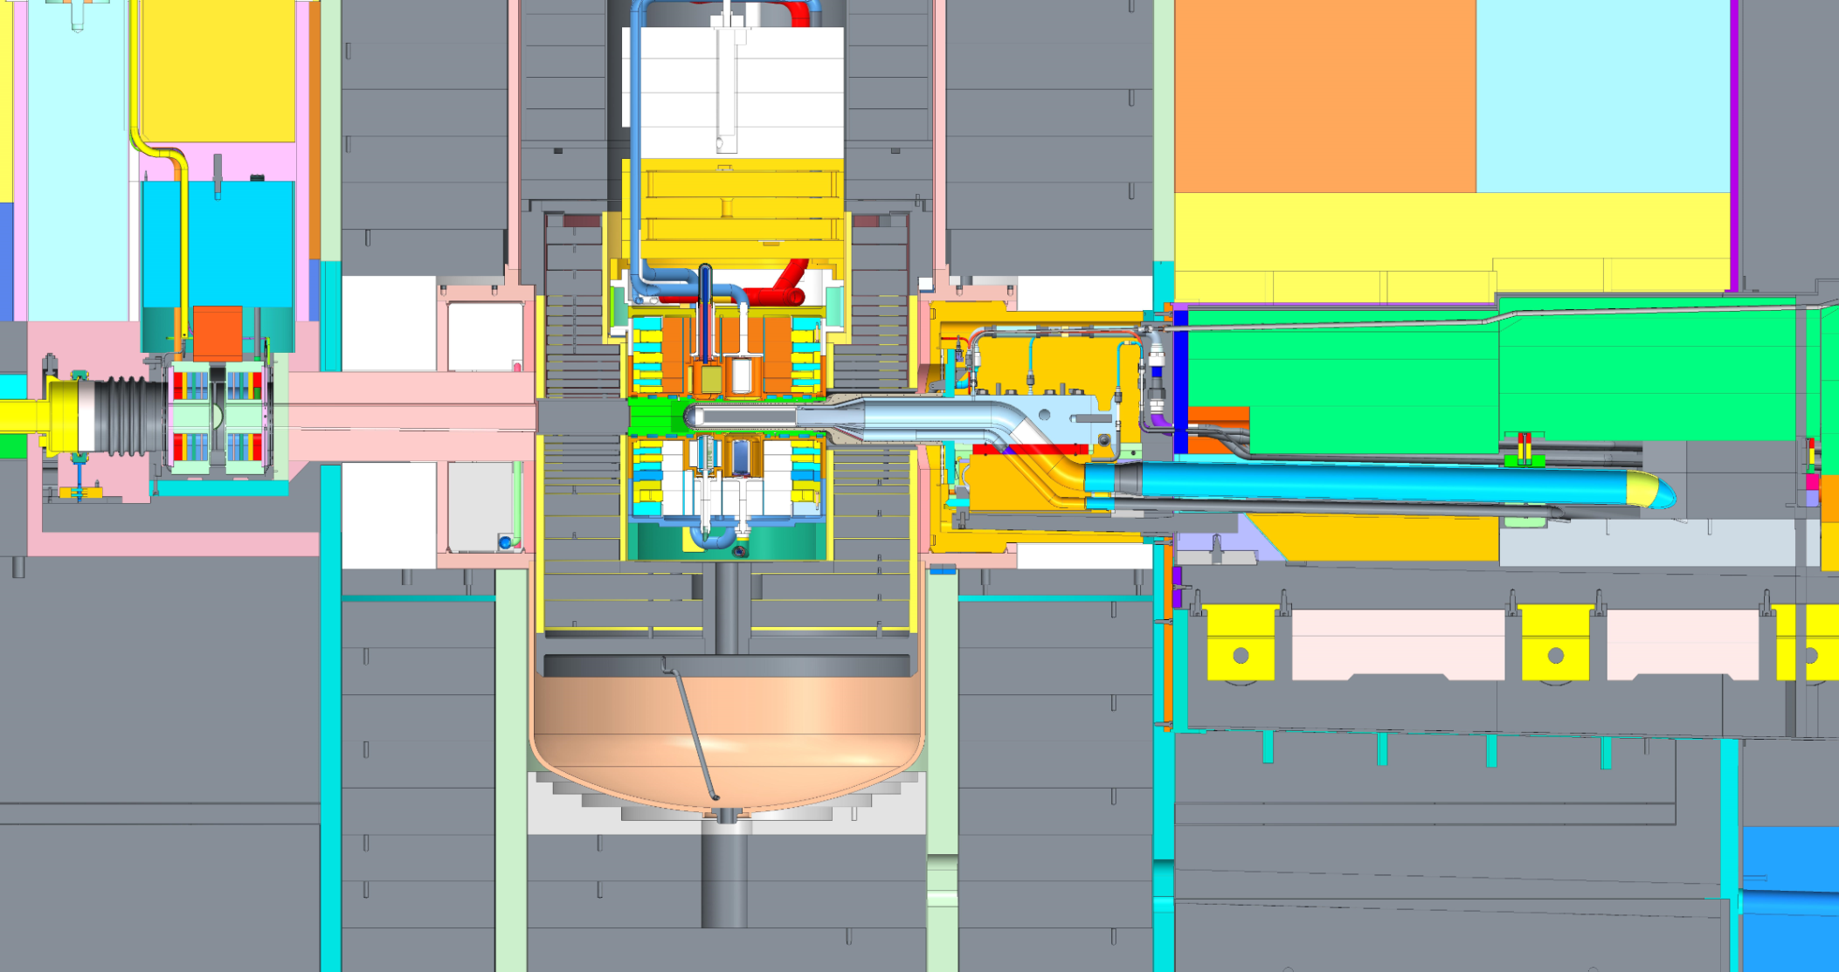
The lower segment of the IRP is inaccessible, and contains the neutron moderators, poisons and decouplers
Rolling Carriage
PROTONS 60 Hz

Slide 7
Two water leaks into the SNS target system core vessel developed during the past operating period
The first leak was identified on September 19, 2016
  Was confirmed to be on Loop 2 that cools Target, Proton Beam Window (PBW) and PBW shields during the target change in October 2016, and specifically on the PBW loop
  Remained small at approximately 0.5 gallons per day
  Confirmed by static pressure test on December 29, 2016 after loop isolation and drying in preparation for PBW change-out
  This problem has been resolved - PBW change was successfully completed
The second leak was identified on about November 14, 2016 when the core vessel leak rate increased
  Subsequent tests indicated a new and higher rate water leak on Loop 3, which services the ambient water moderator, the cryogenic moderator water pre-moderators, and the core vessel inserts for the beam lines
  The leak rate has continued to increase and was about 1.6 – 1.8 gallons per hour when operations ceased on December 22, 2016, and the rate was increasing at about 2.2E-03 gallons per hour²
  Operation of BL-4B was compromised by water accumulation in the canted Core Vessel Insert channel – confirmed by neutron measurement and modeling
Notes:
User Office

Slide 8
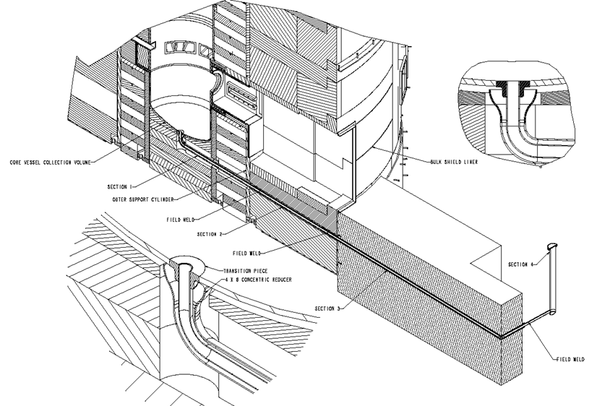
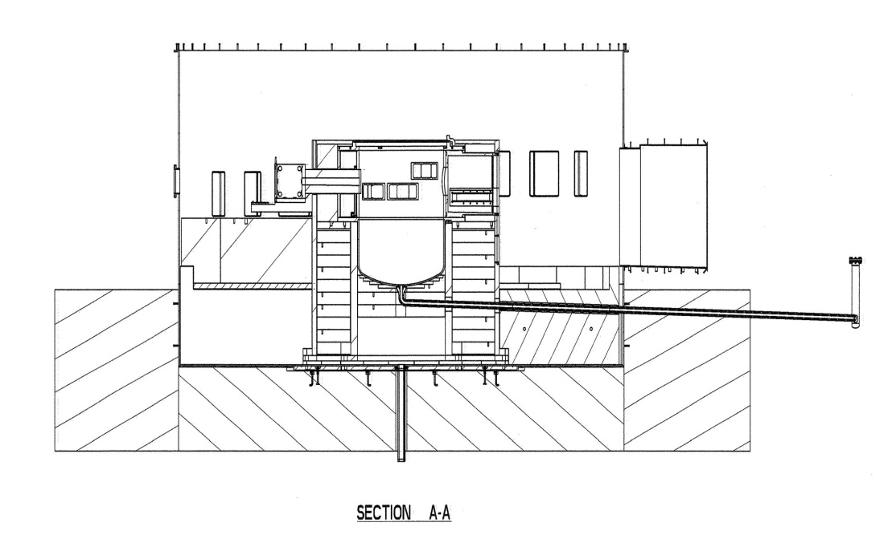
The Core Vessel drain system became an important part of facility operation – regular pumping to the LLLW tanks was required
The Core Vessel/Drain Line/Stand
Pipe was design such that the volume
capacity at the top of the Stand Pipe
is greater than the amount of mercury
that is postulated to drain into the
Core Vessel (182 gallons)
Stand Pipe in Service Bay
6” ID

Slide 9
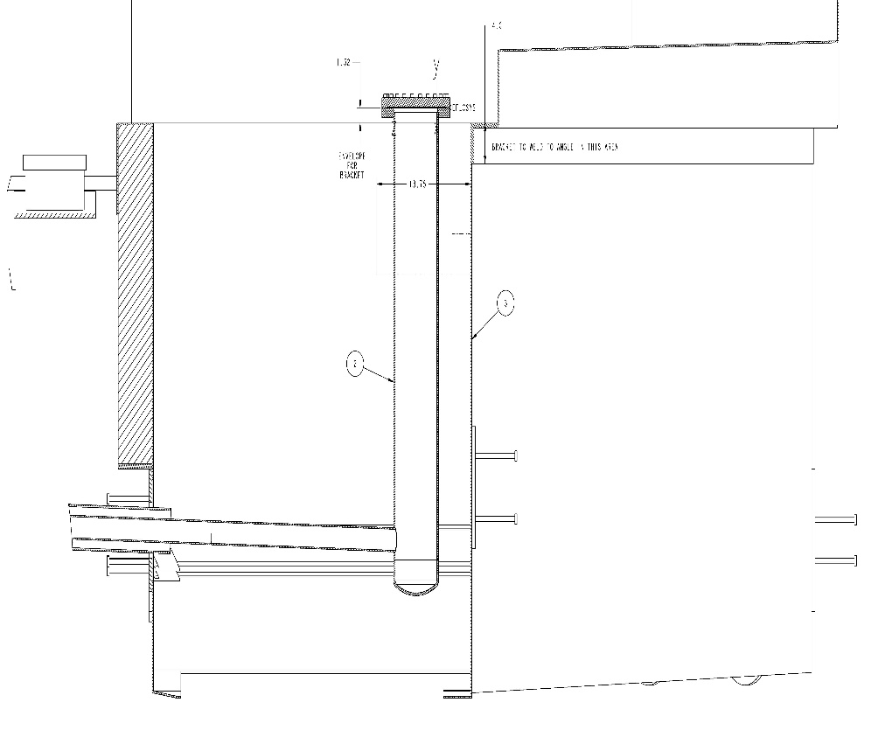
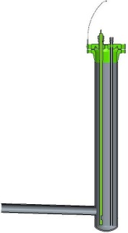
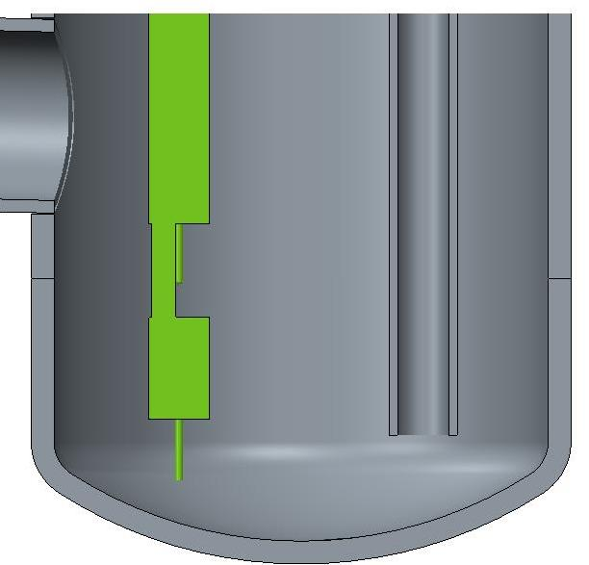
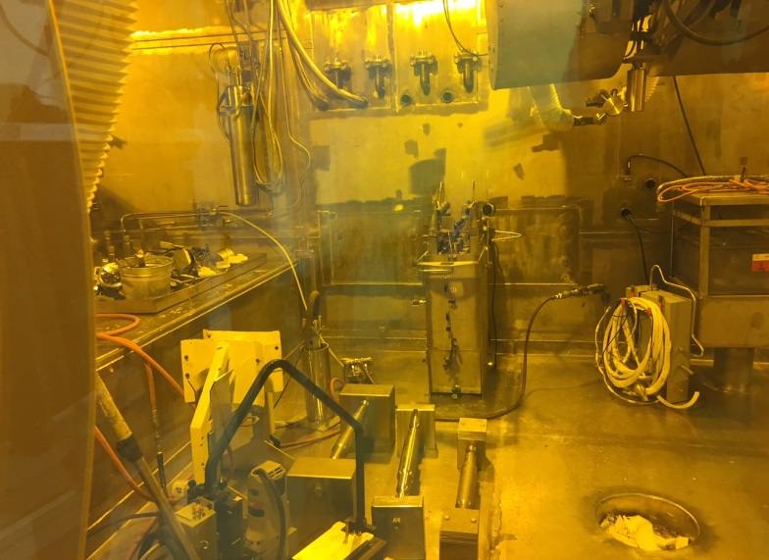
Sensor limits in the stand pipe required a flexible approach to pumping as the leak rate increased
To LLLW
6.065” ID
Dip tube to enable pumping
of Stand Pipe
Instrumentation probe with “low” and “low-low”
liquid indication (mercury/water)
1.03”
Note 1: Tolerance is from drawing -
model is positioned exactly at 2.4”
2.4+/-.1” (1)
.55”
.75”
Core Vessel
Stand Pipe
Connection
LLLW Connection
Diaphragm Pump

Slide 10
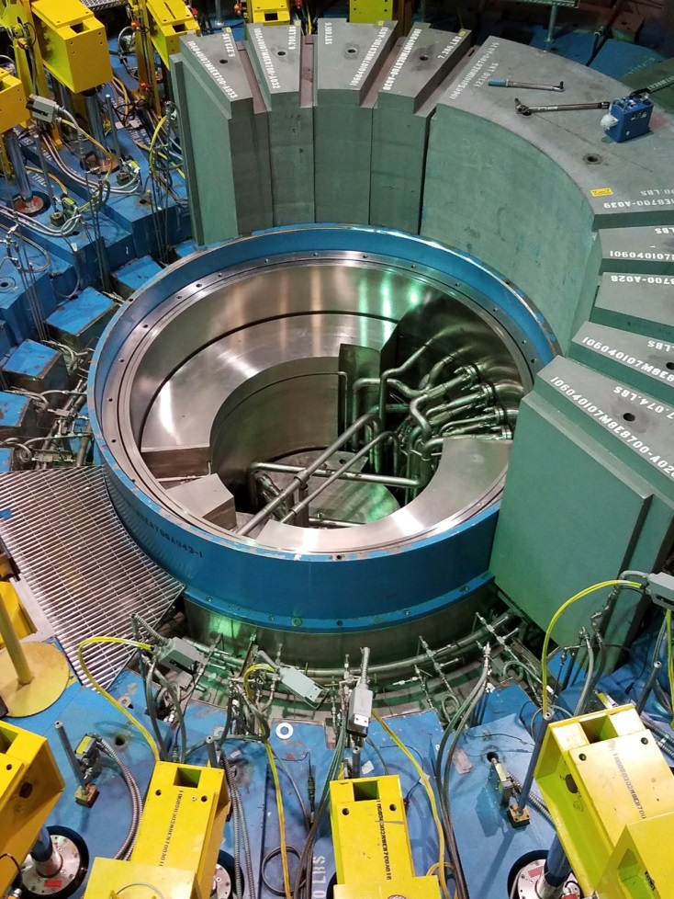
Three important target system activities were undertaken during the recent SNS maintenance outage
Proton Beam Window change
Target change to transition to 3 outages/targets per year
Identification and mitigation of the source of the Core Vessel Loop 3 water leak
  Required un-stacking shielding above the core vessel seal plate and opening the core vessel for the first time since 2006
Outer Reflector Plug
Core Vessel
Flanges and water lines of interest
Top surface of upper section of Inner Reflector Plug
Notes:
User Office

Slide 11
The leak was identified on January 4, 2017, by bore-scope inspection in the pipe chase below the flange mating area
Leak location (details to follow)
Water pooling on top of IRP mid-section
Notes:
User Office

Slide 12

Let’s go to the videotape…..
Notes:
User Office

Slide 13
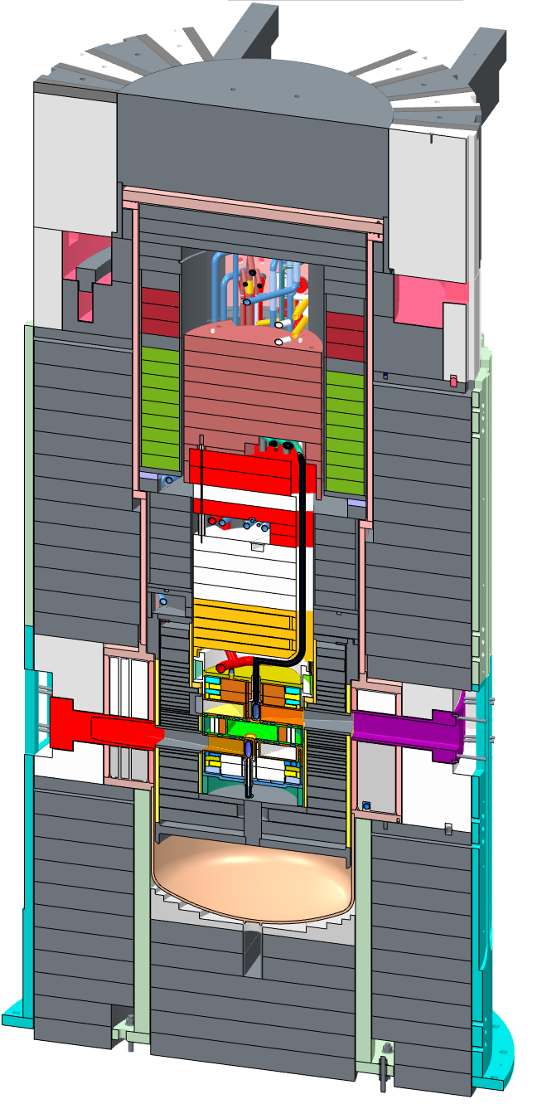
It is important to understand the context of the location within the broader target system assembly
Inner Reflector Plug
Outer Reflector Plug
Core Vessel
Top Downstream Moderator
Bulk shielding
Neutrons to 4, 5, and 6

Slide 14
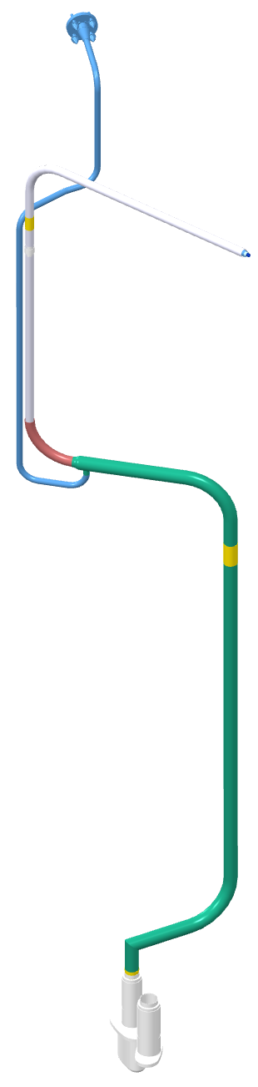
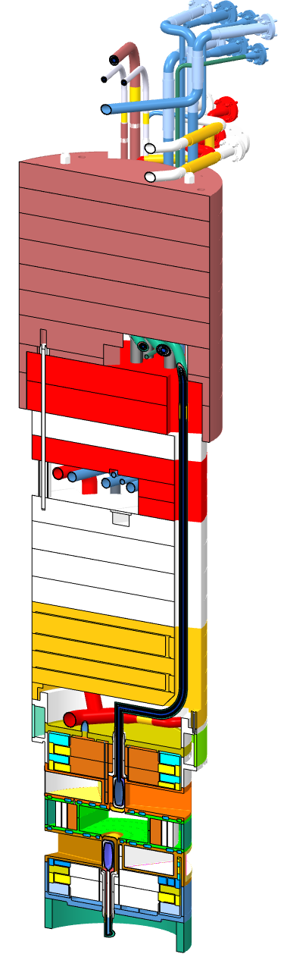
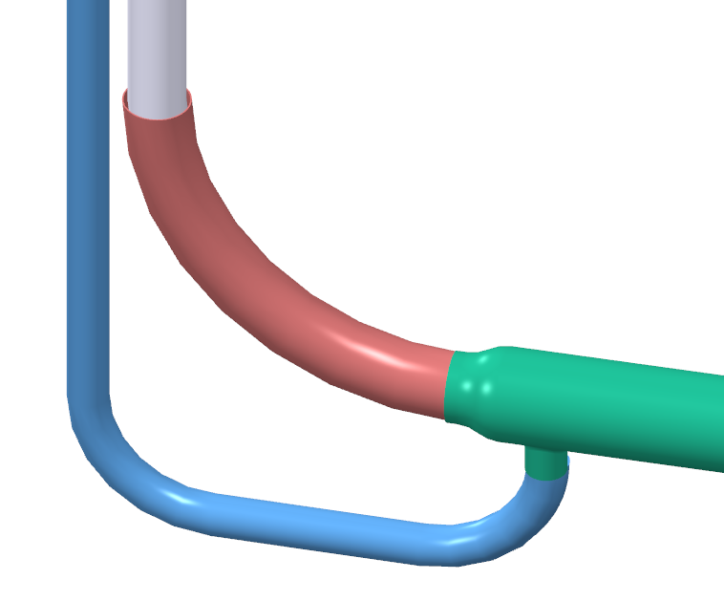
The specific water emanation location is between the mid and upper IRP sections
Helium annulus termination, water flowing from this location
Leak is from water annulus that surrounds the Top Downstream Moderator transfer line between the indicated elevations
Water break off from transfer line
Top Downstream Moderator
Water annulus termination weld to helium line
Top Downstream transfer and water lines
Neutrons to 4, 5, and 6

Slide 15
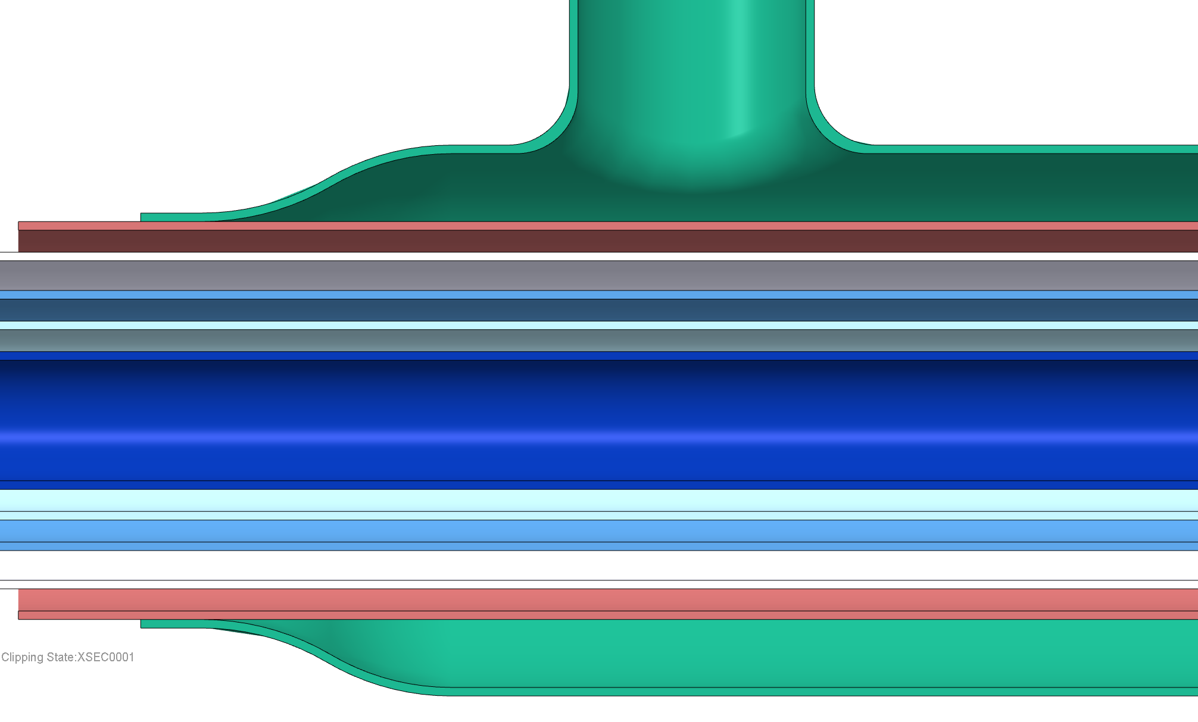
The leak is within the complex nested piping assembly for the top downstream hydrogen moderator but manifests at the end of the helium annulus
Rotated 90 degrees for clarity
Helium annulus termination (vertical in reality), water flowing from this location
Helium boundary, ID of water boundary, which is leaking
Fillet weld sealing water annulus
Loop 3 light water flow
Core Vessel helium by design, filled with stagnant leaked water
Vacuum
H2 return
Vacuum
Center Line
H2 supply
Vacuum
H2 return
Vacuum
Core Vessel helium by design, filled with stagnant leaked water
Helium annulus termination (vertical in reality), water flowing from this location
Helium boundary, ID of water boundary, which is leaking
Loop 3 light water flow

Slide 16
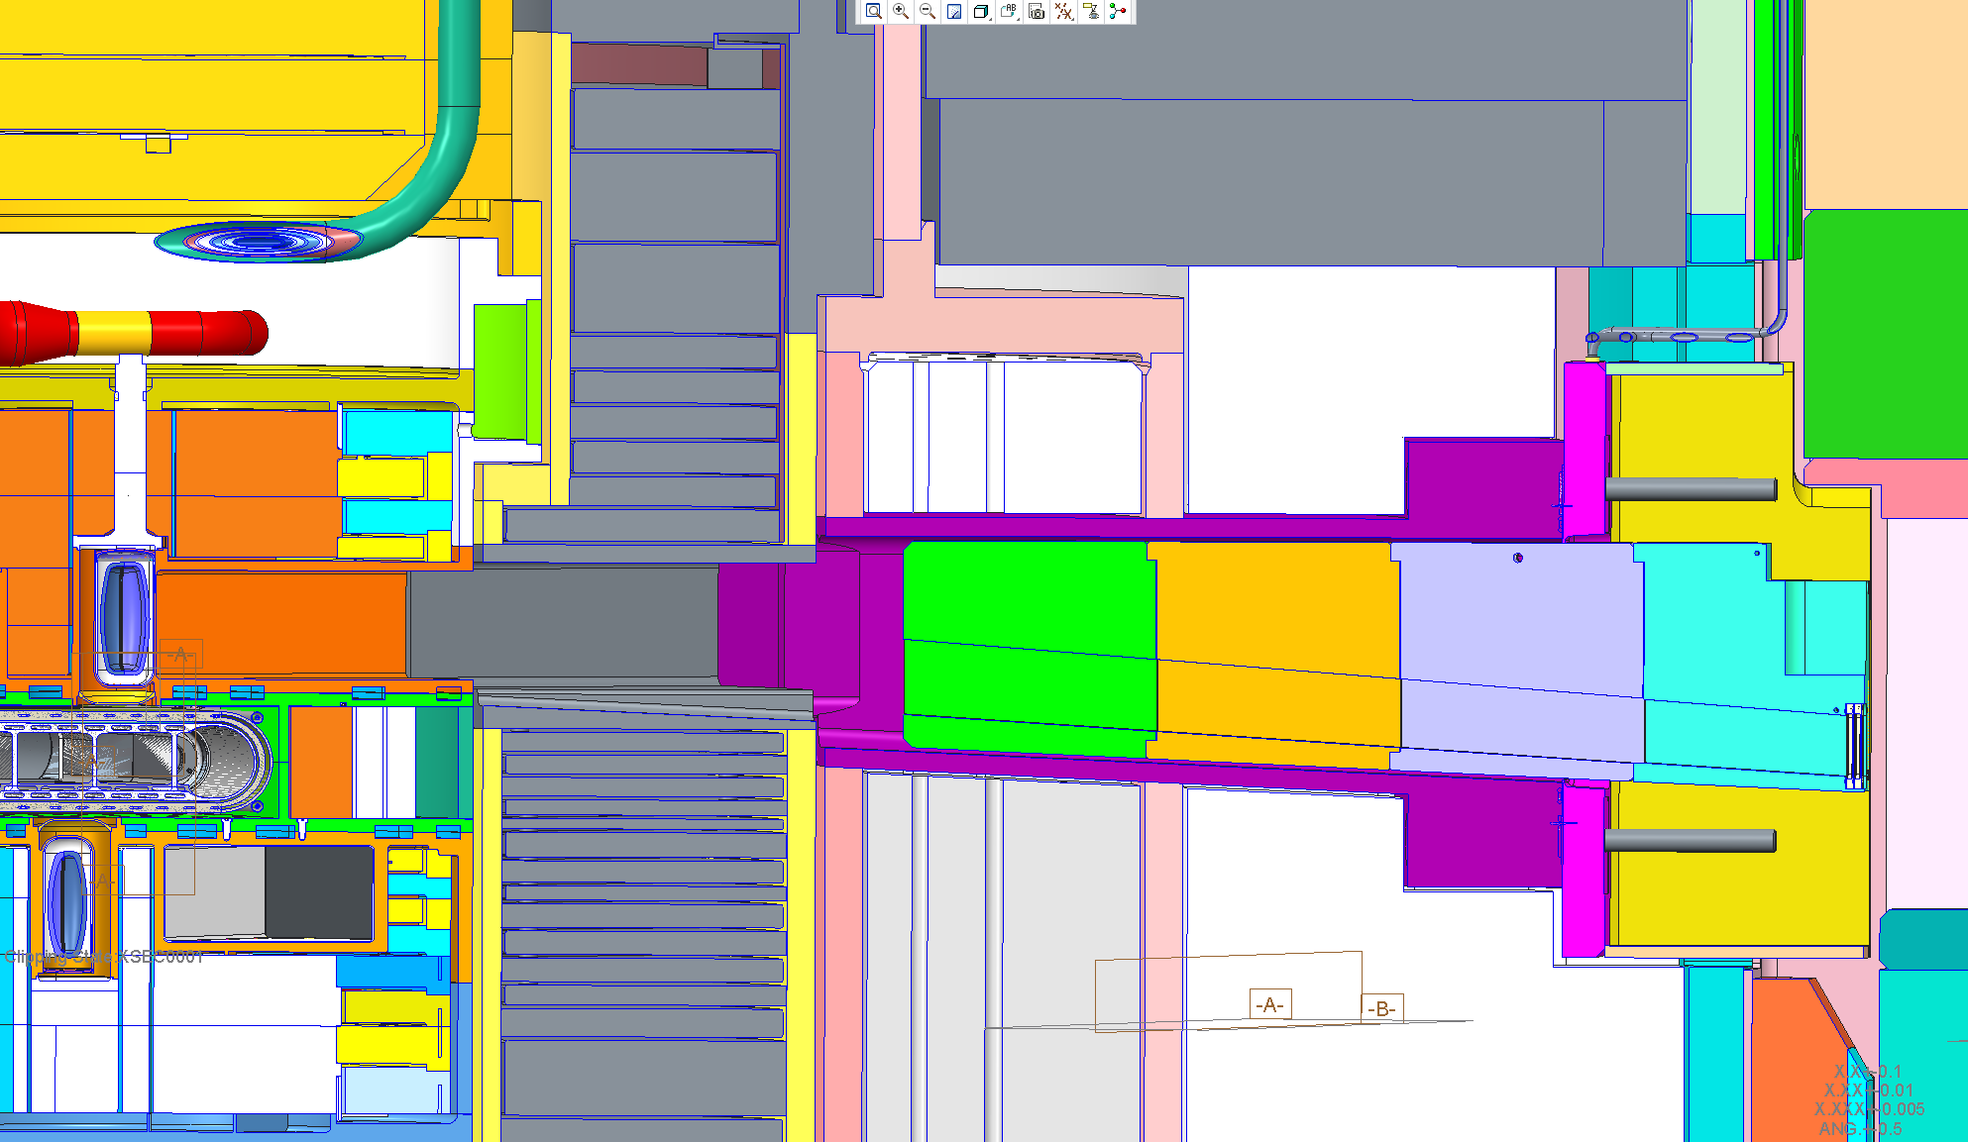
Why did water accumulate in the BL-4B CVI channel and not anywhere else?
BL-4B has the only canted (-4º) CVI channel – has capacity to accumulate ~3.2 liters of water before equilibrium is reached – probably wicking between IRP and ORP

Slide 17
This condition presented a number of challenges had to be addressed
The hydrogen transfer lines and associated vacuum envelopes are Passive Credited Engineered Controls in the Accelerator Safety Envelope
  Filling the helium annulus with water changes the pressure conditions on the outer vacuum jacket, which requires analysis for possible remediation scenarios
  The possibility of freezing the water in the event of a hydrogen leak into the vacuum jacket must be assessed
Operating the core vessel with a humid atmosphere must be assessed for conditions such as galvanic action, corrosion, and so on
  There was evidence of target imaging system mirror damage on the removed PBW
BL-4B (Liquids Reflectometer) could not operate because fugitive water has filled it’s canted CVI channel
Long-term immersion of the Aluminum Window on the BL-4B CVI had to be analyzed to ensure that integrity can be maintained if this condition cannot be remedied (Passive Credited Engineered Control in the Accelerator Safety Envelope)
Capacity for Low Level Liquid Waste accumulation is limited
Notes:
User Office

Slide 18
There was only one viable option to mitigate the leak within the bounds of the approved facility safety basis
Note that the affected circuit also cools the top upstream moderator
Continue operation under the current conditions with water flow extracted at the point of efflux and returned to the loop 3 system
Attempt to seal the leak with a clay / epoxy compound
  Complex problem without knowing details of the size of the leak, configuration and so on
Seal the annular opening and create a static water volume in the helium annulus – eliminated because of engineering analysis/safety basis issues
  May lead to degraded neutronic performance if a water layer develops over the moderator face seen by the instruments
Possibly operate the core vessel in sub-atmospheric pressure Helium condition (while maintaining molecular conduction) or under vacuum – safety basis would have to be modified to permit
Passivate the cryogenic moderator and shut down beam lines 4-6 (last resort)
Notes:
User Office

Slide 19
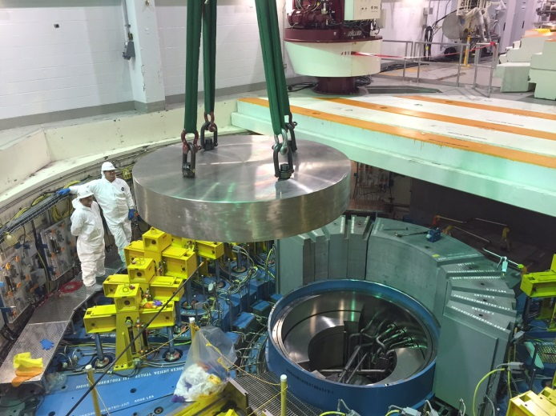
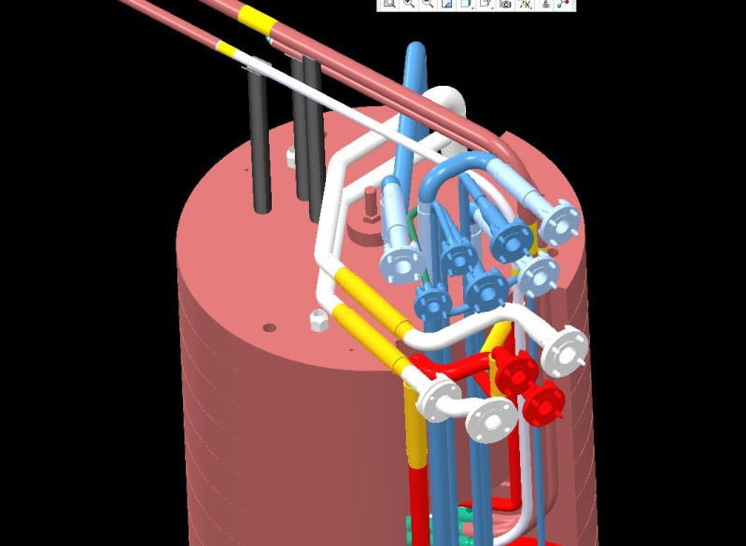
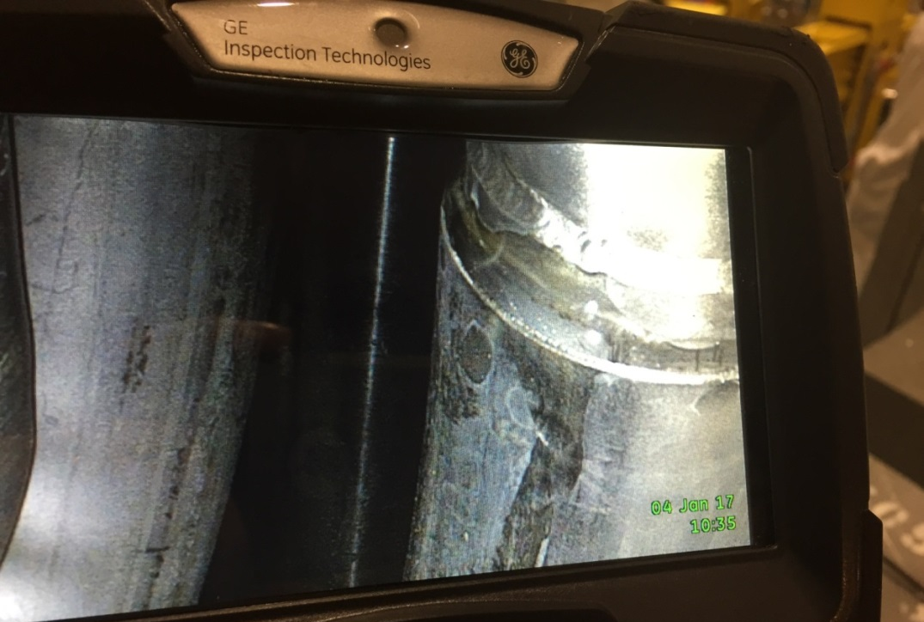
Mitigation of the higher-rate water leak on Loop 3 proved to be challenging
Core vessel lid and shielding were removed
A borescope inspection found water (from a hydrogen moderator cooling & pre-moderator circuit) flowing from an unused helium jacket originally intended to surround the transfer line — exact leak location is unknown and inaccessible
Transfer Line (Vacuum tubing)
1.375” OD
IRP Model
Leak location
Helium Jacket
1.625” OD (.035” wall)
Notes:
RAD

Slide 20
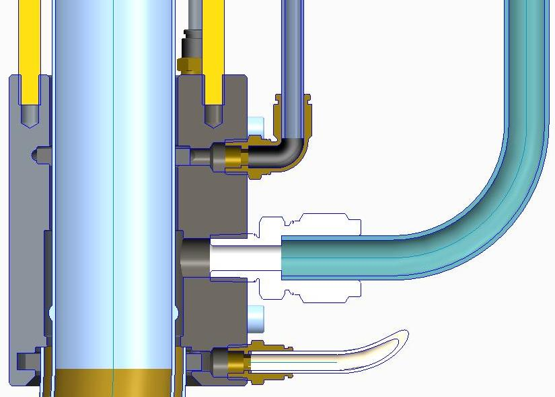
A coupling was designed to seal the emanation point and port the water away
Capacity is up to ~1 gpm – current leak rate is about 1.8 gph
Vacuum tube
Upper Buna-N seal
Threaded rod
Upper RTV port
Water exit port
Internal lip to position clamp
helium tube interface
Lower RTV port
(primary)
Helium tube
Lower Buna-N seal
Notes:
RAD

Slide 21
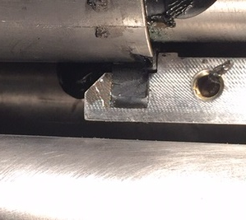
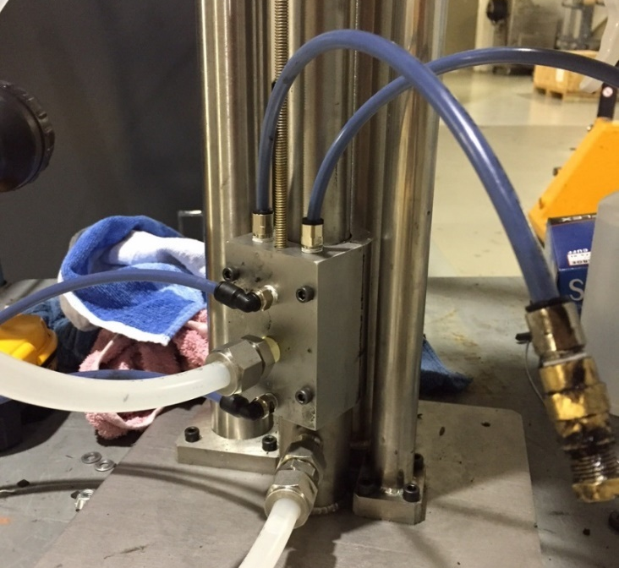
The coupling was thoroughly tested on a mock-up assembly
Two seal designs were considered
A mockup was designed and fabricated to:
  Assess feasibility/ease of installation of the two designs
  Assess the ability to prevent leakage into the core vessel under prototypic conditions
One design option was successful
Per the design, the Room Temperature Vulcanization Silicone filled in well behind the lower seal
Clamp resting on helium tube
Seal cross-section
Notes:
RAD

Slide 22
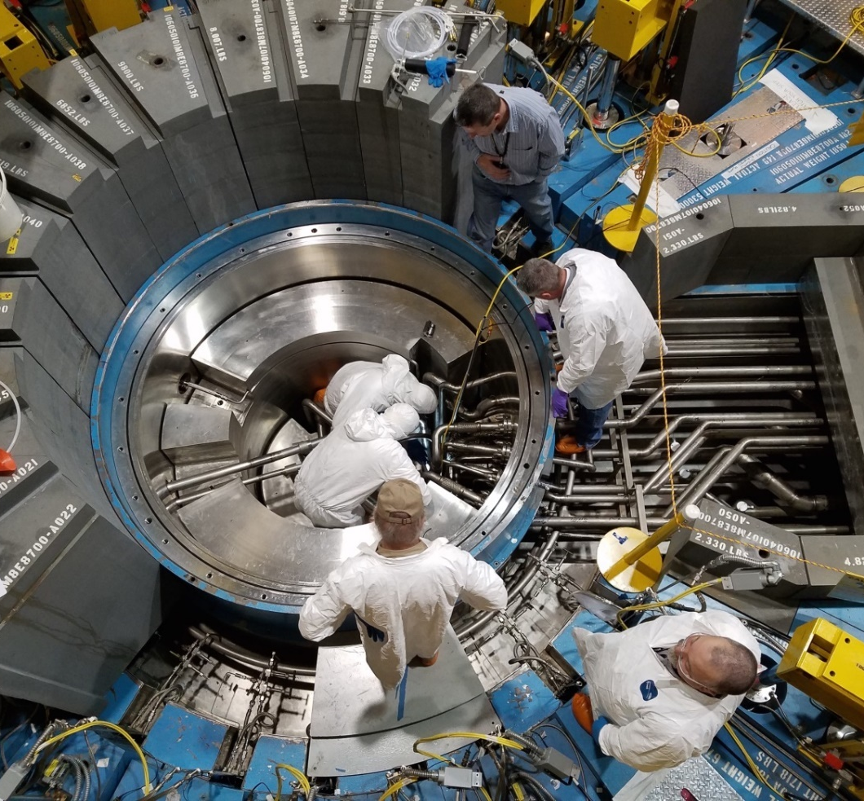
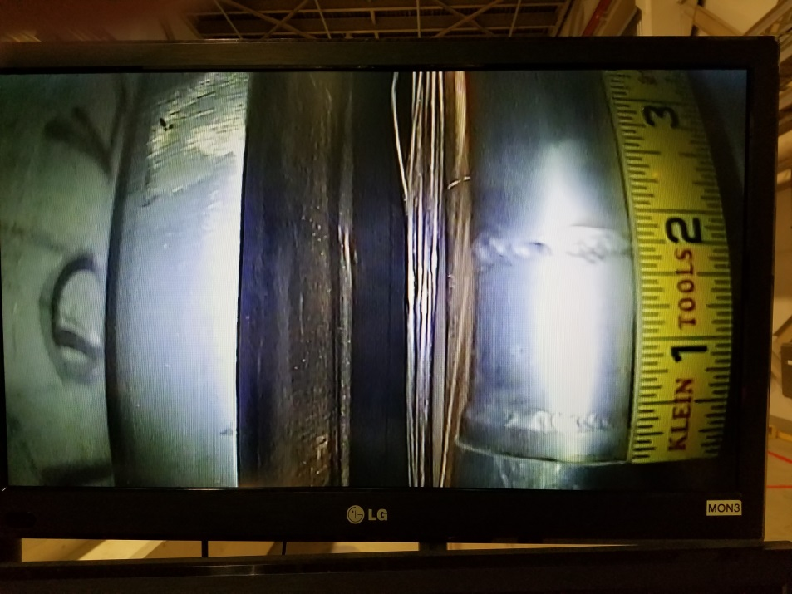
Installation of the coupling was challenging
An initial installation attempt on February 9 revealed unexpected changes in transfer line outer diameter requiring coupling modifications
The coupling was modified and installed after addressing further minor fit-up issues
Notes:
RAD

Slide 23
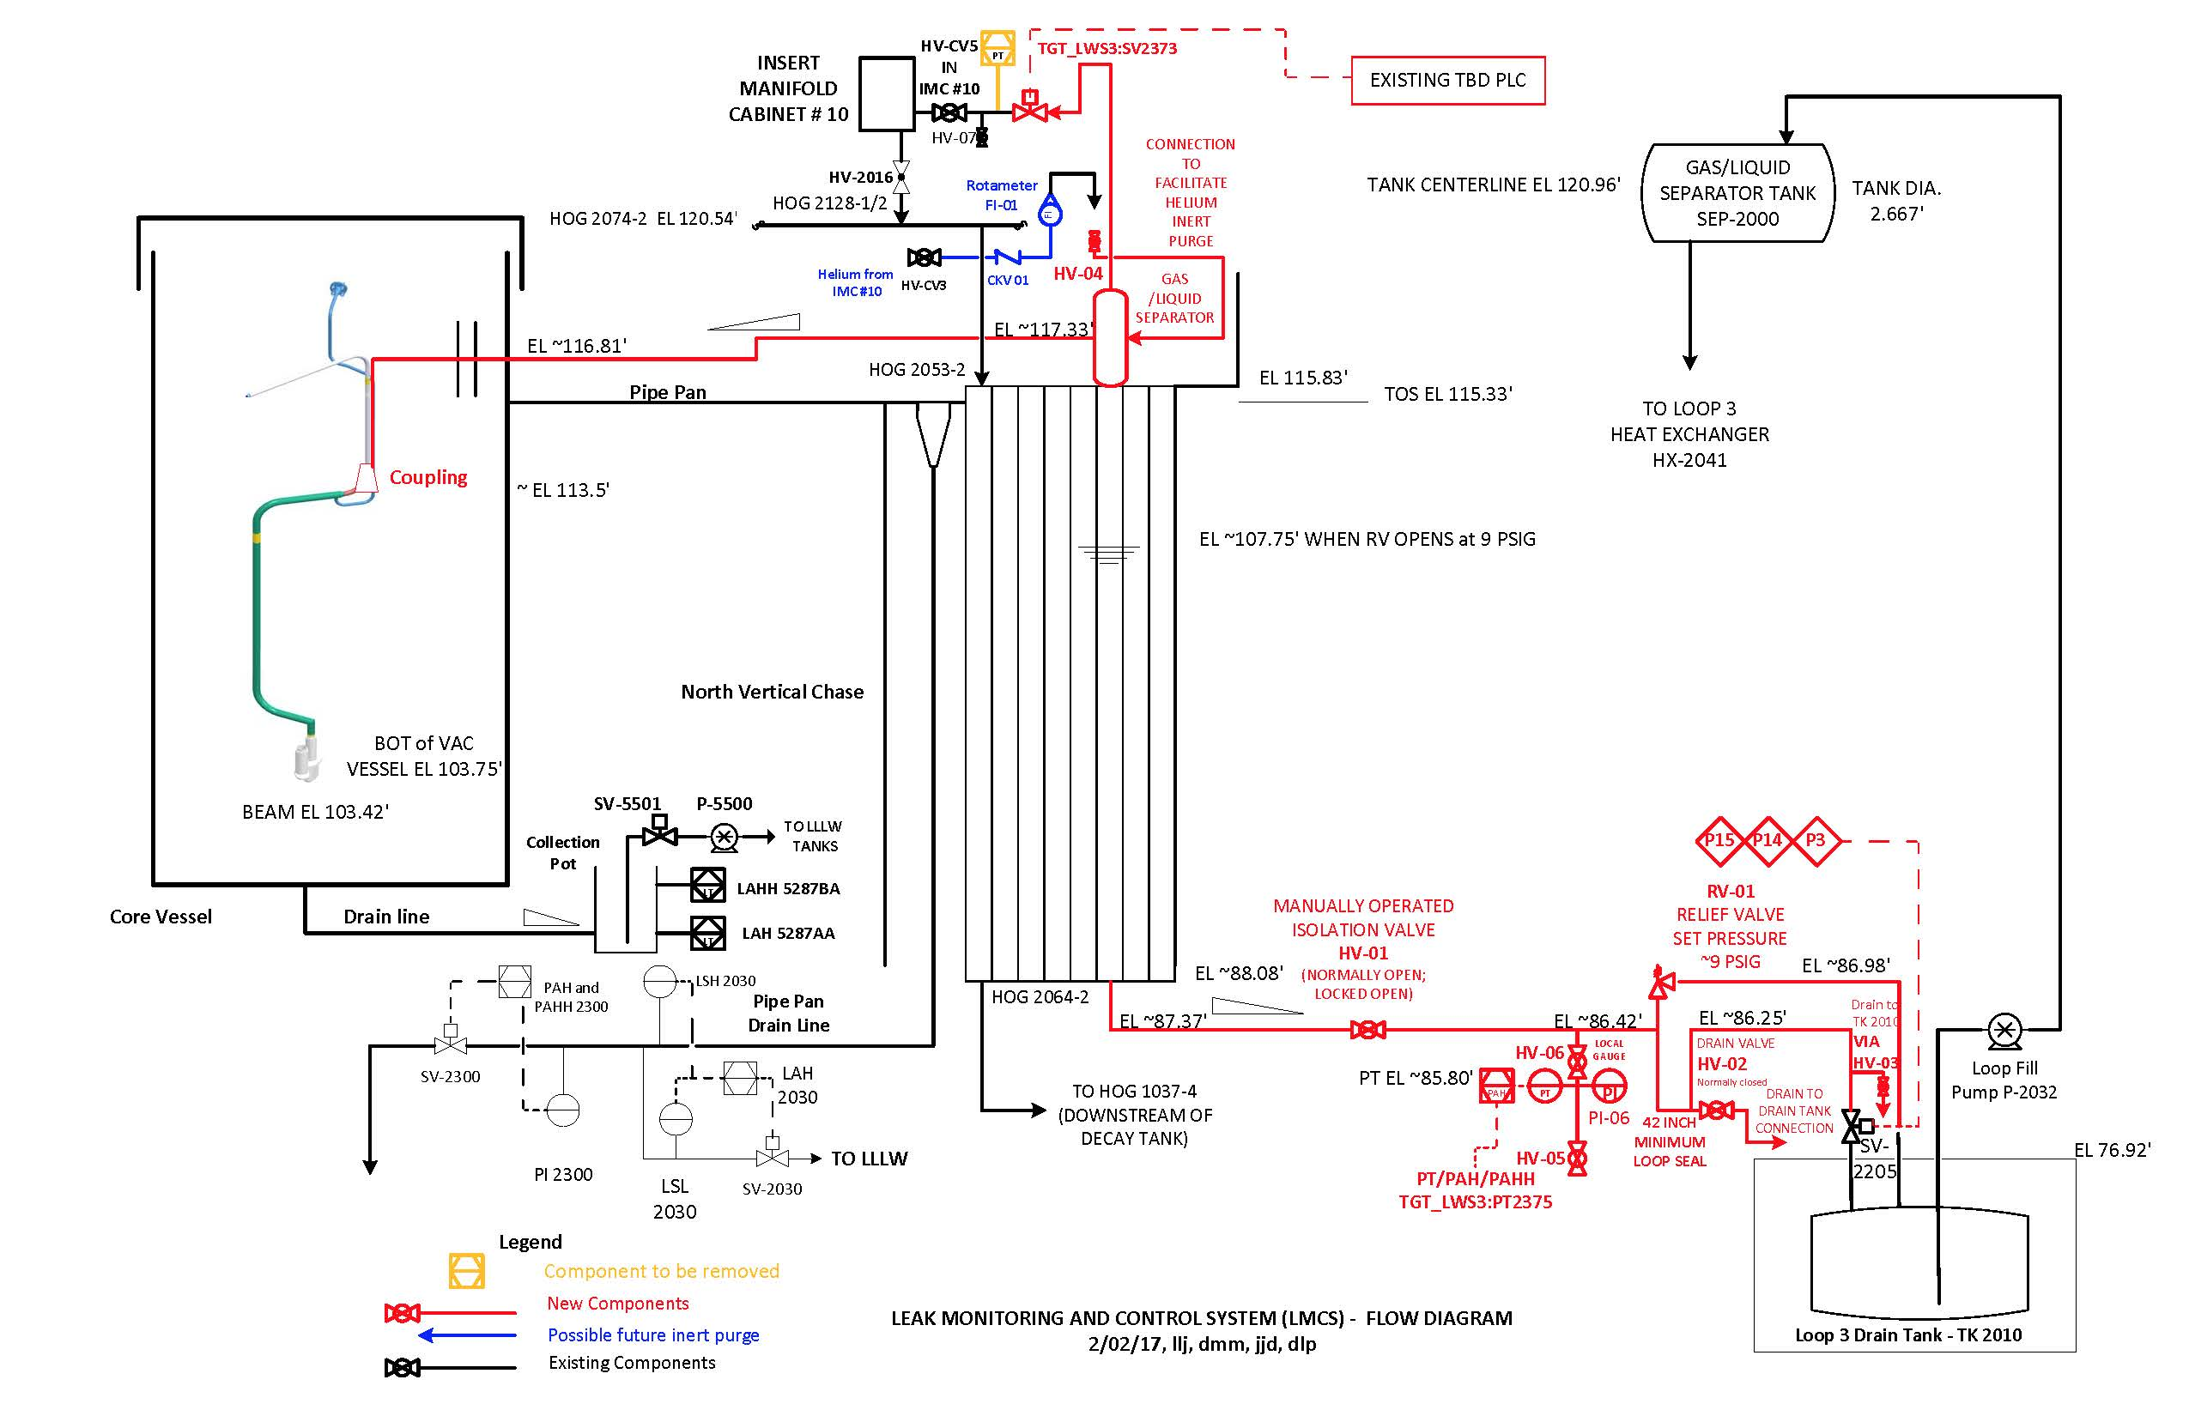
Operational and safety issues required the water to be routed outside the core vessel (vacuum jacket integrity, low level liquid waste, BL-4B)
System is installed and operational
Notes:
RAD

Slide 24
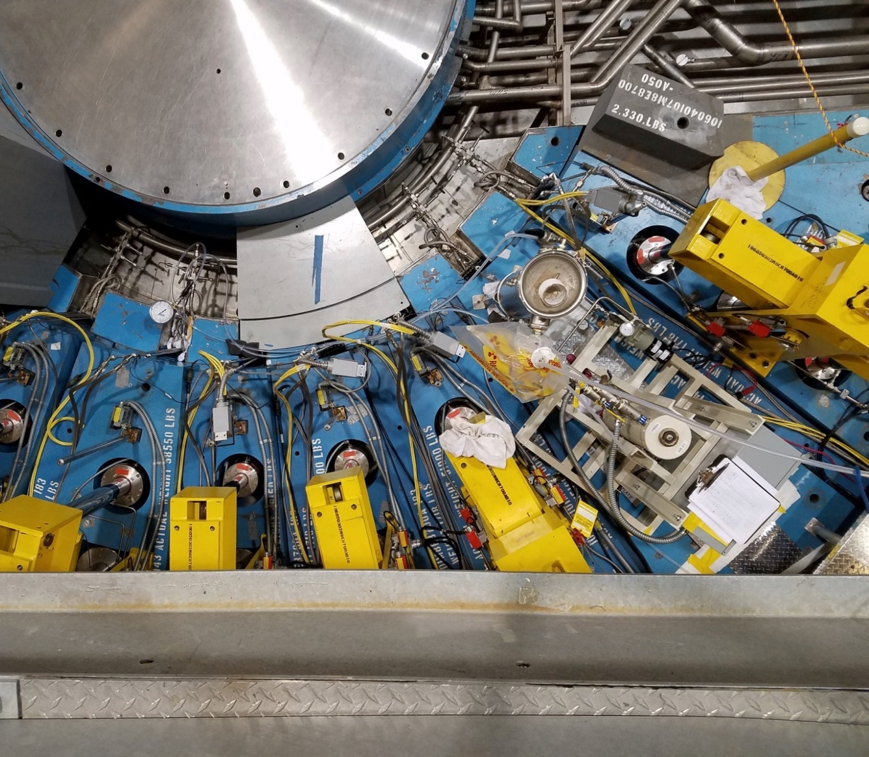
A method was developed and hardware installed to dry out the BL-4B core vessel insert
A temporary hot water pump was attached to the BL-4 core vessel insert (CVI) cooling circuit to force the evaporation of water from the Liquids Reflectometer (BL-4B) side of the dual channel beam line
Available indications are the the strategy was successful
Core Vessel (w/ lid on)
Hot Water Lines Connected to BL-4 CVI;
(Heating began 1/21/17)
Temporary Water Pump w/ Heater (140 ºF)
Notes:
RAD

Slide 25
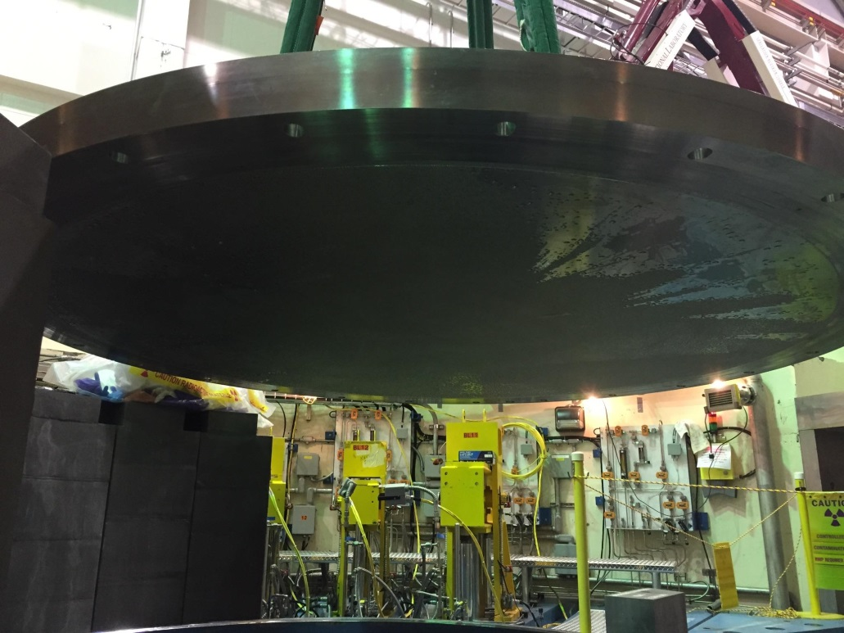
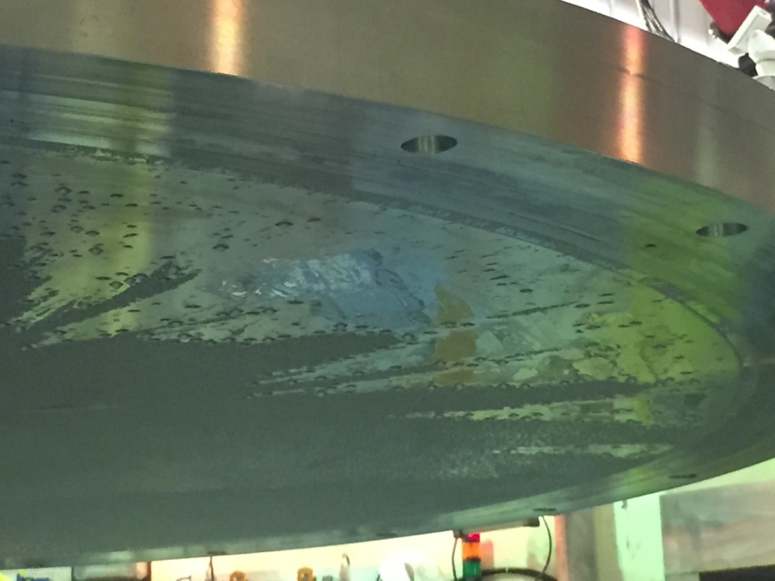
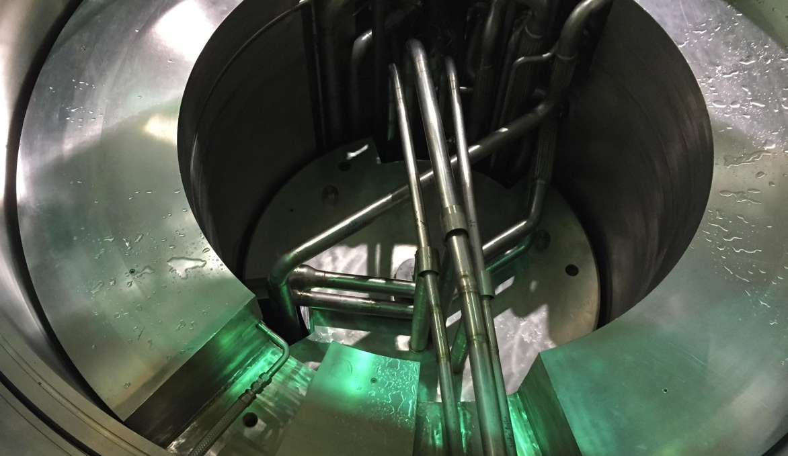
There was direct evidence of water liberated from BL-4B after heating
Condensation Under the Core Vessel Lid
Dripping onto the Inner and Outer Reflector Plugs
Notes:
RAD

Slide 26
All systems were re-assembled and operation has been underway for several weeks
Detailed engineering design analysis calculations done to evaluate presence of water in the helium annulus under a variety of conditions
Unreviewed Safety Issue Evaluation performed based on the detailed engineering calculations – outcome negative
Available indications are the the strategy was successful in re-directing water from the core vessel
Pumping of the drain stand pipe is still required – is there a different leak path we cannot identify
Will the temporary installation last until the end of the calendar year?
  See next year’s meeting!
Can the current IRP service life be extended beyond the end of CY 2017?
Notes:
User Office

Slide 27
We are evaluating impact of the prolonged usage of the current IRP on instrument performance (1)
Decoupled hydrogen beamlines 1-3
Note: Current IRP burnup is 35.5 GWh and will reach
41 GWh prior to replacement
December 2016
December 2017
December 2016
December 2017

Slide 28
We are evaluating impact of the prolonged usage of the current IRP on instrument performance (2)
Decoupled hydrogen beamlines 7-9
Note: Current IRP burnup is 35.5 GWh and will reach
41 GWh prior to replacement
December 2016
December 2017
December 2016
December 2017

Slide 29
We are evaluating impact of the prolonged usage of the current IRP on instrument performance (3)
Decoupled hydrogen beamlines 10-12
Note: Current IRP burnup is 35.5 GWh and will reach
41 GWh prior to replacement
December 2016
December 2017
December 2016
December 2017

Slide 30
We are evaluating impact of the prolonged usage of the current IRP on instrument performance (4)
Decoupled hydrogen beamlines 16-18
Note: Current IRP burnup is 35.5 GWh and will reach
41 GWh prior to replacement
December 2016
December 2017
December 2016
December 2017

Slide 31
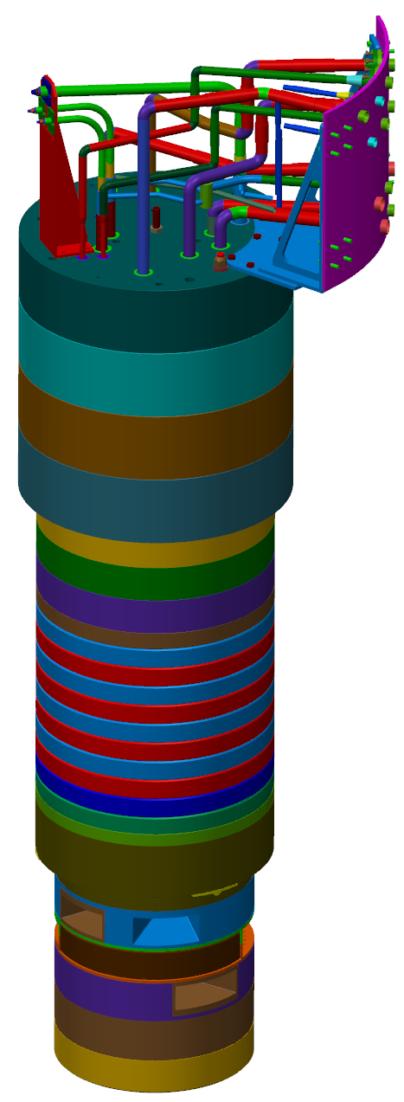
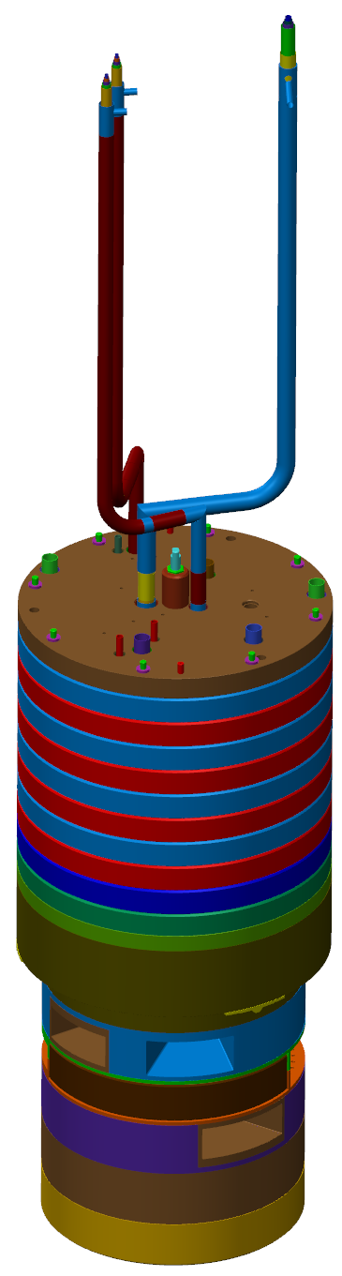
During fabrication, a leak was confirmed in IRP-2 on December 21
Fabrication by the vendor was in the final stages
  Delivery to SNS was scheduled for February 11 to support installation beginning in May
  Assembly of already fabricated components proceeds from bottom to top, and the lower and intermediate IRP assembly was complete
  All of the pre-fabricated transfer lines were installed above the intermediate IRP up through the level of the upper IRP
Final welding, leak testing was being completed to enable installation of upper IRP
  Post-weld leak testing along the full length of the assembly had been completed satisfactorily
The leak was discovered below the level where new welds were being made
Upper IRP
Intermediate IRP
Lower IRP
Status prior to leak
Complete IRP

Slide 32
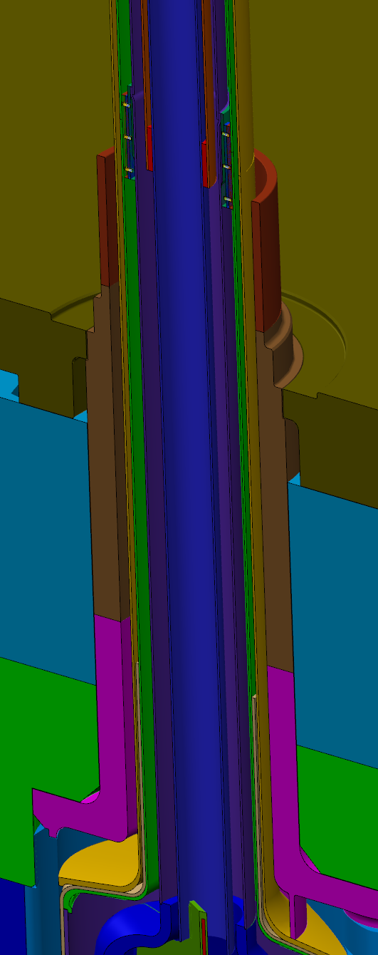
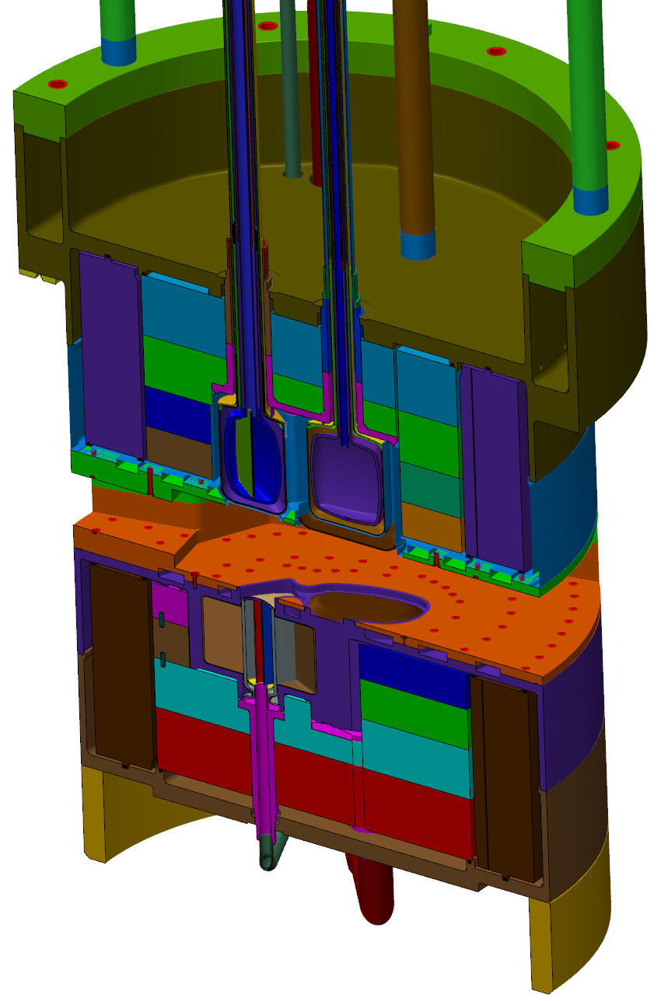
All potential leak locations were evaluated
Easiest to access/repair leak location, aluminum-aluminum butt weld above lower IRP (eliminated by disassembly and testing)
***Either of the remaining leak locations required lower IRP disassembly***
Possible leak location, aluminum- steel friction weld
Confirmed leak location, helium lid fillet weld

Slide 33
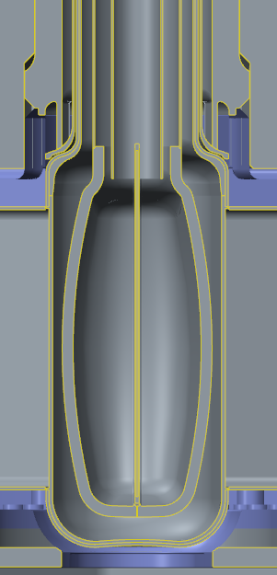
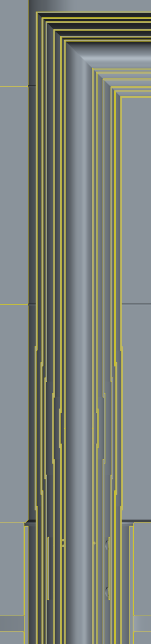
Leak was likely caused by 2 weld induced stresses
Water lid
Water lid weld
Water lid ribs
Small clearance between helium and vacuum lines
Helium lid
2. Helium line piping welds pull up on helium line and lid do to tight clearance in piping
1. Water lid weld shrinkage pushes down on the helium lid locally where rib contacts the top of the helium lid

Slide 34
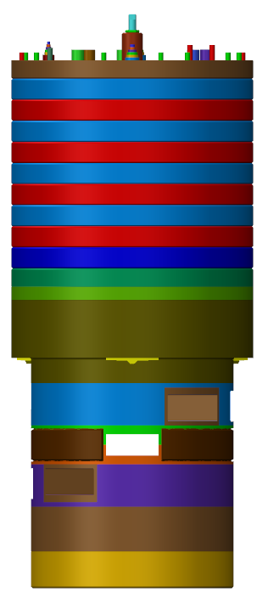
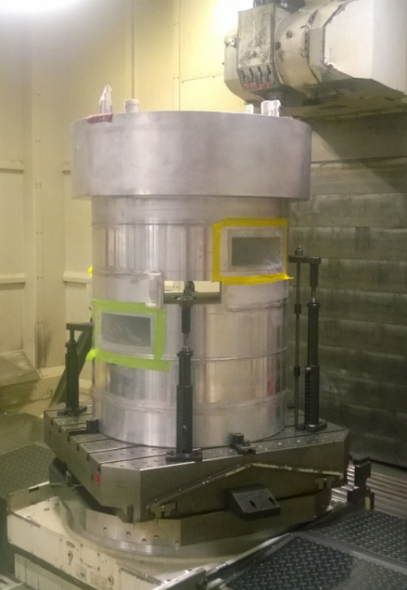
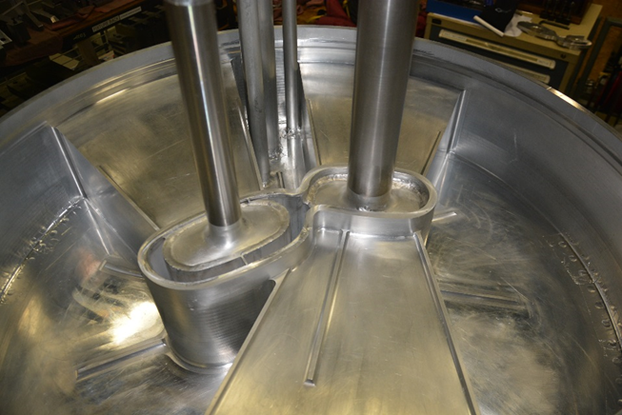
Disassembly to access and remove the helium lid is already complete

Slide 35
Repair options were extensively considered
Three options were evaluated in detail and two are being actively pursued
Schedules have been developed for options 1 and 2
  Option 1: Replace lower IRP plenum with new part
    Ship date: October 2017
  Option 2: Remove and recondition plenum
    Ship date: August 2017
  Option 3: Machine a disk out of the plenum and replace with a plate
    Not being pursued do to welding and repair access risks
  Ship dates are success-oriented with expedited single shift work

Slide 36
Reassembly steps will follow proven processes with adjustments and risk mitigation based on lessons learned
Install helium lid
  Helium lid will be made thicker to lesson thickness disparity and increase leak tightness – this also will reduce any stresses imparted post weld
Re-install Be reflector and stainless shielding – no changes to these components
Re-install lower IRP plenum after refurbishment (spacer added to account for milling during removal)
Install intermediate IRP and piping as done previously
Transfer line piping modified to bring water away from lines before the first 90 degree bends
  This eliminates the chance of weld induced axial stress on the helium line

Slide 37
The impact of the leak and repair effort is significant, so risk mitigation planned on multiple fronts
Fabrication schedule risk mitigation
  Fabrication of several parts not necessarily required by repair path
    These parts may be repurposed for next IRP if not needed
Pursuing direct ORNL support of fabrication activities
  Welding, inspection, leak testing
Design changes for rebuild to reduce / eliminate the understood failure modes
  Changing pipe routing configuration
  Changing weld joint designs
  Increasing thickness of helium lid

Slide 38
The replacement IRP will operate through ~2023 and will be replaced with the 2nd Generation IRP
The 2nd Generation IRP design was being readied for release to fabrication, but this will be held until lessons learned from the IRP-1 and IRP-2 leaks are appropriately addressed
  The goal must be a robust design for both manufacturing and operations, balanced by minimal performance impacts
The first two IRPs had a poor record with regard to manufacturing schedule
  Sufficient time is currently available, but there is no spare and history says we must manage the schedule to minimize risks to facility operation

Slide 39
Status and summary for the replacement IRP
Repair remains on track for August completion
  Replacement helium lid is machined and being prepared to weld
  Initial actions to remove and recondition the plenum indicate that it will be available for reuse
Risk mitigating strategies are being implemented
The impacts associated with shifting the > 3-month long IRP replacement outage have been addressed
  The SNS operation schedule has been modified
  Other activities that were integrated with the long outage have been re-planned
  Instrument performance effects due to continued burn-up of IRP moderator poisons have been analyzed and mitigations have been identified

Slide 40
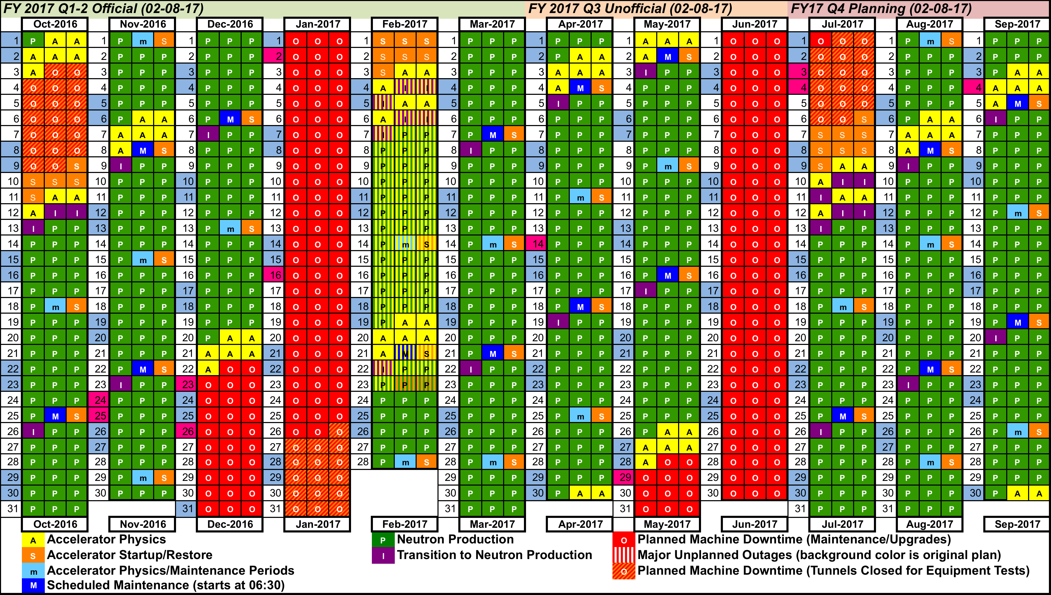
Challenges with the water leak and the assembly of IRP-02 led to substantial changes to the operating schedule
Notes:
User Office

Slide 41
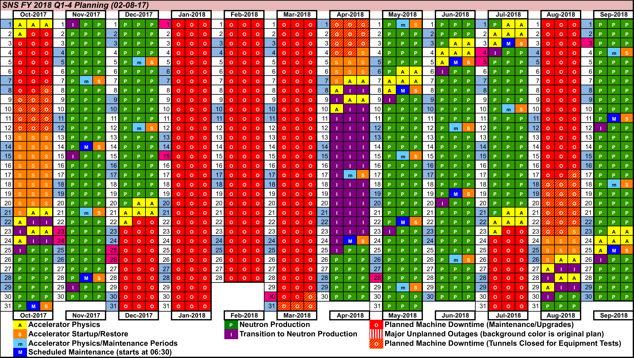
Challenges with the water leak and the assembly of IRP-02 led to substantial changes to the operating schedule
Notes:
User Office

Slide 42
Supplemental slides
Notes:
User Office

Slide 43
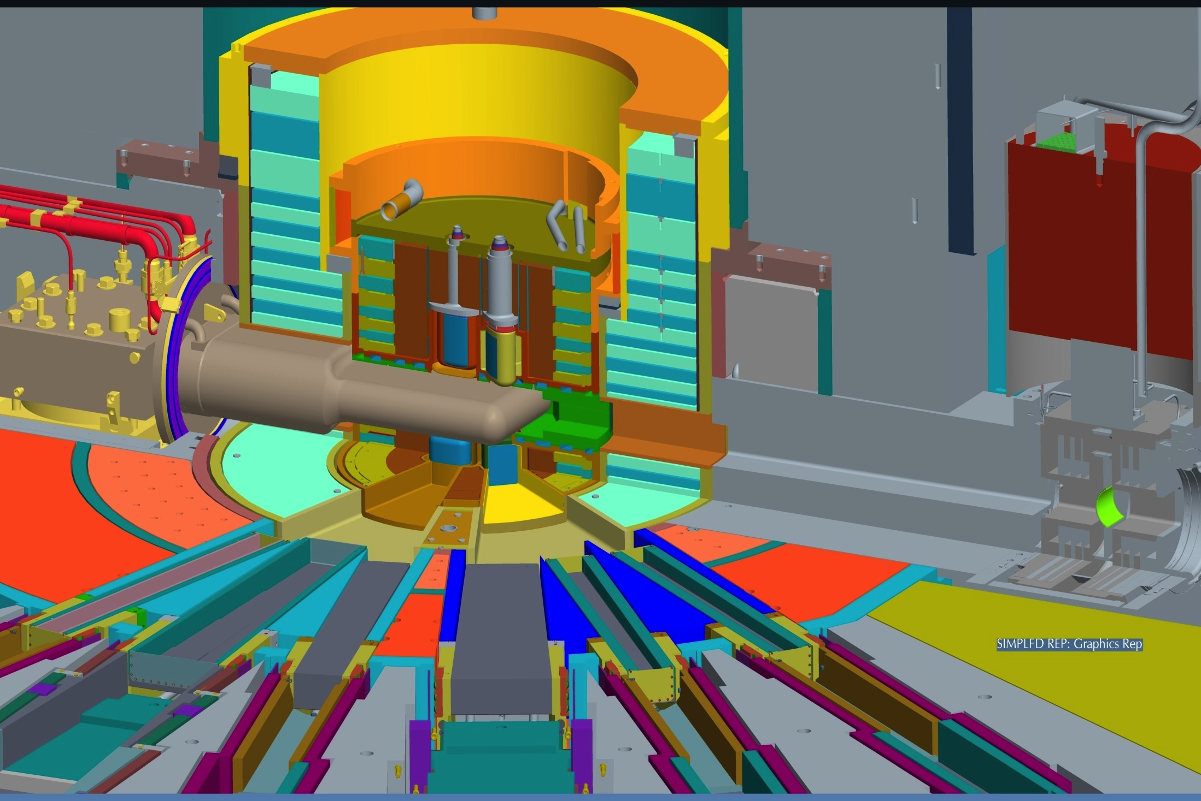
Target
Inner Reflector Plug
Outer Reflector Plug
Core Vessel
Core Vessel Insert
Shutter
Proton Beam Window
Notes:
The SNS has 4 Moderators:
1. Two downstream and one upstream liquid hydrogen
2. One upstream ambient water
Proton Beam Window:
Currently – Inconel 718 (precipitation hardened nickel alloy)
Next Generation Design – 6061-T651

