Slide 1
SNS Accelerator Improvement Projects
Presented to the SNS Accelerator Advisory Committee
George Dodson
Deputy Division Director RAD
March 8, 2017

Slide 2
What are the DOE requirements for an AIP project?
DOE provides AIP funds to SNS for additions, modifications, and improvements to the research accelerator and ancillary equipment facilities to maintain and improve the performance, reliability and efficiency of operations, and to provide new accelerator capabilities; this definition encompasses all systems involved with the production of neutrons for the individual SNS beamlines
AIPs must result in a deliverable that can be identified and the deliverable must have an estimated cost greater than or equal to $500,000, less than $10,000,000 and a lifetime of at least 2 years; fabrication of spares is not allowed in the AIP program (no spare Medium Beta Cryomodule)

Slide 3
How are the AIP priorities established?
Proposed Accelerator Improvement Projects (AIPs) are evaluated against each other at regular intervals using a methodology developed for AIPs that was later expanded for use with all RAD Projects
Criteria used to evaluate the AIPs include three Performance Criteria and two Risk Factors
The Performance Criteria which are :
A. Performance of Accelerator Facilities during Operations
B. Operating Beam Power
C. Obsolescence Mitigation
The Risk Factors are the risks to achieving the sponsor’s goals if the AIP is not undertaken; this total risk is the product of these factors:
A. Probability, the estimated frequency of downtime events if AIP is not undertaken
B. Consequence, the estimated duration of downtime events if AIP is not undertaken
A Poster showing the evaluation is available for viewing

Slide 4
What issues do AIPs address?
Since ~2013, AIPs have begun shifting from addressing design problems with the original installed equipment to what the SNS needs for reliable, predictable operation at 1.4 MW
This includes a recent emphasis on Obsolescence Mitigation since we have been operating for 10 years

Slide 5
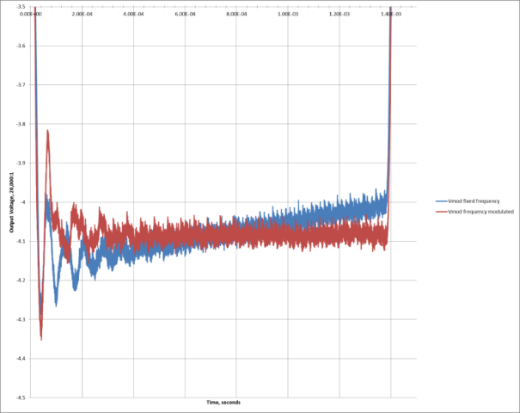
AIPs addressing design problems with the original equipment – HVCM pulse shape
AIP-34: HVCM Improvements (HVCM Pulse Flattening for RF Control Margin)
Originally, the HVCMs ran as “Open Loop” pulse forming networks with no feedback; also, pulse droop reduced RF control margin at the end of the pulse
A new HVCM Controller, with feedback, was developed, tested and deployed
New HVCM controllers have been installed on 11 of 15 production modulators and the test stands; pulse flattening has been demonstrated on all new controller-installed modulators and is currently enabled on 6 systems; droop at end of pulse reduced by factor of 10 improving RF control margin
Inventory is on-hand and staged for installing the remaining 4 new SCL controllers during the upcoming summer outage; funding for the remaining installations is in the 2017 budget
A test stand for full-scale spares testing has also been developed and installed
New Controller with Flattening
Original drooping pulse

Slide 6
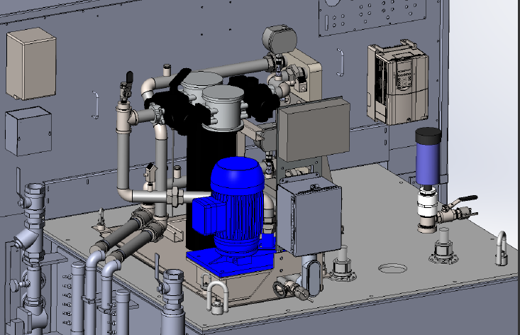
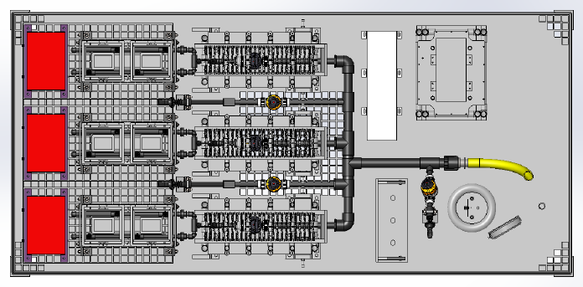
AIPs addressing design problems with the original equipment – HVCM cooling system
AIP-36: HVCM Cooling System Upgrade (Reliability) – Prototype Completed and Tested New Start in FY 2017
Upgrade dramatically improves cooling to reduce component overheating damage; will also reduce oil degradation and downtime due to improved oil flow, external pump, heat exchanger and oil filter(s)
Completed ACCC Review and approval
Continued to monitor 1st Article operation on the test stand

Slide 7
AIP-36: HVCM cooling system upgrade - continued
More reliable self priming vertical pump with higher capacity
Pump/motor assembly can be changed without removing other components
Filter can be swapped during operation w/o interruption
Larger capacity brazed stainless steel heat exchanger
Tank internal cooling piping has been redesigned to eliminate hot spots and direct oil to the critical areas for improved heat transfer
Oil return temperature to the HX dropped from 118 F to 102 F (Design = 115 F max)
Heat removal to the cooling water increased over 250% to 17 KW
Maximum internal surface temperature dropped to 121 F (Design = 160 F max)
Oil Flow has improved by 300% to 44 GPM (Design = 30–40 GPM)

Slide 8
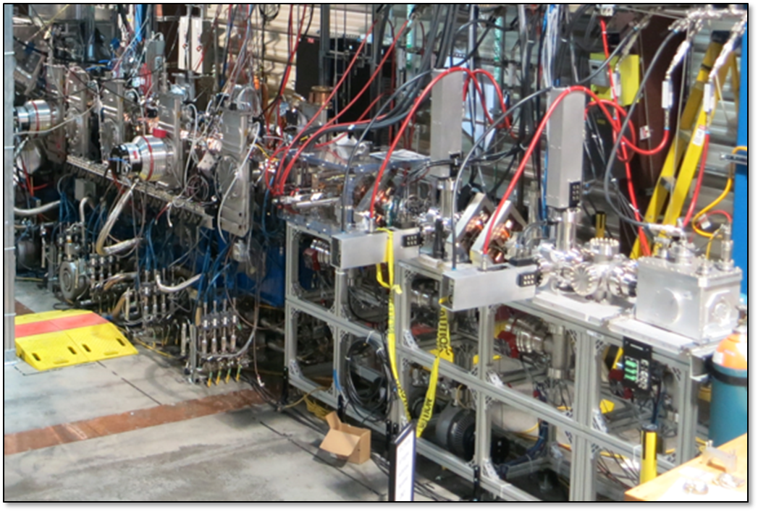
AIPs addressing reliable, sustainable 1.4 MW beam operation - beam current: poor RFQ beam transmission
AIP-30: Integrated Test Stand Facility (Beam Current) –
AIP Completed with 100% of scope delivered and tested; ARR successfully completed
All of the ITSF, since renamed the Beam Test Facility (BTF), hardware was delivered, installed and tested
Commissioning of the new RFQ was outside of the AIP-30 scope, but was also finished; beam transmission is good, 88% at 44mA

Slide 9
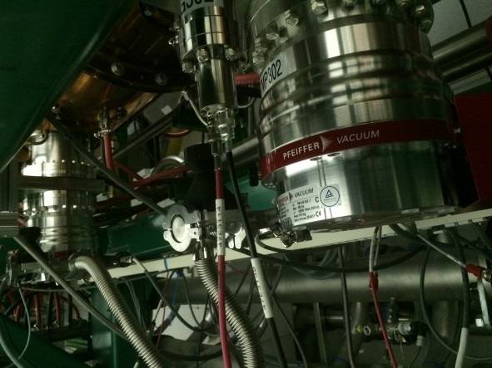
AIPs addressing reliable, sustainable 1.4 MW beam operation - reliability
AIP-35: Warm Linac Vacuum Upgrade (Reliability) – DTL, CCL 3 & 4 and MEBT upgrades are Complete, CCL 1 & 2 are underway in FY 2017
Ion Pumps are replaced with large Turbopumps more suited to the large DTL and CCL accelerating structures, each with many “O” Rings that reduced the number of RF Trips due to vacuum bursts which each took ~30 minutes to recover - this source of downtime stood out in the Accelerator Metrics
In 2016, installed the planned upgrades for the vacuum systems on the MEBT and CCL 3 &4 and pulled the cable infrastructure necessary for upgrading CCL3 & 4 pumps - this AIP will be completed in 2017

Slide 10
AIPs addressing reliable, sustainable 1.4 MW beam operation – obsolescence mitigation
AIP-37: Beam Instrumentation Infrastructure Upgrade (Obsolescence Mitigation) – A resource loaded schedule and budget has been developed – New Start in FY 2017
Replace obsolescent custom components with COTS solution and improve system performance – an example:
Obsolete Custom IBM-PC XP-OS Motherboard dead-end system
replaced by
NI COTS PXIe and FlexRIO with a
RT-OS and an upgrade path

Slide 11
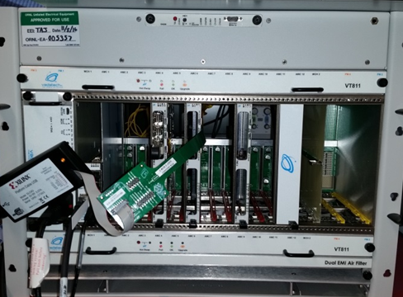
AIPs addressing reliable, sustainable 1.4 MW beam operation – obsolescence mitigation, continued
AIP-39: Machine Protection System (MPS) Upgrade – New Start in FY 2017
Legacy System New System
Decreasing Reliability
Aging hardware => higher probability of failure
Field failure rates are increasing
Lack of integration => more failure points
Declining Maintainability
Increased failure rates reduces spares inventory
Component obsolescence prohibits obtaining adequate supply of spares
Limited Scalability
Current system lacks capacity to be extended for PPU/STS
Limited diagnostics and capacity for developing improvements
Reliable and Maintainable
Simplified and efficient architecture
Highly integrated => failure point reduction
Improved Performance
Lower latency communication links
Scalable Architecture
MicroTCA-based platform
Viable path for major facility upgrades — PPU & STS

Slide 12
Future improvements planned using AIP funding
AIP-46: Warm Linac Magnet Power Supply and Controller Upgrade – Future
Replace obsolescent components, standardize power supplies and controllers for MEBT, DTL and CCL
Power Supplies and Controllers are specified
AIP-42: Warm Linac RCCS Upgrade – Future Funding
Will add redundant pumps, increased capacity, flexibility, instruments and controls for full current beam operation and the capacity to increase for the future PPU needs

Slide 13
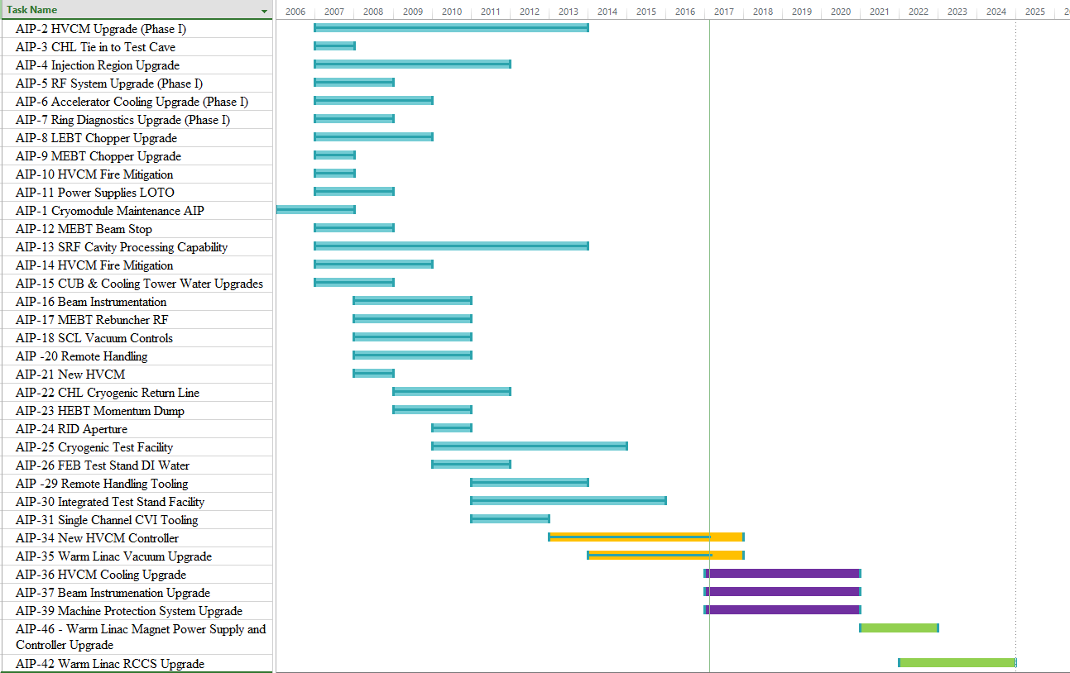
All accelerator improvement projects since 2006
Projects that are:
Completed
Underway
Awaiting DOE Approval
Future Projects

Slide 14
Projects that are: underway, awaiting DOE approval and future projects
These 3 new starts in 2017 consume all AIP funds until 2021 at the current level of AIP funding, $2M per year
The current level of funding does not allow any spending on PPU related improvements, e.g., the Cryogenic Moderator System

Slide 15
Planned and budgeted FY 2016 – 2018 AIPs
 |  | FY 16 |  |  | FY 17 |  | FY 18 | FY 19 | FY 20 | FY 21
AIP Number and Description | Total Project Cost $ | FY16 New BA Request | FY 16 Total Scheduled BA | Costed & Committed FY16 | New FY 17 BA | FY 17 Total Scheduled BA | FY 18 Total Scheduled BA | FY 19 Total Scheduled BA | FY 20 Total Scheduled BA | FY 21 Total Scheduled BA
AIP-34 New HVCM Controller | $ 2,000,000 | $ 364,632 | $ 652,837 | $ (526,754) | $ 120,913 | $ 197,724 | $ - | $ - | $ - | $ -
AIP-35 Warm Linac Vacuum | $ 7,191,000 | $ 1,000,000 | $ 2,373,090 | $ (1,762,014) | $ 681,466 | $ 1,400,000 | $ - | $ - | $ - | $ -
AIP-36 HVCM Cooling Upgrade | $ 2,846,130 | $ 285,368 | $ 285,368 |  | $ 615,505 | $ 615,505 | $ 790,214 | $ 633,622 | $ 718,070 | $ 88,719
AIP-37 Beam Instrumentation Improvements | $ 3,500,000 | $ 250,000 | $ 250,000 |  | $ 396,934 | $ 396,934 | $ 790,214 | $ 633,621 | $ 718,070 | $ 961,161
AIP 39 Machine Protection System Improvements | $ 1,926,231 | $ 100,000 | $ 100,000 |  | $ 185,182 | $ 185,182 | $ 419,572 | $ 637,020 | $ 563,858 | $ 120,599
AIP- 46 WarmLinac Magnet Power Supply & Controller Upgrade |  |  |  |  |  |  |  |  |  | $ 829,521
Subtotal Accelerator Improvement (AIP) | $ 32,049,828 | $ 2,000,000 | $ 3,661,295 | $ (2,288,768) | $ 2,000,000 | $ 2,795,345 | $ 2,000,000 | $ 1,904,263 | $ 1,999,998 | $ 2,000,000
New BA |  |  |  |  | $ 2,000,000 |  | $ 2,000,000 | $ 2,000,000 | $ 2,000,000 | $ 2,000,000
BA Available in FY |  |  |  |  | $ -
We costed/committed ~ $2.288M in AIP funds in FY16 and had $0.76M in carryover; with $2M in FY17 we plan to:
Complete AIP-34: the Warm Linac Vacuum
Complete AIP-35: the New HVCM Controller
Start AIP-36: the New HVCM Cooling Upgrade
Start AIP-37: the Beam Instrumentation Improvement Upgrade
Start AIP-39: the Machine Protection System Upgrade
These 3 new starts in 2017 consume all AIP funds until 2021 at the current level of AIP funding – $2M per year
In FY21 we plan to start:
AIP-46: Warm Linac Magnet Power Supply and Controller Upgrade

Slide 16
AIP funding and spending FY 2007-2016

Slide 17
Other major needs – not AIPs
Spare Medium Beta Cryomodule $2M
CCL Klystron Second Vendor Startup $2M
Additional RF Circulators $1M
Replacement Remote Handling Robot $10M
All non-AIP costs are hardware-only

Slide 18
Summary
We control an active AIP Process
AIPs have shifted over the years from addressing design problems with the original equipment base to what we need for sustainable operation
This includes a recent emphasis on Obsolescence Mitigation
With an installed equipment base of ~$700M, an AIP budget of $2.0 M/Year is not sustainable

