Slide 1
Prioritization Process and Project Planning
Presented to the SNS Accelerator Advisory Committee
Kevin Jones
RAD Director
Glen Johns
SNS Outage Manager
March 8, 2017

Slide 2
Outline
Prioritization Process – K. Jones
Outage Planning – G. Johns
Summer 2016
Winter Outage (2017A)
Path Forward

Slide 3
RAD management developed a project prioritization process in March 2016
Define a project (for the purposes of prioritization)
Establish a dynamic methodology and tool
Recognize that the process is imperfect, and ensure provisions are made for application of management judgment
Cover a broad scope of work, including externally funded projects, instrument upgrades, and so on
Do not yet incorporate day-to-day and periodic maintenance activities – responsible line management must balance resources using the outcome of this process

Slide 4
The definition of a project was important to moving forward
Every project has a beginning and an end
Every project produces a unique product
The term “project” recognizes the applicable elements of the full life cycle of an initiate for the defined scope of work:
Concept development and engineering design
Prototyping, testing, and manufacturing
Installation, commissioning, documentation, readiness for operation
Projects are divided into two types, each of which carries with it specific requirements
Capital projects
Non-capital projects

Slide 5
Project categorization, typically based on funding stream, is also important
Five categories of project were identified
Accelerator Improvement Project (AIP) – a capitalized project funded through the SNS Operations Field Work Proposal using funds set aside specifically for this purpose
General Plant Project (GPP) – a capitalized project funded through the SNS Operations Field Work Proposal using funds set aside specifically for this purpose
Institutional General Plant Project (IGPP) – a competitively selected capitalized project (at the ORNL level) funded through Institutional Overhead using funds collected from program levies set aside specifically for this purposes
Line Item Construction (LI/MIE) – a major construction project (that may be designated as a Major Item of Equipment that is approved and separately funded in the Congressional appropriation process
Operational Improvement Project (OIP) – a non-capitalized project funded through the SNS Operations Field Work Proposal

Slide 6
The relative importance of projects is considered within the context of mission imperatives using five criteria
Deliver predictable and reliable operation against the published operating schedule
Maximize operating power consistent with target longevity
Improve facility capability
Respond to external drivers
Support priorities established for scientific instrument upgrades, LDRD projects, and other externally funded projects

Slide 7
A scoring and weighting methodology was developed to assess importance of these criteria
Scoring is discrete, not continuous: scores of 0, 3, 6 or 9 are allowable depending on the number of factors within a particular criterion that the project addresses
The relative weightings of the first four criteria that focus on accelerator systems were empirically determined to be:
Deliver predictable and reliable operation against the schedule (4.0)
Maximize operating power consistent with target longevity (3.0)
Improve facility capability (2.0)
Respond to external drivers (2.0)
Maximum score for a project is 9*(4+3+2+2) = 99
Stand-alone or science priority projects that are not accelerator-related must compete on an equal footing
Support priorities established for scientific instrument upgrades, LDRD and other externally funded projects (8.0)
Maximum score for a project is 9*8 = 72
This is ~75% of the maximum score available to a project that does not meet this criterion, and reflects that this score might be adjusted by a low non-zero score from the first four criteria
Final criterion score is obtained by summing the two scores

Slide 8
Risk management also plays an important role in assessing the impact of a project
Risk is assessed in terms of the probability of failure leading to down time and the consequence of that failure
The concept can also be applied to neutron scattering instruments and research projects
Allowable values for probability are discrete – integers 1-5
Allowable values for consequence are discrete – integers 1-5
The risk score is the product of the probability and consequence scores (Discrete range of 1-25)
Safety is incorporated by scoring a safety-related project impact on a discrete scale of 1 (no consequence), 10 (likelihood of a recordable injury if project not done), 50 (likelihood of a disabling injury if project not done) or 100 (likelihood of a fatality if project not done)
The overall impact score for a project is then obtained by multiplying together the criterion and risk scores, dividing by 10, and adding the safety score

Slide 9
Here’s a snapshot of the tool – legible version on wall

Slide 10
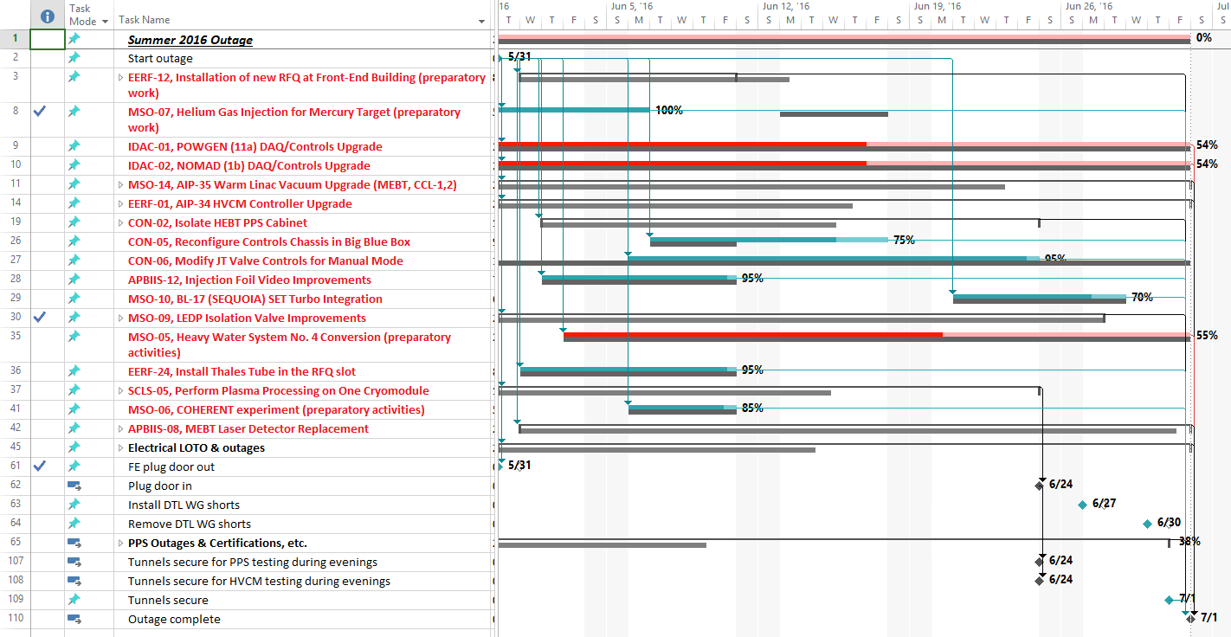
Summer 2016 outage planning represented a first step forward
Developed high level block schedule (early in process)
Created MS Project based on priority activities from memo
Initially added routine maintenance activities (later removed)
Not resource loaded
Used 3-day look ahead slides from task leaders at POD
Updated the project file weekly
Qualitative use of critical path but no additional metrics utilized

Slide 11
Preparations for Winter Outage (2017A) planning began after the summer outage was complete
Held a Lessons Learned meeting
Formalized high priority activities (memo)
Developed high level block schedule
Hired a Project Controls professional with support from ORNL PM Office
Claresa Esteppe
Claresa gave training on Project Management fundamentals and our expectations for collecting activity details
Began developing the resource-loaded schedule…...

Slide 12
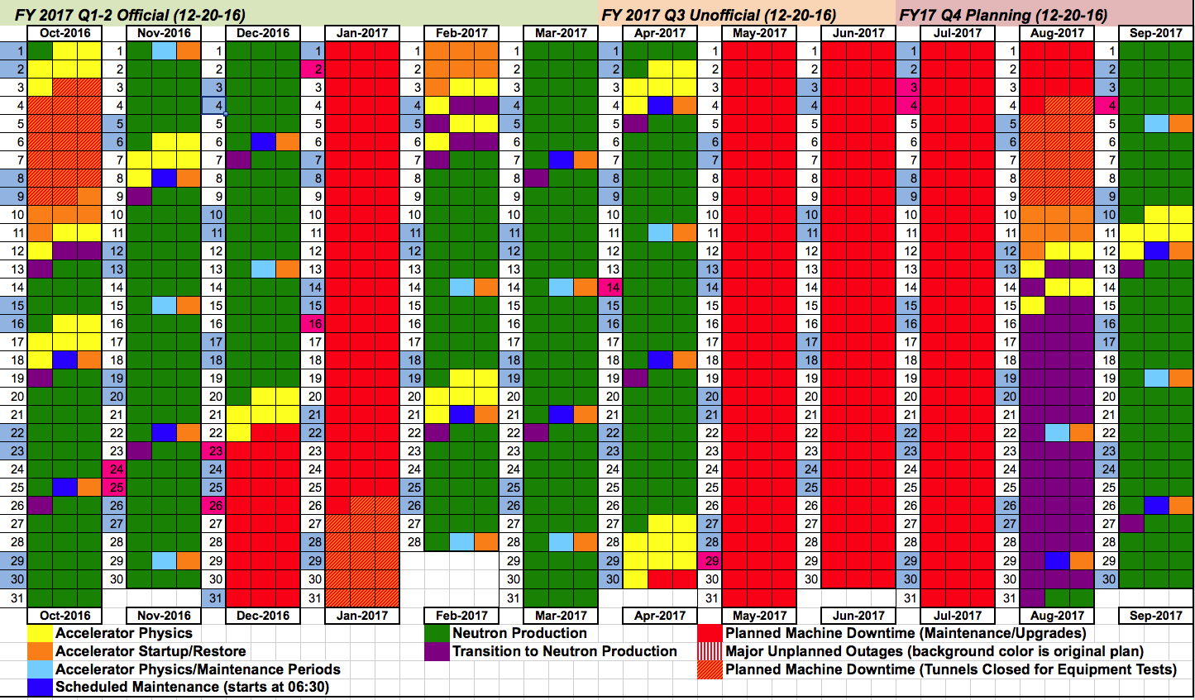
Significant events necessitated schedule changes that made planning challenging
As of 11/30/16 - outage length – 29 days
As of 12/20/16 – outage
length – 41 days

Slide 13
Emergent work added to the scope of the 2017A outage was substantial
Original priority list (10/21/2016)
IDAC-03 – MANDI DAQ/controls upgrade
EERF-01A – RFQ HVCM controller upgrade
MSO-32 – Reconfigure LEBT foreline valves and controls
SSG-04 – 8700 AHU #9 controls upgrade
Proton Beam Window replacement
IPPS certifications
Instrument maintenance
Routine/planned maintenance
As executed list
IDAC-03 – MANDI DAQ/controls upgrade
EERF-01A – RFQ HVCM controller upgrade (3 additional)
MSO-32 – Reconfigure LEBT foreline valves and controls
SSG-04 – 8700 AHU #9 controls upgrade
Proton Beam Window replacement
IPPS certifications
Instrument maintenance
Routine/planned maintenance
Target replacement
Core vessel leak mitigation
Full PPS certification
Core vessel insert drying

Slide 14
We maintained the block schedule showing major constraints on key system availability

Slide 15
We actively managed the schedule during the 2017A outage
Two week look ahead provided on Monday
Weekly updates on Thursday
Email
Project file
Hardcopy markup
3 day look ahead slides used at POD
Daily updates starting week of 2/6
Tracked ~600 activities

Slide 16
The path forward is becoming more robust as we gain experience
Conduct a post 2017A Outage Lessons Learned meeting
Hire a permanent project controls specialist (job posted)
Set priorities and plan the June (2017B) and October (2017C) outages
Develop planning schedule for between outage activities
Gas injection
IRP readiness
Heavy water conversion
Spare medium beta cryomodule
Spare CHL carbon bed
RFQ swap preparations
Develop 2018A outage plan (long Winter outage)

