Slide 1
Beam Test Facility Performance Update
Presented to the
SNS Accelerator Advisory Committee
Alexander Aleksandrov
SNS Beat Test Facility Manager, APBIIS
March 9, 2017

Slide 2
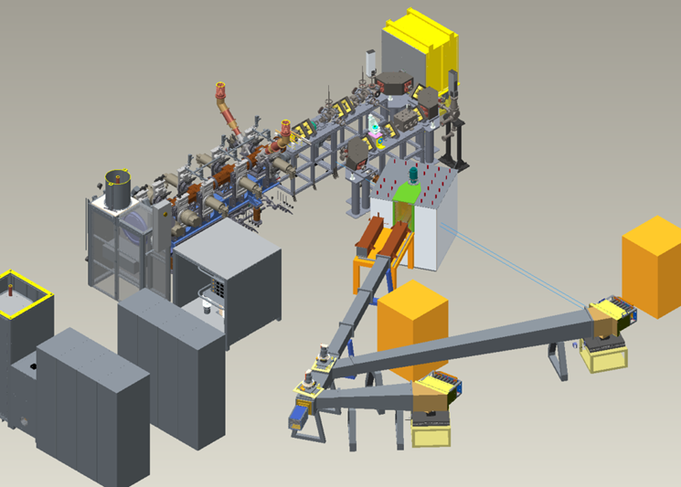
SNS Beam Test Facility (BTF) layout, former ITSF
High Power beam stop
MEBT
RFQ
Low Power beam stop
Ion Source and LEBT
Particles | H⁻
Energy | 2.5 MeV
Current | < 50 mA
Pulse width | < 1 ms
Rep rate | < 60 Hz
Beam Power | < 7.5 kW

Slide 3
SNS Beam Test Facility goals
Acceptance test of the new RFQ
  Output beam parameters to satisfy SNS requirements
  Operational characteristics to be better than for old RFQ
Test stand for SNS accelerator systems development
  External antenna Ion Source
  New Beam Loss Monitor data acquisition
  New Timing Master
  PPS detectors
  …
Test stand for accelerator physics R&D
  Halo formation in high intensity beam
  …
Proton source for other applications
  Moderator Demonstration Facility
  …
Done
In progress
In progress
In planning

Slide 4
BTF PPS enclosure
2.5 MeV proton beam
Two modes of operation
  50mA, 1ms, 60Hz =7.5 kW (high power)
  50mA, 50us, 10Hz = 63W (low power)
Restricted area surrounded by fence
  Interlocked gates
  Radiation Area when beam is on
  RWP, EPD are required inside the fence
Unrestricted area outside fence
  general personnel allowed
Credited PPS system
  1 Chipmunk
  20 mrem/hour prompt (2s)
  2.5 mrem/hour rolling avg (15min)
PPS and MPS functions controlled by
Chief Operator in CCR
24/7 operation is allowed when CCR is staffed

Slide 5
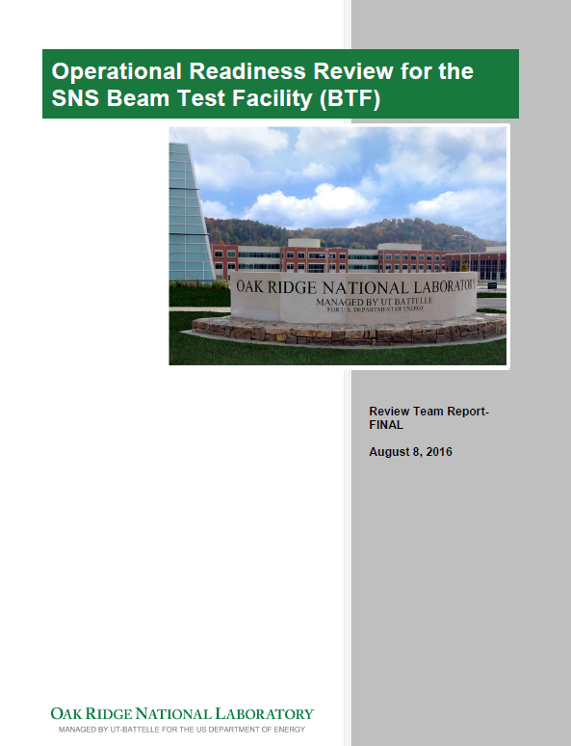
Beam Test Facility readiness review
August 2, 2016
Reviewed safety, organization and operational aspects
  Lead by Alan Tatum (ORNL)
  Mostly non-RAD reviewers
Did not find major problems
  21 pre-start action items
  11 post-start action items
All closed by now

Slide 6
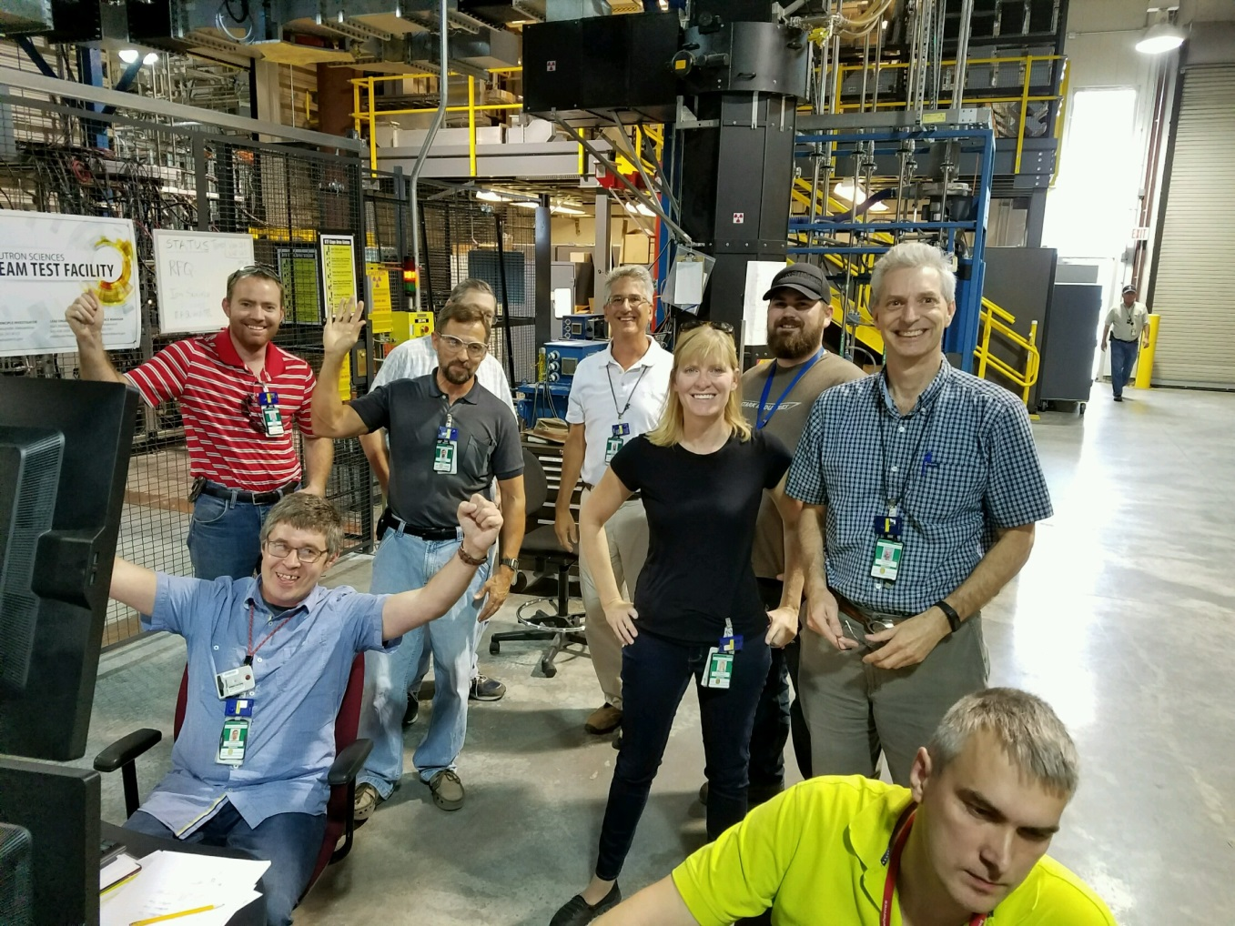
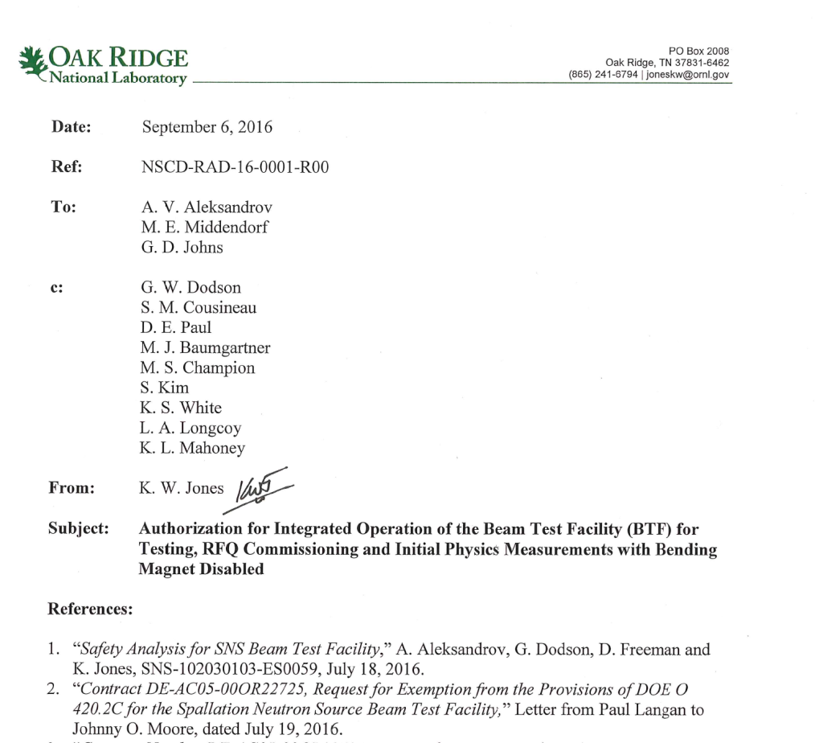
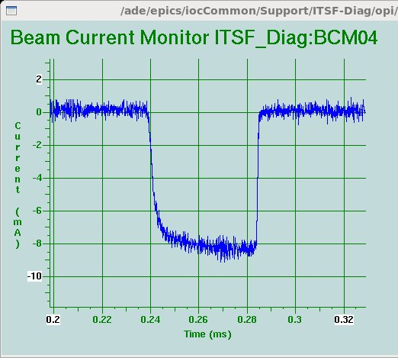
Approval and first beam
Courtesy of R. Welton
First beam out of the new RFQ!
September 8, 2016
8 mA
Received authorization to run the facility on September 6th 2016

Slide 7

Measurements and tests required for RFQ characterization
Beam current (transmission)
Beam energy
Transverse beam emittance
Longitudinal beam emittance
Stable operation with nominal beam power (high power beam test)
Recovery after ion source replacement
Sensitivity to ion source replacement

Slide 8
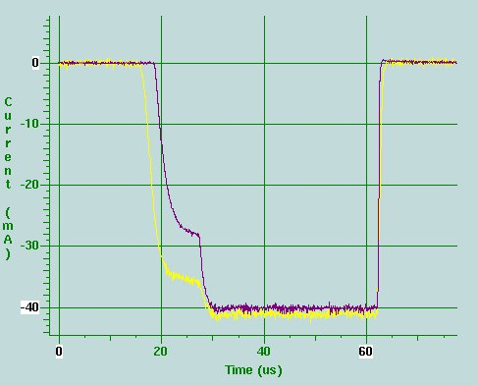
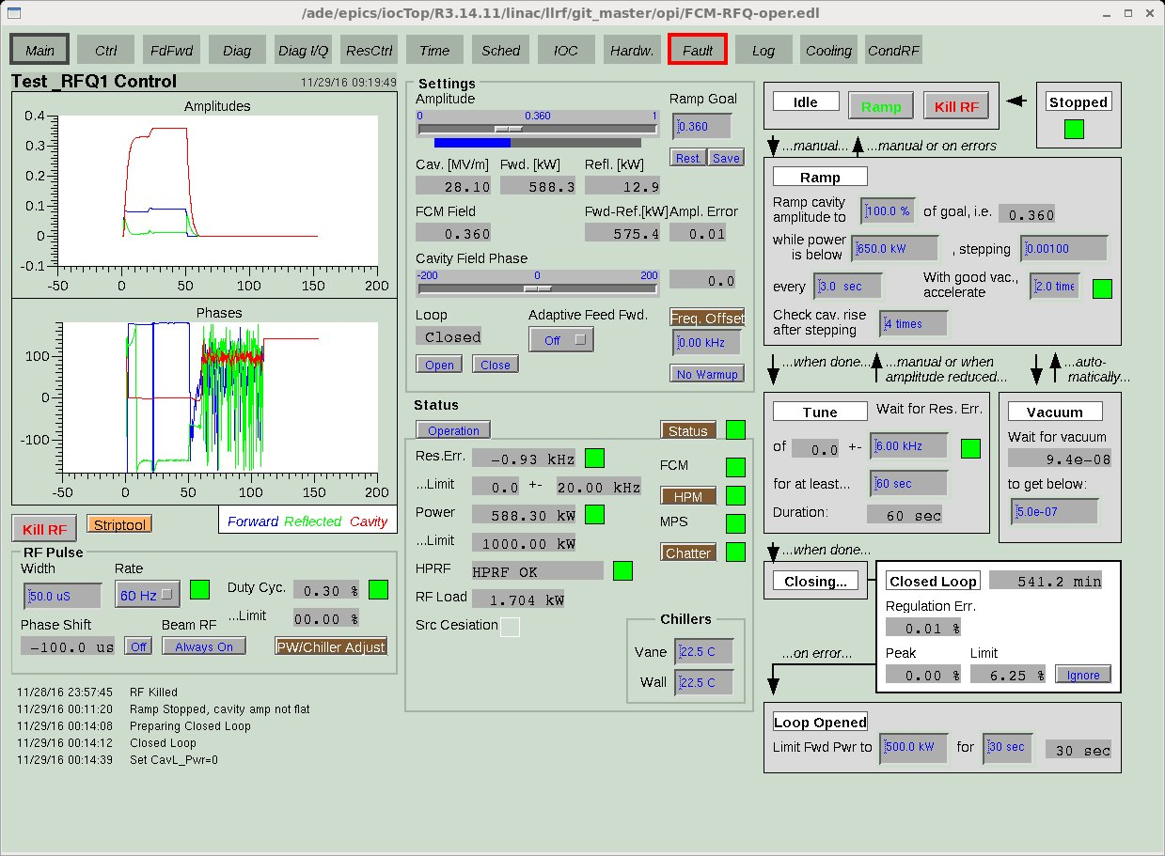
Short beam pulse (50μs) operation
BCM04
BS06
BCM04
BS06
LLRF feedback transient
Ion source is always at full duty factor (1ms, 60Hz)
MPS limits RFQ duty factor to 50μs, 60Hz
Timing system controls overlap of IS and RFQ pulses: 1Hz, 2Hz, 5Hz or 10Hz
RFQ pulse can be positioned anywhere inside IS pulse
No chopper at BTF
RFQ RF field amplitude

Slide 9
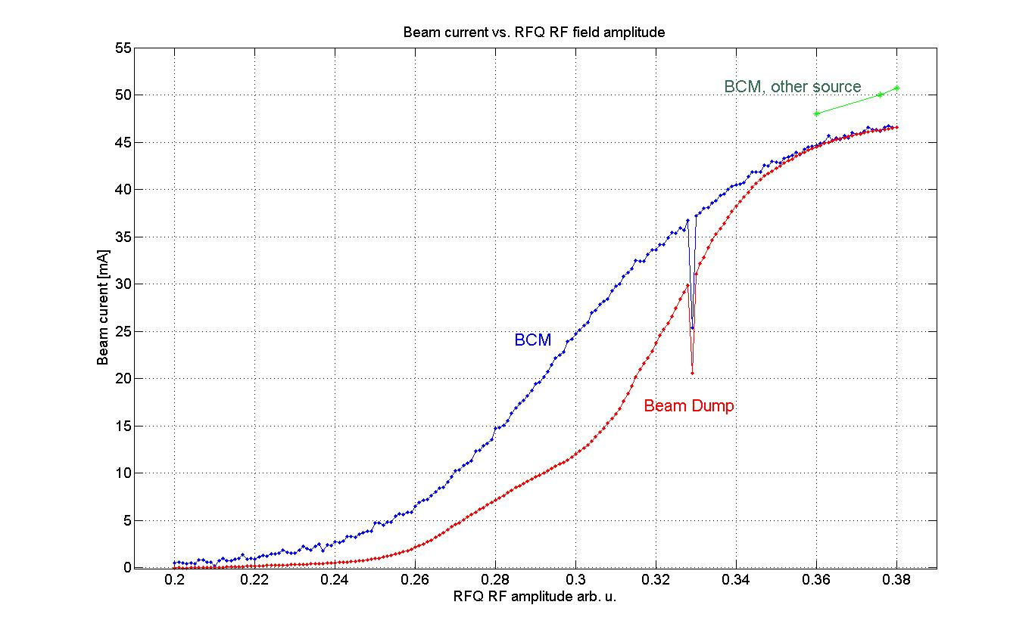
RFQ output beam current vs. RF field strength
design set point -
83kV inter-vane voltage

Slide 10
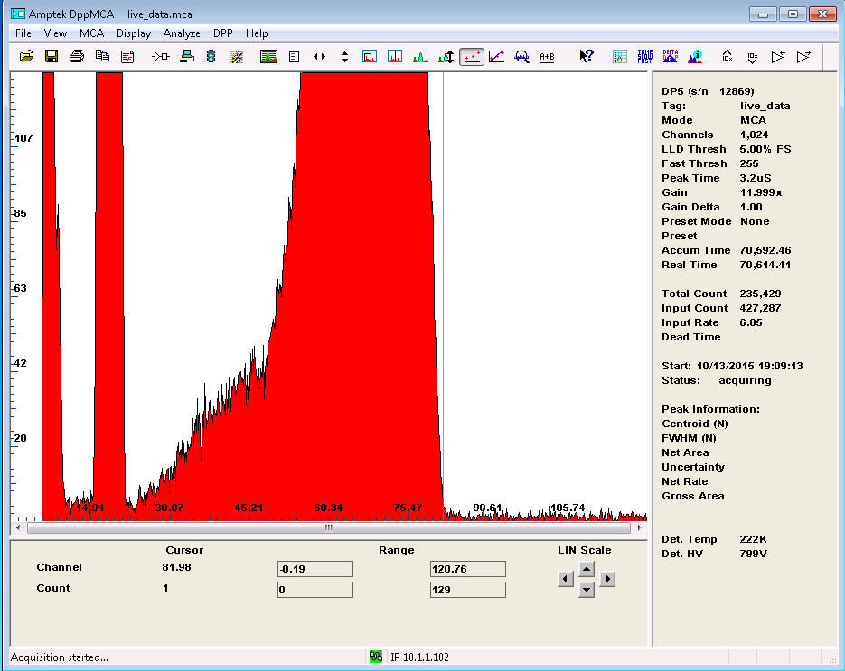
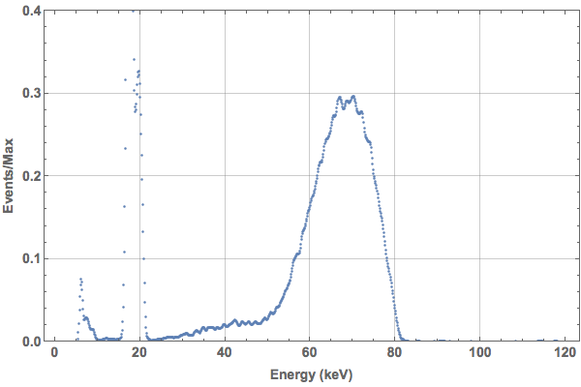
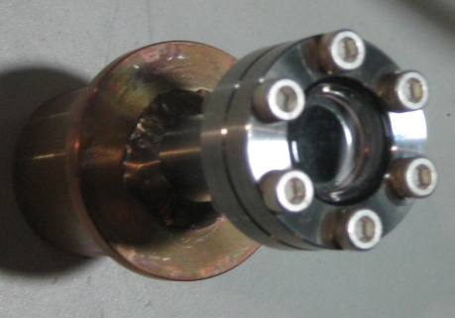
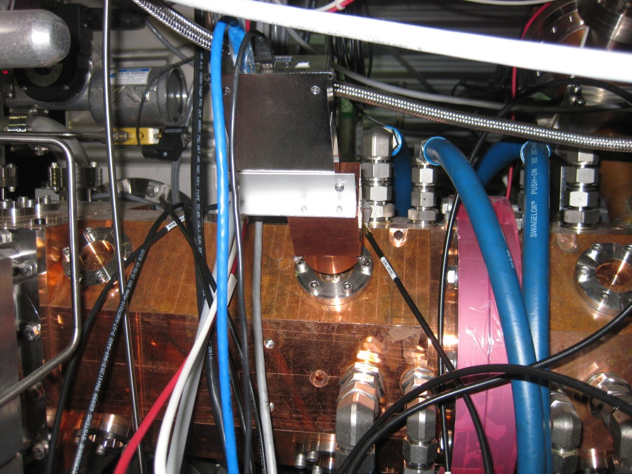
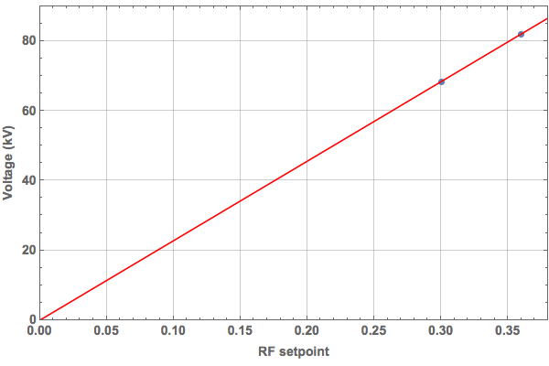
RFQ field strength absolute calibration
X-ray spectrometer
X-ray window
X-ray spectrum
cut off energy
cut off energy vs. RF amplitude
Courtesy of A. Zhukov

Slide 11
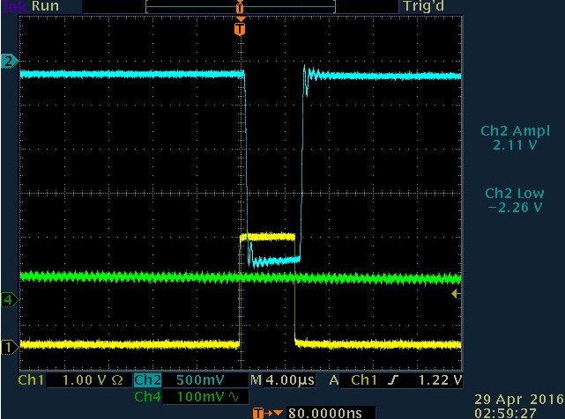
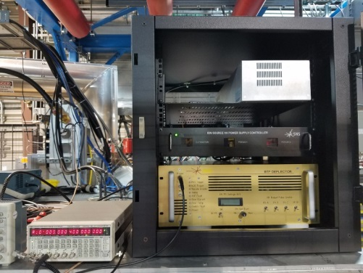
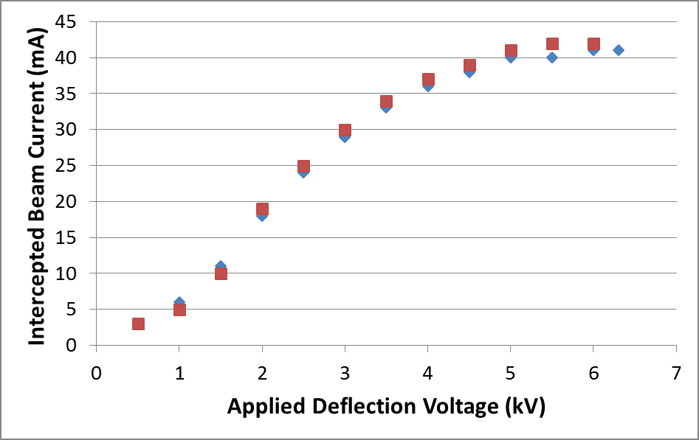
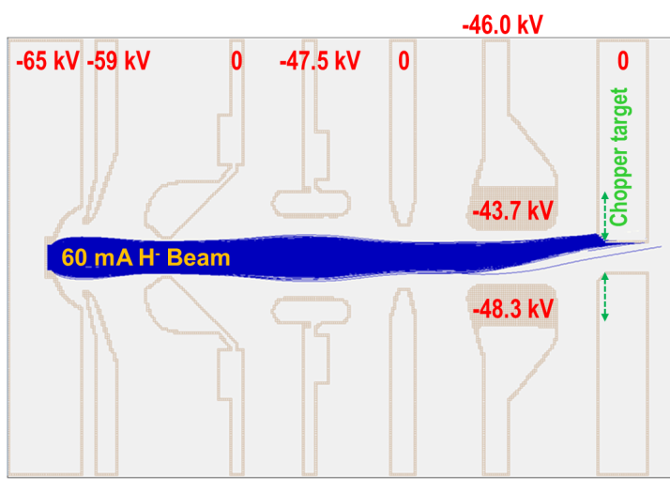
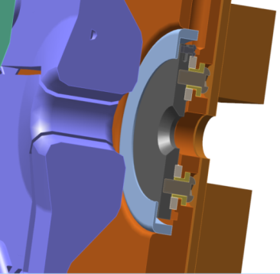
Measure LEBT beam current to evaluate absolute value of RFQ transmission
88% transmission @44mA
Ion Source #6
Courtesy of R. Welton

Slide 12
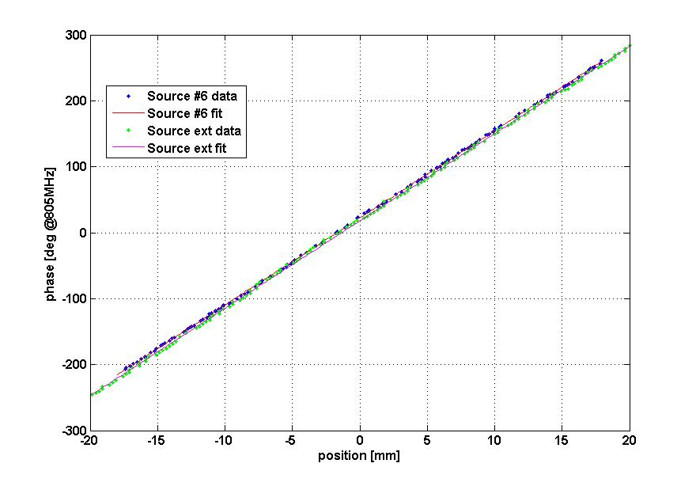
Beam energy measurement using Time-Of-Flight technique
BPM04
2520±20 keV
Movable phase detector (BPM)
Independently confirmed by magnetic spectrometer measurements

Slide 13
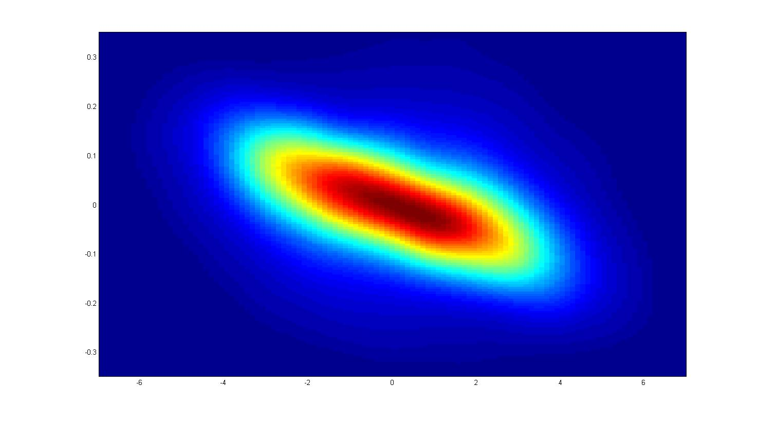
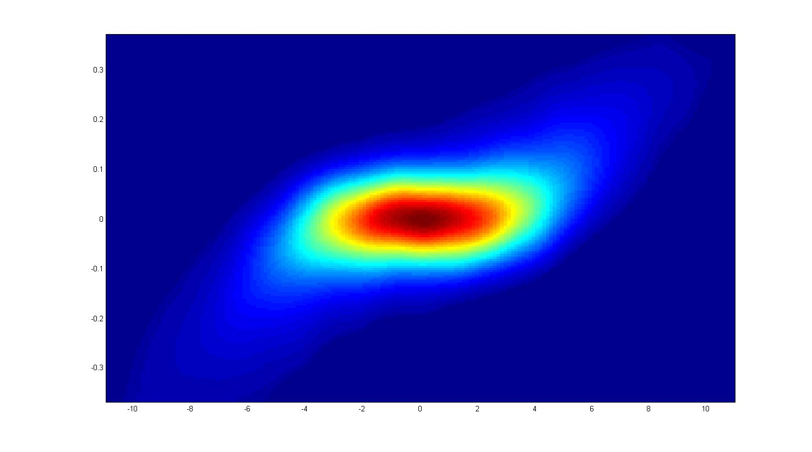
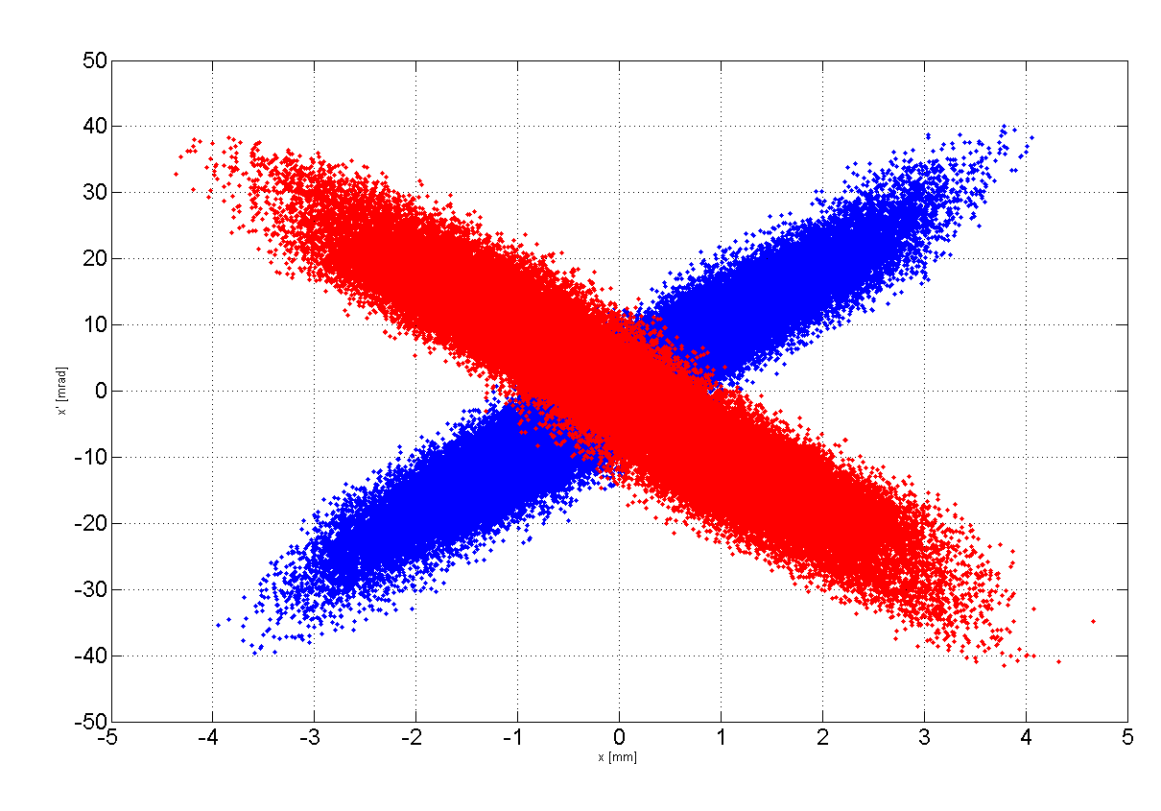
Transverse RMS emittance is close to design
horizontal
vertical
x’ [rad]
y’ [radian]
x [mm]
y [mm]
$$ε_{tr}=.25−.35 π mm∙mrad$$
normalized,
different currents, ion sources, MEBT optics
Particle distribution generated from measured emittances and traced back to RFQ exit (PyORBIT)

Slide 14
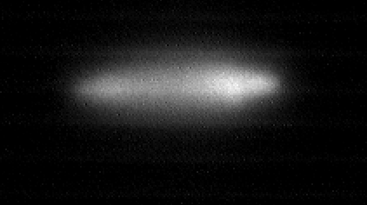
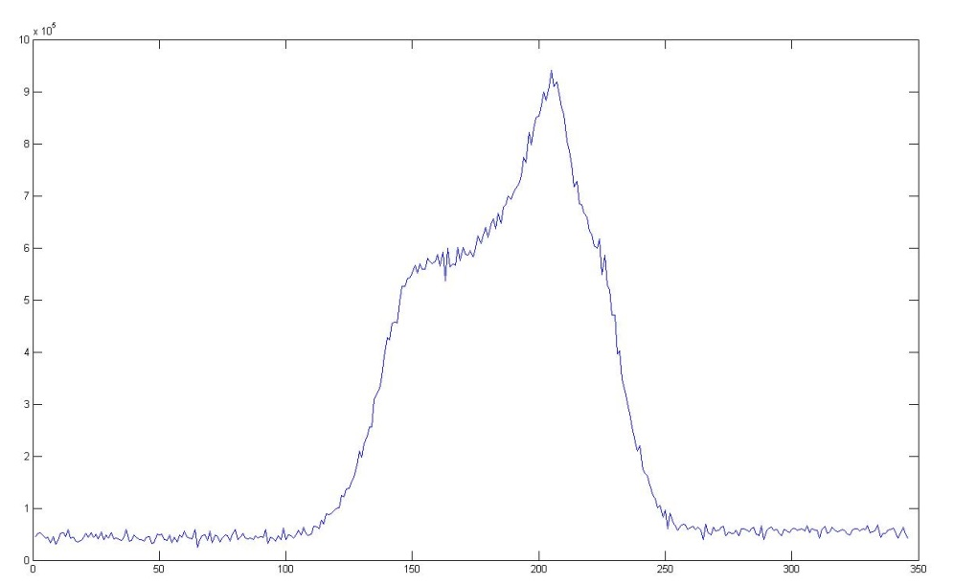
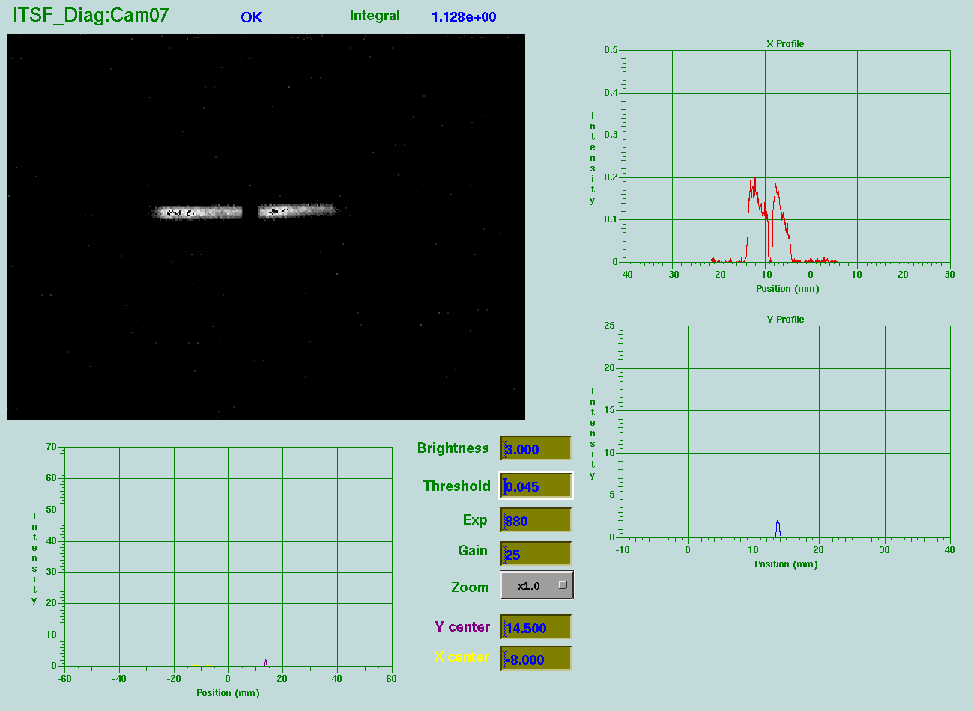
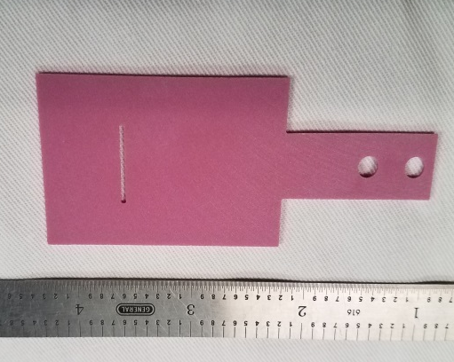
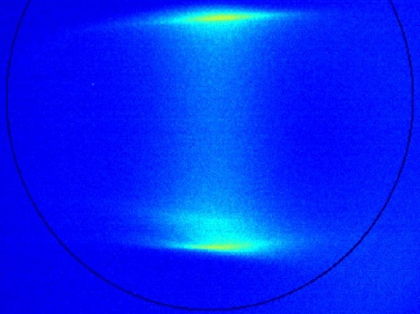
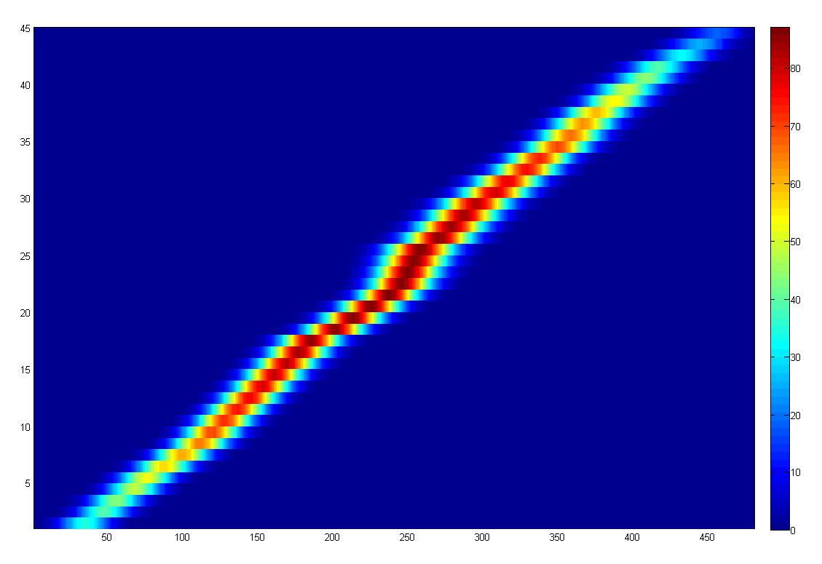
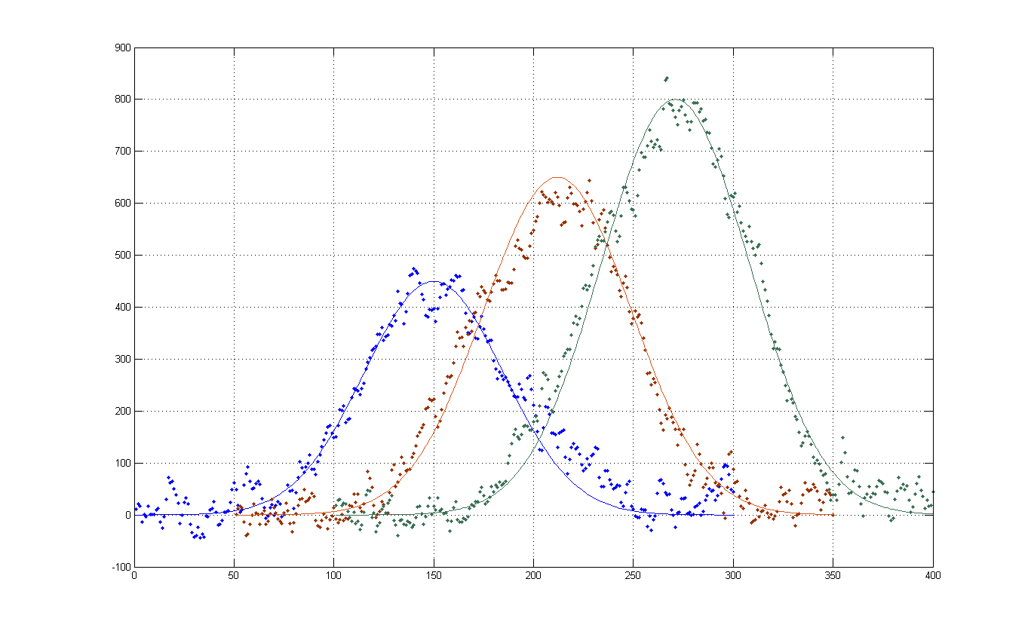








Longitudinal beam parameters
video camera
Bunch energy spectrum
$$Intencity [arb. units]$$
Energy view screen and slit
$$\frac{∆p}{p} [arb. units]$$
Longitudinal emittance
Longitudinal profiles at different slit positions
$$\frac{∆p}{p}=0$$
Beam Shape Monitor
screen image
$$\frac{∆p}{p}$$
$$\frac{∆p}{p}=0.2\%$$
$$\frac{∆p}{p}=0.3\%$$
$φ$ [⁰]
$φ$ [⁰]

Slide 15
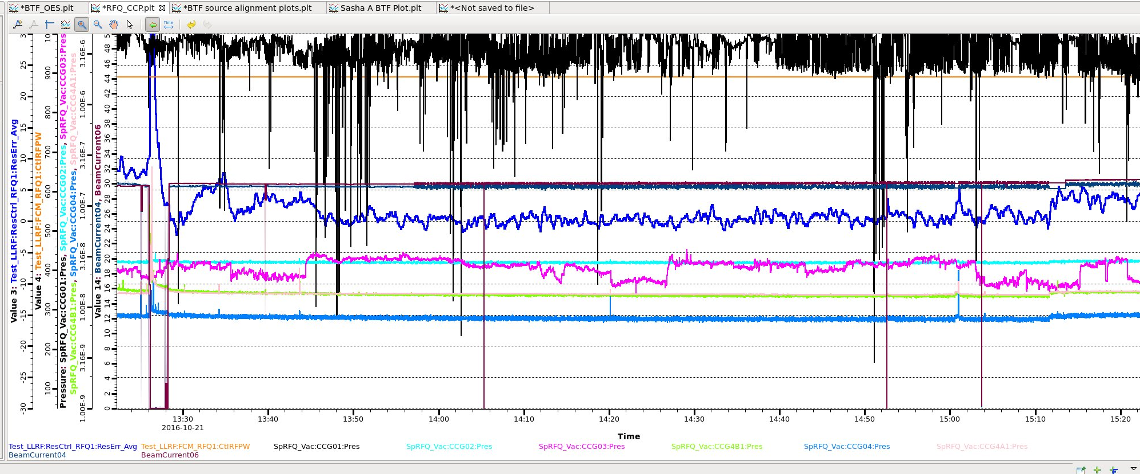
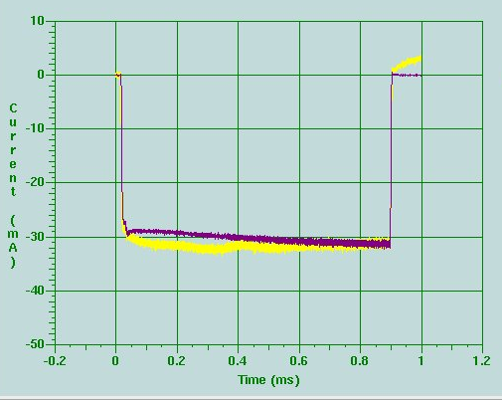
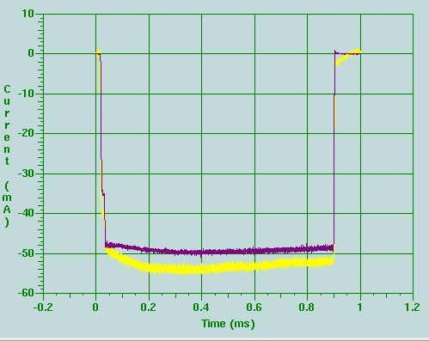
High Power Beam Test (4kW)
Courtesy C. Peters
30mA
900μs
60Hz
50mA
900μs
demo
RFQ resonant error
Beam current
RFQ RF amplitude
4kW at 2.5MeV = 1.6MW at 1GeV

Slide 16
Dependence on the ion source
Source | installed | removed | Days tested | RF set point | LEBT beam current | MEBT beam current typ/max | Issues
#6 | Aug 2014 | Aug 24, 2016 | ~14 days | ~60 kW | ~60 mA | na | Edump dips (end of run) thin walled insulator
#6 | Aug 29, 2016 | Oct 11, 2016 | ~2 days | ~60 kW ~30 kW ~35 kW ~40 kW | ~60 mA ~13 mA ~22 mA ~33 mA | Na 8 mA 18 mA 26 mA | Struggled with alignment, extractor heating
#6 | Oct 14, 2016 | Nov 25, 2016 | ~10 days | ~50 kW ~55 kW ~70 kW | ~45 mA ~50 mA C. Target failure | ~32 mA ~44 mA ~50 mA | Aligned with dummy source, o-ring unloaded, full power RFQ operation test, bend mode, lost chopper target
x3 | Nov 28, 2016 | Dec 9, 2016 | ~11 days | ~36 kW ~35 kW ~43 kW |  | ~40 mA ~44 mA ~50 mA | 5D measurements no explicit Cesiation!
#3 | Dec 14, 2016 | Jan 25, 2017 |  | ~53 kW ~44 kW ~43 kW |  | ~46 mA ~40 mA ~29 mA | Edump struggles, beam decay, 2 min Cs partially recovered beam
x4 | Jan 25, 2017 | running | 20+ days | ~32kW |  | ~40mA | Lens 2 conditioning, plasma ignition, water line leak
Courtesy of R. Welton

Slide 17
RFQ swap plan
~2months to integrate new RFQ in SNS Front End
  New vacuum and water controls
Need extended shutdown period
  Combine with IRP replacement
Detailed resource loaded RFQ swap plan is being developed
  Start BTF disassembly 1-2 months before RFQ move
  Plan includes reintegration of old RFQ to BTF
November 2017 is projected BTF decommissioning date
  Might change if IRP schedule changes again
Develop flexible BTF beam study plans to accommodate any scenario most efficiently

Slide 18
BTF current beam use program
Ion Source testing in real environment
  External antenna source
Beam diagnostics development
  High dynamic range measurements
New SNS accelerator subsystems testing
  Controls, Power Supplies, etc.
Beam Dynamics Study
  Beam Halo Experiment
    Funded by NSF grant through University of Tennessee (S. Cousineau is PI)
    Support for Postdocs, students + some hardware
Computer simulations tools benchmarking
  PyORBIT linac simulation code

Slide 19
High Intensity Beam Dynamic Experiment
To understand mechanism of halo formation
Inspired by results of 2001 LEDA halo experiment at Los Alamos
We plan to avoid known LEDA experiment deficiencies
Measure initial particles distribution in 6D phase space
Inject into simplest accelerator structure: FODO line
Measure halo in output beam
Reproduce results in computer simulations
Has been never done anywhere
State-of-the-art and beyond
Negative LEDA simulation result was explained by lack of knowledge of initial distribution
missed ingredient in LEDA experiment

Slide 20
Develop 6D particles distribution measurement system
Build a test FODO line
Develop reliable halo measurement system

Slide 21
6D Phase space measurement principle
BENDING MAGNET
SLIT_Y_2
SLIT_X_2
SLIT_Y_1
SLIT_X_1
dx⋅dy⋅dx´⋅dy´
BEAMLET
dx⋅dy
BEAMLET
SLIT_X_3
RF deflector
Magnetic spectrometer for energy determination
RF deflector or other time resolving device for temporal degree of freedom
SLIT_X_4
FARADAY CUP or other detector

Slide 22


6D Phase space measurement difficulties:
#1 Scan Time!
$$N_{bins}=m_{}^{D}$$
dimensionality
Total number of bins
Number of steps per degree of freedom
For ${m=10, D=6 N_{bins}=10}^{6}$
1 2 …….. m
Total scan time at $1 \frac{step}{sec}:{ T_{total}=10}^{6} sec=280 hours$
Total scan time at $10 \frac{step}{sec}:{ T_{total}=10}^{5} sec=28 hours$
Tens of hours of uninterrupted available beam time are required

Slide 23
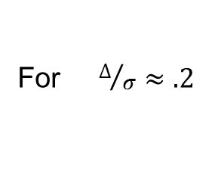



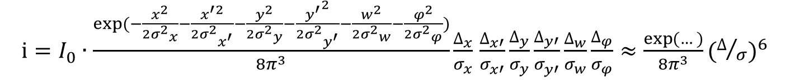


6D Phase space measurement difficulties:
#2 Signal Strength!
$i=I_{0}∙\frac{exp⁡(−\frac{x^{2}}{2{σ^{2}}_{x}^{}}−\frac{x^{′2}}{2{σ^{2}}_{x^{′}}^{}}−\frac{y^{2}}{2{σ^{2}}_{y}^{}}−\frac{{y^{′}}^{2}}{2{σ^{2}}_{y^{′}}^{}}−\frac{w^{2}}{2{σ^{2}}_{w}^{}}−\frac{φ^{2}}{2{σ^{2}}_{φ}^{}})}{8π^{3}}\frac{∆_{x}}{σ_{x}^{}}$ $\frac{∆_{x′}}{σ_{x′}^{}}\frac{∆_{y}}{σ_{y}^{}}\frac{∆_{y′}}{σ_{y′}^{}}\frac{∆_{w}}{σ_{w}^{}}\frac{∆_{φ}}{σ_{φ}^{}}≈\frac{\exp{(…)}}{8π^{3}}{(∆/σ)}^{6}$
For $∆/σ≈.2$
current after all 6 slits
$i≈I_{0}∙2.6{∙10}^{−7}∙exp⁡(…)$
Number of particles in $I_{0}≈32 mA, τ≈50 μs$
beam pulse is $N_{0}≈{10}^{13}$
Number of particles after 6 slits: $N_{FC}≈2.6{∙10}^{6}$ at the distribution center $r=0$
$N_{FC}≈1.6{∙10}^{6}$ at $r=2 σ$
$N_{FC}≈2.9{∙10}^{4}$ at $r=3 σ$
$N_{FC}≈9.7$ at $r=5 σ$

Slide 24
6D Phase space measurement Implementation at BTF
Movable
View Screen
90-DEG. BENDING MAGNET (spectrometer)
Quadrupoles
Beam
Bunch Shape
Monitor (z)
2 pairs of movable slits for
x, x’, y, y’ selection
Movable slit for energy selection (z’)
Faraday Cup

Slide 25
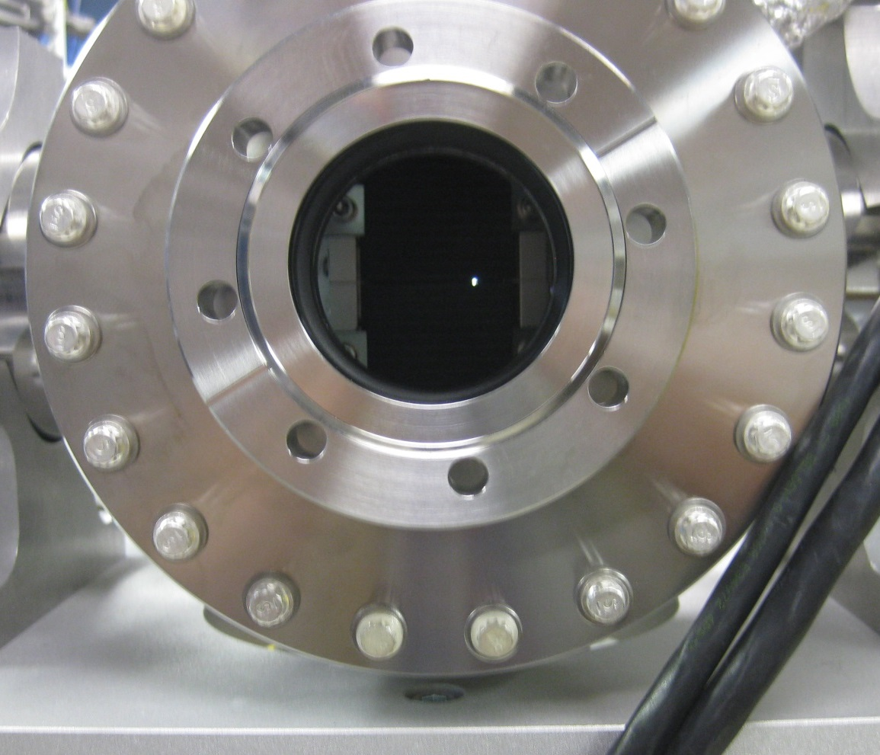
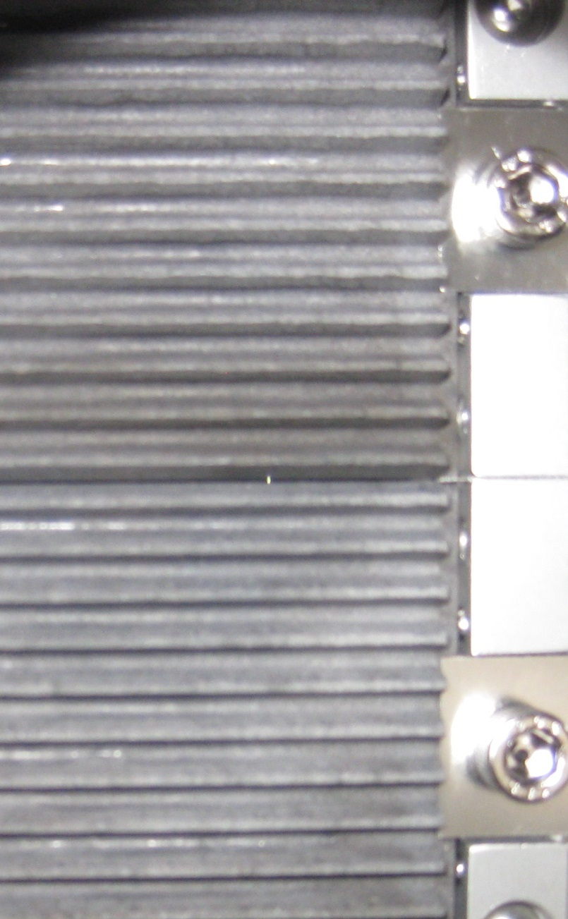
X-Y Slits arrangement
200-by-200 μm aperture

Slide 26
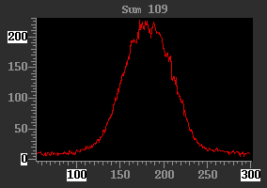
6D Phase space measurement progress
4D scan
  Well developed automated script
  Full scan takes ~5hours @5Hz
5D scan
  Uses separate 4D scans with different energy slit positions
  Produced several 3-4 energy slices sets, ~20hours each
    Limited by beam availability
6D scan
  Working on improving BSM sensitivity, scan speed
    Demonstrated measurement of few hundreds point in 6D phase space
Longitudinal profile measured after 5 upstream slits

Slide 27
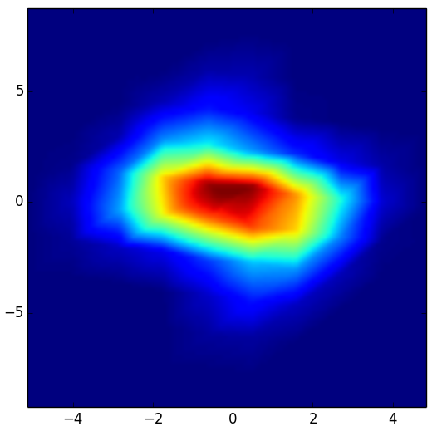
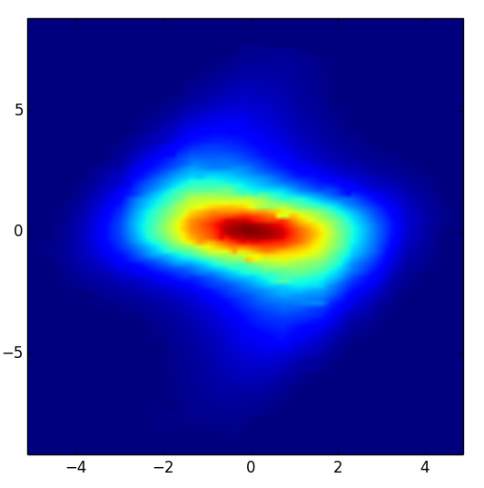
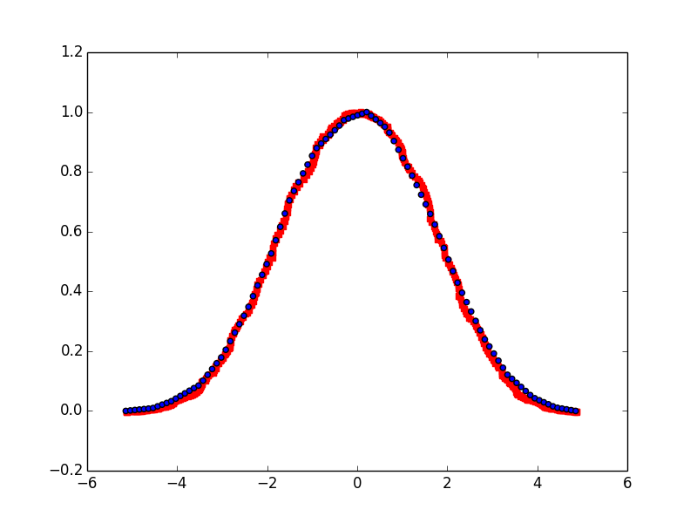
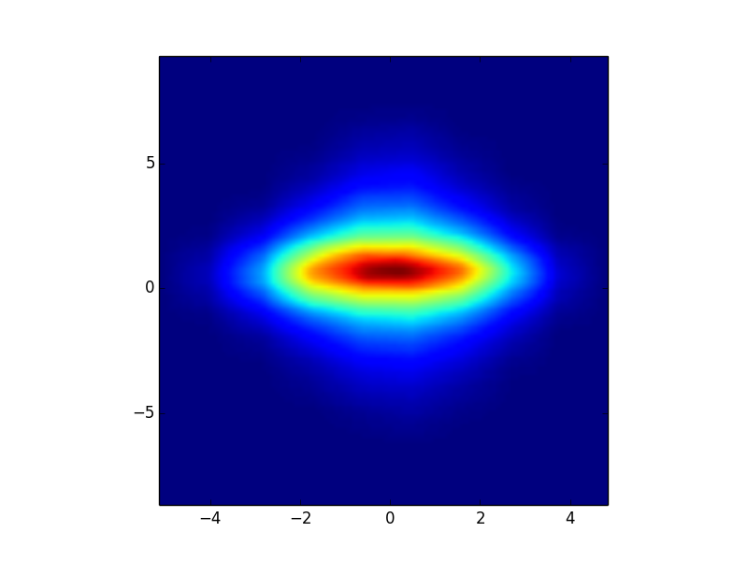
6D Phase space measurement progress
x-x’ projection obtained from measured 4D distribution
x projection obtained from 4D measured distribution (blue)
x profile from 1D scan (red)
x-x’ emittance from 2D scan
charge [a. u.]
x’ [mrad]
x’ [mrad]
x [mm]
x’-y’ projection obtained from measured 4D distribution
x [mm]
x [mm]
Learning to manipulate large data sets
Learning to validate data
Learning to generate initial particle distribution for PIC simulation
  2D+2D+2D
  4D + 2D
  6D
y’ [mrad]
x’ [mrad]
Courtesy of B. Cathey

Slide 28
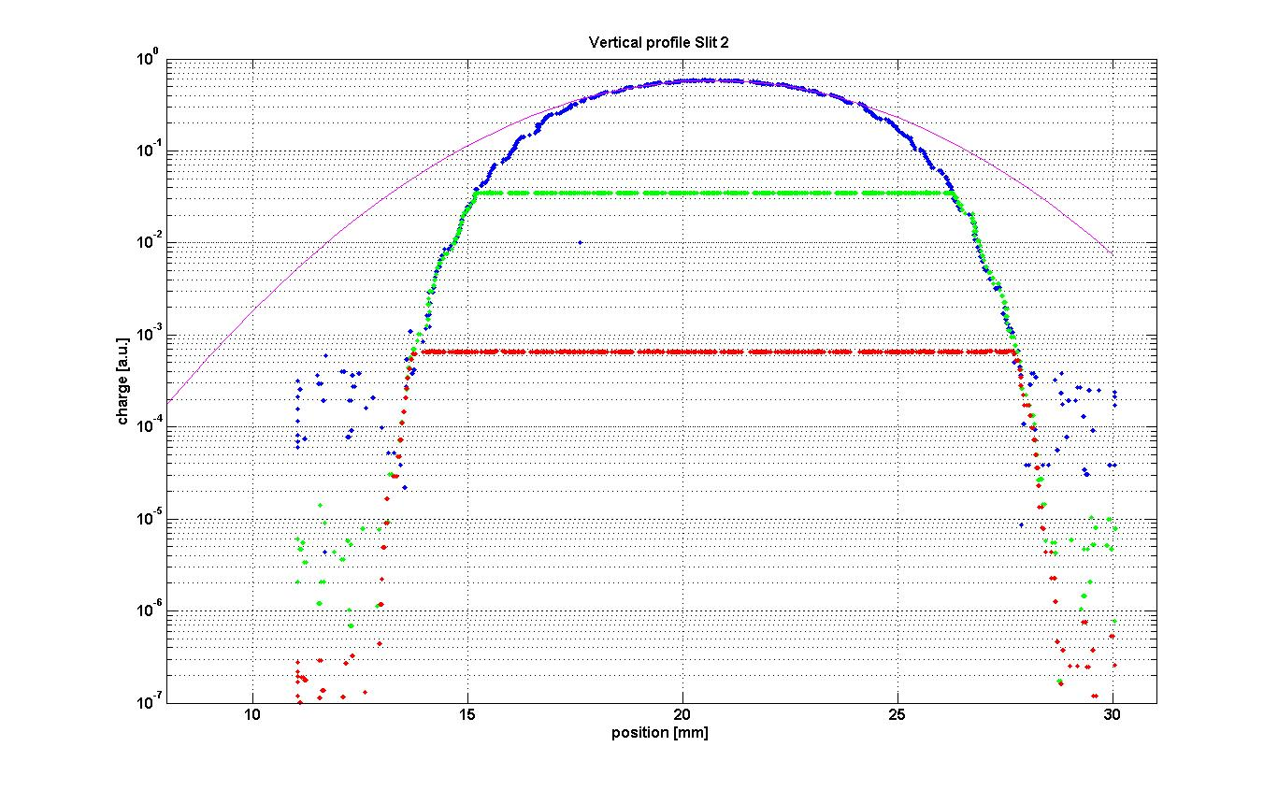
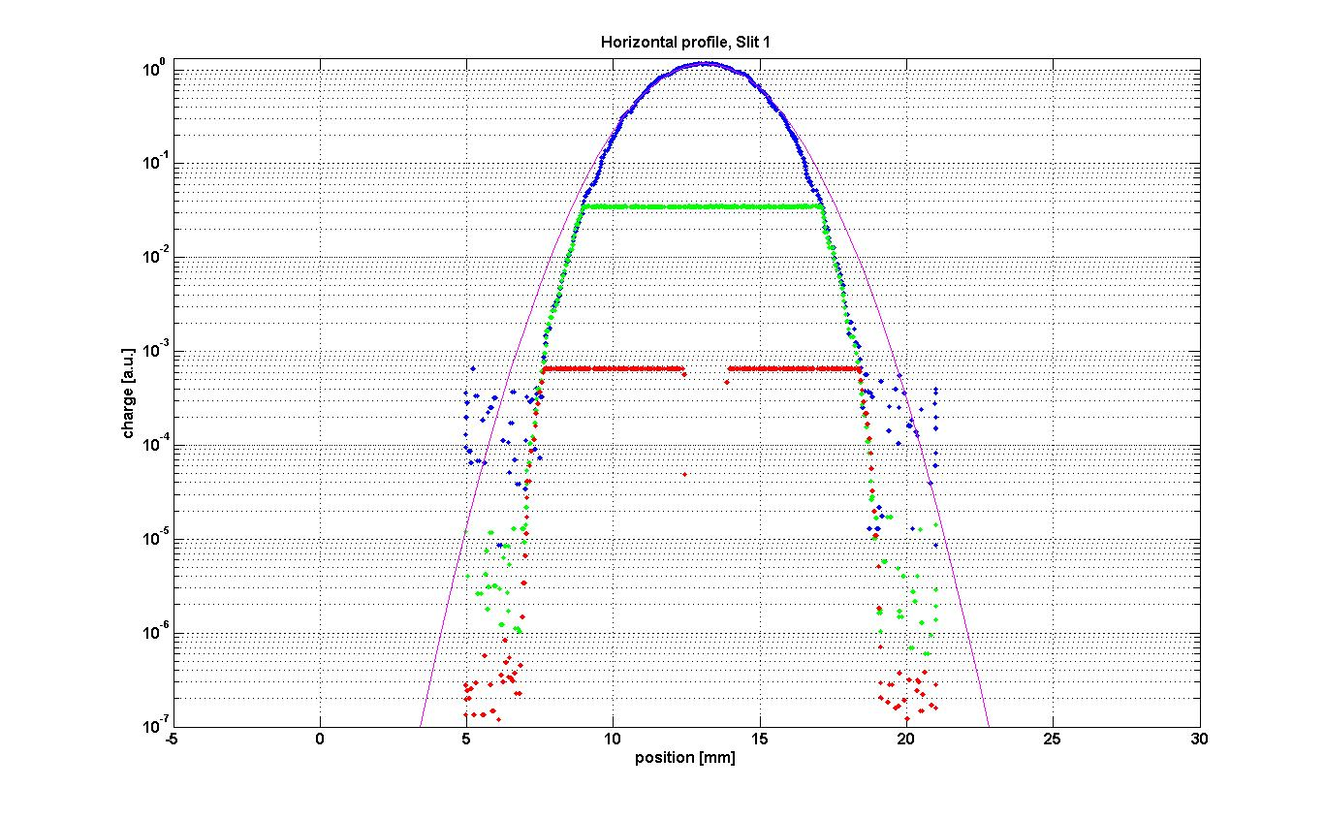
High Dynamic Range measurements (halo)
Measure transverse profiles with > 10⁶ dynamic range
  (Switch amplifier gain to overcome ADC bit depth limit )
Need to develop 2D emittance measurement with similar dynamic range

Slide 29
FODO lattice design and simulation
RFQ
Units: cm
Energy slit
BSM
Achromatic
bend
Matching quads
FODO line
Courtesy of Z. Zhang

Slide 30
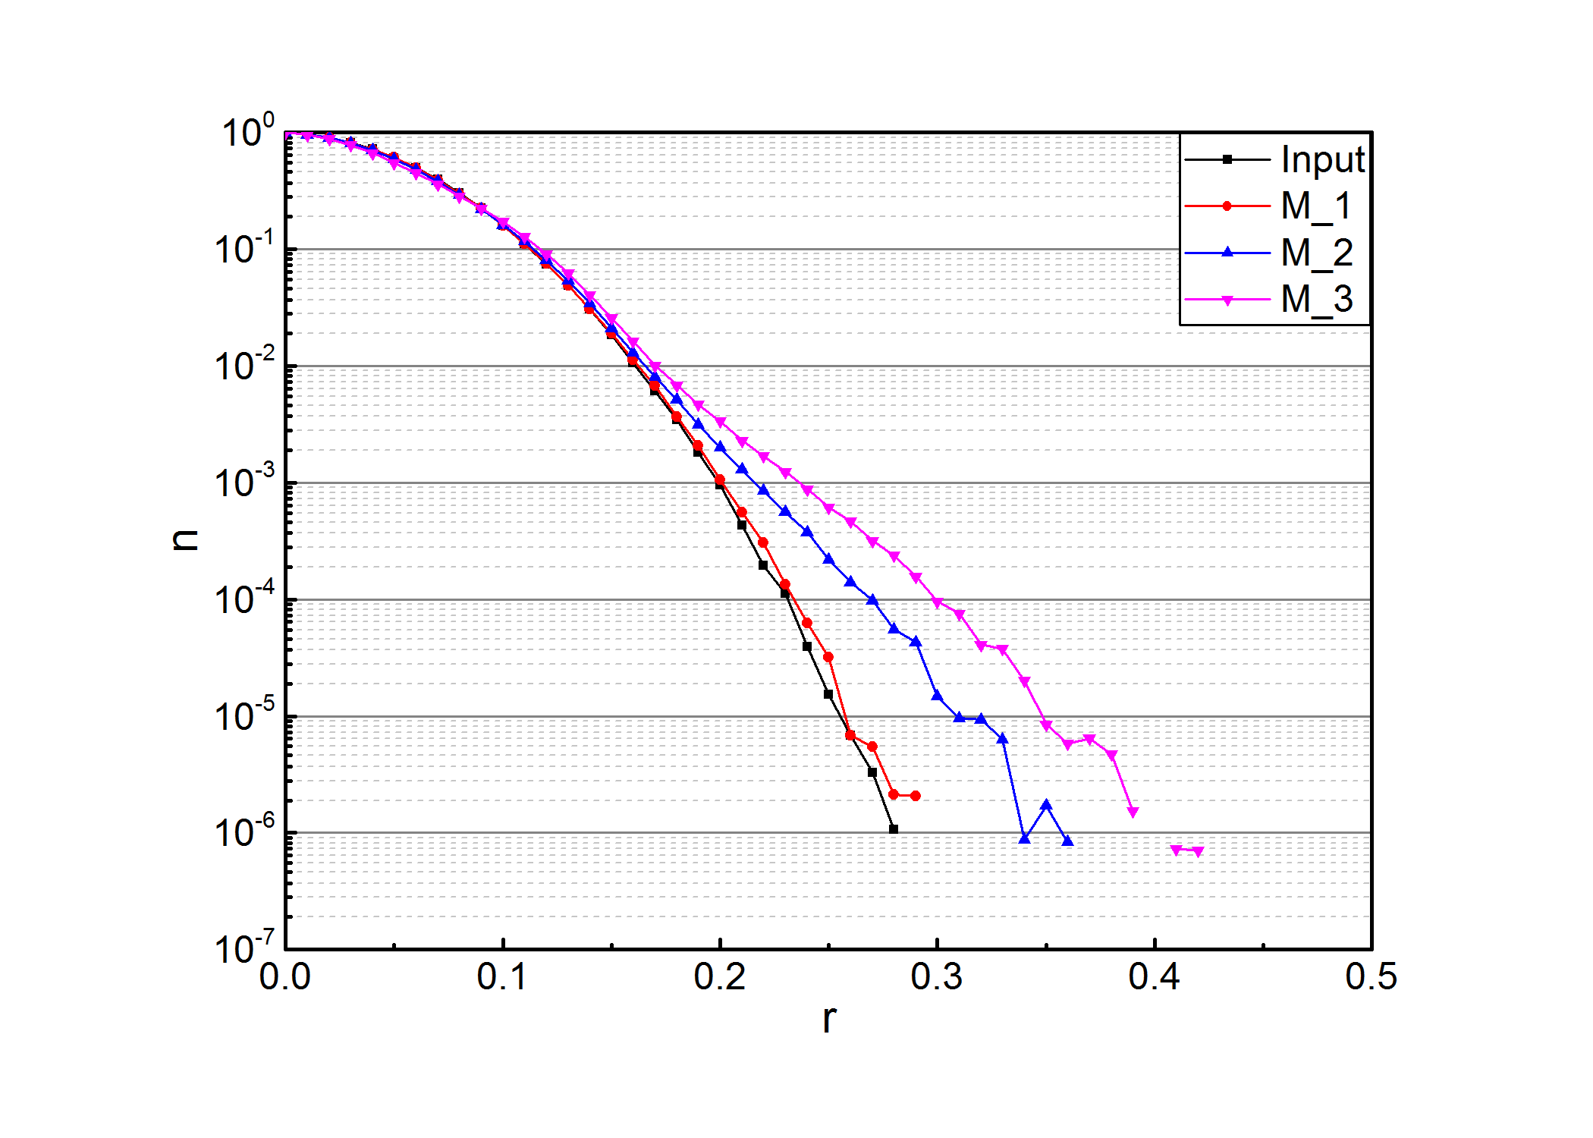
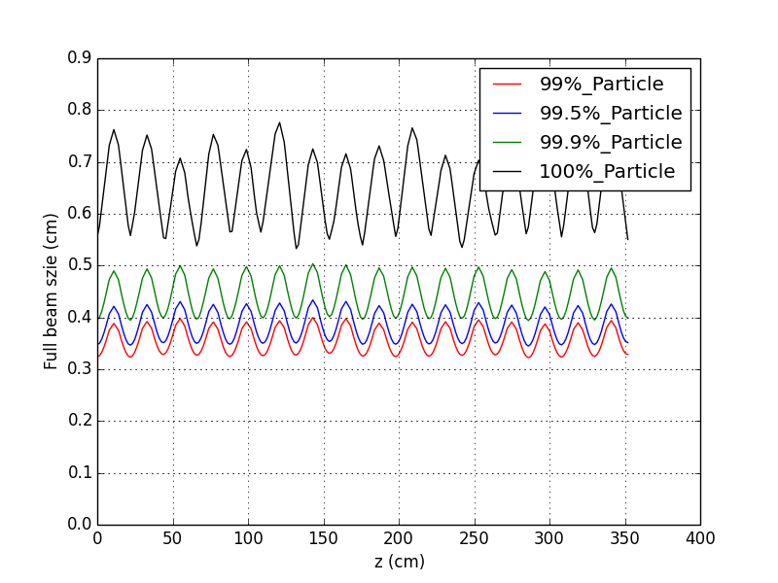
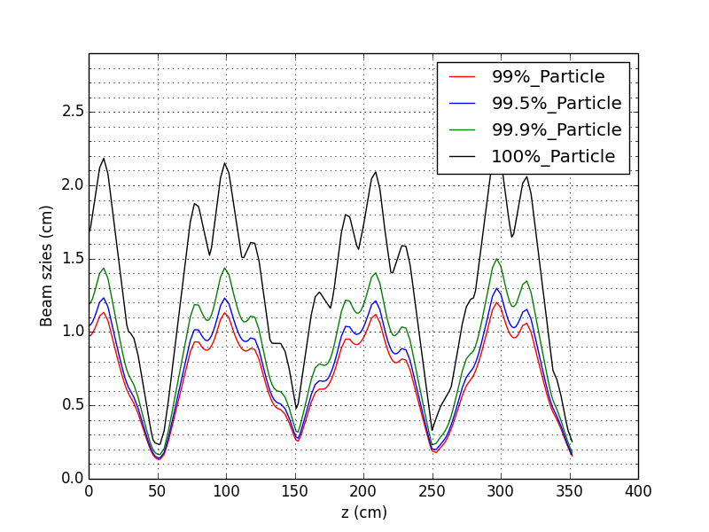
FODO lattice design and simulation
(PyORBIT, TraceWin)
Determine minimum number of FODO periods
Determine required mismatch factor
Phase advance=80º, G=26.6 T/m
Phase space density plot in y plane
Determine required beamline aperture
Matched beam size
Beam sizes (m = 1)
Beam sizes (m = 3)
Courtesy of Z. Zhang

Slide 31
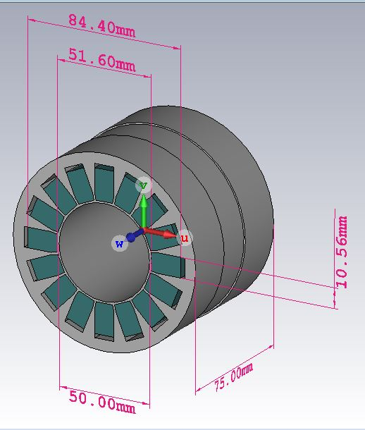
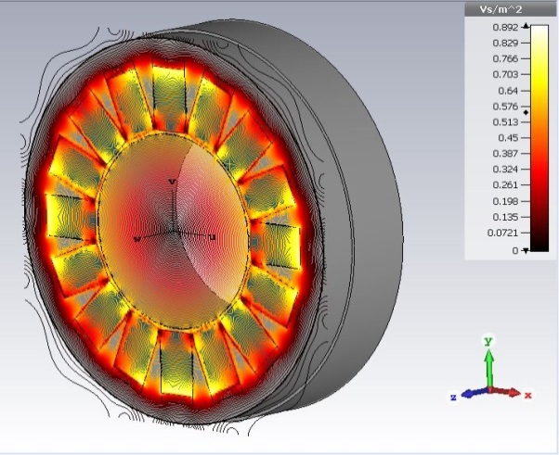
Permanent Magnet FODO line quadrupoles
Courtesy of A. Menshov
Magnet gradient:
G = 5.7367487 kG / 2.25 cm = 2.549666 kG/cm
Magnet strength:
G x L = 2.549666 kG/cm x 3.50 cm = 8.9238 kG
Mounting structure will allow changing phase advance of FODO line using different combinations of magnets and drift lengths
39 half-length magnets have been ordered

Slide 32
BTF FY17-18 beam line extension plan
Timeline is determined by IRP replacement schedule
Phase I
  Add achromatic 180⁰ bend
  Install HDR emittance station
  Ready for operation in April/May 2017
  Determine need for collimation section in front of FODO line
Phase II
  Add matching section and FODO line
  Hardware ready in August/September 2017
  Install before or after RFQ swap

Slide 33
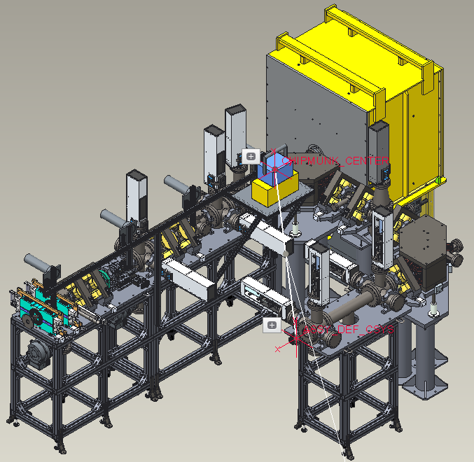
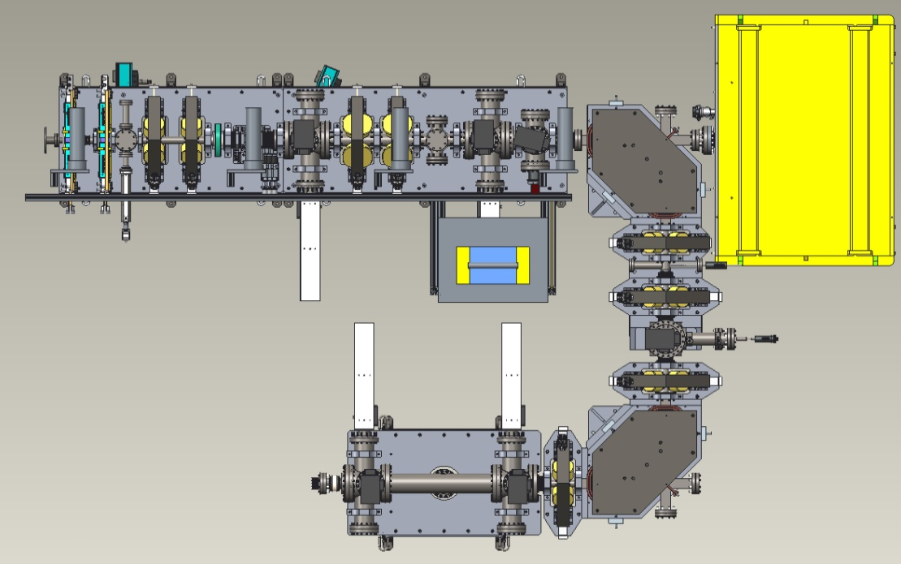
Beam line extension Phase I
6D phase space measurements
Achromatic bend
High Dynamic Range emittance measurements

Slide 34

Beam line extension Phase II
RFQ
BSM
Low power
beam dump
FODO line
Matching
quadrupoles
High Dynamic Range
Emittance station
~6 months lead time
Installation timeline will be driven by IRP replacement schedule

Slide 35

Moderator Demonstration Facility
Accelerator driven source of neutrons, neutron beam lines and instrumentation for R&D on prospective moderator designs with hands on access
(~60W of 2.5Mev protons)
MDF layout
LDRD grant in FY15-16 to
Design proton beam line
Feasibility study of 2.5MeV Li target
Feasibility study of neutronics and instrumentation
space for AP line
Neutron target with test moderator
MDF is feasible and of great importance for future source development (STS)
Neutron beam lines

Slide 36

Long Term BTF development
BTF area expansion would allow the two experiments to co-exist and to add other capabilities
Beam dynamics beam line
Building wall
PPS fence

Slide 37
Summary
BTF has been successfully commissioned with beam
New RFQ demonstrated excellent operational parameters exceeding the old RFQ performance in all areas
RFQ swap is planned simultaneously with IRP replacement
BTF is indispensable test bench for SNS accelerator systems improvement and testing
BTF provides unique opportunities for general accelerator physics R&D
There is ongoing R&D program and well developed plans for near and mid term future

