Slide 1
Laser Stripping Experiment Status
Presented to the SNS Accelerator Advisory Committee
Abdurahim Rakhman
Yun Liu
March 9, 2017

Slide 2
Outline
Why Laser Stripping?
Laser Stripping Concept
Demonstration of 10 µs Stripping Experiment
Laser Power Savings Techniques
Experiment Layout
Experimental Results
Path to Full Cycle Laser Stripping
Doubly-Resonant Enhancement Cavity
Technical Challenges in UV Cavity Developments
New Approaches in Cavity Locking Technique
Conclusions

Slide 3
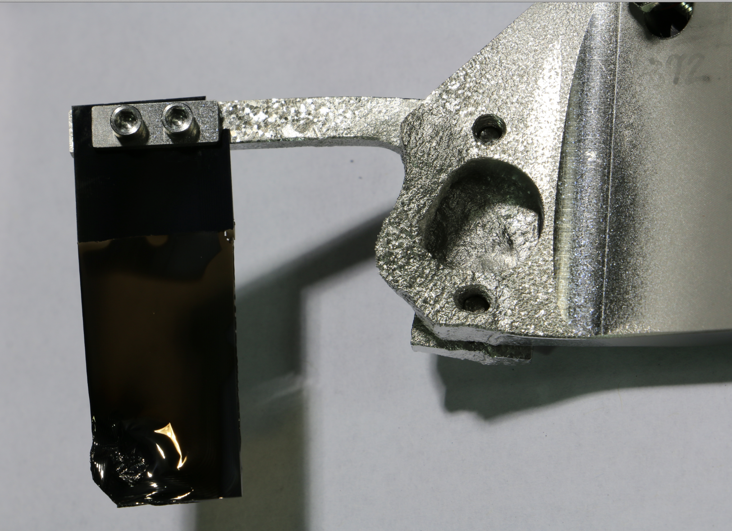
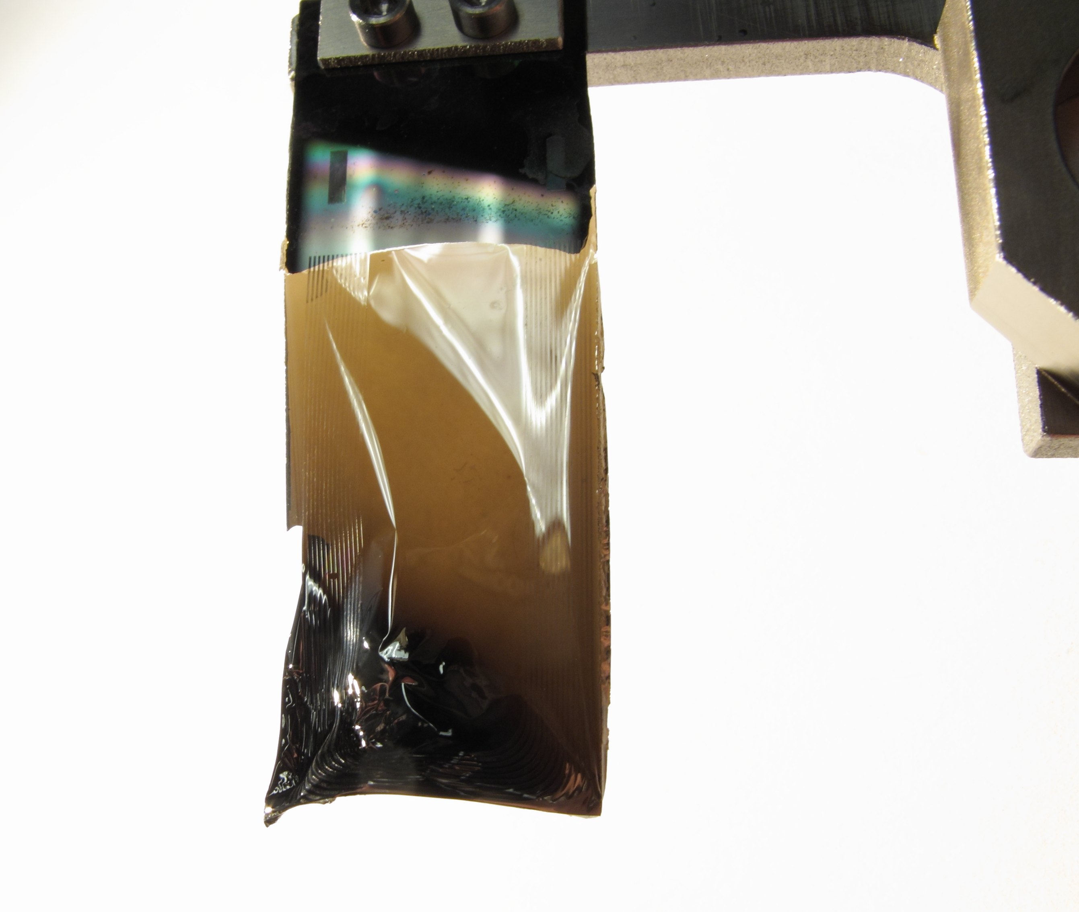
Why laser stripping?
Bracket damage from convoy electrons
Foil Damage
Radiation
Foil used for entire run cycle
New foil
Nanocrystalline diamond
#1073
#1872, up to 1.4 MW, 3 months
The problem of injection foil survivability is the main beam power limiting factor for future high intensity proton synchrotrons
Due to beam loss from scattering in the foil, the injection area is typically the most radioactive area of the accelerator– 800 mrem/hr @ 30 cm
Typical Beam Loss Pattern of SNS Ring, 1.3 MW

Slide 4
Laser stripping concept
N
Laser Field
S
e
e
e
e
e
α
e
p
H⁻
H⁰
H^{0*}
S
N
Step 1:
Lorentz Stripping
H⁻ → H⁰ + e⁻
Step 2:
Resonant Laser Excitation
H⁰ (n=1) + γ → H^{0*} (n=3)
Step 3:
Lorentz Stripping
H^{0*} → p + e⁻
12.1 eV (102.6 nm)
I. Yamane, Phys. Rev. STAB 1, 053501 (1998)
Demonstrated at SNS with >90% stripping efficiency using a 6 ns laser with 10 MW peak power! V. Danilov et al. Phys. Rev. STAB 10, 053501 (2007)

Slide 5
Laser power savings techniques
Straightforward scaling to 1 ms and 60 Hz requires: ~600 kW average UV laser power
Temporally match laser to ion beam 402.5 MHz structure with10 μs burst
Apply dispersion tailoring (match the beam energy spread to the laser angular spread) to reduce transition frequency spread
Squeeze beam longitudinally and vertically to maximize photon density and overlap: (<1 mm vertical beam size, < 35 ps FWHM longitudinal size)
Results in ~3 orders of magnitude reduction in required average laser power
10 μs
1 μs
402.5 MHz
402.5 MHz
402.5 MHz
402.5 MHz
$$D_{x}^{′}=0$$
$$D_{x}^{′}  0$$
Laser beam
H⁰
H⁰
V. Danilov et al. Phys. Rev. STAB, 6, 053501 (2003)
α

Slide 6
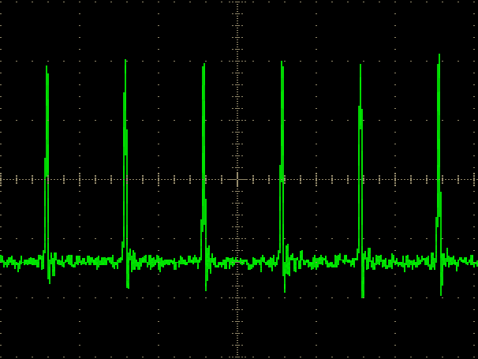
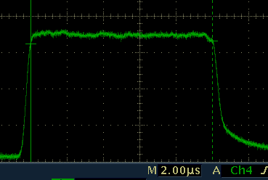
Burst-mode macropulse laser system
Seeder: generate micro-pulses matching micro-bunch structure of ion beam
Pulse Picker: provide macro-pulses matching macro-bunch structure of ion beam
Amplifier & Harmonic Converter: boost power to the required level, e.g. 1MW @ 355 nm
CW seeder:
Output wavelength: Micropulse:
Macropulse:
Peak/Average power:
linewidth <5 kHz
355 nm
50 ps/402.5 MHz, 100 µJ
10 μs/10 Hz, 400 mJ
2 MW/4W
2.5 ns
~50 ps
Micropulse
10 µs
Macropulse
C. Huang, C. Deibele, and Y. Liu, Opt. Exp. 21, 9123 (2013)

Slide 7
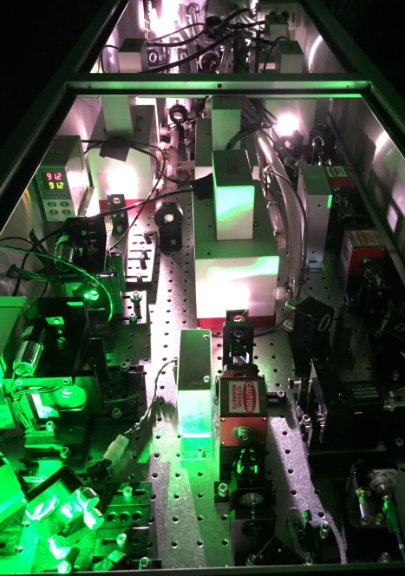
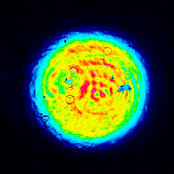
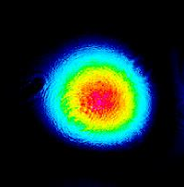
Macropulse laser specifications
UV pulse width & peak power
Spatial Profiles
1 mm
0.1 mrad
A. Rakhman et al. Appl. Opt. 53, 7603-7609 (2014)

Slide 8
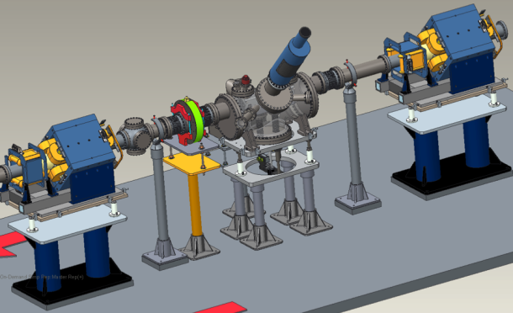
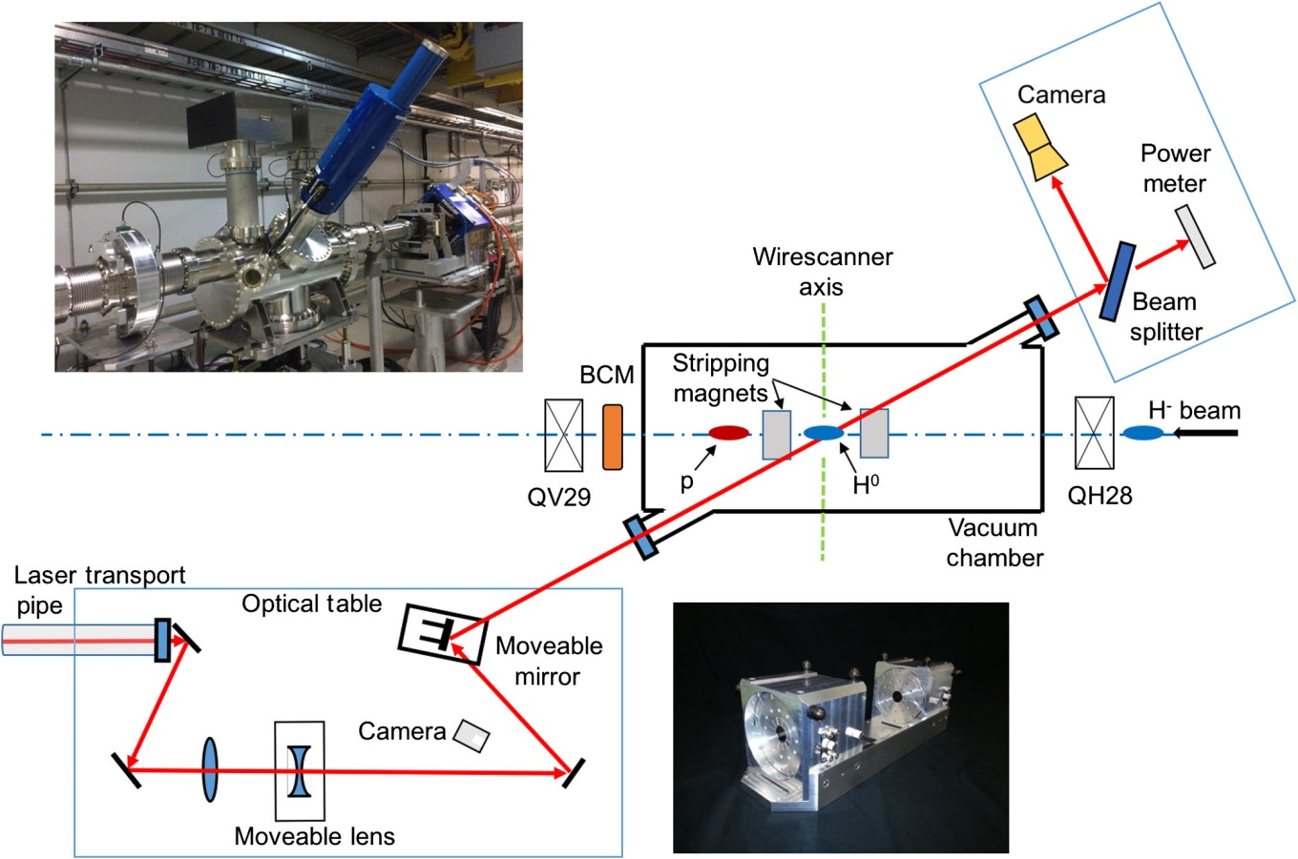
Experimental layout of 10 µs experiment
Experiment is in the transport line to the ring (HEBT)
Laser is located remotely in Ring Service Building (RSB)
60 m + 9 mirrors in transport
Concerns:
Laser power loss
Pointing stability
Wire scanner
Beam
Current monitor
H⁻
p
Laser
Interaction point
Retractable
Stripper Magnets
Laser in Ring Service Building
~60 m
Interaction point
Y. Liu et al., NIMA 847, 171-178 (2017)

Slide 9
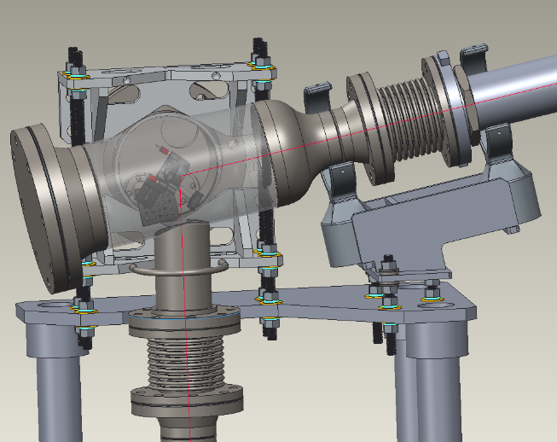
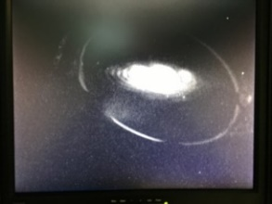
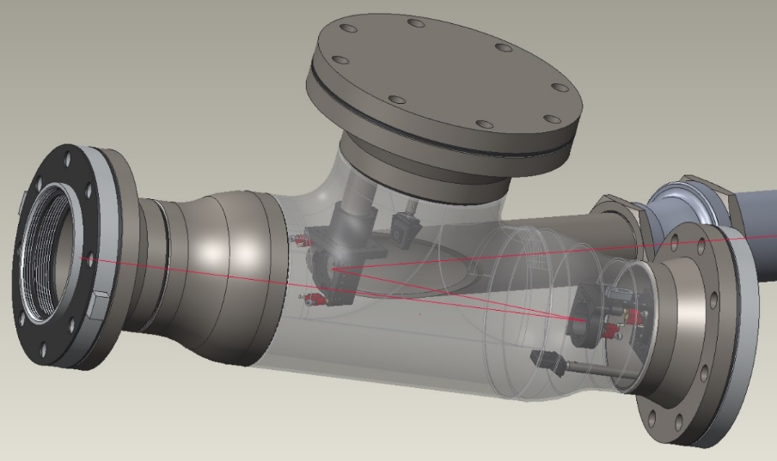
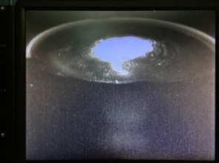
Laser beam transport line
SNS Ring Service Building
100.56°
M₁
M₄
M₂
M₃
M₆
M₅
M₇
Pico-motor actuators
Camera
M₈
33.75°
11.25°
SNS Accumulator Ring

Slide 10
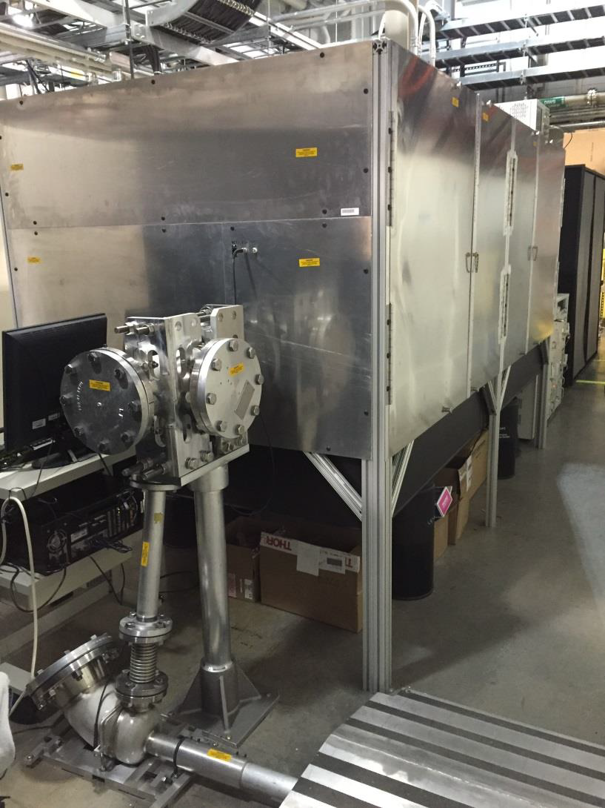
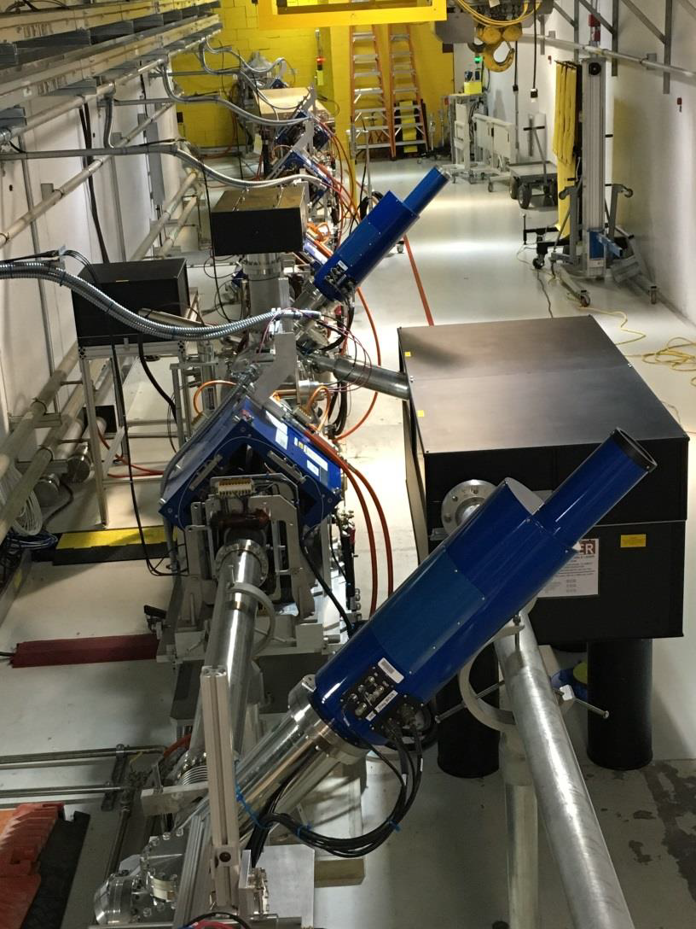
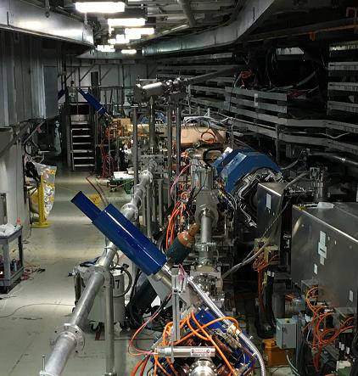
Laser beam transport line
Laser in RSB
Final optics table
From RSB
Local optics table

Slide 11
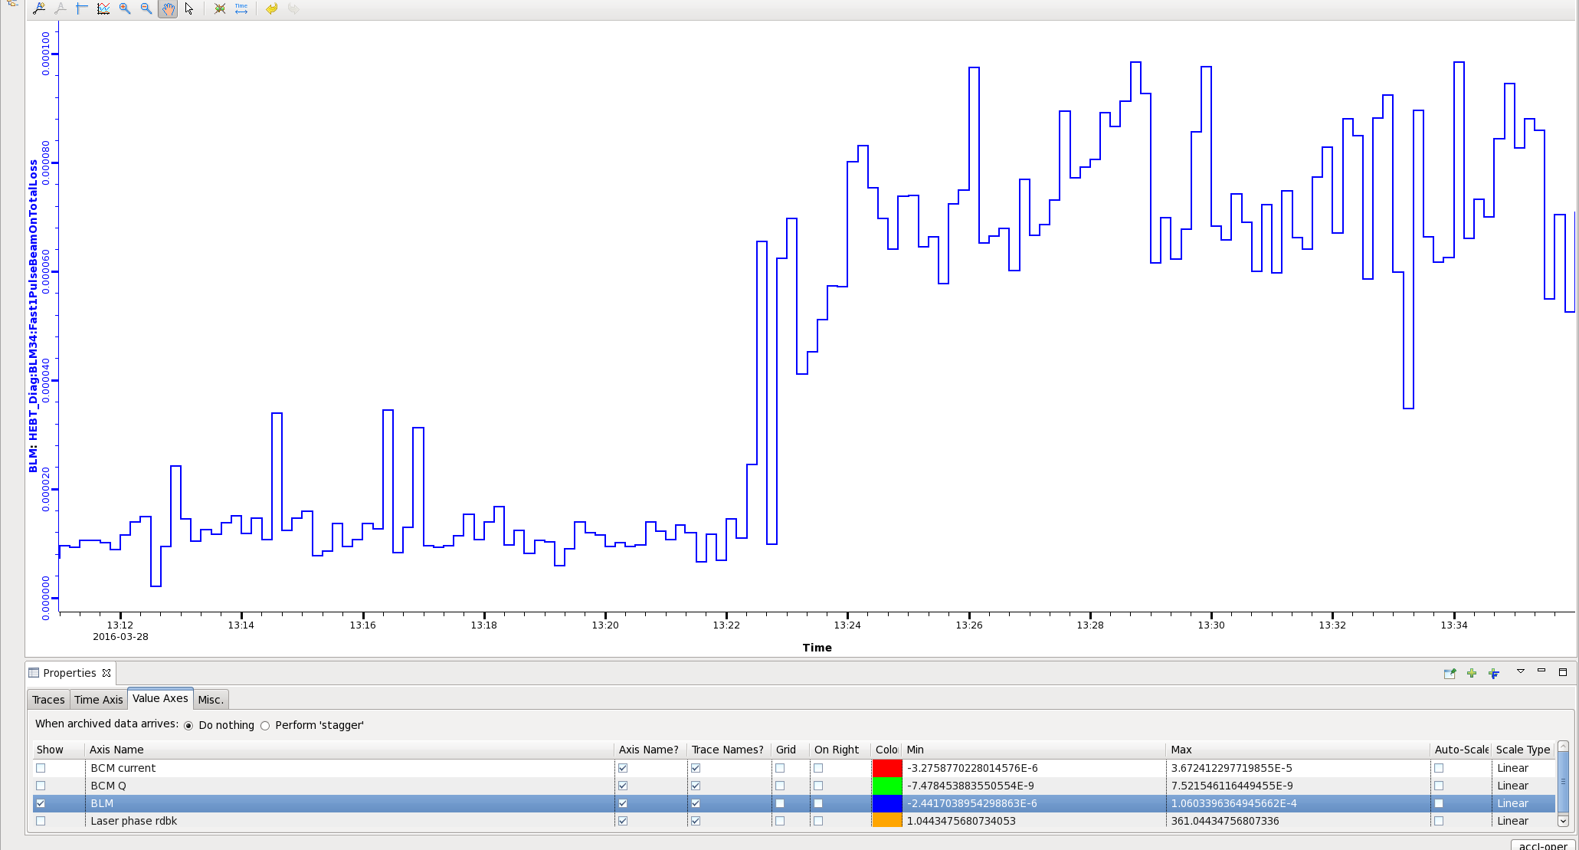
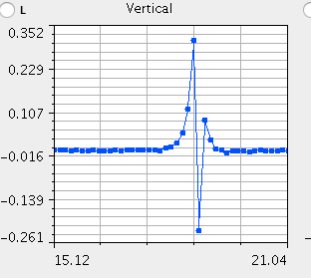
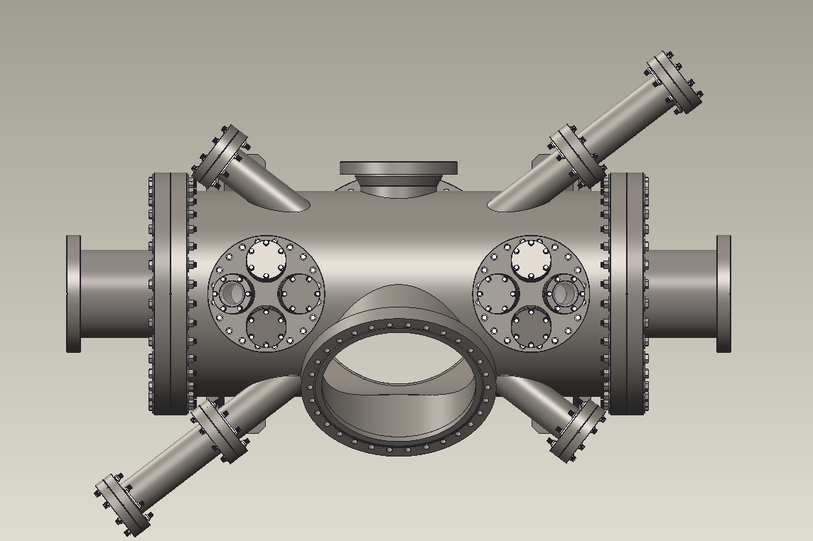
Laser-ion beam alignment
photo-detachment
Need vertically align laser and ion beams
Position tuning is complicated by the need to also phase match the laser and ion beam, therefore laser is running at a slightly different repetition rate from 402.5 MHz
Steer laser or ion beam, look for beam loss by photo-detachment
Look for ion and laser beam on interaction point by wire scanner
Phase matching between laser and ion beams
After vertical alignment accomplished, restore laser to 402.5 MHz
Sweep laser phase and look for beam loss from photo-detachment
Final steps:
Insert stripping magnets, confirm H⁰ conversion
Vary laser incoming angle to fine tune resonant frequency
Only indication of correct angle is stripped beam (sensitivity ~0.1°)
First Attempt – No Stripping
Vessel was designed for 930 MeV, α=37.5°
2 years later we had forgotten this -- set the experiment up for 1 GeV, α=39.7°
Resulted in incorrect resonant excitation frequency for H⁰
Beam Loss Monitor
H⁰
Laser
Wirescanner
Top Down View of Experimental Vessel
H⁻
⍺=37.5°
Laser

Slide 12
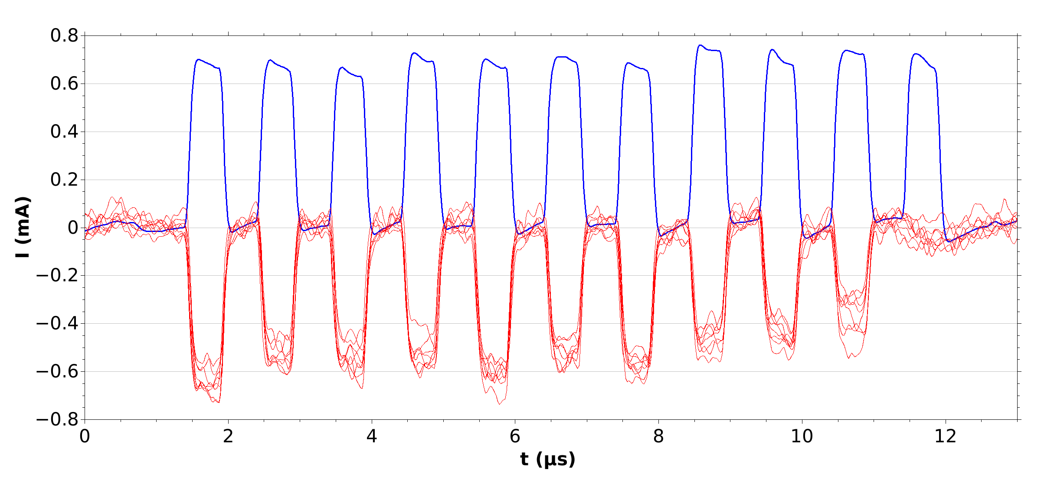
10 µs stripping experiment was successful!
Five experiments were conducted during March-May, 2016:
Successfully stripped 10 µs, 1 GeV H⁻ pulse
Demonstrated >95 % stripping efficiency
Proof of principle (6 ns, 2007) → proof of practicality (10 µs, 2016)
Work supported in part by U.S. DOE (HEP) grant DE-FG02-13ER41967.
H⁻ reference pulses
Stripped proton pulses
S. Cousineau et al., Phys. Rev. Lett. 118, 074801 (2017)

Slide 13
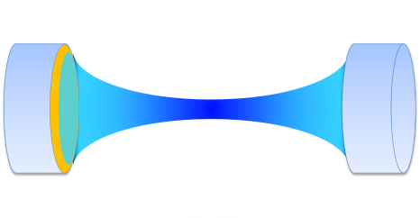
Expanding to 1-ms/60-Hz laser stripping
Macropulse Laser Amplifier
Average laser power at 1 ms burst duration is the fundamental limitation
Current flash-lamp pumped Nd:YAG amplifier can produce UV pulses over 30 – 50 ps with max peak power 3.5 MW at 10 μs
Solid-state amplifiers with 1 ms burst duration need to be developed
Optical Recycling Cavity
Photons/Electrons: ~ 10⁷ - very low photon loss in the laser stripping process
It is highly desirable to enhance and recycle the laser power with an optical cavity
The problem is how to do the enhancement for the burst-mode UV laser light that is not continuously pulsed
We developed a novel technique to solve this problem
H⁻ beam
Optical Cavity

Slide 14
Doubly-resonant enhancement cavity
CW pulses used for feedback control (cavity locking)
System enhances the UV pulses when double resonance conditions are met
The phase difference between the resonance points of the UV and IR beams, simultaneous locking of the UV and IR pulses can only be achieved with appropriate phase/frequency compensation
External control of auxiliary (IR/UV) light frequency by Fiber Acousto-Optic Frequency Shifter (AOFS)
In a doubly-resonant cavity, an auxiliary beam that is phase-locked to the burst-mode beam can be used to lock the cavity
Doubly-Resonant Cavity Locking Scheme

Slide 15
Doubly-resonant cavity locking
Locking technique was first developed to test CW pulses with two different wavelengths (1064 nm and 355 nm)
Built a CW UV laser source from scratch
Achieved a robust locking of both beams
Laser Frequency Tuning Curve
Cavity Locking Signal
A. Rakhman, M. Notcutt, and Y. Liu, Opt. Lett. 40, 5562 (2015)

Slide 16
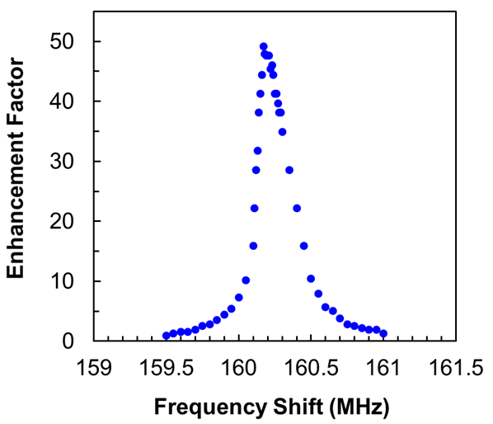
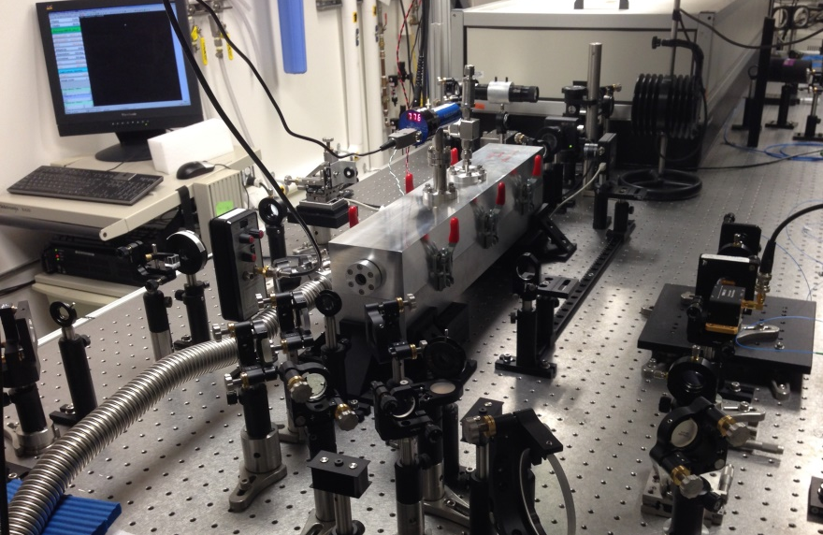
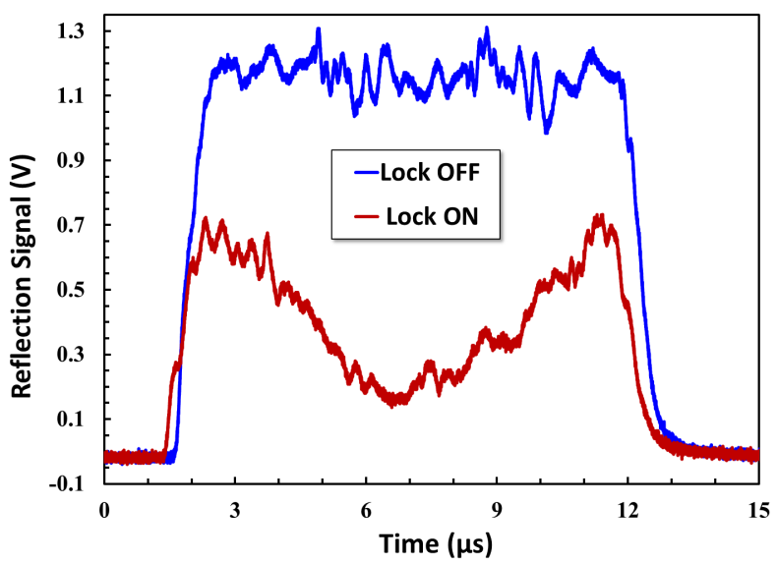
Burst-mode UV macropulse locking
Developed a novel technique for power enhancement UV lasers operating in burst mode with arbitrary macropulse structure
Demonstrated 50 times power enhancement with 10 µs UV pulses at 10 Hz
Intra-cavity peak power ~100 kW for 10 µs pulses at 10 Hz
First demonstration of laser macropulse enhancement in an optical cavity
Laser Frequency Tuning Curve
Macropulse Locking Signal
Cavity
Burst-mode UV beam
Auxiliary Beam

Slide 17
Technical challenges in burst-mode UV cavity development
Small divergence required by ion beam dispersion tailoring makes laser spot size small on the cavity mirrors
Absorption induced coating damage in the cavity mirrors due to high power density
Non-uniform light coupling to the cavity within a macro-pulse causes instability in cavity locking
UV wavelength required for low energy (1.0 GeV) ion beam stripping
Achievable macropulse width is limited by laser amplifier material and scheme

Slide 18
Laser beam size and divergence effect on stripping efficiency
Dependence on laser beam size & divergence @ 1MW laser power
Dependence on laser power
Laser beam parameters of stripping experiment 2016
(1.1, 2.6)
Data provided by T. Gorlov (2016)

Slide 19
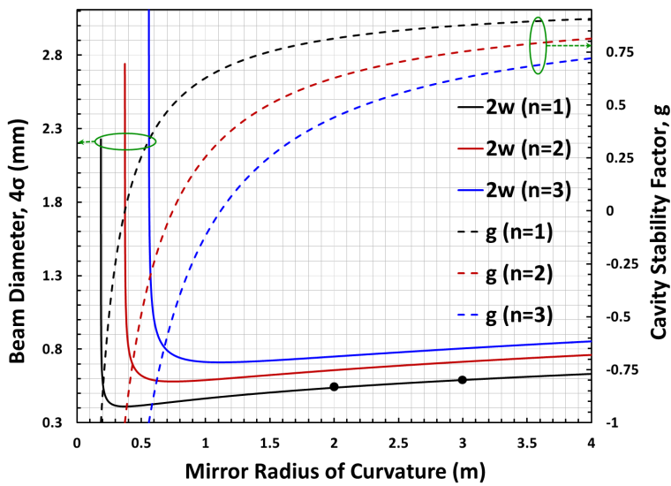
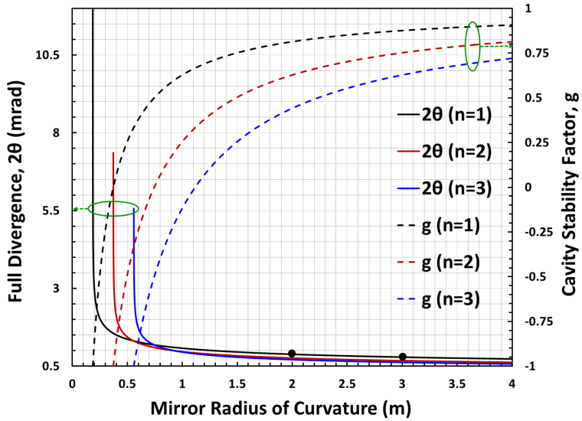
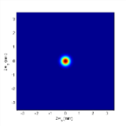
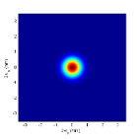
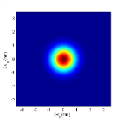
Cavity parameters vs. cavity length
4σ beam size on cavity mirror is the function of beam divergence (2θ) and cavity length (L)
Beam diameter (4σ) on cavity mirror (for 2θ=2.5 mrad case)
n = 1, L = 372.4 mm
0.499 mm
n = 2, L = 744.8 mm
0.948 mm
n = 3, L = 1117.2 mm
1.408 mm

Slide 20
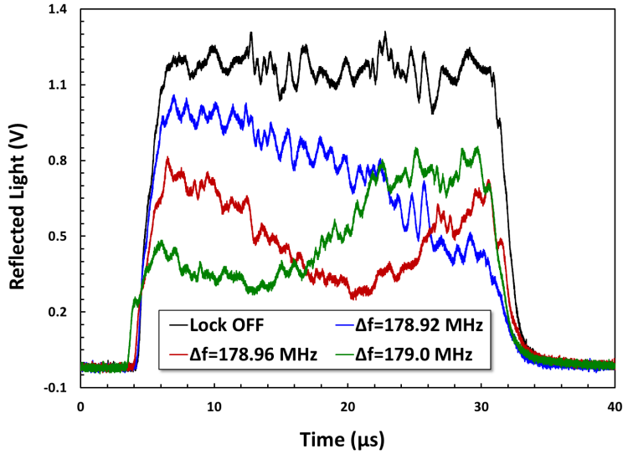
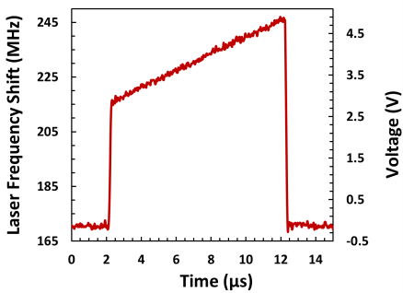
New approaches in cavity locking technique
New set of mirrors with ROC=186.26 mm, and g = -0.999 being tested
Non-uniform macropulse temporal profile was observed in cavity enhancement – caused by small (~ 10 kHz order) laser frequency drift during macropulse enhancement process
We propose to tune the macropulse laser frequency using an acousto-optic device
The Acousto-Optic Frequency Shifter (AOFS) can be triggered to the laser macropulses and produce desired frequency shift pattern in the burst-mode beam
Schematic of New Approach
Non-uniformity of macropulse
light coupling to cavity
10 µs waveform
applied to AOFS

Slide 21
Large mode doubly-resonant cavity locking
CW UV laser with p-polarization used for generating locking signal to the cavity
Macropulse frequency is tuned by AOFS before pulse picker in order to establish double-resonance
Both beams are mode-matched to the large mode F-P cavity (g=-0.999) and injected to the cavity with orthogonal polarizations

Slide 22
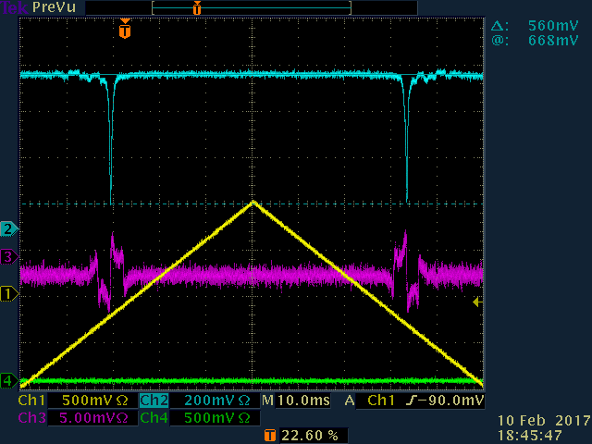
Large mode cavity locking
Achieved good coupling of CW UV light to the cavity. (max UV light coupling to the cavity is 0.84, Finesse = 85)
Demonstrated stable locking of the cavity at the stability edge with g = -0.999
Double-resonance with UV macropulse has been demonstrated while the frequency tune is applied to the macropulse itself
Macropulse light coupling of ~30% has been observed while its locked to the cavity
Macropulse mode matching and signal optimization are on going
Finesse = 85, Coupling = 0.84
Lock ON
Lock OFF

Slide 23
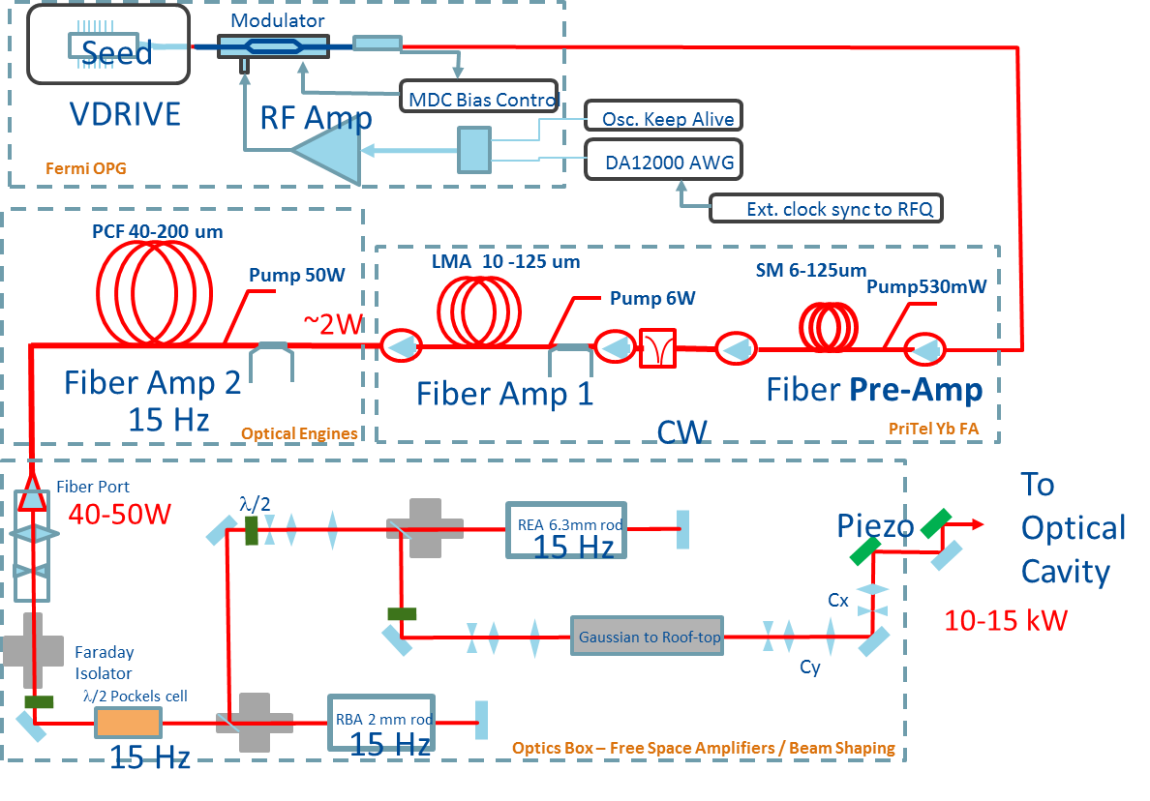
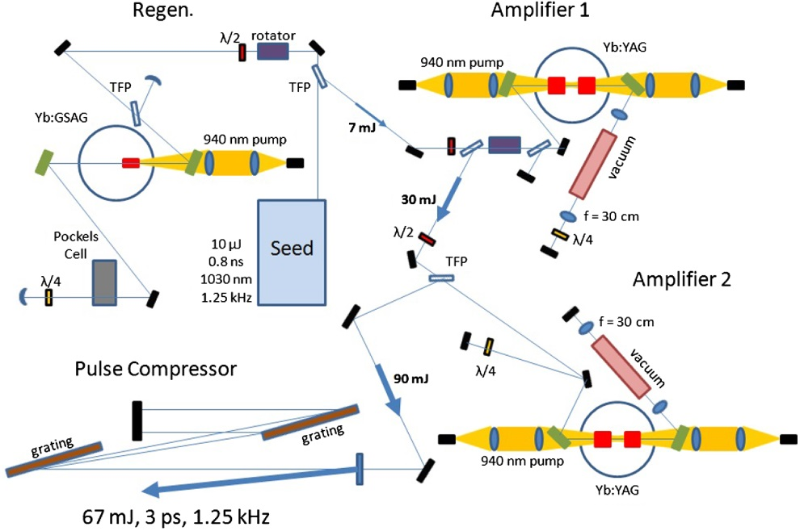
1ms macropulse laser amplifier development
1 ms macropulse amplifier at 60 Hz needs another research and development
Looking into collaboration with various groups experienced with high power burst-mode laser amplifiers
Solid state amplifiers (Fermilab Laser Notcher)
Cryogenically cooled laser amplifiers (Lincoln Lab, MIT)
Courtesy of D. Johnson
F. X. Morrissey, T. Y. Fan, D. E. Miller, and D. Rand, Opt. Lett. 42, 707-710 (2017)

Slide 24
Conclusions and outlook
High efficiency laser stripping on a 10 µs ion beam has been successfully demonstrated at SNS
As a key technology for future laser stripping, burst-mode laser macropulse enhancement in an optical cavity was demonstrated
Technical challenges (UV beam intensity on cavity mirrors, non-uniform macropulse enhancement in cavity, millisecond macropulse laser system) toward full-cycle laser stripping are identified and the following mitigation approaches are researched:
Optimization of cavity configuration and beam parameters to reduce beam intensity below the coating damage threshold
Building cavity with good thermal and mechanical stability in vacuum operation
Frequency compensation with acousto-optic device
Investigation of millisecond macropulse laser amplification technology using cryogenically cooled solid-state amplifiers

