Slide 1
SNS Stripper Foil Production and R&D
Presented to the
SNS Accelerator Advisory Committee
Mike Baumgartner
Mechanical Systems & Operations Group Leader
March 9, 2017

Slide 2
Additional contributors (and the real experts):
E. Barrowclough
D. Briggs
S. Cousineau
C. Feigerle
D. Hensley
K. Leonard
K. Lester
C. Luck
A. Menshov
C. Parish
C. Peters
M. Plum
J. Price
S. Retterer
R. Shaw
B. Srijanto
Y. Takeda
L. Wilson

Slide 3
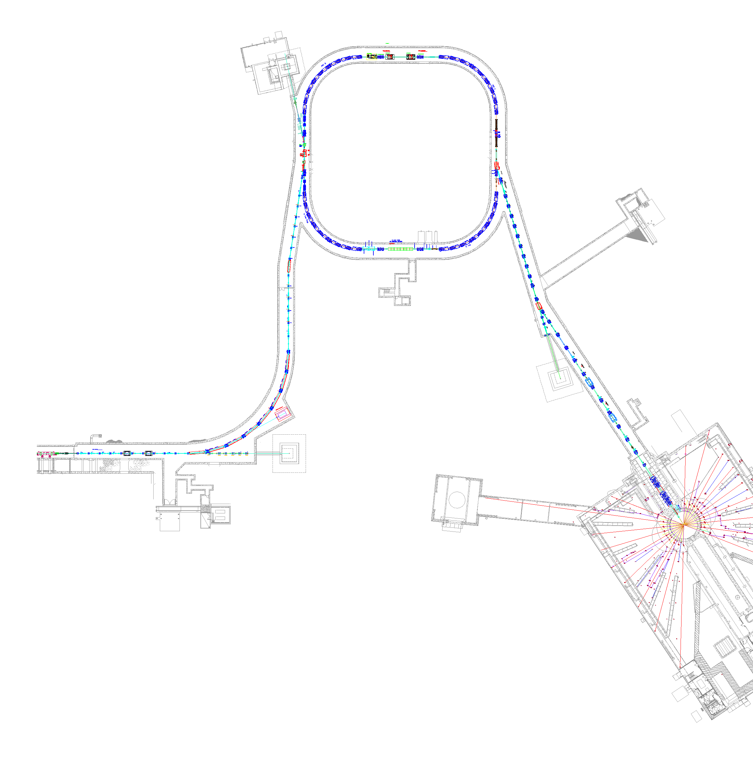


Background: SNS Accelerator Complex
Accumulator Ring
Accumulator Ring
Injection Region & Primary Stripper Foil Location
1 GeV LINAC
Collimators
Front-End:
Produce a 1-msec long, chopped,
H⁻ beam
Extraction
Injection
RF
1000 MeV
RTBT
2.5 MeV
HEBT
Front-End
LINAC
Liquid Hg Target
Chopper system makes gaps
945 ns
mini-pulse
Current
Current
1 ms macropulse
Compress 1 msec pulse to 700 nsec
1ms

Slide 4
Background: Accumulator Ring will not work without stripper foils
Need H+ to compress, stack, and kick-out to target but cannot merge beams of same charge
Two electrons are removed from the accelerator beam by the primary stripper foil and the injected protons are merged with previously accumulated beam
The Secondary foil strips the H⁻ and H⁰ which survive the first foil
e⁻
proton beam
H⁻
Linear Accelerator
e⁻
Accumulator Ring
circulating H⁺
beam
thin diamond foil (Stripper Foil)

Slide 5
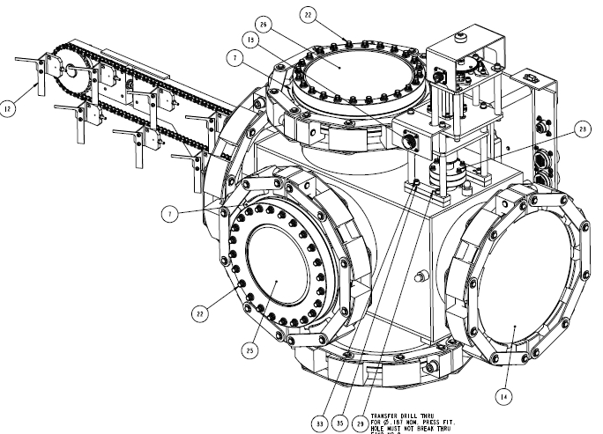
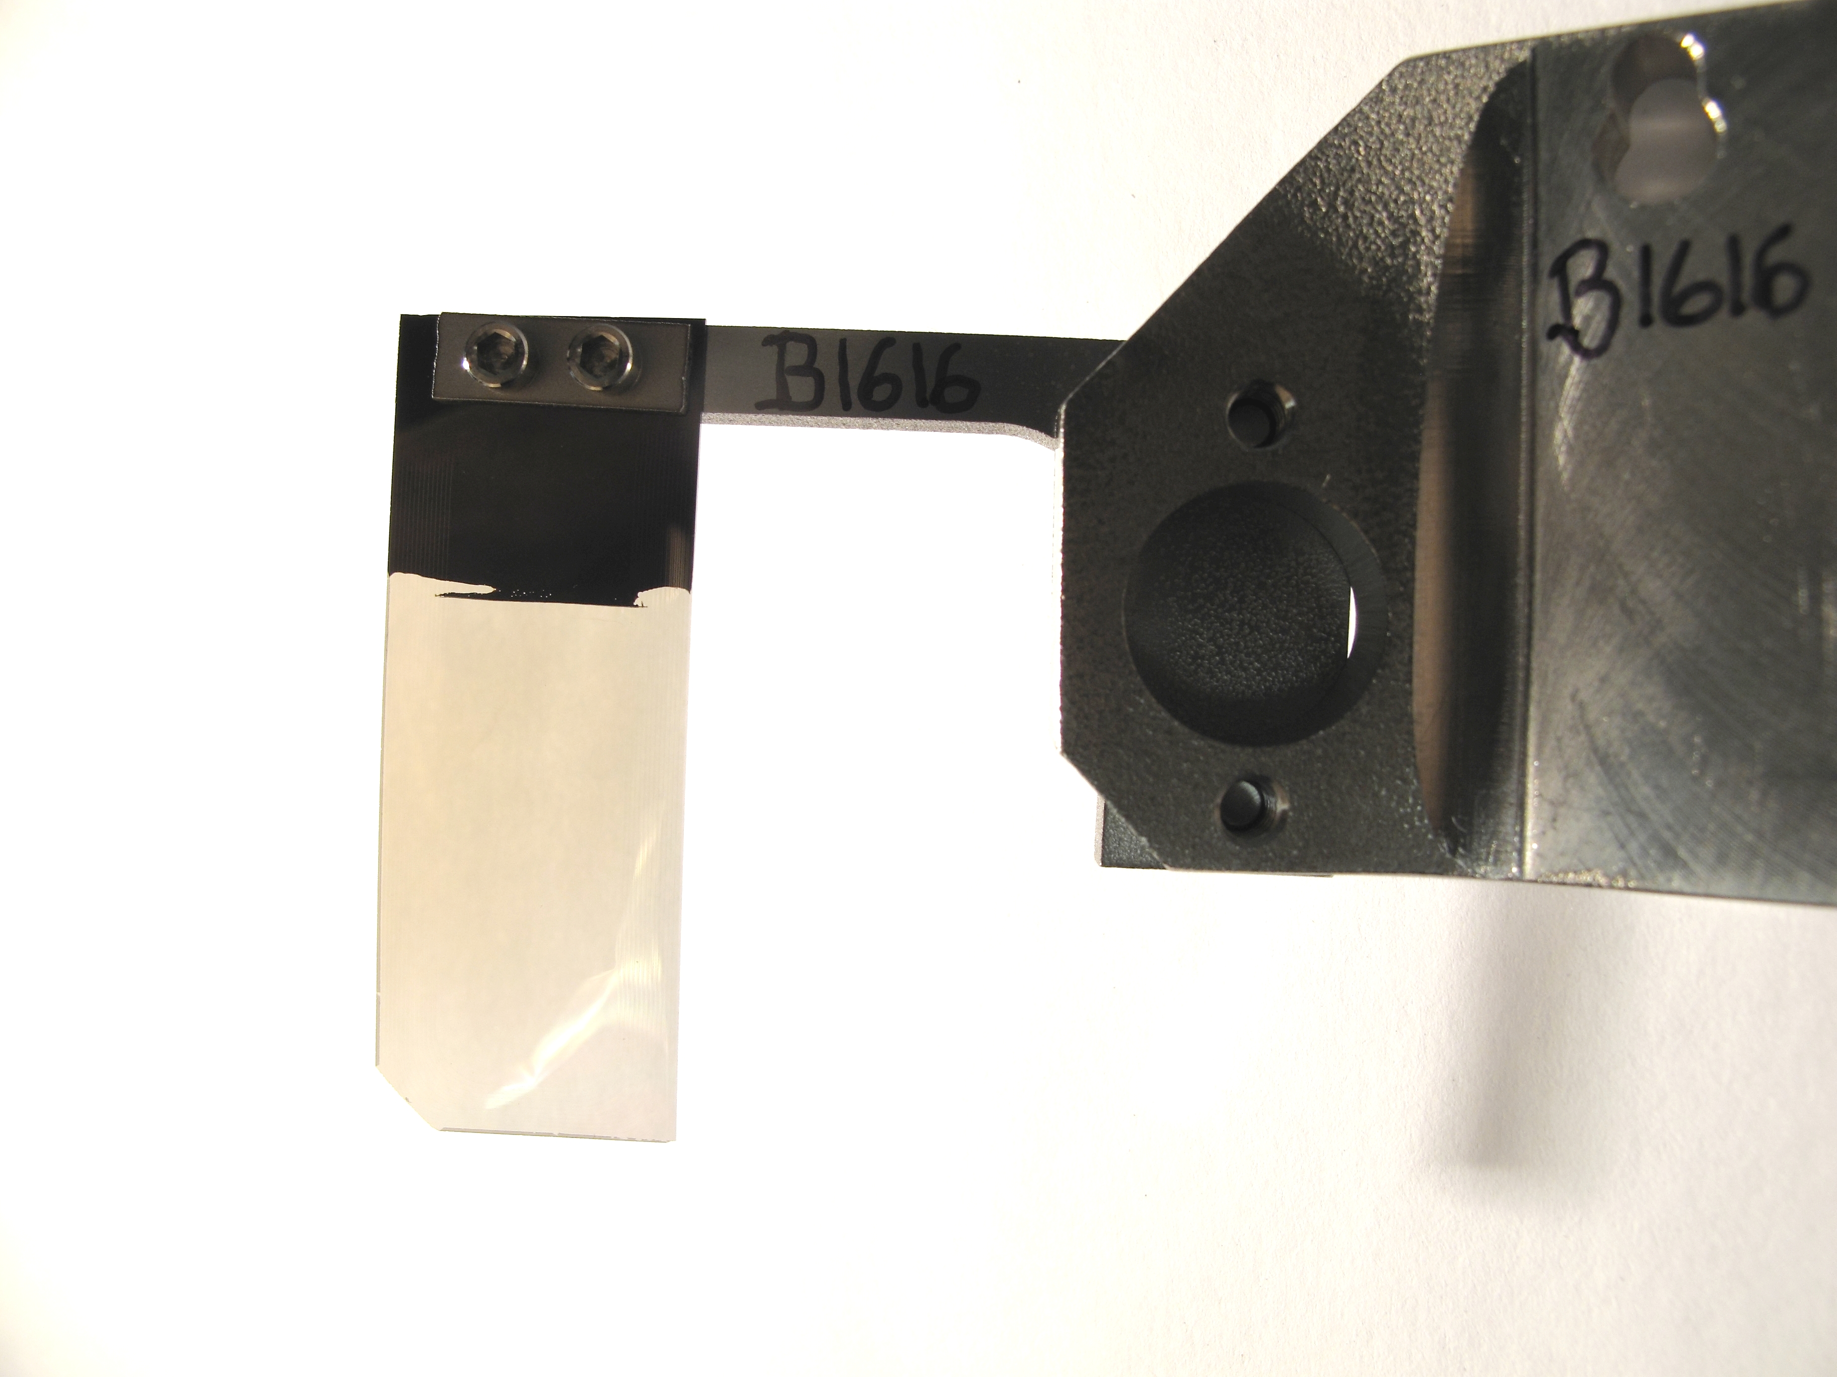
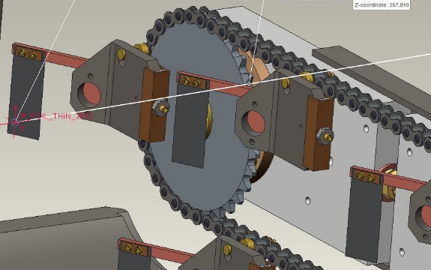
Background: Primary Foil Changer & Stripper Foils

Slide 6
Background: The 2014 motivation to expand SNS stripper foil production and R&D capabilities
SNS foil production and R&D capability was at risk
  The foil production process was completely expert based and resided in the Chemical Sciences Division Bldg. 4100 lab; performed by a single ORNL technician (L. Wilson)
  Long term R&D leads (R. Shaw and C. Feirgerle), one of them the technician supervisor, were going to retire in a few months
Diamond foil behavior was not understood and current technology was not known to be capable of supporting high power operations
  The Center for Nanophase Material Sciences (CNMS), co-located with SNS, had the technical expertise and an interest in developing a diamond foil production and R&D capability
  CNMS involvement also provided an opportunity to back-up critical skills

Slide 7
After careful consideration, decision was made to move SNS foil production and R&D to CNMS on October 1, 2014

Slide 8
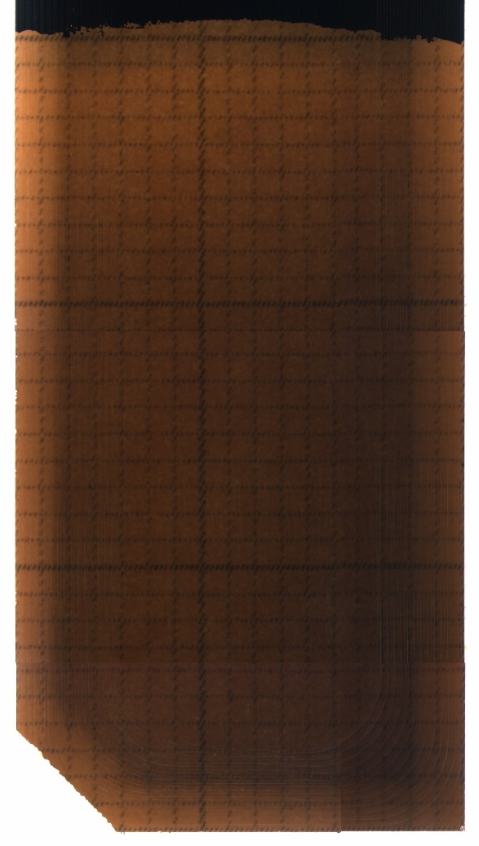
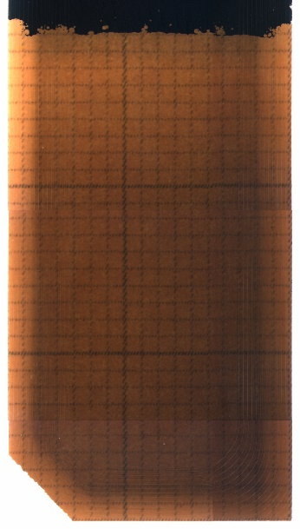
Chemical Vapor Deposition (CVD) supplier was identified
A vendor was identified, Microwave Enterprises (MWE) LTD, with experience in CVD diamond foil growth
  Had several automated CVD tools in use world-wide
  Had a tool in use at Michigan State University (MSU) similar to what was being requested (DT700)
  Agreed to produce “proof of capability” foils for evaluation using the MSU tool
MSU foils successfully evaluated through the established foil QA inspection processes (7/21/15)
MWE CVD tool ordered 8/4/15
MSU25 performed well in the SNS accelerator @ 850 kW during October, 2015
MSU25
MSU26
Photos by C. Luck

Slide 9
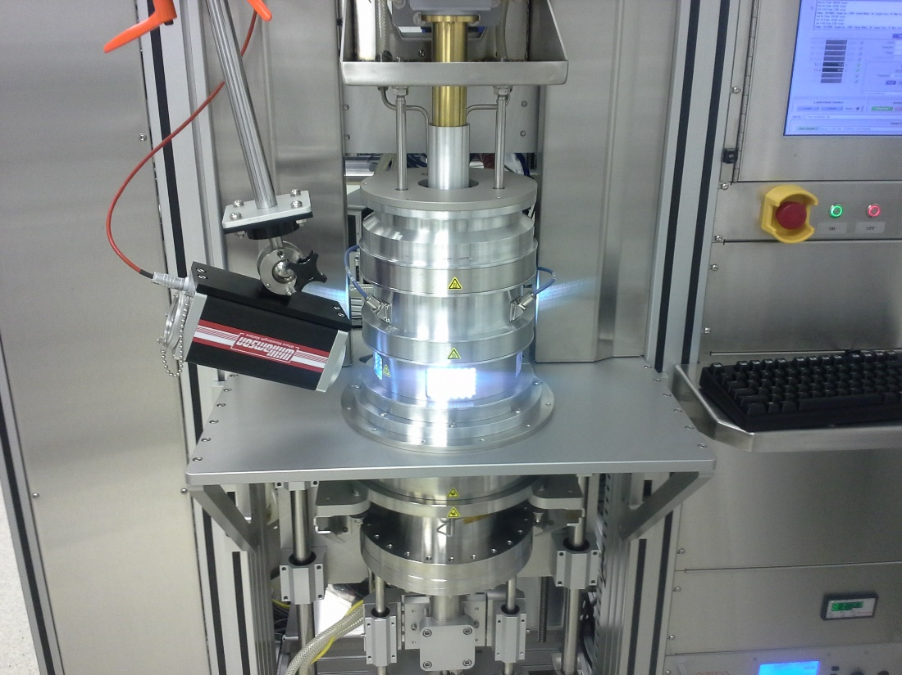
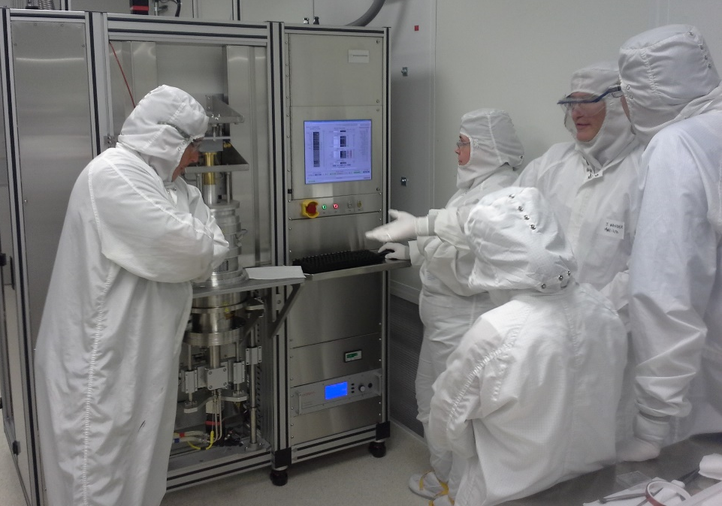
Foil production capability installed at CNMS
MWE CVD tool design and drawings were completed and approved on 9/25/15
MWE CVD tool and foils passed inspection at the North Carolina facility on 4/1/2016
CVD tool arrived at CNMS on 4/26/16; with vendor assistance, installation and commissioning was completed on 5/26/2016
CNMS staff cross-trained in stripper foil growth and SNS QA processes
Foil growth in progress in CVD reactor

Slide 10
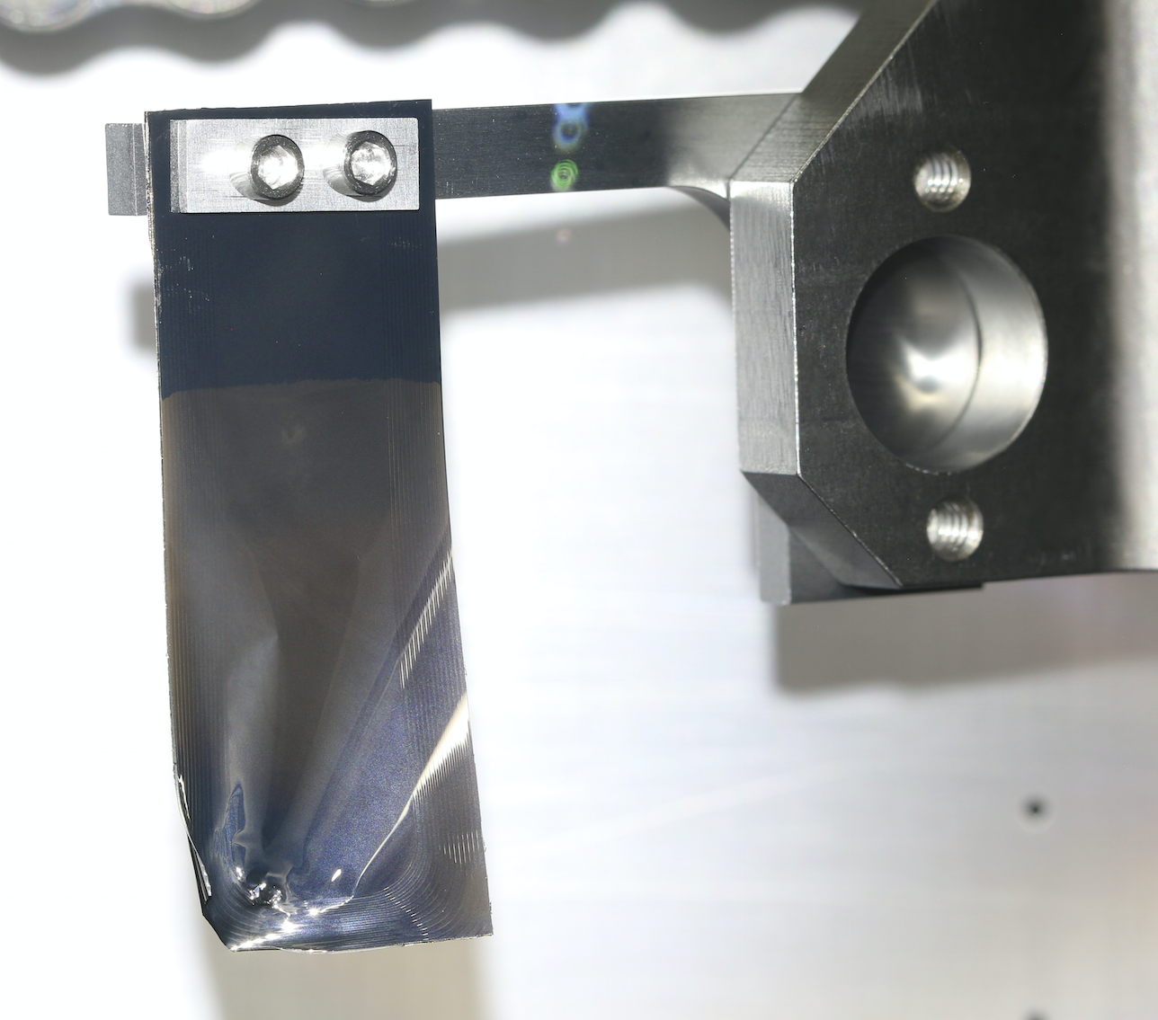
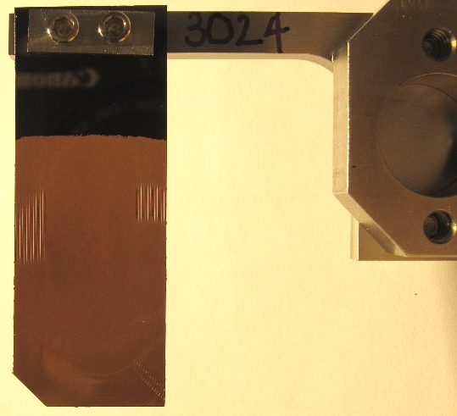
Stripper foil production shifted to CNMS
Stripper foils produced entirely at CNMS were installed in the SNS accelerator on 6/29/16 (foils 3023 & 3024)
Both performed well and SNS stripper foil production was formally transferred to CNMS on 9/29/2016
Foil #3024
Photo taken 8/9/2016
1 MW beam power from July 8 to August 9.
Very stable foil, little shaking
Good beam loss
Up to 180 deg. foil curl
No obvious rips or tears
Overall a very good foil
Photos by C. Luck

Slide 11
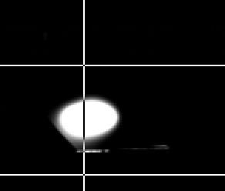
Characteristics of a good stripper foil
Lifetime at least 4 weeks
  To avoid downtime due to the foil change process, downtime due to foil conditioning, and limited number of slots on the foil changer
Keep flat shape with nice straight edges
  Needed to keep injected beam spot on the corner of the foil to minimize foil hits, minimize beam loss, minimize foil temperature
No shaking / flutter
injected beam
spot
footprint of painted beam
aperture

Slide 12
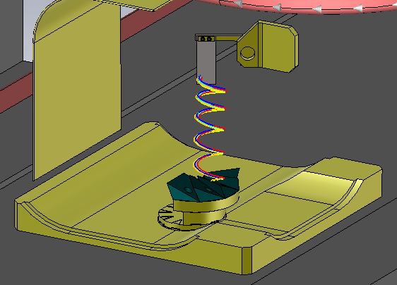
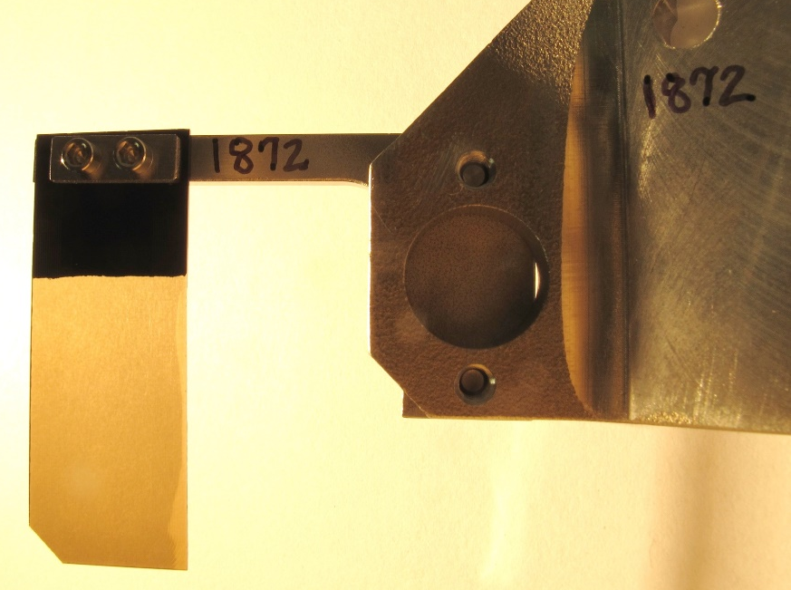
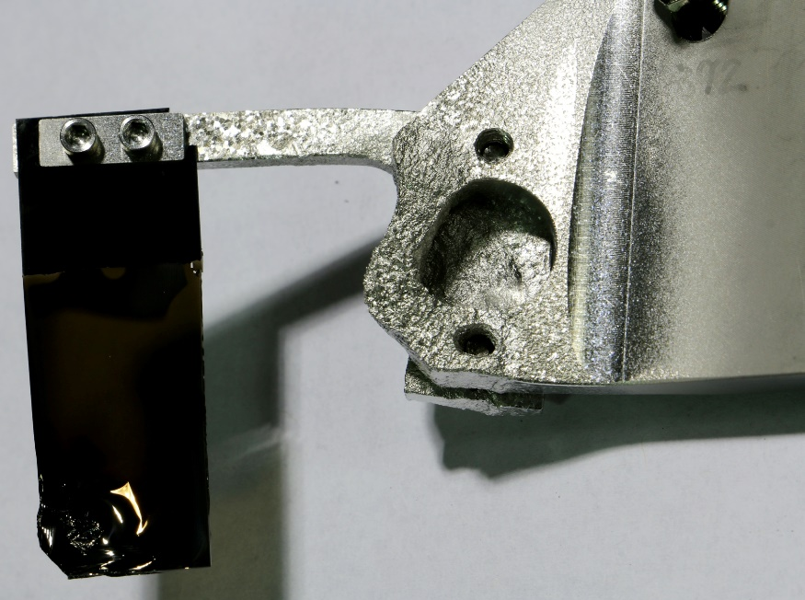
Known issues: Foils don’t always last 4 weeks
Foils have mechanically failed—cause(s) uncertain
Foil holders have failed due to convoy electron heating
  Experienced failures with aluminum holders in 2009, switched to titanium
  Experiencing similar behavior with titanium at higher powers, testing titanium-zirconium-molybdenum (TZM) alloy
Titanium, 3,034ºF melting point

Slide 13
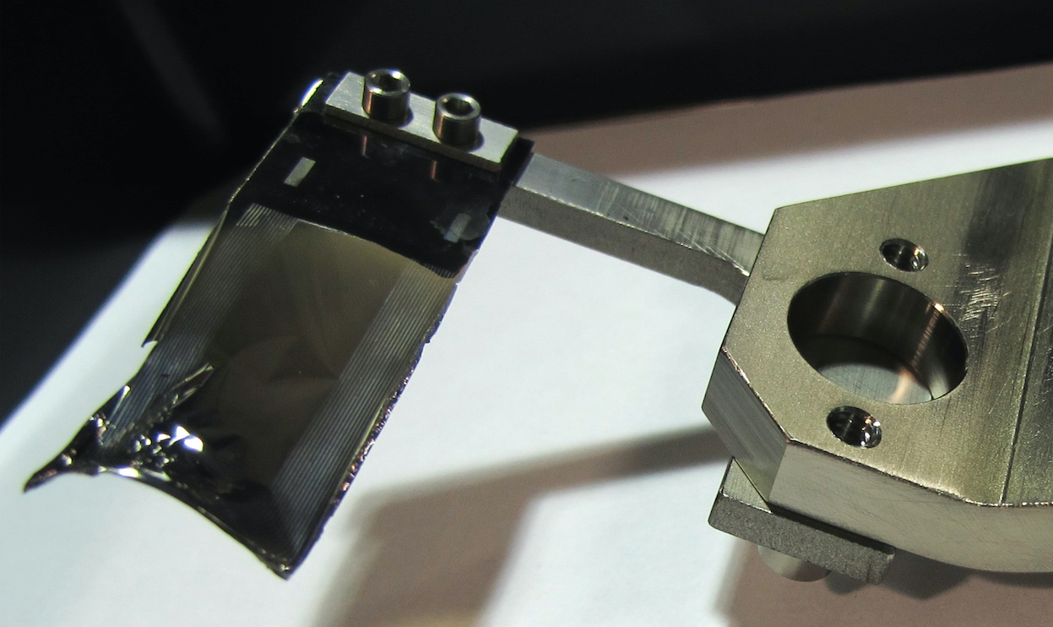
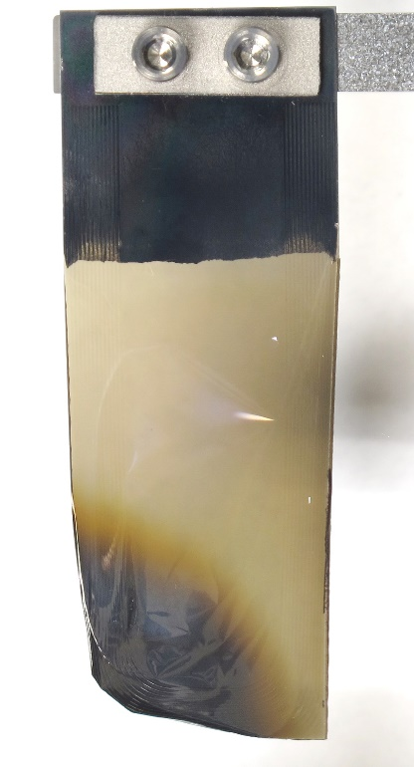
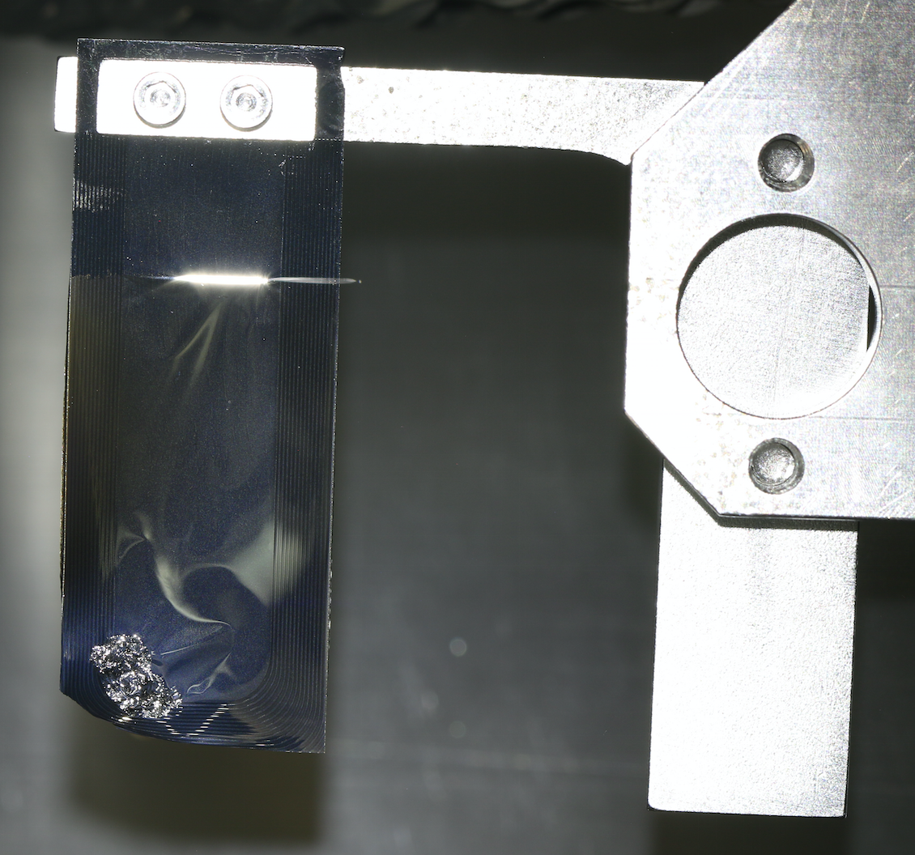
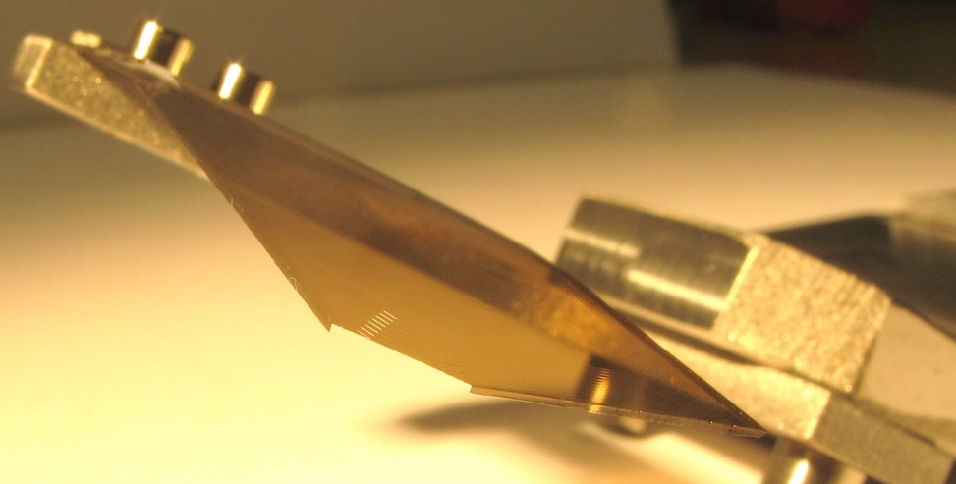
Known issues: Flat shape doesn’t necessarily exist before use and certainly doesn’t during use
Foil B1616
Foil 1792
Foil 1073 rotation
Photos by C. Luck
Foil curl

Slide 14
Known issues: Foil “shaking” requires foils to be taken out of service
Injection dump current management becomes too time intensive
Too time intensive to keep the desired beam spot on the foil
Potential causes
  Electric charge build-up and dissipation?
  Physical impact of proton beam? (Estimated to be ~50 μg / pulse!)
  Residual stress?
  Thermal stress?

Slide 15
Future: Expand stripper foil R&D in order to produce foils that can survive high power operations
Through R&D, reach an understanding and develop models that can predict foil material behavior & in-beam performance
Use that understanding to solve foil issues and enable reliable high operations
Leverage ORNL capabilities to gain this understanding
  CNMS (CVD and nanomaterials expertise)
  Low Activation Materials Development and Analysis (LAMDA) lab (materials measurement expertise)
  SNS neutron science capabilities (Vulcan [BL7] residual stress measurement capability)
  SNS Foil Test Stand (beam simulation and foil behavior expertise)
  SNS accelerator in-beam measurements (beam physics, foil in-beam performance, and foil behavior expertise)

Slide 16
Summary
SNS primary stripper foil production and R&D was successfully moved to CNMS
The move was a win-win situation for both facilities, mitigating operational risk for SNS while enhancing the capabilities of the CNMS user program
The leveraged capabilities of SNS, CNMS, and LAMDA provide an opportunity to enhance the stripper foil R&D effort, improving theoretical understanding of foil performance and characteristics necessary for predictable high power accelerator operation

