Slide 1
Self-Consistent Beams in SNS
Presented to the
SNS Accelerator Advisory Committee
Mike Plum
and Jeff Holmes
March 9, 2017

Slide 2
Motivation – why do we care?
New type of beam distribution. Has never been realized.
They suppress space-charge induced halo growth and the associated beam loss → reduced beam loss in high intensity rings
The beam density is more uniform → better for targets
They can be manipulated to give flat beams when space charge effects are weak → increased collision rates for colliders and heavy ion fusion applications
Until recently work was highly theoretical and assumed an ideal ring
Can these distributions be created in a real-life ring like SNS?
DOE BES grant for $1M awarded June 2016

Slide 3
Background – early work
From 2003-2006, S. Danilov and J. Holmes studied self-consistent distributions from a mathematical and computational standpoint
The idea was to find beam distributions satisfying the Vlasov equation
  They are elliptical with uniform density in real n-dimensional space and
  They retain these properties, shape and density, under all linear transport, even accounting for space charge forces.
We called these distributions self-consistent.
Prior to this work, the only known self-consistent distribution was the famous K-V. However, injecting a K-V distribution into a real accelerator is not feasible.
Our goal: Find self consistent distributions that could be practically achieved in a real-life ring, and that would be robust under real transport, space charge effects, nonlinearities, impedances, and other loss mechanisms

Slide 4
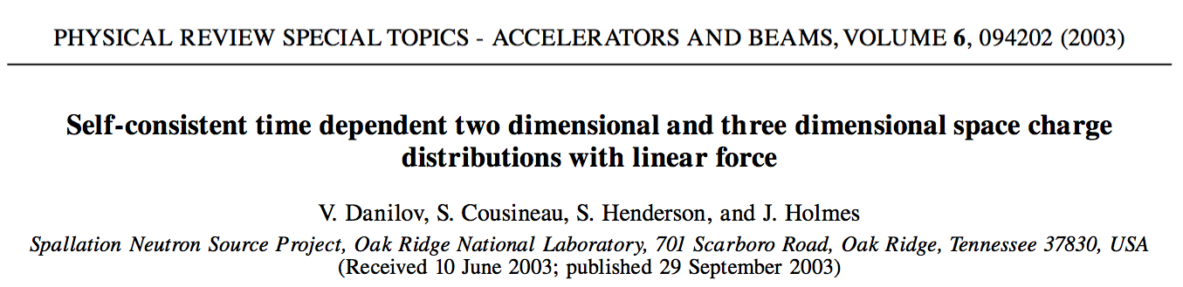
First results
The initial 2003 journal article was mainly a mathematical exercise. It showed:
  How to construct these distributions
  Included an idealized ORBIT simulation of injection of a 2D self-consistent distribution including space charge into a linearized SNS lattice as a coasting beam (no gap, no ring RF, only linear magnets).
Some conditions had to be met to inject the distribution:
  The painted horizontal and vertical emittances had to increase linearly in time in order to yield constant charge density.
  The horizontal and vertical tunes had to be equal during injection.
  The painted horizontal and vertical phases had to differ by 90°

Slide 5
First results
Improper phasing
Unequal tunes
Equal tunes and
Proper phasing
Linear Emittance Painting

Slide 6
Subsequent studies (still early work)
Chromaticity, nonlinearities, and fringe fields were introduced:
  Self consistency was destroyed due to the coupling of two degenerate eigensolutions
  A pair of solenoids was introduced symmetrically into the RF straight section in order to break the degeneracy
The required injection kicker waveforms necessary to paint the {2,2} self-consistent distribution were worked out and shown to be feasible. However, this was not tested in ORBIT simulations, where only artificial bumps were employed
Impedances and bunched beams were also introduced

Slide 7
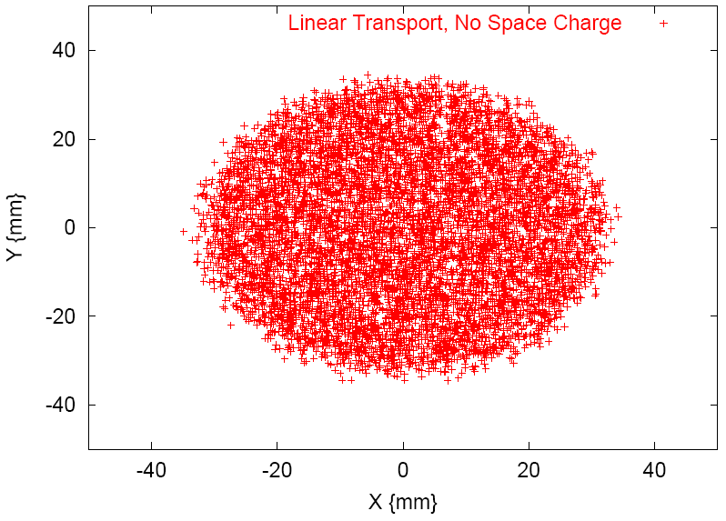
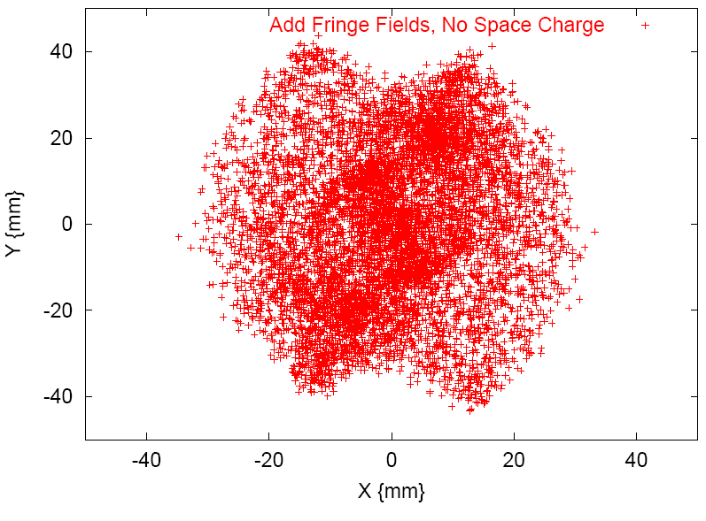
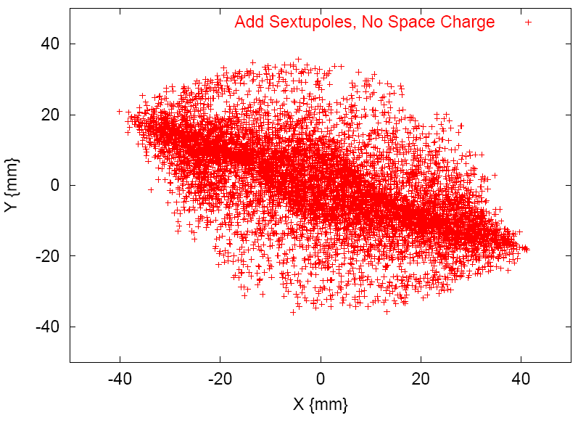
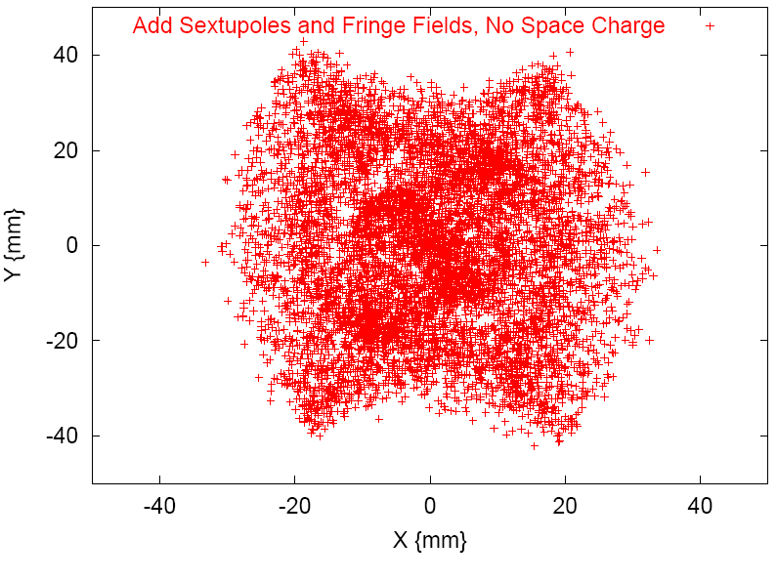
Paint {2,2} distribution in SNS: nonlinear effects destroy self-consistency
Linear
Fringe Fields
Sextupoles
Fringe Fields + Sextupoles

Slide 8
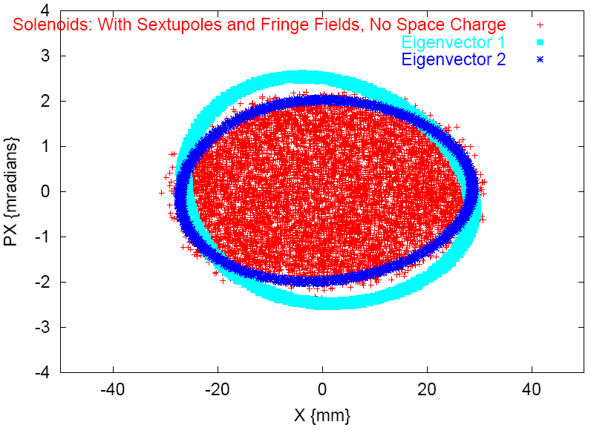
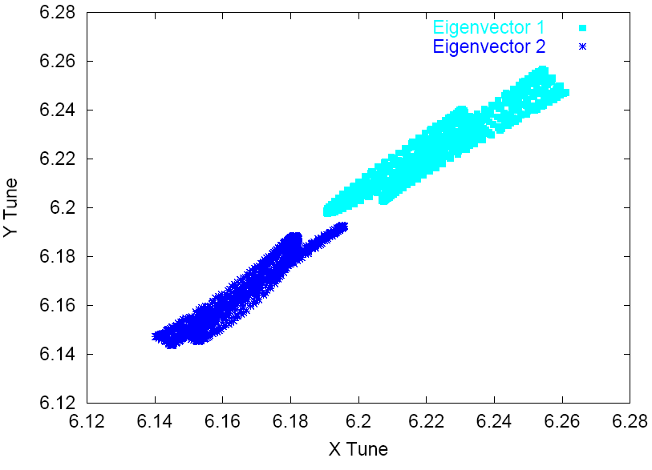
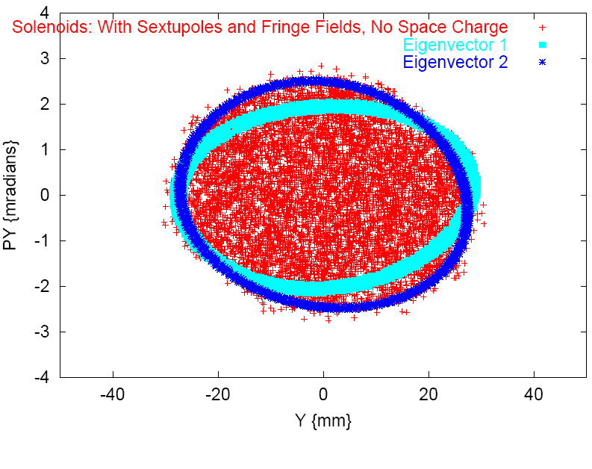
Solution: include solenoids to split tunes and paint to an eigenfunction
For the same SNS case as the previous slide, include two solenoids symmetrically in RF straight section to split tunes and paint {2,2} distribution to one of the eigenfunctions
Results show painted beam in phase space and tune separation and spread of eigenvectors
x-x'
Tunes
y-y'

Slide 9
How to paint a self-consistent {2,2} distribution
Injection bump trajectories vs. distance
Injection kicker angles vs. time
Beginning
End

Slide 10
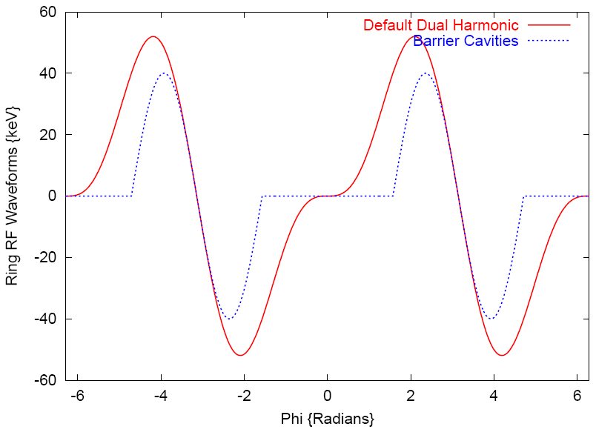
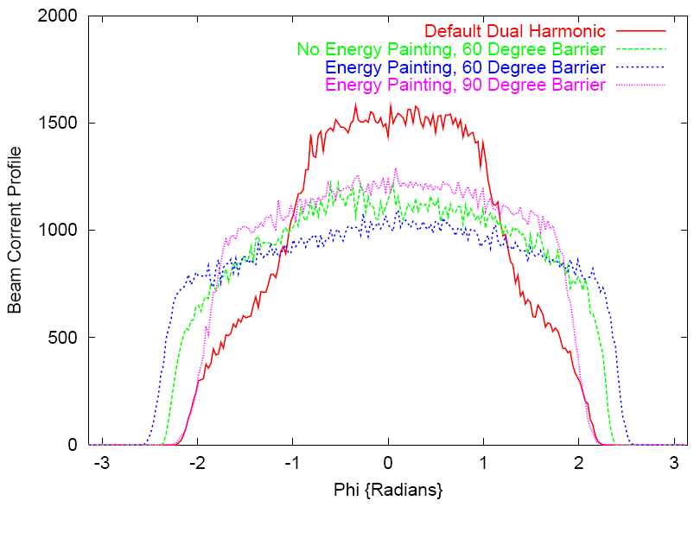
Barrier cavities → flat current profiles
Dual Harmonic Waveform (four cavities):
V = 40 × sin(φ) – 20 × sin(2φ)
Barrier Cavity Waveform (four cavities):
V = -40 × sin((φ – nπ) × π / Δ)
for |(φ – nπ) × π / Δ| < π, and
V = 0 otherwise.
The dual harmonic waveform leads to peaked beam current profiles (low bunch factors), while barrier cavities give flat beam current profiles – the current profiles shown are taken at the end of accumulation (1100 turns)
For given peak current, barrier cavities allow higher total current and flat longitudinal profiles provide the possibility of painting self-consistent distributions

Slide 11
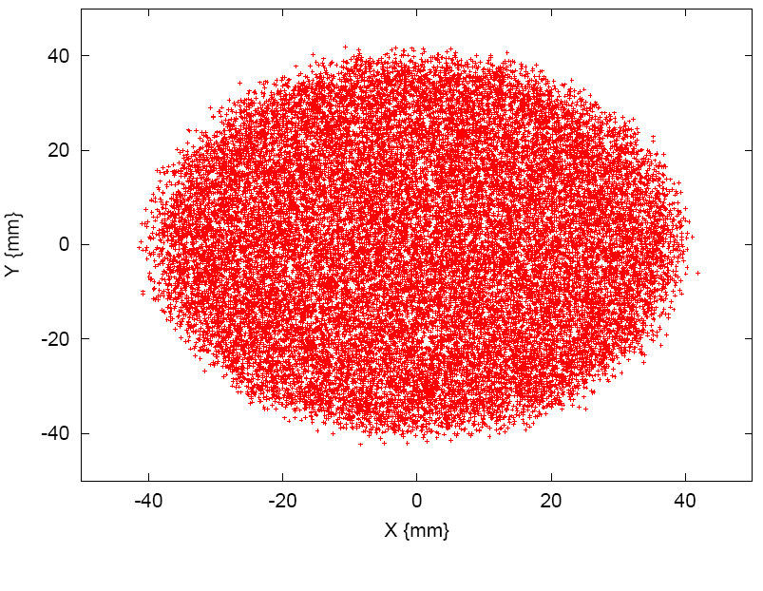
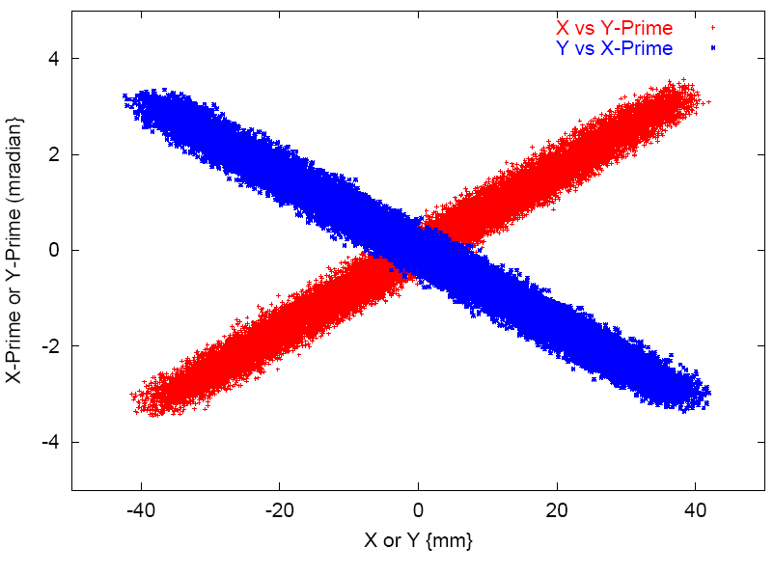
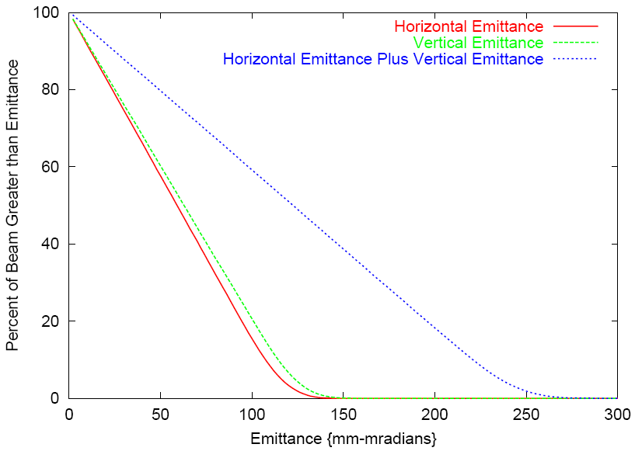
Barrier cavities: self-consistent beam injection
(Linear lattice with space charge.)
Example self-consistent beam distribution using barrier cavities

Slide 12
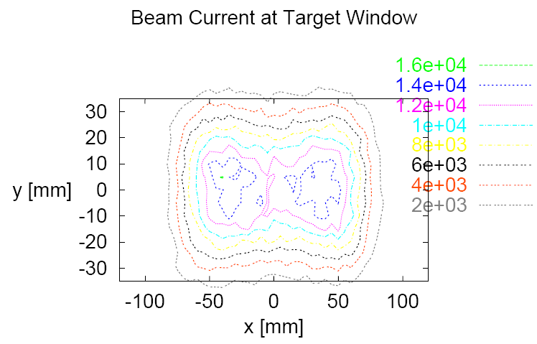
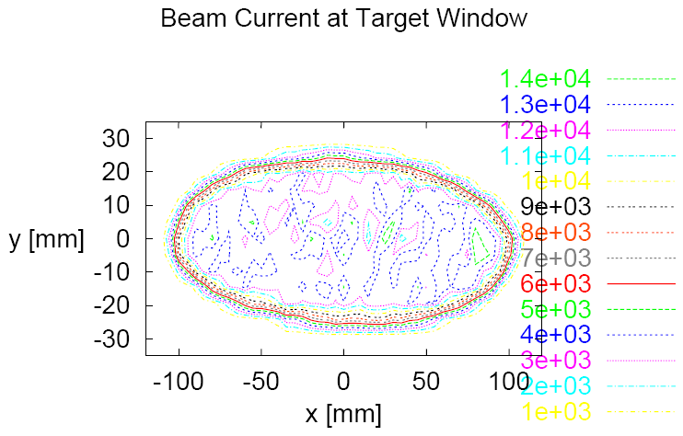
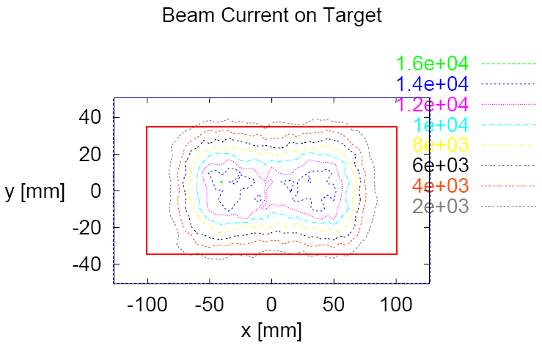
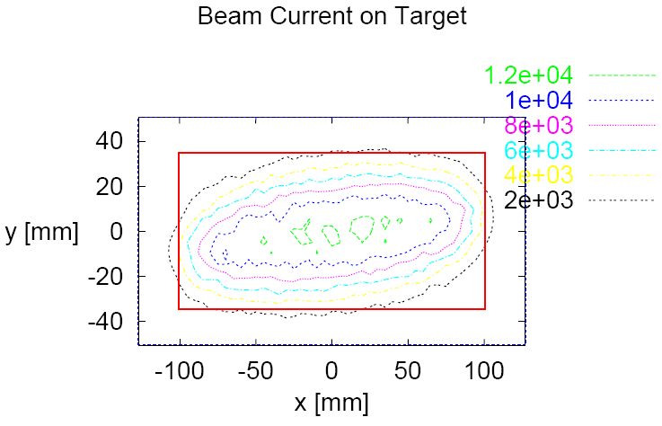
Barrier cavities: self-consistent beams → uniform beam profiles at the target
Standard Painting
Self-Consistent Beam

Slide 13
New work
The results presented so far were all obtained in 2006 or earlier
The remainder of this presentation shows what we have done recently, since restarting the work last fall

Slide 14
New work: starting where we left off
The calculation shown here features a {2,2} distribution, equal tunes of 6.18, full nonlinear transport including fringe fields, solenoids in the lattice, production beam intensity, foil scattering, apertures and losses, 10⁶ macroparticles, 3D (sliced) space charge, and transverse and longitudinal impedances. Its unrealistic limitations are
barrier cavities and
artificial bumps for painting.

Slide 15
Distributions
The calculation shown here features a {2,2} distribution, equal tunes of 6.18, full nonlinear transport including fringe fields, solenoids in the lattice, production beam intensity, foil scattering, apertures and losses, 10⁶ macroparticles, 3D (sliced) space charge, and transverse and longitudinal impedances. Its unrealistic limitations are
barrier cavities and
artificial bumps for painting.
Looks good! Just need to implement real injection painting using the kickers and to use existing RF cavities

Slide 16
Barrier Ccavities -> existing RF
In the original (2003-2006) studies, barrier cavities were necessary to maintain self-consistency
The design SNS ring RF cavities were to operate with 40 kV first harmonic and 20 kV second harmonic voltages, which destroyed the uniform density beam current profile.
Today, we actually operate with much smaller (<10 kV) ring RF voltages
When we apply these operating voltages in the self-consistent beam simulations, self-consistency survives
The remaining results to be presented were calculated using 4 kV first harmonic and 4 kV second harmonic RF voltages

Slide 17
Effect of dual harmonic RF cavities
V_{RF} = 4kV (both harmonics)
Longitudinal profiles peak up somewhat
Little effect on transverse properties

Slide 18
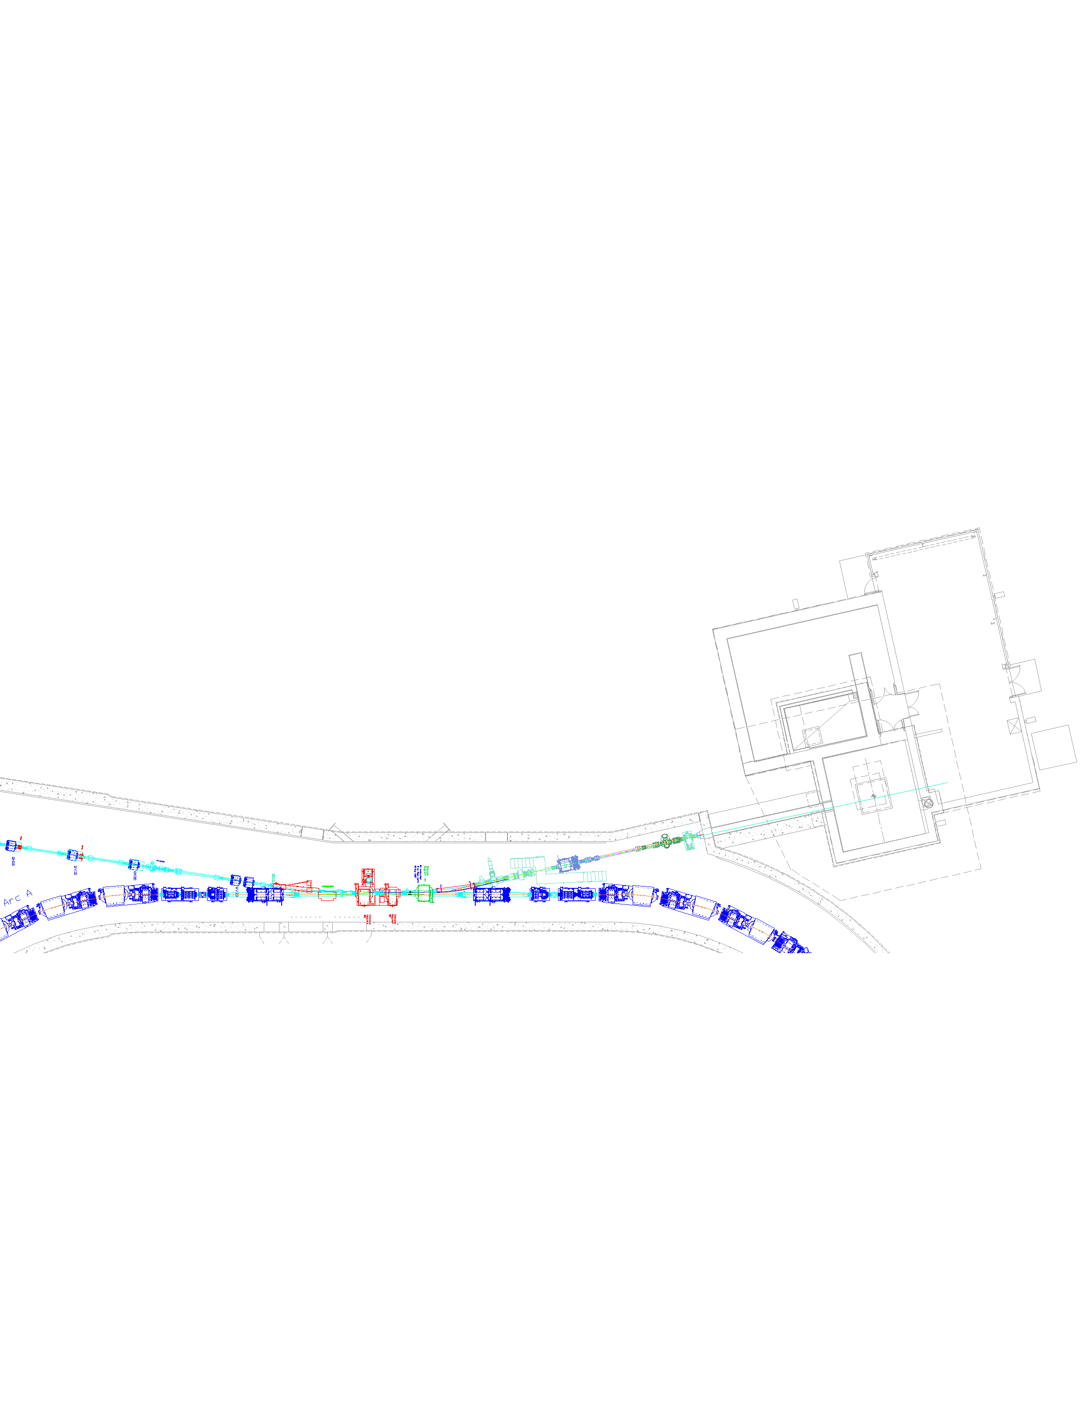
Simulate real injection painting
Quad doublets
Quadrupole fringe
fields could be the
show stopper
Ring injection section
Uh-oh!

Slide 19
Mitigating fringe fields from quad doublets
Injection painting → Off-axis beam passage through quad doublets in injection straight section → fringe fields → self-consistency lost
Lots of numerical studies led to following measures:
  Move foil and injection spot in and down by 1.6 cm to allow smaller injection painting bump
  Increase fields in injection chicane dipoles by 20% to provide more of the injection bump inside the doublets, hence reducing the painting bump further
  Paint a smaller beam (60% size) in the transverse dimensions to reduce the painting swings further
The following results are for this final best case

Slide 20
Present results
Transverse profiles agree with self-consistent
Current profile is reasonably flat
Emittances are broadened because of effects of linac beam spot size and small painted beam

Slide 21
Present results
Transverse beam spot is round with very uniform density
X-Y’ and Y-X’ remain correlated, although significant spreading occurs for small injected beam

Slide 22
Present results
Beam density is very uniform

Slide 23
Present results
Injection kicker waveforms are easily achievable with modification to allow power supplies to change signs
Because a small beam is injected, foil hits by circulating particles are high at 58 foil hits / proton in 1060 turns
The calculated losses are 5.7e-04, mostly in the injection and collimation regions

Slide 24
Ring modifications required for this experiment
Add two solenoid magnets in locations where the horizontal and vertical betatron functions are equal
Modify injection kickers to be bipolar (two horizontal and one vertical, but may be able to optimize this)
Upgrade H1, H2, V3, injection kicker power supplies to be bipolar
Ring injection section

Slide 25
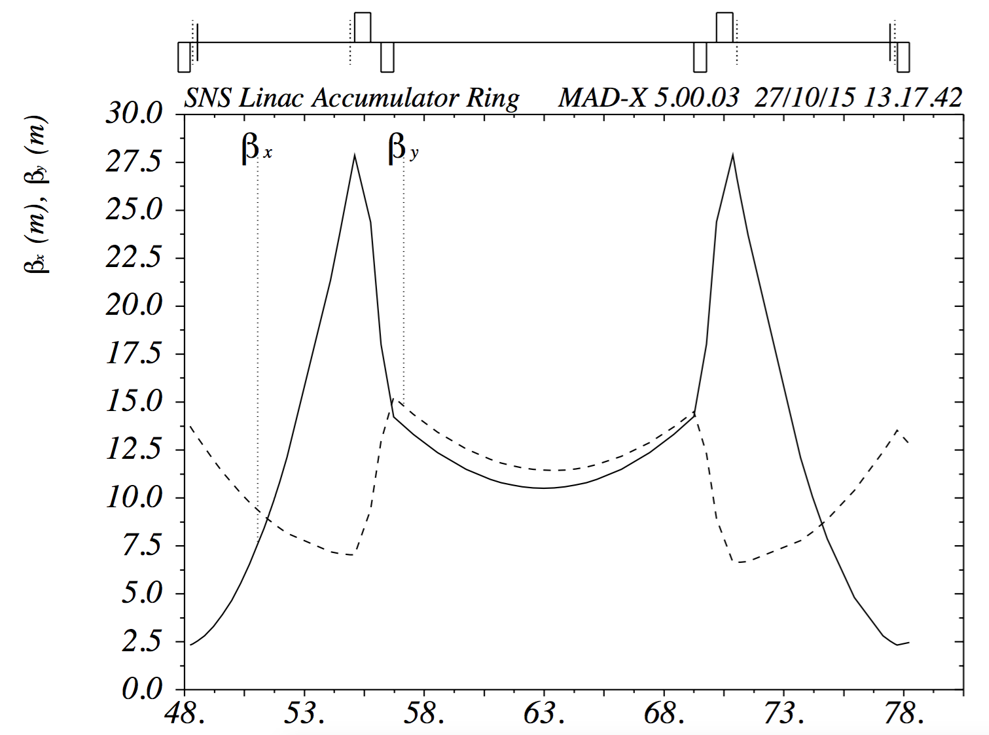
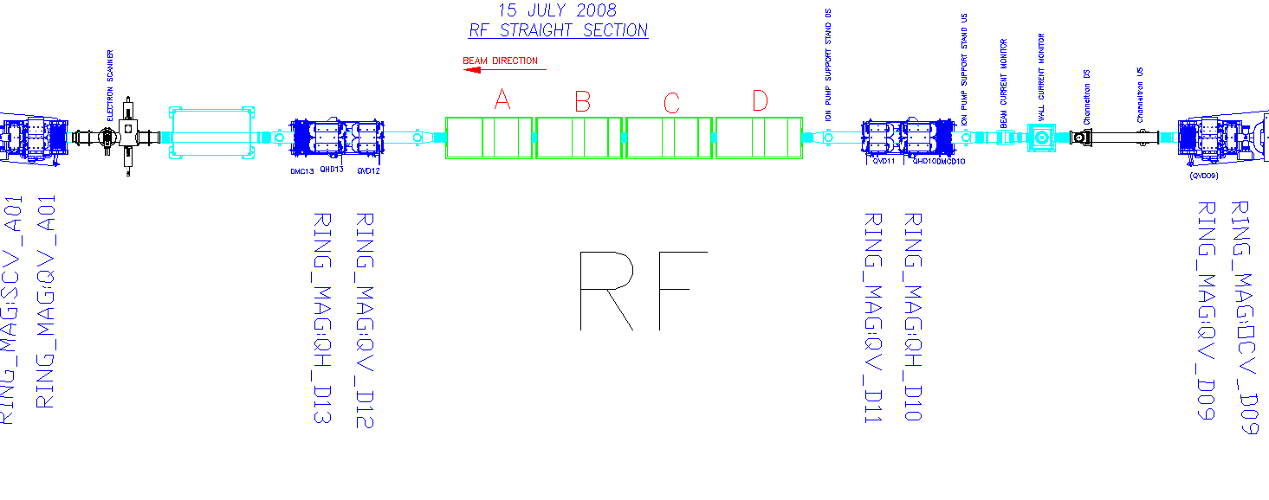
Ring RF area modifications – add two solenoid magnets
Solenoid placement
1.5 T, 0.5 m long
Note: beam is left to right on MADX plot,
right to left on CAD image

Slide 26
Conclusions and Next Steps
Computational studies indicate that a self-consistent beam can be created in SNS if
  the foil and injection spot can be moved 1.6 cm toward the closed orbit in each transverse direction,
  three injection kicker power supplies are reconfigured to allow sign changes in the waveforms,
  the injection chicane dipole magnet currents are increased by 20%, and
  a pair of solenoids is added to one of the straight sections.
Next steps will be to check the feasibility of the above changes, to study their impact on the SNS waste beams, and to further explore the validity of the simulations – especially their dependence on the fringe field model

Slide 27
Summary
If we can show that self consistent beam distributions can be practically realized, and if they perform as expected,
  it should be possible to lower the beam loss in high intensity rings
  improve beam distributions on targets
  improve collision rates in colliders and heavy ion fusion machines
We are close to showing that we can create these distributions in the SNS ring
Some modifications will be required
  Injection kicker modifications to be bipolar
  Add two solenoid magnets
  Move injection point 1.6 cm in and down

Slide 28
Extra Slides
Extra Slides

Slide 29
Early work: references
The tangible results of this early work were published in a journal article and in several conference proceedings:
  “Self-consistent Time Dependent Two Dimensional and Three Dimensional Space Charge Distributions with Linear Force”, V. Danilov, S. Cousineau, S. Henderson, and J. Holmes, Physical Review Special Topics – Accelerators and Beams 6, (2003) 094202. URL: http://link.aps.org/abstract/PRSTAB/v6/i9/e094202
  “Injection Schemes for Self Consistent Space Charge Distributions”, Viatcheslav V. Danilov, Sarah M. Cousineau, Stuart Henderson, Jeffrey Alan Holmes, and Michael Plum, in Proceedings of the European Particle Accelerator Conference (EPAC04), Lucerne, Switzerland, 2004.
  “Painting Self-Consistent Beam Distributions in Rings” J. A. Holmes, V. V. Danilov, and S. Cousineau, in 33rd ICFA Advanced Beam Dynamics Workshop on High Intensity and High Brightness Hadron Beams, Bensheim, Germany, 2004.
  “Painting Self-Consistent Beam Distributions in Rings” J. A. Holmes, S. Cousineau, and V. V. Danilov, in Proceedings of the 2005 Particle Accelerator Conference, Knoxville TN, May 2005.
  “RF Barrier Cavity Option for the SNS Ring Beam Power Upgrade” J. A. Holmes, S. M. Cousineau, V. V. Danilov, and A. P. Shishlo, in 39th ICFA Advanced Beam Dynamics Workshop on High Intensity and High Brightness Hadron Beams, Tsukuba, Japan, 2006.

