Slide 1
Beam Diagnostics Systems, Status and Upgrade
Presented to the
SNS Accelerator Advisory Committee
Alexander Aleksandrov
Beam Instrumentation and Experimental Technology Team Leader, APBIIS
March 9, 2017

Slide 2

SNS Beam Instrumentation Systems are numerous, diverse and growing in number
IDump
3 Position
1 Wire
6 Loss
2 Current
2 Video
RING
44 Position
54+ Loss
1 Current
12 Fast Loss
5 Electron Detectors
2 Electron Profile Scanner
2 Transverse feedback damper
BCM, BLM, BPM, BSM, WS….
15+ systems, 400+ IOCs
MEBT
6 Position and Phase
2 Current
5 Wires
1 CHUMPS
1 Emittance
1 Laser longitudinal profile
CCL
10 Position and Phase
9 Wires
48 Loss
1 Faraday Cup
4 Bunch Shape
10 Neutron Detectors
HEBT
29 Position and Phase
26+ Loss,
3 Fast Loss
10 Wires
4 Current
2 Bunch Shape
6 Scrapers Charge
1 Laser emittance
EDump
1 Current
4 Loss
1 Wire
MDump
4 Loss
2 Current
1 Wire
LDump
6 Loss
6 Position
2 Wire
RTBT
17 Position
26 Loss
5 Wires
4 Current
1 Harp
3 Fast Loss
1 Target Imaging
DTL
10 Position and Phase
5 Wire
4 Loss
5 Faraday Cup
6 Current
18 Neutron Detectors
SCL
34 Position and Phase
33+ Loss
9 Laser Wire
24 Neutron Detectors
No new systems added since last review

Slide 3
SNS Beam Diagnostics Performance Assessment
now
1-2 years
3-5 years
Model based machine tuning
 | Function | Neutron Production | Machine Tuning | Single particle model | RMS model | Hi Res model | Obsolescence problem
BCM (18) | current
BLM (360) | radiation |  |  |  |  |  | 0.5M$
BPM (160) | Position x, y, z |  |  |  |  |  | 2.0M$
Target Harp (1), TIS (1) | Transverse profile, 1D,2D
WS (40) | Transverse profile, 1D
Laser WS (10) | Transverse profile, 1D
BSM (6) | Longitudinal profile, 1D
Laser BSM (1) | Longitudinal profile, 1D
2.5 MeV emm (1) | Transverse emittance, 2D
1 GeV emm (1) | Transverse emittance, 2D

Slide 4
Changes in BIET team
Changed name from ‘Beam Instrumentation’ to ‘Beam Instrumentation and Experimental Technology’ to better reflect additional scope
  Laser stripping
  Target instrumentation
  Beam Test Facility beam line
searching for replacement
Changes in staffing
M. Santana from IS
Dawson
new hire
J. Zhang new hire on NSF grant
B. Cathy
new hire on NSF grant
Laser stripping grant
A. Zhukov left to AP
J. Diamond retired
J. Bryan left
N. Evans left to AP
engineers and
physicists
grad
students
technicians
postdocs

Slide 5
Electronics obsolescence problem
Hardware is 15-20 years old
  Critical for digital electronics
Software is outdated
  Often poorly documented
  Often impossible to update due to hardware compatibility
  Hard to find people for programming outdated systems
Outdated and complex designs
  Some systems easier to replace than maintain
“Big three” – multichannel distributed systems
  Linac Beam Position and Phase Monitors
  Ring Beam Position Monitors
  Beam Loss Monitors

Slide 6
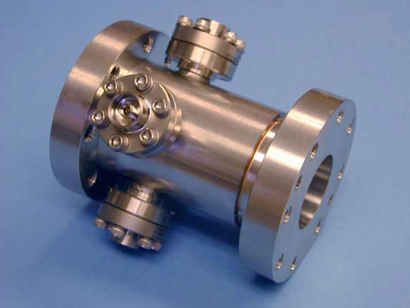
Linac Beam Position and Phase Monitors (BPMs)
Main tool for linac tuning and troubleshooting
  Phase measurements for fast linac tune-up, phase resolution and accuracy is of major importance
  Position measurements for trajectory correction, injection set-up
96 strip-line pick-ups and electronics chassis
  2 types of electronics: 402.5MHz and 805MHz
Custom made PCI analog front-end and digital cards
LabView 2001 software under embedded Windows XP on individual PCs (one per pick-up),
Meet all specs but reliability is poor and deteriorating
  Typically 10-15 BPMs require attention after ~ 1 month of no use
BPM pick up
PCI board
Hardware obsolescence is major problem
  Parts, cards, PC motherboards,
Software obsolescence is major problem
  Impossible to upgrade OS, security concerns
Lost ability to repair boards with J. Bryan departure
Long term solution: new system

Slide 7
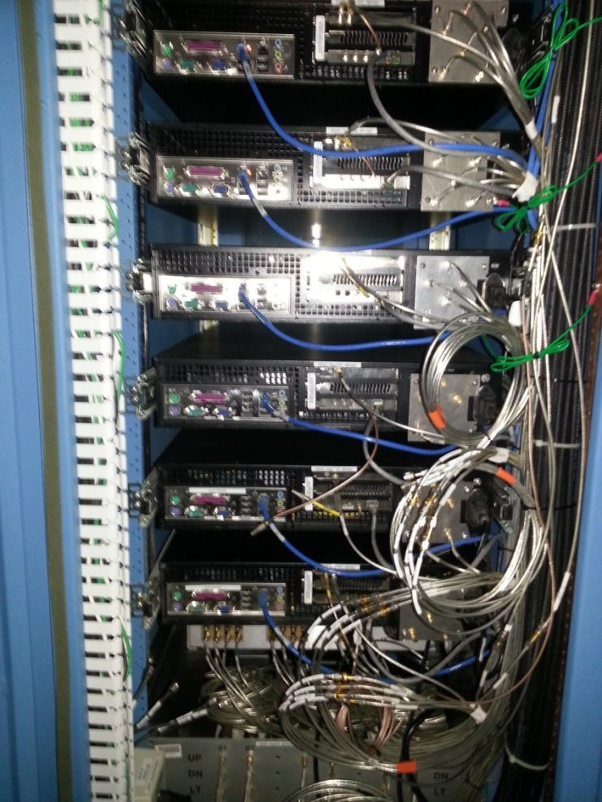
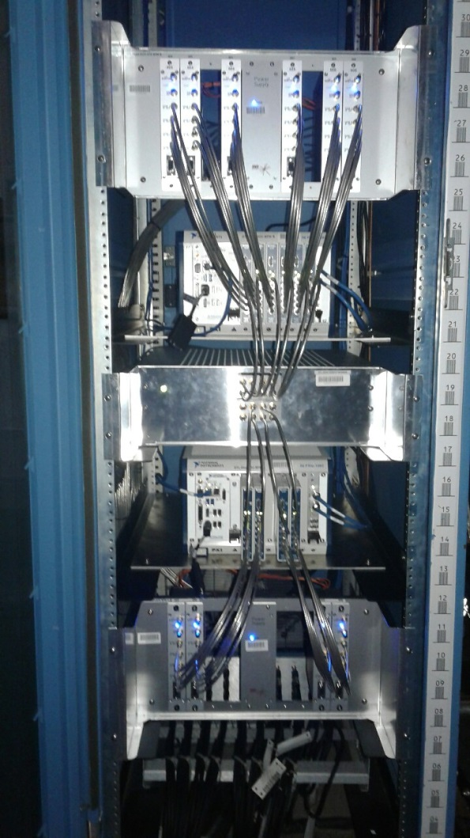
Test of new Linac BPM electronics in the field
AFE and digital
RF distribution
Digital
AFE
Old BPM electronics
1 BPM per chassis
New DTL BPM electronics
6 BPMs per crate
New Ring BPM electronics have 60Hz update rate – suitable for STS beam format
Courtesy of C. Long

Slide 8
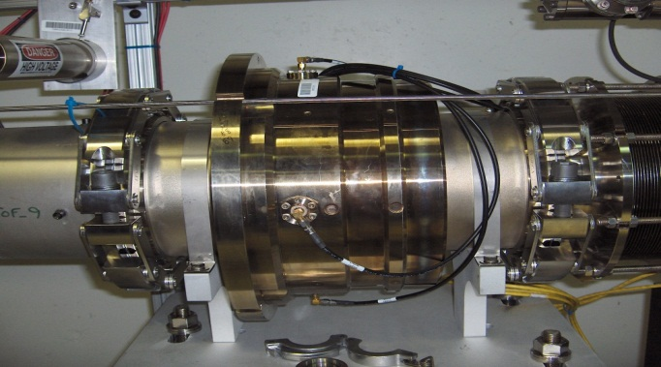
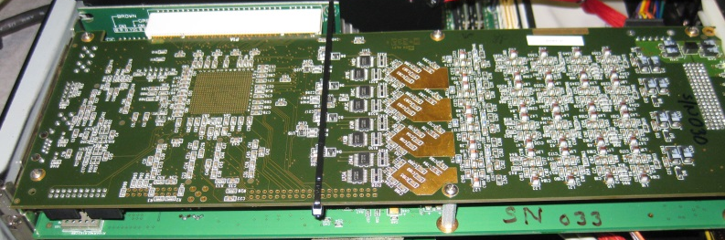
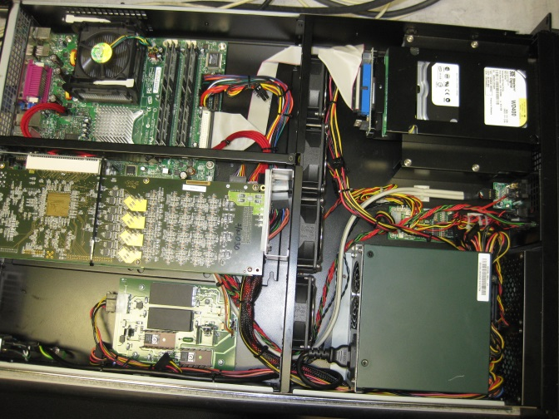
Ring Beam Position Monitors (BPMs)
Main tool for machine tuning and troubleshooting
  Position measurements for trajectory correction, injection set-up and centering beam on dumps and target
  5mA to 50A beam. Dynamic range is of major importance
64 “ring type” strip-line pick-ups and electronics
  electronics operate at low frequency, 5MHz BW
Custom made PCI analog front-end and digital cards
LabView 2001 software under embedded Windows XP on individual PCs (one per pick-up)
Meets accuracy specs but reliability is poor
BPM pick up
Hardware obsolescence is major problem
  Parts, cards, PC motherboards,
Software obsolescence is major problem
  Impossible to upgrade OS, security concerns
Lost ability to repair boards with J. Bryan departure
Long term solution: new system

Slide 9
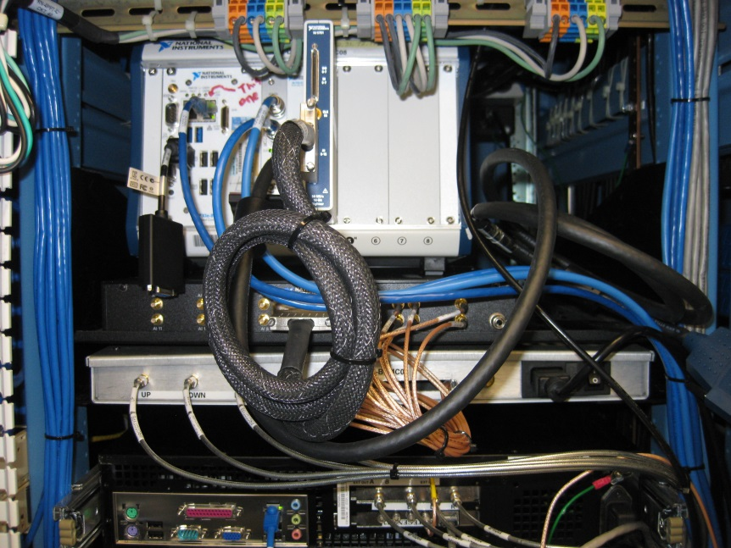
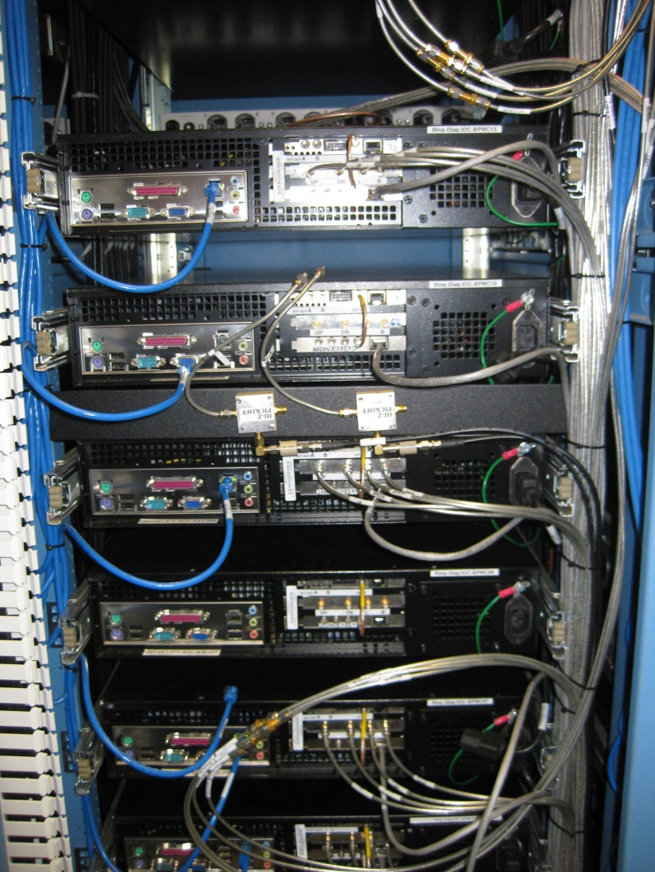
Test of new Ring BPM electronics in the field
New DTL BPM electronics
8 BPMs per crate
1/4 space, 1/5 power consumption
Old BPM electronics
1 BPM per chassis
New Ring BPM electronics have 60Hz update rate – suitable for STS beam format
Courtesy of R. Dickson

Slide 10
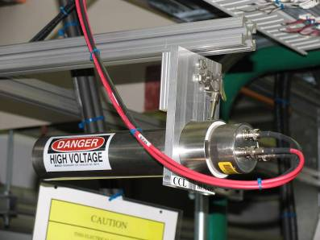
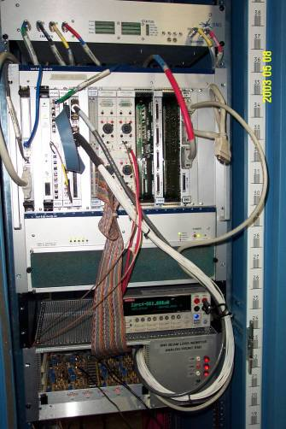
Beam Loss Monitors (BLMs)
Major tool for machine protection and tuning
Ionization Chamber Detectors (307)
Scintillation Detectors (55)
  Neutron detectors
  Fast loss detectors
Multi-channel analog front-end VME cards
Digital electronics in VME crate
VxWorks software
Very reliable
Hardware obsolescence is a problem
  ~1 channel/run fail, reconnect to spare channels
One person in BIET and a few in RAD understand software
Short term solution: stock up on spares
Long term solution: new system

Slide 11
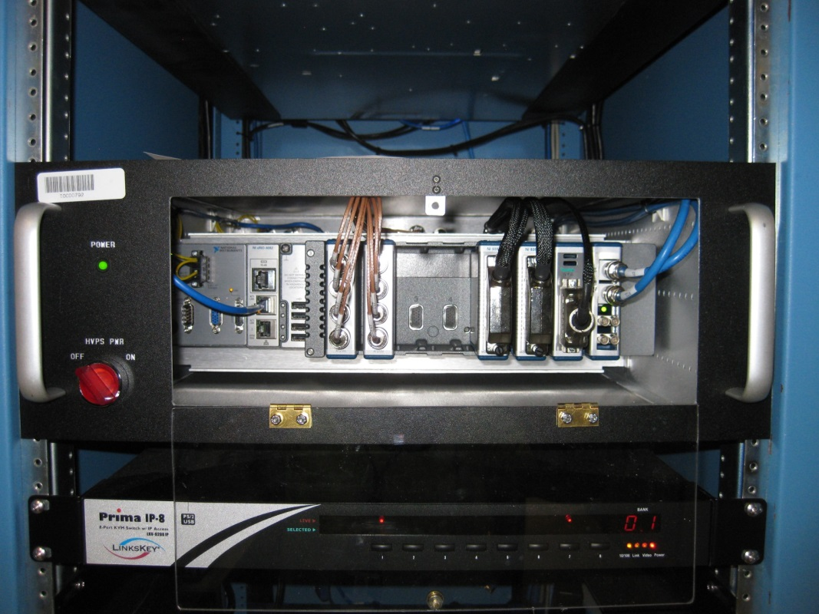
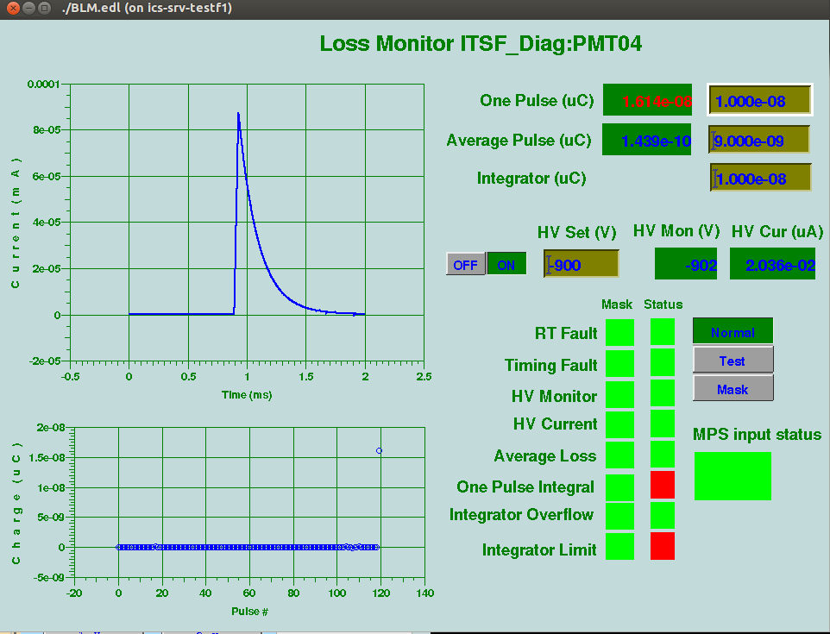
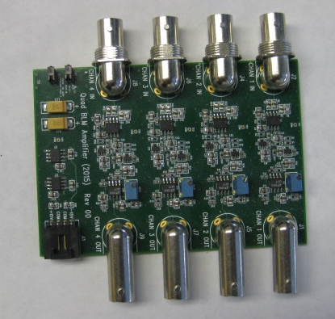
Test of new BLM electronics in BTF beam line
cRIO crate
AFE board
Connected to BTF MPS for protection from beam loss
Courtesy of S. Zhukov

Slide 12
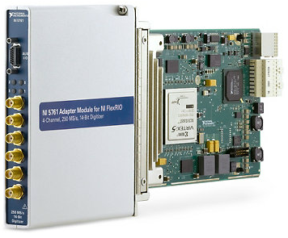
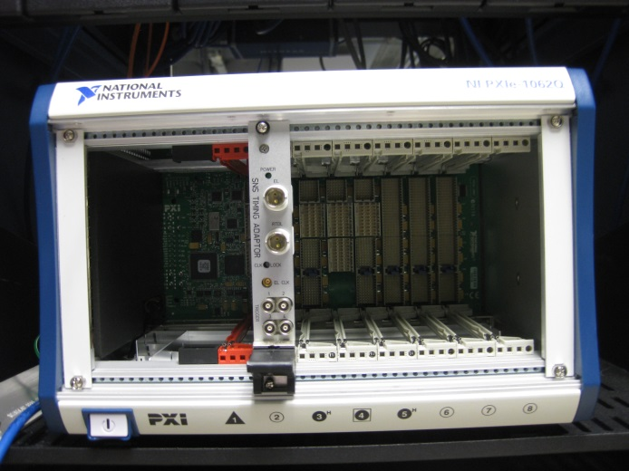
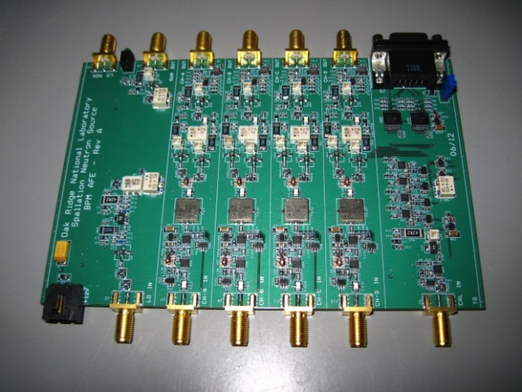
Our approach to all new electronics designs is to minimize custom design efforts
SNS design
Commercial Off-the-Shelf
Custom built
Analog Front-End
COTS
Analog-To-Digital
Conversion
COTS
General Purpose FPGA
COTS
Crate and controller
BPM AFE boards are ready for large quantity production in industry
High Level Language Programming

Slide 13
Upgrade plan for BPMs and BLMs
Have 1 Linac set (6 BPMs) running in the field
  Done. Have 2 sets in operation, MEBT and DTL
Have 1 Ring set (8 BPMs) running in the field
  In Progress. Have 4 BPMs installed in summer 2016 shutdown, will add 4 more in FY17
Have 1 BLM set (8 BLMs) running in the field
  Done. 1 set is running since Aug. 2015 at BTF. 1 set is installed in RTBT
Request AIP to fund upgrade of all systems
  ~ 1.6M$ + .6M$ for linac and ring BPMs
  ~ .6 M$ for BLMs
Install during 8 subsequent shutdowns (4+ years total)
AIP-37 = 2.8M$ M&S + .7M$ Labor
June ‘17
June ‘21
CCL, SCL
BPMs
SCL, HEBT
BPMs
SCL, HEBT
BPMs
HEBT, Ring
BPMs
Ring BPMs,
BLMs
Ring BPMs,
BLMs
BLMs
BLMs
MPS upgrade

Slide 14
Obsolescence problems of smaller scale systems are solved within spares budget
RTBT harp electronics
  90 channels of low current measurements
  We have a new replacement system ready to deploy if the old one fails
Beam Current Monitor BCM25i analog Front-End
  Measures integrated charge on target
  We have a prototype of fully digital new system installed for testing
Chopper operation monitoring system (CHuMPS)
  Monitors cleanness of chopped gaps
  Large dynamic range and high speed are required
  Digital processor is being tested in the field
  Analog Front-End is being developed

Slide 15
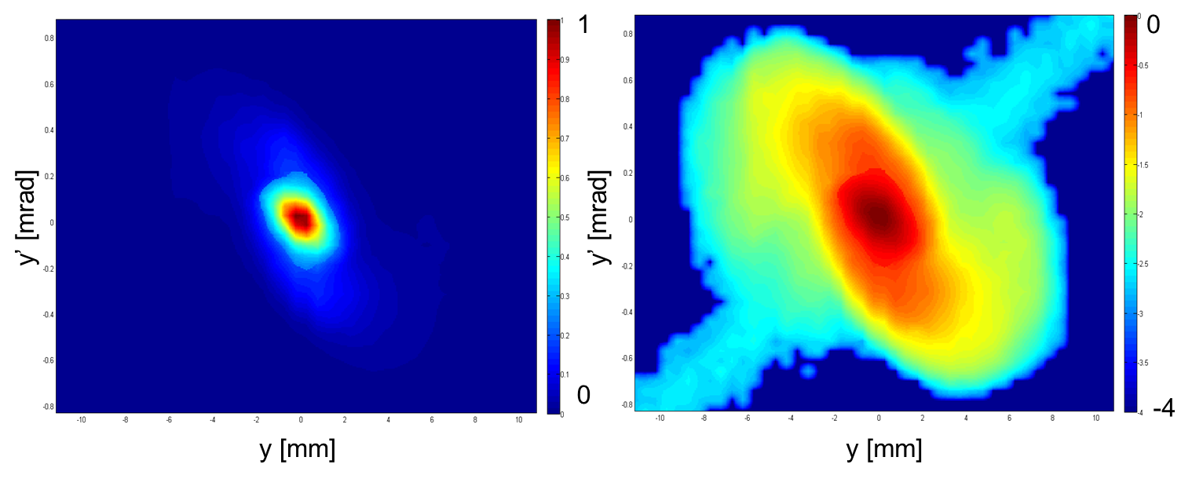
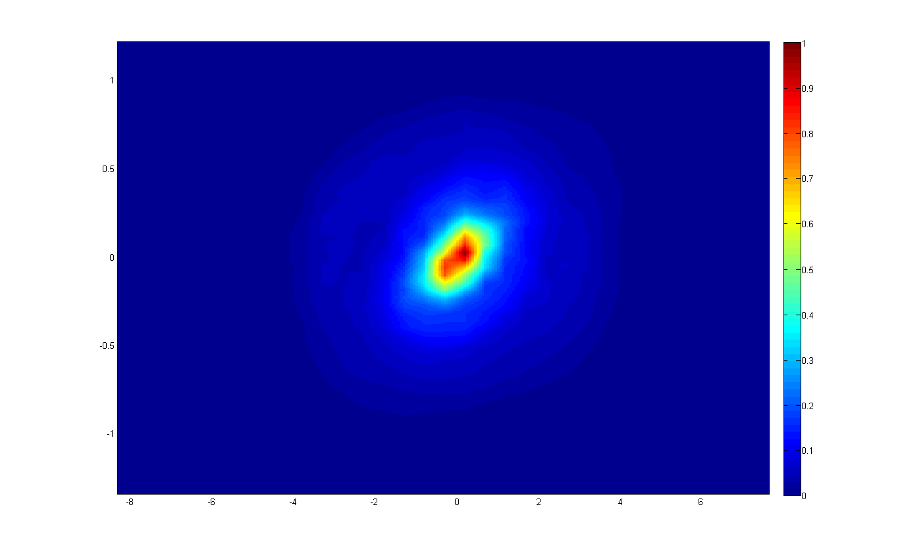
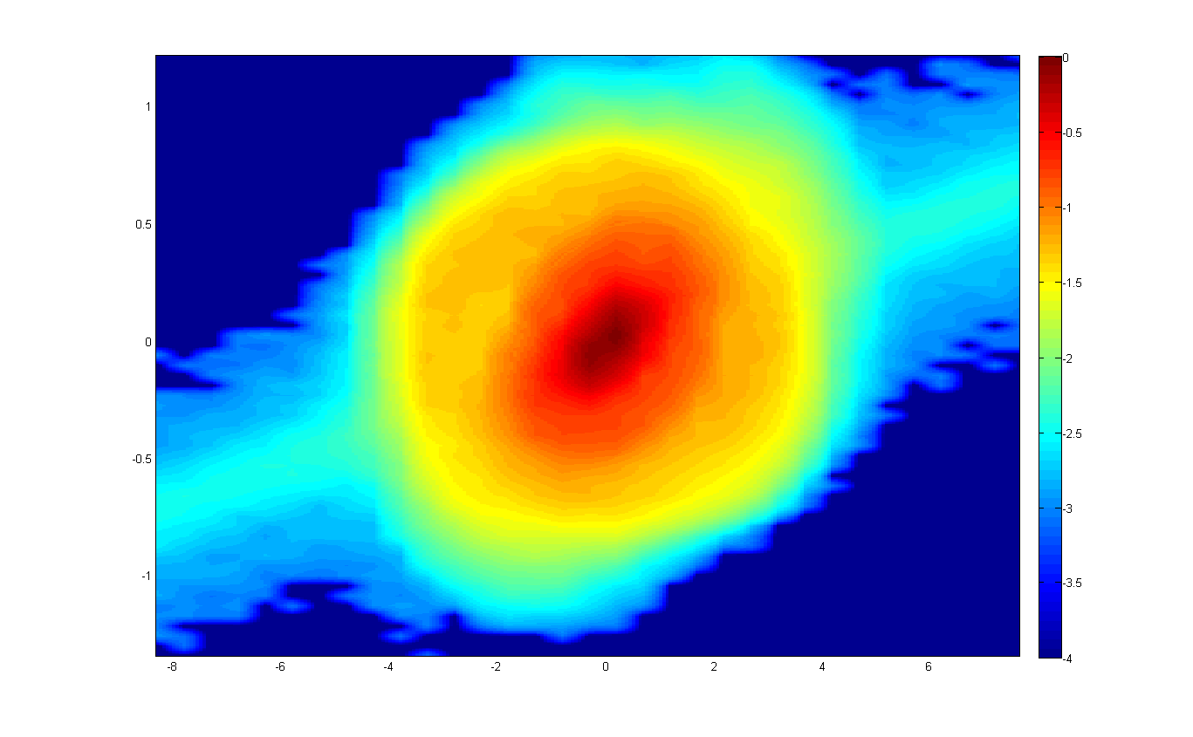
Steadily improving performance of existing systems
HEBT laser emittance measurement dynamic range increased by x10.
linear scale
log scale
1
0
x’ [mrad]
x’ [mrad]
0
-4
x [mm]
x [mm]

Slide 16
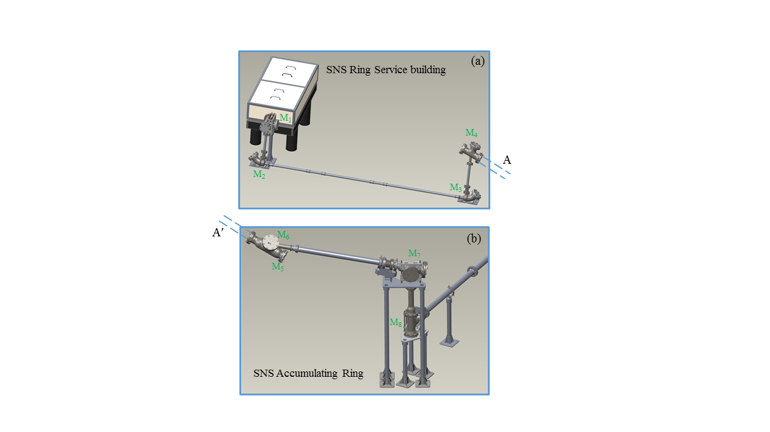
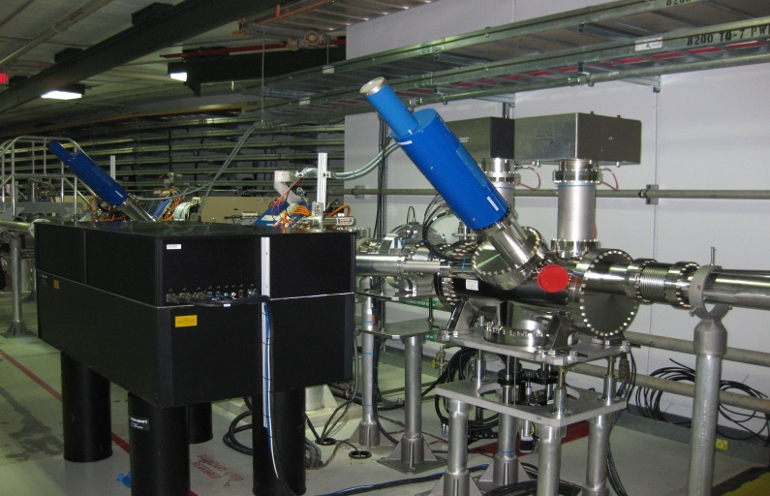
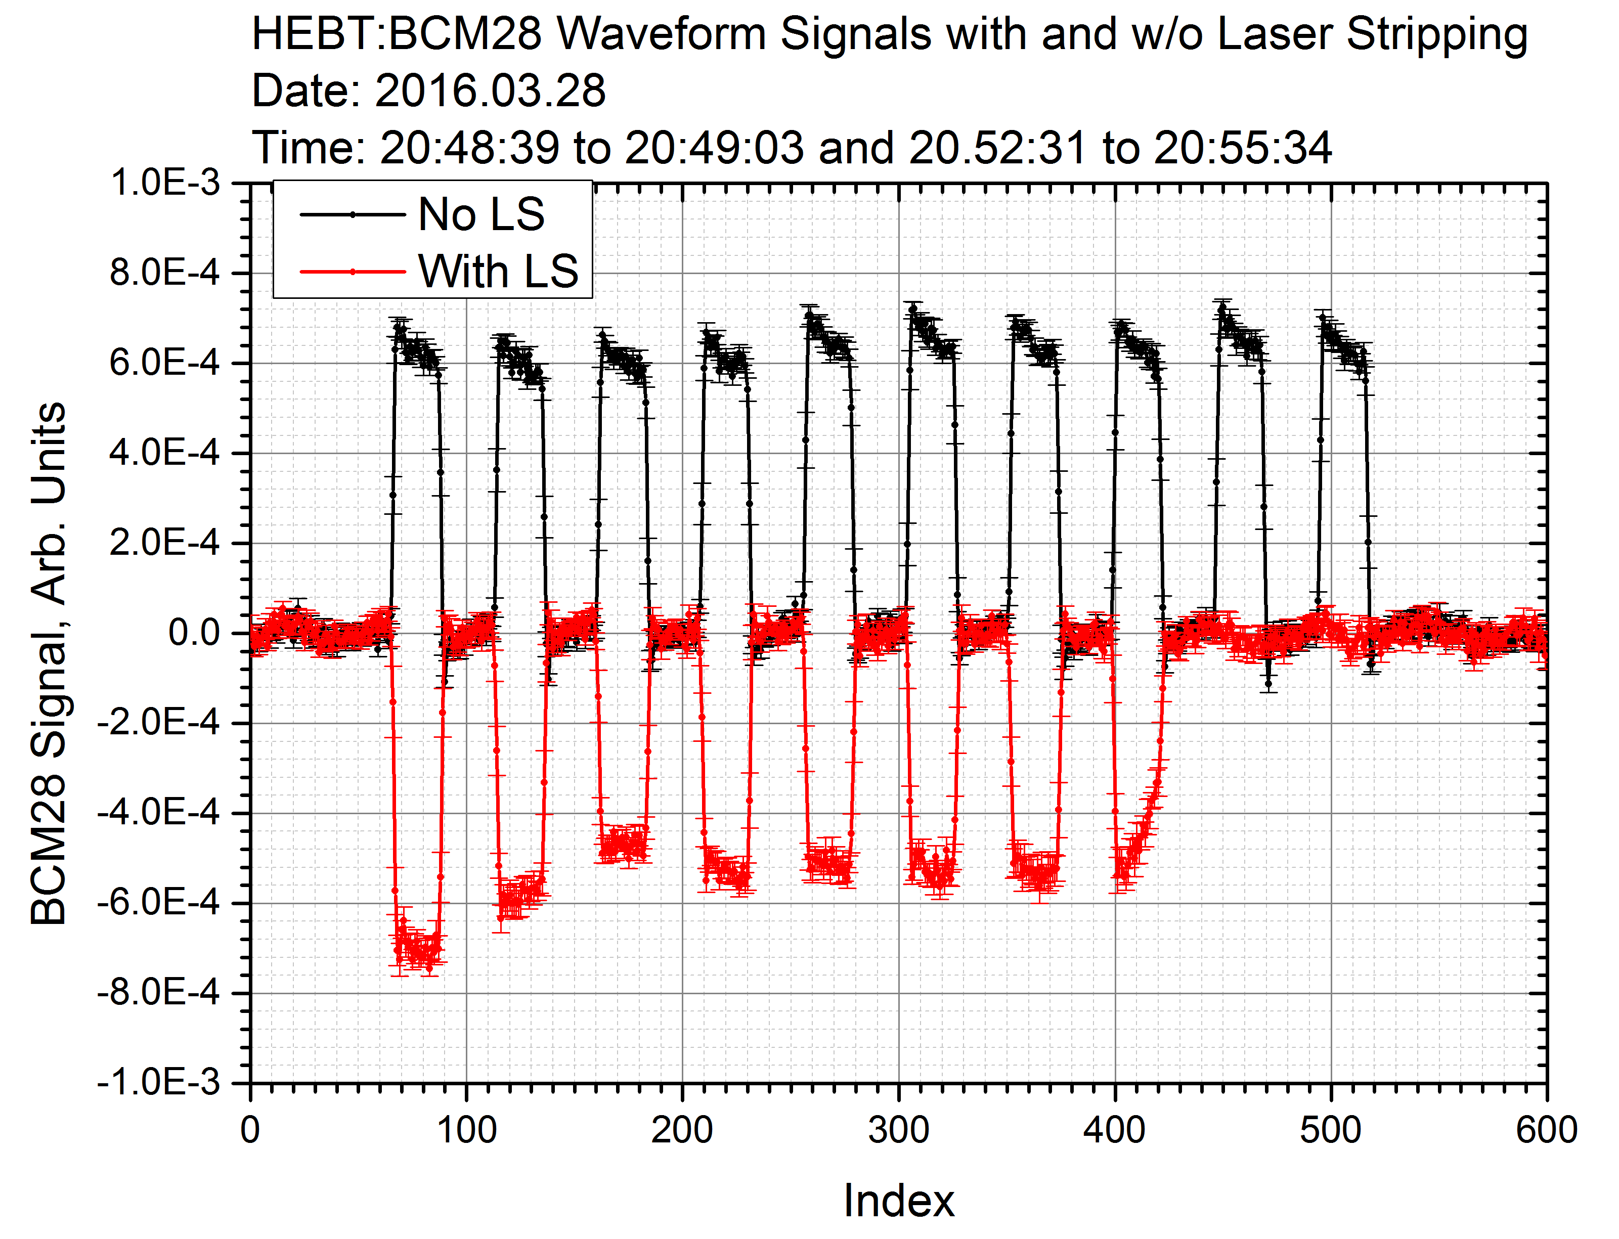
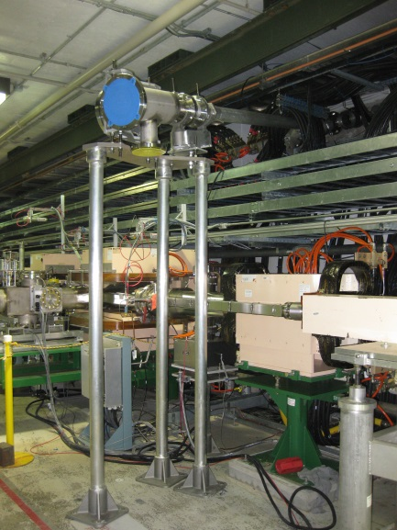
Laser stripping experiment
Installed 60m long UV laser beam
transport line with 8 mirrors in January 2016
Commissioned all systems
Successfully conducted in April-May 2016
More details in A. Reheman’s presentation

Slide 17
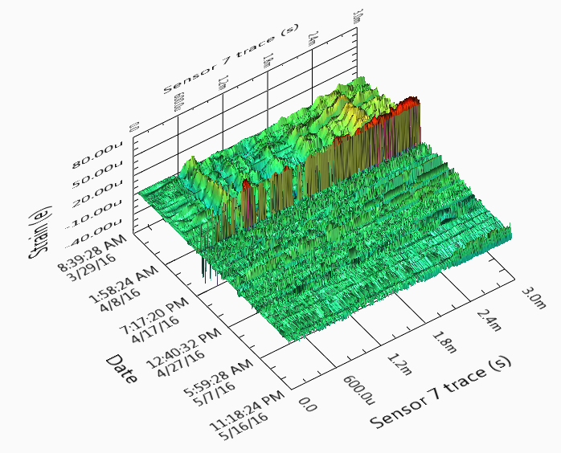
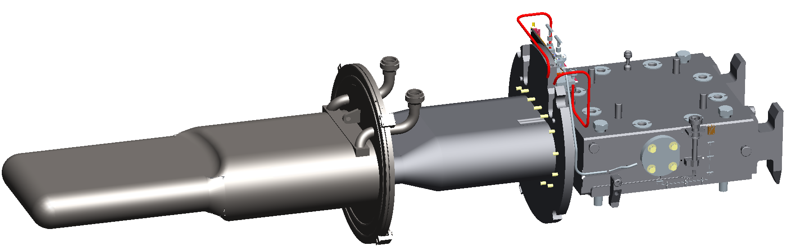
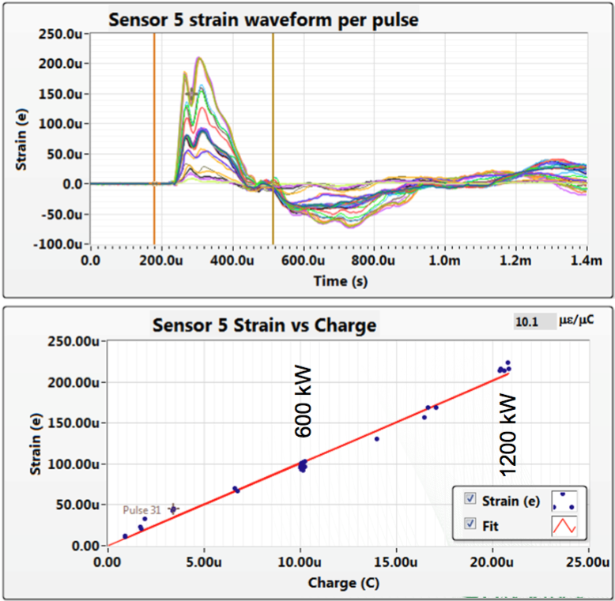
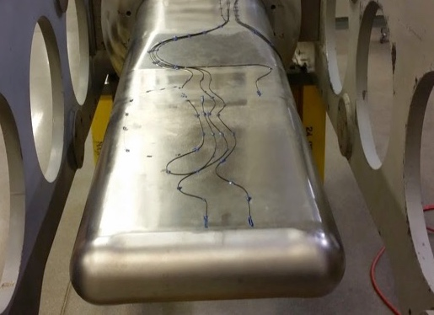
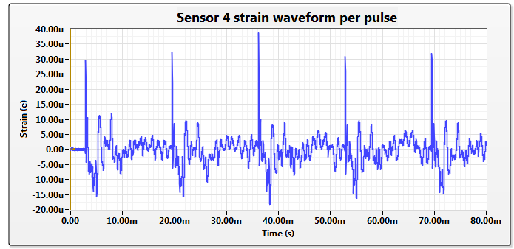

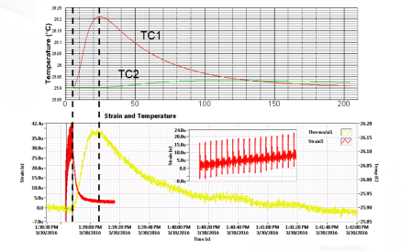
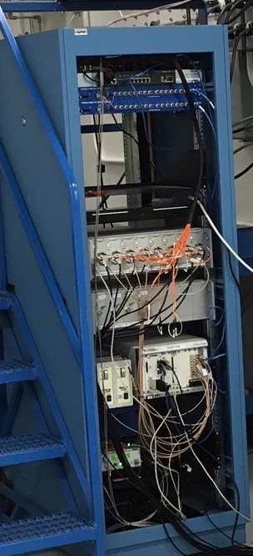
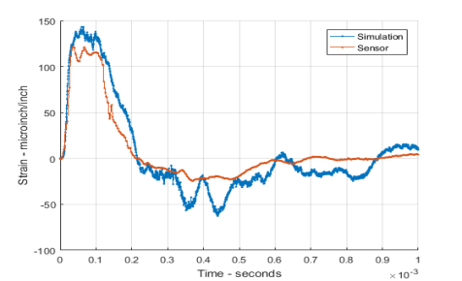
Target instrumentation and measurements
Mercury vessel
Shroud
Multi-mode lasts ~1-2 weeks
This is where most sensors are placed
Linear response to beam intensity
Instrumentation:
Multi-mode Strain sensors
Single-mode Strain sensors
Thermocouples
Metal Strain Gages
Accelerometers
→
No resonance buildup
Temperature response as simulated
Agreement between strain simulation and measurements decent (shape) but not always exact (amplitude)
Future
Measure different target designs
Multi-pulse response
Optical Signal Processors (FISO)
PXI Data-acquisition and Timing
Strain response to temperature rise due to 600 pulses of 3.5 µC
Accelerometer PS and Amps (PCB)
Lights source and power meters
Instrument Rack
Simulation over-predicts by ~40% for sensor 1 (shapes scaled)
Courtesy of W. Blokland

Slide 18
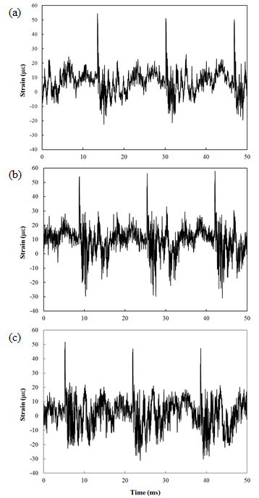
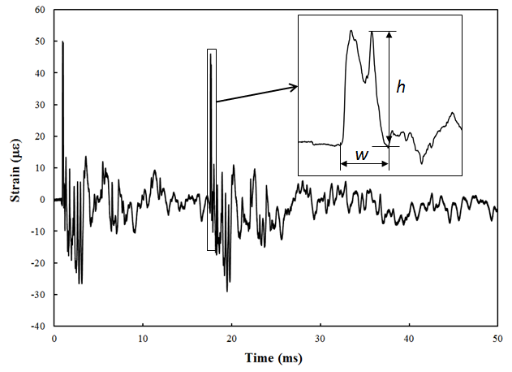
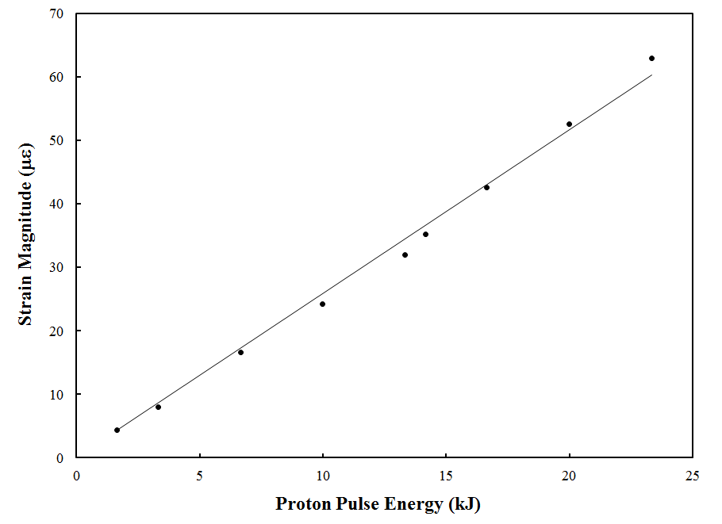
R&D on radiation-resistant fiber-optic strain sensors for SNS target instrumentation
Courtesy of Y. Liu
Low-coherence light source
Fiber circulator
Fiber sensor
Key features
Developed sensors using radiation-resistant fluorine-doped single-mode fibers
Implemented digital signal demodulation unit based on phase-shifted detection scheme
Sensors have been installed on SNS targets T14 and T15 for strain measurement
Sensors demonstrated order of magnitude higher radiation resistance (~ 10⁹ Gy) than commercial products
Signal demodulation unit
Fiber collimator
Beam-splitter
Mirror
PZT
FPGA-based data processing
Phase-shifted detection
Radiation-Resistant Fiber-Optic Strain Sensor
Successfully measured strains of 100 με at 100 kHz.
Strain waveforms on T15. (a) Oct. 29, (b) Nov. 21, (c) Dec. 20.
Typical strain waveform on T15
Strain amplitude vs proton pulse energy

Slide 19
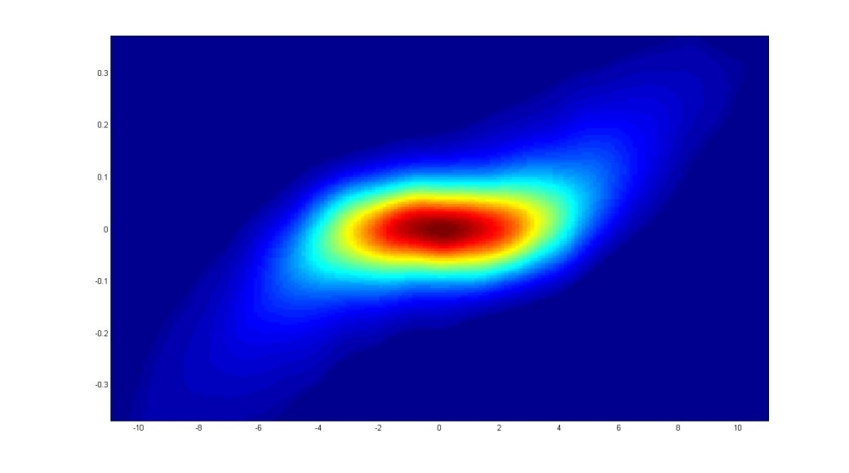
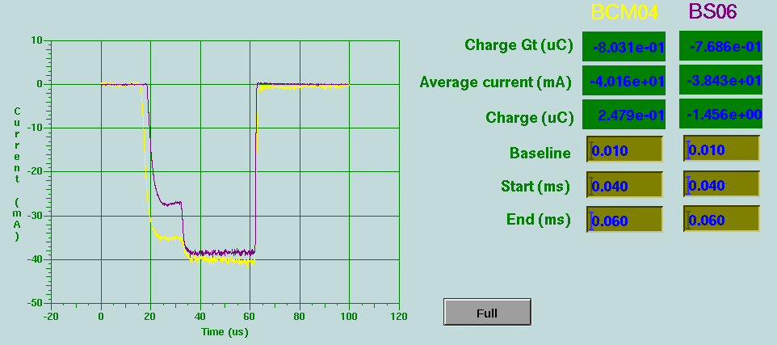
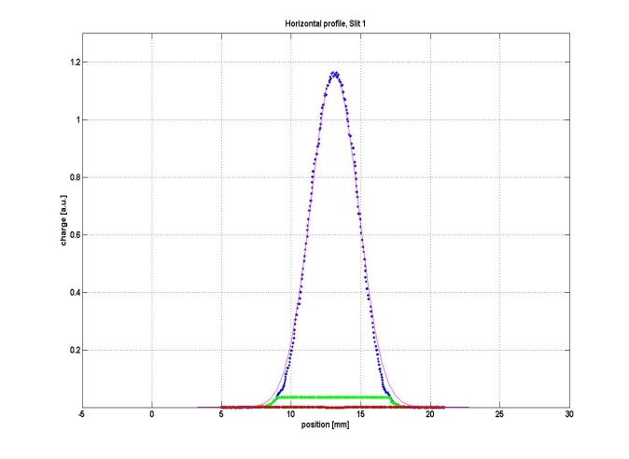
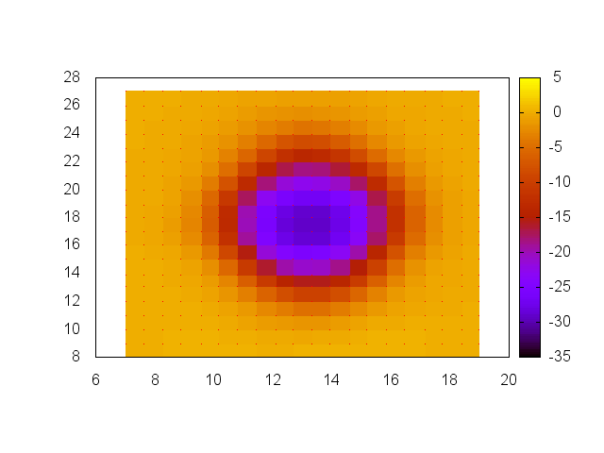
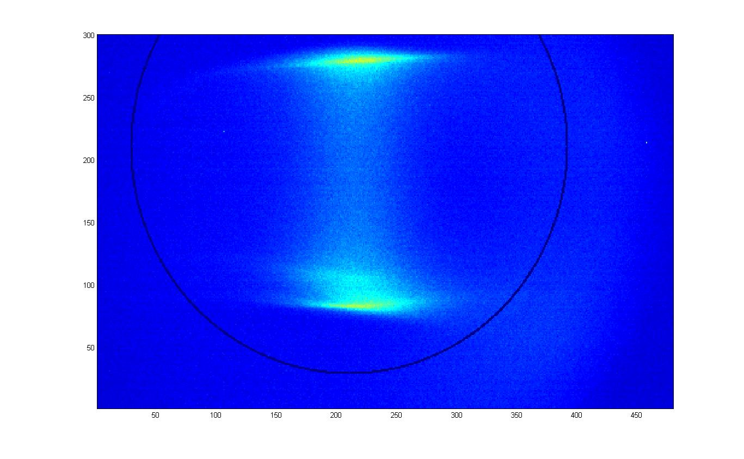
BTF commissioning
Commissioned many diagnostics in very short time

Slide 20
We need to catch up on long range imaging systems development
Injection foil imaging and foil temperature measurement
  Development stagnated since 2012
  Assign higher priority due to PPU and STS requirements
Target imaging system
  Performance degraded over last few years
  1-2 year cycle of trial-and-error driven by Proton Beam Window replacement schedule
Both projects need reinforcing team expertise in optics engineering
  Igor Nesterenko lead optics design for foil temperature – left
  Curt Maxi lead optics design for target imager - left

Slide 21
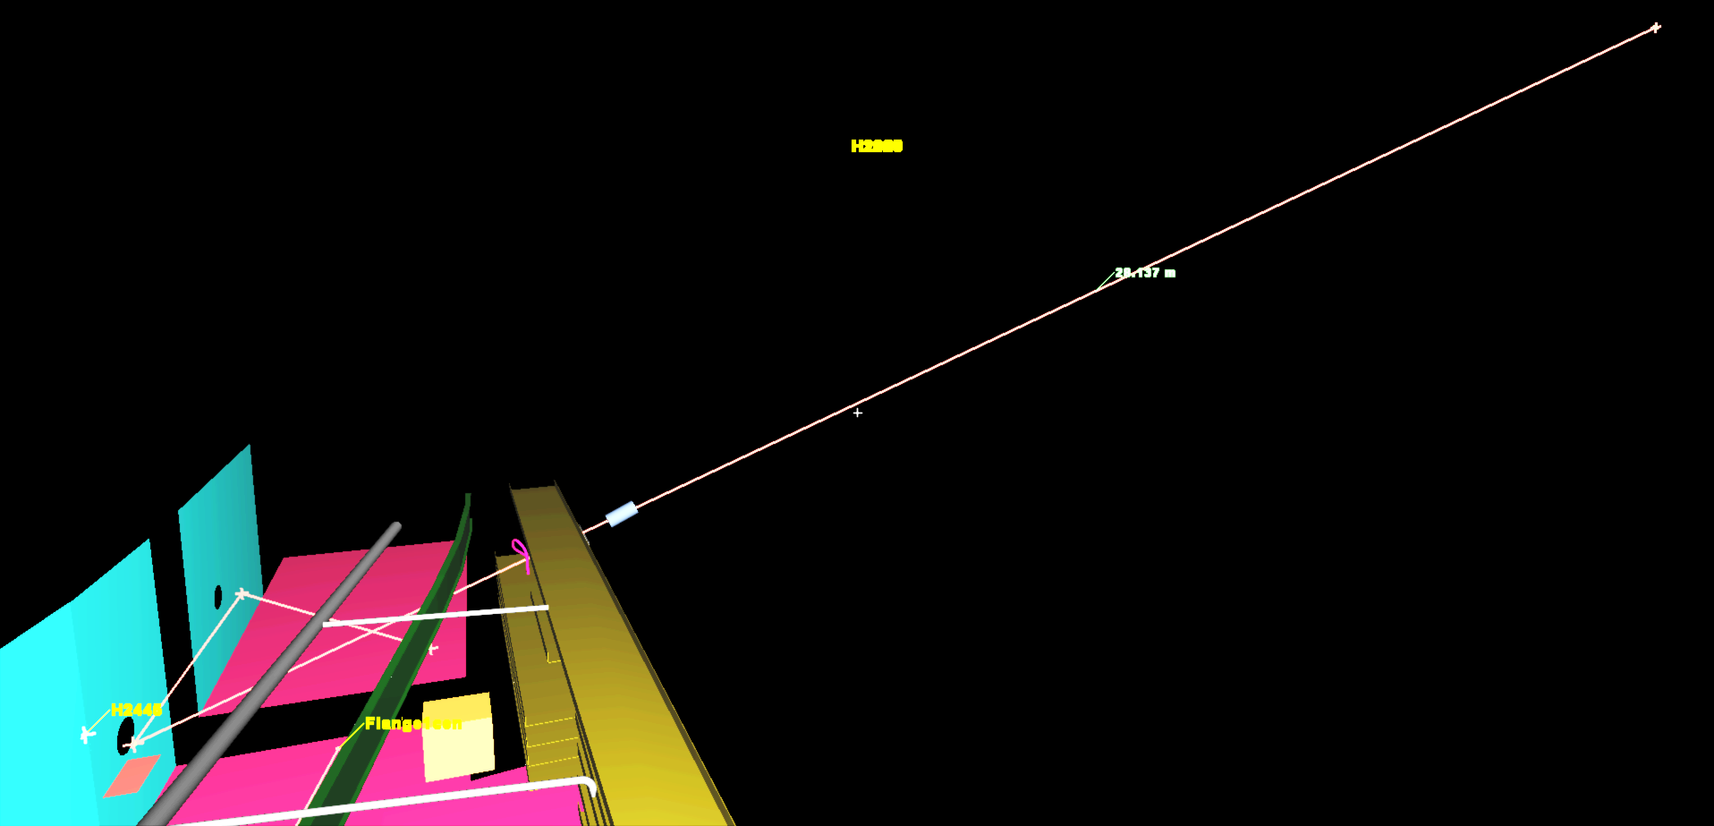
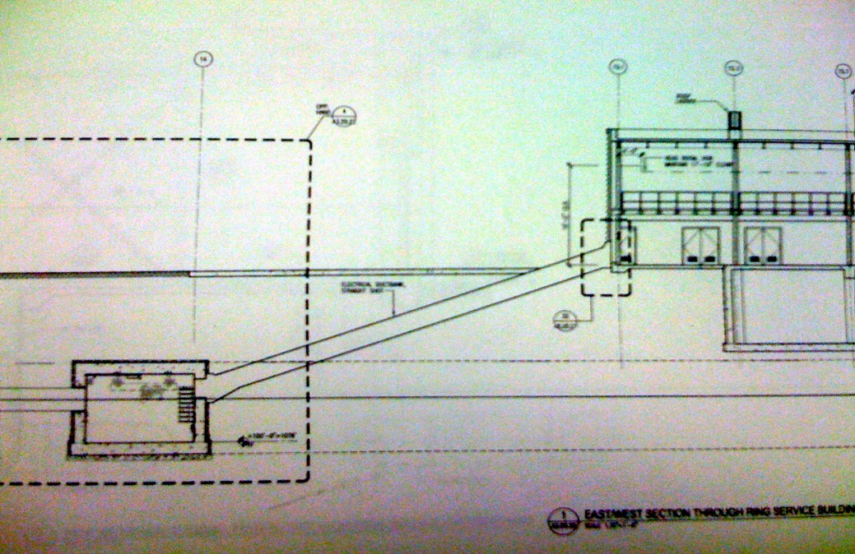
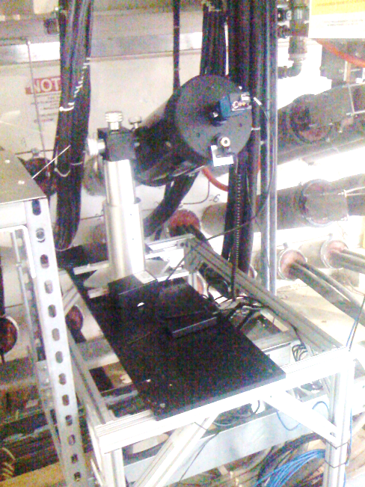
Foil video system layout
Courtesy of W. Blokland
Total Path Length ~ 40 m
Window
Chase
Mirror
Window
Foil
Mirror
Drawing Courtesy: G. Hamm

Slide 22
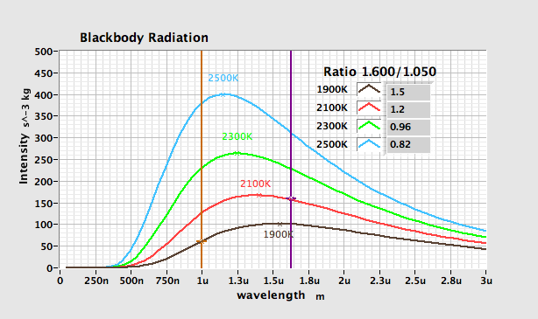
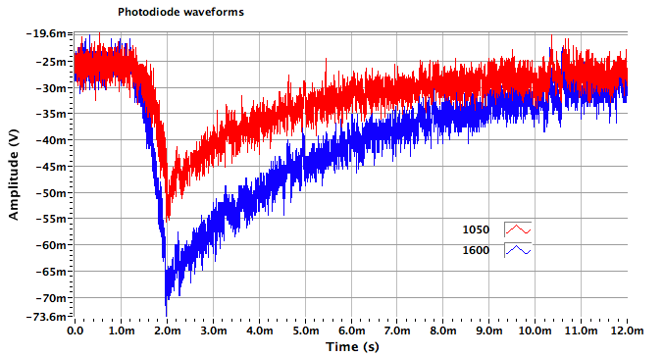

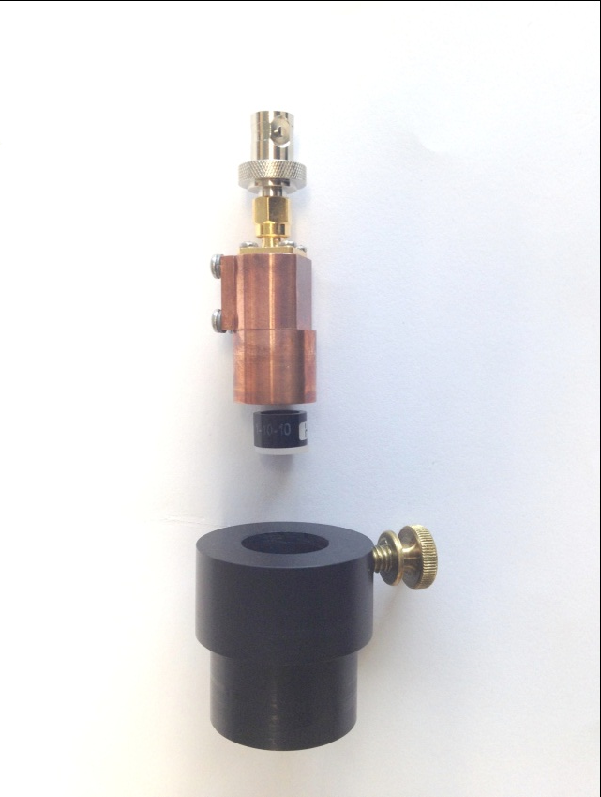

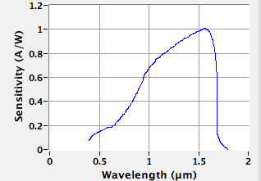
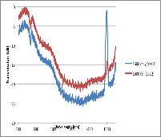
Foil temperature measurements
Two-color optical pyrometer
Courtesy of W. Blokland,
AAC 2012
Foil
Black body radiation
Photo diode
Bandpass
Filter
Adapter
Photo diode
Filters

Slide 23
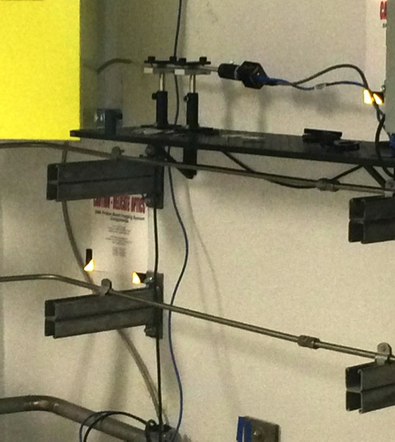
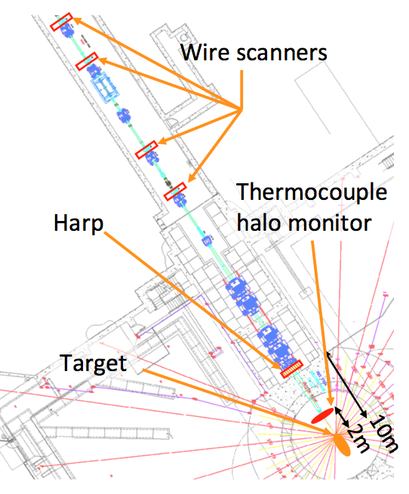
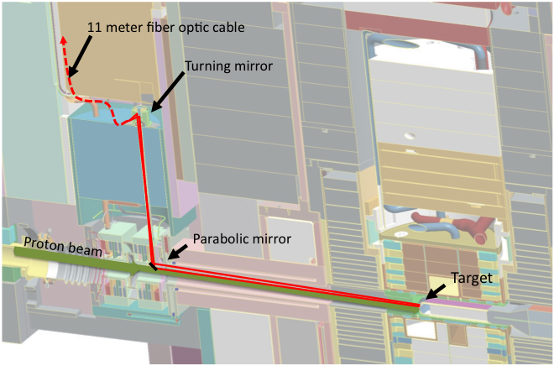




Target Imaging system layout
GigE Camera
Beam image
Target with coating and overlaid beam image
Nearby diagnostics
2.2 meters
Courtesy of W. Blokland,
Optical Path of Target Imaging System

Slide 24




Target Imaging system performance
The good old days of 2012-14
The bad days of 2014-16
(image averaged and filtered)
The slightly better days of 2017
131219_150521.803_Image1
141118_191809.949_Image1
Courtesy of W. Blokland,

Slide 25








STS Imaging System Design
Courtesy of A. Reheman
Zemax Optical Design Layout
Optical Imaging Principle
Periscope System 3D Layout
Imaging
Station
Mirror 2
Contrast Analysis from Modulation Transfer Function (MTF)
Experiment
Simulation
Riflescope
Mirror 1
2nd Target
Periscope Mockup System Assembly

Slide 26
Summary
Beam Instrumentation provide tools for reliable operation and fast machine tuning
Addressing obsolescence issues for BI systems
  BIET team developed new electronics for BPM and BLM systems
  Need about 3.5M$ over 5 years to implement upgrade
Steadily improving BI dynamic range and accuracy to support AP efforts toward model based accelerator tuning
Support other RAD activities
  Laser stripping experiment was a success
  BTF commissioning and new RFQ test was a success
  Developed target vibration measurement system
Need to strengthen expertise in optical engineering to improve performance of remote imaging systems

