Slide 1
Superconducting Linac Systems (SCLS) Status and SRF Activities
Presented to the
SNS Accelerator Advisory Committee
Sang-ho Kim
Group Leader, SCL Systems Group
March 9, 2017

Slide 2
Outline
SNS SCL systems scope
Recommendation from the last AAC
SCL systems status
SRF and cryogenic activities
Summary

Slide 3
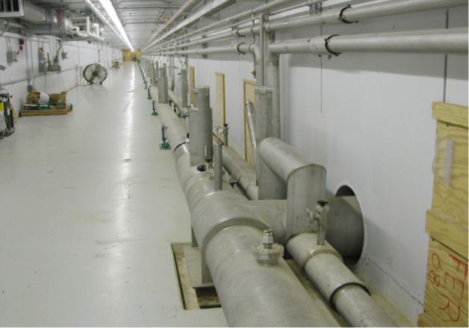
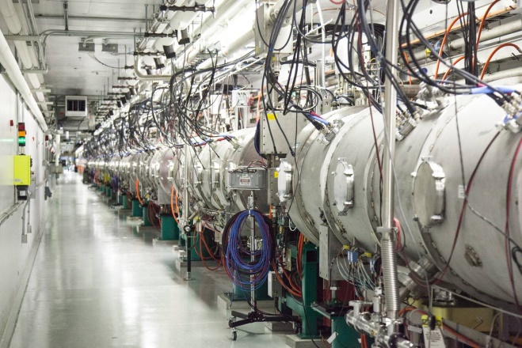
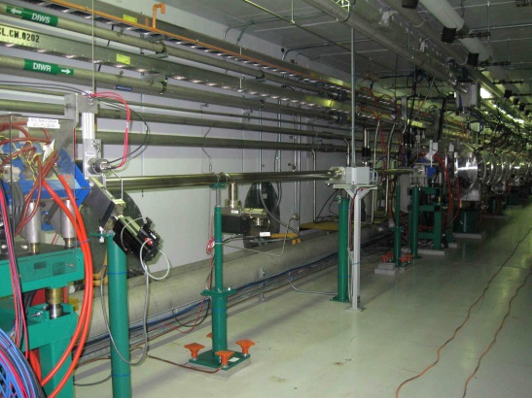
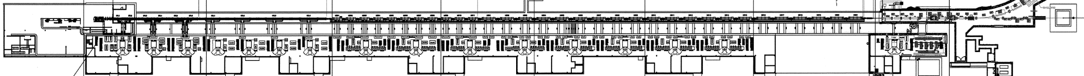
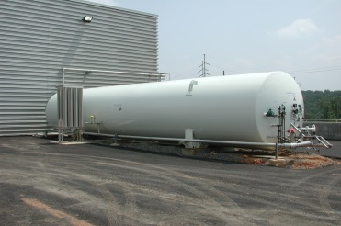
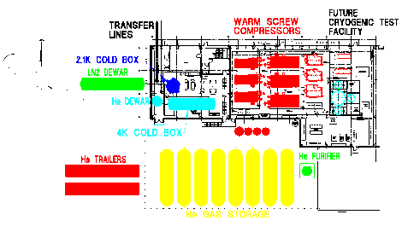
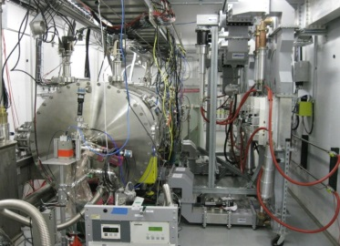
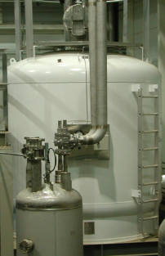
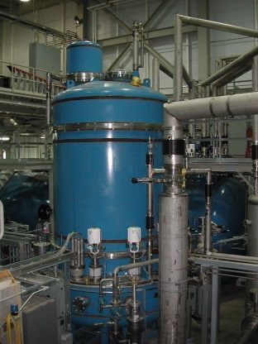
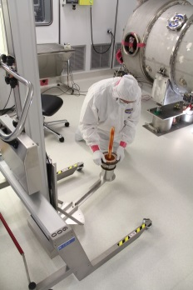
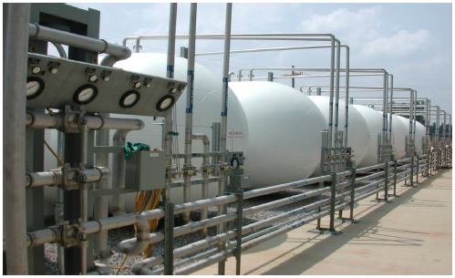
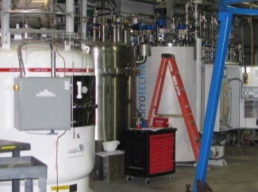
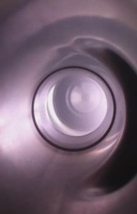
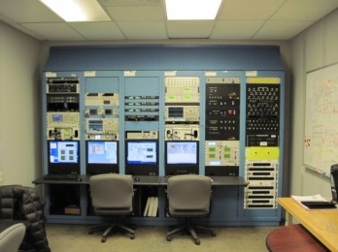
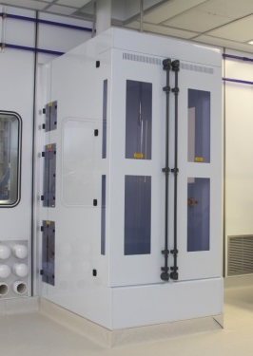
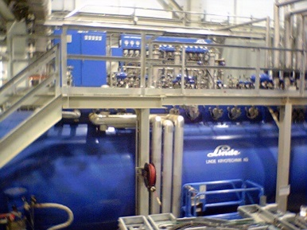
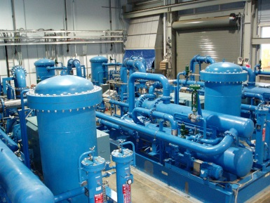
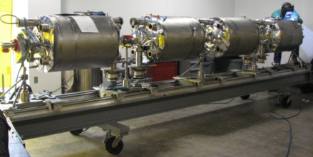
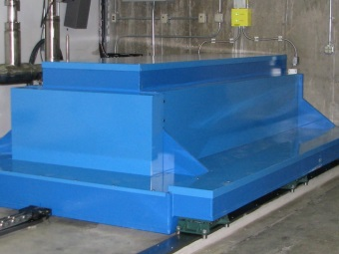
SNS SCL system scope
Empty slots
for upgrade
Transfer lines in the tunnel (during installation)
Cryomodules
in the tunnel
SNS Linac
LN2
Test cave
LHe dewar
R&D
CM
rework
2 K Cold Box
GHe storage
Control room
CTF
CTF
4 K
Cold Box
CM development
VTA
Warm Compressor
HPR

Slide 4
Response to recommendation from last AAC
Recommendation 28: Proceed with plasma processing during the 4-month outage, and take advantage of other opportunities in the schedule for plasma processing. Plan strategically to ensure that resources are available for this effort and prioritize cryomodules with the highest potential for improvement.
  Plasma processed CM18 in summer outage 2016
  Developed hardware for multiple cavity processing simultaneously and trained additional staff. Both hardware and resources are available
  Prioritized cryomodules for the upcoming summer outage and the following outage

Slide 5
SCL system status

Slide 6
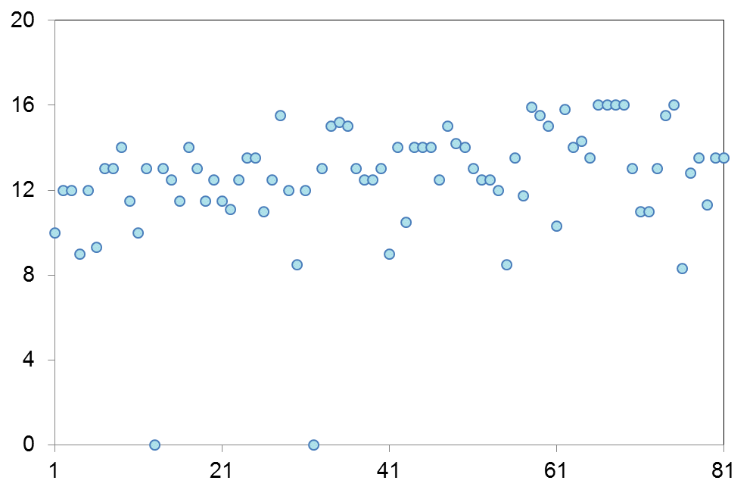
Current operating gradients of SRF cavities
Average E_{acc} of medium and high beta cavities:12 MV/m, 13.5 MV/m respectively
Average accelerating gradient of high beta cavities increased after plasma processing
E_{acc} (MV/m)
MB design gradient
HB design gradient
Cavity Number

Slide 7
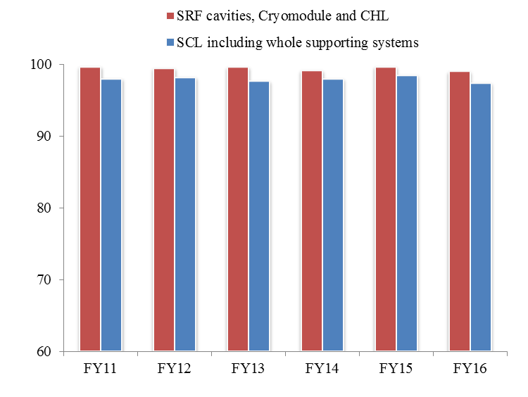
Numerous lessons have been learned to achieve a stable and reliable operation of the SCL*
Availability for neutron production (%)
Availability last 6 years:
  Whole SCL including RF, HVCM, Control, Vacuum, etc.: ~98 %
  SRF cavities, cryomodules, and CHL: >99 %
    Average trip or downtime: <1 trip/day or
    <5 min./day
Operational flexibility using energy reserve
  Phase of the last cavity (23d) is set for zero acceleration at the start of every run period
  Every run, a few cavities show problems sustaining gradient
    Due to hot spot or temperature increase in the end group
    Gradients are slightly lowered for those cavities keeping the linac output energy same using the energy reserve
  Overall no systematic performance degradation, but requires many actions to keep performance and integrity of cavities
*S-H. Kim, R. Afanador, D.L. Barnhart, M. Crofford, B.D. Degraff, M. Doleans, J. Galambos, S.W. Gold, M.P. Howell, J. Mammosser, C.J. McMahan, T.S. Neustadt, C. Peters, J.W. Saunders, W.H. Strong, D.J. Vandygriff, D.M. Vandygriff, “Overview of ten-year operation of the superconducting linear accelerator at the Spallation Neutron Source,” Nuclear Inst. and Methods in Physics Research A, 852 (2017) 20-32. http://dx.doi.org/10.1016/j.nima.2017.02.009

Slide 8
Performance degradation during operation
Degradation related to vacuum activity
  Trigger by electron activity, gate valve operation, ion pump pressure spike, beam halo, errant beam, etc.
    Desorption and redistribution of gas and particulate contamination → could create conditions for vacuum breakdown or hot spots
      Effect of event can be intensified by interaction with RF (one of the worst case is surface damage)
    Not every event makes a cavity trip. But the probability for degradation increases with frequency and intensity of events
  Most frequent symptoms are the creation of hot spots and partial quench in the end group
  Actions have been taken to minimize these unwanted events
    Fast beam abort at errant beam condition
    Minimize valve operation
    Turn off ion pump on CM23
When a cavity shows a symptom of performance degradation, the gradient is lowered slightly (typically lowered by 1 MV/m) to avoid further degradation and to minimize downtime
  Early diagnostics and prompt involvement from system experts are the key to minimize additional degradation
  Usually recover performance during maintenance period

Slide 9
Performance recovery and improvement in FY16
Recovery of cavity performance to previously attained operating gradients
  RF conditioning
    A few cavities recovered during maintenance periods including 19a (errant beam) and 23c (pressure spike)
  Thermal cycling
    Several cavities including 20d (hot spot) recovered during outages in 2016
    More cryomodules are waiting for thermal cycling
Improvement to new higher operating gradients by in-situ plasma processing
  CM18 and CM19 have been successfully plasma processed
Rework of cryomodules (to be done)
  5a (FPC) and 11b (HOM coupler) repair will be conducted when the spare medium beta cryomodule is available

Slide 10
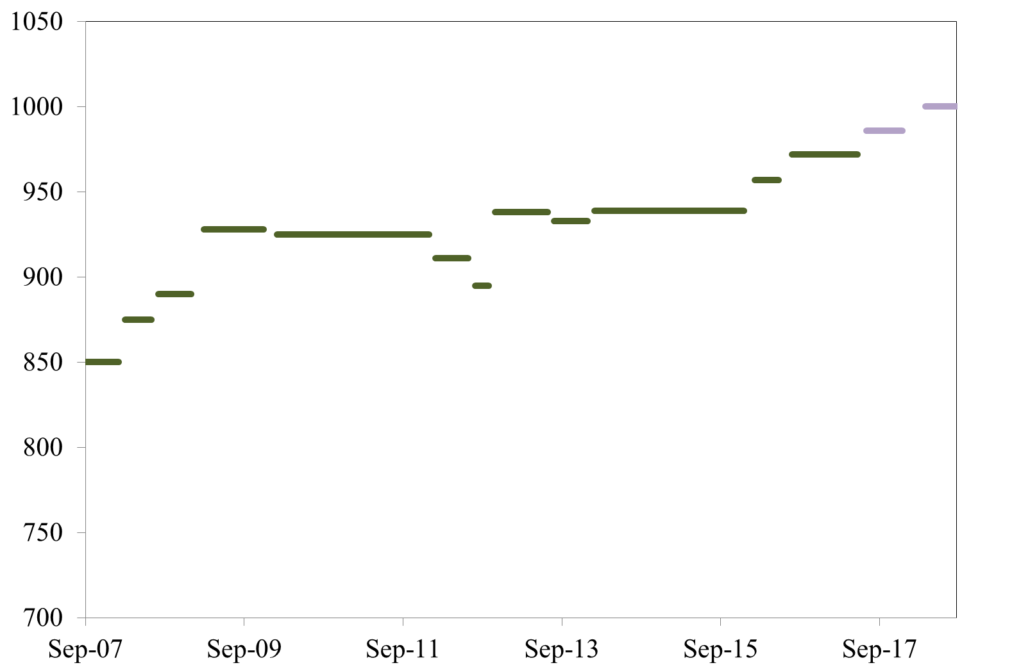
Linac output energy has been increase to 972 MeV since July 2016 (highest ever for 60-Hz operation)
Current plan to achieve a stable 1-GeV operation is to plasma process 4-5 CMs;
  In summer 2017, deploy plasma processing technique to two additional cryomodules (CM16 and CM17)
  In winter 2018, deploy the technique to two or three additional cryomodules (CM21, CM22 and CM23)
Second in-situ
plasma
Processing
&
recoveries
1 GeV
Recognized
Errant
Beam
3 cavities
Turned off
(errant beam)
972 MeV
plasma
processing
for 4-5 CMs
1
2
957 MeV
939 MeV
Additional
HVCM
MB CM in (slot 6)
after repair
First in-situ
plasma
processing
&
recoveries
Linac output energy (MeV)
CMs out
from slot 6 and 20
for repair
High beta
spare CM in
for slot 20
RF/Control improvement
Two CM Repairs
Other misc.
1. Full pulse length
for 1.4 MW
2. Worst performing
HB CM out (slot 19),
HB CM from slot 20 in
after repair

Slide 11
Central Helium Liquefier (CHL) system is running reliably
Typically one 2K cold box trip per year
  99%~100% availability
  Most of the trips are caused by Variable Frequency Drive (VFD) trips due to lightning strikes and loose wires
CHL control room: 1 shift/day to cover CHL operation and to conduct daily maintenance
  CCR operators have been trained to control of some the basic CHL parameters when CHL is not covered by cryo-experts
Auto-dial system for alarm conditions
Full time monitoring of impurities in helium (O2, N2, water, Oil)
In-line spares for critical components (e.g. one spare warm compressor for each stage)

Slide 12
SRF and cryogenic system activities

Slide 13
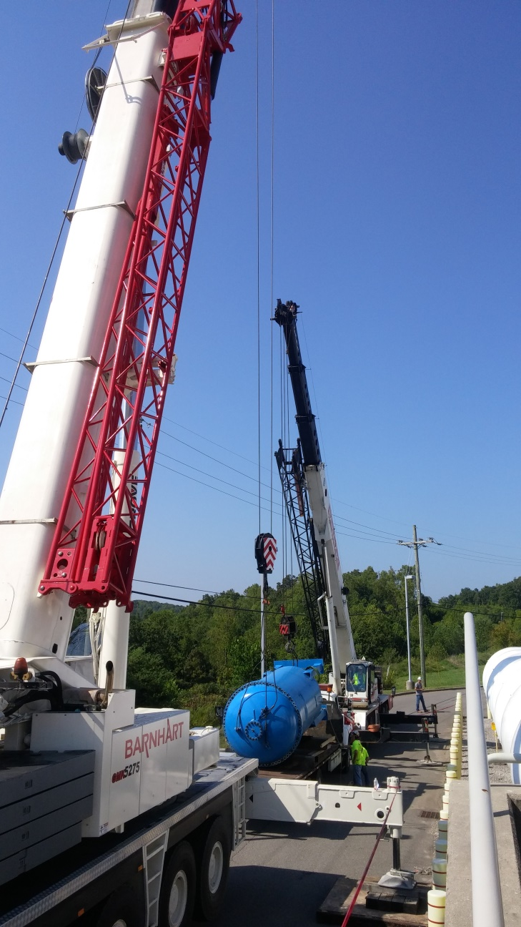
CHL spare carbon bed project (on-going)
The CHL carbon bed and final filter are part of the helium purification system
  CHL carbon bed is approaching its lifetime according to the original estimation
  Carbon bed oil contamination carryover to the 4K cold box represents a single point failure
  Replacement of activated carbon in the existing carbon bed vessel is a process requiring 4-6 months of CHL downtime
The spare CHL carbon bed will allow for redundant helium purification
Initiated spare carbon bed project in FY16 and will be completed in March 2017 and ready for final tie-in
  Tie-in to the main system will require CHL shut-down for 2-3 weeks
  Engineering analysis is ongoing to keep critical components cold during the tie-in period

Slide 14
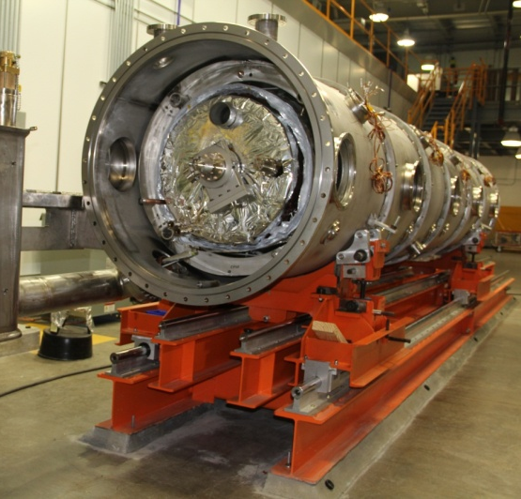
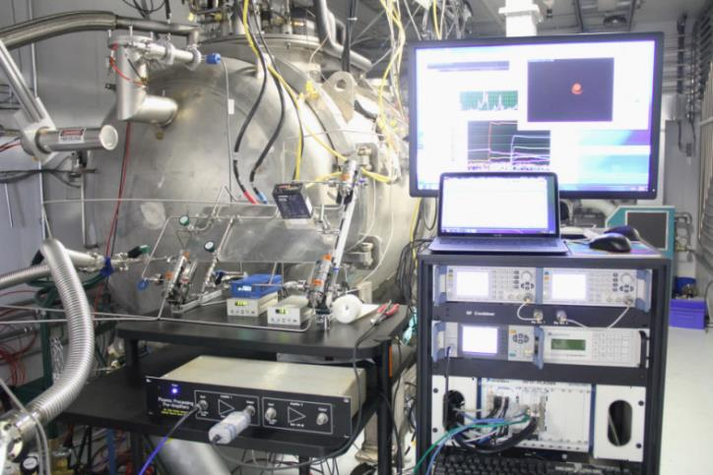
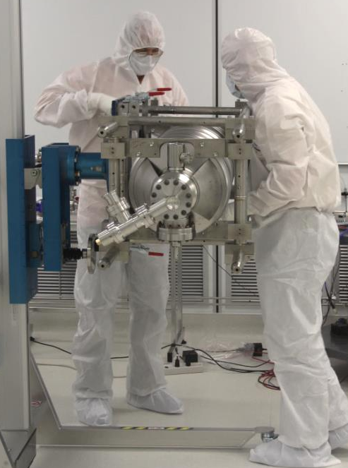
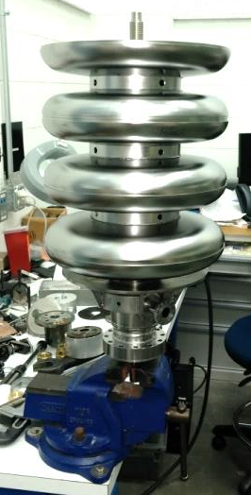
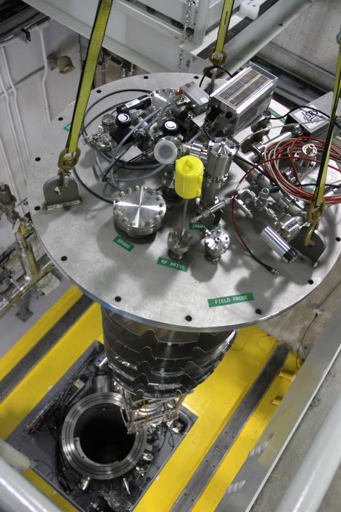
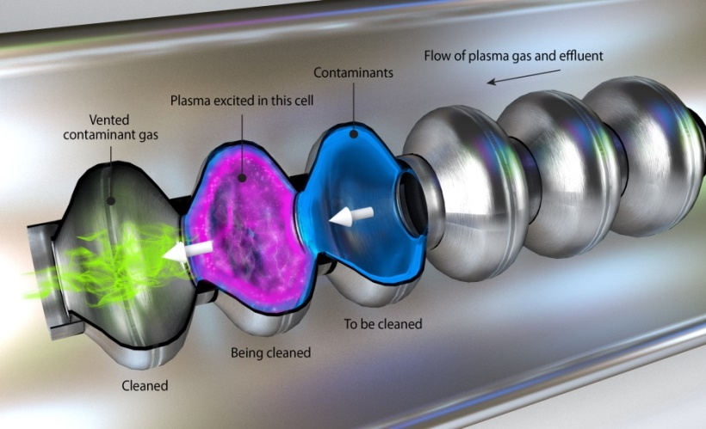
SRF developments
The superconducting RF and Cryogenic test facilities enable a robust research and development program
  Vertical test system
  Horizontal test apparatus
  Cryomodule test facility
  In-house prototyping of SRF cavities
  cryomodule development/fabrication
  Quality assurance program for SRF cavity and beamline components
  SRF R&D and surface science
  PPU project related activities

Slide 15
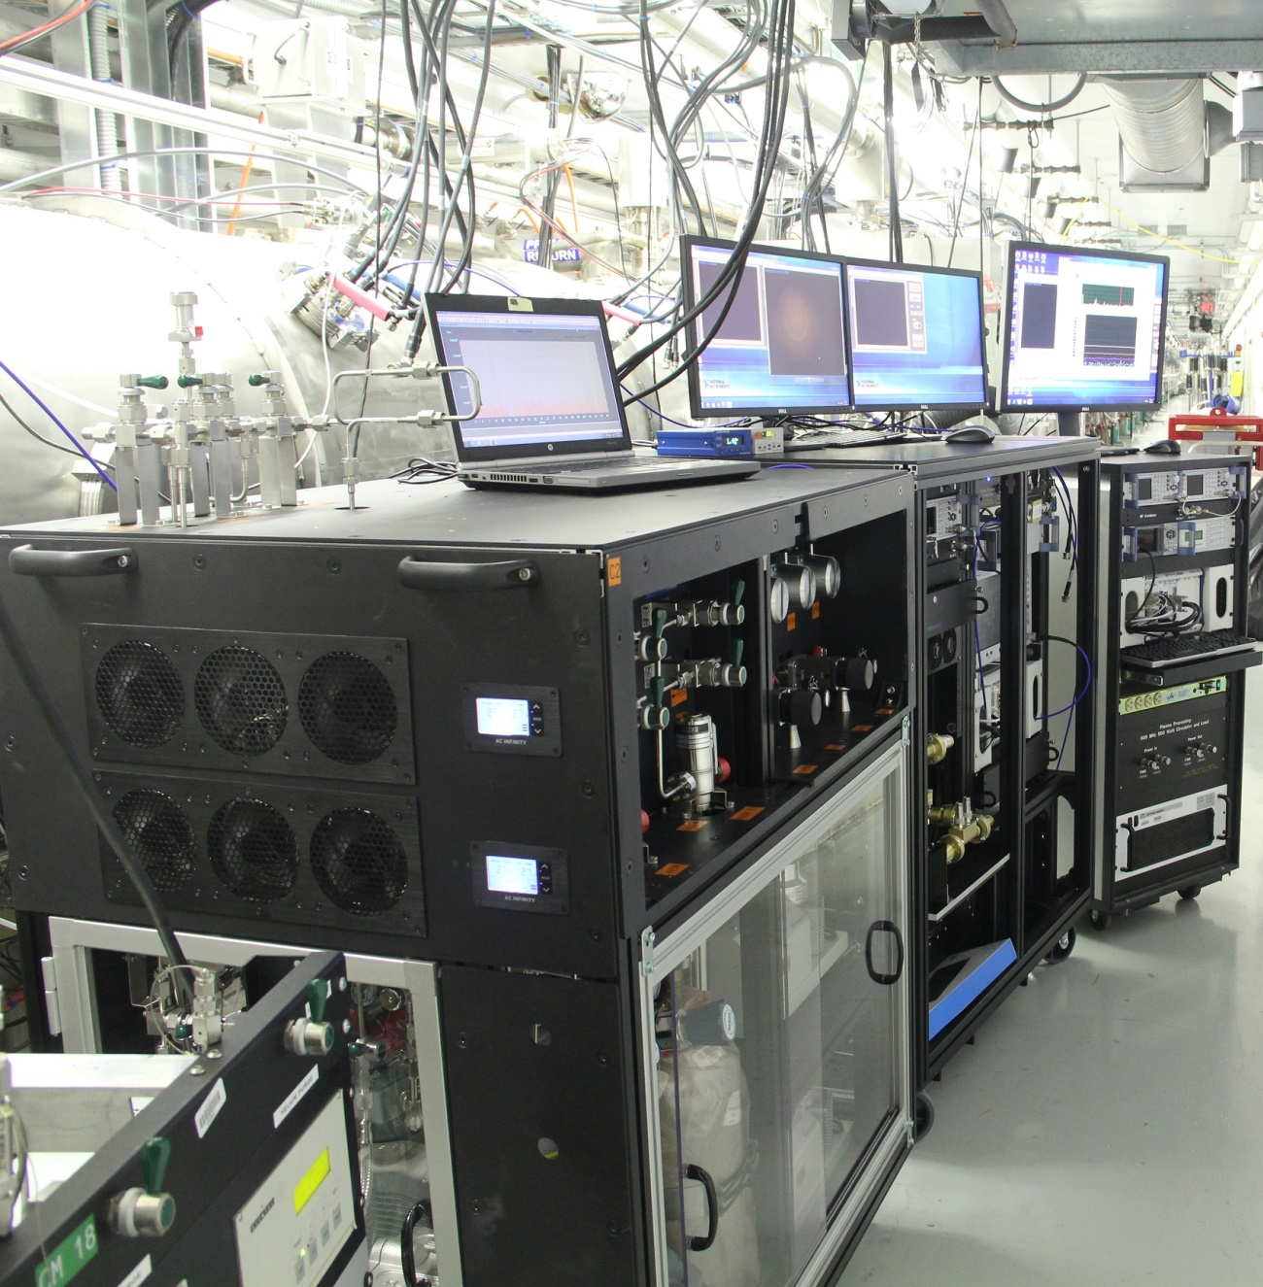
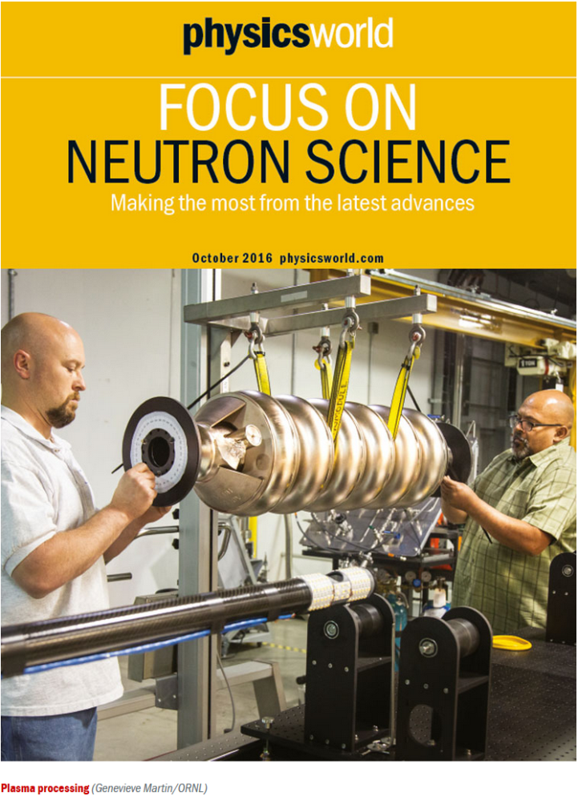
Successful deployment of in-situ plasma processing on CM19 in January and CM18 in June 2016
Feature article in Physics World
‘Plasma boost for acceleration’
RF cart 2
RF cart 1
Gas manifold cart
http://live.iop-pp01.agh.sleek.net/physicsworld/reader/#!edition/editions_neutron-2016/article/page-16231

Slide 16
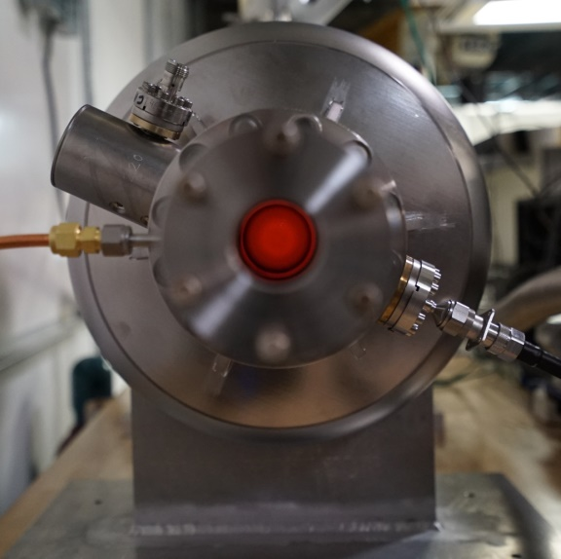
Radiation level reduced after plasma processing
Examples of radiation signals from two cavities
Plasma processing has been observed to reduce radiation related to both field emission and multipacting
  Reduction amount varies between cavities
Field emission regime
Multipacting regime

Slide 17
Three cryomodules successfully plasma processed so far
Successful completion of R&D* for in-situ plasma processing of SNS high beta cavities
1 offline cryomodule
2 cryomodules in linac tunnel
Improvement of E_{acc}
  Ranges from 0.2 to 5.5 MV/m
  10 MV/m per CM increase on average (~20%)
  No cavity performance degradation from plasma processing observed so far
Offline cryomodule
CM19
CM18
*M. Doleans, P.V. Tyagi, R. Afanador, C.J. McMahan, J.A. Ball, D.L. Barnhart, W. Blockland, M. Crofford, B. Degraff, S. Gold, B. Hannah, M. Howell, S-H. Kim, S-W Lee, J. Mammosser, T. Neustadt, J. Saunders, S. Stewart, W. Strong, D.J. Vandygriff, D.M. Vandygriff, “In-situ plasma processing to increase the accelerating gradients of superconducting radio-frequency cavities,” Nuclear Instruments and Methods A 812 (2016) 50−59, http://dx.doi.org/10.1016/j.nima.2015.12.043
*P.V. Tyagi, M. Doleans, B. Hannah, R. Afanador, C. McMahan, S. Stewart, J. Mammosser, M. Howell, J. Saunders, B. Degraff, S-H. Kim, “Improving the work function of the niobium surface of SRF cavities by plasma processing,” Applied Surface Science 369 (2016) 29-35, http://dx.doi.org/10.1016/j.apsusc.2016.02.030

Slide 18
Spare medium beta cryomodule project started in FY17
Will allow removal of any operating medium beta cryomodule for repair
  Rework is the only option for unrecoverable damage of cavity surface/parts
    5a and 11b are currently off
  Necessary for long-term sustainability of SNS operation
AAC 15 recommendation: “The committee accepts plans for spare medium-beta cryomodule. However, we encourage the inclusion of procurement of the spare into the project prioritization process”
  FY17 funding has been allocated for cavity string components procurement from the operation budget

Slide 19
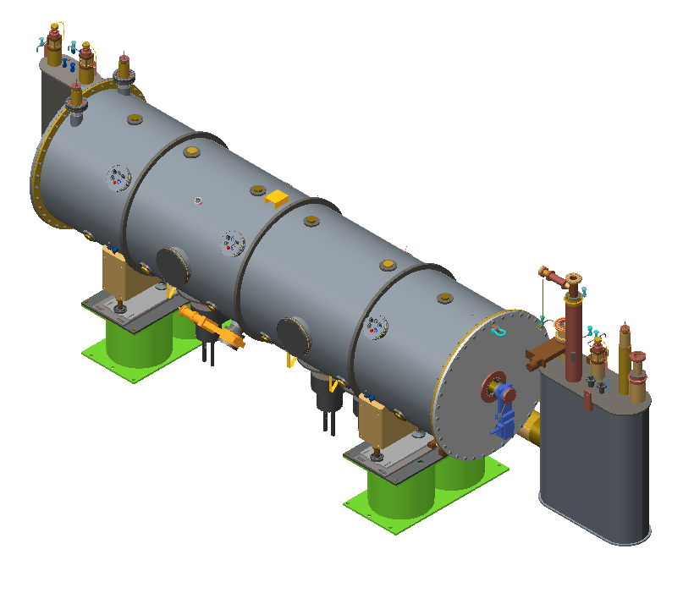
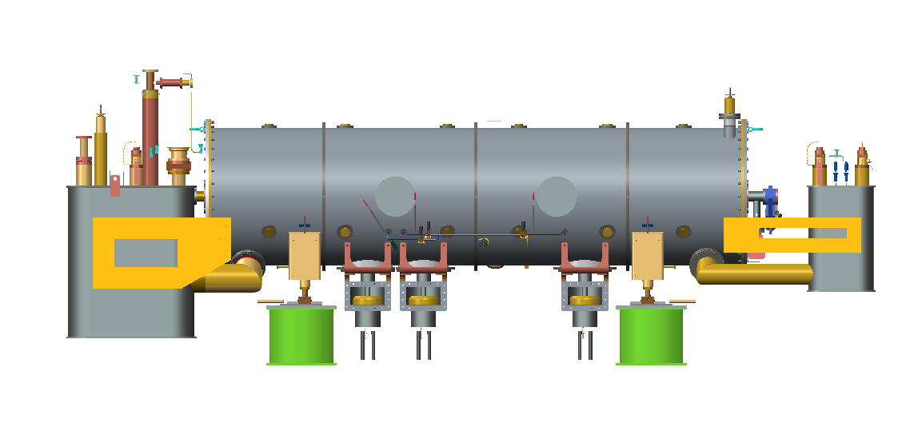
Design package is completed for spare medium beta cryomodule
Same design changes than for the spare high beta cryomodule to comply with 10CFR851
  Pressure boundaries are vacuum vessel and end cans
CM interface points are the same
Minor changes to improve performance and reliability
  No HOM couplers and no piezo tuner
  High RRR niobium for the end group

Slide 20
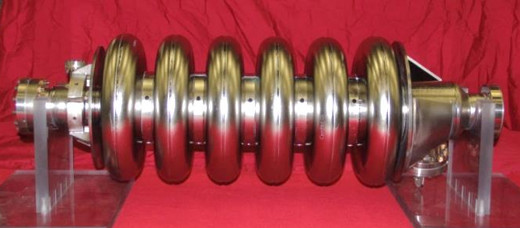
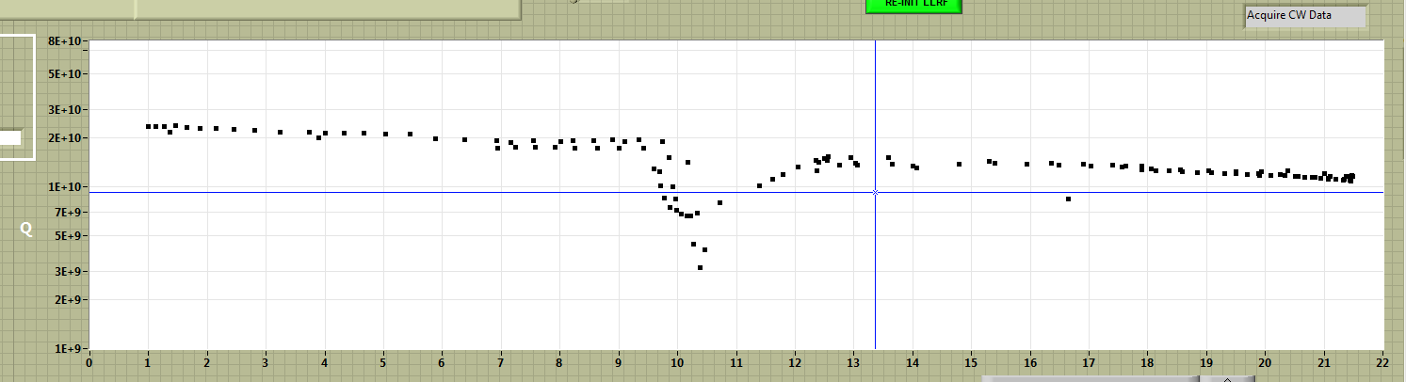
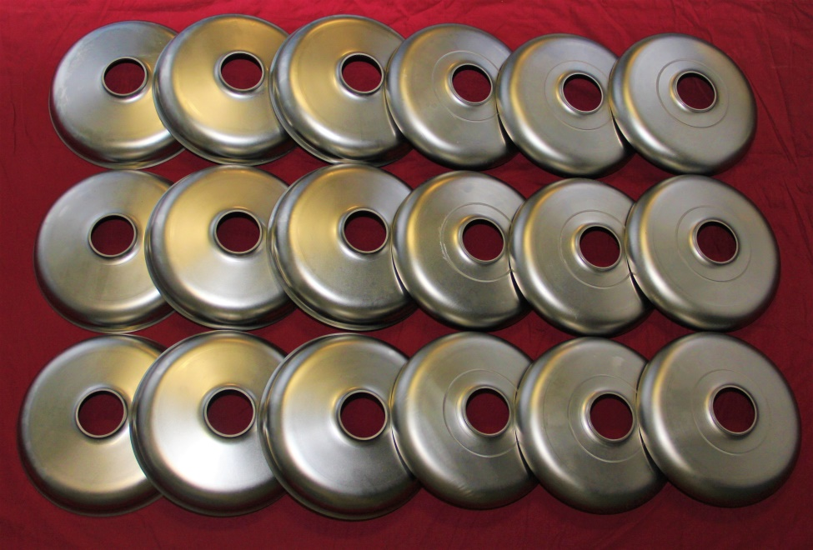
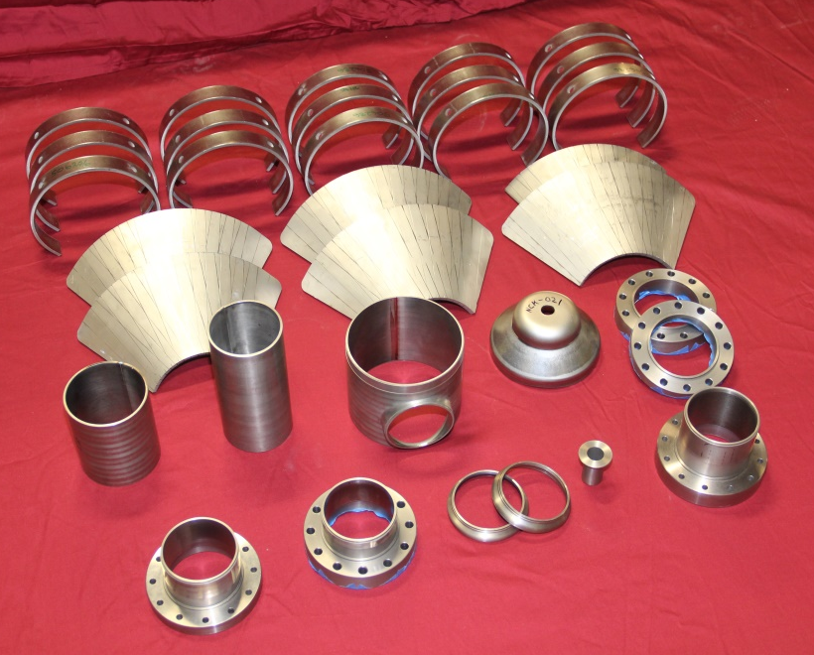
String assembly components for spare medium beta cryomodule
Prototyping of medium beta cavity has been completed
  Fabrication in-house
  E-beam weld and chemistry at partner laboratory (TJNAF)
21.5 MV/m
Cavity fabrication and components procurement for cavity string assembly are progressing

Slide 21
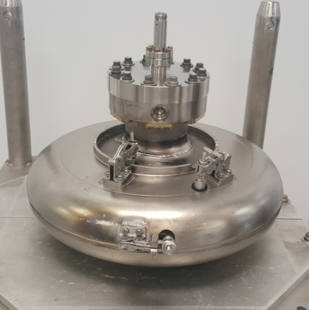
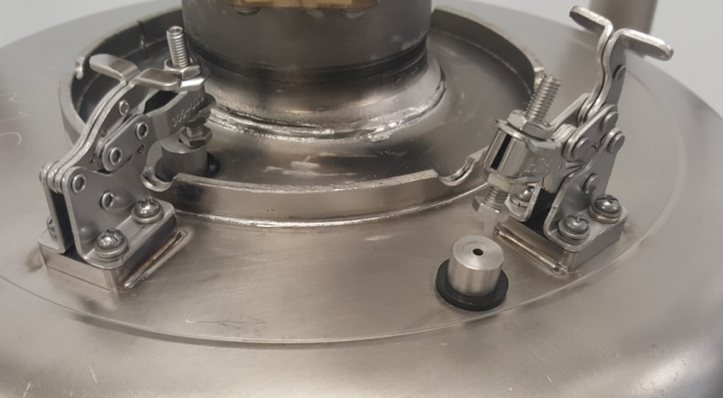
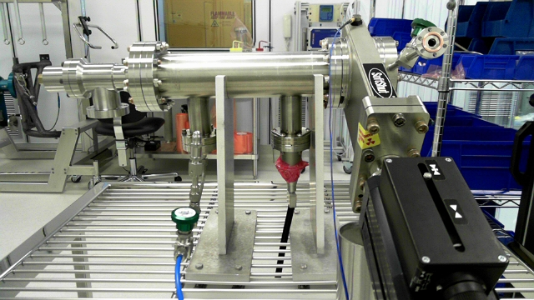
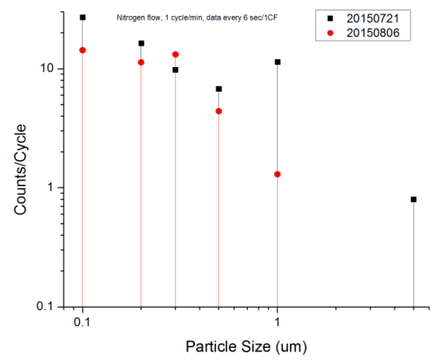
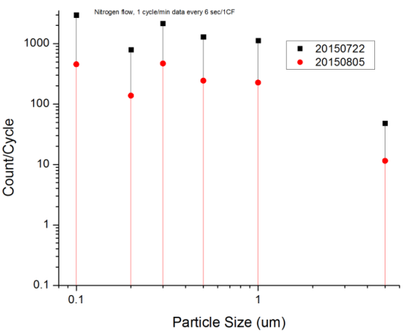
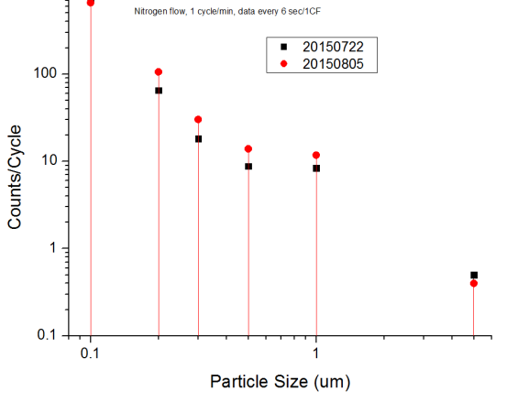
SRF quality assurance program
Cavity for evaluation of processes
  Demountable samples at iris, side wall and equator
  Evaluation of cleaning process
  Evaluation of effectiveness of plasma processing
Evaluation of particulate generation
  Valve qualification before installation
  Cleaning process evaluation
  Pumping and venting process evaluation
  Particulate control during beamline work for cryomodules
Valve 1
Valve 2
Valve 3

Slide 22
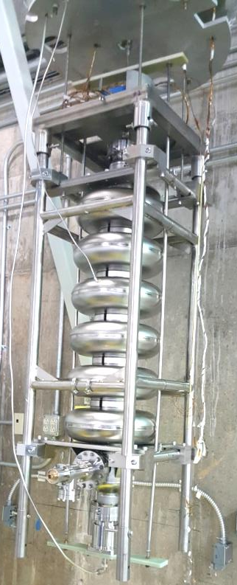
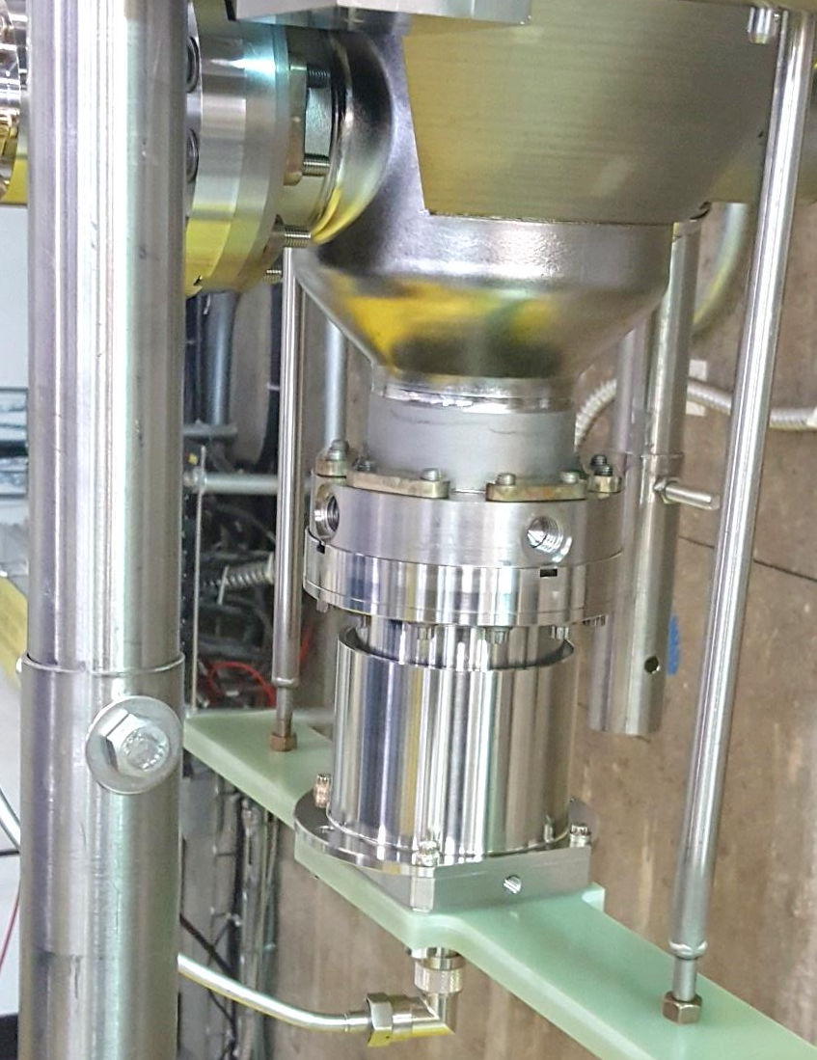
SRF R&D: Variable coupler for VTA test
Objectives
  Large dynamic range (30-35 dB): Enable plasma processing in the vertical test configuration
  Robust and precise control of Q_{ex} of input coupler: Provide better matching condition for accuracy during vertical test
Bench test was successfully completed
  30 dB dynamic range has been achieved
  Plasma ignition technique in each cell was developed and demonstrated for vertical test configuration

Slide 23
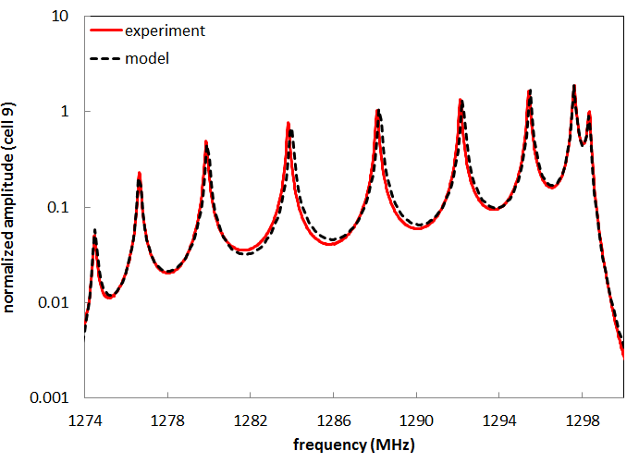
Collaboration R&D for LCLS-II cavities
DOE encouraged ORNL to help adapting the plasma processing technique to other important accelerator projects in its portfolio
  The project ‘In-situ plasma processing R&D for LCLS-II cryomodule’ (collaboration between ORNL, FNAL and SLAC) started in FY17
  ORNL contributions
    Characterize the effect of plasma processing with reactive oxygen on nitrogen-doped niobium samples
    Provide supporting role to partner labs regarding plasma generation in LCLS-II type cavities
Applied the modeling tool* developed for the ignition of the SNS cavities to 9-cell LCLS-II cavity
*M. Doleans, "Ignition and monitoring technique for plasma processing of multicell superconducting radio-frequency cavities." Journal of Applied Physics 120(24), 243301 (December 2016) http://dx.doi.org/10.1063/1.4972838

Slide 24
Summary
The SCL and CHL are operating reliably
Active efforts are in-place for SRF cavity performance recovery, improvement and long-term sustainability
  Linac output energy is increasing toward to 1-GeV operation
  Critical spare components are under development
SRF activities and facility developments are ongoing in support of maintenance, improvement and upgrade project

Slide 25
Backup slides

Slide 26
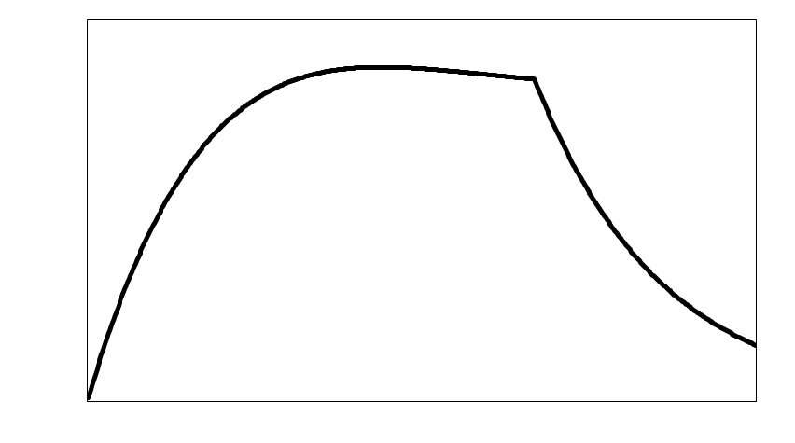
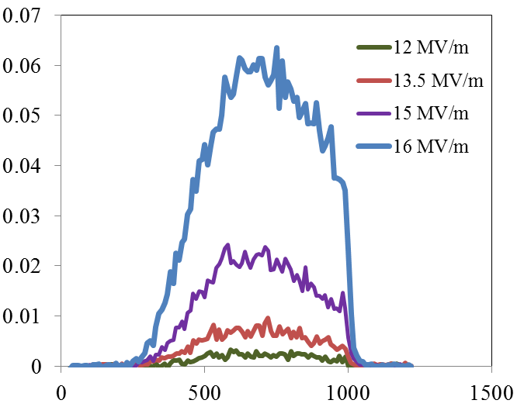
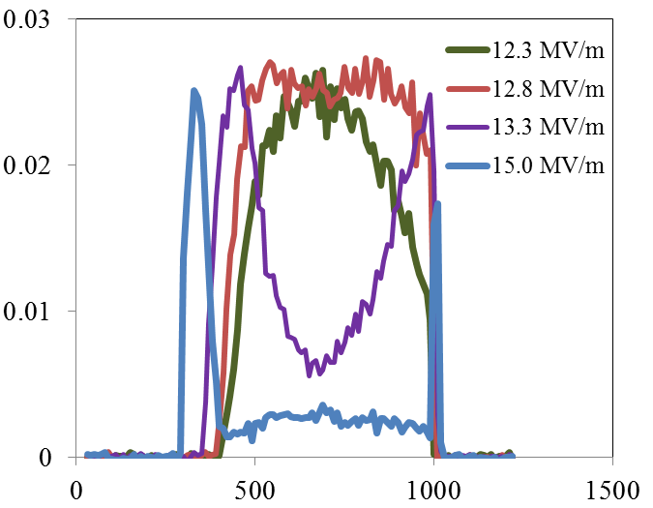
Radiation waveforms from field emission and multipacting
Field emission
Multipacting
Cavity field in open loop
Cavity field in open loop
Radiation (arb. Unit)
Radiation (arb. Unit)
Time (μs)
Time (μs)

Slide 27

Hot spot example 1: meta-stable condition at the same gradient
JT valve position (10% more: 50-60 W)
Cavity gradient
Coupler flange temperature
(not hottest spot)
Some part in the end group (must be very low field region) must be normal conducting but still operable
Additional cryogenic load at 2K is about 50W more from one cavity (would be 800W in CW)

Slide 28

Hot spot example 2: unstable condition
JT valve position (10% more 50-60 W)
Cavity gradient
Coupler flange temperature
(not hottest spot)
Reduce gradient during operation by 0.5-1MV/m due to end group quench
Cavity still unstable → have to wait 10-15 min. for cool-down

Slide 29
Ex. Simulation of hot spot in the end group

Slide 30



Ion pump pressure spike example
A cavity was tripping with ion pump pressure spikes. Slight performance degradation (~1 MV/m) was observed.
The cavity trips and pressure spikes became more frequent
  What is the root cause?
To verify the cause we turned off one ion pump after interlock logic changes
  No trip since summer 2014
Vacuum reading
from ion pumps
Cavity field

Slide 31



Gate valve
Valve actuations causing pressure spikes: observed from a few valves in the tunnel
Particulate generation are measured on the test bench
  Tested gate valves from three vendors
Valve verification before installation
During operation: Minimize valve actuation
Vendor 1
open
open
Valve closed
Warm section IP
CM IP
Vendor 3

