Slide 1
Options for the ServoManipulator Replacement
Presented to the
SNS Accelerator Advisory Committee
Rick DeCosta
Sr. Research Staff
Process Controls Engineer
March 9, 2017

Slide 2
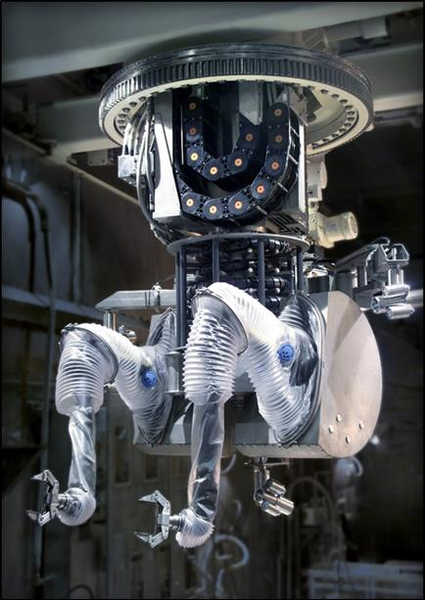
What are the Servomanipulators at SNS?
SNS currently has two dual arm Servomanipulators in use:
  They are used to perform work in areas of high radiation or contamination
  One is located in the Service Bay, the other in the High Bay
  Both units were put into service in early 2006
  The workload for the Service Bay unit has increased considerably over time and it performs >95% of the total work

Slide 3
How are they important to SNS operations?
The Service Bay Servo is used for target changes, post irradiation examination (PIE), waste disposal, infrastructure maintenance, and facility modifications
It has to be operative and available at all times
During target changes, the Servo is operated approximately eight hours per day for five to seven consecutive days
At other times it is also used for about twenty hours per week for PIE, experiments, and maintenance
We have experienced some failures in the past and more occurrences recently; luckily all were quickly recoverable
The risk and frequency of failures are expected to increase over time with age and greater use

Slide 4
Why are we concerned?
The Servomanipulator supplier is no longer in business so no replacement parts or support services are available
SNS has limited or no spare parts on some critical components such as electronics, cables, drives, motors, etc. with no option to reverse engineer some of the components
  We could be one critical failure away from some serious downtime
The Servomanipulator installed in the High Bay is close but it is not an exact duplicate of the Service Bay unit
The cables associated with the Servo and crane have a projected ten year lifespan – they were put in service in 2006
The technology is approximately 15 years old and obsolete
  Imagine relying on a desktop PC running since the year 2000

Slide 5
A few common assumptions we can agree on
The controls components (computers, drives, motors) will fail more frequently with time and as beam power increases
Eventually one or more conductors in the cables will break
Mechanical systems such as grippers and joints will incur wear and breakdowns
As a result, downtimes will become more frequent, more difficult to resolve, and longer in duration
The level of effort and costs required to keep the systems running will increase over time
Usage and demands on the system will increase as PIE and Proton Power Upgrade (PPU) requirements come into play

Slide 6
Additional points that should be considered
All of the related cables should be replaced when the Servomanipulator is replaced:
  It is not possible to only replace the servomanipulator cables
  All of the cables have the same aging and projected lifetime issues
  There are no spare cables or conductors installed; should we lose a single conductor in a cable we may lose the associated functionality
It will be challenging and hazardous work to replace the cables necessitating careful planning and coordination
During replacement, the Service Bay ServoManipulator will be out of service for three to six months, so this must be coordinated and planned carefully
Project will involve cooperative efforts with the crane vendor

Slide 7
Some feasible options to resolve the issue
Status Quo – make repairs as needed:
  Higher risk, especially as age and use increases
  More unplanned interruptions and downtime
Rehabilitate – retrofit controls:
  Higher costs, less performance, more challenging and takes longer
  It would not mitigate mechanical or cable failure risks
Change out units – move the High Bay unit into Service Bay:
  This would not mitigate critical parts, support, or cable risks
  It would be a short term solution and would increase disposal costs
Replacement – install new ServoManipulators:
  Replace both systems in phases to spread costs, reduce risks
  This is the best solution to resolve the issues listed previously

Slide 8
Our research to find a solution
We evaluated our current and future needs and developed a design criteria based on ten years of operational experience
Conducted a search world-wide for potential suppliers willing and capable of providing equipment to meet our needs
Located two vendors that have the capabilities we need:
  Oxford Technologies Ltd. – Oxford, England
  Wälischmiller GMbH – Markdorf, Germany
Both organizations have installed comparable remote handling equipment in facilities around the world and both have U.S. subsidiaries for localized support and service

Slide 9
How we evaluated the suppliers and their equipment
First we developed a list of important attributes and performance criteria to be able to conduct objective testing
Then we created test plans to evaluate the attributes of each system (and different control configurations)
The results of the tests were compiled on a scorecard
The current system was also evaluated on the same criteria
The results were ranked side by side and the scores tallied
Also reviewed was the capability of each organization to manufacture, commission, and install systems, their design capabilities, and existing support infrastructure

Slide 10
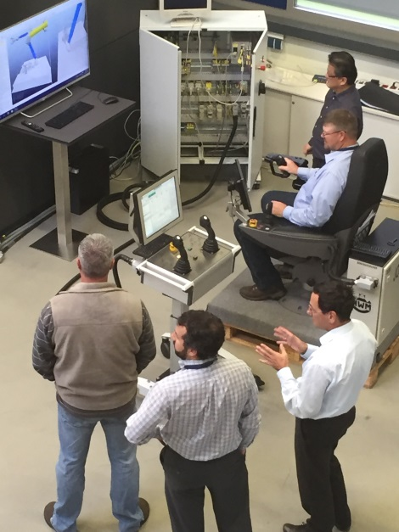
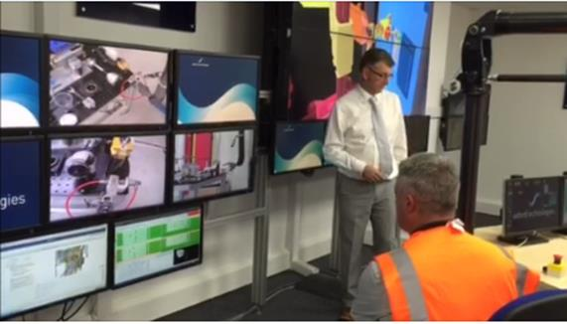
We performed “test drives” of the equipment
We made site visits to both vendors and performed trials on their systems to evaluate the capabilities to meet our needs:
  Oxford’s “Dexter” servomanipulator is considerably smaller and lighter than our requirements but they indicated it can be scaled up
  The Wälischmiller “Telbot” is produced in a variety of sizes and capacities and with three differing types of controllers

Slide 11
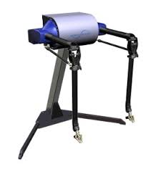
The Pros and Cons of Oxford’s Dexter
Pros:
  The systems will be custom designed and built to meet our specifications
  Lower price
Cons:
  Higher maintenance – remote uses tendons which must be replaced frequently
  They are a ‘solutions provider”, not an original equipment manufacturer
  There is no track history on the equipment; it will be unique to us.
  Cables not provided as part of the project – we will need to outsource this task at additional cost

Slide 12
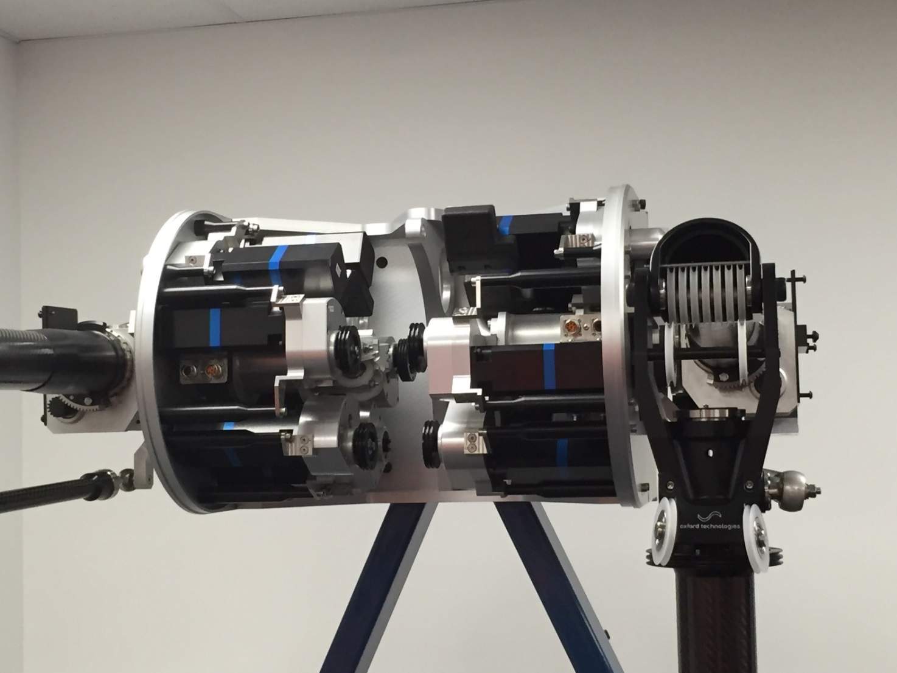
Cut-away view of the Dexter System

Slide 13
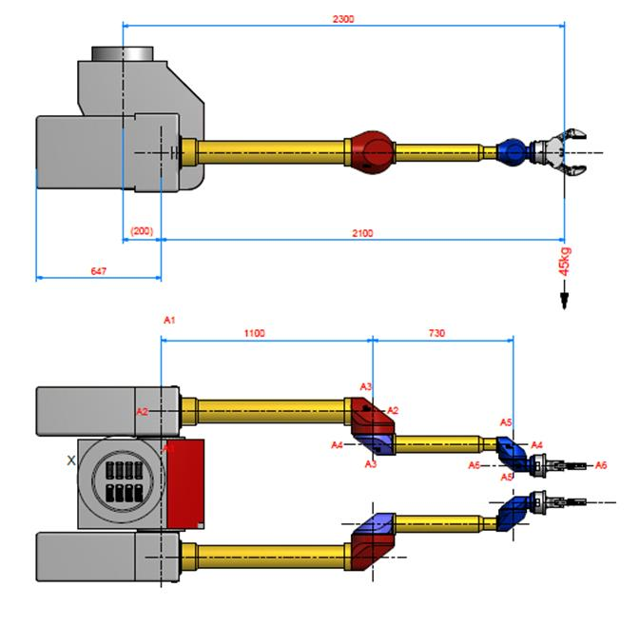
The Pros and Cons of Wälischmiller’s Telbot
Pros:
  They are an established equipment manufacturer with numerous products in field
  Support infrastructure has been established and is experienced
  Their equipment has a proven track history and is more or less COTS with some minor modifications
  It scored better on the trials criteria evaluations
Cons:
  More expensive

Slide 14
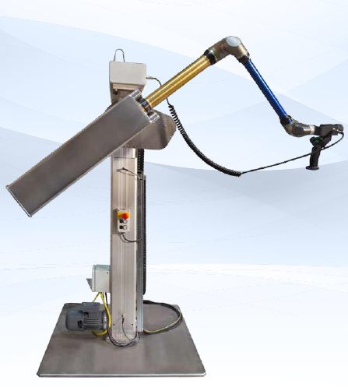
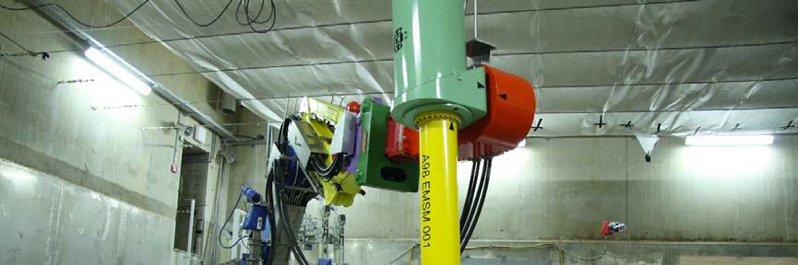
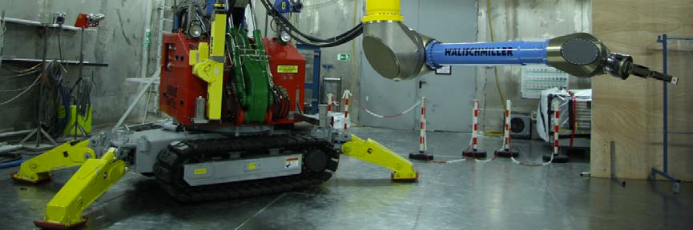
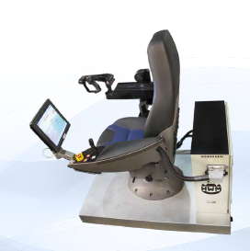
We performed trials of the Wälischmiller Telbot
Demonstration slave unit above and to the right; MasterArm and JoyArm controllers are on the left

Slide 15
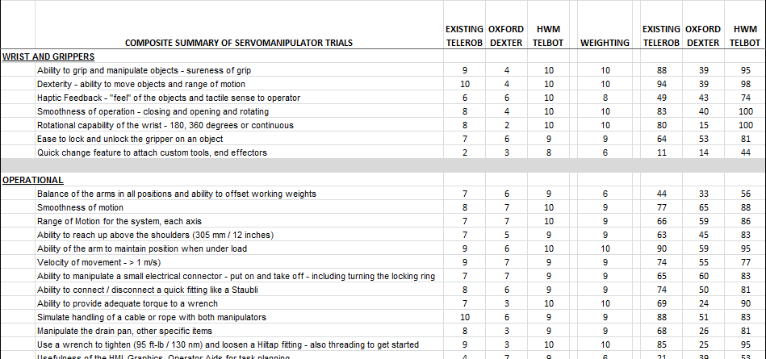
The results of the trials were scored and compiled in a summary
Perfect Score = 3345

Slide 16
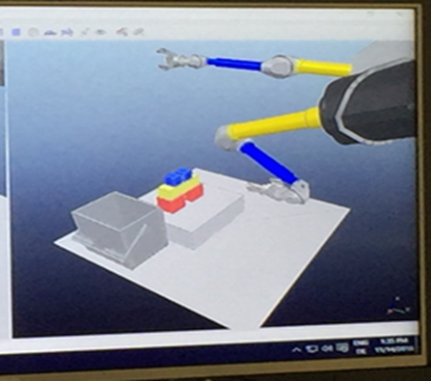
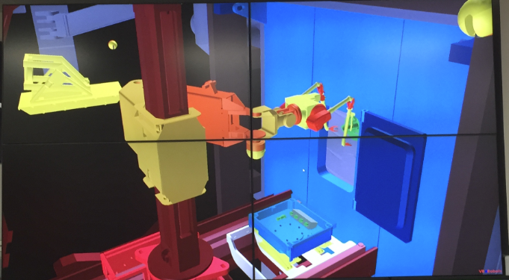
Both vendors have virtual reality augmentation and tools to aid in operations and planning
Both Vendors offer VR simulations as part of their tool set
Useful for feasibility studies, pre-planning jobs, and training
The models are based off of the work environment and the configuration of the servomanipulator

Slide 17
How can we execute the work?
We have planned the project activities in three phases:
  Phase I:
    Project planning
    Design and development of both systems – they will be identical
  Phase II:
    Removal of the existing High Bay Servomanipulator, cabling, and master controller – to be stored as spare parts for the Service Bay system
    Installation and commissioning of the new servomanipulator, trials, and operator training
  Phase III:
    Removal of the existing Service Bay Servomanipulator, cabling, and master controller – including the crane and camera cables
    Installation and commissioning of the new servomanipulator including crane and camera cables
    Operator and Maintenance training

Slide 18
The vendors have provided ROM Quotes
(in thousands USD)
Phase |  | Oxford |  |  |  | Wälischmiller |  |  | Lead Time (mos)
Phase I |  | 661.5 |  |  |  | 475.0 |  |  | 9
Phase II |  | 1,985.6 |  |  |  | 3,300.0 |  |  | 12
Phase III |  | 2,047.7 |  |  |  | 3,300.0 |  |  | 12
Total |  | 4,694.8 |  |  | * | 7,075.0 |  |  | 33
* - Does not include cables – estimated cost ~ 750.0

Slide 19
To summarize the estimated costs
 | ITEM / TASK |  | COST (K$)
 | ServoManipulators w/ cables |  | 7,000
 | Replacement crane cables |  | 400
 | Camera cables, hoses, carriers |  | 60
 | PAR Design Support |  | 150
 | Demolition and Installation |  | 615
 | Disposal |  | 140
 | Subtotal |  | 8,965
 | Contingency (10%) |  | 896
 | Total |  | 9,862

Slide 20
What is the path forward?
Review and Final Approval of the Design Criteria
Management direction to proceed or select another path
Timing and Funding Apparatus
  Phase I
  Assurance of Phases II and III
Many thanks to the Mike Dayton and the Remote Handling Group for all their participation and hard work

