Slide 1
Mercury Target Engineering Design and Analysis
Presented to the SNS Accelerator Advisory Committee
Drew Winder
Team Lead, Mercury Target Engineering
March 9, 2017

Slide 2
Outline
Overview
Review of Past Year
Review of Previous AAC Recommendations
Status and Remaining Challenges
Mercury Process System
Target Carriage
Target Modules
Looking Ahead

Slide 3
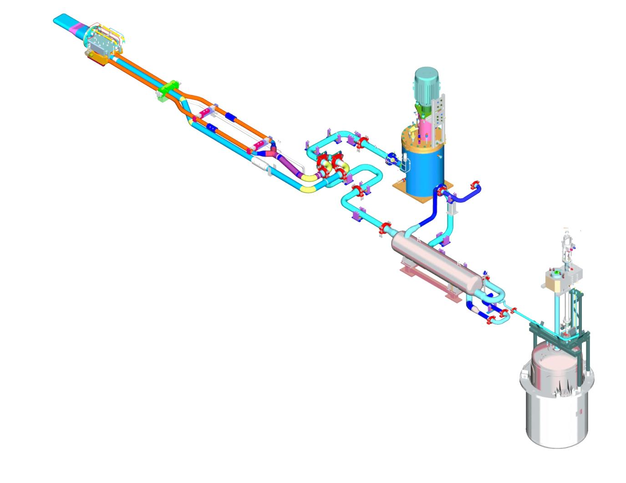
Overview
Mercury Target Engineering – This team is responsible for engineering associated with the SNS mercury target system, including support of operations and the design, analysis, and planning for replaceable components such as mercury target modules, pumps, and heat exchangers.
Hg Pump Motor
Target
Supply Pipes (3)
Hg Pump Tank
Return Pipe (1)
Transfer Valve
Heat Exchanger
Mercury Storage Tank

Slide 4
Overview – Mercury process system
The mercury process loop is located in the Service Bay, and is only accessible remotely
Limits maintenance and repair activities
Safe and reliable operation of the mercury loop is critical to SNS function
Radiation fields challenge equipment
Equipment is aging
Hg Pump Motor
Target
Supply Pipes (3)
Hg Pump Tank
Return Pipe (1)
Transfer Valve
Heat Exchanger
Mercury Storage Tank

Slide 5
Overview – Target module
Target module contains and directs the flowing mercury target material
Designed to be a regularly replaced component
Not safety credited
Limitation on lifetime can include:
Mercury cavitation
Fatigue
Effect of radiation on materials

Slide 6
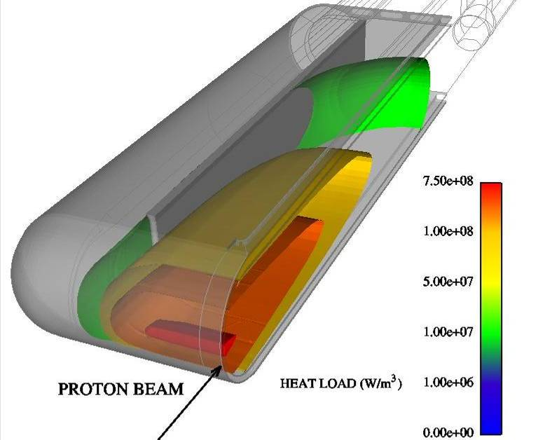
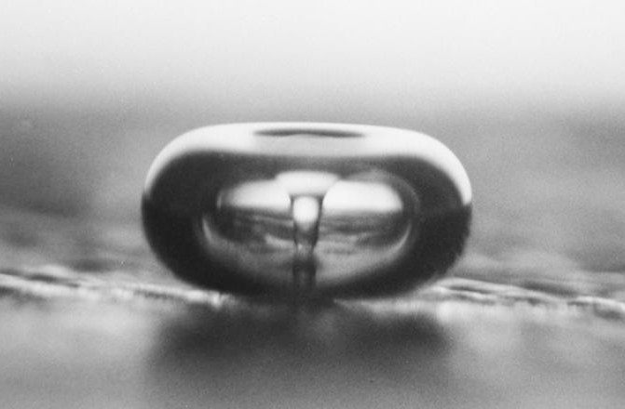
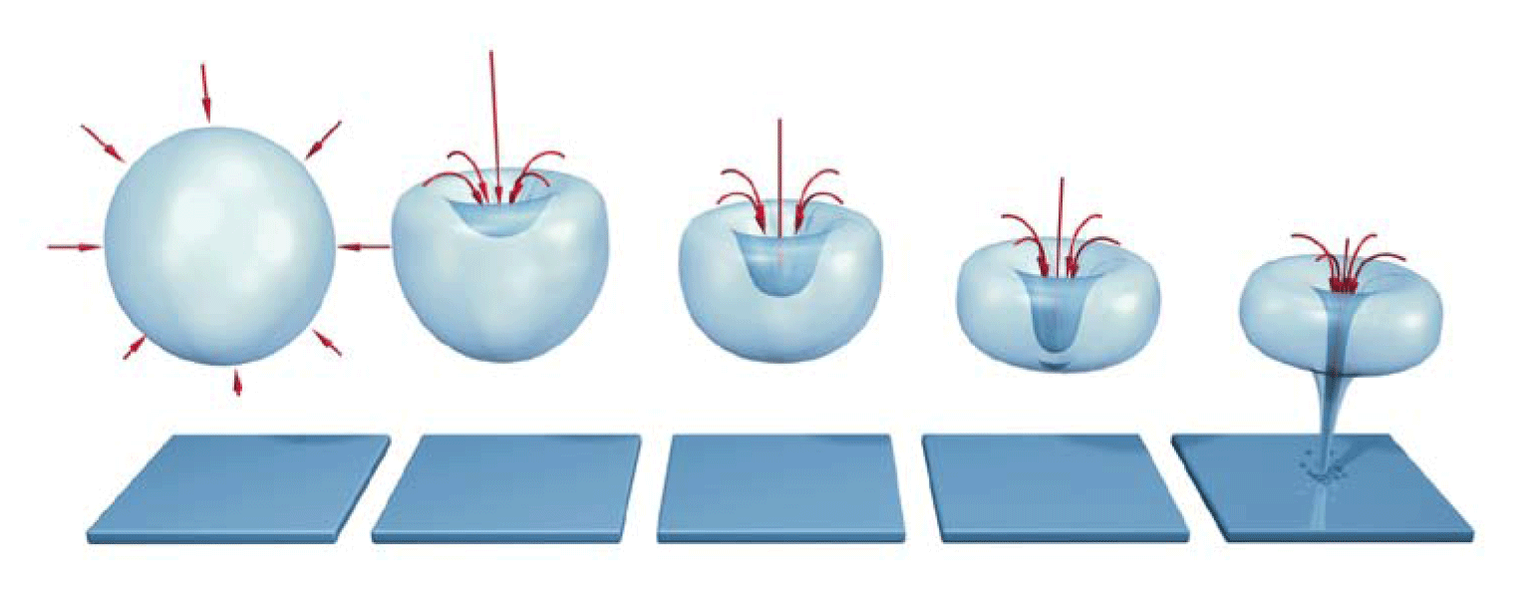
Overview – Target module
Temperature rise from a high-power (1.4 MW) proton beam pulse is approximately 10 K
Rate of temperature rise is approximately 10⁷ K/s
The isochoric (constant volume) energy deposition leads to formation of tensile pressure waves that cavitate the mercury
The collapsing bubbles create mercury “jets”, which erode the target vessel surfaces by:
Direct erosion
Fatigue “spalling”
Photo Credit: Lawrence Crum (University of Washington)
Photo Credit: http.eswt.net/cavitation

Slide 7
Overview – Target module
Stainless structure of the target module is subjected to cyclic loading from individual pulses and from beam trips
1,200,000,000 beam pulses
10,000 beam trips over the life of the target
Solution method: B.W. Riemer, Jnl. Nucl. Mat. 343 (2005) 81-91

Slide 8
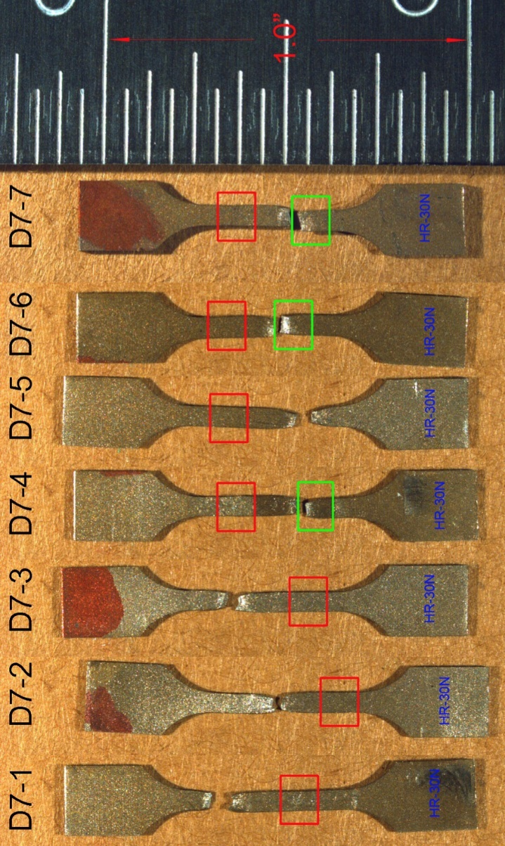
Overview – Target module
Radiation induced changes to the target material not currently limiting
The original radiation damage limit for target structural material was 5 dpa
SNS has performed post-irradiation examination of highly irradiated material from spent targets
This has allowed the limit to be increased to the current value of 12 dpa to the water-cooled shroud
Provides roughly 7,500 MW-Hrs, greater than goal value for the target
Figure Credit: D. McClintock & B. Vevera

Slide 9
Review of the past year
Feb | Mar | Apr | May | Jun | Jul | Aug | Sep | Oct | Nov | Dec | Jan | Feb
At the time of the last AAC meeting:
T12 had become the first target to develop a leak near the nose after a record setting run of 4460 MW∙hr
T13 had provided a limited number of measurements of target response to pulses
Design for retrofit of jet-flow targets with gas injection was complete.
Target inventory and fabrication status at the time:
Two spares, one vintage original and one newer original mercury flow type
One original, two jet-flow targets in fabrication at one vendor
One jet-flow target on hold
Analysis was progressing on the Adelie target design, an original type target with fatigue improvements
First attempt at design had found that a change to the center baffle had increased the stress seen in the side baffles beyond acceptable limits

Slide 10
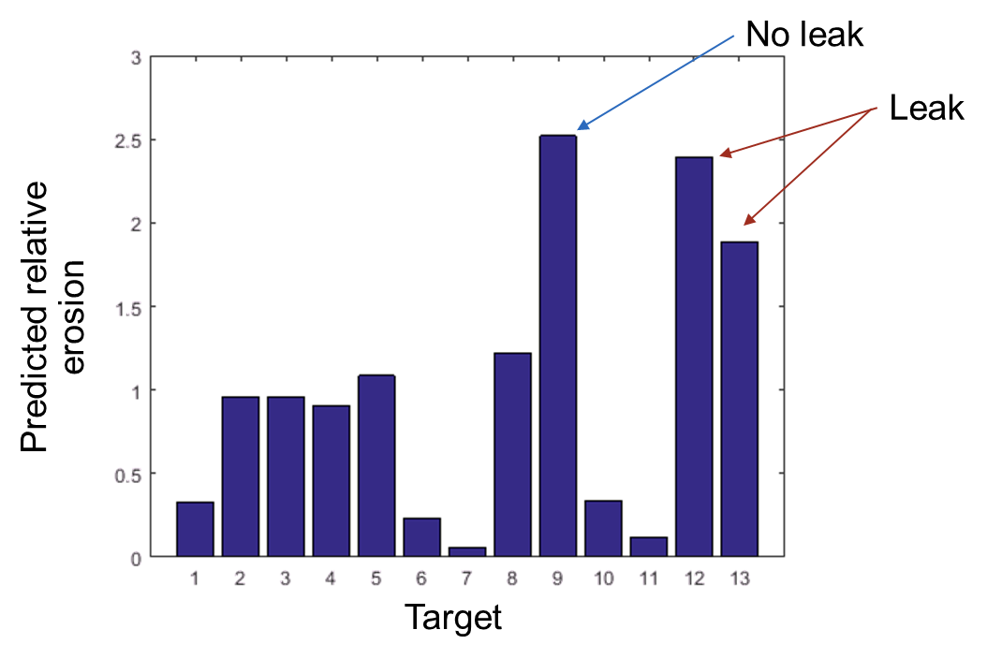
Review of the past year
Feb | Mar | Apr | May | Jun | Jul | Aug | Sep | Oct | Nov | Dec | Jan | Feb
In March, target T13 developed a leak in its nose at the same location as seen on T12
T14, a newer original type target, was installed
Provided us with our second opportunity to measure strains on the target
Predicted erosion scaling from Haines, 2005, is not consistent with observed data.

Slide 11
Instrumentation results need study

Slide 12
Instrumentation results need study

Slide 13
Instrumentation results need study
Feb | Mar | Apr | May | Jun | Jul | Aug | Sep | Oct | Nov | Dec | Jan | Feb
Switched focus to addressing issue at nose
Stopped work on Adelie target design and analysis
Started work on MTX-008 (4/2016)
This target was a jet-flow target which had been on hold
Due to an earlier issue, this target had a nose which was thinner than nominal at the T12 and T13 leak location, making it a prime candidate for improvement
As a stopgap measure, desired to add additional material at the leak location

Slide 14
Review of the past year
Feb | Mar | Apr | May | Jun | Jul | Aug | Sep | Oct | Nov | Dec | Jan | Feb
Unplanned leaks in T12 and T13 had decreased our planned number of spare targets
No time to create new target design by the time we needed more
Started fabrication of additional jet-flow target

Slide 15
Review of the past year
Feb | Mar | Apr | May | Jun | Jul | Aug | Sep | Oct | Nov | Dec | Jan | Feb
Issued design change in early August 2016 for both original and jet-flow target change
Released fabrication hold on MTX-008
We were swiftly running through our original type targets. Since jet-flow was relatively unproven, decided to buy additional original targets
These targets were updated to include increased thickness at nose
Requirements and specifications also updated based on lessons learned

Slide 16
Review of the past year
Feb | Mar | Apr | May | Jun | Jul | Aug | Sep | Oct | Nov | Dec | Jan | Feb
Work on the Blue target ramped up as work on the thicker-nose target finished
Blue target is based on the jet-flow design and was to include
Improvements to the nose leak location of T12 and T13
Other improvements as possible
Developed multiple candidate concepts
Planned to purchase water shroud ahead of mercury vessel to buy more time for analysis
Planned to evaluate concepts until October and then start final design and analysis, which was projected to take ~4 months

Slide 17
Review of the past year
Feb | Mar | Apr | May | Jun | Jul | Aug | Sep | Oct | Nov | Dec | Jan | Feb
T14 completed its run after 2762 MW∙hr at a steady 1.0 MW
First part of a planned approach wherein two targets would be operated for near the same number of operating hours at two different power levels
A near identical target was installed as T15 to complete the other part of the experiment at 1.2 MW

Slide 18
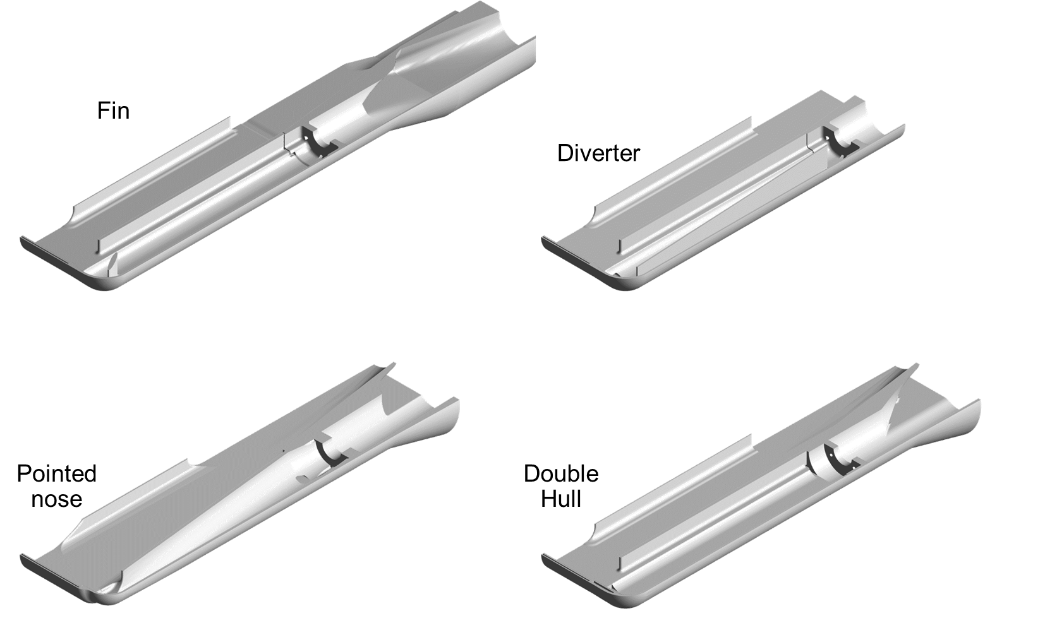
Review of the past year
Feb | Mar | Apr | May | Jun | Jul | Aug | Sep | Oct | Nov | Dec | Jan | Feb
Concept chosen at beginning of October
Based on a significant amount of analysis on four concepts

Slide 19
Review of the past year
Feb | Mar | Apr | May | Jun | Jul | Aug | Sep | Oct | Nov | Dec | Jan | Feb
Decision made to remove T15 early
Move to a quicker target cycle (3 targets per year vs. 2)
Supported by higher than expected erosion in T14 samples

Slide 20
Review of the past year
Feb | Mar | Apr | May | Jun | Jul | Aug | Sep | Oct | Nov | Dec | Jan | Feb
Blue target is reaching end of analysis and design effort
~1 ½ months behind schedule
Delays associated with
Neutronics
Meshing/structural analysis
Conflicts for team attention

Slide 21
2016 AAC Recommendations
Recommendation:
Place more emphasis on an effective and stable gas bubble injection system.
Progress:
Two gas injection capable targets have been delivered
Replacement mercury pump tank rupture disk and venting hardware has been designed
Miscellaneous gas supply jumpers for gas injection targets in final design

Slide 22
2016 AAC Recommendations
Recommendation:
Use fatigue and stress analysis to set a quantitative minimum reduction in strain required to achieve satisfactory target vessel performance.
Progress:
Instrumentation has provided critical checks of simulation models
Developed an updated Structural Design Criteria document for targets
Includes fatigue design curves
Target vessel life performance is complicated by interactions between fatigue and cavitation damage

Slide 23
2016 AAC Recommendations
Recommendation:
Set the requirements and scope of the short-term bubble injection system such that significant pressure wave mitigation is achieved even at the expense of making needed changes to the mercury loop. Steps in this process are:
Incorporate the short-term bubble injection system with the jet-flow design concept in the next target/build cycle.
Incorporate target vessel instrumentation in the gas bubble/jet-flow target design to ensure comprehensive evaluation of the effects of the gas bubble injection system.
Progress:
Multiple jet-flow targets with gas injection hardware have been delivered and are being fabricated
Instrumentation system has matured and is ready for study of gas injection system effectiveness

Slide 24
2016 AAC Recommendations
Recommendation:
A re-prioritization of activities should be considered:
Gas bubble injection with jet flow, including strain measurements
Continued PIE of spent targets
Target design modifications to reduce stress concentrations and effects of fabrication flaws
Fabrication improvements (QA, manufacturing methods, welding)
Progress:
Activities have continued, and will continue in all areas. Most significant progress has been made in the highest priority areas.
Gas capable targets have been delivered
Strain measurement capabilities have matured
Target design improvement work continues

Slide 25
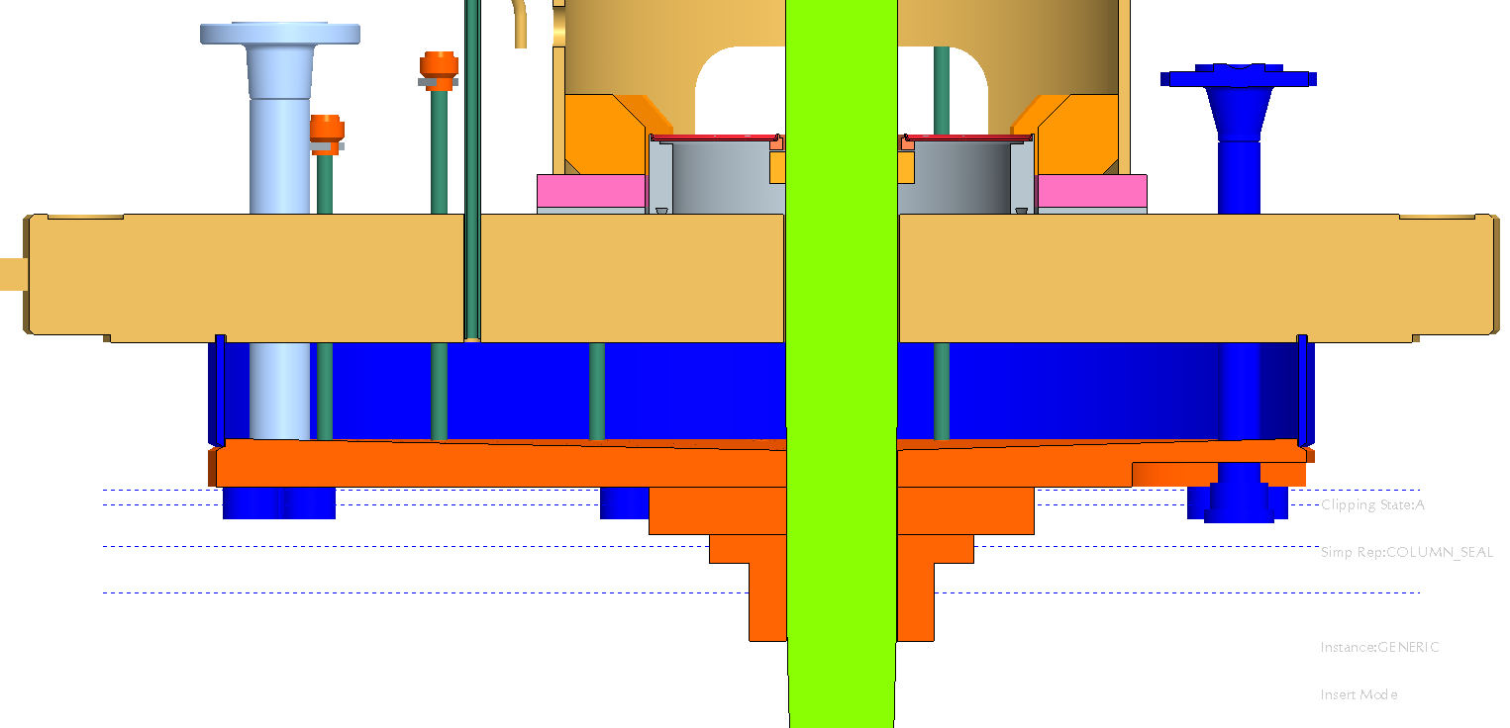
Mercury pump operating, work needed for gas injection
Mercury Process System
Mercury pump operating successfully at 350 RPM
Need to change pump tank rupture disk to support gas injection
Spare pump needs changes to handle possible tank level swings from gas injection

Slide 26
Uncredited mercury loop sensors not reliable
Mercury Process System
Process loop flow sensors (not safety credited) are not reliable
Thanks to work from RAD Process Controls, we now have spares
We have not replaced these sensors before - new remote handling operation

Slide 27
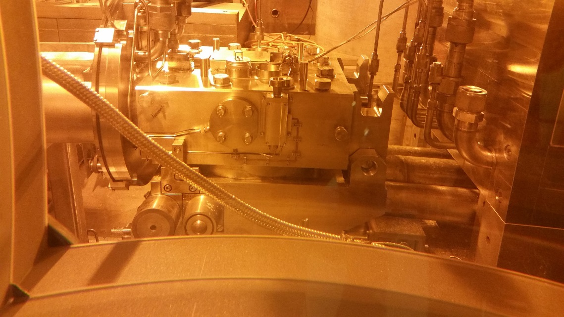
Target carriage issues increasing
Target Carriage
Carriage is starting to show its age
Rollers – The alignment rollers at the front of the carriage cannot be removed for replacement. Currently working better.
Vibration – Set-screws at the target have loosened repeatedly during operation. In addition, the pivot pin at the rear has come out during operation.
Iron seals – Have had to increase the thickness of the iron seal gaskets, but leak rates for this seal continue to be larger than planned.
Carriage drive – Became stuck and couldn’t move forward several times during the last target change.

Slide 28
Improvements to analysis needed
Target Modules
Improvements to Pulse Simulations and Measurements
Understand issues with sensor data
Use sensor data to improve our modeling of single phase mercury
Develop models capable of simulating mercury with gas bubbles
Use WNR experimental data for support
Continuous Improvement of Design and Analysis Methods and Processes
Continue to improve methods and processes to obtain the maximum value from our limited resources

Slide 29
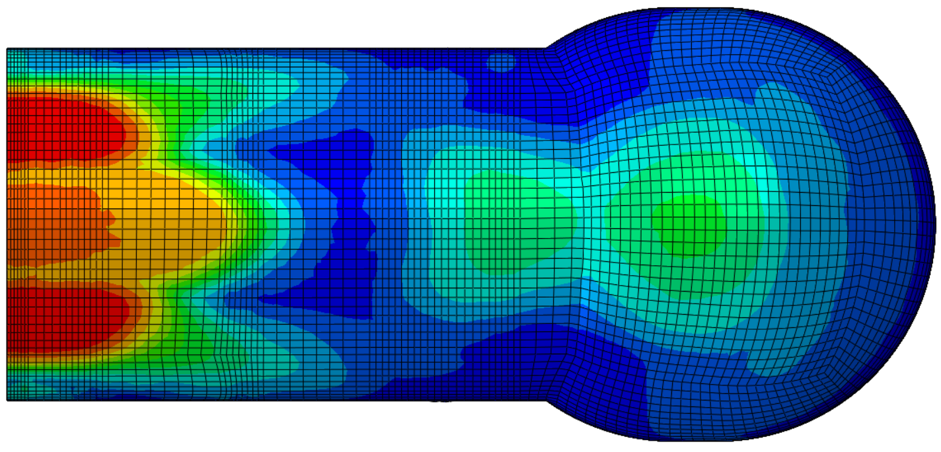
Prediction of cavitation damage erosion is a challenge
Target Modules Continued
We have a method of predicting cavitation damage potential, but it needs refinement
Investigating alternate approaches, including prediction of bubble size
Look again at cavitation damage prediction
Use our past PIE photographs, fluids simulations, and pulse simulations to try to stake out “safe zones” and “danger zones”
Use measurements of nose erosion to develop power scaling rules
Predicted Max Cavitation Bubble Size at Target Nose after 1 millisecond

Slide 30
Prediction of Cavitation Erosion a Challenge
Target Modules Continued
We have a method of predicting cavitation damage potential, but it needs refinement
Look again at cavitation damage prediction
Use our past PIE photographs, fluids simulations, and pulse simulations to try to stake out “safe zones” and “danger zones”
Use measurements of nose erosion to develop power scaling rules
Predicted erosion scaling from Haines, 2005, is not consistent with observed data.

Slide 31
Improving methods
Target Modules continued
Improve design and analysis methods
Develop and implement optimization methods
Later talk by Saul Kaminskas
Improve fatigue evaluation
Synergy with cavitation damage

Slide 32
ORTE-003 spare needs repair
ORTE-003 target repair
One of our current spares, ORTE-003, is an older design which has an area which has been a failure location on three previous targets
Failure of two of these targets was attributed to manufacturing defects
Failure of one is not attributable to manufacturing defects, leads to questions about ORTE-003 reliability
Plan to perform repair of this target to increase our assurance of its reliability
Repair is currently planned for during the long IRP/RFQ shutdown to minimize the amount of operating hours when the target is unavailable for use

Slide 33
Interface with operations
Over the past year, there has been a serious push to integrate target engineering activities with operational needs
Historically, the goal of target operations has been to satisfy the following triad
High power operation
≤ 2 targets per year
No leaks

Slide 34
Interface with operations
In order to support goals associated with high power, reliable operation…
In the short term we plan to operate three targets per year
Speeds learning
Reduces demands on each target module
High power operation
≤ 2 targets per year
No leaks

Slide 35
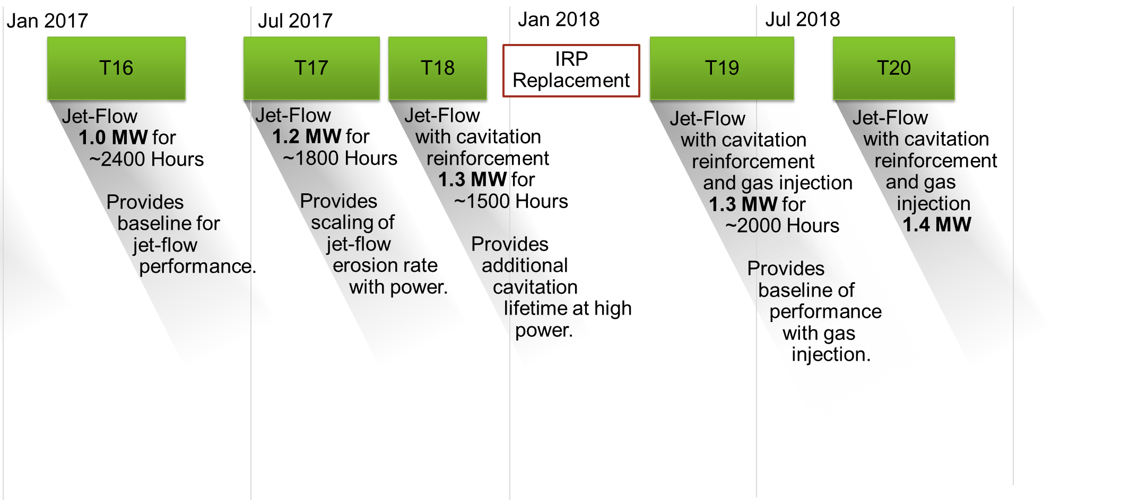
Interface with operations
A Target Management Plan document has become a vehicle for developing a comprehensive plan for target operation, design, and fabrication
Operation of upcoming targets has been planned to facilitate systematic learning
Oct 2017

Slide 36
Interface with operations

Slide 37
Interface with operations

Slide 38
Interface with operations
Increased target use tempo will put a strain on our supply lines until mid 2018
Addressed in target management plan
Peter Rosenblad will discuss fabrication issues in a later talk
Target Key
Original – Yellow
Original CDE reinforced – Orange
Jet-flow – Green
Jet-flow CDE reinforced – Dark Green
Blue – Blue
Chinstrap – Grey

Slide 39
Summary
Mercury target modules and loop remain key to reliable operation
Pivoted to address target module life limiting cavitation erosion issues
Mercury loop equipment is aging and developing new issues
Making progress, but challenges remain in improving and predicting target useful lifetime at high power
Developed target management plan and improving integration of design, analysis, fabrication, and operations

Slide 40
Backup

Slide 41
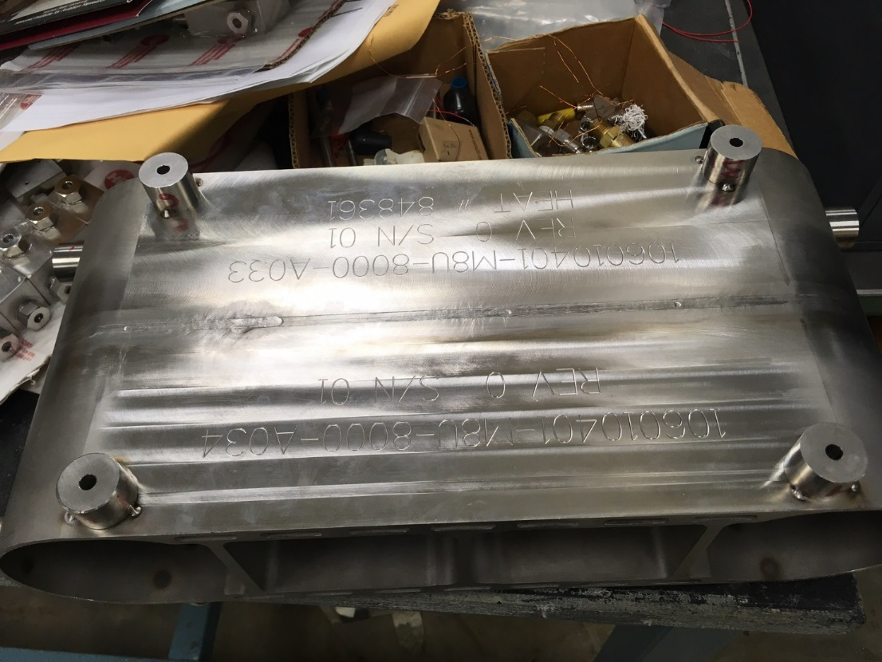
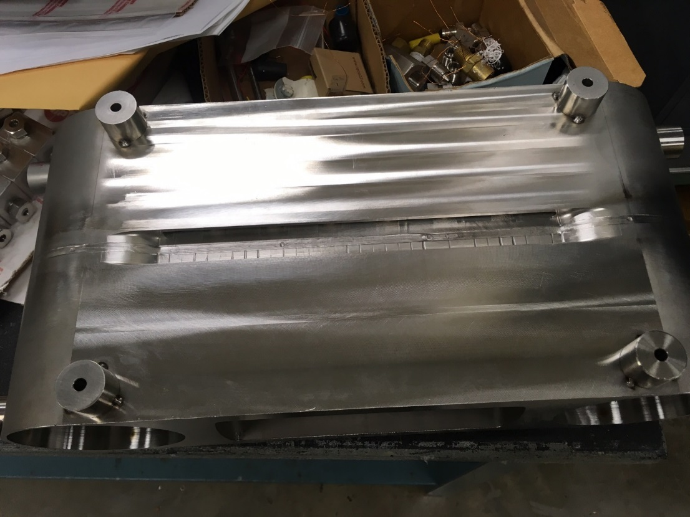
GTAW with Flux

