Slide 1
Fabrication of Major Neutron Source Components
Presented to the SNS Accelerator Advisory Committee
Peter Rosenblad
Manufacturing Team Leader for Source Development and Engineering Group
March 9, 2017

Slide 2
Outline
What are Major Neutron Source Components?
Manufacturing goals, strategies, internal roles
Present and future inventory status
Present challenges
Summary

Slide 3
Major neutron source components?
Perishable Components:
Target Modules
Inflatable seals, leak detectors, instrumentation, bubblers
Proton Beam Windows (PBW)
Inner Reflector Plugs (IRP)
Moderators, shielding, piping, etc.
Cryogenic Moderator System (CMS) components
Non-perishable components (all major spares on hand):
Heat exchanger
Hg transfer valve
Hg pump – will require modification / rebuild to comply with gas injection
New Installations
Gas Injection Components
PPU equipment

Slide 4
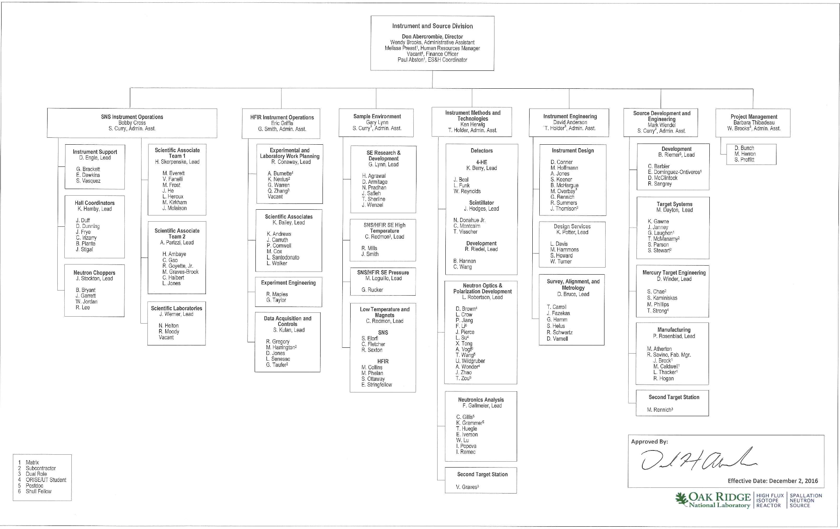
There is now a dedicated manufacturing team within ISD’s Source Design and Engineering Group

Slide 5
Manufacturing team goals are established to support operation and design
Confidence in product
On time delivery
Repeatable, conveyable processes
In depth understanding of manufacturing processes and challenges
Feedback provided to design and manufacturing
Cost control, competition, non-singular supply chain
Traceable (audit strong) processes
Efficient use of budget – planning appropriate spending spread amongst critical components
Successful relationships –more profit for suppliers is good

Slide 6
The present realities surrounding source component manufacturing offer room for improvement
Today:
High visibility
History includes delays and some flawed product
Limited spares (1 target, 1 PBW, 0 IRPs)
Little room to accommodate the unexpected
Future:
Healthy spares, which allows for:
more aggressive design improvement
Manufacturing difficulties without large consequences
Become transparent to management / sponsor
Regain leverage with suppliers

Slide 7
SNS personnel roles are now clearly defined
Design Engineer (DE):
Holds complete design and technical authority over the product configuration
Responsible for all requirement changes
Contributes to process related requirements
Manufacturing Engineer (ME) and Technical Project Officer (TPO):
Fulcrum for success
Contributes to process related requirements
Reviews design requirements for manufacturability
Ensures execution of process and technical requirements
Establishes productive relationship with suppliers
Primary contact between Company and Seller
Tracks and ensures schedule performance
Witnesses and/or performs inspections of product or processes
Quality Assurance Representative
Verifies performance of contractual requirements via audit (data package)
Witnesses and/or performs inspections of product or processes

Slide 8
Target Module inventory has been affected by reactions to end of life events, manufacturing delays, and operational changes
Current operating model calls for 3 scheduled target module changes per year – thus we need to produce 3/year at steady state
Goal is to reach a steady state level of 5 spare target modules, which represents ~1.5+ years of operation
The cycle time for implementing improvements is approximately 2 years - 0.5 for design, 1.5 for manufacturing, and 0.5 for operation and PIE

Slide 9
One spare proton beam window (PBW) is on hand and one is in early procurement stage
New aluminum PBW installed during the recent winter 2016/2017 outage
This PBW will require replacement no sooner than the winter of 2018/2019
Spare Inconel PBW is on hand
An additional aluminum PBW is presently in the solicitation phases of procurement, delivery is expected around January, 2018
Plan is to retain the Inconel window as a spare and continue to install aluminum PBWs

Slide 10
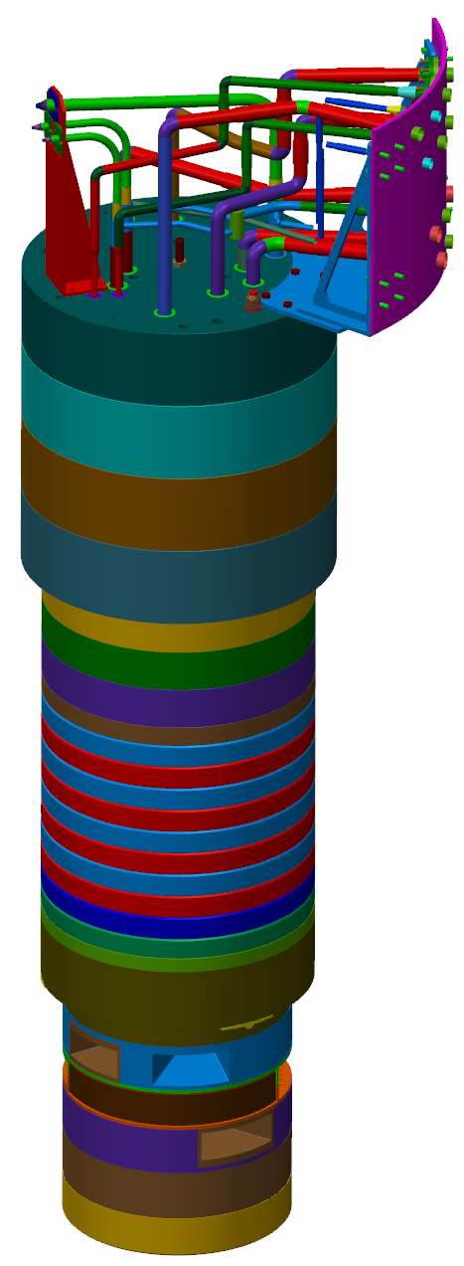
Currently installed IRP is past due for replacement and has a leak – replacement IRP is delayed due to a leak
Lower and intermediate IRP sections were complete and assembled
All piping was installed above Intermediate IRP (water cooled stainless steel shielding)
All three transfer lines were assembled to level above eventual carbon steel shielding (top of IRP)
Upper IRP, carbon steel shielding
Intermediate IRP, stainless steel shielding
Lower IRP, moderators, reflector, and shielding
Status prior to leak
Complete IRP

Slide 11
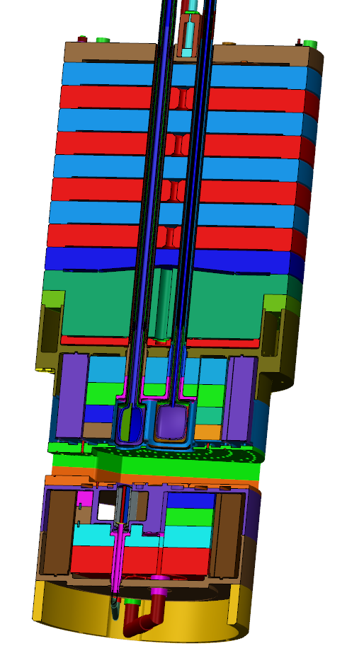
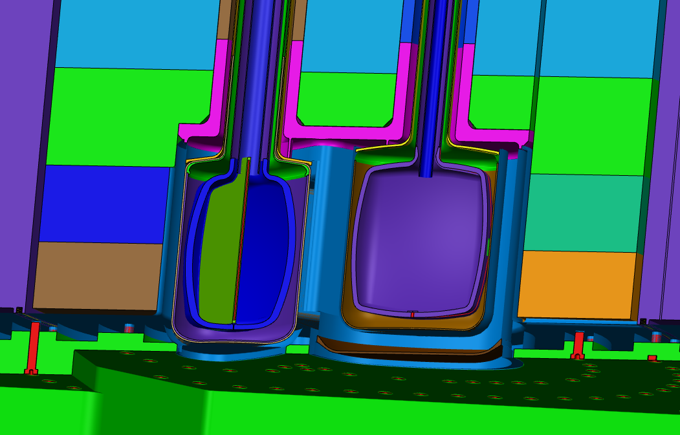
Leak location
Top upstream helium lid
Top upstream moderator
Top downstream moderator
Protons
Target
Cross section through top moderator centers

Slide 12
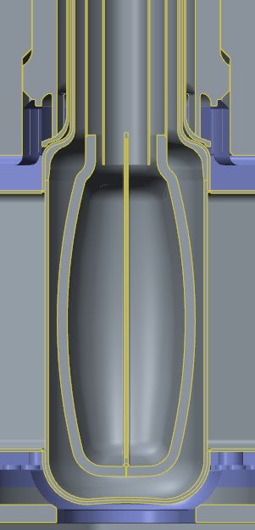
Leak is likely caused by 2 weld induced stresses
Water lid
Water lid weld
Water lid ribs
Small clearance between helium and vacuum lines
Helium lid
2. Helium line piping welds pull up on helium line and lid do to tight clearance in piping
1. Water lid weld shrinkage pushes down on the helium lid locally where rib contacts the top of the helium lid

Slide 13
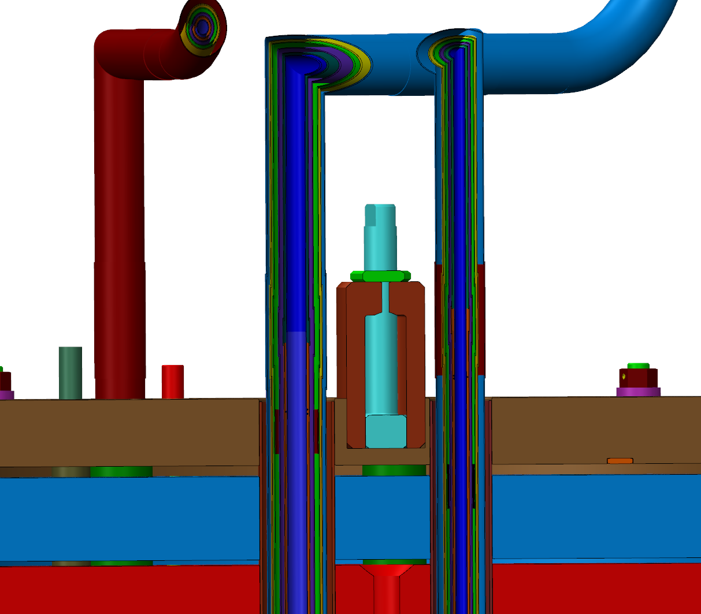
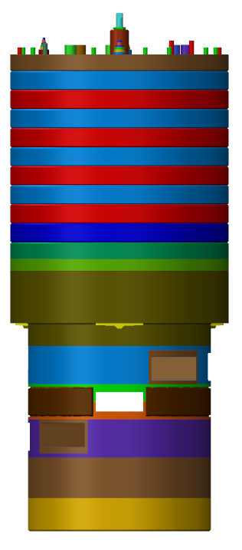
Disassembly step 1, remove 3 upper transfer line spools – completed
Requires cutting 3x6 layers of transfer line spools

Slide 14
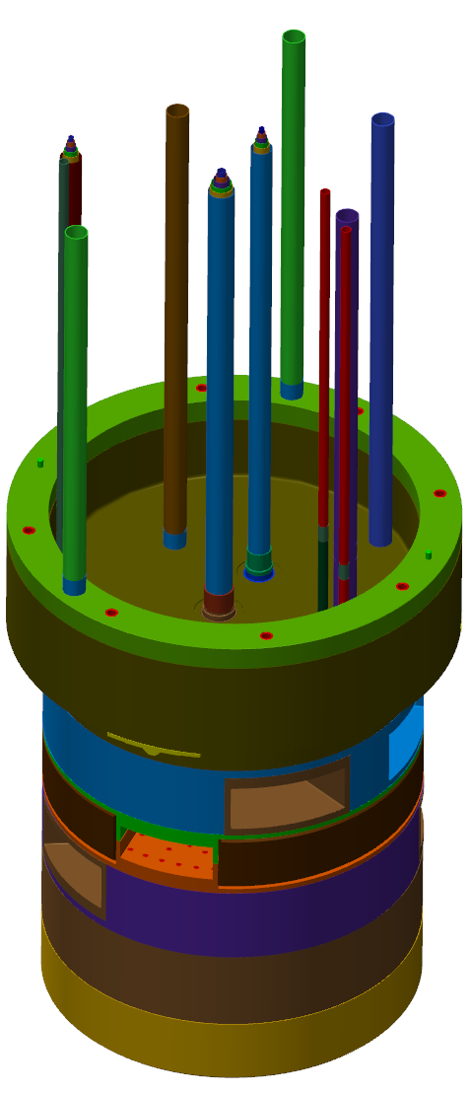
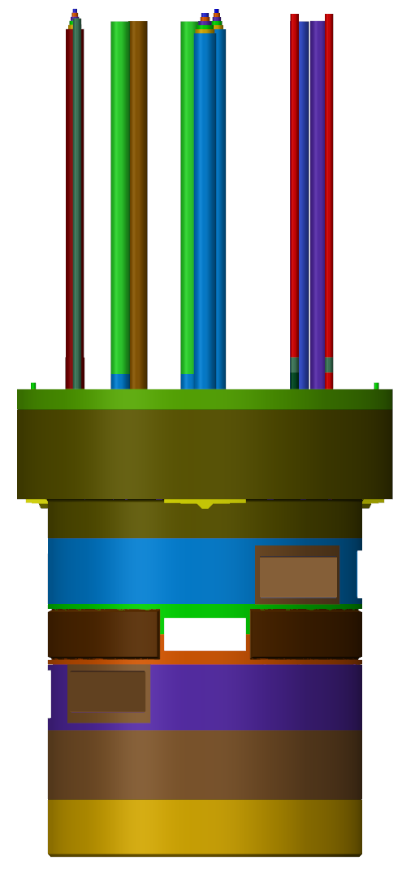
Disassembly step 2, remove intermediate IRP – complete
Leak is in second outermost layer of TUM line (helium layer)

Slide 15
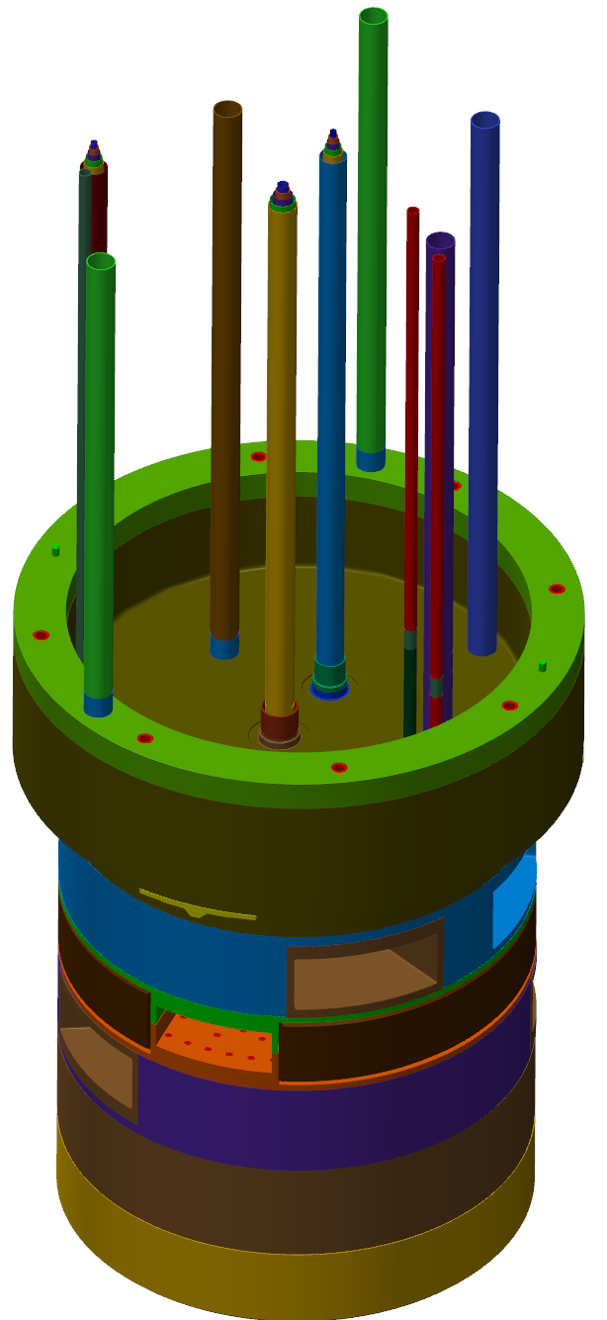
Disassembly step 3, remove piping above lower IRP– complete
Water layer (blue) removed

Slide 16
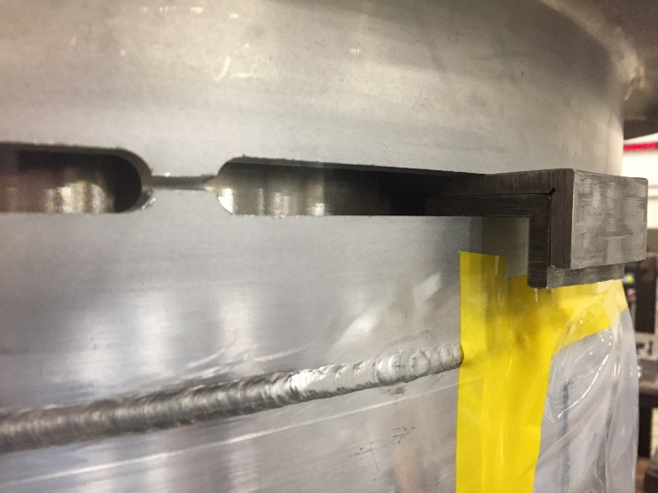
Disassembly step 4, mill circumference of lower IRP and water lid welds to open the structure – complete
Ribs cut by hand grinder
Spacers

Slide 17
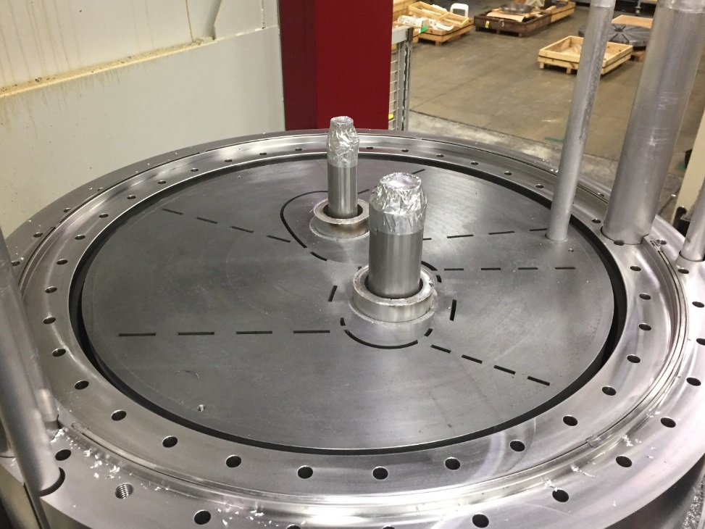
Disassembly step 5, separate lower IRP and remove stainless steel shielding and beryllium reflector – complete
Be ready for removal
Stainless shielding ready for removal

Slide 18
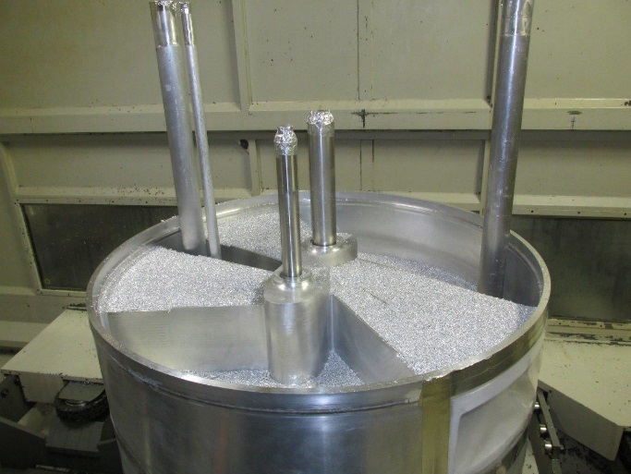
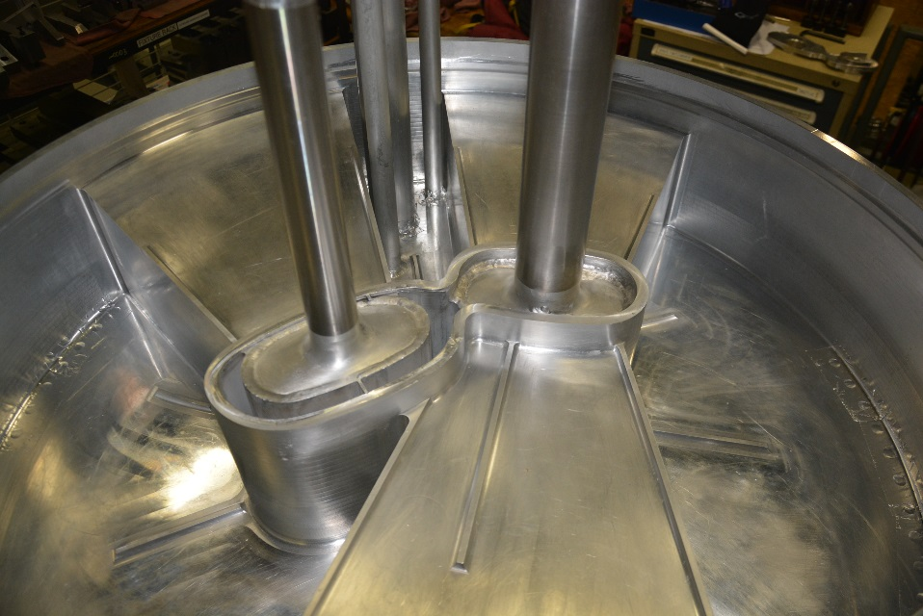
Disassembly step 6, mill away combined water lid in order to access leak location on helium lid – complete
Exposed top upstream helium lid
Milling of combined water lid

Slide 19
Disassembly step 7, remove top upstream moderator helium lid – in progress
The leak in the helium lid was confirmed, but could not be isolated for repair
Removal of leaking lid is risky due to proximity to the vacuum vessel and cadmium coating below
Replacement helium lid is nearly complete, ready for installation

Slide 20
Reassembly steps will follow proven processes with adjustments and risk mitigation based on lessons learned
Install helium lid
Helium lid will be made thicker to lesson thickness disparity and increase leak tightness – this also will reduce any stresses imparted post weld
Re-install Be reflector and stainless shielding – no changes to these components
Re-install lower IRP plenum after refurbishment (spacer added to account for milling during removal)
Install intermediate IRP and piping as done previously
Transfer line piping modified to bring water away from lines before the first 90 degree bends
This eliminates the chance of weld induced axial stress on the helium line

Slide 21
The impact of the leak and recovery operations is significant – present delivery date is August, 2017 – risk mitigation planned on multiple fronts
Fabrication schedule risk mitigation
Fabrication of several parts not necessarily required by repair path
These parts may be repurposed for next IRP if not needed
Pursuing direct ORNL support of fabrication activities
Welding, inspection, leak testing
Design changes for rebuild to reduce / eliminate the understood failure modes
Changing pipe routing configuration
Changing weld joint designs
Increasing thickness of helium lid

Slide 22
The replacement IRP will last until summer 2024 – replaced with 2nd Generation IRP
Lessons learned from recent IRP-1 and IRP-2 leaks will be valuable for design and manufacturing of the 2nd Generation IRP
See J. Janney presentation for detailed changes employed in 2nd generation IRP
Goal is robust design for manufacturing and operations balanced by minimal performance impacts
First 2 IRPs have awful track record with regard to manufacturing schedule – sufficient time is currently available, but there is no spare and history says we must proceed deliberately

Slide 23
Summary
A dedicated team is in place responsible for producing major neutron source components
Personnel roles are clearly defined – feedback between design and manufacturing is well established
Vendor relationships are strong and the selection of vendors is constantly being updated – supply chains are being diversified
Target module inventory is presently low, but a plan is in place to address the issue
IRP supply is high risk for the facility, but current situations provide opportunity
The replacement IRP will benefit from limited lessons learned during its rebuild
The 2nd generation IRP will fully benefit from all lessons learned

