Slide 1
Second Generation IRP Design
Presented to the SNS Accelerator Advisory Committee
Jim Janney
Target Systems Engineer
March 9, 2017

Slide 2
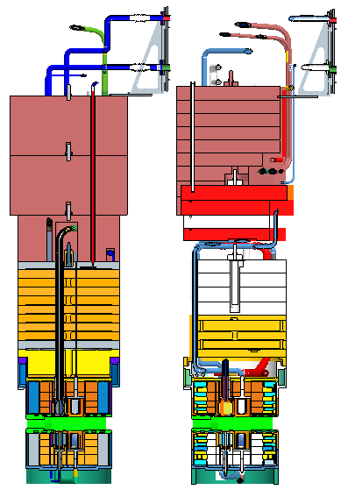
Inner reflector plug overview
The IRP is a 63,000lb plug divided into 3 main segments
Upper IRP – Carbon steel shielding
Middle IRP – Water cooled stainless steel shielding
Lower IRP – Water cooled aluminum vessel filled with steel and beryllium surrounding aluminum ambient and cryogenic moderator vessels
Water piping and cryogenic transfer lines transverse all three assemblies
Spare
Original

Slide 3
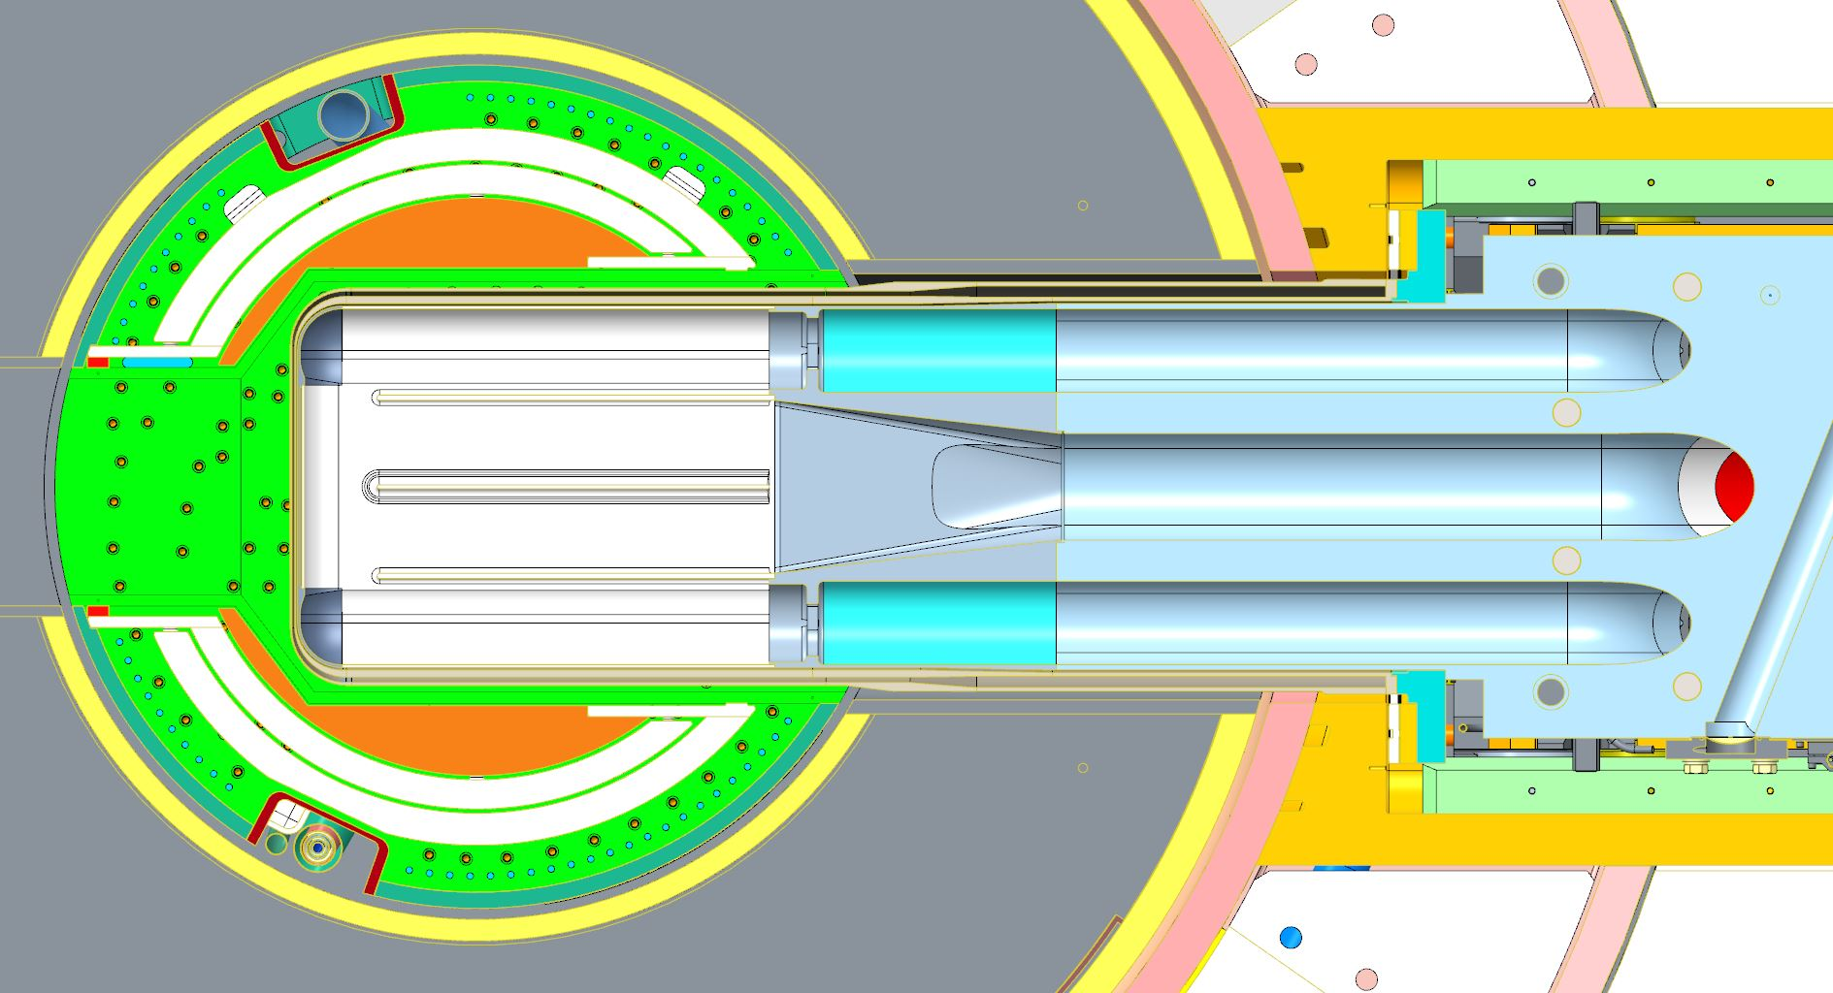
Lower IRP surrounding structures
IRP
Proton Beam
Target Module

Slide 4
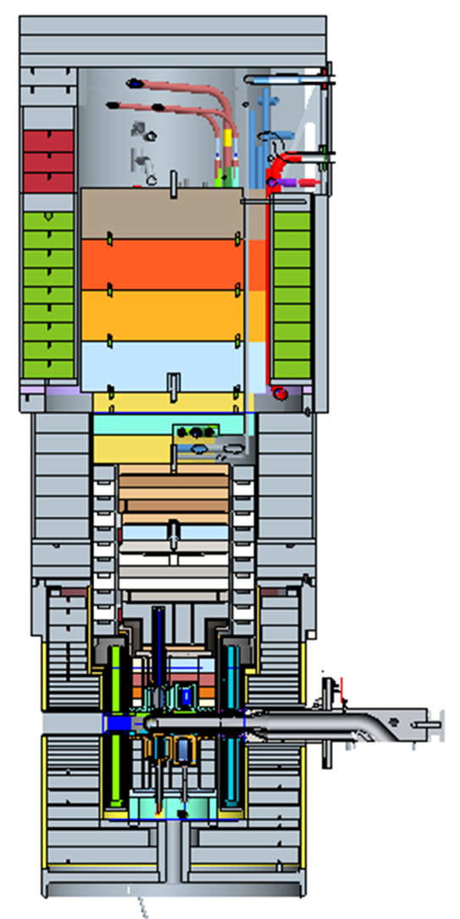
Moderator locations
Top Downstream Coupled H₂
Top Upstream Decoupled H₂
Bottom Upstream Decoupled H₂O
Bottom Downstream Coupled H₂

Slide 5
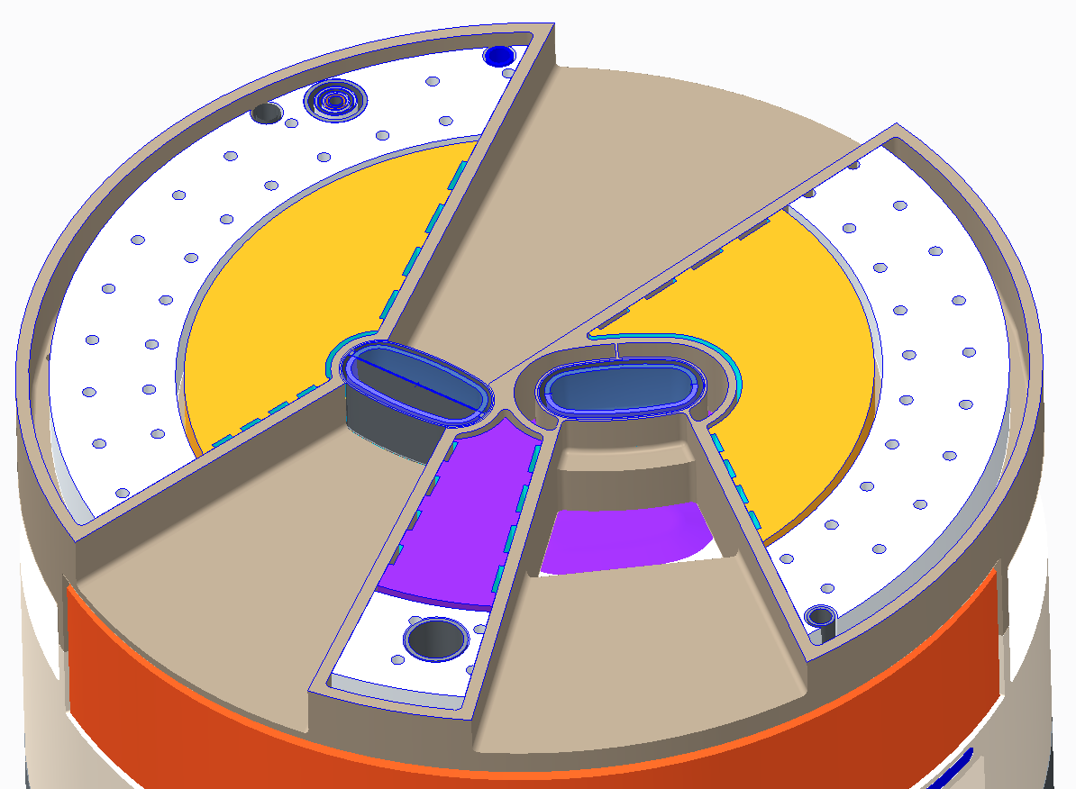
Beamline locations
Cd Coated Beamtube
Beamtube without Cd
Top Downstream Coupled H₂
Top Upstream Decoupled H₂

Slide 6
Goals for second generation IRP
Simplify Manufacturing
Spare IRP Manufacturing has taken over 8 years and counting
Many complicated and difficult to repeat processes
Increase Robustness
Current IRP is leaking in top downstream water to helium boundary
Spare IRP is currently in large rebuild effort due to top upstream helium lid weld failure
Increase Lifetime
Optimize poison/decoupler thicknesses so IRP lifetime is limited by aluminum radiation damage
Maintain Current Physics Design
Keep same moderator, premoderator, and reflector geometries
Decision made not to include larger top downstream moderator

Slide 7
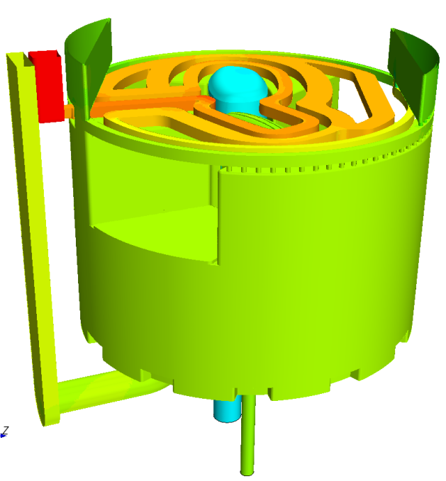
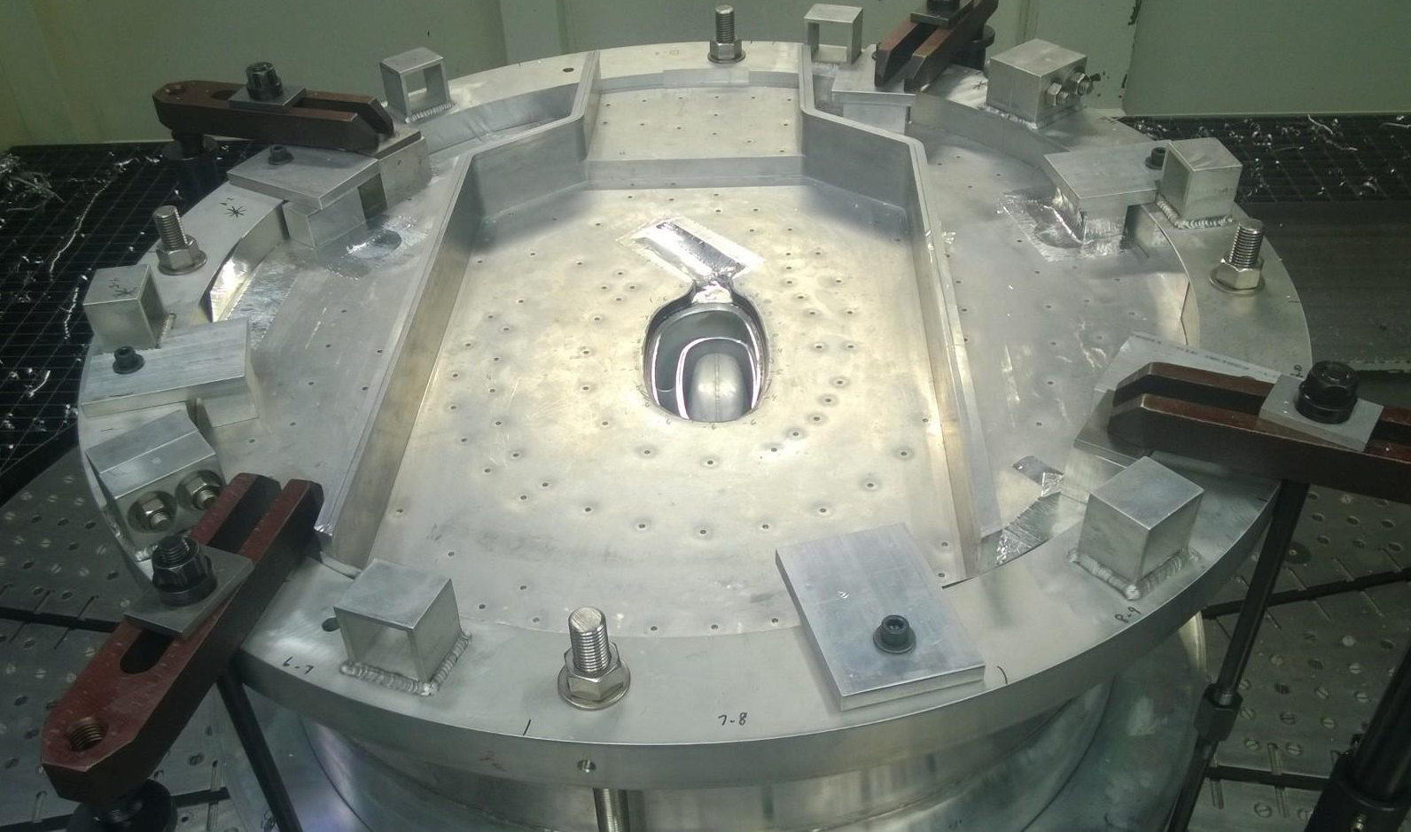
Removal of split plates
Split plates introduce hundreds of aluminum welds
Cooling not needed where aluminum is cooled from at least one side by reflector water flow

Slide 8
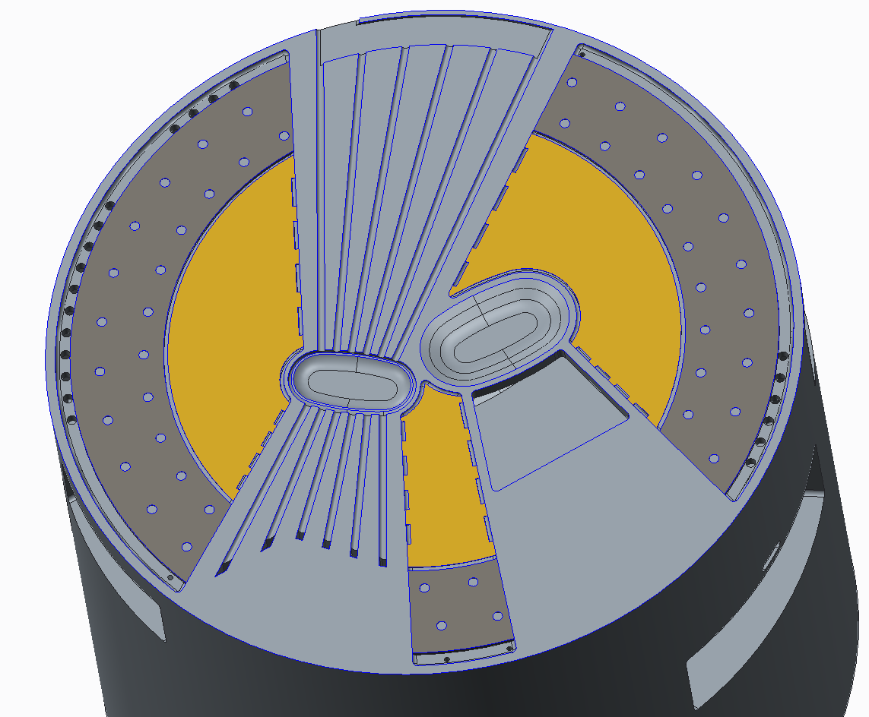
Removal of split plates
Cooling only needed where decoupled (Cd coated) beam ports pass over target port
Accomplish with deep drilled holes from outside
Remove aluminum between coupled beam ports and target port
Advantages
Removes lots of aluminum welding
Stiffens critical structures for aligning target and moderators making it easier to achieve required tolerances
Removes difficult to analyze and inspect structures

Slide 9
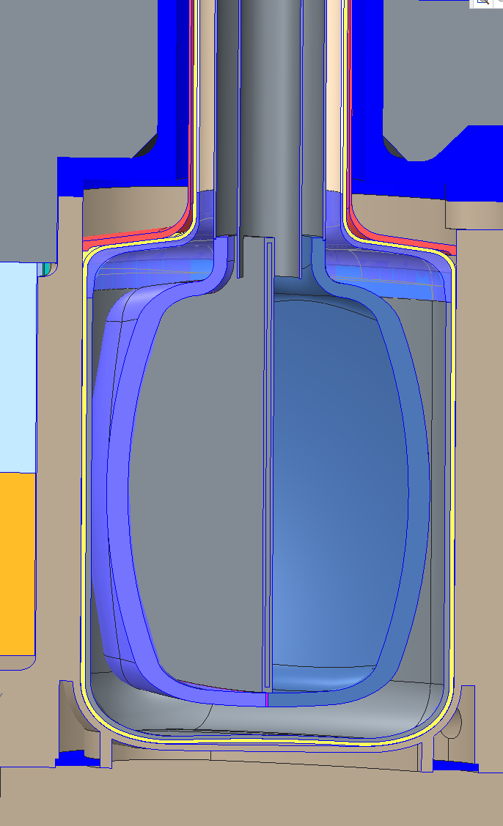
No cadmium applied to TUS vacuum vessel
Cadmium currently sprayed onto TUS vacuum vessel
Requires great fit up between vacuum vessel and surrounding structures for cooling
Risk of damage to vacuum vessel
Instead cadmium will be sprayed onto moderator housing surfaces and helium lid
Maintains Cd thickness and geometry
Requires subsequent Cd machining to achieve fit of vacuum vessel
Less stringent fit up requirement since Cd heat generation does not have to cross fit up gap

Slide 10
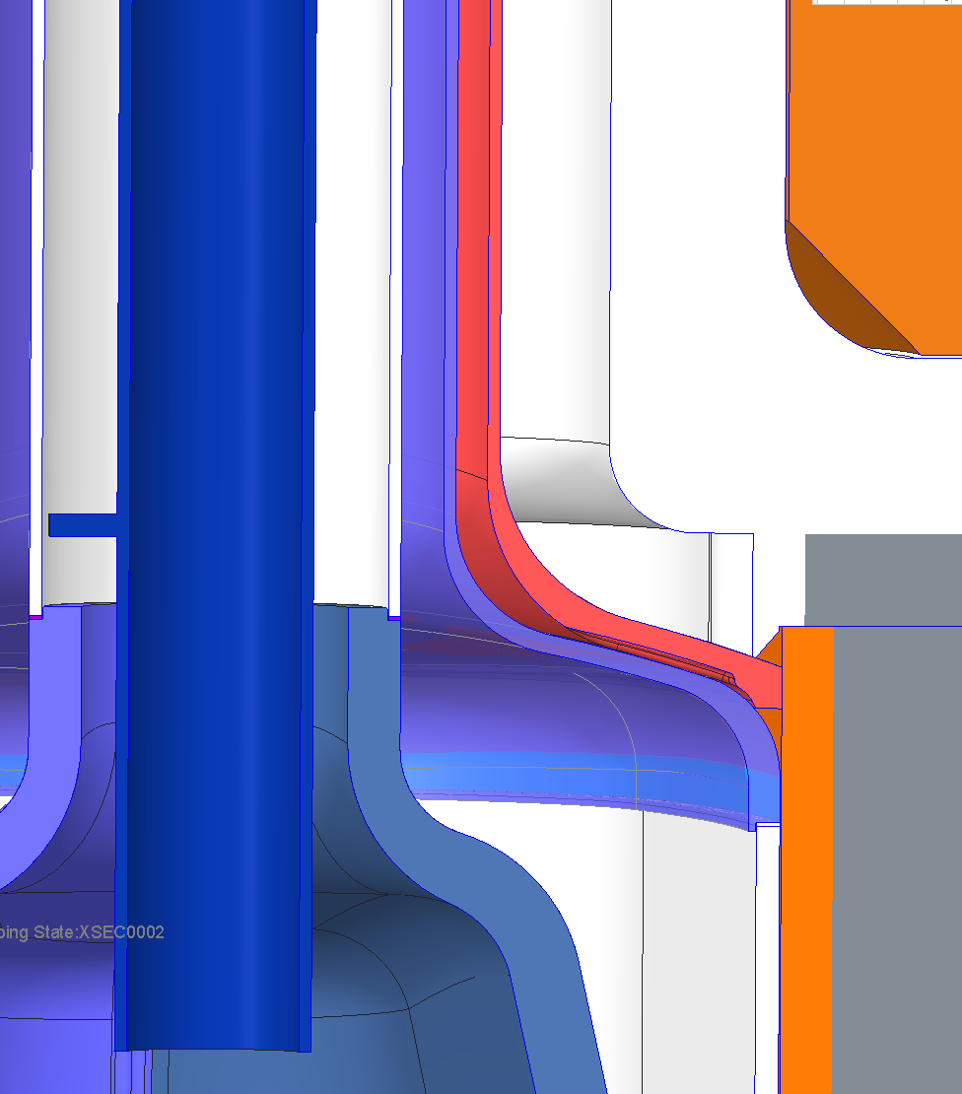
More robust helium lids and lid joints
Helium lids pose significant assembly vulnerabilities as seen in original and spare IRPs
Helium lids can be thickened to increase boundary robustness and make weld joint easier
Weld geometry can be modified for easier access
Considering EB-welding to remove filet welds
Helium Lid Weld Joint

Slide 11
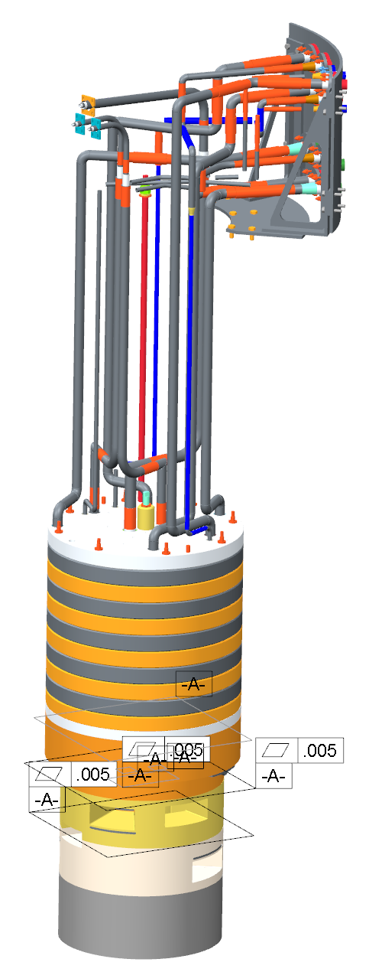
Transfer lines simplified
Transfer line over constraint is suspected cause in spare IRP helium lid leak
Water and helium layers will be branched off from concentric lines just above intermediate IRP instead of at top of IRP
Changes make transfer lines easier to fabricate and reduce possibility of over constraint
Slightly higher heat loads to hydrogen systems

Slide 12
Thickening of gadolinium poison plates
Current IRP life time limited to about 40 GW-Hrs due to Gadolinium burn up
IRP life time can be extended to 50 GW-Hrs by thickening poison plates
Life time cannot be extended further due to radiation damage to aluminum structures closest to target module
Slight neutron production penalty at beginning of life due to thicker poison plate

Slide 13
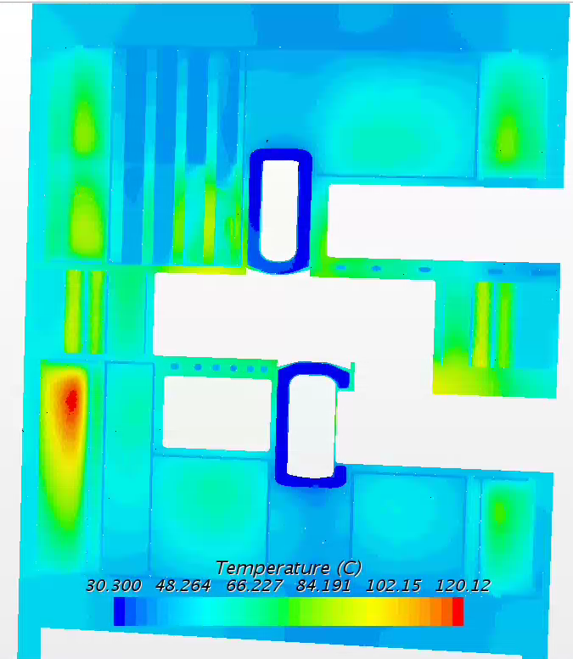
Analysis of design changes is progressing
Structural analysis has verified design changes for pressure and deadweight loadings
Thermal analysis has shown changes are promising, but some modifications to flow distribution baffles have been made to improve cooling
2nd Iteration CFD analysis on ongoing
Thermal stress analysis will be completed once thermal analysis is completed

Slide 14
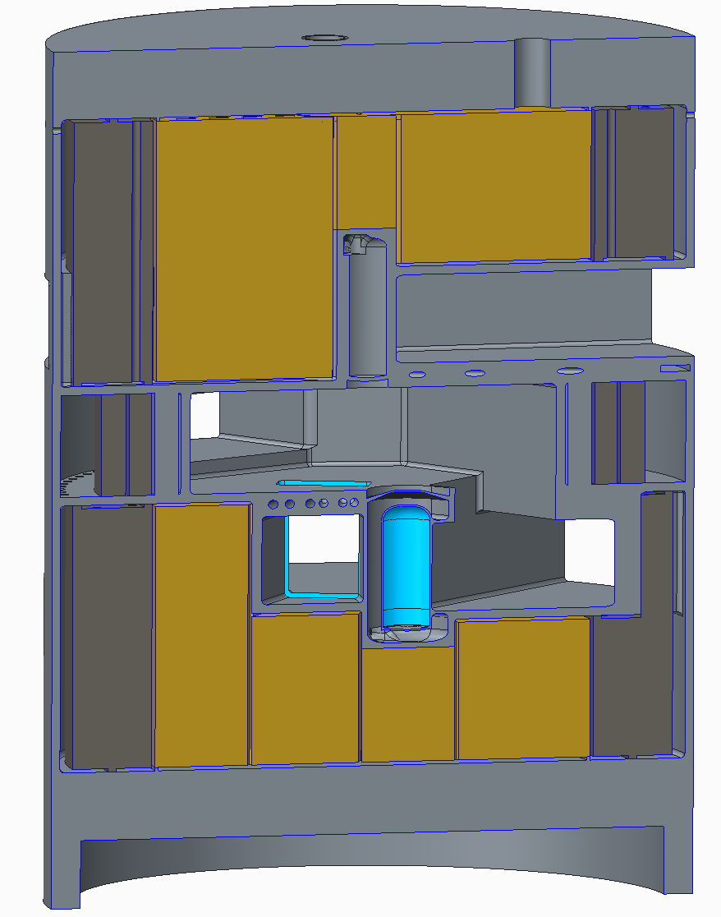
Conclusions
Design for second generation IRP is progressing to simplify manufacturing, make boundaries more robust, and increase lifetime while maintaining the current physics design
Incorporates lessons learned from Original and Spare IRP fabrication and IRP operations
Structural and thermal analysis shows that design changes are feasible but baffle design has been changed to improve flow distribution and analysis is ongoing

