Slide 1
Status of the Accelerator Radio-Frequency Systems
Presented to the
SNS Accelerator Advisory Committee
Mark Champion
Electrical and RF Systems Group Leader
March 09, 2017

Slide 2
Outline
RF system overview
Performance and availability
Events since last meeting
Ongoing developments and plans
Risks and vulnerabilities
Plans for RFQ swap
PPU RF scope
Summary

Slide 3
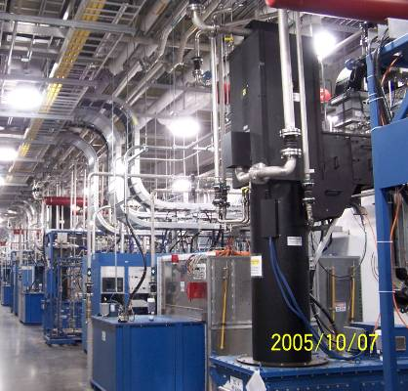
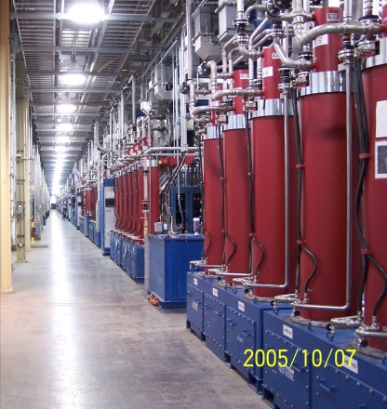
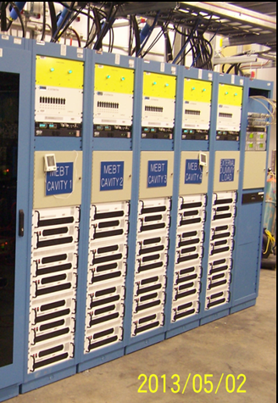
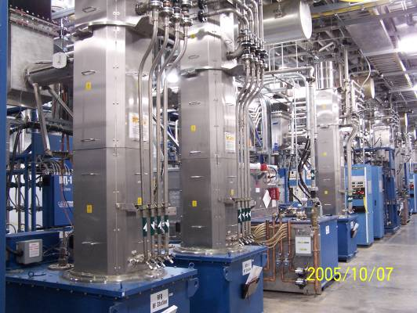
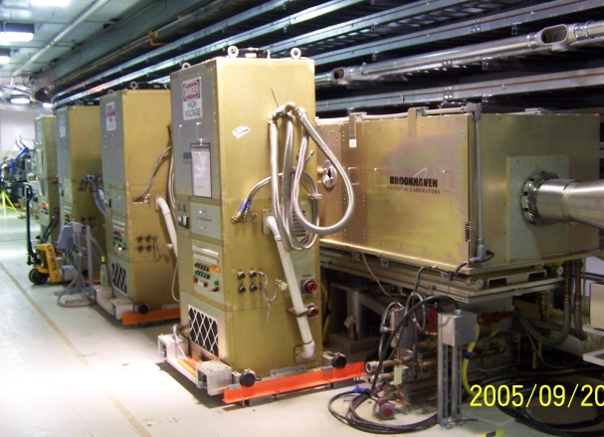
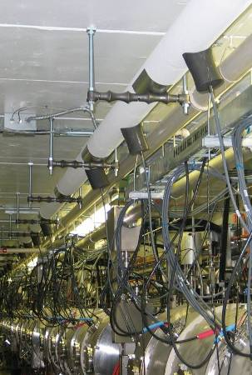
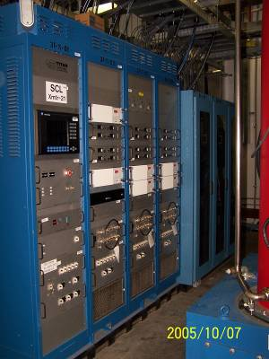
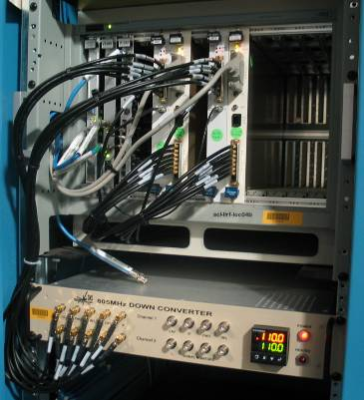
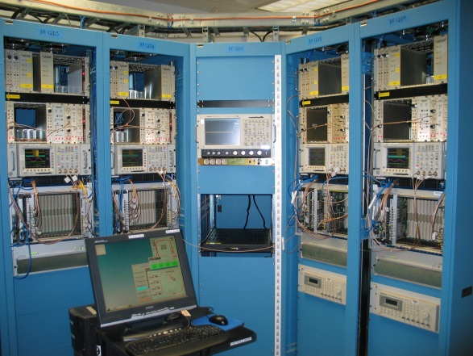
RF System Overview
CCL
SCL
MEBT
RFQ & DTL
100 RF Stations drive the Linac and Accumulator Ring
4 MEBT solid-state amplifiers: 20 kW, 402.5 MHz
7 RFQ-DTL klystrons: 2.5 MW, 402.5 MHz
4 CCL klystrons: 5 MW, 805 MHz
81 SCL klystrons: 550 and 700 kW, 805 MHz
4 Ring tetrode amplifiers: 100 kW, 1 and 2 MHz
Ring
Transmitters
Linac
LLRF
Reference
System
Ring
LLRF

Slide 4
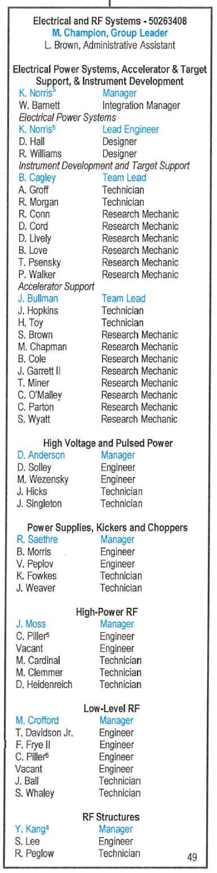
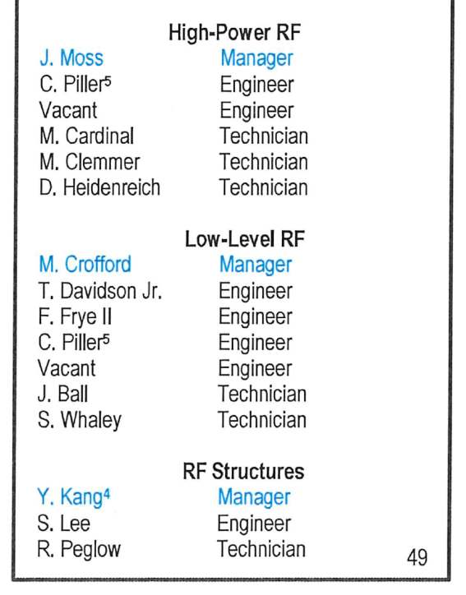
RF team organization modified for increased efficiency
Three RF System managers now report directly to the group leader
Allows greater focus on low-level RF development
Provides for leadership career growth

Slide 5
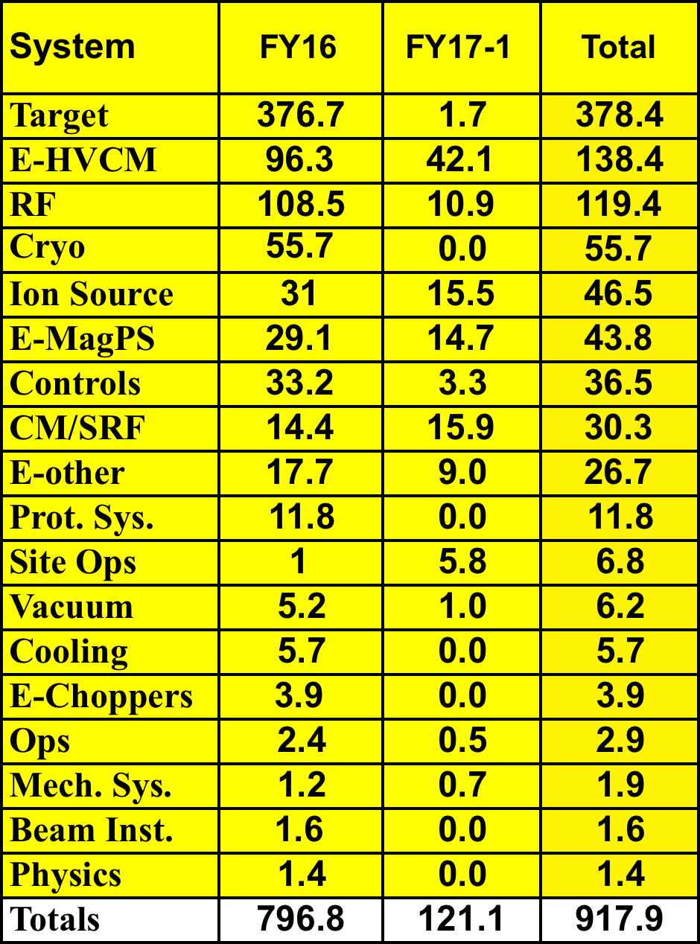
RF downtime accounts for 13% of total downtime in FY16-17

Slide 6
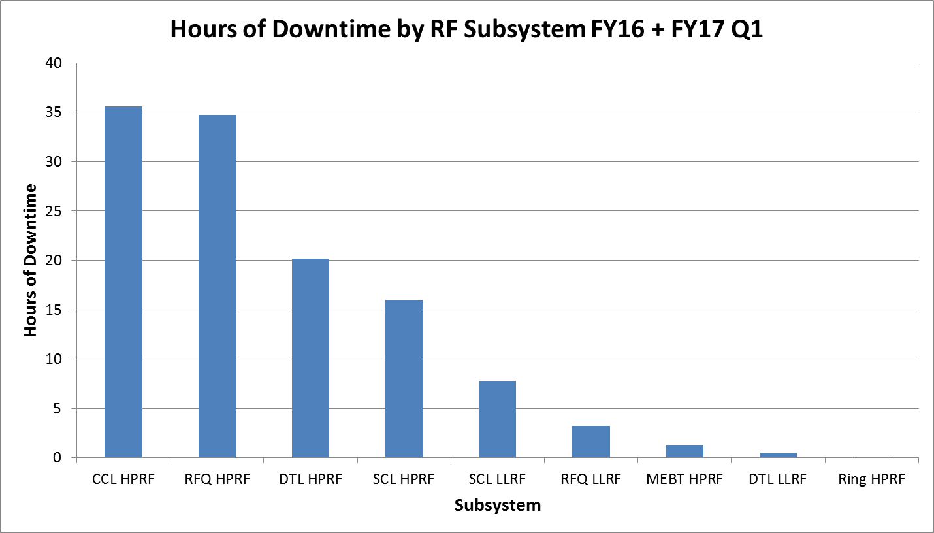
RF downtime is dominated by Linac high-power RF
- Relatively low DTL downtime indicates effectiveness of vacuum upgrade
10.1 hours for RFQ klystron swap
Cavity Vacuum Activity
CCL HPRF: 31 hours
DTL HPRF: 11 hours
6 hours for DTL6 circulator swap
9 faults of duration 2 – 10 hours
21 faults of duration 1 – 2 hours
33 faults of duration 0.5 – 1 hours
157 faults of duration 0 – 0.5 hours

Slide 7
RF System availability is trending up

Slide 8
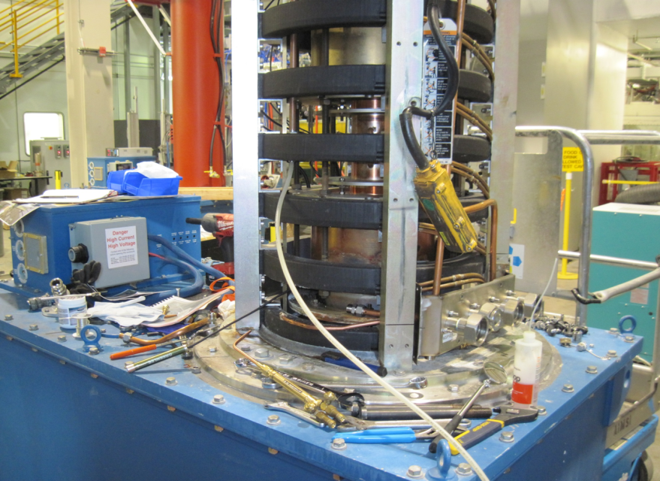
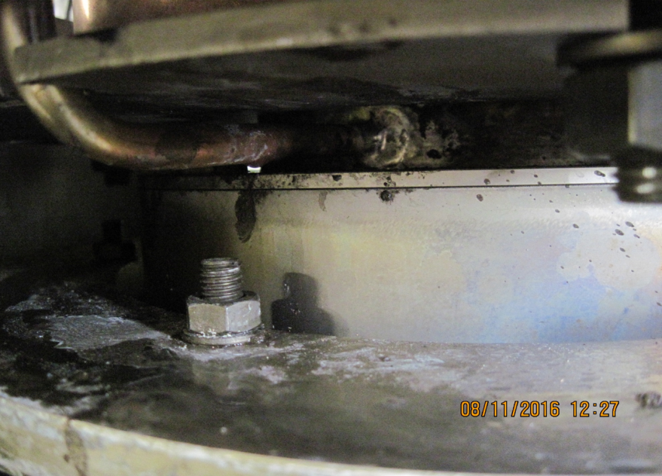
RFQ klystron cooling circuit leak forced klystron swap in February 2016
Water entered the high-voltage oil tank
  installed spare klystron/tank pair
  first installation of Thales 402.5 MHz klystron in Linac
Repair was challenging due to location, but the Accelerator Cooling Systems team successfully executed repairs
Klystron was tested and placed in spares stock
Note: this klystron has never met RF power requirements and can only be used on the RFQ RF station
  Reinstall or keep as spare?

Slide 9
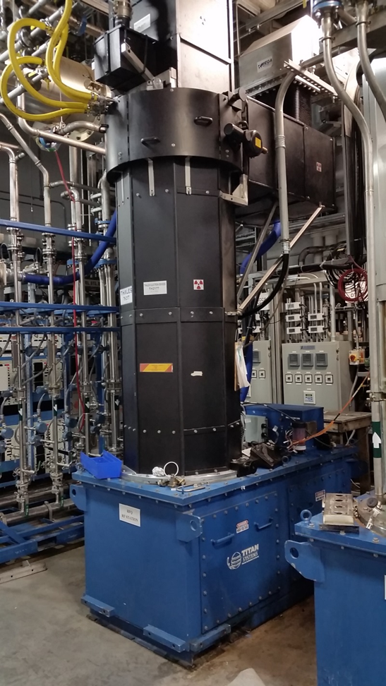
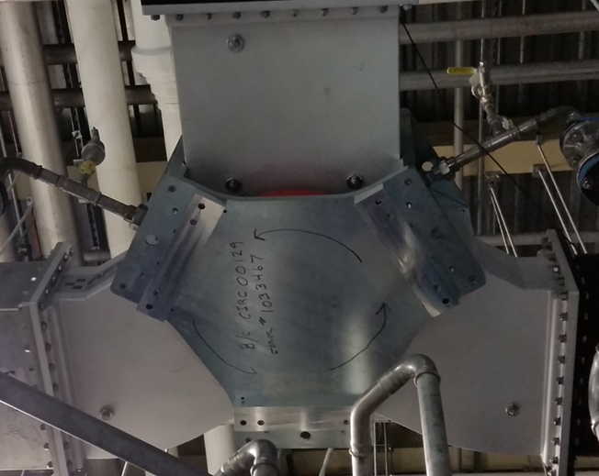
Installed new high-power RF components
New 402.5 MHz, 2.5 MW Thales klystron installed on RFQ in February 2016
This is the first installation of this klystron, which is a plug-compatible replacement for the original E2V klystrons
New 402.5 MHz, 2.5 MW RF circulators installed on RFQ and DTL1

Slide 10
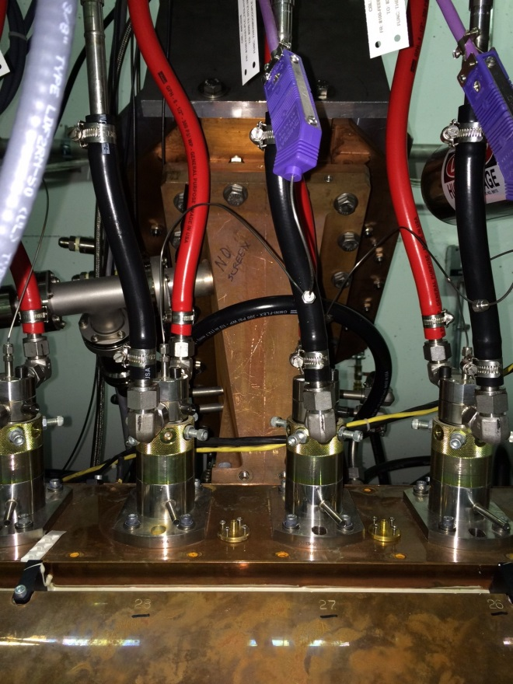
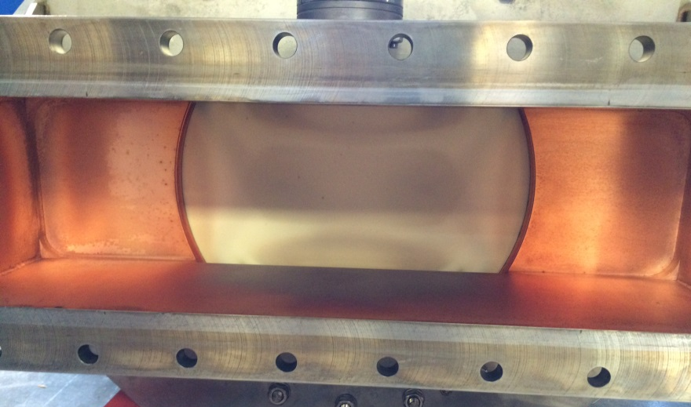
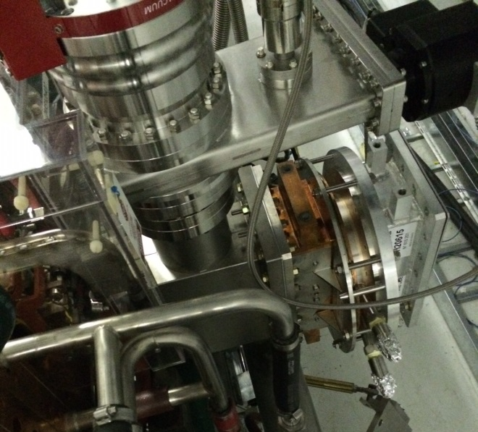
Installed new RF-vacuum windows on DTL2 and CCL4a
Source of heating appears to be metallization of the ceramic
This is not unusual in windows that have seen many years of service
Window longevity is expected to improve due to the DTL vacuum upgrade
Replaced original DTL2 window due to abnormal window heating during operation
Replaced CCL4a window due to excessive outgassing during operation

Slide 11
Developing 2nd vendor for DTL and CCL RF-Vacuum windows
Prototypes delivered and tested with good results
Some challenges
  Vacuum integrity of CCL window flange design (copper gaskets)
  2nd article DTL window failed catastrophically during testing (sign error at vendor)
Vendor’s ceramic source struggling to provide hermetic brazed assemblies
  We’re working with them to identify alternative capable ceramic vendors
All DTL and CCL windows in service were provided by a single vendor
Prices have increased dramatically, procurement cycle is long, and quality does not always meet expectations

Slide 12
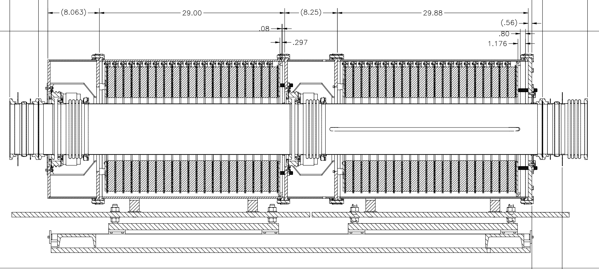
Spare Ring RF cavity vacuum chambers are in production
Four ferrite-loaded double-gap coaxial cavities maintain the beam gap and minimize peak intensity in the accumulator ring
The cavity beam pipe consists of 5 separate sections including ceramic breaks and bellows
Limited spares and the occurrence of a vacuum leak (in 2012) prompted an effort to secure sufficient spares to repair cavities if needed
Parts are now being delivered with all components expected within the next 1-2 months
  At conclusion of procurement we will have 3 spares each of the 5 separate sections

Slide 13
Replacement of RFQ-DTL circulators in progress
Design problem with the original 402.5 MHz circulators manifested in 2014 (water leaks)
  Mitigation included procurement of 4 new circulators with design improvements and development of a repair technique
  2 of 4 new circulators are installed on the RFQ and DTL1 klystrons
  Plan to install another new circulator in DTL during Summer 2017
  Plan to continue procuring new circulators to completely retrofit DTL
  Cost per new circulator: $150k each
  Additional $450k investment needed
Application | Frequency | Peak Power | Vendor | Installed | Spare
RFQ, DTL, BTF and RF Test Facility | 402.5 MHz | 2.5 MW | AFT | 7 + 2 | 2 + 1*
CCL and RF Test Facility | 805 MHz | 5 MW | AFT | 4 + 1 | 6
SCL | 805 MHz | 550-700 kW | AFT | 81 | 3
* in production

Slide 14
No new klystron end-of-life events – stable inventory
Type | Application | Frequency | Peak Power | Vendor | Installed | Spare
Klystron | RFQ, DTL | 402.5 MHz | 2.5 MW | E2V & Thales | 7 + 2 on test stands | 3 + 1 RFQ-only
Klystron | CCL | 805 MHz | 5 MW | Thales | 4 | 4
Klystron | SCL | 805 MHz | 550-700 kW | CPI & Thales | 81 | 45
SCL klystrons 5a and 11b were disconnected from high voltage January 2017 to conserve lifetime (corresponding cavities are inoperable)
Most in-service klystrons have 70-75k filament hours and 65-70k high-voltage hours
Developed new capability to test SCL klystrons on RFTF test stand

Slide 15
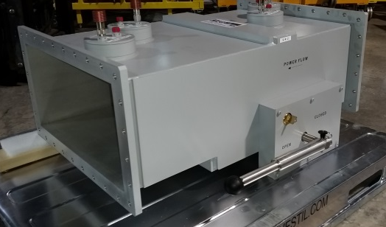
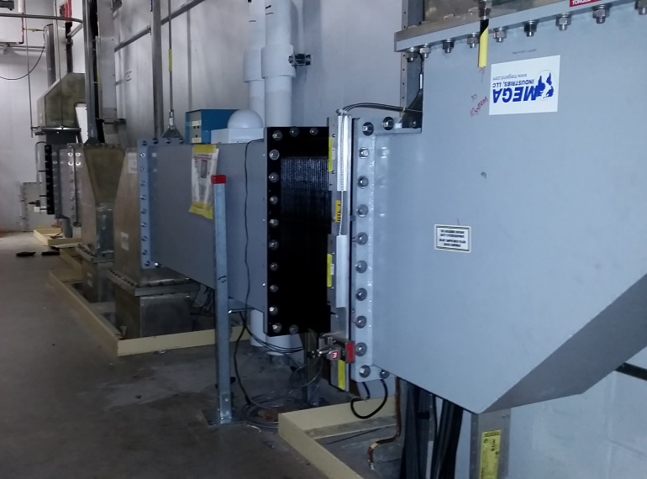
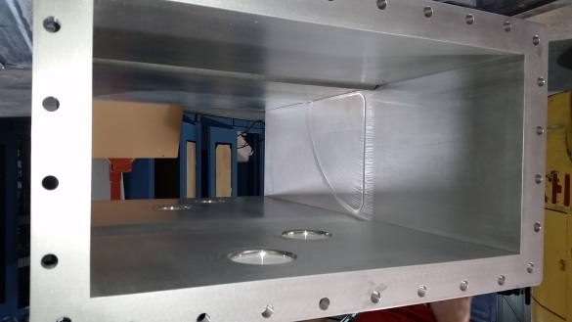
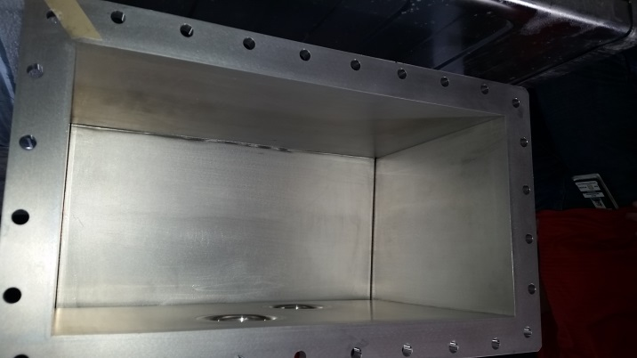
Waveguide switches for DTL1-2 are in house and will be installed during the summer outage
Front-end-only mode during extended maintenance requires manual installation of shorting plates
Upgrade will allow FE-only mode on maintenance days

Slide 16
Risks and Vulnerabilities
Klystron spares
  No recent procurements of 2.5 and 5 MW klystrons for normal-conducting Linac
  Procurement of additional DTL klystrons would essentially be a new development
  Lifetime of DTL and SCL klystrons is unknown (adequate spares?)
RF-Vacuum window spares
  Single vendor for DTL and CCL; prices increasing precipitously
  Alternate vendor development underway – some growing pains
RFQ-DTL circulators
  Risk of additional leaks mitigated through new purchases and rebuild techniques (replacement of a failed unit is time consuming)
Obsolescence prevents fabrication of additional low-level RF spares

Slide 17
Preparing for RFQ swap in early 2018
Status
Spare RFQ is fully tested with beam and meets performance requirements
It is being used daily for beam physics experiments in the Beam Test Facility (BTF)
Accomplishments
Prototype LEBT gate valve has been received and is undergoing testing
Upgraded Ion Source cage has been installed on the ion source test stand
All control cabling required for installation is fabricated and ready to install
Vacuum blanking flanges for transportation are in house
LEBT transport cradles are tested and ready for RFQ swap
All RF waveguide necessary for installation is in house
Procurement of two spare RFQ chillers is in progress

Slide 18
Preparing for RFQ swap in early 2018 (continued)
Plans
Utilize installation delay to engineer and commission an improved RFQ inlet flange
Finalize design of RFQ lifting fixture and transportation dollies
Review 3D model of RF waveguide and technical equipment installation
Test the prototype LEBT gate valve on the ion source test stand to verify vacuum requirements and voltage standoff capability. Following successful testing, procure two production units: one for BTF, the other for the production RFQ.
Disassemble Spare RFQ at Beam Test Facility in late 2017
Disassemble Berkley RFQ at Linac Front End and begin installation of Spare RFQ in early 2018

Slide 19
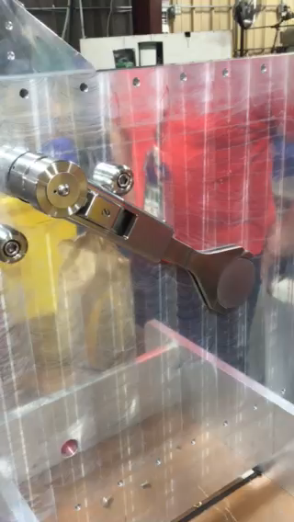
Prototype of LEBT gate valve meets requirements
Courtesy of Tom Roseberry and RAD Vacuum Systems Team

Slide 20
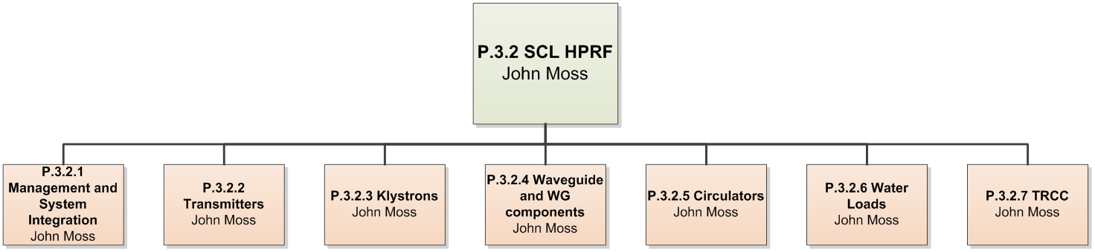
PPU superconducting linac high-power RF systems
PPU RF Scope
Director’s Review
28 (+3) klystrons, transmitters, and RF components
3 high-voltage converter modulators
Racks, cable trays, cabling, electric power, controls,
low-level RF, water cooling, waveguide chases
Upgrade existing HVCMs and water cooling system for increased capacity

Slide 21
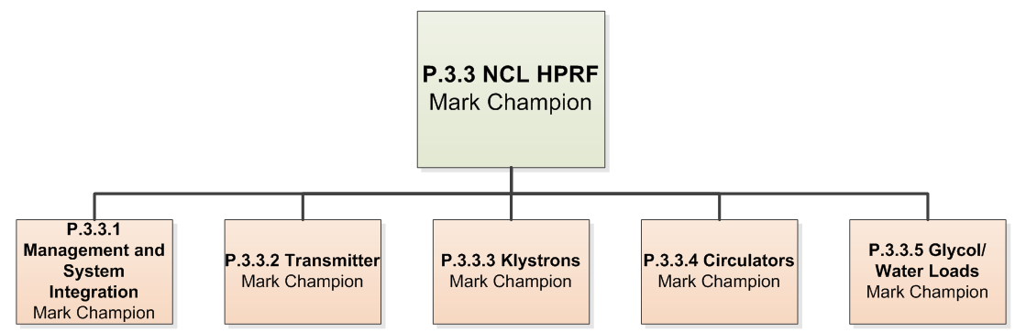
PPU normal conducting linac high-power RF systems
PPU RF Scope
Director’s Review
Upgrade DTL4 and DTL5 klystrons from 2.5 MW to 3.0 MW
  New plug-compatible 3 MW klystrons
  New filament and solenoid power supplies, RF circulator, and RF load
  High voltage converter modulator upgrade
Upgrade associated water cooling system for increased capacity
RF-vacuum windows and iris couplers were removed from project scope in December
  No need due to design basis and
  operational experience

Slide 22
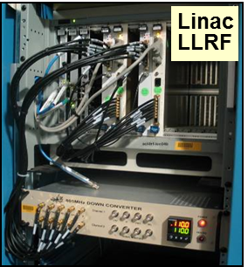
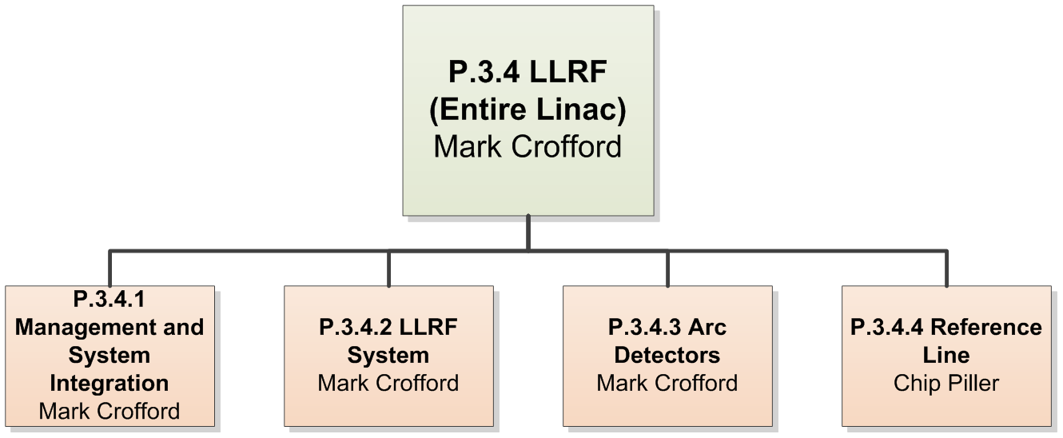
PPU low-level RF systems
PPU RF Scope
Director’s Review
28 Low-level RF systems
  Essential functions: field control and high-power protection
  Addresses obsolescence
  Supports interleaving of FTS and STS beam pulses
  Provides quick-learning adaptive feedforward
  Relies on existing arc detection hardware and reference line
  Existing Linac to be retrofitted with PPU low-level RF system during STS project

Slide 23
Summary
RF system availability is high, trending upward, and meets program needs
Maintenance of critical spares is an ongoing concern
  Klystrons
  RF-Vacuum windows
  RFQ-DTL circulators
Klystron acquisitions will require funding external to group budget
Preparing for RFQ swap next winter
PPU project is being supported with existing staff, but additional support will be needed as the project develops

Slide 24
Backup Slides
Presentation from previous AAC meeting

Slide 25
Status of the Linac Radio Frequency (RF) Systems
John Moss
Lead Engineer, Linac RF
February 17, 2016

Slide 26
Linac RF Systems – Outline
Linac RF Overview
Performance and Availability
Klystrons
High Power Circulators
Low Level Radio Frequency Systems
Equipment Obsolescence
Test Stands
Proton Power Upgrade
Risks and Vulnerabilities
Summary

Slide 27
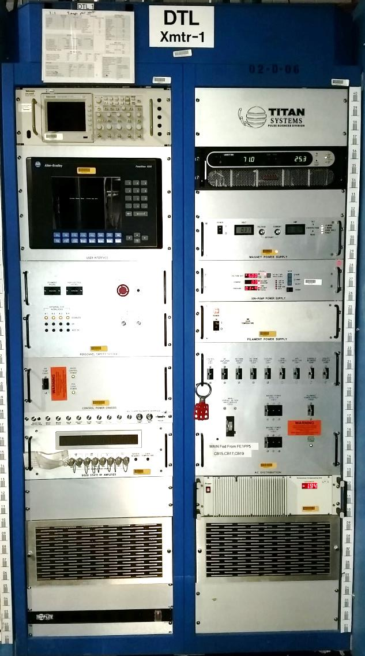
RFQ, DTL and CCL RF Stations
    Operate at 402.5 and 805 MHz
    RFQ and DTL RF Stations:
      150 Watt solid state amplifier
      2.5MW pulsed klystrons
        Nominal Vc is 125 kV
        Nominal Ic is 30 A
      Maximum of three klystrons per Modulator
      Total of seven stations
    CCL RF Stations
      100 Watt solid state amplifier
      5MW pulsed klystrons
        Nominal Vc is 135 kV
        Nominal Ic is 70 A
      Maximum of one klystron per Modulator
      Total of four stations

Slide 28
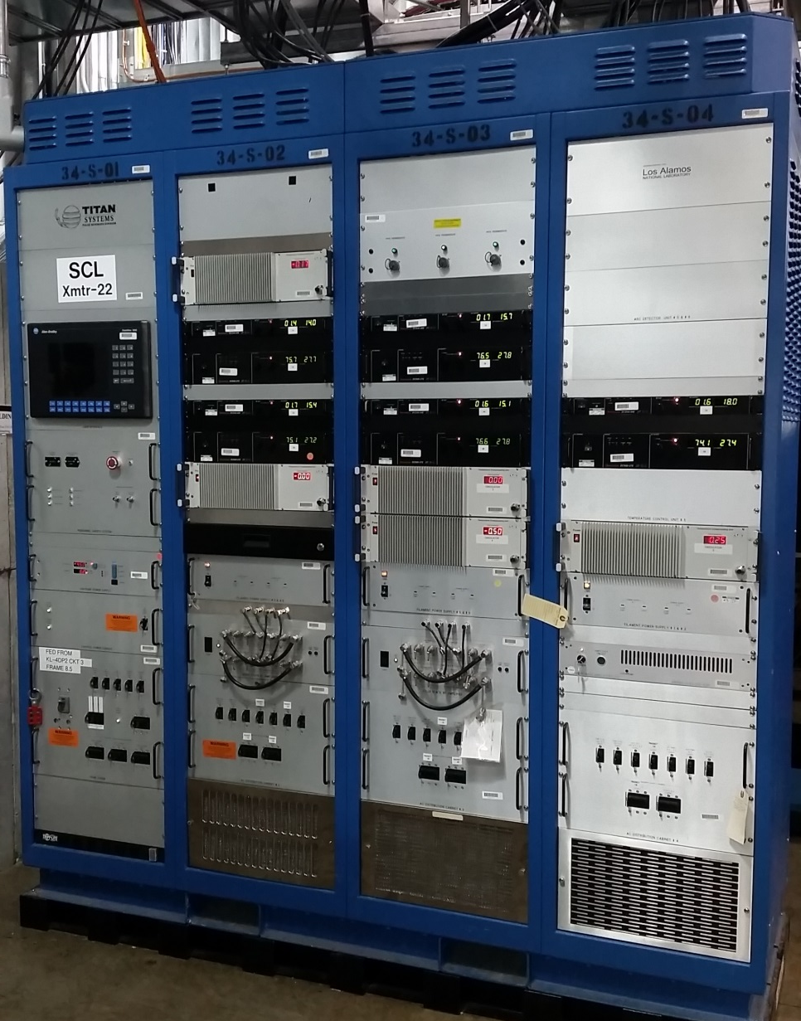
SCL RF Stations
    Operate at 805 MHz
    17 Watt solid state dual amplifier
      One amplifier for two klystrons
    550 and 700 kW pulsed klystrons
      Nominal Vc is 75-80 kV
      Nominal Ic is 9-11 A
    Maximum of 11 klystrons per Modulator
    Total of 81 stations

Slide 29
Linac RF Performance and Availability
May 2013 through December 2015:
  Total Machine operation time – 13,110 hours out of 16,161 requested operation hours for neutron production and accelerator physics
  Total RF system downtime– 413 hours
    Total includes non-beam downtime and cavity vacuum trips
  Major contributors of downtime:
    DTL High Power RF
      28 hours for two DTL6 circulator replacements
      114 hours for DTL5 window replacement and conditioning
    CCL High Power RF
      36 hours for CCL3 klystron replacement
      14 hours for CCL2 klystron replacement
    SCL High Power RF
      20 hours for SCL-1C klystron replacement
  Most trips are in the DTL and CCL and ~ 20 – 30 minutes in duration

Slide 30
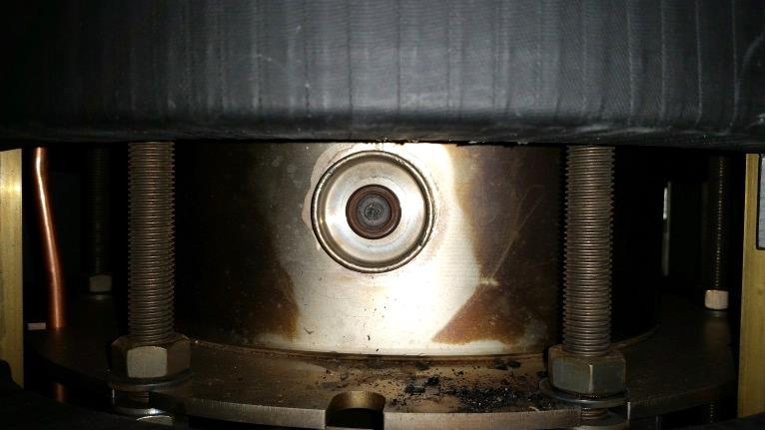
Klystron Failures
From March 2013 to October of 2014 six klystrons were replaced
  Two DTL klystron failures due to the second cavity load.
    DTL -2 March 2013
    DTL-4 July 2013
  Two CCL klystron failures due to the electron gun filament circuit
    CCL-2 May 2014
    CCL-3 October 2014
  One CCL klystron failure due to reduced cathode emission (cathode end of life)
    CCL -4 January 2014
  One SCL klystron failure due to the electron gun filament circuit
    SCL-1C September 2013
Operational management of klystrons is now focused on prolonging tube life
Filament
Anode
Cathode
Picture courtesy of Ed Eisen, CPI

Slide 31
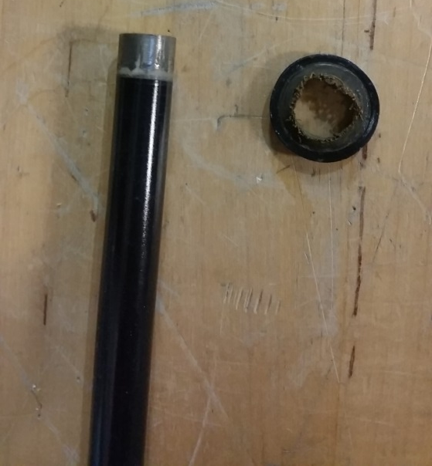
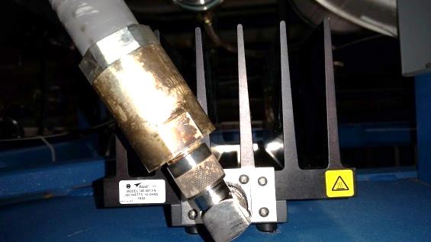
Klystron Management Process
After six klystron failures in 18 months, there have been no failures in 15 months
  Second Cavity Load Failures:
    Speculate that water chemistry is causing contact failure.
      Record load impedance every six months and replace the load when readings are over 50 ohms.
      Results of impedance measurements show a life of approximately three years
      Currently testing an air cooled load on DTL-5
  Record klystron emission data annually
    Look for decreasing emission as an end of life indicator
    Decrease filament current set point in order to achieve full cathode emission at a lower temperature
      Current rule of thumb is one ampere above the filament current at which the cathode is operating at 98 percent emission
    Reduce filament on-off cycles
      Leave filaments warm during maintenance days
      Reduce set point to 50 percent when not operating cathode for more than 24 hours

Slide 32
Use of Klystron Cathode Emission Data
Example Cathode Emission Curve
  Communications and Power Industries, CPI, VKP-8291A, 550kW klystron
  Filament current is approximately 7.8A at the 98% emission point which is the start of the knee
  Using rule of thumb, the new filament current set point is 8.8A
  Emission is still well into space charge limited operating region and operating at 100% output

Slide 33
SCL-1C Klystron Rebuild
SCL klystron 1C failed in September 2013 due to an opened filament
  The klystron had 48,736 operational hours.
  The vendor, CPI, was contacted for an evaluation in early 2014
  The klystron was returned to CPI and their analysis indicated that the cathode filament wire had opened as a result of faulty potting material used to insulate the wire from the cathode body.
  The klystron was repaired for a cost of $147,250 or approximately 90 percent of the cost of a new tube
  The klystron was successfully factory tested in February 2015 and returned to SNS spares last spring

Slide 34
Klystron Inventory
Type | Application | Frequency | Peak Power | Vendor | Installed | Spare
Klystron | RFQ, DTL | 402.5 MHz | 2.5 MW | E2V & Thales | 7+2* | 3 (2**)
Klystron | CCL | 805 MHz | 5 MW | Thales | 4+1* | 3 (2**)
Klystron | SCL | 805 MHz | 550-700 kW | CPI & Thales | 81 | 45
Notes:
E2V discontinued their production and support of the 2.5 MW klystrons; Thales developed a plug-compatible replacement (3 delivered).
Thales is presently assisting with oscillation of one 5 MW klystron.
Of the 45 spare 550-700 kW klystron
12 550 kW Thales klystrons were removed due to oscillations at high voltage
Key:
* Installed on test stand
** Fully site tested

Slide 35
High Power Circulators
Arcing was detected in the DTL-6 circulator on June 16th, 2014
A leak was detected on the bottom pancake of the circulator assembly
A spare circulator was removed from the Radio Frequency Test Facility (RFTF) and installed to allow for continued operations
  No ready spares were available
The manufacturer, Advanced Ferrite Technology, AFT, was contacted for field support and to inquire about the purchase of new spare 402.5 MHz circulators
AFT provided costs for a new circulator at $149,000 per unit. Refurbishment costs are $86,000 per unit with a minimum of three units.
A purchase order for three new circulators was issued for a total of $463,575 and a delivery of May 28, 2015
Inspections of the remaining six 402.5 MHz circulators revealed similar problems with all installed devices
  Evidence of corrosion and possible past water leaks
Inspections of a single CCL circulator and a single SCL circulator revealed no evidence of leaks – Circulator cooling design is different

Slide 36
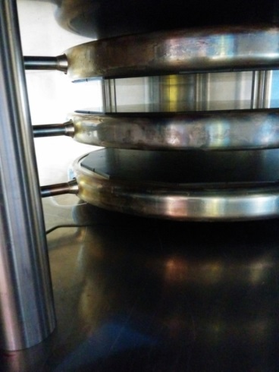
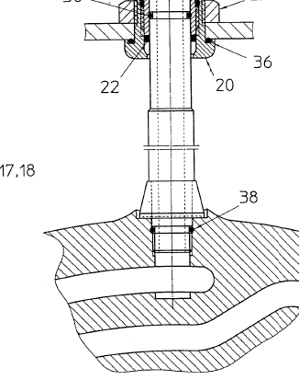
Circulator Repairs
Leaks were attributed to a failed gasket in the connection between the cooling manifold and the pancake cooling channels
AFT sent a field engineer to repair the defective gasket
  The SNS RF structures technician was trained in making the same repair
    Air pad (blood pressure cuff) used to maintain pancake spacing and provide support while piping is decoupled
  Leaks in other locations require the removal and relocation of the circulator to the RFTF
  Takes approximately eight hours to remove and replace a 402.5 MHz 2.5 MW circulator
  Believe that it may be possible to repair gaskets in place

Slide 37
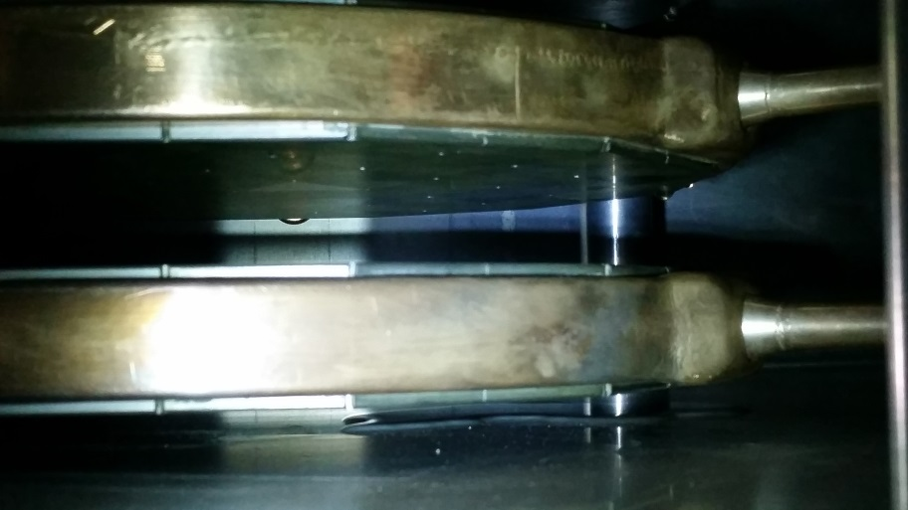
2015 DTL-6 Circulator Cooling Leak
Arcing was detected again in the replacement DTL-6 circulator on November 24, 2015
A leak was detected on the center of the top pancake of the circulator assembly
  Location prevented in-place repair
  Refurbishment required by AFT
A spare circulator was removed from the RFTF and installed to allow for continued operations
  No ready spares were available
New spares arrived onsite approximately one week later
  Original due date was May 2015
Drop
Puddle

Slide 38
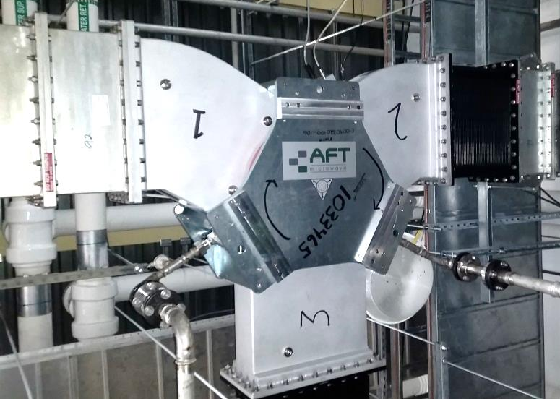
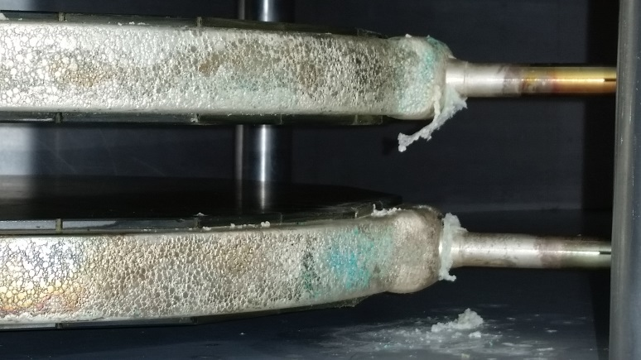
High Power Circulators
New circulator was installed in the RFQ transmitter during the first week of January, 2016
Successfully tested to 1MW in the RFTF
Under power since mid January 2016 and has had no operational problems
Old RFQ circulator gaskets were replaced and it is scheduled to be tested in the RFTF
Two more new high power circulators are scheduled to be tested this winter in the RFTF

Slide 39
Circulator Inventory
Application | Frequency | Peak Power | Vendor | Installed | Spare
RFQ, DTL / Test Facility | 402.5 MHz | 2.5 MW | AFT | 7+2 | 3 (1*)
CCL / Test Facility | 805 MHz | 5 MW | AFT | 4 + 1 | 6 (1*)
SCL | 805 MHz | 550-700 kW | AFT | 81 | 3
There is one 805 MHz 550 kW circulator manufactured by The Ferrite Company purchased for testing
Key:
* Inoperative

Slide 40
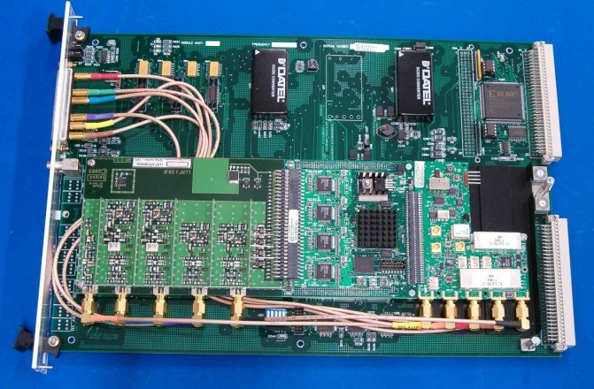
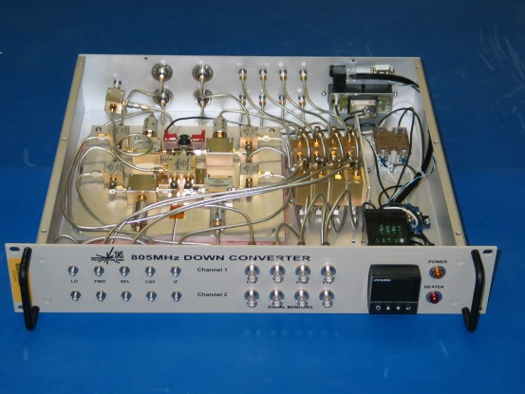
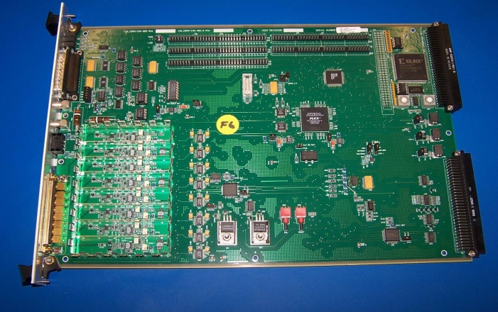
SNS Low-Level RF Systems
Linac LLRF – 402.5 & 805 MHz
  Field Control Module (FCM)
  High-power Protection Module (HPM)
  Down Converter
The system continues to operate within specification
Improvements and features added over time to enhance operations
  Voltage droop compensation
  Fill time ramp for multipacting reduction
  Sequencer logic improvements to minimize operator errors
  AFF forget time changes to lower beam loss during beam restoration after trips
FCM
Down converter
HPM

Slide 41
LLRF Issues & Obsolescence
10 years of successful operation but some failures are starting to manifest
  Majority of failures have been limited to the RF output module of the field control module
System has several obsolete components including the FPGAs
  Adequate spares are available
  Redesign of the LLRF system is underway
    Will be needed to support the Second Target Station
    More and deeper history buffers
    Improved time resolution and triggering functions
    Additional hardware inputs
  Redesign of the high-power protection module is underway and the prototype test board has been utilized to verify the VXI interface and ADC functionality

Slide 42
Transmitter Obsolescence
Transmitter equipment is over ten years old
  Several components are no longer manufactured or losing manufacture support in the next two to three years:
    E2V 2.5 MW klystrons
    Personnel Safety System PCBs (Titan – L3)
    Dual magnet power supplies (SCL system)
    Temperature Transmitters
    Operator Interface, Allen Bradley PanelView 1000

Slide 43
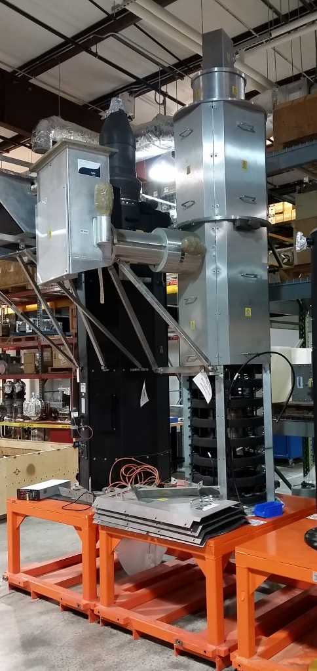
Equipment Upgrades
E2V 2.5 MW klystrons
  Thales has provided three 2.5MW klystrons
  Engaged both CPI and Thales on feasibility of a 3 MW replacement
    Operate at 130kV, 42.2A
    Fit same physical dimensions as existing 2.5 MW tubes
    Supports STS
Personnel Safety System PCBs
  Engaged L3 to produce spares
  LLRF team currently estimating the effort necessary to redesign
    Outside vendor Sierra Circuits to estimate cost per board

Slide 44
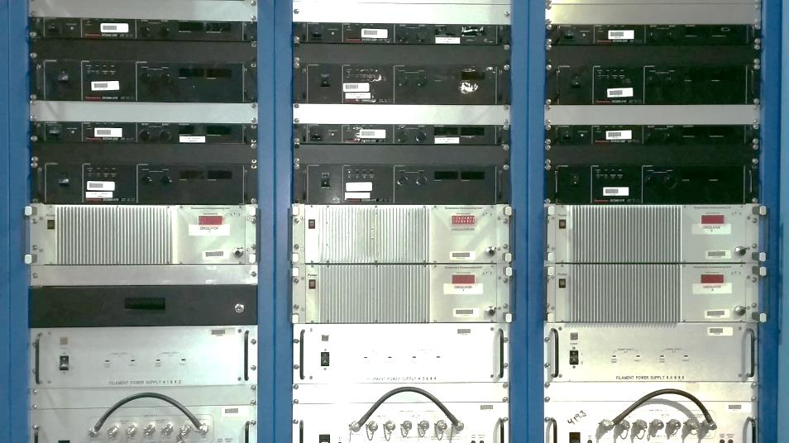
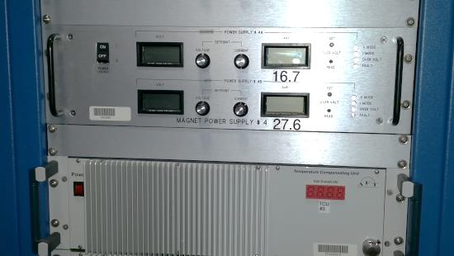
Equipment Obsolescence
Dual magnet power supplies (SCL transmitters)
  Ametek now provides two supplies that fit in the same rack space of the old supply
  Off-the-shelf supply
Temperature Transmitters
  Using Rosemount 3144P as replacement for 3244MV
  Still have 3244MV spares
Transmitter Operator Interface
  Reclaiming old Allen Bradley PanelView 1000 from HVCM team for spares
  Outside vendor fixing communication board issues
  Working on integration of PanelView 1250

Slide 45
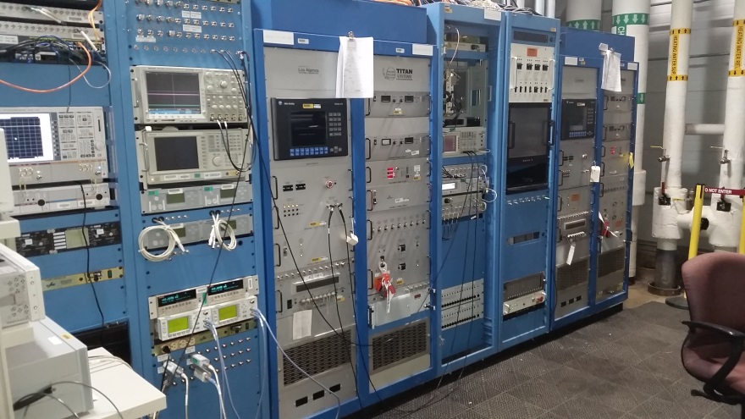
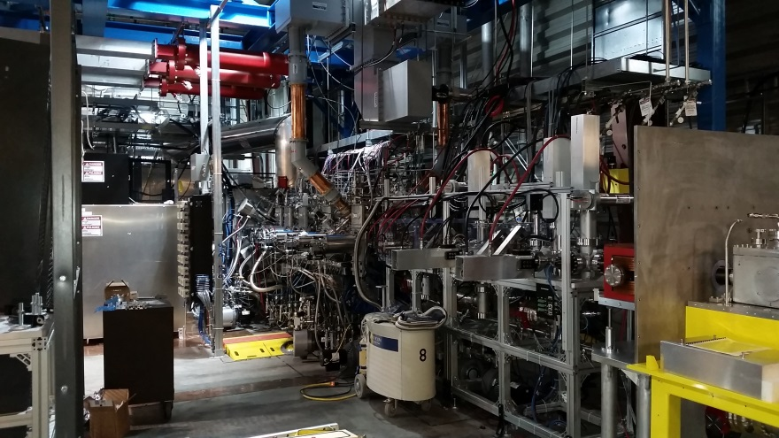
Test Stands
Two main test stands
  Radio Frequency Test Facility (RFTF)
    One 402.5 and one 805 MHz transmitter
    Testing of klystrons, RF waveguide components and structures such as couplers and windows
    Occasional transmitter chassis and component testing
  Integrated Test Stand Facility (ITSF)
    RF Testing and conditioning of spare RFQ
      Planning underway now to replace the operational RFQ in winter 2016-2017
    Includes ion source, MEBT and beam dump
    Beam testing this year to validate RFQ performance

Slide 46
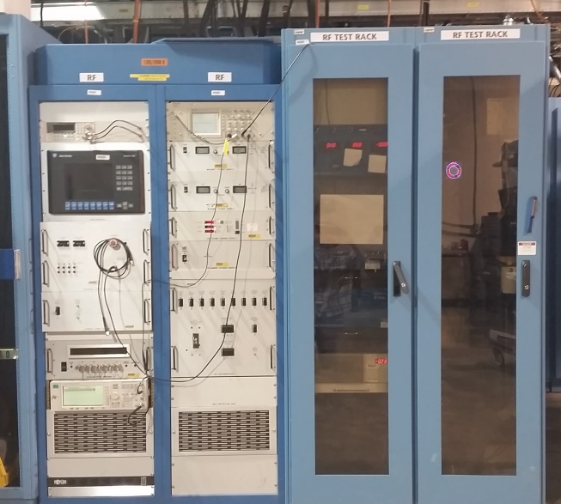
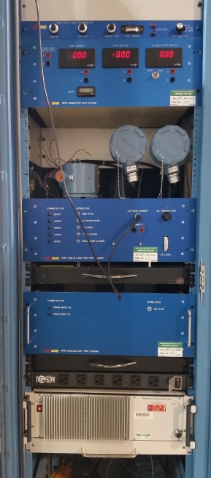
Offline Transmitter Test Stands provide new testing capabilities
Two test systems for transmitters that are decoupled from the Linac, RFTF and ITSF
  Normal Conducting
    Operates like a normal conducting DTL or CCL into resistive loads
    Testing of ALL transmitter components
      Individual Chassis
      PCBs
      Flow transmitters
      Everything outside of the klystron and HV tank
      Test Chassis for diagnostics and monitoring
  Super Conducting
    Under construction
    Test Chassis under design

Slide 47
Proton Power Upgrade – 1.3 GeV
7 Cryomodules:
CM25
CM27
CM28
CM29
CM30
CM31
CM32
5 HPRF Transmitters:
5 Transmitter Racks
10 HV (3-hole) Tanks
5 Transmitter Cooling Carts
28 LLRF Systems
28 Klystrons
28 Circulators
28 Water Loads
28 Waveguide Runs
112 Directional Couplers
14 Chase Inserts
3 High Voltage Modulators:
3 Utility Transformers
3 SCR Cabinets
3 Control Racks
3 Modulators (HVCMs)
First two HVCMs:
  9 klystrons each
Third HVCM:
  10 klystrons
Supporting Infrastructure:
AC Power Distribution
Cable Routing
Water Systems
Marshalling Panels

Slide 48
Risks and Vulnerabilities
Klystrons are aging and most have exceeded specified life of 50,000 operational hours
  Need to continue to engage vendors and purchase replacement klystrons, especially for the 2.5 MW and 5 MW systems
    Not enough spare klystrons for full replacement
Failure of high power circulators
  Evidence of leaks on RFQ and all DTL stations
  While no leaks were discovered in the CCL and SCL, only two circulators were inspected
    Waveguide installation makes inspections difficult
  Need to continue to engage with AFT and purchase more spares for all systems
    Consider an alternate vendor such as The Ferrite Company or MEGA industries

Slide 49
Summary
Klystron operational management is focused on promoting long tube life
  Operational klystrons are aging. Engaging vendors and acquiring additional spares remains a high priority
High power waveguide circulators still pose a significant operational risk
  New spares are on location and there is onsite repair gasket available
Equipment obsolescence is being mitigated on a continuous basis
  Some solutions are already in place, i.e. SCL magnet power supplies
Development of testing ability has greatly improved troubleshooting and in house repair capabilities
RF systems are exceeding operational requirements for the SNS accelerator

