Slide 1
Implementing Gas Injection at SNS:
Short and Long Term
Presented to the
SNS Accelerator Advisory Committee
Bernie Riemer
ISD Development Lead
PPU FTS Systems Lead
March 9, 2017

Slide 2
Outline
Gas Injection Conceptual Design Report
Recent target lifetimes review
Prospects for fatigue and erosion mitigation
Review of recommendations AAC 2016
Short term gas injection
  Gas Injection Initial Implementation (GI3)
Long term gas injection
  Proton Power Upgrade (PPU) project

Slide 3
Gas injection Conceptual Design Report was issued last summer
Establishes comprehensive plan for short- and long-term SNS target gas injection

Slide 4
Recent target experience suggest fabrication and design improvements have been effective
Cavitation erosion was cause of last two leaks
Nevertheless, both erosion and fatigue remain vulnerabilities for reliable target operation as average power increases
Small gas bubble injection will mitigate the pressure waves that lead to these vulnerabilities
D. McClintock
Target | MW-h | P_{ave} [kW] | Removal Date | Reason for Removal
T-8 | 3750 | 851 | Oct-13 | Admin
T-9 | 4195 | 1033 | Jul-14 | Admin
T-10 | 601 | 1052 | Sep-14 | Weld: Top Front Body to Transition Leak
T-11 | 167 | 1116 | Nov-14 | Weld: Trap CP Leak
T-12 | 4460 | 964 | Oct-15 | Erosion: Nose Leak
T-13 | 2589 | 1075 | Mar-16 | Erosion: Nose Leak
T-14 | 2762 | 968 | Oct-16 | Admin
T-15 | 1667 | 1133 | Dec-16 | Admin

Slide 5
Target pulse fatigue life* vs. power is non-linear
FE-SAFE analysis, jet-flow design
S. Kaminskas
*fatigue life: onset of fatigue damage
8 – Inner Window
7 – Front Upper Rib
6 – Side Baffle Base
5 – Center Baffle Base
4 – Front Lower Rib Channel
3 – Center Baffle Front Lower
2 – Front Lower Rib
1 – Center Baffle Front Upper
8
2.00 MW
7
5
6
4
3
2
1.4 MW power
1
0.85 MW
~10 days
~3.5 months
~7 months
S-N curve – “316 Stainless Steel” from Fe-Safe DB
Notes:
Weld fatigue life will be less than base material.
This analysis is for base material.
It does not account for effects of mercury, radiation, or synergistic effects of cavitation erosion and fatigue.

Slide 6
Small gas bubbles will improve fatigue life
A reduction of pulse stress of is equivalent to reducing power
A 20% reduction in pulse stress by small gas bubbles would substantially improve fatigue life
8 – Inner Window
7 – Front Upper Rib
6 – Side Baffle Base
5 – Center Baffle Base
4 – Front Lower Rib Channel
3 – Center Baffle Front Lower
2 – Front Lower Rib
1 – Center Baffle Front Upper
8
7
5
6
4
3
2
1.12 MW
1
0.85 MW
1500 h
Notes:
Weld fatigue life will be less than base material.
This analysis is for base material.
It does not account for effects of mercury, radiation, or synergistic effects of cavitation erosion and fatigue.

Slide 7
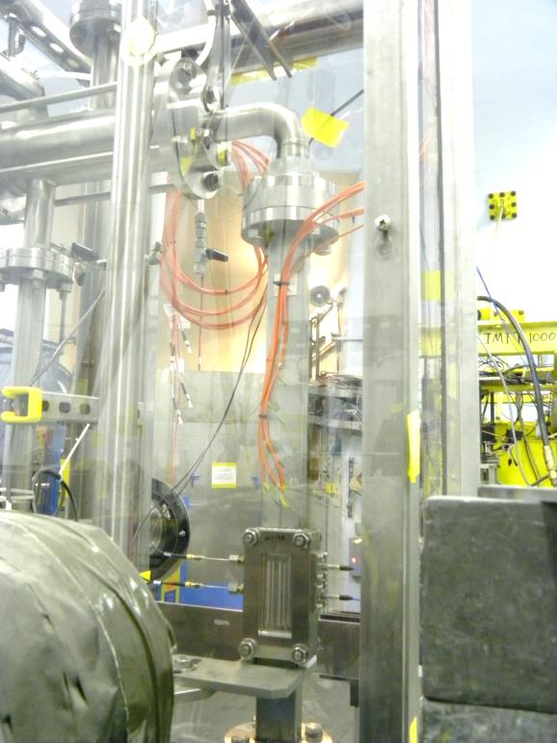
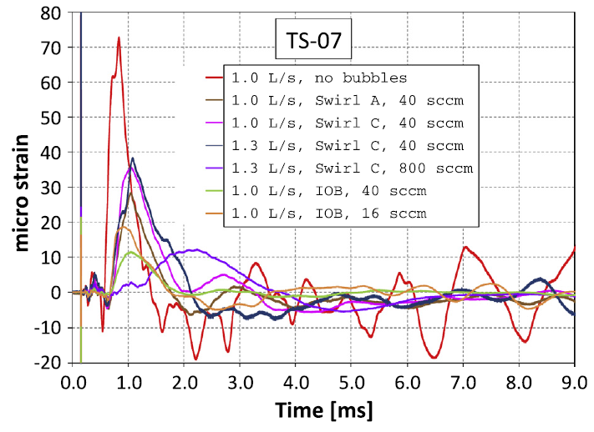
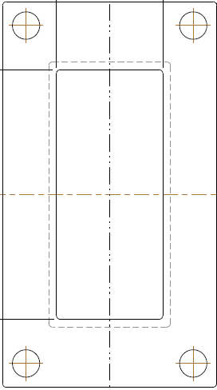
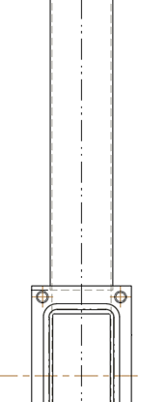
20+% pulse stress is achievable –
Fatigue reduction by SGB demonstrated in SNS target development experiments
SNS experiments at the LANSCE – WNR showed significant strain reduction at locations some distance from incident beam spot
Vertical mercury flow inside 25x50x1.5 mm rectangular tube
Injected gas
fraction 0.067%
Gas bubbles reduced strain magnitude and cycles
50 mm
50 mm
92 mm
50 mm
TS-07
8 mm
81 mm
100 mm
  B.W. Riemer et al. / Journal of Nuclear Materials 450 (2014) 192–203
  Beam spot on target
  1 and 2 σ outlines
  Bubbler test loop at WNR
Strain reduction in / near the beam spot was less clear
Notes:
Experimental evidence from both in-beam and offline testing done by SNS and by J-PARC.
This example is from our most recent experiment, done in 2011
LANSCE – WNR: Los Alamos Neutron Science Center – Weapons Neutron Research facility. 800 MeV protons; 0.3 micro-sec pulses; ca. 3x10¹³ protons per pulse
Note: injected gas fraction for 40 sccm helium / 1 L/s mercury is 6.7E-4 or 0.067% - similar to GI3
Swirl C 800 sccm case

Slide 8
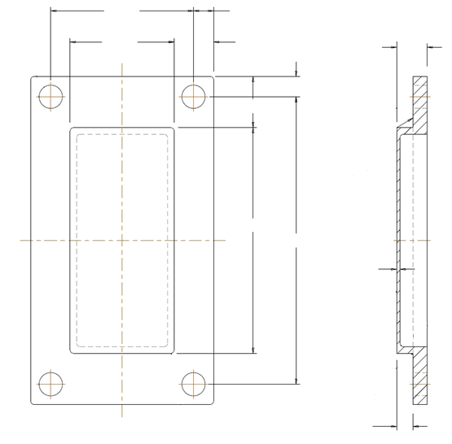


SGB target experiment also showed pitting damage reduction to ~half that without gas can be expected
Test plates were allowed to decay for several months, then carefully decontaminated
Microscopy and analysis of test plates assessed
  Damaged area fraction
  Maximum pit depth
63.2
8.9
46.1
17.4
13.5
9.0
22.7
Optical microscope scan region
21.5 x 16.1 mm
100.1
127.5
1.5
1, 2 σ nominal beam profiles
Example plate sub-image
Binarized sub-image for damage fraction assessment
Mercury wetted surface
Damage can be reduced in the SNS target to less than half that without gas injection
[mm]
7.2
B.W. Riemer, et al., Jnl. Nucl. Mat. 450 (2014) 192-203
Notes:
1800 images per test condition were analyzed

Slide 9
Erosion mitigation experiments done at high cycles show better damage reduction with SGB
In-beam experiments done at WNR were limited to 100 pulses per test condition, vs. ~10⁹ for real target
  Differences in this early stage of pitting damage do not clearly reflect long term trends
JPARC tests (non-beam cavitation of mercury) show greater damage mitigation benefit with high cycles
We can expect a similar trend in real targets with gas injection
No. impacts
M. Futakawa et al., Jnl. Nucl. Sci. and Tech, v 45, No. 10, Oct. 2008

Slide 10
2016 AAC recommendations relevant to target gas injection (VIII. Target Systems (including IRP))
Set the requirements and scope of the short-term bubble injection system such that significant pressure wave mitigation is achieved even at the expense of making needed changes to the mercury loop. Steps in the process are:
  Incorporate the short-term bubble injection system with the jet-flow design concept in the next target design/build cycle.
  Incorporate target vessel instrumentation in the gas bubble/jet-flow target design to ensure comprehensive evaluation of the effects of the gas bubble injection system.

Slide 11
2016 AAC committee response to charges
XIX. Charge Question 7: How might the target design & fabrication decisions that we are making now be improved for reaching the short-term 1.4 MW reliability goal?
Observations and Comments
“… a strategy to reduce overall pressure wave effects, while still making some efforts to reduce stress concentrations through design (at a lower priority) may be a more efficient use of resources.”
Recommendations
29. To this end, along with previous applicable recommendations, a re-prioritization of activities should be considered:
Gas bubble injection with jet flow
  Note: Strain measurements on the target is an integral part of evaluating effects of gas bubble injection
Continued PIE of spent targets
Target design modifications to reduce stress concentrations and effects of fabrication flaws
Fabrication improvements (QA, manufacturing methods, welding)

Slide 12
2016 AAC committee response to charges
XX. Charge Question 8: How aggressively should SNS pursue implementation of gas injection for the short-term (1-year) and long-term plans? Are we using the right strategies?
Observations and Comments
As discussed earlier, to achieve reliable operation at 1.4 MW with two or less target replacements per year by the end of FY17 (Objective A), a more ambitious short-term gas injection system should be pursued aggressively. This likely includes more significant mercury loop modifications needed to safely and reliably handle gas-loading impacts on the system (pump tank overflow, gas bubble separation, etc).
Note that the goal is not just to demonstrate effects on pressure wave mitigation, but to achieve reliable operation at 1.4 MW by the end of FY17. The current short-term plan certainly would be helpful in perhaps demonstrating bubble injection effects and gaining experience with an injection system’s effects on mercury loop operation. But in our opinion, the current short-term plan will not assure reliable target operation at 1.4 MW within the goal time frame of 1.5 years.
Long-term plans will always take a “back-seat” (lower priority) to achieving near-term goals, current operations and spare fabrication due to time criticality. Therefore, the short-term plan should be ambitious enough to achieve the reliability goal as well as inform the design of the long-term solution.
Recommendation
Recommendations relevant to this charge are given in the Gas Bubble Injection section above.

Slide 13
Short term: GI3 is underway
“Turn on” goal is October 2017
  A target exchange is planned
Interaction and iteration with safety staff has been integral to the design – and limitations – of GI3
Safety authorization must be obtained
  Internal safety agreement
  USI (positive expectation)
  Supplement to Facility Safety Assessment Document (FSAD)
  Supplement to Accelerator Safety Envelop (ASE)
    DOE approval required
  Accelerator Readiness Review (ARR)
Targets [will be] available with retrofit orifice bubblers:
  MTX-011 (T-16), MTX-012 (T-17) [ MTX-008 (T-18), MTX-014 (T-19) ]
  These are all jet-flow targets
Notes:
Un-reviewed Safety Issue

Slide 14
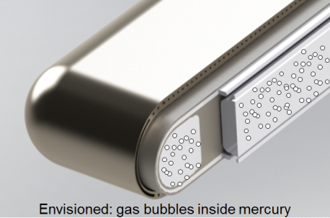
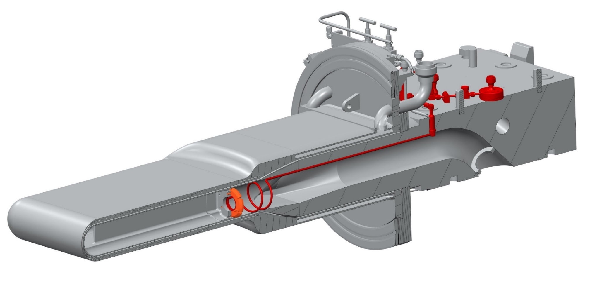
Retrofit orifice bubbler assembly installed in a target
D. Winder
New gas supply port
Modified vent
New hardware in mercury passages
(one on each side)
Note: shown installed in an original type target, but GI3 will be in a jet-flow target
Notes:
30 orifices per side
Gas orifice φ = 0.0003” (7.6 µm)
Shown installed in an original type target, but GI3 will be in a jet-flow target

Slide 15
GI3 employs orifice bubblers with a modest gas flow rate and a once-through gas helium supply system
Envisioned GI3 gas injection parameters
Bubbler type | Orifice
Supply pressure [ATM] | 6.8
Gas injection rate [SLPM] | 1.0
Gas injection method | Once-through
Injected gas rate volume percent (at STP) | 0.08 %
This injected gas rate is comparable to that tested in 2011 WNR mercury target experiment
  similar strain reductions are expected
Substantially higher gas rates incur significant risk for mercury pump tank overflow that require further safety features
  Long-term: pump tank overflow and Hg return line gas liquid separator
We need to try soon with low rate injection and learn
  Lessons will guide high gas flow parameters and requirements for safety

Slide 16
Expectations for GI3
Modest strain reductions at locations outside the beam spot
  Will add substantial fatigue life margin over much of the target
  Sensitivity to injected gas / mercury condition to be explored
Cavitation erosion benefit from GI3 SGB should be better than result from experiments done at WNR with 100 pulses
Maintained MOTS function with increased gas flow, with low dose in MOTS equipment room
  Added delay bed functionality
Mercury process loop
  Rise in mercury level is not expected to fill pump tank at GI3 gas rate, but this cannot be assured
  Increased pressure drop; pump motor power could go up
  Minor - if any - impact on HX efficiency
  Perturbation of mercury return flow instrument is expected
    Credited dP instruments should be OK
Opportunity to learn and improve, inform designs for PPU

Slide 17
GI3 is commissioning goal is for
October 2017
Operating schedule
Design
CDR
PDR
FDR
Component Testing
Facility Safety
Preliminary Internal Safety Agreement
Final Internal Safety Agreement
USI / FSAD / ASE
Final Approval
Accelerator Readiness Review
Operations Prep
Identify Operating Parameters
Evaluate off-normal scenarios
Installation, test, and commissioning plans
Component Fab
Installation
Delay bed in place
Supply panel, Controls, Penetration (not connected)
Pump tank pressure relief devices
Delay bed shielding & piping finished
In cell supply components
Final connections
Commissioning
Delay bed
Gas on
Operations
Jul 2016
Oct 2016
Jan 2017
May 2017
Oct 2017

Slide 18
Significant progress on GI3 achieved
All performance parameters identified
System flow diagram nearly complete
All critical facility safety issues have been addressed
  Inherently safe design - helium supply from high bay to eliminate Hg accident through supply line
  Gas liquid separator will added to the MOTS vent line to prevent loss of Hg through outlet (this is not a Hg return line GLS)
  Hg pump tank burst disk will be replaced with lower pressure disk to assure static mercury head cannot exceed vent line loop seal height
Additional MOTS delay bed will counter increased off-gas effects
  Delay bed is vessel installed; cartridge to be loaded
  Associated shielding delivered
  Plumbing and support structural fabrication started
  Commissioning scheduled for summer 2017 – before gas injection operation
Some gas supply hardware installed outside of service bay
Controls work initiated and progressing

Slide 19
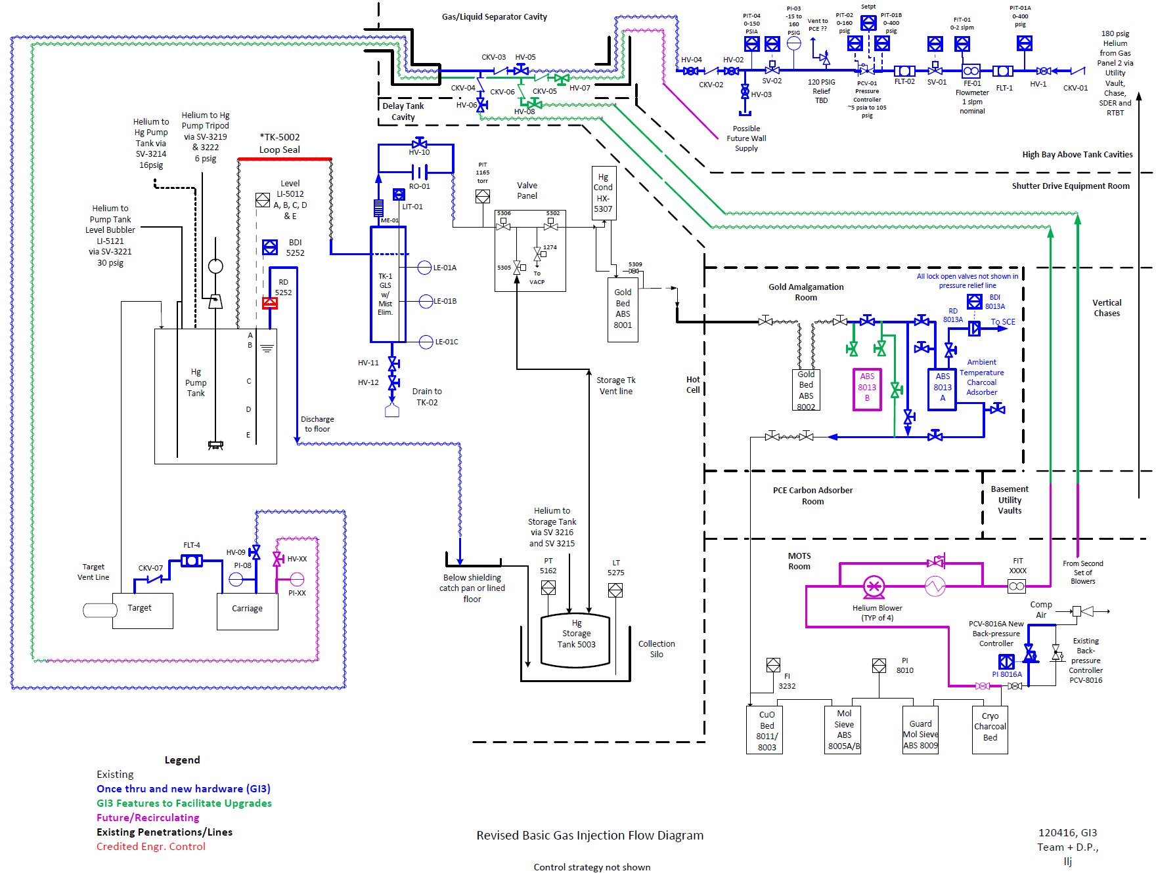
System flow diagram

Slide 20
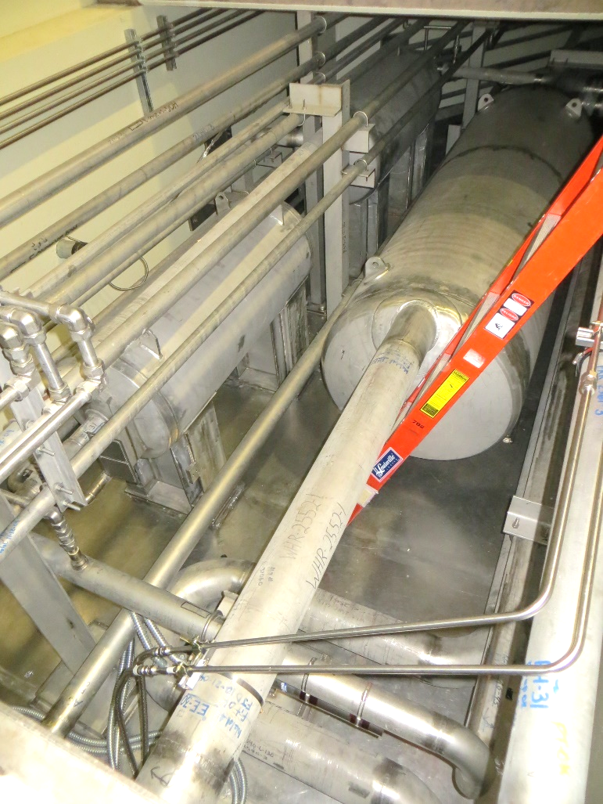
Gas supply tasks to be completed
High bay gas panel final design, fabrication, installation
High bay gas lines connections in water GLS cavities
Gas supply lines run through to service bay via spare water shroud pipe
Service bay gas lines procured, installed and connected
Controls hardware design finalized, procured, installed
Controls software changes implemented
GI3 gas lines in water GLS cavity

Slide 21
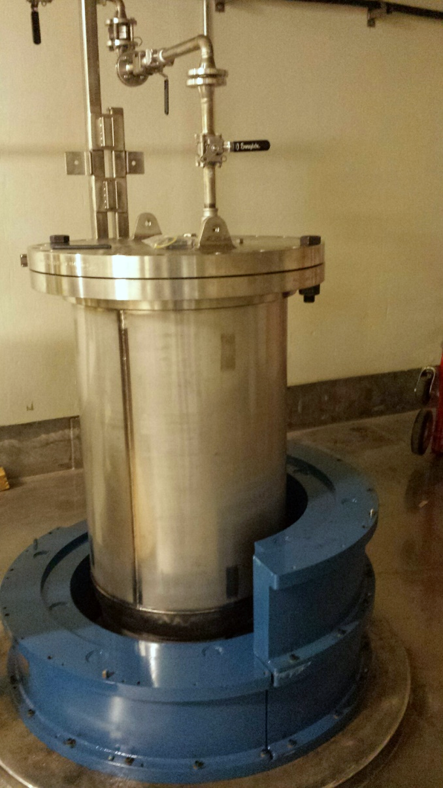
MOTS delay bed commissioning goal is after summer 2017 outage – prior to gas injection
Final design review completed
Delay bed vessel has been installed in gold amalgamation room
Piping and support fabrication started
Delay bed shielding delivered
  Installation started
Carbon cartridge will be loaded in final stage
Commissioning of delay bed without gas injection to follow

Slide 22
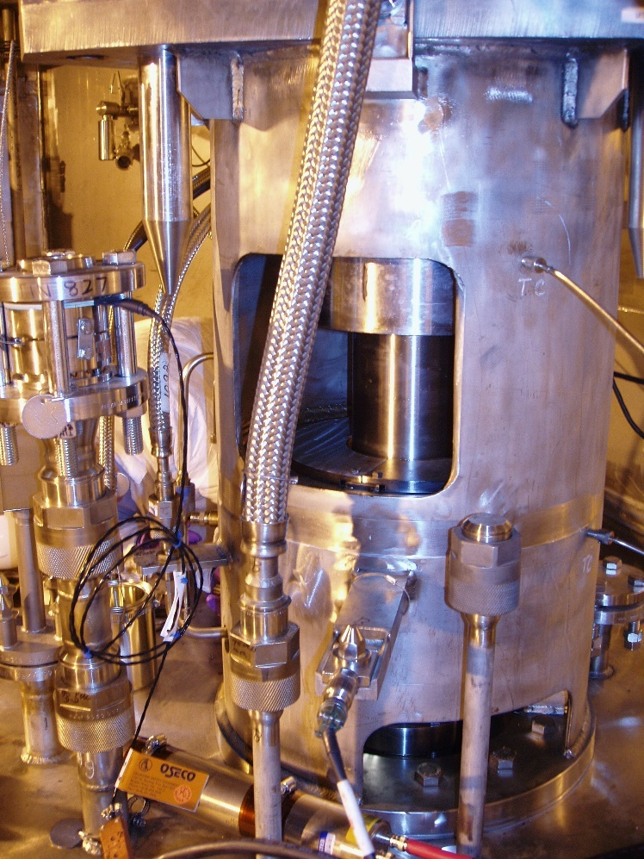
Mercury pump tank burst disk will be replaced with lower rupture pressure unit that cannot support Hg height to top of vent line
This protects against mercury height above MOTS vent loop seal, should reaction to pump tank level fail
Possible transient effects of gas blobs moving through process loop will be mitigated by MOTS vent line GLS
Hardware delivered
Installation in summer outage

Slide 23
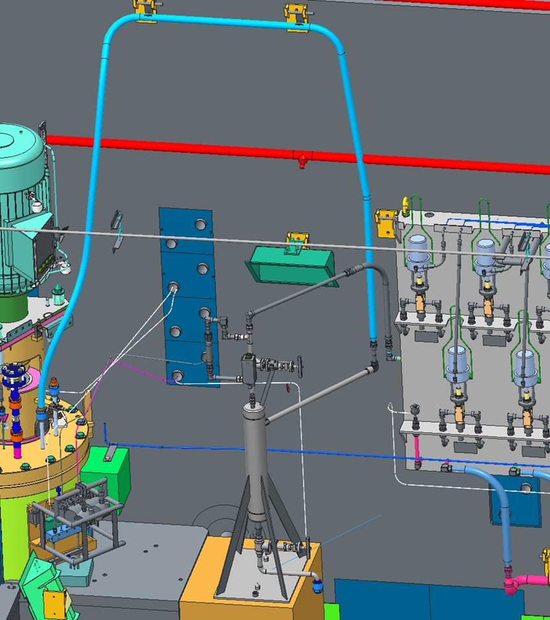
MOTS vent line GLS adds protection against liquid mercury getting into service bay gas panel
GLS vessel will trap any transient mercury excursions up and over the vent line high point
GLS vessel includes
  Hg detectors w/ control system logic to trip beam, stop gas injection, drain mercury loop
  Manual draining capability
Design is > 80% complete
MOTS vent
loop seal
MOTS vent loop GLS
Notes:
\\nscd\users\nrg\GLS

Slide 24
Long-term gas injection:
Proton Power Upgrade project scope
2.0 MW 1.3 GeV proton beam to the target at 60 Hz
Two types of gas injection will be deployed to maximize erosion mitigation and fatigue life:
  Small gas bubbles (SGB) for pressure wave mitigation
  Protective gas walls (GW): a barrier that isolates vessel wall from cavitation
Envisioned near- and long-term gas injection parameters
 | GI3 SGB | Long term SGB | Long term gas wall
Bubbler type | Orifice | Swirl | Nozzle
Supply pressure [ATM] | 6.8 | < 1 | tbd
Gas injection rate [SLPM] | 1.0 | 5.0 ~ 8.0 | 5.0 ~ 8.0
Gas injection method | Once-through | Recirculating | Recirculating
Injected gas rate volume percent (at STP) | 0.08 % | 0.3 ~ 0.6 % | 0.3 ~ 0.6 %
If both SGB and GW deployed: ~1%
Notes:
Speak to point that PPU requirements do not include 2MW at lower rep rate with STS comes online

Slide 25
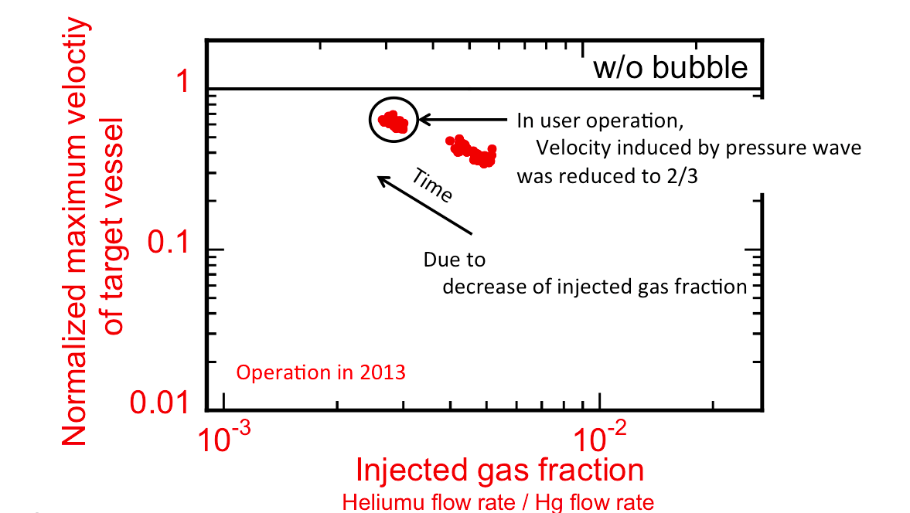
Fully developed gas injection is envisioned to be ~1% injected gas volume fraction for both SGB & GW
SGB injection high-rate goal is based – in part – on experience with JPARC mercury target small gas bubble injection
SNS high gas rates will result in increased process loop gas hold-up which is expected to require aggressive mitigation
The effect of injected gas fraction on JSNS target maximum velocity at spot monitored by LDV.
From H. Kogawa, 2012 SNS-JSNS Collaboration meeting. Small gas bubbles only.
GI3 injected gas volume fraction is only ca. 0.08%
Notes:
1% gas in the target is a negligible loss of neutrons
Hg flow 1.2 m³/m at 350 rpm assumed and 0.7 slpm helium gas rate

Slide 26
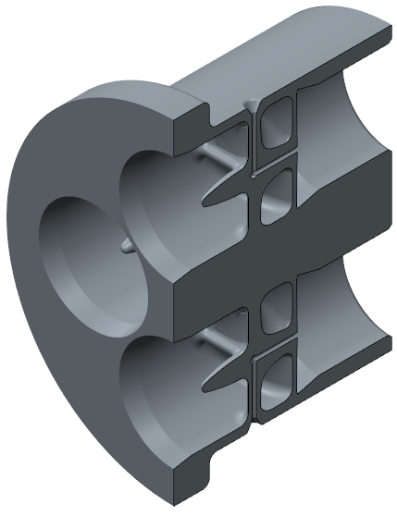
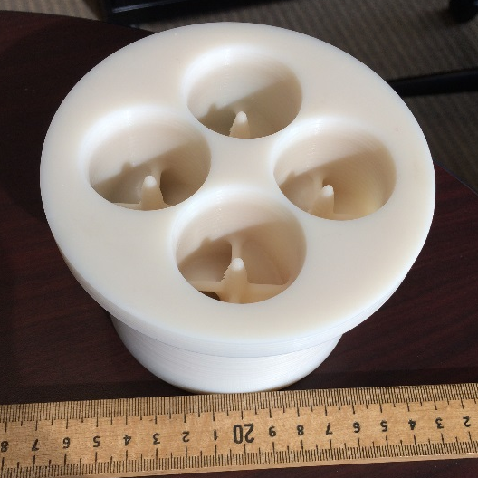
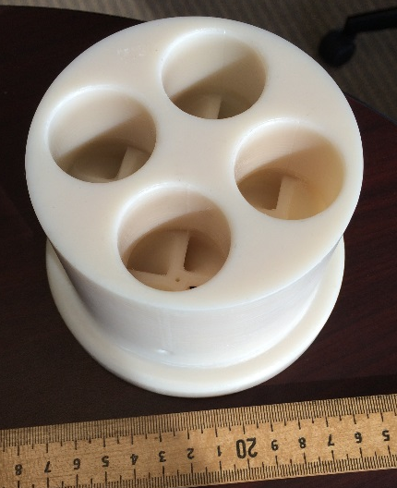
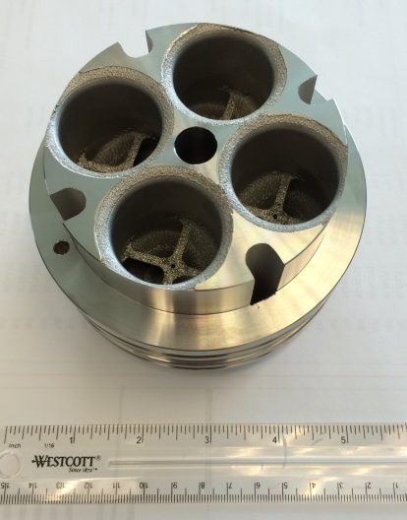
Long term: Swirl bubbler development
More efficient at small bubble production vs. orifice
  Smaller bubbles have better prospects for damage mitigation and fatigue reduction
Design assistance from JPARC
First generation units were 3D printed and have undergone water testing
We now have 3D printed metal versions ready for mercury testing in TTF
FLOW
3D printed metal version
Inlet side
Outlet side
Notes:
See Charlotte’s presentation

Slide 27
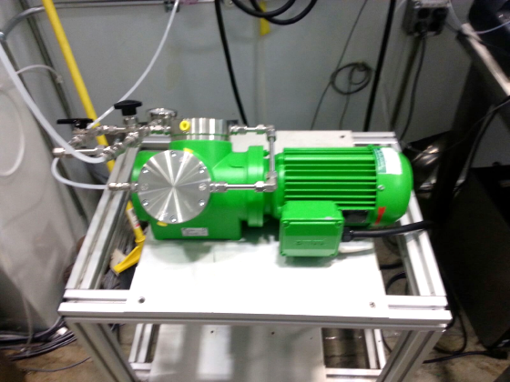
Longer term: recirculating compressor as primary source of target gas injection
Benefits
  Conservation of helium
  Reduced mercury loop off-gas flow to HOG and the stack
Location preference:
  In the MOTS equipment room
    Accessible for maintenance
    Draws “cleaned” gas from MOTS discharge
    All injection gas flow is processed by MOTS
Currently evaluating performance and reliability of KNF diaphragm compressor
Candidate helium compressor

Slide 28
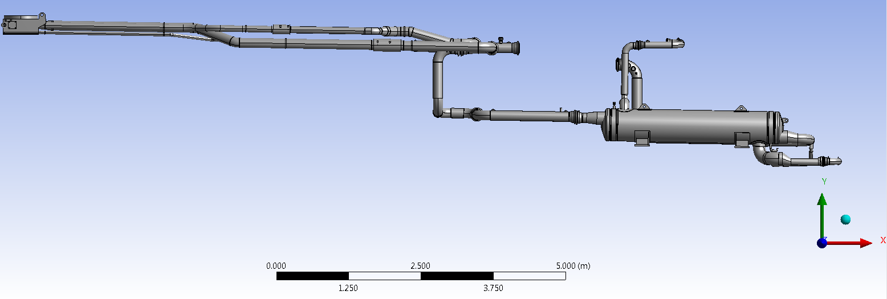
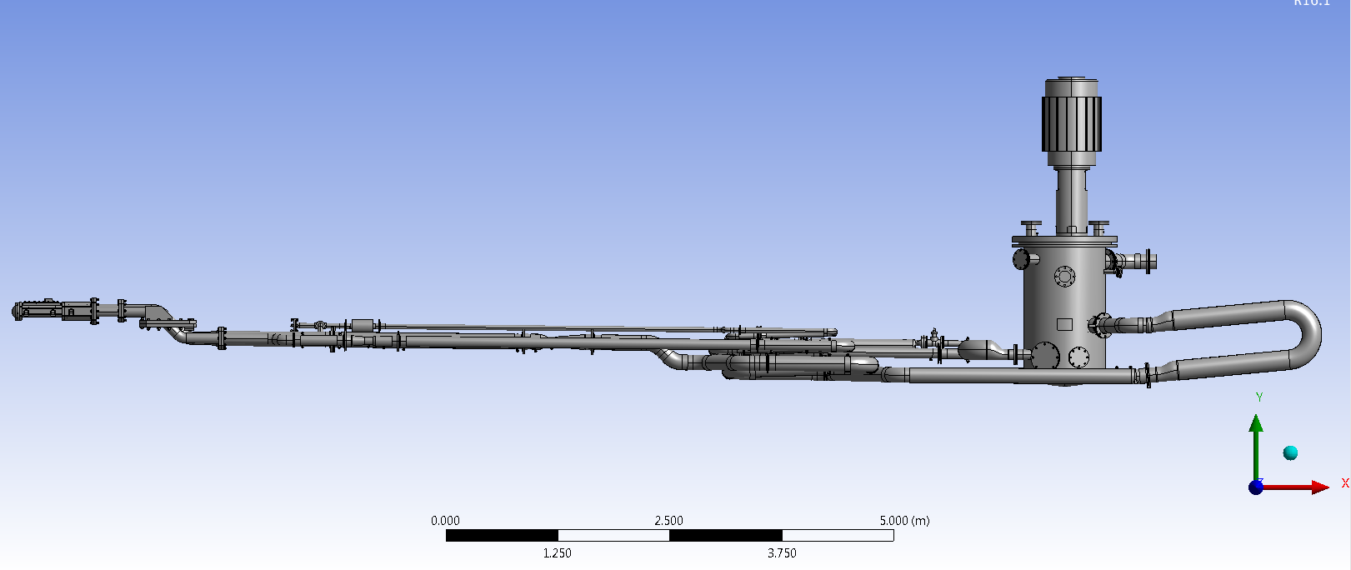
SNS mercury loop is not well suited for gas injection – gas hold-up is expected
pump
Sloped for draining
SNS
(w/o pump and target)
Sheet & tube
heat exchanger
Target Test Facility
Notes:
Elevation view
Heat exchanger and large down elevation drop in SNS loop make gas hold-up worse

Slide 29
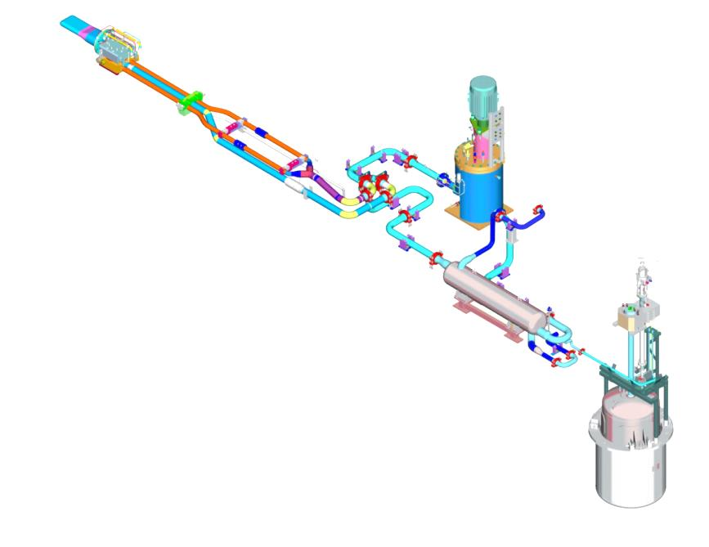
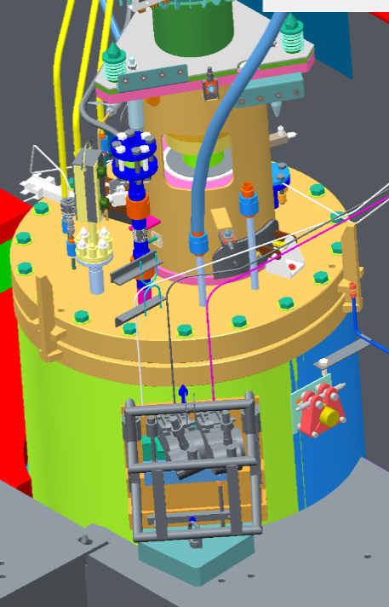
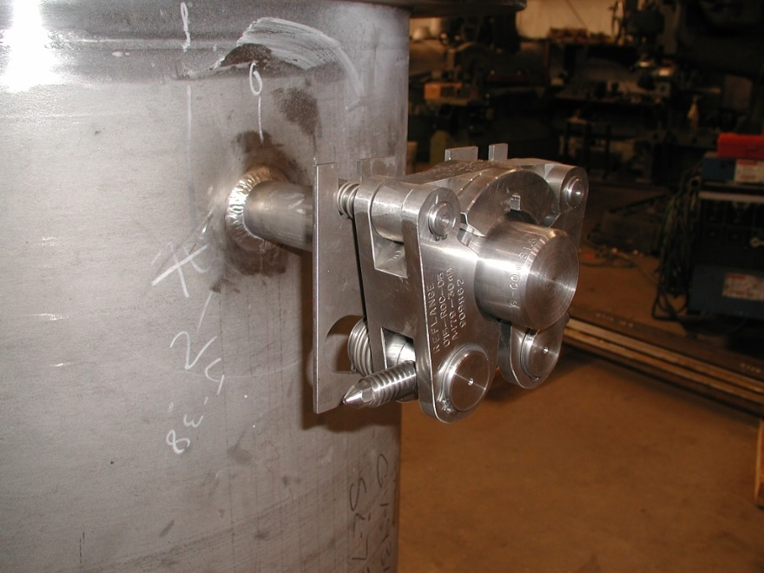
Safety features for high flow gas injection include adding mercury pump tank overflow
Mercury pump tank overflow will connect to unused pump tank nozzle
Remote installation is required
Hg Pump Motor
Supply Pipes (3)
Target
Hg Pump Tank
Return Pipe (1)
Transfer Valve
Heat Exchanger
Mercury Storage Tank
Proposed Mercury
Overflow Port

Slide 30
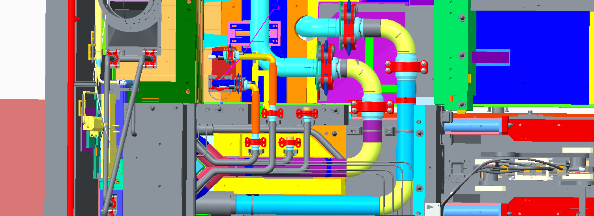
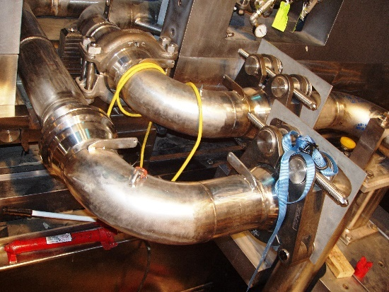
A gas-liquid separator in the mercury return pipe is also planned
Hg Pump Motor
GLS will mitigate excess gas hold-up and mercury displacement
Only suitable location is pipe elbow at the end of the carriage
This location must be shielded
Remote installation required
Supply Pipes (3)
Target
Hg Pump Tank
Return Pipe (1)
Transfer Valve
Heat Exchanger
Mercury Storage Tank
Proposed Mercury
Overflow Port
Mercury Return
Jumper
Candidate GLS location

Slide 31
Summary
We are pushing to begin target gas injection in October 2017
  Remaining tasks vs. time are a challenge with other staff & operational priorities, but goal is achievable
Even though GI3 is limited to low gas rates, useful strain reduction is expected that will improve fatigue margins and reduce cavitation erosion
GI3 will also characterize extent of adverse effects of gas hold-up on mercury loop behavior
When steady GI3 gas operation is achieved, erosion mitigation can be characterized through target PIE
GI3 success will assure 1.4 MW operation by end of CY2018
GI3 lessons – along with R&D outcomes and other target operating experience – will guide requirements for PPU target gas injection

