Slide 1
Target Design Reaching for 2 MW
Presented to the SNS Accelerator Advisory Committee
Saulius Kaminskas
Structural Analyst
March 9, 2017

Slide 2
What challenges are on the horizon?
Reliable Operation at 1.4 MW
Reliable Operation at 2.0 MW
2.0 MW
1.4 MW
Target Problems are the same just
More Challenging:
Fatigue damage
Cavitation damage
Fatigue – Cavitation coupled damage
Linear Increase
of Power leads to Nonlinear Increase of fatigue damage
Advanced design development technologies
are available to succeed:
Design Space Exploration and Optimization
Robustness and Reliability Optimization

Slide 3
Fatigue life nonlinearity vs beam power
“fatigue life” indicates the beginning of fatigue damage – not the predicted cycles to failure
Jet-Flow target pulse fatigue life at different locations (Fe-Safe results)
2.30 MW
8 – Inner Window
7 – Front Upper Rib
6 – Side Baffle Base
5 – Center Baffle Base
4 – Front Lower Rib Channel
3 – Center Baffle Front Lower
2 – Front Lower Rib
1 – Center Baffle Front Upper
8
2.00 MW
7
5
6
1.70 MW
1.7 MW power
4
3
2
1.4 MW power
1
0.85 MW
~10 days
~3.5 months
~5 months
~7 months
Material S-N curve – “316 Stainless Steel” from Fe-Safe DB

Slide 4
Jet flow target pulse fatigue damage – results summary
Fatigue damages:
1.7 MW – 4 locations in ~10 days
2.0 MW – 6 locations in ~20 days
Structure will lose integrity resulting in:
unknown stresses
reduced target reliability
1
6 – Side Baffle Base
5 – Center Baffle Base
4 – Front lower Rib Channel
3 – Center Baffle Front lower
2 – Front lower Rib
1 – Center Baffle Front upper
3
5
6
4
2
But study did not include:
Thermal fatigue
Weld fatigue
Material degradation
Cavitation damage
Fatigue – Cavitation damage interaction
Those factors will deteriorate structure even more at 2 MW
Addition of gas injection will soften
the impacts of beam on the target
Ultimate Strategy:
Optimize design towards 2 MW without gas injection
Add gas injection for substantial increase of reliability and longevity margins

Slide 5
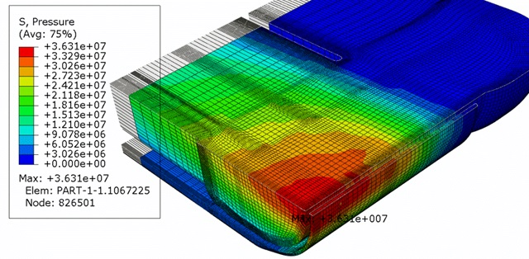
Local shape optimization with TOSCA – Minimize max pulse stresses at side baffle
Original Target Design – simplified FE model is sufficient
Pulse pressure, mercury – Max = 36.3 Mpa
Von Mises stresses at side baffle,
20 micro sec – Max = 29.06 Mpa
Side baffle shape optimization area – Minimize local stresses
Optimization variables - nodes
to move

Slide 6
Local shape, optimized with TOSCA
Problem is complicated:
Pulse wave is changing max stress levels and locations
Optimization surface (steel) is in contact with mercury surface
Max stress reduced from 29.09 MPa to 26.44 MPa
Local shape improvement is limited by global deformation
Global Structural Response needs to be addressed first
Design space boundaries are changing during the optimization process

Slide 7
Problem formulations for fatigue
Local shape optimization for fatigue durability:
Minimize: s_{i}^{max}
Subject to: p_{j}^{min} ≤ p_{j} ≤ p_{j}^{max}
Where: s_{i}^{max} – max stress at i^{th} stress concentration
p_{j} – local parametric geometry features (nodal coordinates)
NOTE: minimize s_{i}^{max}
is replaceable by
maximize life cycles
Global geometry optimization for vessel structural response: *
Minimize: f_{g} ( s₁^{max}, s₂^{max}, . . . ,s_{n}^{max} )
Subject to: P_{j}^{min} ≤ P_{j} ≤ P_{j}^{max}
Where: f_{g} – aggregate function of max stresses s_{i}^{max}
s_{i}^{max} – max stress at i^{th} stress concentration
P_{j} – parametrized design features (geometric locations, etc.)
* Interactive Design Space Exploration – solution for this problem

Slide 8
Global interactive target optimization process
Initial Design Concept (CAD)
Design of experiment,
Response surfaces,
Sensitivity exploration
Design Space Exploration
Multi-Objective Optimization
Stresses vs frequency,
Stresses vs mercury flow
Stresses vs stresses at
different locations
Topology Optimization
Material distribution on a basis of exploration results
Shape Optimizations (Local)
Predominantly at fatigue susceptible locations
Robustness/Reliability (Stochastic) Optimization
With respect to variabilities and uncertainties
NO
Good enough?
YES
> Highest priority (value)
Back to CAD
> Lowest priority (value)

Slide 9
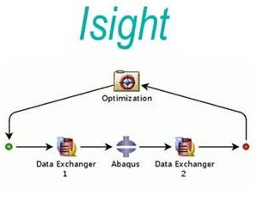
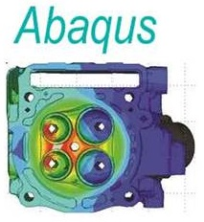
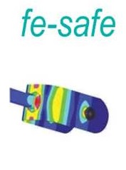
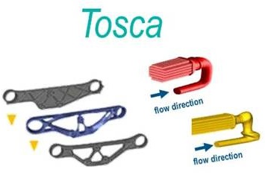
Abaqus extended tools – Package for advanced design development technology
Optimization:
Parametric
Multi-objective
Stochastic
Design exploration
Process Integration
Fatigue and Durability
Evaluation for:
Pulse
Thermal
cycles
FEA Multiphysics Simulations:
CFD (Hg flow)
Static (Thermal)
Dynamic (Pulse)
Non-Parametric Optimization for:
Shape
Topology
Fluid
Integrate, Optimize, Understand Sensitivities & Trade-Offs
Explore Design Space,
Achieve optimum overall design under quantified uncertainty

Slide 10
Parametric design space exploration with Isight: Multi-objective optimization – fatigue life vs Hg pump speed
Higher Hg pump speed → lower thermal stress → higher fatigue life
At the same time:
Higher Hg pump speed → higher Hg pressure → lower fatigue life
For simplified target FE model:
Response surface Indicates the point of optimal pump speed for longest thermal fatigue life
Thermal stresses
Max = 162 MPa
Hg flow pressure stresses
Max = 52 MPa
The search for trade-offs among other operation parameters is also possible to maximize the vessel fatigue life

Slide 11
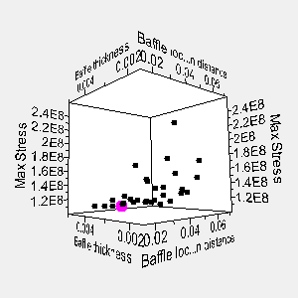
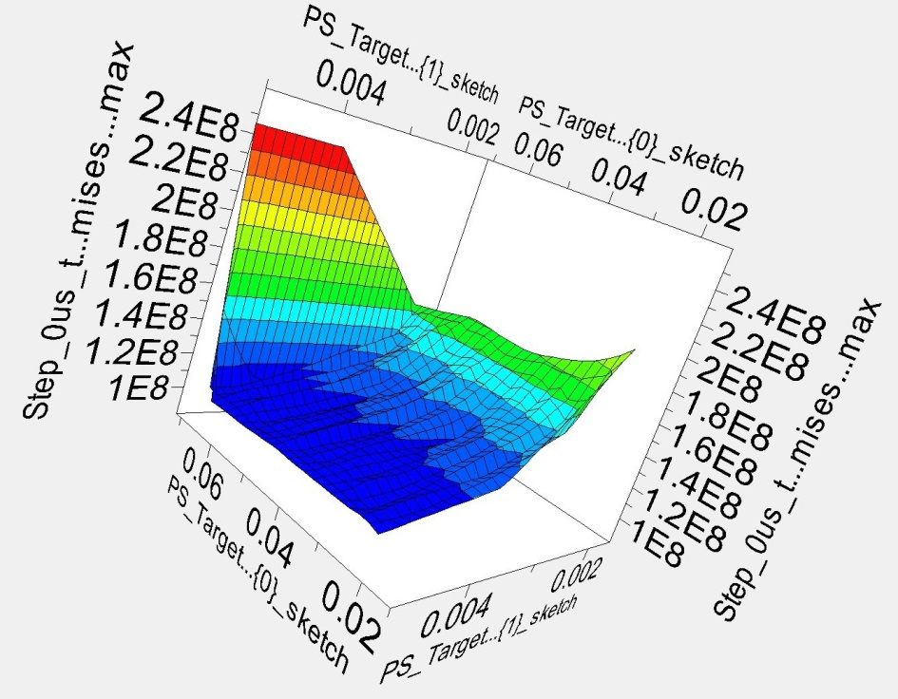
Geometric design exploration with Isight
Target virtual mock-up test
Design variables:
Baffle distance from symmetry line
Baffle thickness
Design response:
Max Mises stress
Design of Experiment:
3D Scatter plot
Design response surface:
Mock-Up model:
Drew Winder

Slide 12
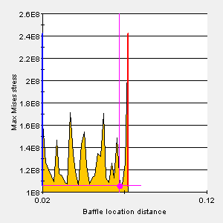
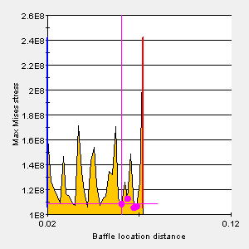
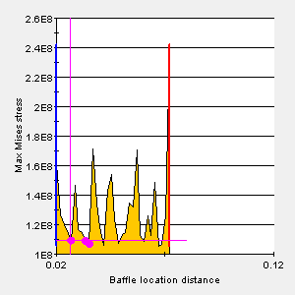
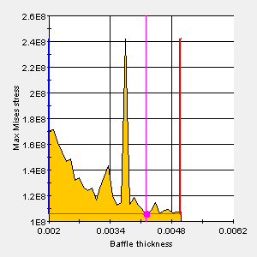
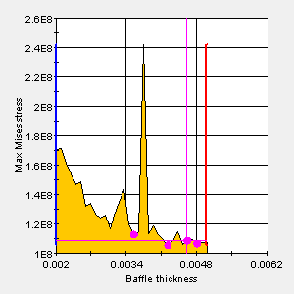
Geometric design exploration with Isight
Target virtual mock-up test - 2D plots for trade-off analysis
Max Stress vs Baffle Location Distance
Max Stress vs Baffle Thickness

Slide 13
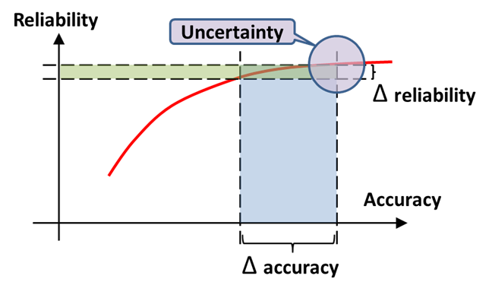
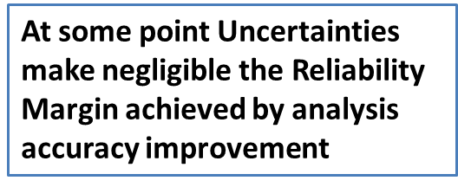
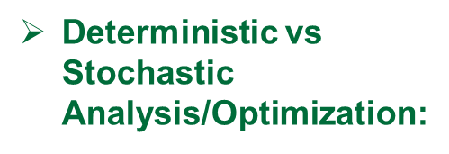
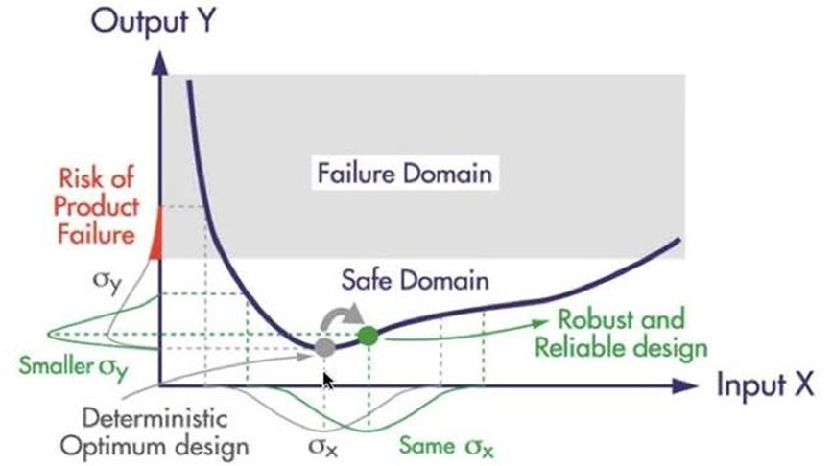
Why conventional practices are not sufficient
for efficient target design development
Lessons from Hardware Tests:
Real testing is possible only by placing target in service
Time from design to PIE results is long and overlaps a number of new target installations needed in between
The number of samples is too small for statistical observations
Improvement of Analysis Accuracy:

Slide 14
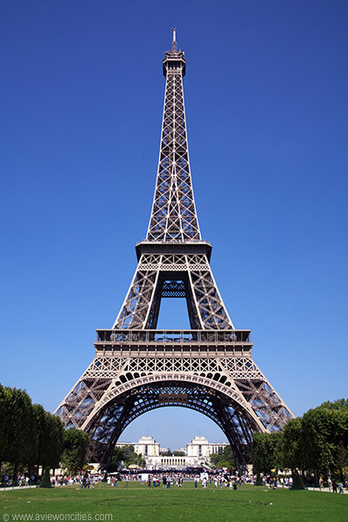
What are the conventional and
optimized design development strategies?
Costs
Decrease in costs
Optimization Driven Design Development makes the New Quality available
Reduction of development time
Time
Optimized
Design Development
Conventional
Design Development
Optimize
Design
Design
Design
Analyze
Build
Build
Build
Test
Validate
Test

Slide 15
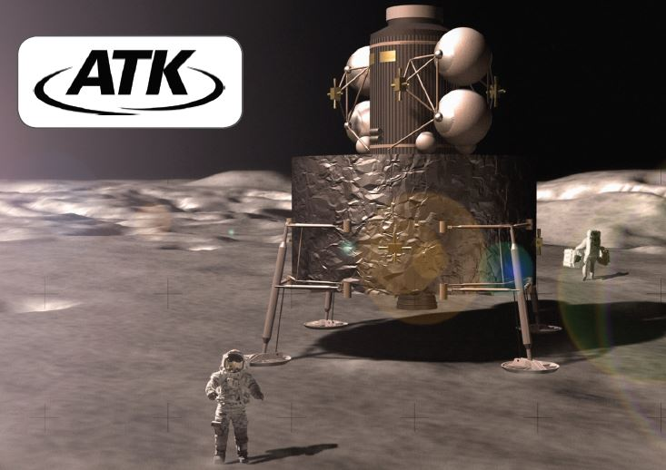
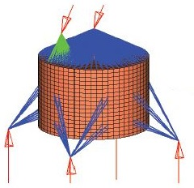
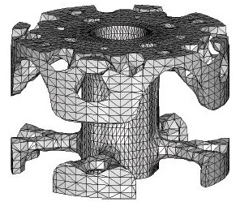
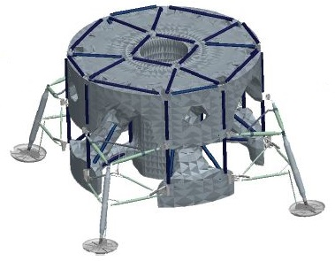
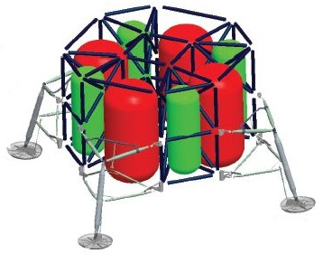
Examples of successful industrial applications
Volkswagen compressor bracket optimization
Conventional design
Optimization driven design
NASA Lunar Lander
size and shape optimization
Model
Topology optimization
Topology interpretation
Optimal design

Slide 16
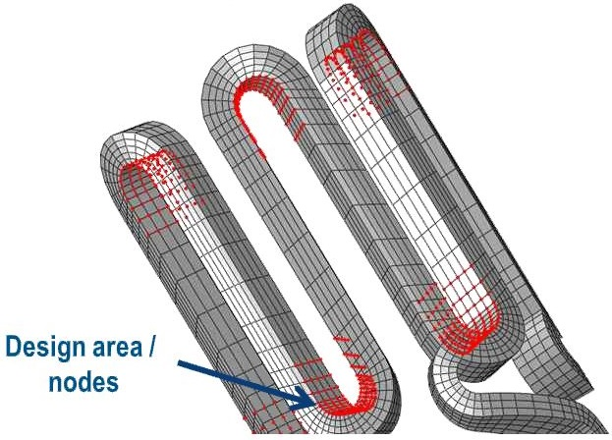
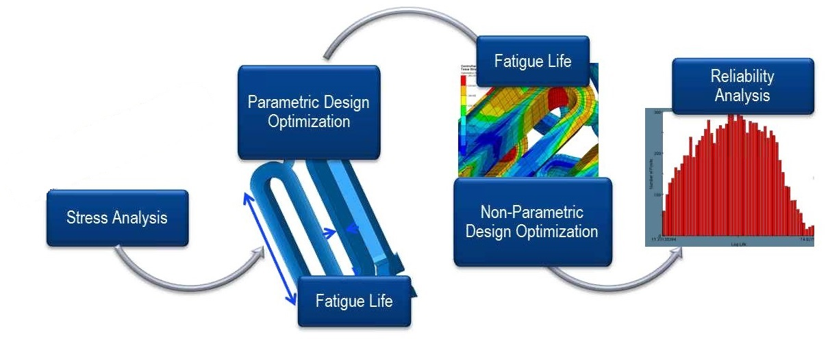
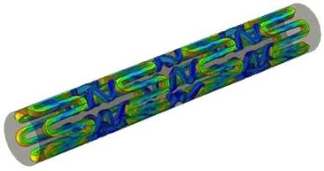
Examples of successful industrial applications
Coronary Stent shape optimization for fatigue
Finite element model
Optimization workflow

Slide 17
Path forward reaching for 2MW
Adopt and develop optimization driven design technologies for the real mercury target concept:
Design Exploration Techniques
Topology Optimization
Localized Shape Optimization
Stochastic Analysis Techniques
Robustness/Reliability Optimization
Multi-Objective Optimization
Next 2 years – focus on
Pulse Fatigue Life Improvement:
Employ Design Exploration for the best
Target Geometry to minimize fatigue
(optimize locations of baffles, ribs, etc.)
Use the Shape Optimization to
lower Fatigue Damages
(optimize fillets, thicknesses, etc.)
Perform Robustness/Reliability Optimization with respect to Uncertainties (material, manufacturing, cavitation, beam irregularity, etc.)
Develop the optimal design of target ultimately performing
with existing constraints
Conclusion: Advanced design technology based strategy is the path to success reaching 2 MW

Slide 18
Thanks for your attention
Questions,
Comments…

