Slide 1
SNS Operations Report for FY16 and FY17-Q1
Presented to the SNS Accelerator Advisory Committee
Glen D. Johns
Accelerator Operations Manager
March 8, 2017

Slide 2
Outline
FY16/17 Run Schedules
Review of SNS Commitments
Beam Power
Performance
Downtime Overview
Summary

Slide 3
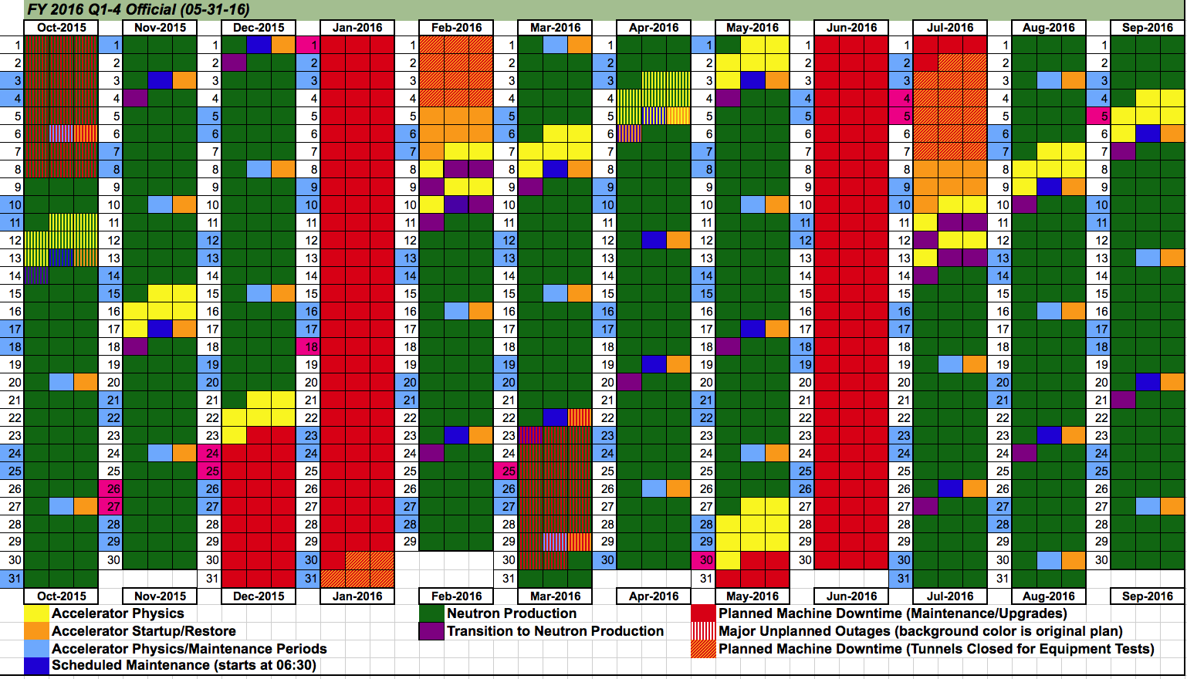
FY16 schedule adjusted for unplanned target failure at start of FY; commitment of 4230 hours delivered for NP

Slide 4
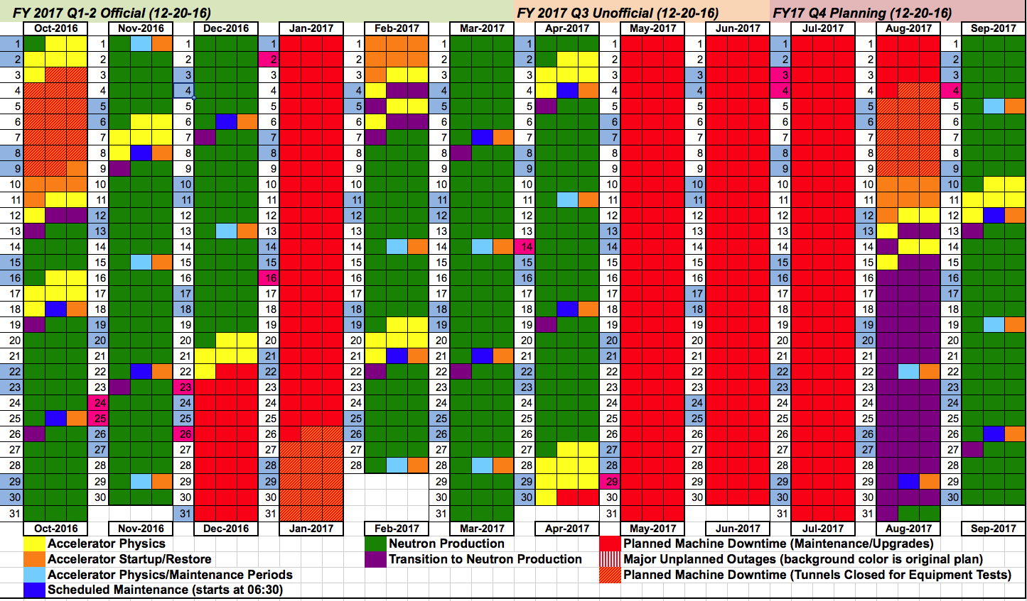
Plan for FY17 after extending Winter Outage and shifting Summer Outage; this was the plan going into the Winter Outage

Slide 5
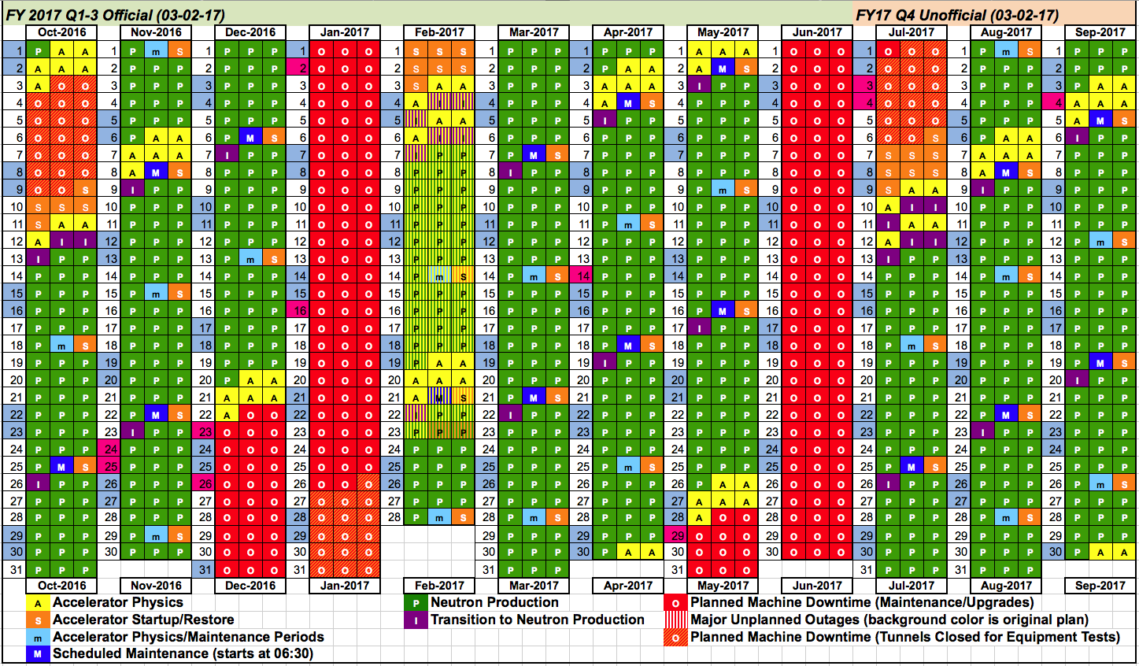
IRP delivery delay results in major schedule modification

Slide 6
SNS Commitments
Year | Neutron Production Availability |  | Integrated Beam Power (MW-hrs)
 | Commitment | Actual | Commitment | Actual
FY2007 | 68.0% | 65.7% | 117 | 159
FY2008 | 74.0% | 72.0% | 877 | 945
FY2009 | 80.0% | 80.7% | 2031 | 2166
FY2010 | 85.0% | 85.6% | 3253 | 3455
FY2011 | 88.0% | 92.0% | NA | 4132
FY2012 | 90.0% | 90.0% | NA | 4368
FY2013 | 90.0% | 72.4% | NA | 3848
FY2014 | 90.0% | 83.7% | NA | 4798
FY2015 | 90.0% | 74.6% | NA | 4612
FY2016 | 90.0% | 86.4% | NA | 5348
FY2017 (Q1) | 90.0% | 92.6% | NA | 1687
Year | Neutron Production Hours Delivered |  | Total Operating Hours Delivered
 | Commitment | Actual | Commitment | Actual
FY2007 | 1500 | 2078 | 3500 | 3779
FY2008 | 2700 | 2807 | 4000 | 4032
FY2009 | 3500 | 3553 | 4500 | 4916
FY2010 | 3900 | 4250 | 4800 | 5310
FY2011 | 4300 | 5002 | 5000 | 5941
FY2012 | 4500 | 4725 | 5000 | 5746
FY2013 | 4000 | 4202 | 5000 | 5120
FY2014 | 4230 | 4424 | 5000 | 5294
FY2015 | 4230 | 4441 | 5000 | 5278
FY2016 | 4230 | 4972 | 5000 | 5832
FY2017 (Q1) | 3240 | 1388 | 4600 | 1681

Slide 7
Beam power on target (60 sec average)
1419.6 kW peak
(≥1.3 MW for ~18 days)
1337.6 kW peak
(≥1.2 MW for ~38 days, ~1.3 MW for ~23 days)
1228.0 kW peak
(≥1.2 MW for ~61 days)
Winter outage
Target 13 failure
Planned Target 14 replacement
Target 12 failure
Winter outage
Summer outage

Slide 8
Two target failures were challenging (86.4% against schedule) 92.9% excluding target failures (after T14 failure - 50% of the weeks >95%)
RF, Ion source, & HVCM issues
2K coldbox trips
Target
failures
Core vessel leak
Winter outage
Summer outage
850 kW
T13
1.2–1.4 MW T13
1.2–1.3 MW
T13
1.0 MW (T14)
1.0 MW (T14)

Slide 9
FY17 started off with excellent performance (92.6%)
Ion source E-dump water leak & CM17 vacuum issues
9 out of 11 weeks > 90%
Planned Target replacement
Winter outage
850 kW T15
1.2 MW (T15)

Slide 10
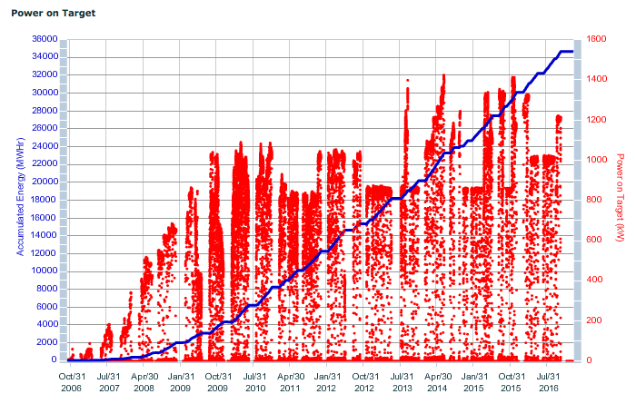
Energy and power on target from October 2006
Will approach 41 GW-hrs by the end of CY17
Delivered over 35 GW-hrs
FY13 – 3848 MW-hrs
FY14 – 4798 MW-hrs
FY15 – 4612 MW-hrs
FY16 – 5348 MW-hrs
FY17 – 1687 MW-hrs

Slide 11
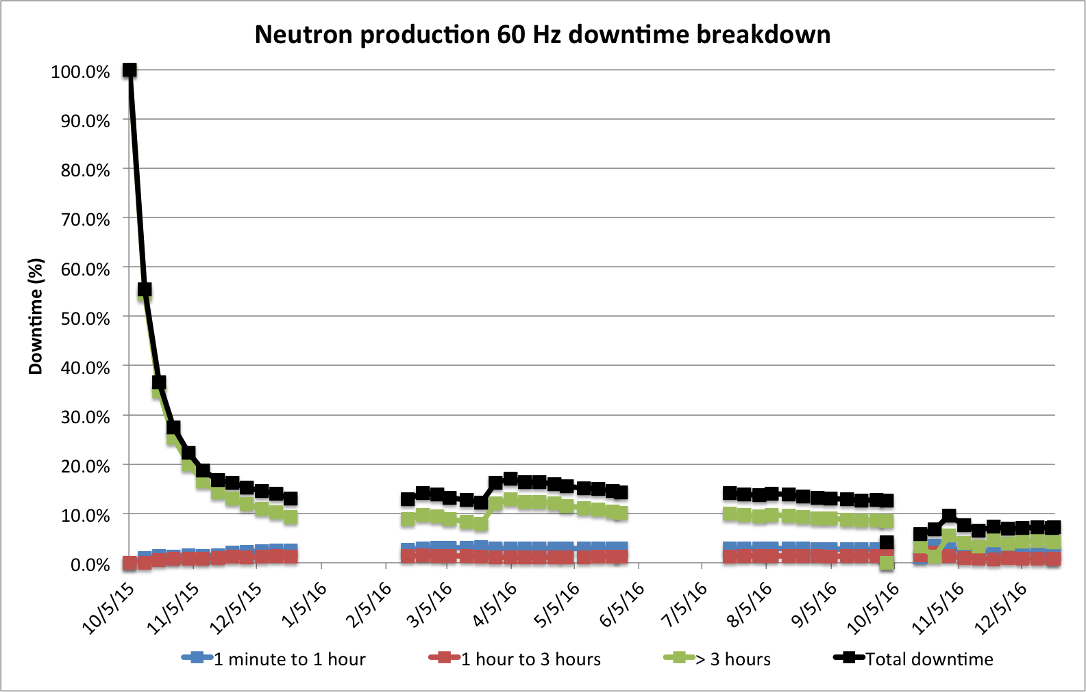
Long duration events dominate our overall downtime numbers
UNSCHEDULED TARGET CHANGE
MAINTENANCE
UNSCHEDULED TARGET CHANGE
MAINTENANCE
SCHEDULED TARGET CHANGE
FY16
Run 1
FY16
Run 2
FY16
Run 3
FY17
Run 1

Slide 12
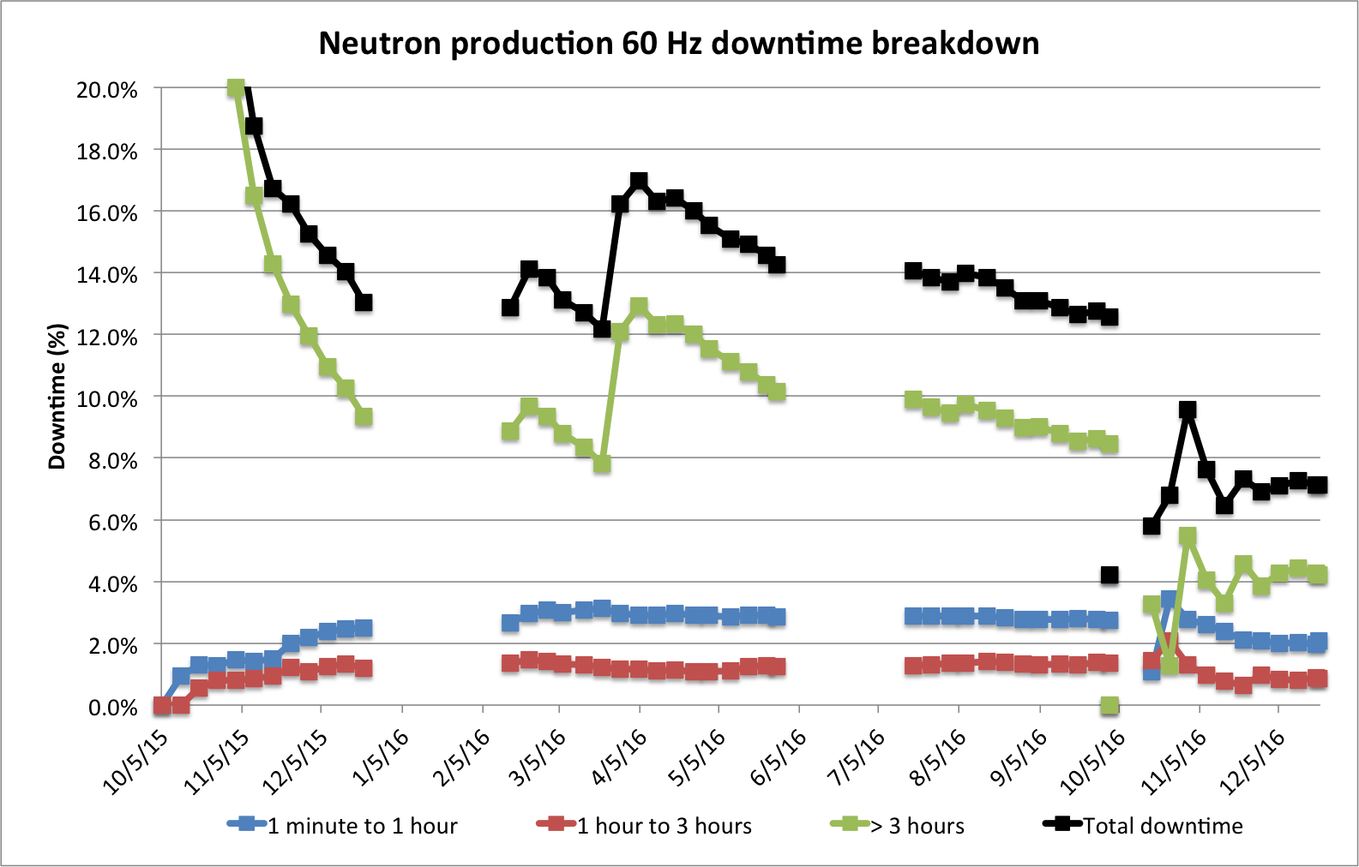
Less than 3 hours trips consistently account for ~3-4% of downtime
UNSCHEDULED TARGET CHANGE
MAINTENANCE
UNSCHEDULED TARGET CHANGE
MAINTENANCE
SCHEDULED TARGET CHANGE
FY16
Run 1
FY16
Run 2
FY16
Run 3
FY17
Run 1
SCL cavity 17b vacuum & corrupted re-phasing file,
Ion source water leak

Slide 13
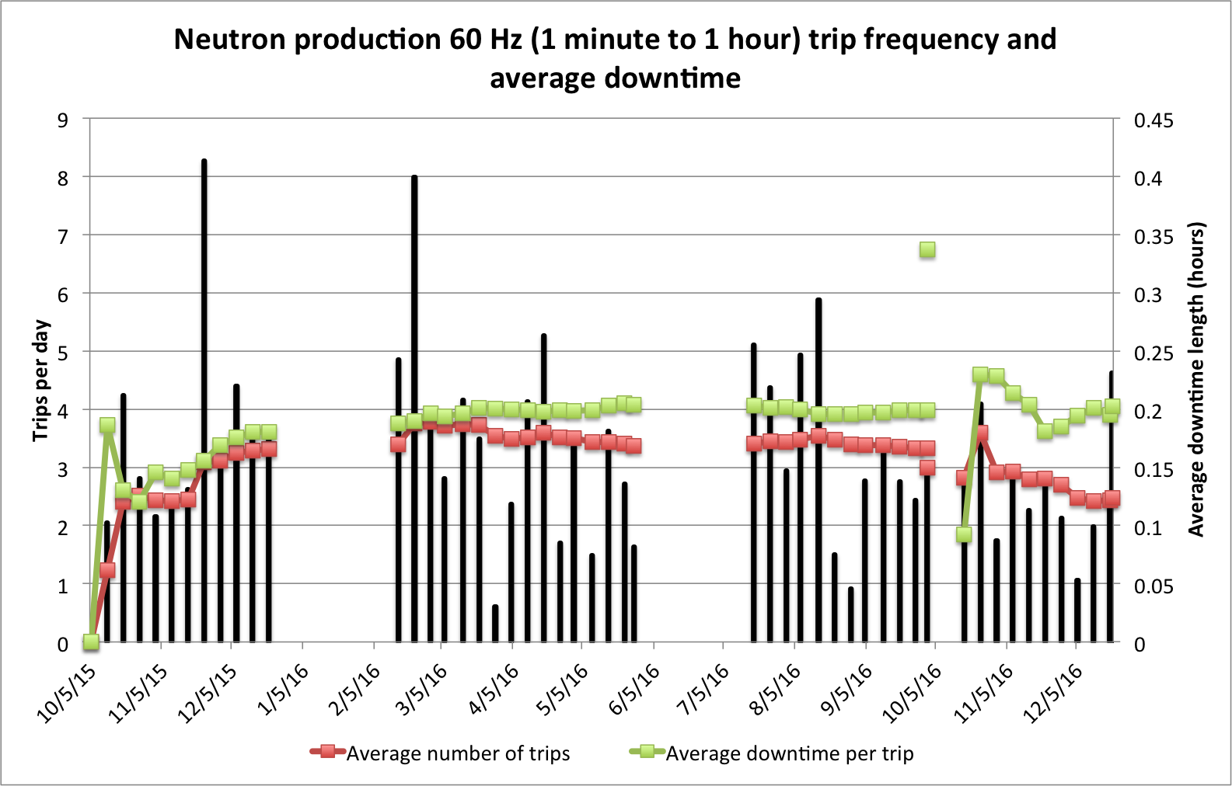
Continue to use frequency plots to evaluate performance; just under 3 trips/day for FY17 Q1
UNSCHEDULED TARGET CHANGE
MAINTENANCE
UNSCHEDULED TARGET CHANGE
MAINTENANCE
SCHEDULED TARGET CHANGE
FY16
Run 1
Ion source arcing
FY16
Run 2
FY16
Run 3
FY17
Run 1
Ion source edump insulator arcing
Multiple unrelated issues
Notes:
July to August 2016: Moving foil during conditioning, SCL cavities in CM17 vacuum burst, errant beam tripping SCL cavities (2K coldbox trip made cavities unstable), magnet power supply quick resets, RFQ open loop, extraction kickers jumping around,

Slide 14
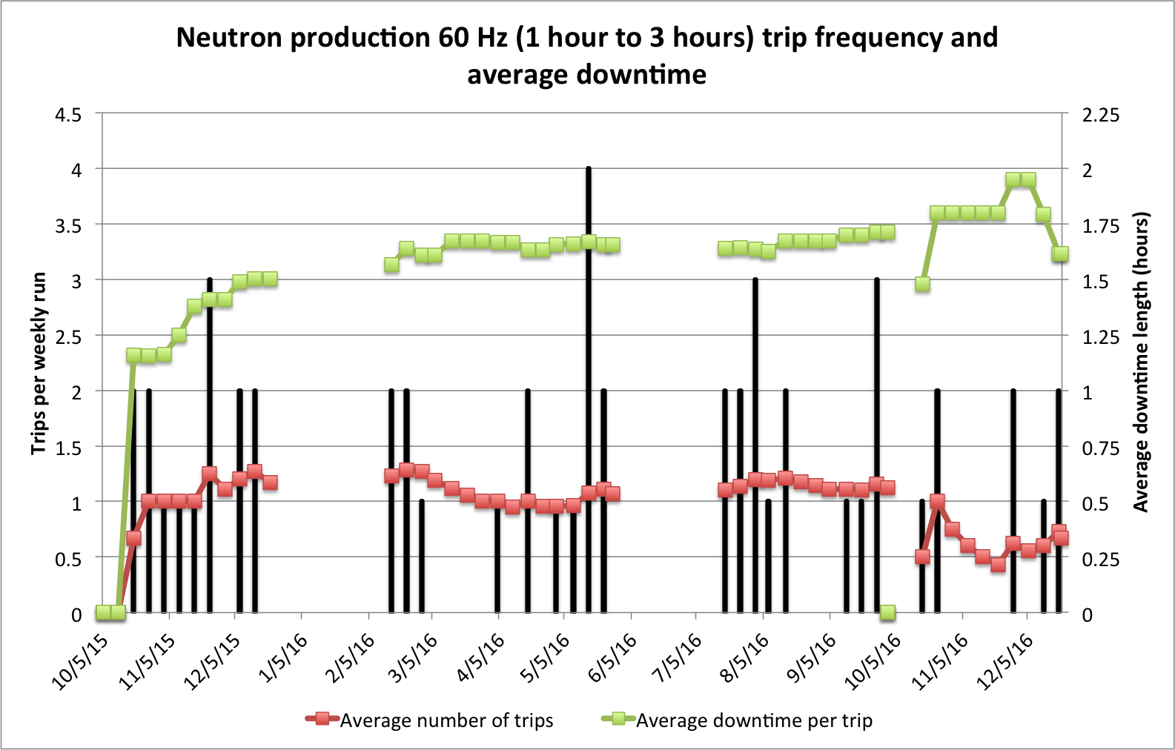
Medium duration events are fairly constant
UNSCHEDULED TARGET CHANGE
MAINTENANCE
UNSCHEDULED TARGET CHANGE
Multiple unrelated issues
MAINTENANCE
SCHEDULED TARGET CHANGE
FY16
Run 1
FY16
Run 2
FY16
Run 3
FY17
Run 1
Notes:
May 2016: Communication for HVCMs, power dip, MPS chassis had to be replaced, extraction kicker tune around

Slide 15
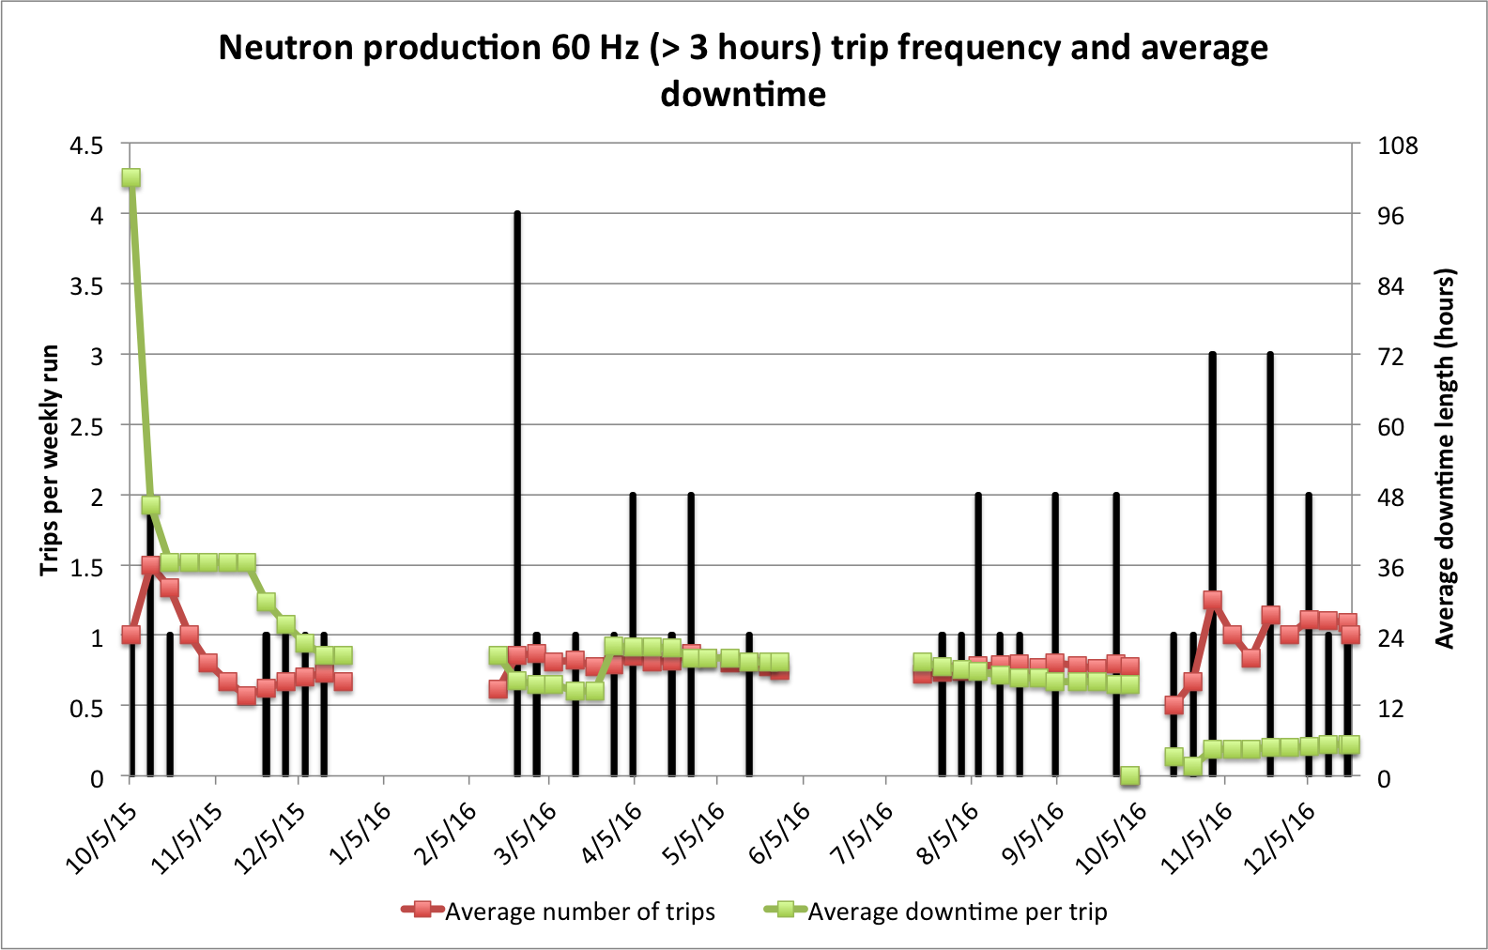
Strive for no more than 1 long duration trip every 2 weeks
UNSCHEDULED TARGET CHANGE
MAINTENANCE
UNSCHEDULED TARGET CHANGE
MAINTENANCE
SCHEDULED TARGET CHANGE
FY16
Run 1
FY16
Run 2
FY16
Run 3
FY17
Run 1
Multiple unrelated issues
Multiple unrelated issues
Notes:
February 2016: CCL2 HVCM smoke alarm, CCL4 neg regen, RFQ klystron, ion source water leak and arcing
October 2016: SCL cavity 17b vacuum and corrupted SCL phase file, ion source water leak at extractor hose
November 2016: SCL9 HVCM smoke alarm twice, SCL15 HVCM oil pump

Slide 16
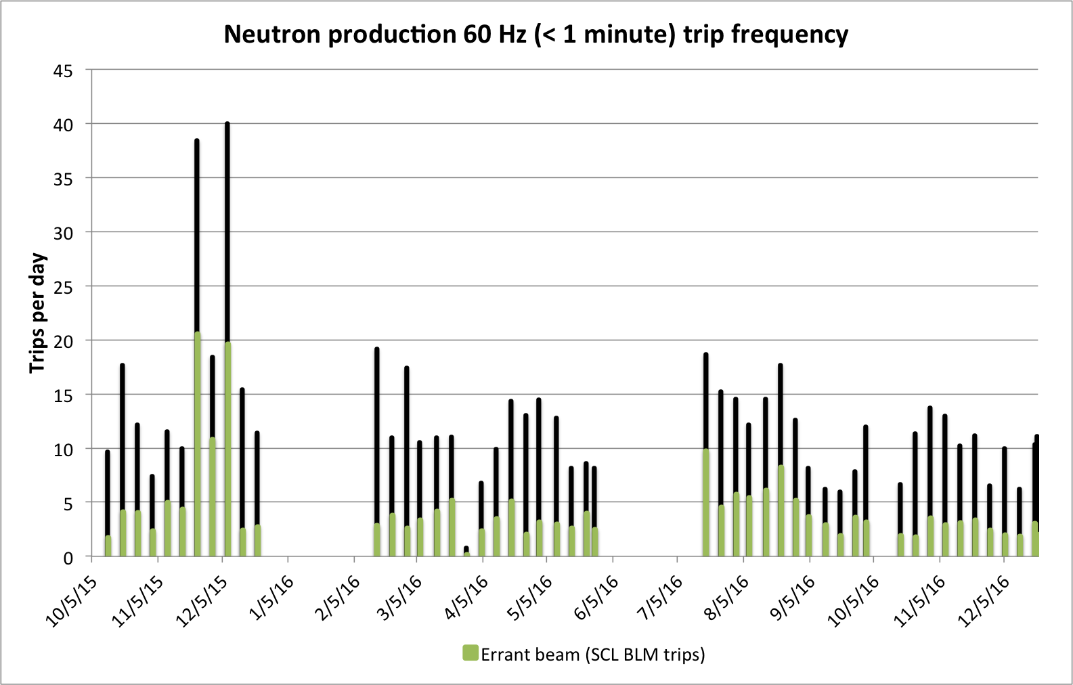
Continue to monitor errant beam trips; individual equipment issues significantly affect the trip rate
UNSCHEDULED TARGET CHANGE
MAINTENANCE
UNSCHEDULED TARGET CHANGE
MAINTENANCE
SCHEDULED TARGET CHANGE
FY16
Run 1
FY16
Run 2
FY16
Run 3
FY17
Run 1
Ion source edump insulator arcing
RF power and cavity field calibration changed

Slide 17
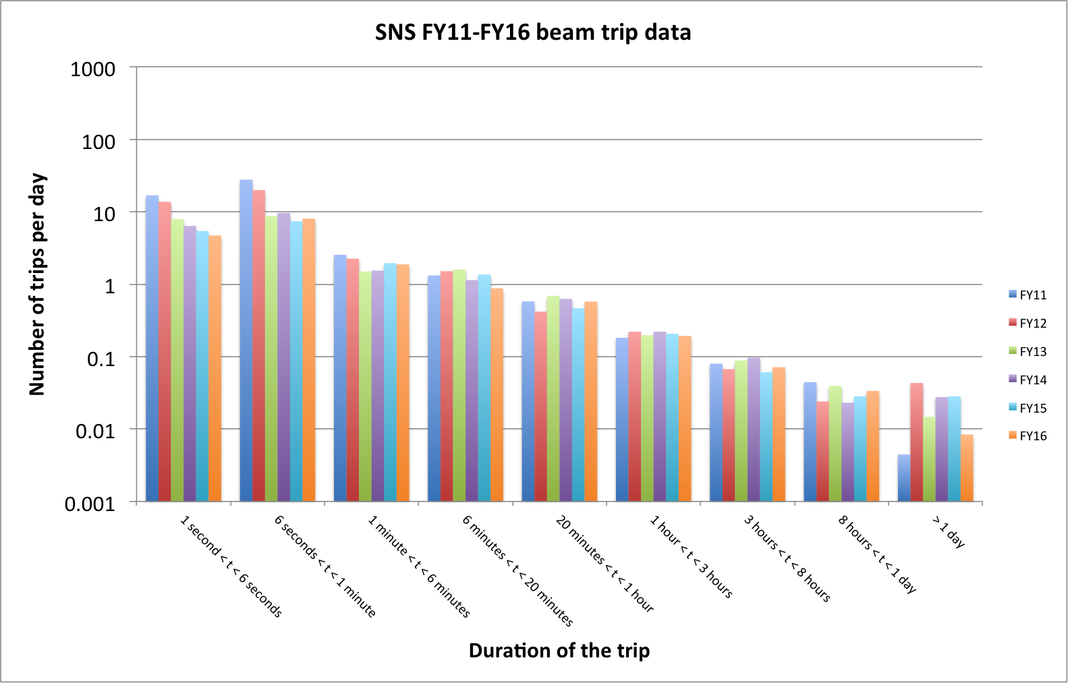
Good progress on reducing the number of short duration trips
Errant beam, magnet ps
SCL cavity trips
Warm linac cavity trips
Requires tech expert or repair (call-in)

Slide 18
Target failures accounted for 47% of downtime in FY16

Slide 19
Summary
Predictable operations at 1 MW and 1.2 MW as part of controlled experiment after T13 failure
Excellent availability excluding target failures
Long downtime events continue to have an impact on scheduling, performance, and beam power levels
We continue to measure our performance and make system improvements as you will hear over the next two days

