Slide 1
Control Systems Status and Upgrades
Presented to the
SNS Accelerator Advisory Committee
Karen S. White
Control Systems
Group Leader
March 9, 2017

Slide 2
Outline
Overview
Availability
Response to recommendations from AAC 2016
Staffing
System Tools
Slow Controls
Process Controls
Protection Systems
Controls Hardware

Slide 3
Integrated Control System overview
ICS Scope: Controls, Timing and Protection Systems
      Accelerator Instruments (PPS, Vacuum, Tools)
      Target Conventional Facilities
      Cryogenics Test Facilities
Large, distributed system based on the Experimental Physics and Industrial Control Systems (EPICS) toolkit and Control System Studio (CSS)
EPICS provides a flexible, layered architecture and integrates a variety of front end platforms
Scalable, distributed architecture is extensible (PPU/STS)
  new devices, capability, functionality can be added as needed
Emphasis on commercial, configurable, collaborative solutions

Slide 4
System Performance - availability

Slide 5

Recommendations from AAC 2016
Recommendation 11
  Keep a focus on Cyber Security. Keep current with evolving NIST standards. Try to maintain a risk-based approach to mitigating measures. Unfortunately some impediments to ease of use are almost inevitable. Educating staff on the importance of cyber-security is a good thing.
Response
  We continue our efforts to keep the ICS secure from cyber attacks
  System validated 2 time a year using highly regarded ICS-Cert tools from Department of Homeland Security (DHS)
  Intrusion Detection System (IDS) added last year provides an additional monitoring by ORNL IT; no unauthorized attempts to access the system detected
  Participated in DHS Industrial Control Systems Joint Working Group
  All employees take annual cyber security awareness training

Slide 6
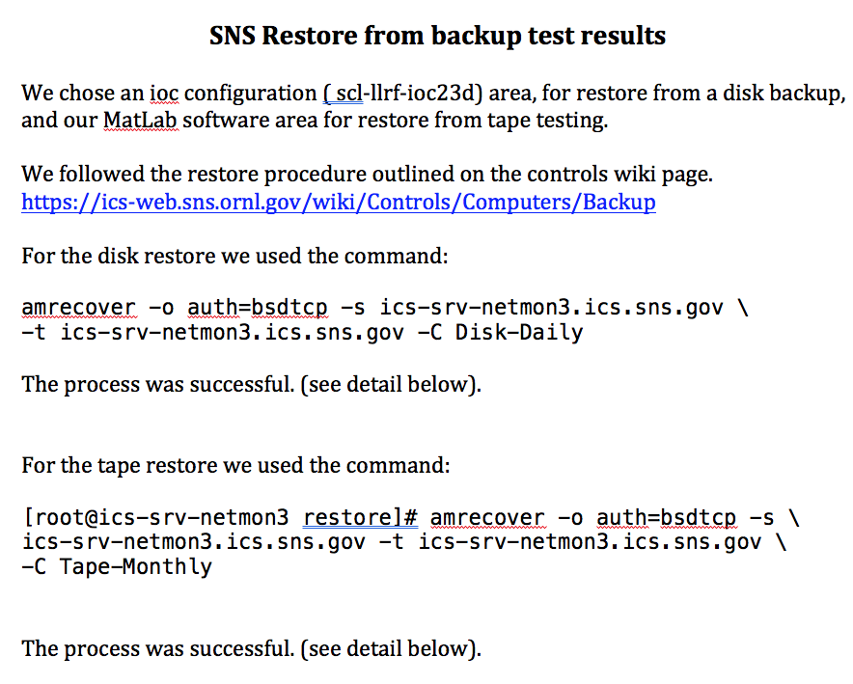
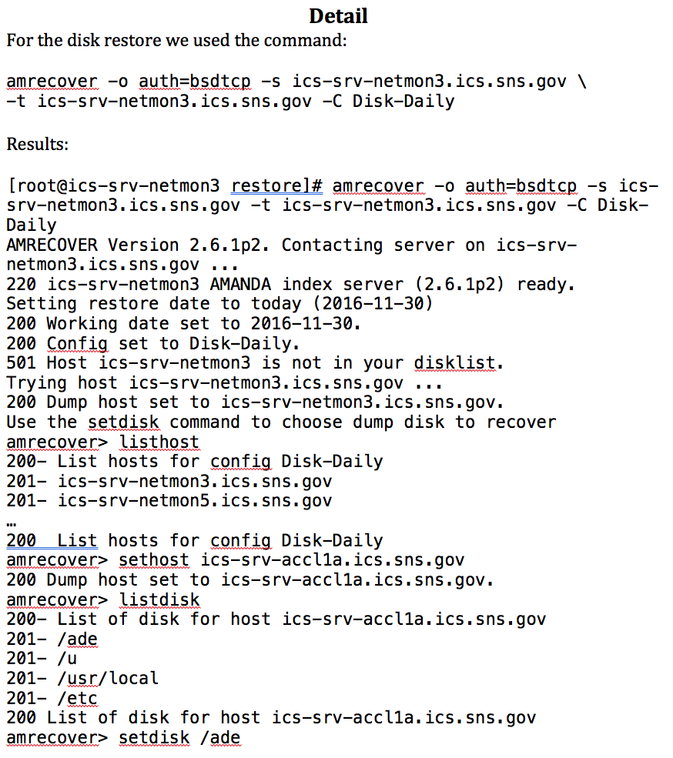
Recommendations from AAC 2016
Recommendation 12
  Make sure your backups are reliable, including those of user data. Among the many other good reasons for reliable backups, it is a key mitigation for addressing ransom-ware attacks.
Response
  Backups traditionally executed daily using a set of 24 rotating tapes
  Tapes are stored in the front end building, geographically separate from our server room
  Backups are tested periodically and user requests for restore of missing files have been successfully
  Recently augmented the tape backup system with daily disk-to-disk file copies, capable of storing approximately one year of backup files on-line for quick recovery

Slide 7
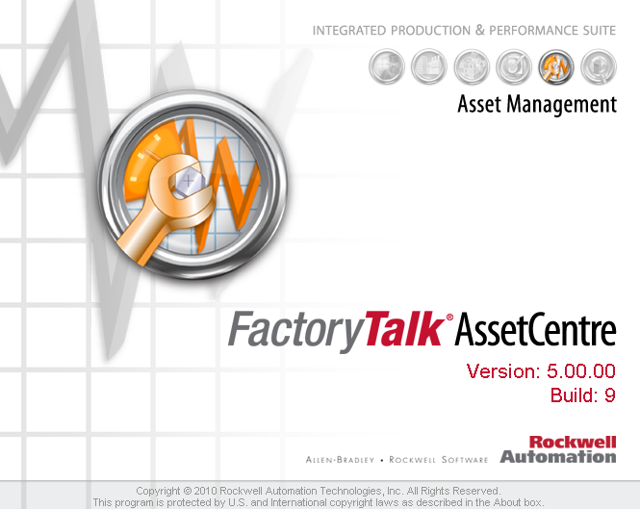
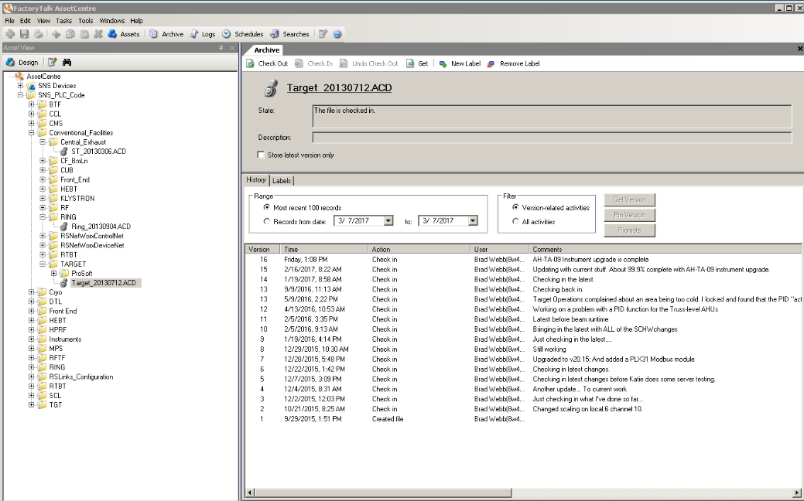
Recommendations from AAC 2016
Recommendation 13
  Consider adopting the same code management tools for other PLC systems at the facility, including, but not limited those that the Controls group has responsibility for. Importantly this should include the PPS PLC systems. This is an important tool for ensuring and validating that correct versions of code are deployed.
Response
  Now in AssetCentre
    All process controls for accelerator, target and instruments including RF and MPS
  Not in AssetCentre
    HVCM - Labview replacement complete in June 2017
    PPS - plan to migrate in FY18, need to modify relevant requirements and procedures first

Slide 8
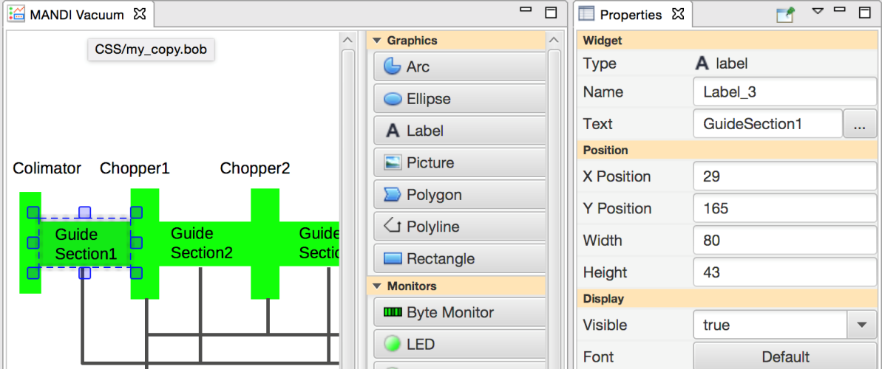
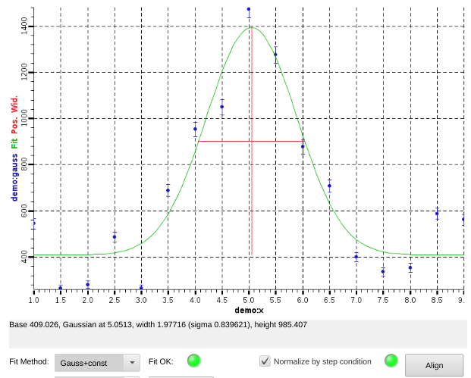
Recommendations from AAC 2016
Recommendation 14
  Continue to address CSS-BOY scaling problems. This is key if CSS-BOY (or its evolved version) is to replace EDM.
Response
  We continue to develop CS-Studio Display Builder as a comprehensive update of the CS-Studio BOY panel editor and runtime engine
  Modular design separates the model, (widgets/properties), from the graphical representation and runtime engine
  Model is fully multithreaded and demonstrated in both SWT and JavaFX
  The runtime engine, based on the thread-safe model, avoids user delays when opening new displays, handles control system updates and improves overall performance for complex widgets
  Operational on BL-11B, handles most existing BOY displays without modifications
  Deployment will continue on beamlines prior to more demanding use in the accelerator complex

Slide 9
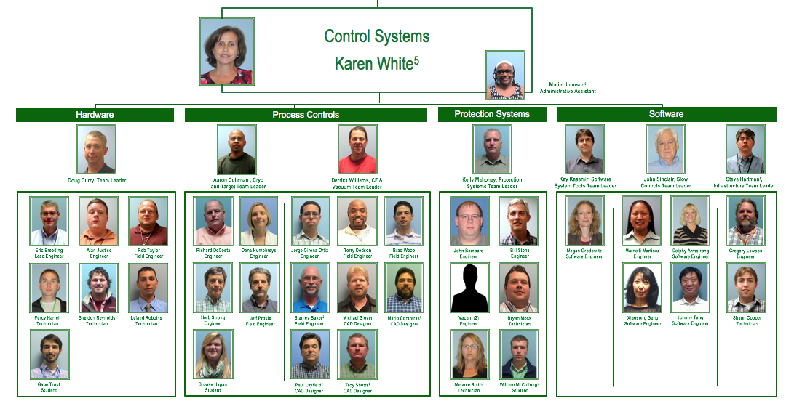
Staffing
Five new hires since last AAC
Process Controls - 2 engineer positions added after project prioritization process
Protection System - 3 engineer replacement positions filled
Positions for two anticipated retirements filled in advance to allow time for handoff and cross training
Considerations for hiring
  Skills mix to support existing systems and deliver planned projects
  Succession planning, working to balance the ratio of senior/junior staff
Improving group diversity
  60% of new hires are female or under represented minorities
Using contract labor to augment process controls engineer and designer effort

Slide 10
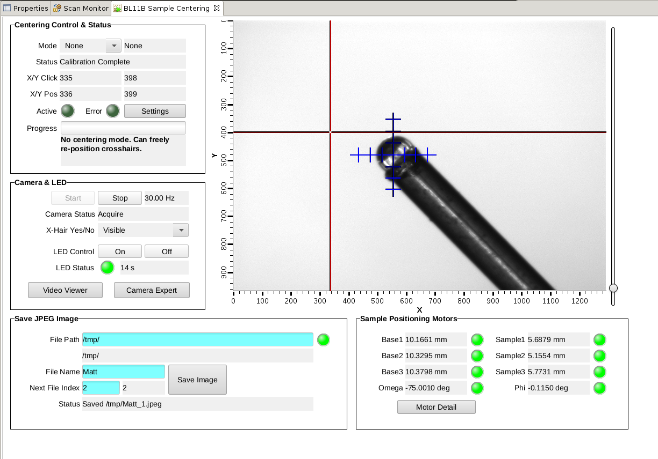
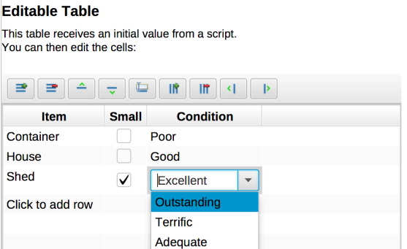
CS Studio - Display Builder initial release
Replaces BOY
Operational on MANDI
Better Editor
Improved Plot, Table and
Image Support
Improved script
performance
Supports EPICS V4

Slide 11
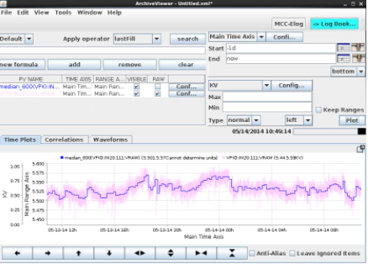
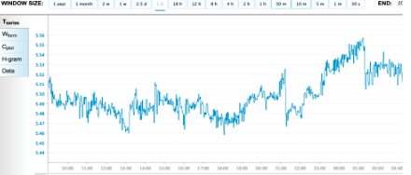
CS Studio - Archive Appliance evaluation
Promises to be fast
Nice web interface
Full CS-Studio integration
Configuration changes still need vetting
Does not “just work” with SNS configuration
  About 5x more channels on IOCs
  Cannot test via gateway
Concern about custom data files
  How to maintain ~300,000 custom data files?
  (90,606 files each { day, month, year })
  Cannot easily create large test data set
No way to ‘patch’ values (BCM25I)
Continuing with Oracle-based archive
Exploring InfluxDB
Notes:
Offers plots with error bars and allows integration of the point-to-center camera-based sample centering application and is our first tool capable of displaying the full-resolution detector histogram (4500 x 1800 pixels) with interactive zooming and panning.

Slide 12
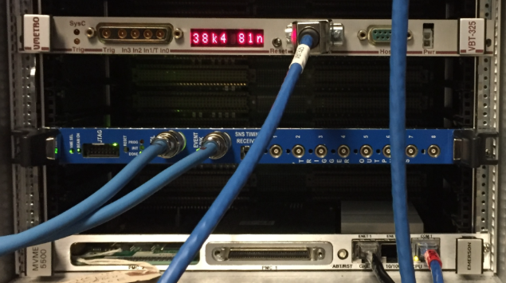
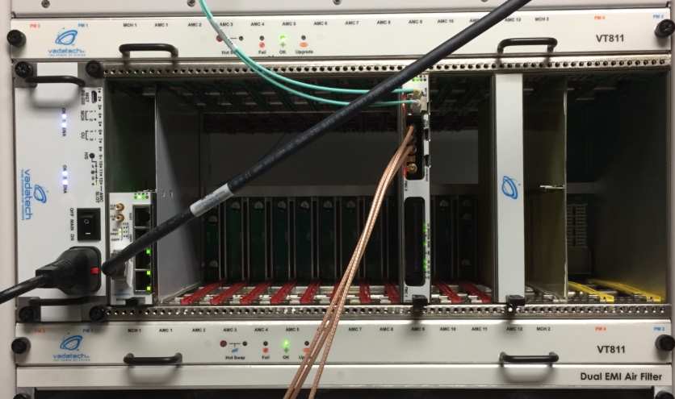
Slow Controls
EPICS support for a multitude of accelerator, target, instrument and test stand upgrades
Upgrades support phasing out obsolete hardware and improve spares pool
  IOCs with new timing receiver card (11 HPRF, 57 LLRF, 3 BTF)
  Updated device support for Group3 hardware and power supply controllers/interfaces on 5500s
  Upgrading IOCs from MVME2100 to MVME5500
    96 2100s, 66 5500s, 17 5100s (BLMs)
  EPICS support for new HVCM controls and vacuum upgrades
Developing PCI-e device drivers for Linux IOC for MicroTCA hardware (supports AIP-39)

Slide 13
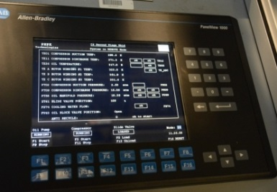
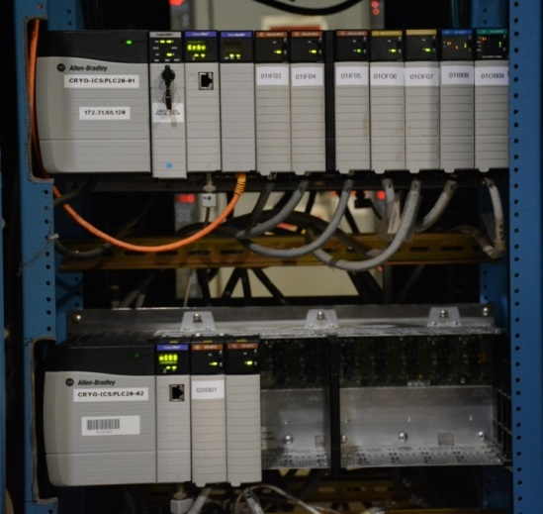
Process Controls
Support for accelerator and target upgrades and phasing out obsolete hardware
CHL
  New gas management PLC and firmware upgrades
  Automatic Transfer Switches for CHL PLCs and IOCs
Target
  Requirements development and vendor evaluation for remote handling controls replacement
  See DeCosta talk – Options for ServoManipulator Replacement (Target breakout session)
  Mercury leak detection controls
  Target leak mitigation
  Developing controls for small bubble gas injection

Slide 14
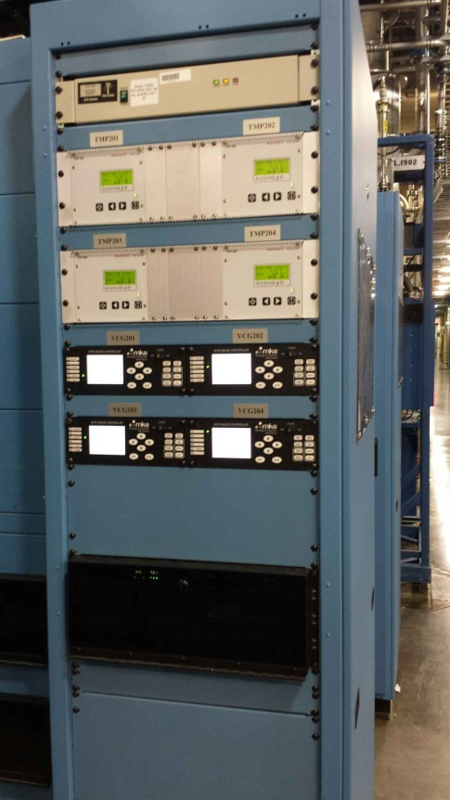
Process Controls
Foil and Scraper Motion Controls
  Test stand to support testing of stripper foil mechanical systems
  Using PLC based solution, proposed to replace obsolete VME hardware
Vacuum Upgrade (AIP-35)
  New controls for CCL3 & 4, and MEBT
  Will complete in 2017 with installation of CCL1 & 2
  Replaces obsolete controls components: gauge controllers, ion pump controllers, PLCs
Standardized and upgraded BL18 vacuum controls

Slide 15
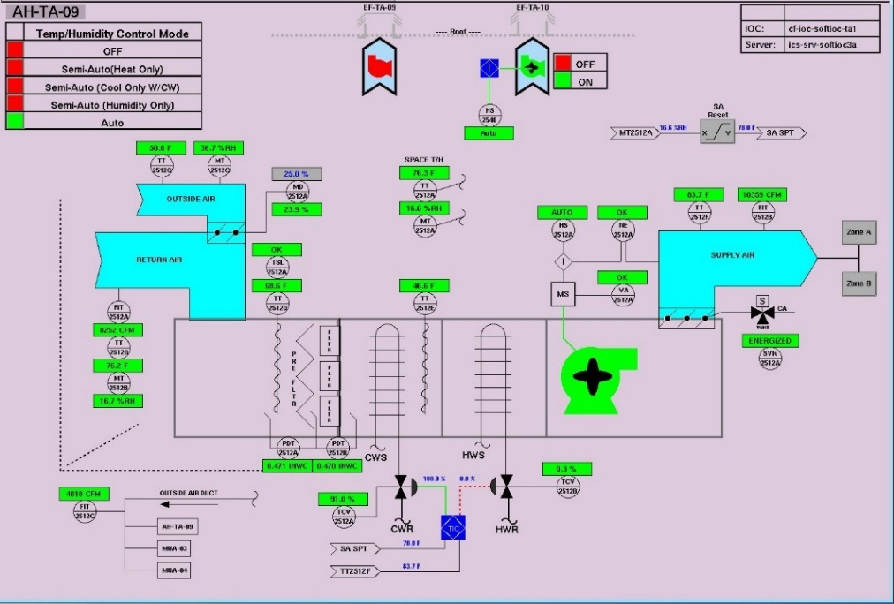
Process Controls
CUB CF Improvements
  Chiller Controls
  Trane LonWorks communication modules were replaced with BACnet solution
  Designing BTF DI water system upgrade
Target CF Improvements
  AHU-09 upgraded to standard controls

Slide 16
Protection Systems
PPS power supply ground isolation project - on schedule
Grounding issue discovered July 2013 in PPS CCR rack
Defect corrected, grounding evaluated system-wide and improvement plan developed
ETC is Summer 2018
  July 2015 – Isolated CCR, replaced racks
  January 2016 – Isolated klystron gallery PPS cabinets
  June 2016 - Isolated HEBT PPS cabinet
  June 2017 - Replace front end PPS cabinets
  January 2018 - Isolate Ring and RTBT cabinet power
  August 2018 - Isolate Target PPS power
Continuing effort to complete as-built drawings

Slide 17
Protection Systems
Support for SNS Projects
  Beam Test Facility (BTF) PPS
  ODH system for COHERENT neutrino experiment
  Modified standard secondary shutter motion control assembly/PPS interface for 2 more beamlines
FY17
  Replace Front End Racks
  Replace DTL 1 & 2 waveguide blanks with shutters to enable quick (4 hours => ~30 minutes) configuration for front-end only mode during maintenance days

Slide 18
Protection Systems
Future Upgrades
  Linac ODH System
  Move to COTs-based Radiation Monitor
  Move to certified safety equipment (Safety PLC)
  Convert two beamlines to standard configuration
  Convert ControlNet to Ethernet
  Upgrade PPS-RF Interface

Slide 19




Hardware
Chopper Controls Improvements
  Smart Chopping
    Modify ramp down sequence from single stage to triple stage
  Beam blanking
    Full chop up to 20 Hz during non-beam machine cycles
      20 Hz limit is set by chopper target cooling capacity
    Reduce contamination to the RFQ
Ramp up
Ramp down
Faster MPS Shutdown
  Interfaced SCL DBCM to the LEBT Chopper controller cutting MPS response time in half for total beam loss conditions in the Lina
Chopper gaps

Slide 20
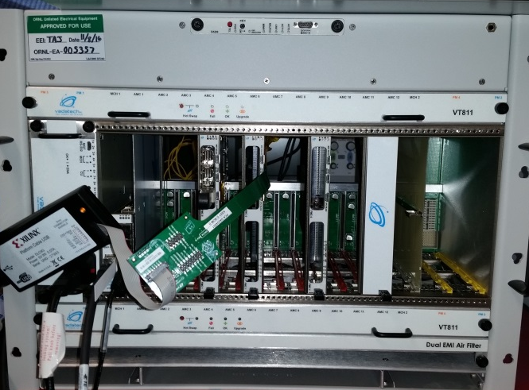
Hardware
Evaluating μTCA to support for future projects
  MPS AIP-39 and new LLRF system
  LLRF bandwidth requirement for STS (360 MB/s) exceeds VME capability
      VMEbus32 40 MB/s
      VME64x 160 MB/s
      μTCA 1 GB/s for PCIe Gen 1
      μTCA 4 GB/s PCIe Gen3
  Currently running two unique IOC configurations @ 600 MB/s
  Collaboration with Argonne using our firmware/device support @ 200 MB/s with a different IOC, OS and μTCA crate

Slide 21
AIP-39 modernizes MPS
Legacy System
New System
Decreasing Reliability
  Aging hardware => higher probability of failure
  Field failure rates increasing
  Complexity => more failure points
Declining Maintainability
  Increased failure rates reduce spares inventory
  Component obsolescence prohibits obtaining adequate supply of spares
Limited Scalability
  Lacks capacity to be extended for PPU/STS
  Limited diagnostics/capacity for improvements
Reliable and Maintainable
  Simplified, efficient architecture
  Highly integrated => failure point reduction
  Uses more modern subsystems and components
Improved Performance
  Lower latency communication links
Scalable Architecture
  MicroTCA-based platform
  Provides a viable path for major facility upgrades — PPU/STS

Slide 22
New MPS – multiyear phased deployment
Notes:
We are limited to replacing systems during scheduled outages.

Slide 23
Summary
Controls is successfully
  Managing the performance of our large, distributed EPICS based control system
  Integrating a wide variety of device types, supporting accelerator, target and instrument improvement and development projects and phasing out obsolete elements
  Improving design and development processes
  Simplifying systems to reduce support requirements and maintain availability
  Collaborating with IDAC to develop and test new software tools on the instrument beamlines before migration to the accelerator

Slide 24
Backup

Slide 25
New FPS: Low-latency, distributed architecture
“Form, fit and function compatible” with legacy system interfaces
Hierarchical topology:
  5-Gbps Aurora-based fiber-optic interconnects
Scalable architecture based on MicroTCA standard and COTS hardware.

