Slide 1
Production ion source performance and progress on the external antenna source
Presented to the SNS Accelerator Advisory Committee
Robert Welton
APBIIS
March 8, 2017

Slide 2
Content
The SNS ion source and test facilities
Performance of the production ion source, operational issues, improvements and R&D highlights
BTF ion source systems and start-up
The external antenna ion source
Outlook: meeting SNS requirements with both RFQs and supporting BTF operations

Slide 3
2016 AAC comments
No specific ion source recommendations just general comments…..
The ion source continues to run with good reliability, although this year there were several failures of the edump which turn out to have been related to a change in vendor for the alumina insulator. The problem now seems to be resolved by reverting to the original supplier plus increasing the insulator thickness in the weakest area. Through ongoing improvements, the source intensity continues to get better, although it is not yet to the point where one has a comfortable margin over the operational requirements (partly due to the still reduced RFQ transmission). Good progress in several areas - operation at reduced gas pressure, improvements on understanding and elimination of plasma outages, and operation with higher extraction voltage to reduce the emittance and improve the RFQ transmission.
Test Stand external antenna studies were resumed, with good results on long term stability. This external antenna source seems close to using for operations. For test stand studies of source performance variations and operation at higher extraction voltages, it would be good to get water cooling on the front slits so that source emittances can be made at full duty factor.
One expects that the source performance will continue to improve, since there is much activity worldwide on H- sources, and the SNS team are active participants in this community effort.
No LEBT valve yet on either ITSF or operational source. Committee still supports the installation of this valve in both locations at the appropriate time.

Slide 4
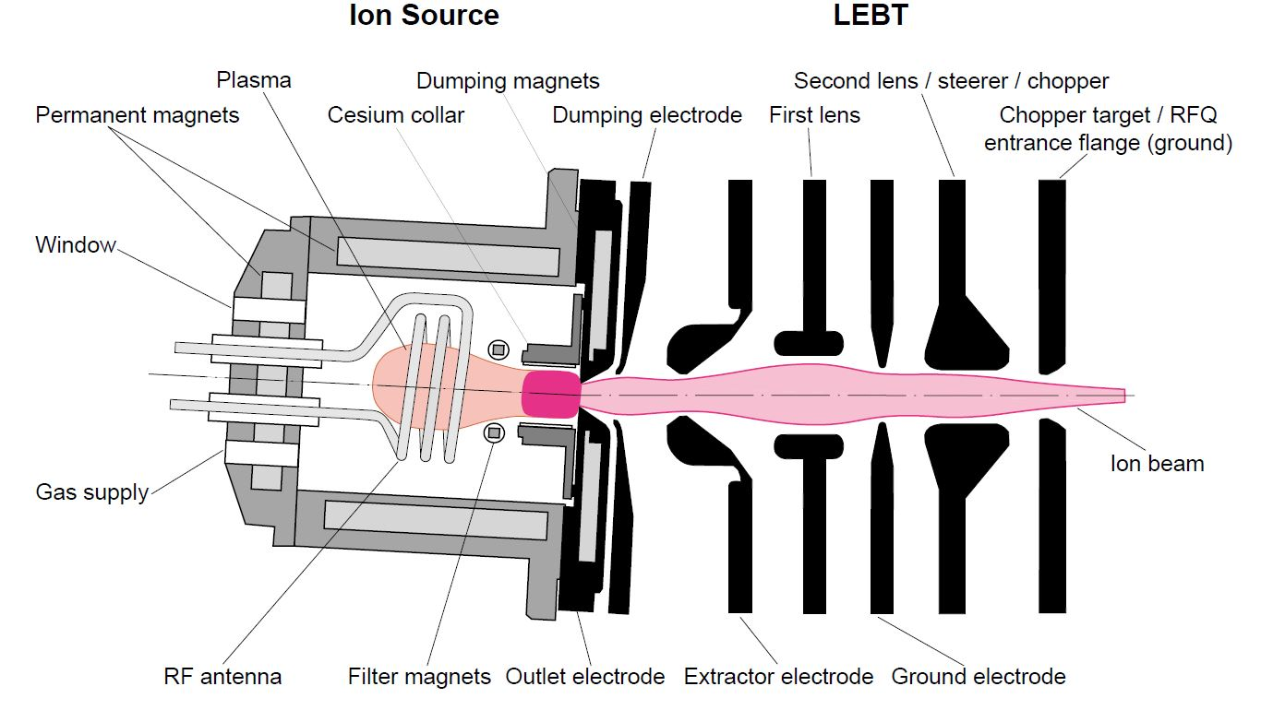
The SNS ion source and the electrostatic Low Energy Beam Transport (LEBT)
Both systems were designed at LBNL and improved over the years at ORNL
RF-driven, internal antenna, Cs-enhanced, multicusp H⁻ ion source has been operating on the SNS from the start of the facility
The Low Energy Beam Transport (LEBT) is composed of 2 Einzel lenses which match the extracted beam into the RFQ
LEBT beam current measurement
2 +13 MHz
Outlet aperture assembly

Slide 5
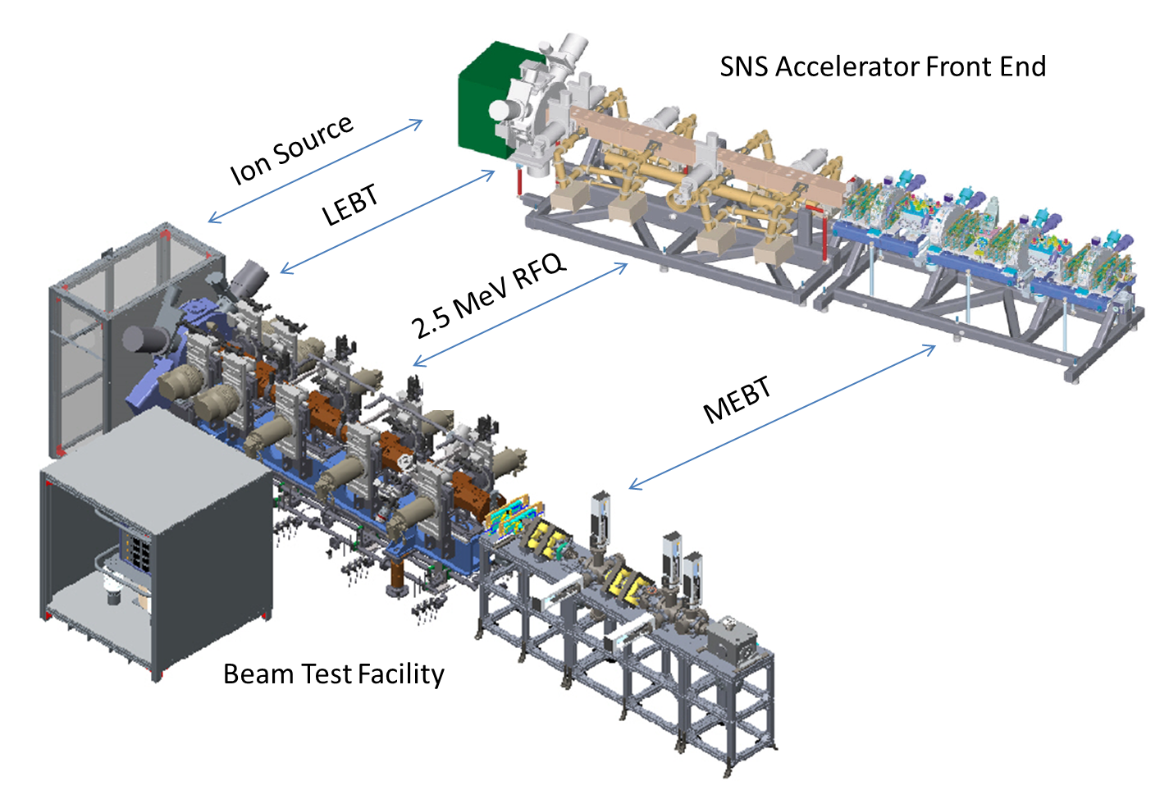
Source testing areas now include the BTF!
ORNL baseline source #2,3,4,5,6,7 and external antenna sources x3, x4 can be installed interchangeably on the SNS accelerator (8100), test stand (8100) and BTF (8320)
Nearly identical electrostatic Low Energy Beam Transports (LEBT) are also installed, interchangeably in each facility
Tomco 120kW RF generator
Ion Source
Diagnostic chamber
Small test stand
Big Blue Box
Ion source, LEBT, RFQ, diagnostics
Ion Source Test Stand:
ion source, LEBT, diagnostics
Plasma diagnostics: Spectroscopy and RGA

Slide 6
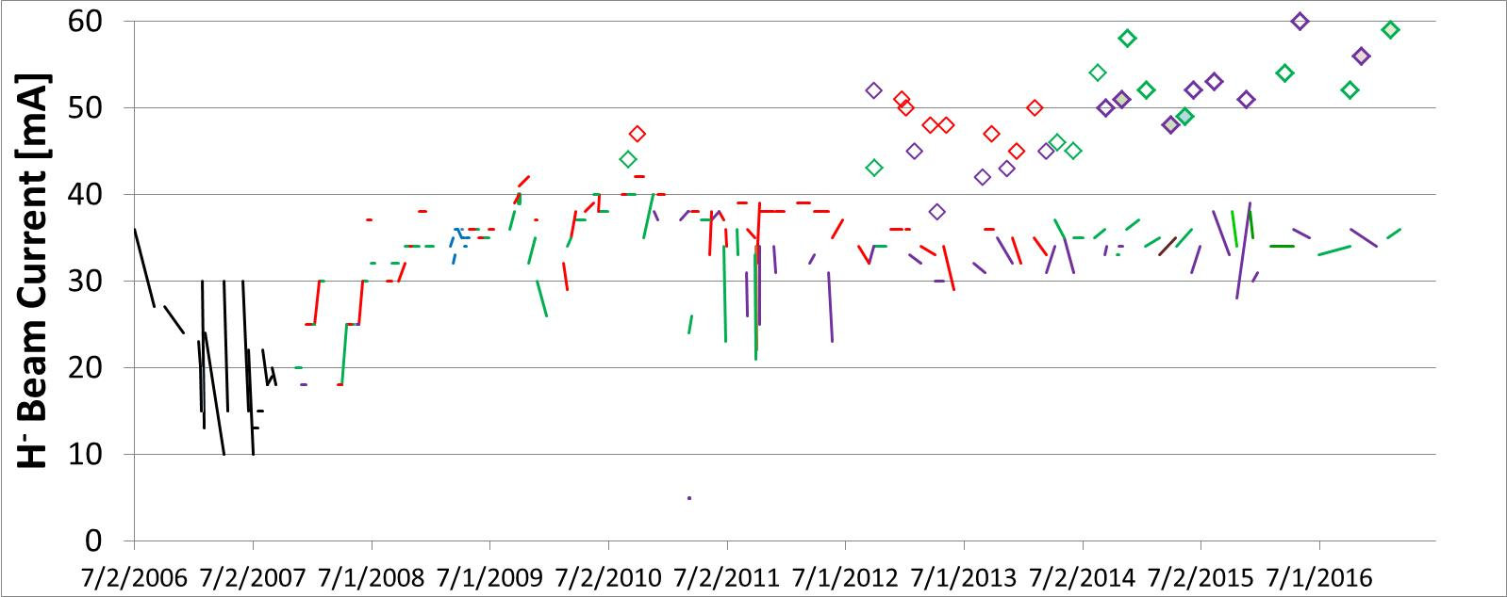
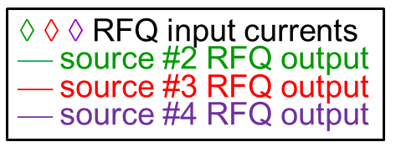
SNS ion source history: pushing source performance while maintaining high reliability
Year of ~40 mA MEBT currents
RFQ input current
Only source #3 makes ~38 mA
Less sources, less variations
Decaying beams before developing proper conditioning
E-dump failures
7A·h
run
Antenna failures
Reduced RFQ transmission
Ramping up the beam with many improvements
source leaks & contamination
large leak
140 H⁻ sources have been started up for n-production. In recent years ion sources have been pushed harder due to decreased RFQ performance while maintaining high availability typically >99%

Slide 7
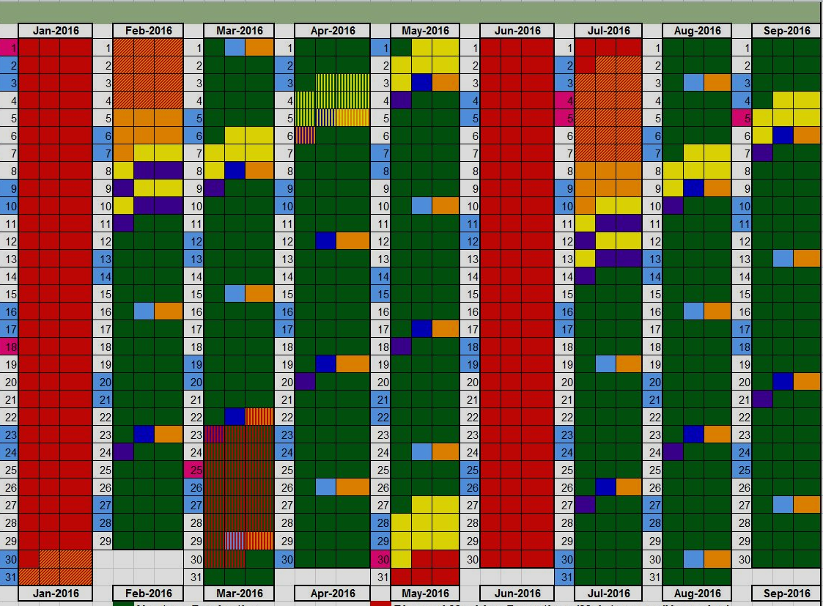
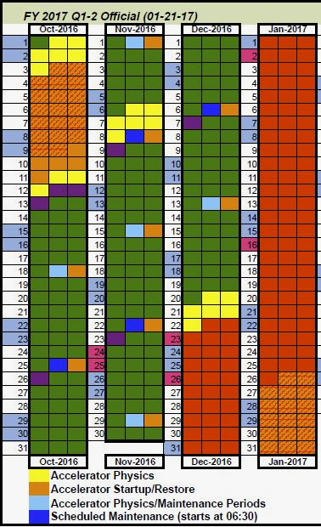
2016 SNS run schedule: planned source rotation
LEBT
change
#2
#2
#4
#4
LEBT
change

Slide 8
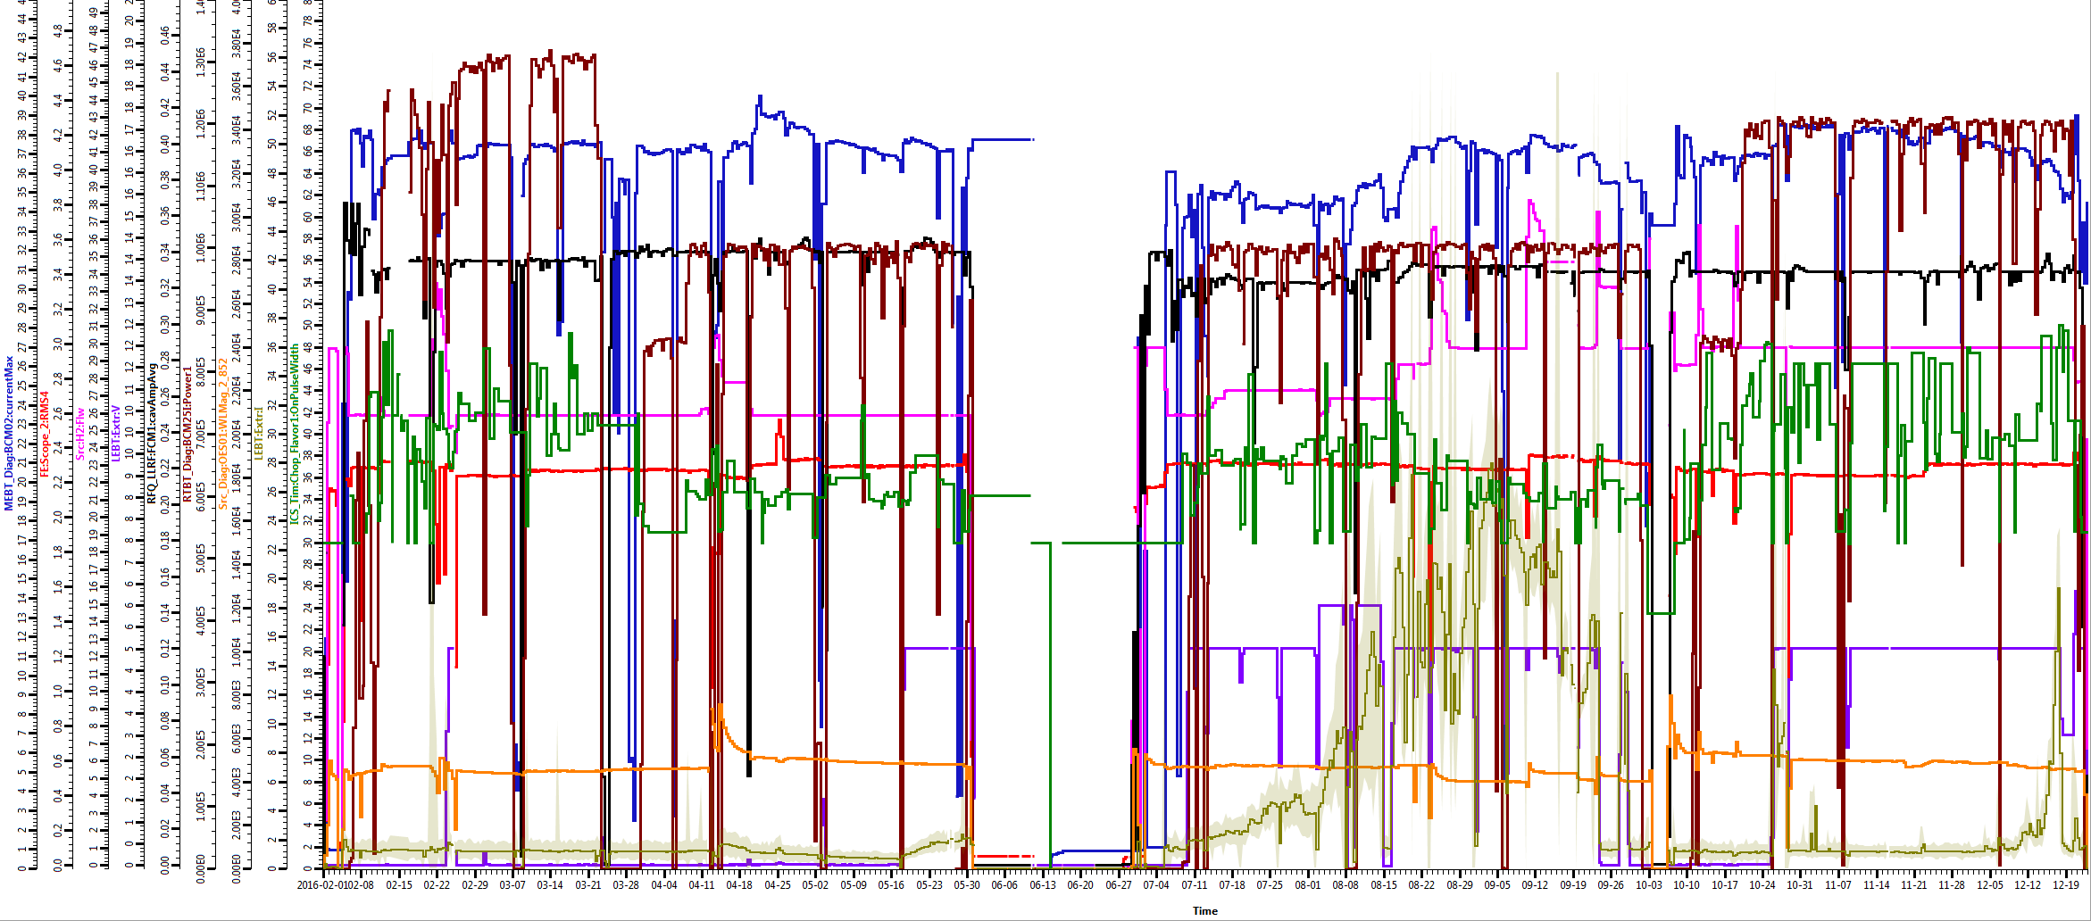
Delivered record performance in 2016, extended source service cycle, no unscheduled source changes high availability!
Target fails
RFQ input: 52-60 mA
1.3 MW power
34-36 mA
1.2 MW
30-37 mA
1 MW
33-34 mA
1 MW
RFQ
26 sccm
Increased
extractor
voltage
~55 kW
chopper%
Cesiation
Cs 852
source #2
source #4
source #2
Extractor water line bursts
source #4
2016 run summary: significantly increased source service cycle up to 96 days (record 7 amp-hours!), no unscheduled source replacements (71, 48, 96, 78 day service cycles) !!
Source / LEBT availability 99.5% !!!
For the last 41 days the H⁻ source injects 59 mA into the RFQ, with 36 mA exiting. The source is expected to remain for a total of 122 days, accumulating ~10 A·h!

Slide 9
System issues and improvements made in 2016
2016 ion source/LEBT downtime (31/5554h= 0.6%) was led by
water hose failures and consequences
13 MHz RF & AC system issues
plasma outages/voltage/arc/dips
These motivated some of the system improvements undertaken in 2016:
Lengthened Source/LEBT HV water lines, thereby slowing the deposition of material in the water, implemented the use of clear tubing, inspection and routine replacement
Added protection components (MOVs) to the AC side of the13 MHz amplifier
Installed a larger, more accessible, 45kV steering deck
Designed and built a new ion source cage in preparation for the BTF RFQ installation on the SNS accelerator.

Slide 10
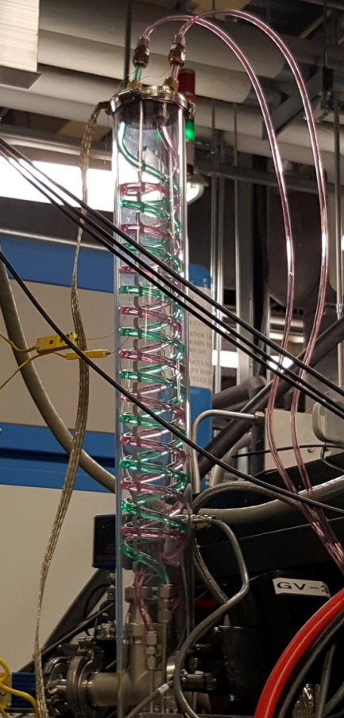
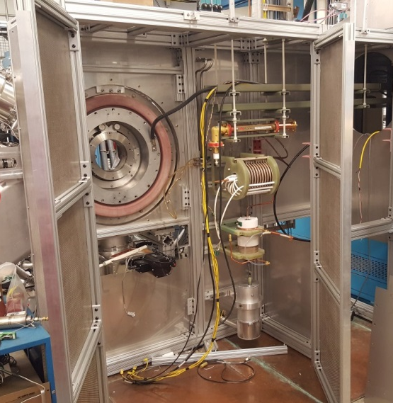
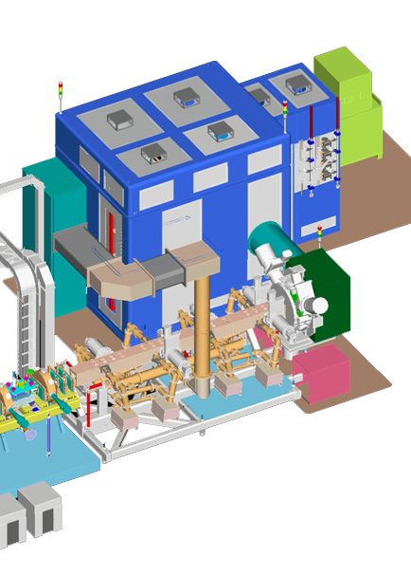
Upgrading HV water lines, steering deck & ion source cage
Previous configuration
New 45kV steering deck inside source HV enclosure
-45kV
New ion source cage on ion source test stand
-45kV
New and old extractor water feed lines FE
-65kV
Former location of 2MHz supply
Removable 45kV control chassis
-65kV
Allows the use of rack mounted controls chassis
D. Curry
Big Blue Box

Slide 11
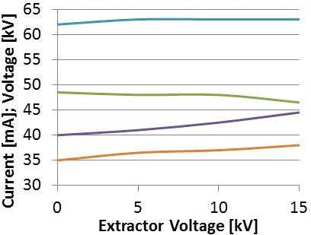
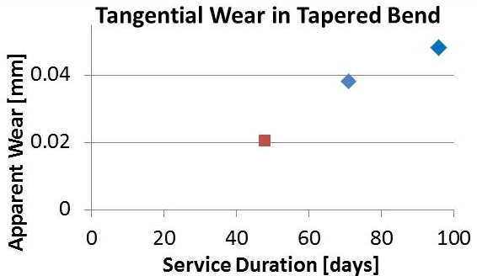
2016 R&D highlights: improved RFQ transmission, refined LEBT beam current measurements & quantification of antenna wear
Beam studies in May 2016 and theoretical work showed that increasing the extraction field reduced emittance and improved RFQ transmission yielding a few more mA out of the RFQ: implemented during run
Beam studies showed that our LEBT beam current measurements were refined by increased focusing of lens 2.
Chopper target beam current measurements were performed on the test stand allowing direct comparison of this technique with BCM & FC measurements to continually refine our technique
Internal antenna wear measurements of the most plasma exposed surface showed 0.5 µm/day (0.1%/day) and that long service cycles (even greater than target cycles) would not be limited by antenna wear
Extractor at 0 kV
RFQ input current
lens 1 voltage
lens 2 voltage
RFQ output current

Slide 12
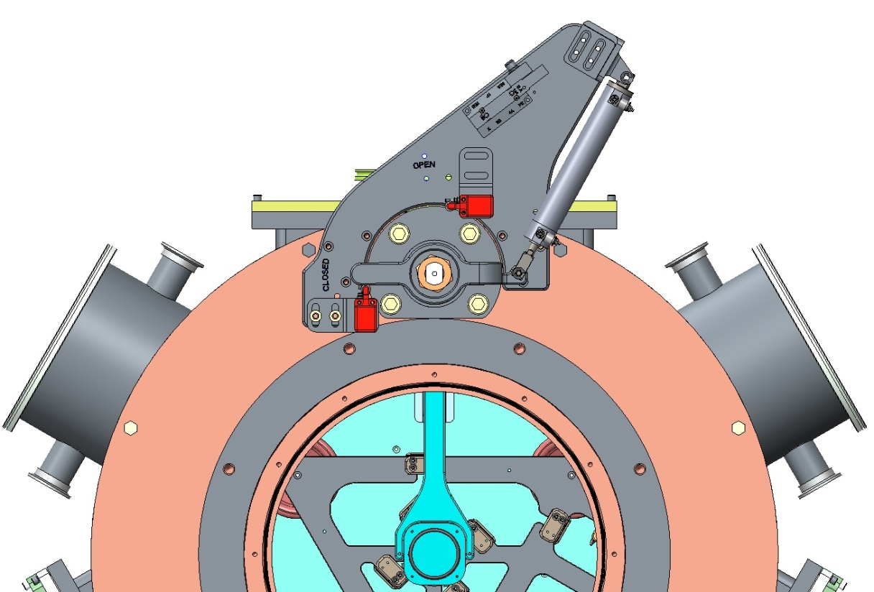
Engineering projects: LEBT-RFQ gate valve, replaceable chopper target and upgraded emittance scanner
Existing Chopper target
Allison scanner with cooled TZM front plates
Measure emittance under operational conditions
Status: in design
Goal: measurements in 2017
Replaceable chopper target
Old design: Service requires removal of the critical RFQ end wall
New design allows easy service from LEBT side
Status: in design
Goal: use on test stand, parts ready during RFQ move
Isolate LEBT & RFQ vacuum
Status: prototype made, testing on test stand
Install during RFQ move to front end
New Chopper target

Slide 13
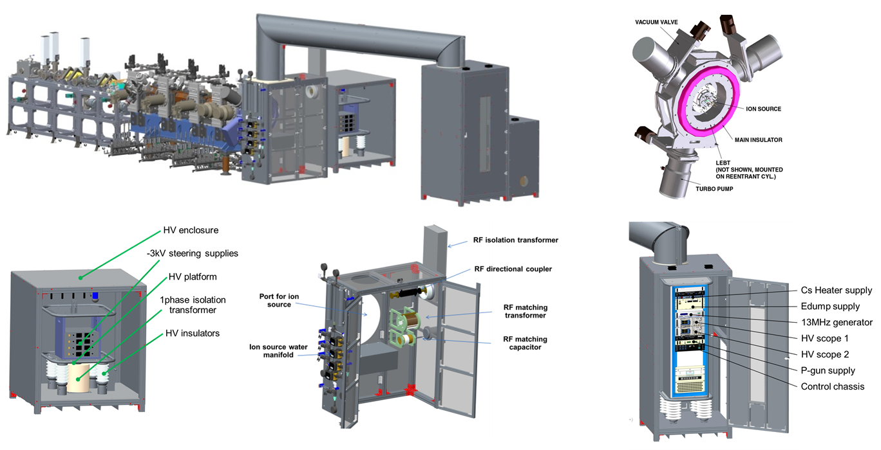
The BTF Ion Source Systems
Includes all electrical & mechanical components supporting the ion source and LEBT, extensive use of 80-20 frameworks + custom sheet metal
Complete safety interlock chain, water shutoffs
Isolation transformers
19kVA
HV conduit
~3000l/s
LEBT tank
Steering Deck
HV enclosure
Ion Source Cage
All HV structures have a min of 6” gaps (2.5x FOS)

Slide 14
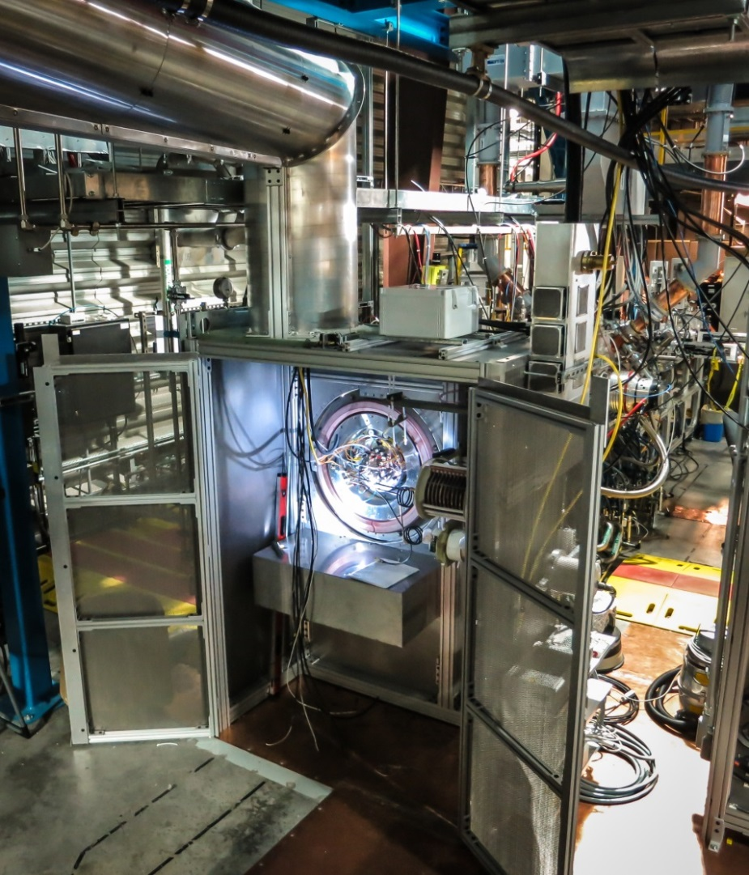
The BTF ion source systems timeline
July 2013 Ion Source / LEBT systems design and acquisition work begins in earnest (weekly meetings)
July 2014 RFQ acceptance test
March 2014 First Vacuum in LEBT tank
August 2014 construction largely complete
August 2014 installed 1st ion source #6
July 2015 - RFQ fully conditioned to 1ms, 60Hz, 550kW
Aug 2015 1st plasma and HV source operation
March 2016 1st beam extraction in LEBT
April 2016 1st LEBT beam measurements
August 2016 BTF operational readiness review
Sept 2016 beam through the RFQ!
Oct 2016 high current beam routinely produced, transition to operations

Slide 15
Table of ion sources tested on the BTF
Source | installed | removed | Days tested | RF set point | LEBT beam current | MEBT beam current | Issues
#6 | Aug 2014 | Aug 24, 2016 | ~14 days | ~60 kW | ~60 mA | na | Edump dips (end of run) thin walled insulator
#6 | Aug 29, 2016 | Oct 11, 2016 | ~2 days | ~60 kW ~30 kW ~35 kW ~40 kW | ~60 mA ~13 mA ~22 mA ~33 mA | Na 8 mA 18 mA 26 mA | Struggled with alignment, extractor heating
#6 | Oct 14, 2016 | Nov 25, 2016 | ~10 days | ~50 kW ~55 kW ~70 kW | ~45 mA ~50 mA C. Target failure | ~32 mA ~44 mA ~50 mA | Aligned with dummy source, o-ring unloaded, full power RFQ operation test, bend mode, lost chopper target
x3 | Nov 28, 2016 | Dec 9, 2016 | ~11 days | ~36 kW ~35 kW ~43 kW |  | ~40 mA ~44 mA ~50 mA | 5D measurements no explicit Cesiation!
#3 | Dec 14, 2016 | Jan 25, 2017 |  | ~53 kW ~44 kW ~43 kW |  | ~46 mA ~40 mA ~29 mA | Edump struggles, beam decay, 2 min Cs partially recovered beam
x4 | Jan 25, 2017 | running | 20+ days | ~32kW |  | ~40mA | Lens 2 conditioning, plasma ignition, water line leak

Slide 16
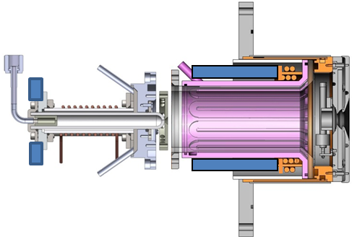
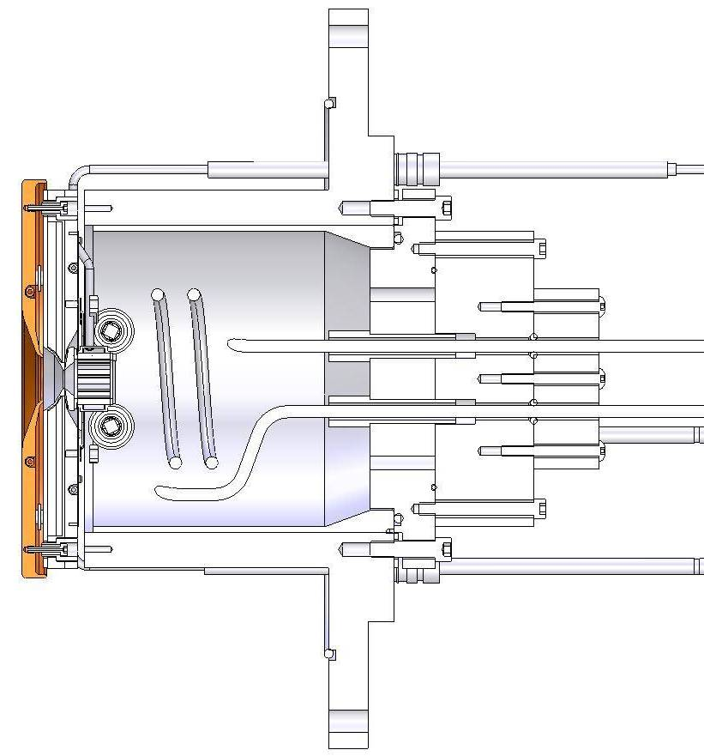
The SNS external antenna source
8 Cs₂CrO₄ dispensers loaded into the collar
Filter field
External Antenna Source
RF Plasma gun
Cs Collar
Outlet
aperture
AlN Plasma Chamber
Electron Dump
Internal Antenna Source
PEEK cooling jacket
Antenna
Multicusp magnets
Mounting
flange
Designed and developed at ORNL in previous years
An alternative to the internal antenna source which does not depend on the ‘art’ of porcelain enamel airbrushing conducted by a single manufacture. Presently the internal antenna quality is high but in the past quality lapses have resulted in considerable SNS downtime in 2010-2011. Source also requires much less RF power.
2015 AAC committee observation & findings, “It was also very nice to see that external antenna development has resumed on the test stand, since ultimately this will most likely be the preferred configuration, compared to the internal antenna.”

Slide 17
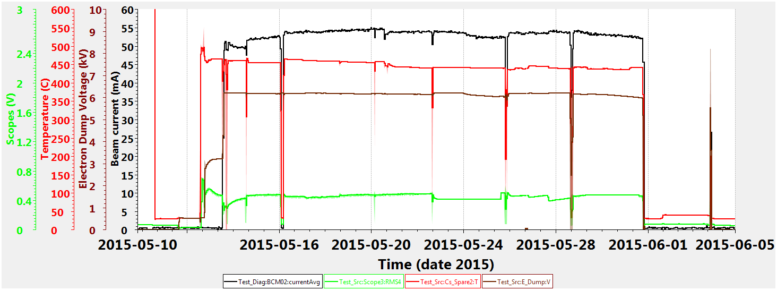
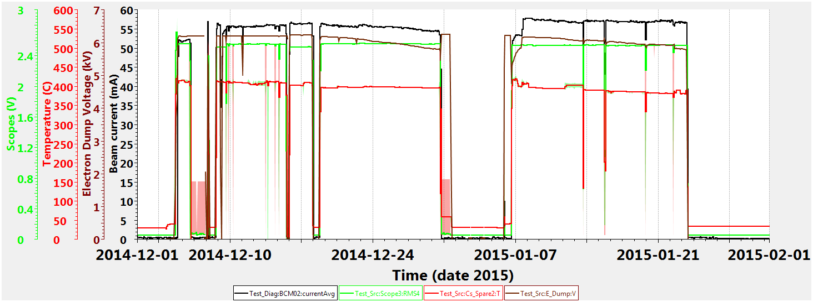
SNS external antenna source background & plans
In 2014-15 the design evolved to allow persistent beams of 50-55 mA through the LEBT measured on the test stand (no RFQ) for periods 5-6 weeks
~52mA for 34 days
~56mA for 40 days
Now it is important to update documentation of source drawings and procedures (assembly, installation, operation, removal, refurbishment and troubleshooting) to bring the source to operational readiness.
This year testing resumes on the BTF to support long 6D experimental runs which is an ideal to develop this operational rigor with the source

Slide 18
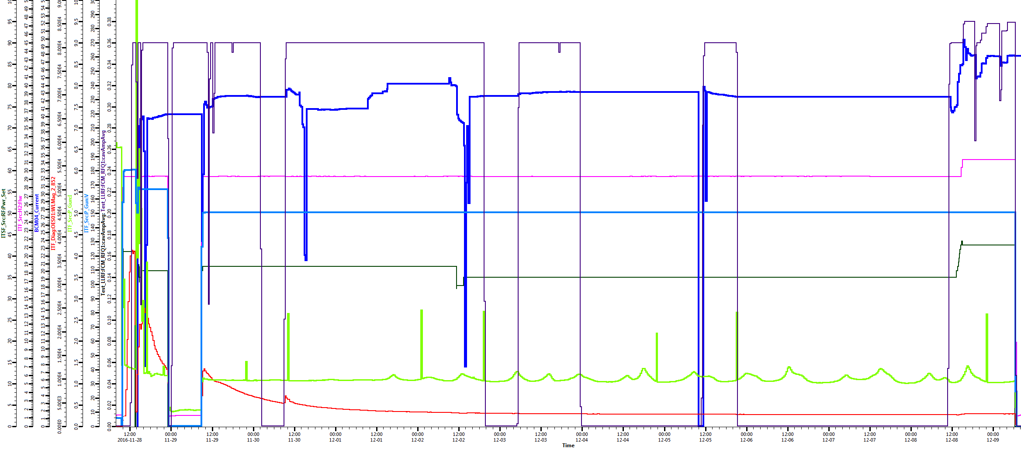
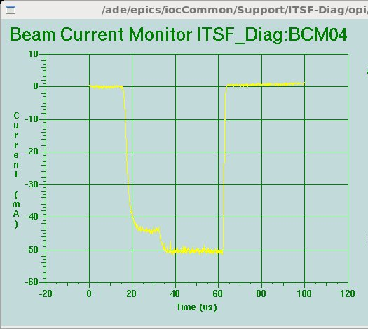
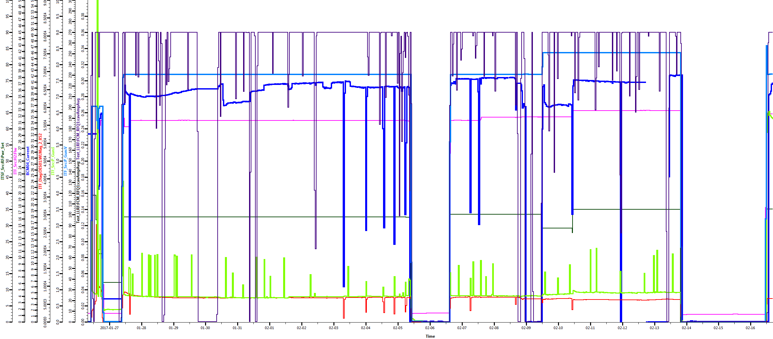
Recent external antenna source performance on the BTF – beam out of RFQ
Source x3: ~40mA, 11 days, 35kW
Source x4: ~40mA, 14 days, 35kW
~45 kW
~50 mA
In late 2017 all reliability data from extended BTF usage will be examined and compared with baseline source performance and the decision made to use on the SNS

Slide 19
Summary and outlook
In 2016 we delivered record beam currents, up to 7 A·h and 99.5% availability with no unscheduled source changes, aiming for 10 A·h matching the target service cycle with a single source!
BTF ion source systems routinely delivered 40 mA out of the RFQ supporting the research program, tested with five different sources
Two external antenna ion sources were tested on the BTF produced up to 50 mA and 40 mA for multiple week runs. Reliability data will determine use on SNS accelerator.
Baseline source #2 or #4 can provide 1-1.2 MW operations with the Berkeley RFQ with sufficient margin
Sources with the new RFQ can provided 40 mA output beams, as demonstrated now routinely on the BTF, easily supporting 1.4 MW operations and closing the gap to PPU requirements!

