Slide 1

Managing your Globus Deployment
Oak Ridge National Lab
Rachana (rachana@globus.org)
Greg (greg@globus.org)

Slide 2
Slides and useful links:
globusworld.org/admin-tutorial
All passwords: globus2017

Slide 3
Enabling your storage system:
Globus Connect Server

Slide 4



Globus Connect Server
Local system users
Globus Connect Server
MyProxy
CA
OAuth
Server
GridFTP Server
Local Storage System
(HPC cluster, campus server, …)
DTN
Create endpoint on practically any filesystem
Enable access for all users with local accounts
Native packages: RPMs and DEBs

Slide 5
Demonstration
Creating a Globus endpoint on your storage system
In this example, storage system = Amazon EC2 server
Akin to what you would do on your DTN

Slide 6
Step 0: Create a Globus ID
Installation and configuration of Globus Connect Server requires a Globus ID
Go to globusid.org
Click “create a Globus ID”

Slide 7
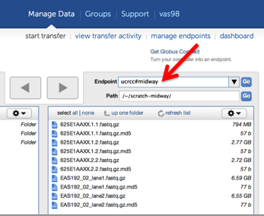

What we are going to do:
1
Install Globus Connect Server
Access server as user “campusadmin”
Update repo
Install package
Setup Globus Connect Server
Server
(AWS EC2)
ssh
2
Log into Globus
3
Access the newly created endpoint (as user ‘researcher’)
Test Endpoint
4
Transfer a file

Slide 8
Access your host
Create a Globus ID
  Optional: associate it with your Globus account
Get the DNS for your EC2 server
Log in as user ‘campusadmin’:
ssh campusadmin@<EC2_instance_IP_address>
  (password: globus2017)
NB: Please sudo su before continuing
  User ‘campusadmin’ has sudo privileges

Slide 9
Step 3: Install Globus Connect Server
Cheatsheet: globusworld.org/admin-tutorial
$ sudo su
$ curl –LOs http://toolkit.globus.org/ftppub/globus-connect-server/globus-connect-server-repo_latest_all.deb
$ dpkg –i globus-connect-server-repo_latest_all.deb
$ apt-get update
$ apt-get -y install globus-connect-server
$ globus-connect-server-setup
Use your Globus ID username/password when prompted
You have a working Globus endpoint!

Slide 10
Access the Globus endpoint
Go to Manage Data → Transfer Files
Access the endpoint you just created
  Search for your EC2 DNS name in the Endpoint field
  Log in as user “researcher” (pwd: globus2017); you should see the user’s home directory
Transfer files to/from a test endpoint (e.g. Globus Tutorial, ESnet) and your endpoint

Slide 11
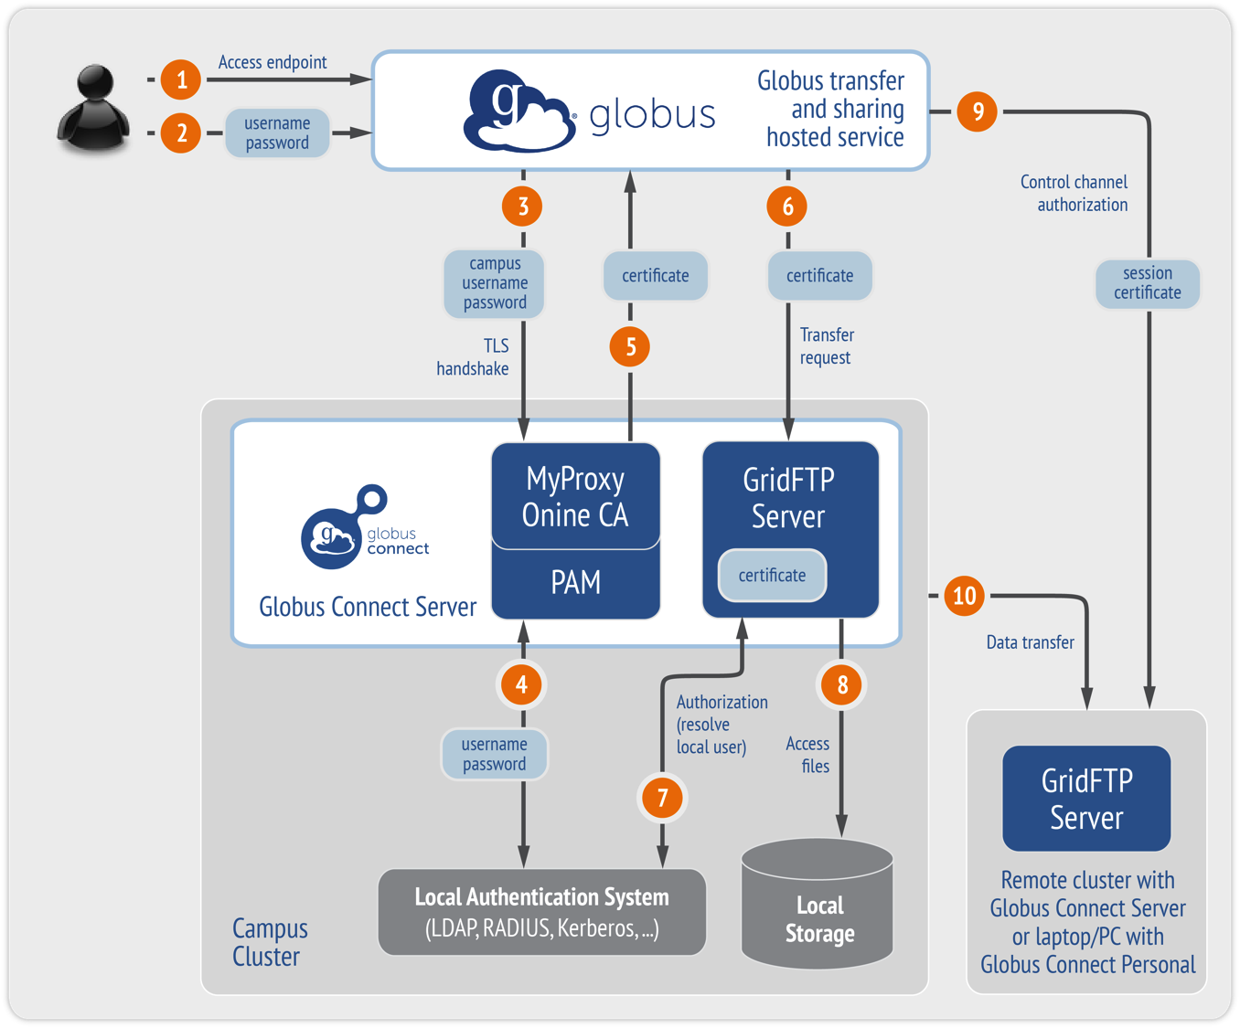
Endpoint activation using MyProxy

Slide 12
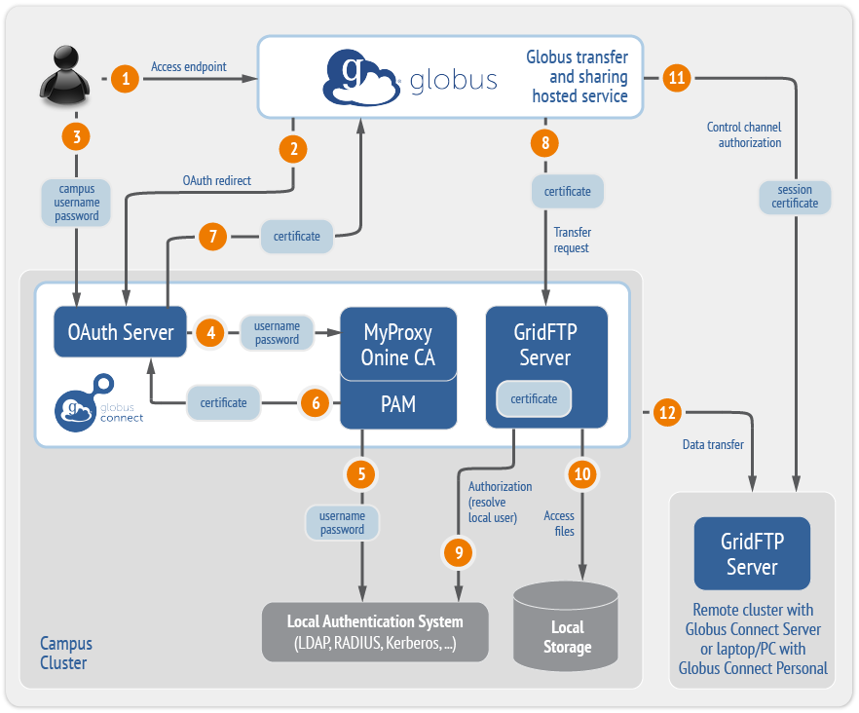
Endpoint activation using MyProxy OAuth

Slide 13
Ports needed for Globus
Inbound: 2811 (control channel)
Inbound: 7512 (MyProxy), 443 (OAuth)
Inbound: 50000-51000 (data channel)
If restricting outbound connections, allow connections from:
  80, 2223 (used during install/config)
  50000-51000 (GridFTP data channel)
Futures: single-port GridFTP

Slide 14
Configuring Globus Connect Server
Configuration options specified in:
  /etc/globus-connect-server.conf
To enable changes you must run:
  globus-connect-server-setup
“Rinse and repeat”

Slide 15
Configuration file walkthrough
Structure based on .ini format
  [Section]
  Option
Commonly configured options:
  Name
  Public
  RestrictedPaths
  Sharing
  SharingRestrictedPaths
  IdentityMethod (CILogon, Oauth)

Slide 16
Exercise: Make your endpoint visible
Set Public = true
Run globus-connect-server-setup
Edit endpoint attributes
  Change the name to something useful, e.g. <your_name> EC2 Endpoint
Find your neighbor’s endpoint
  You can access it too ☺

Slide 17
Enabling sharing on an endpoint
Set Sharing = True
Run globus-connect-server-setup
Go to the Transfer Files page
Select the endpoint
Create shared endpoints and grant access to other Globus users*
* Note: Creation of shared endpoints requires a Globus subscription for the managed endpoint

Slide 18
Path Restriction
Default configuration:
  All paths allowed, access control handled by the OS
Use RestrictPaths to customize
  Specifies a comma separated list of full paths that clients may access
  Each path may be prefixed by R (read) and/or W (write), or N (none) to explicitly deny access to a path
  '~’ for authenticated user’s home directory, and * may be used for simple wildcard matching.
e.g. Full access to home directory, read access to /data:
  RestrictPaths = RW~,R/data
e.g. Full access to home directory, deny hidden files:
  RestrictPaths = RW~,N~/.*
Notes:
As the name suggests, it is a server version of Globus Connect, a one click install of GridFTP server for laptops and desktops

Slide 19
Exercise: Restrict access
  Set RestrictPaths=RW~,N~/archive
Run globus-connect-server-setup
Access your endpoint as ‘researcher’
What’s changed?

Slide 20
Limit sharing to specific accounts
SharingUsersAllow =
SharingGroupsAllow =
SharingUsersDeny =
SharingGroupsDeny =

Slide 21
Sharing Path Restriction
Restrict paths where users can create shared endpoints
Use SharingRestrictPaths to customize
  Same syntax as RestrictPaths
e.g. Full access to home directory, deny hidden files:
  SharingRestrictPaths = RW~,N~/.*
e.g. Full access to public folder under home directory:
  SharingRestrictPaths = RW~/public
e.g. Full access to /proj, read access to /scratch:
  SharingRestrictPaths = RW/proj,R/scratch

Slide 22
Advanced Configuration

Slide 23
Using MyProxy OAuth server
MyProxy without OAuth
  Passwords flow via Globus to MyProxy server
  Globus does not store passwords
  Still a security concern for many campuses
Web-based endpoint activation
  Sites run MyProxy OAuth server or use CI Logon
  Globus gets short-term X.509 credential via MyProxy OAuth protocol

Slide 24
Single Sign-On with InCommon/CILogon
Your Shibboleth server must release the ePPN attribute to CILogon
Local resource account names must match institutional ID (InCommon ID)
AuthorizationMethod = CILogon
CILogonIdentityProvider = <institution_listed_in_CILogon_IdP_list>

Slide 25
Integrating your IdP
InCommon members
  Must release R&S attributes to CILogon
  Mapping uses ePPN; can use GridMap
  AuthorizationMethod = CILogon
  CILogonIdentityProvider = <institution_name_in_CILogon_IdP_list>
Non-members
  IdP must support OpenID Connect
  Requires Alternate IdP subscription
Using an existing MyProxy server

Slide 26
Managed endpoints and subscriptions

Slide 27
Subscription configuration
Subscription manager
  Create/upgrade managed endpoints
  Requires Globus ID linked to Globus account
Management console permissions
  Independent of subscription manager
  Map managed endpoint to Globus ID
Globus Plus group
  Subscription Manager is admin
  Can grant admin rights to other members
Notes:
Coming soon:
- Endpoint Administrator
- Endpoint Manager
- Endpoint Monitor

Slide 28
Creating managed endpoints
Required for sharing, management console, reporting, etc.
Convert existing endpoint to managed:
endpoint-modify --managed-endpoint <endpoint_name>
Must be run by subscription manager, using the Globus CLI
Important: Re-run endpoint-modify after deleting/re-creating endpoint

Slide 29
Demonstration:
Command Line Interface (CLI)

Slide 30
Exercise: Globus CLI (hosted)
Add your SSH key to your Globus ID
  Go to: globusid.org/keys
ssh <globusid>@cli.globusonline.org
Run help to see available commands
Start a transfer and check its status

Slide 31
Globus Python CLI
Locally installed Python application
Globus Auth and Transfer service
https://globus.github.io/globus-cli/
$ globus –help
$ globus login
$ globus endpoint search “Globus Tutorial Endpoints”

Slide 32
Managed endpoint activity accessible via management console
Monitor all transfers
Pause/resume specific transfers
Add pause conditions with various options
Resume specific tasks overriding pause conditions
Cancel tasks
View sharing ACLs

Slide 33
Demonstration:
Management console

Slide 34
Endpoint Roles
Administrator: define endpoint and roles
Access Manager: manage ACLs
Activity Manager: perform control tasks
Activity Monitor: view activity

Slide 35
Other Deployment Options

Slide 36
Encryption
Requiring encryption on an endpoint
  User cannot override
  Useful for “sensitive” data
Globus uses OpenSSL cipher stack as currently configured on your DTN
FIPS-140-2 compliance
  Limit number of ciphers used by OpenSSL
  https://access.redhat.com/solutions/137833

Slide 37
Distributing Globus Connect Server components
Globus Connect Server components
  globus-connect-server-io, -id, -web
Default: -io, –id and –web on single server
Common options
  Multiple –io servers for load balancing, failover, and performance
  No -id server, e.g. third-party IdP such as CILogon
  -id on separate server, e.g. non-DTN nodes
  -web on either –id server or separate server for OAuth interface

Slide 38
Setting up multiple –io servers
Guidelines
  Use the same .conf file on all servers
  First install on the server running the –id component, then all others
Install Globus Connect Server on all servers
Edit .conf file on one of the servers and set [MyProxy] Server to the hostname of the server you want the –id component installed on
Copy the configuration file to all servers
  /etc/globus-connect-server.conf
Run globus-connect-server-setup on the server running the –id component
Run globus-connect-server-setup on all other servers
Repeat steps 2-5 as necessary to update configurations

Slide 39
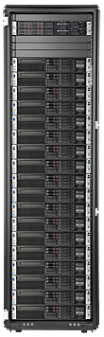
Example: Two-node DTN
/etc/globus-connect-server.conf
[Endpoint] Name = globus_dtn
[MyProxy] Server = ec2-34-20-29-57.compute-1.amazonaws.com
-id
-io
/etc/globus-connect-server.conf
[Endpoint] Name = globus_dtn
[MyProxy] Server = ec2-34-20-29-57.compute-1.amazonaws.com
-io

Slide 40
Optimizing transfer performance

Slide 41
Balance: performance - reliability
In-flight tuning based on transfer profile (#files, sizes)
Request-specific overrides
  Concurrency
  Parallelism
Endpoint-specific overrides; especially useful for multi-DTN deployments
Service limits, e.g. concurrent requests

Slide 42
Network Use Parameters
Concurrency and parallelism configuration to tune transfers
Maximum and Preferred
Use values set for source and destination to determine parameters for a given transfer
min (max (preferred src, preferred dest), max src, max dest)

Slide 43
Network paths
Separate control and data interfaces
"DataInterface =" option in globus-connect-server-conf
Common scenario: route data flows over Science DMZ link

Slide 44

Best-practice deployment
Details at: fasterdata.es.net

Slide 45
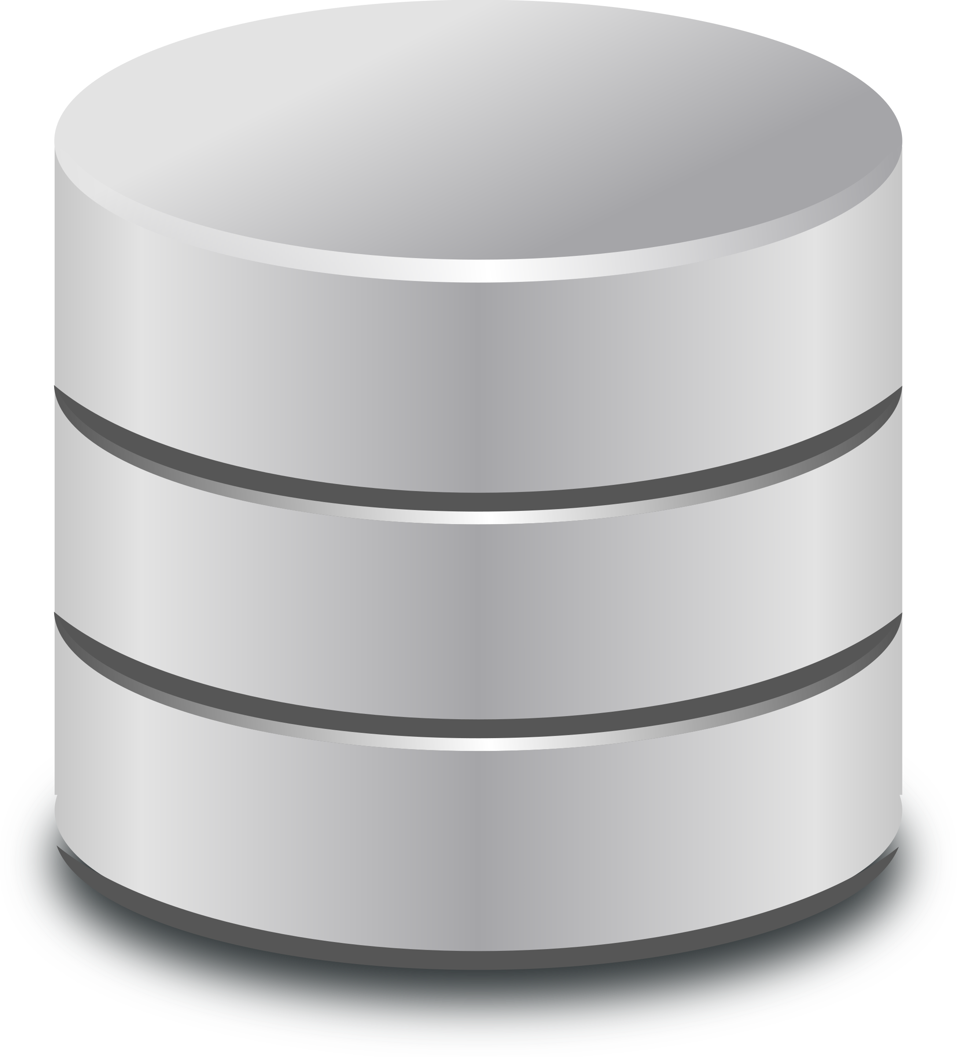

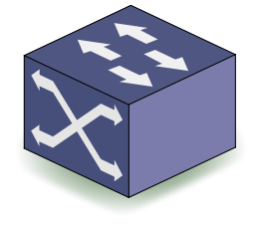


Network Paths - Illustrative
Data Transfer Node (DTN)
DATA
Data Transfer Node (DTN)
Destination security filters
Source security filters
* Ports 50000-51000
Destination security filters
CONTROL
* Ports 443, 2811, 7512
Source Science DMZ
Destination Science DMZ
Source
Border Router
Destination Border Router
Source Router
User
Organization
Destination Router
Physical Data Path
Physical Control Path
Logical Data Path
Logical Control Path
* Please see TCP ports reference: https://docs.globus.org/resource-provider-guide/#open-tcp-ports_section

Slide 46
Illustrative performance
20x scp throughput (typical)
  >100x demonstrated
On par/faster than UDP based tools (NASA JPL study and anecdotal)
Capable of saturating “any” WAN link
  Demonstrated 85Gbps sustained disk-to-disk
  Typically require throttling for QoS

Slide 47
Disk-to-Disk Throughput
Berkeley, CA to Argonne, IL (RTT: 53 ms, Capacity: 10Gbps)
scp is 24x slower than GridFTP on this path
>1 Gbps (125 MB/s) disk-to-disk requires RAID array
Source: ESnet (2016)

Slide 48
For the very brave...

Slide 49
Globus Network Manager
Information from GridFTP to facilitate dynamic network changes
Callbacks during GridFTP execution on local DTN
Supplements information available via Globus transfer API

Slide 50
Globus Network Manager Callbacks
Pre-listen (binding of socket)
Post-listen
Pre-accept/Pre-connect (no Data yet)
Post-accept/Post-connect (data in flight)
Pre-close
Post-close

Slide 51
Network manager use cases
Science DMZ Traffic Engineering
  Use SDN to dynamically route data path
  Control path uses traditional route
Automated WAN bandwidth reservation
  OSCARS, AL2S
Note: All this requires custom code

Slide 52
Discussion

Slide 53
Enable your storage system
Get started: docs.globus.org/how-to
Install and configure Globus Connect Server: docs.globus.org/resource-provider-guide/
Need help? support.globus.org
Mailing Lists: globus.org/mailing-lists
Subscribe to help us make Globus self-sustaining:
  globus.org/provider-plans
Follow us: @globusonline

