Slide 1

Globus for Research Data Management
Oak Ridge National Lab
Rachana (rachana@globus.org)
Greg (greg@globus.org)

Slide 2
Globus for Research Data management
Greg, Rachana
greg@globus.org
rachana@globus.org
University of Chicago

Slide 3






Thank you to our sponsors!
U.S. DEPARTMENT OF
ENERGY
Notes:
Talk about the Globus as being part of UChicago + ANL, as well as other context setting about how this work came about and is funded

Slide 4
Thank you, our users...
5
major services
245 PB
transferred
30 Bn
files processed
45,000 registered users
13
national labs
use Globus
10,000
active endpoints
10,000
active users/year
99.9%
uptime
60+
institutional subscribers
1 PB
largest single transfer to date
3 months longest continuously managed transfer
130
federated campus identities

Slide 5




















...and thank YOU, our subscribers!

Slide 6
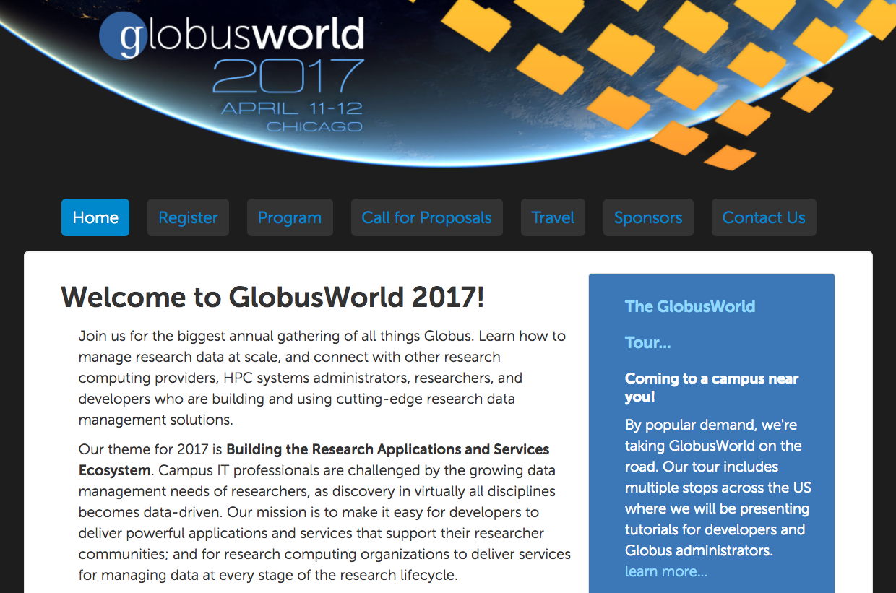
GlobusWorld
https://www.globusworld.org/

Slide 7
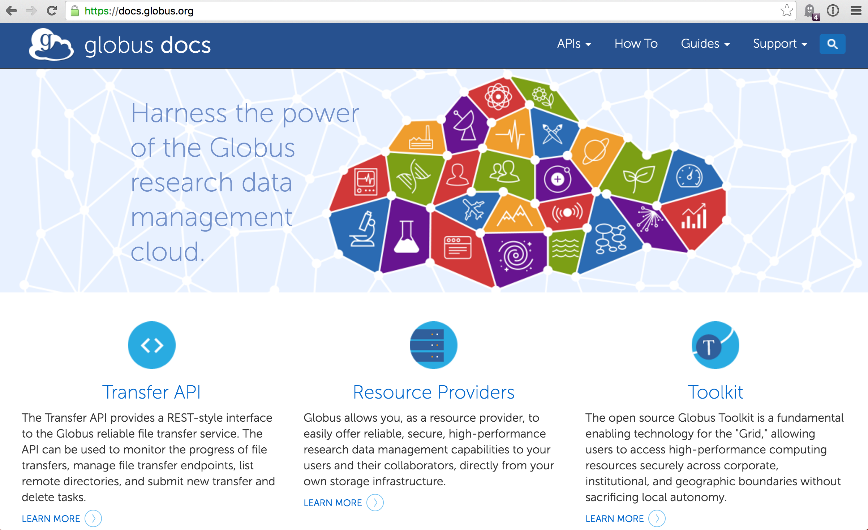
docs.globus.org

Slide 8
Presentation material available at https://www.globusworld.org/ admin-tutorial

Slide 9
Cloud has transformed how software and platforms are delivered
Software as a service: SaaS
(web & mobile apps)
Platform as a service: PaaS
Infrastructure as a service: IaaS
PaaS enables more rapid, cheap, and scalable delivery of powerful (SaaS) apps
Notes:
Amazon VPC
Microsoft one
Add consumers
Consumers, SMBs, large enterprises

Slide 10
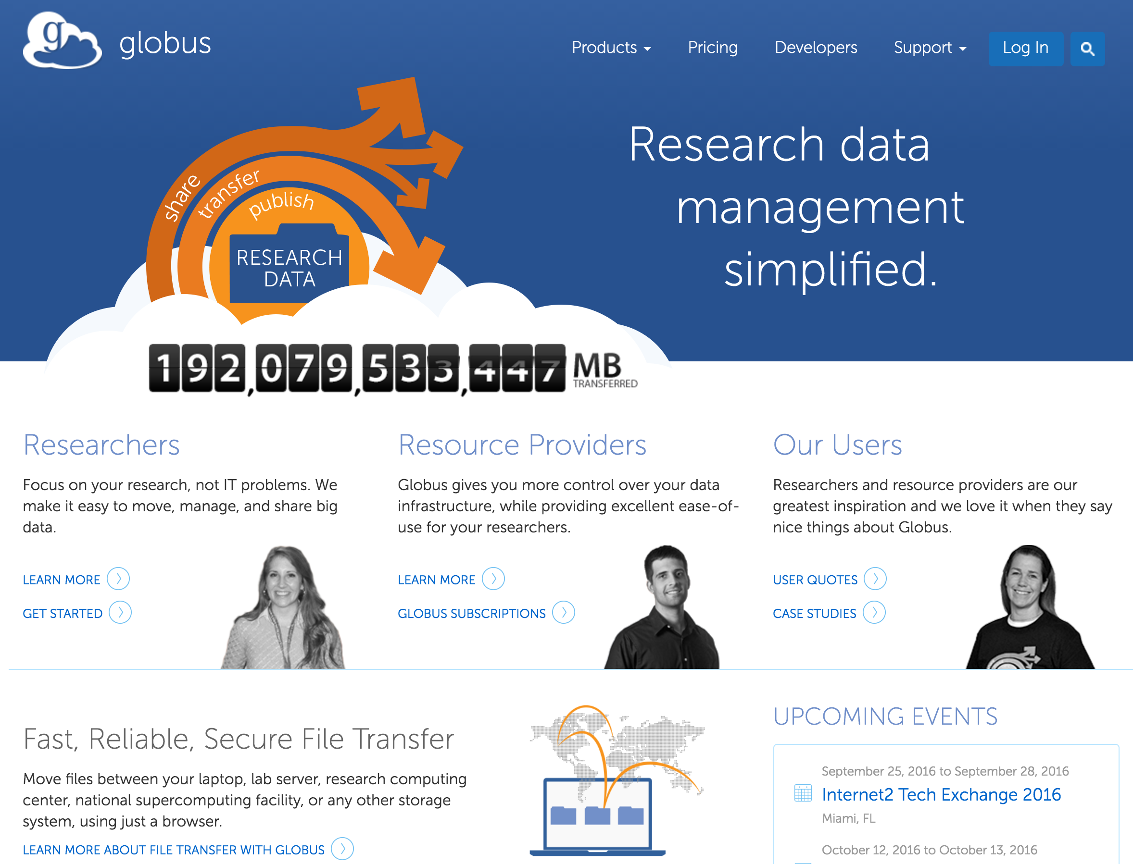
Notes:
Explain Globus briefly – I think the audience knows what Globus is.

Slide 11
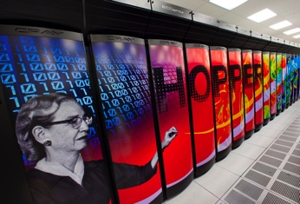
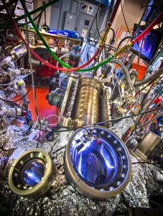
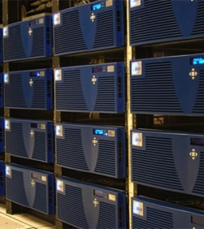



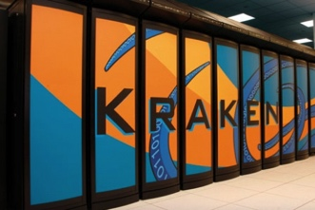


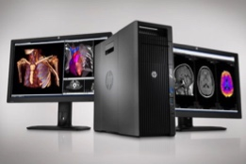

Globus SaaS: Research data lifecycle
Compute Facility
Instrument
Globus transfers files reliably, securely
Globus controls access to shared files on existing storage; no need to move files to cloud storage!
4
2
Curator reviews and approves; data set published on campus or other system
Transfer
7
3
Share
1
Researcher selects files to share, selects user or group, and sets access permissions
6
Researcher initiates transfer request; or requested automatically by script, science gateway
Researcher assembles data set; describes it using metadata (Dublin core and domain-specific)
Publication Repository
Collaborator logs in to Globus and accesses shared files; no local account required;
download via Globus
5
Only a Web browser required
Use storage system of your choice
Access using your campus credentials
Publish
6
8
Peers, collaborators search and discover datasets; transfer and share using Globus
Discover
Personal Computer

Slide 12
Globus SaaS Demo
Logging into Globus with any identity
Endpoint search
Transfer
HTTPS access
Sharing with any identity
Management Console

Slide 13
Premium Connectors
AWS S3
HPSS
SpectraLogic BlackPearl
Google Drive (soon)
Ceph (Beta)
iRODS (planned)

