Slide 1
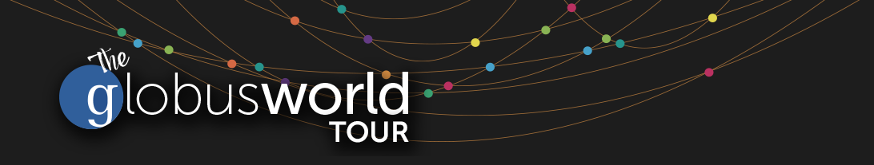
Building the
Modern Research Data Portal
Oak Ridge National Lab
Rachana (rachana@globus.org)
Greg (greg@globus.org)

Slide 2
All tutorial materials at
https://github.com/globus

Slide 3

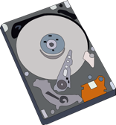
Prototypical research data portal
Identity Provider
Globus
Cloud
Globus Web Helper Pages
HTTPS
Desktop
Globus Auth
Globus Transfer
Login
Browser
Applications
Firewall
Other Services
Portal Web Server (Client)
REST
GridFTP
User’s Endpoint (optional)
Science DMZ
Portal Endpoint
Other Endpoints

Slide 4
Maximizing the value of the Science DMZ

Slide 5
Prototypical research data portal
Identity Provider
Globus
Cloud
Globus Web Helper Pages
HTTPS
Desktop
Globus Auth
Globus Transfer
Login
Browser
Applications
Firewall
Other Services
Portal Web Server (Client)
REST
GridFTP
User’s Endpoint (optional)
Science DMZ
Portal Endpoint
Other Endpoints

Slide 6
HTTPS to Endpoints
Each endpoint HTTPS server is a Globus Auth service (resource server)
Web page can link to file on server
  Browser GET will cause HTTPS server to authorize request via Globus Auth (note SSO)
Portal (client) can request scope for endpoint resource server
  Use access token in requests

Slide 7
Prototypical research data portal
Identity Provider
Globus
Cloud
Globus Web Helper Pages
HTTPS
Desktop
Globus Auth
Globus Transfer
Login
Browser
Applications
Firewall
Other Services
Portal Web Server (Client)
REST
GridFTP
User’s Endpoint (optional)
Science DMZ
Portal Endpoint
Other Endpoints

Slide 8











Globus PaaS
Globus APIs
…
Globus Connect
Data Publication & Discovery
File Sharing
File Transfer & Replication
Auth & Groups
Globus Toolkit

Slide 9
Challenge
How to provide:
  Login to apps
    Web, mobile, desktop, command line
  Protect all REST API communications
    App → Globus service
    App → non-Globus service
    Service → service
While:
  Not introducing even more identities
  Providing least privileges security model
  Being agnostic to programming language and framework
  Being web friendly
  Making it easy for users and developers
Notes:
Single sign on preferred
Want to encourage application development to the Globus Service.
Want to encourage others to use Globus Auth for their own services.
But not only for Apps, for other service to service communication.

Slide 10
Globus Auth
Foundational identity and access management (IAM) platform service
Simplify creation and integration of advanced
apps and services
Brokers authentication and authorization interactions between:
  end-users
  identity providers: InCommon, XSEDE, Google, portals
  services: resource servers with REST APIs
  apps: web, mobile, desktop, command line clients
  services acting as clients to other services
Notes:
Identity provider Proxy
Getting user authenticated
Consented so users are consenting to what tokens are being used for
Issueing tokens
Verifying tokens
Globus Auth is a Foundational service for all of these
In some sense it’s an IdP but think of it more as an Identity Broker
Mission is providing a platform for app/service developers to integrated these capabilities so they can access the growing system of IdPs with just a bit of standard code
Two protocols:
OAuth2 – OpenID Connect (Web World)
SAML – Shibboleth (Universities)
NOT and identity manager.

Slide 11
Globus Auth
Identity and access management PaaS
docs.globus.org/api/auth
Specification
Developer Guide
API Reference
Notes:
Show the Docs site

Slide 12
Based on widely used web standards
OAuth 2.0 Authorization Framework
  aka OAuth2
OpenID Connect Core 1.0
  aka OIDC
Use various OAuth2 and OIDC libraries
  Google OAuth Client Libraries (Java, Python, etc.), Apache mod_auth_openidc, etc.
  Globus Python SDK
Notes:
OAuth2 – OpenID Connect (Web World)
OpenID Connect – Authentication Layer (RESTful / JSON)

Slide 13
Globus account
A Globus account is a set of identities
  A primary identity
    Identity can be primary of only one account
  One or more linked identities
    Identity can (currently) be linked to only one account
Account does not have own identifier
  An account is uniquely identified using its primary identity
Notes:
Collections of identities. Now we’re just part of the web.
Primary Identity. If account compromised can just unlink primary identity.

Slide 14
Sample Research Data Portal
UChicago Identity Provider
Globus
Cloud
Globus Web Helper Pages
HTTPS
Desktop
Globus Auth
Globus Transfer
Login
Browser
Applications
Firewall
Graph
Services
Demo Portal (Client)
REST
GridFTP
My Laptop
Science DMZ
Portal Endpoint
UChicago Midway Endpoints

Slide 15
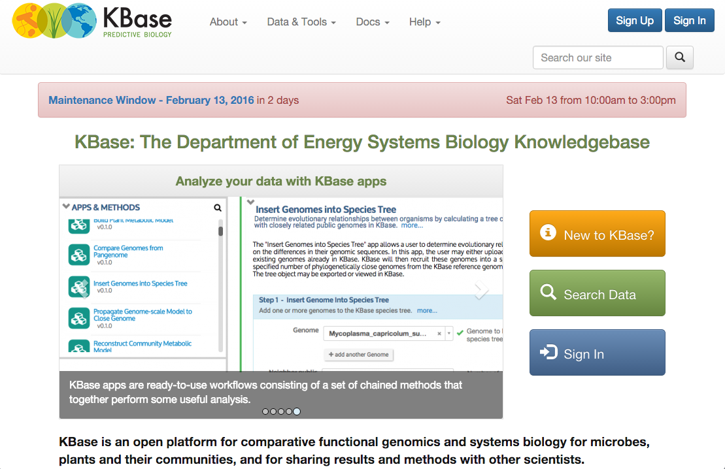
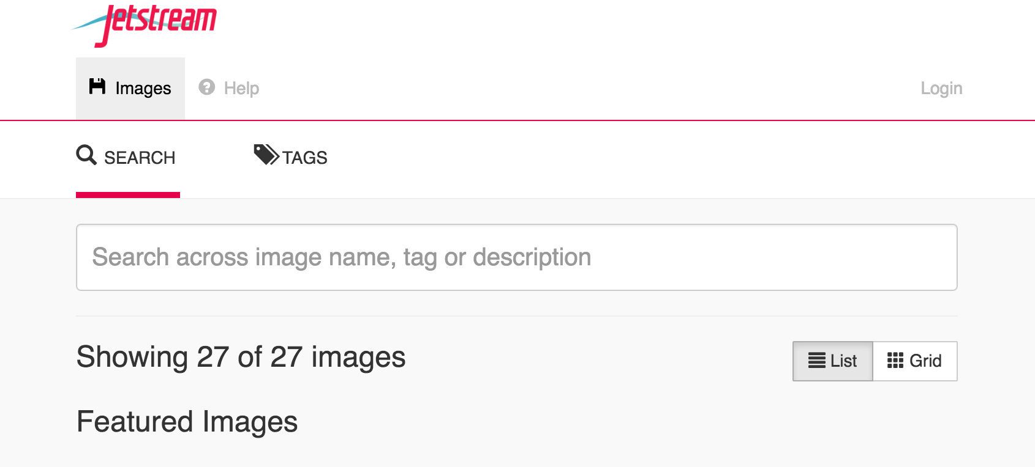
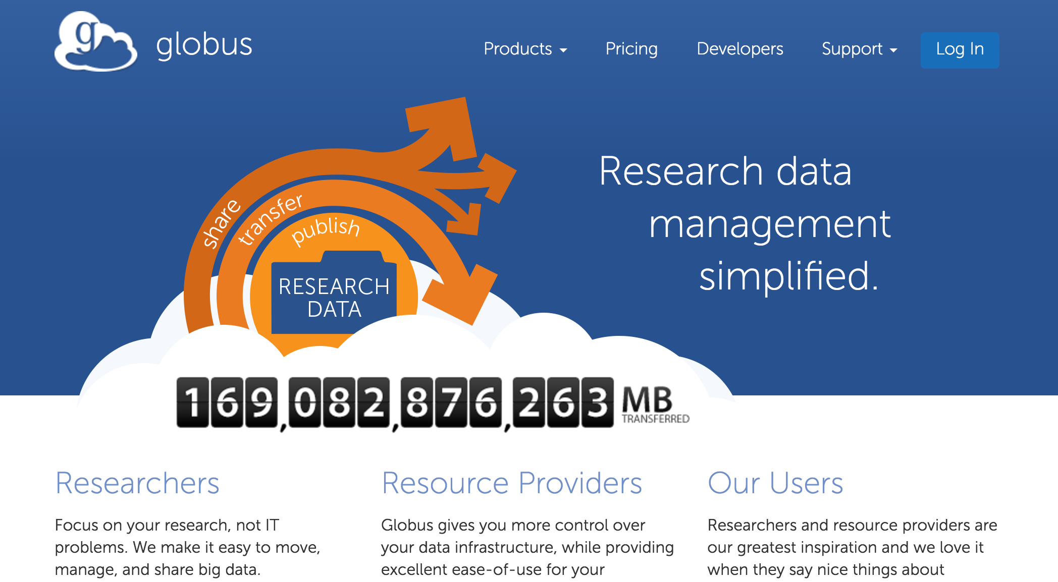
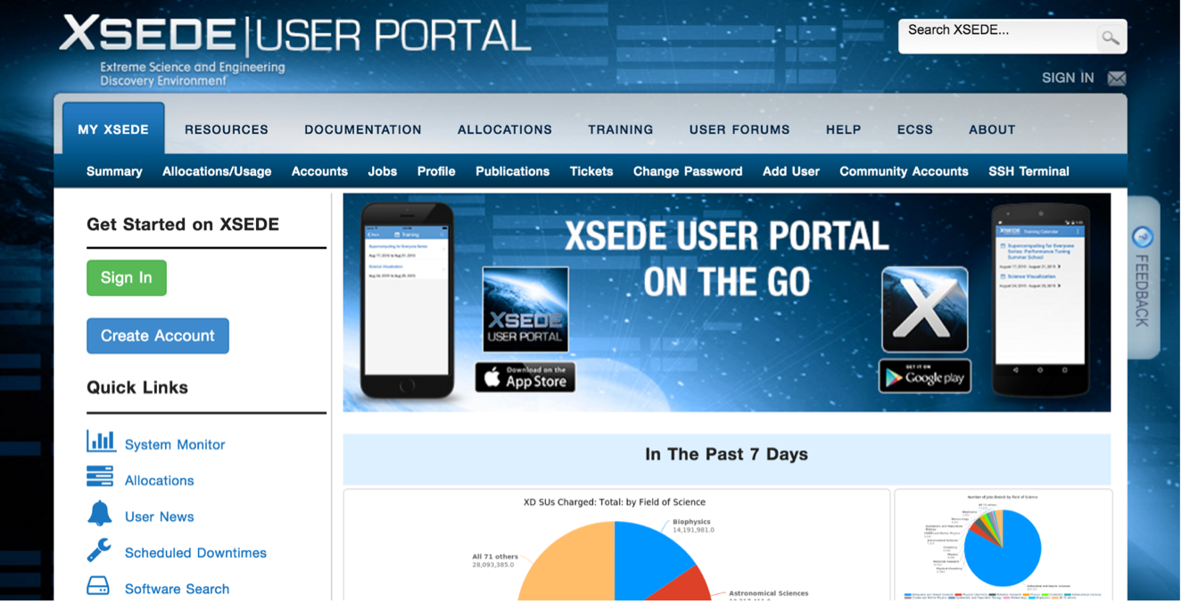
Use case: Log in with Globus
Similar to:
“Log in with Google”
“Log in with Facebook”
Using existing identities
Providing access to community services

Slide 16
Demo
Jetstream App use of Globus Auth

Slide 17
Sample Research Data Portal
UChicago Identity Provider
Globus
Cloud
Globus Web Helper Pages
HTTPS
Desktop
Globus Auth
Globus Transfer
Login
Browser
Applications
Firewall
Graph
Services
Demo Portal (Client)
REST
GridFTP
My Laptop
Science DMZ
Portal Endpoint
UChicago Midway Endpoints

Slide 18
Use case: Portal calling services on user’s behalf
Examples:
  Portal starting transfer for user
Authorization Code Grant
  With service scopes
  Can also request OIDC scopes
Confidential client
Globus SDK:
  To get tokens: ConfidentialAppAuthClient
  To use tokens: AccessTokenAuthorizer

Slide 19

Authorization Code Grant
Browser (User)
3. User authenticates and consents
2. Redirects user
4. Authorization token
1. Access portal
Globus Auth (Authorization Server)
5. Authenticate using client id and secret, send authorization code
Portal (Client)
6. Access tokens
Globus Transfer (Resource Server)
7. Authenticate with access tokens to invoke transfer service as user

Slide 20
Scopes
APIs that client is requesting access to
Scope syntax:
  OpenID Connect: openid, email, profile
  urn:globus:auth:scope:<service-name>:<scope-name>
If client requests multiple scopes
  Token response has tokens for first scope
  other_tokens field in response has list of token responses for other scopes
  Client must use correct token with each request
Notes:
Service-name + scope-name is unique

Slide 21
Consent
Resource owner authorization that a client can request access to a service scope on the resource owner's behalf within a limited scope
  If service has dependent scopes, they are part of the consent
User can rescind a consent at any time
  Invalidates all access, dependent, and refresh tokens originating from the client

Slide 22
Identity id vs. username
Identity id:
  Guaranteed unique among all Globus Auth identities, and will never be reused
  UUID
  Always use this to refer to an identity
Identity username:
  Unique at any point in time
    May change, may be re-used
  Case-insensitive user@domain
  Can map to/from id, for user experience
Auth API allows mapping back and forth
Notes:
Guarantee that the ID will not change AND that the ID will only be bound to a single identity

Slide 23
App registration
Client_id and client_secret for service
App display name
Declare required scopes
  Need long-term, offline refresh tokens?
  May require authorization from scope admin
OAuth2 redirect URIs
Links for terms of service & privacy policy
Effective identity policy (optional)
developers.globus.org
Notes:
Allows an application to identify itself to Globus Auth

Slide 24
Sample Research Data Portal
Demo: Install and Register
Code walk through

Slide 25
Exercise: Install sample data portal
Install sample data portal
  either locally or on EC2 instance
github.com/globus/
globus-sample-data-portal.git
Register your application at:
  developers.globus.org
Instructions in the README file

Slide 26
Prototypical research data portal
Identity Provider
Globus
Cloud
Globus Web Helper Pages
HTTPS
Desktop
Globus Auth
Globus Transfer
Login
Browser
Applications
Firewall
Other Services
Portal Web Server (Client)
REST
GridFTP
User’s Endpoint (optional)
Science DMZ
Portal Endpoint
Other Endpoints

Slide 27
Use case: Native apps
Examples
  Command line, desktop apps
  Mobile apps
  Jupyter notebooks
  Any client that cannot keep a secret (downloaded)
Native app is registered with Globus Auth
  Not a confidential client
Native App Grant is used
  Variation on the Authorization Code Grant
Globus SDK:
  To get tokens: NativeAppAuthClient
  To use tokens: AccessTokenAuthorizer

Slide 28
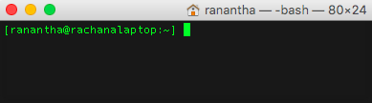
Native App grant
3. Authenticate and consent
Globus Auth (Authorization Server)
Browser
1. Run application
4. Auth code
2. URL to authenticate
5. Register auth code
6. Exchange code
Native App (Client)
7. Access tokens
8. Authenticate with access tokens to invoke transfer service as user
Globus Transfer (Resource Server)

Slide 29
Mobile apps
Globus Auth supports mobile apps
  “Log in with Globus” in mobile apps
    RFC 7636: Proof Key for Code Exchange by OAuth Public Clients (PKCE, pronounced “pixy”)
    Extension to OAuth2 to allow OAuth2 Authorization Code Grant to work from mobile apps
  Uses mobile browser for web-based login
  Mobile apps can call any service REST APIs that use Globus Auth
  iOS and Android
  Same approach as used by Google, Facebook, etc.

Slide 30
Desktop & command line apps
Globus Auth “Native App” PKCE support
Use browser if possible
  “OAuth 2.0 for Native Apps”
    draft-ietf-oauth-native-apps-02
    Use external browser if possible
    Embed browser in app
    Embed mini web server in app
Allows copy-n-paste of authorization code
  A little like app passwords, but OAuth2 compliant
Globus Python SDK and CLI support Native App login
Limited support for username/password authentication
  Not recommended

Slide 31
Use case: Apps that need access tokens for long time
Examples:
  Portal checks for transfer status when user is not logged in
  Run command line app from script
App requests refresh tokens
Globus SDK:
  To get token: ConfidentialAppClient or NativeAppClient
  To use tokens: RefreshTokenAuthorizer

Slide 32
Refresh tokens
3. Authenticate and consent
Globus Auth (Authorization Server)
1. Run application
Browser
4. Auth code
2. URL to authenticate
5. Register auth code
6. Exchange code, request refresh tokens
7. Access tokens and refresh tokens
Native App (Client)
9. Exchange refresh token for new access tokens
10. Access tokens
Globus Transfer (Resource Server)
8. Store refresh tokens
11. Authenticate with access tokens to invoke transfer service as user

Slide 33
Refresh tokens
For “offline services”
  E.g., Globus transfer service working on your behalf even when you are offline
Refresh tokens issued to a particular client for use with a particular scope
Client uses refresh token to get access token
  Confidential client: client_id and client_secret required
  Native app: client_secret not required
Refresh token good for 6 months after last use
Consent rescindment revokes resource token

Slide 34
Sample Research Data Portal
Demo: Native Apps and Refresh tokens

Slide 35
Exercise: Native App
https://github.com/globus/native-app-examples
README for install instructions
./example_copy_paste.py
  Copy paste code to the app
./example_local_server.py
  Local server to get the code
./example_copy_paste_refresh_token.py
  Stores refresh token locally, uses it to get new access tokens

Slide 36
Use case: App invoking services as itself
Examples
  Sample portal invoking graph service and accessing endpoints as itself
  Robots, agents, services
App registers with Globus to get client id and secret
  Native app cannot do this, because no client_secret
Client Credential Grant is used
Globus SDK:
  To get tokens: ConfidentialAppAuthClient
  To use tokens: AccessTokenAuthorizer

Slide 37
Client credential grant
Globus Auth (Authorization Server)
1. Authenticate with portal client id and secret
Portal (Client)
2. Access Tokens
3. Authenticate as portal with access tokens to invoke service
Globus Transfer (Resource Server)

Slide 38
User identity vs. portal identity
User logging into portal results in portal having user’s identity and access token
  Used to make requests on the user’s behalf
Portal may also need its own identity
  Access and refresh tokens for this identity
  Used to make requests on its own behalf
Notes:
1. Portal uses the user identity to access the Globus transfer service
2. Portal uses its own identity when working with the Graph service, e.g. to create a shared endpoint and put the graph into it

Slide 39
Client identity
Portal App has client_id & client_secret
Globus Auth client_id is an identity_id
  <client_id>@clients.auth.globus.org
Use OAuth2 Client Credentials Grant to authenticate the client identity
  Using client_id and client_secret
Can use the client_id just like any other identity_id
  Sharing access manager role, permissions, group membership, etc.

Slide 40
Exercise: Using Client credential grant
Start with native app examples
Register a new app to get client id and secret
Globus SDK:
  ConfidentialClientApp
  AccessTokenAuthorizer
Using the Globus webapp:
  Create a shared endpoint
  Set Access Manager role for the new client id
List files on the shared endpoint as the client identity
Change permissions on the shared endpoint as the client identity
Hint: Look at Jupyter notebook for SDK calls for the transfer operations

Slide 41
Prototypical research data portal
Identity Provider
Globus
Cloud
Globus Web Helper Pages
HTTPS
Desktop
Globus Auth
Globus Transfer
Login
Browser
Applications
Firewall
Other Services
Portal Web Server (Client)
REST
GridFTP
User’s Endpoint (optional)
Science DMZ
Portal Endpoint
Other Endpoints

Slide 42
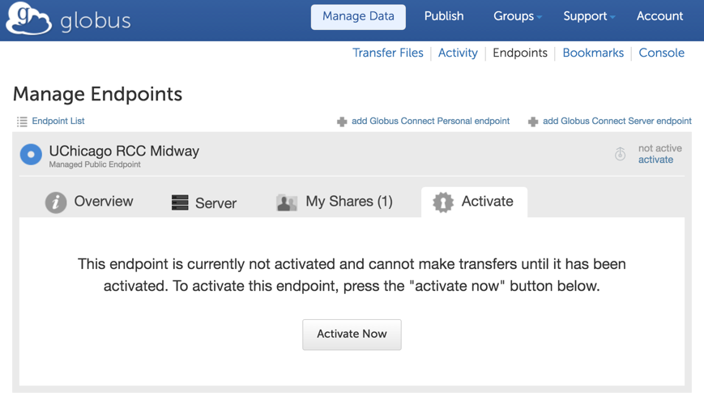
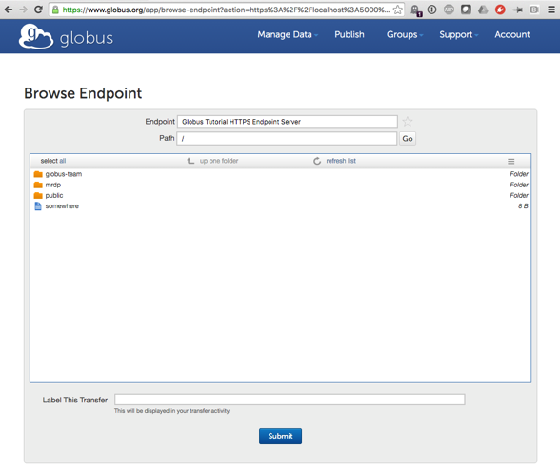
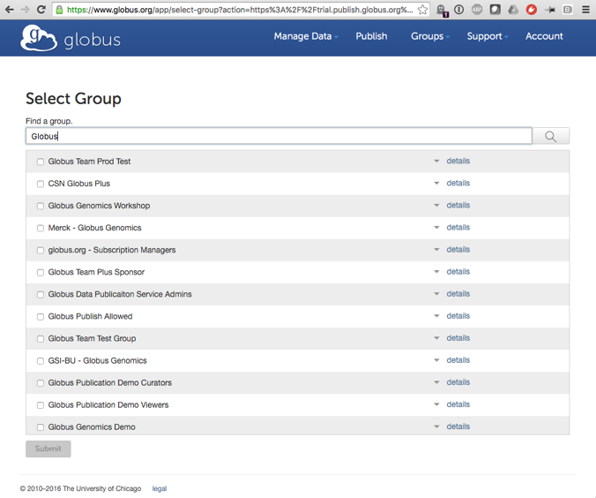
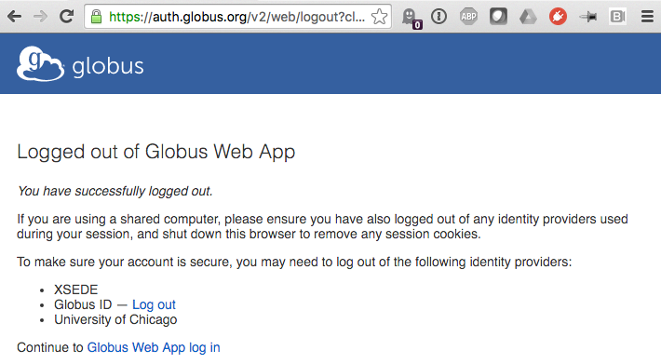
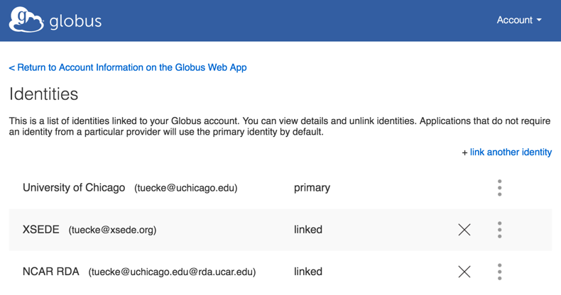
Globus Helper Pages
Globus provided web pages designed for use by your web apps
  Browse Endpoint
  Activate Endpoint
  Select Group
  Manage Identities
  Manage Consents
  Logout
docs.globus.org/api/helper-pages

Slide 43
Client Logout
Call token revocation on access tokens
  https://auth.globus.org/v2/oauth2/token/revoke
  Doc: docs.globus.org/api/auth/reference
  Note: Does not revoke dependent tokens
Delete access tokens
Redirect to logout helper page
  https://auth.globus.org/v2/web/logout
  Doc: docs.globus.org/api/helper-pages

Slide 44
Prototypical research data portal
Identity Provider
Globus
Cloud
Globus Web Helper Pages
HTTPS
Desktop
Globus Auth
Globus Transfer
Login
Browser
Applications
Firewall
Other Services
Portal Web Server (Client)
REST
GridFTP
User’s Endpoint (optional)
Science DMZ
Portal Endpoint
Other Endpoints

Slide 45
Adding your identity provider
InCommon identity providers that release research & scholarship attributes to CILogon (free)
Any other OpenID Connect identity provider (subscription)

Slide 46
Adding an identity provider
If your portal has identities already:
  Deploy OIDC server in front of it
    Globus Python OIDC (coming soon)
    Any standard OIDC server should work
    Requires claim that can map to username
    Optional claims: name, email, organization
  Can register apps and services with an effective identity policy
    Requires account to have identity from your identity provider when logging into your app

Slide 47
Portal accounts for users
Your app portal can still have portal accounts for users
Tie portal account to Globus account identity, rather than username/password
Associate your profile with this account
Globus Auth handles authentication of that identity, in order to log user into your portal account

Slide 48
Prototypical research data portal
Identity Provider
Globus
Cloud
Globus Web Helper Pages
HTTPS
Desktop
Globus Auth
Globus Transfer
Login
Browser
Applications
Firewall
Other Services
Portal Web Server (Client)
REST
GridFTP
User’s Endpoint (optional)
Science DMZ
Portal Endpoint
Other Endpoints

Slide 49
Why create your own services?
Front-end / back-end within your portal
  Remote backend for portal
  Backend for pure Javascript browser apps
Extend your portal with a public REST API, so that other app and service developers can integrate with and extend your portal

Slide 50
Why Globus Auth for your service?
Outsource all identity management and authentication
  Federated identity with InCommon, Google, etc.
Outsource your REST API security
  Consent, token issuance, validation, revocation
  You provide service-specific authorization
Apps use your service like all others
  Its standard OAuth2 and OIDC
Your service can seamlessly leverage other services
Other services can leverage your service
Implement your service using any language and framework
Add your service to the science cyberinfrastructure platform

Slide 51
Portal to Graph service interaction
Globus Auth (Authorization Server)
1. Login and consent for portal and use of graph & transfer service.
2. Client credential grant to get access tokens
5. Return validity, client, scope, effective identity, identity set (for the portal)
4. Authenticate with graph service client id and secret to introspect token
Portal (Client)
3. Authenticate with access tokens to invoke graph service: HTTPS with access token as header
Graph Service
(Resource Server)
6. Verifies token, authorization checks
7. Graph service response

Slide 52
Service registration
Client_id and client_secret for service
Service display name
Validated DNS name for service
One or more scopes
Authorize clients to use each scope
  All clients (public API), or specific clients
Declare dependent scopes
  Need long-term, offline refresh tokens?
  May require authorization from scope admin
Links for terms of service & privacy policy
Effective identity policy (optional)
Email: support@globus.org

Slide 53
Typical service interactions
Service receives HTTPS request with header
  Authorization: Bearer <request-access-token>
Introspects the request access token
  Auth API: POST /v2/oauth2/token/introspect
  Authorized by client_id and client_secret
  Returns: validity, client, scope, effective_identity, identities_set
Verifies token info
Authorizes request
If service needs to act as client to other services:
  Calls Globus Auth Dependent Token Grant
    Returns a token for each dependent service
  Uses correct dependent token for downstream REST call
Responds to client HTTPS request as appropriate

Slide 54
Prototypical research data portal
Identity Provider
Globus
Cloud
Globus Web Helper Pages
HTTPS
Desktop
Globus Auth
Globus Transfer
Login
Browser
Applications
Firewall
Other Services
Portal Web Server (Client)
REST
GridFTP
User’s Endpoint (optional)
Science DMZ
Portal Endpoint
Other Endpoints

Slide 55
Dependent tokens
Your service can act as client to other services (scopes)
  Globus Transfer and Auth
  XSEDE (e.g., Jetstream, XUP)
  Other community services
  Future: Commercial services (e.g., Google Drive)
Entire service call tree consented by user and service owners
  Rescinding consent revokes all dependent tokens
Dependent tokens are restricted to a particular client, calling a particular scope, on behalf of a particular resource owner (e.g., user)
  Restricted delegation!

Slide 56
Graph service to transfer interaction
1. Client credential grant to get access tokens
Portal (Client)
Globus Auth (Authorization Server)
4. Request dependent tokens, authenticate with graph client id and secret
2. Authenticate with access tokens to invoke graph service, user identity as parameter
5. Returns access tokens for use with transfer service & any other downstream service
Graph Service (Resource Server)
Transfer Service (Resource Server)
6. Invoke transfer service with access token to move files and set permissions for user to access files
3. Verifies token, authorization checks and generate graph

Slide 57
Graph service to transfer interaction
Portal (Client)
Globus Auth (Authorization Server)
7. Token introspection
9. Graph service response
Graph Service (Resource Server)
Transfer Service (Resource Server)
9. Transfer service response
8. Authorize, process request

Slide 58
Walk-through
Graph Service Code
Notes:
Walk through registering a portal on an EC2 instance

Slide 59
Exercise: Graph service
Either locally or on EC2 instance
Modify service/service.conf
  PORTAL_CLIENT_ID should be set to your portal’s client id from portal/portal.conf
github.com/globus/globus-sample-data-portal.git
Find and print to console:
  Expiration time of each of dependent tokens
  The complete ACL rule added to the folder for the user
  The full response from token introspection
Modify cleanup to wait for files to be deleted before returning

Slide 60
Additional Features for Service Developers

Slide 61
Effective identity
App or service can choose to operate only with identities from a particular identity provider
  Globus Auth login will require an identity from that provider to be linked to user’s account
  OIDC id_token uses this “effective identity”
If app or service does not set an effective identity policy, then the primary identity of the account is used as the effective identity for that app

Slide 62
Authorization based on identity set
Use identities_set when authorizing a request based on the resource owner associated with an access token
  E.g., ACLs on Globus shared endpoints
Authorizing based on set of identities is same complexity as authorizing based on group membership set

Slide 63
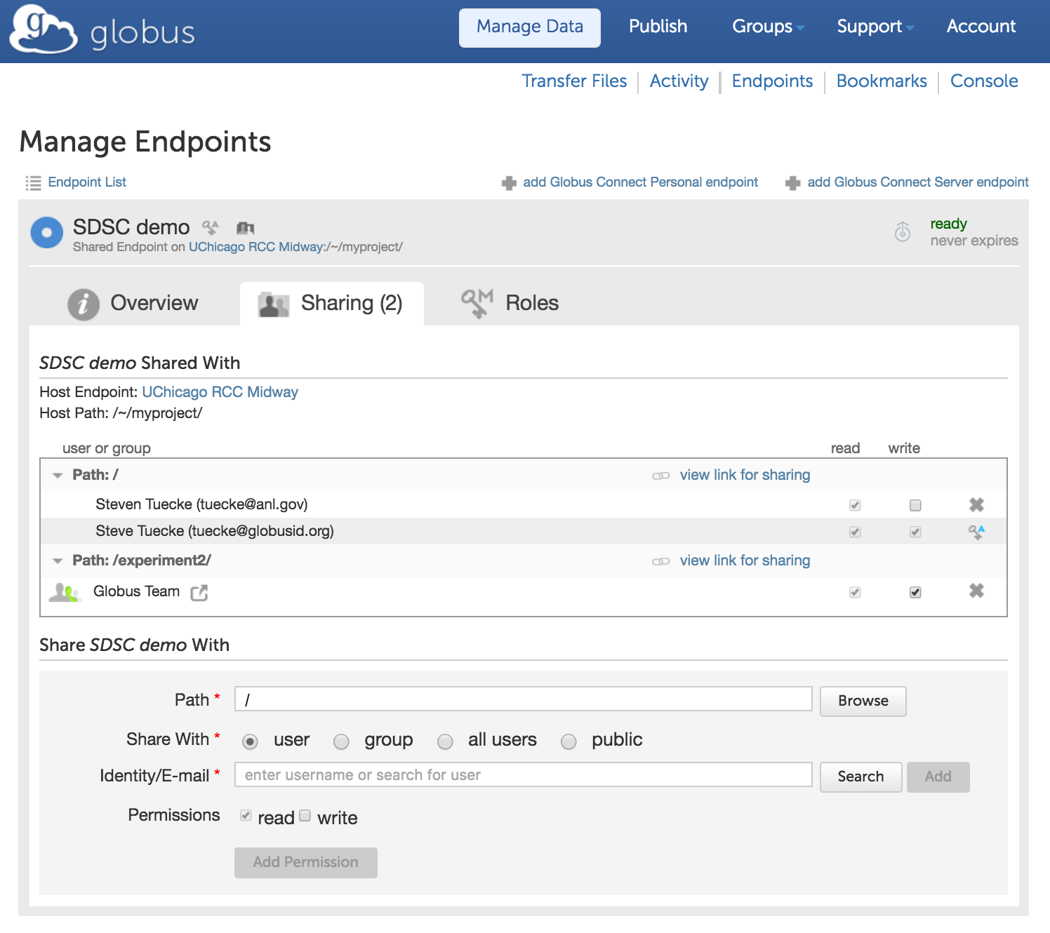
Groups
Globus group service is identity set aware
  “Tell me all groups for all identities of the logged in user”
Services can leverage this for authorization

Slide 64
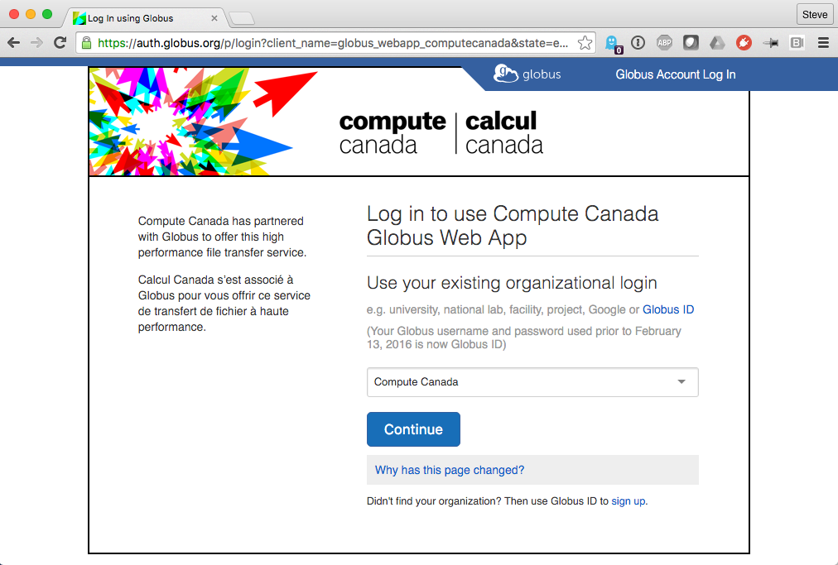
Branding
Can skin Globus Auth pages
  Header
  Text
  Default IdP

Slide 65
Token caching
Service should cache tokens and related information
  Improves performance of service
  Reduces load on Globus Auth
Access token -> introspect response
  Cache timeout: 1-30 seconds recommended
  To improve performance and load related to bursty use of REST API
  Validity: Timeout duration determines responsiveness to token revocation and rescinding consent
  client, scope, effective_identity: These will never change for an access token
  identities_set: This may change at any time, due to identity (un)linking. May affect authorization. Timeout duration affect responsiveness to linking changes.
  Future: add group membership to this, which is dependent on identities_set
Access token -> dependent access tokens
  Cache timeout: lifetime of access token
  To avoid costly dependent token re-issuance
  Rescinding consent will invalidate everything
Refresh tokens
  For however long they are needed for specific operations.

Slide 66
Join the Globus developer community
Join developer-discuss@globus.org mailing lists: globus.org/mailing-lists
Python SDK is open source
  github.com/globus/globus-sdk-python
  Submit issues, pull requests
  Discussions on developer-discuss@globus.org
Jupyter notebook, sample data portal and native applications are open source on github
Documentation: docs.globus.org
We’re hiring: globus.org/jobs
Notes:
Strongly recommend you join this list if developing against our API

Slide 67
OAuth Flows
Notes:
Walk through registering a portal on an EC2 instance

Slide 68
Globus Auth interactions
Login
App
(Client)
HTTPS/REST call
Service
(Resource Server)
User
(Resource
Owner)
Globus Auth (Authorization Server)
Identity Provider
Notes:
In OAuth2: APP = Client and SERVICE = Resource Server
Trying to provide login information and get tokens to protect comms with the REST API
2 problems. Protect the Login, protest the REST communication.
Resource Server – URI with a document.
Stuff in parentheses right from the OAuth spec.

Slide 69
Globus Auth interactions
Login
App
(Client)
HTTPS/REST call
Service
(Resource Server)
User
(Resource
Owner)
Globus Auth (Authorization Server)
Request authorization
For a set of scopes
  Login: openid, email, profile
  HTTPS/REST APIs
User selects identity provider
Identity Provider
Notes:
First step is redirect to Globus to get a set of scopes
Scopes are a fundamental concept
- e.g. scope can be “I want login information”
Talking to services: talk to a scope; service can have multiple scopes
Example: Groups service (API coming soon)
1 scope is full management scope
2nd scope is things like “tell me groups that user belongs to”; this is a key action for many other actions in the Globus service
So an app only needs to use 2nd scope

Slide 70
Globus Auth interactions
Login
App
(Client)
HTTPS/REST call
Service
(Resource Server)
User
(Resource
Owner)
Globus Auth (Authorization Server)
Request authorization
Authenticates a resource owner
Using existing identities
  XSEDE, University (via InCommon), Google, web app, etc.
User can link multiple identities into a single Globus Account
No Globus username (Globus ID) required
Globus Auth handles naming details, e.g., ePPN vs ePTID
Identity Provider
Notes:
“Resource Owner” in this case is the user
To do this we will redirect to an IdP

Slide 71
Globus Auth interactions
Login
App
(Client)
HTTPS/REST call
Service
(Resource Server)
User
(Resource
Owner)
consent
Globus Auth (Authorization Server)
Request authorization
Authenticates a resource owner
Obtains authorization (consent) for a client to access a resource
Resource is provided by a resource server
Limited by a scope
Identity Provider
Notes:
Then after authentication from IdP Globus gets consent for whatever the app needs to do on your behalf

Slide 72
Globus Auth interactions
Login
App
(Client)
HTTPS/REST call
Service
(Resource Server)
User
(Resource
Owner)
access_token
Globus Auth (Authorization Server)
Request authorization
Authenticates a resource owner
Obtains authorization (consent) for a client to access a resource
Issues OAuth2 access_token to client
Some grant types issue authorization code, which client exchanges for access token
Access token is opaque to client
May include a refresh token, for offline access
Identity Provider
Notes:
Access token is the thing that allows the client to protect this REST communication
It’s actually a set of access tokens, one for each scope - limits effect of compromise

Slide 73
Globus Auth interactions
Login
App
(Client)
HTTPS/REST call
Service
(Resource Server)
User
(Resource
Owner)
id_token
Globus Auth (Authorization Server)
Request authorization
Authenticates a resource owner
Obtains authorization (consent) for a client to access a resource
Issues OAuth2 access_token to client
May issue OIDC id_token to client with resource owner identity
JWT id_token:
sub: Globus Auth identity id
iss: https://auth.globus.org
name: full name
preferred_username:
e.g., tuecke@uchicago.edu
email: email contact
other standard OIDC claims
Identity Provider
Notes:
May also get an ID token if the client asked for OpenID Connect scopes (openid, email, profile)

Slide 74
Globus Auth interactions
Login
App
(Client)
HTTPS/REST call
Service
(Resource Server)
Authorization: Bearer <access_token>
User
(Resource
Owner)
Globus Auth (Authorization Server)
Request authorization
Authenticates a resource owner
Obtains authorization (consent) for a client to access a resource
Issues OAuth2 access_token to client
May issue OIDC id_token to client with resource owner identity
HTTPS/REST call with access_token
Identity Provider
Notes:
Now the client can use the access token by setting an HTTP header with the appropriate token
Everything up to this point is standard OAuth2
BUT, this is where we go a step further...

Slide 75
Globus Auth interactions
Login
App
(Client)
HTTPS/REST call
Service
(Resource Server)
User
(Resource
Owner)
access_token
Globus Auth (Authorization Server)
Request authorization
Authenticates a resource owner
Obtains authorization (consent) for a client to access a resource
Issues OAuth2 access_token to client
May issue OIDC id_token to client with resource owner identity
HTTPS/REST call with access_token
Validates access_token for resource server, gets additional info
RFC 7662: OAuth 2.0 Token Introspection response:
active: true or false
client_id
scope
sub: Globus Auth identity id
username: user@myu.edu
identity_set: linked identities
email
name
other standard claims
Identity Provider
Notes:
You can build your own services that use these same mechanisms to authorize access for your own app
Extension (new RFC) allows the Service to introspect the token “is the token valid”? “who is it for”? “who am I talking to”?, etc.

Slide 76
Globus Auth interactions
Login
App
(Client)
HTTPS/REST call
Service
(Resource Server)
User
(Resource
Owner)
Dependent
access_token
Globus Auth (Authorization Server)
Dependent Services
(Resource Servers)
Request authorization
Authenticates a resource owner
Obtains authorization (consent) for a client to access a resource
Issues OAuth2 access_token to client
May issue OIDC id_token to client with resource owner identity
HTTPS/REST call with access_token
Validates access_token for resource server, gets additional info
Issues dependent access tokens to resource server
Allows resource server to act as client to other resource servers
Service uses request access_token to get a dependent access_token for each dependent service
Service acts as client to its dependent services
Identity Provider
Notes:
Can go a step further
Suppose the service wants to call another service
We call that a dependent service
E.g. service wants to call Globus Transfer on behalf of the user
Same token will not work – cannot be used anywhere else outside of the service
We have this extension, specific to Globus Auth
Uses access token to call Globus Auth and request dependent access tokens for my downstream dependent scopes
For example transfer can get the scope for Groups and check if user is member of a group before taking some action like allowing access to a shared endpoint

